Slide 1
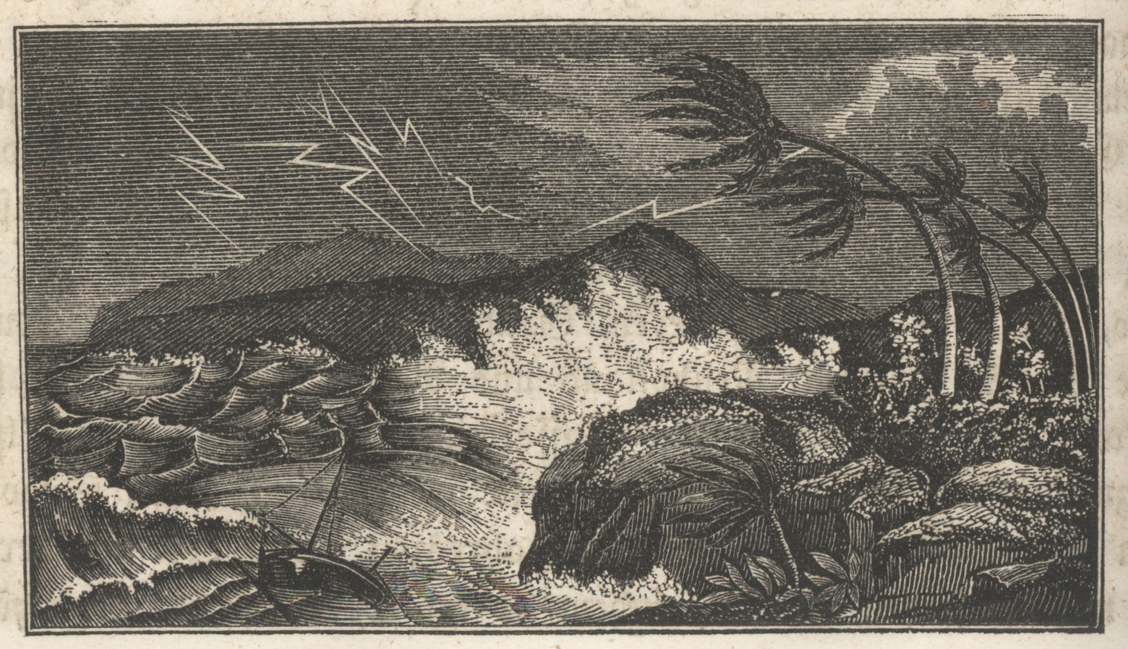
100 Years of Progress in Tropical Cyclone Research
Kerry Emanuel
Lorenz Center
MIT
Notes:
Like performing all of Shakespeare's play in 30 minutes

Slide 2
Major Advances in the Meteorology of Tropical Cyclones
Instrumentation
Observing Platforms
Models
Basic Understanding
Forecasting

Slide 3
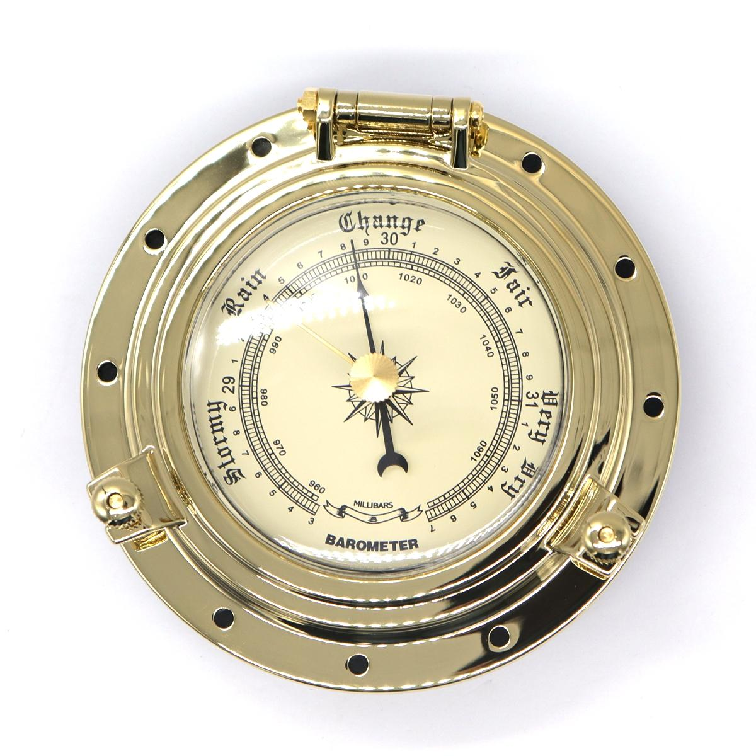
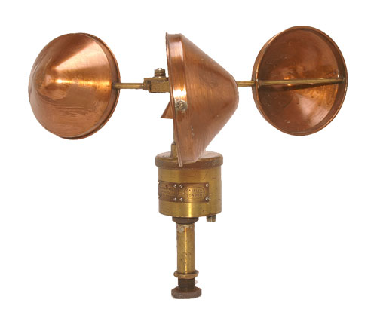


Instrumentation
Circa 1919:
Barometer
Anemometer
State of the sky
Sea state

Slide 4
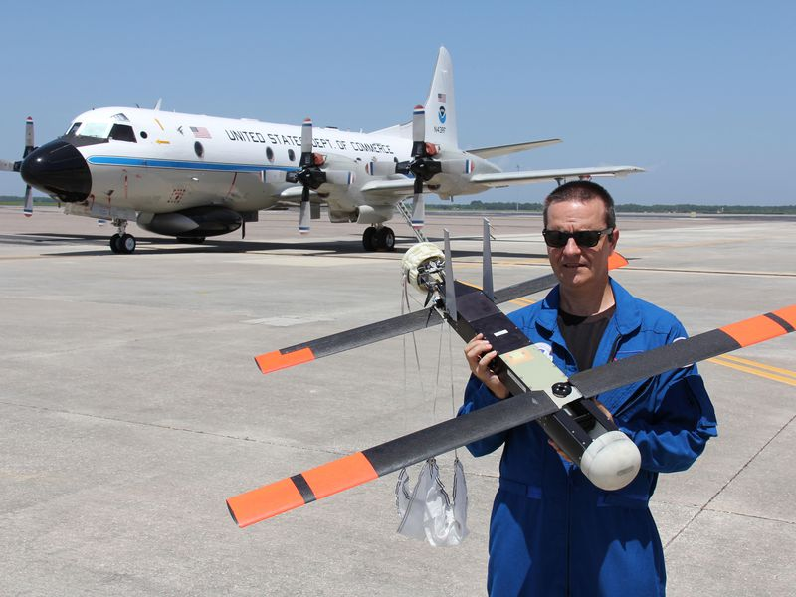
Now:
Joseph Cione shows a Coyote drone, soon to be dropped into a hurricane from the P-3 behind them. (NOAA/AOML)

Slide 5
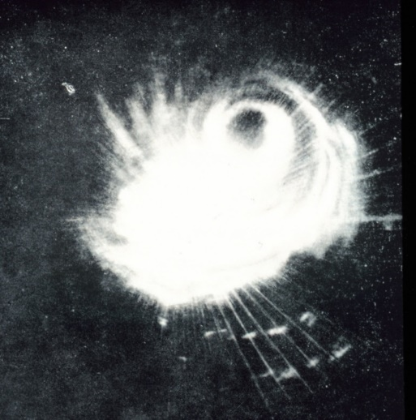
Radar
1944:
Radar image of Typhoon Cobra captured on 18 December 1944 from one of the ships of Admiral Halsey’s Third Fleet, east of the Philippines. This was only the second tropical cyclone captured on radar.

Slide 6
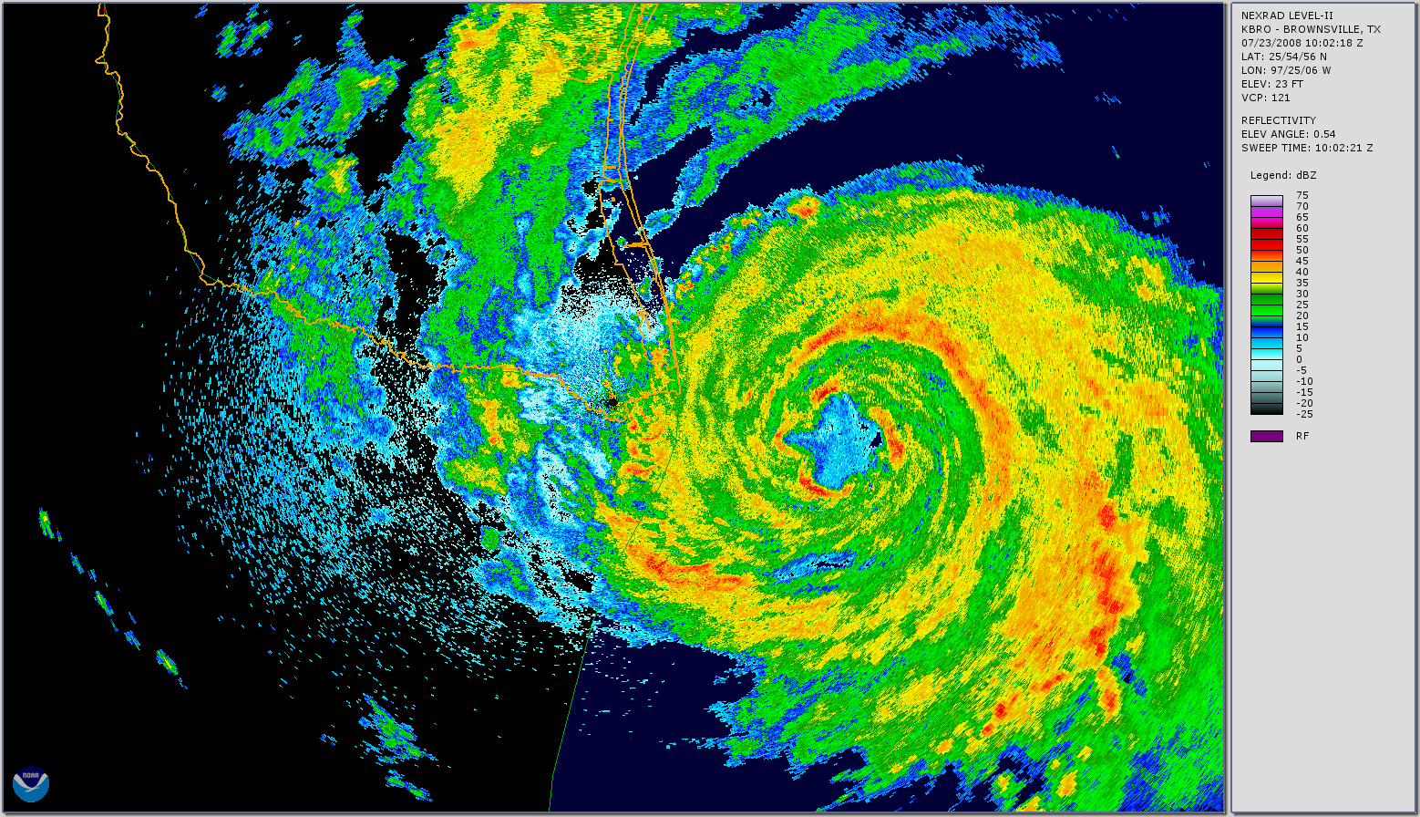
Now:
NOAA/NEXRAD image from Brownsville, Texas, showing Hurricane Dolly approaching the Texas–Mexico border on 23 Jul 2008. The radar reflectivity scale (dBZ) is given at the right.

Slide 7
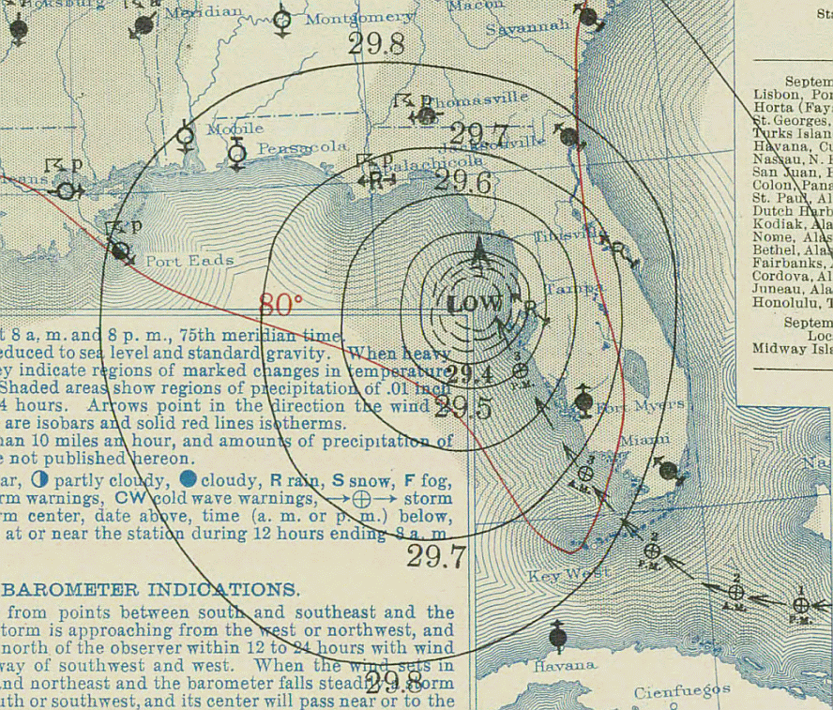
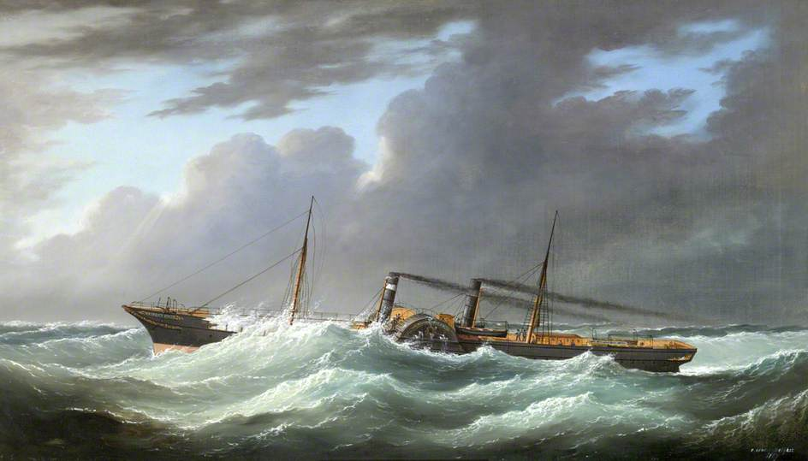
Observing Platforms
Early 20th Century:
Ships of Opportunity
Surface network during the Labor Day Hurricane of 1935
Note: Wireless telegraphs became common on ships in the 1920s

Slide 8

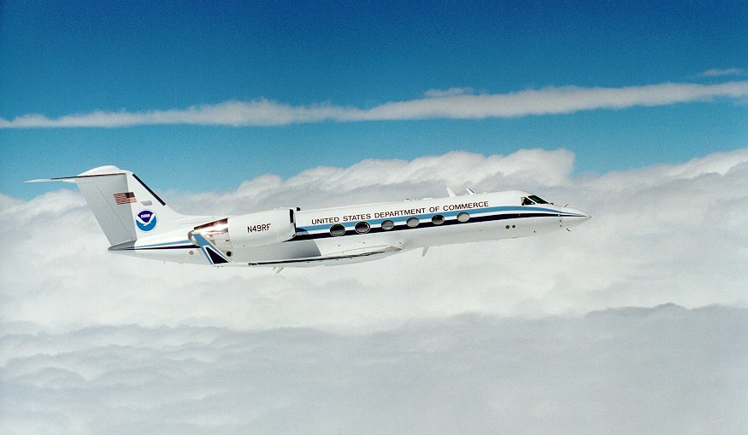
Aircraft
An AT-6, like the plane used by Joseph Duckworth to achieve the first penetration of the core of a hurricane in 1943
NOAA Gulfstream IV-SP

Slide 9

2020:
Boeing-Aurora Odysseus solar-powered drone flying at 20 km altitude

Slide 10
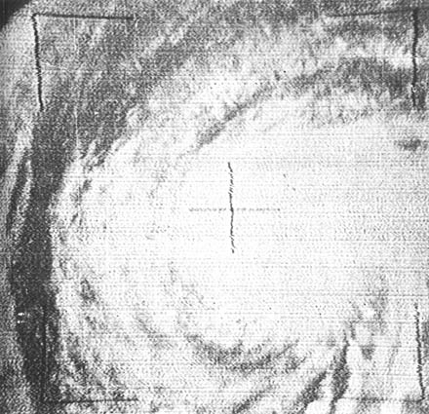
Satellites
Hurricane Esther of 1961, as photographed from TIROS III. This was first tropical cyclone to have been discovered from space.

Slide 11
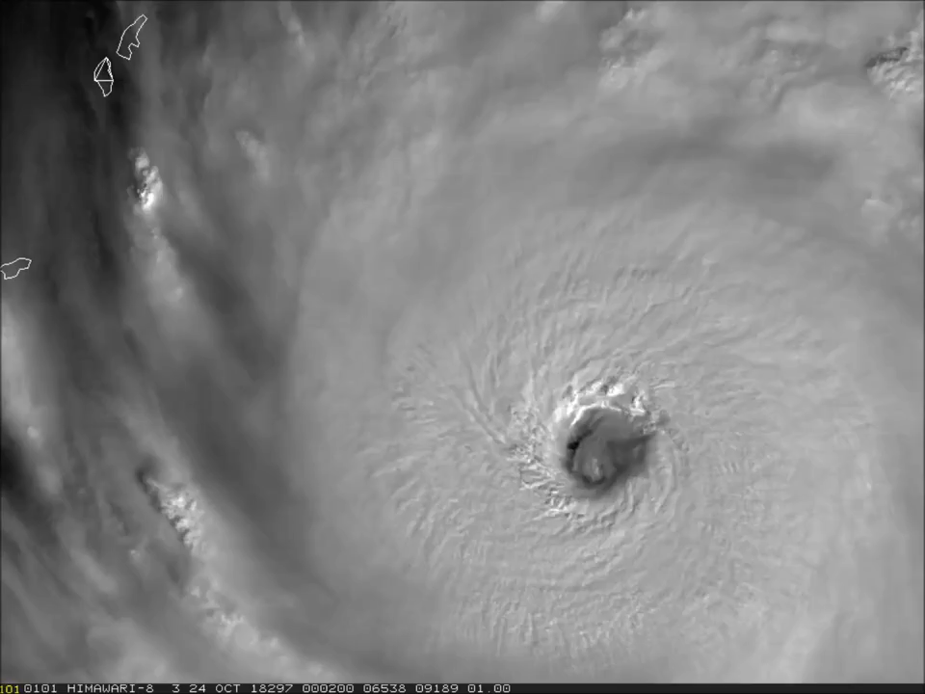
Typhoon Yutu on 24 October 2018

Slide 12
Models
Time evolutions of maximum wind speed, and radius of maximum winds
First successful numerical simulation of a tropical cyclone by Vic Ooyama in 1969.
Model Structure

Slide 13
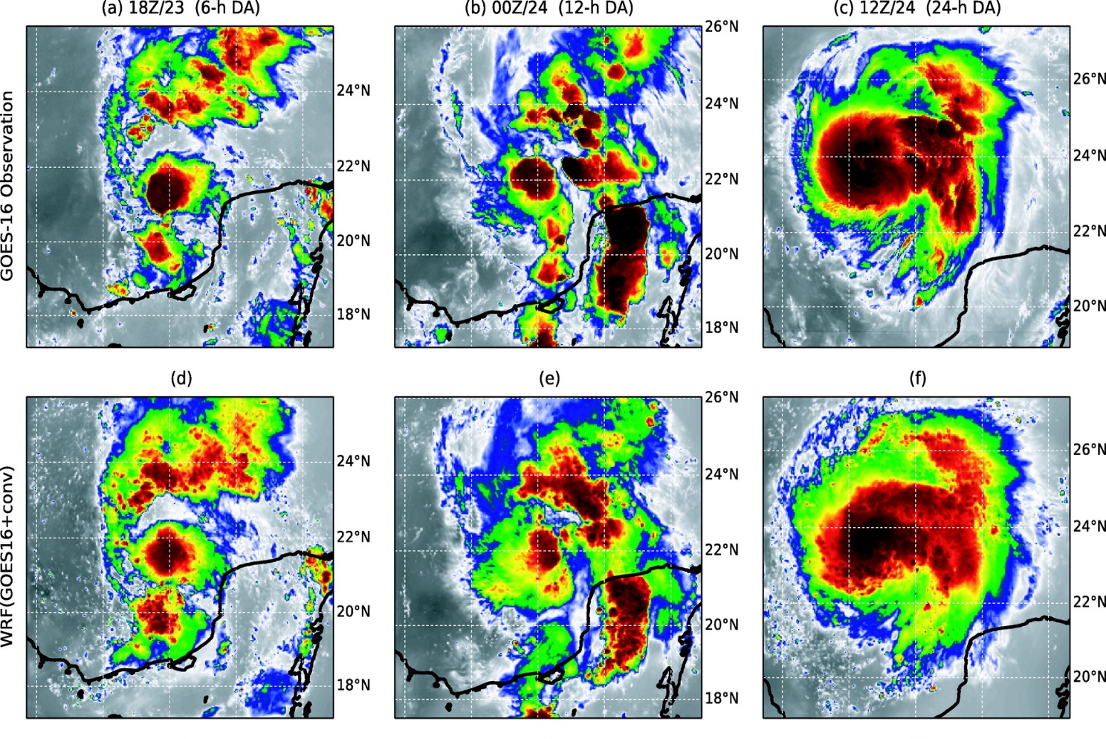

2019
Observed Brightness Temperature, TC Harvey of 2012
WRF-simulated Brightness Temperature
Zhang, F., M. Minamide, R. G. Nystrom, X. Chen, S.-J. Lin, and L. M. Harris, 2019: Improving Harvey forecasts with next-generation weather satellites: Advanced hurricane analysis and prediction with assimilation of GOES-r all-sky radiances. Bull. Amer. Meteor. Soc., 100, 1217-1222, doi:10.1175/bams-d-18-0149.1.
.

Slide 14
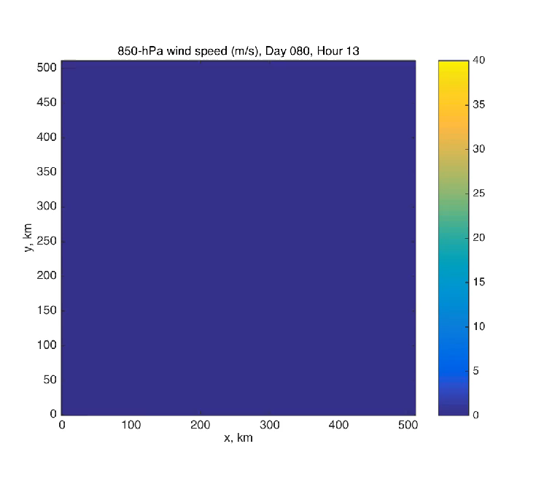
Courtesy Tim Cronin, MIT

Slide 15
Basic Understanding
In 1919 we had essentially no understanding of tropical cyclones, only empirical knowledge of their climatology. In the mean time, there has been enormous progress in understanding many aspects of TCs:
Energy cycle
Tropical cyclone structure
Movement
Intensification physics
Eye dynamics
Tropical cyclone boundary layers
Ocean response and feedback
Interaction with atmospheric environment (including shear)
Extratropical transition
Subtropical storms, medicanes, polar lows, and agukabams
Tropical cyclones and climate
(Genesis)

Slide 16
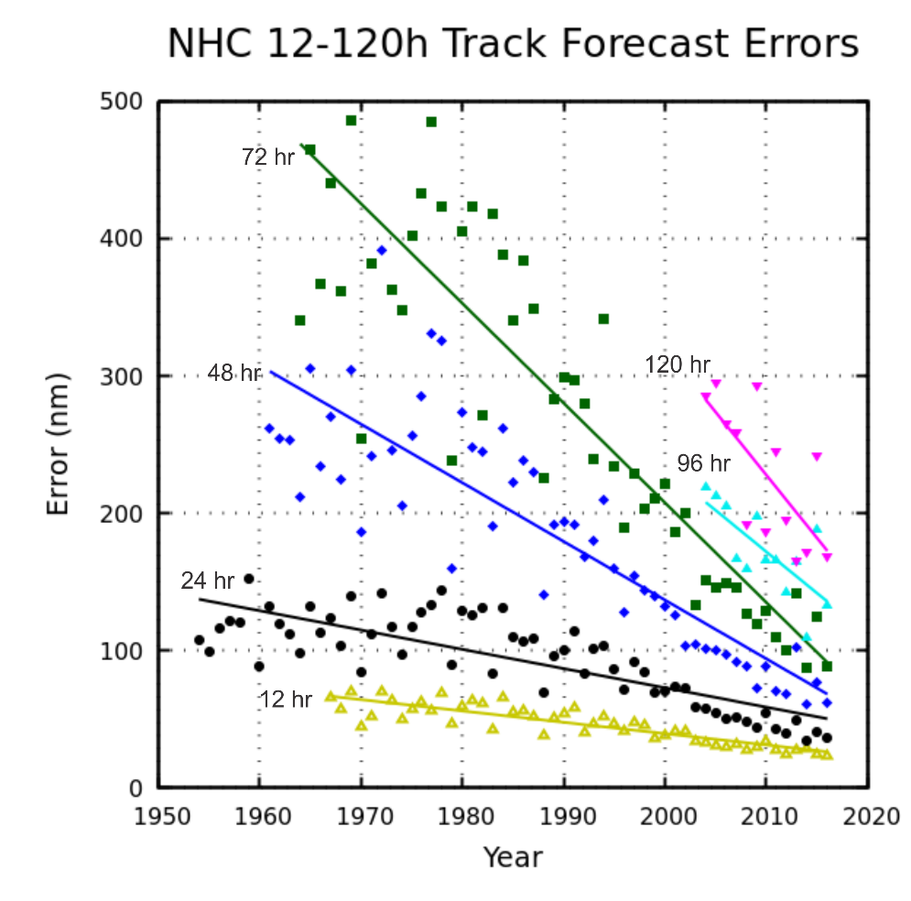
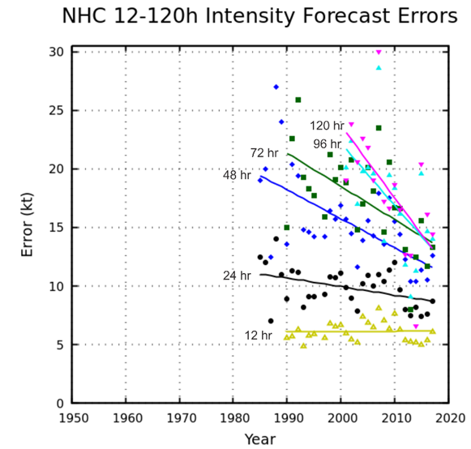
Forecasting
Track
Intensity
Note: Not easy to rule out the hypothesis that all of the improvement in the intensity skill came from improvements in track forecasts

Slide 17
We Need to Accelerate the Migration to Pointwise Probabilistic Forecasts

Slide 18
Work of Jonathan Lin, MIT
50-km strike probability (color), for Hurricane Irma in the Atlantic Basin, using 1000 synthetic tracks generated from the ECMWF ensemble. Overlaid lines (black) depict TC centers from the ECMWF ensemble.
Probability of wind exceeding 64-kts over a 5-day period (color), for Hurricane Irma in the Atlantic Basin, using 1000 ensemble members bootstrapped from the ECMWF ensemble. Black contour depicts extent of the observed 64-kt winds

Slide 19
Summary
Aside from empirical studies of TC climatology, the science of tropical cyclones did not begin in earnest until the 1940s
There has been very satisfying progress in virtually all facets of tropical cyclone science, though there remain many interesting issues such as genesis and spiral bands
Beginning with reconnaissance aircraft and radar deployment in the 1940s, there have been spectacular advances in the measurement of tropical cyclones (e.g. satellites and Doppler radar) while numerical forecasts did not overtake statistical methods until the 1990s
Tropical cyclone forecast skill increased rapidly in parallel with the aforementioned developments
We need to migrate more rapidly away from traditional track and intensity metrics to pointwise probabilistic metrics

