Slide 1
Introduction to Tropical Cyclones

Slide 2

Program
Overview of hurricanes
Physics of mature, steady hurricanes
Hurricanes and climate change

Slide 3
Overview: What is a Hurricane?
Formal definition: A tropical cyclone with 1-min average winds at 10 m altitude in excess of 32 m/s (64 knots or 74 MPH) occurring over the North Atlantic or eastern North Pacific
A tropical cyclone is a nearly symmetric, warm-core cyclone powered by wind-induced enthalpy fluxes from the sea surface

Slide 4


The word Hurricane is derived from the Mayan word Huracan and the Taino and Carib word Hunraken, a terrible God of Evil, and brought to the West by Spanish explorers

Slide 5

The View from Space
Notes:
The advent of reconnaissance aircraft and radar in the 1940s, and of satellites in the 1960s, gave scientists the means to determine the detailed structure and evolution of hurricanes. Today, almost everything we know about hurricanes is based on observations by aircraft, radar, and satellites. This satellite image shows Hurricane Floyd approaching the east coast of Florida in 1999. This image has been digitally enhanced to lend a three-dimensional perspective. The swirling mass of clouds is about 300 kilometers (180 miles) across, and Floyd’s eye is about 50 kilometers (30 miles) in diameter. Surrounding the eye is a deep ring of thick cloud called the eyewall. A thin veil of very high cloud covers most of the swirling mass of thicker clouds; this is the veil of cirrus, made up of tiny ice crystals. Underneath it, and thus invisible from above, are several spiral shaped bands of deep, thick cumulonimbus clouds, interspersed between relatively clear sky. These spiral bands produce heavy rains and gusty winds well outside the eyewall of the hurricane, where the strongest winds are found.
Image: Satellite image of Hurricane Floyd approaching the east coast of Florida in 1999. The image has been digitally enhanced to lend a three-dimensional perspective. Credit: NASA/Goddard Space Flight Center.
Description from “Divine Wind: The History and Science of Hurricanes”, Kerry Emanuel, 2005, Oxford University Press, 296 p.
Definitions
Reconnaissance is the military term for the active gathering of information about an enemy, or other conditions, by physical observation (from and for more information see http://en.wikipedia.org/wiki/Reconnaissance).
The eye is a region of mostly calm weather found at the center of strong tropical cyclones. The eye of a storm is usually circular and typically 25–40–65 kilometers (40 miles) in diameter. It is surrounded by the eyewall, where the most severe weather of a cyclone occurs (from and for more information see http://en.wikipedia.org/wiki/Eyewall).
Cirrus clouds are thin and often wispy clouds that are the most common form of high-level clouds. Typically found at heights greater than 20,000 feet (6,000 meters), cirrus clouds are composed of ice crystals that originate from the freezing of supercooled water droplets (from and for more information see http://weather.about.com/library/glossary/blglossary.htm).
Cumulonimbus clouds are large and vertically developed clouds that are fueled by vigorous convective updrafts (sometimes in excess 50 knots), the tops of cumulonimbus clouds can easily reach 39,000 feet (12,000 meters) or higher (from and for more information see http://weather.about.com/library/glossary/blglossary.htm).

Slide 6
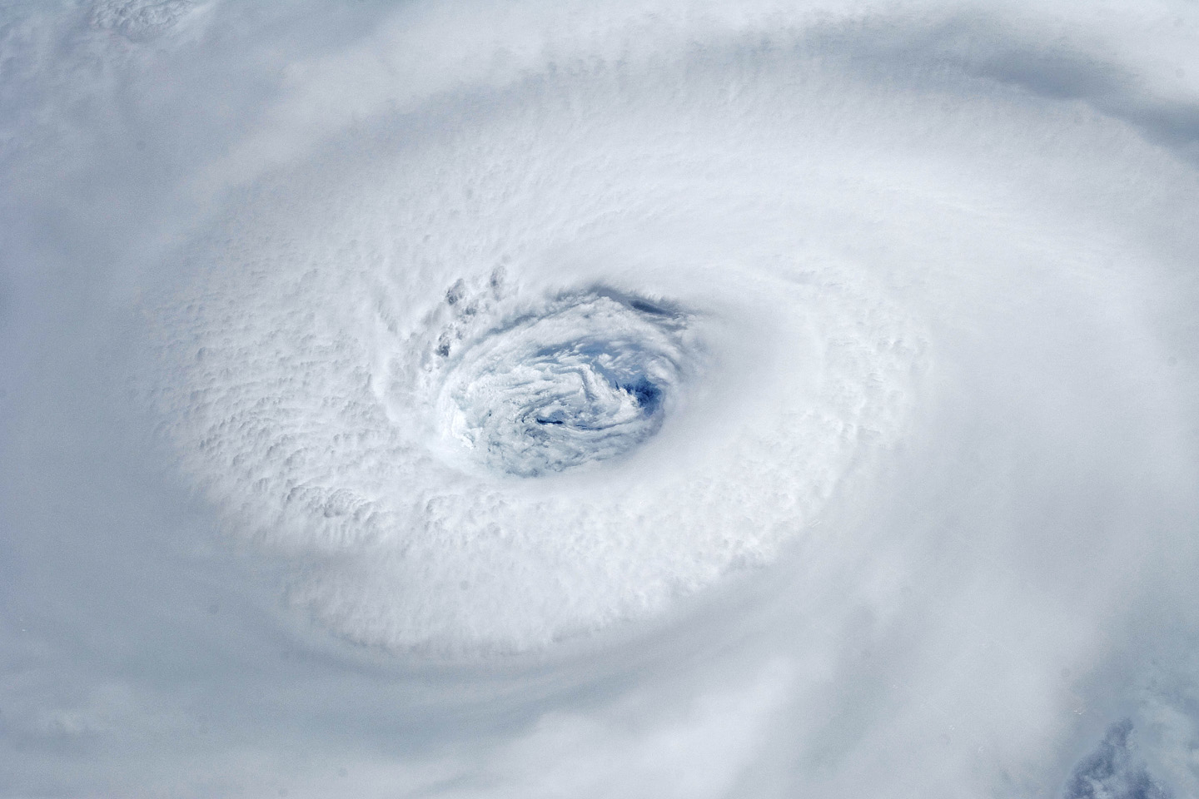
Igor, 2010
Notes:
Astronauts aboard the International Space Station took this digital photograph of the eye of Hurricane Igor at 10:56 Atlantic Daylight Time (13:56 UTC) on September 14, 2010. The storm was a category four hurricane on the Saffir-Simpson scale of intensity. At the time of the image, Igor was centered in the Atlantic Ocean near 18°N 52°W and slowly moving west-northwest at 11 kilometers (7 miles) per hour, according to the U.S. National Hurricane Center. Maximum sustained winds of 213 km (132 mi.) per hour, with gusts to 259 km (161 mi.) per hour. Credit: NASA

Slide 7
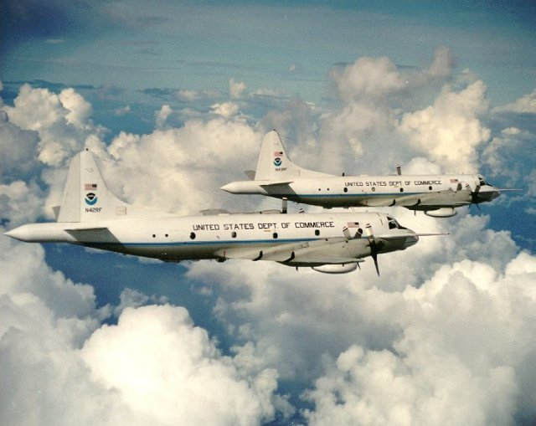

Slide 8
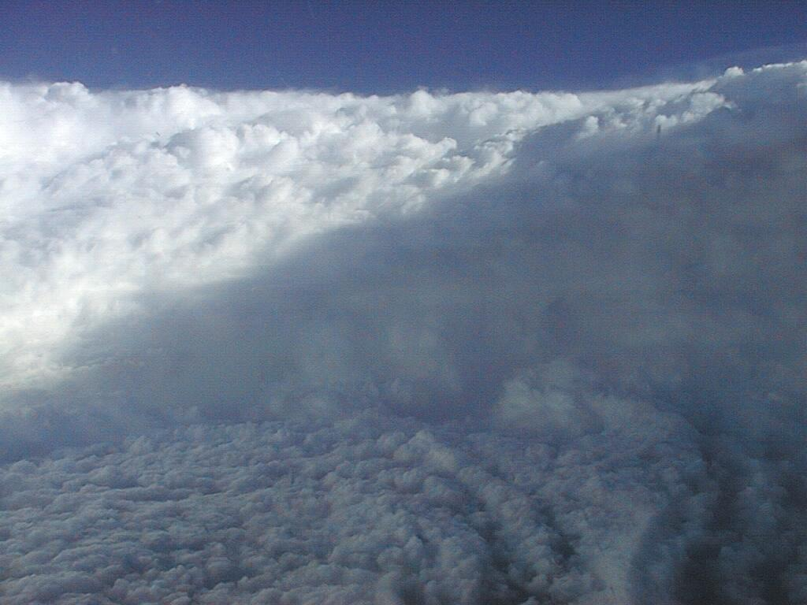
Notes:
The eye of Hurricane Georges in this photo taken from a reconnaissance aircraft gives some impression of a hurricane’s eye.
However impressive a hurricane’s visual appearance, it is the instruments aboard satellites and aircraft that reveal the essence of a hurricane’s structure and inner workings. In the early days of aircraft reconnaissance, the crew estimated wind speeds by looking down and noting how rough the sea appeared. Today, a sophisticated array of instruments automatically collects large quantities of high-quality data, which are taken back to laboratories and analyzed.
Image: The eye of Hurricane Georges in photo taken from a reconnaissance aircraft. The eyewall at right is casting a shadow across part of the eyewall ahead. Credit: Michael Black, Hurricane Research Division, NOAA-AOML, Miami, Florida.
Description from “Divine Wind: The History and Science of Hurricanes”, Kerry Emanuel, 2005, Oxford University Press, 296 p.

Slide 9
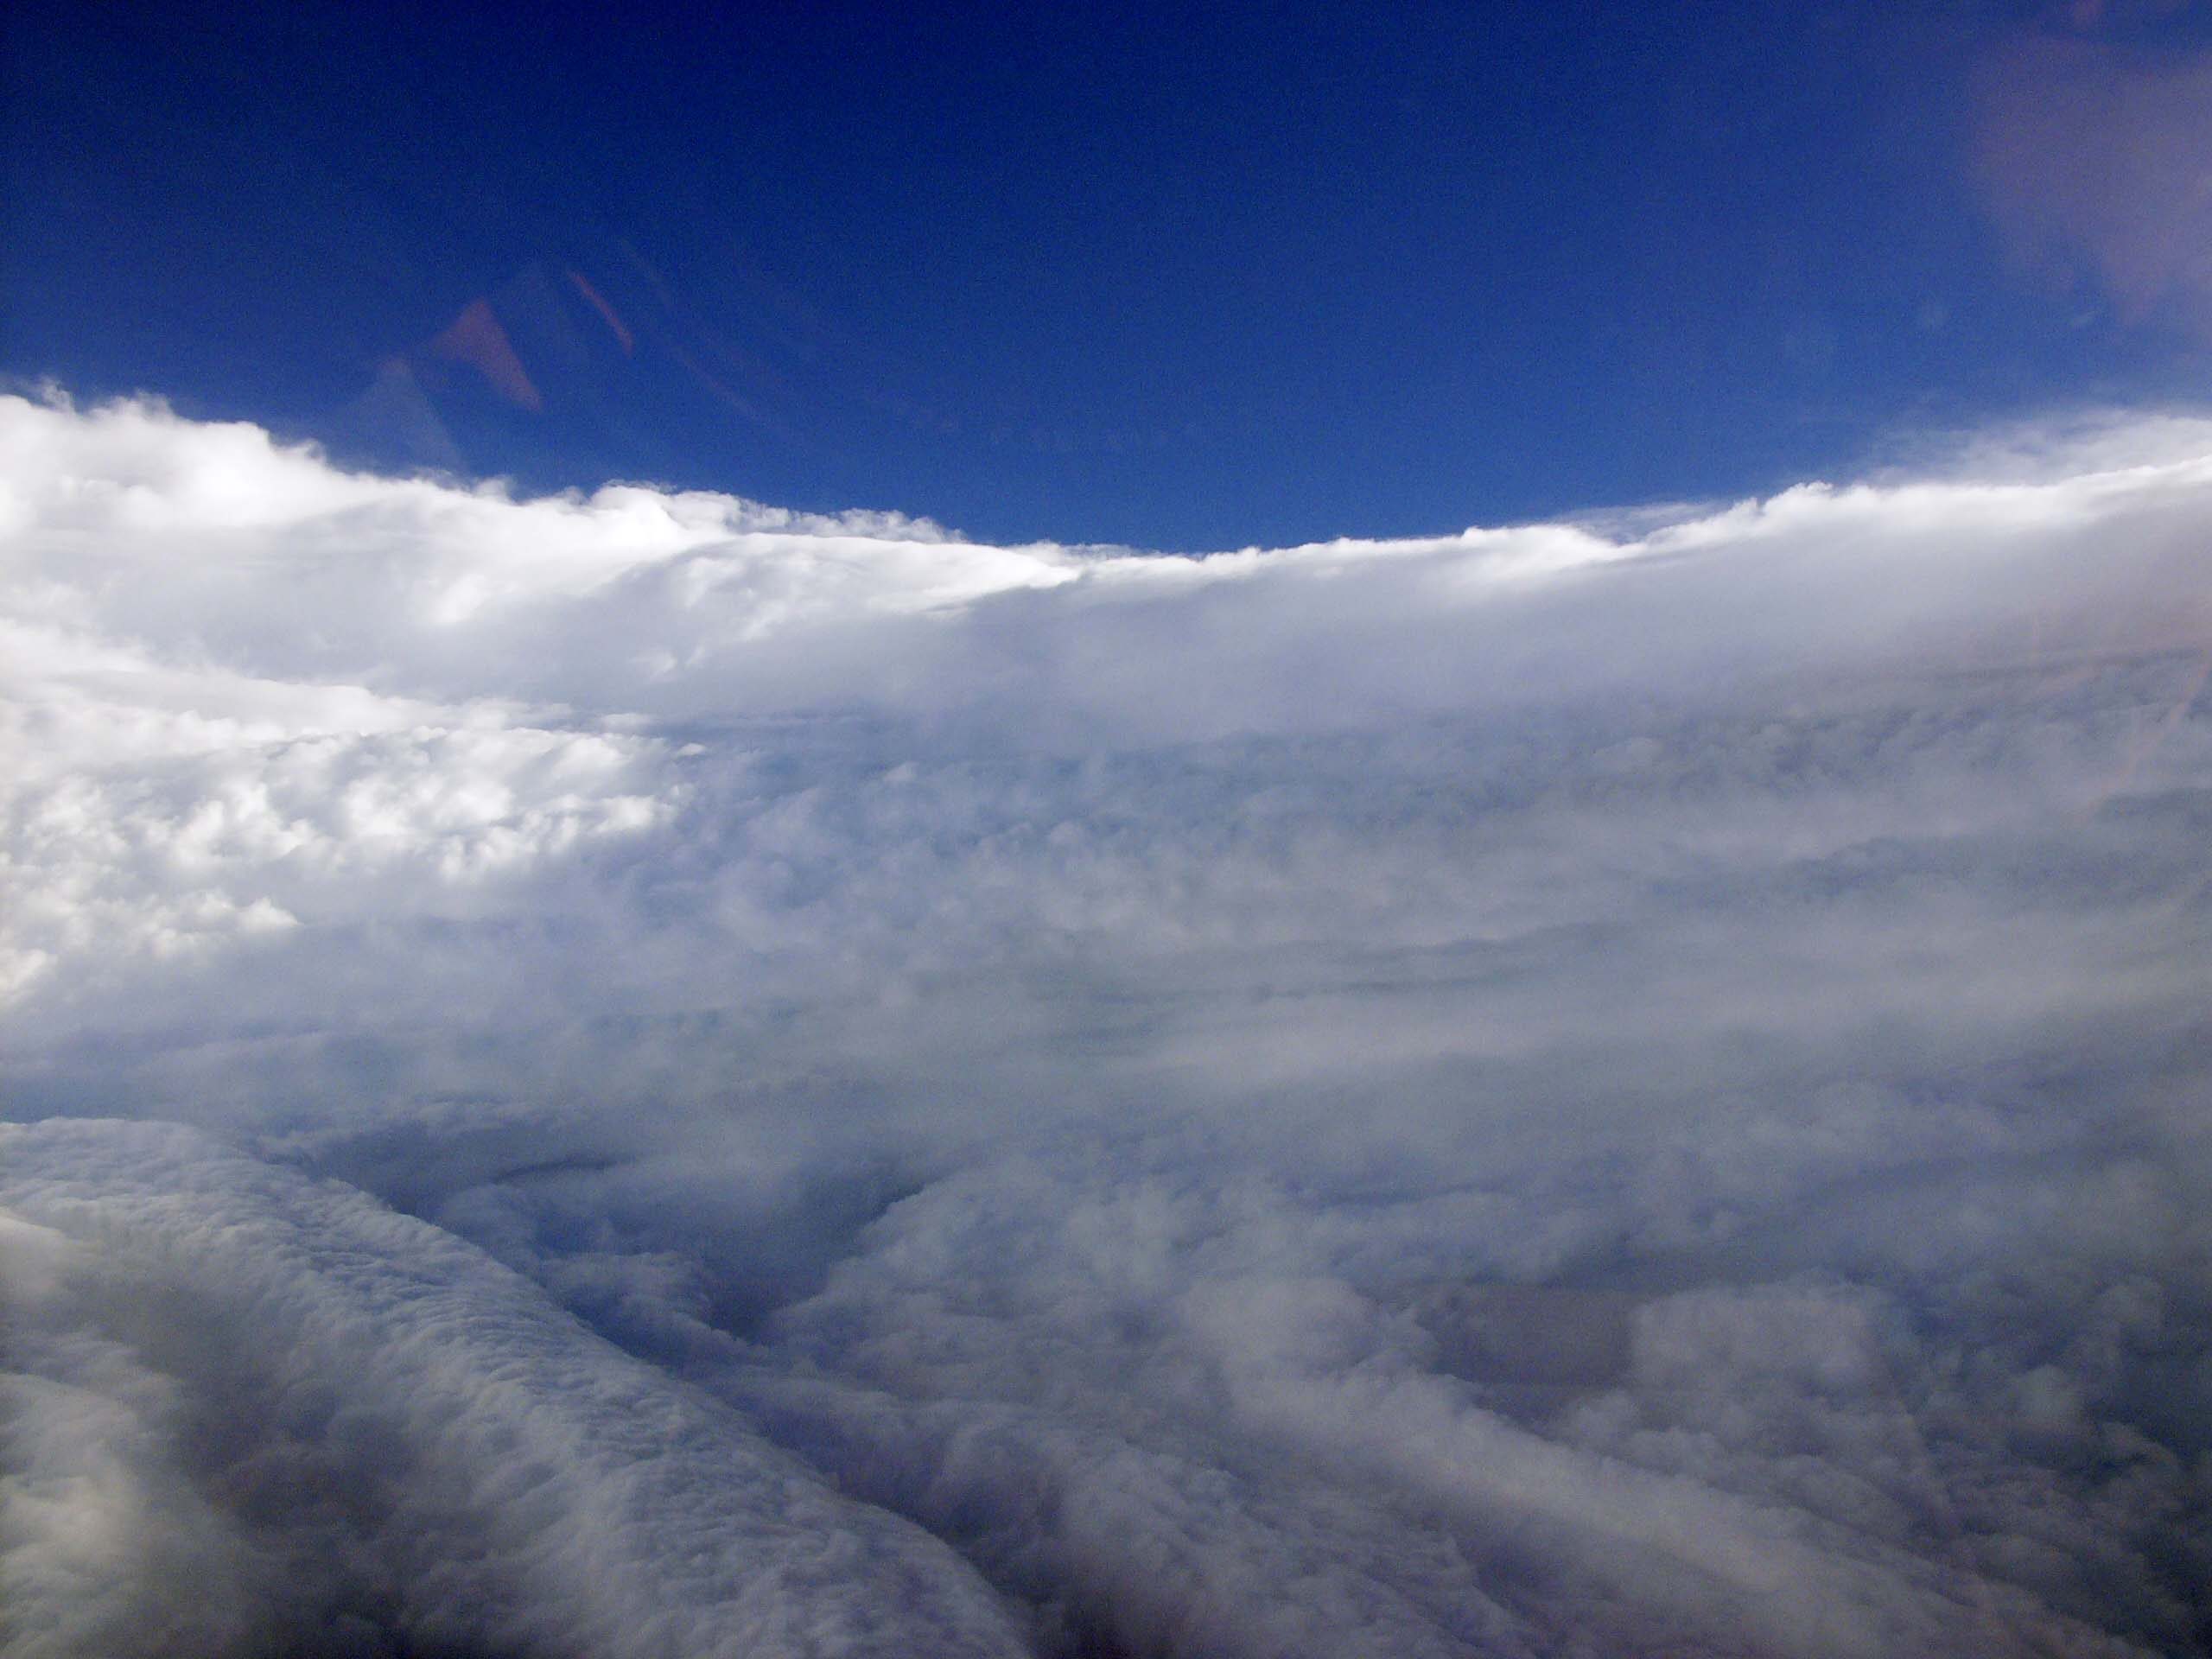
View of the eye of Hurricane Katrina on August 28th, 2005, as seen from a NOAA WP-3D hurricane reconnaissance aircraft.

Slide 10
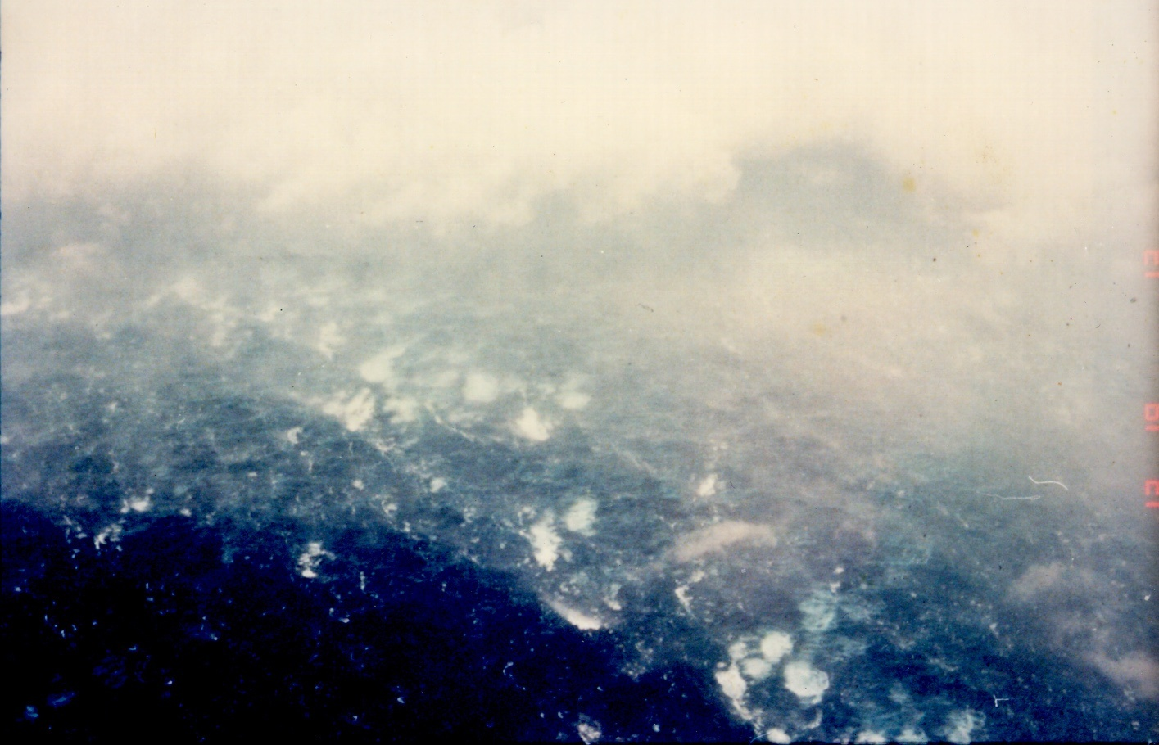

Slide 11
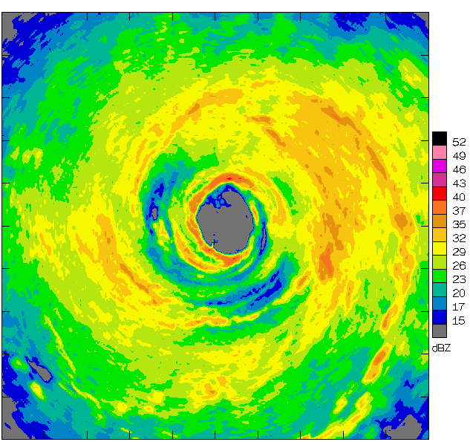
Airborne Radar: Horizontal Map
360 km
(220 mi)

Slide 12
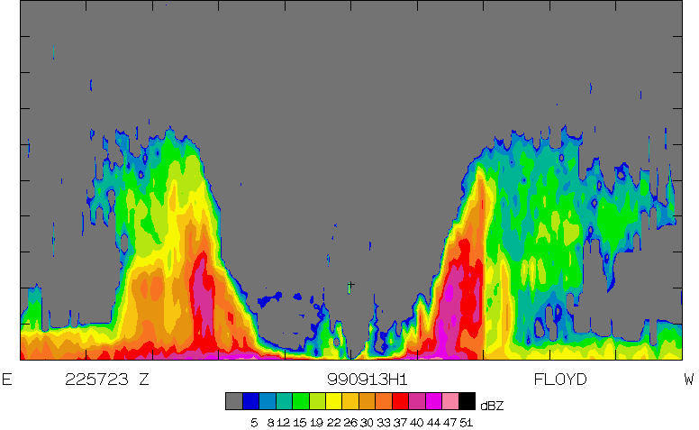
Airborne Radar: Vertical Slice
20 km
(12 mi)
120 km
(75 mi)

Slide 13
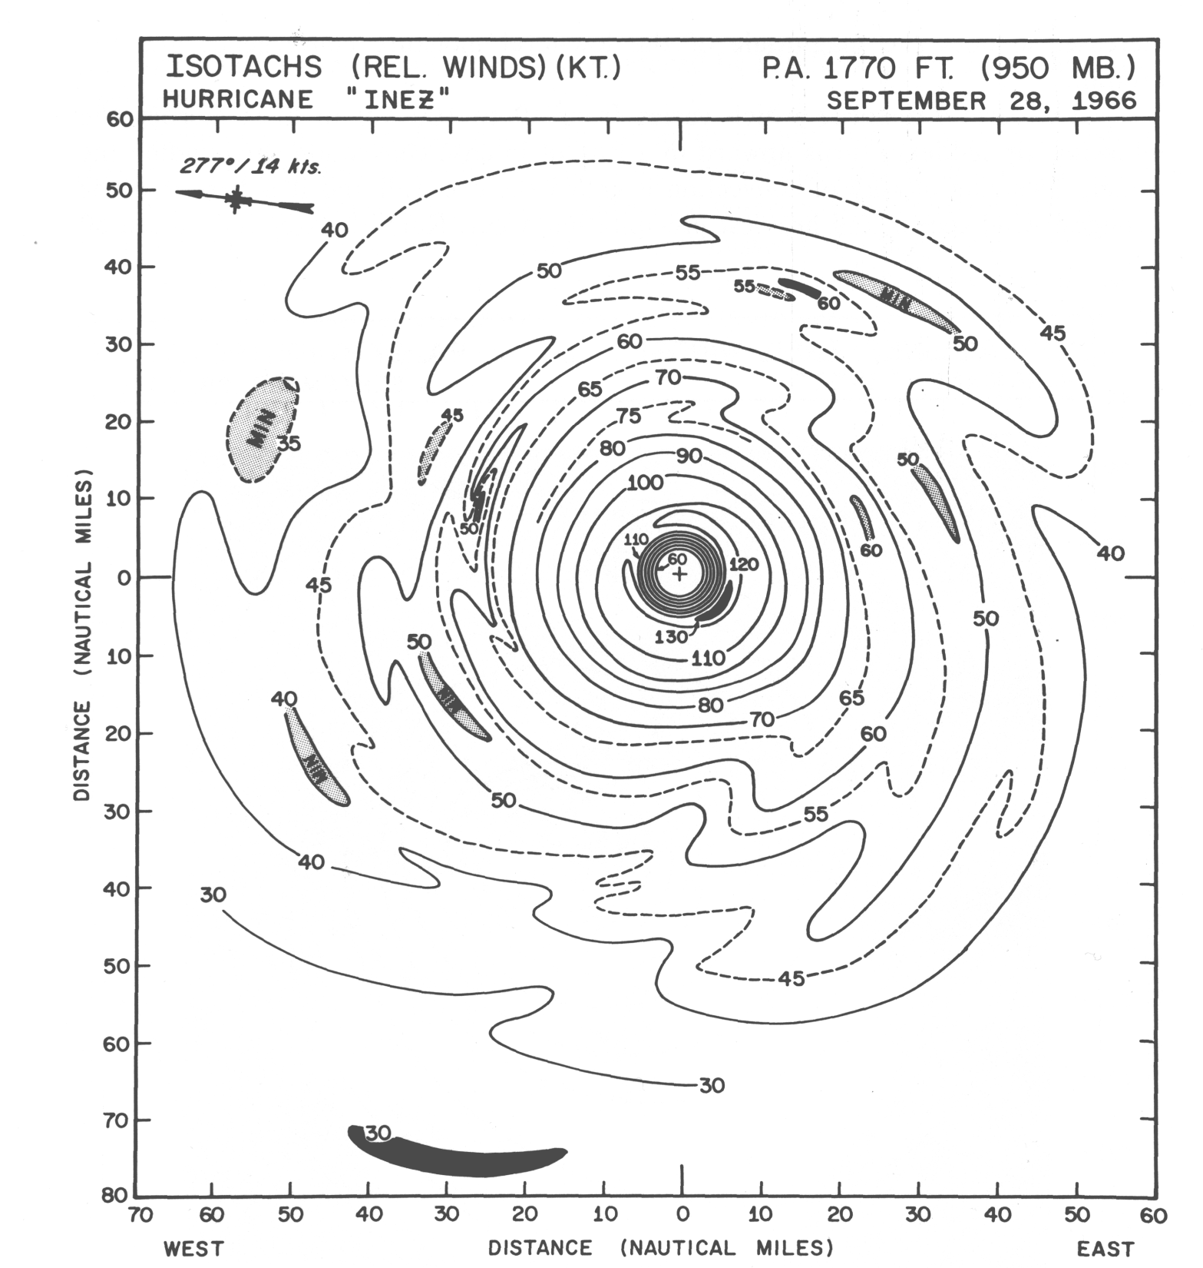

Slide 14
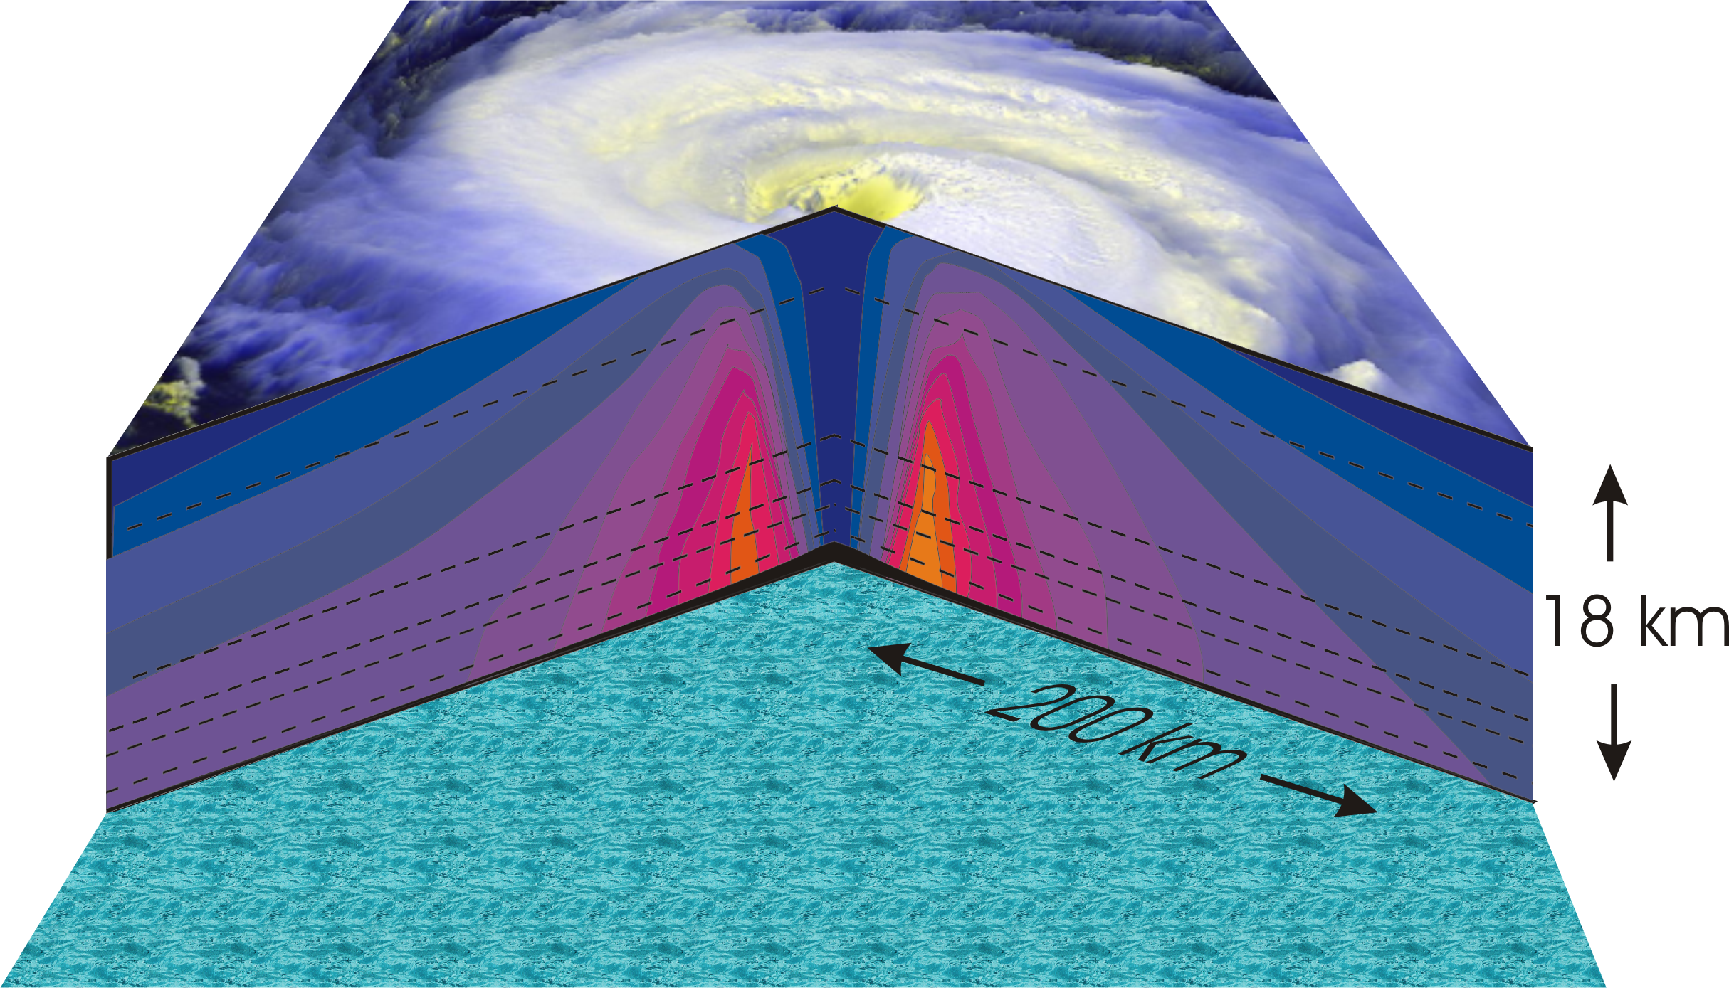
Hurricane Structure: Wind Speed
Azimuthal component of wind
< 11 mph - > 145 mph
Notes:
A composite view of the distribution of wind speed in a typical hurricane based on measurements made from research aircraft. In this image and the two that follow, the center of the hurricane is in the center of the panel and the cutaway extends outward about 200 km (125 miles) and upward to about 18 km (11 miles). A satellite image of the top of a storm has been superimposed.
This image shows the speed of the wind going counterclockwise around the center of the storm; the black dashed lines show the altitudes at which the aircraft were flying. The darkest shade of blue indicates the lightest winds, less than 5 meters/second (11 mph). Each successive color represents an increment of 5 meters/second (11 mph), with bright orange showing winds in excess of 65 meters/second (145 mph). The strongest winds occur just above the ocean in a ring around the center, slightly outside the eyewall of the storm. Winds decrease rapidly inward toward the center, which is practically calm. They also decrease outward from the ring of maximum wind , but much more slowly, so that strong winds can still be found 100 kilometers (60 miles) from the center of the storm. As we go up from the surface, the counterclockwise winds get lighter and lighter. If the highest aircraft had flown even higher, it would have actually encountered “negative” wind speed, which here means winds going the other way (clockwise) around the center.
Image is copyrighted 2005 by Oxford University Press.
Image and description from “Divine Wind: The History and Science of Hurricanes”, Kerry Emanuel, 2005, Oxford University Press, 296 p.

Slide 15
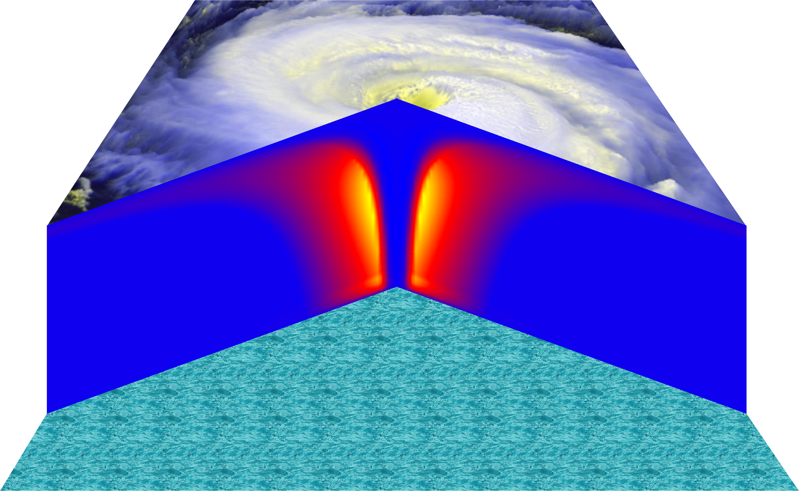
Vertical Air Motion
Updraft Speed
Strong upward motion in the eyewall
Notes:
This image shows a composite view of the distribution of updraft (vertical air motion) in a typical hurricane based on computer model calculations. The yellow and orange represent a strong upward motion in the eyewall. Although it is too weak to be seen in this figure, there is downward motion in the eye itself, strongest right next to the eyewall, and also in a broad region outside the eyewall. But since this figure is made by averaging the air motion along circles centered at the storm center, the strong updrafts associated with the spiral rain bands are missed.
Image is copyrighted 2005 by Oxford University Press.
Description from “Divine Wind: The History and Science of Hurricanes”, Kerry Emanuel, 2005, Oxford University Press, 296 p.

Slide 16
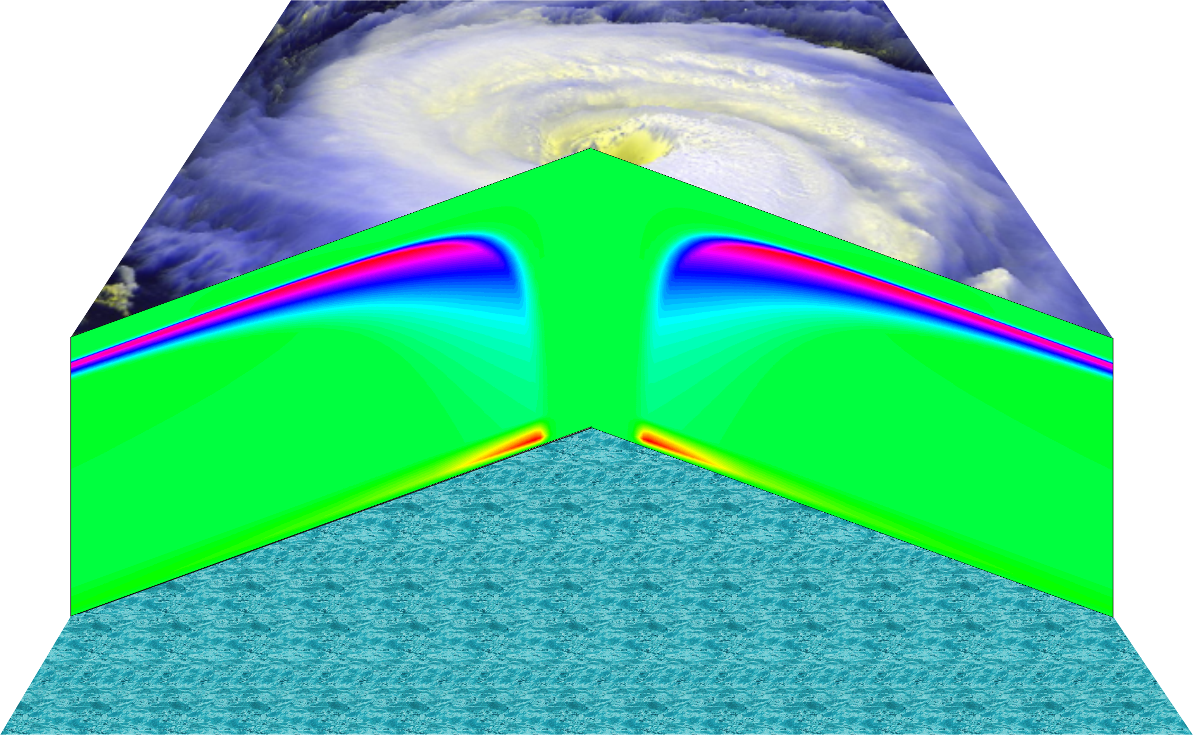
Radial wind

Slide 17
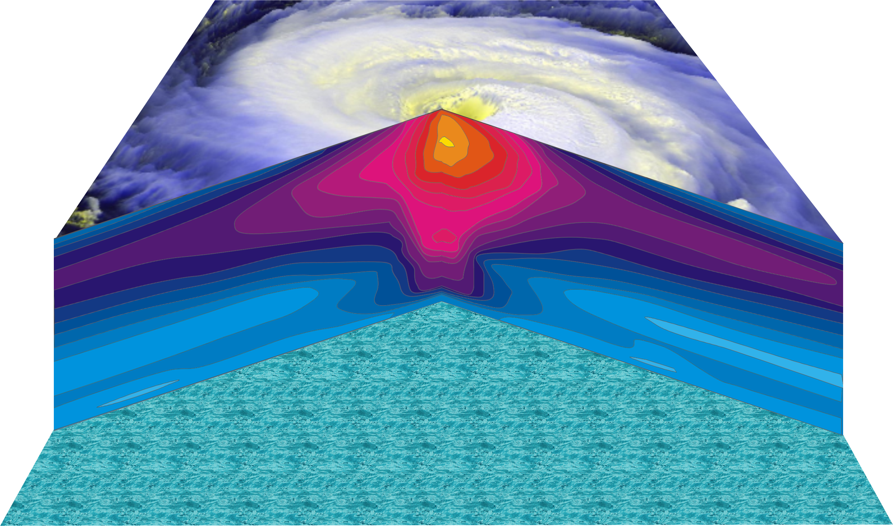
Hurricane Temperature Perturbations
No temperature difference - > 16°C (29°F) warmer
Notes:
This image shows a composite view of the distribution of temperature in a typical hurricane. This actually shows the difference between the temperature at any point and the temperature at the same altitude far away from the storm. The lightest shade of blue shows no temperature difference, while bright yellow shows air that is more than 16°C (29°F) warmer than its distant environment; each shade represents an increment of 1°C (1.8°F). Hurricanes are very hot in their centers, especially near their tops. This great warmth is one consequence of the enormous amount of heat sucked out of the ocean by the storm. On the other hand, there is very little change in temperature as you move in toward the eye along the surface of the ocean.
The distributions of temperature and wind in hurricanes are related to each other. Look carefully at the images in this slide and the slide that shows wind speed. Notice that the rate at which the wind decreases upward is proportional to the rate at which the temperature decreases outward. This relationship is fundamental to rotating fluid flows and is called the thermal wind relation.
Image is copyrighted 2005 by Oxford University Press.
Description from “Divine Wind: The History and Science of Hurricanes”, Kerry Emanuel, 2005, Oxford University Press, 296 p.
Definitions
Thermal wind is a theoretical concept that describes the wind shear between two levels in terms of the geostrophic wind at those two levels (from and for more information see http://wxman256.home.att.net/fcst/wf-pt5e.html). The basic principle of the thermal wind relationship is that in the presence of a horizontal temperature gradient, the wind speed must increase with increasing height (from and for more information see http://opwx.db.erau.edu/~mullerb/Therm_wind.html).
Wind shear is the change of wind speed or direction with distance, usually vertical (from http://ggweather.com/glossary.htm).

Slide 18
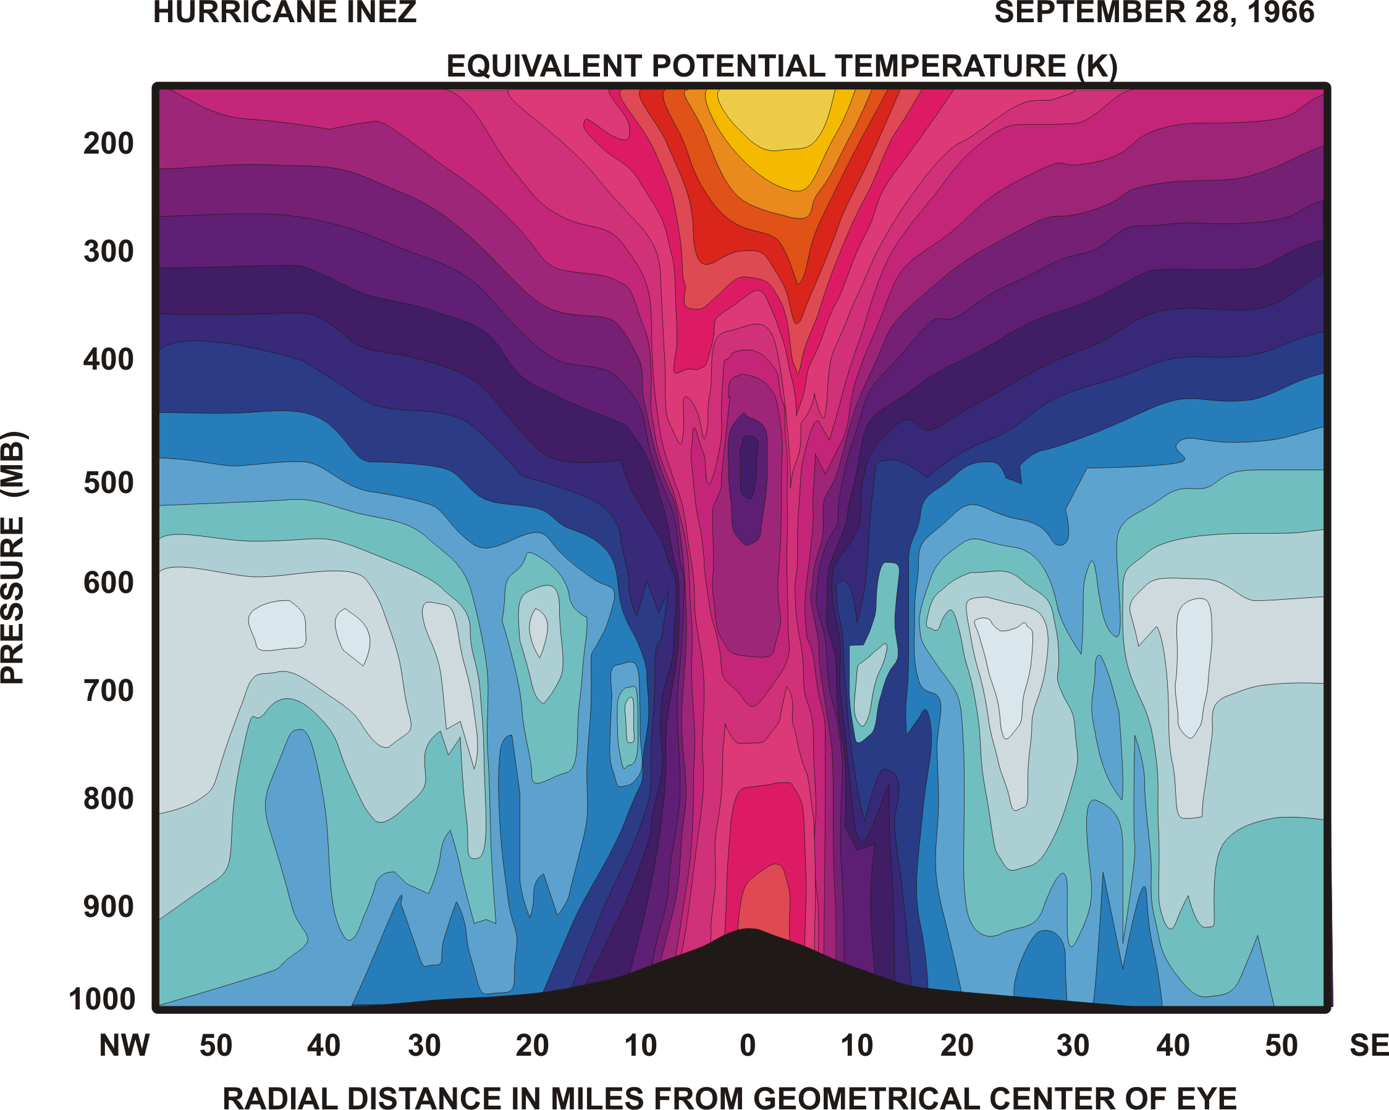

Slide 19
Specific entropy

Slide 20
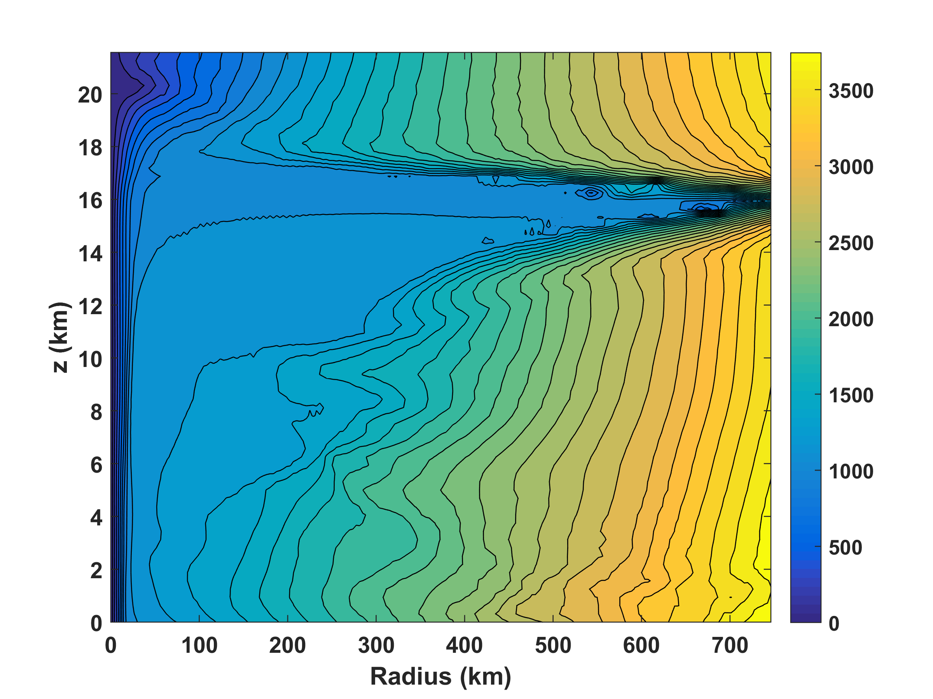
Absolute angular momentum per unit mass

Slide 21
Tropical Cyclone Climatology

Slide 22
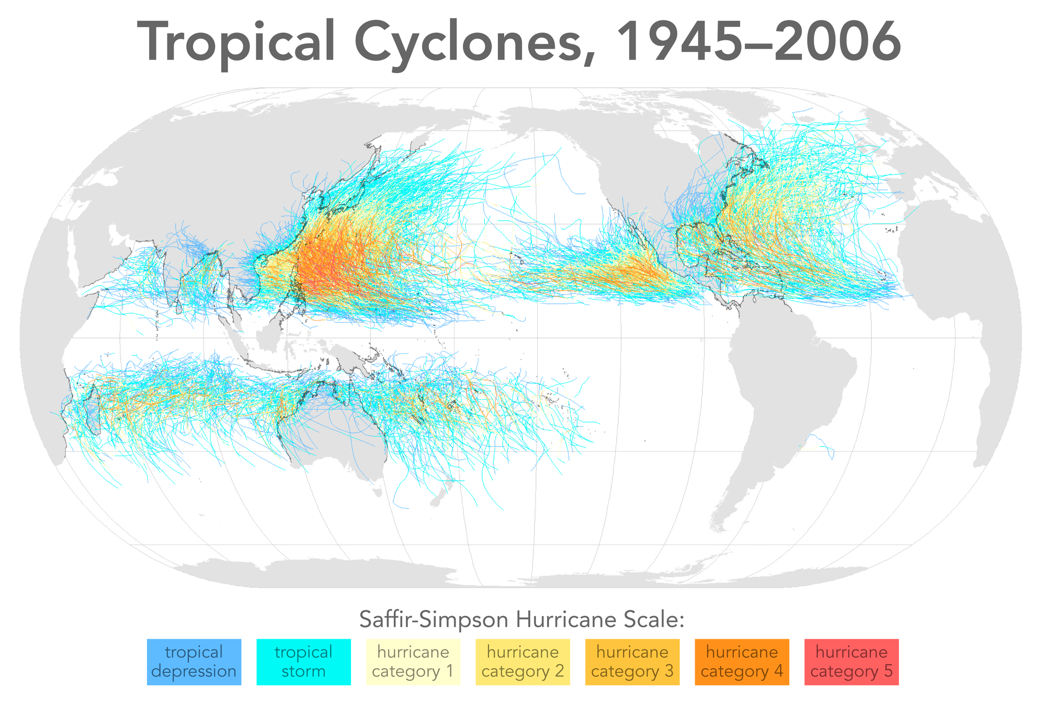

Slide 23
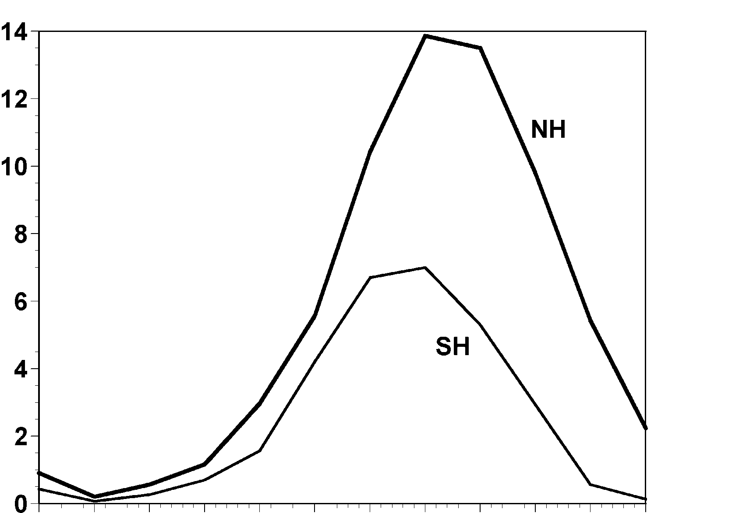
Annual Cycle of Tropical Cyclones
Number of Events per Month
a
Northern
Hemisphere
(NH)
a
Southern
Hemisphere
(SH)
Jan Feb Mar Apr May Jun Jul Aug Sep Oct Nov Dec NH
Jul Aug Sep Oct Nov Dec Jan Feb Mar Apr May Jun SH
Notes:
This graph shows the average number of tropical cyclones per month in the northern and southern hemispheres. Hurricanes tend to follow the sun, peaking in the summer and autumn and all but vanishing during the early spring. Typhoons can develop over the western North Pacific during any month of the year, but they are rare in the winter.
Image is copyrighted 2005 by Oxford University Press.
Image and description from “Divine Wind: The History and Science of Hurricanes”, Kerry Emanuel, 2005, Oxford University Press, 296 p.

Slide 24
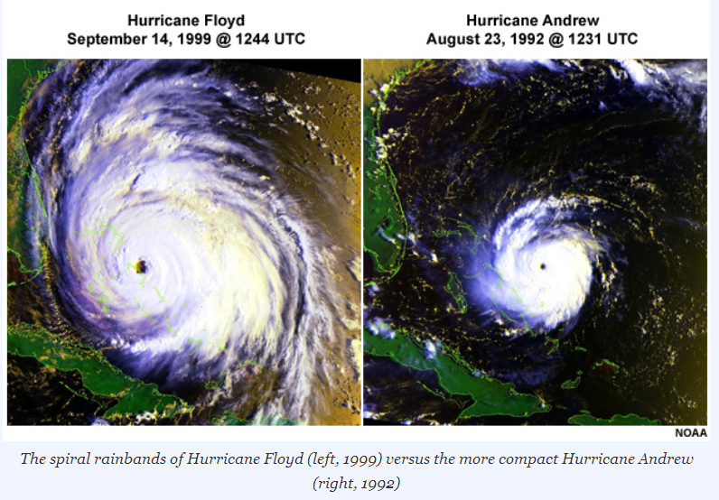

Slide 25
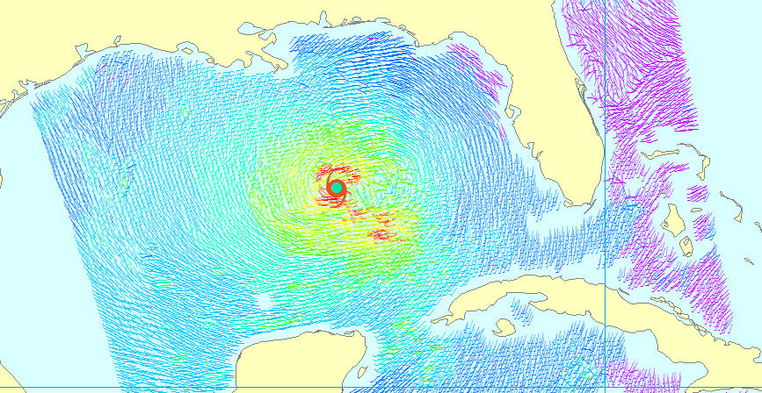
Climatology of Tropical Cyclone Size

Slide 26
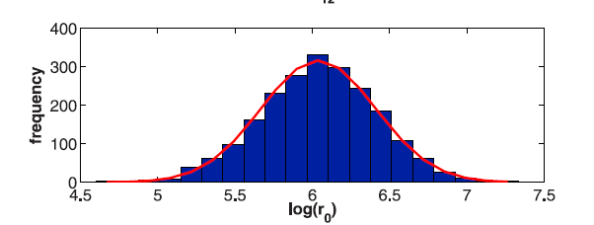
Outer radius very nearly follows a log-normal distribution with a median value of about 420 km (Courtesy Dan Chavas)

Slide 27
Global Tropical Cyclone Frequency, 1978-2017
Data Sources: NOAA/TPC and NAVY/JTWC
Notes:
27

Slide 28
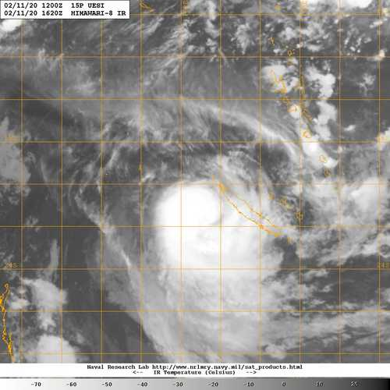
Tropical Cyclone Uesi, February 11 2020 7 AM EST

Slide 29
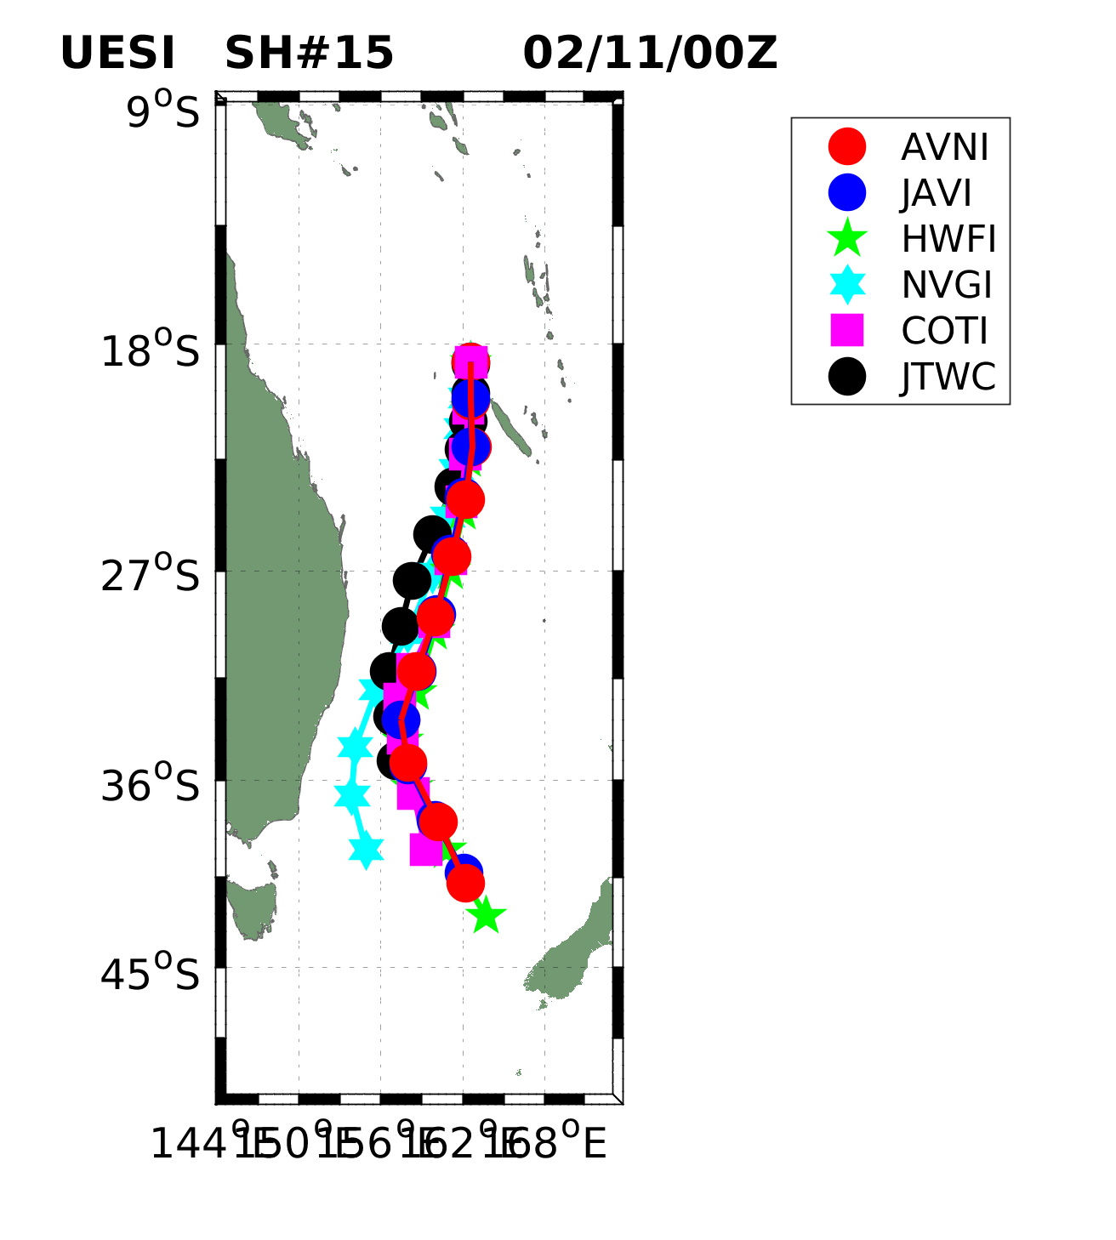
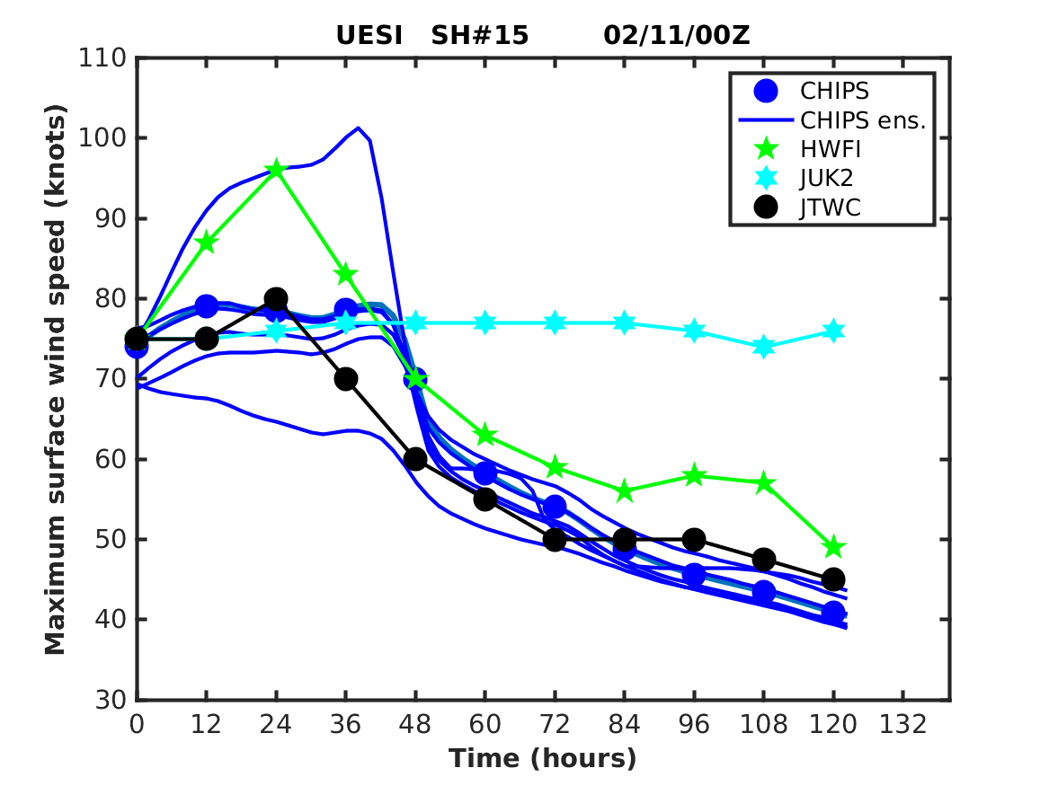

Slide 30

Physics of Mature Hurricanes

Slide 31
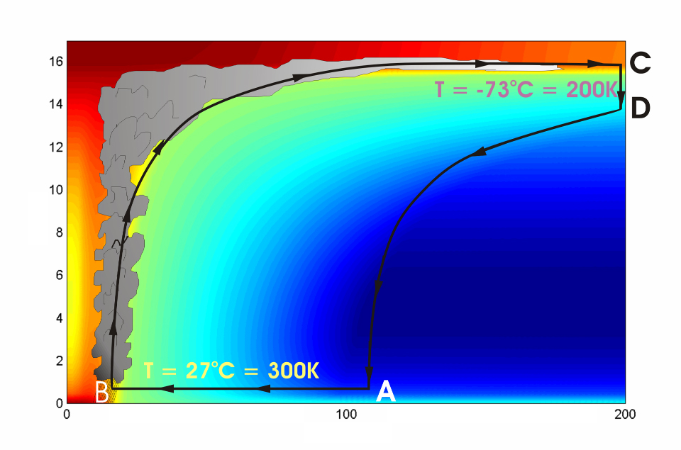





Cross-section through a Hurricane & Energy Production
eye
edge
Isothermal compression
Moist adiabatic expansion
Diabatic compression
Along a moist adiabat
Height above ocean
Nearly isothermal expansion
Low entropy
Ocean surface
Radius (km)
Notes:
NOTE: We have animated the path of air for this slide and included labels to help our audience understand what you will be describing. Many of them will have never even heard of a Carnot heat engine and do not have a strong understanding of entropy. We would like to do whatever we can in to make this information accessible to our audience. Please let us know if you approve of these changes, and feel free to replace the labels as needed. The simpler you can keep your description of this, the better. You do an excellent job of describing the process in your book.
***
The energy cycle of a mature hurricane - the hurricane as a Carnot heat engine. This two-dimensional plot of the thermodynamic cycle shows a vertical cross section of the hurricane, whose storm center lies along the left edge. The colors depict the entropy distribution; cooler colors indicate lower entropy. Loosely, this means the total heat content of the air. Note that as air approaches the eyewall, its entropy increases rapidly, reflecting the large input of heat from the ocean.
Let’s follow a sample of air that begins at point A near the sea surface, a hundred kilometers or so from the storm center. The process mainly responsible for driving the storm is the evaporation of seawater, which transfers energy from sea to air. As a result of that transfer, air spirals inward close to the sea surface, between Points A and B. The storm center is an area of relatively low pressure, so the pressure on air decreases as it travels from A to B. But it is always in contact with the sea surface, which acts as an almost unlimited heat reservoir, so its temperature is approximately constant (acquiring entropy at a constant temperature). It is during this leg that enormous quantities of heat are added to the air from evaporation of seawater. Evaporation of water is a very efficient way to transfer heat from one body to another. That is why you feel cold when you are wet, especially if it is windy and/or dry: evaporation is taking heat from your body. Thus the addition of heat in leg A-B shows up mostly as an increase in humidity in the air. This form of heat is called latent heat. Evaporation of sea water into the inflowing air is by far the most important source of heat driving the hurricane, which makes leg A-B the firebox of the hurricane. When hurricanes reach land, they quickly die because they are cut off from their oceanic energy source. At point B, the air turns and flows upward through the towering cumulonimbus clouds that make up the hurricane’s eyewall. It is here that the latent heat is converted to sensible heat as water vapor condenses. But it is important to note that although there is enormous conversion between these two forms of heat, the total heat content (entropy, actually) remains approximately constant along this leg (note that the colors do not change along leg B-C). As the air flows upward, the pressure on it decreases very rapidly. What we have here is an example of adiabatic expansion. By the time the air reaches point C in the high troposphere or lower stratosphere, some 12 to 18 kilometers above the sea surface, the adiabatic expansion has lowered its temperature to a value close to that of the undisturbed upper tropical atmosphere, around -70°C or about 200 Kelvin. The air remains at approximately this temperature as it sinks down toward the tropopause (point D). Although the air is undergoing compression, it is losing heat by electromagnetic radiation to space. The depicted compression is very nearly isothermal. Finally, between D and A, the air returns to its starting point while undergoing an adiabatic compression. Voilà, the four legs of a Carnot cycle.
In a real hurricane, the energy cycle is open because hurricanes continuously exchange air with their environment.
Image is copyrighted 2005 by Oxford University Press.
Description from “Divine Wind: The History and Science of Hurricanes”, Kerry Emanuel, 2005, Oxford University Press, 296 p.

Slide 32
Carnot Theorem: Maximum efficiency results from a particular energy cycle:
Isothermal expansion
Adiabatic expansion
Isothermal compression
Adiabatic compression
Note: Last leg is not adiabatic in hurricanes: Air cools radiatively. But since the environmental temperature profile is moist adiabatic, the amount of radiative cooling is the same as if air were saturated and descending moist adiabatically.
Maximum rate of energy production:

Slide 33
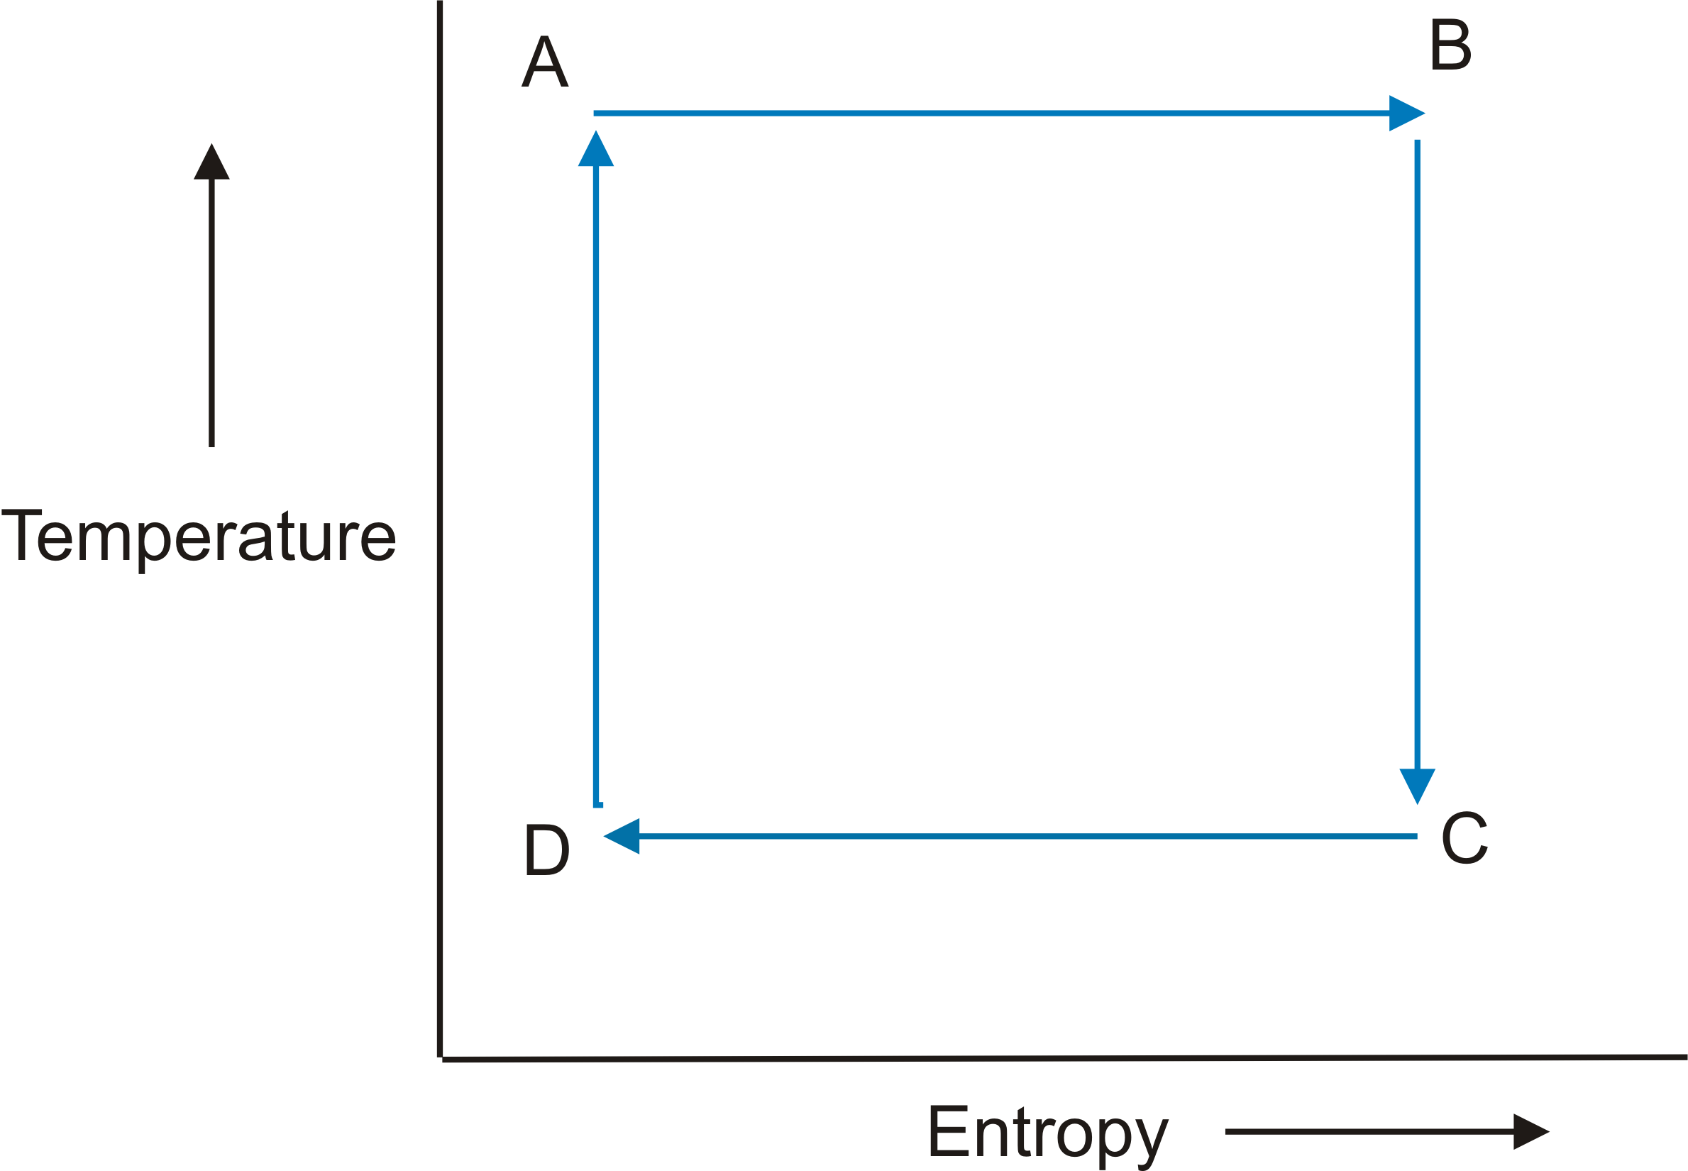

Slide 34
Total rate of heat input to hurricane:
Dissipative heating
Surface enthalpy flux
In steady state, energy production is used to balance frictional dissipation:

Slide 35
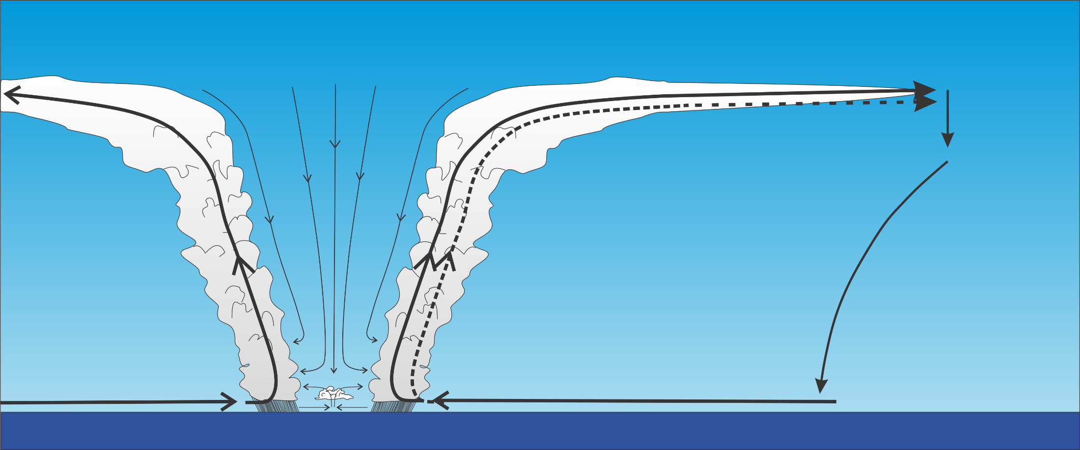
Differential Carnot Cycle

Slide 36
Internally determined
Note that this is valid between ANY two streamlines in the region of ascent

Slide 37
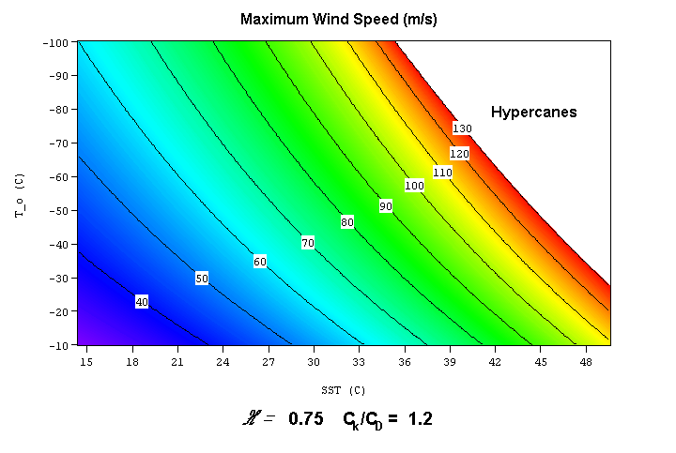

Slide 38
Annual Maximum Potential Intensity (m/s)

Slide 39
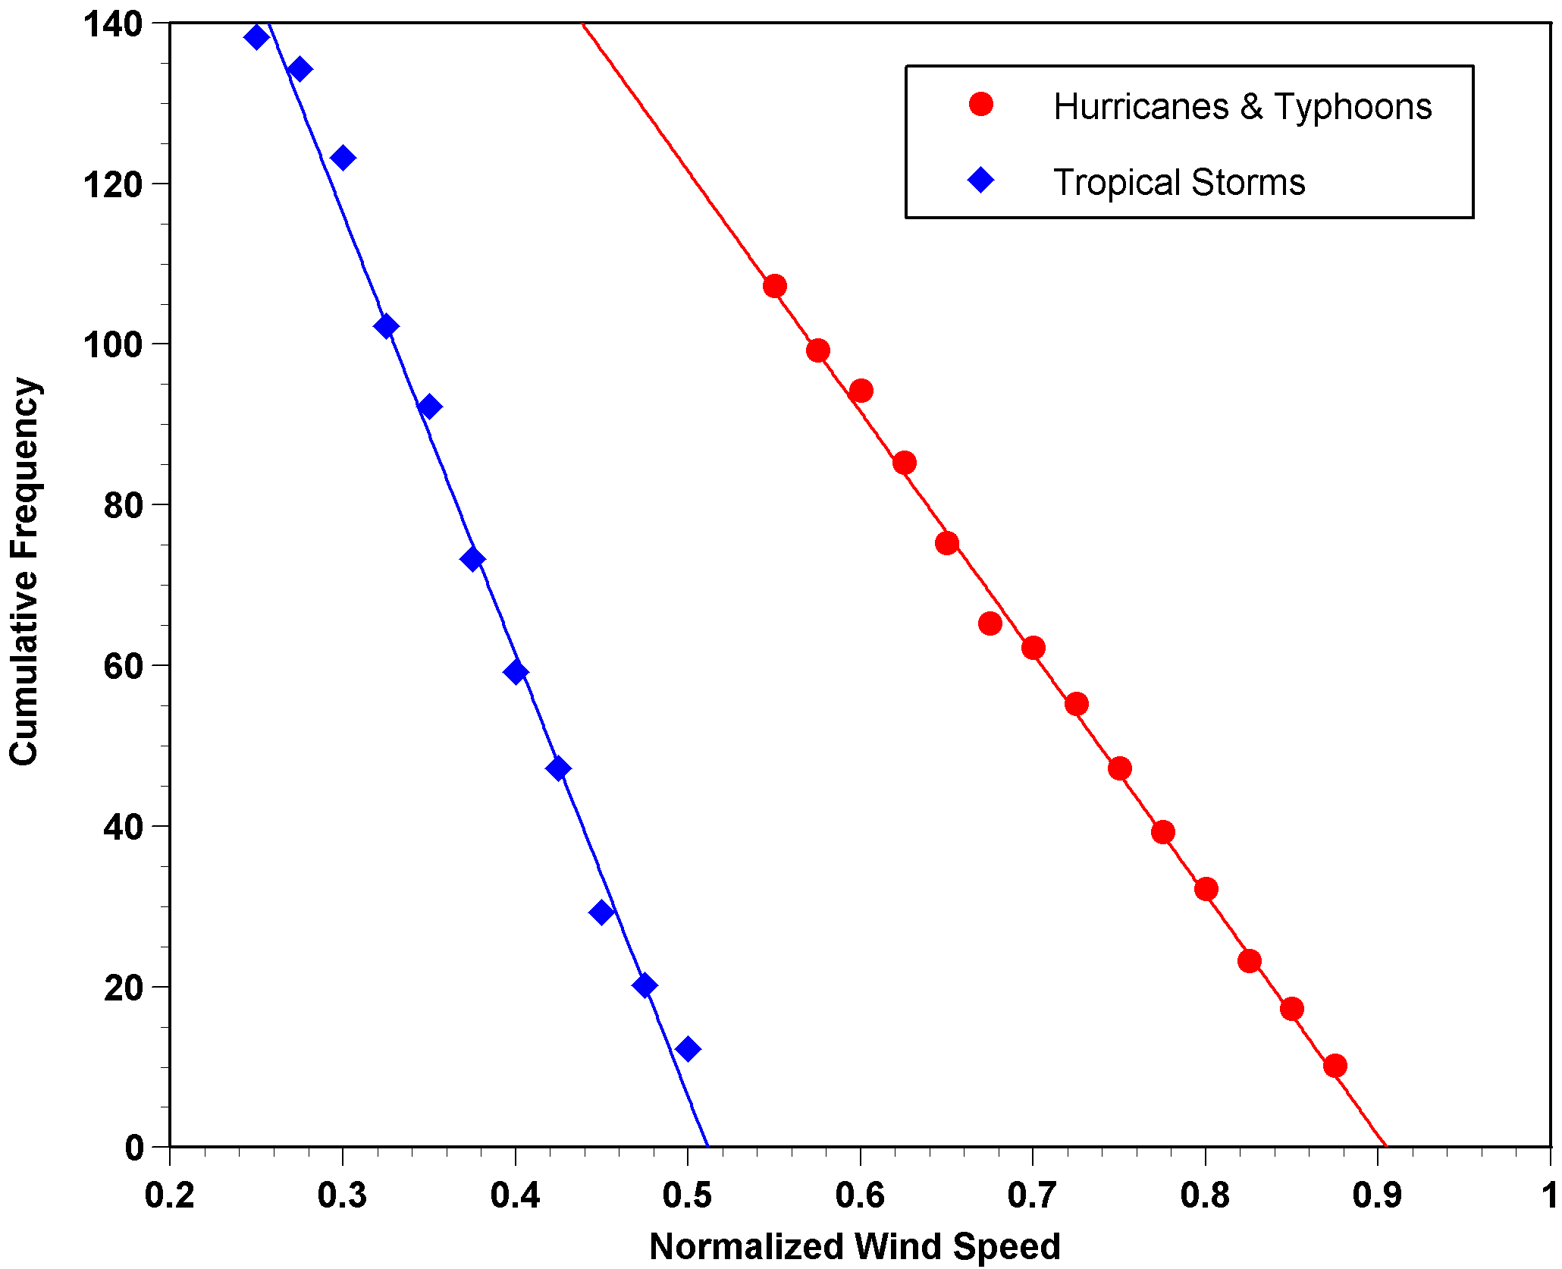

Slide 40
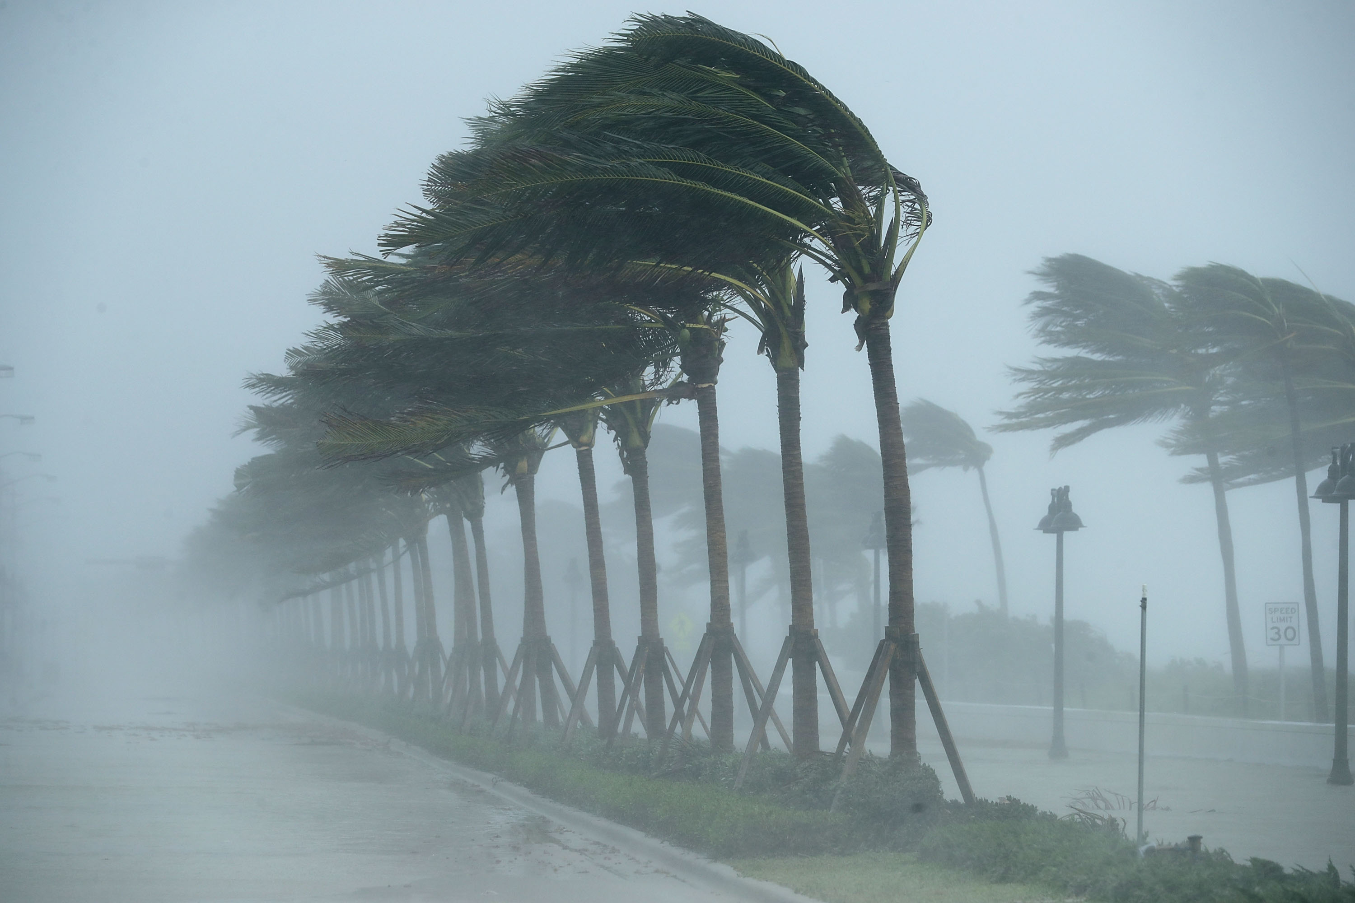
Hurricanes and Climate Change

Slide 41
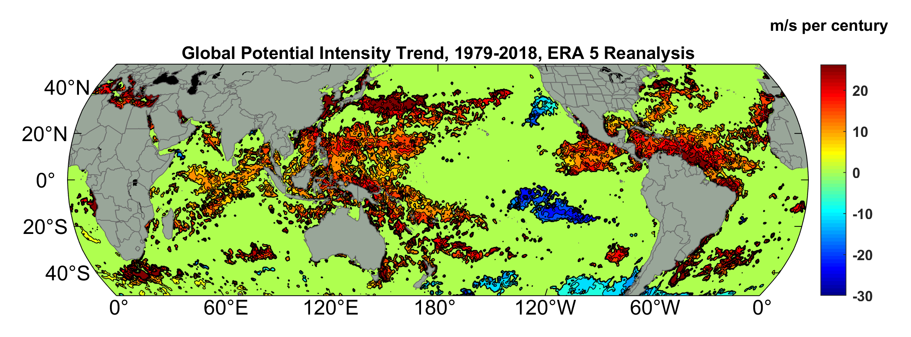
Potential Intensity Trend, 1979-2018, ERA 5 Reanalysis
(Trend shown only where p value < 0.05)

Slide 42
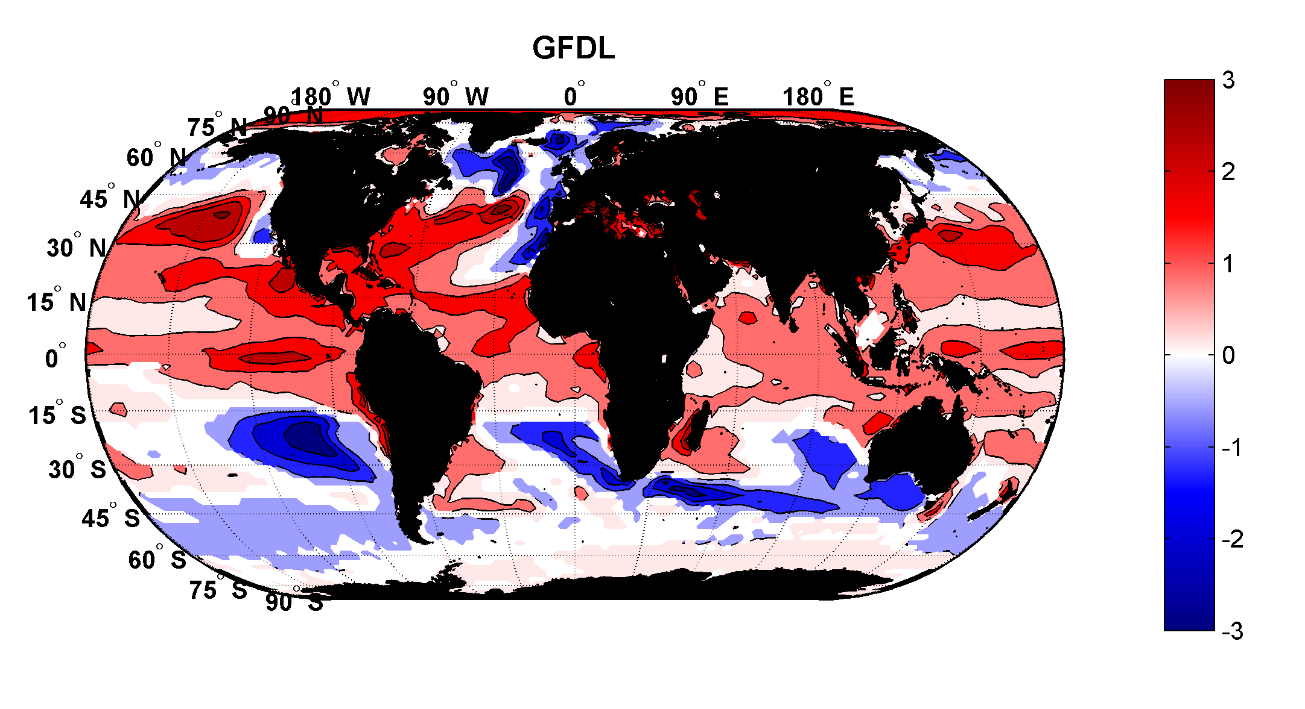
Projected Trend Over 21st Century: GFDL model under RCP 8.5
ms⁻¹decade⁻¹

Slide 43
Time series of the latitudes at which tropical cyclones reach maximum intensity.
From Kossin et al. (2014)

Slide 44
“Downscaling” hurricanes from global analyses and models
Embed detailed hurricane forecast model in global climate analyses or climate models
Generate thousands of synthetic hurricane tracks consistent with global climate
Use these synthetic hurricanes to estimate hurricane risk

Slide 45
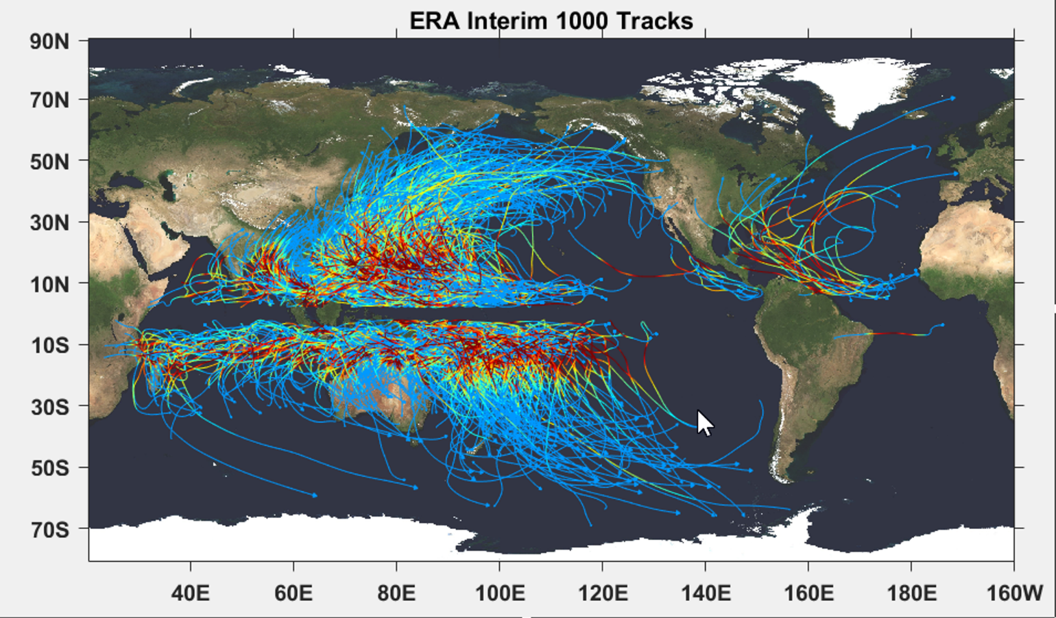

Slide 46
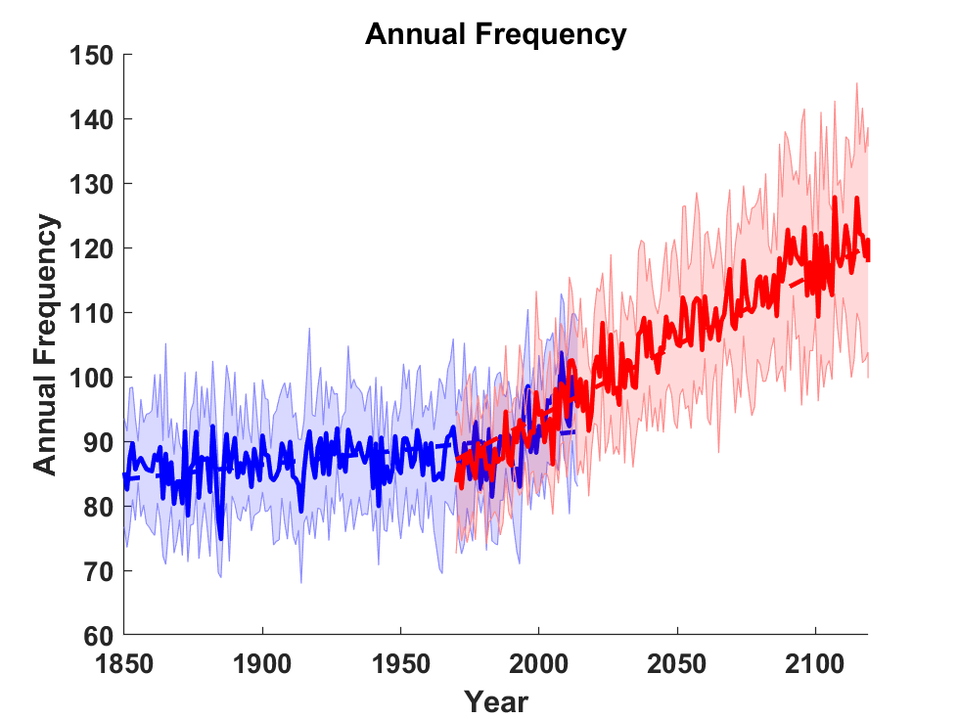
Downscale 9 climate models with observed forcings, 1850-2015 and with CO₂ increasing at 1% per year from 1970 to 2120

Slide 47
