Slide 1
Introduction to Tropical Cyclones

Slide 2
Tropical Cyclone: Definition
A warm-core non-frontal synoptic-scale cyclone, originating over tropical or subtropical waters, with organized deep convection and a closed surface wind circulation about a well-defined center. Once formed, a tropical cyclone is maintained by the extraction of heat energy from the ocean at high temperature and heat export at the low temperatures of the upper troposphere. In this they differ from extratropical cyclones, which derive their energy from horizontal temperature contrasts in the atmosphere (baroclinic effects).
-- NOAA National Hurricane Center

Slide 3
Hurricane: Definition
Formal definition: A tropical cyclone with 1-min average winds at 10 m altitude in excess of 32 m/s (64 knots or 74 MPH) occurring over the North Atlantic or eastern North Pacific

Slide 4

The View from Space
Notes:
The advent of reconnaissance aircraft and radar in the 1940s, and of satellites in the 1960s, gave scientists the means to determine the detailed structure and evolution of hurricanes. Today, almost everything we know about hurricanes is based on observations by aircraft, radar, and satellites. This satellite image shows Hurricane Floyd approaching the east coast of Florida in 1999. This image has been digitally enhanced to lend a three-dimensional perspective. The swirling mass of clouds is about 300 kilometers (180 miles) across, and Floyd’s eye is about 50 kilometers (30 miles) in diameter. Surrounding the eye is a deep ring of thick cloud called the eyewall. A thin veil of very high cloud covers most of the swirling mass of thicker clouds; this is the veil of cirrus, made up of tiny ice crystals. Underneath it, and thus invisible from above, are several spiral shaped bands of deep, thick cumulonimbus clouds, interspersed between relatively clear sky. These spiral bands produce heavy rains and gusty winds well outside the eyewall of the hurricane, where the strongest winds are found.
Image: Satellite image of Hurricane Floyd approaching the east coast of Florida in 1999. The image has been digitally enhanced to lend a three-dimensional perspective. Credit: NASA/Goddard Space Flight Center.
Description from “Divine Wind: The History and Science of Hurricanes”, Kerry Emanuel, 2005, Oxford University Press, 296 p.
Definitions
Reconnaissance is the military term for the active gathering of information about an enemy, or other conditions, by physical observation (from and for more information see http://en.wikipedia.org/wiki/Reconnaissance).
The eye is a region of mostly calm weather found at the center of strong tropical cyclones. The eye of a storm is usually circular and typically 25–40–65 kilometers (40 miles) in diameter. It is surrounded by the eyewall, where the most severe weather of a cyclone occurs (from and for more information see http://en.wikipedia.org/wiki/Eyewall).
Cirrus clouds are thin and often wispy clouds that are the most common form of high-level clouds. Typically found at heights greater than 20,000 feet (6,000 meters), cirrus clouds are composed of ice crystals that originate from the freezing of supercooled water droplets (from and for more information see http://weather.about.com/library/glossary/blglossary.htm).
Cumulonimbus clouds are large and vertically developed clouds that are fueled by vigorous convective updrafts (sometimes in excess 50 knots), the tops of cumulonimbus clouds can easily reach 39,000 feet (12,000 meters) or higher (from and for more information see http://weather.about.com/library/glossary/blglossary.htm).

Slide 5
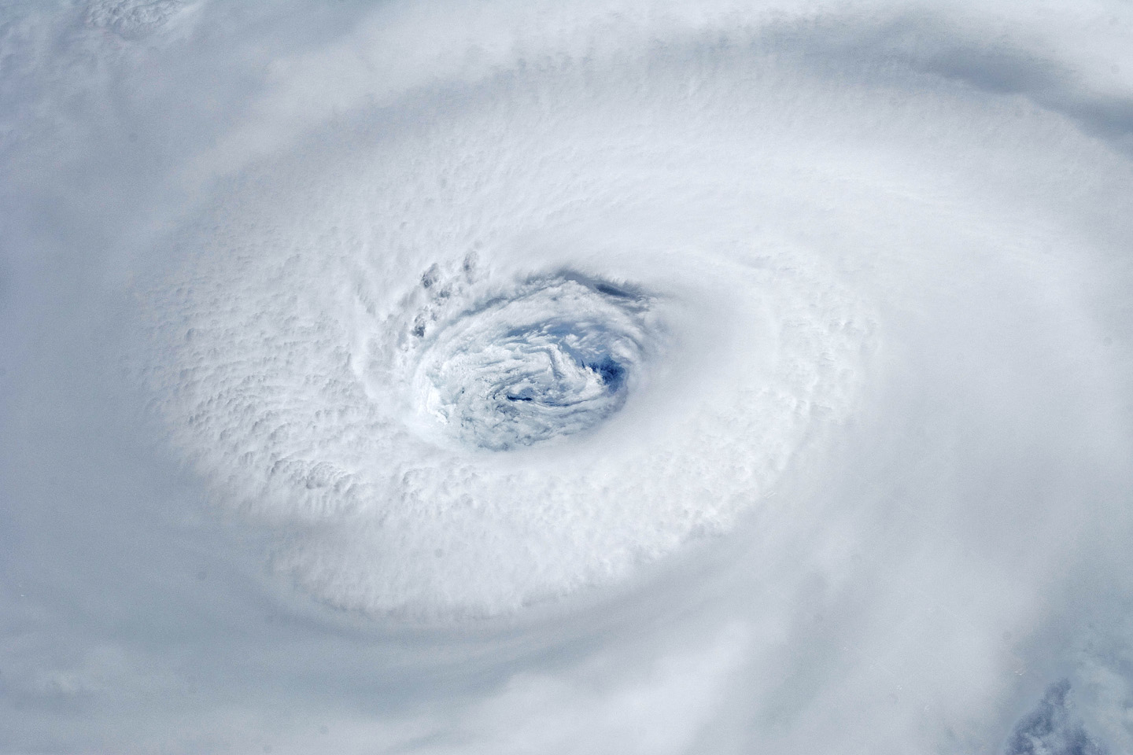
Igor, 2010
Notes:
Astronauts aboard the International Space Station took this digital photograph of the eye of Hurricane Igor at 10:56 Atlantic Daylight Time (13:56 UTC) on September 14, 2010. The storm was a category four hurricane on the Saffir-Simpson scale of intensity. At the time of the image, Igor was centered in the Atlantic Ocean near 18°N 52°W and slowly moving west-northwest at 11 kilometers (7 miles) per hour, according to the U.S. National Hurricane Center. Maximum sustained winds of 213 km (132 mi.) per hour, with gusts to 259 km (161 mi.) per hour. Credit: NASA

Slide 6
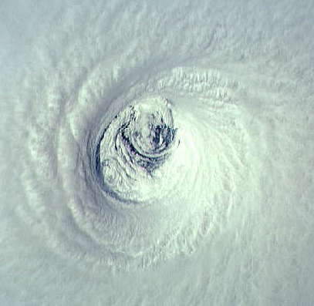
Emelia, 1994
Notes:
The eye of Hurricane Emilia over the eastern North Pacific ocean, as seen from directly above by the crew of the space shuttle Columbia on July 19th, 1994. At this time, Emilia had maximum sustained winds of 155 miles per hour. Looking at the eye from above is like staring down the middle of a bathtub whirlpool, except that the boundaries are made of cloud and the “funnel” comes to an abrupt end at the sea surface. The eyewall is visible as the stadium of thick, white cloud surrounding the eye. This is where the strongest winds and heaviest rains are found. Unlike the bathtub whirlpool, the air inside the eyewall is going up, not down, as it swirls around the eye. There are spiral striations along the inner edge of the eyewall and two big swirling eddies in the low clouds at the base of the eye. No mere photograph can do justice to the sensation of being inside the eye of a hurricane. Imagine a Roman coliseum 20 miles wide and 10 miles high, with a cascade of ice crystals falling along the coliseum’s blinding white walls.
Image: The eye of Hurricane Emilia over the eastern North Pacific on July 19, 1994, at 19:33 GMT. Credit: NASA Johnson Space Center Digital Image Collection.
Description from “Divine Wind: The History and Science of Hurricanes”, Kerry Emanuel, 2005, Oxford University Press, 296 p.
Definitions
Striations are grooves or channels in cloud formations, arranged parallel to the flow of air and therefore depicting the airflow relative to the parent cloud. Striations often reveal the presence of rotation, as in the barber pole or "corkscrew" effect often observed with the rotating updraft of an Low Precipitation (LP) storm (from http://www.srh.weather.gov/srh/jetstream/append/glossary_s.htm).
Eddies are water or air currents flowing in circular patterns (from www.terrax.org/sailing/glossary/ge.aspx).

Slide 7
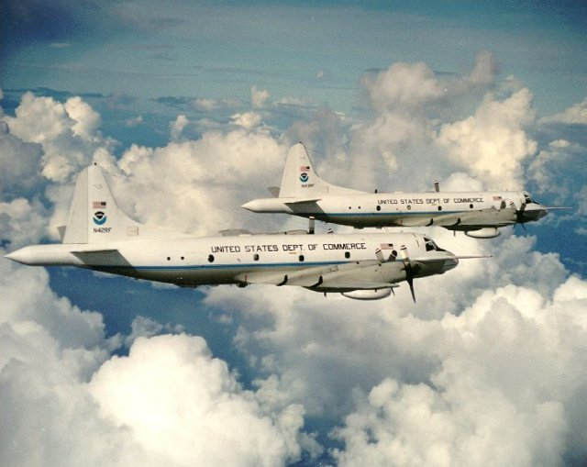

Slide 8
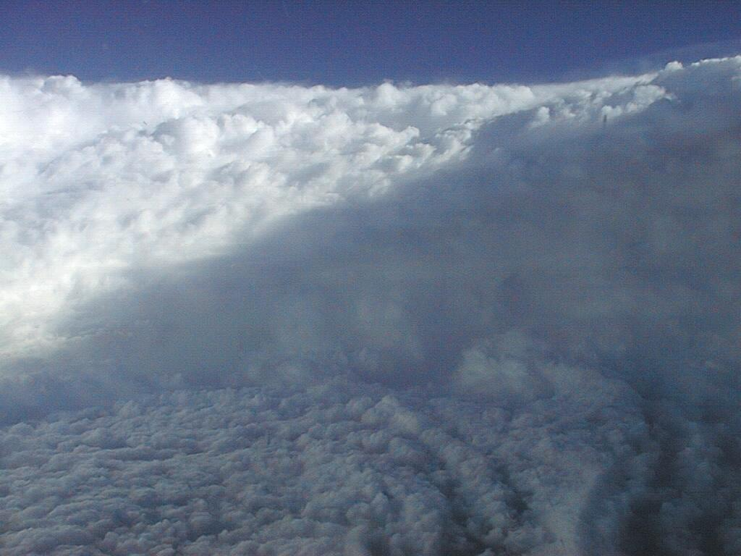
Notes:
The eye of Hurricane Georges in this photo taken from a reconnaissance aircraft gives some impression of a hurricane’s eye.
However impressive a hurricane’s visual appearance, it is the instruments aboard satellites and aircraft that reveal the essence of a hurricane’s structure and inner workings. In the early days of aircraft reconnaissance, the crew estimated wind speeds by looking down and noting how rough the sea appeared. Today, a sophisticated array of instruments automatically collects large quantities of high-quality data, which are taken back to laboratories and analyzed.
Image: The eye of Hurricane Georges in photo taken from a reconnaissance aircraft. The eyewall at right is casting a shadow across part of the eyewall ahead. Credit: Michael Black, Hurricane Research Division, NOAA-AOML, Miami, Florida.
Description from “Divine Wind: The History and Science of Hurricanes”, Kerry Emanuel, 2005, Oxford University Press, 296 p.

Slide 9
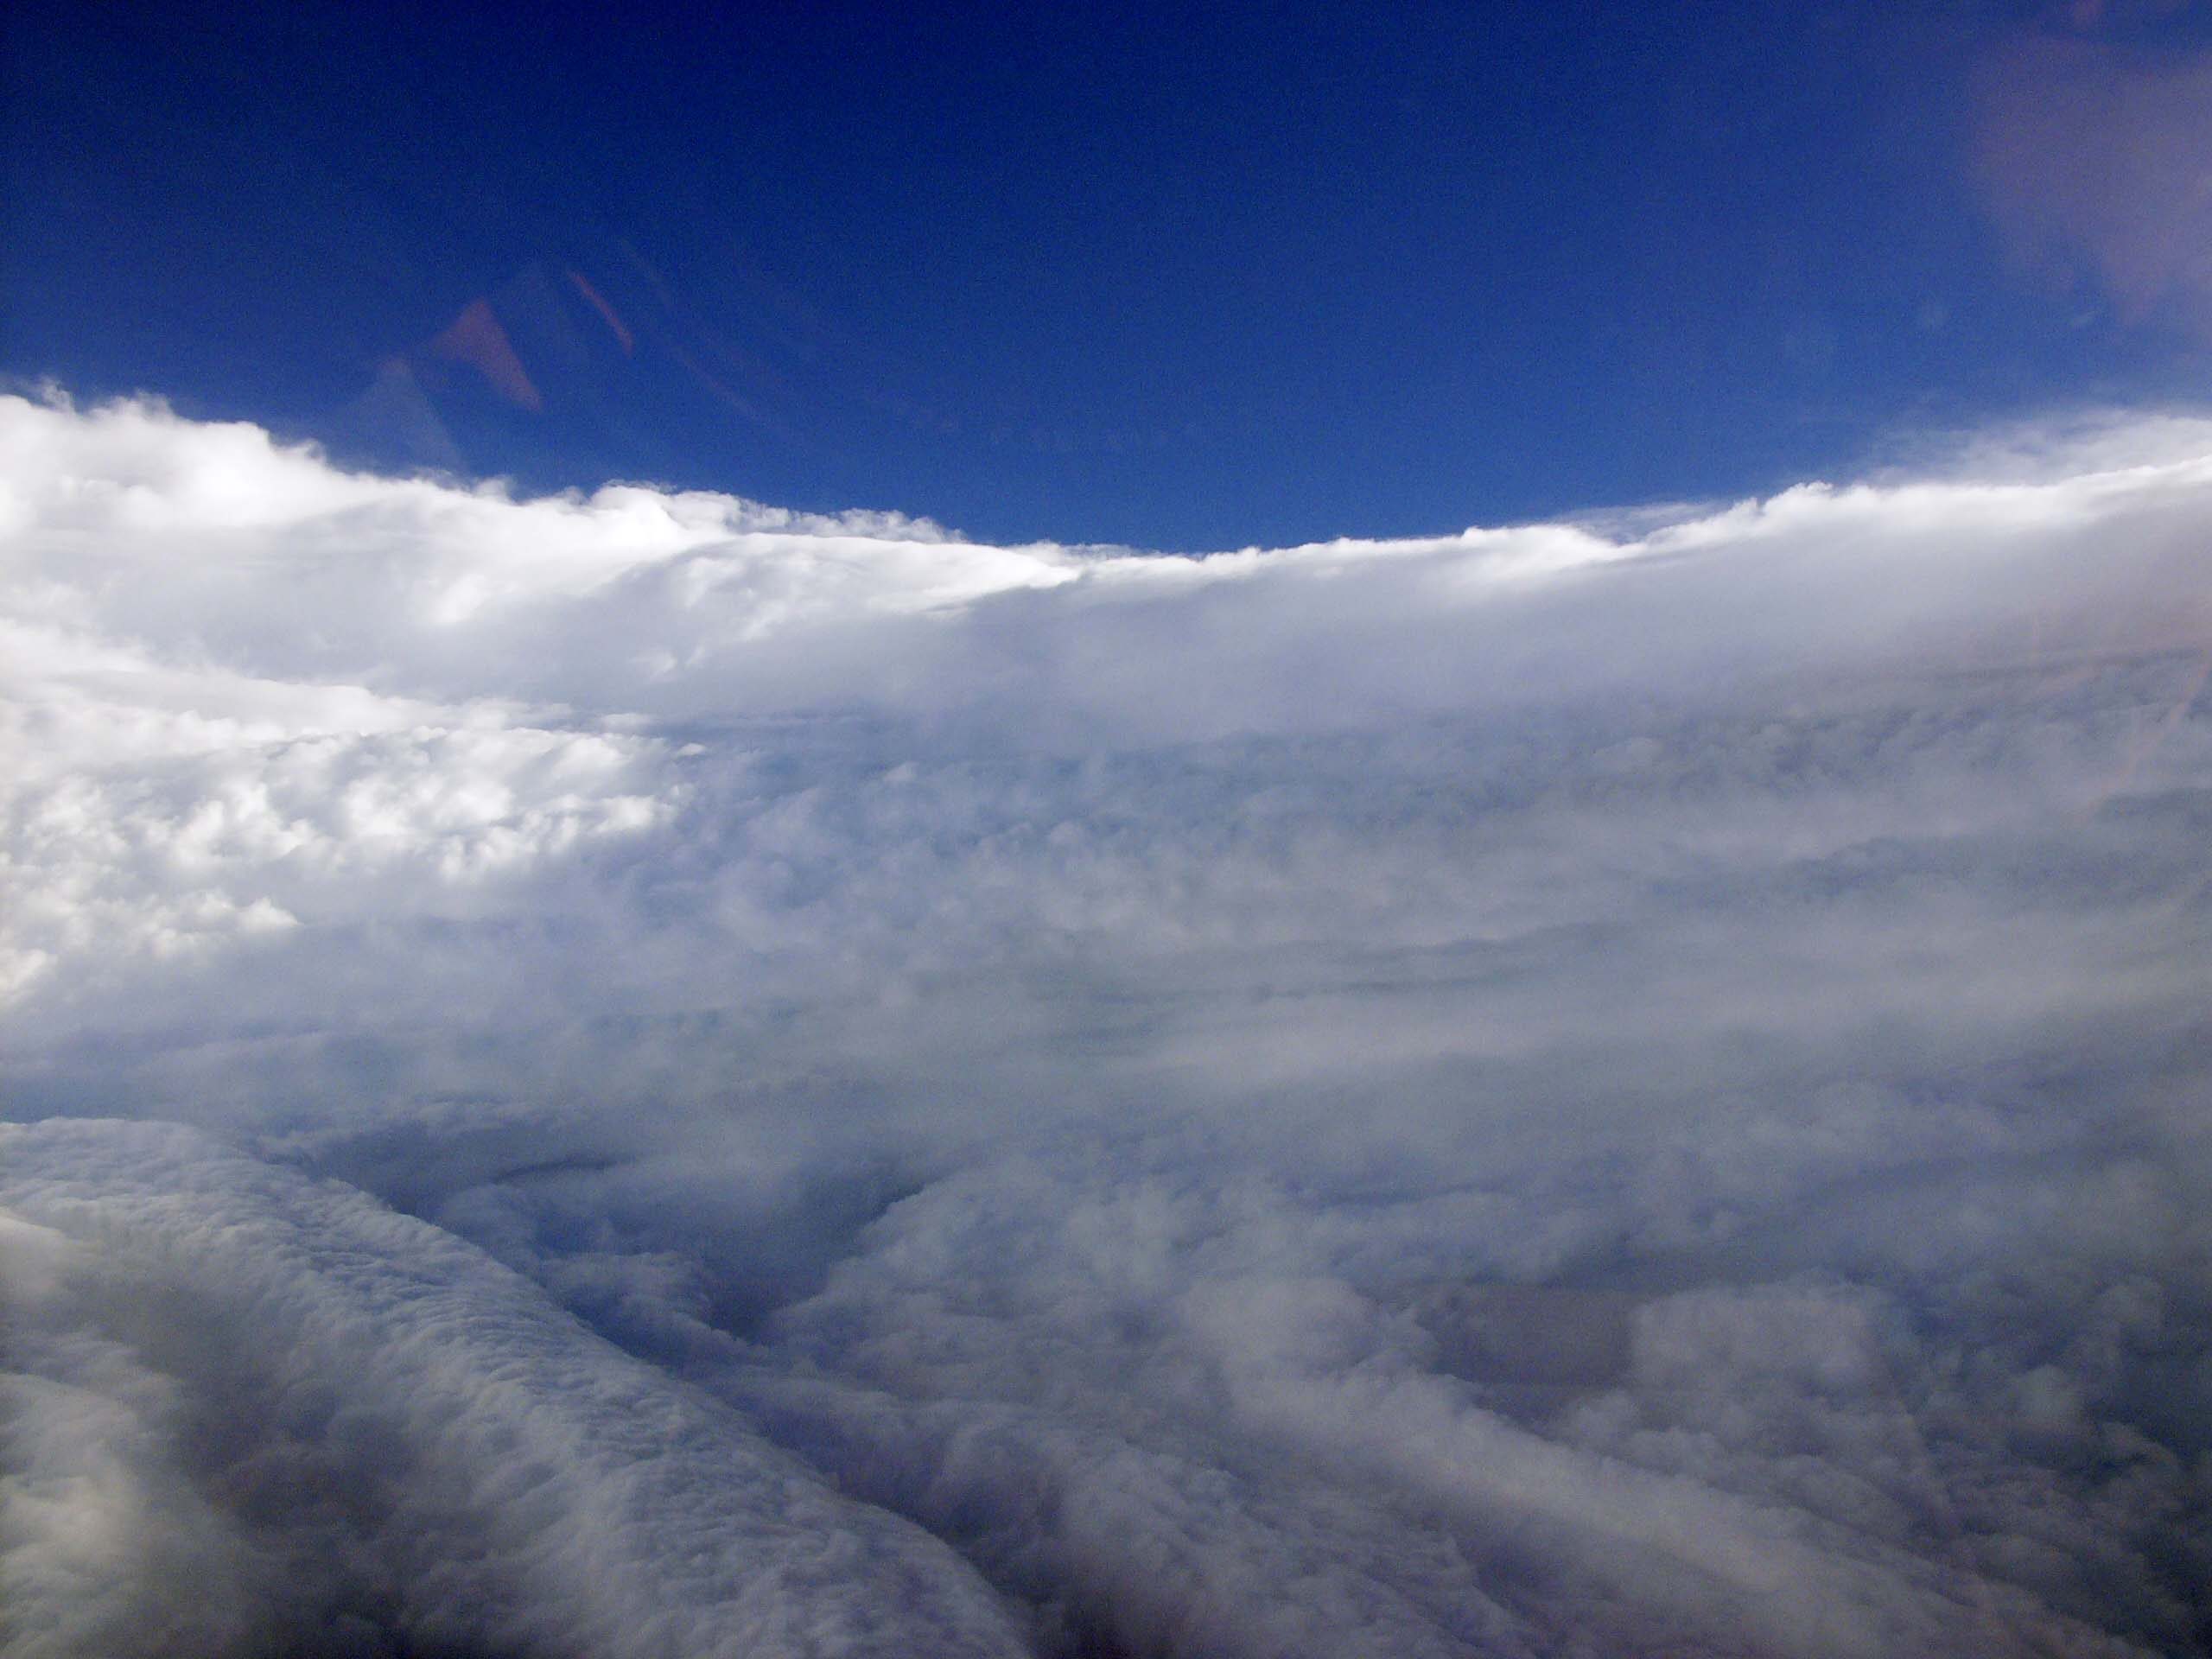
View of the eye of Hurricane Katrina on August 28th, 2005, as seen from a NOAA WP-3D hurricane reconnaissance aircraft.

Slide 10
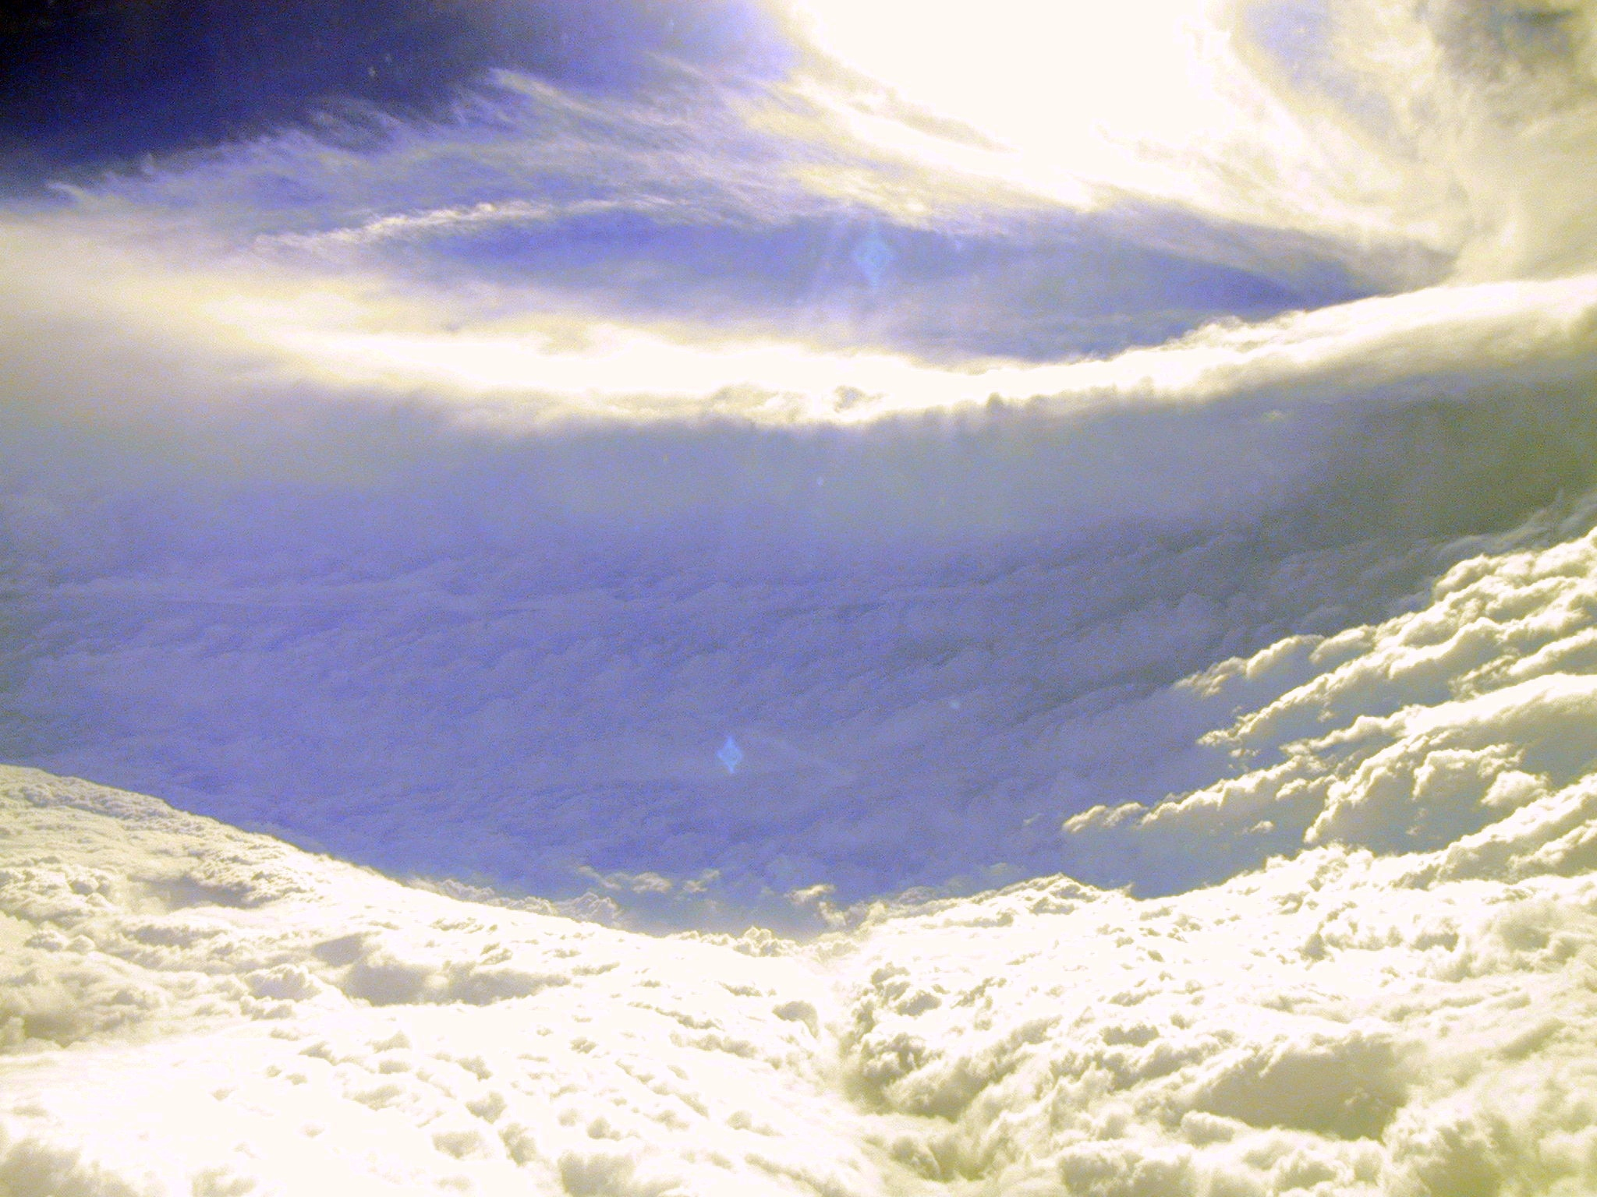

Slide 11
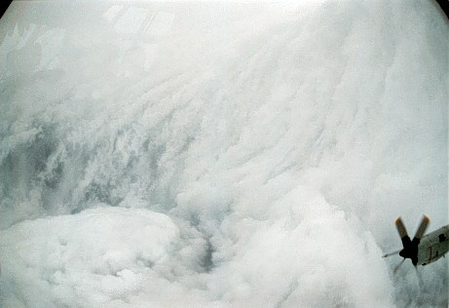

Slide 12
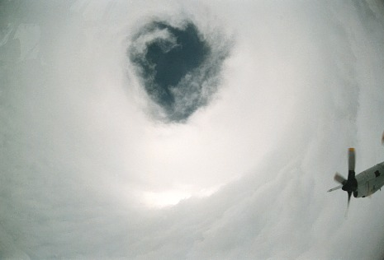

Slide 13
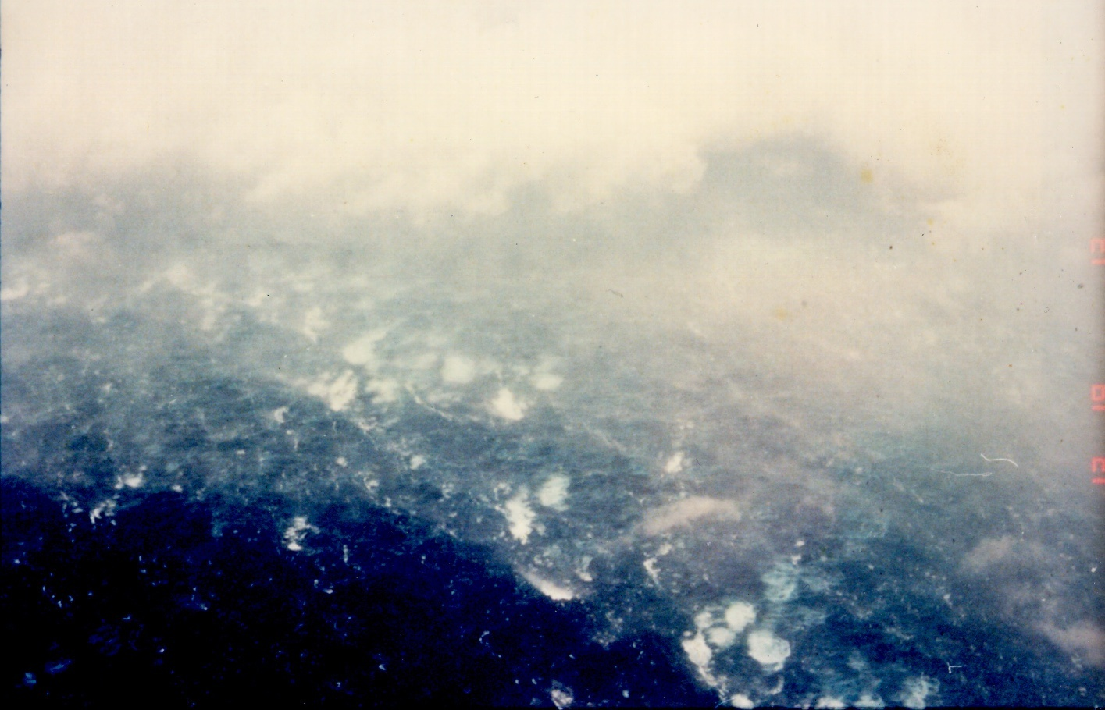

Slide 14
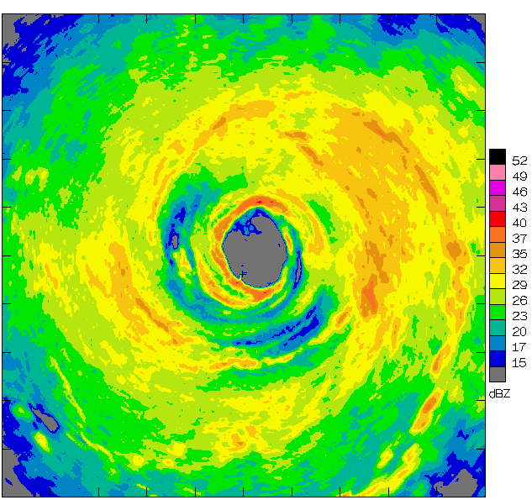
Airborne Radar: Horizontal Map
360 km
(220 mi)

Slide 15
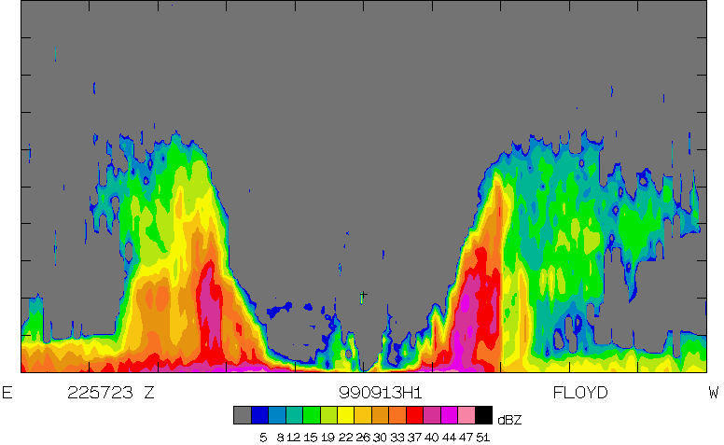
Airborne Radar: Vertical Slice
20 km
(12 mi)
120 km
(75 mi)

Slide 16
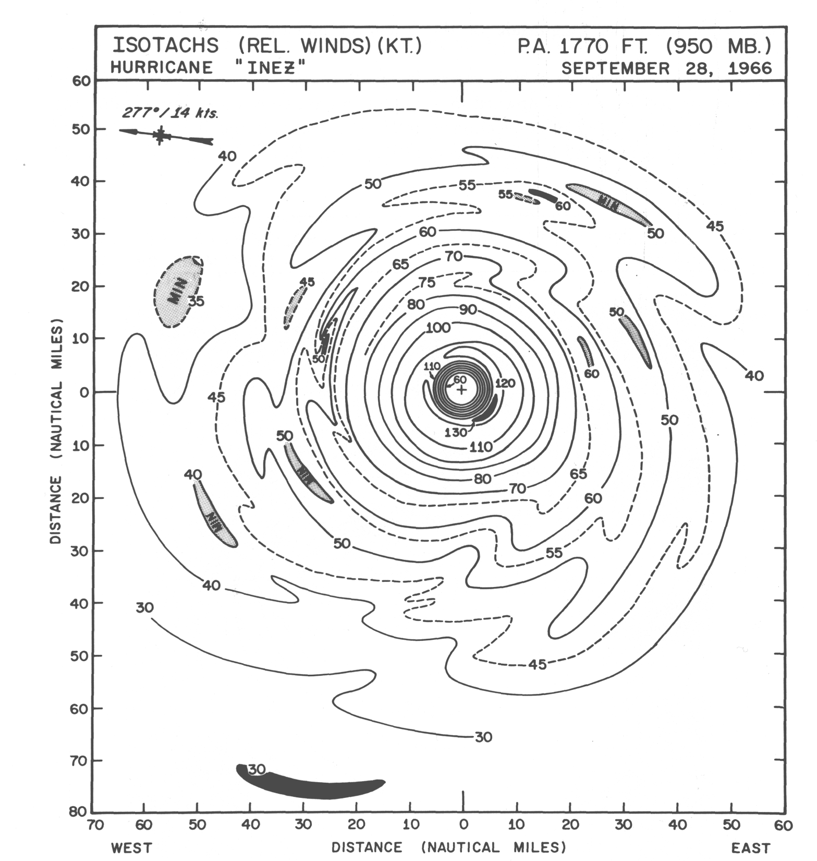

Slide 17
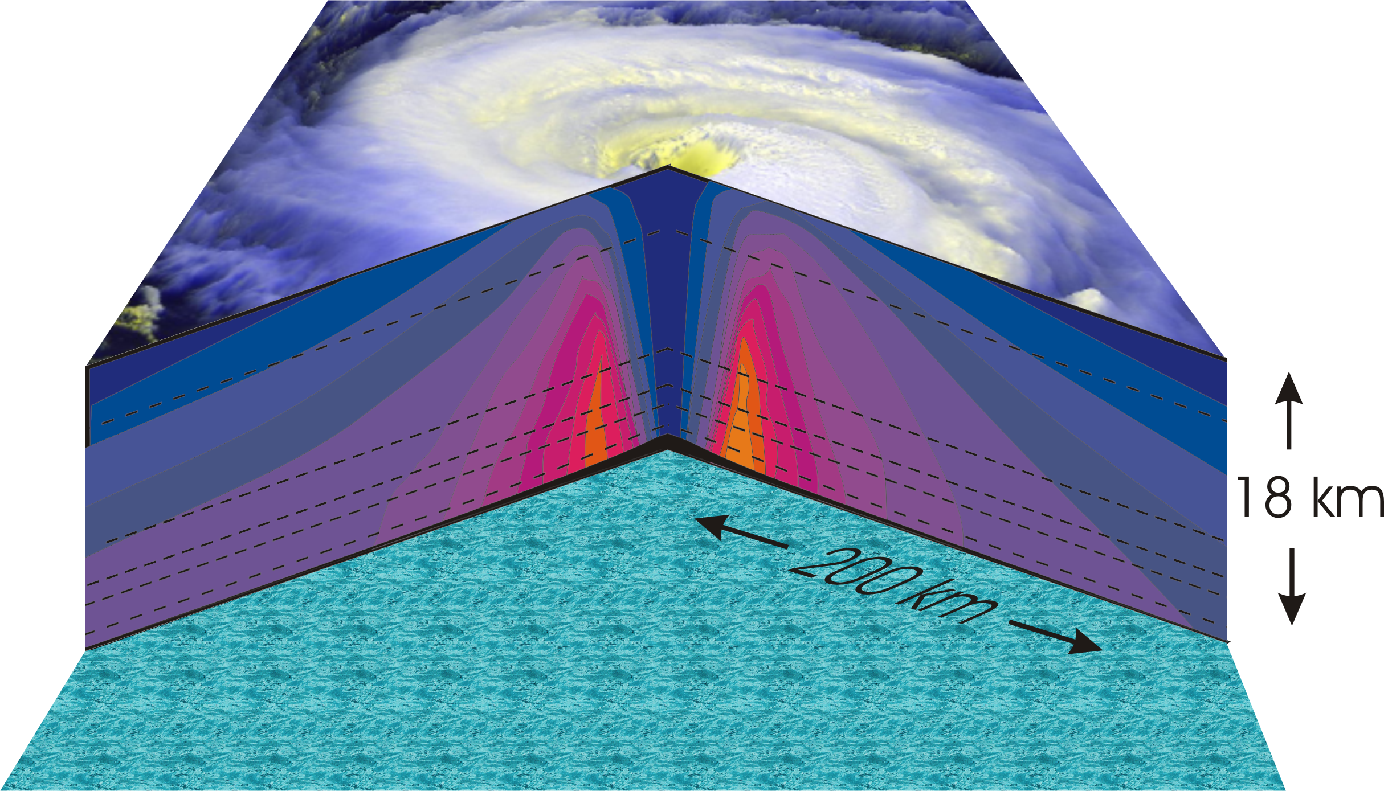
Hurricane Structure: Wind Speed
Azimuthal component of wind
< 11 mph - > 145 mph
Notes:
A composite view of the distribution of wind speed in a typical hurricane based on measurements made from research aircraft. In this image and the two that follow, the center of the hurricane is in the center of the panel and the cutaway extends outward about 200 km (125 miles) and upward to about 18 km (11 miles). A satellite image of the top of a storm has been superimposed.
This image shows the speed of the wind going counterclockwise around the center of the storm; the black dashed lines show the altitudes at which the aircraft were flying. The darkest shade of blue indicates the lightest winds, less than 5 meters/second (11 mph). Each successive color represents an increment of 5 meters/second (11 mph), with bright orange showing winds in excess of 65 meters/second (145 mph). The strongest winds occur just above the ocean in a ring around the center, slightly outside the eyewall of the storm. Winds decrease rapidly inward toward the center, which is practically calm. They also decrease outward from the ring of maximum wind , but much more slowly, so that strong winds can still be found 100 kilometers (60 miles) from the center of the storm. As we go up from the surface, the counterclockwise winds get lighter and lighter. If the highest aircraft had flown even higher, it would have actually encountered “negative” wind speed, which here means winds going the other way (clockwise) around the center.
Image is copyrighted 2005 by Oxford University Press.
Image and description from “Divine Wind: The History and Science of Hurricanes”, Kerry Emanuel, 2005, Oxford University Press, 296 p.

Slide 18
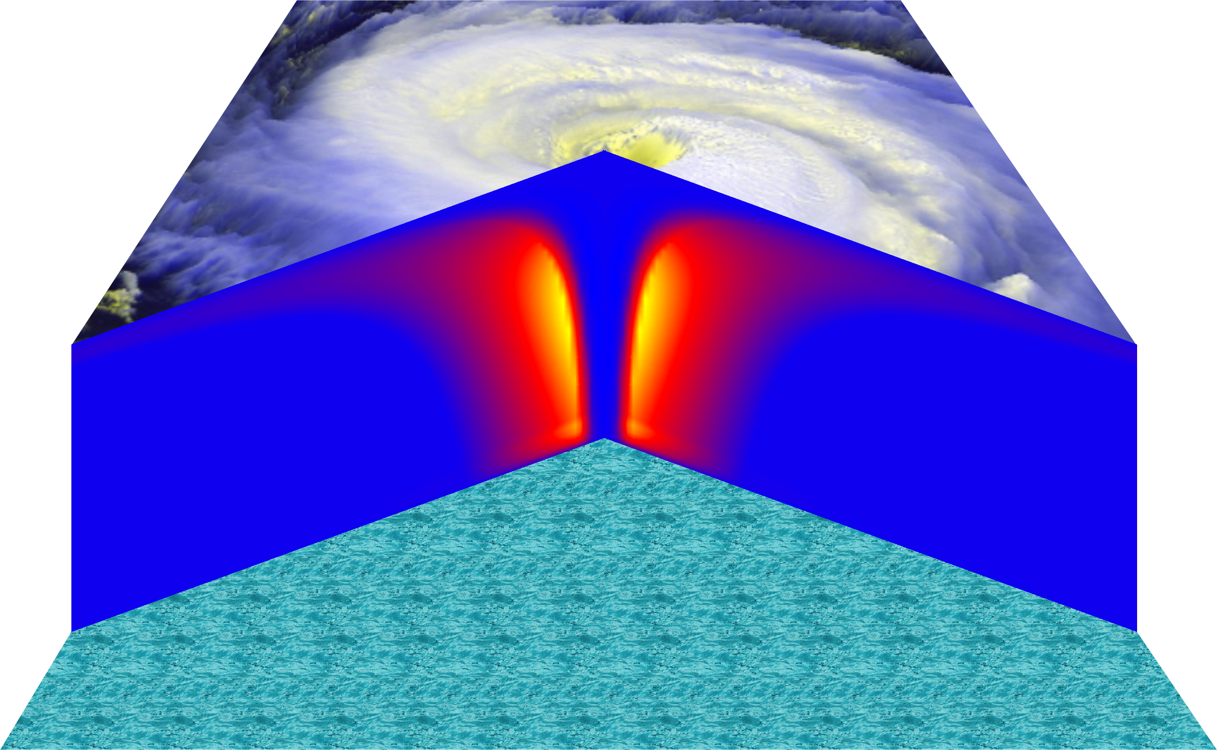
Vertical Air Motion
Updraft Speed
Strong upward motion in the eyewall
Notes:
This image shows a composite view of the distribution of updraft (vertical air motion) in a typical hurricane based on computer model calculations. The yellow and orange represent a strong upward motion in the eyewall. Although it is too weak to be seen in this figure, there is downward motion in the eye itself, strongest right next to the eyewall, and also in a broad region outside the eyewall. But since this figure is made by averaging the air motion along circles centered at the storm center, the strong updrafts associated with the spiral rain bands are missed.
Image is copyrighted 2005 by Oxford University Press.
Description from “Divine Wind: The History and Science of Hurricanes”, Kerry Emanuel, 2005, Oxford University Press, 296 p.

Slide 19
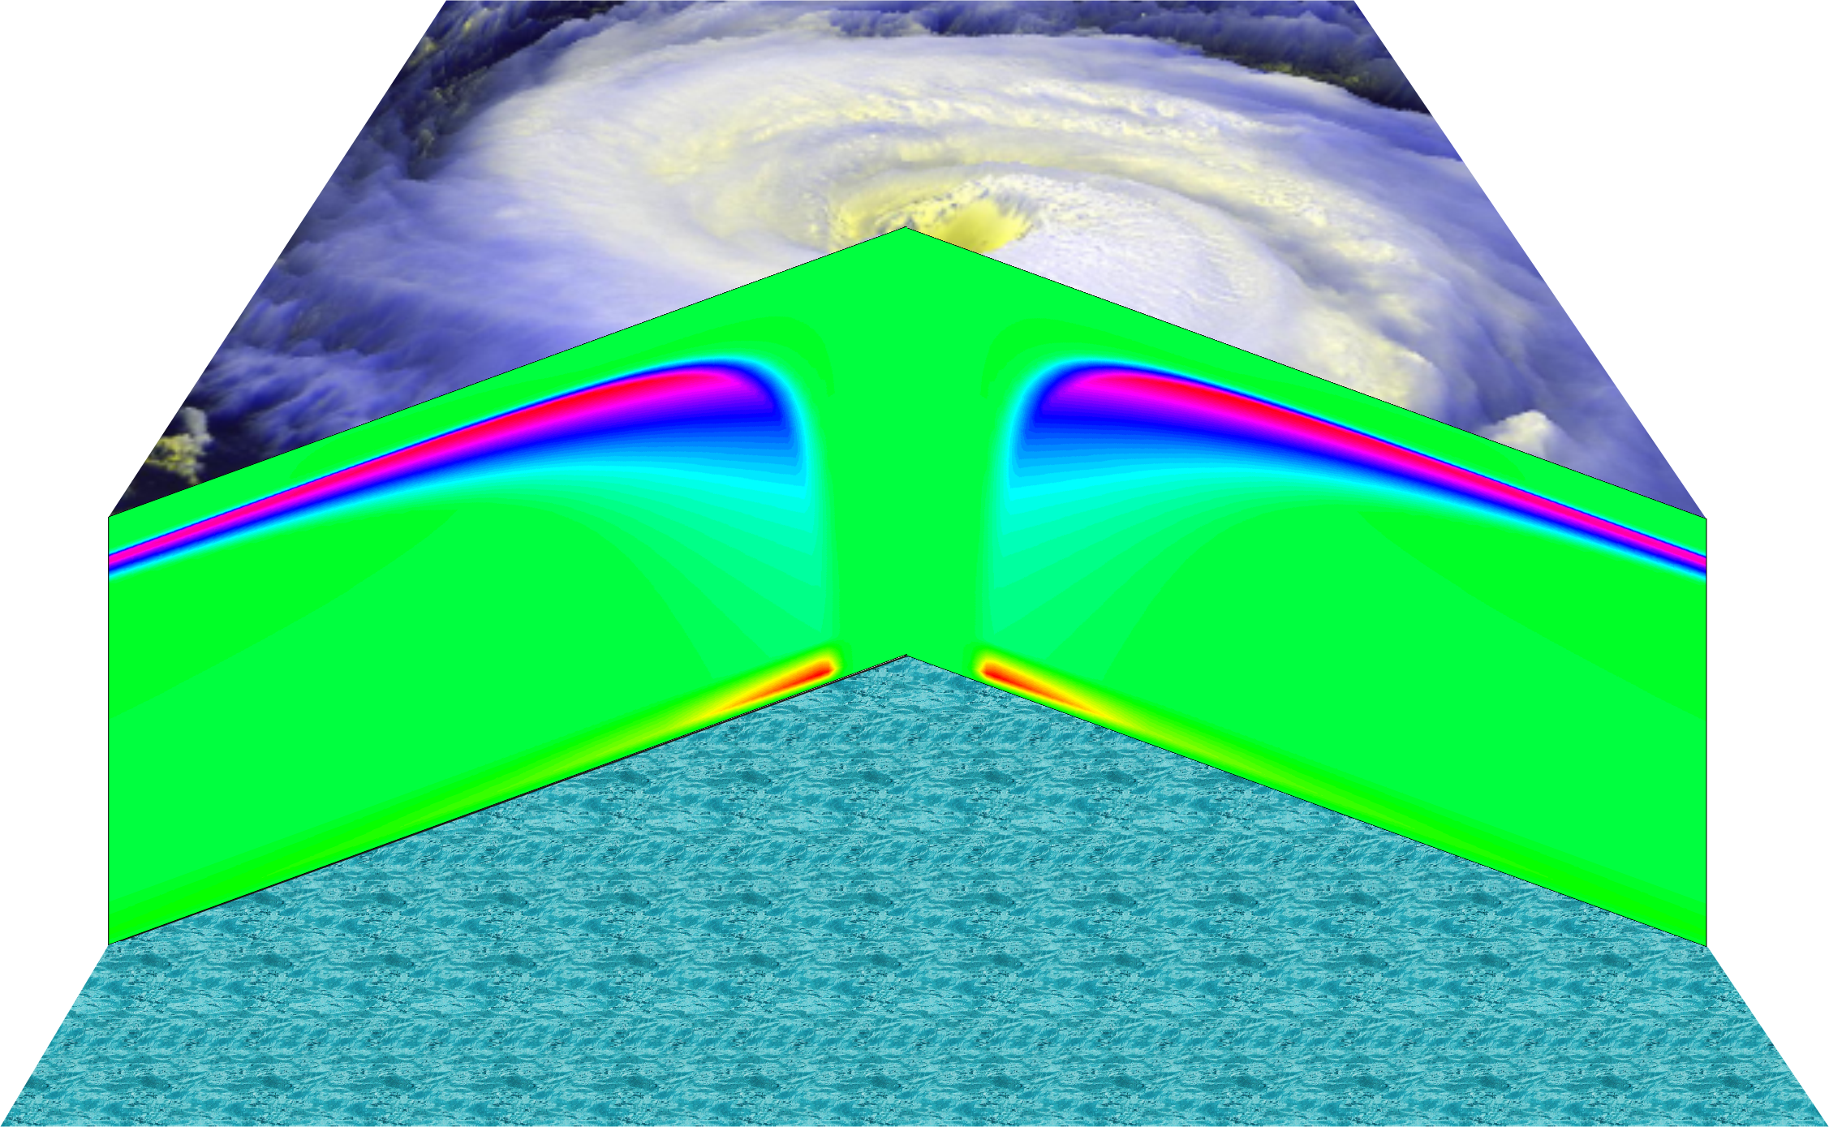
Radial wind

Slide 20
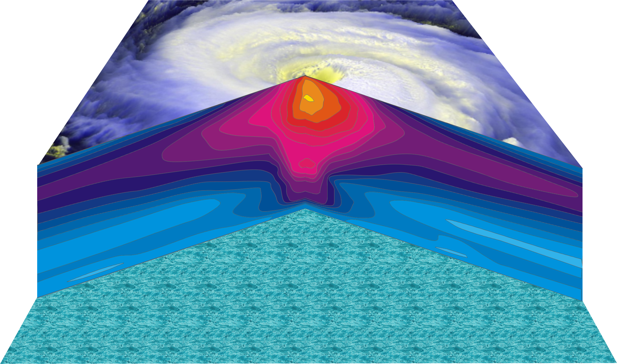
Hurricane Temperature Perturbations
No temperature difference - > 16°C (29°F) warmer
Notes:
This image shows a composite view of the distribution of temperature in a typical hurricane. This actually shows the difference between the temperature at any point and the temperature at the same altitude far away from the storm. The lightest shade of blue shows no temperature difference, while bright yellow shows air that is more than 16°C (29°F) warmer than its distant environment; each shade represents an increment of 1°C (1.8°F). Hurricanes are very hot in their centers, especially near their tops. This great warmth is one consequence of the enormous amount of heat sucked out of the ocean by the storm. On the other hand, there is very little change in temperature as you move in toward the eye along the surface of the ocean.
The distributions of temperature and wind in hurricanes are related to each other. Look carefully at the images in this slide and the slide that shows wind speed. Notice that the rate at which the wind decreases upward is proportional to the rate at which the temperature decreases outward. This relationship is fundamental to rotating fluid flows and is called the thermal wind relation.
Image is copyrighted 2005 by Oxford University Press.
Description from “Divine Wind: The History and Science of Hurricanes”, Kerry Emanuel, 2005, Oxford University Press, 296 p.
Definitions
Thermal wind is a theoretical concept that describes the wind shear between two levels in terms of the geostrophic wind at those two levels (from and for more information see http://wxman256.home.att.net/fcst/wf-pt5e.html). The basic principle of the thermal wind relationship is that in the presence of a horizontal temperature gradient, the wind speed must increase with increasing height (from and for more information see http://opwx.db.erau.edu/~mullerb/Therm_wind.html).
Wind shear is the change of wind speed or direction with distance, usually vertical (from http://ggweather.com/glossary.htm).

Slide 21
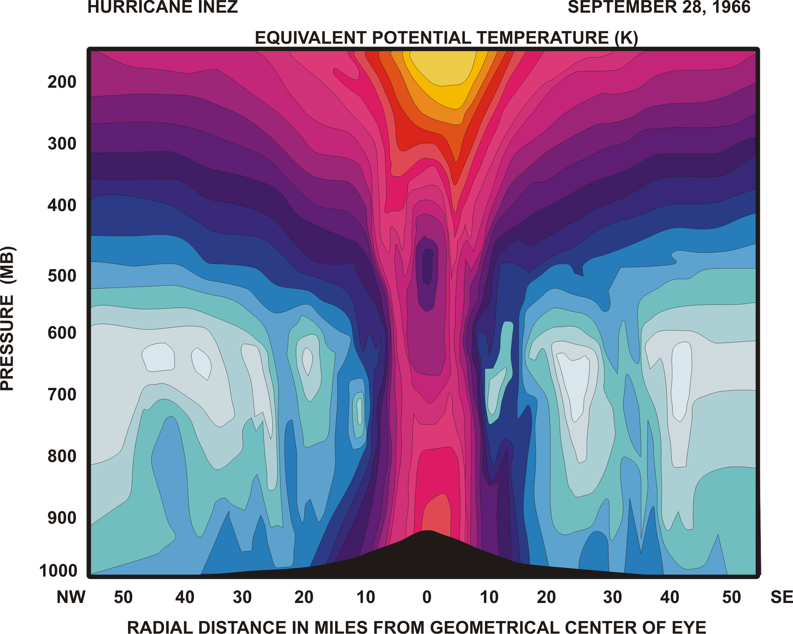

Slide 22
Specific entropy

Slide 23
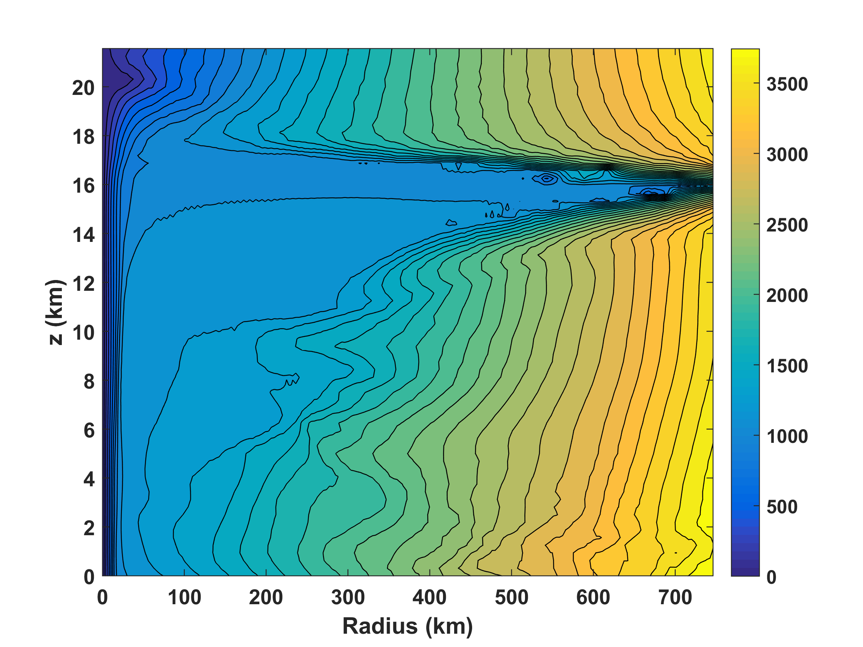
Absolute angular momentum per unit mass

Slide 24
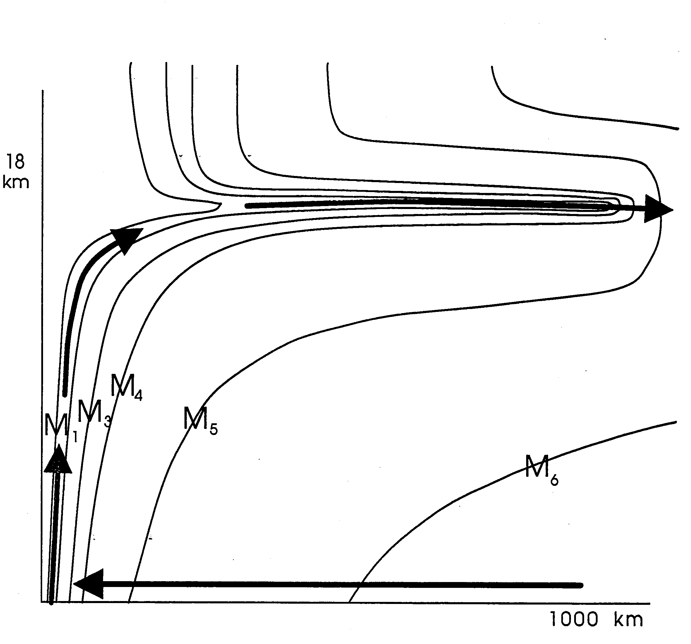

Slide 25
Tropical Cyclone Climatology

Slide 26
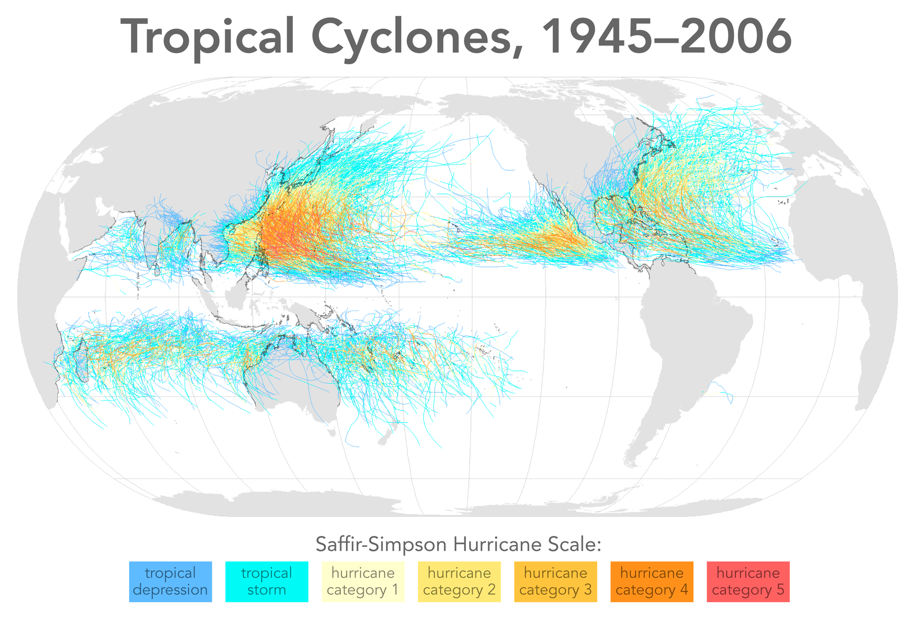

Slide 27
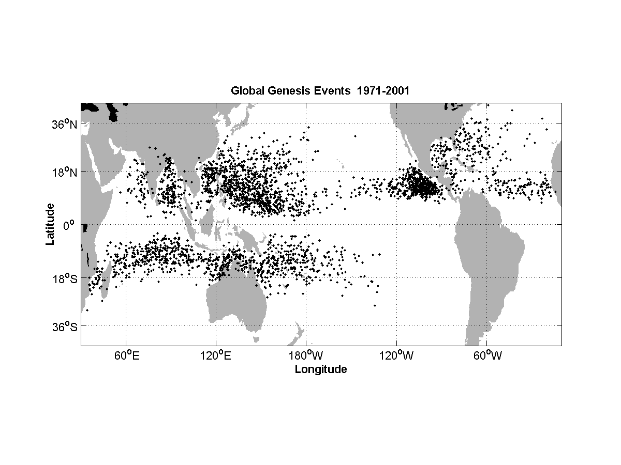

Slide 28
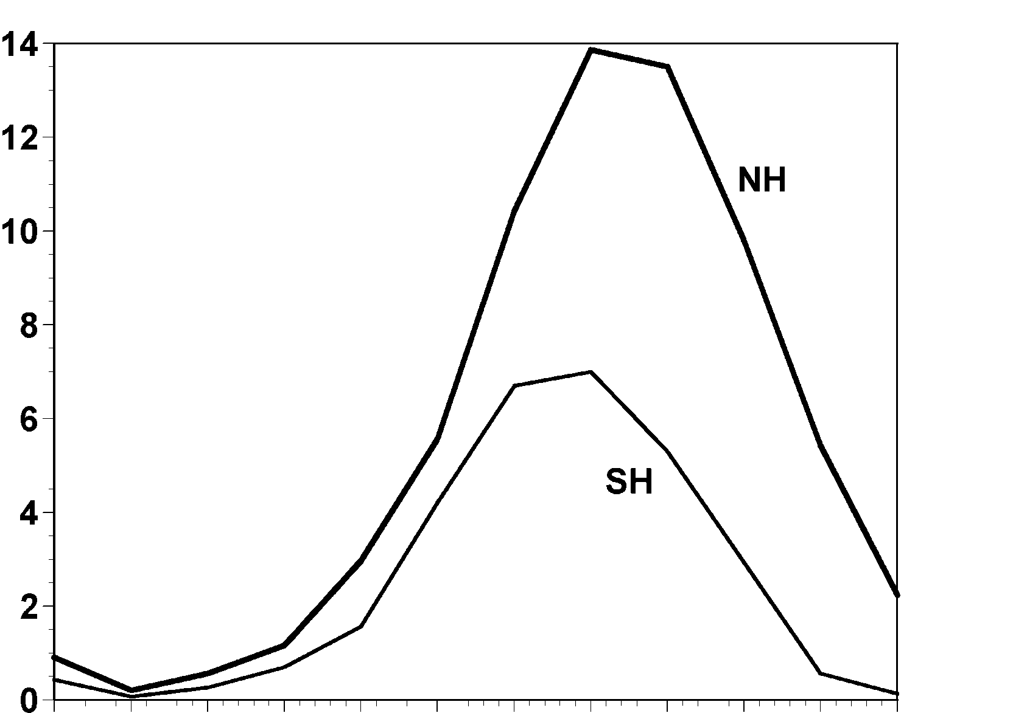
Annual Cycle of Tropical Cyclones
Number of Events per Month
a
Northern
Hemisphere
(NH)
a
Southern
Hemisphere
(SH)
Jan Feb Mar Apr May Jun Jul Aug Sep Oct Nov Dec NH
Jul Aug Sep Oct Nov Dec Jan Feb Mar Apr May Jun SH
Notes:
This graph shows the average number of tropical cyclones per month in the northern and southern hemispheres. Hurricanes tend to follow the sun, peaking in the summer and autumn and all but vanishing during the early spring. Typhoons can develop over the western North Pacific during any month of the year, but they are rare in the winter.
Image is copyrighted 2005 by Oxford University Press.
Image and description from “Divine Wind: The History and Science of Hurricanes”, Kerry Emanuel, 2005, Oxford University Press, 296 p.

Slide 29
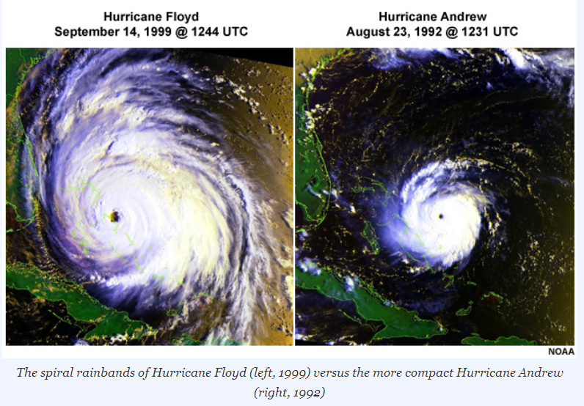

Slide 30
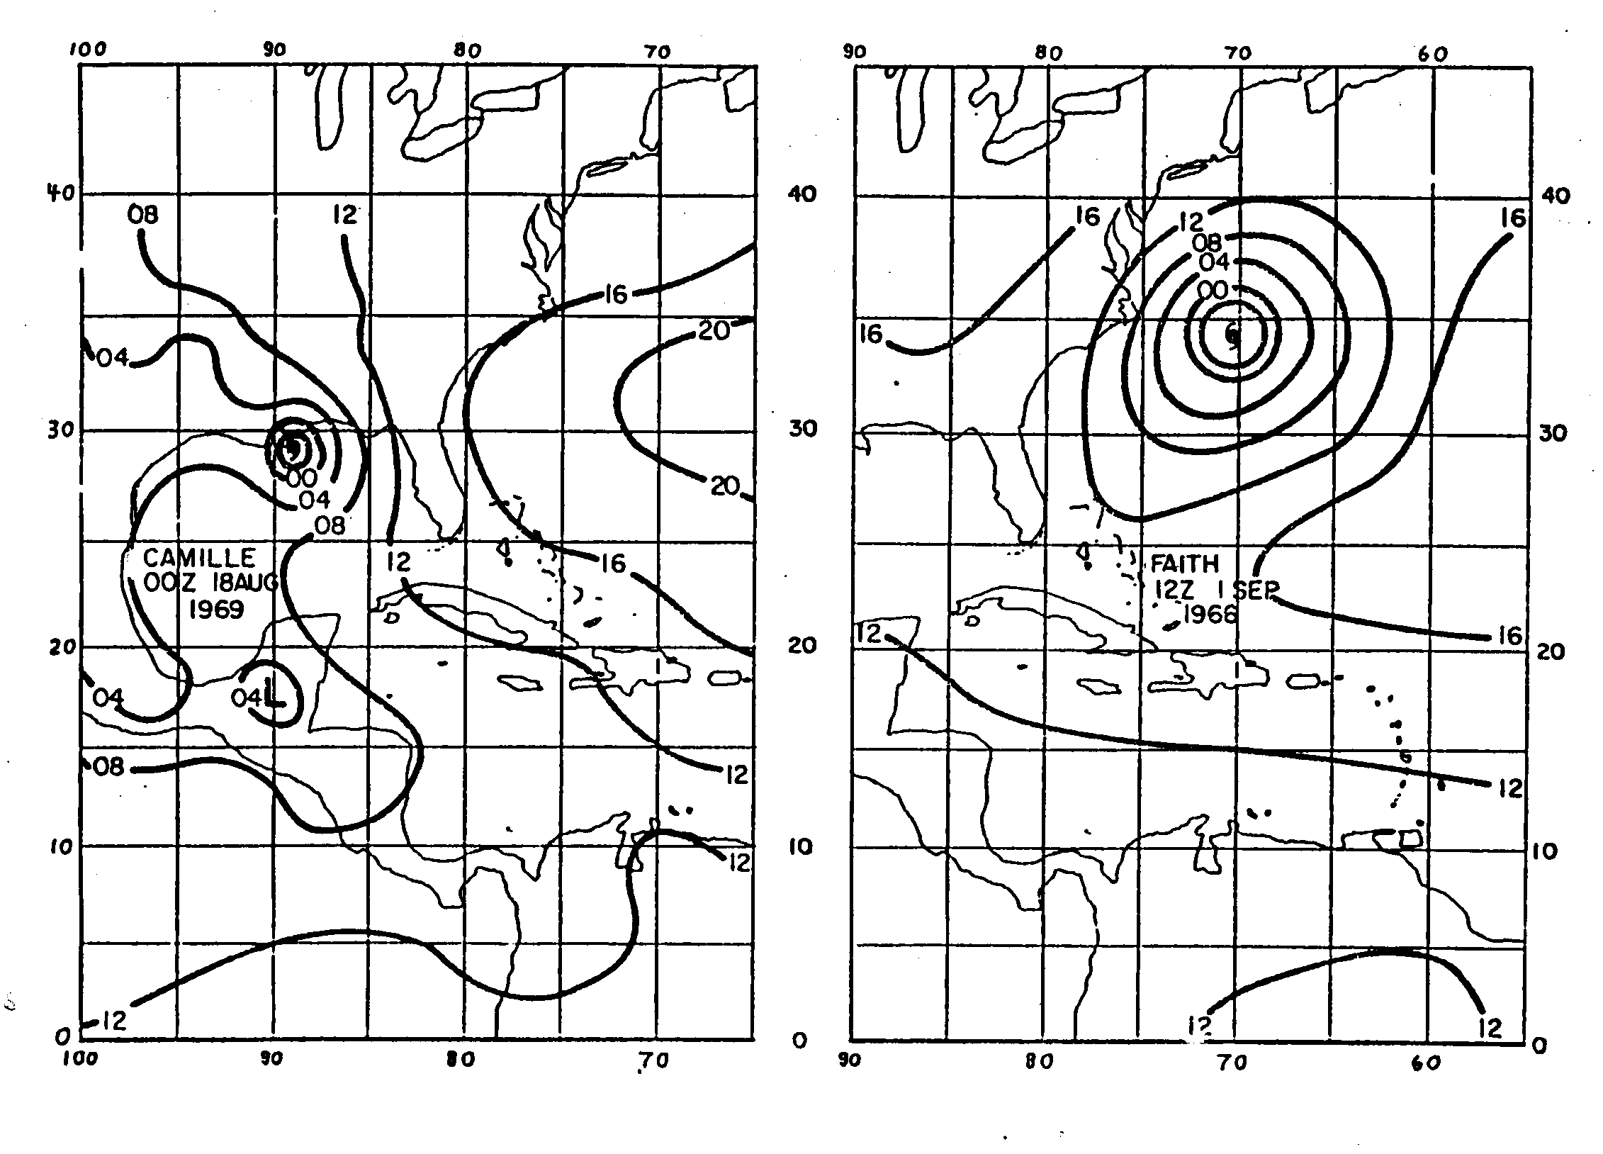

Slide 31
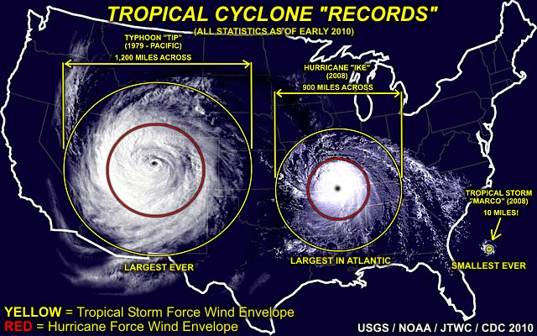
Note: Ike’s record was broken by Hurricane Sandy of 2012

Slide 32
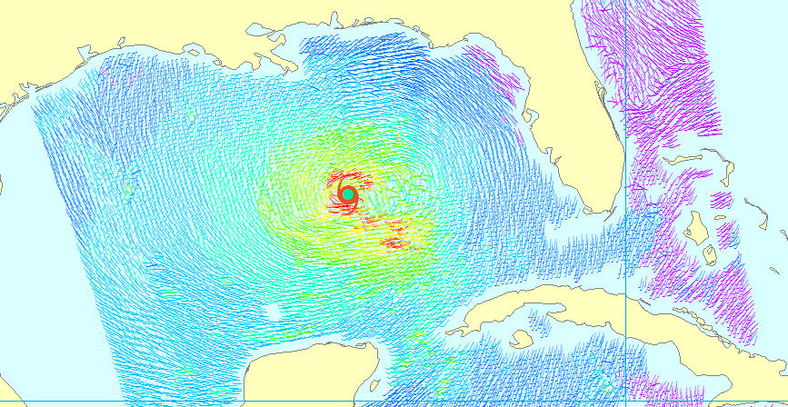
Climatology of Tropical Cyclone Size

Slide 33
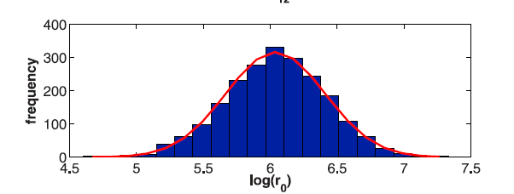
Outer radius very nearly follows a log-normal distribution with a median value of about 420 km (Courtesy Dan Chavas)

Slide 34
Global Tropical Cyclone Frequency, 1980-2019
Data Sources: NOAA/TPC and NAVY/JTWC
Notes:
34

Slide 35
TC Trends

Slide 36
Time series of the latitudes at which tropical cyclones reach maximum intensity.
From Kossin et al. (2014)

Slide 37
Satellite-derived proportion of major hurricane fixes
Time series of fractional proportion of global major hurricane estimates to all hurricane estimates for the period 1979–2017. Each point, except the earliest, represents the data in a sequence of 3-y periods. The first data point is based on only 2 y (1979 and 1981) to avoid the years with no eastern hemisphere coverage. The linear Theil−Sen trend (black line) is significant at the 98% confidence level (Mann−Kendall P value = 0.02). The proportion increases by 25% in the 39-y period (about 6% per decade).
Kossin et al., PNAS, 2020

Slide 38
Pushing Back the Record of Tropical Cyclone Activity:
Paleotempestology
Notes:
38

Slide 39
Paleotempestology
barrier beach
upland
overwash fan
backbarrier marsh
a)
lagoon
barrier beach
upland
overwash fan
b)
backbarrier marsh
lagoon
terminal lobes
flood tidal delta
Source: Jeff Donnelly, WHOI
Notes:
39

Slide 40
Source: Jeff Donnelly, Jon Woodruff, Phil Lane; WHOI
Notes:
40

Slide 41
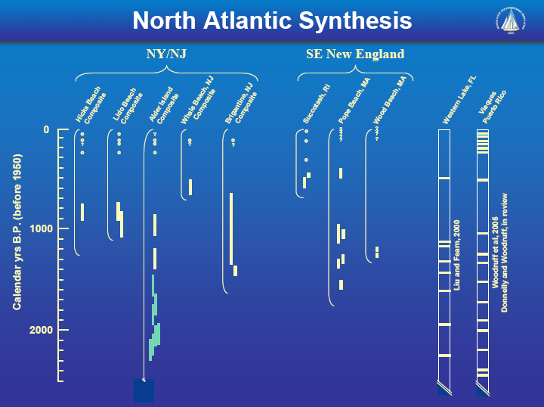
Source: Jeff Donnelly, Jon Woodruff, Phil Lane; WHOI
Notes:
41

Slide 42
Jeffrey P. Donnelly and Jonathan D. Woodruff, Nature, 2007

Slide 43
Hurricanes and Society

Slide 44
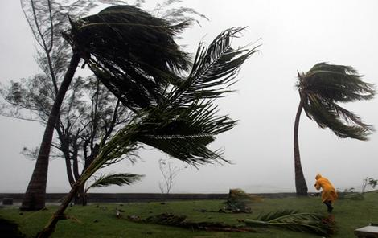
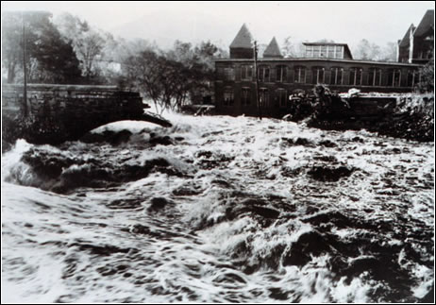
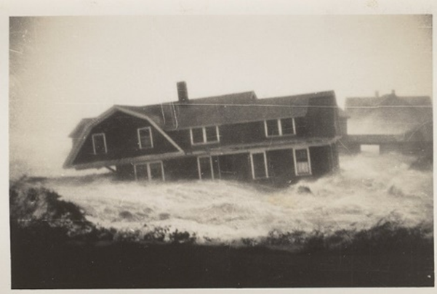

Hurricane Risks:
Wind
Rain
Storm Surge

Slide 45


Slide 46
The Global Hurricane Hazard
About 15,000 deaths per year since 1971
$ 1.1 trillion 2015 U.S. dollars in damages ($21 billion/yr) since 1971
Global population exposed to hurricane hazards has tripled since 1970
EM-DAT, 2020: The OFDA/CRED International Disaster Database
http://www.emdat.be/.

Slide 47

Publicly
insured…
No $$$
Privately insured… $$$

Slide 48

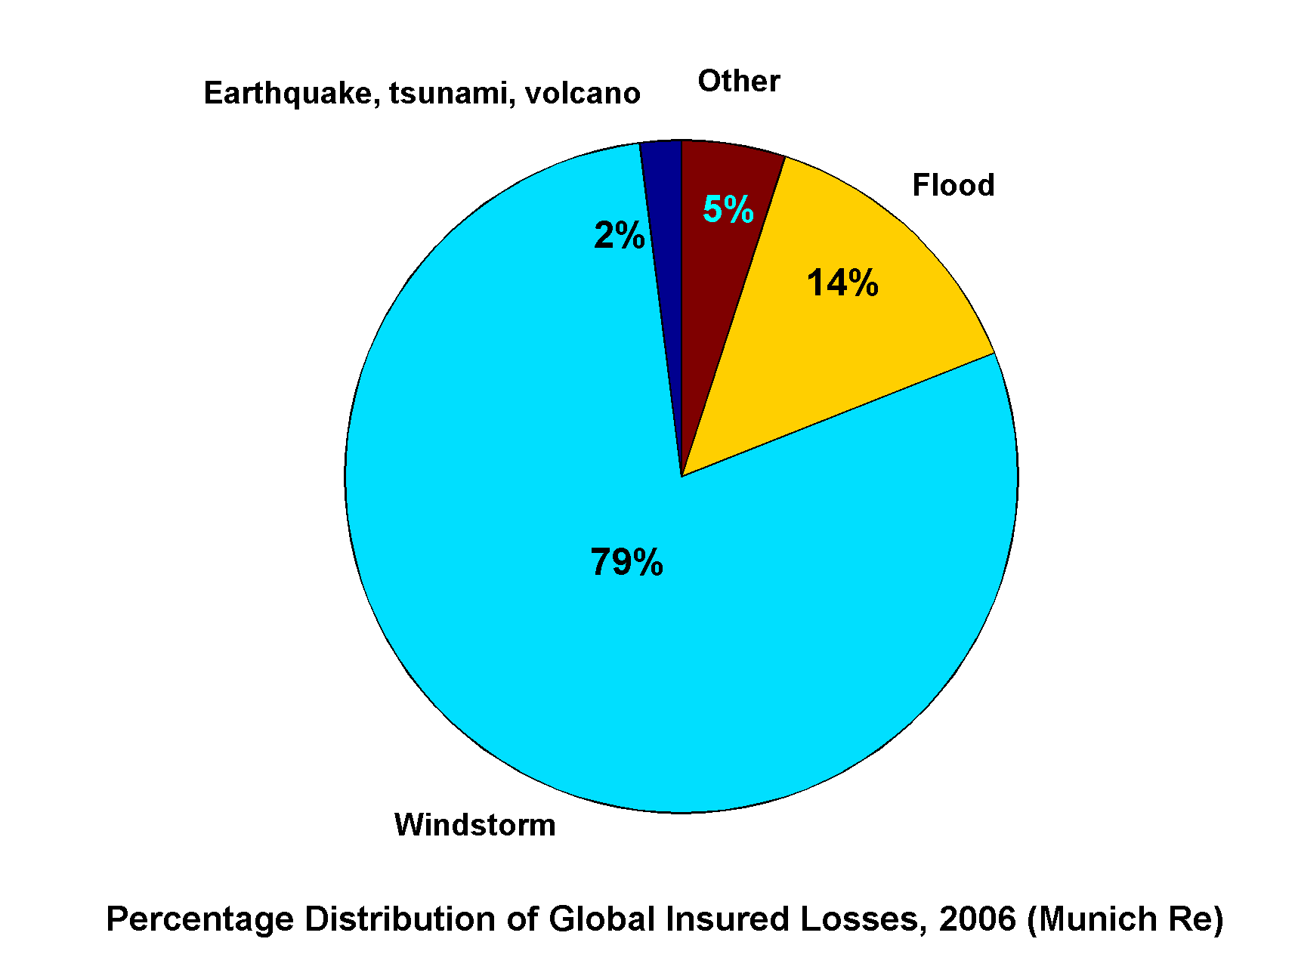
Windstorms Account for Bulk of Insured Losses Worldwide

Slide 49
Global Tropical Cyclone Damage Normalized by Gross World Product
380% increase since 1970
Population of TC-prone regions increased by ~200%
Suggests that climate change has contributed to increasing damage
EM-DAT, 2020: The OFDA/CRED International Disaster Database
http://www.emdat.be/.

Slide 50
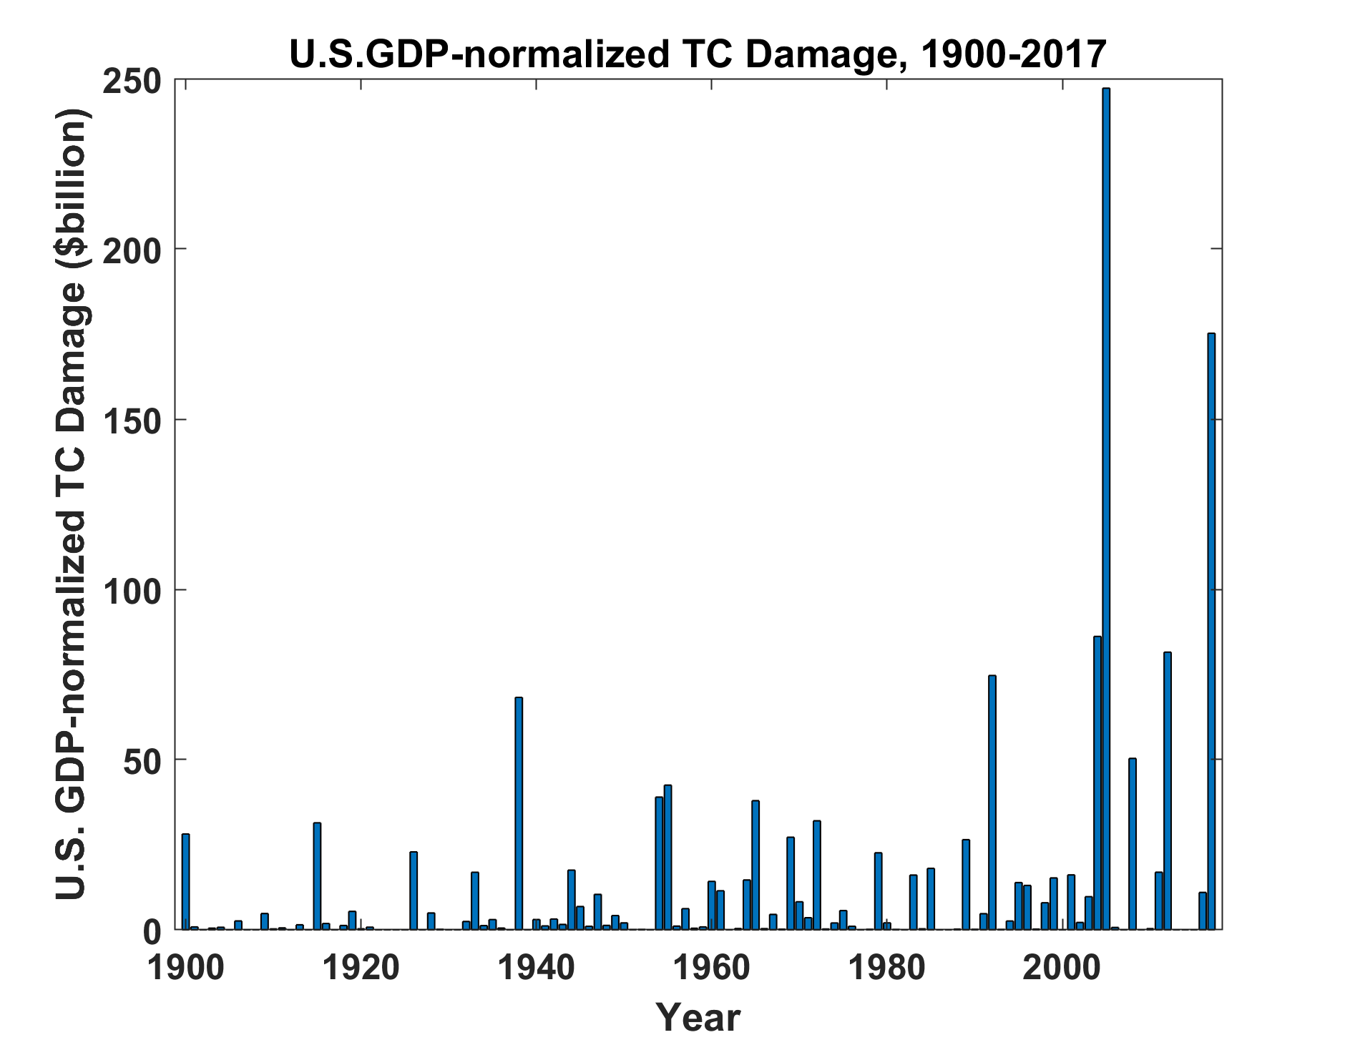
Source: ICAT Damage Estimator, http://www.icatdamageestimator.com/
GDP data from https://www.measuringworth.com/datasets/usgdp/

Slide 51
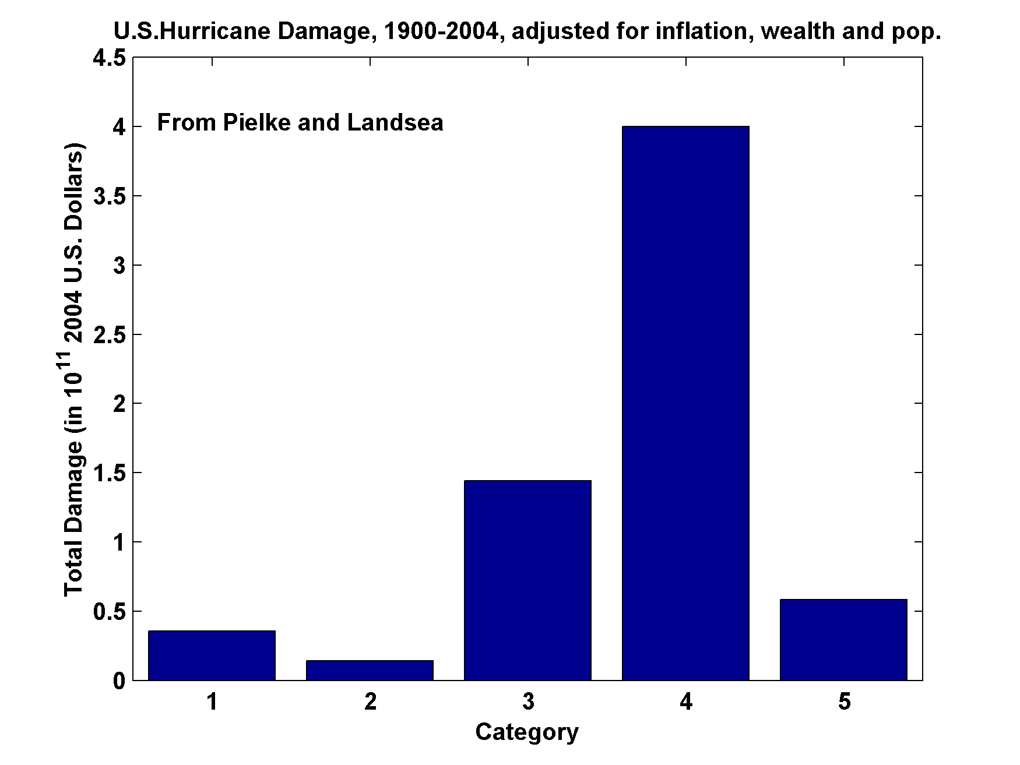
U.S. Hurricane Damage, 1900-2004,Adjusted for Inflation, Wealth, and Population

Slide 52
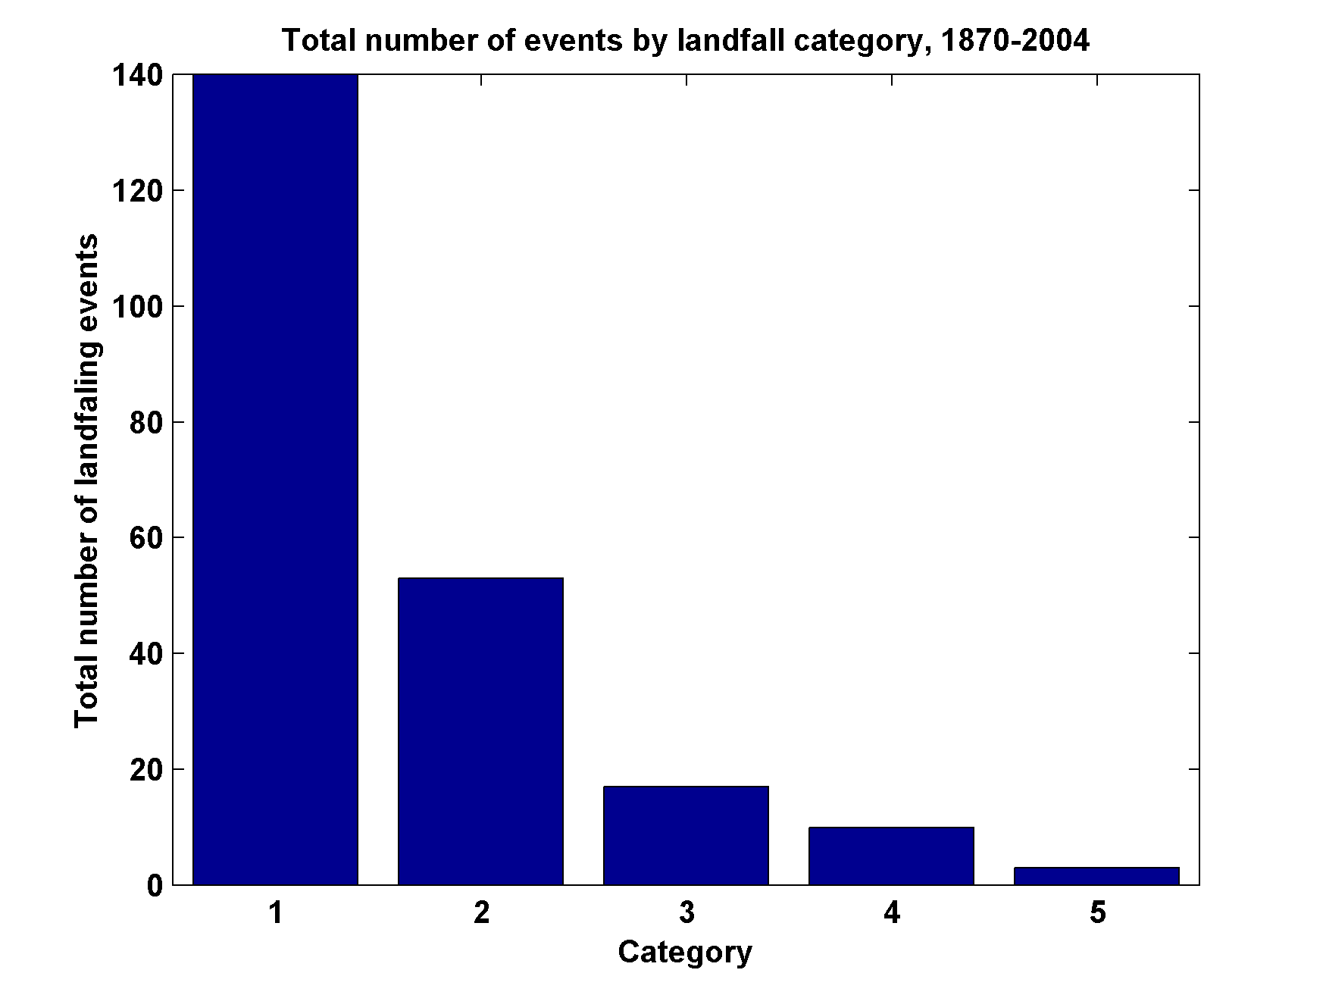
Total Number of Landfall Events, by Category, 1870-2004

