Slide 1

Physics-based downscaling of evolving hurricane risk
Kerry Emanuel
Lorenz Center
Massachusetts Institute of Technology

Slide 2

Advantages of physics-based approach:
Valid in arbitrary climate states
Can produce statistically robust risk estimates of rare events

Slide 3
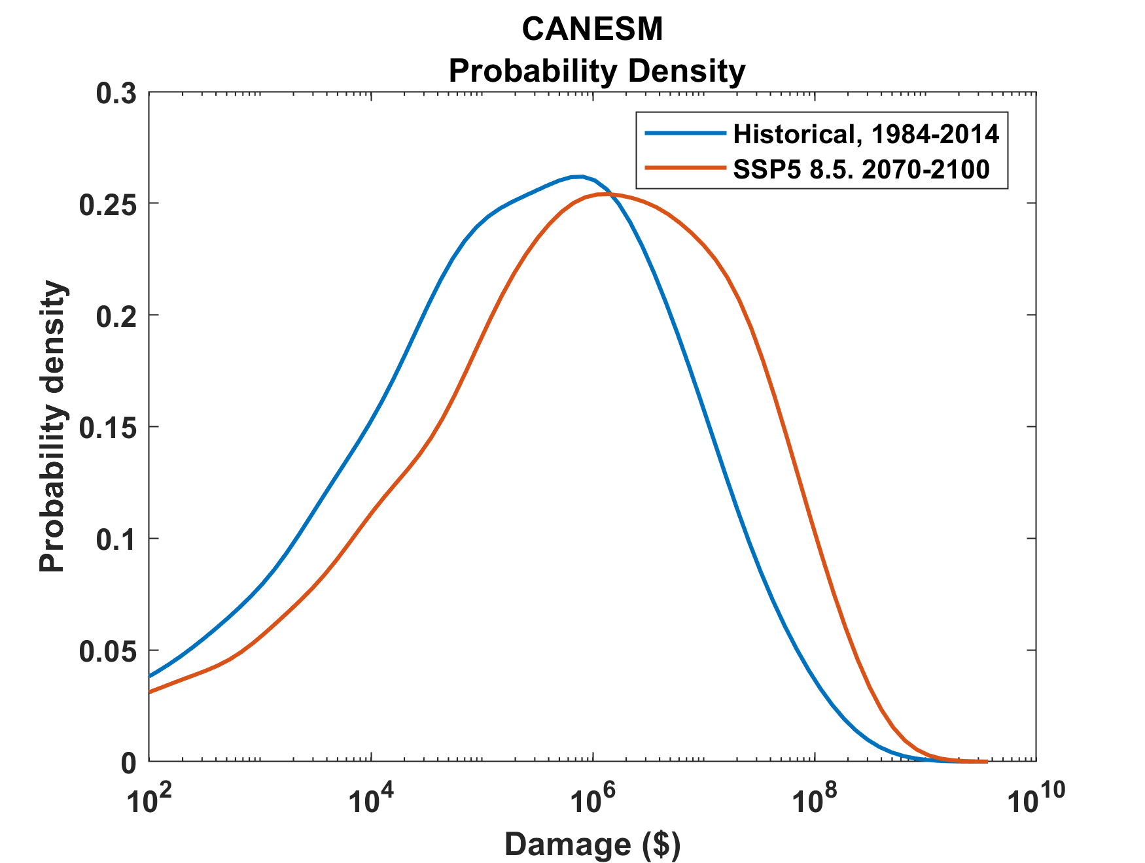
Example:
Tropical Cyclone Risk Arises Largely from High Intensity Events
1984-2014
2070-2100
Probability
Probability density of annual damage to a portfolio of insured property in the U.S.

Slide 4
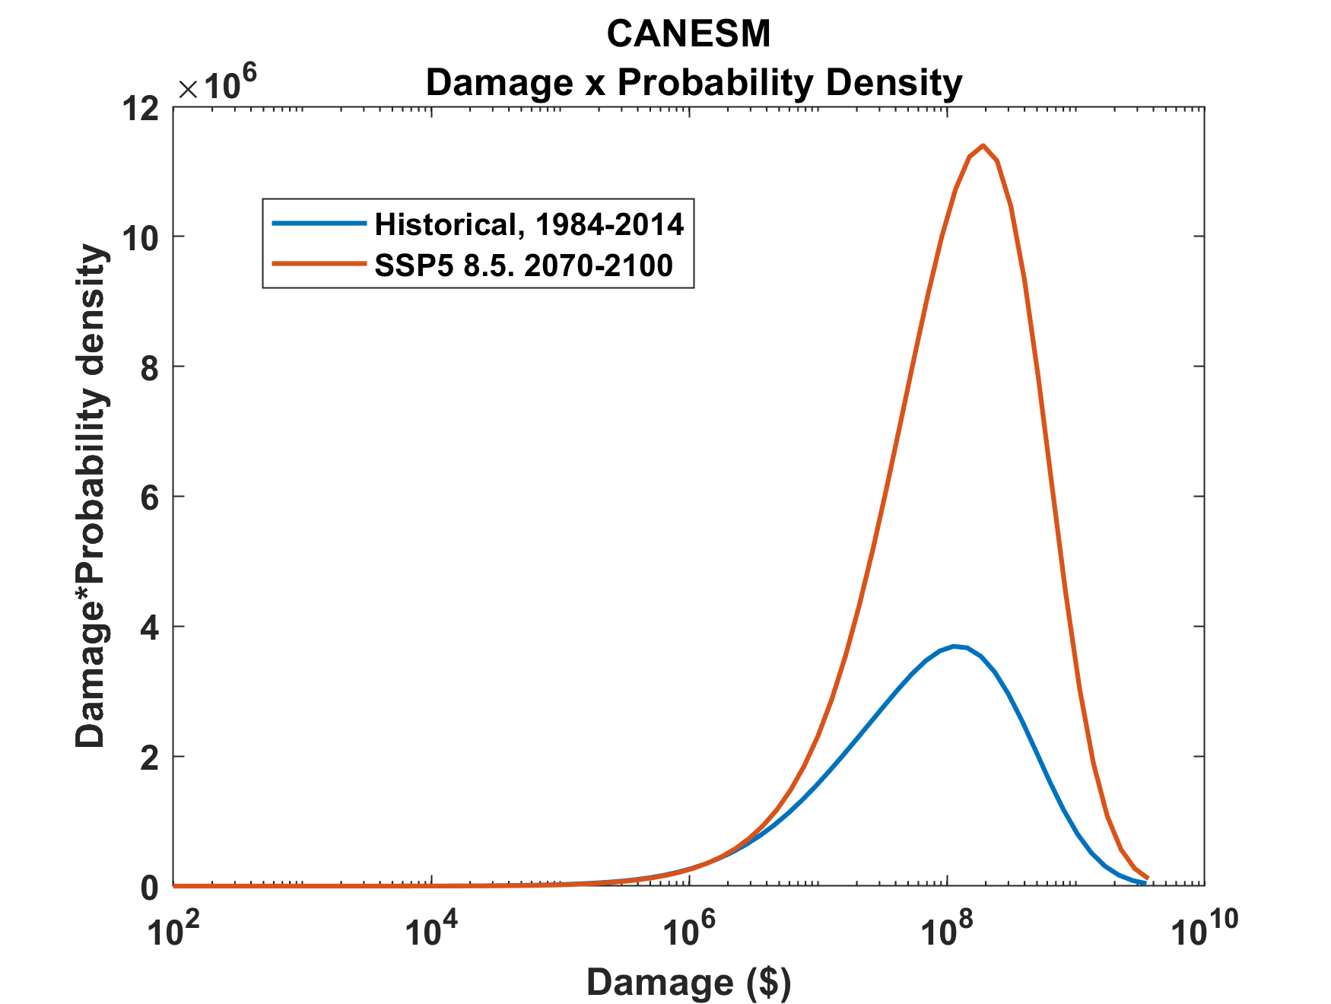
Tropical Cyclone Risk Arises Largely from High Intensity Events
2070-2100
Total expected damage proportional to area under curves
Risk
1984-2014
Damage times probability density of annual damage to a portfolio of insured property in the U.S.

Slide 5
MIT Synthetic Hurricanes
Embed high-resolution, fast coupled ocean-atmosphere hurricane model in global climate model or climate reanalysis data
Coupled Hurricane Intensity prediction Model (CHIPS) has been used for 16 years to forecast real hurricanes in near-real time

Slide 6
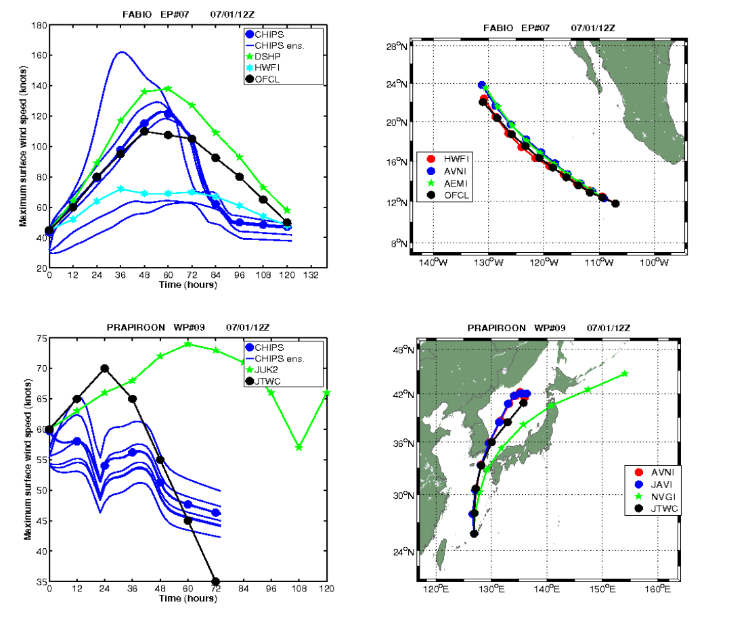
Real-time forecasts at http://wind.mit.edu/~emanuel/storm.html

Slide 7
How Can We Use This Model to Help Assess Hurricane Risk in Current and Future Climates?

Slide 8
Risk Assessment Approach:
Step 1: Seed each ocean basin with a very large number of weak, randomly located cyclones
Step 2: Cyclones are assumed to move with the large scale atmospheric flow in which they are embedded, plus a correction for the earth’s rotation and sphericity
Step 3: Run the CHIPS model for each cyclone, and note how many achieve at least tropical storm strength
Step 4: Using the small fraction of surviving events, determine storm statistics. Can easily generate 100,000 events
Details: Emanuel et al., Bull. Amer. Meteor. Soc, 2008
Notes:
8

Slide 9
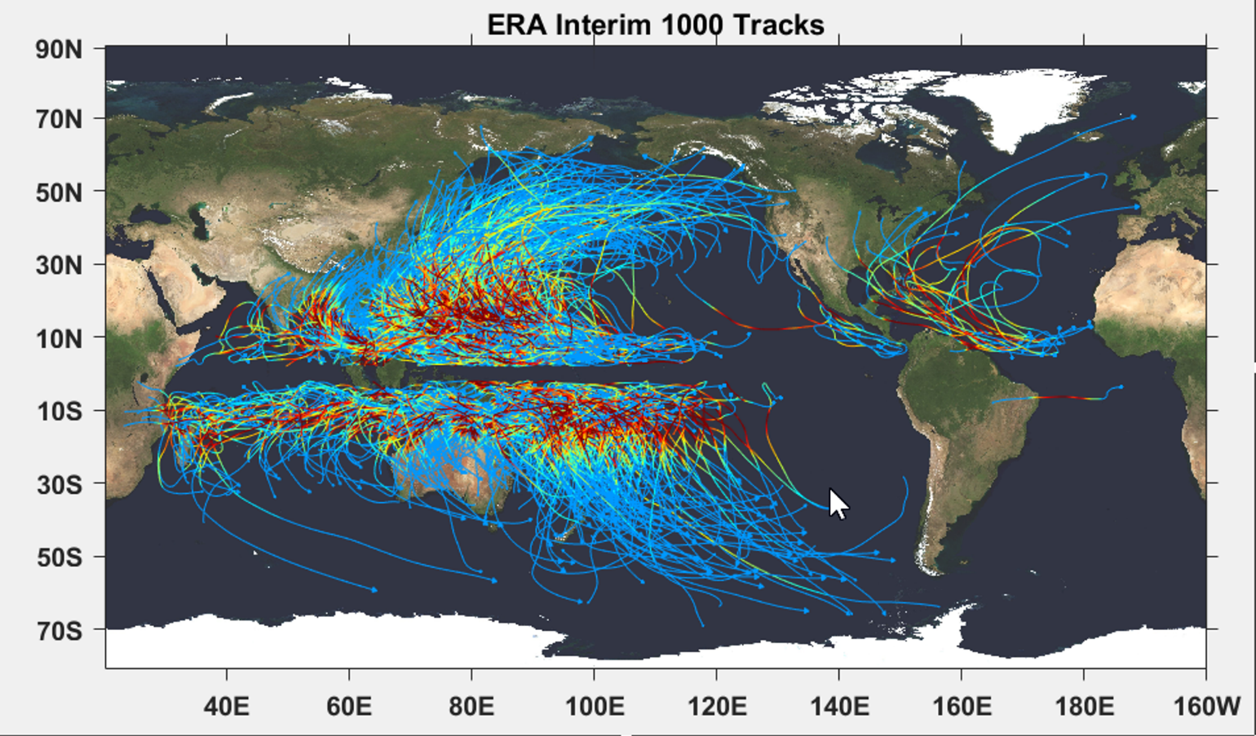

Slide 10
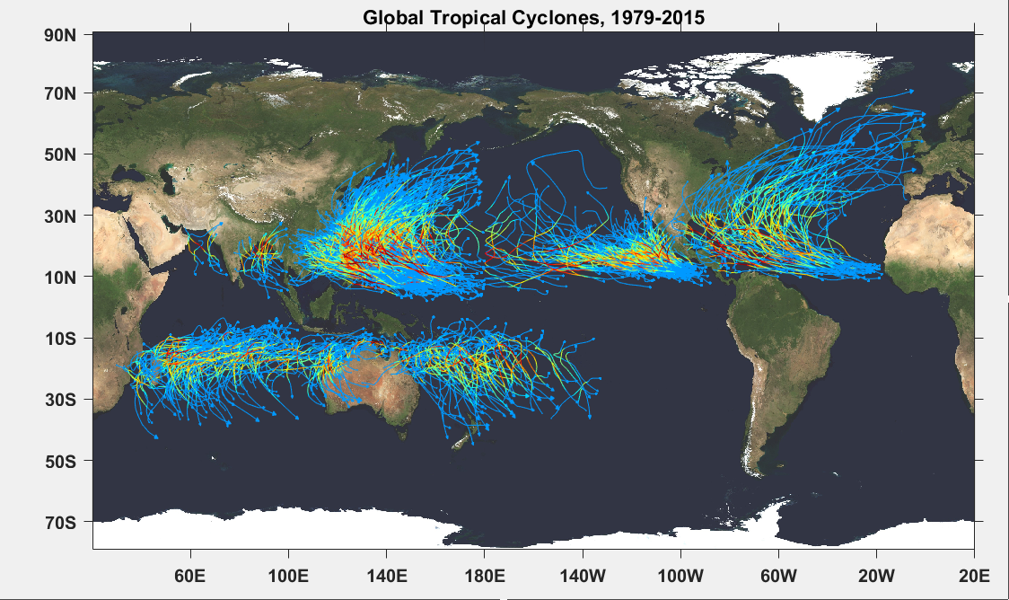

Slide 11
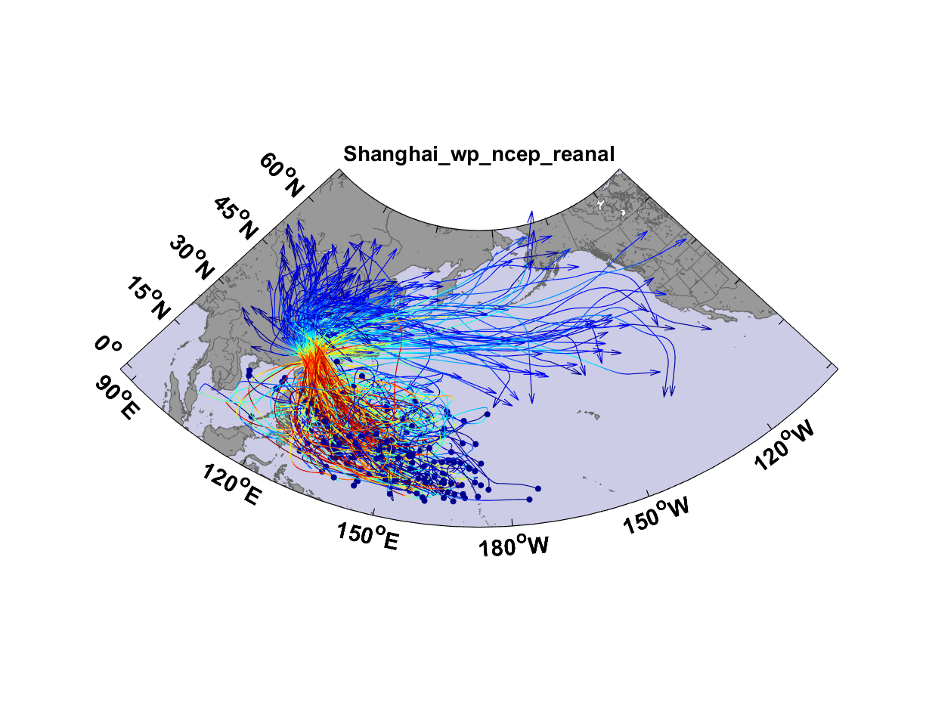
Top 200 out of 5180 TCs Affecting Shanghai

Slide 12
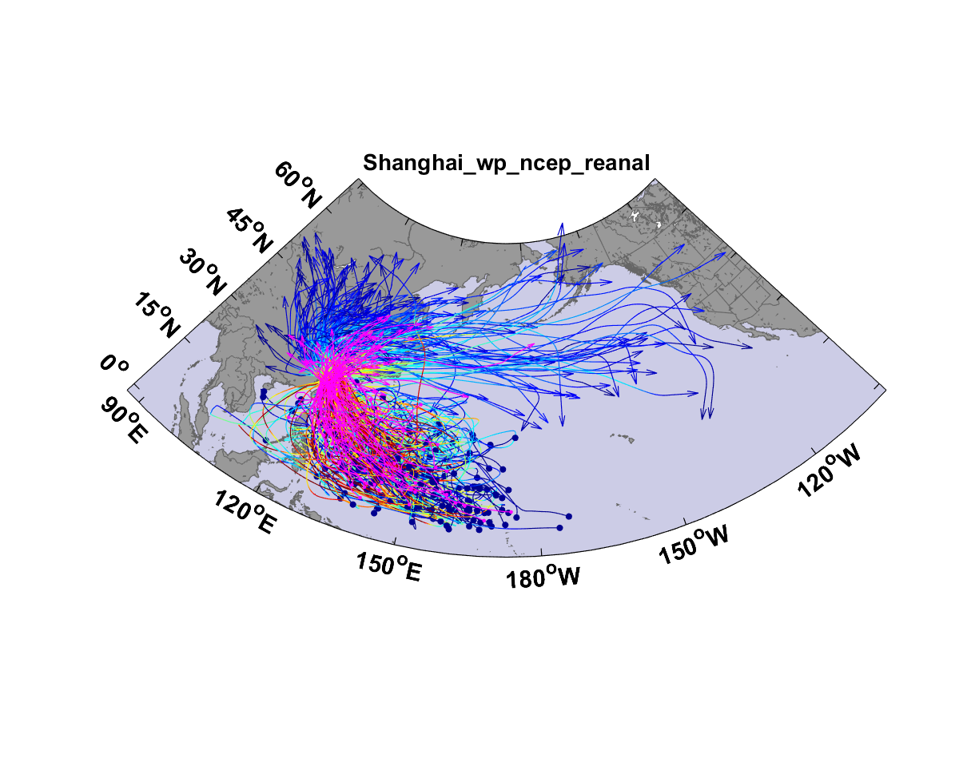
Top 200 out of 5180 TCs Affecting Shanghai

Slide 13

Return Periods

Slide 14
Accumulated Rainfall (mm)

Slide 15
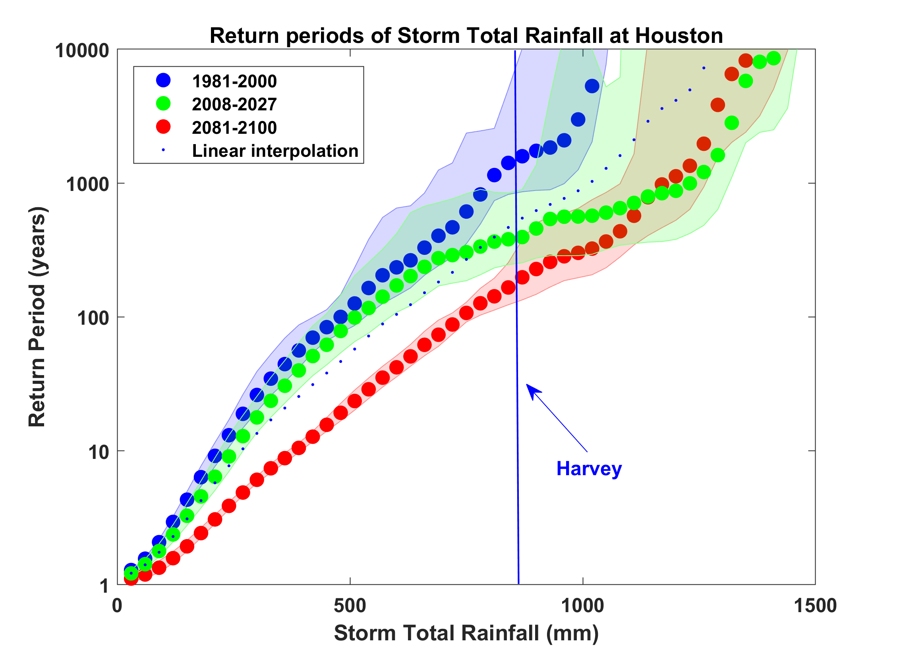
Probability of Storm Accumulated Rainfall in Harris County, from 6 Climate models, 1981-2000, 2008-2027, and 2081-2100, Based on 2000 Events Each, and Using RCP 8.5. Shading Shows Spread Among the Models.

Slide 16
Summary
History is too short and imperfect to estimate long-term hurricane risk
We should bring physics to bear on estimating hurricane risk, not just in the future but now
Hurricanes clearly vary with climate and climate change has already invalidated historically based statistical risk estimates in many places

