Slide 1
A Subtropical Cyclonic Gyre of Midlatitude Origin
John Molinari and David Vollaro

Slide 2
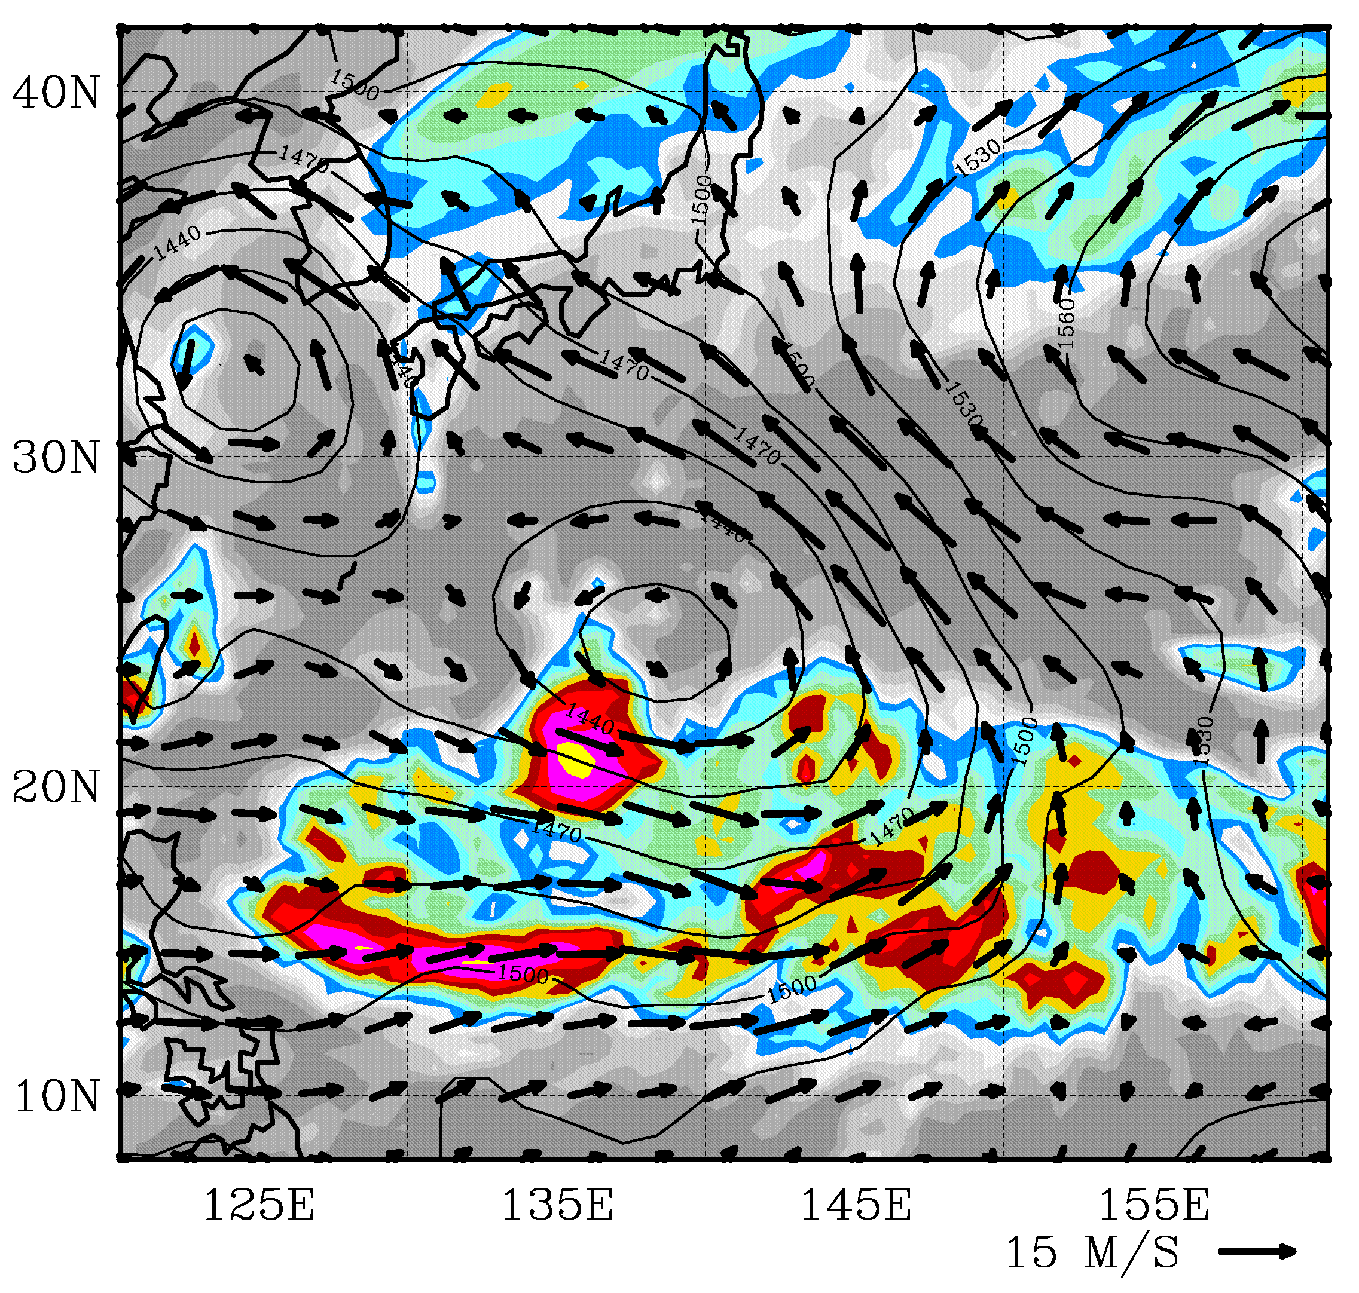
L
L
Infrared brightness temperature (shaded) and 850 hPa winds and height (contoured) at 0000 UTC 27 July 1988.

Slide 3
29
RMW = 700-800 km in gyre
28
27
Gloria
Azimuthally-averaged circulation in the gyre, averaged during 27 (light black), 28 (blue), and 29 (red) July. Also shown is the same field for Hurricane Gloria (1985), available only to r = 1200 km.

Slide 4
Questions
Where did the gyre come from and how did it form?
Why is it so large and so asymmetric?
What is the significance of such disturbances in the northwest Pacific in boreal summer?

Slide 5
Large-scale environment before gyre formation
Formation of the gyre
Structure of the mature gyre
Applications to meteorology of the subtropics

Slide 6
Meridional wind Hovmöller diagram at 200 hPa from mid-June to mid-August 1988. Values are averaged from 30-40N. Warm colors represent southerlies and cool colors northerlies. Shading begins at 3 ms⁻¹ in increments of 6 ms⁻¹.

Slide 7
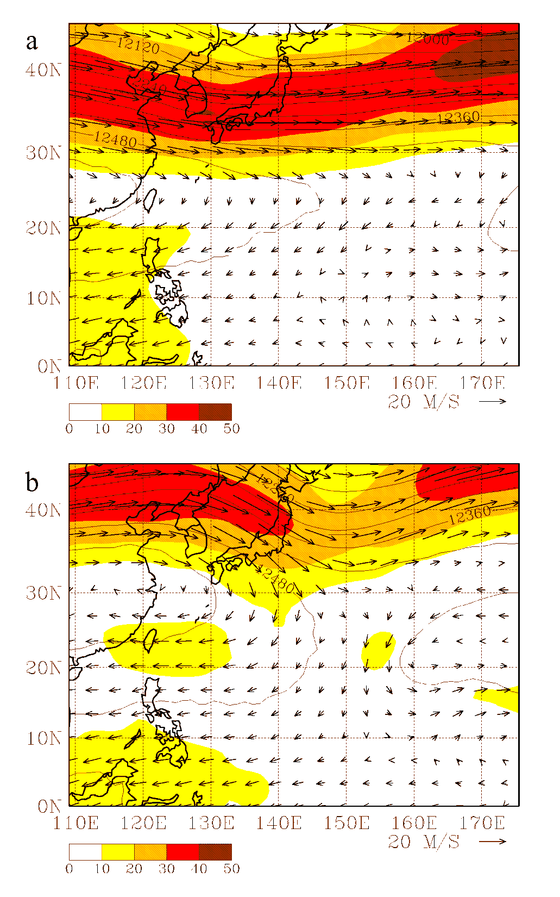
Mean wind (vectors), wind speed (shading), and height (contours, in m) at the 200 hPa level, averaged from (a) 6-30 June and (b) 1-25 July 1988. Shading begins at 10 m s⁻¹ in increments of 10 m s⁻¹.

Slide 8
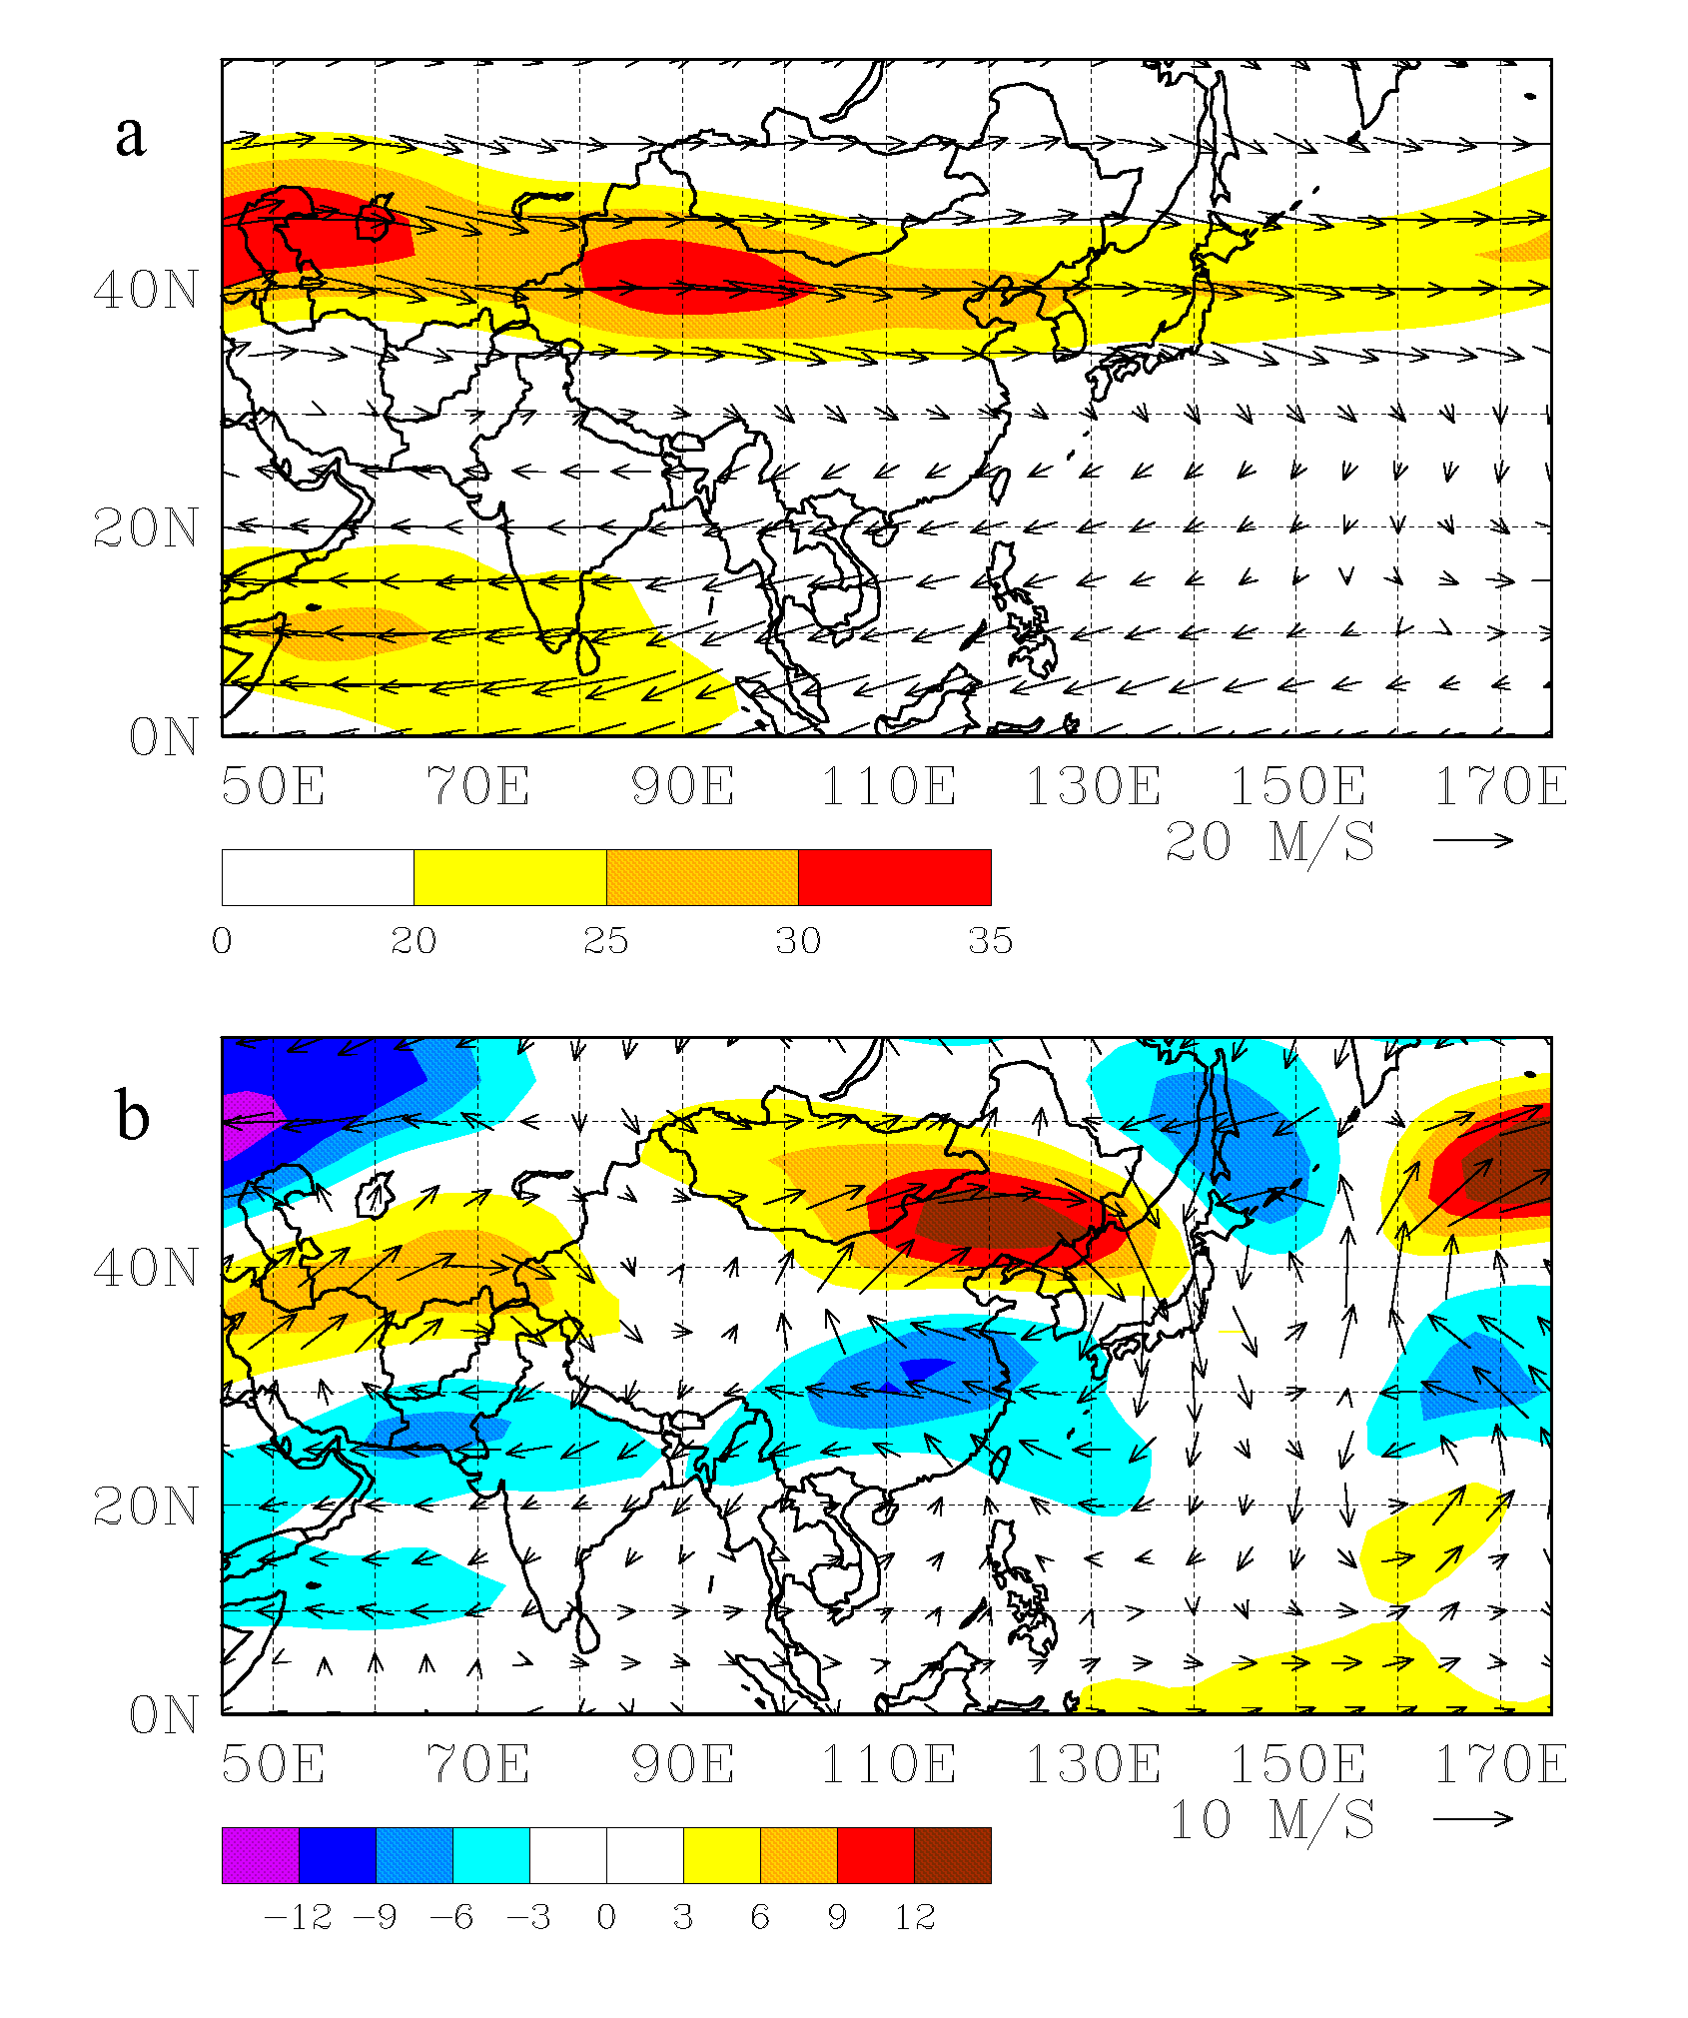
(a) Climatological mean 200 hPa wind vectors and wind speed (increment 5 m s⁻¹, shaded beginning at 20 m s⁻¹) for 1-25 July from 1968 to 1996. (b) Wind anomalies for 1-25 July 1988 (vectors) and zonal wind anomalies (shaded; increment 3 m s⁻¹).

Slide 9
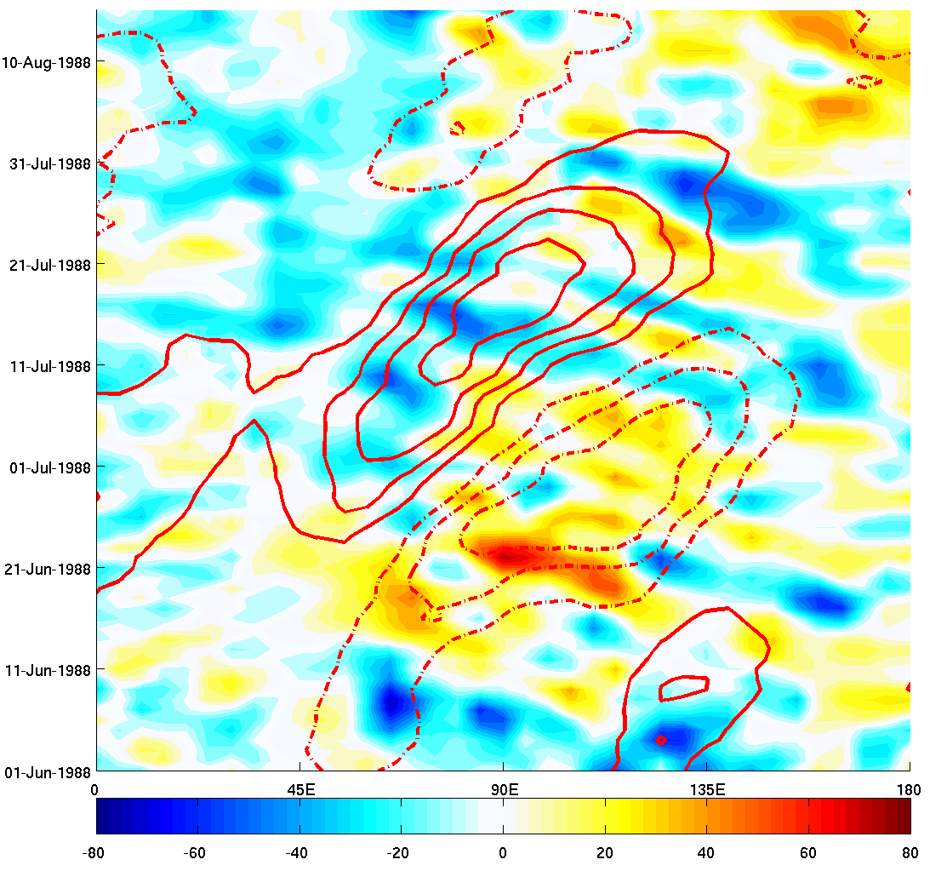
*
Longitude-time diagram of OLR (shaded; cool colors represent active convection) and MJO-filtered OLR (red contours; solid represent active MJO, dashed inactive). OLR is unfiltered except for removal of the seasonal cycle

Slide 10
Velocity potential (contours; increment 2 X 10⁶ m² s⁻¹) and divergent part of the wind (vectors), both at 200 hPa, and infrared brightness temperature (K; shaded as in Fig 1), all averaged from 1-25 July 1988. The magenta contour represents the 30 m s⁻¹ value of the mean 200 hPa wind speed.

Slide 11
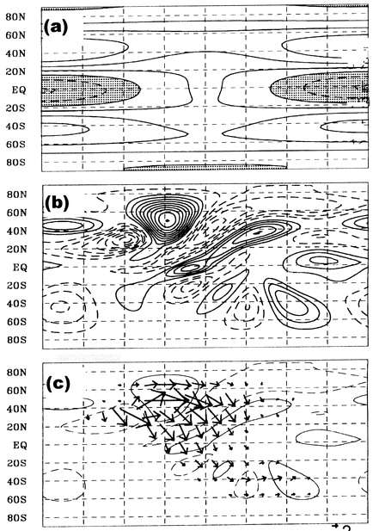
Fig. 1 from Takaya and Nakamura (2001) showing the equatorward turning of a Rossby wave packet from a middle latitude jet exit region. A Rossby wave source was placed in the upstream jet. Panels (b) and (c) show the solution after two weeks of integration.
zonal wind
Ψ’
wave activity flux with ψ

Slide 12
Summary of large-scale prior to the gyre formation
Active MJO over the Indian Ocean
Divergent flow from that convection builds a westerly jet over Asia with a jet exit region near 145°E
This favors equatorward turning of Rossby wave packets
NEXT: How does the gyre form?

Slide 13
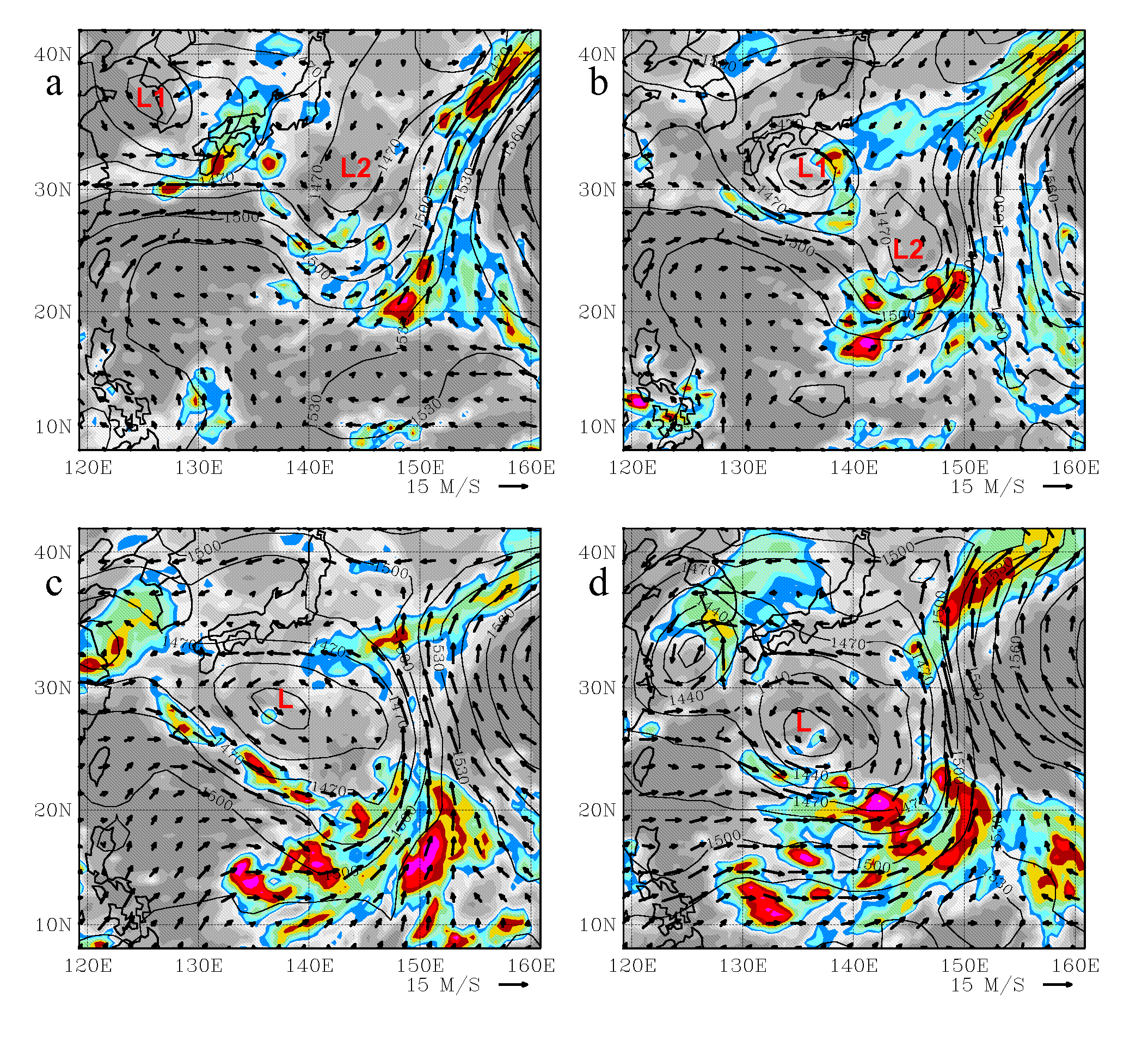
Gyre formation
Wind vectors at 850 hPa and infrared brightness (CLAUS) at 0000 UTC (a) 23 July; (b) 24 July; (c) 25 July; and (d) 26 July 1988.

Slide 14
L
L
Same, but for 27 July. This feature lasts 2.5 days, with continued strongly asymmetric structure.

Slide 15
Formation of the gyre
Repeated anticyclonic wave breaking along 150°E, the longitude of the jet exit region aloft
Multiple midlatitude lows move equatorward behind the mean trough
Merger of two lows creates a single large cyclonic gyre
All the forcing for this low seems to come from middle latitudes
NEXT: Gyre structure

Slide 16
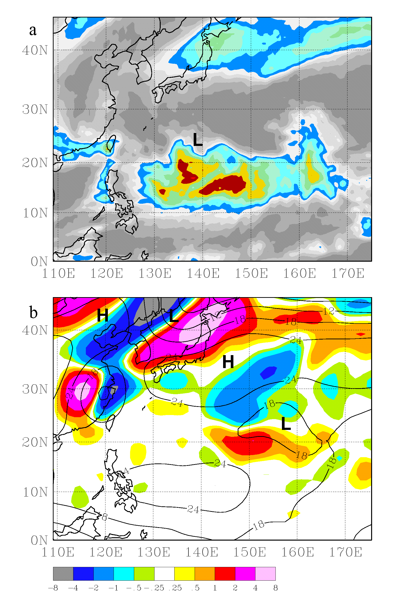
Comparison of infrared brightness temperature (top) and Q-vector convergence (bottom; warm colors indicate forcing for rising motion). Both fields are averaged from 0000 UTC 27 July – 0000 UTC 28 July.

Slide 17
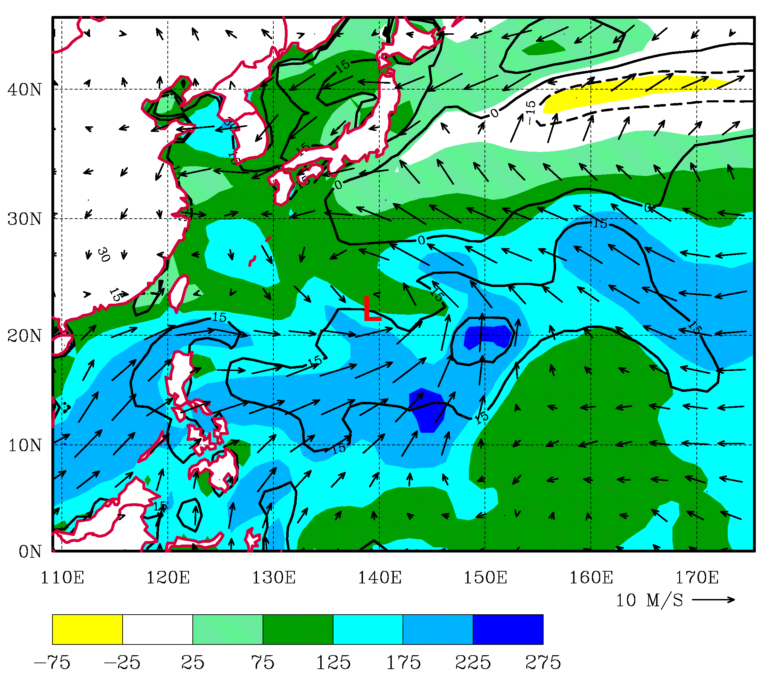
Surface latent heat flux (shaded), sensible heat flux (contoured), and surface wind vectors, all averaged between 0000 UTC 27 July and 0000 UTC 28 July.

Slide 18
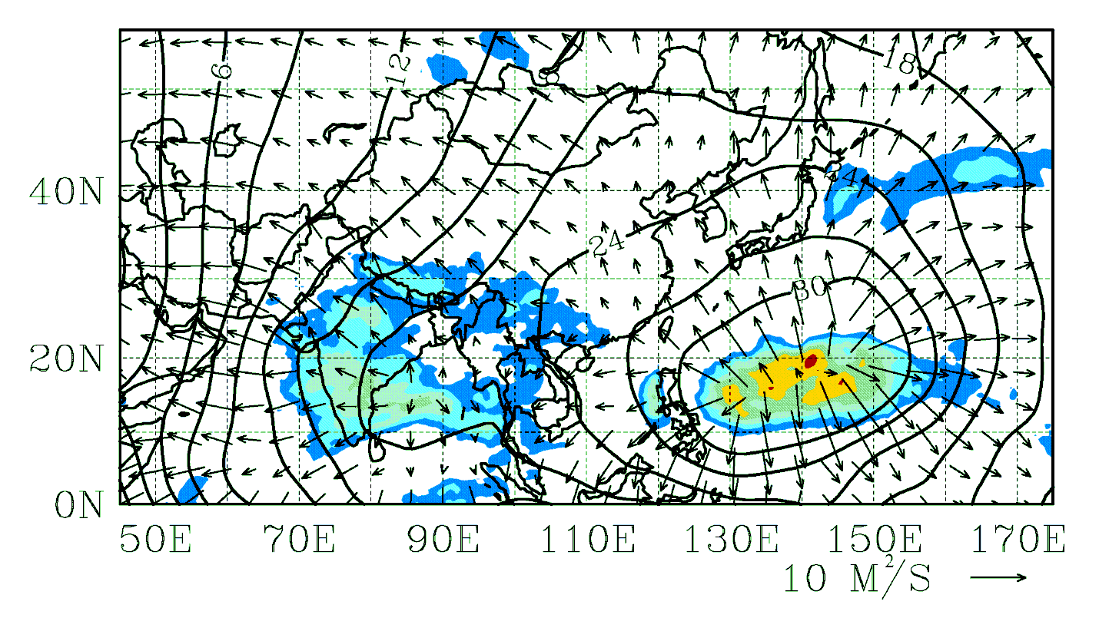
Velocity potential (contours; increment 2 X 10⁶ m² s⁻¹) and divergent part of the wind (vectors), both at 150 hPa, and infrared brightness temperature (K; shaded as in Fig 1), all averaged from 0000 UTC 26 July to 1800 UTC 29 July 1988.

Slide 19
Questions from earlier
Why was the gyre so large?
Resulted from a merger of two midlatitude lows
Why so asymmetric?
Strong convection to the south associated with large surface fluxes. These arise from very strong westerlies over warm ocean water.
Clear air to the north driven by the subsiding region in the Rossby wave packet that turned equatorward from midlatitudes.
Vertical shear from the north also favors convection south of the center

Slide 20
Like in Matthews and Kiladis (1999), MJO forcing of the gyre is indirect: MJO creates the jet and jet exit region, which encourages Rossby wave packets to turn equatorward and eventually help to drive gyre formation.
Significance of these gyres?
Four other gyres have been found in virtually the same location.
All were in July or August and all during La Niña events. All appear to have an active MJO in the Indian Ocean.

Slide 21
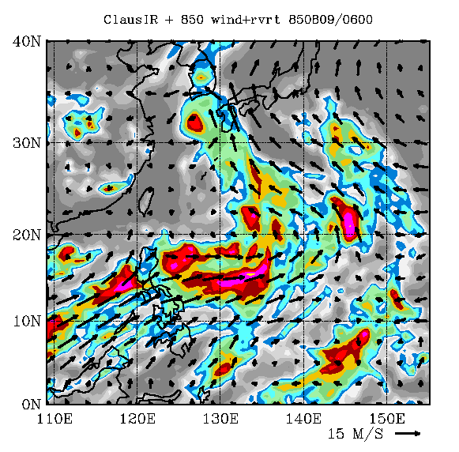
L
AUGUST 1985 GYRE

Slide 22
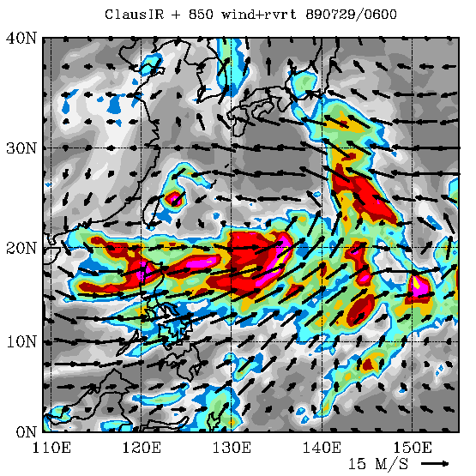
L
JULY 1989 GYRE

Slide 23
This gyre and a 1991 gyre studied previously (Lander 1994; Holland 1995; Molinari et al. 2007) are interesting, but are they important in the general subtropical weather and climate?
How common are they?
How big a role do they play in subtropical precipitation?
What percentage of tropical cyclones are associated with them?
Are they all associated with midlatitude forcing?
What happens downstream in middle latitudes?
These questions must still be answered

