Slide 1

Hurricanes and Other Storms in a Warmer World
Kerry Emanuel
Massachusetts Institute of Technology
Notes:
1

Slide 2

Program
Climate and Extreme Weather
Climate control of hurricane frequency and intensity

Slide 3
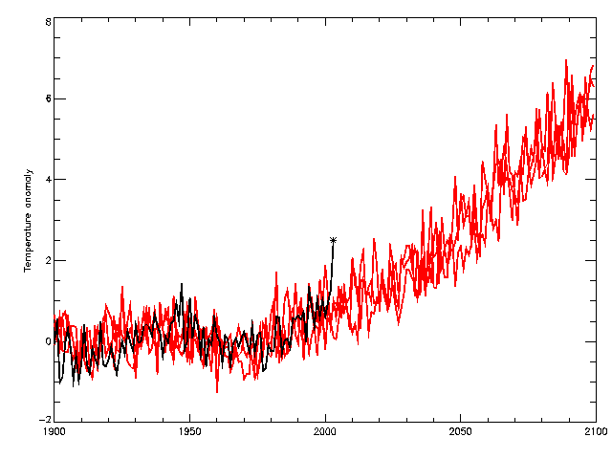
Heat Waves
2060s
observations
HadCM3 Medium-High (SRES A2)
2040s
2003
Temperature anomaly (wrt 1961-90) °C

Slide 4
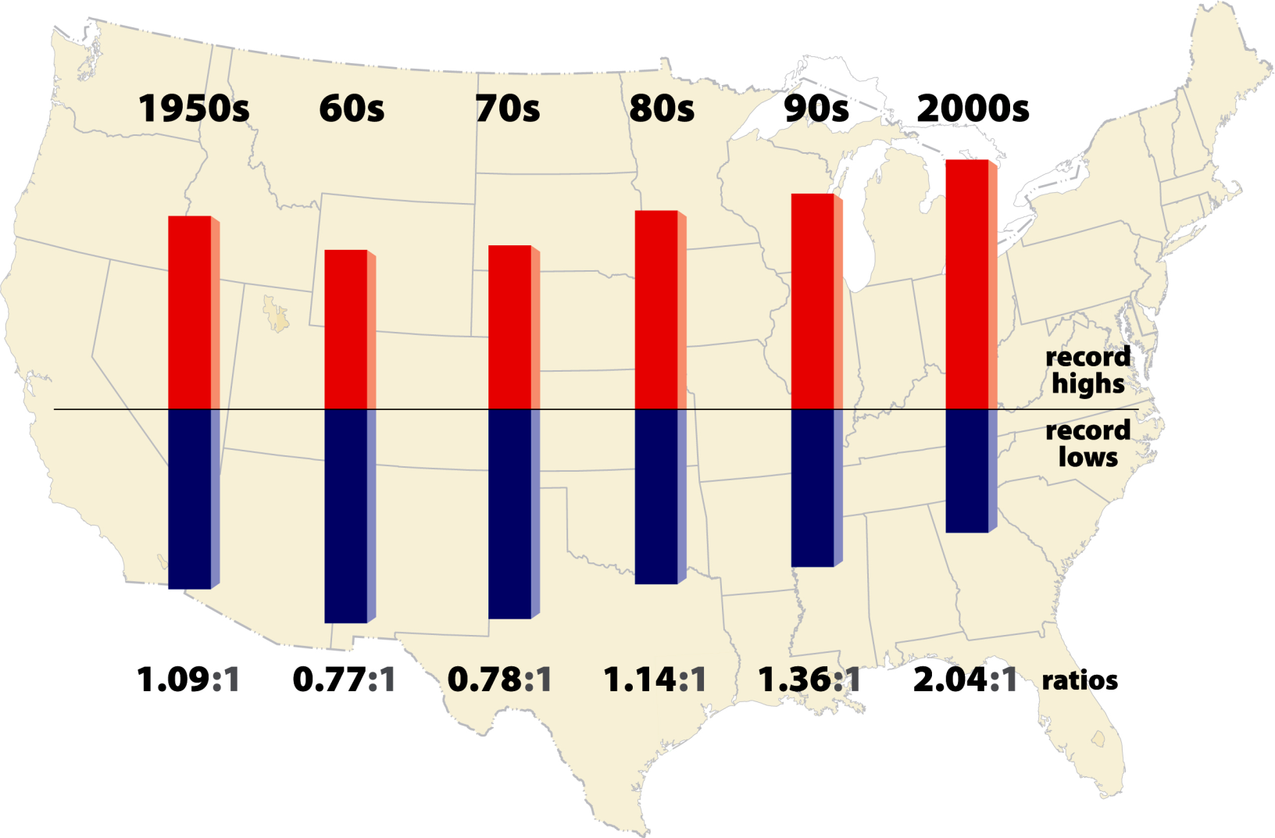
High vs Low Temperature Records
2011- 2.7:1

Slide 5
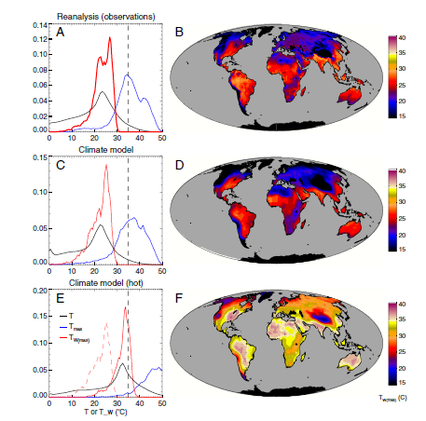
Sherwood and Huber, PNAS, 2010
Adaptation Limit:
Maximum Tolerable Wet Bulb Temperature
12º increase in mean global T

Slide 6
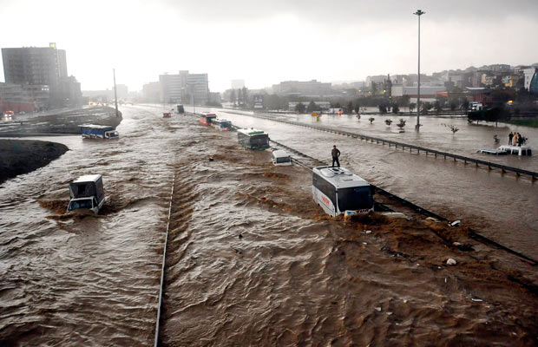
Hydrological Extremes Increase with Temperature
Floods

Slide 7
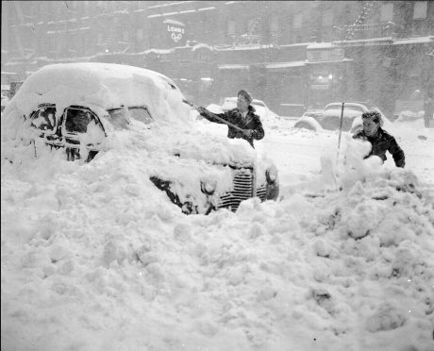
Blizzards

Slide 8

Drought

Slide 9
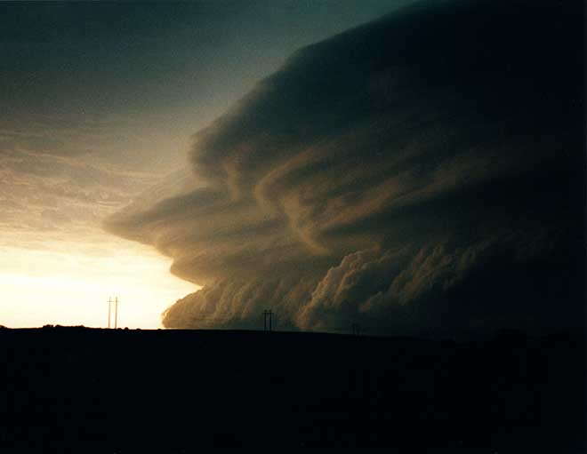
Severe Thunderstorms

Slide 10
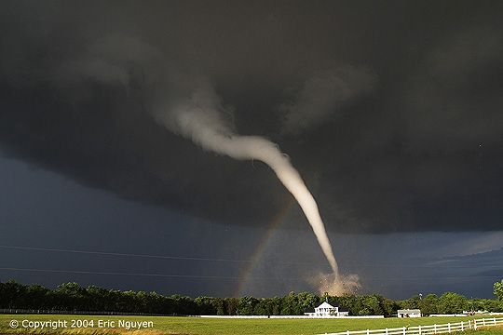
Tornadoes

Slide 11

Hail Storms

Slide 12
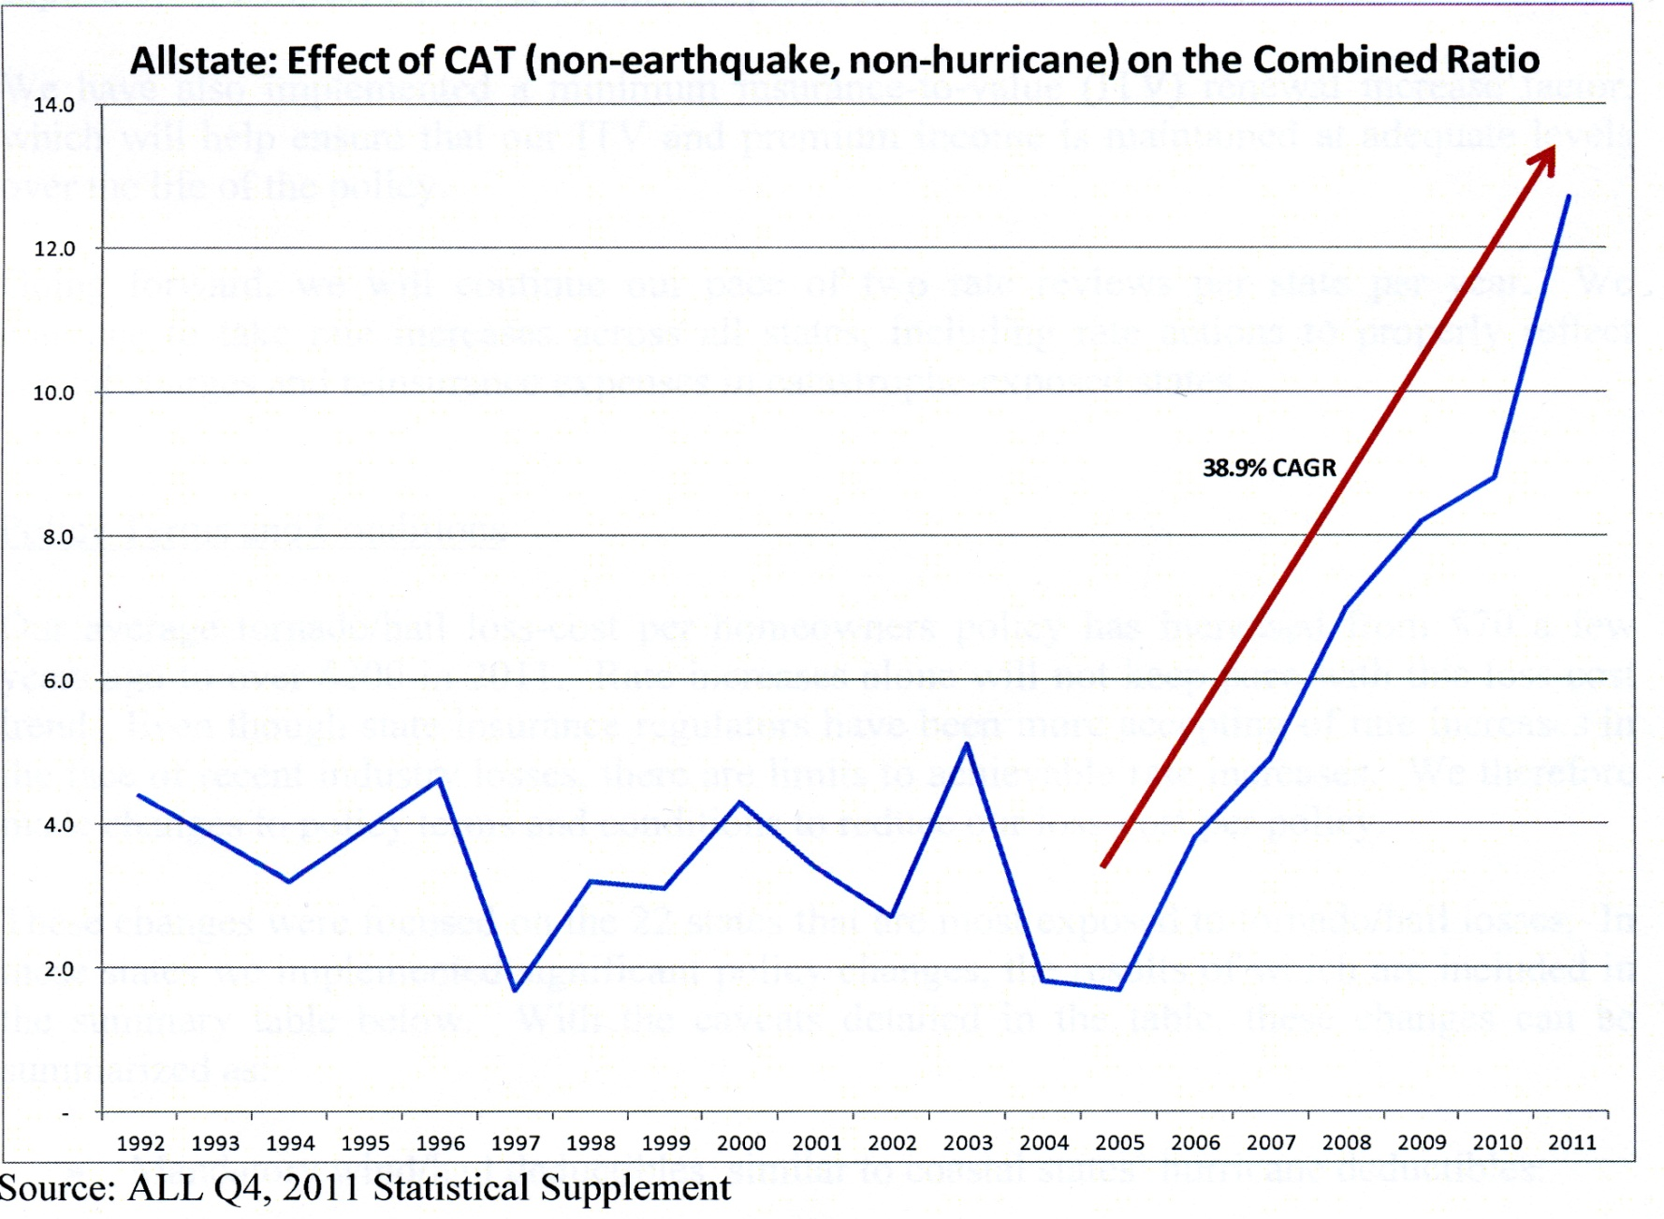
Allstate ratio of losses to premiums

Slide 13

Hurricanes

Slide 14
Intensity Theory
Potential Intensity: Maximum sustainable surface wind speed in a given thermodynamic environment (sea surface temperature and atmospheric temperature profile)

Slide 15
Annual Maximum Potential Intensity (m/s)

Slide 16
What Climate Parameters Determine the Tropical Cyclone Frequency?

Slide 17
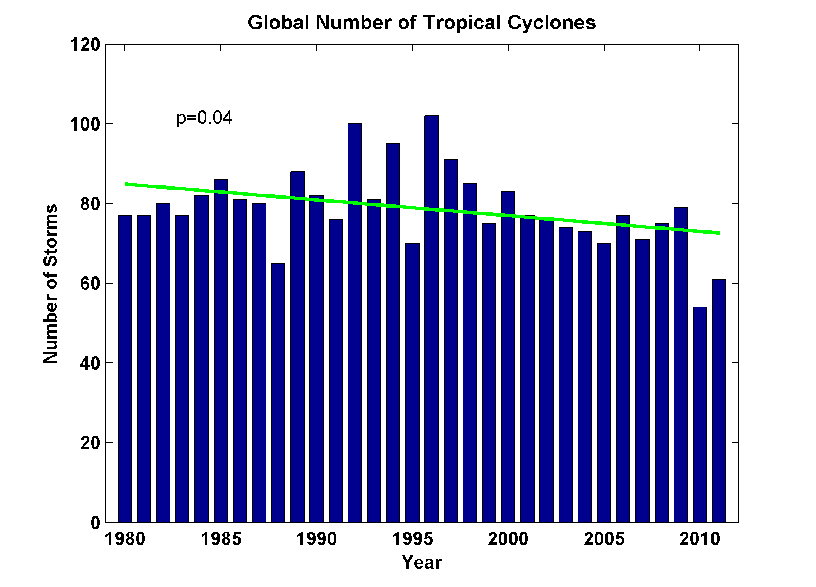
Global Tropical Cyclone Frequency, 1980-2011
2012
Data Sources: NOAA/TPC and NAVY/JTWC
Notes:
17

Slide 18
Self-Aggregation of Convection

Slide 19
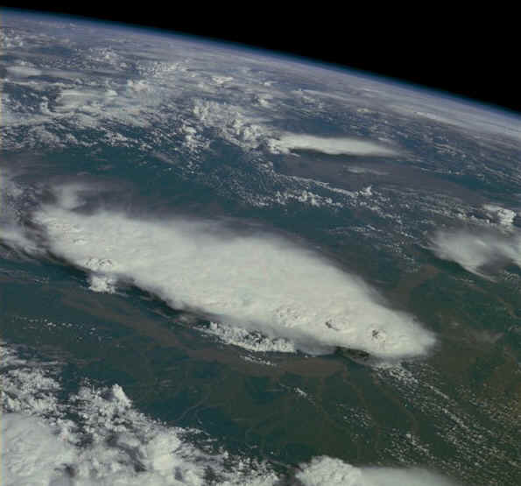
Monsoonal Thunderstorms, Bangladesh and India, July 1985

Slide 20
Inferences from Cloud-Permitting Models with Marat Khairoutdinov, SUNY Stony Brook
Doubly-periodic, radiative-convective equilibrium with specified, uniform SST
Horizontal grid spacing of 1-3 km
Pushes current computational capabilities

Slide 21
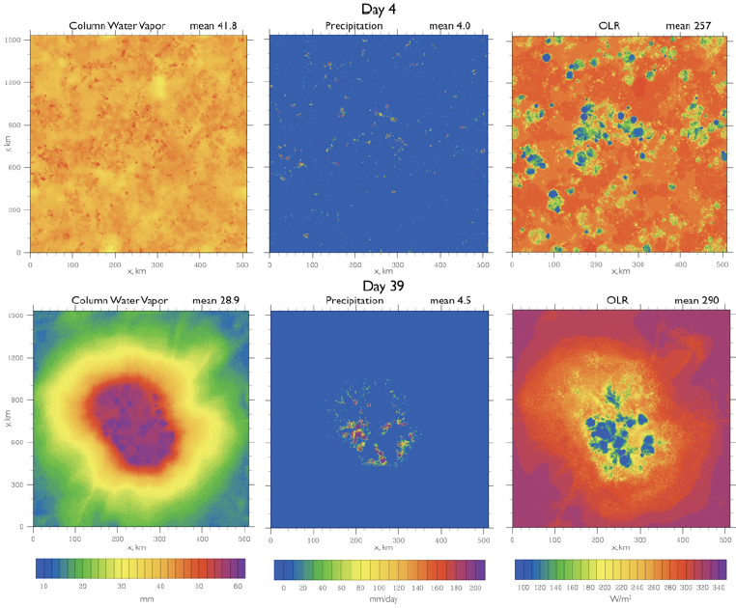
Spontaneous Aggregation of Convection

Slide 22
Spontaneous Aggregation of Convection

Slide 23
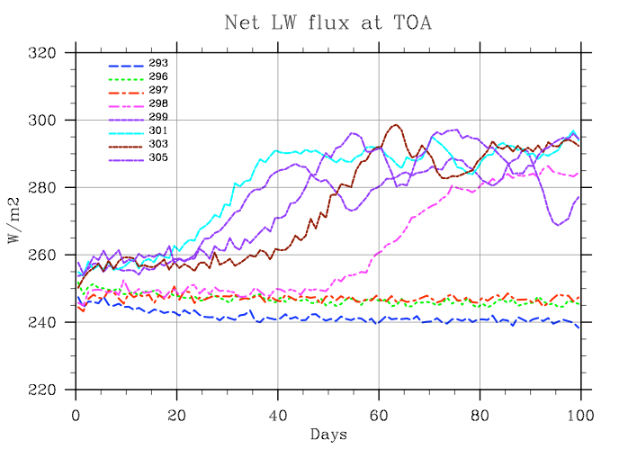
Self-Aggregation is Temperature-Dependent (Nolan et al., 2007; Emanuel and Khairoutdinov, in preparation, 2013)

Slide 24

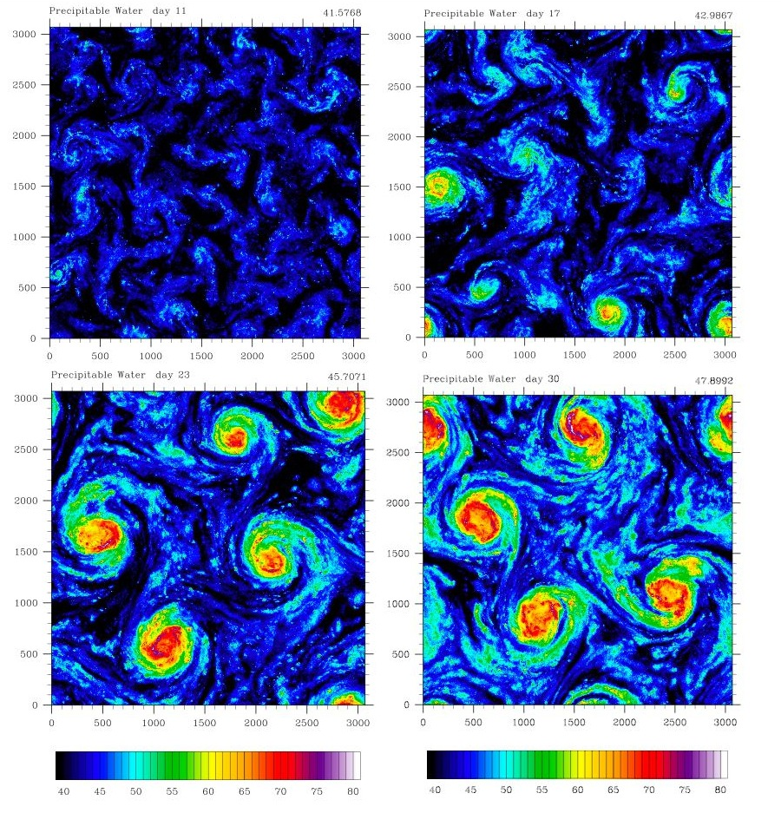
Self-Aggregation on a Rotating Planet
Vincent Van Gogh: Starry Night
Distance between vortex centers scales as V_{pot}/f

Slide 25
Some Empirical Findings

Slide 26
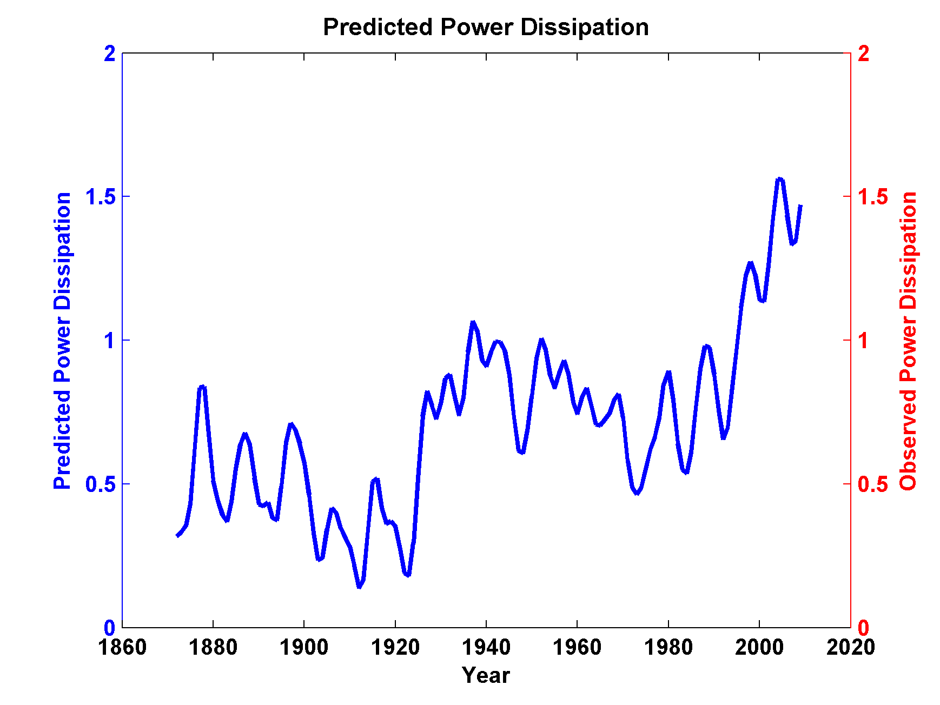
Sea Surface Temperature Scaled to Observed Hurricane Power Dissipation, 1980-2011

Slide 27
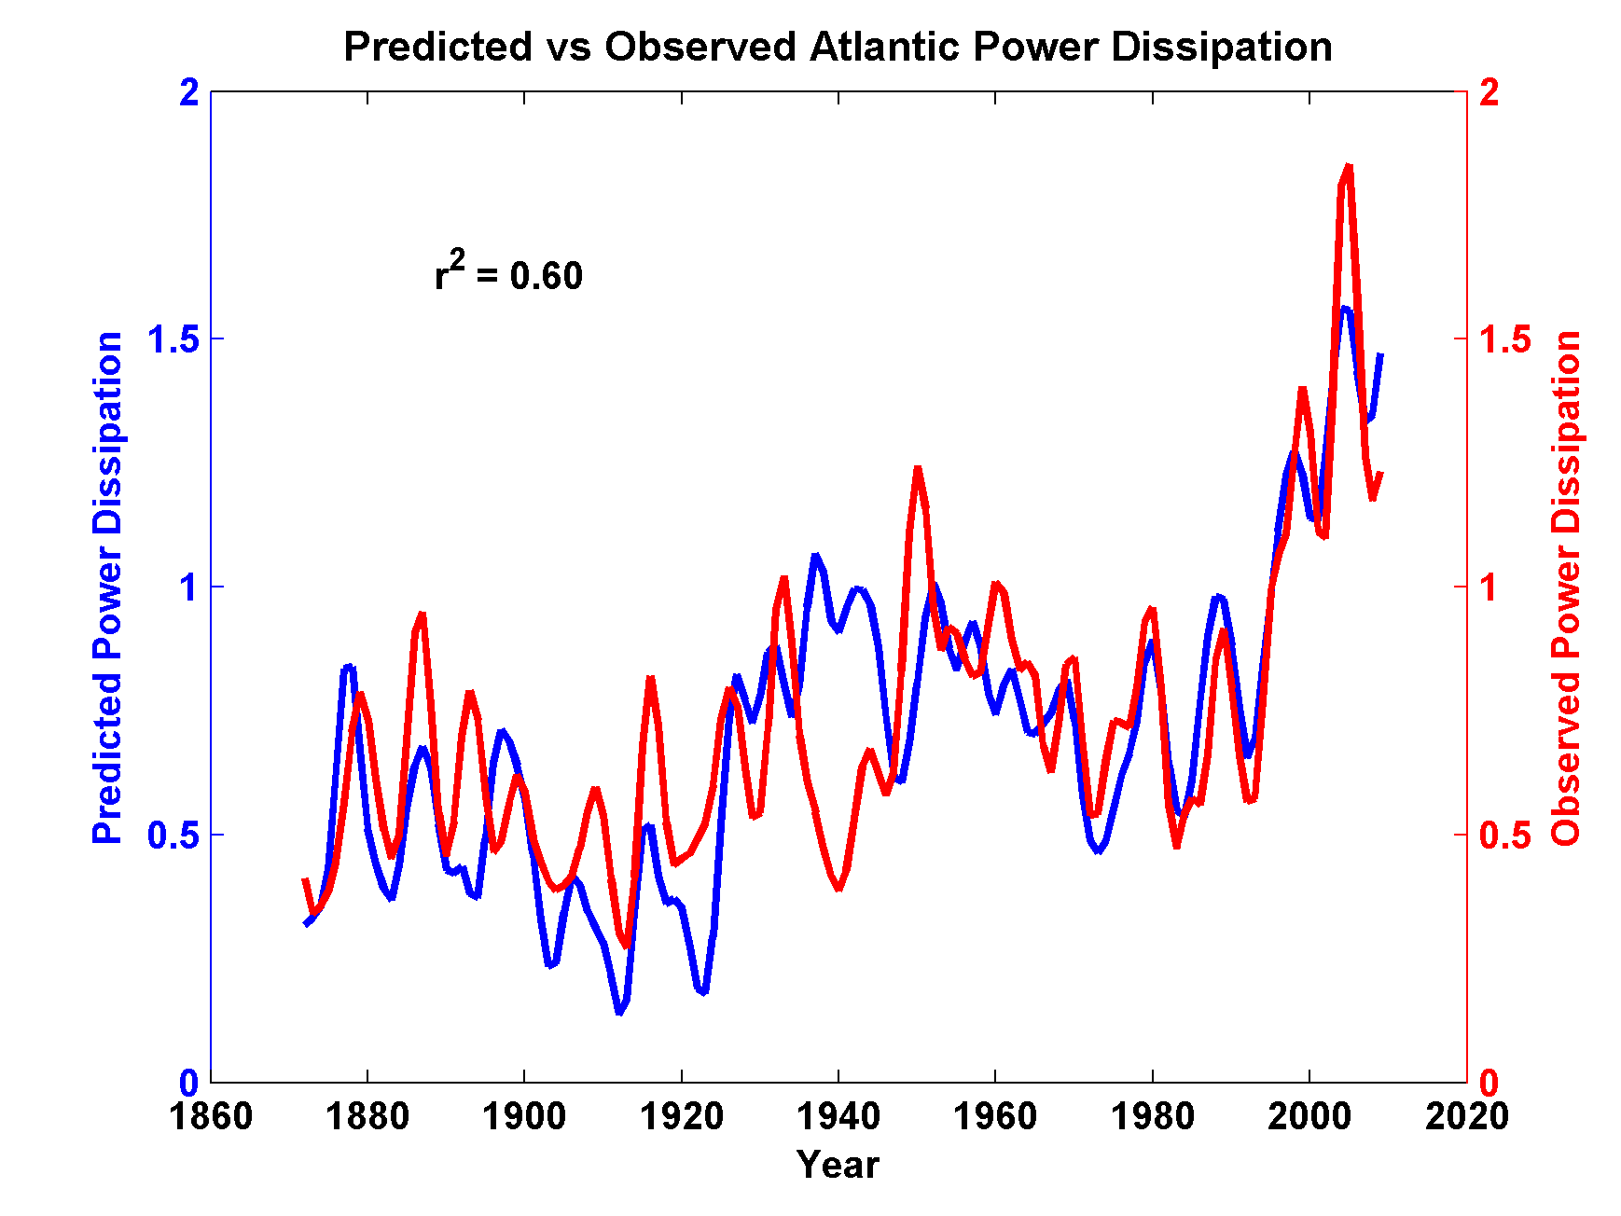
Compare to Observed Storm Maximum Power Dissipation

Slide 28
Looking Ahead:
Using Physics to Assess Hurricane Risk

Slide 29

Our Approach to Downscaling Tropical Cyclones from Climate Models
Step 1: Seed each ocean basin with a very large number of weak, randomly located vortices
Step 2: Vortices are assumed to move with the large scale atmospheric flow in which they are embedded
Step 3: Run a coupled, ocean-atmosphere computer model for each vortex, and note how many achieve at least tropical storm strength; discard others
Step 4: Using the small fraction of surviving events, determine storm statistics.

Slide 31
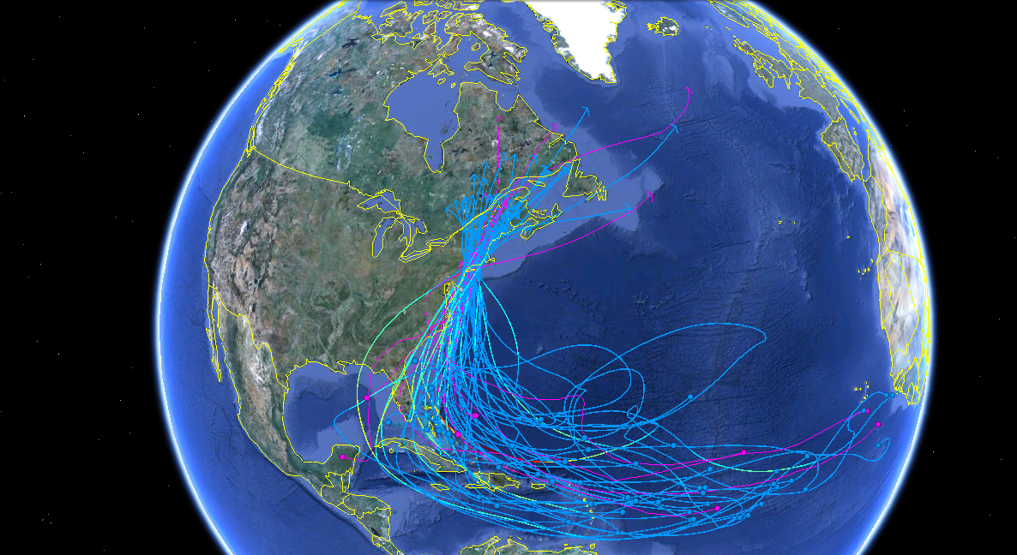
50 MIT Synthetic (various colors) and 8 Historical Hurricanes (lavender) Affecting New Haven

Slide 32
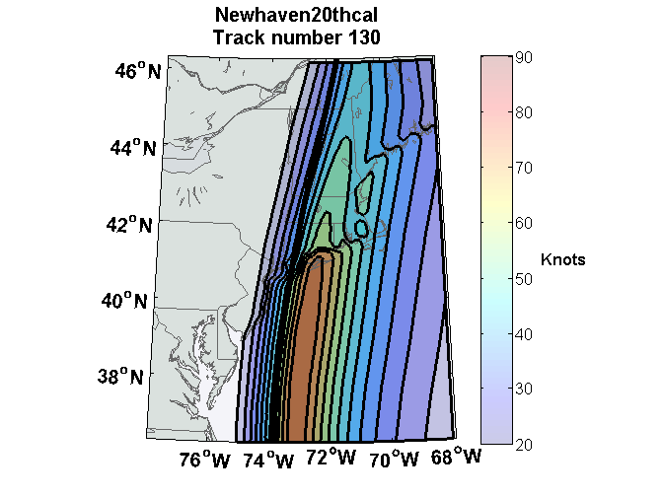
Peak Wind during Event

Slide 33
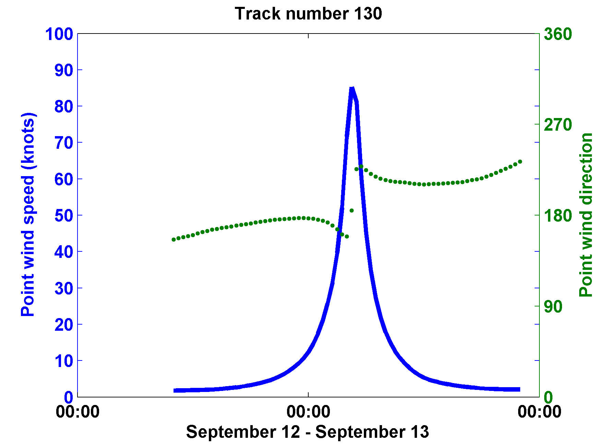

Slide 34
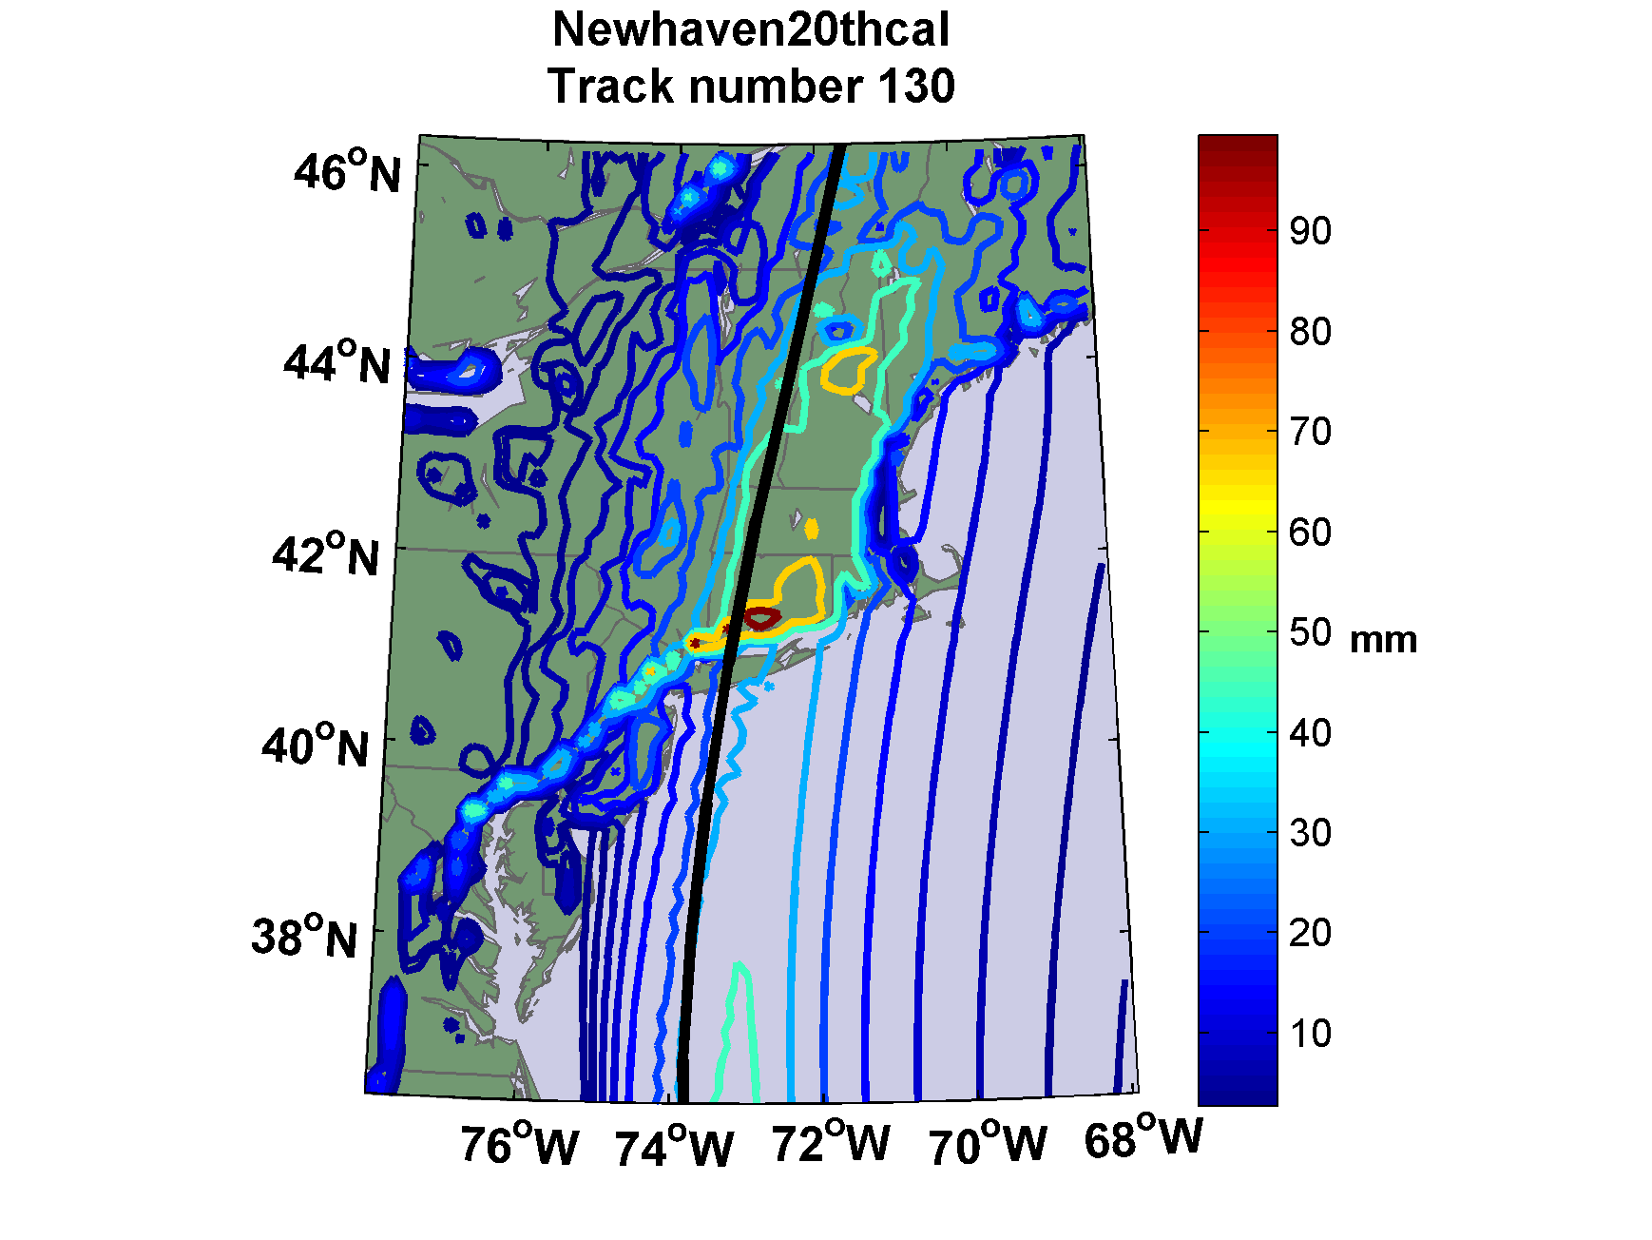
Accumulated Rainfall (mm)

Slide 35


Storm Surge Simulation
SLOSH model
(Jelesnianski et al. 1992)
SLOSH mesh
~ 10³ m
ADCIRC mesh
~ 10² m
Battery
ADCIRC model
(Luettich et al. 1992)
ADCIRC mesh
~ 10 m
(Colle et al. 2008)
Notes:
Given the storm wind and pressure fields (which is estimated from the Holland parametric pressure model) we can simulate the surge. Surge simulations with high resolution are computationally intensive, so to make it possible to simulate accurate surges for our large synthetic storm sets, we apply the two hydrodynamic models with girds of various resolutions in such a way that the main computational effort is concentrated on the storms that determine the risk. First, we apply the SLOSH model, using a mesh with resolution of about 1 km around NYC to simulate the surges for all storms and select the storms that have return periods, in terms of the surge height at the Battery, greater than 10 years. Second, we apply the ADCIRC simulation, using a grid mesh with resolution of ~100 m around NYC, to each of the selected storms. Then, we apply another ADCIRC mesh with resolution as high as ~10 m around NYC, for a set of the most extreme events, to check if the resolution of our ADCIRC grid is sufficient and if needed to make statistical correction to the results.

Slide 36
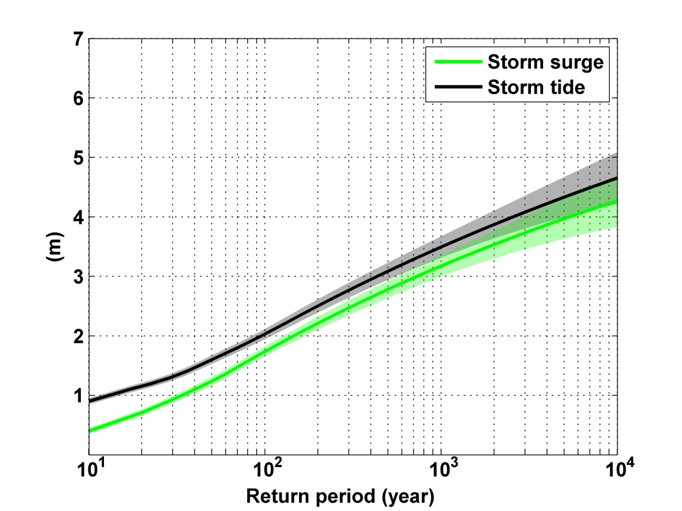
Notes:
Storm surge and storm tide (surge and tide) return level curves for the Battery, NYC, for the 1981-2000 NCAR/NCEP climate conditions (5000 synthetic storms). Astronomical tide and nonlinear interaction between surge and tide are accounted for statistically.

Slide 37
Downscaling of AR5 GCMs
GFDL-CM3
HadGEM2-ES
MPI-ESM-MR
MIROC-5
MRI-CGCM3
Historical: 1950-2005, RCP8.5 2006-2100

Slide 38
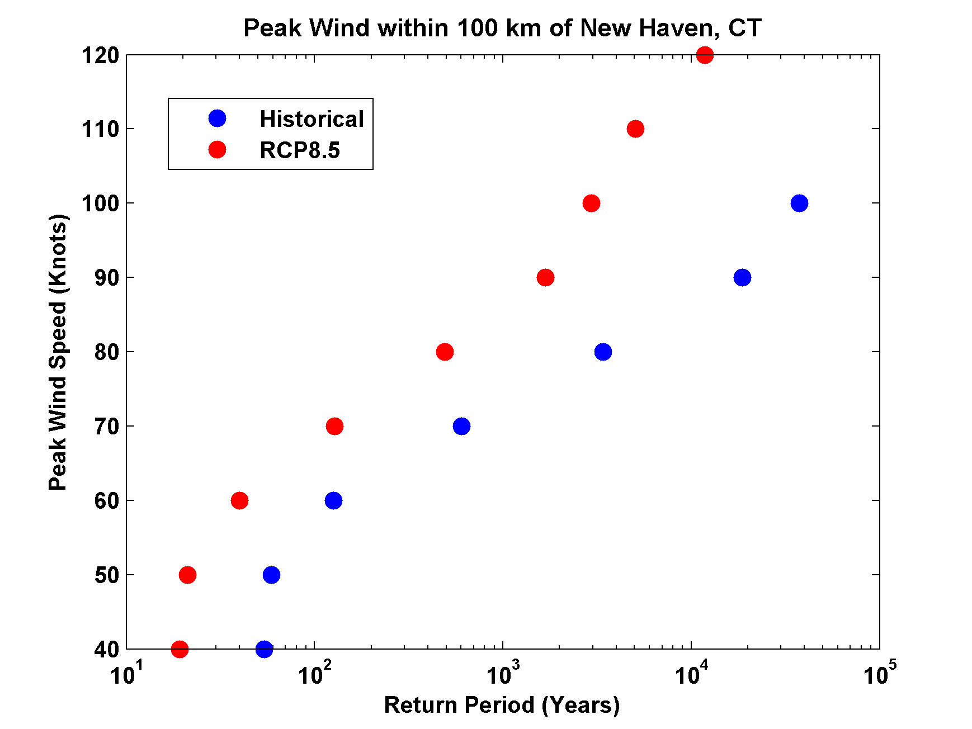
Return Periods based on GFDL Model

Slide 39

GCM flood height return level
(assuming SLR of 1 m for the future climate )
Black: Current climate (1981-2000)
Blue: A1B future climate (2081-2100)
Red: A1B future climate (2081-2100) with R₀ increased by 10% and R_{m} increased by 21%
Lin et al. (2012)
Notes:
Then we calculate the flood height (including surge, tide, and sea level rise) return level for the four climate models, assuming a sea level rise of 1 m for the future climate, for the Battery, NYC. These results show that the combined effects of storm climatology change and sea level rise will greatly shorten the flood return periods for NYC and, by the end of the century, the current 100-year surge flooding may happen less than every 30 years, with CNRM and GFDL prediction to be less than 10 years, and the 500-year flooding may happen less than every 200 years, with the CNRM and GFDL prediction to be 20-30 years.

Slide 40
Summary
Hurricanes appear to be sensitive to climate
Hurricane power has more than doubled in the North Atlantic over the past 25 years

Slide 41
Simple but high resolution coupled hurricane model can be used to ‘downscale’ hurricane activity from global climate data sets
Studies based on this downscaling suggest some sensitivity of hurricanes to climate state, with increasing incidence of intense storms as the climate warms

Slide 42
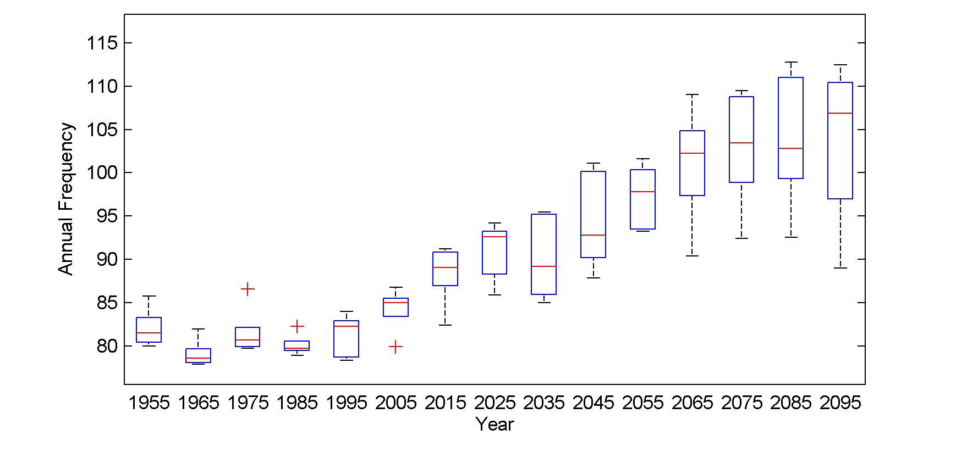
Global annual frequency of tropical cyclones averaged in 10-year blocks for the period 1950-2100, using historical simulations for the period 1950-2005 and the RCP 8.5 scenario for the period 2006-2100. In each box, the red line represents the median among the 5 models, and the bottom and tops of the boxes represent the 25th and 75th percentiles, respectively. The whiskers extent to the most extreme points not considered outliers, which are represented by the red + signs. Points are considered outliers if they lie more than 1.5 times the box height above or below the box.

Slide 43
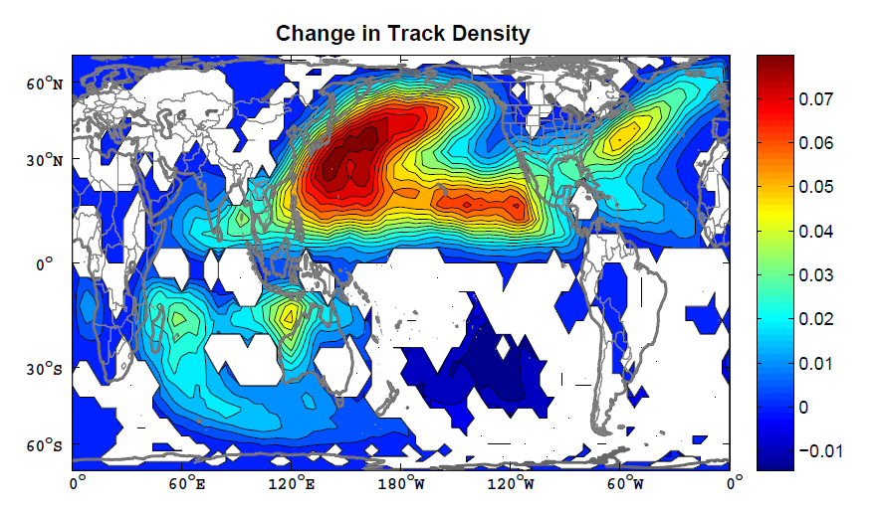
Change in track density, measured in number of events per 4º X 4º square per year, averaged over the five models. The change is simply the average over the period 2006-2100 minus the average over 1950-2005. The white regions are where fewer than 4 of the 5 models agree on the sign of the change.

Slide 44
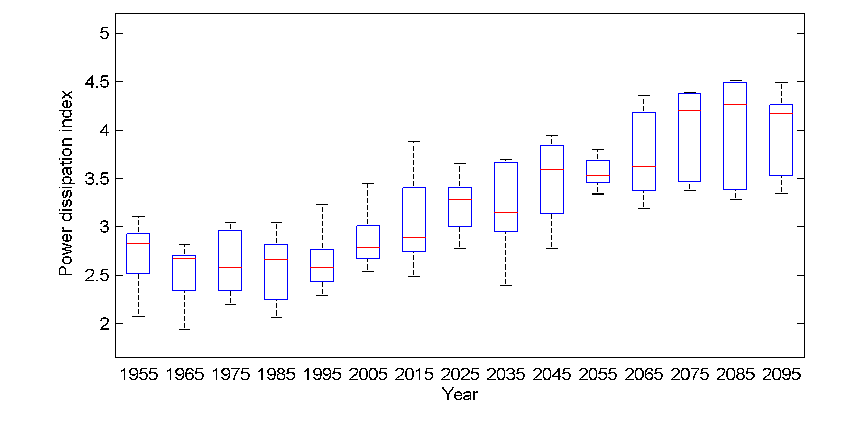
Global Tropical Cyclone Power Dissipation

Slide 45
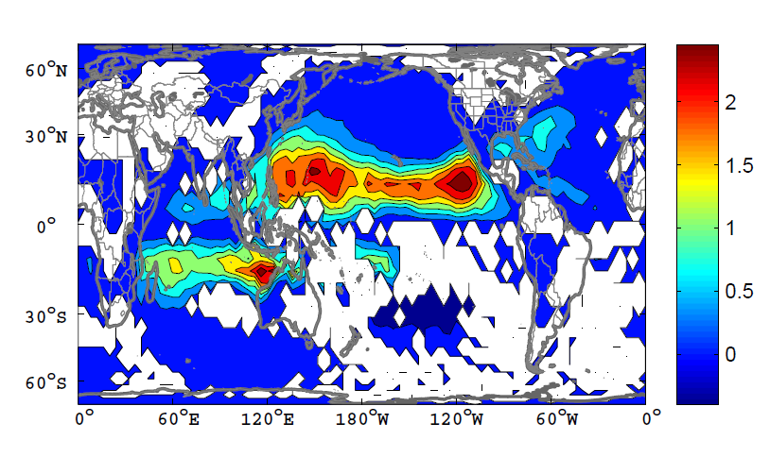
Change in Power Dissipation

Slide 46
Integrated Assessments with Robert Mendelsohn, Yale

Slide 47


Probability Density of TC Damage, U.S. East Coast
Damage Multiplied by Probability Density of TC Damage, U.S. East Coast

Slide 48
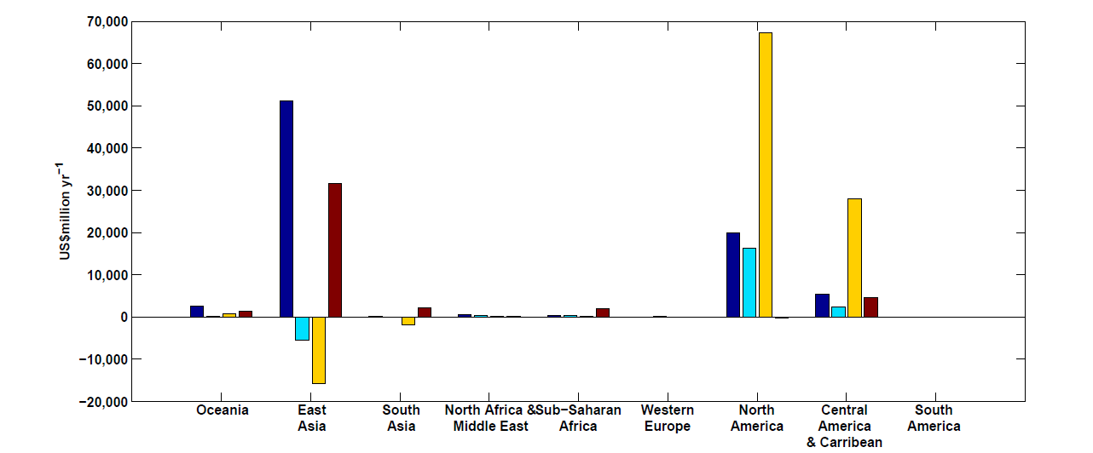
Mendelsohn et al., 2012
Climate change impacts on tropical cyclone damage by region in 2100. Damage is concentrated in North America, East Asia and Central America–Caribbean. Damage is generally higher in the CNRM and GFDL climate scenarios.

Slide 49
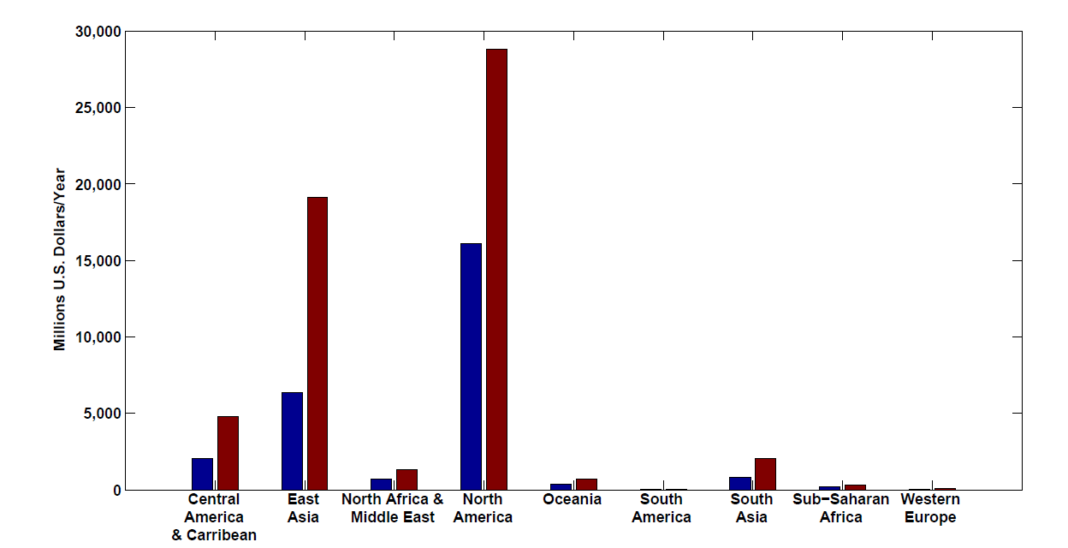
Present and future baseline tropical cyclone damage by region.
Changes in income will increase future tropical cyclone damages in 2100 in every region even if climate does not change. Changes are larger in regions experiencing faster economic growth, such as East Asia and the Central America–Caribbean region.

Slide 50
Climate change impacts on tropical cyclone damage by region in 2100. Damage is concentrated in North America, East Asia and Central America–Caribbean. Damage is generally higher in the CNRM and GFDL climate scenarios.

Slide 51
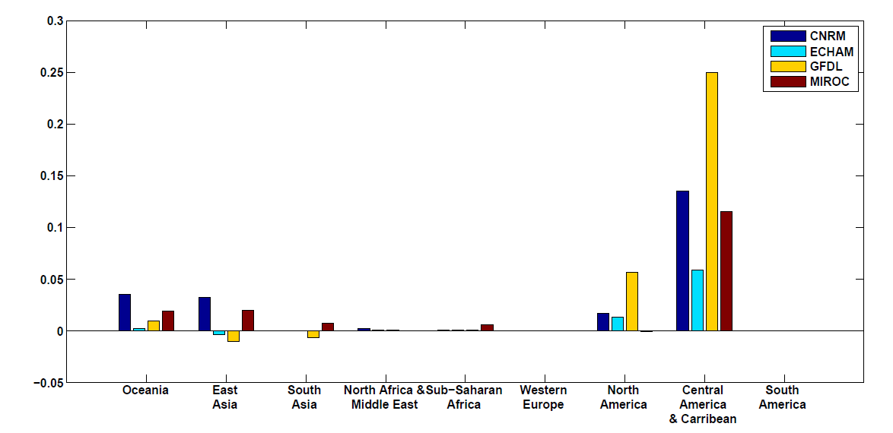
Climate change impacts on tropical cyclone damage divided by GDP by region in 2100. The ratio of damage to GDP is highest in the Caribbean–Central American region but North America, Oceania and East Asia all have above-average ratios.

Slide 52
What is Causing Changes in Tropical Atlantic Sea Surface Temperature?

Slide 53
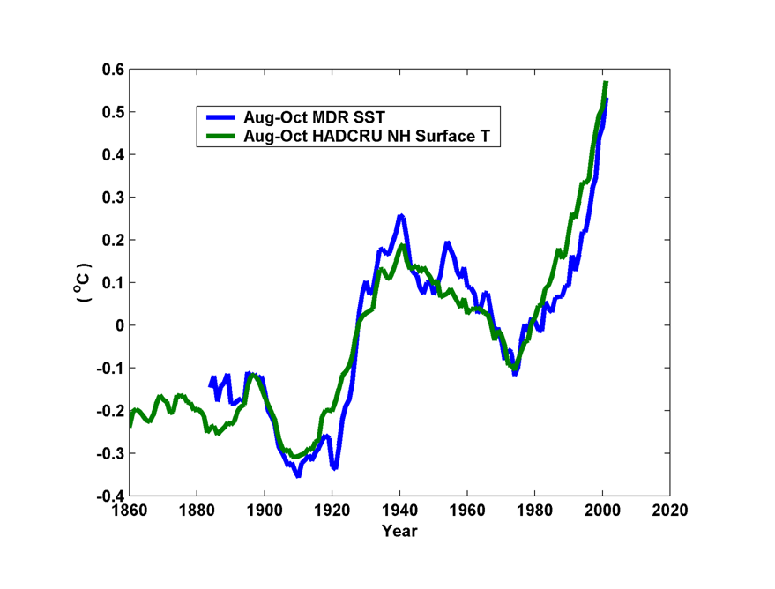
10-year Running Average of Aug-Oct Northern Hemisphere Surface Temp and Hurricane Region Ocean Temp

Slide 54
Estimates of Global Mean Surface Temperature from the Instrumental Record
Notes:
54

Slide 55
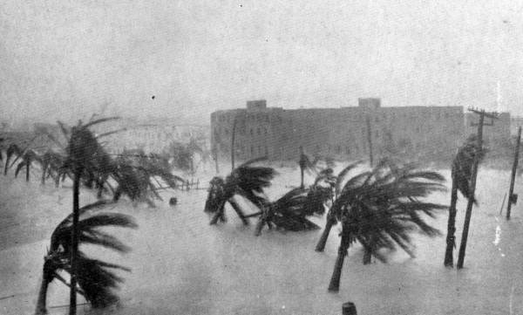
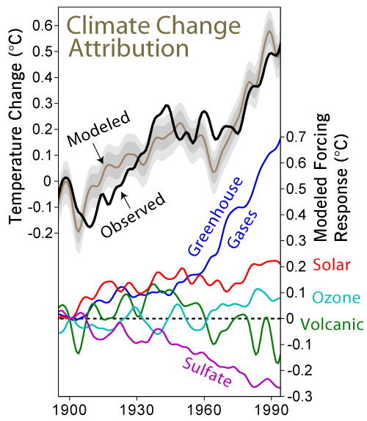

Slide 56
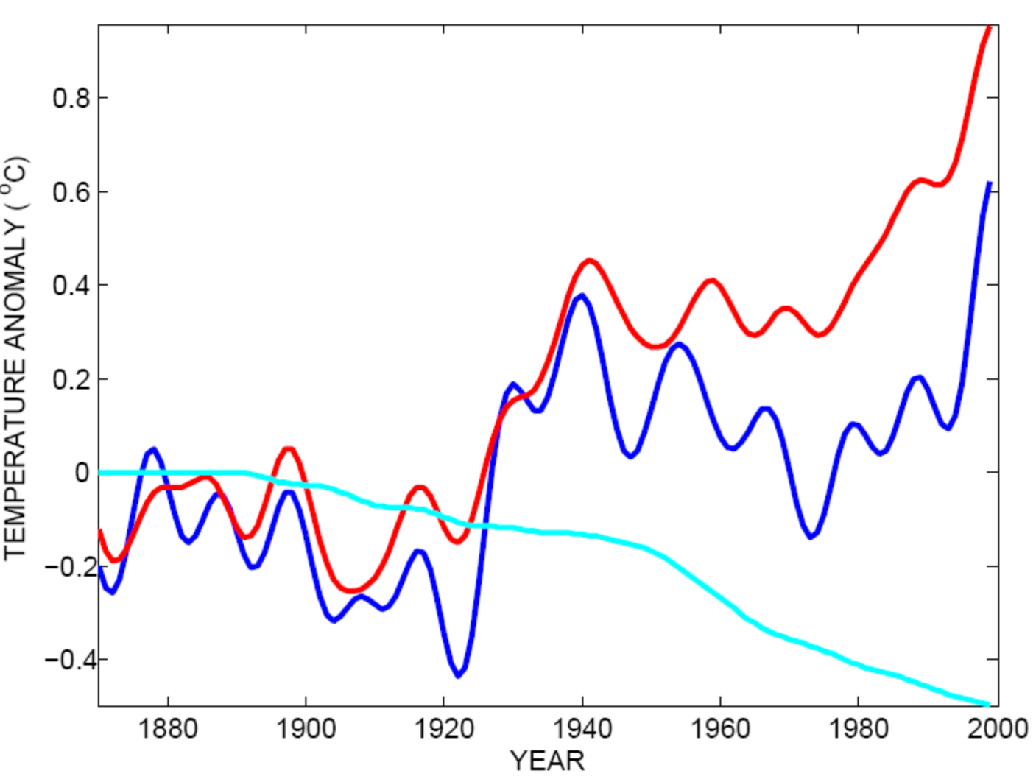
Tropical Atlantic SST(blue), Global Mean Surface Temperature (red),
Aerosol Forcing (aqua)
Global mean surface temperature
Tropical Atlantic sea surface temperature
Sulfate aerosol radiative forcing
Mann, M. E., and K. A. Emanuel, 2006. Atlantic hurricane trends linked to climate change. EOS, 87, 233-244.

Slide 57
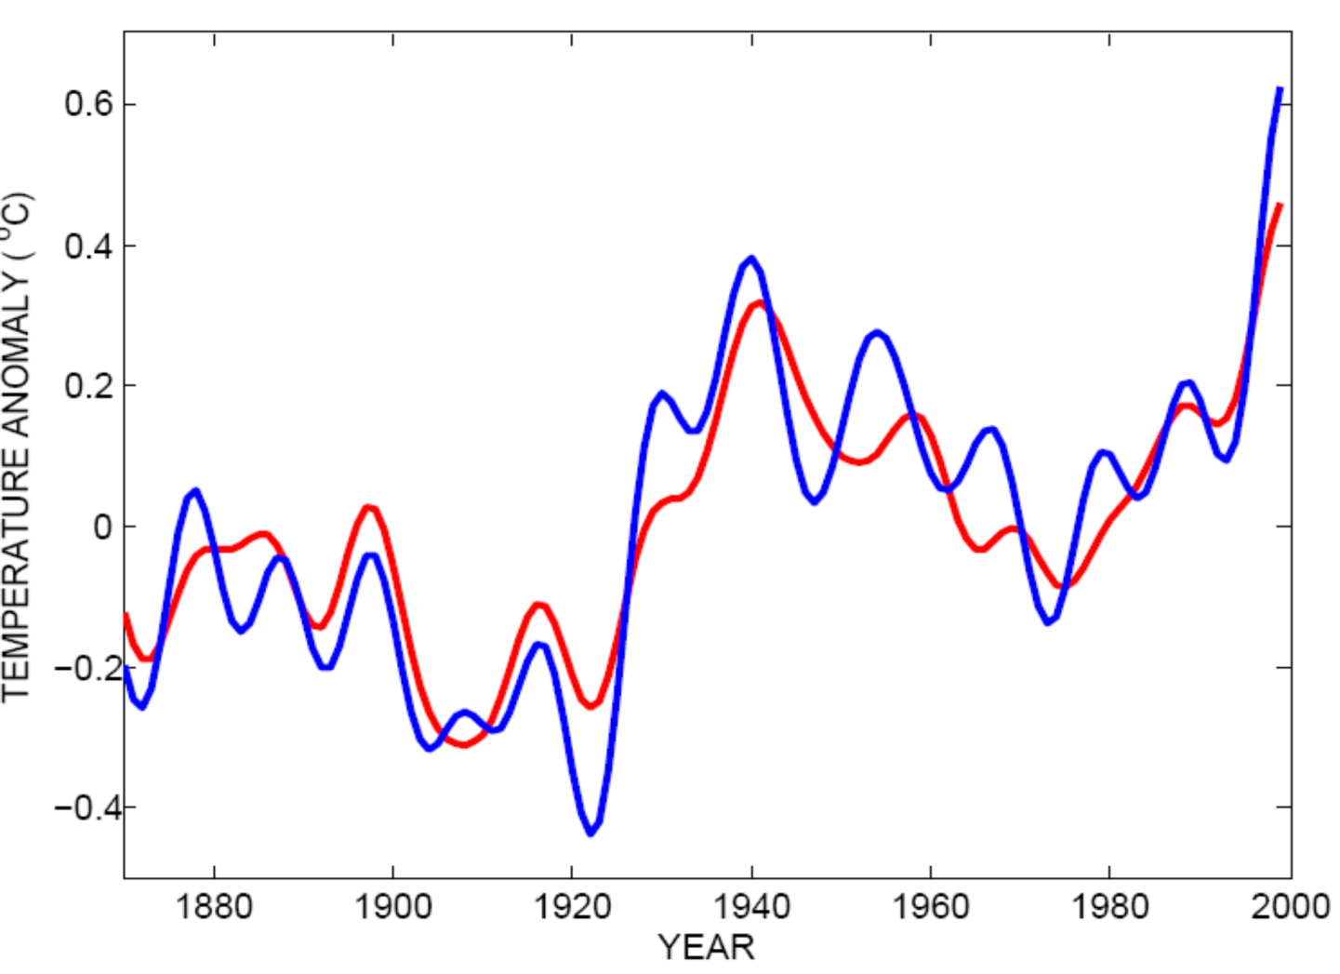
Best Fit Linear Combination of Global Warming and Aerosol Forcing (red) versus Tropical Atlantic SST (blue)
Tropical Atlantic Sea Surface Temperature
Global Surface T + Aerosol Forcing
Mann, M. E., and K. A. Emanuel, 2006. Atlantic hurricane trends linked to climate change. EOS, 87, 233-244.

Slide 58
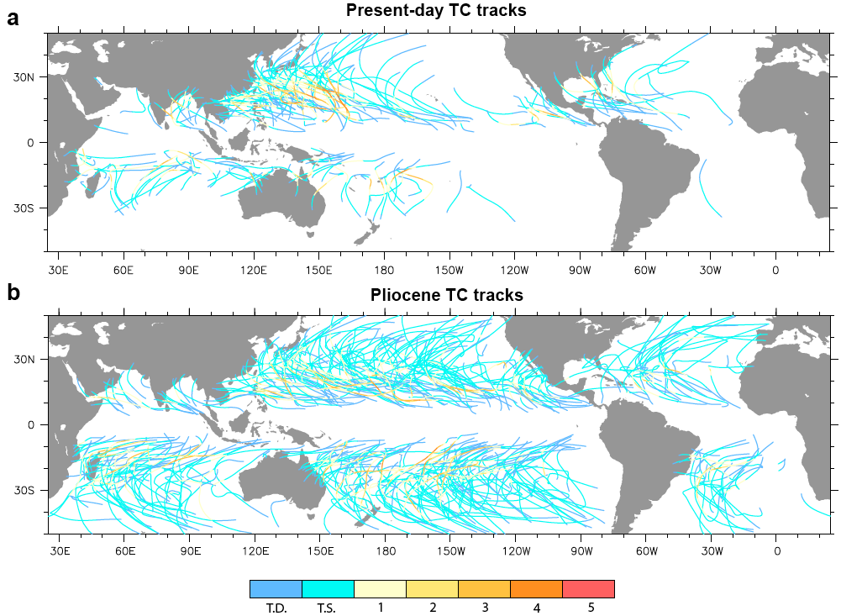
Application to the Climate of the Pliocene

