Slide 1

What do Hurricanes Harvey and Irma Portend?
Kerry Emanuel
EAPS and Lorenz Center, MIT
Notes:
1

Slide 2

Program
The global hurricane hazard
Inferences from historical and geological records
Inferences from basic physics
Using physics to estimate risk
MIT’s hurricane flood risk

Slide 3
The Global Hurricane Hazard
About 10,000 deaths per year since 1971
$700 Billion 2015 U.S. Dollars in Damages Annually since 1971
Global population exposed to hurricane hazards has tripled since 1970
EM-DAT, 2016: The OFDA/CRED International Disaster Database
http://www.emdat.be/.

Slide 4
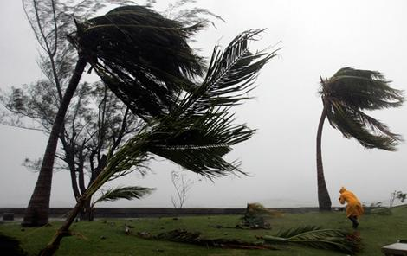
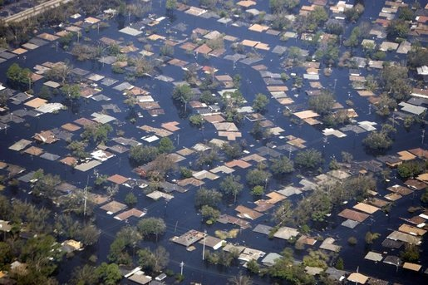
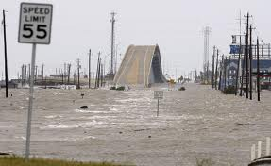

Hurricane Risks:
Wind
Rain
Storm Surge

Slide 5
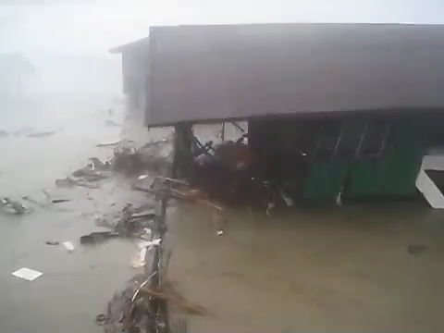

Slide 6

Publicly
insured…
No $$$
Privately insured… $$$

Slide 7
Historical Records
Pre-1943: Anecdotal accounts from coastal cities and ships
1943: Introduction of routine aircraft reconnaissance in Atlantic, western North Pacific
1958: Inertial navigation permits direct measurement of wind speed at flight level
1970: Complete global detection by satellites
1978: Introduction of satellite scatterometry
1987: Termination of airborne reconnaissance in western North Pacific
2017: Introduction of CYGNSS scatterometry

Slide 8
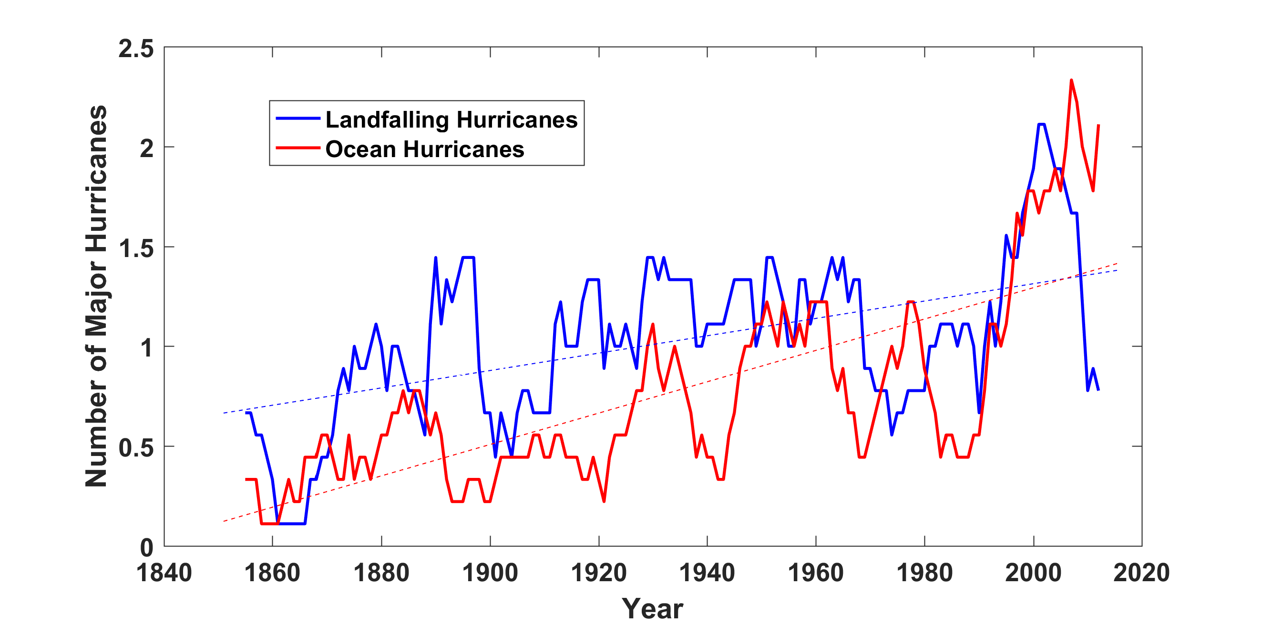
Prior to 1970, Many Storms Were Missed
Major hurricanes in the North Atlantic, 1851-2016, smoothed using a 10-year running average. Shown in blue are storms that either passed through the chain of Lesser Antilles or made landfall in the continental U.S.; all other major hurricanes are shown in red. The dashed lines show the best fit trend lines for each data set.

Slide 9
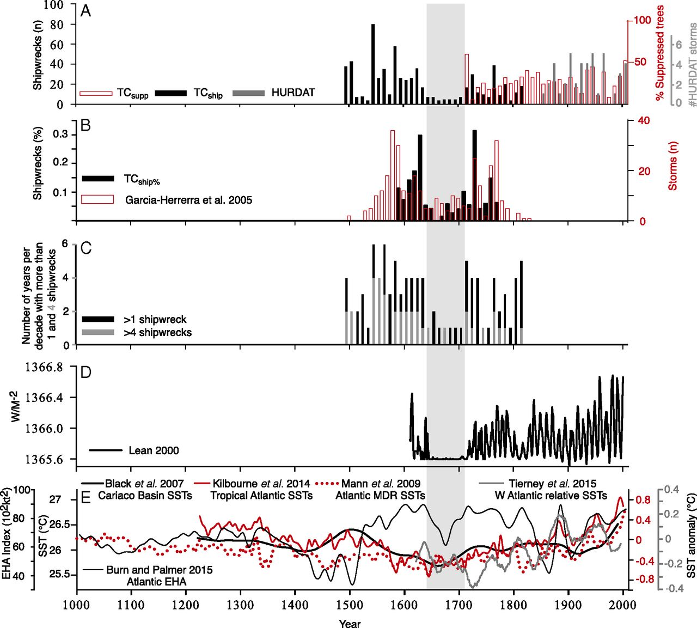
Inferences from Spanish Shipwrecks
Trouet at al., PNAS. 2016

Slide 10
Hurricanes are reaching peak intensity at higher latitudes
Time series of the latitudes at which tropical cyclones reach maximum intensity.
From Kossin et al. (2014)

Slide 11
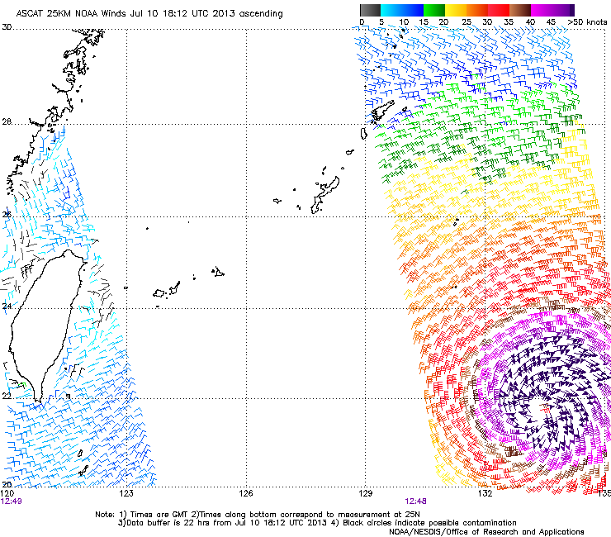
Sea Surface Scatterometry

Slide 12
Note: Instrument not yet calibrated for V > 35 m/s …readings above capped at that value.
Courtesy Chris Ruf, U. Michigan

Slide 13
Flood inundation signal. Courtesy Chris Ruf

Slide 14
Paleotempestology
barrier beach
upland
overwash fan
backbarrier marsh
a)
lagoon
barrier beach
upland
overwash fan
b)
backbarrier marsh
lagoon
terminal lobes
flood tidal delta
Source: Jeff Donnelly, WHOI
Notes:
14

Slide 15
Jeffrey P. Donnelly and Jonathan D. Woodruff, Nature, 2007

Slide 16
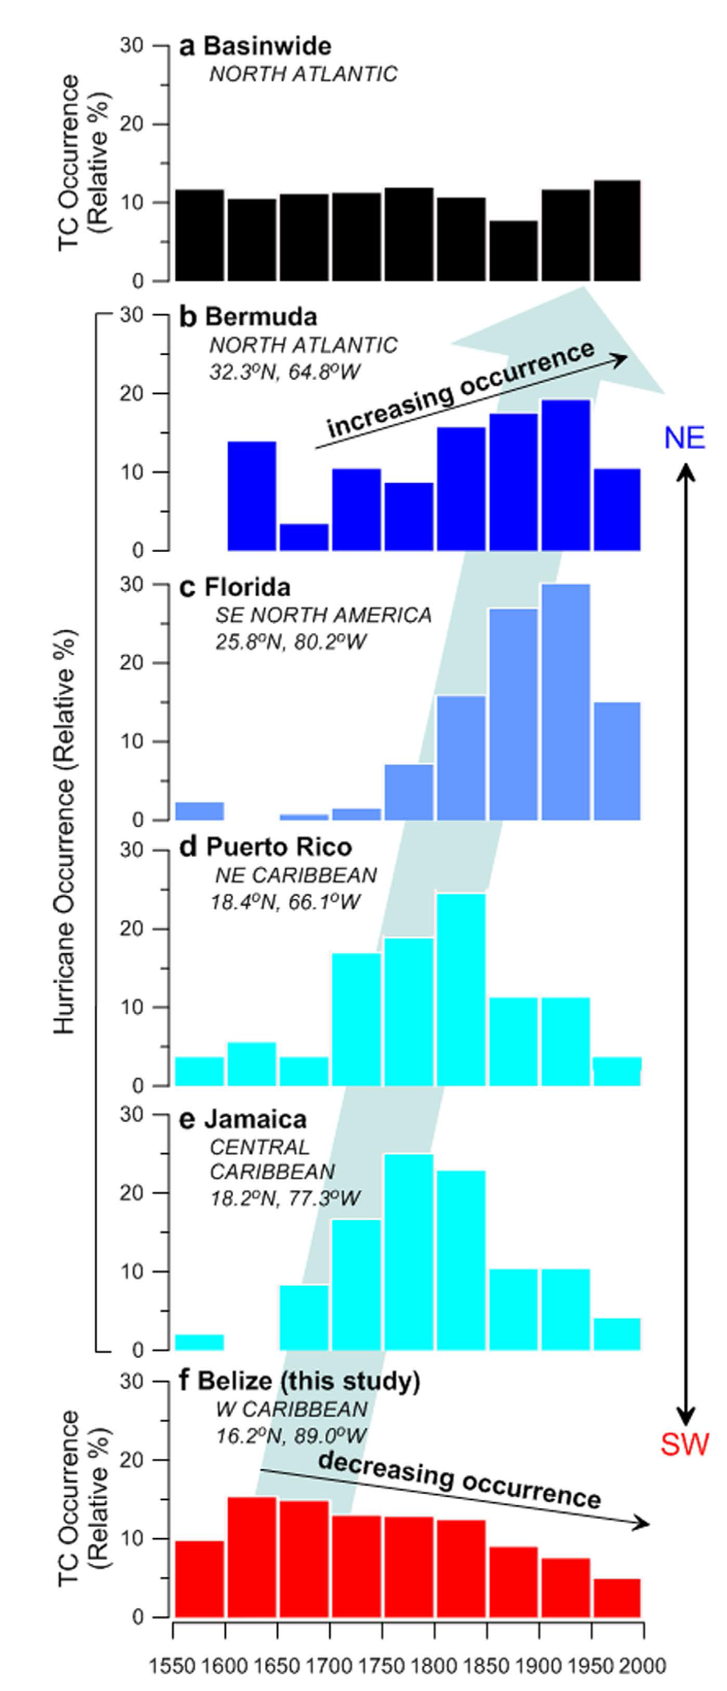
The YOK-GTC reconstruction compared to documentary records of hurricane landfall in the Caribbean and North Atlantic Basins. Frequency distributions (relative %) of hurricanes affecting (a) the entire North Atlantic Basin and locations along the western margin of the North Atlantic (b) Bermuda, (c)
Florida, (d) Puerto Rico, and (e) Jamaica, calculated from previously published documentary data. From Baldini et al., Nature Scientific Reports, 2016, DOI: 10.1038/srep37522
Belize data based on stable isotope analysis of stalagmites at Yoks Balum cave in southern Belize

Slide 17
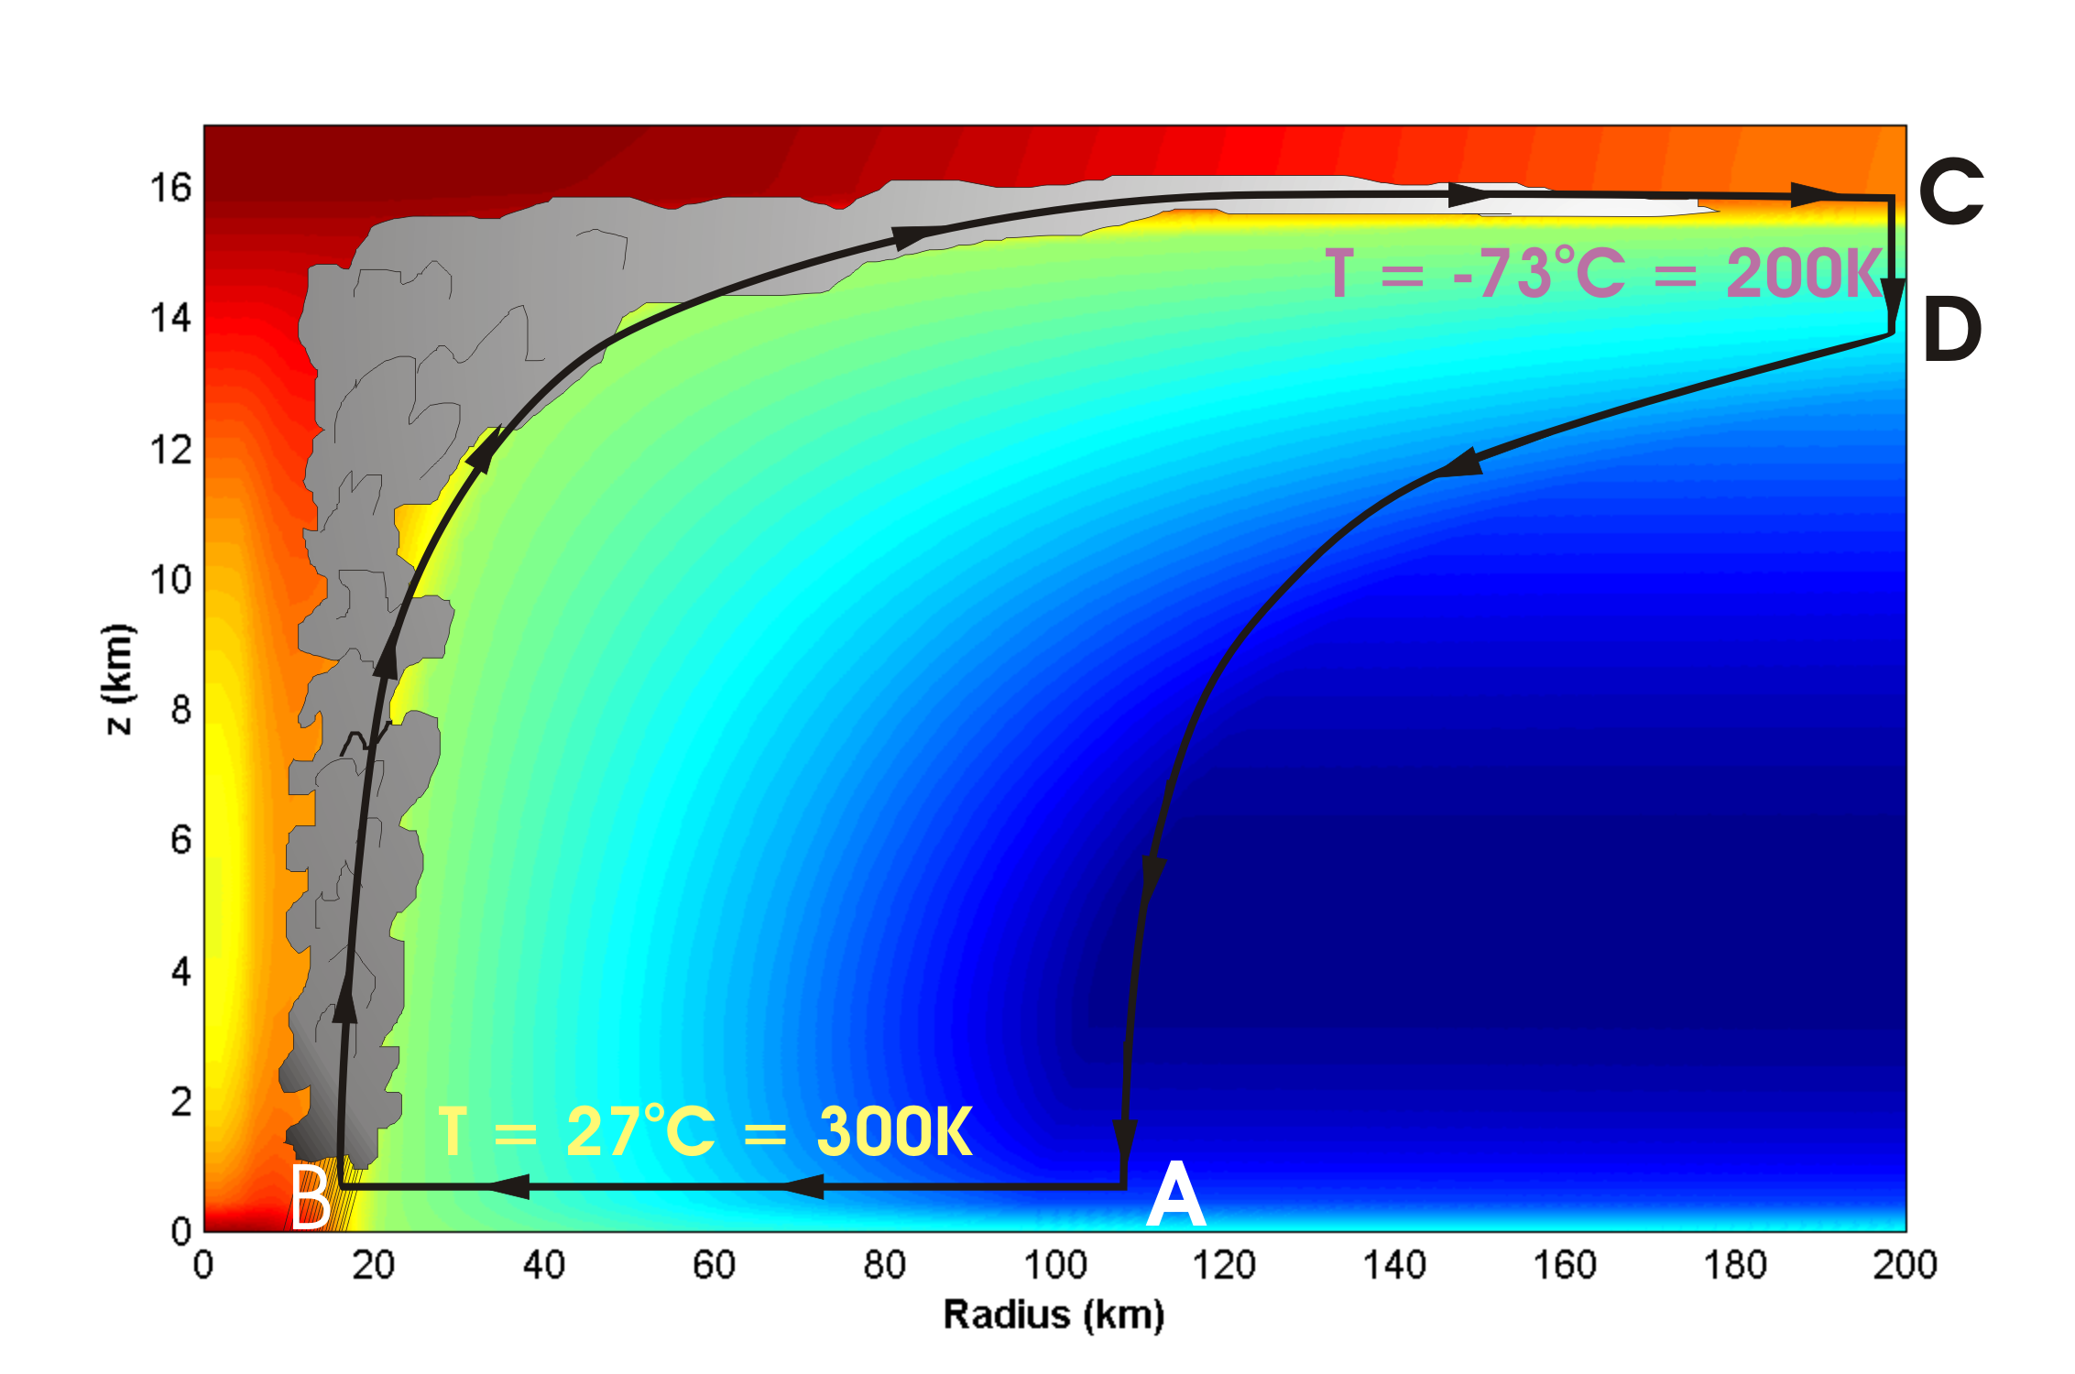
Basic Physics: Energy Production

Slide 18
Theoretical Steady-State Maximum Hurricane Wind Speed:
Surface temperature
Saturation static energy of sea surface
Saturation static energy of troposphere
Ratio of exchange coefficients of enthalpy and momentum
Outflow temperature
Air-sea enthalpy disequilibrium of moist static energy

Slide 19
Annual Maximum Potential Intensity (m/s)

Slide 20
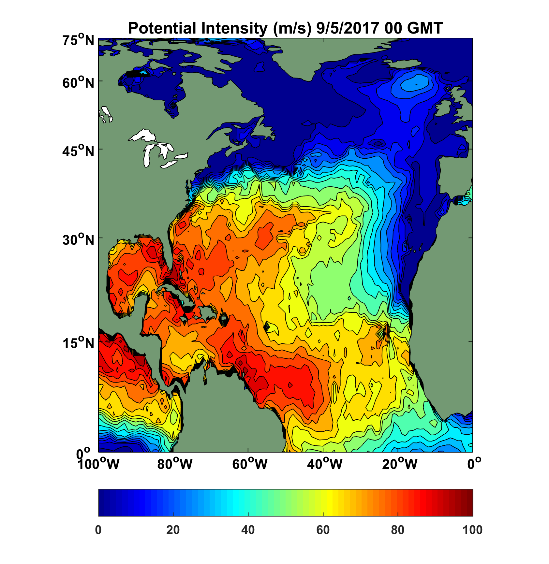
Potential Intensity at Onset of Hurricane Irma

Slide 21
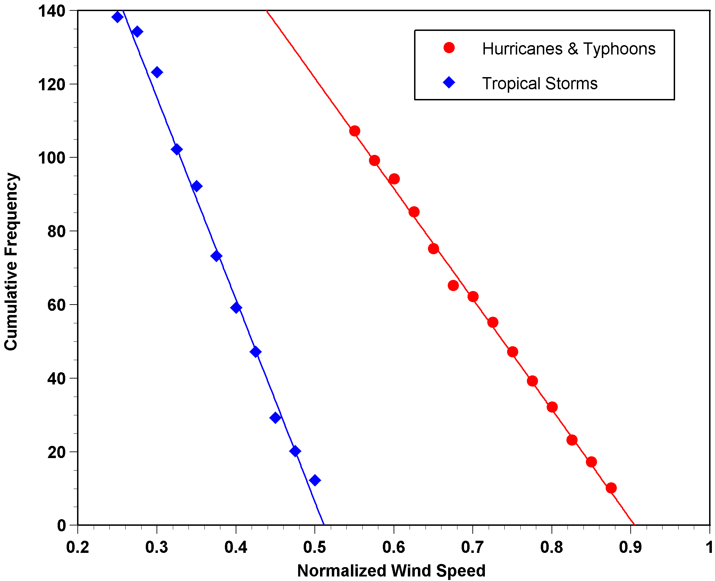
Cumulative Frequency of Storm Lifetime Maximum Intensity Normalized by Potential Intensity

Slide 22
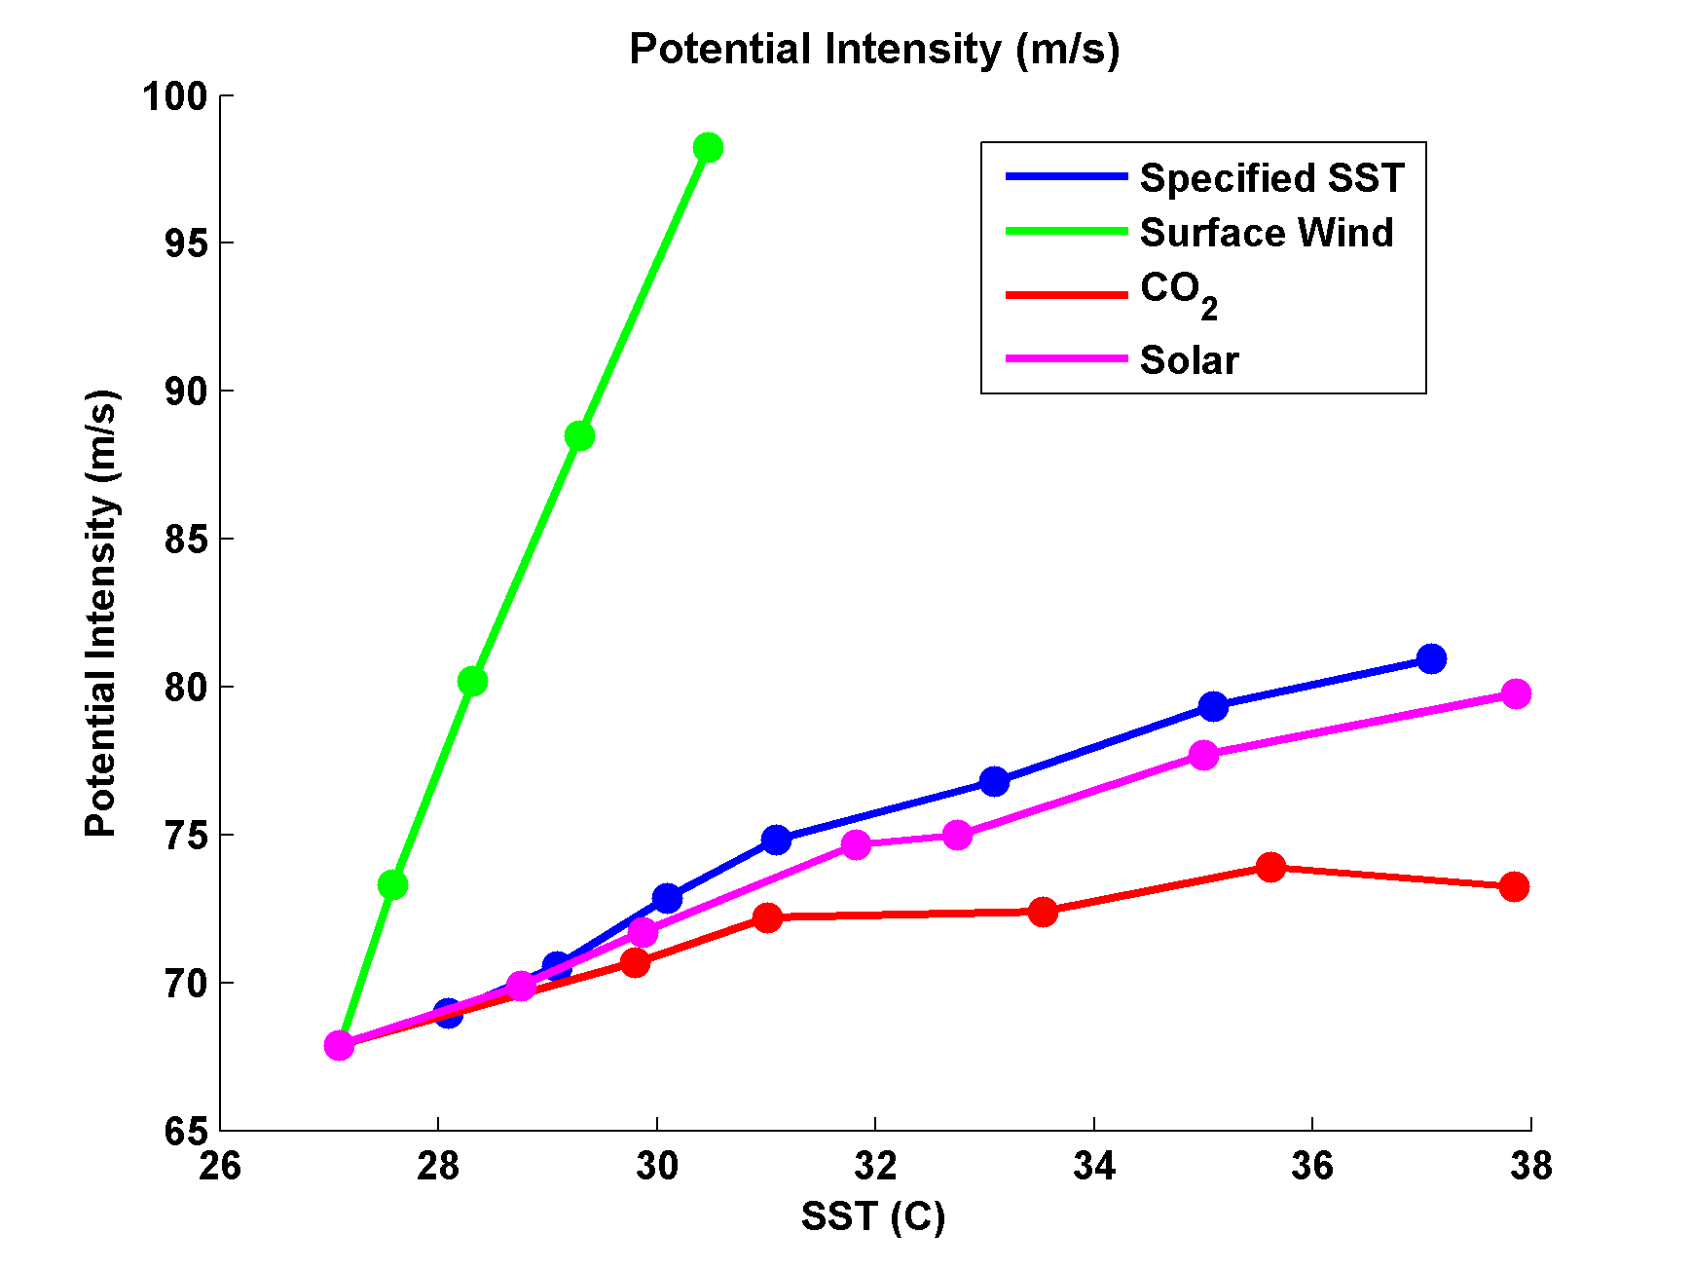
Variation of Potential Intensity with Ocean Heat Flux, Surface Wind Speed, CO₂, and Solar Forcing
Emanuel, K., and A. Sobel, 2013: Response of tropical sea surface temperature, precipitation, and tropical cyclone-related variables to changes in global and local forcing. J. Adv. Model. Earth Sys., 5, doi:10.1002/jame.20032

Slide 23
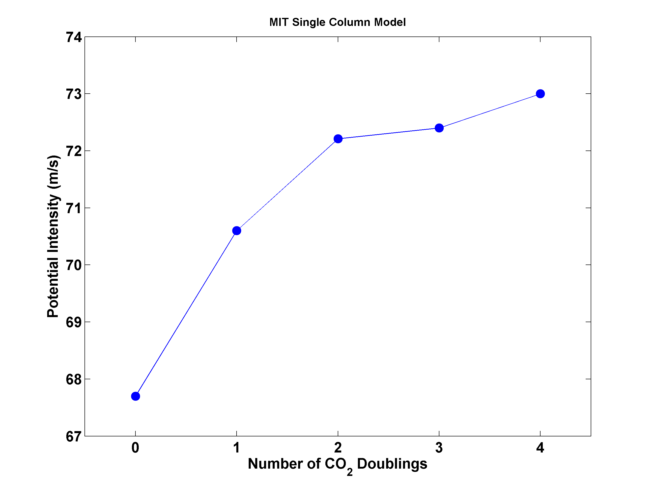
Potential Intensity and CO₂

Slide 24
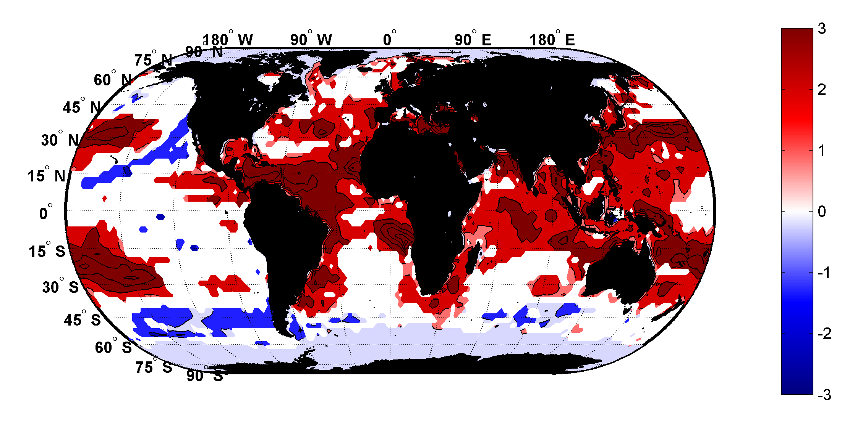
Trends in Thermodynamic Potential for Hurricanes, 1980-2010
(NCAR/NCEP Reanalysis)
ms⁻¹decade⁻¹

Slide 25
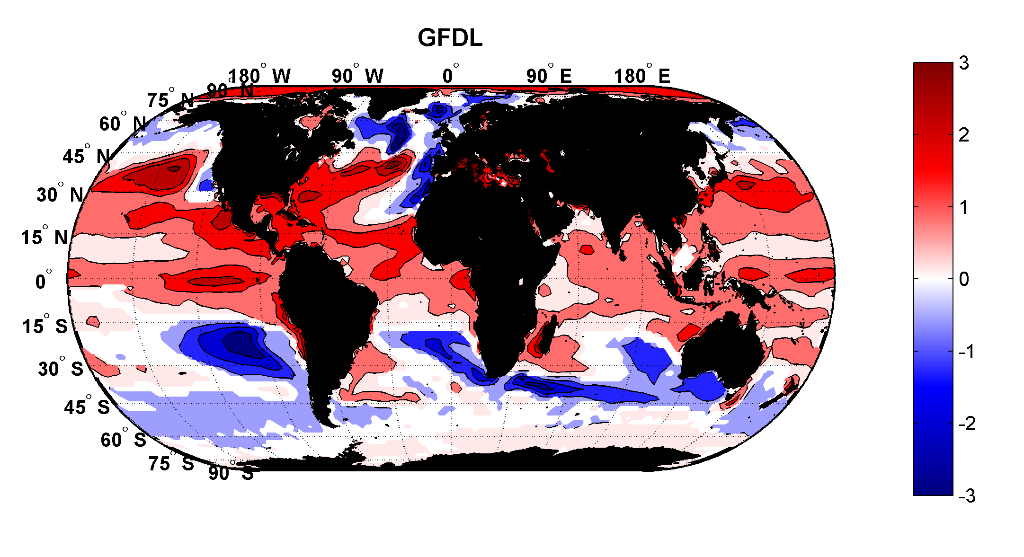
Projected Trend Over 21st Century: GFDL model under RCP 8.5
ms⁻¹decade⁻¹

Slide 26
Inferences from Basic Theory:
Potential intensity increases with global warming
Incidence of high-intensity hurricanes should increase
Increases in potential intensity should be faster in sub-tropics
Hurricanes will produce substantially more rain: Clausius-Clapeyron… ~7% increase in water vapor per 1ºC warming

Slide 27
Using Physics to Estimate Hurricane Risk

Slide 28
Why Not Use Global Climate Models to Simulate Hurricanes?

Slide 29

Problem: Today’s models are far too coarse to simulate destructive hurricanes
Histograms of Tropical Cyclone Intensity as Simulated by a Global Model with 30 mile grid point spacing. (Courtesy Isaac Held, GFDL)
Category 3
Modeled
Observed
Global models do not simulate the storms that cause destruction
Wind Speed (meters per second)

Slide 30
How to deal with this?
Embed high-resolution, fast coupled ocean-atmosphere hurricane model in GCM or reanalysis data

Slide 31
Time-dependent, axisymmetric model phrased in R space
Hydrostatic and gradient balance above PBL
Moist adiabatic lapse rates on M surfaces above PBL
Boundary layer quasi-equilibrium convection
Deformation-based radial diffusion
Coupled to simple 1-D ocean model
Environmental wind shear effects parameterized

Slide 32
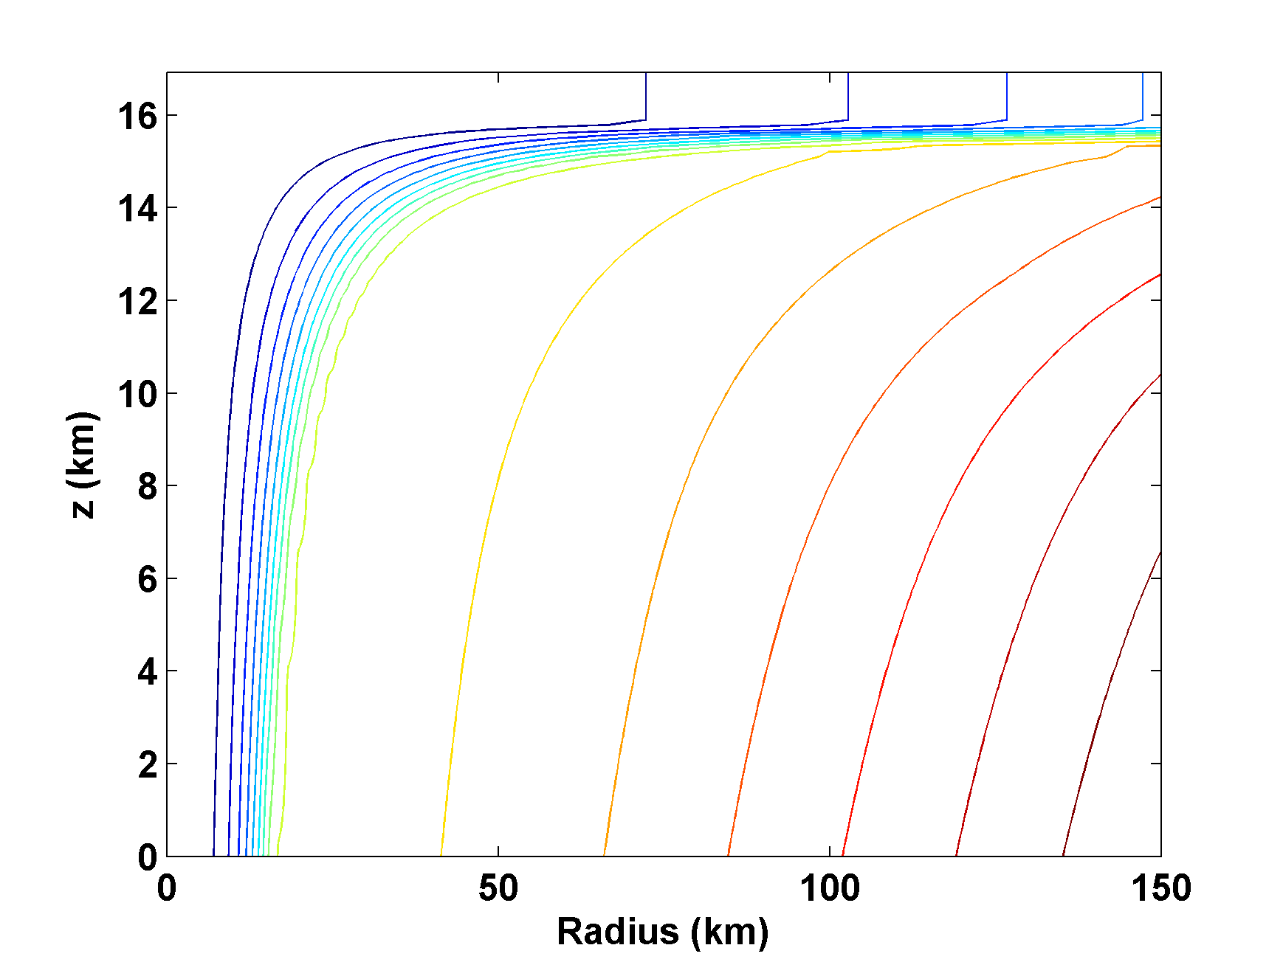
Angular Momentum Distribution
Altitude (km)
Storm Center

Slide 33
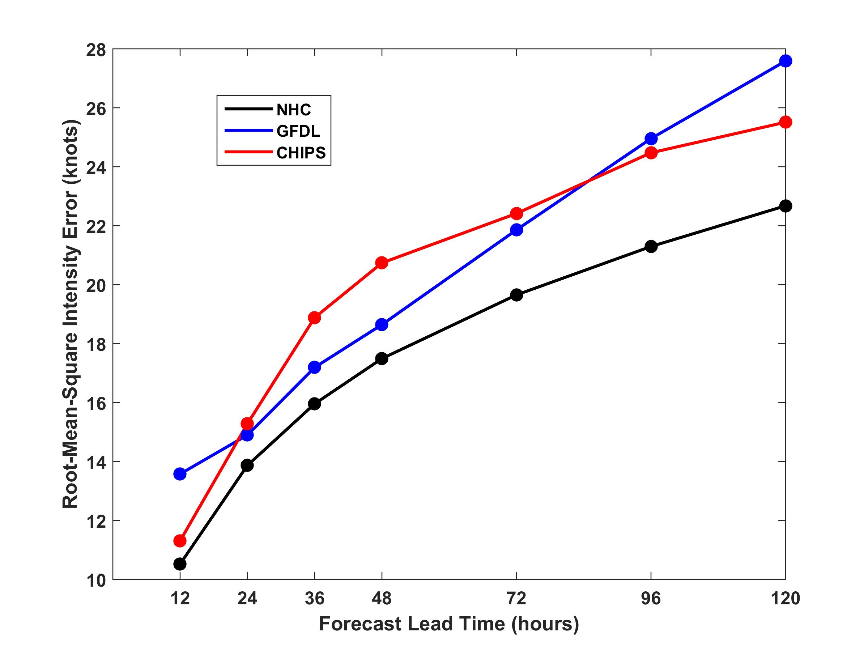
RMS Intensity Error, 2009-2015
North Atlantic

Slide 34
How Can We Use This Model to Help Assess Hurricane Risk in Current and Future Climates?

Slide 35
Risk Assessment Approach:
Step 1: Seed each ocean basin with a very large number of weak, randomly located cyclones
Step 2: Cyclones are assumed to move with the large scale atmospheric flow in which they are embedded, plus a correction for the earth’s rotation and sphericity
Step 3: Run the CHIPS model for each cyclone, and note how many achieve at least tropical storm strength
Step 4: Using the small fraction of surviving events, determine storm statistics. Can easily generate 100,000 events
Details: Emanuel et al., Bull. Amer. Meteor. Soc, 2008
Notes:
35

Slide 36
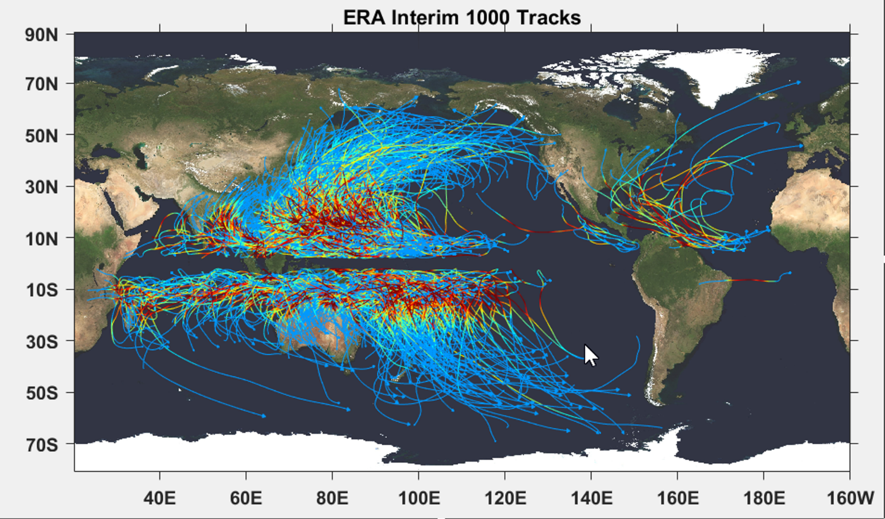

Slide 37

Cumulative Distribution of Storm Lifetime Peak Wind Speed, with Sample of 1755 Synthetic Tracks
90% confidence bounds

Slide 38
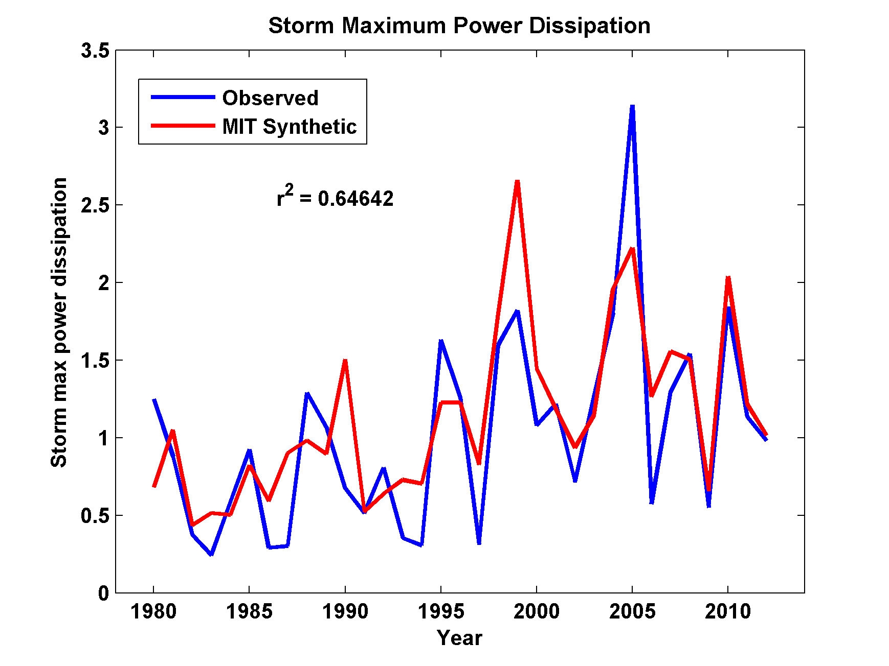
Captures Much of the Observed North Atlantic Interannual Variability
r²=0.65

Slide 39
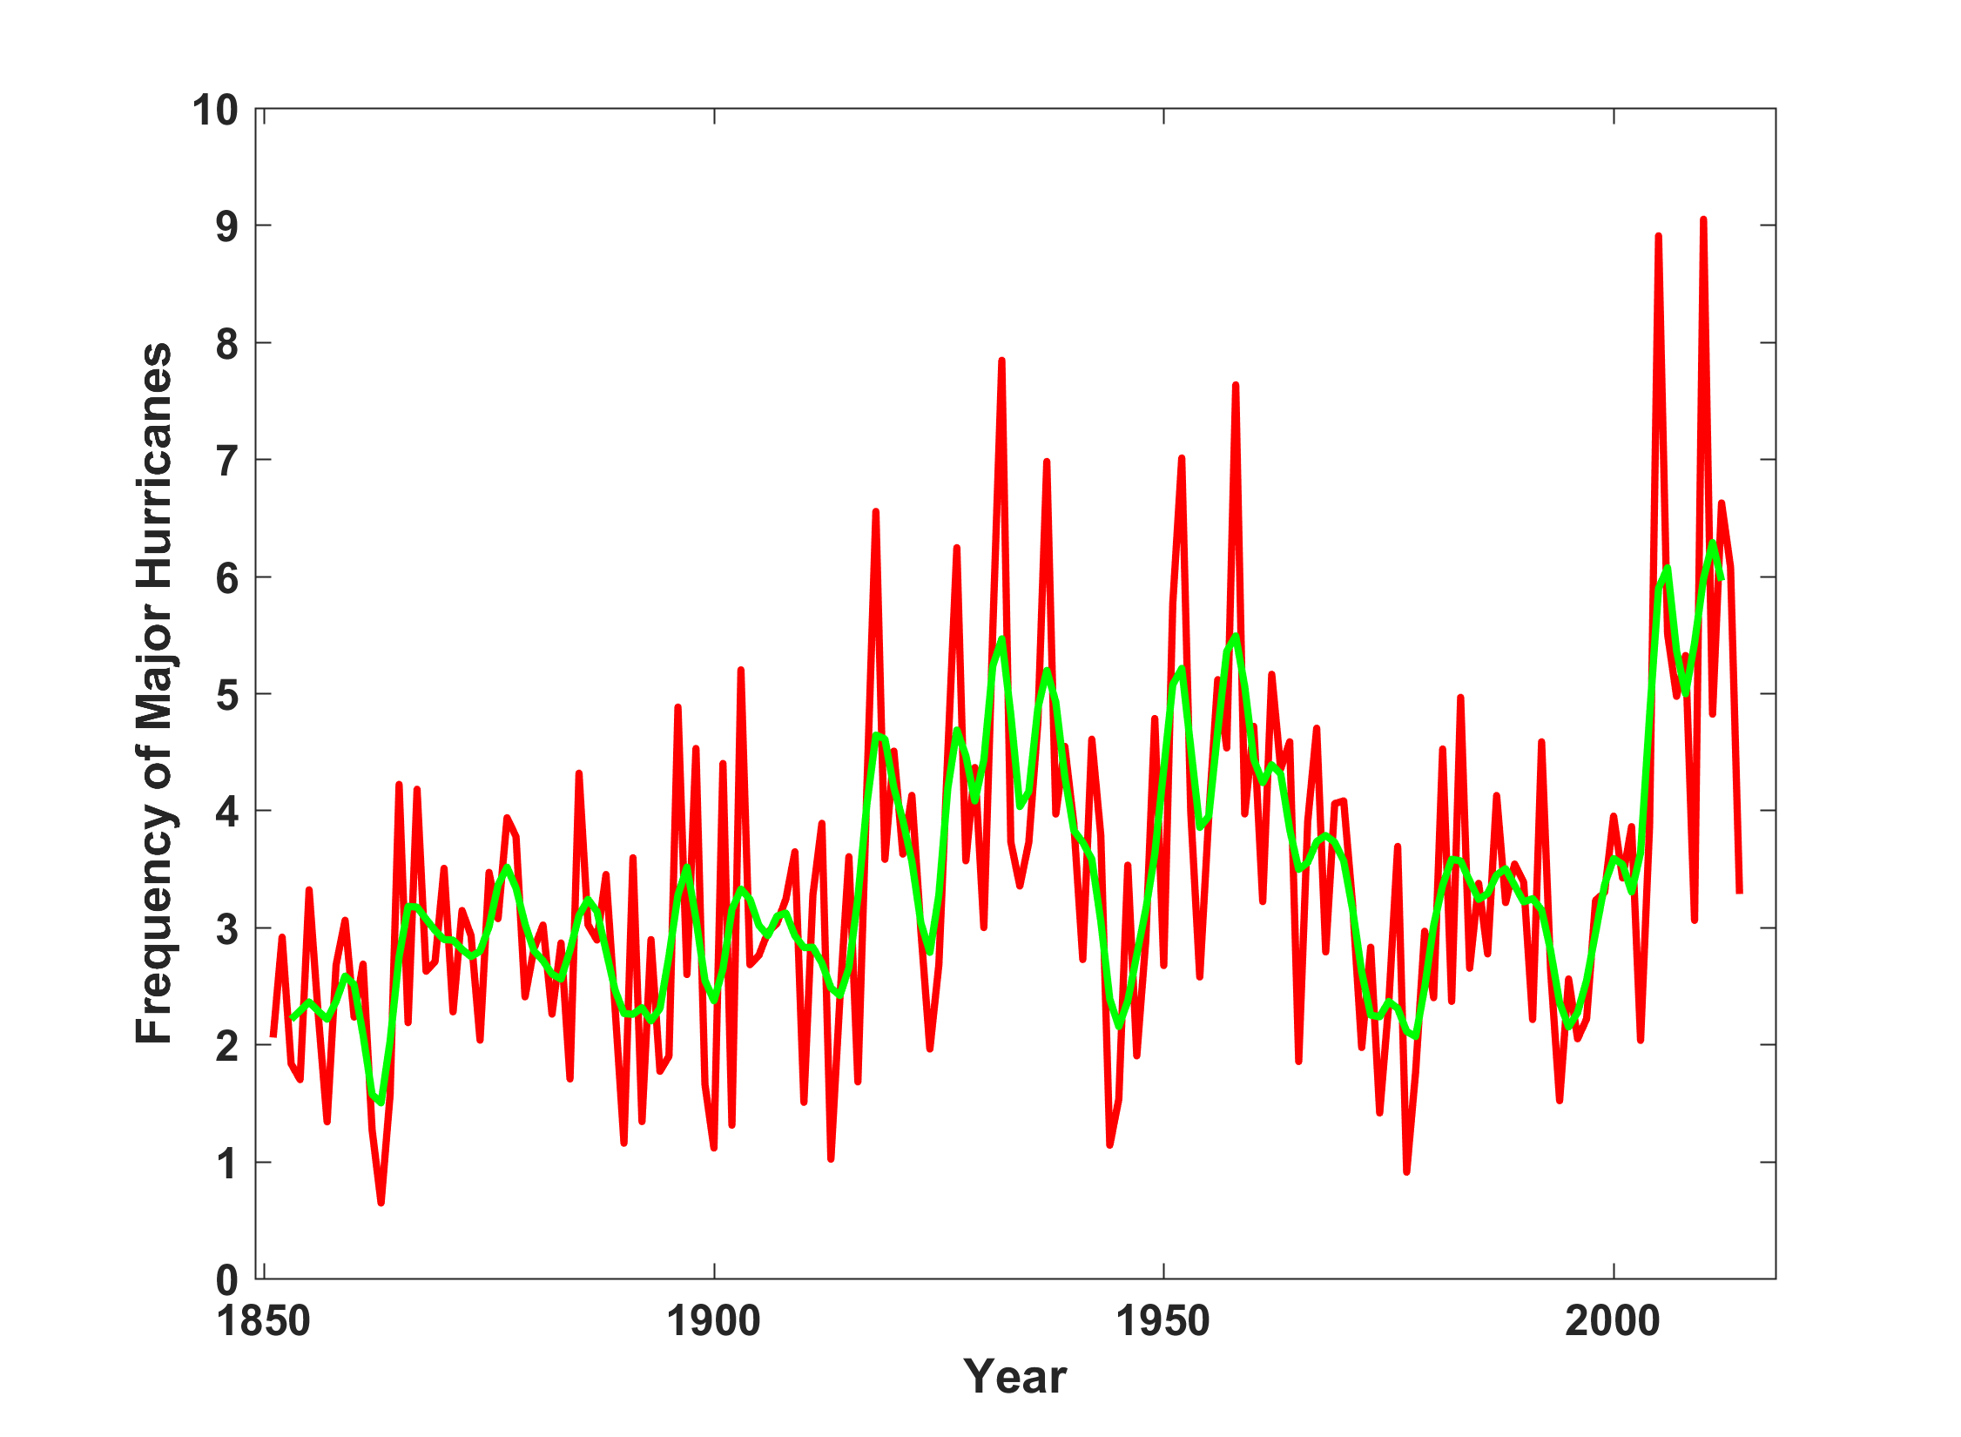
North Atlantic Major Hurricanes Downscaled from NOAA 20th Century Reanalysis
(Forced by sea surface temperature, surface pressure, and sea ice only)

Slide 40
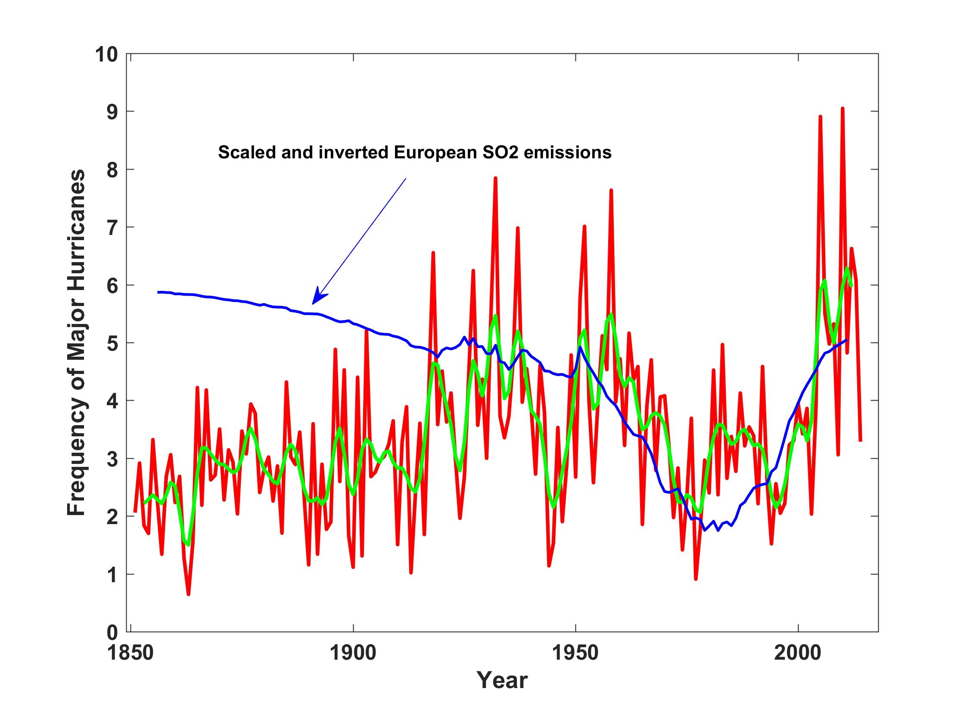
North Atlantic Major Hurricanes Downscaled from NOAA 20th Century Reanalysis
(Forced by sea surface temperature, surface pressure, and sea ice only)

Slide 41


Storm Surge Simulation (Ning Lin)
SLOSH model
(Jelesnianski et al. 1992)
SLOSH mesh
~ 10³ m
ADCIRC mesh
~ 10² m
Battery
ADCIRC model
(Luettich et al. 1992)
ADCIRC mesh
~ 10 m
(Colle et al. 2008)
Notes:
Given the storm wind and pressure fields (which is estimated from the Holland parametric pressure model) we can simulate the surge. Surge simulations with high resolution are computationally intensive, so to make it possible to simulate accurate surges for our large synthetic storm sets, we apply the two hydrodynamic models with girds of various resolutions in such a way that the main computational effort is concentrated on the storms that determine the risk. First, we apply the SLOSH model, using a mesh with resolution of about 1 km around NYC to simulate the surges for all storms and select the storms that have return periods, in terms of the surge height at the Battery, greater than 10 years. Second, we apply the ADCIRC simulation, using a grid mesh with resolution of ~100 m around NYC, to each of the selected storms. Then, we apply another ADCIRC mesh with resolution as high as ~10 m around NYC, for a set of the most extreme events, to check if the resolution of our ADCIRC grid is sufficient and if needed to make statistical correction to the results.

Slide 42
Surge Return Periods for The Battery, New York
Sandy

Slide 43
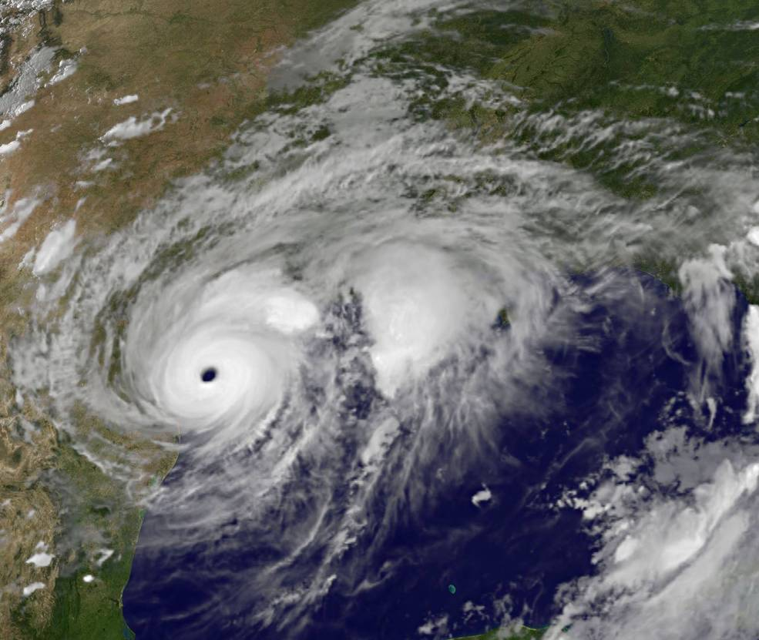
Application to Hurricane Harvey

Slide 44
Risk Assessment for Houston and Texas:
Run 100 events for each year from 1980 to 2016 (3700 events total) passing within 300 km of Houston, downscaled from three climate reanalyses
Run 100 events each year from 1979-2015 passing over the Texas coastline, downscaled from NCAR/NCEP reanalyses. Calculate storm total rainfall for each event at each of 78 points constituting a grid extending from 26º N to 31º N and from 99º W to 94º W, at increments of 0.5º, but excluding points over the Gulf
Run 100 events each year during two periods: 1981-2000 and 2081-2100, passing within 300 km of Houston, downscaled from six climate models
Notes:
44

Slide 45
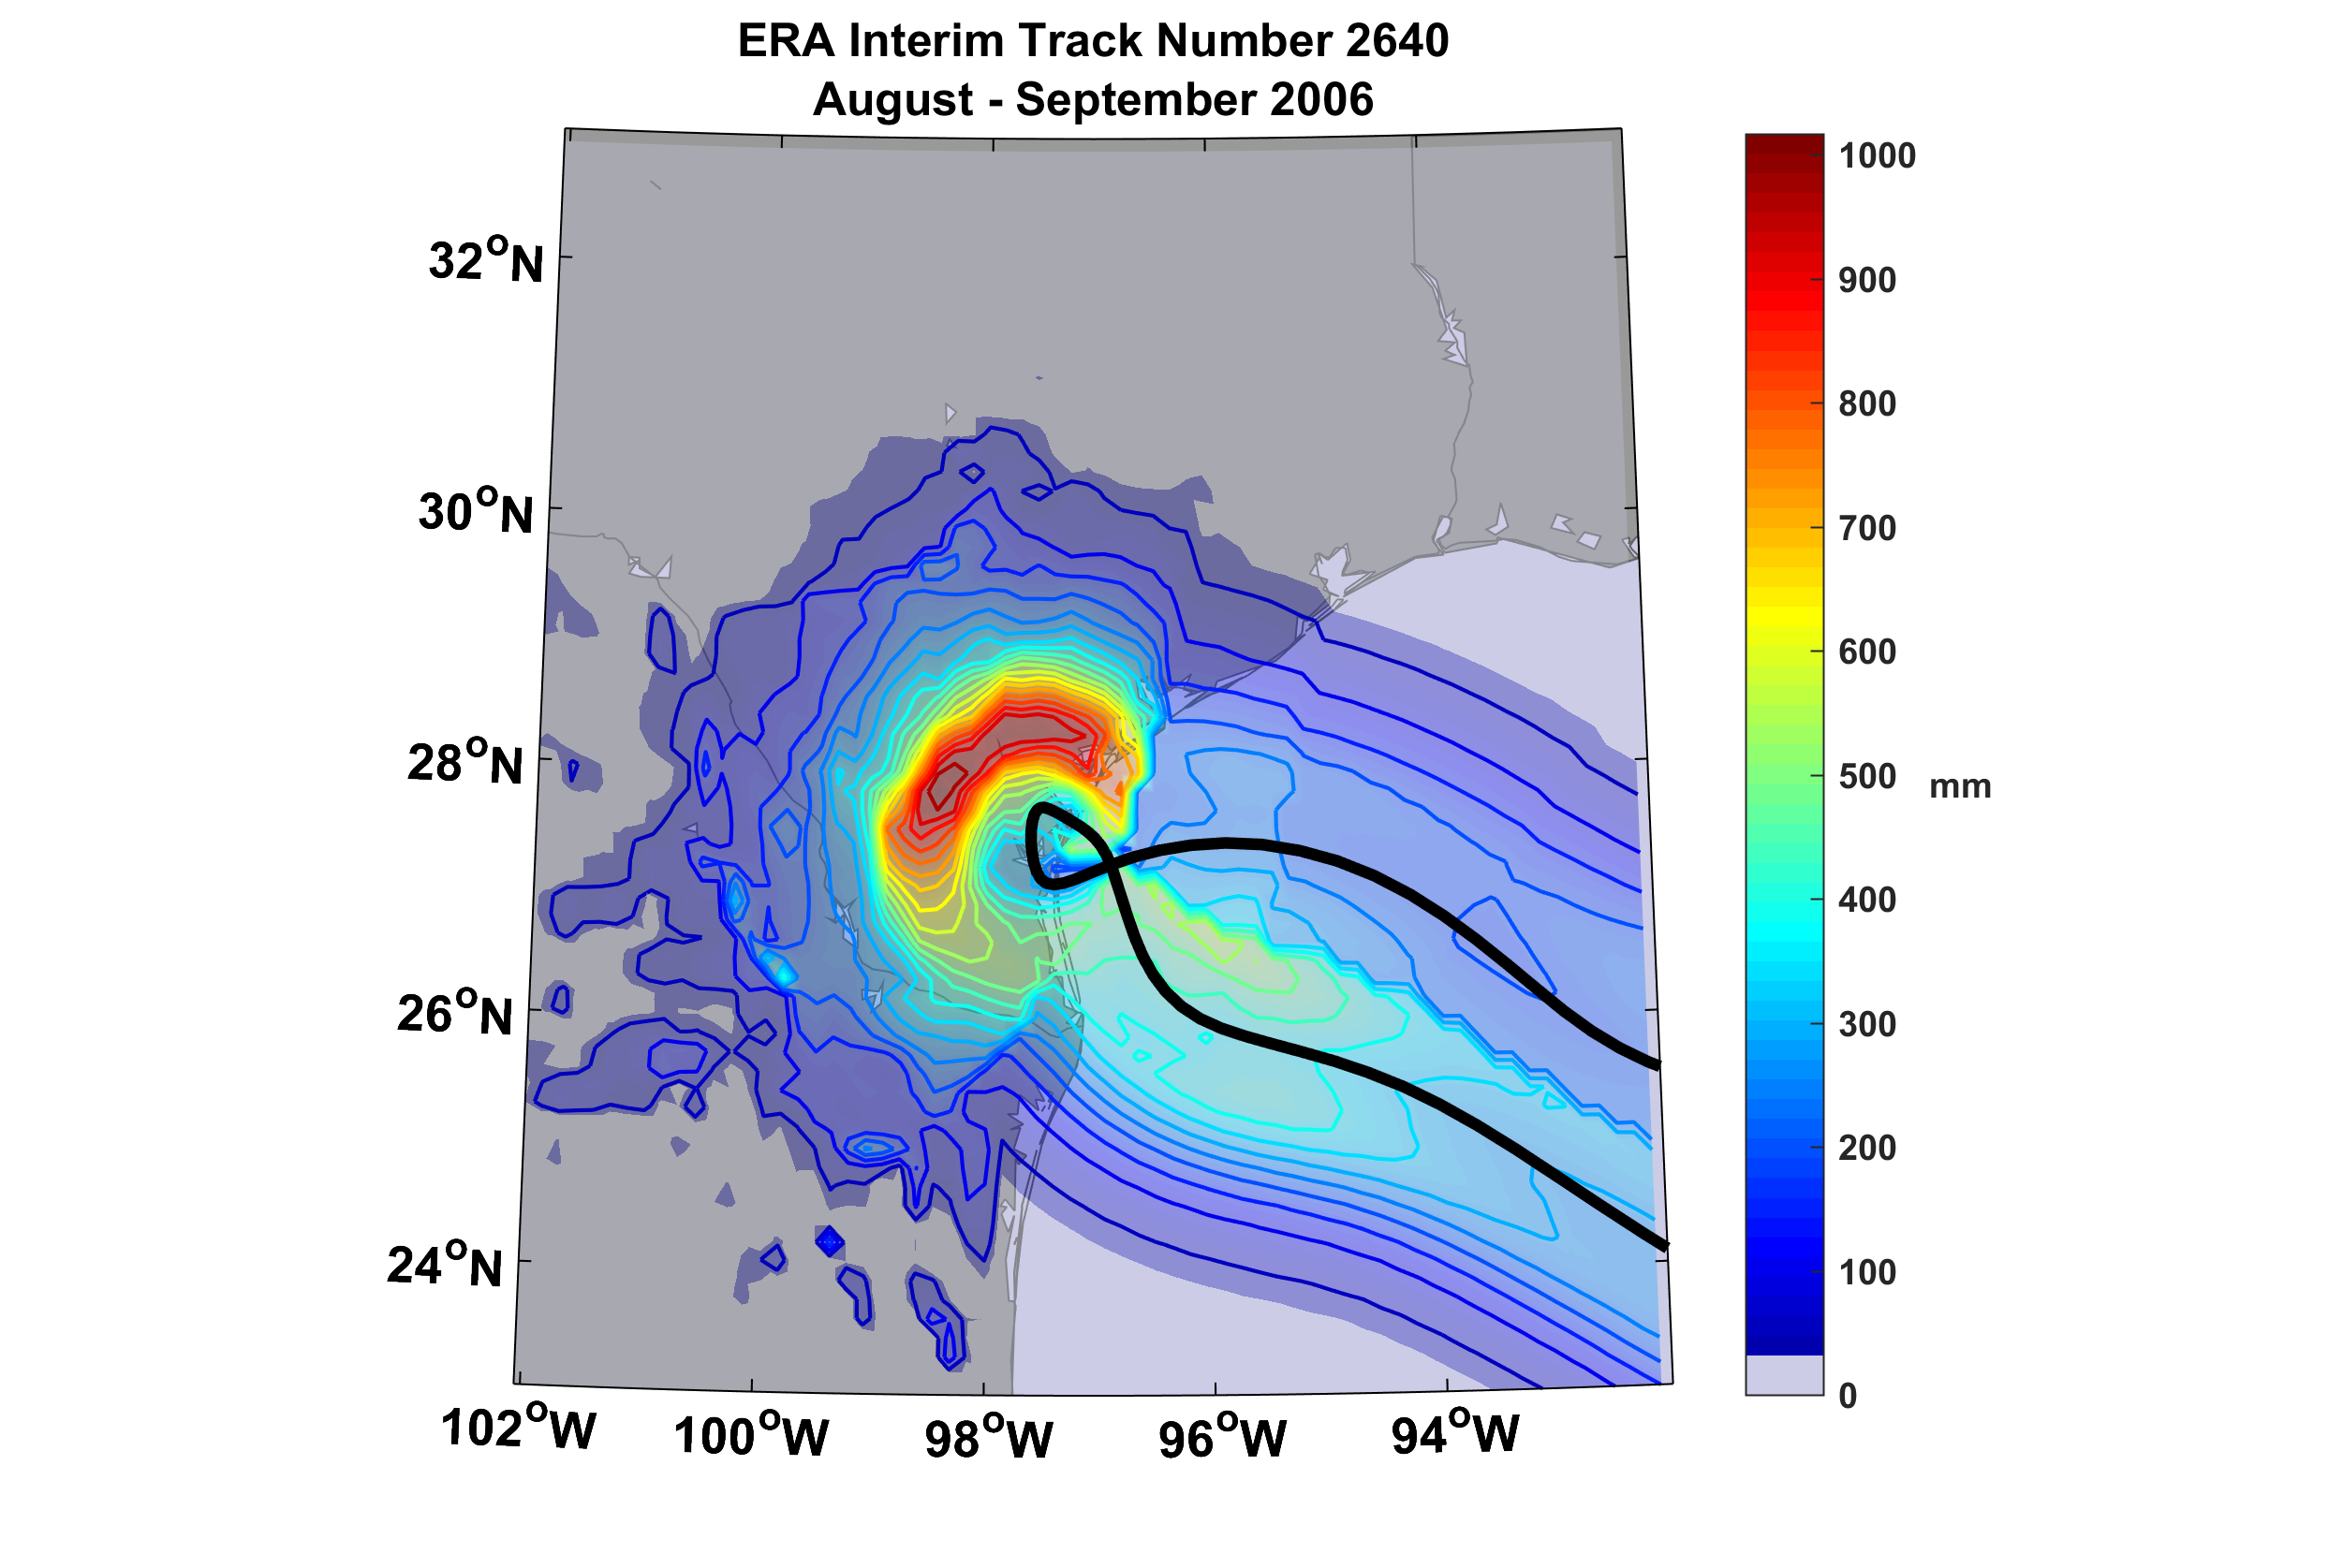
Example of Accumulated Rainfall from a Harvey-like Event Downscaled from ERA Interim Reanalysis

Slide 46
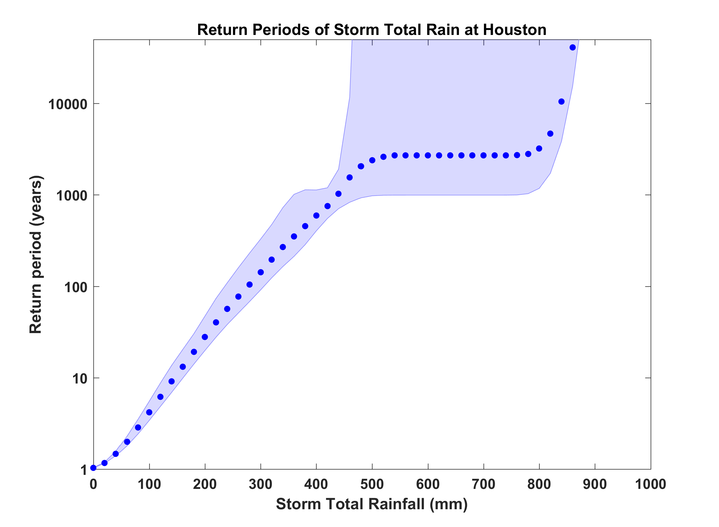
Probability of Storm Accumulated Rainfall at Houston, from 3 Climate Reanalyses, 1980-2016 Based on 3700 Events Each. Shading shows spread among the reanalyses.
Harvey

Slide 47
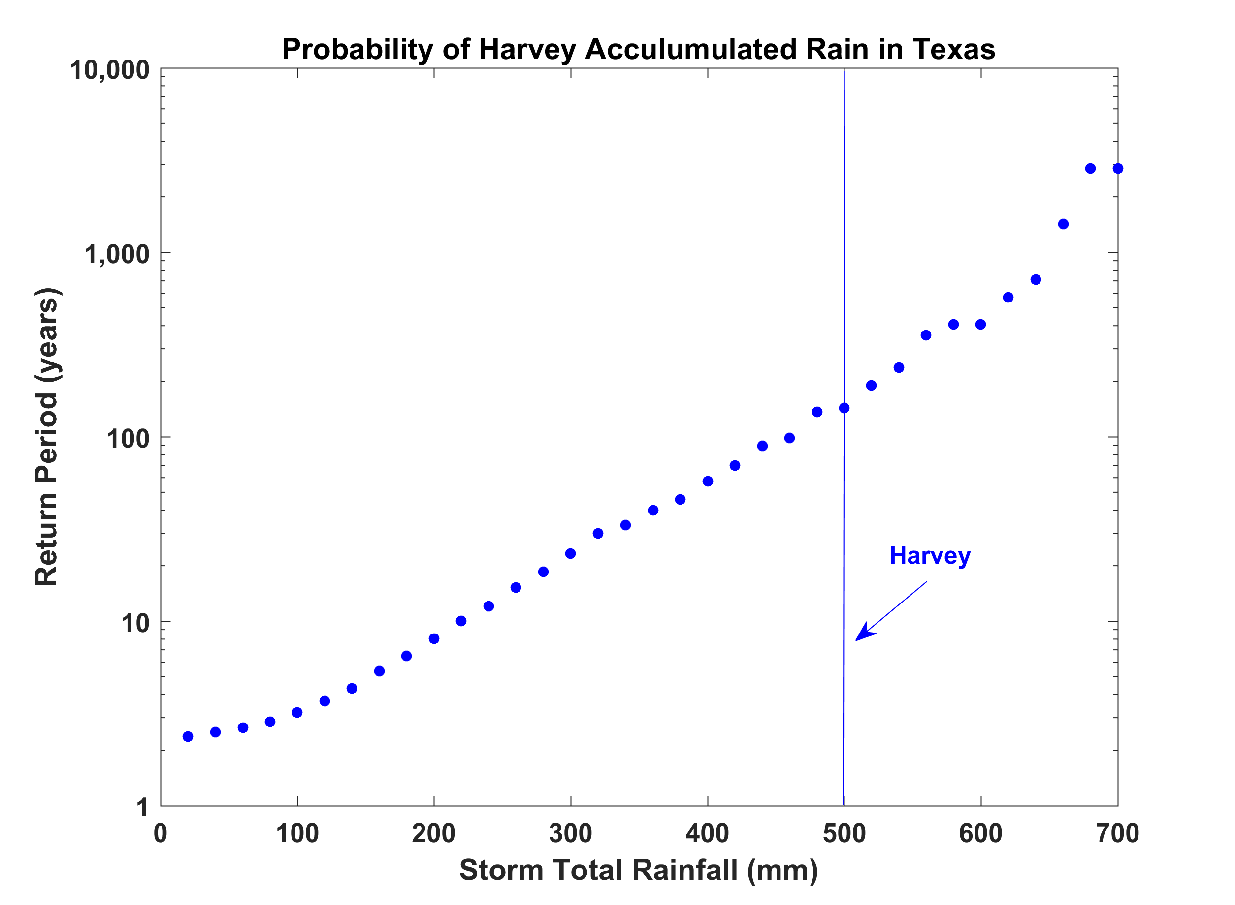
Probability of a Accumulated Hurricane Rain Anywhere in Texas, based on 3700 Events Downscaled from NCAR/NCEP Reanalysis

Slide 48
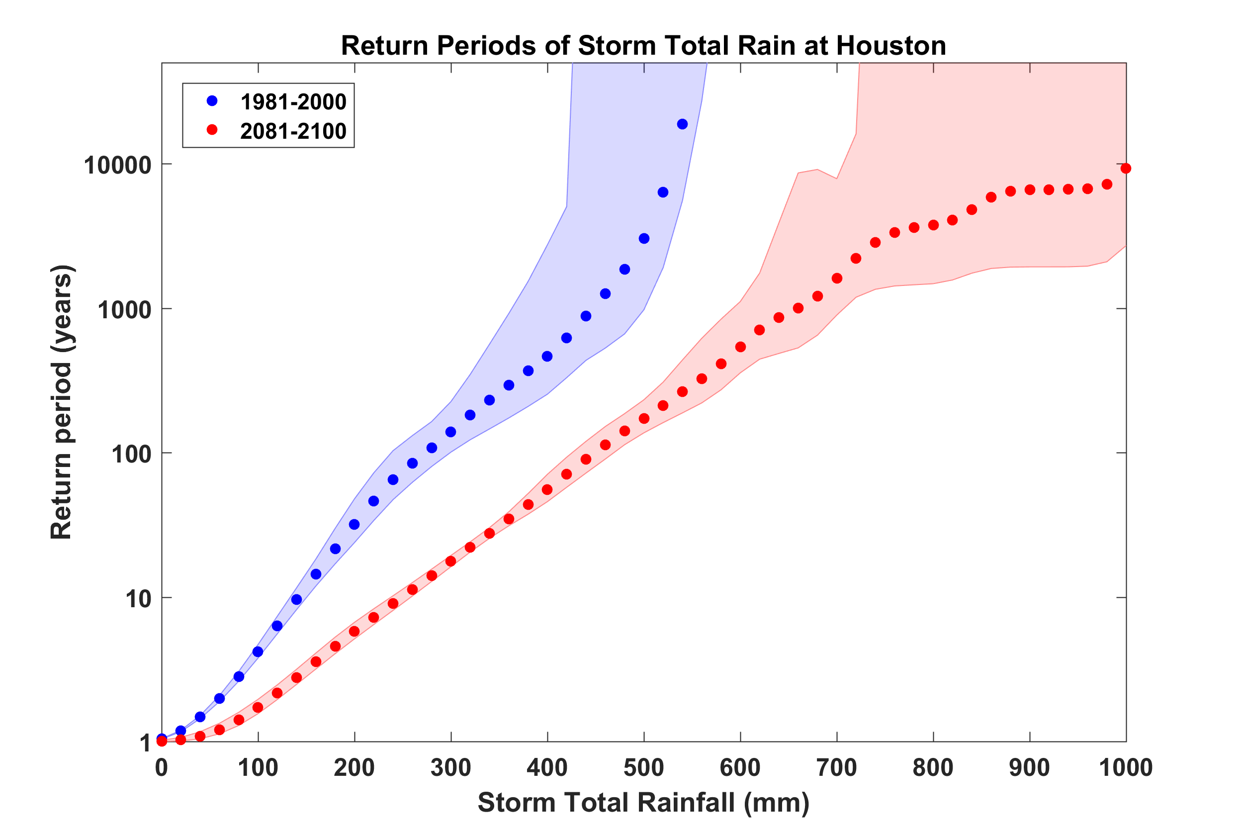
Probability of Storm Accumulated Rainfall at Houston, from 6 Climate models, 1981-2000 and 2081-2100, Based on 2000 Events Each. Shading shows spread among the models.
Harvey

Slide 49
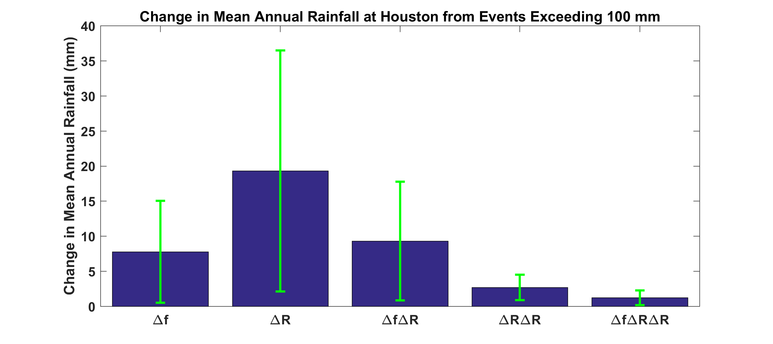
Contributions to Changes in Annual Mean Hurricane Rainfall at Houston from Changes in Overall Event Frequency and in Average Storm Rainfall
Δf = Change in overall hurricane frequency
ΔR= Change in Rainfall amounts in excess of 100 mm

Slide 50
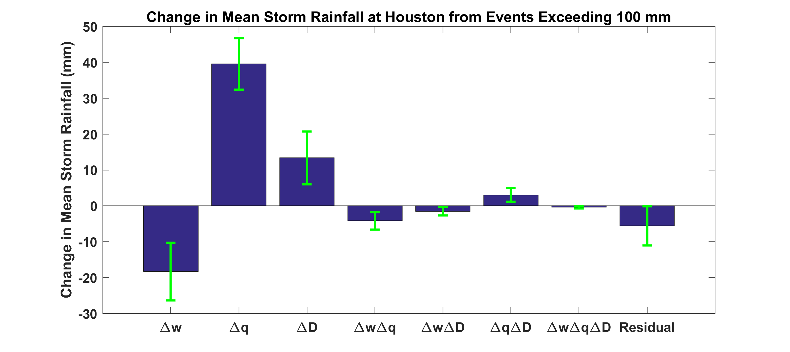
Contributions to Changes in Hurricane Rainfall at Houston from Changes in Updraft Speed, Water Vapor Content, and Storm Duration
Δw = Change in updraft speed
Δq = Change in water vapor concentration
ΔD = Change in storm duration

Slide 51
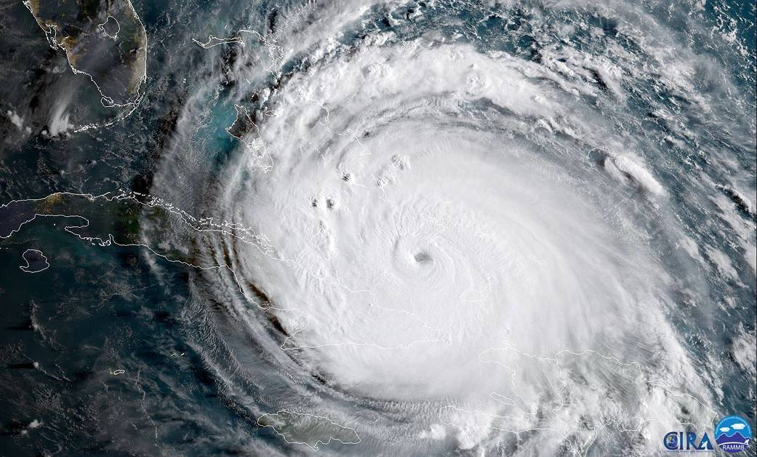
Hurricane Irma

Slide 52
Irma
Run 100 events each year during two periods: 1981-2000 and 2081-2100, passing within 300 km of Houston, downscaled from six climate models

Slide 53
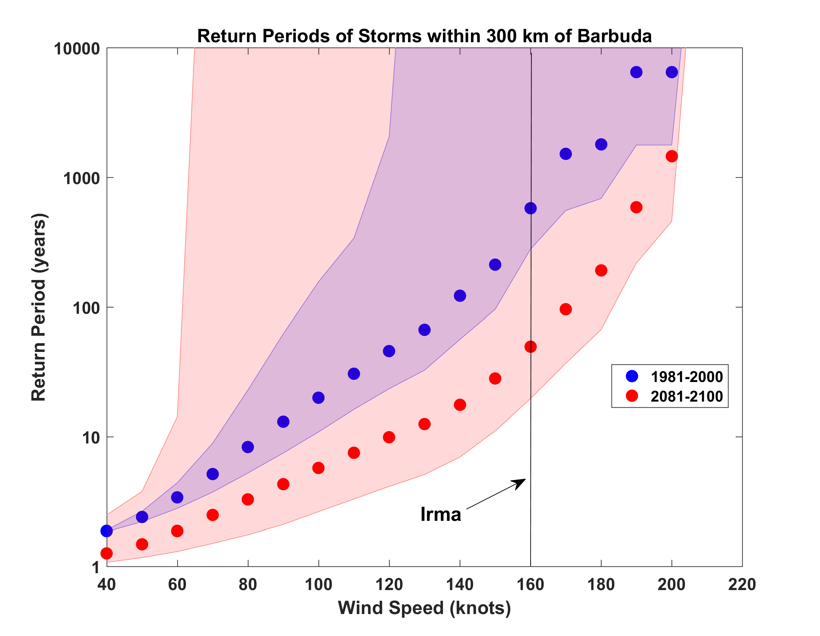
Probabilities of Storms of Irma’s Intensity within 300 km of Barbuda, from 6 Climate models, 1981-2000 and 2081-2100, Based on 2000 Events Each. Shading shows spread among the models.

Slide 54

MIT’s Hurricane Flood Risk

Slide 55
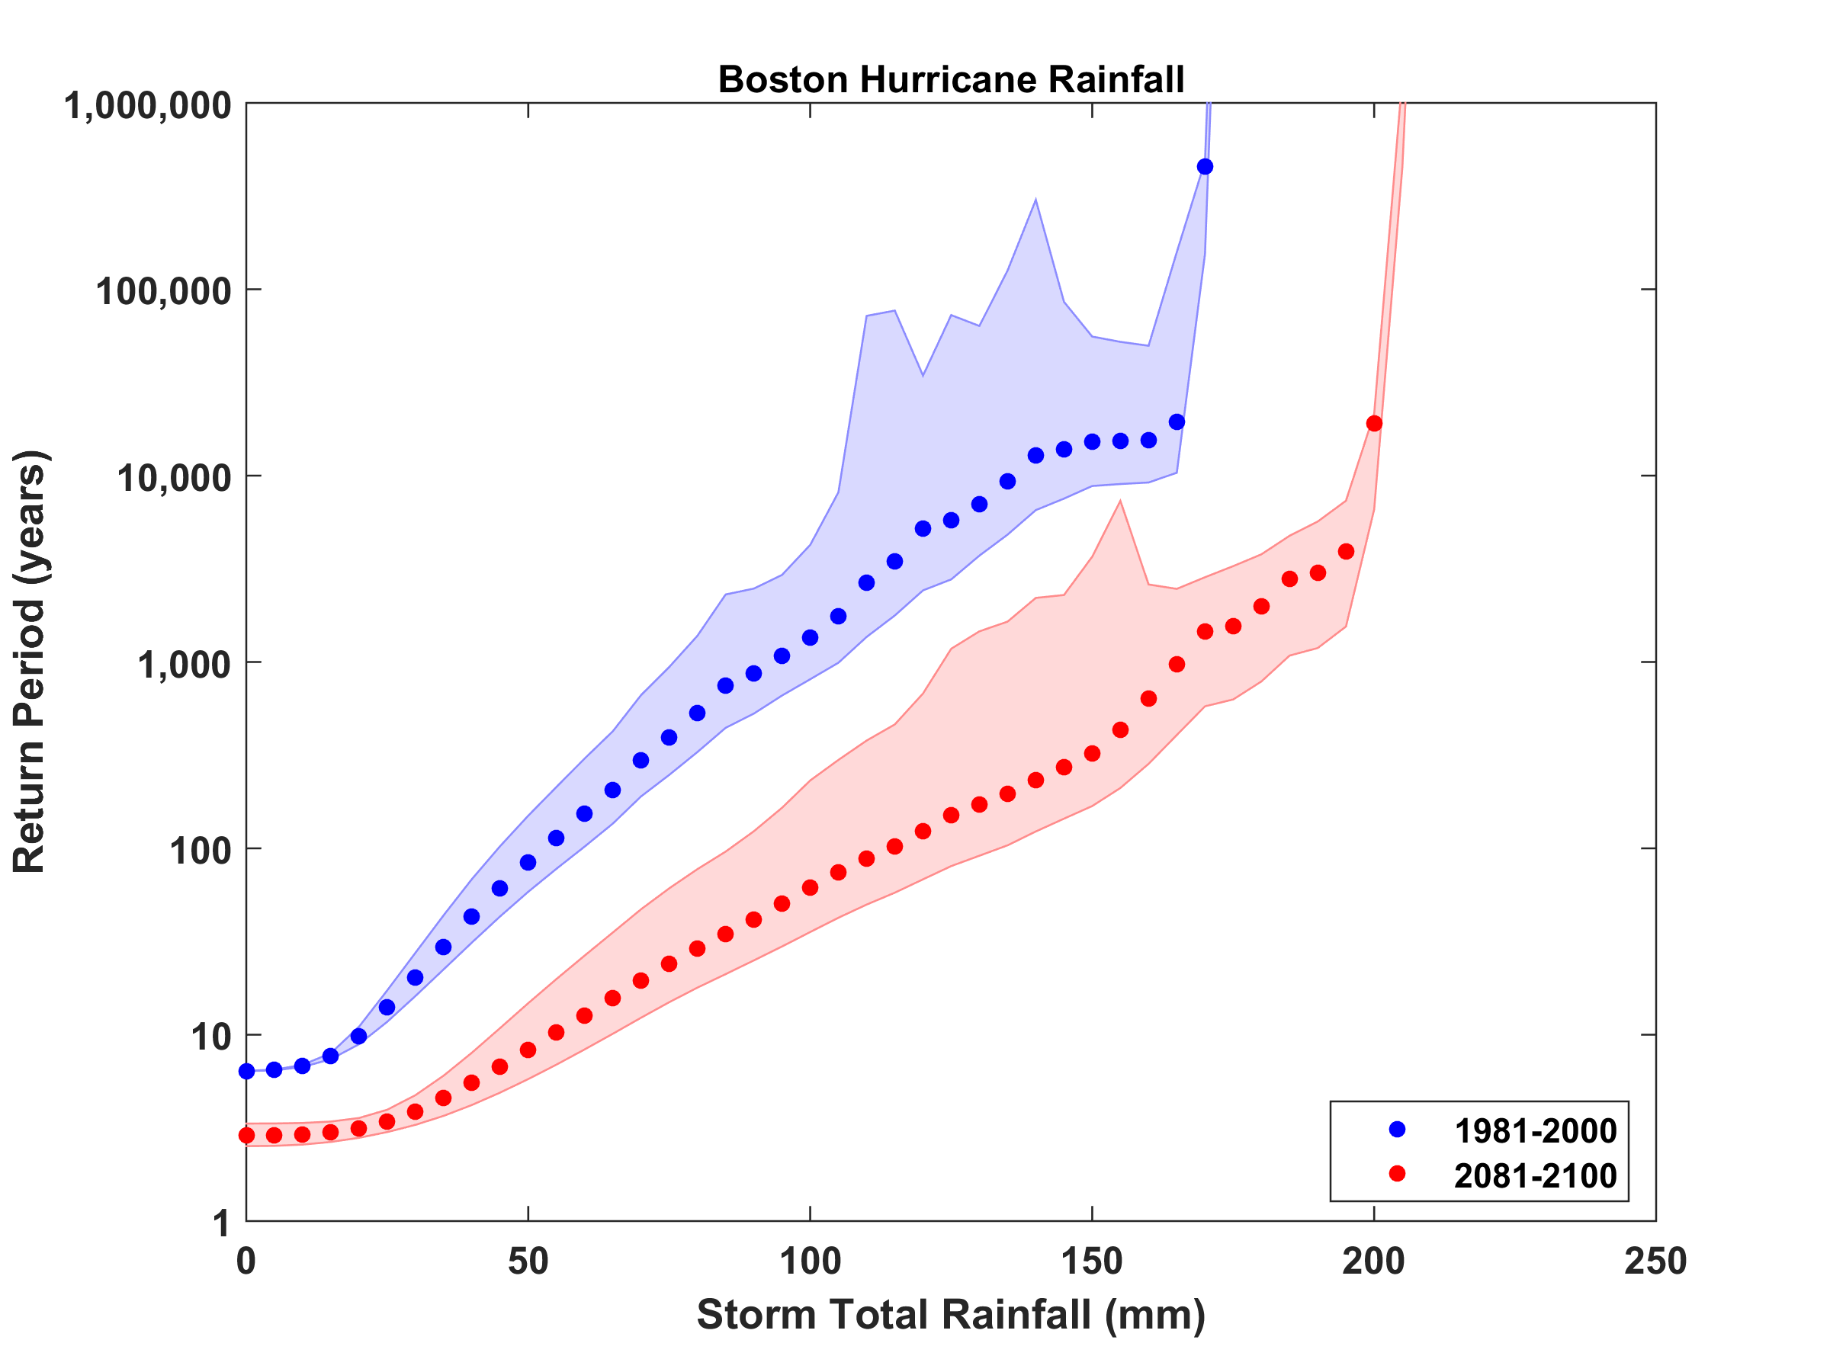
Cambridge and Boston Hurricane Rain Risk

Slide 56
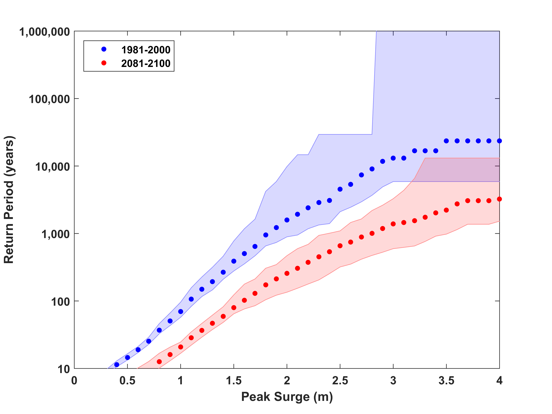
Surge Risk at the Charles River Dam

Slide 57
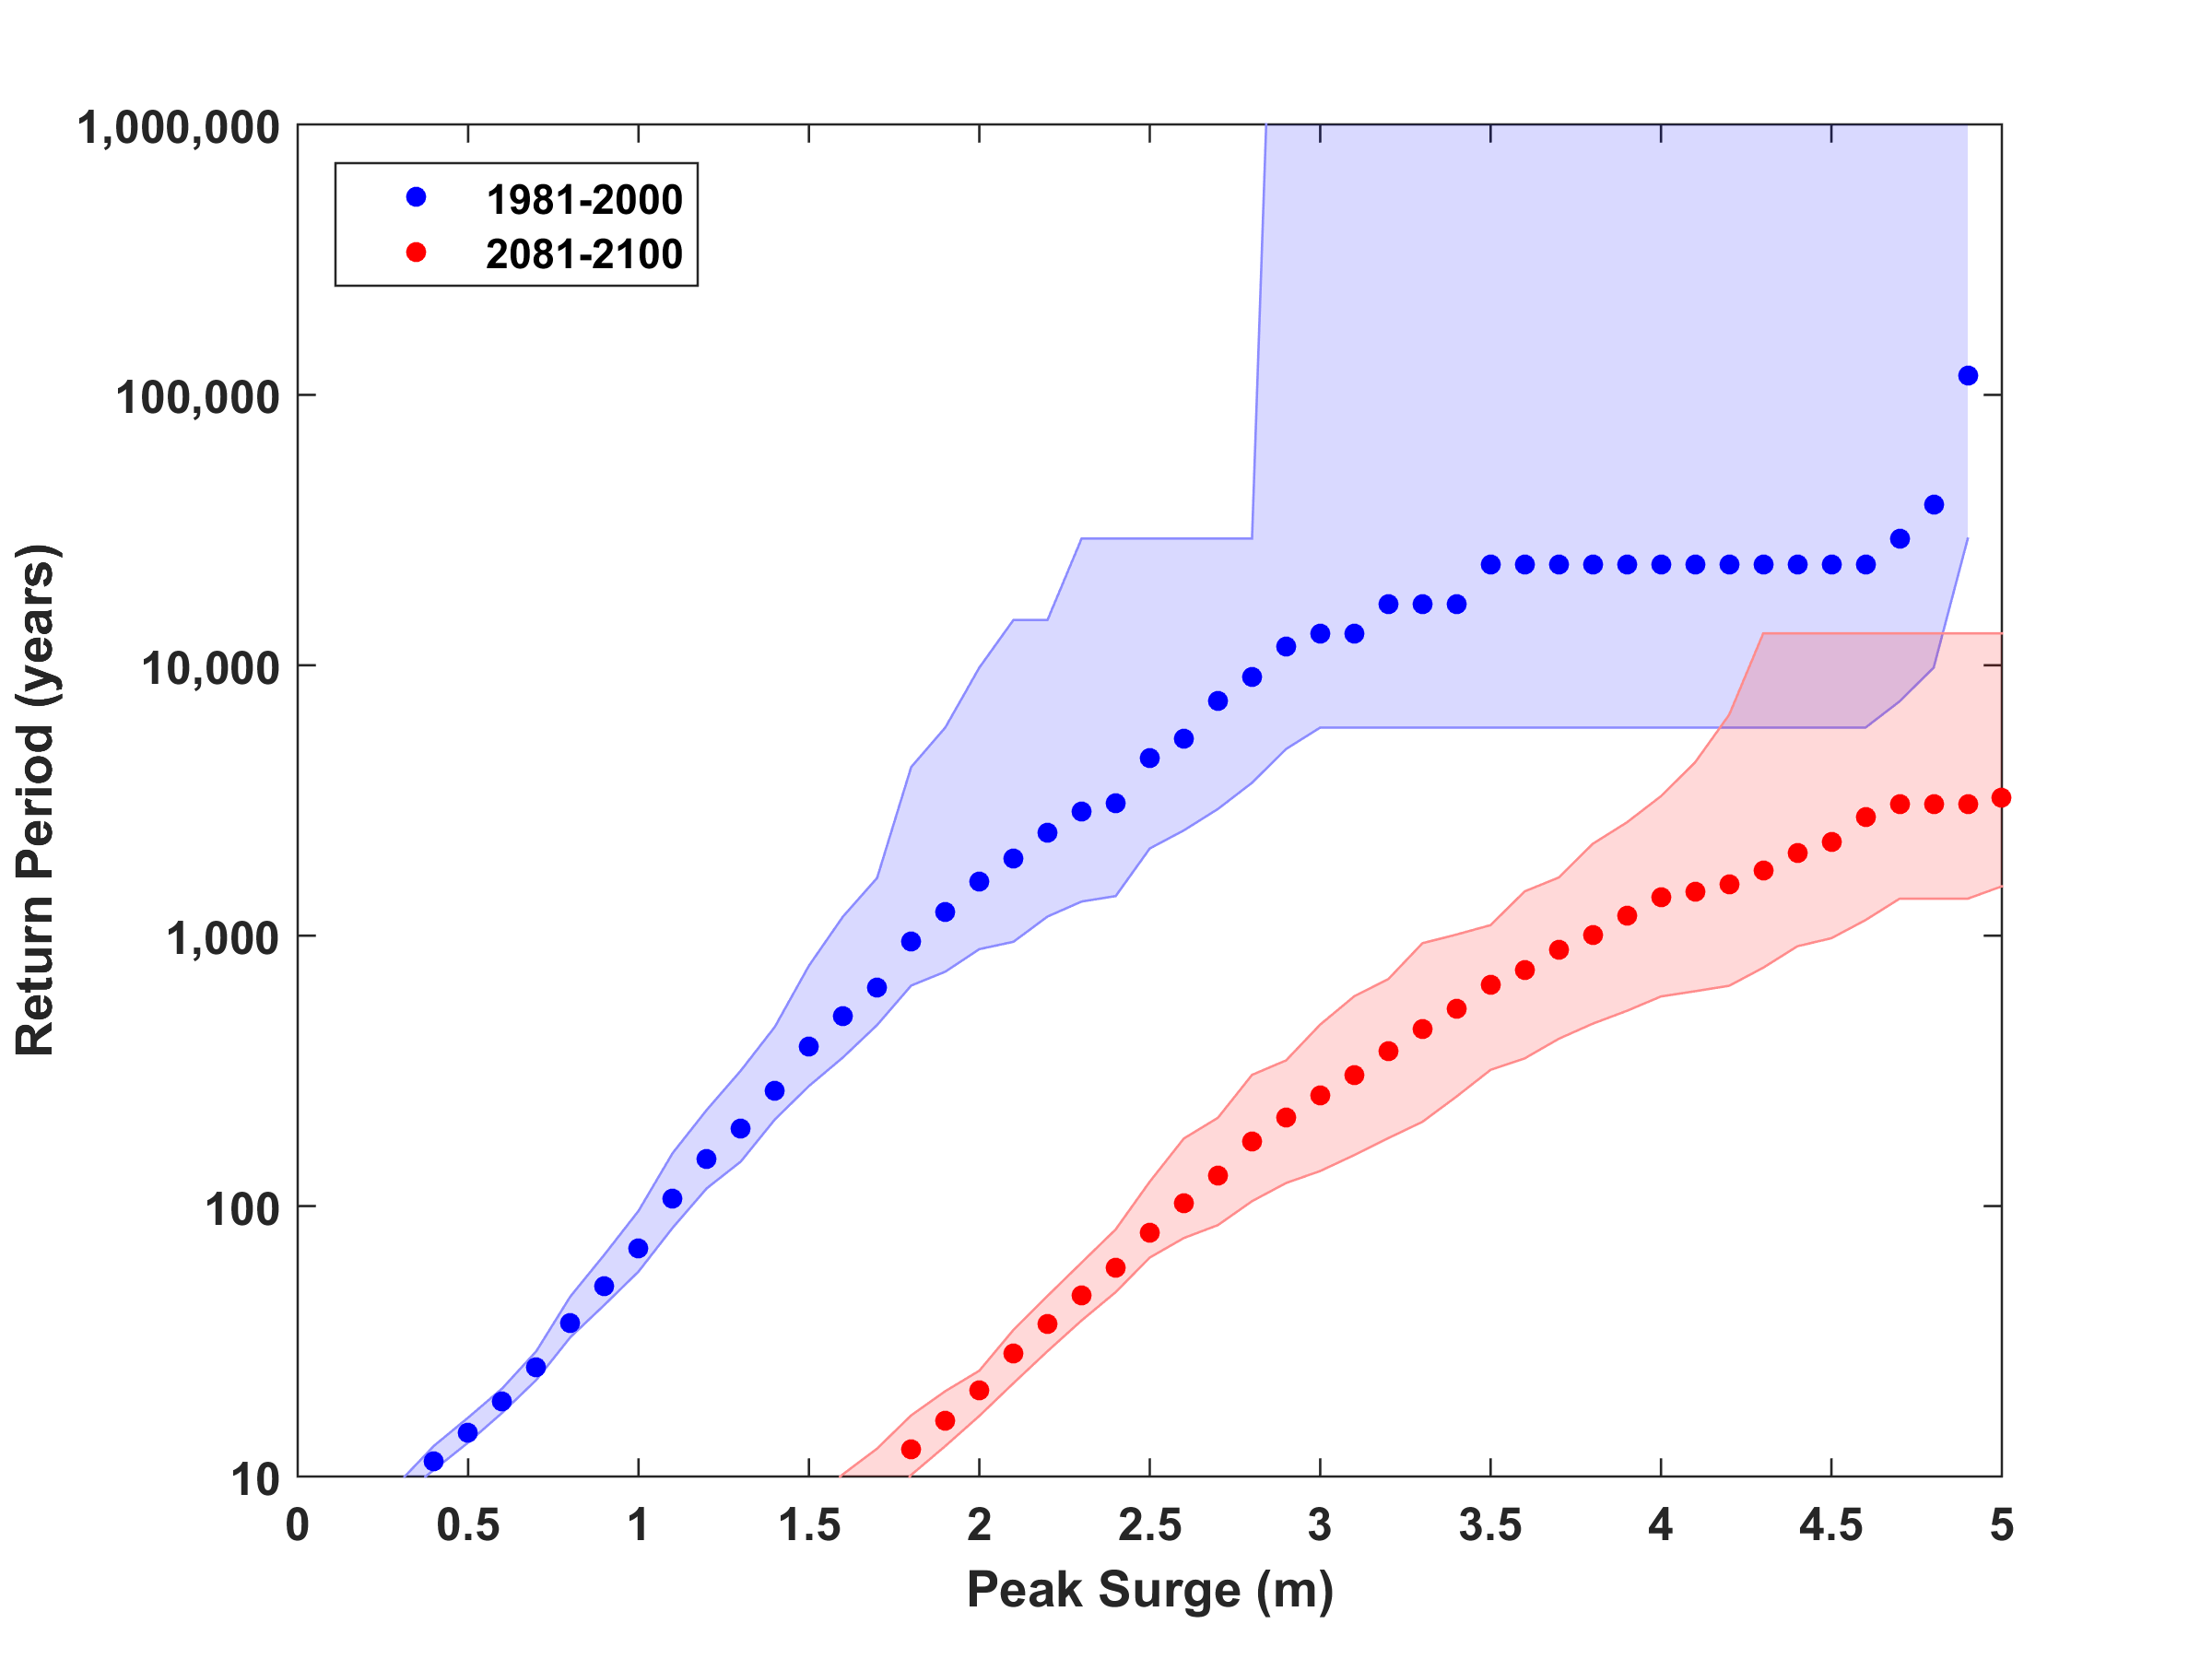
Surge Risk with 1 meter sea level rise

Slide 58
Sea Level Rise / Storm Surge Propagation (2070)
Courtesy Ken Strzepek
1-3 feet peak
<1 foot peak
1% or 100 year SLR/SS event under climate change conditions (2070) (precipitation not yet included)
Note: not for distribution – in-progress MIT Flood Vulnerability Study (Jun 2017); based on MassDOT/Central Artery Flood Modelling assumptions for river levels
Notes:
Scenario shows 1% probability storm surge event in 2070 (with sea level rise and climate changes)
Surge would flank the Charles River dam and flood areas of the campus with 1-3 feet of peak flood water.
Rather than overtop the seawall along Memorial Drive, surge water would propagate stormwater drainage pipes and flood lowest campus elevation areas along Vassar and Albany and Main St.
Areas that would likely be flooded include many of the same lower elevation areas that are of risk and noted below under probable precipitation-flooding areas.
Scenario only accounts for a surge of seawater, not precipitation run-off from Cambridge land.
Surge would likely bring salty water into campus utility and building systems.
KEY ASSUMPTIONS FOR MODELLING: MassDOT/Central Artery Tunnel Flood Study - https://www.massdot.state.ma.us/Portals/8/docs/environmental/SustainabilityEMS/Pilot_Project_Report_MassDOT_FHWA.pdf

