Slide 1
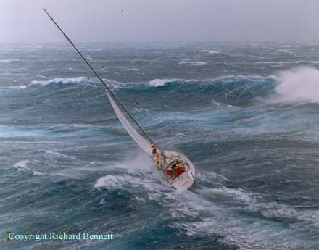
Weather for Sailors
Kerry Emanuel
Atmospheric Science
MIT

Slide 2
Weather happens on a continuum of space and time scales, but it is helpful to think differently about weather forecasts on 4 time scales:
1- 7 days “Synoptic scale”
2-24 hours “Mesoscale”
30 minutes – 2 hours “Local scale”
0-30 minutes “Microscale”

Slide 3
Two fundamentally different kinds of information:
Maps
Time series of weather at fixed locations

Slide 4
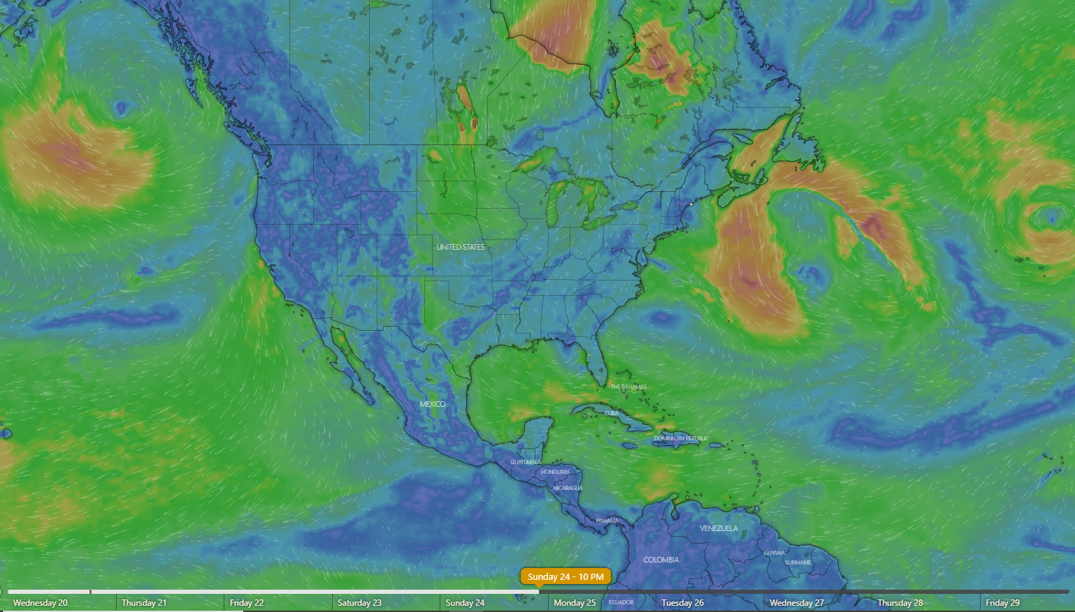
Dealing with the Synoptic Scale: Global Models
Windy.com
European Center for Medium-Range Forecasts, 102-hour forecast for 10 PM Sunday

Slide 5
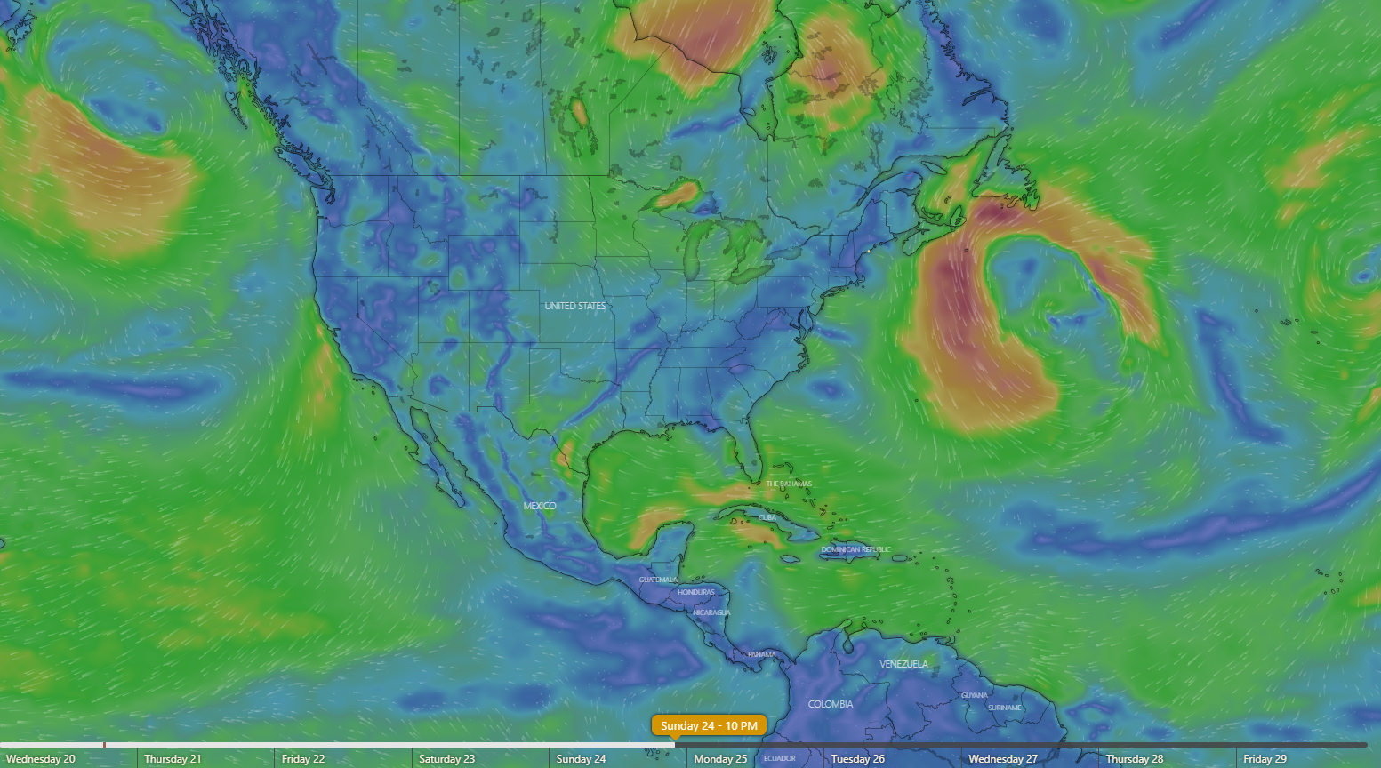
Global models typically run out to 10 days
Windy.com
Global Forecast System (U.S.), 102-hour forecast for 10 PM Sunday

Slide 6
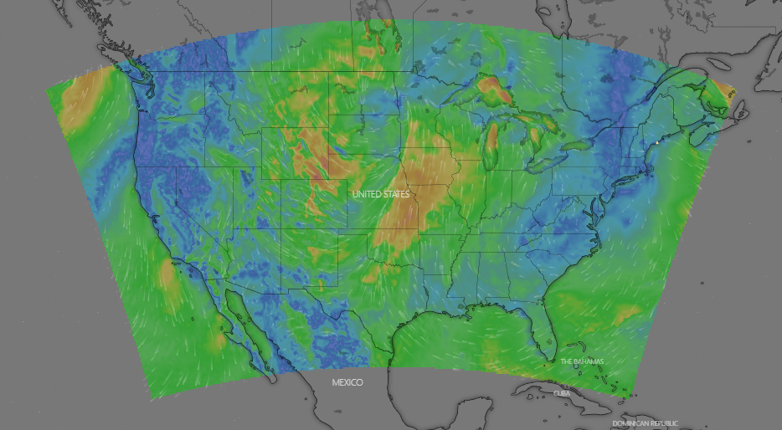
Regional Models
Windy.com
North American Model (U.S.), 60-hour forecast for 2 PM Saturday

Slide 7
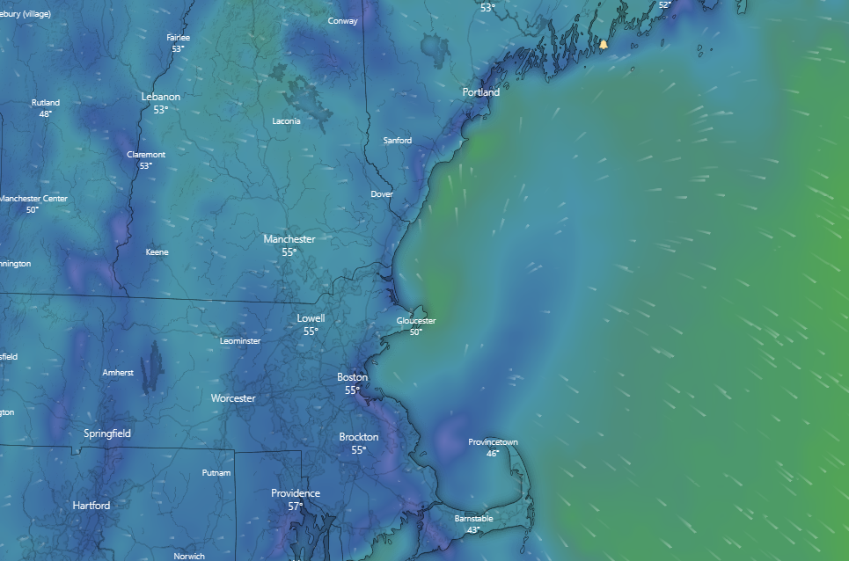
Regional models typically run out to 84 hours
Windy.com
North American Model (U.S.), 60-hour forecast for 2 PM Saturday

Slide 8
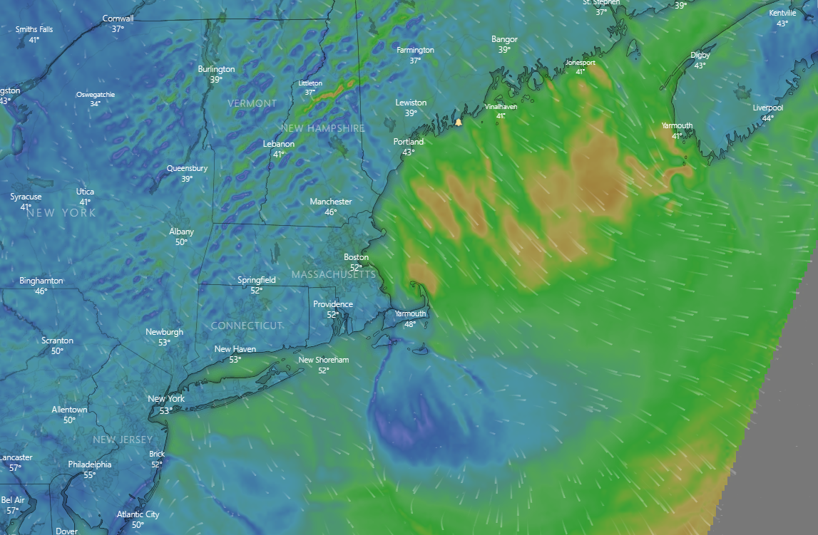
High-Resolution Rapid Refresh (HRRR) 3-km mesh model (U.S.)
Run out to 18 hours, updated every hour
60-hour forecast for 9 PM Friday

Slide 9
How to keep your necks above the waterline and win ocean races:
Quantify Uncertainty
Avoid hazardous weather and sea states
Formulate better racing strategies
The key to quantifying uncertainty:
Ensemble Forecasts

Slide 10
Ensemble Forecasting: The general idea
It has been traditional to use all available computer power to generate a single, “best shot”, very high resolution forecast
Instead, generate many lower-resolution forecasts starting from very slightly different initial states
An army of butterflies

Slide 11
Example: A “Re-Forecast” of an Historical Storm:
The devastating North Sea flood of 1953 caused catastrophic damage and loss of life in Scotland, England, Belgium and The Netherlands and became one of the worst peacetime disasters of the 20th century. 307 people died in England, 19 died in Scotland, 28 died in Belgium, 1,836 died in the Netherlands and a further 361 people died at sea.

Slide 12
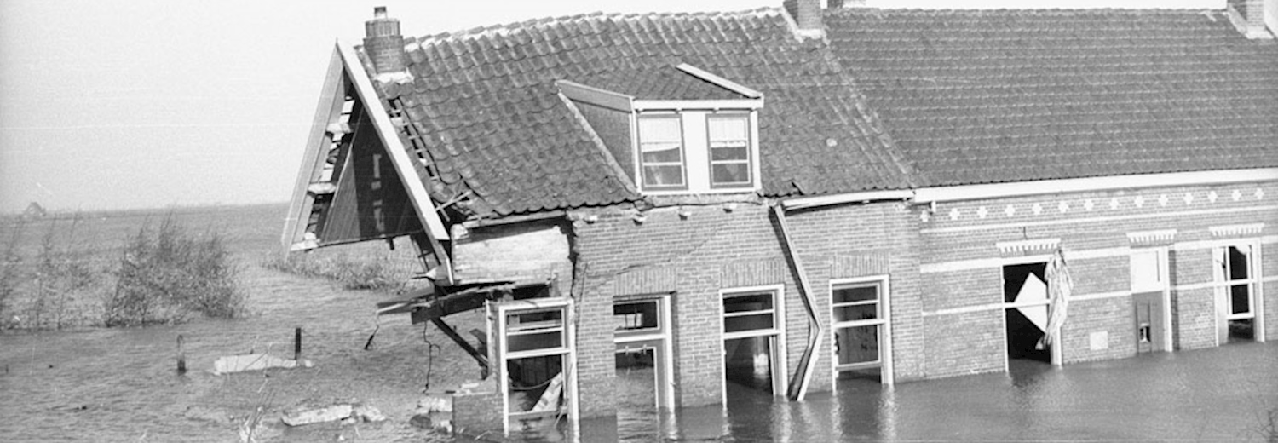
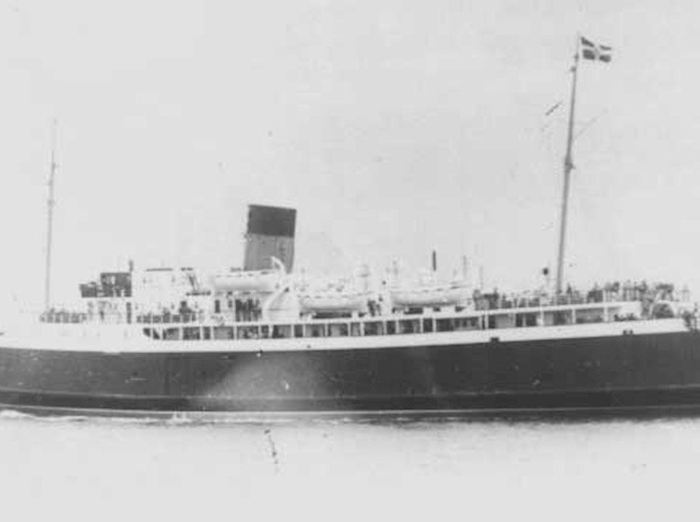
Loss of the MV Princess Victoria

Slide 13
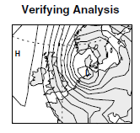
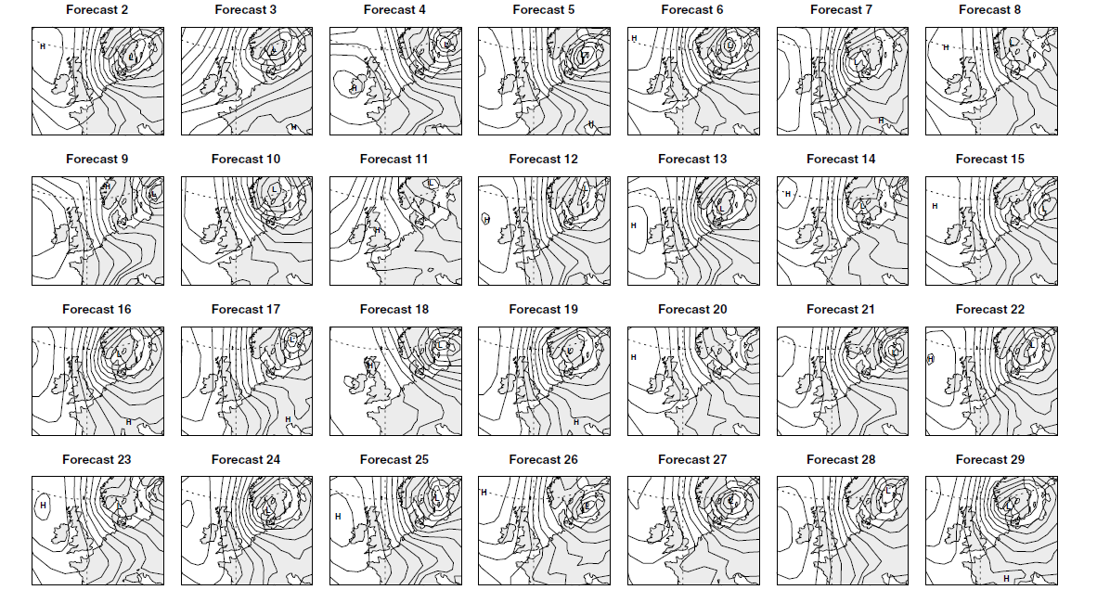
84-hour forecasts:
28 out of 50 ensemble members
Mean sea level pressure analysis at 00 UTC on 1 February 1953

Slide 14
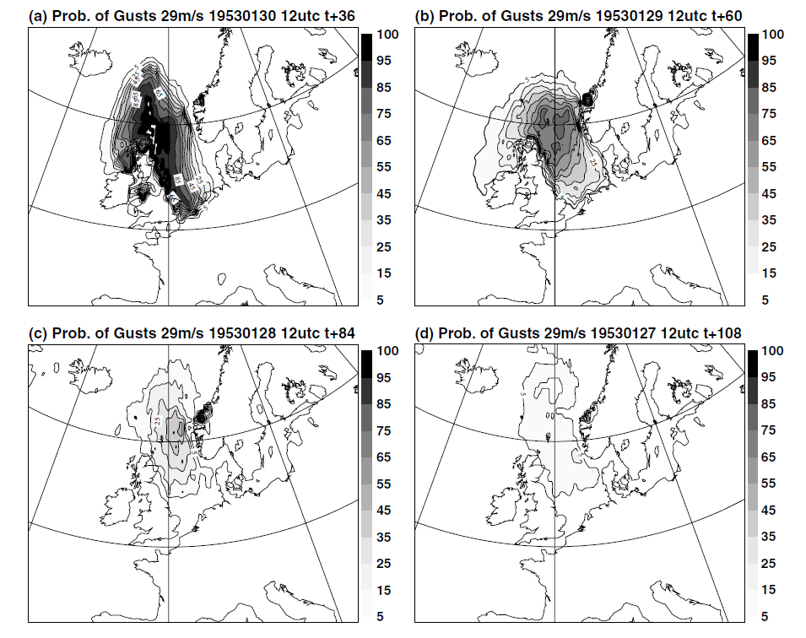

Slide 15
Two infamous offshore races that almost certainly would have been cancelled had forecast ensembles been available at the time:
Fastnet Race of 1979
Sydney-Hobart Race of 1998

Slide 16
The 1979 Fastnet Race
605-mile race started on August 11th, 1979, with 306 yachts participating
25 yachts were sunk or disabled owing to high winds and/or mountainous seas
19 fatalities; Deadliest storm in the modern history of sailing
Largest peace-time rescue operation in history, with 4000 people participating

Slide 17
The 1979 Fastnet Race
Deadliest storm in the modern history of sailing

Slide 18
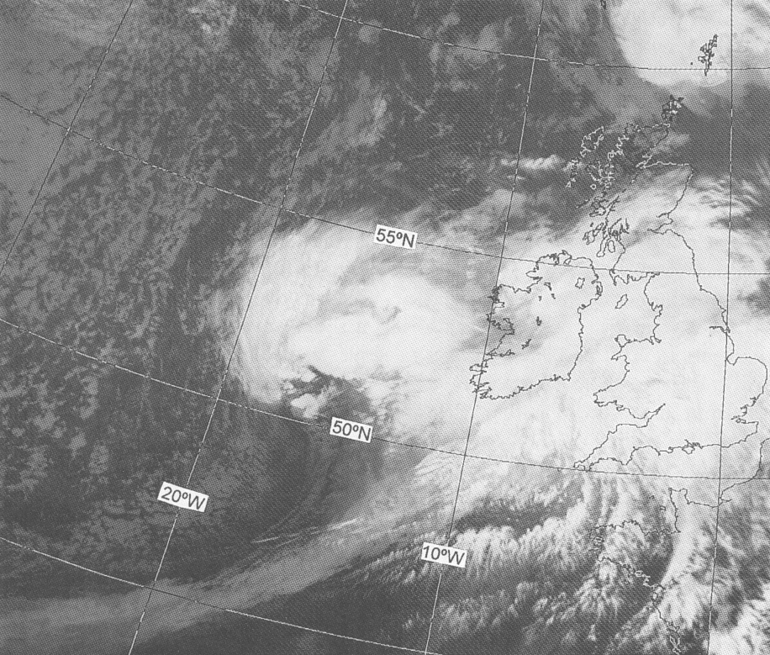
Satellite image at 1537 GMT, 13 August

Slide 19
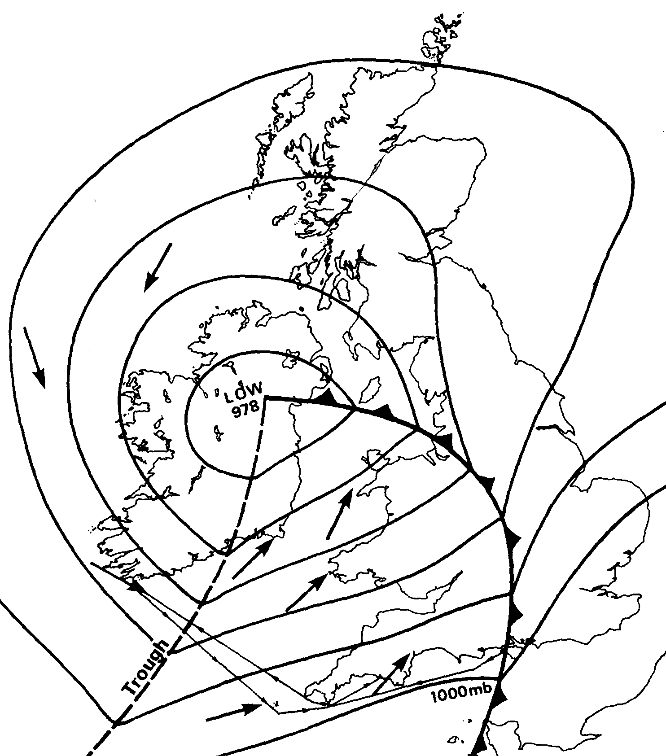
7 AM August 14th, 1979

Slide 20
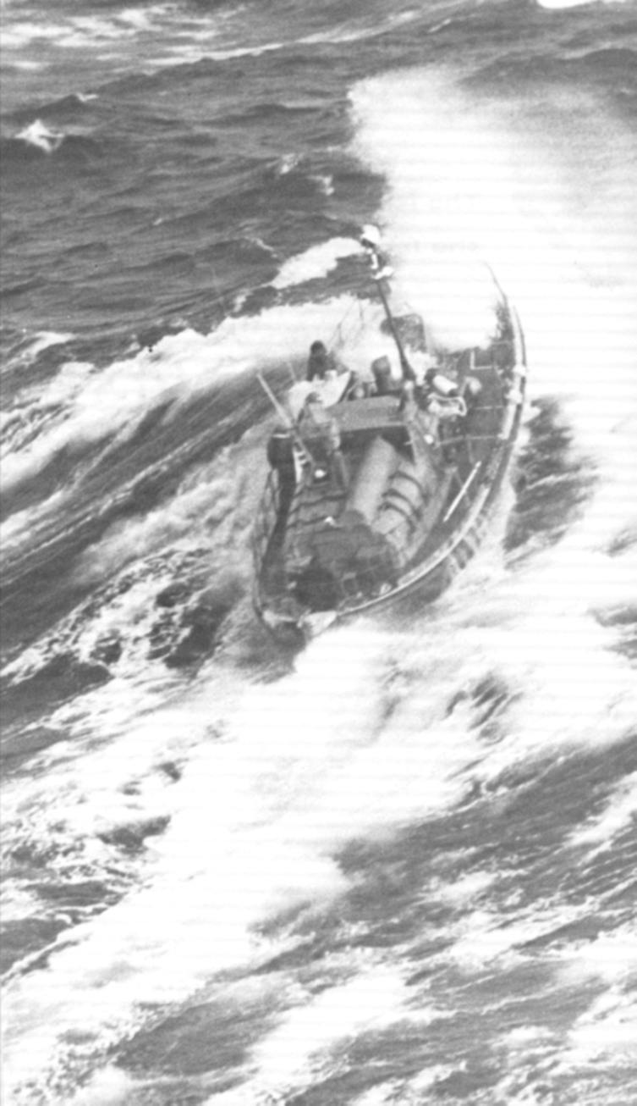
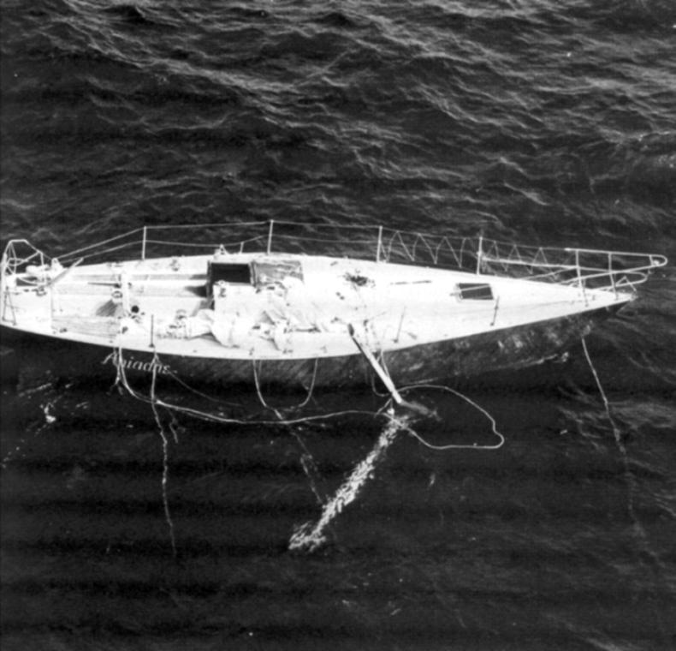

Slide 21
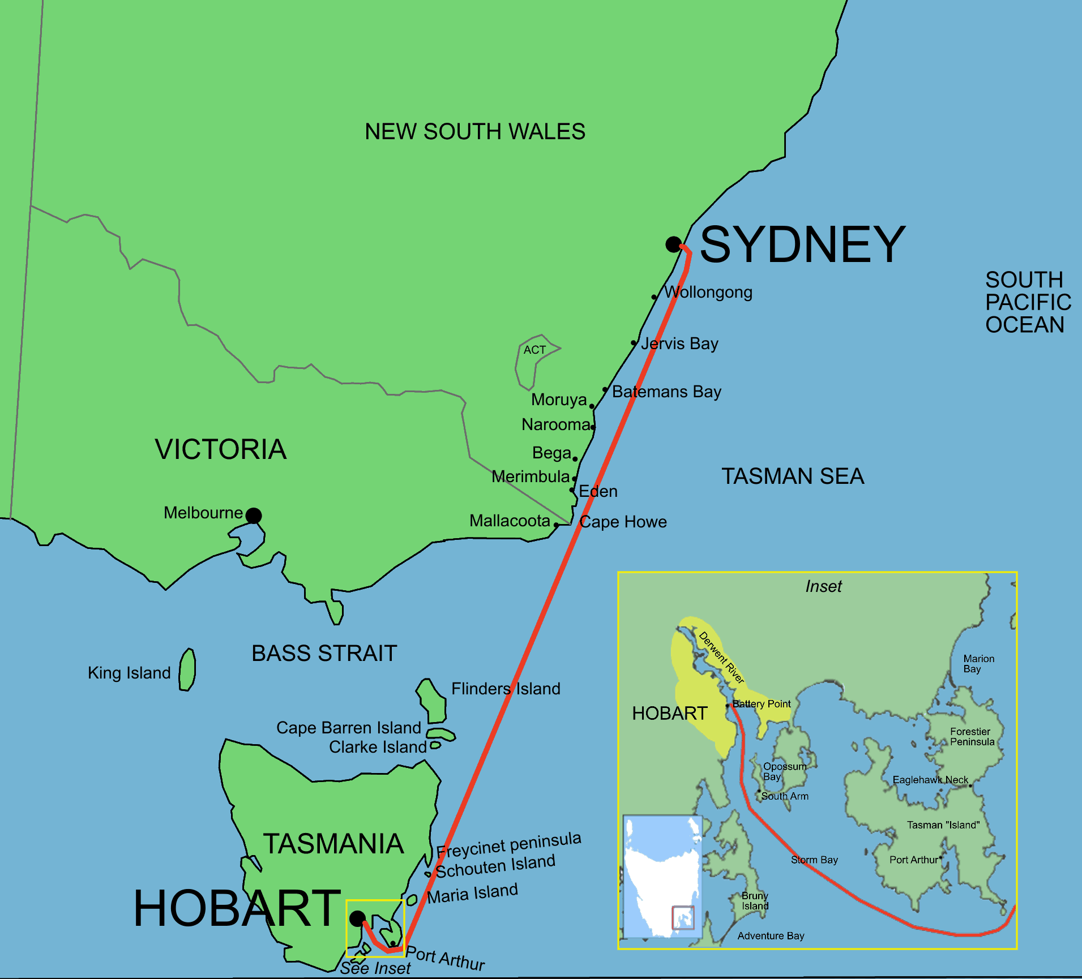
The 1998 Sydney-Hobart Race

Slide 22
115 boats started race on December 26th
Yachts encounter Hurricane-force winds and 40-ft seas
Only 44 make it to Hobart; 5 boats sank
6 sailors lost their lives
55 sailors rescued from yachts, mostly by helicopter

Slide 23
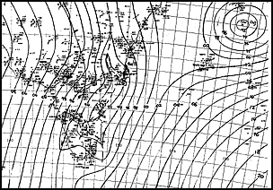
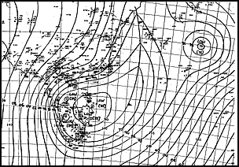
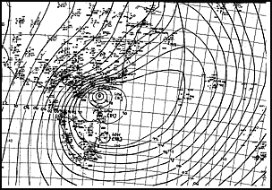
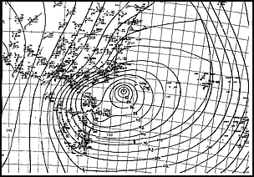
6 PM December 26
3 AM December 27
9 AM December 27
3 PM December 27

Slide 24
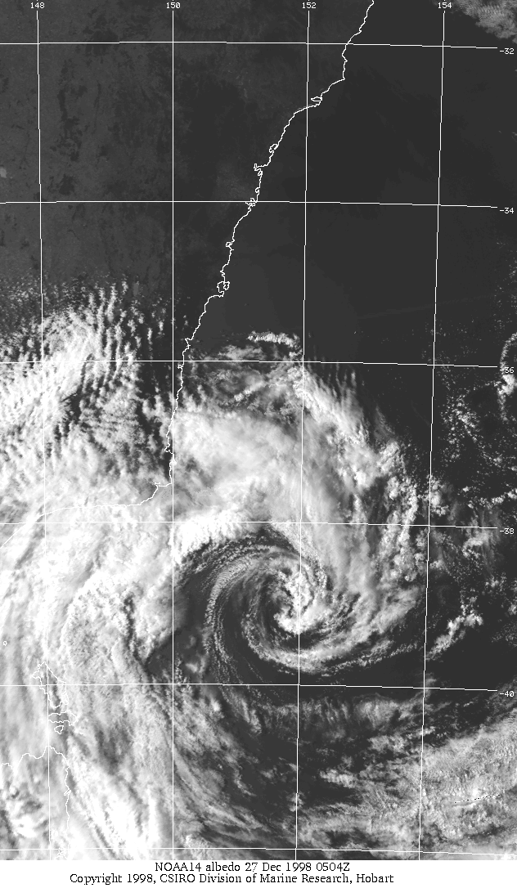

Slide 26
How can you access and use ensemble forecasts to your advantage?
Think in terms of times series at fixed points rather than maps
Explore different apps, websites
Keep track of updates to forecasts

Slide 27
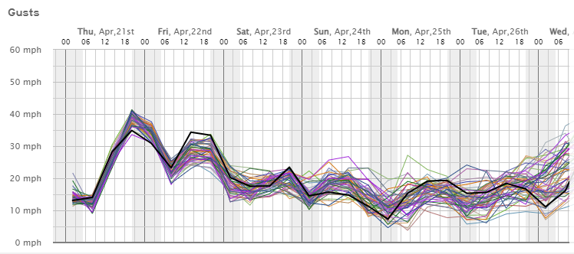
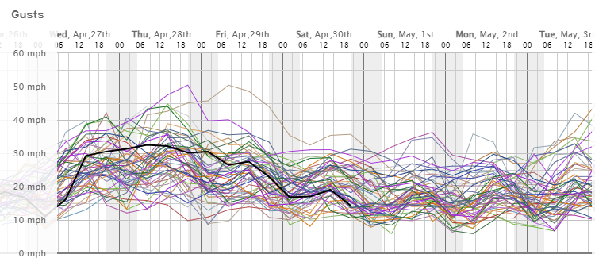
Example: Weather.US Forecast from 00 GMT 21 April 2022

Slide 28
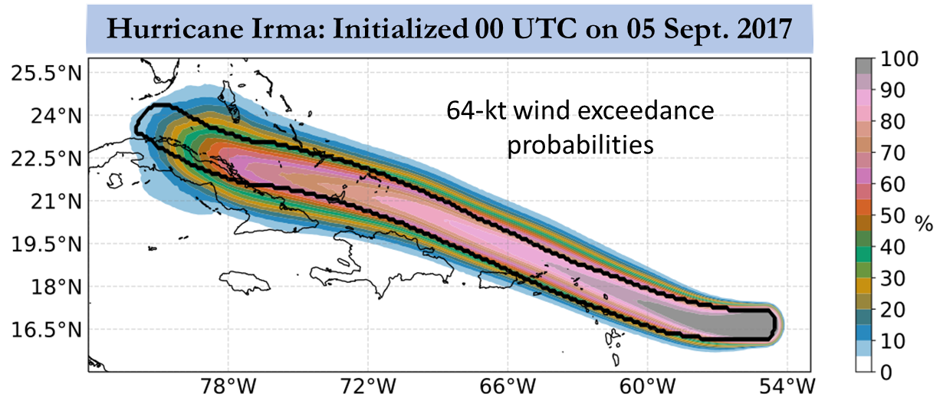
Example of hazardous weather:
Probability of encountering hurricane-force winds based on a 1,000-member hurricane forecast ensemble

Slide 29
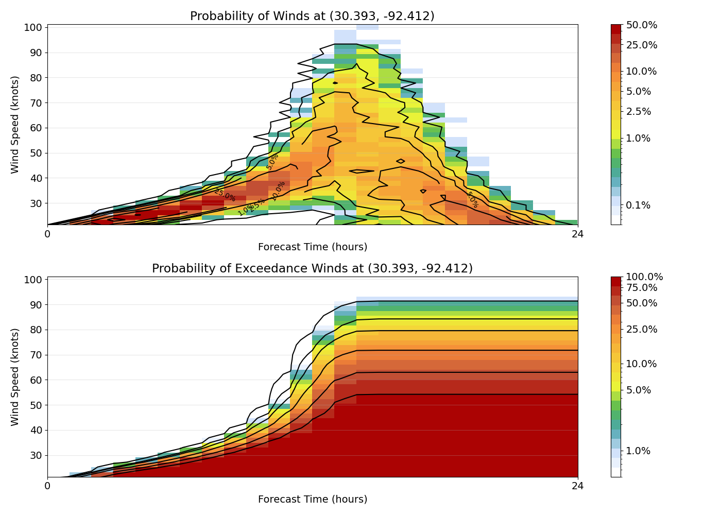
Probability of exceeding wind speed thresholds at Mowata, LA

Slide 30
Mesoscale Weather
Fronts
Squall lines
Topographically induced circulations

Slide 31
Fronts
Accompany non-tropical cyclones
Warm, cold or occluded
Wind shift can be diffuse ranging to almost discontinuous
Stronger in cold seasons; usually weak in summer

Slide 32
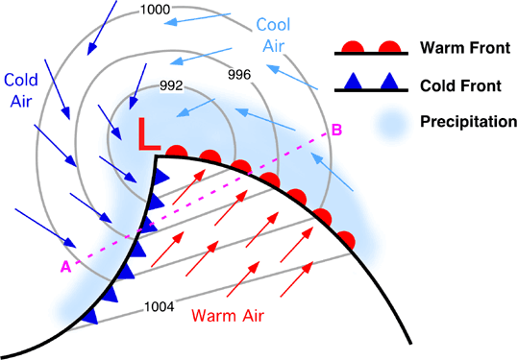
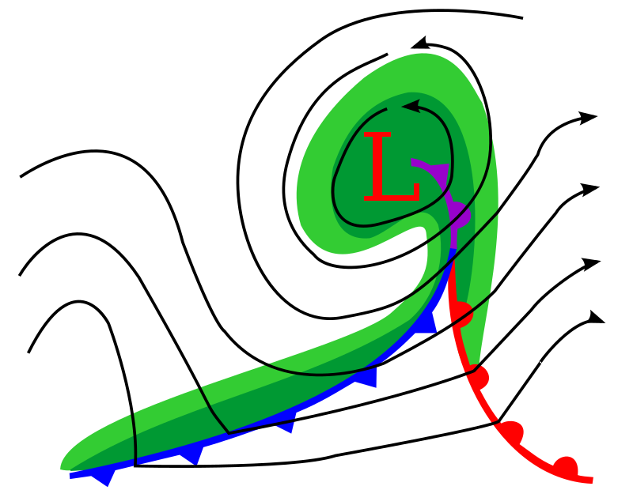
Textbook frontal configuration
Occlusion

Slide 33
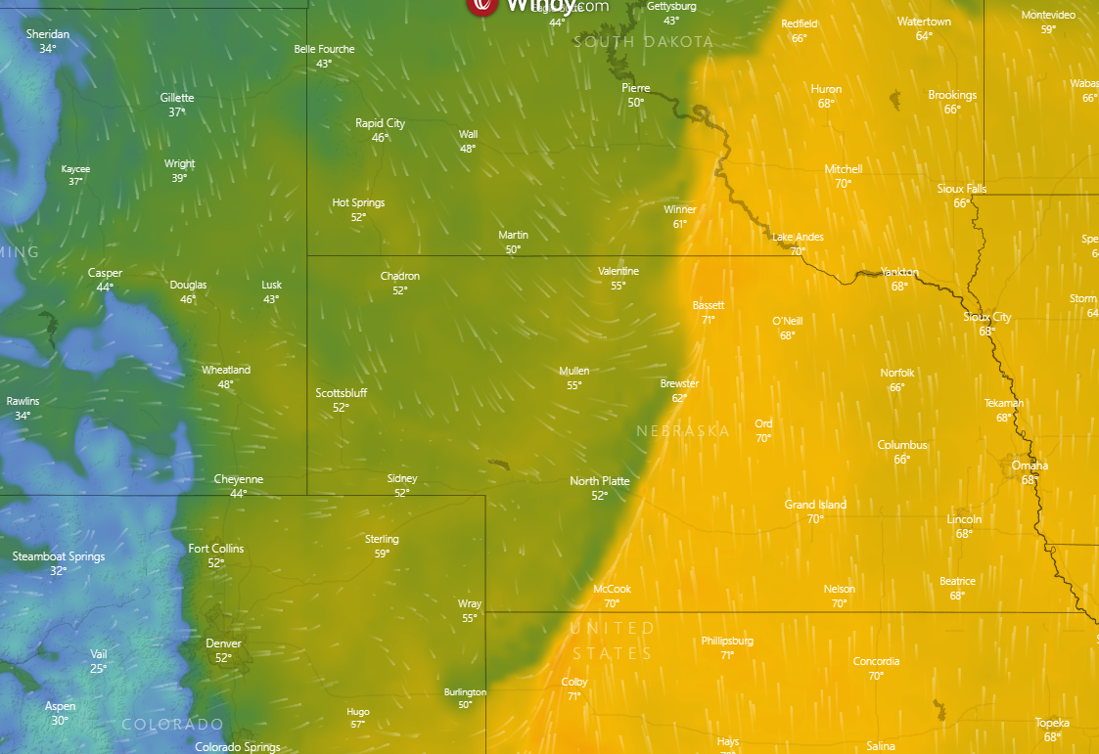
Reality is Messy!
Cold front advancing through Nebraska

Slide 34
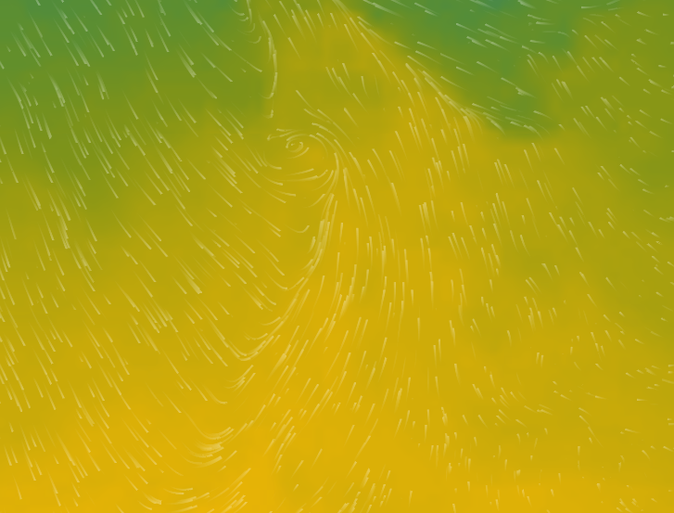
Cold front in the central North Atlantic

Slide 35
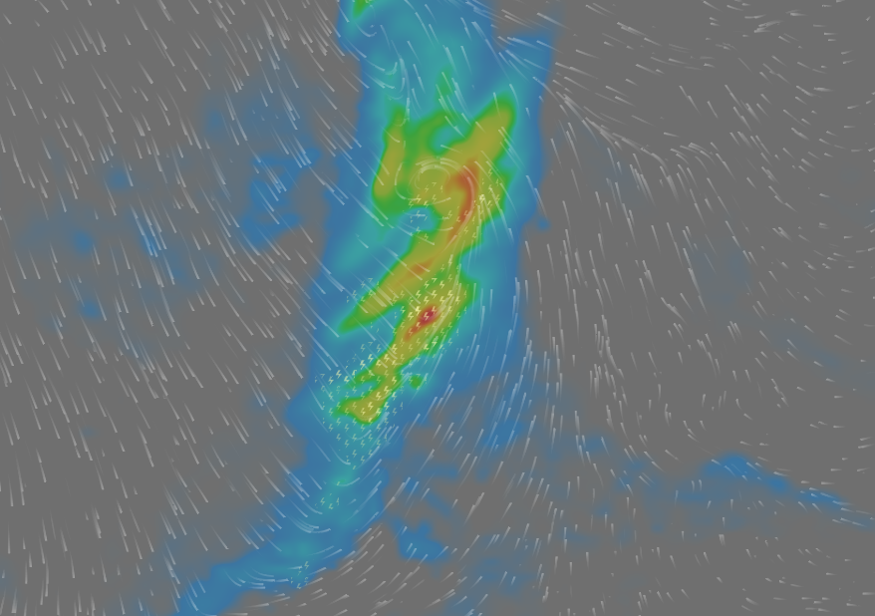
Cold front in the central North Atlantic

Slide 36
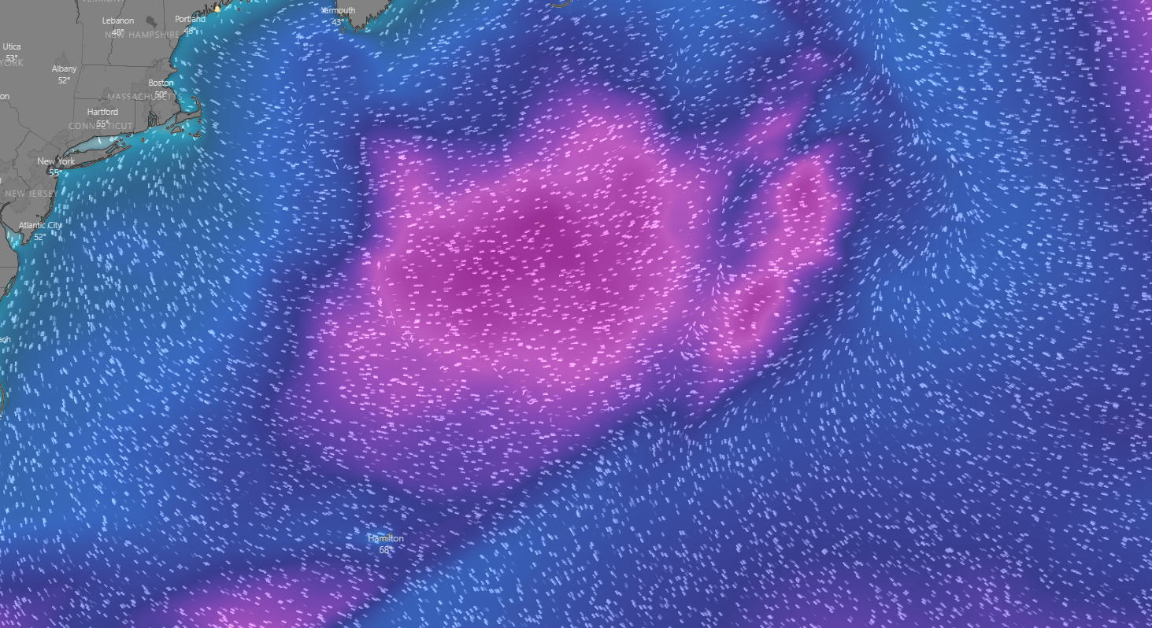
Forecast Wave Field

Slide 37
Squall Lines
Can produce hazardous weather, including strong winds and lightning
Can move quite fast
Wind shift is usually very sharp

Slide 38
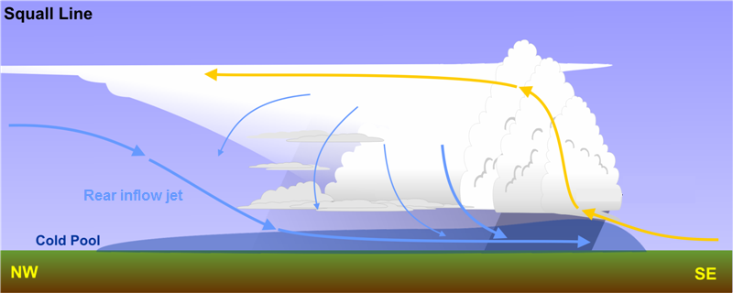
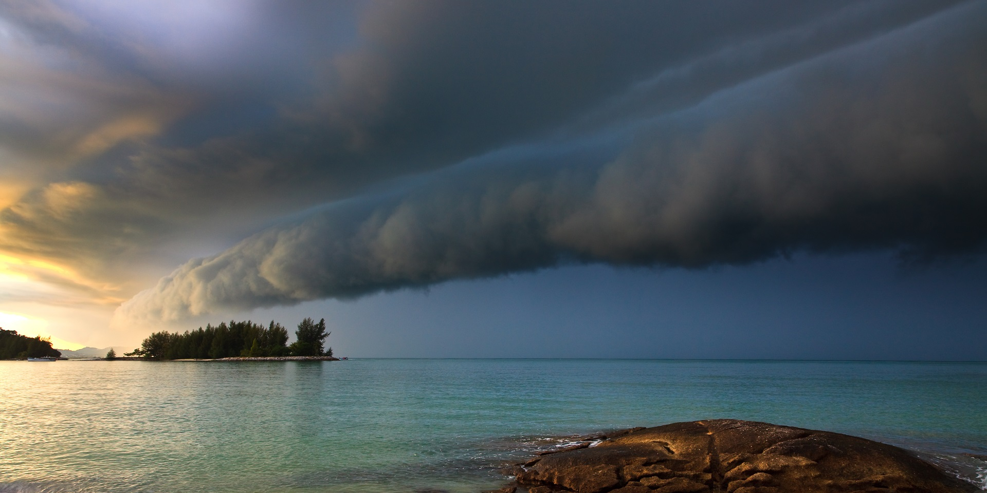

Slide 39
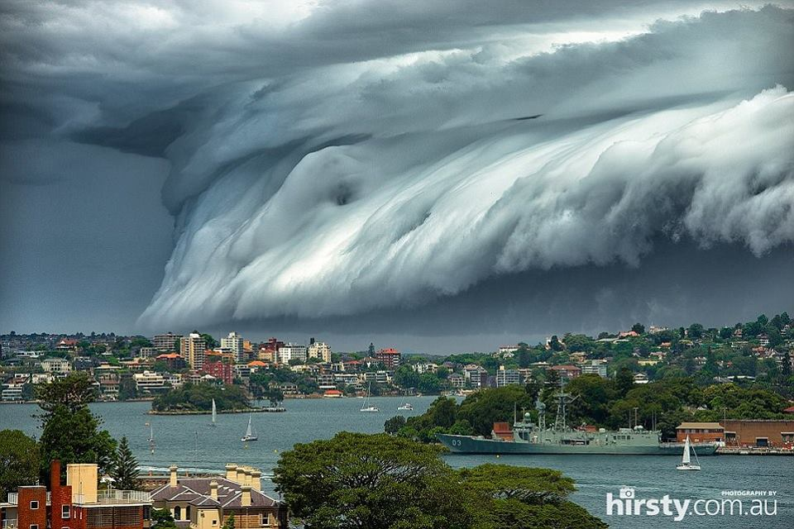

Slide 40
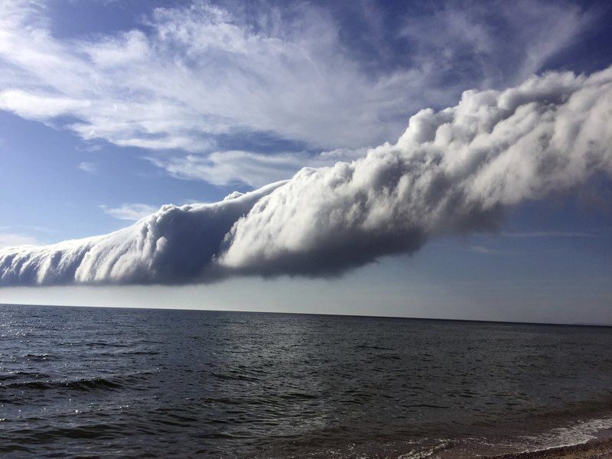
Gust fronts can out-live their parent storms

Slide 41
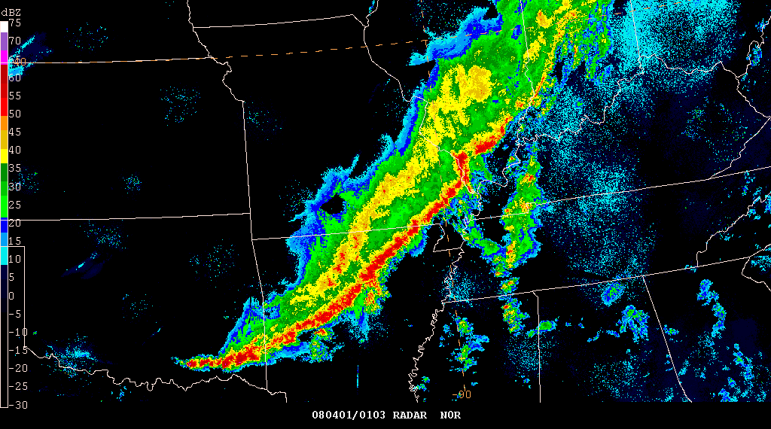
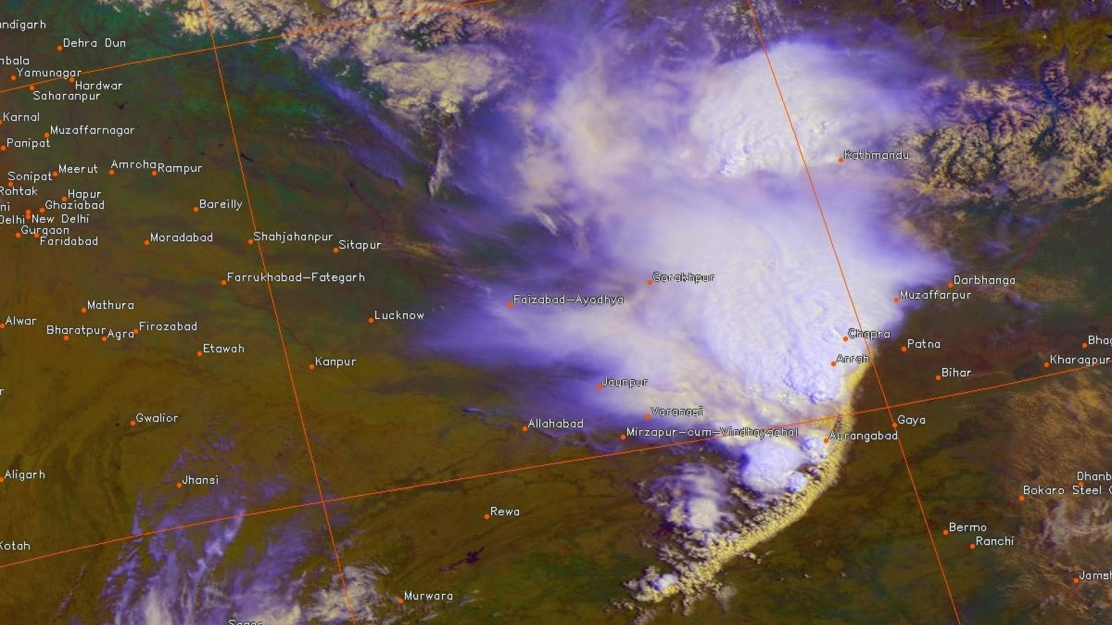
Radar
Satellite

Slide 42
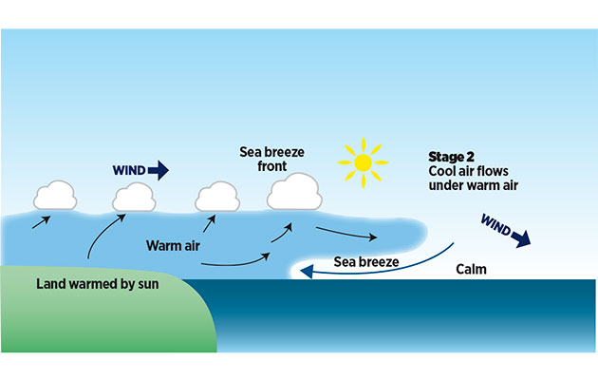
Sea Breezes
Strongest in late spring, early summer
Tend to be stronger when terrain is elevated
Winds tend to veer during the afternoon
Are superimposed on background winds

Slide 43
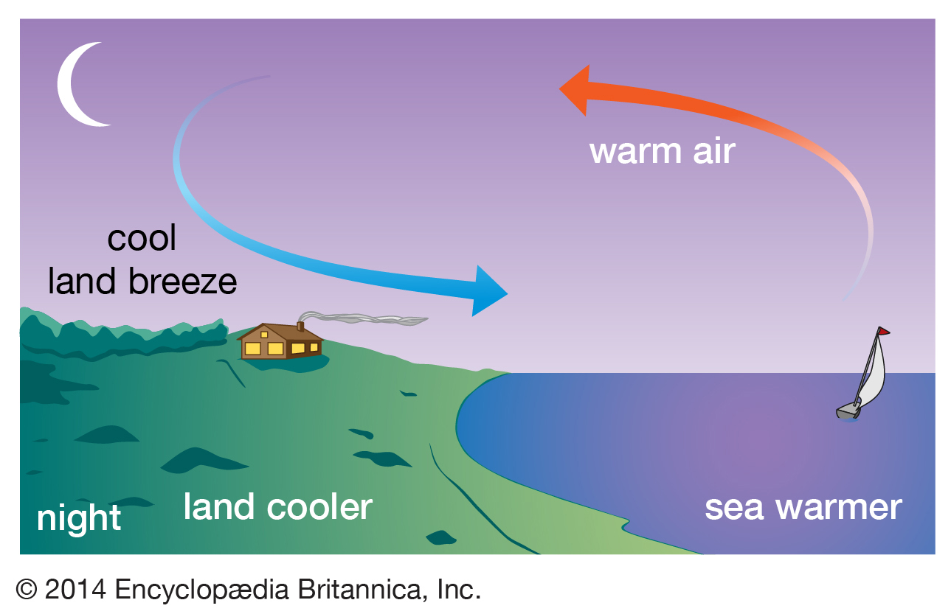
Land Breezes
Almost always much weaker than sea breezes
Fickle and unpredictable

Slide 44
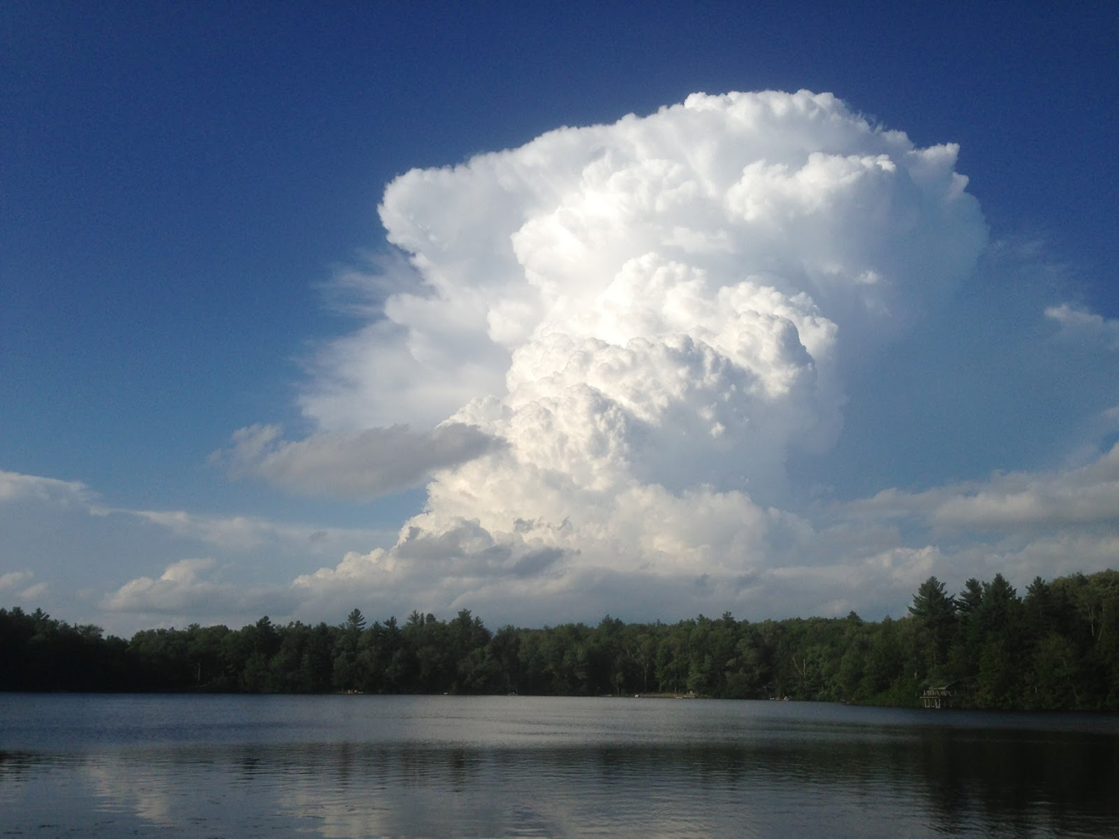
Example of local scale weather: Afternoon thunderstorms

Slide 45
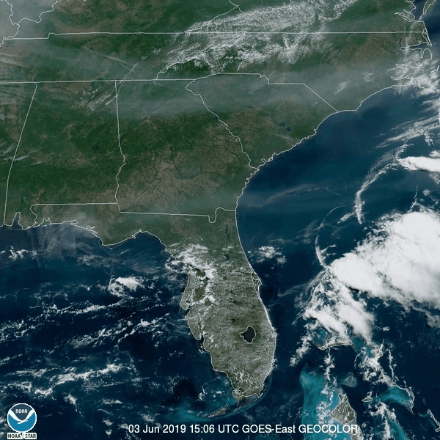

Slide 46
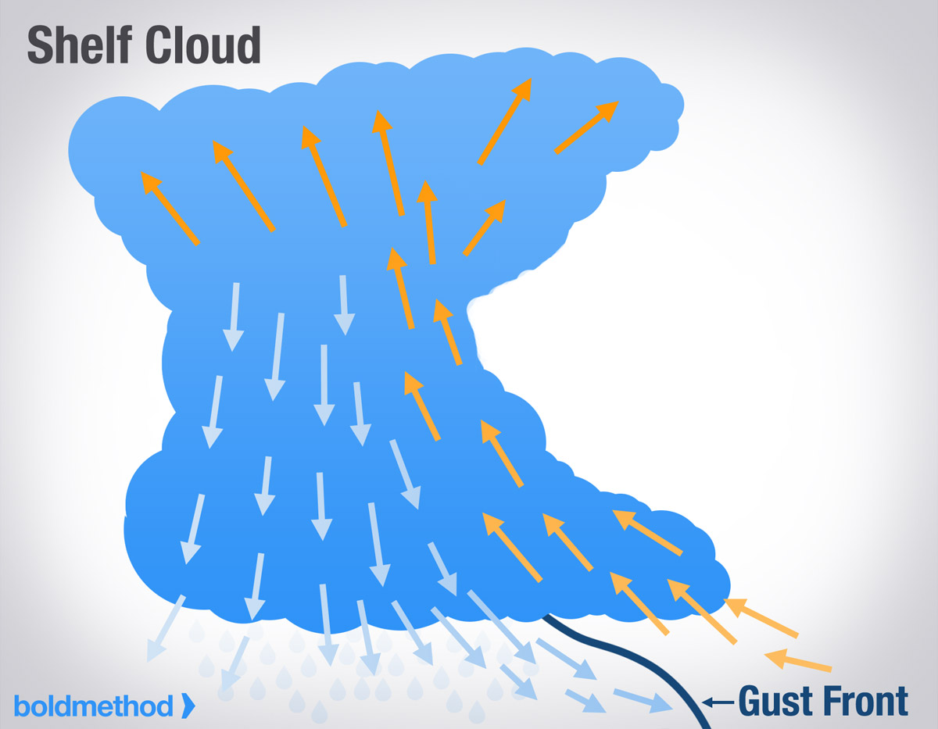

Slide 47
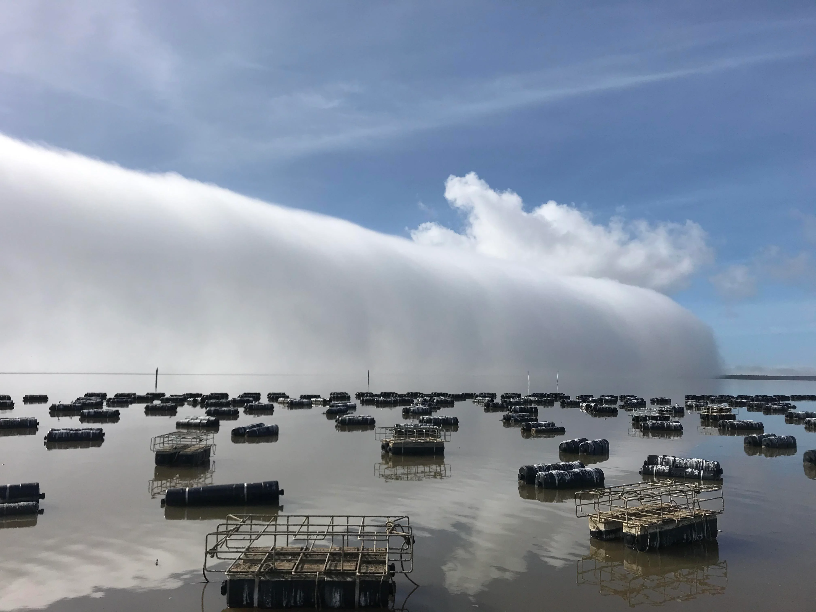
Example of microscale weather: The fog roller

Slide 48
Summary
Weather occurs on all time and space scales
Use of ensemble forecasts can avoid catastrophes and also help with strategy
Rapid increase of apps and website that use ensemble forecast data
Use satellite, radar, and surface observations to update numerical weather forecasts
Learn about local and microscale weather
Be weatherwise, not otherwise

Slide 49
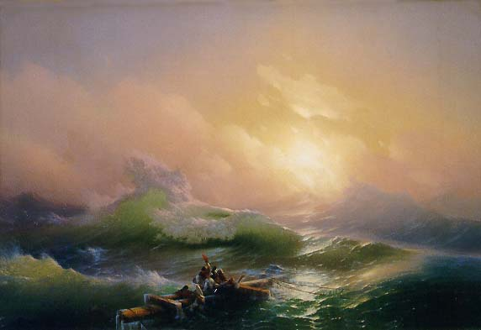
Questions?
The 9th Wave, by Ivan Aivazovsky (1850)

