Slide 1

Hurricanes, Climate, and Culture: How We Cope with Natural Disasters
Kerry Emanuel
Lorenz Center, MIT
Notes:
1

Slide 2
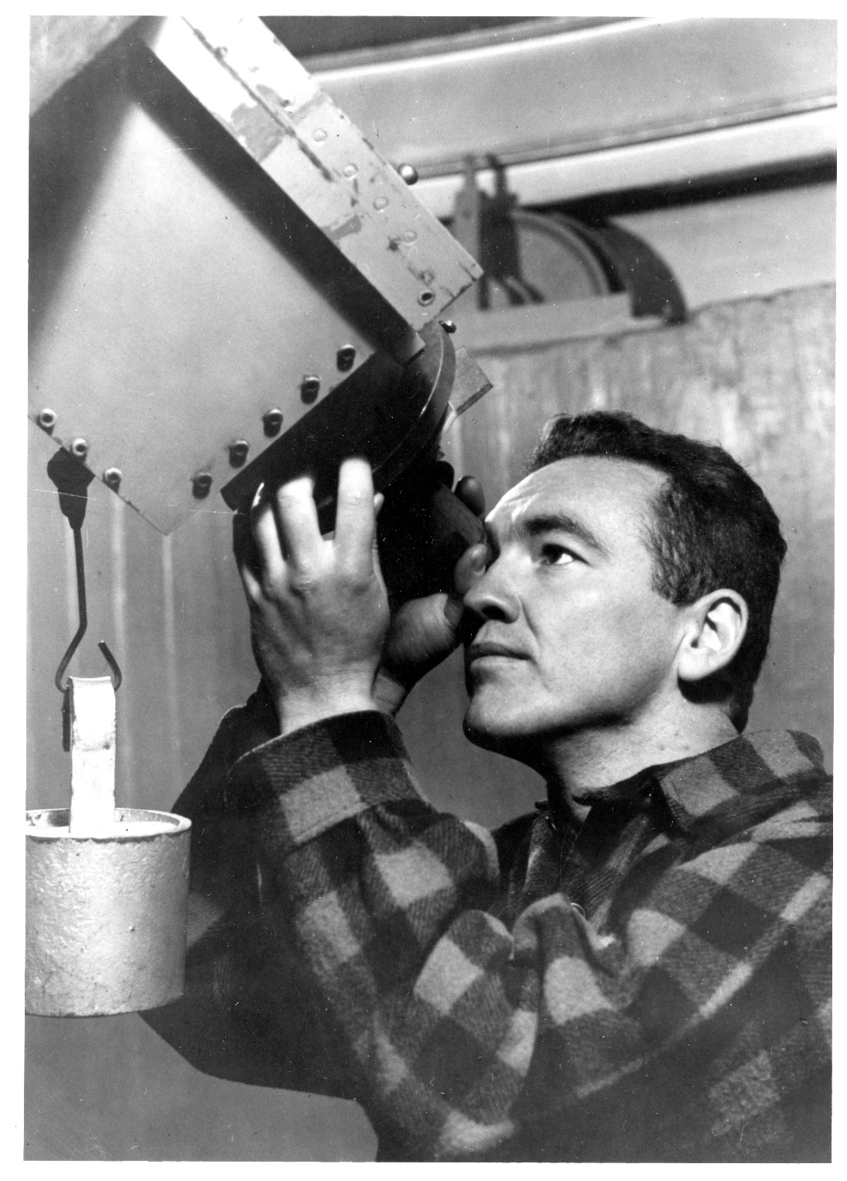
Walter Orr Roberts
(1915-1990)
Dedicated to Science in the Service of Society

Slide 3

Program
Hurricanes and Hurricane Disasters
Hurricane Impacts
Societal Response to Hurricanes
The Future of Hurricane Disasters

Slide 4
The View from Space
Notes:
The advent of reconnaissance aircraft and radar in the 1940s, and of satellites in the 1960s, gave scientists the means to determine the detailed structure and evolution of hurricanes. Today, almost everything we know about hurricanes is based on observations by aircraft, radar, and satellites. This satellite image shows Hurricane Floyd approaching the east coast of Florida in 1999. This image has been digitally enhanced to lend a three-dimensional perspective. The swirling mass of clouds is about 300 kilometers (180 miles) across, and Floyd’s eye is about 50 kilometers (30 miles) in diameter. Surrounding the eye is a deep ring of thick cloud called the eyewall. A thin veil of very high cloud covers most of the swirling mass of thicker clouds; this is the veil of cirrus, made up of tiny ice crystals. Underneath it, and thus invisible from above, are several spiral shaped bands of deep, thick cumulonimbus clouds, interspersed between relatively clear sky. These spiral bands produce heavy rains and gusty winds well outside the eyewall of the hurricane, where the strongest winds are found.
Image: Satellite image of Hurricane Floyd approaching the east coast of Florida in 1999. The image has been digitally enhanced to lend a three-dimensional perspective. Credit: NASA/Goddard Space Flight Center.
Description from “Divine Wind: The History and Science of Hurricanes”, Kerry Emanuel, 2005, Oxford University Press, 296 p.
Definitions
Reconnaissance is the military term for the active gathering of information about an enemy, or other conditions, by physical observation (from and for more information see http://en.wikipedia.org/wiki/Reconnaissance).
The eye is a region of mostly calm weather found at the center of strong tropical cyclones. The eye of a storm is usually circular and typically 25–40–65 kilometers (40 miles) in diameter. It is surrounded by the eyewall, where the most severe weather of a cyclone occurs (from and for more information see http://en.wikipedia.org/wiki/Eyewall).
Cirrus clouds are thin and often wispy clouds that are the most common form of high-level clouds. Typically found at heights greater than 20,000 feet (6,000 meters), cirrus clouds are composed of ice crystals that originate from the freezing of supercooled water droplets (from and for more information see http://weather.about.com/library/glossary/blglossary.htm).
Cumulonimbus clouds are large and vertically developed clouds that are fueled by vigorous convective updrafts (sometimes in excess 50 knots), the tops of cumulonimbus clouds can easily reach 39,000 feet (12,000 meters) or higher (from and for more information see http://weather.about.com/library/glossary/blglossary.htm).

Slide 5
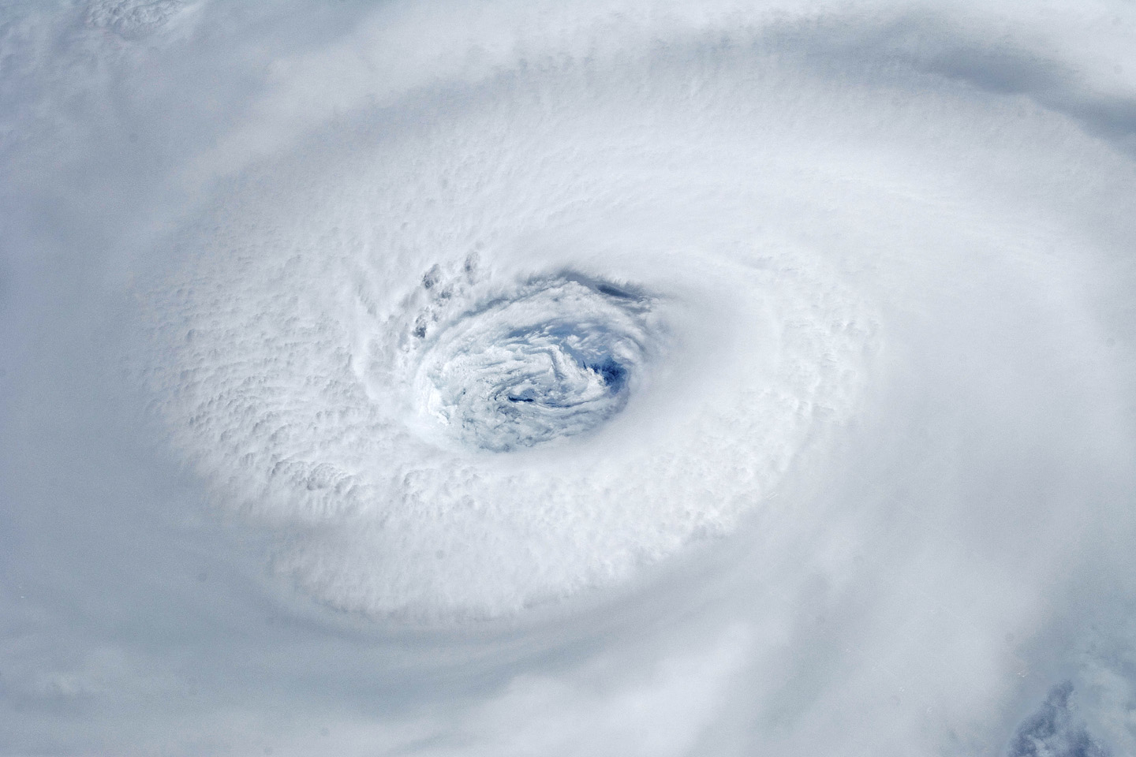
Igor, 2010
Notes:
Astronauts aboard the International Space Station took this digital photograph of the eye of Hurricane Igor at 10:56 Atlantic Daylight Time (13:56 UTC) on September 14, 2010. The storm was a category four hurricane on the Saffir-Simpson scale of intensity. At the time of the image, Igor was centered in the Atlantic Ocean near 18°N 52°W and slowly moving west-northwest at 11 kilometers (7 miles) per hour, according to the U.S. National Hurricane Center. Maximum sustained winds of 213 km (132 mi.) per hour, with gusts to 259 km (161 mi.) per hour. Credit: NASA

Slide 6
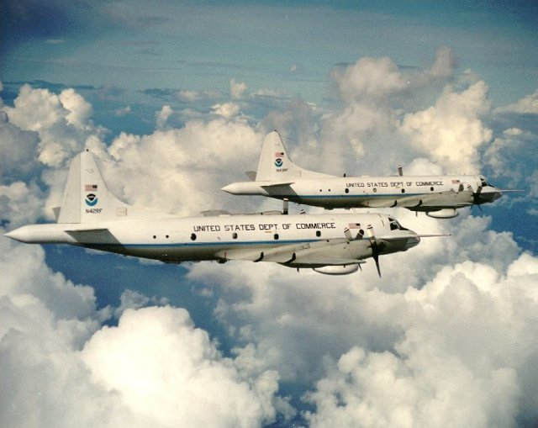

Slide 7
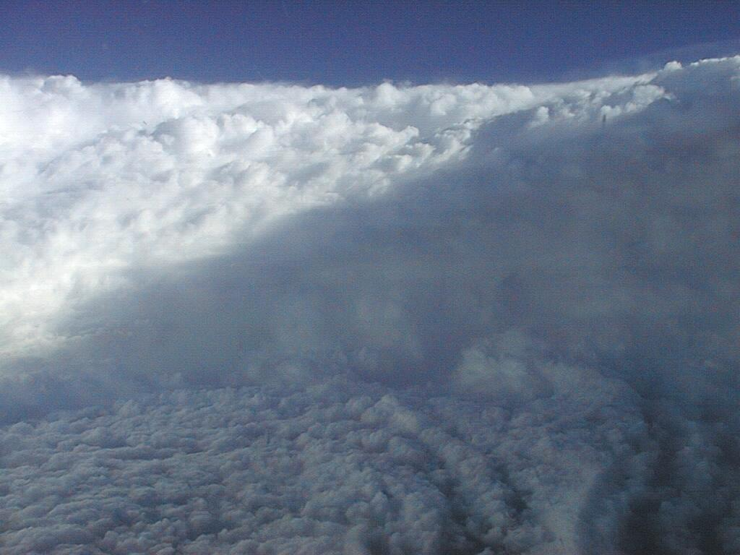
Notes:
The eye of Hurricane Georges in this photo taken from a reconnaissance aircraft gives some impression of a hurricane’s eye.
However impressive a hurricane’s visual appearance, it is the instruments aboard satellites and aircraft that reveal the essence of a hurricane’s structure and inner workings. In the early days of aircraft reconnaissance, the crew estimated wind speeds by looking down and noting how rough the sea appeared. Today, a sophisticated array of instruments automatically collects large quantities of high-quality data, which are taken back to laboratories and analyzed.
Image: The eye of Hurricane Georges in photo taken from a reconnaissance aircraft. The eyewall at right is casting a shadow across part of the eyewall ahead. Credit: Michael Black, Hurricane Research Division, NOAA-AOML, Miami, Florida.
Description from “Divine Wind: The History and Science of Hurricanes”, Kerry Emanuel, 2005, Oxford University Press, 296 p.

Slide 8


The word Hurricane is derived from the Mayan word Huracan and the Taino and Carib word Hunraken, a terrible God of Evil, and brought to the West by Spanish explorers

Slide 9
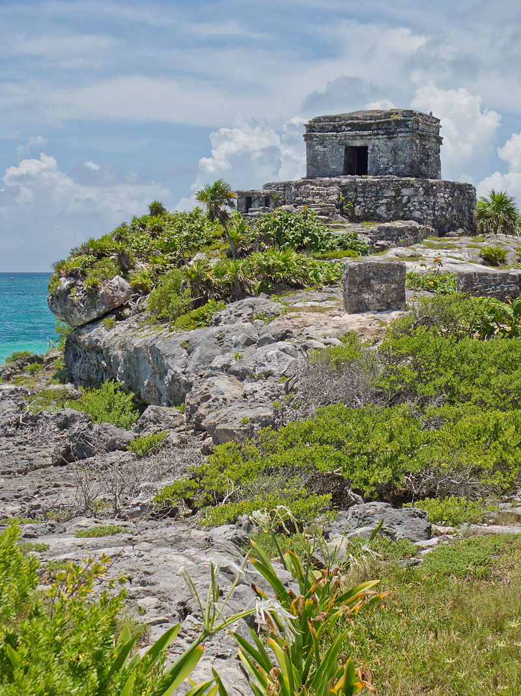
God of Winds Temple, Tulum, Mexico
13th – 15th Centuries

Slide 10
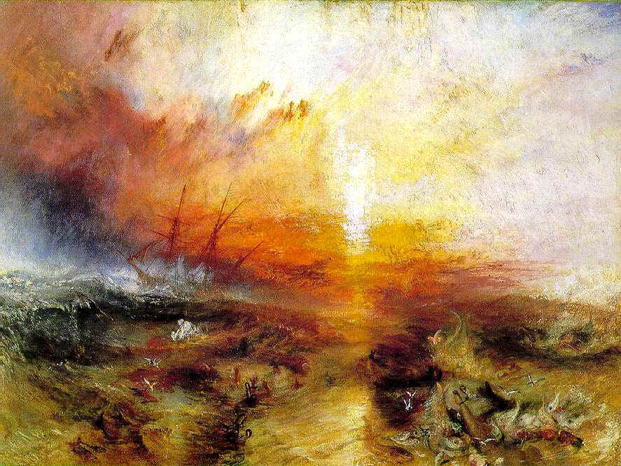
Slavers throwing overboard the Dead and Dying – Typhoon coming on (‘The Slave Ship’), 1840 – J. M. W. Turner, Museum of Fine Arts, Boston

Slide 11
Hurricane Impacts
Notes:
11

Slide 12
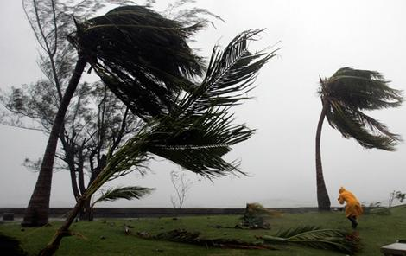
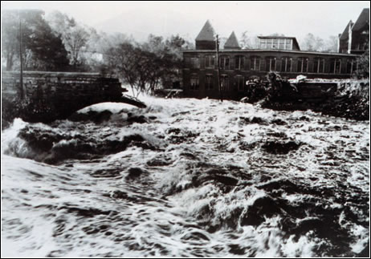
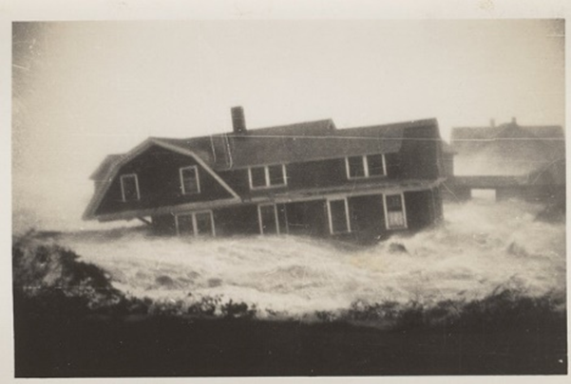
Hurricane Risks:
Wind
Rain
Storm Surge

Slide 13
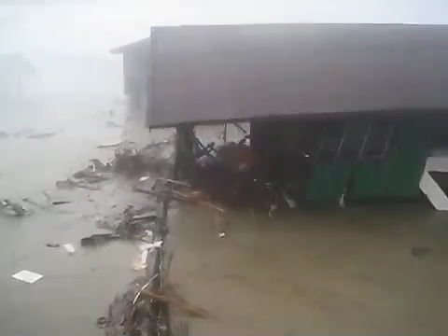

Slide 14
The Global Hurricane Hazard
About 10,000 deaths per year since 1971
$700 Billion 2015 U.S. Dollars in Damages Annually since 1971
EM-DAT, 2016: The OFDA/CRED International Disaster Database
http://www.emdat.be/.

Slide 15

Publicly
insured…
No $$$
Privately insured… $$$

Slide 16

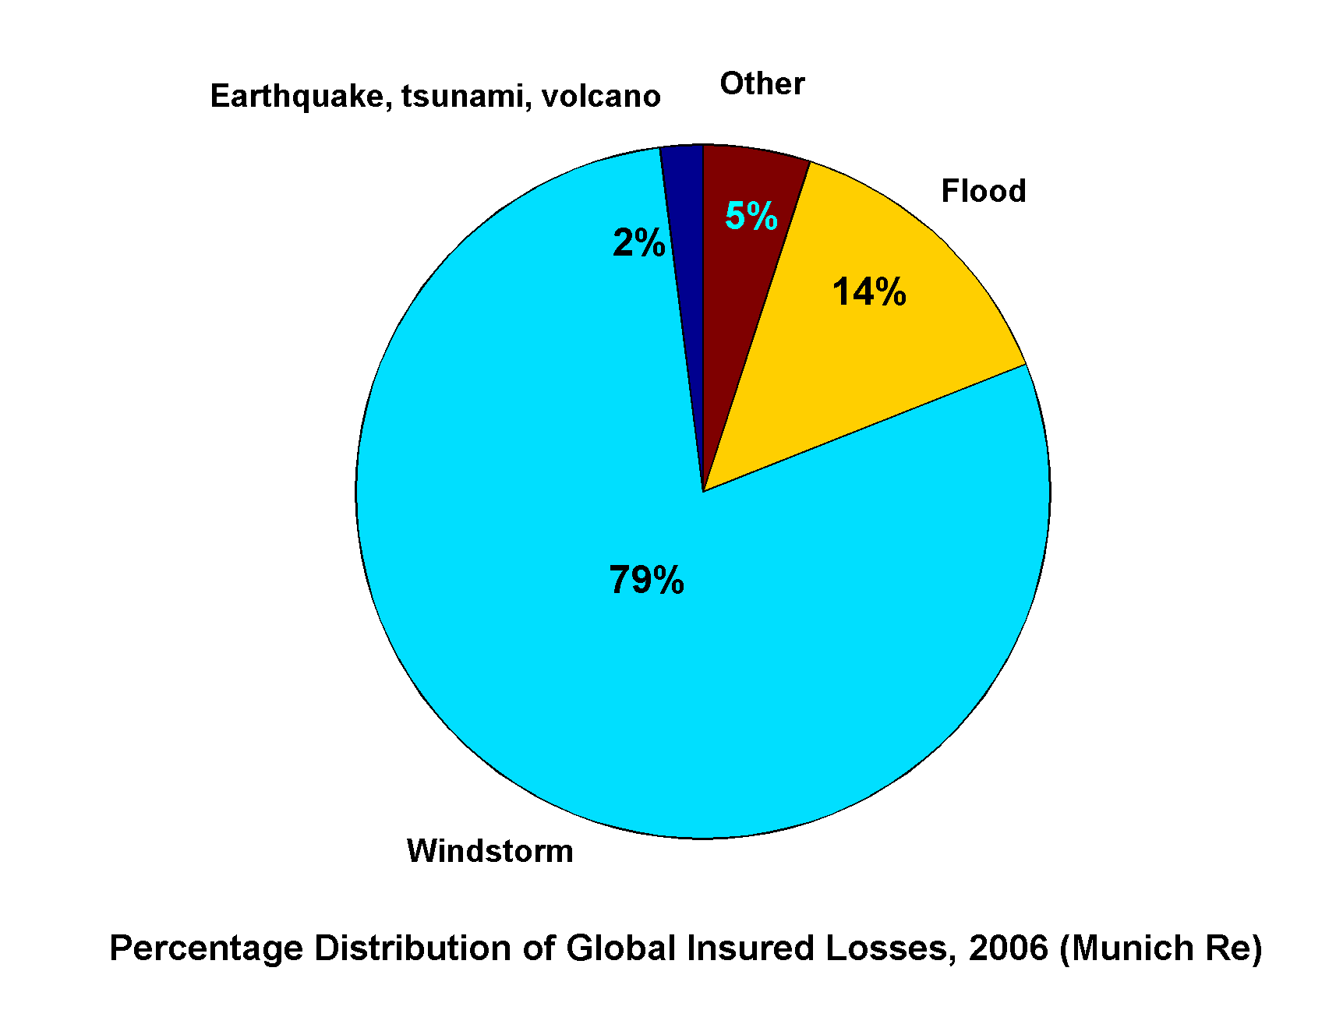
Windstorms Account for Bulk of Insured Losses Worldwide

Slide 17
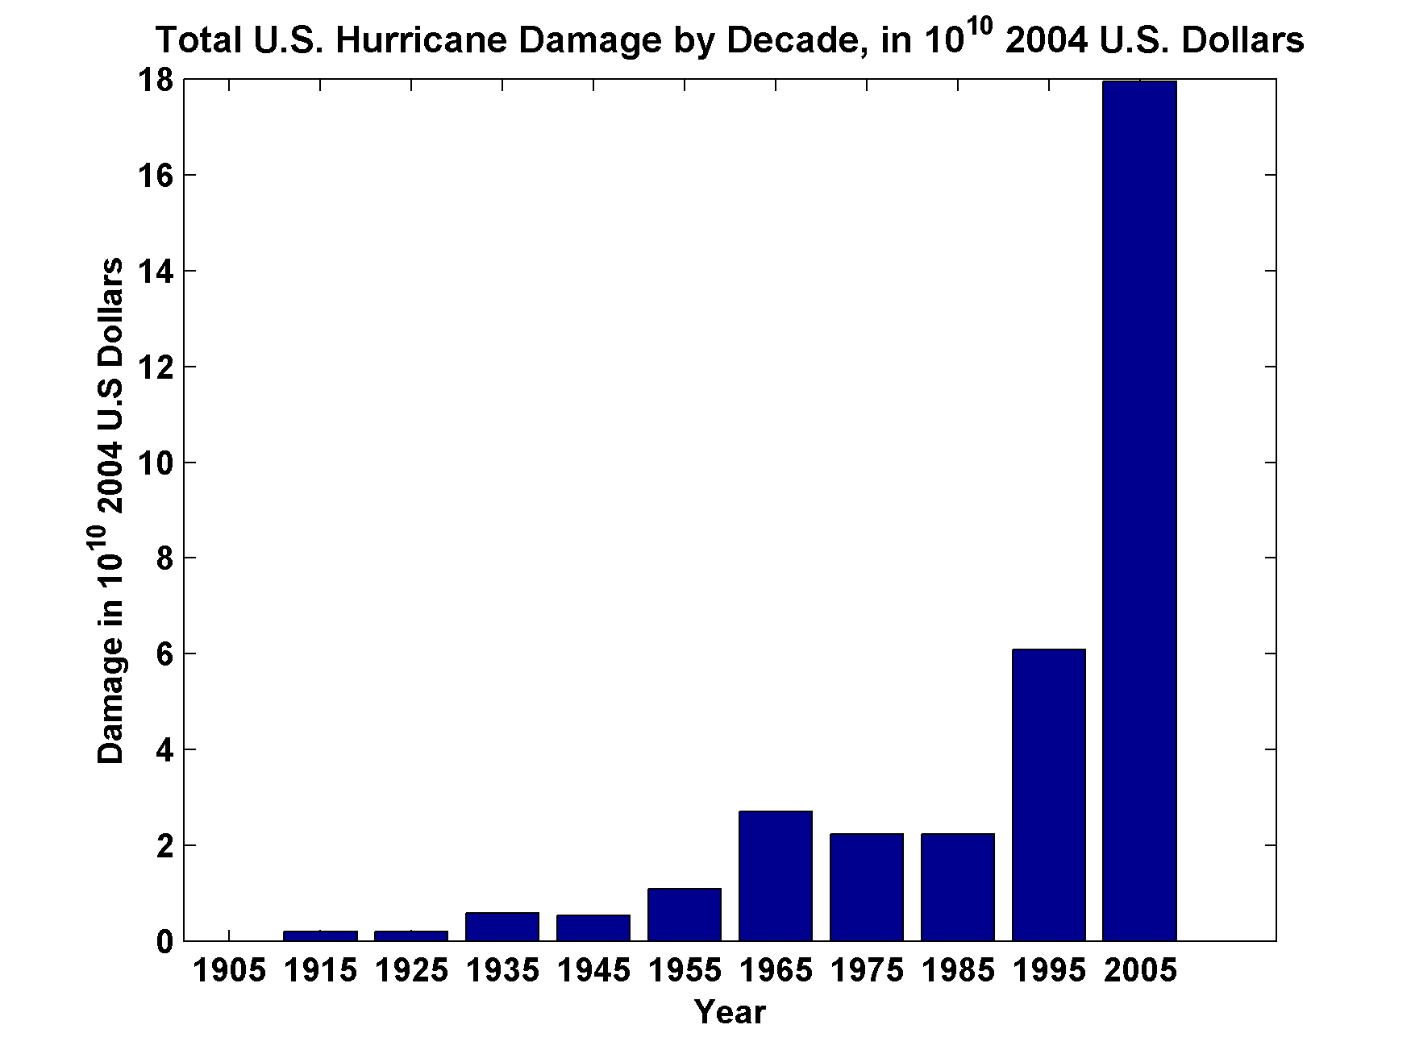
Total U.S. Hurricane Damage by Decade, in 10¹⁰ 2004 U.S. Dollars
Source: Roger Pielke, Jr.

Slide 18
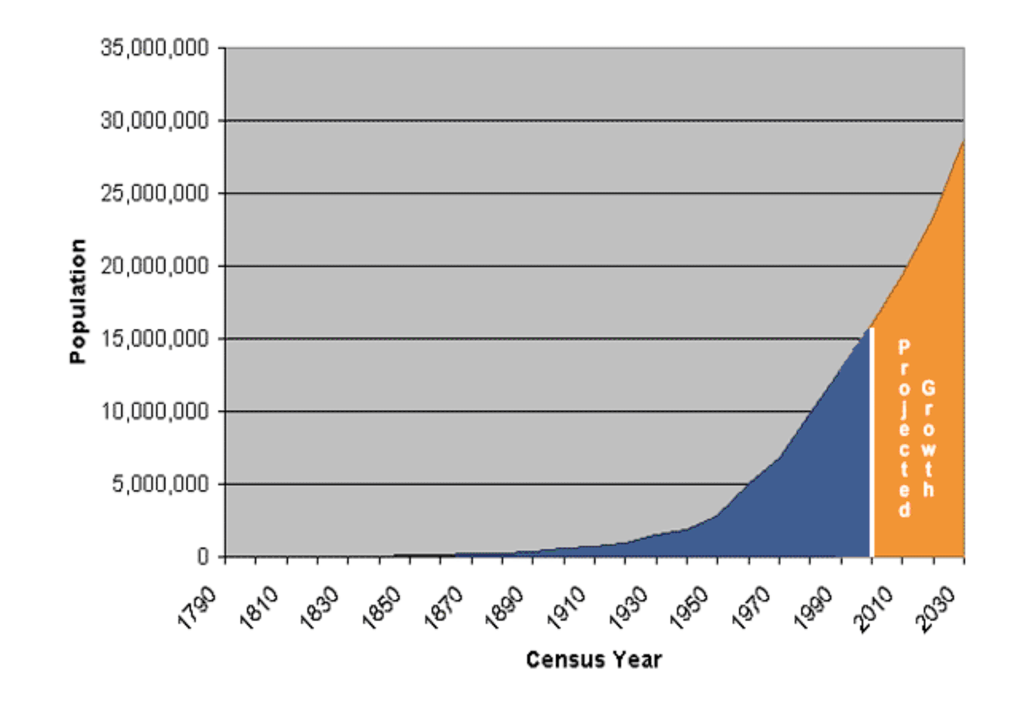
Population of Florida, 1790-2004

Slide 19
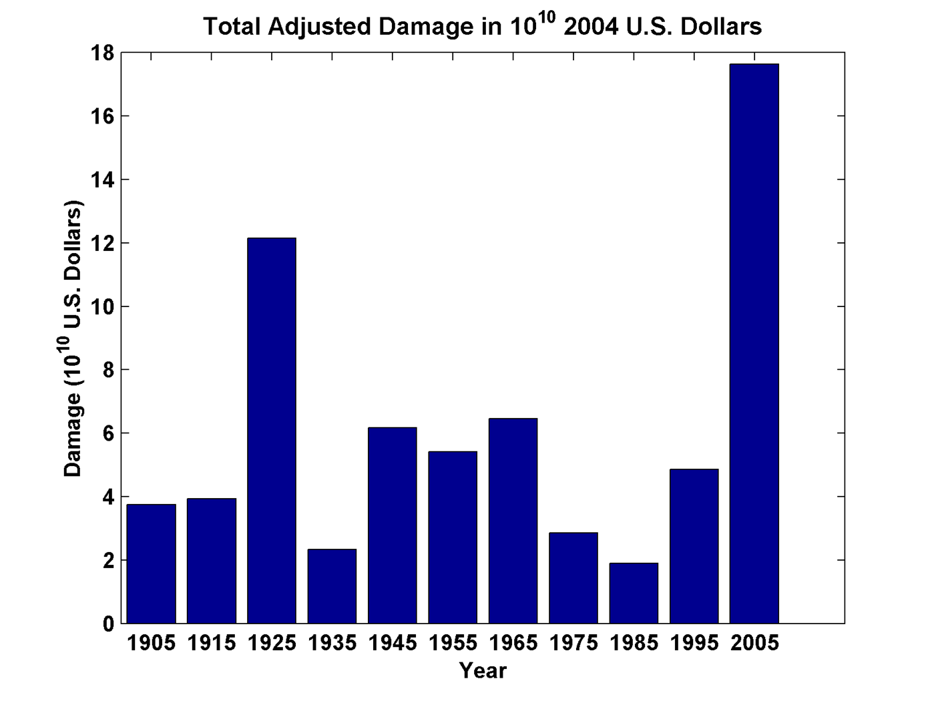
Total Adjusted Damage by Decade, in 10¹⁰ 2004 U.S. Dollars
Source: Roger Pielke, Jr.

Slide 20
How Does Society Cope with Hurricanes? Some Examples
Notes:
20

Slide 21
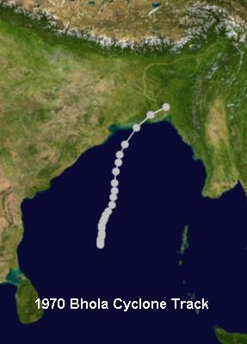
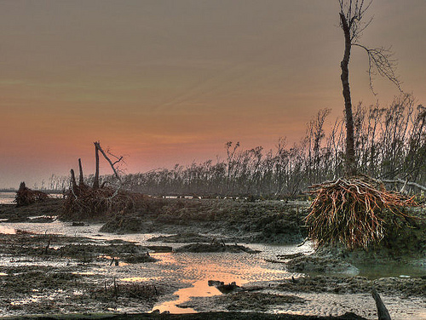
Bhola Cyclone of 1970, East Pakistan
Deadliest tropical cyclone ever recorded
350,000 – 500,000 lives lost
Led to formation of Bangladesh

Slide 22
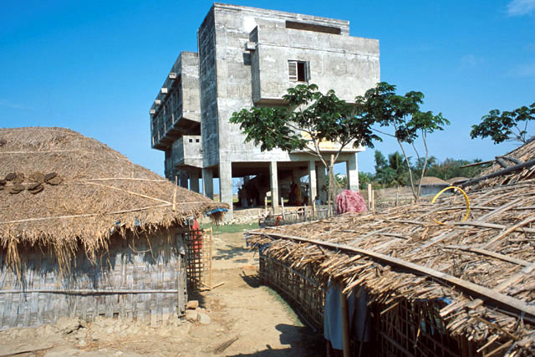
Bangladesh currently has > 2,500 cyclone shelters with more under construction. World Bank, NGOs

Slide 23
The U.S. Hurricane Problem
Notes:
23

Slide 24
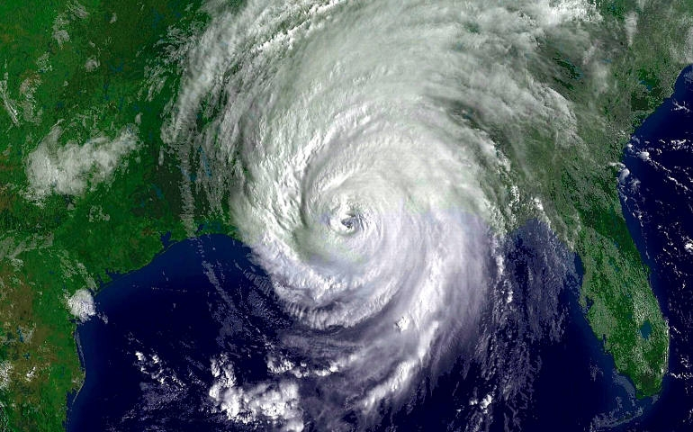
Case 1: Hurricane Katrina
August, 2005

Slide 25
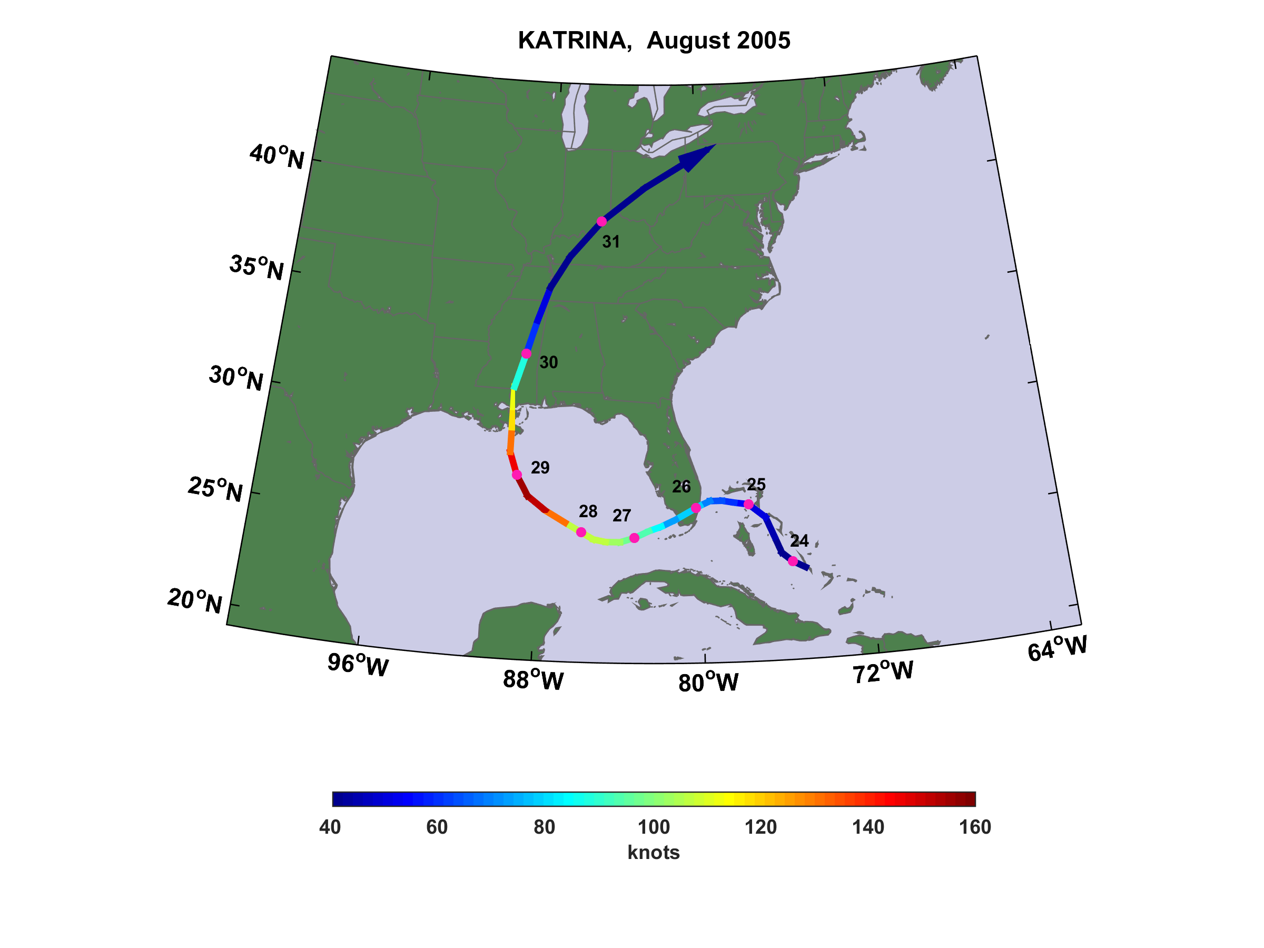

Slide 26
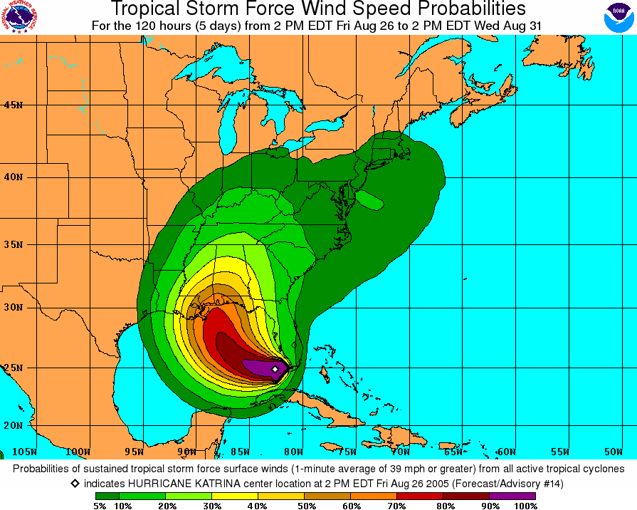
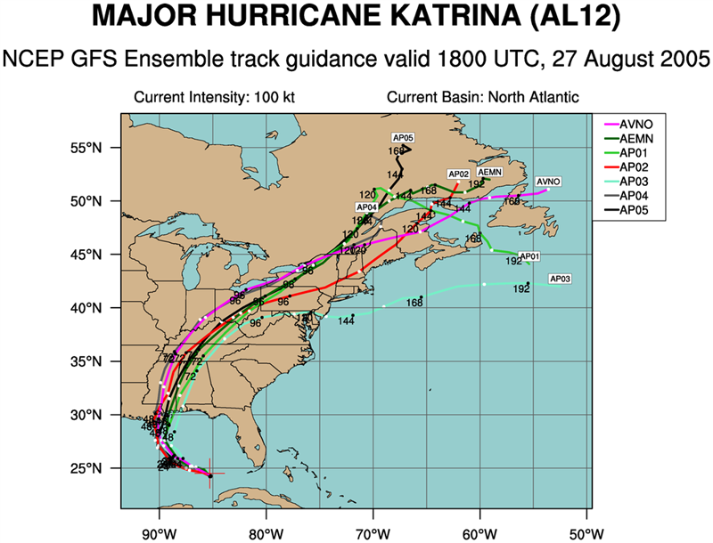
Katrina was exceptionally well forecast
Forecast from 18 GMT 26 August
Forecast from 18 GMT 27 August

Slide 27
Relevant Facts
Excellent forecasts from > 3 days prior to landfall
Costliest natural disaster in U.S. history
Among the 5 deadliest hurricanes in U.S. history
  > 1800 deaths
  Highest death toll since 1928 Okeechobee Hurricane
> 50 breaches of New Orleans surge protection system
> 80% of city flooded
Total economic impact in Louisiana and Mississippi may have exceeded $150 billion

Slide 28
Elements of the Disaster

Slide 29
27 August, evening EDT: National Hurricane Center Director Max Mayfield personally calls Louisiana Governor Blanco and Mississippi Governor Barbour, telling them that Katrina will be a “big, big deal”.
27 August 8 PM EDT: Mayfield has been trying to reach Ray Nagin, mayor of New Orleans, and finally contacts him by routing call through White House. Mayfield asks Nagin to order a mandatory evacuation. Nagin later recalled that Mayfield “scared the crap out of me”. But Nagin orders only a voluntary evacuation and asks his attorneys to look into his legal liability to lawsuits from local businesses.
28 August 0500 UTC: NOAA data buoy 42003, 200 nm west of Naples, FL, capsizes after reporting 11 meter significant wave heights. First capsizing of a 10-meter buoy in the Gulf of Mexico in NDBC's 30-year history of operation.
28 August 1200 UTC: Katrina upgraded to Category 5. Hurricane warning is issued for north central Gulf Coast including New Orleans

Slide 30
28 August 9:30 AM CDT: Mayor Nagin finally issues mandatory evacuation order
28 August 10:10 AM CDT: National Weather Service New Orleans issues nearly apocalyptic statement:
Most of the area will be uninhabitable for weeks ... perhaps longer. At least one half of well constructed homes will have roof and wall failure. … The majority of industrial buildings will become non functional. … Airborne debris will be widespread and may include heavy items such as household appliances and even light vehicles. … Persons, pets, and livestock exposed to the winds will face certain death if struck. Power outages will last for weeks … water shortages will make human suffering incredible by modern standards.

Slide 31
29 August 1110 UTC: Katrina makes landfall near Buras, Louisiana, as a high Category 3 hurricane
29 August, morning CDT: Mayor Nagin abandons post at Emergency Operations Center in favor of the Hyatt hotel, which then loses power, cutting off communications
29 August 1300 CDT: Two major flood-control levees are breached and the National Weather Service reports "total structural failure" in parts of New Orleans. Many are feared dead in flooded neighborhoods under as much as 20 feet of water
29 August, morning: Many New Orleans Police officers abandon duty in favor of evacuating their families. More than 200 are later put on trial
29 August: By evening, 80% of New Orleans is underwater

Slide 32
The Aftermath
30 August: New Orleans is left with no power, no drinking water, dwindling food supplies, widespread looting, fires and steadily rising waters from major levee breaches. Efforts to limit the flooding are unsuccessful and force authorities to try evacuating the thousands of people at city shelters
Individual acts of heroism and the action of the U.S. Coast Guard and Louisiana Wildlife and Fisheries Department save many
FEMA director Michael Brown is virtually missing for several days
Politicians begin finger-pointing
Cuba and Venezuela offer aid
September 1, 2 PM CDT: On national television New Orleans Mayor Ray Nagin issues a "desperate SOS" for help from the federal government
2014: Nagin was convicted on twenty of twenty-one charges of wire fraud, bribery, and money laundering related to bribes from city contractors before and after Hurricane Katrina and was sentenced to ten years in federal prison

Slide 33
Lessons from Katrina
Years of planning and excellent forecasts cannot succeed when leadership fails owing to corruption, cowardice, and incompetence
Breakdown of technical and human communication is a major element in many disasters
Business interests can trump safety considerations in the lead- up to disasters
Short-term rescue and recovery often depends on ad-hoc and creative acts of bravery and spontaneous organization among individuals and organizations with much local knowledge
Local culture is a critical element in preparing for and reacting to natural disasters

Slide 34
Is New Orleans Sustainable?

Slide 36
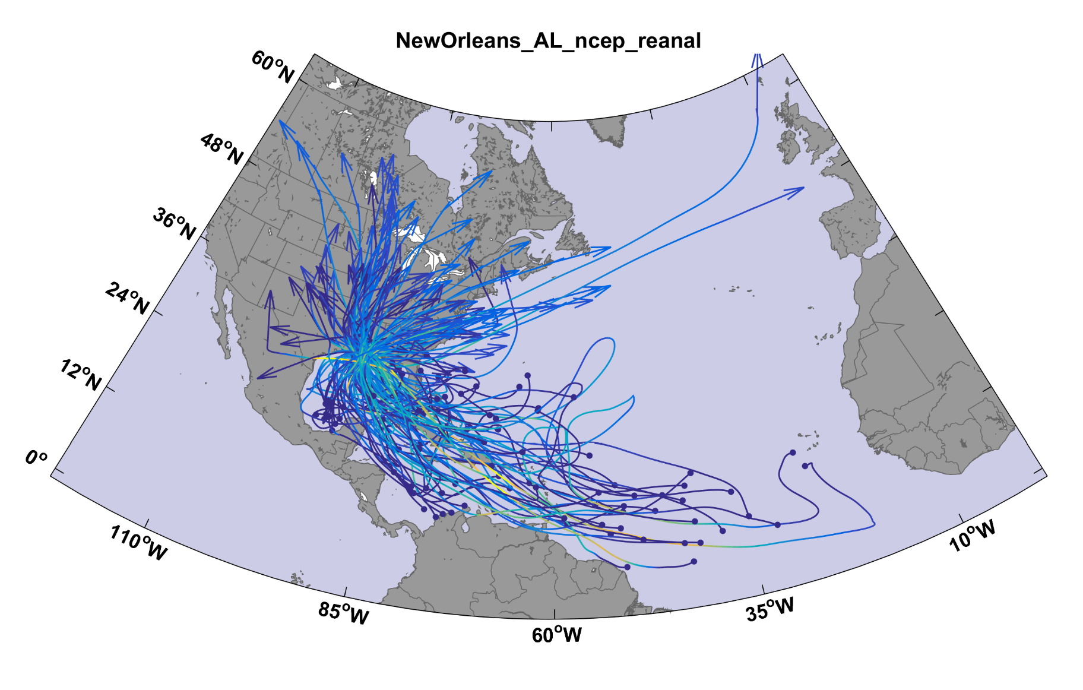
100 of a set of 3400 tracks affecting New Orleans

Slide 37
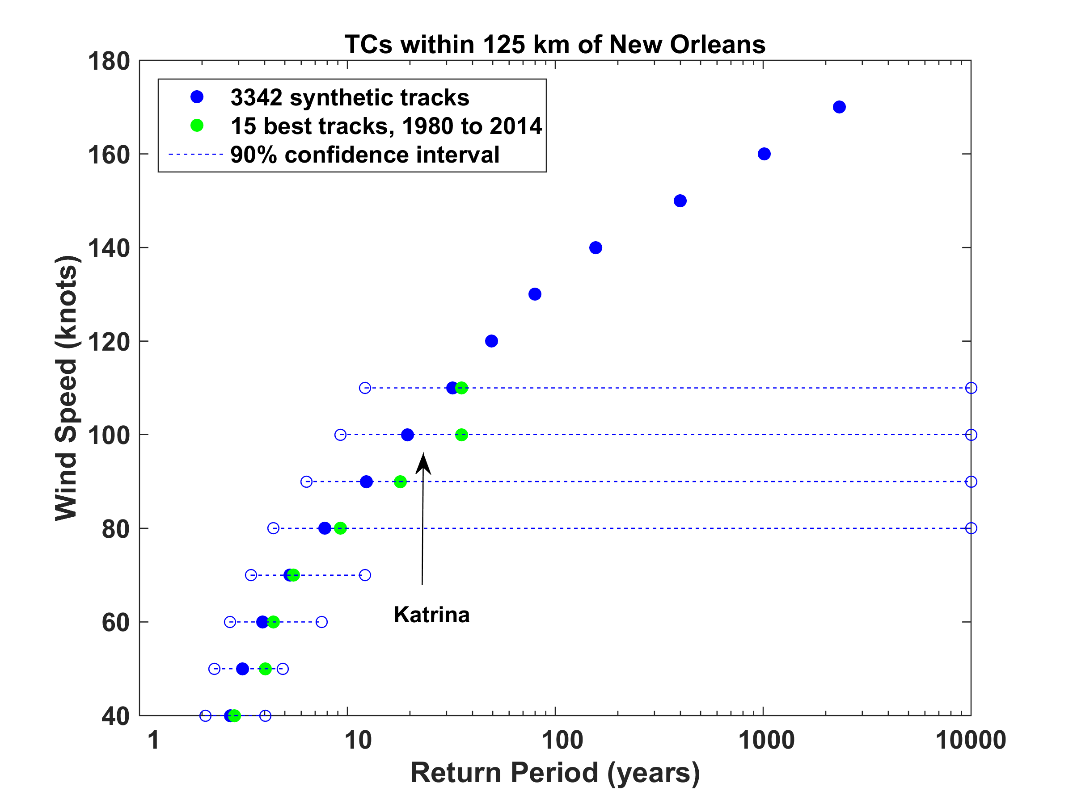

Slide 38
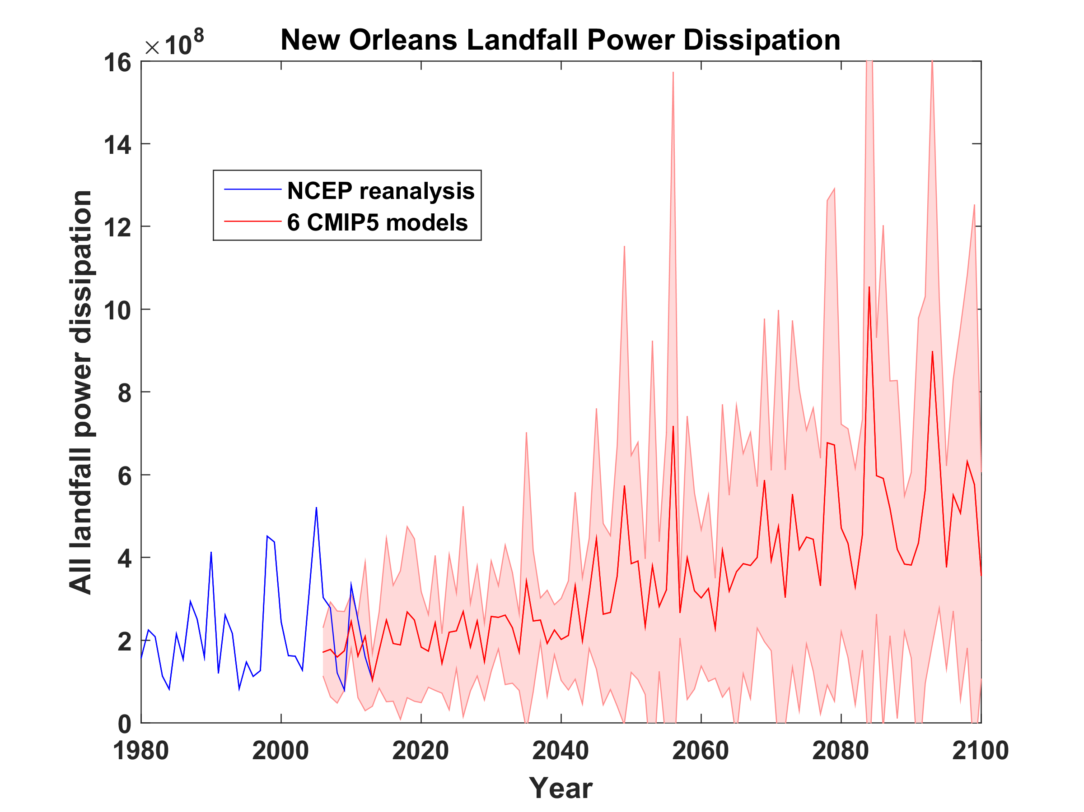
Projections of TC Power at Landfall near New Orleans
RCP 8.5

Slide 39
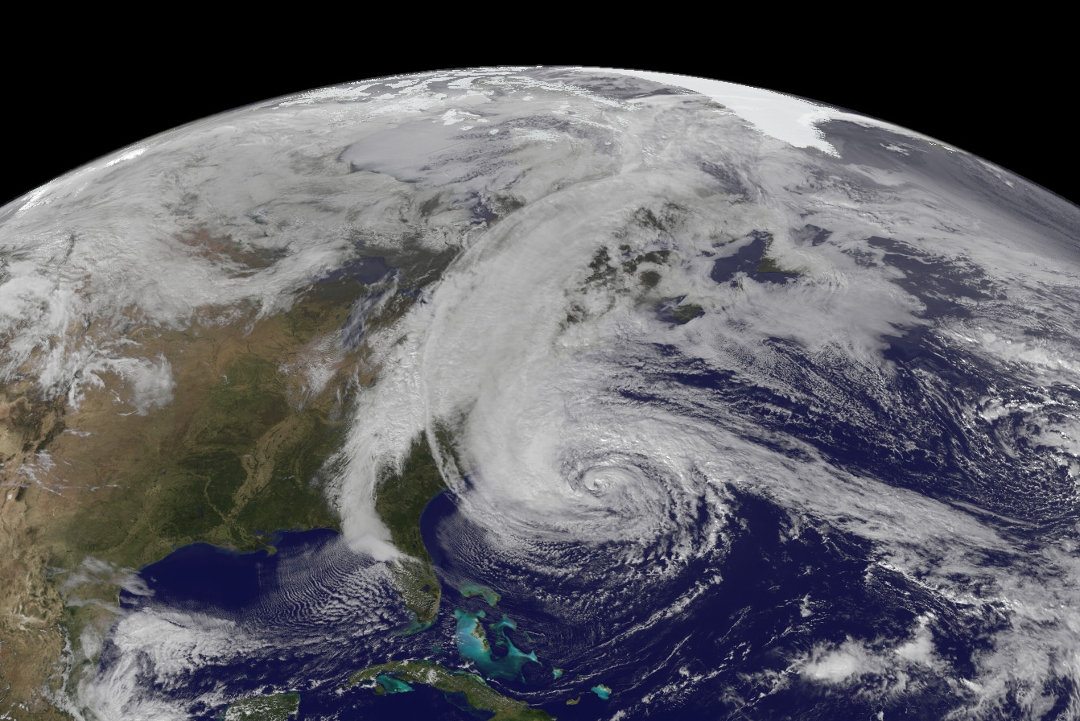
Case 2: Hurricane Sandy
October, 2012

Slide 40
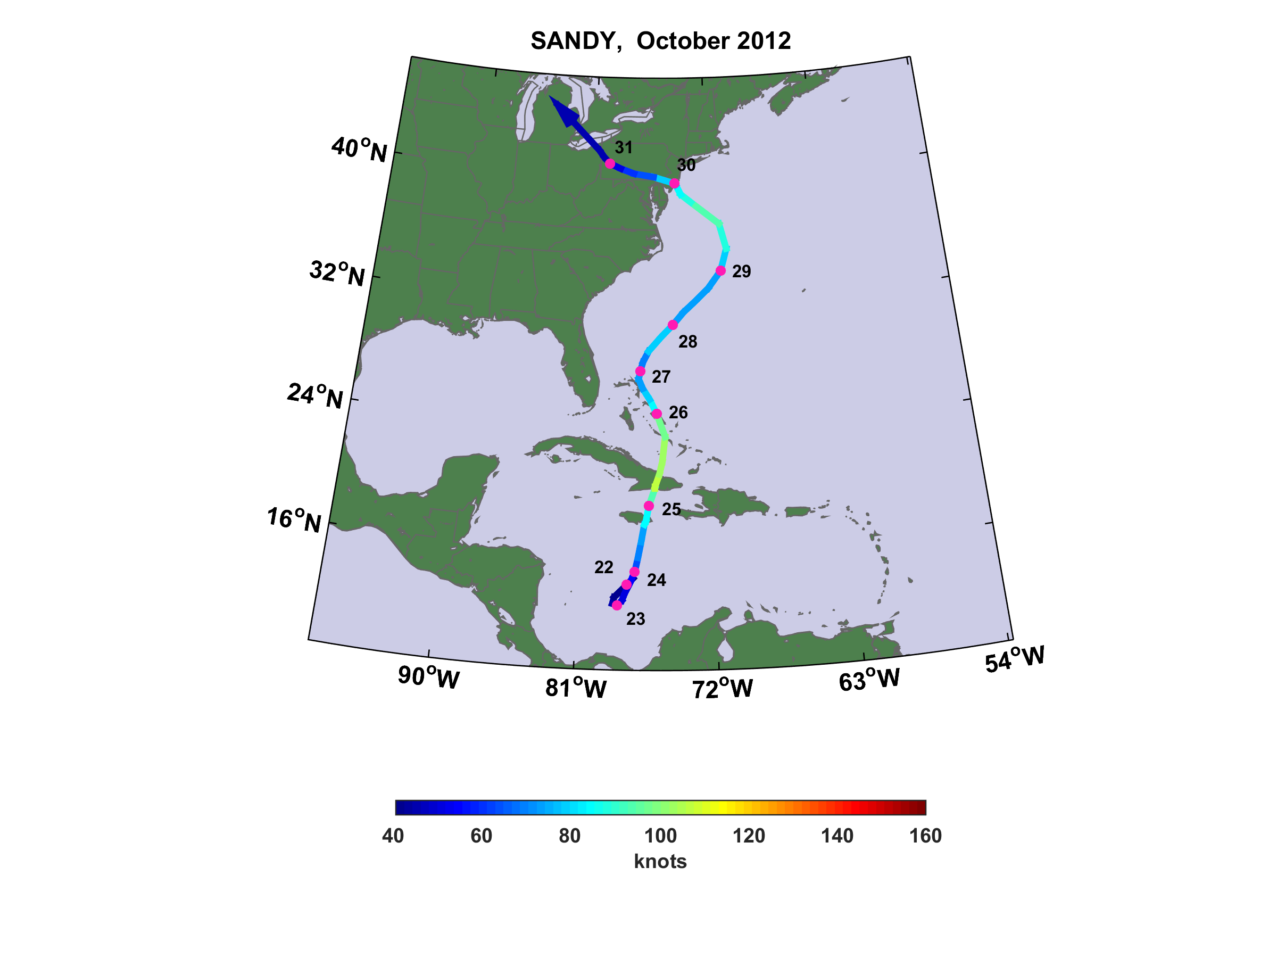

Slide 41
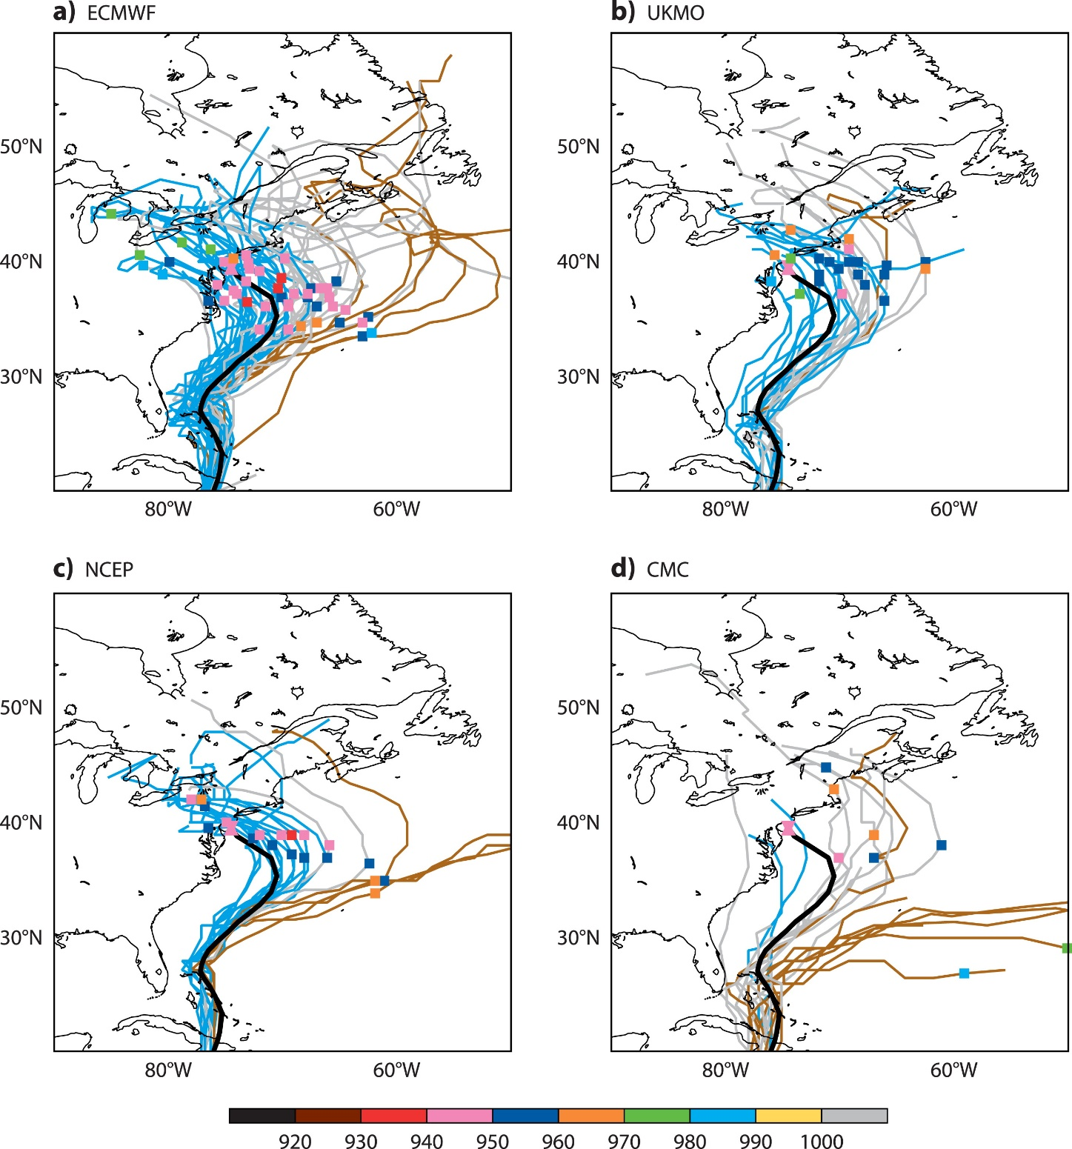
Hard to imagine better track forecasts
Sandy made landfall in New Jersey around 00 GMT October 30
Ensemble forecasts initialized at 1200 UTC 24 Oct (5 ½ days before U.S. landfall)
(Magnusson et al., Mon. Wea. Rev., 2014)

Slide 42
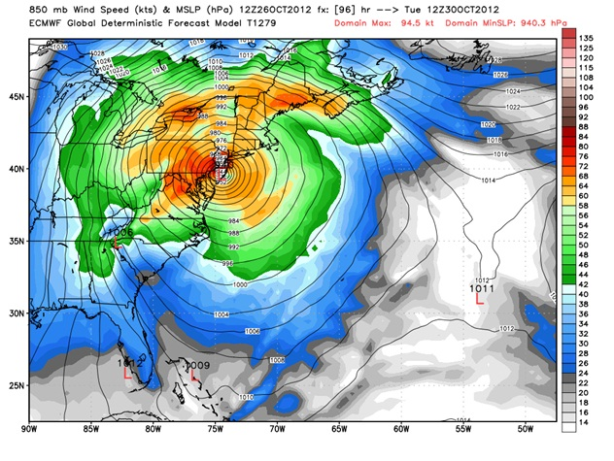
96-hour forecast by the European Center for Medium-Range Forecasts

Slide 43
Relevant Facts
233 fatalities
Strongly affected Haiti and Cuba as well as a large swath of the U.S. eastern seaboard
$75 billion 2012 U.S. dollars in damage – second costliest hurricane in U.S. history (after Katrina)
While a Category 2 hurricane off the U.S. northeastern coast, Sandy became the largest Atlantic hurricane in history, with a diameter of 1800 km - this contributed to the large magnitude of its storm surge in New York
Governor Andrew Cuomo declared a statewide state of emergency and asked for a pre-disaster declaration on October 26

Slide 44
Record 13.88 foot storm surge at the Battery, Manhattan
Worst disaster in the 108-year history of the New York Subway System
New York Stock Exchange closed for two days – the first two-day weather closure since the Blizzard of 1888
Over 10 billion gallons of raw and partially treated sewage released in New York and New Jersey
1-3 feet of snow in West Virginia

Slide 45
Elements of the Disaster

Slide 46
28 October 00 UTC: New York Mayor Michael Bloomberg holds press conference, explaining that he is not ordering any evacuations “based on the nature of the storm….it is not expected to be a tropical storm or hurricane-type surge”
28 October 00-12 UTC: National Hurricane Center Director Richard Knabb has numerous phone conversations with NYC Office of Emergency Management
29 October, morning EDT: Mayor Bloomberg orders evacuation of Zone A…home to about 375,000 residents, and announces shut-down of entire NYC public transportation system at 7 PM EDT that evening
29 October 12 UTC: Hurricane Sandy reaches second peak intensity of 85 knots, 220 nm southeast of Atlantic City
29 October 21 UTC: NHC advisory continues to emphasize powerful surge threat extending far north of actual storm center

Slide 47
29 October 21 UTC: NHC declares that Sandy has become extratropical but continues to issue warnings on storm, including its first ever snowfall advisory (for the mountains of West Virginia)
29 October 2330 UTC: Post-tropical Storm Sandy makes landfall near Brigantine, NJ, with an estimated intensity of 70 kt and a minimum pressure of 945 mb
30 October 00-12 UTC: Record surge arrives in lower Manhattan overtopping seawall at The Battery and flooding parts of the NYC subway system as well as the Hugh Carey Tunnel, which links Lower Manhattan and Brooklyn. Much of lower Manhattan flooded

Slide 48
Lessons from Hurricane Sandy
Remarkably good forecasts, excellent communications between forecasters, emergency managers, and political leaders still did not prevent loss of >150 lives
Preparations for and reactions to Sandy were by and large greatly superior to those in Katrina
Management of and resilience to natural disasters strongly depends on local culture
Much confusion and delayed evacuation resulted from misunderstandings arising from use of multiple and culturally loaded terms such as “hurricane”. Some insurance policies tied to tropical status and/or “named storm” status. Strong impetus for re-visiting warning terminology, storm categorization, and related issues

Slide 49

GCM flood height return level, Battery, Manhattan
(assuming SLR of 1 m for the future climate )
Black: Current climate (1981-2000)
Blue: A1B future climate (2081-2100)
Red: A1B future climate (2081-2100) with R₀ increased by 10% and R_{m} increased by 21%
Lin, N., K. Emanuel, M. Oppenheimer, and E. Vanmarcke, 2012: Physically based assessment of hurricane surge threat under climate change. Nature Clim. Change, doi:10.1038/nclimate1389
Notes:
Then we calculate the flood height (including surge, tide, and sea level rise) return level for the four climate models, assuming a sea level rise of 1 m for the future climate, for the Battery, NYC. These results show that the combined effects of storm climatology change and sea level rise will greatly shorten the flood return periods for NYC and, by the end of the century, the current 100-year surge flooding may happen less than every 30 years, with CNRM and GFDL prediction to be less than 10 years, and the 500-year flooding may happen less than every 200 years, with the CNRM and GFDL prediction to be 20-30 years.

Slide 50
Population and Climate Change:
The Elephants in the Room
Global population exposed to tropical cyclone hazards has tripled since 1970
Sea level is rising and is projected to do so at an accelerating pace through this century
Incidence of intense tropical cyclones is expected to increase
In spite of improving forecasts, incidence of tropical cyclone disasters will almost certainly rise very substantially

Slide 51
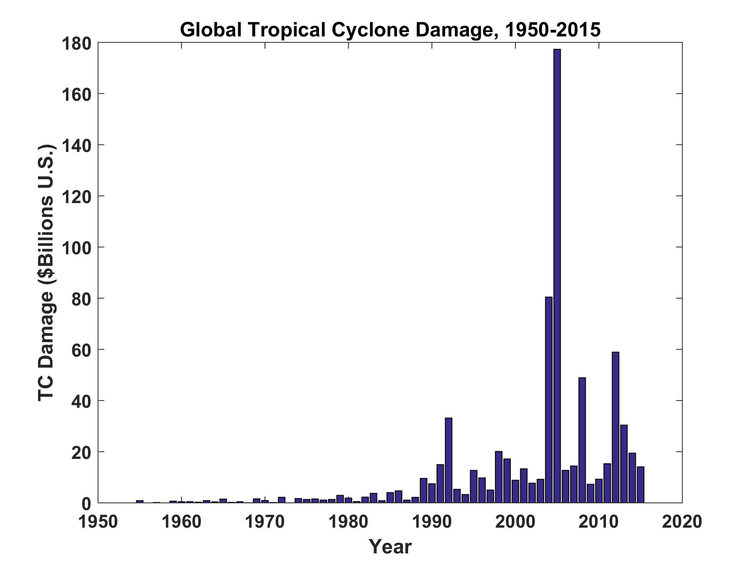

Slide 52
Why the U.S. Will Have Many More Katrinas and Sandys
Federal and State governments massively subsidize flood risk
National Flood Insurance Program (NFIP) created by Congress in 1968 in response to reluctance of private firms to insure flood risk
Most states heavily regulate property insurance and many restrict premium pricing under pressure from wealthy coastal property owners
NFIP was amended in 2012 by the Biggart-Waters Act that changed NFIP premiums to match actuarial risk-based premiums. In some areas, premiums rose by a factor of 10
Under pressure from coastal and floodplain property owners, Congress effectively repealed many provisions of Biggart- Waters with the Homeowner Flood Insurance Affordability Act of 2014

Slide 53
Political left emphasizes affordability; means-tested subsidies (such as vouchers) helps those of modest means but inadvertently encourages them to live in risky places (e.g. “FAIR Plan” act of 1968, insurer of last resort)
Political right favors effective subsides for wealthy coastal property owners over free-market principles (FAIR Plan now covers most wealthy coastal property owners in Massachusetts)
Net result is massive publicly financed incentives to live and build in risky locations
We can predict with confidence that U.S. coastal hurricane-related losses will increase over time, exacerbated by sea level rise and, possibly, by increases in hurricane risk itself

Slide 54
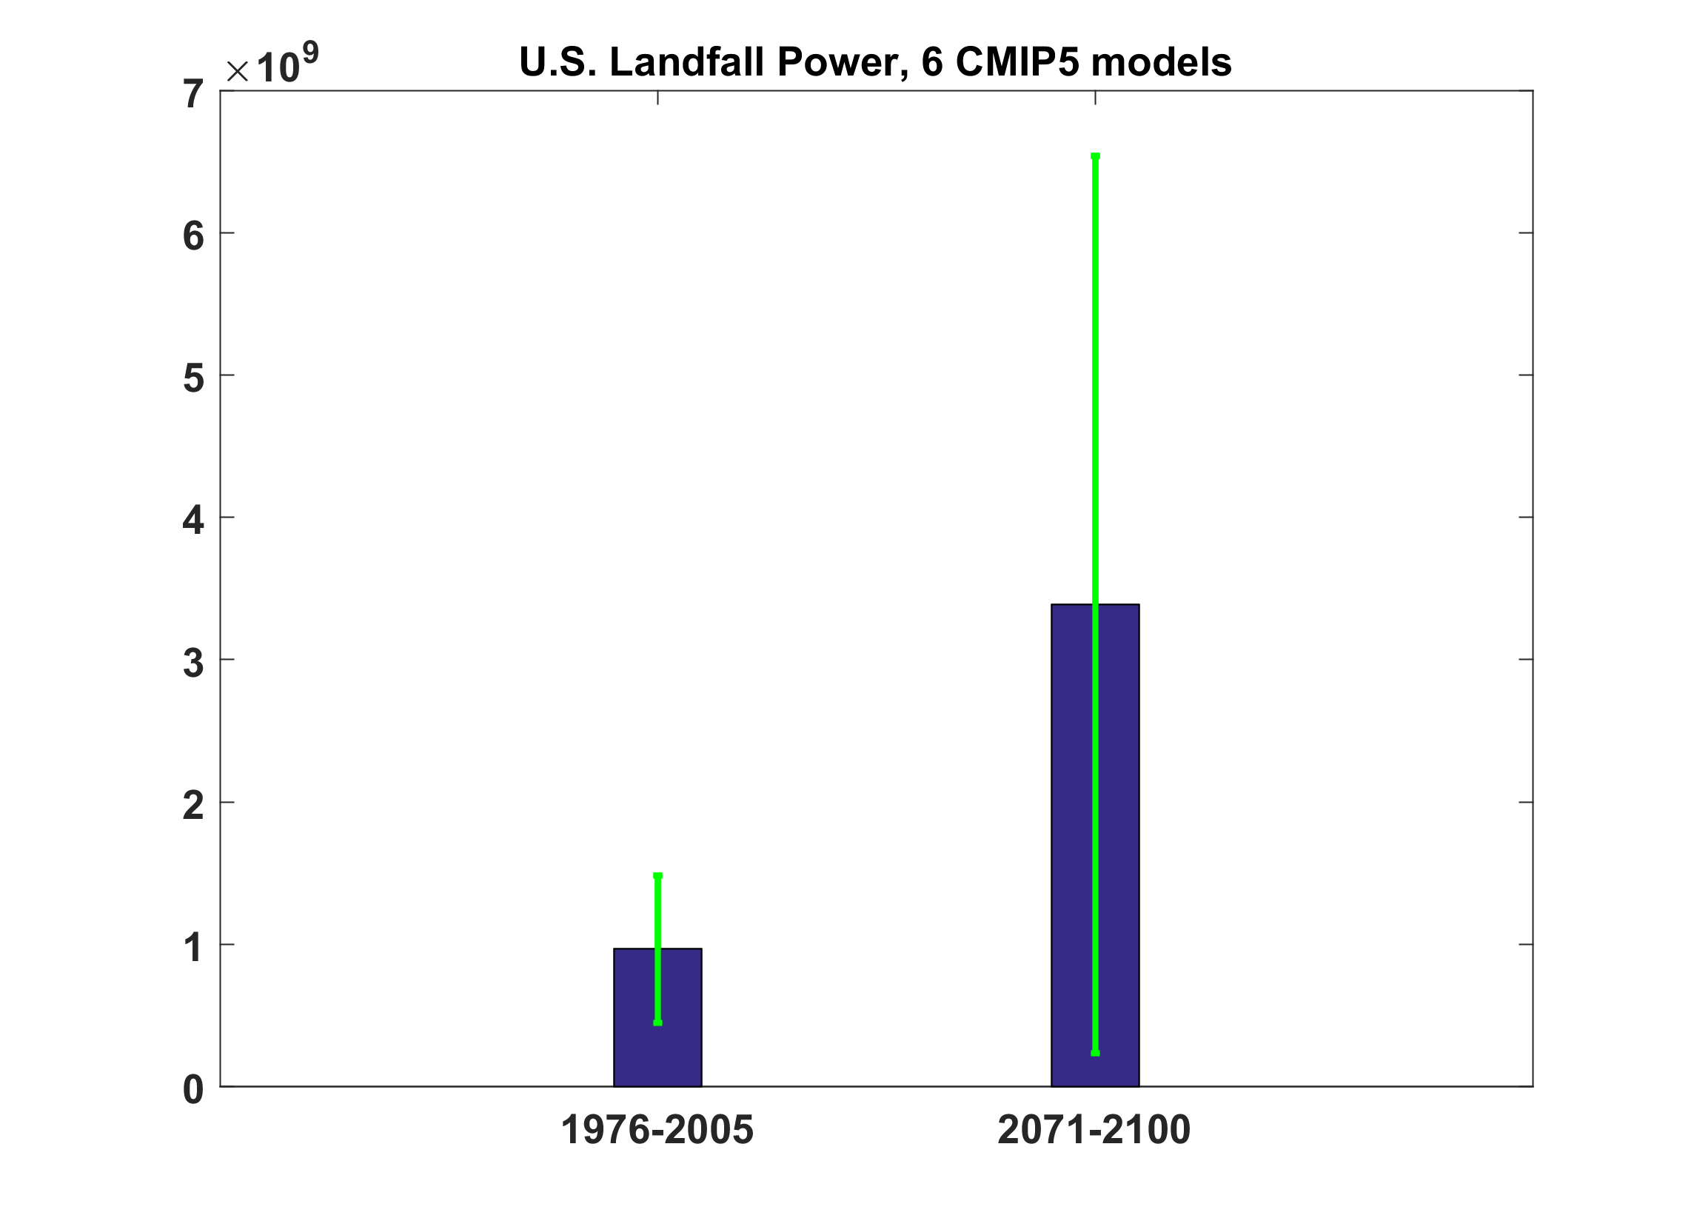
Projections of U.S. Hurricane Landfall Power from 6 CMIP5 models

Slide 55
Sea level rise + changing storms
Sea level rise alone
From: American Climate Prospectus Economic Risks in the United States

Slide 56
Summary
Hurricanes take 10,000 lives and cost $700 billion annually
Response to actual and perceived hurricane threats highly dependent on local and national culture
Greatly increasing coastal population coupled with rising sea levels and, possibly, increases in frequency of intense storms portend ever increasing damage and mortality from hurricanes

Slide 57
Summary
These trends make it urgent to revisit and reform hurricane-related policies
Adaptation pathways depend on location, long-term vs short-term viewpoints, and assumed discount rates
Hurricanes are just one among many climate hazards we must mitigate or adapt to

