Slide 1
Using Physics to Estimate MIT's Flood Risk
Kerry Emanuel
EAPS
With thanks to Ken Strzepek and MIT’s Office of Sustainability

Slide 2
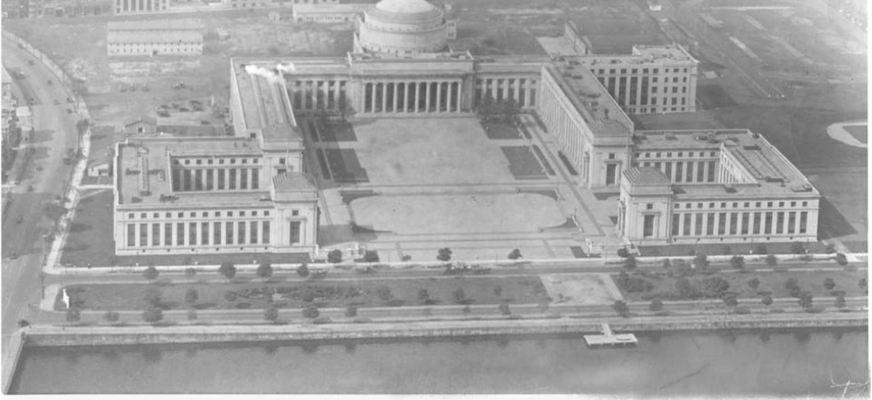
Purpose of Climate Resiliency Committee
1. Complete a climate vulnerability assessment of the MIT campus that assesses impacts from climate risks and the interaction of these risks.
2. Provide advice and contributions about how risk response through research, education and operations can transform MIT towards a more prepared and climate-resilient campus. |

Slide 3
Flood risks to MIT
Springtime rains coupled with snow melt
Flash floods caused by summer thunderstorms
Sustained rainfall in early fall or late spring non-tropical cyclones
Storm surge and heavy rain threats from tropical cyclones

Slide 4
Flood risks to MIT
Springtime rains coupled with snow melt
Flash floods caused by summer thunderstorms
Sustained rainfall in early fall or late spring non-tropical cyclones
Storm surge and heavy rain threats from tropical cyclones

Slide 5
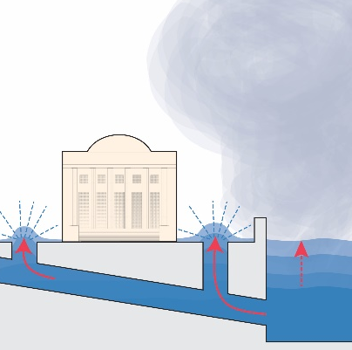
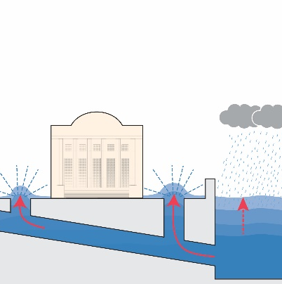
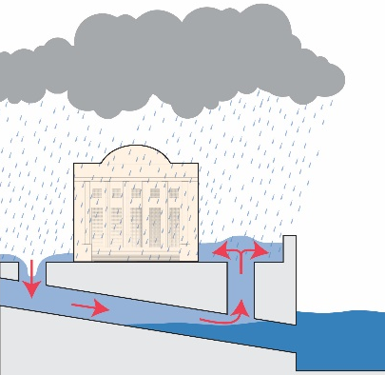
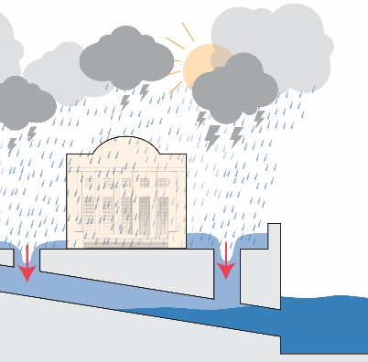
MIT Campus Flood Risks: 2019
Storm Surge + SLR
Upriver Rain
Day of Rain
Flash Floods
Probable after 2050--a hurricane or nor’easter that blows a surge of water from the ocean into Boston Harbor and around or over-top the Charles river dam.
A rain event upstream in the Charles River watershed, up to 3 days of rain
A 24 hour rain event over Cambridge, likely covering the entire region.
A 1-3 hour intense rain event, covering a portion of campus.

Slide 6
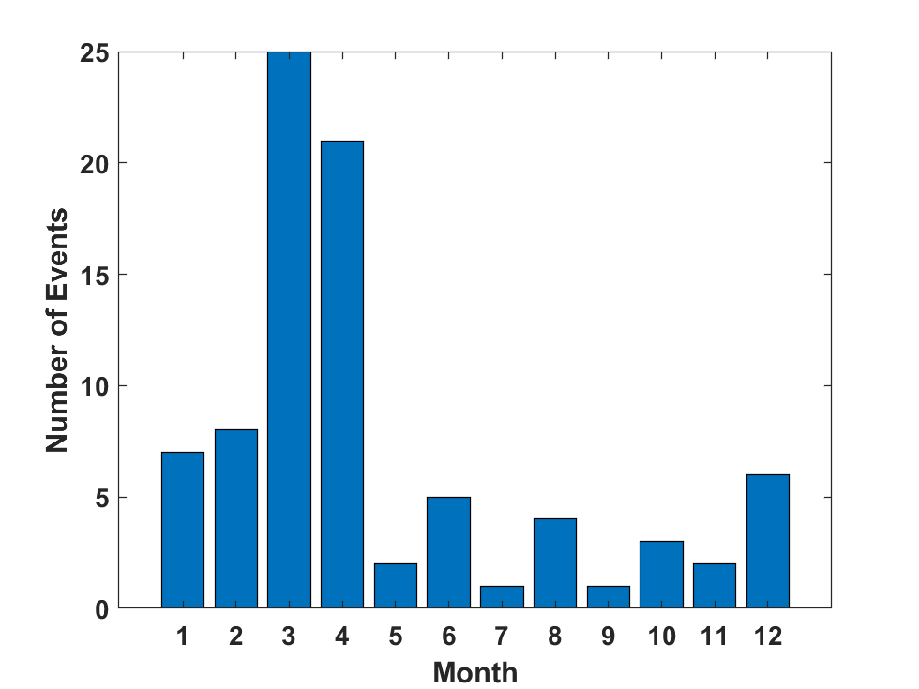
Analysis of annual maximum flows in Charles River at Waltham (1932-2016)

Slide 7
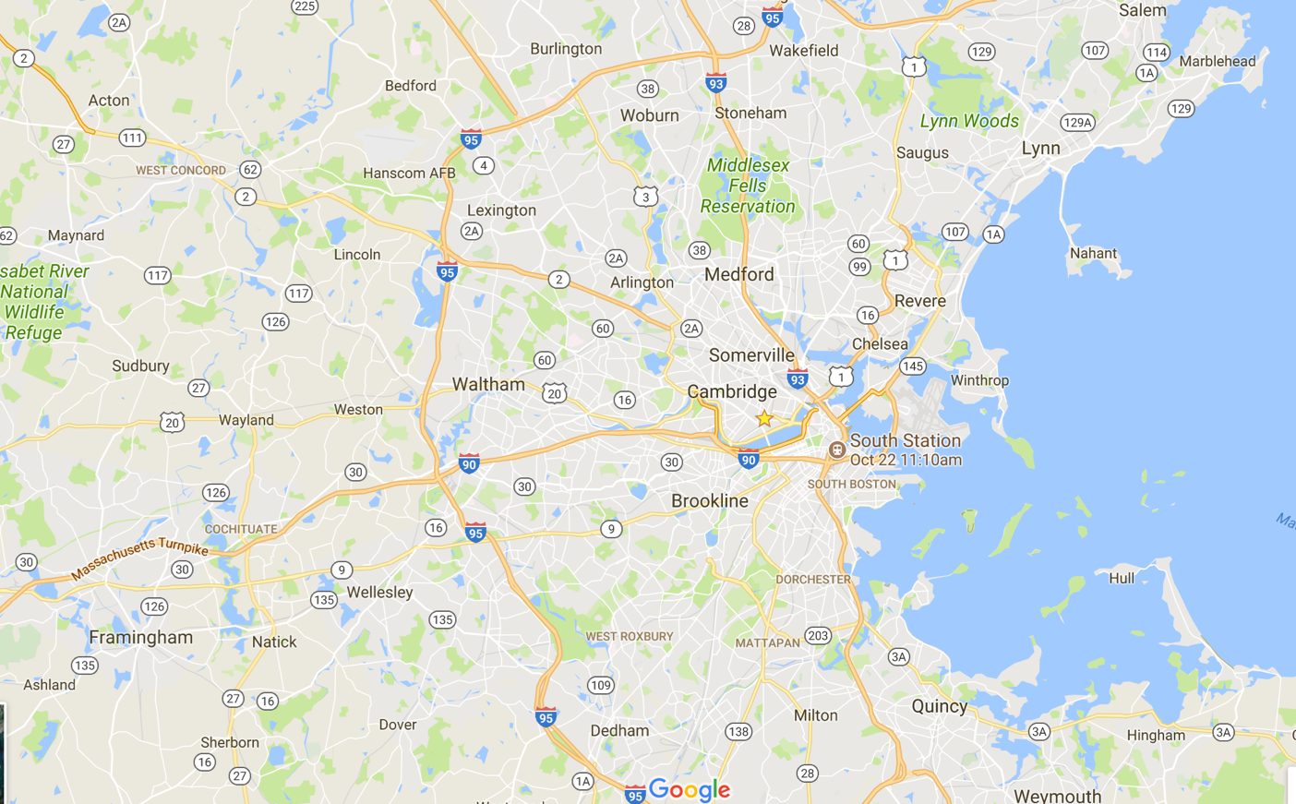
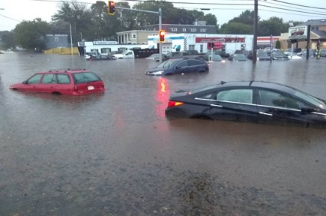
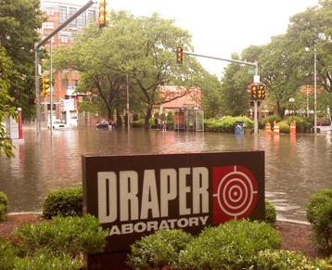



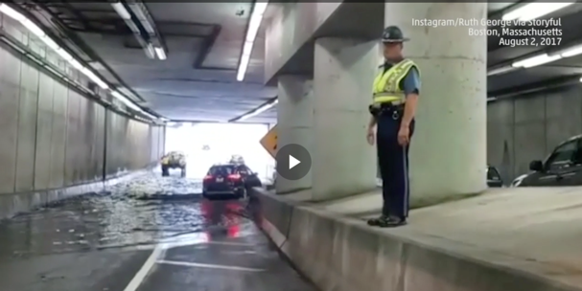
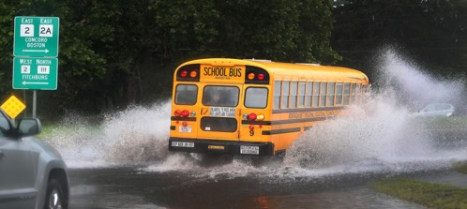
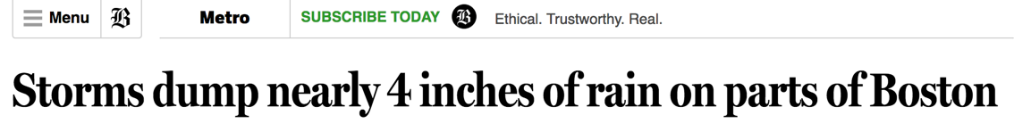
Local flood events since 2010
July 10, 2010 - 3.5 “ in 1 hr: Cambridge, MA
Aug 12, 2018 – 8” in 2 hrs;
Sept 30, 2017 - 4 “ in 1 hr: Lynn, MA
August 2, 2017 - 4 “ in 2 hrs:
Maynard, MA;
Dorchester, MA
March 30, 2014 - 3 “ in 24 hrs:
Logan Int’l Airport:
7

Slide 8
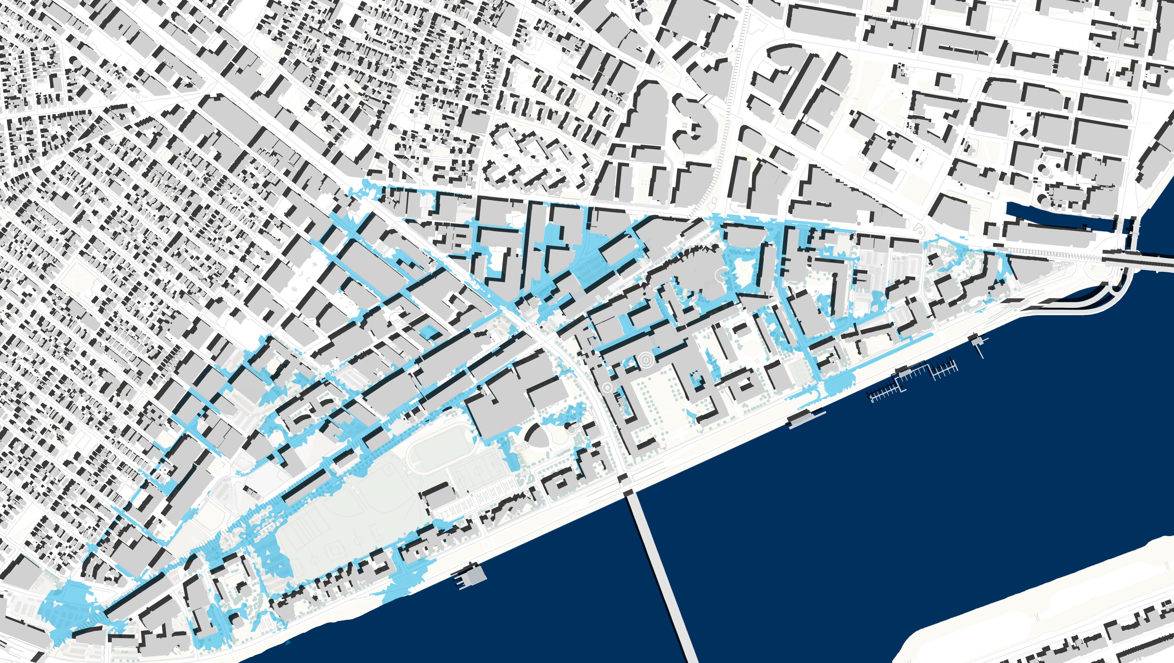
MIT campus flash flood study
Upriver flood risk study
Joint-flood event probability study
Basement/tunnel cascade risk study
Researching MIT
Climate Impacts + Risks
Reducing uncertainty by applying academic research to campus as test bed.

Slide 9
Physical modeling of tropical cyclones affecting Cambridge, present and future

Slide 10
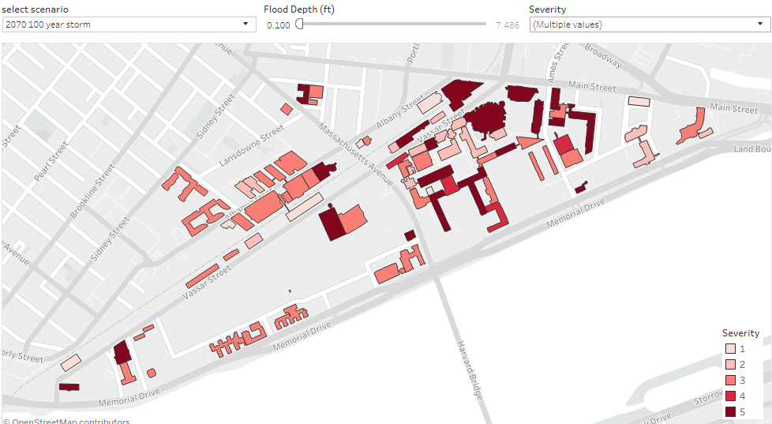
Creating tools to support the MIT community – Hazard + Flood risks map

Slide 11
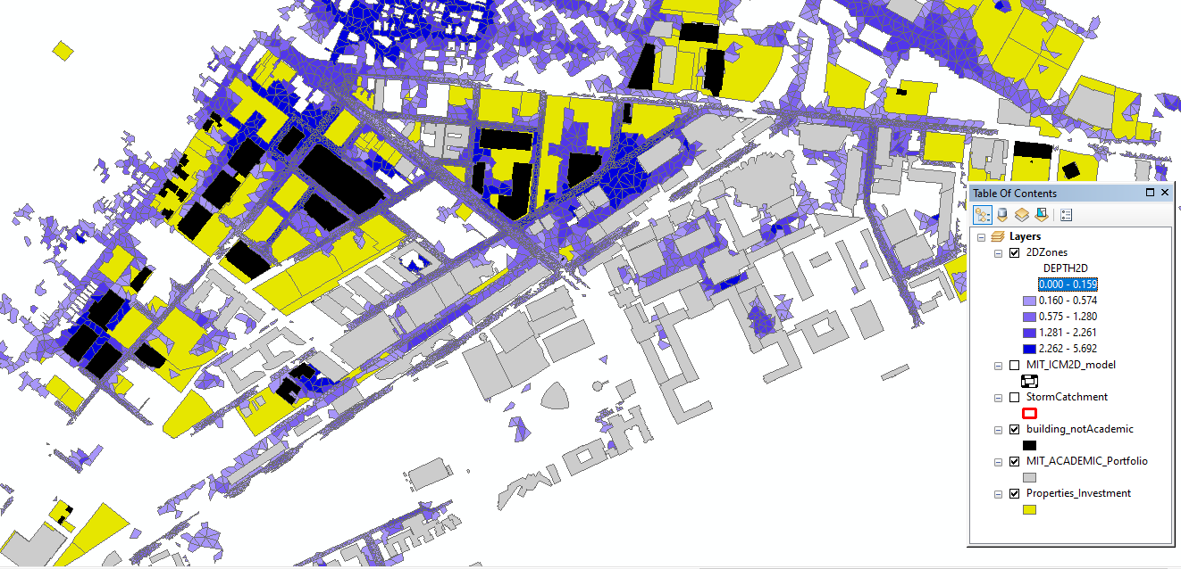
2070 1-% 24hour Harmonized

Slide 12
Summary
MIT is engaged in a major effort to assess its own flood risk
This effort actively involves MIT’s Resilience Committee, faculty and students from several departments, and MIT’s physical plant
We are supplementing historical flood statistics with advanced physical modeling to estimate how flood risks might evolve over time in a changing climate
We also model flow of water through the MIT campus, storm drains and buildings
In addition to developing a comprehensive assessment of MIT’s flood risk, we are creating a template for other organizations to assess their current and climate-related risks

