Slide 1

Will our weather extremes become even more extreme?
Kerry Emanuel
Lorenz Center
MIT

Slide 2
Weather Extremes
Temperature
Hydrology
Tropical Cyclones and Medicanes
Severe local storms

Slide 3
Weather Extremes
Temperature
Hydrology
Tropical Cyclones and Medicanes
Severe local storms

Slide 4
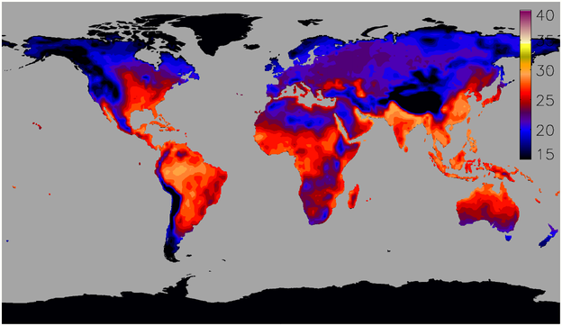
Peak annual afternoon wet-bulb temperature attained in the present climate
Courtesy Steve Sherwood, http://web.science.unsw.edu.au/~stevensherwood/wetbulb.html

Slide 5
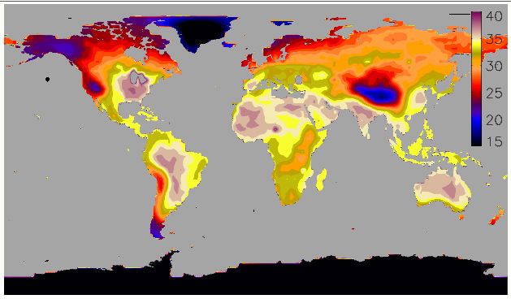
Same after ~10 C global warming
Courtesy Steve Sherwood, http://web.science.unsw.edu.au/~stevensherwood/wetbulb.html

Slide 6
Sherwood, S. C., and M. Huber, 2010: An adaptability limit to climate change due to heat stress. Proc. Nat. Acad. Sci., 107, 9552-9555

Slide 7
Weather Extremes
Temperature
Hydrology
Tropical Cyclones and Medicanes
Severe local storms

Slide 8
Hydrologic Extremes
Evaporation = Precipitation ~= Net Radiative Cooling
Radiative cooling increases slowly with temperature
Water vapor concentration increases rapidly with T
Rainfall intensity increases, rain frequency decreases
See Held and Soden, J. Climate, 2006

Slide 9
RCE
Radiative cooling
Clear air energy balance:
Static stability
Radiative cooling increase slowly with T
Static stability increases rapidly with T
Mass flux decreases with warming

Slide 10
But….
Convective rainfall intensity scales as wq*
In convection-permitting RCE simulations, w ~ constant
  Robe and Emanuel (1996)
  Scales with hydrometeor fall speed
    Parodi and Emanuel (2009)
    Singh and O’Gorman (2014)
Rainfall intensity scales with q* (Clausius-Clapeyron)
Fractional area covered by updrafts must decrease
  Shown by Parodi et al. (2011)

Slide 11
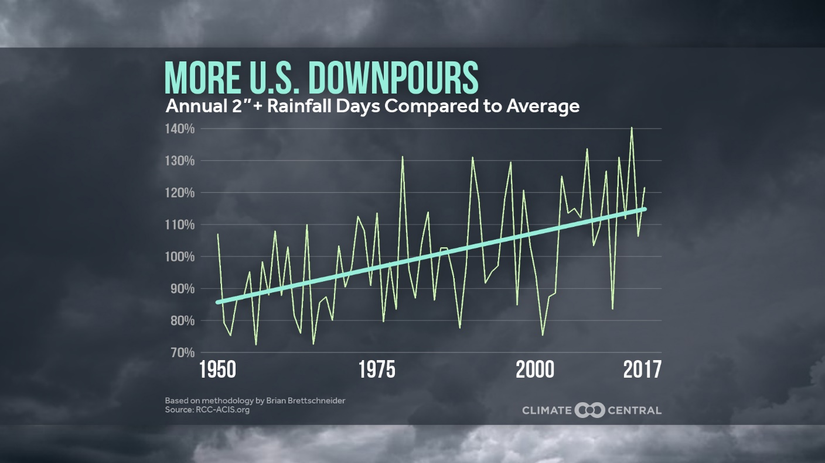

Slide 12
Weather Extremes
Temperature
Hydrology
Tropical Cyclones and Medicanes
Severe local storms

Slide 13
Tropical Cyclones and Climate Change
Greenhouse-induced warming increases potential intensity Emanuel, 1987)
Yet the thermodynamic inhibition to genesis, measured by the saturation deficit of the middle troposphere, increases with temperature
Rainfall intensity increases with Clausius-Clapeyron, and storm total rainfall may increase even faster if storm translation speeds decrease
Strong consensus that incidence of very intense tropical cyclones will increase and that storm surge and freshwater flooding will become more problematic; little consensus on frequency of weak storms
See just-published review by Knutson et al., BAMS, 2019

Slide 14
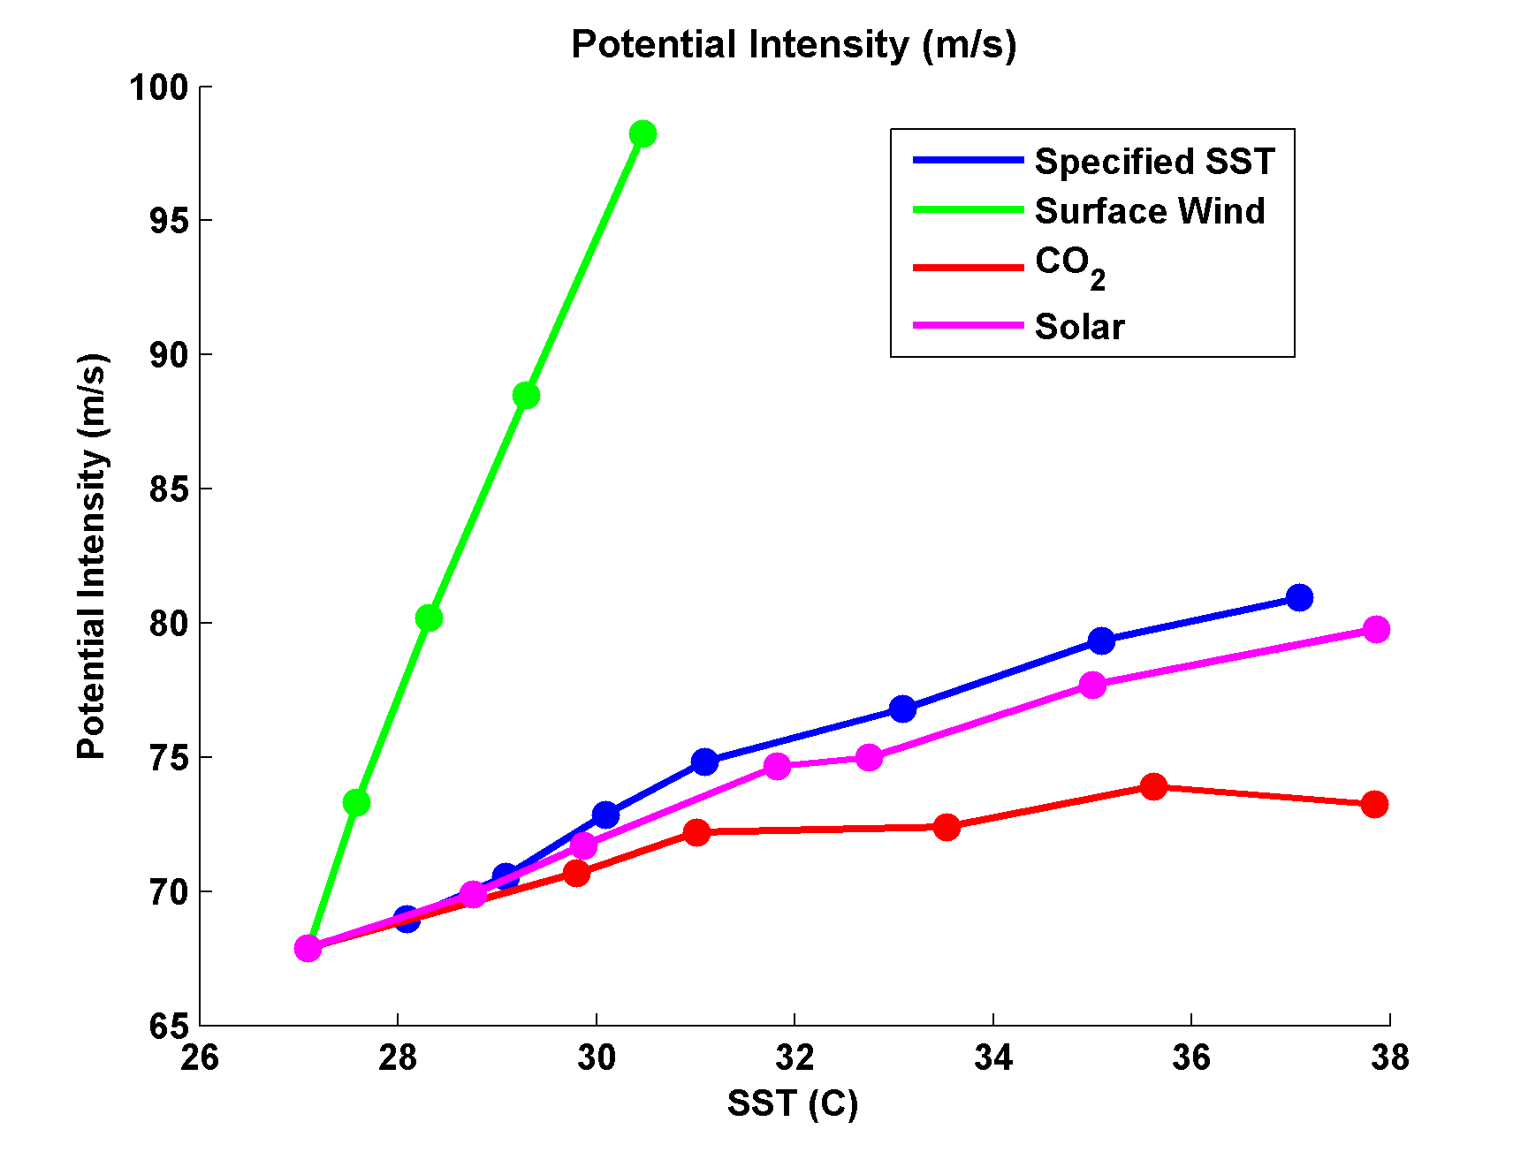
Emanuel and Sobel, JAMES, 2013

Slide 15
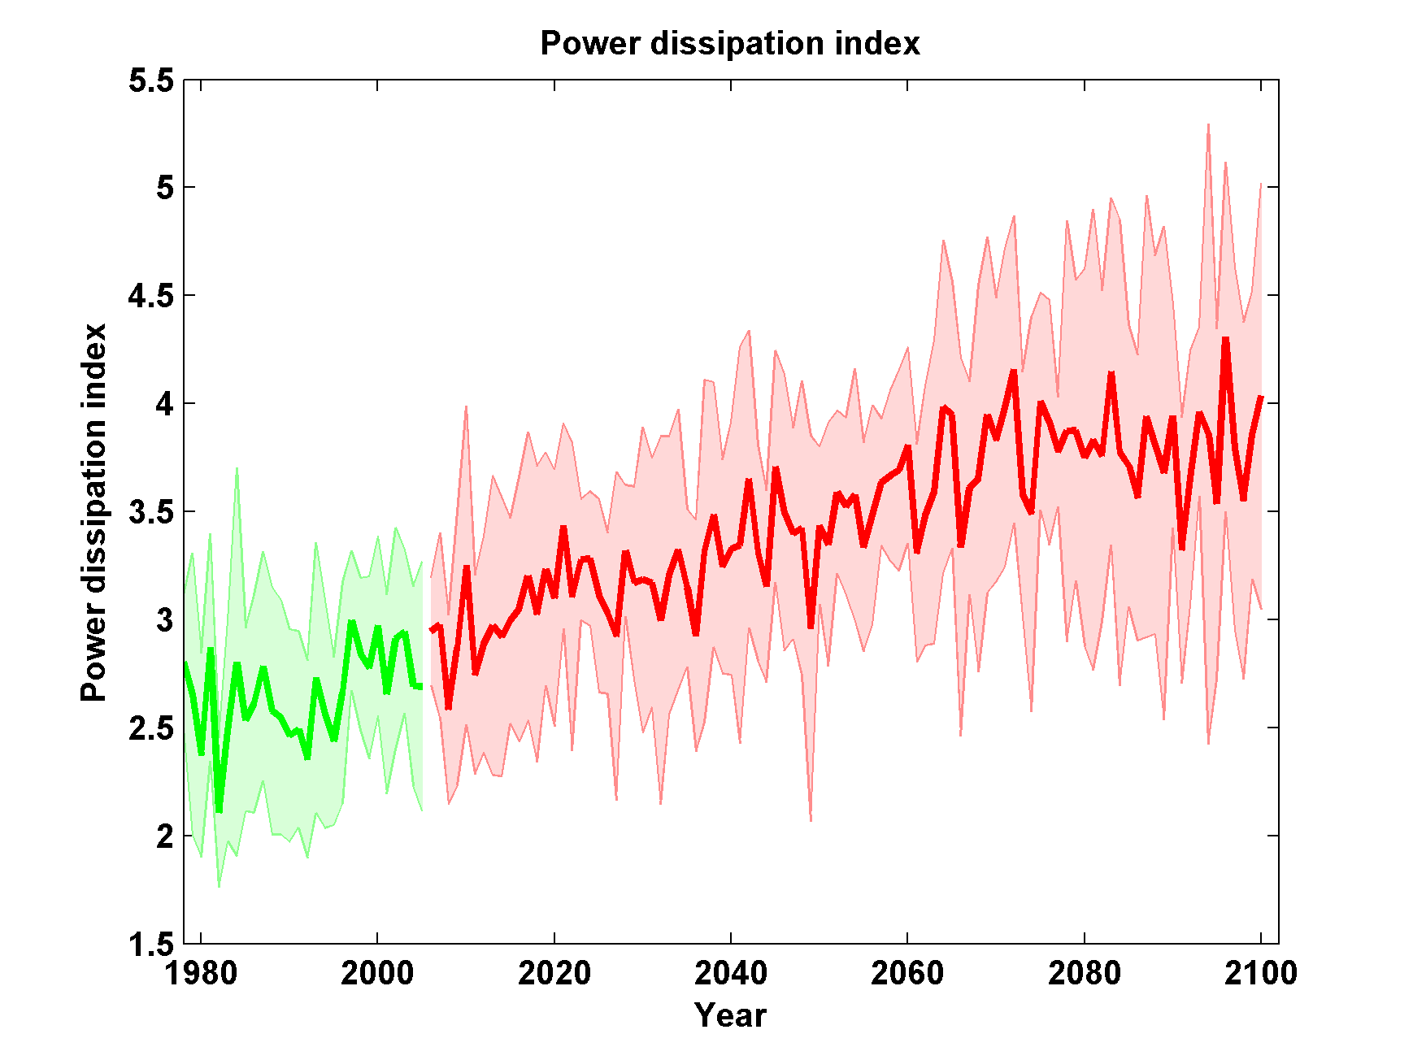
Global Hurricane Power under RCP 8.5
Six CMIP5 Models
Emanuel, Proc. Nat. Acad. Sci., 2013

Slide 16
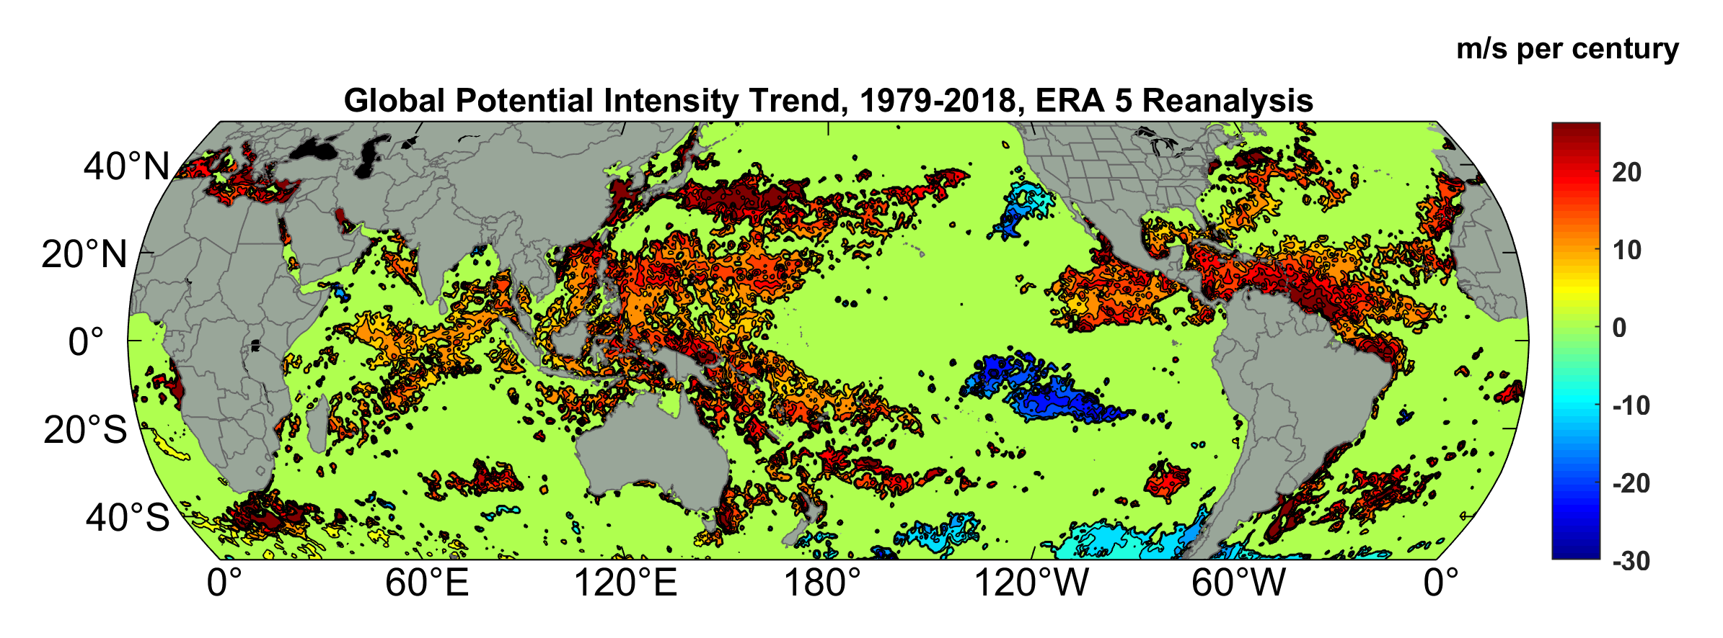
Potential Intensity Trend, 1979-2018, ERA 5 Reanalysis
(Trend shown only where p value < 0.05)

Slide 17
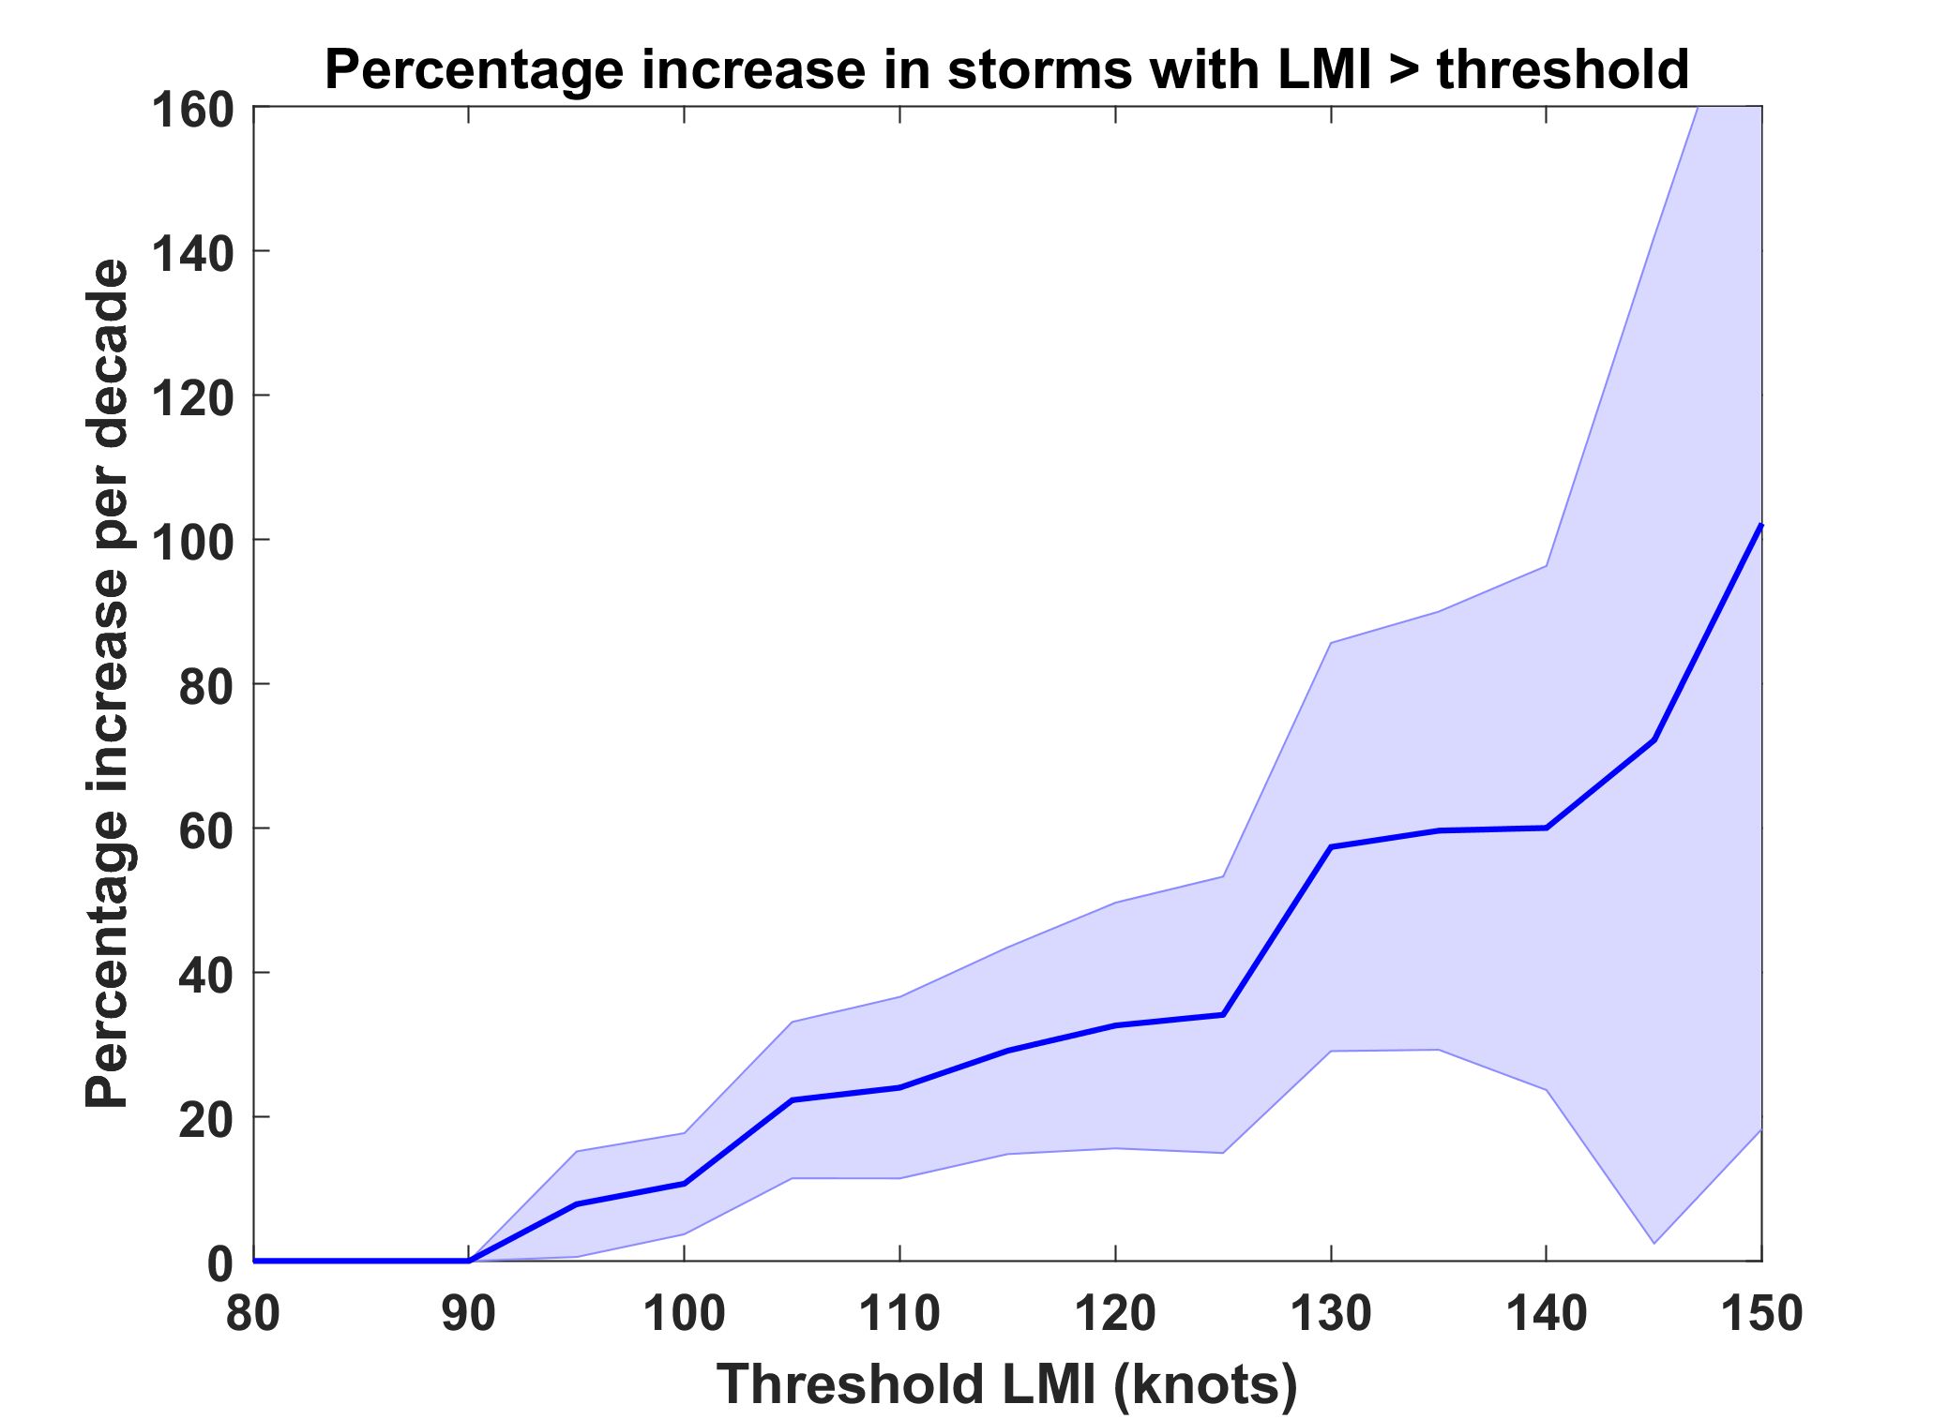
Trends in Global TC Frequency Over Threshold Intensities, from Historical TC Data, 1980-2016. Trends Shown Only When p < 0.05.

Slide 18


Why the Strongest Storms Matter Most
Event Probability
Damage Probability
Current and Future Probability Density of U.S. TC Wind Damages
Current and Future Damage Probability

Slide 19
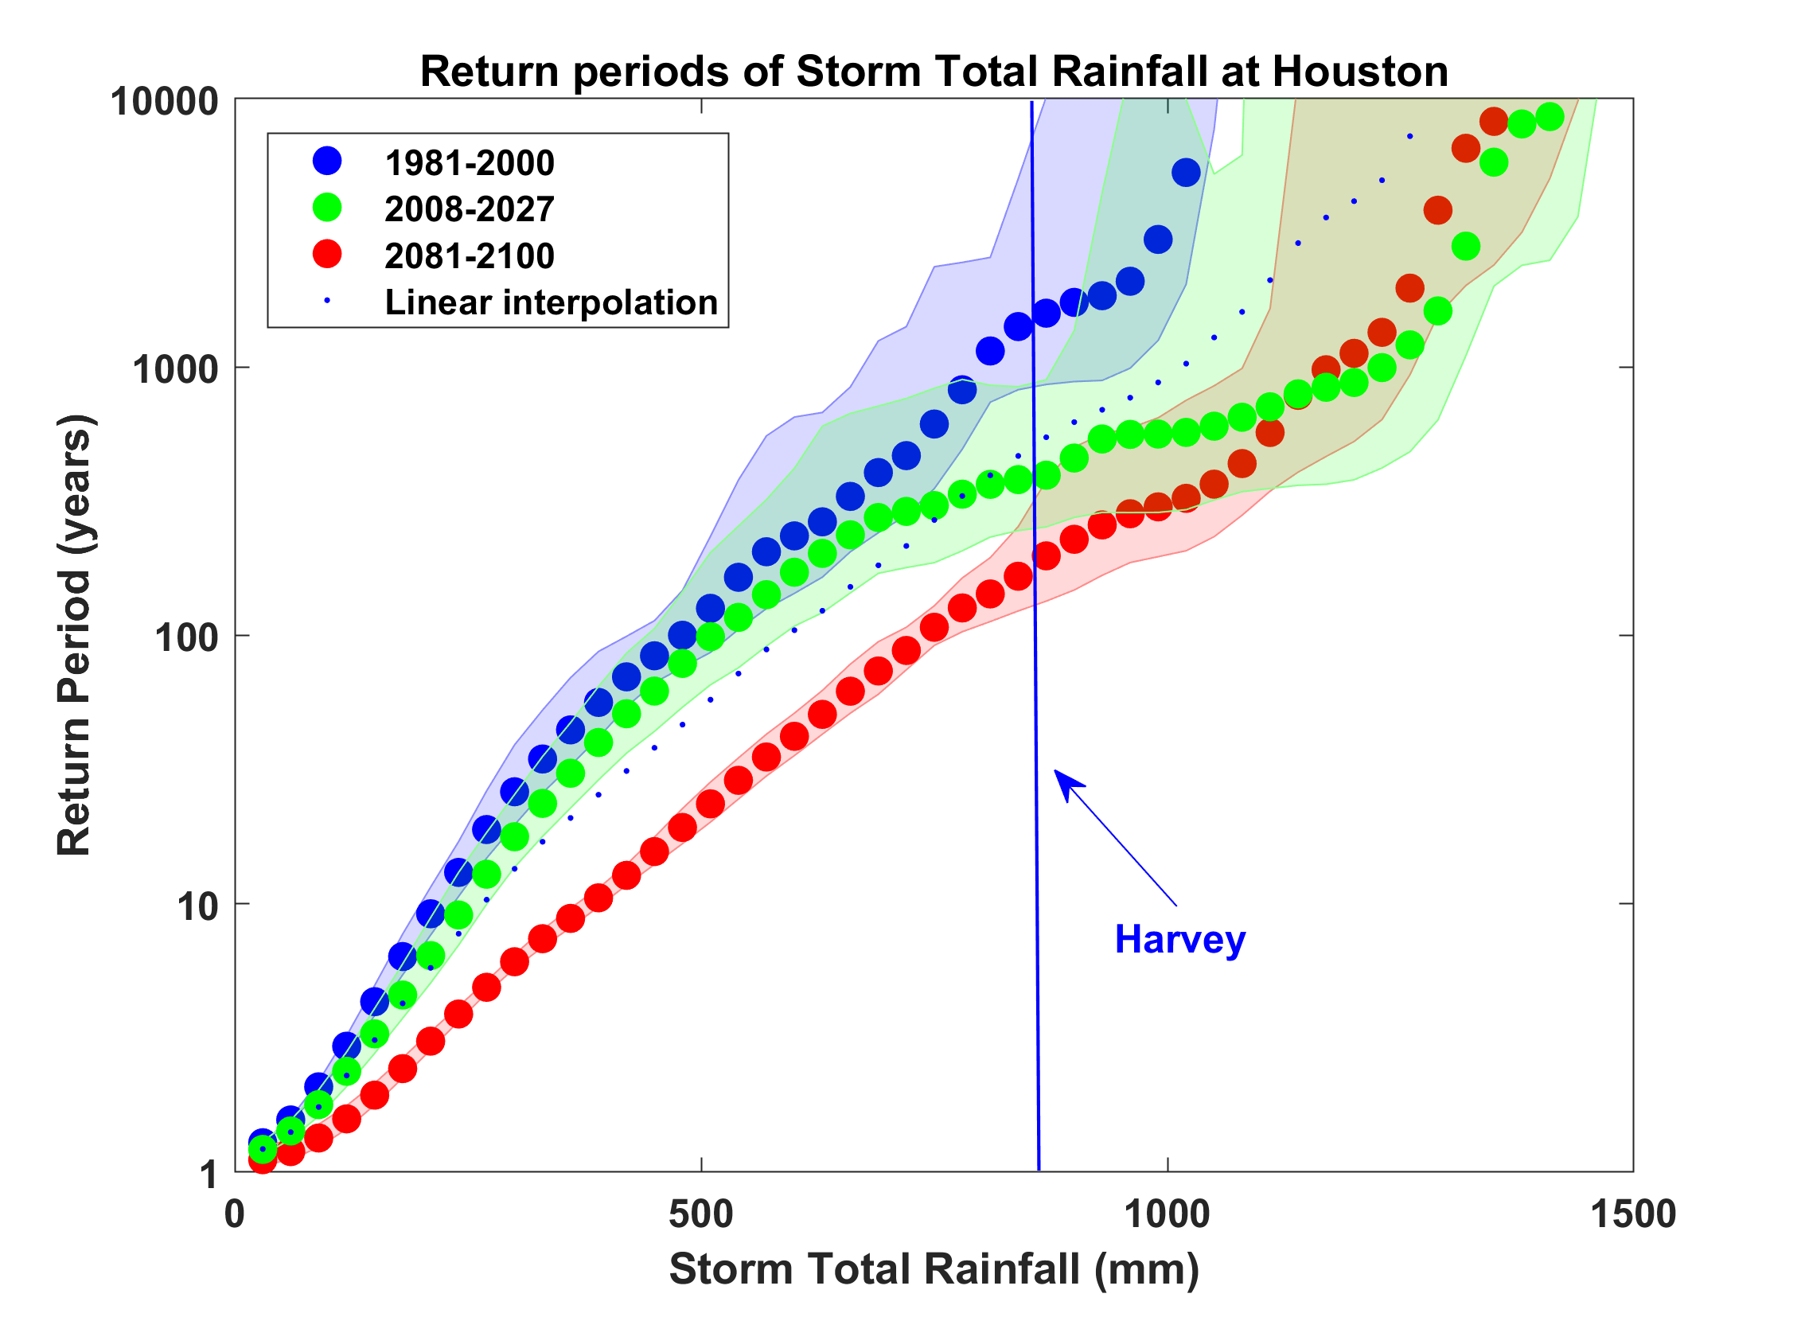
Probability of Storm Accumulated Rainfall in Harris County, from 6 Climate models, 1981-2000, 2008-2027, and 2081-2100, Based on 2000 Events Each, and Using RCP 8.5. Shading Shows Spread Among the Models.
Emanuel, Proc. Nat. Acad. Sci., 2017

Slide 20
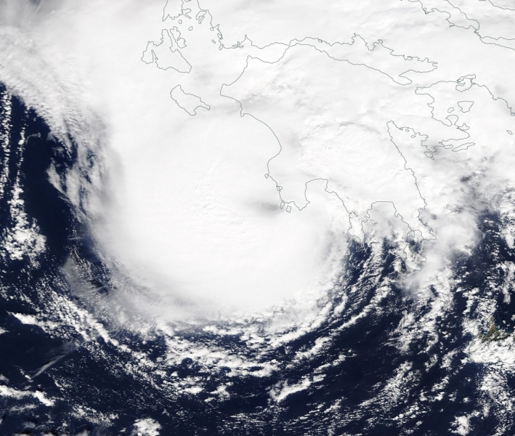
Mediterranean Hurricanes (“Medicanes”)
Medicane “Zorba” making landfall in southwest Peloponnese, September 29th 2018

Slide 21
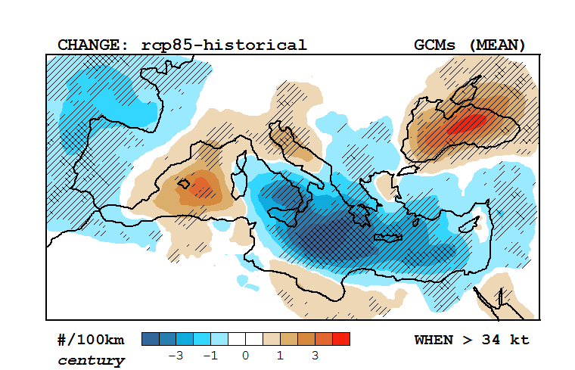
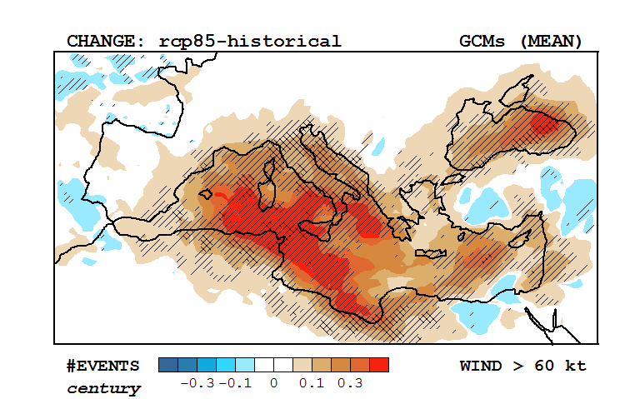
Response of Medicanes to a Changing Climate
Change in multi-model mean track density, RCP 8.5 –historical (2090-1995)
Based on downscaling of 30 CMIP5 models
(light and dark hatching; > 66% and 80% consensus)
Change in multi-model mean frequency of winds > 60 knots, RCP 8.5 –historical (2090-1995)
Romero and Emanuel, J. Clim., 2017

Slide 22
Weather Extremes
Temperature
Hydrology
Tropical Cyclones and Medicanes
Severe local storms

Slide 23
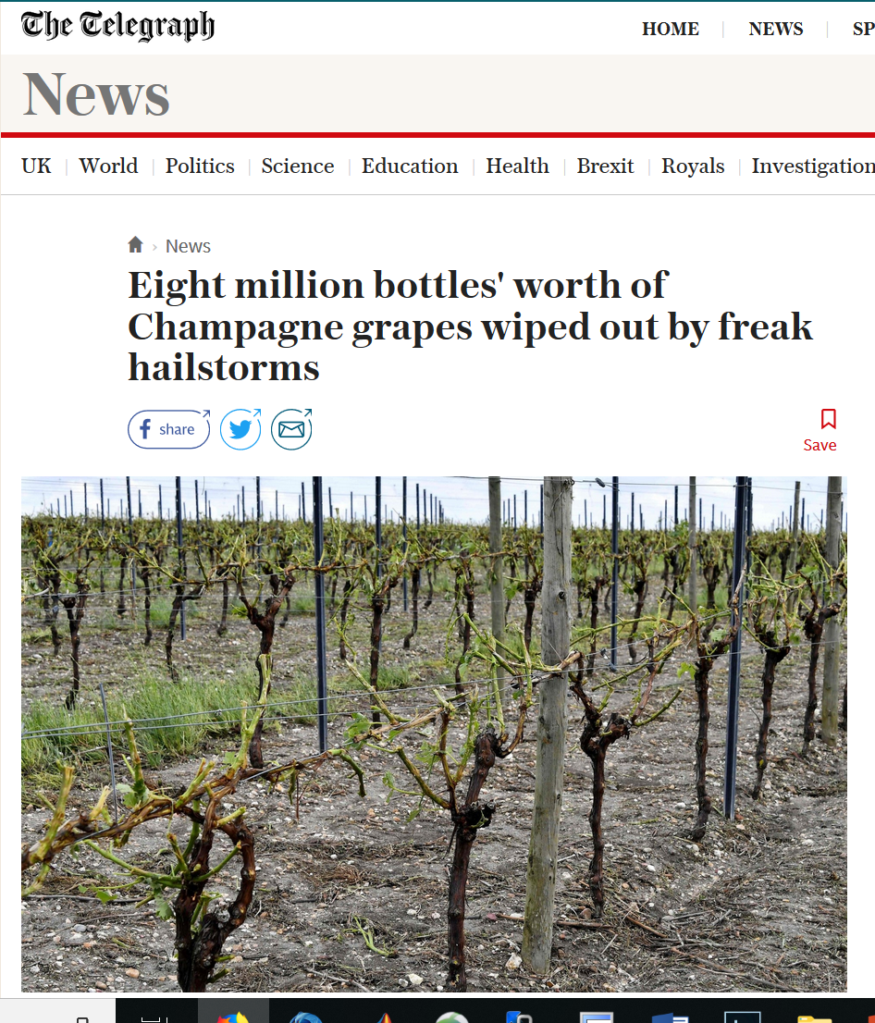
Why We Should Worry….

Slide 24
A Key Ingredient for Severe Local Storms:
Convective Available Potential Energy (CAPE)
Large CAPE created by solar heating when deep, dry air moves over moist soil (NOT over moist air!)
Peak values of CAPE given by:
Convective Inhibition (CIN) also increases with T_{s}
Insolation
Boundary layer T
Saturation q of soil
Surface wind speed
Tropopause T
Soil moisture
See Agard and Emanuel, J. Atmos. Sci., 2017

Slide 25
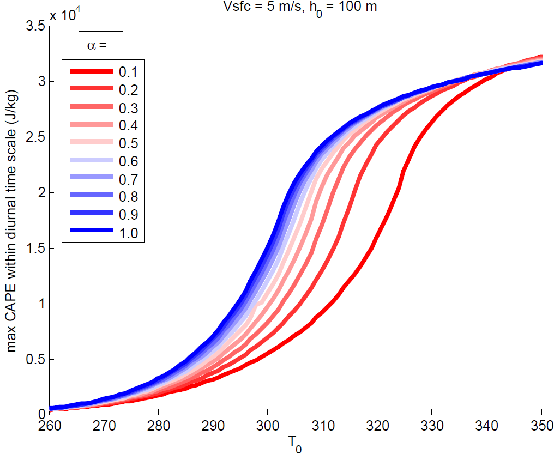
A moister land surface means higher CAPE at lower temperatures
Notes:
While the peak CAPE increases with increasing temperature, the *time* to peak CAPE increases also.

Slide 26
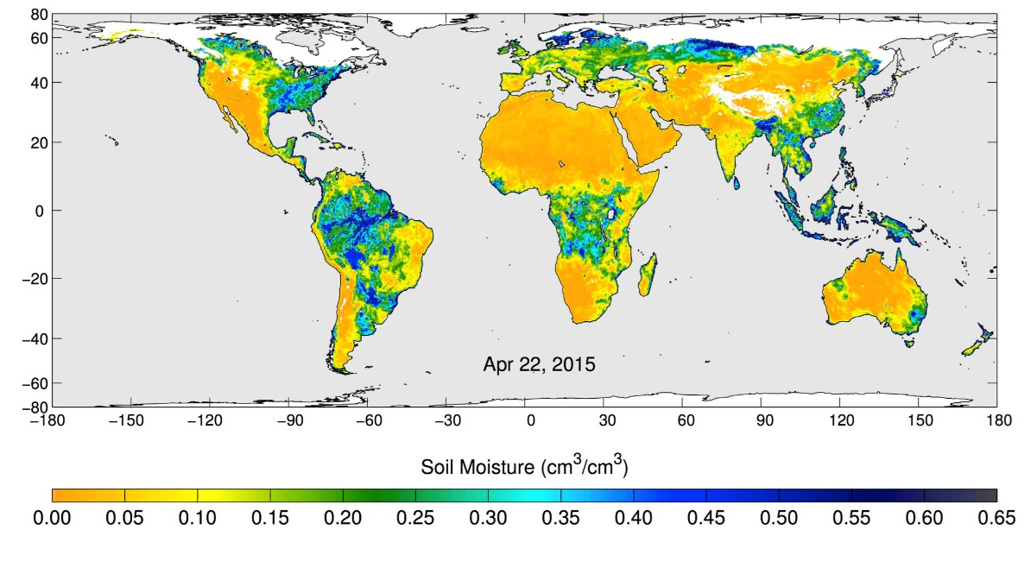
Volumetric water content in the top 5 centimeters of soil, from NASA's Soil Moisture Active Passive (SMAP) observatory, 22 April 2015
Notes:
These maps of global soil moisture were created using data from the radiometer instrument on NASA's Soil Moisture Active Passive (SMAP) observatory. Each image is a composite of three days of SMAP radiometer data, centered on April 15, 18 and 22, 2015. The images show the volumetric water content in the top 2 inches (5 centimeters) of soil. Wetter areas are blue and drier areas are yellow. White areas indicate snow, ice or frozen ground.

Slide 27
Summary
Climate warming implies high temperature extremes closer to the human endurance limit
Hydrologic extremes, including floods and droughts, increase with global mean temperature
Incidents of intense tropical cyclones expected to increase, as will the frequency of both saltwater and freshwater flooding. Incidence of weak TCs may actually decline.
Frequency of severe local storms may decline, owing to increased values of CIN, but intensity should increase with temperature….more violent tornadoes and large hail stones. We need to pay attention to changing patterns of soil moisture.

