Slide 1

The Physics of Large-Scale Organization of Convection
Kerry Emanuel
Lorenz Center
MIT

Slide 2
Central Hypothesis
Self-organization of convection on scales larger than squall lines requires modulation of radiative cooling rates and/or surface wind speeds

Slide 3
Self-Aggregation of Moist Convection

Slide 4
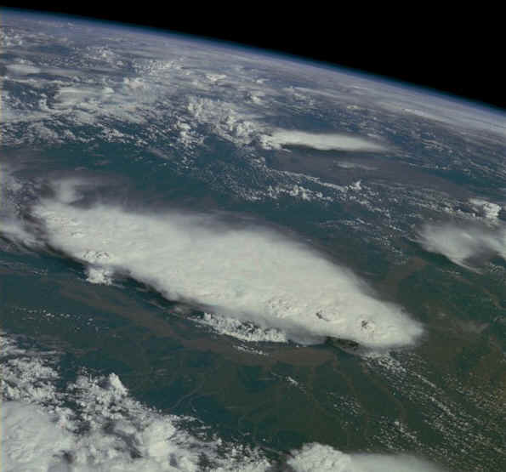
Monsoonal Thunderstorms, Bangladesh and India, July 1985

Slide 5
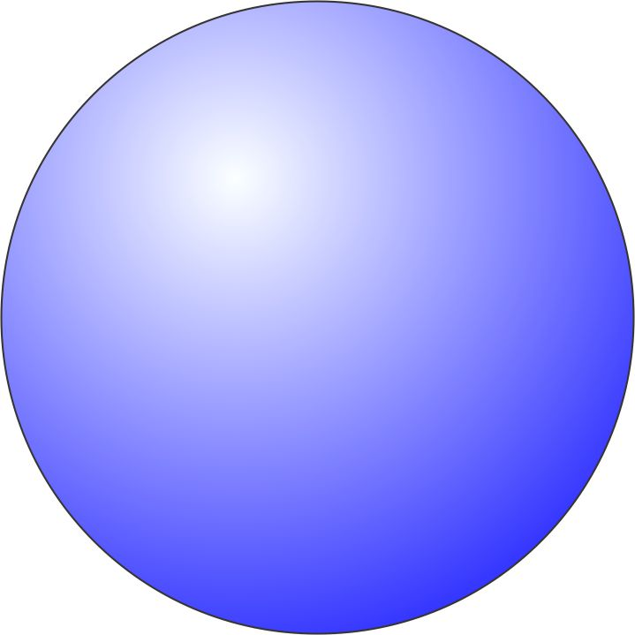
Compelling Evidence from Cloud-Permitting Models:
Tompkins and Craig, 1998: RCE in 3-D box: “This organization seems to result from interactions between radiation, convection and surface fluxes.”
Bretherton, Blossey and Khairoutdinov (2005): “The self-aggregation is analyzed as an instability of a horizontally homogeneous convecting atmosphere driven by convection–water vapor–radiation feedbacks that systematically dry the drier air columns and moisten the moister air columns.”
  Self-aggregation can be suppressed by horizontally homogenizing the radiative cooling or surface fluxes.
  Lower-tropospheric wind shear leads to slightly slower and less pronounced self-aggregation into bands aligned along the shear vector.

Slide 6

Analysis of Feedback Terms
Framework: Budget for spatial variance of column integrated frozen moist static energy
Consider anomalies from the horizontal mean (primes)
Feedback term: FMSE anom * Diabatic term anom
Positive Feedback: Process increases FMSE of already moist region
Negative Feedback: Process decreases FMSE of moist region
Courtesy Allison Wing
Notes:
Surface fluxes. Column shortwave heating, column longwave cooling. FMSE conserved, convection can’t change column integral.
Advantages: not just det by removing processes, actually can compare magnitudes within given simulation, calc a number that is relevant.

Slide 7
Total Diabatic Feedback Term
All terms normalized by
Black line:
DRY
MOIST
DRY
MOIST
Courtesy Allison Wing
Notes:
Explain axes, black line. When does cluster form? Point out pos fb (red) in dry region, beginning, shifting to moister regions as progresses. Strong pos fv developing in moist regions ~day 60. Point out blue (neg fb) in dry days 30-60, but h’ still increasing in magnitude there. Colors -> magnitude UNITS J/m^2 W/m^2

Slide 8
Column Shortwave Flux Convergence
DRY
MOIST
DRY
MOIST
Courtesy Allison Wing
Notes:
SW: mostly a positive feedback. Magnitude indicates not trivial, important.

Slide 9
Column Longwave Flux Convergence
DRY
MOIST
DRY
MOIST
Courtesy Allison Wing
Notes:
LW is sometimes pos fb, sometimes neg. magnitude comparable to sw. point out super strong in moistest regions – LW cloud fb maintaining cluster.

Slide 10
Total Surface Flux Feedback Term
DRY
MOIST
DRY
MOIST
Courtesy Allison Wing
Notes:
Sfc flux: mostly negative fb.

Slide 11
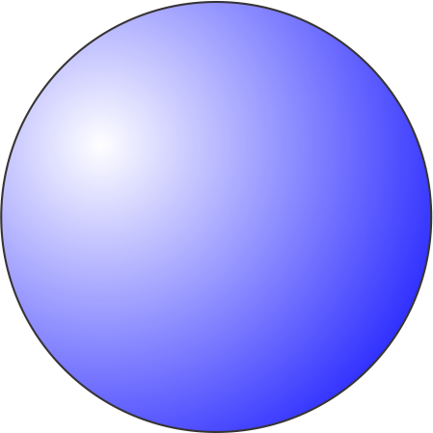
MIT Single-Column Model
Fouquart and Bonnel shortwave radiation, Morcrette longwave
Emanuel-Zivkovic-Rothman convection
Bony-Emanuel cloud scheme
25 hPa level spacing in troposphere; higher resolution in stratosphere
Run into RCE state with fixed SST, then re-initialized in WTG mode with T fixed at 850 hPa and above; add small perturbations to w in initial condition
Note: No WISHE!

Slide 12
Results
No drift from RCE state when SST <~ 32 C
Migration toward states with ascent or descent at higher SSTs
These states correspond to multiple equilibria in two-column models by Raymond and Zeng (2000) and by several others since (e.g. Sobel et al., 2007; Sessions et al. 2010)

Slide 13
Evolution of perturbation quantities in drying column

Slide 14
Note that first reversal is in the boundary layer
Perturbation net radiative heating rates in response to an instantaneous reduction of specific humidity of 20% from the RCE states for SSTs ranging from 25 to 45C.

Slide 15
Aggregation Physics Appears to Drive Low Frequency Variability in the Equatorial Waveguide

Slide 16
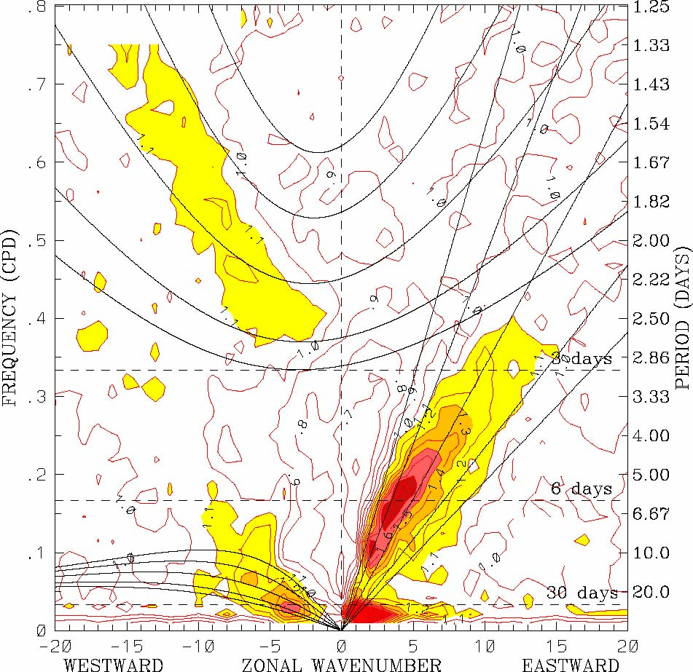
OLR power spectrum, 1979–2001 (Symmetric)
High frequency WISHE modes
Westward Inertio-Gravity
Kelvin
Low frequency Radiation modes
Equatorial Rossby
Madden-Julian Oscillation
from
Wheeler and Kiladis, 1999

Slide 17
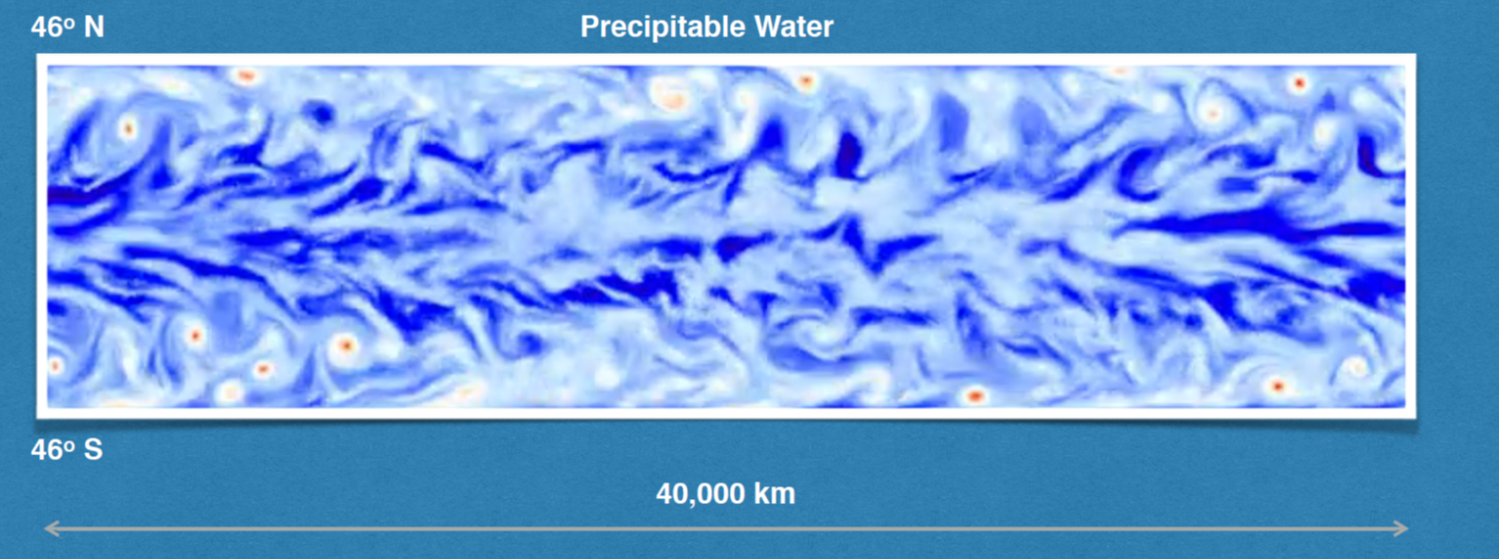
Khairoutdinov and Emanuel (2018)
Model: System for Atmospheric Modeling (SAM; Khairoutdinov and Randall 2003)
Domain: 40,000 km x 10,000 km; top at 30 km
Zonally periodic; solid walls at 46ºN/S; equator at the center
Grid spacing 20 km
Aqua-planet with uniform SST=300K
Constant insolation: 650 W/m² with constant zenith angle of 52º
Realistic Coriolis parameter

Slide 18
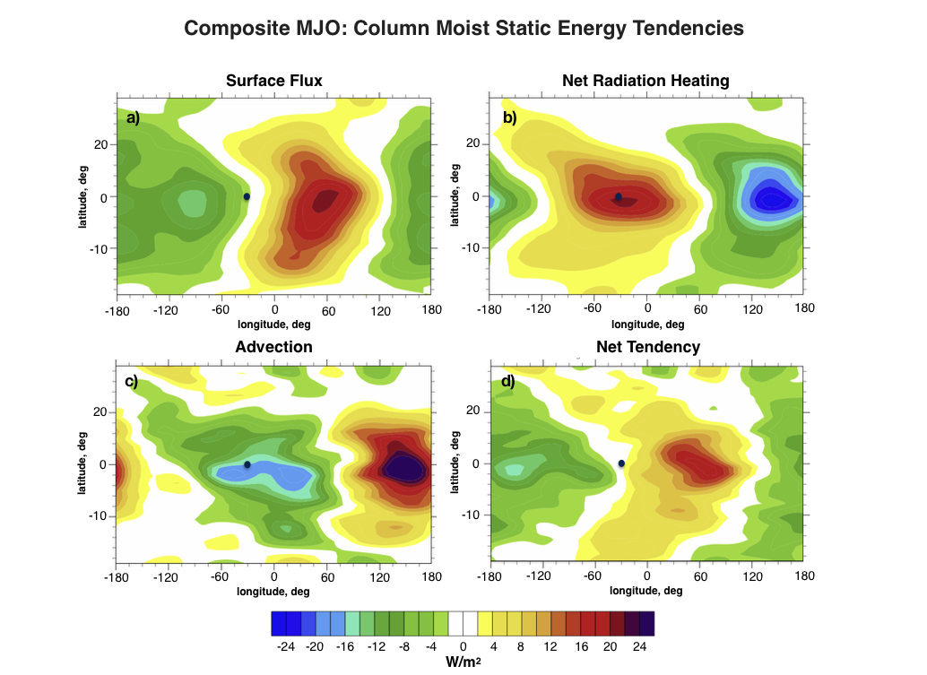
Black dot shows approximate location of precipitation maximum
From Khairoutdinov and Emanuel (2018)

Slide 19
Mechanism-Denial Experiments:
Time-Longitude sections on Equator
From Khairoutdinov and Emanuel (2018)

Slide 20
Linear WTG model on equatorial ß plane: Khairoutdinov and Emanuel (2018) extended to include higher order modes
Look for solutions of form:
Wave radiation emulator
Cloud-radiation feedback
WISHE
Gross Moist Stability

Slide 21
Equatorial WTG Modes
Frequency vs. wavenumber; size of circles proportional to growth rate

Slide 22
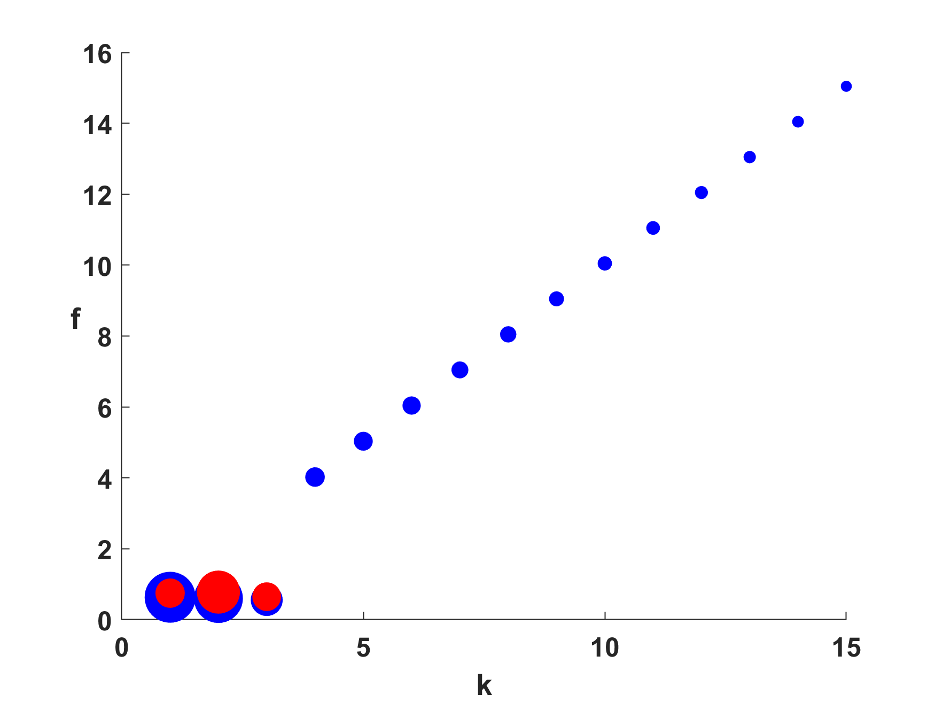
Compare to V=0 equatorial modes without WTG approximation
WISHE-driven moist Kelvin waves
WTG approximation
MJO mode
From Khairoutdinov and Emanuel (2018)

Slide 23
Summary
Evidence from cloud-permitting models suggests that large- scale organization of convection is driven by modulation of radiation by clouds and water vapor, and by WISHE feedback
Radiative feedbacks most important in the boundary layer but would become more important in the free troposphere in a substantially warmer climate
Interaction between convection and large-scale circulation does not appear to cause, by itself, unstable growth but strongly modulates the character of waves and instabilities

