Slide 1

Economic Effects of Increasing Sea Level and Changing Climate on Future US Hurricane Wind and Storm Surge Damages
Kerry Emanuel
Lorenz Center
Massachusetts Institute of Technology
Notes:
Are hurricanes becoming more powerful and destructive? Are these changes due to a natural cycle of hurricane activity or are they caused by human-induced climate change? Although this is currently a hot debate among scientists, new research suggests that the destructive potential of hurricanes is increasing due to the heating of the oceans.
Image: Satellite image of Hurricane Floyd approaching the east coast of Florida in 1999. The image has been digitally enhanced to lend a three-dimensional perspective. Credit: NASA/Goddard Space Flight Center.

Slide 2

Program
Assessing Hurricane Event Risk
  Wind
  Freshwater Flooding
  Storm Surge
Economics of Hurricane Risk

Slide 3


The word Hurricane is derived from the Mayan word Huracán (“Heart of the Sky”) and the Taino and Carib word Hunraken, a terrible God of Evil, and brought to the West by Spanish explorers

Slide 4
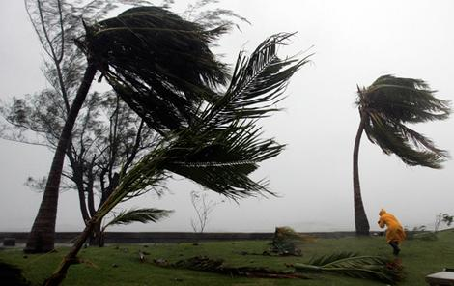
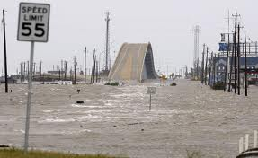
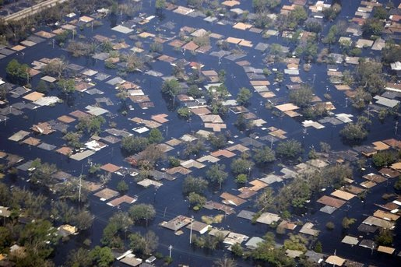
Hurricane Risks:
Wind
Storm Surge
Rain

Slide 5

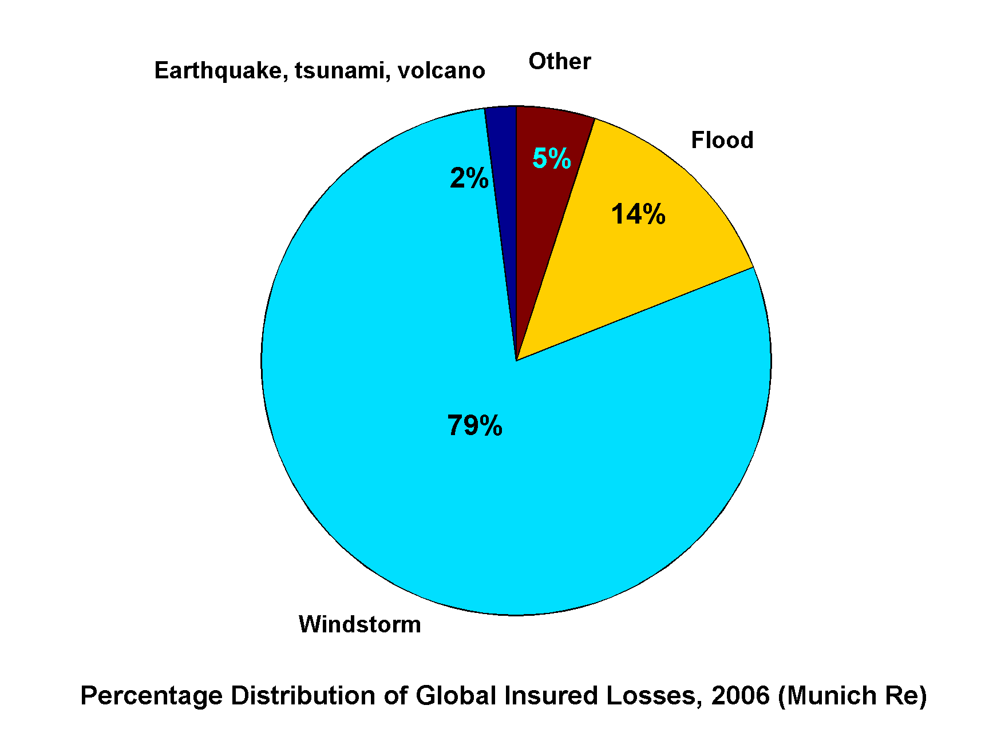
Windstorms Account for Bulk of Insured Losses Worldwide

Slide 6
Limitations of a strictly statistical approach
>50% of all normalized damage caused by top 8 events, all category 3, 4 and 5
>90% of all damage caused by storms of category 3 and greater
Category 3,4 and 5 events are only 13% of total landfalling events; only 30 since 1870
Landfalling storm statistics are inadequate for assessing hurricane risk

Slide 7
Additional Problem:
Nonstationarity of climate

Slide 8
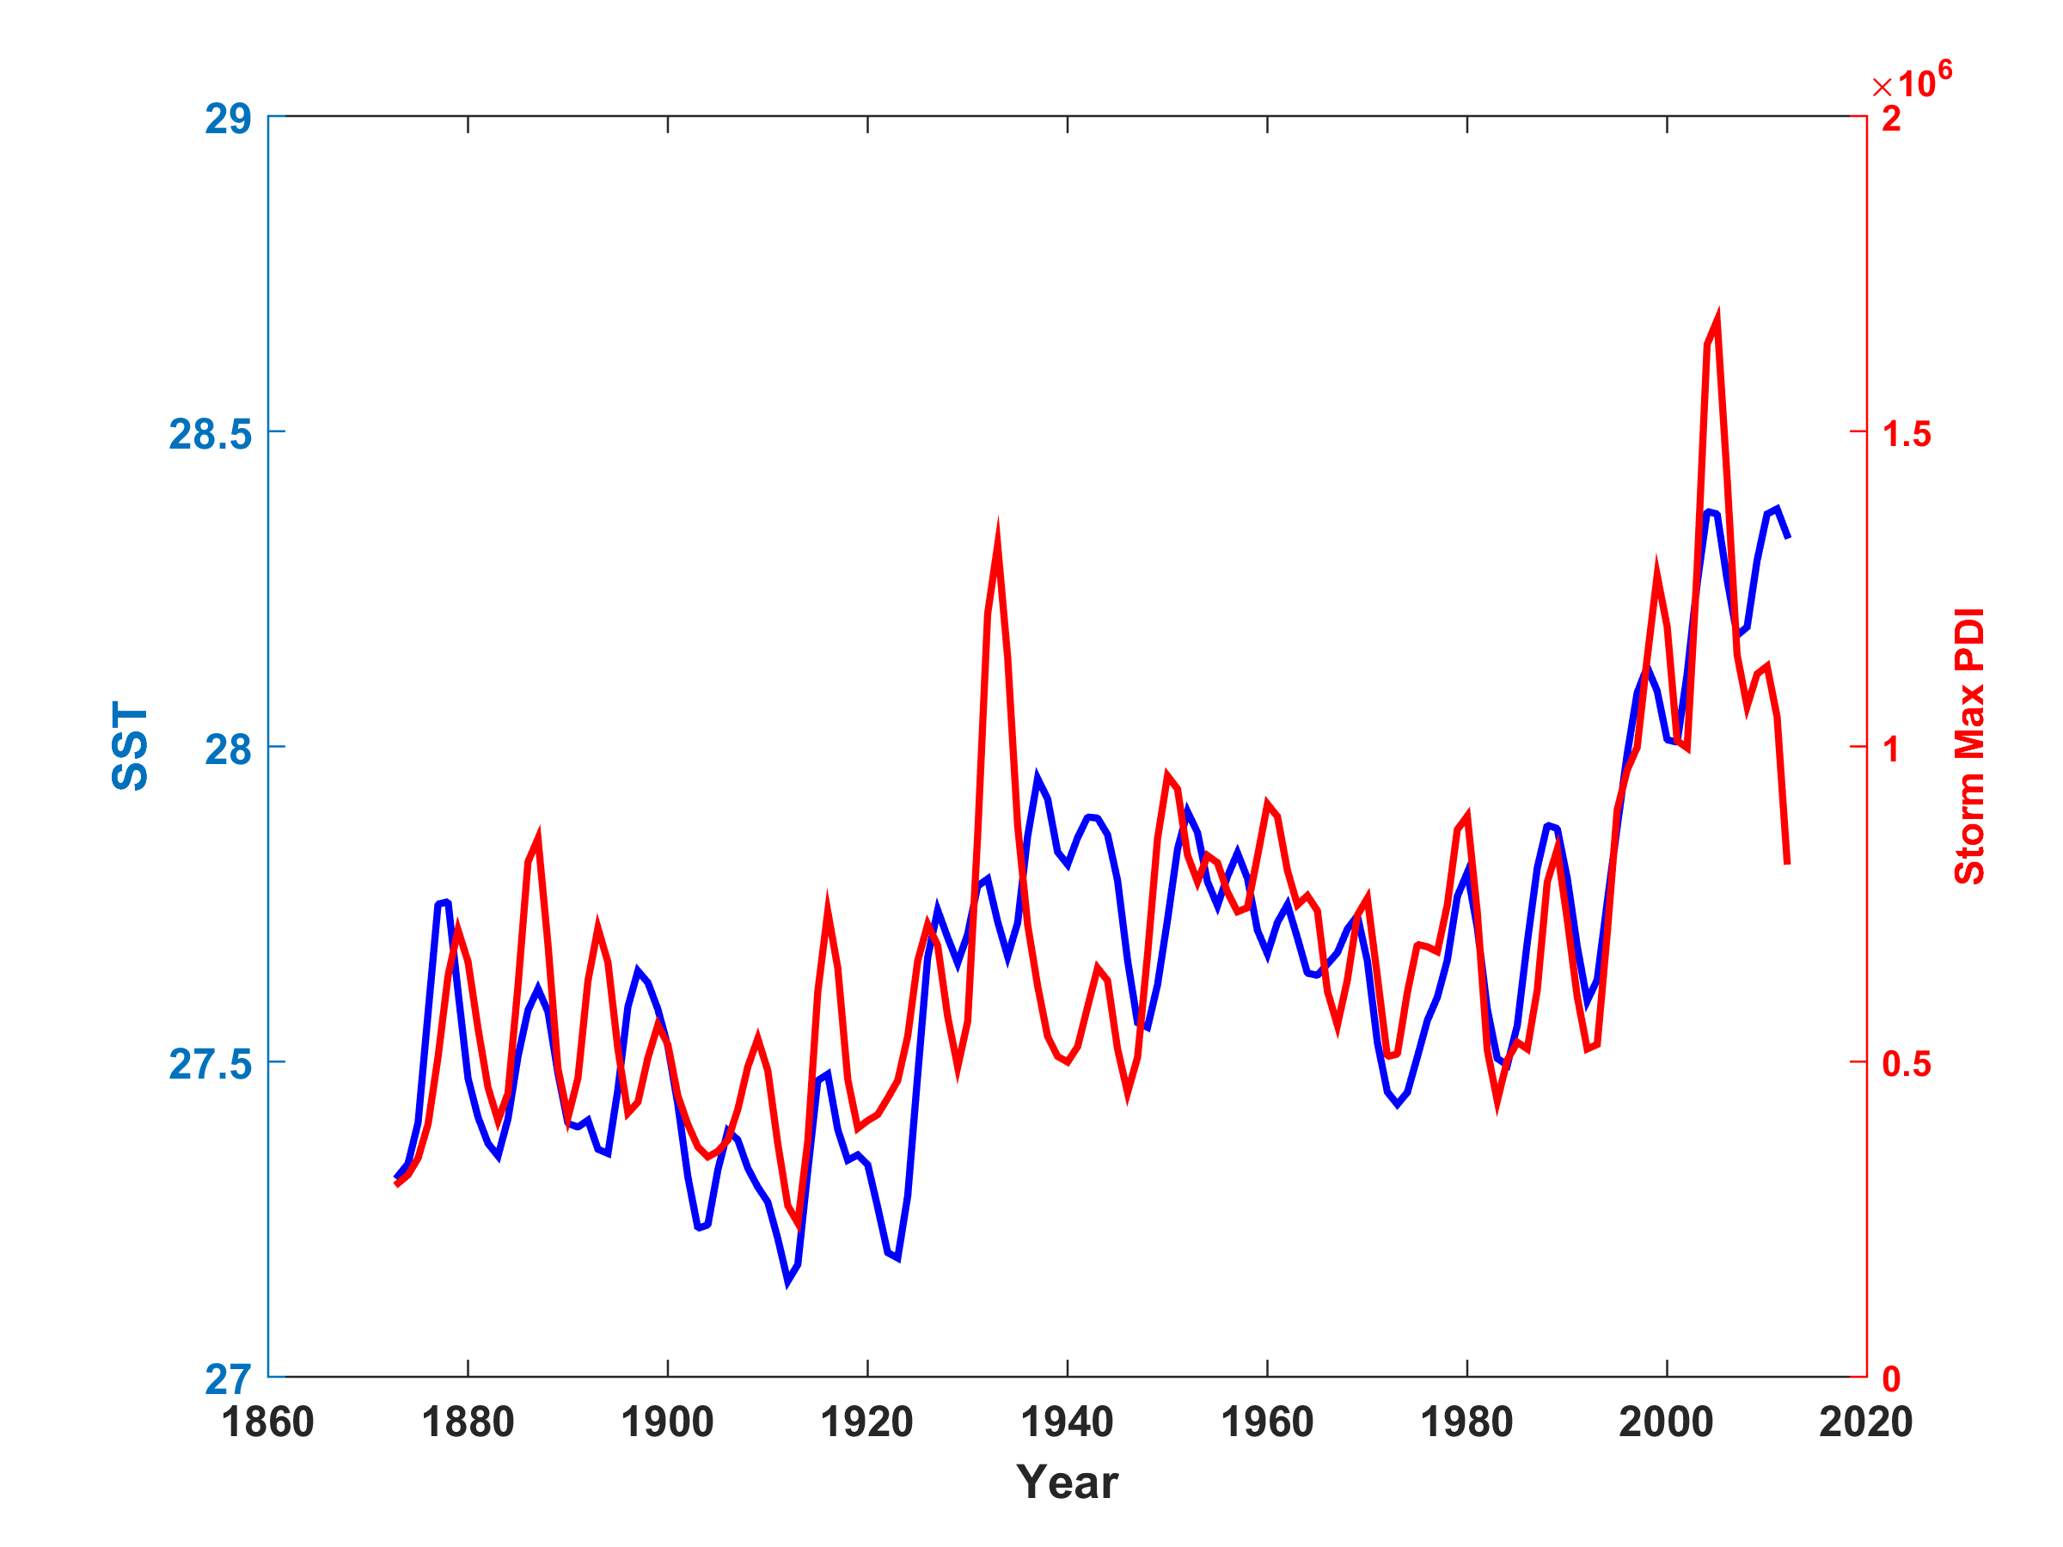
Atlantic Sea Surface Temperatures and Storm Max Power Dissipation
(Smoothed with a 1-3-4-3-1 filter)
Years included: 1870-2014
Data Sources: NOAA/TPC, UKMO/HADSST1
Notes:
8
The low value of storm power in the early 1940s is thought to be due to the lack of reports from ships at sea because of the radio silence imposed during WWII.

Slide 9
Risk Assessment by Direct Numerical Simulation of Hurricanes:
The Problem
The hurricane eyewall is very narrow: ~ 1 km or less
At the same time, the storm’s circulation extends to ~1000 km and is embedded in much larger scale flows

Slide 10

Histograms of Tropical Cyclone Intensity as Simulated by a Global Model with 50 km grid point spacing. (Courtesy Isaac Held, GFDL)
Modeled
Observed
Global models do not simulate the storms that cause destruction
Category 3

Slide 11

MIT Coupled Hurricane Intensity Prediction System (CHIPS)
Simple hurricane model coupled to a simple ocean model
Although simple, it is adapts to the storm, resolving the eyewall extremely well
Originally developed as a forecasting tool
Used by the U.S. Navy since 2000 to help predict typhoon intensity
Takes ~10 seconds per storm to run on an ordinary laptop (vs. hours on a super computer)

Slide 12
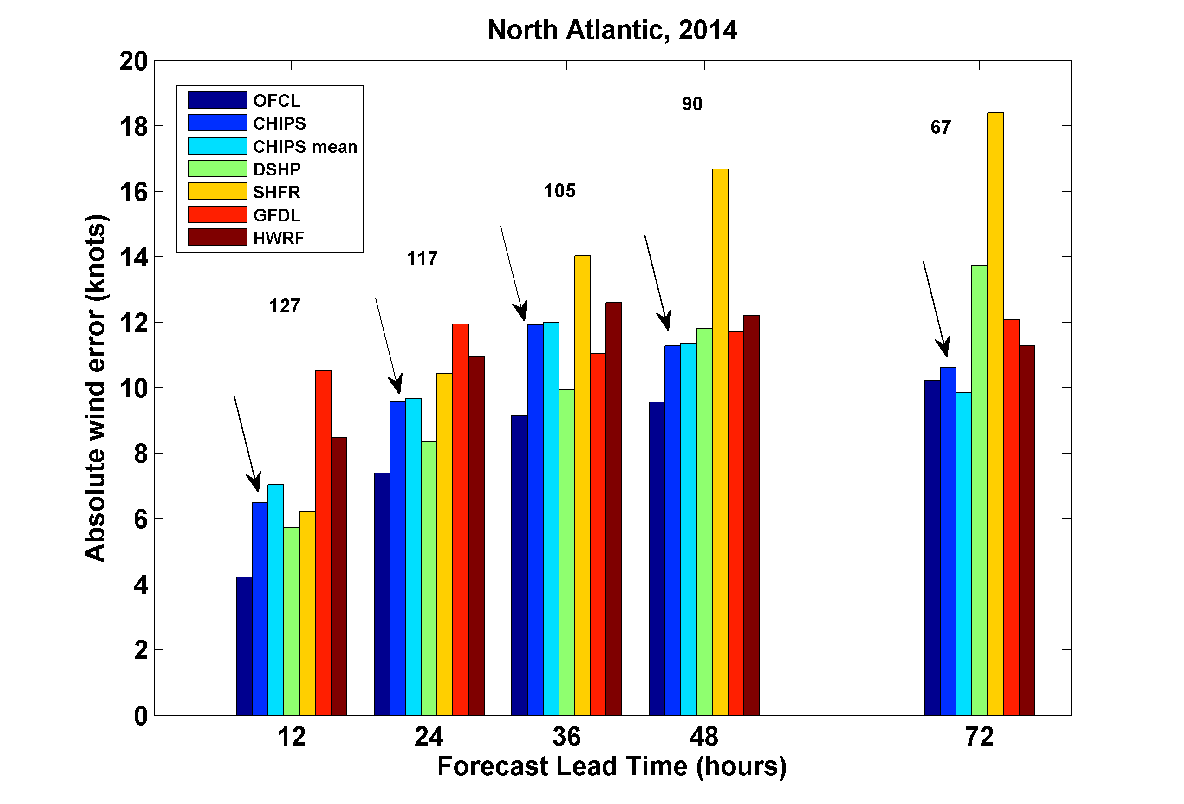
As A forecasting tool, CHIPS performs comparably to or better than other models

Slide 13
How Can We Use This Model to Help Assess Hurricane Risk in Current and Future Climates?

Slide 14
Risk Assessment Approach:
Step 1: Seed each ocean basin with a very large number of weak, randomly located cyclones
Step 2: Cyclones are assumed to move with the large scale atmospheric flow in which they are embedded, plus a correction for beta drift
Step 3: Run the CHIPS model for each cyclone, and note how many achieve at least tropical storm strength
Step 4: Using the small fraction of surviving events, determine storm statistics
Details: Emanuel et al., Bull. Amer. Meteor. Soc, 2008
Notes:
14

Slide 15
Calibration
Absolute genesis frequency calibrated to globe during the period 1980-2005
Notes:
15

Slide 16
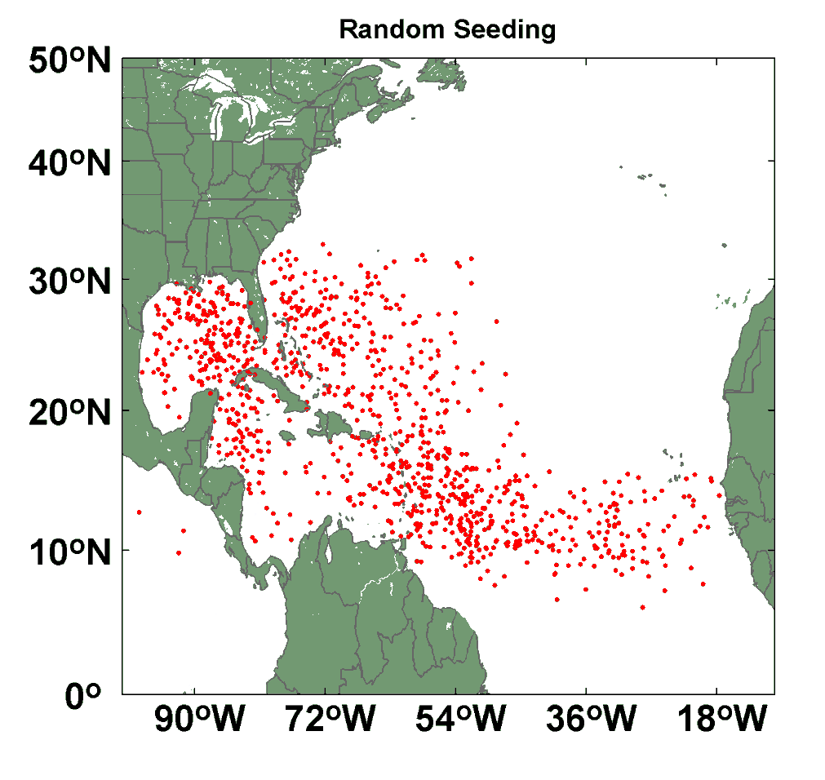
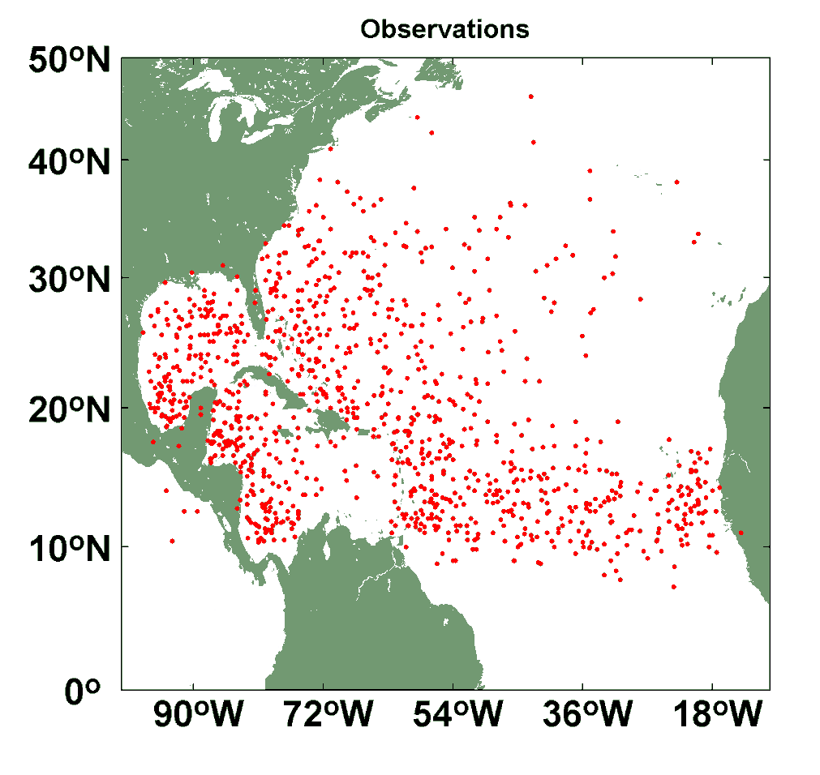
Comparison of Random Seeding Genesis Locations with Observations

Slide 18

Return Periods

Slide 19
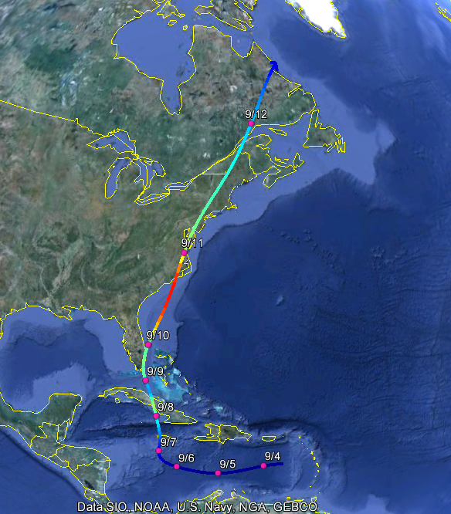
Example: Hurricane affecting New York City

Slide 20
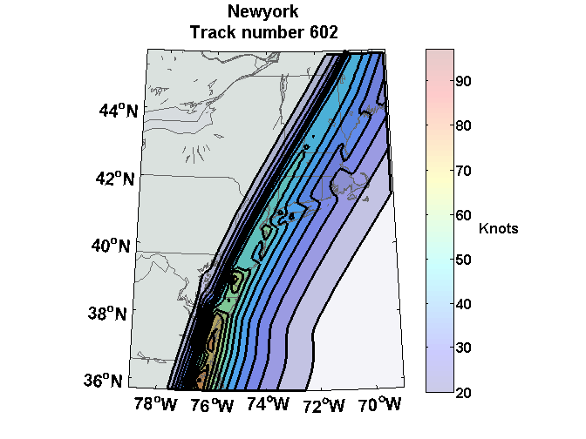
Wind Swath

Slide 21
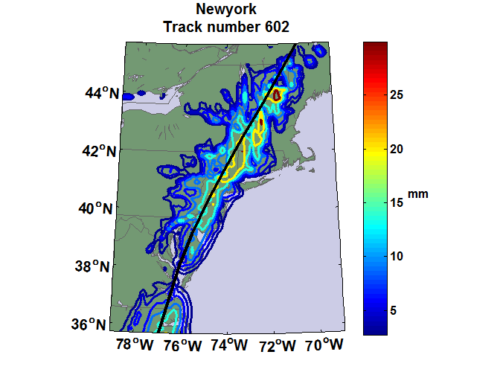
Accumulated Rainfall (mm)

Slide 22
Coupling large hurricane event sets to surge models (with Ning Lin)
Couple synthetic tropical cyclone events (Emanuel et al., BAMS, 2008) to surge models
  SLOSH
  ADCIRC (fine mesh)
  ADCIRC (coarse mesh)
Generate probability distributions of surge at desired locations
Lin, N., K. A. Emanuel, J. A. Smith, and E. Vanmarcke, 2010: Risk assessment of hurricane storm surge for New York City. J. Geophys. Res., 115, D18121, doi:10.1029/2009JD013630

Slide 23


Storm Surge Simulation
SLOSH model
(Jelesnianski et al. 1992)
SLOSH mesh
~ 10³ m
ADCIRC mesh
~ 10² m
Battery
ADCIRC model
(Luettich et al. 1992)
ADCIRC mesh
~ 10 m
(Colle et al. 2008)
Notes:
Given the storm wind and pressure fields (which is estimated from the Holland parametric pressure model) we can simulate the surge. Surge simulations with high resolution are computationally intensive, so to make it possible to simulate accurate surges for our large synthetic storm sets, we apply the two hydrodynamic models with girds of various resolutions in such a way that the main computational effort is concentrated on the storms that determine the risk. First, we apply the SLOSH model, using a mesh with resolution of about 1 km around NYC to simulate the surges for all storms and select the storms that have return periods, in terms of the surge height at the Battery, greater than 10 years. Second, we apply the ADCIRC simulation, using a grid mesh with resolution of ~100 m around NYC, to each of the selected storms. Then, we apply another ADCIRC mesh with resolution as high as ~10 m around NYC, for a set of the most extreme events, to check if the resolution of our ADCIRC grid is sufficient and if needed to make statistical correction to the results.

Slide 24
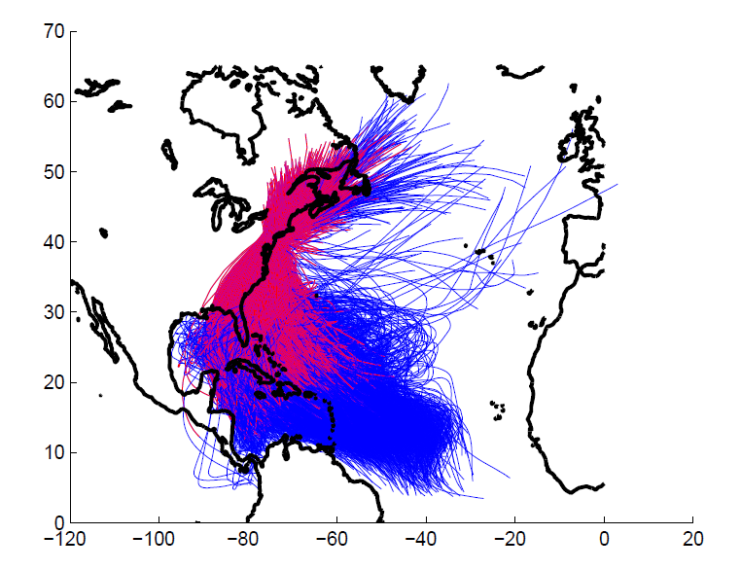
5000 synthetic storm tracks under current climate. (Red portion of each
track is used in surge analysis.)

Slide 25
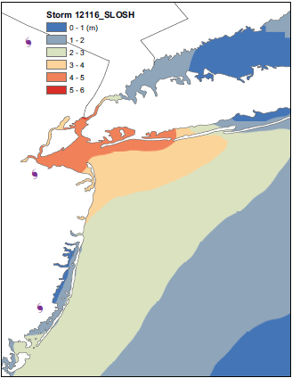
Surge map for single event

Slide 26
Surge Return Periods for The Battery, New York
Sandy

Slide 27
Taking Climate Change Into Account

Slide 28

Captures effects of regional climate phenomena (e.g. El Niño, Atlantic Meridional Mode)

Slide 29
CMIP5 Models
Modeling Center | Institute ID | Model Name | Average Horizontal Resolution (degrees longitude x degrees latitude)
NOAA Geophysical Fluid Dynamics Laboratory | GFDL | CM3 | 2.5 x 2.0
UK Met Office Hadley Center | HadGEM | HadGEM2-ES | 1.875 x 1.25
Institut Pierre Simon LaPlace | IPSL | CM5A-LR | 3.75 x 1.89
Atmosphere and Ocean Research Institute (The University of Tokyo), National Institute for Environmental Studies, and Japan Agency for Marine-Earth Science and Technology | MIROC | MIROC-5 | 1.4 x 1.4
Max Planck Institute for Meteorology | MPI | MPI-ESM-MR | 1.88 x 1.86
Meteorological Research Institute | MRI | MRI-CGCM3 | 1.12 x 1.12
National Center for Atmospheric Research/Center for Ocean-Land-Atmosphere Studies | NCAR-COLA | SP-CCSM4 | 1.25 x 0.94

Slide 30
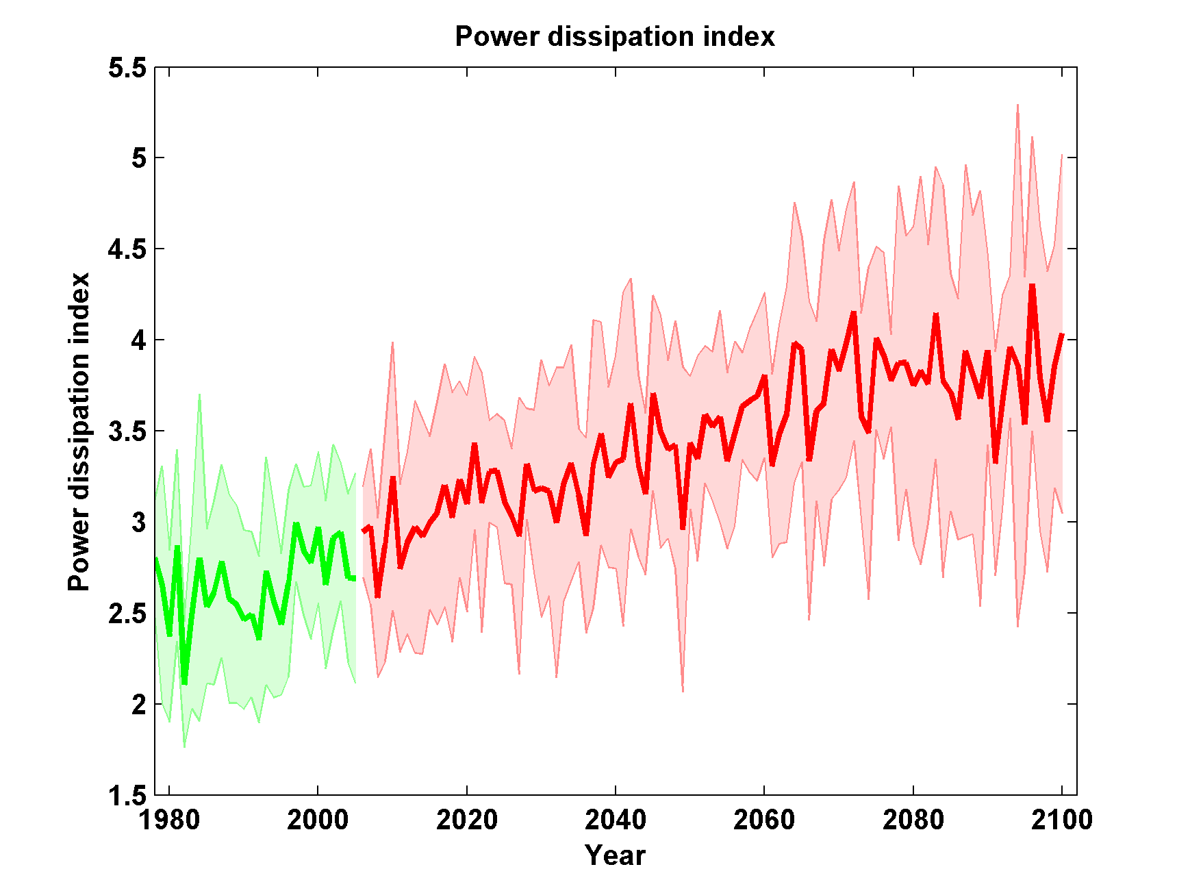

Slide 31
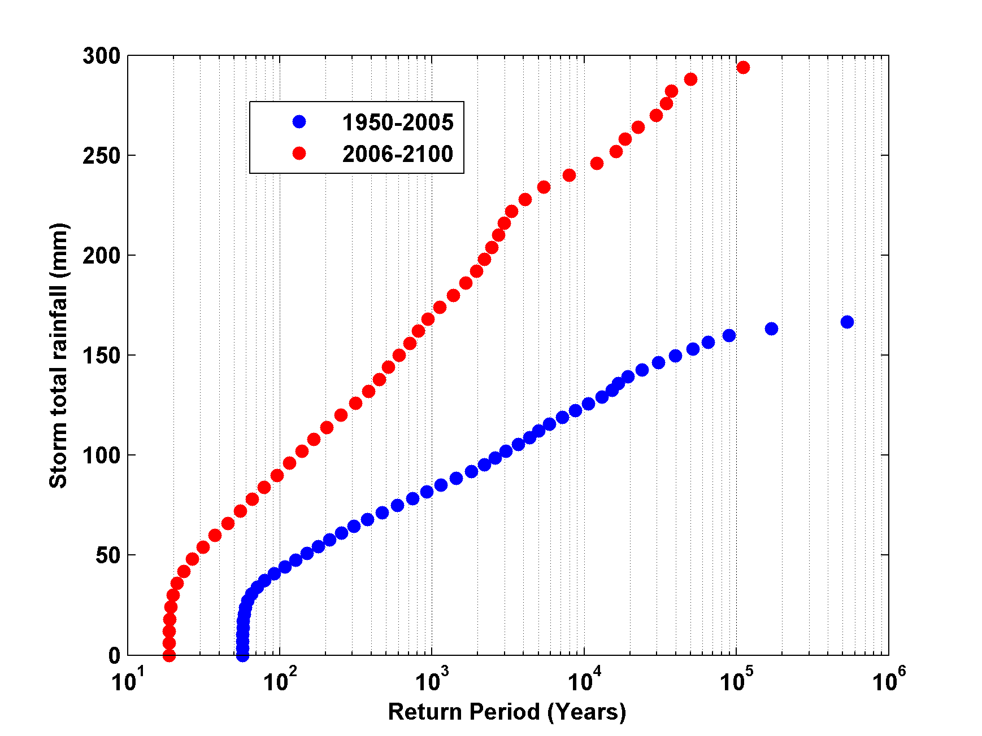
Return Periods of Storm Total Rainfall at New Haven
GFDL Model

Slide 33

GCM flood height return level, The Battery
(assuming SLR of 1 m for the future climate )
Black: Current climate (1981-2000)
Blue: A1B future climate (2081-2100)
Red: A1B future climate (2081-2100) with R₀ increased by 10% and R_{m} increased by 21%
Lin, N., K. Emanuel, M. Oppenheimer, and E. Vanmarcke, 2012: Physically based assessment of hurricane surge threat under climate change. Nature Clim. Change, doi:10.1038/nclimate1389.
Notes:
Then we calculate the flood height (including surge, tide, and sea level rise) return level for the four climate models, assuming a sea level rise of 1 m for the future climate, for the Battery, NYC. These results show that the combined effects of storm climatology change and sea level rise will greatly shorten the flood return periods for NYC and, by the end of the century, the current 100-year surge flooding may happen less than every 30 years, with CNRM and GFDL prediction to be less than 10 years, and the 500-year flooding may happen less than every 200 years, with the CNRM and GFDL prediction to be 20-30 years.

Slide 34
Aerts, C. J. H. J., W. J. W. Botzen, K. Emanuel, N. Lin, H. de Moel, and E. O. Michel-Kerjan, 2014: Evaluating flood resilience strategies for coastal megacities. Science, 344, 473-475.

Slide 35
Benefit-Cost Ratios

Slide 36
Sea level rise + changing storms
Sea level rise alone
From: American Climate Prospectus Economic Risks in the United States

Slide 37
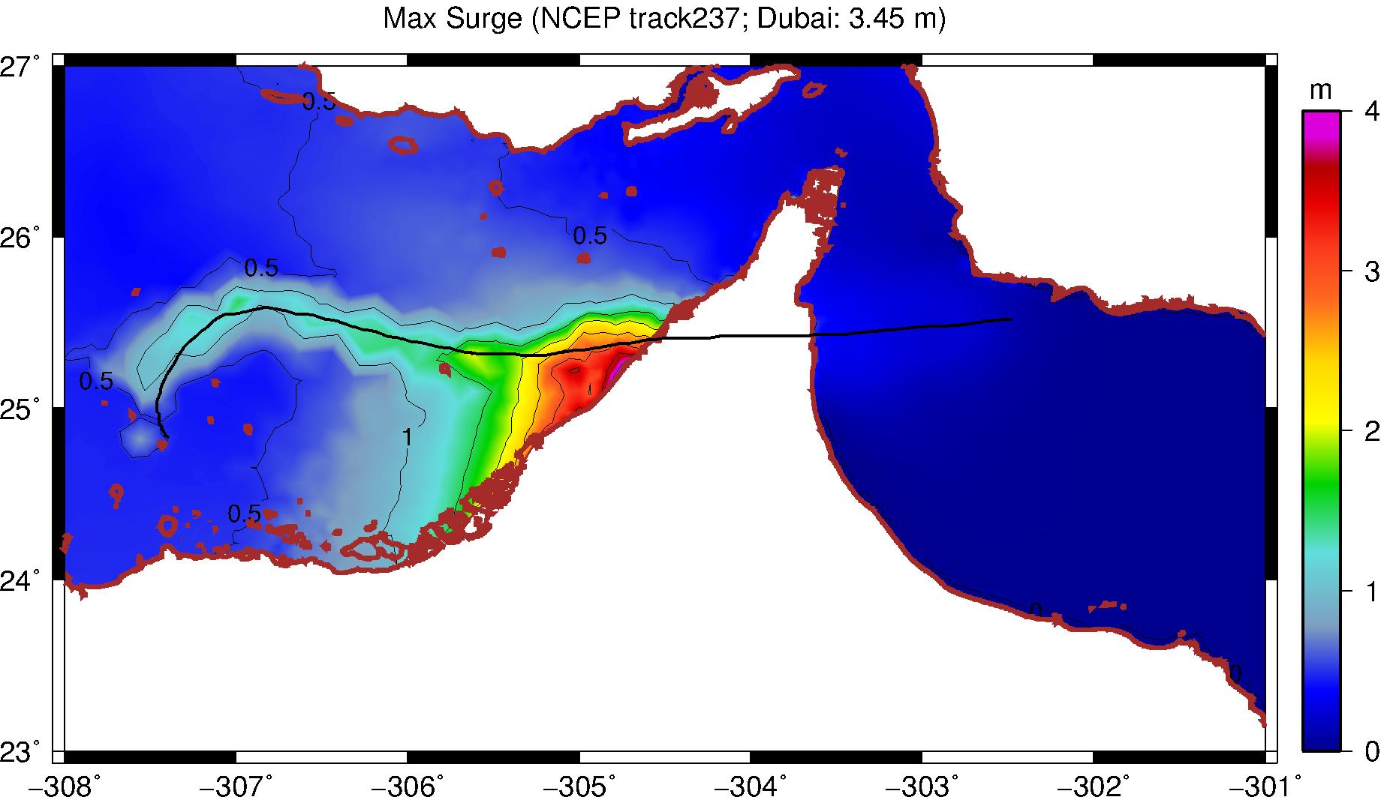
A “Grey Swan” Event:
Dubai

Slide 38
Summary:
History too short and inaccurate to deduce real risk from tropical cyclones
Global (and most regional) models are too coarse to simulate reasonably intense tropical cyclones
Globally and regionally simulated tropical cyclones are not usually coupled to the ocean

Slide 39
We have developed a technique for downscaling global models or reanalysis data sets, using a very high resolution, coupled TC model phrased in angular momentum coordinates
This model has been coupled to hydrodynamic surge models to assess long-term surge risk
These models can be coupled to damage and economic models to assess vulnerability to storms in current and future climates

Slide 40
Spares

Slide 41
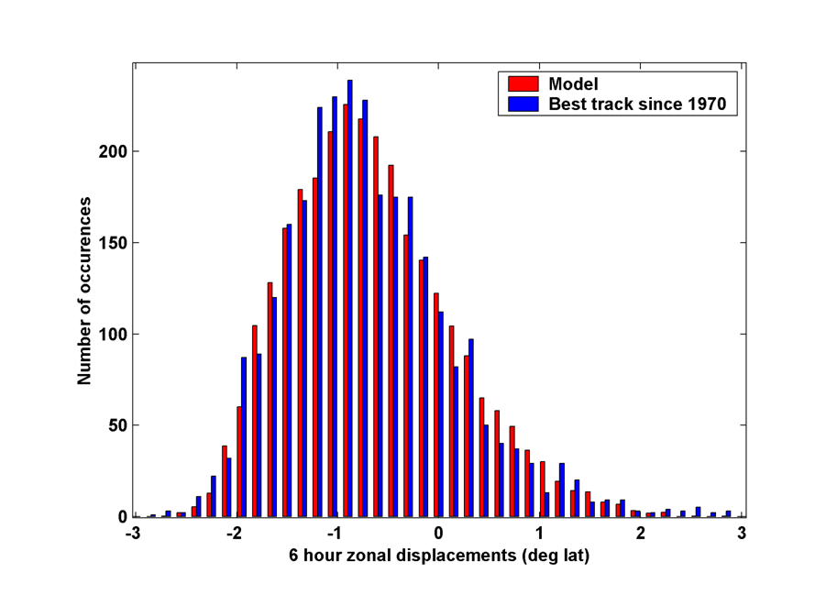
6-hour zonal displacements in region bounded by 10º and 30º N latitude, and 80º and 30º W longitude, using only post-1970 hurricane data
Notes:
41

Slide 42

Cumulative Distribution of Storm Lifetime Peak Wind Speed, with Sample of 1755 Synthetic Tracks
95% confidence bounds

Slide 43
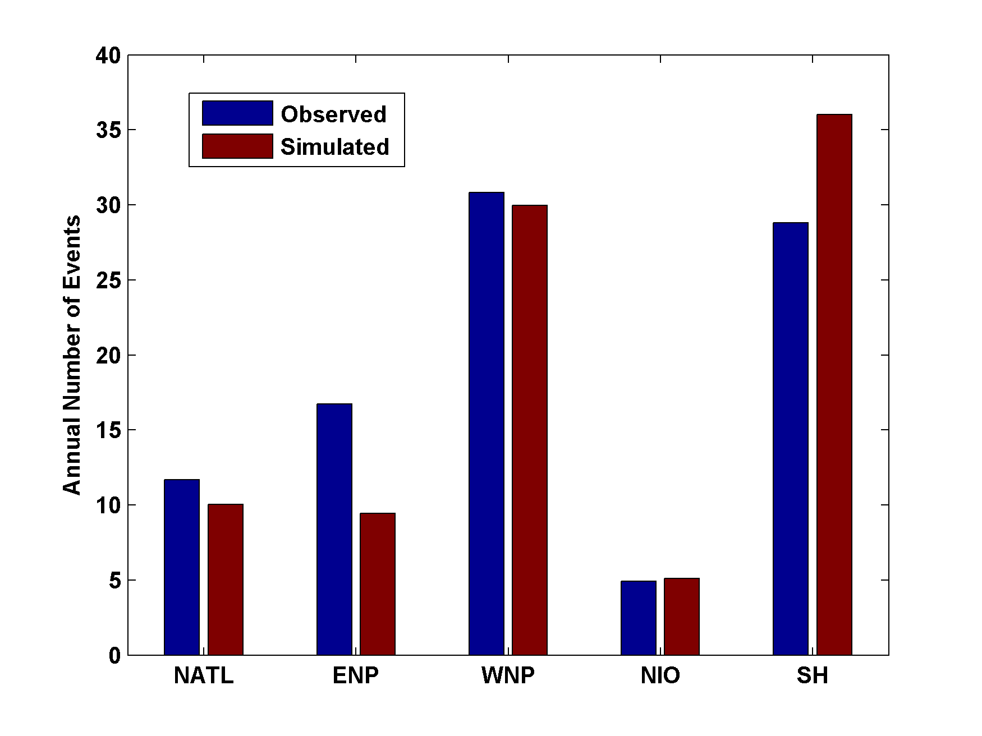
Genesis rates
Western North Pacific
Southern Hemisphere
Eastern North Pacific
Atlantic
North Indian Ocean
Notes:
43

Slide 44
Captures effects of regional climate phenomena (e.g. ENSO, AMM)

Slide 45
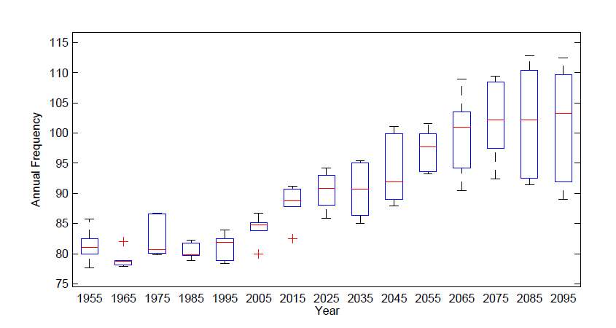
Global Frequency

Slide 46
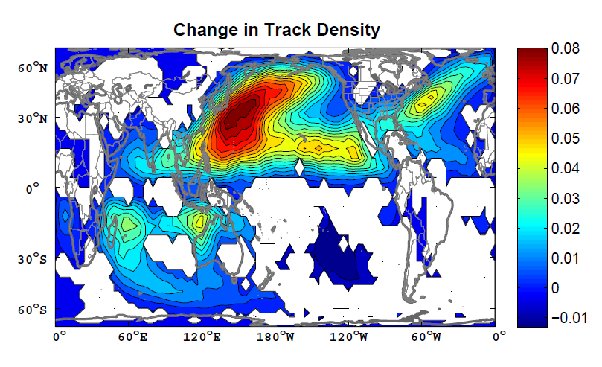

Slide 47
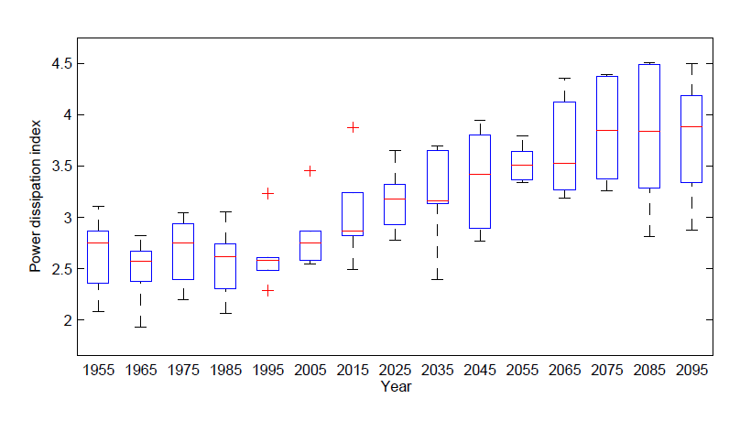
Global Power Dissipation

Slide 48
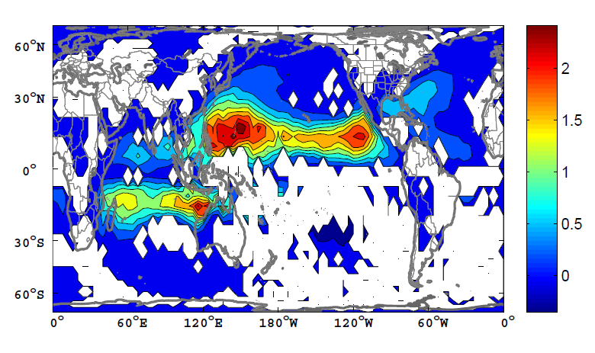
Change in Power Dissipation

