Slide 1

Tropical Cyclones and Climate Change: TC Risk in India
Kerry Emanuel
Lorenz Center, MIT
Notes:
1

Slide 2
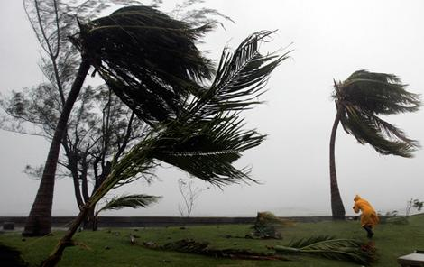
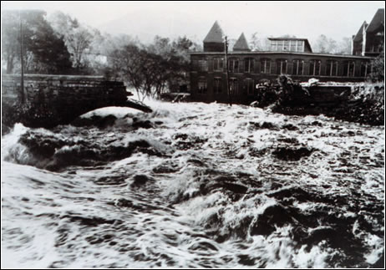
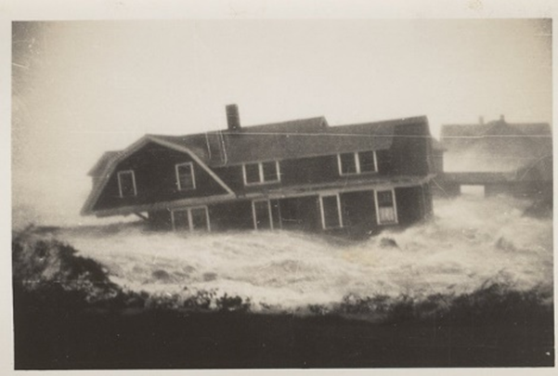

Hurricane Risks:
Wind
Rain
Storm Surge

Slide 3


Slide 4
The Global Hurricane Hazard
About 10,000 deaths per year since 1971
$700 Billion 2015 U.S. dollars in damages annually since 1971
Global population exposed to hurricane hazards has tripled since 1970
EM-DAT, 2016: The OFDA/CRED International Disaster Database
http://www.emdat.be/.

Slide 5
Tropical Cyclones in India
About 160,000 deaths since 1916 (~1500/yr)
$200 million 2015 U.S. dollars in damages annually since 1916
370 million people are exposed to tropical cyclones in India
EM-DAT, 2016: The OFDA/CRED International Disaster Database
http://www.emdat.be/ and Government of India https://ncrmp.gov.in/cyclones-their-impact-in-india/

Slide 6
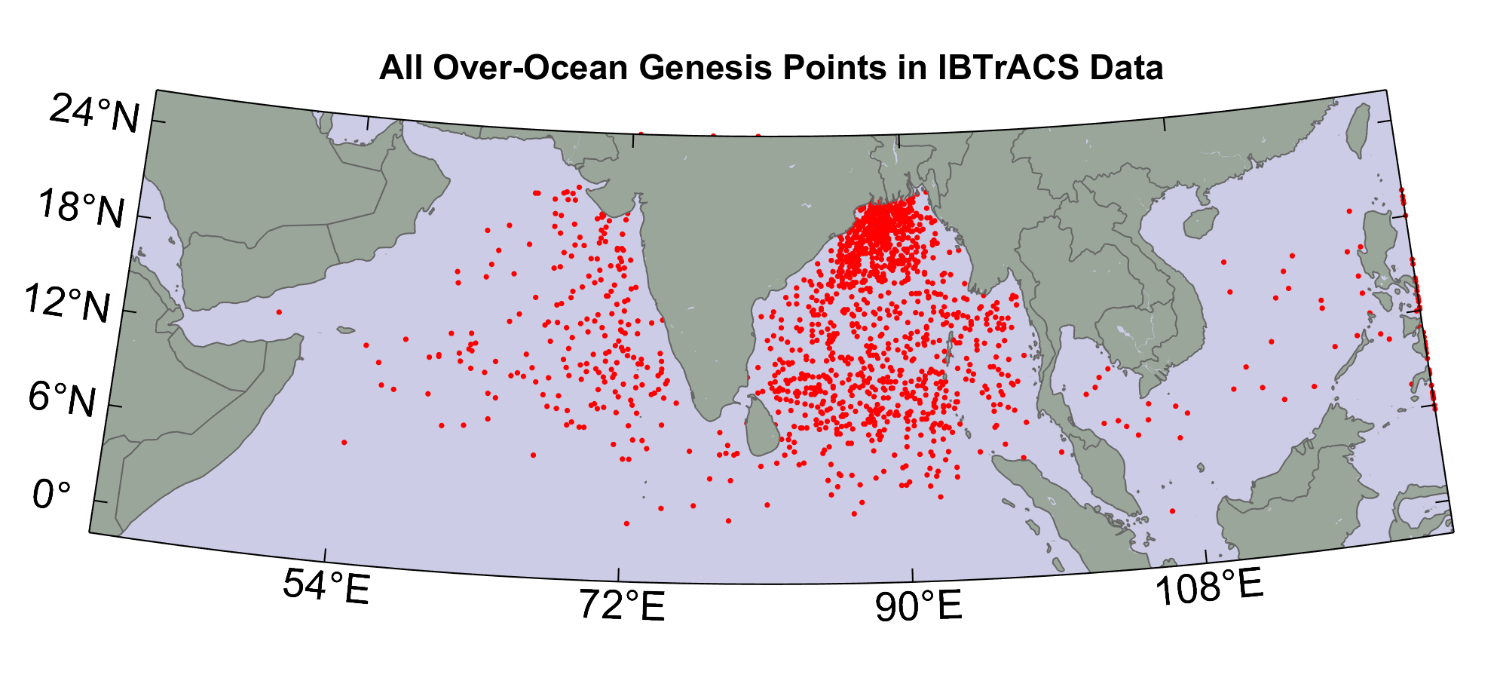
1686 Indian Ocean events in IBTrACS
(points on eastern boundary originated east of boundary)

Slide 7
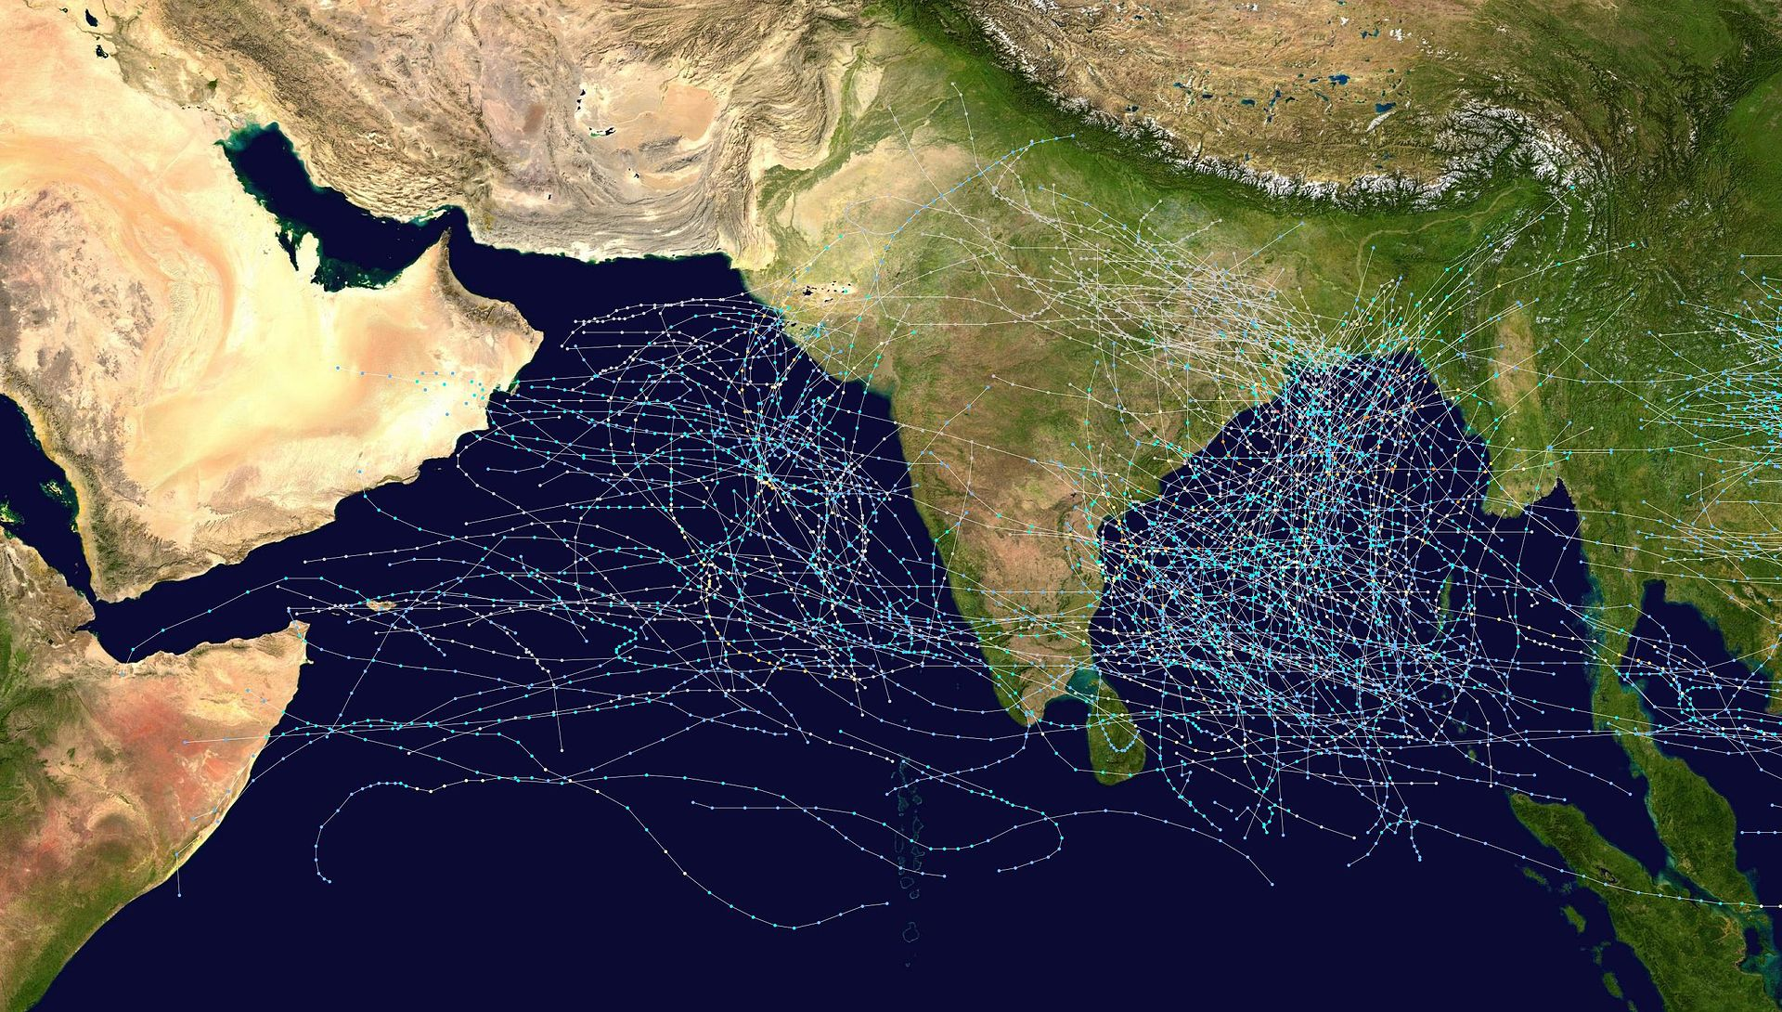
Tropical Cyclone Tracks, India, 1970-2005
Source: Wikipedia https://en.wikipedia.org/wiki/North_Indian_Ocean_tropical_cyclone

Slide 8
Arabian Sea Tropical Cyclones, 1879-2016
Tropical cyclone tracks from the India Meteorological Department’s extended dataset, 1879–2016, color coded by intensity using the U.S. Saffir–Simpson hurricane wind scale. Sobel et al. Mon. Wea. Rev., 2019

Slide 9

Is Hurricane Risk Changing?

Slide 10

Historical Records
Pre-1943: Anecdotal accounts from coastal cities and ships
1943: Introduction of routine aircraft reconnaissance in Atlantic, western North Pacific
1958: Inertial navigation permits direct measurement of wind speed at flight level
1970: Complete global detection by satellites
1978: Introduction of satellite scatterometry
1987: Termination of airborne reconnaissance in western North Pacific
2017: Introduction of CYGNSS scatterometry

Slide 11
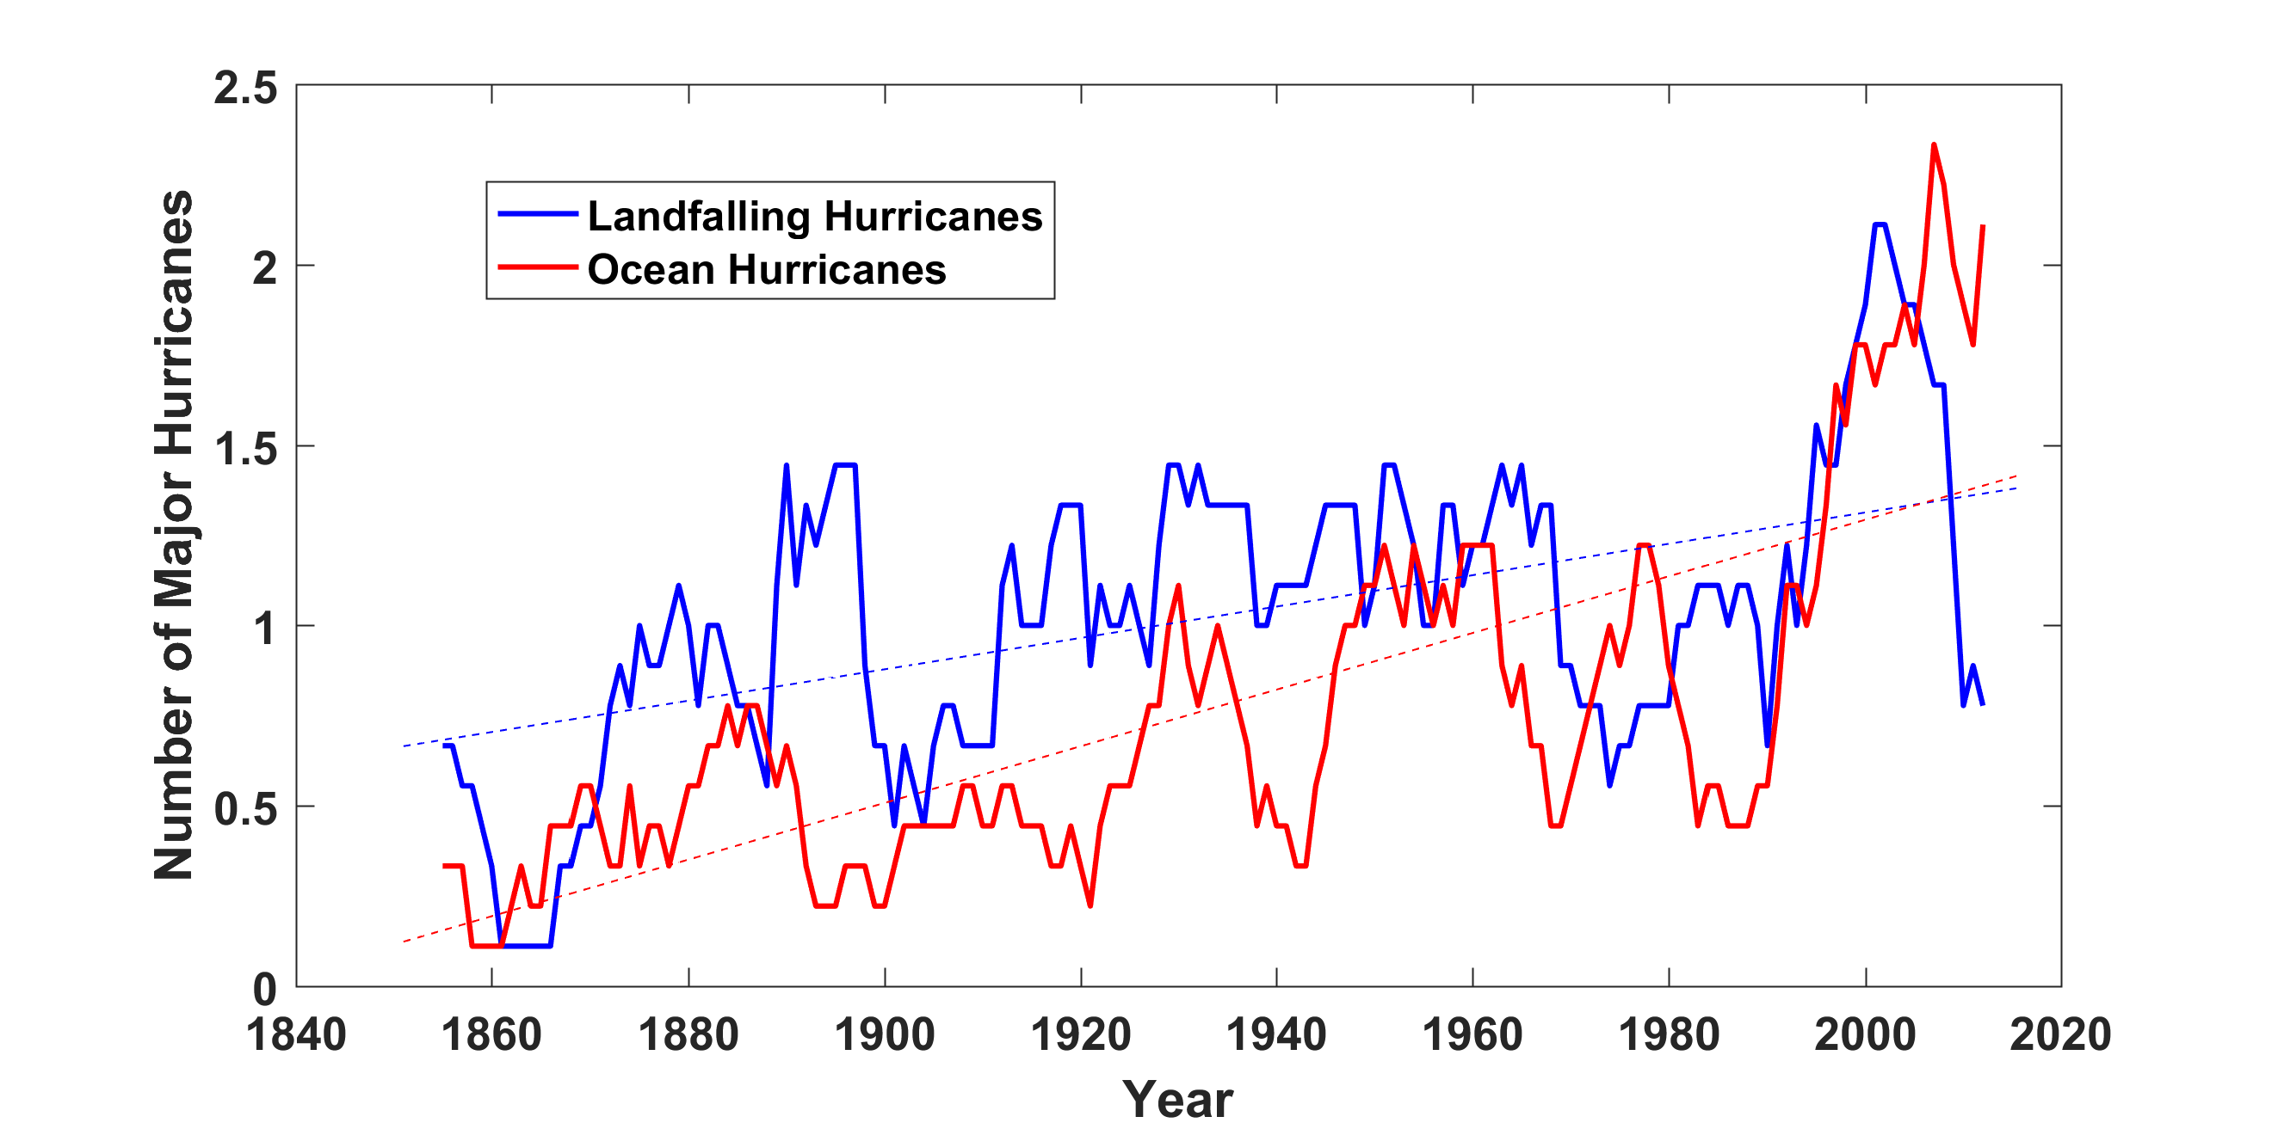
Historical Records:
Prior to 1970, Many Storms Were Missed
Major hurricanes in the North Atlantic, 1851-2016, smoothed using a 10-year running average. Shown in blue are storms that either passed through the chain of Lesser Antilles or made landfall in the continental U.S.; all other major hurricanes are shown in red. The dashed lines show the best fit trend lines for each data set.

Slide 12
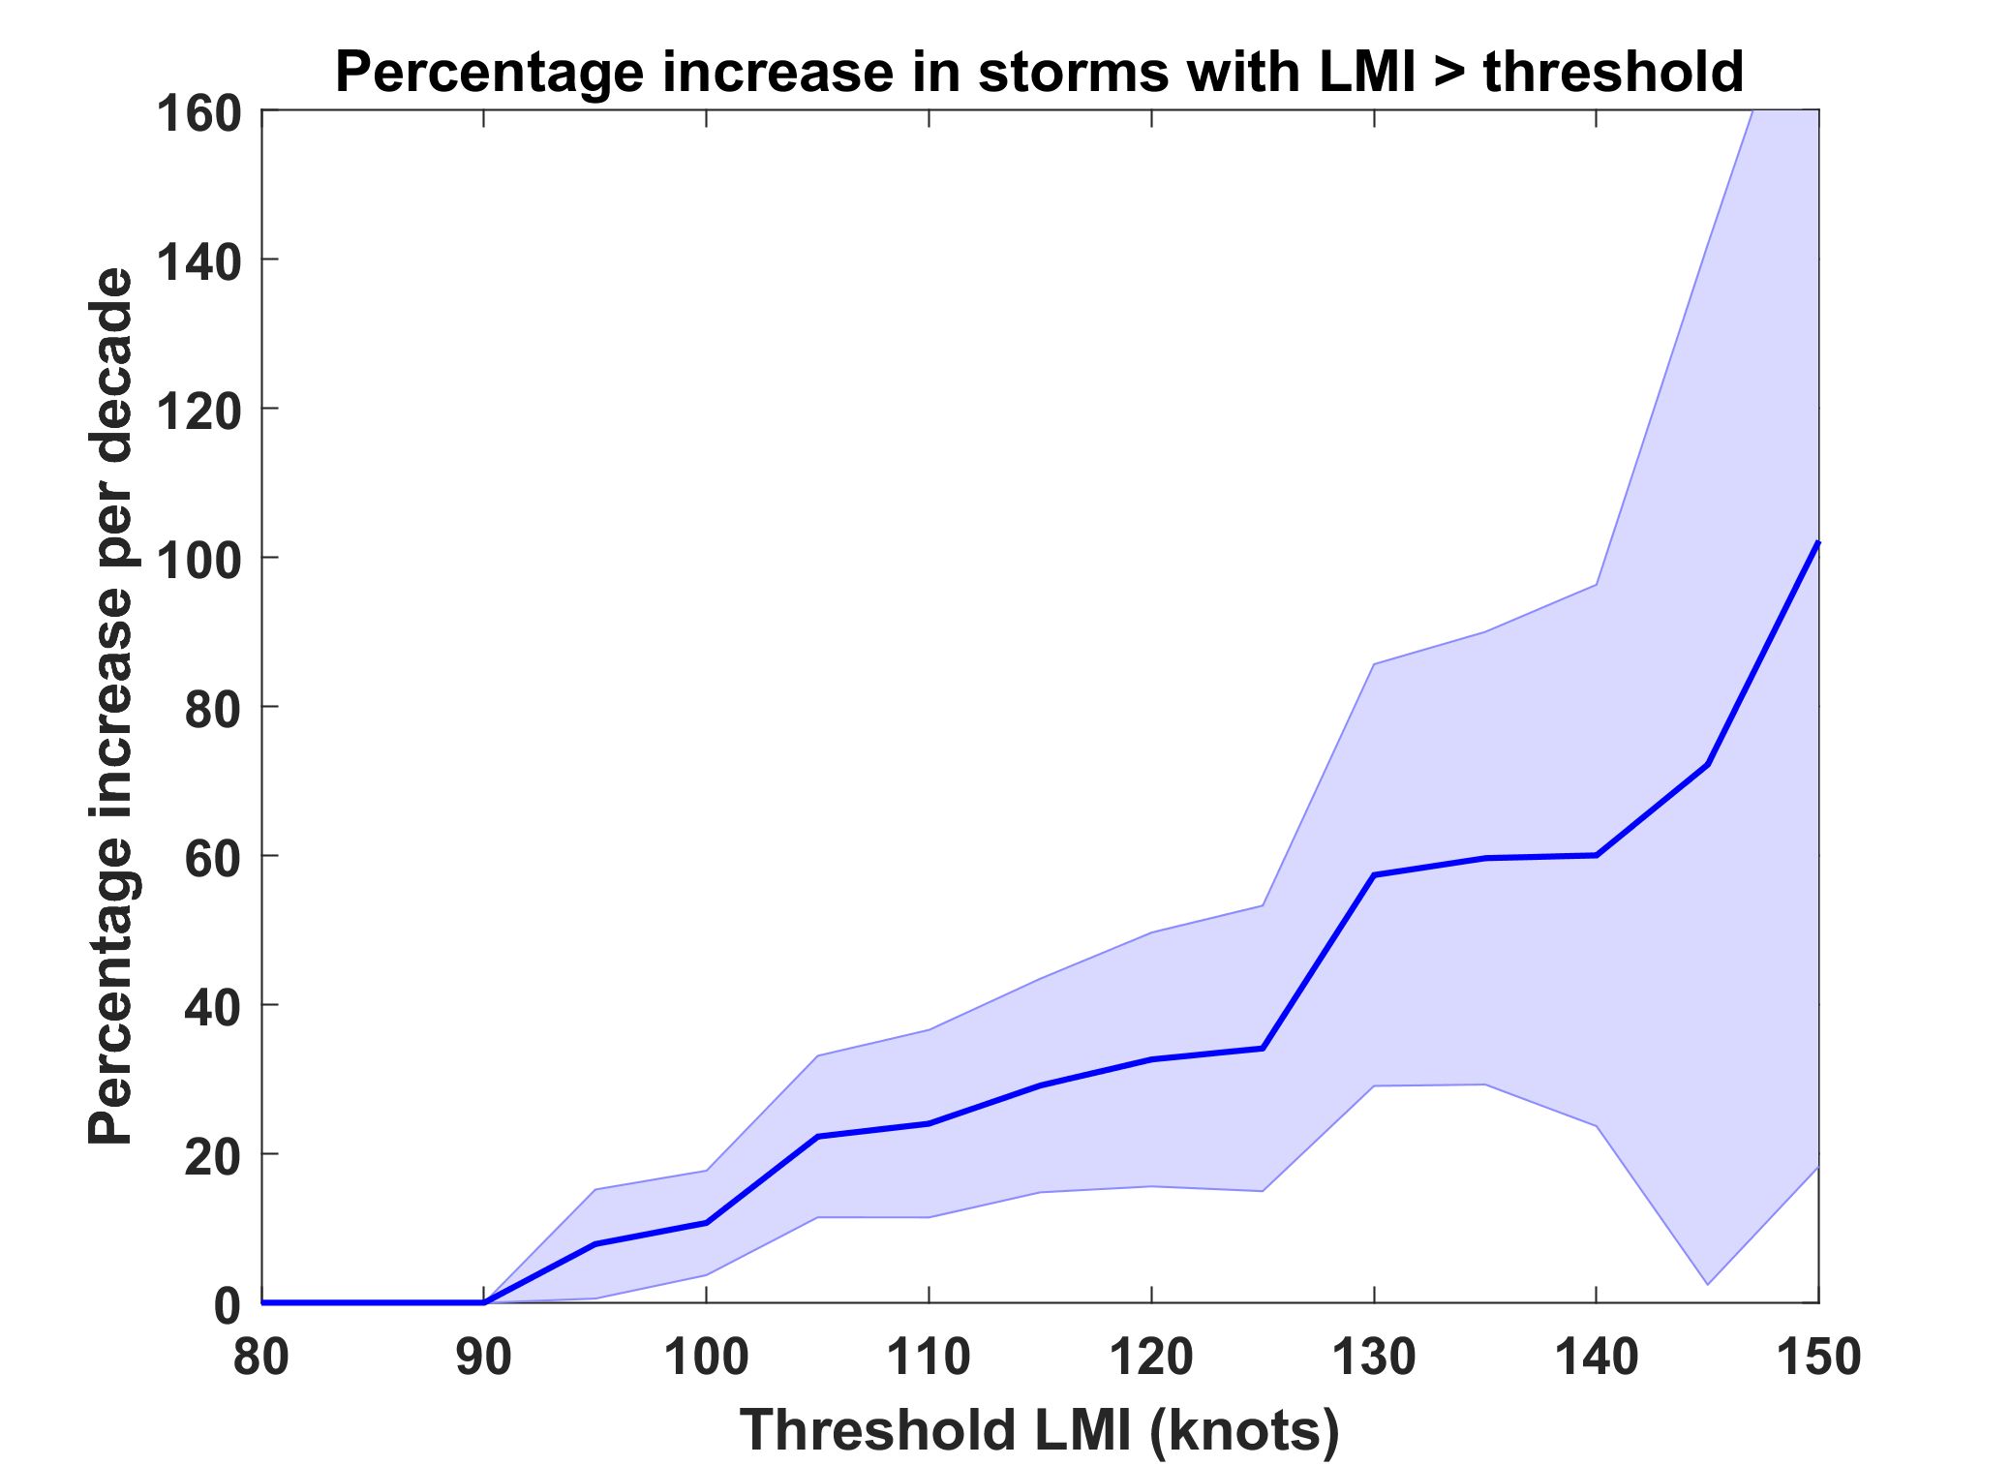
Trends in Global TC Frequency Over Threshold Intensities, from Historical TC Data, 1980-2016. Trends Shown Only When p < 0.05.

Slide 13
Potential Intensity
The highest azimuthally averaged surface wind speed achievable in a given thermodynamic environment, derived from treating the cyclone as a Carnot engine

Slide 14
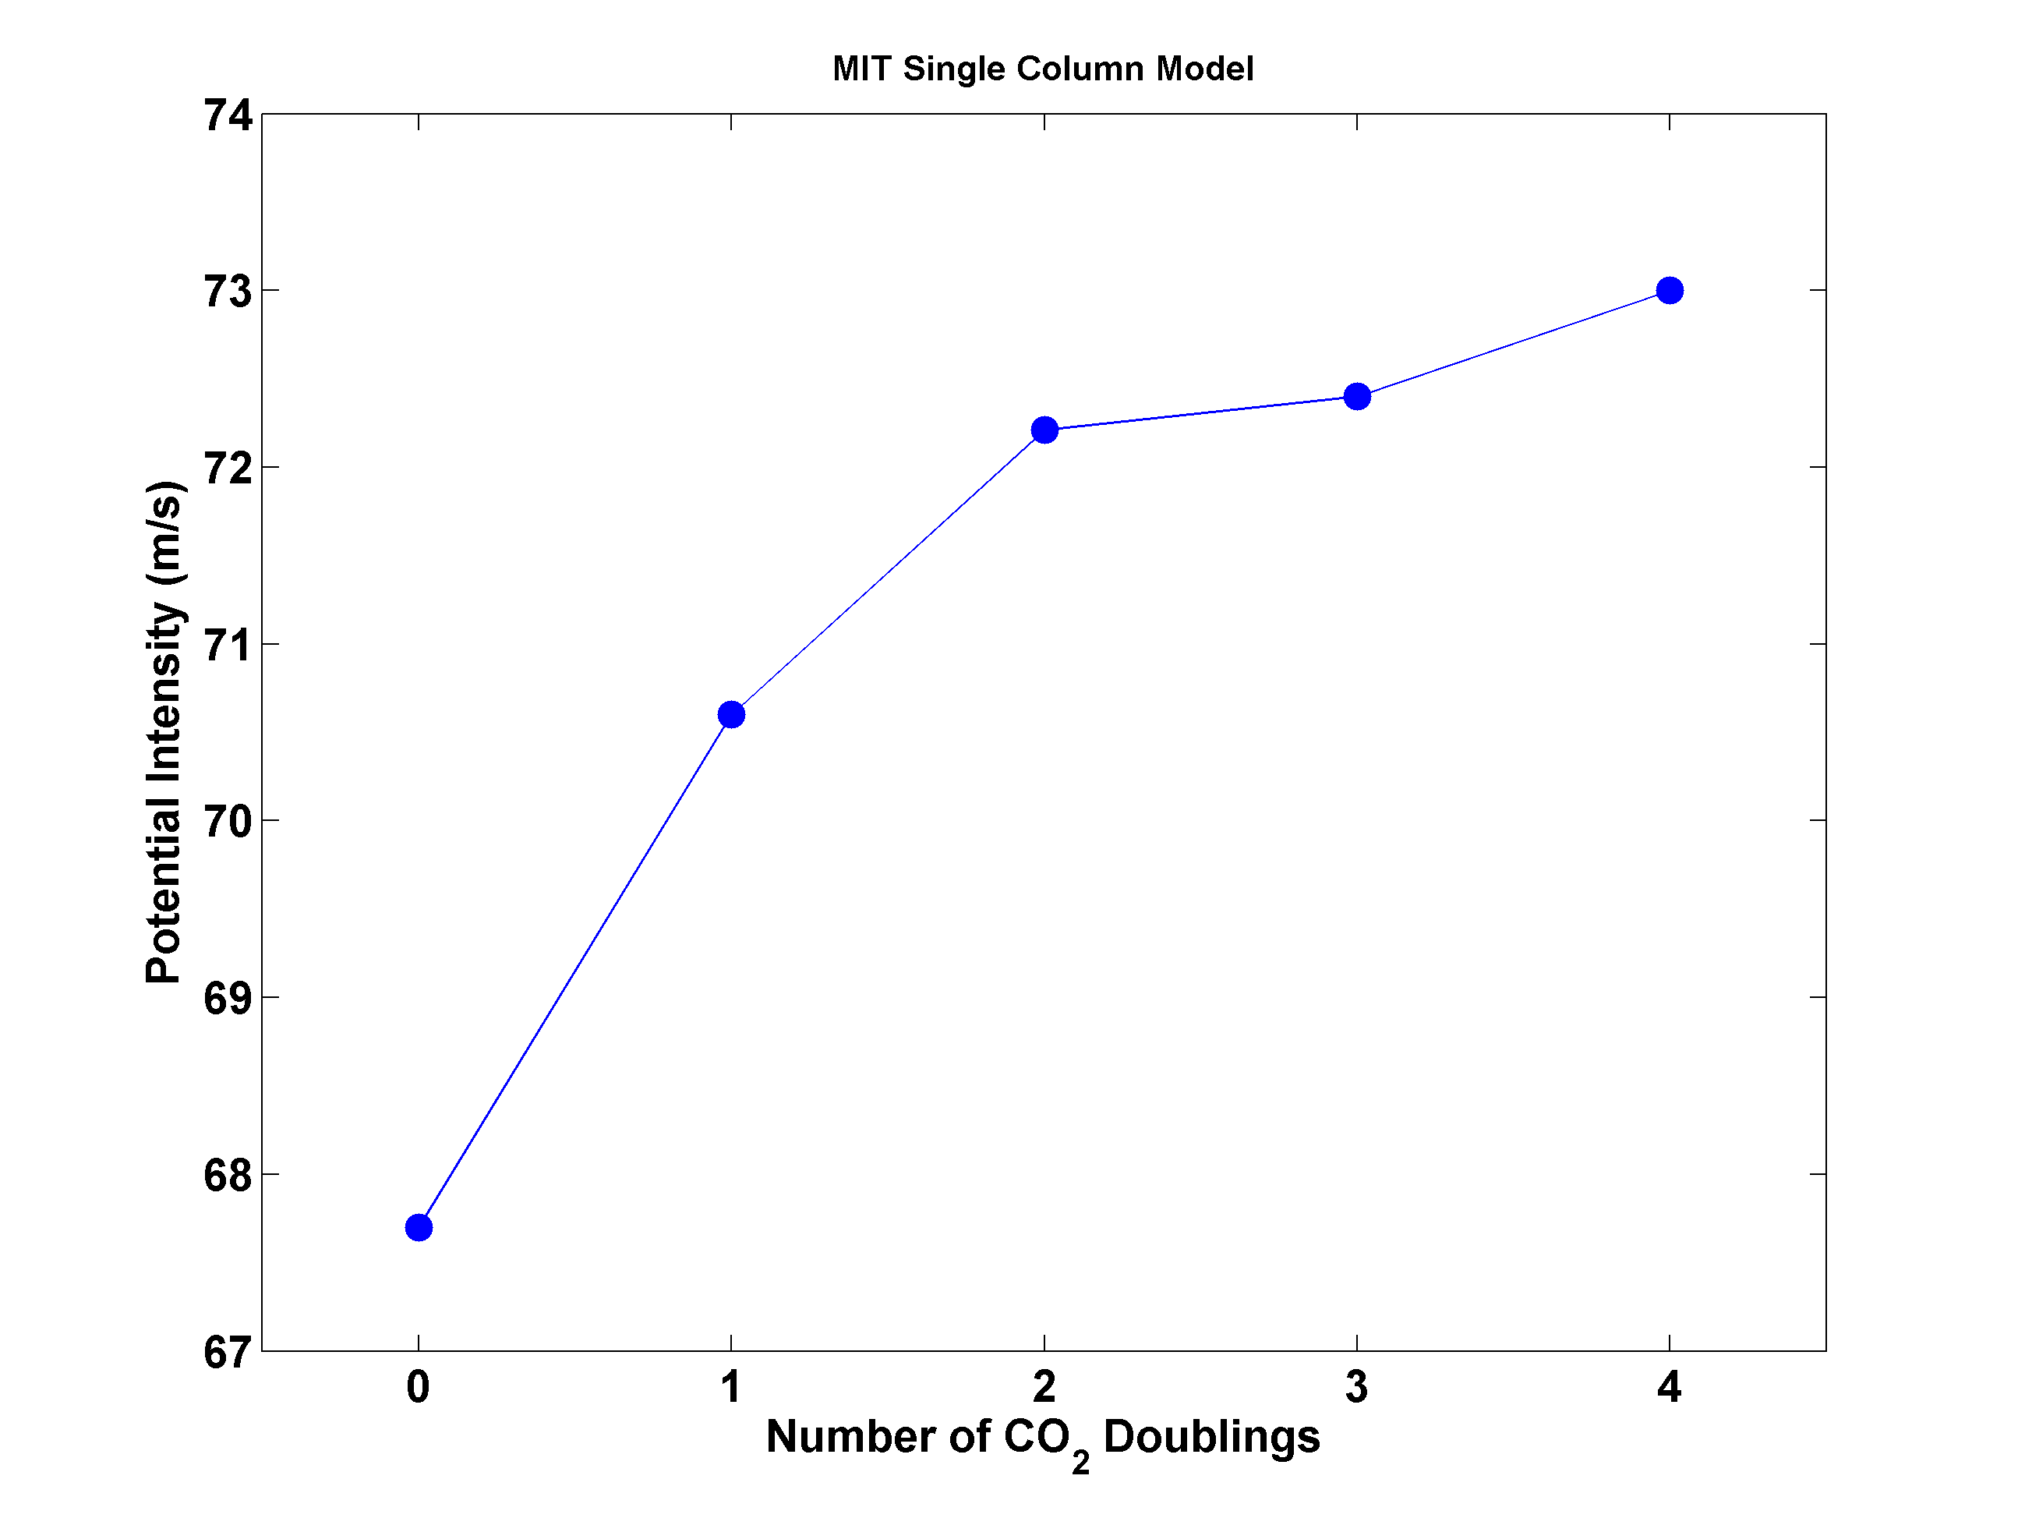
Potential Intensity and CO₂

Slide 15
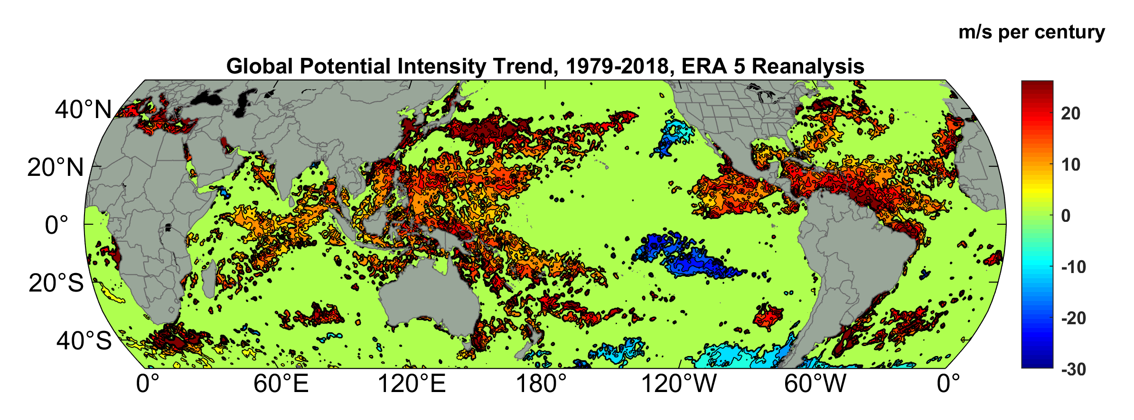
Potential Intensity Trend, 1979-2018, ERA 5 Reanalysis
(Trend shown only where p value < 0.05)

Slide 16
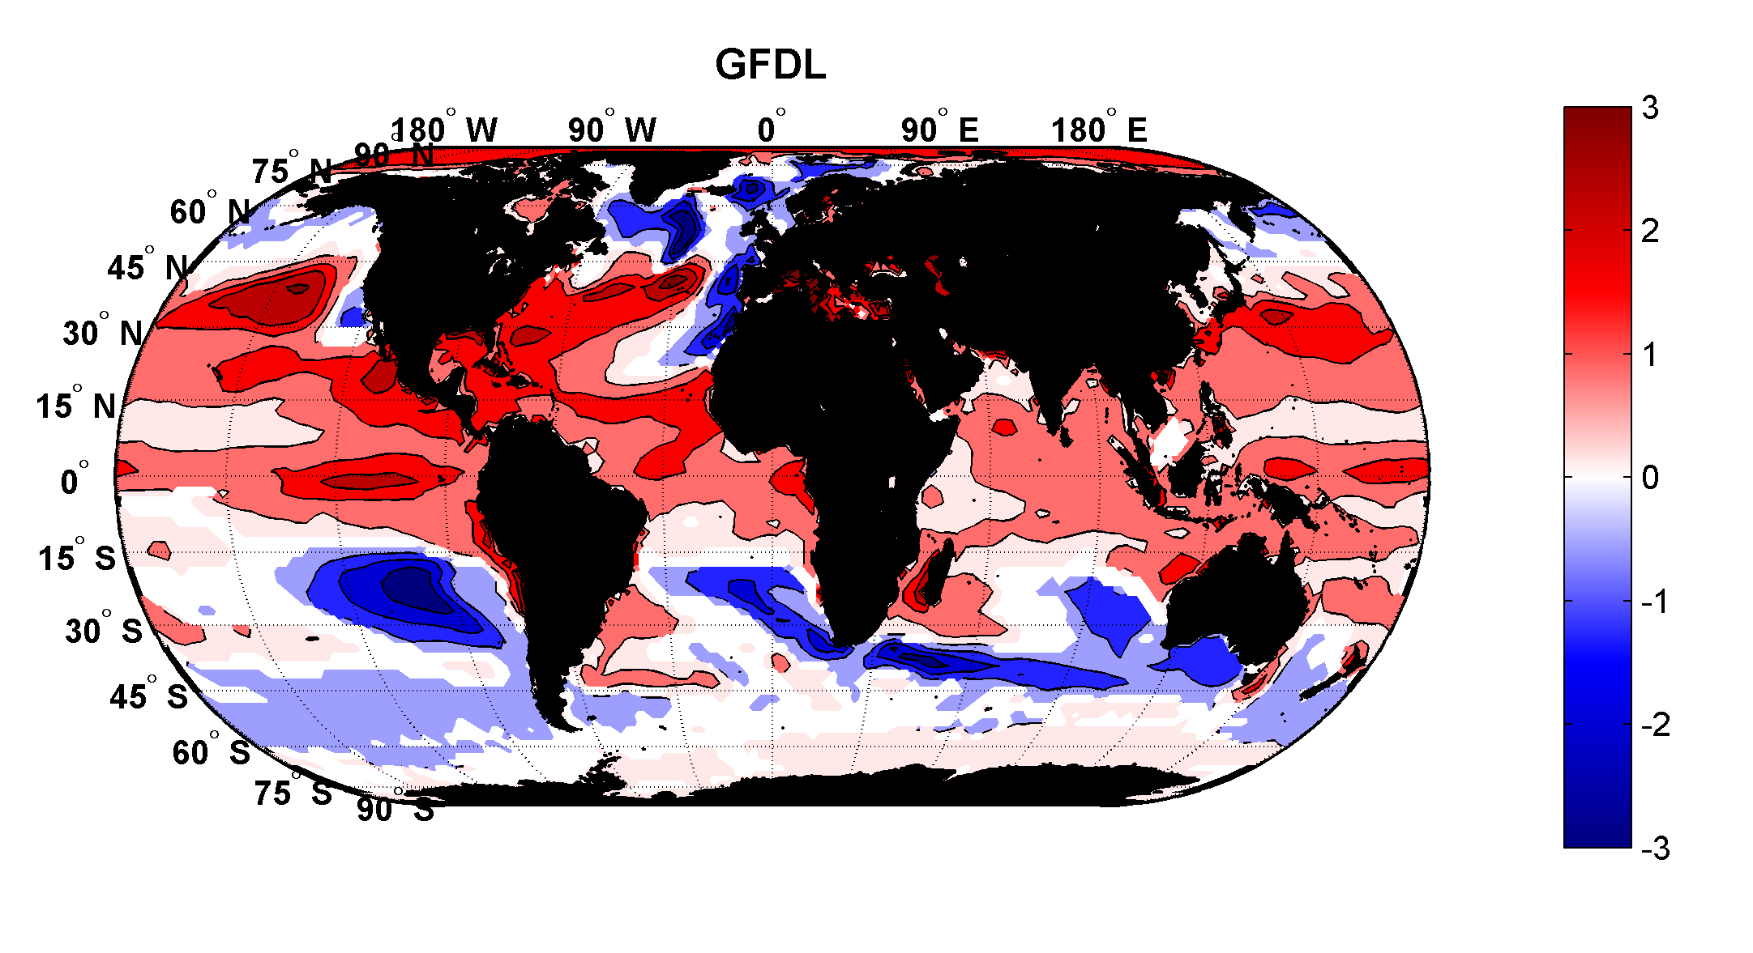
Projected Trend Over 21st Century: GFDL model under RCP 8.5
ms⁻¹decade⁻¹

Slide 17
Inferences from Basic Theory:
Potential intensity increases with global warming
Incidence of high-intensity hurricanes should increase
Increases in potential intensity should be faster in sub-tropics
Hurricanes will produce substantially more rain: Clausius-Clapeyron yields ~7% increase in water vapor per 1ºC warming

Slide 18

The Nature of Hurricane Risk
Notes:
18

Slide 19


Risk Assessment in a Changing Climate: The Problem
Event Probability
Damage Probability
Current and Future Probability Density of U.S. TC Wind Damages
Current and Future Damage Probability

Slide 20
The Heart of the Problem:
Societies are usually well adapted to frequent events (> 1/100 yr)
Societies are often poorly adapted to rare events (< 1/100 yr)
Robust estimates of the character of ~100 yr events require ~1,000 years of data
We do not have ~1,000 years of meteorological observations

Slide 21
How We Deal with This:
For local events, accumulate statistics over locations far enough apart to sample different individual events, but close enough to sample the same overall climatology.
  Example: 500 mm of TC rain in metro Houston may be a 100-year event, but a 20-year event over coastal Texas
Extrapolate well-sampled events to rare events using extreme value theory. Dicey!

Slide 22
How We COULD Deal with This:
Bring physics to bear on natural hazard risk assessment… problem too important to leave to statisticians
But several impediments:
  Academic stove-piping: Too applied for scientists; too complicated for risk professionals
  Brute force modeling probably too expensive to be practical for many applications

Slide 23
Using Physics to Estimate Hurricane Risk

Slide 24
Why Not Use Global Climate Models to Simulate Hurricanes?

Slide 25

Problem: Today’s models are far too coarse to simulate destructive hurricanes
Histograms of Tropical Cyclone Intensity as Simulated by a Global Model with 30 mile grid point spacing. (Courtesy Isaac Held, GFDL)
Category 3
Modeled
Observed
Global models do not simulate the storms that cause destruction
Wind Speed (meters per second)

Slide 26
How to deal with this?
Embed high-resolution, fast coupled ocean- atmosphere hurricane model in global climate model or climate reanalysis data
Coupled Hurricane Intensity prediction Model (CHIPS) has been used for 18 years to forecast real hurricanes in near- real time
Can easily generate > 100,000 storms

Slide 27
Risk Assessment Approach:
Step 1: Seed each ocean basin with a very large number of weak, randomly located cyclones
Step 2: Cyclones are assumed to move with the large scale atmospheric flow in which they are embedded, plus a correction for the earth’s rotation and sphericity
Step 3: Run the CHIPS model for each cyclone, and note how many achieve at least tropical storm strength
Step 4: Using the small fraction of surviving events, determine storm statistics. Can easily generate 100,000 events
Details: Emanuel et al., Bull. Amer. Meteor. Soc, 2008
Notes:
27

Slide 28
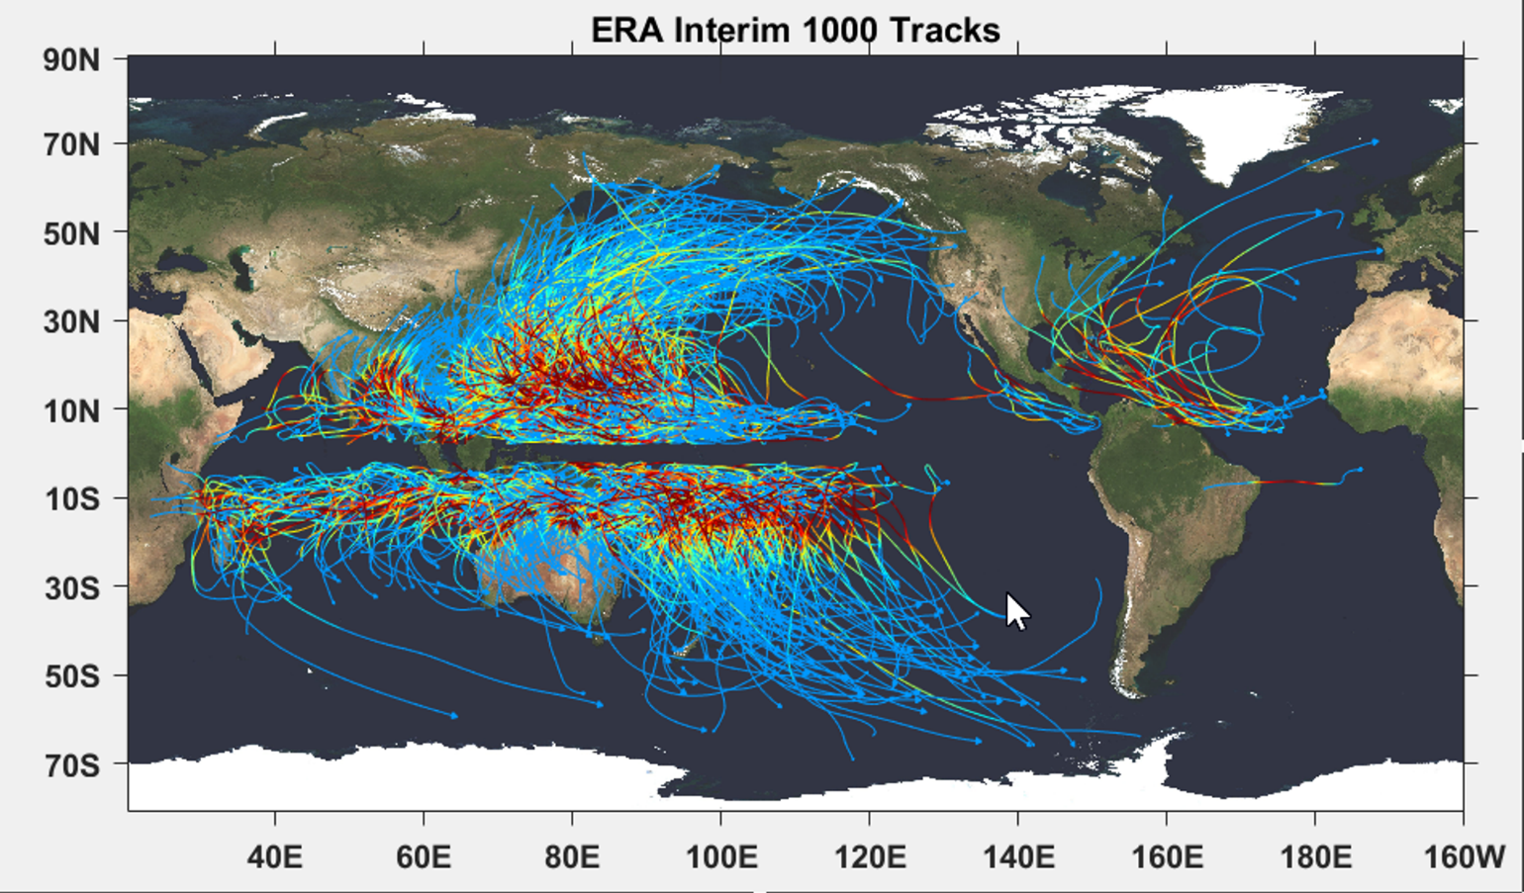

Slide 29

Cumulative Distribution of Storm Lifetime Peak Wind Speed, with Sample of 1755 Synthetic Tracks
90% confidence bounds

Slide 30
Atlantic Annual Cycle

Slide 31

Return Periods

Slide 32

Captures effects of regional climate phenomena (e.g. ENSO, AMM)

Slide 33
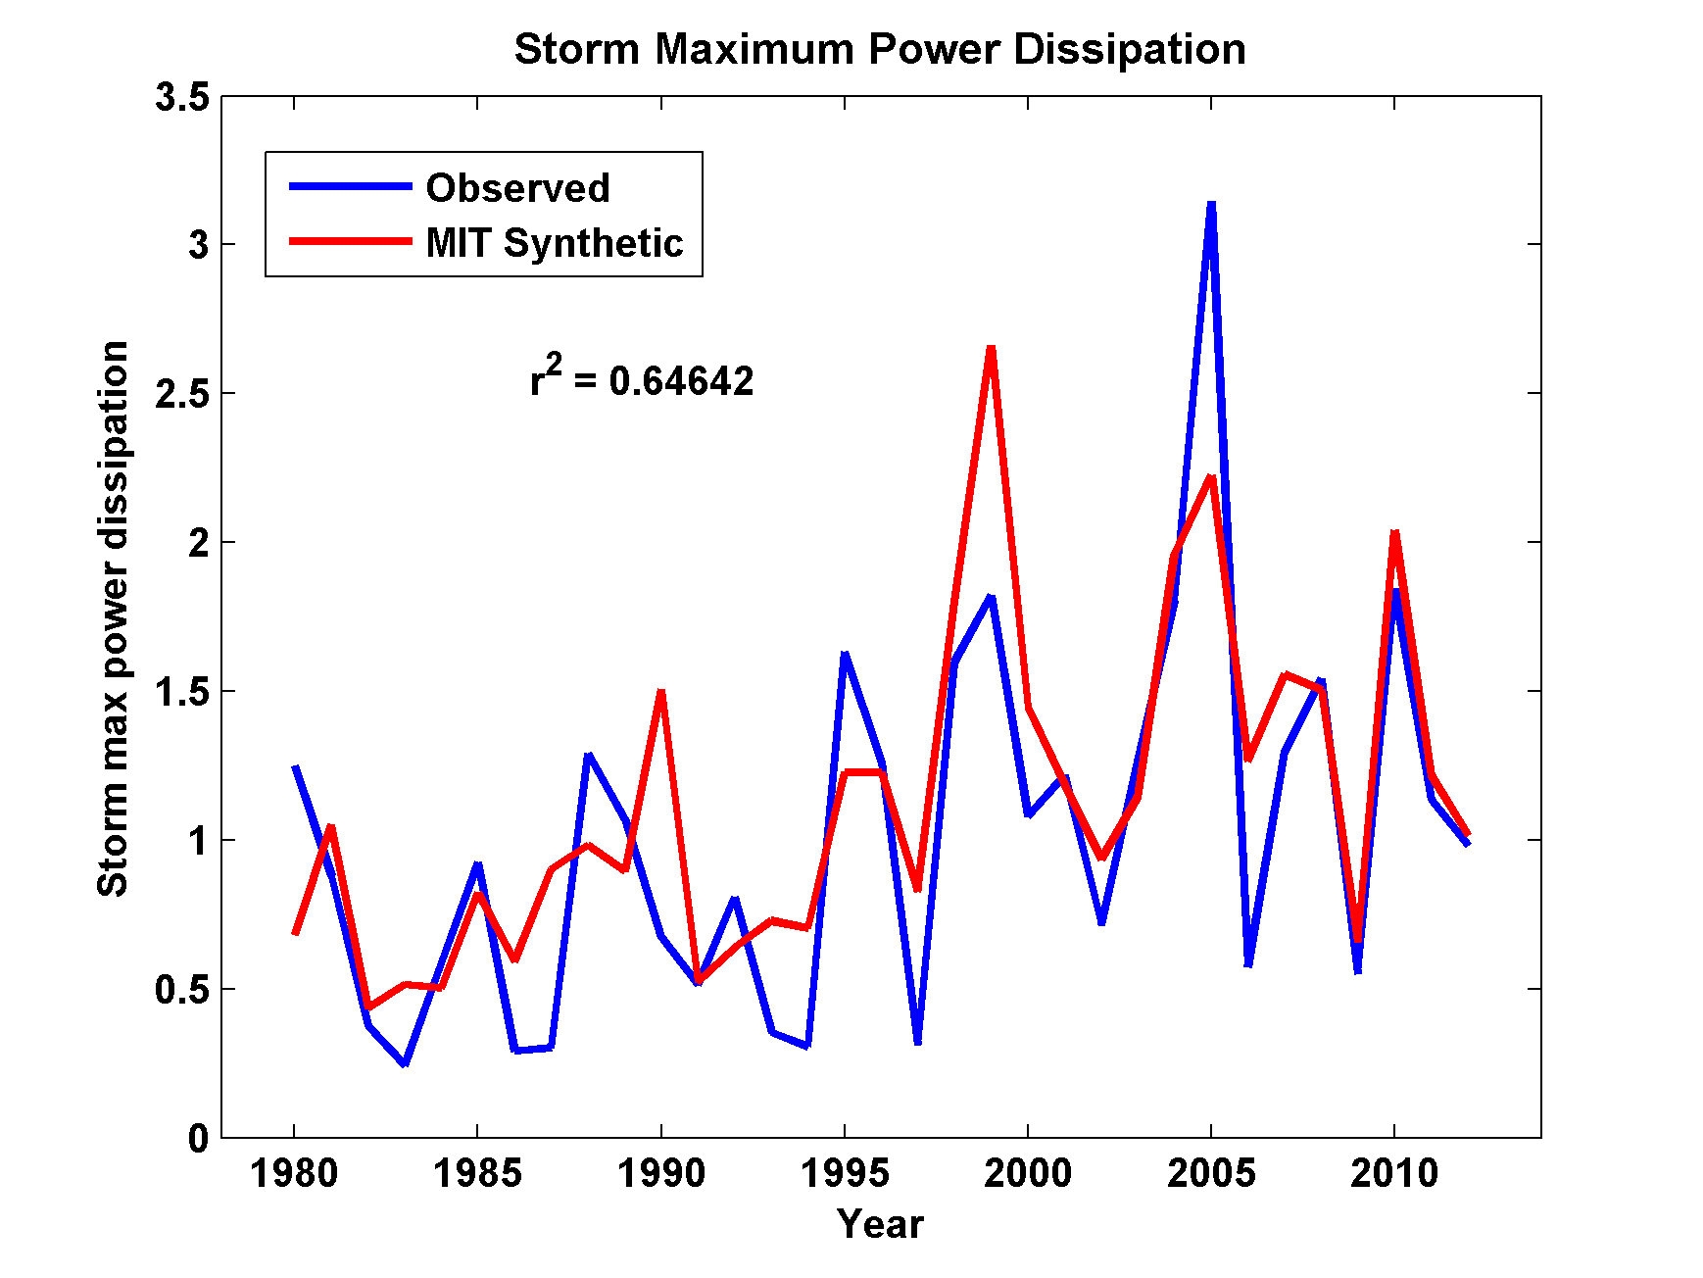
Captures Much of the Observed North Atlantic Interannual Variability
r²=0.65

Slide 34


Storm Surge Simulation (Ning Lin)
SLOSH model
(Jelesnianski et al. 1992)
SLOSH mesh
~ 10³ m
ADCIRC mesh
~ 10² m
Battery
ADCIRC model
(Luettich et al. 1992)
ADCIRC mesh
~ 10 m
(Colle et al. 2008)
Notes:
Given the storm wind and pressure fields (which is estimated from the Holland parametric pressure model) we can simulate the surge. Surge simulations with high resolution are computationally intensive, so to make it possible to simulate accurate surges for our large synthetic storm sets, we apply the two hydrodynamic models with girds of various resolutions in such a way that the main computational effort is concentrated on the storms that determine the risk. First, we apply the SLOSH model, using a mesh with resolution of about 1 km around NYC to simulate the surges for all storms and select the storms that have return periods, in terms of the surge height at the Battery, greater than 10 years. Second, we apply the ADCIRC simulation, using a grid mesh with resolution of ~100 m around NYC, to each of the selected storms. Then, we apply another ADCIRC mesh with resolution as high as ~10 m around NYC, for a set of the most extreme events, to check if the resolution of our ADCIRC grid is sufficient and if needed to make statistical correction to the results.

Slide 35
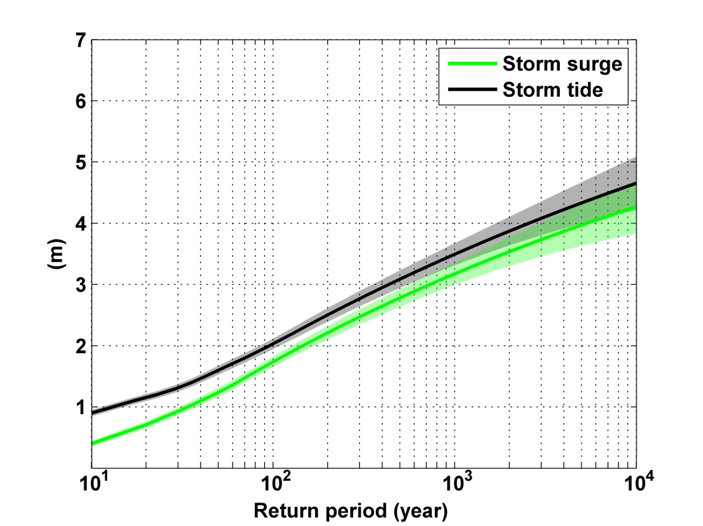
Sandy, 2012
Sandy: ~ 400 years
Notes:
Storm surge and storm tide (surge and tide) return level curves for the Battery, NYC, for the 1981-2000 NCAR/NCEP climate conditions (5000 synthetic storms). Astronomical tide and nonlinear interaction between surge and tide are accounted for statistically.

Slide 36
NEXRAD Sites

Slide 37
An Example:
Estimated gauge sampling error
Estimated radar sampling error

Slide 38
TC Risk in India

Slide 39
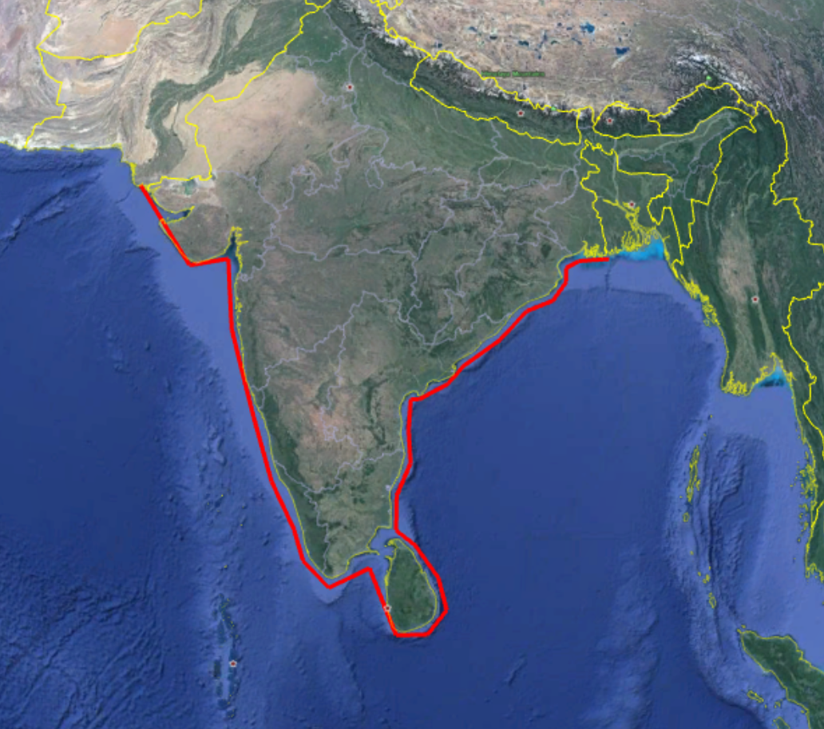
India Filter

Slide 40
Annual Frequency

Slide 41
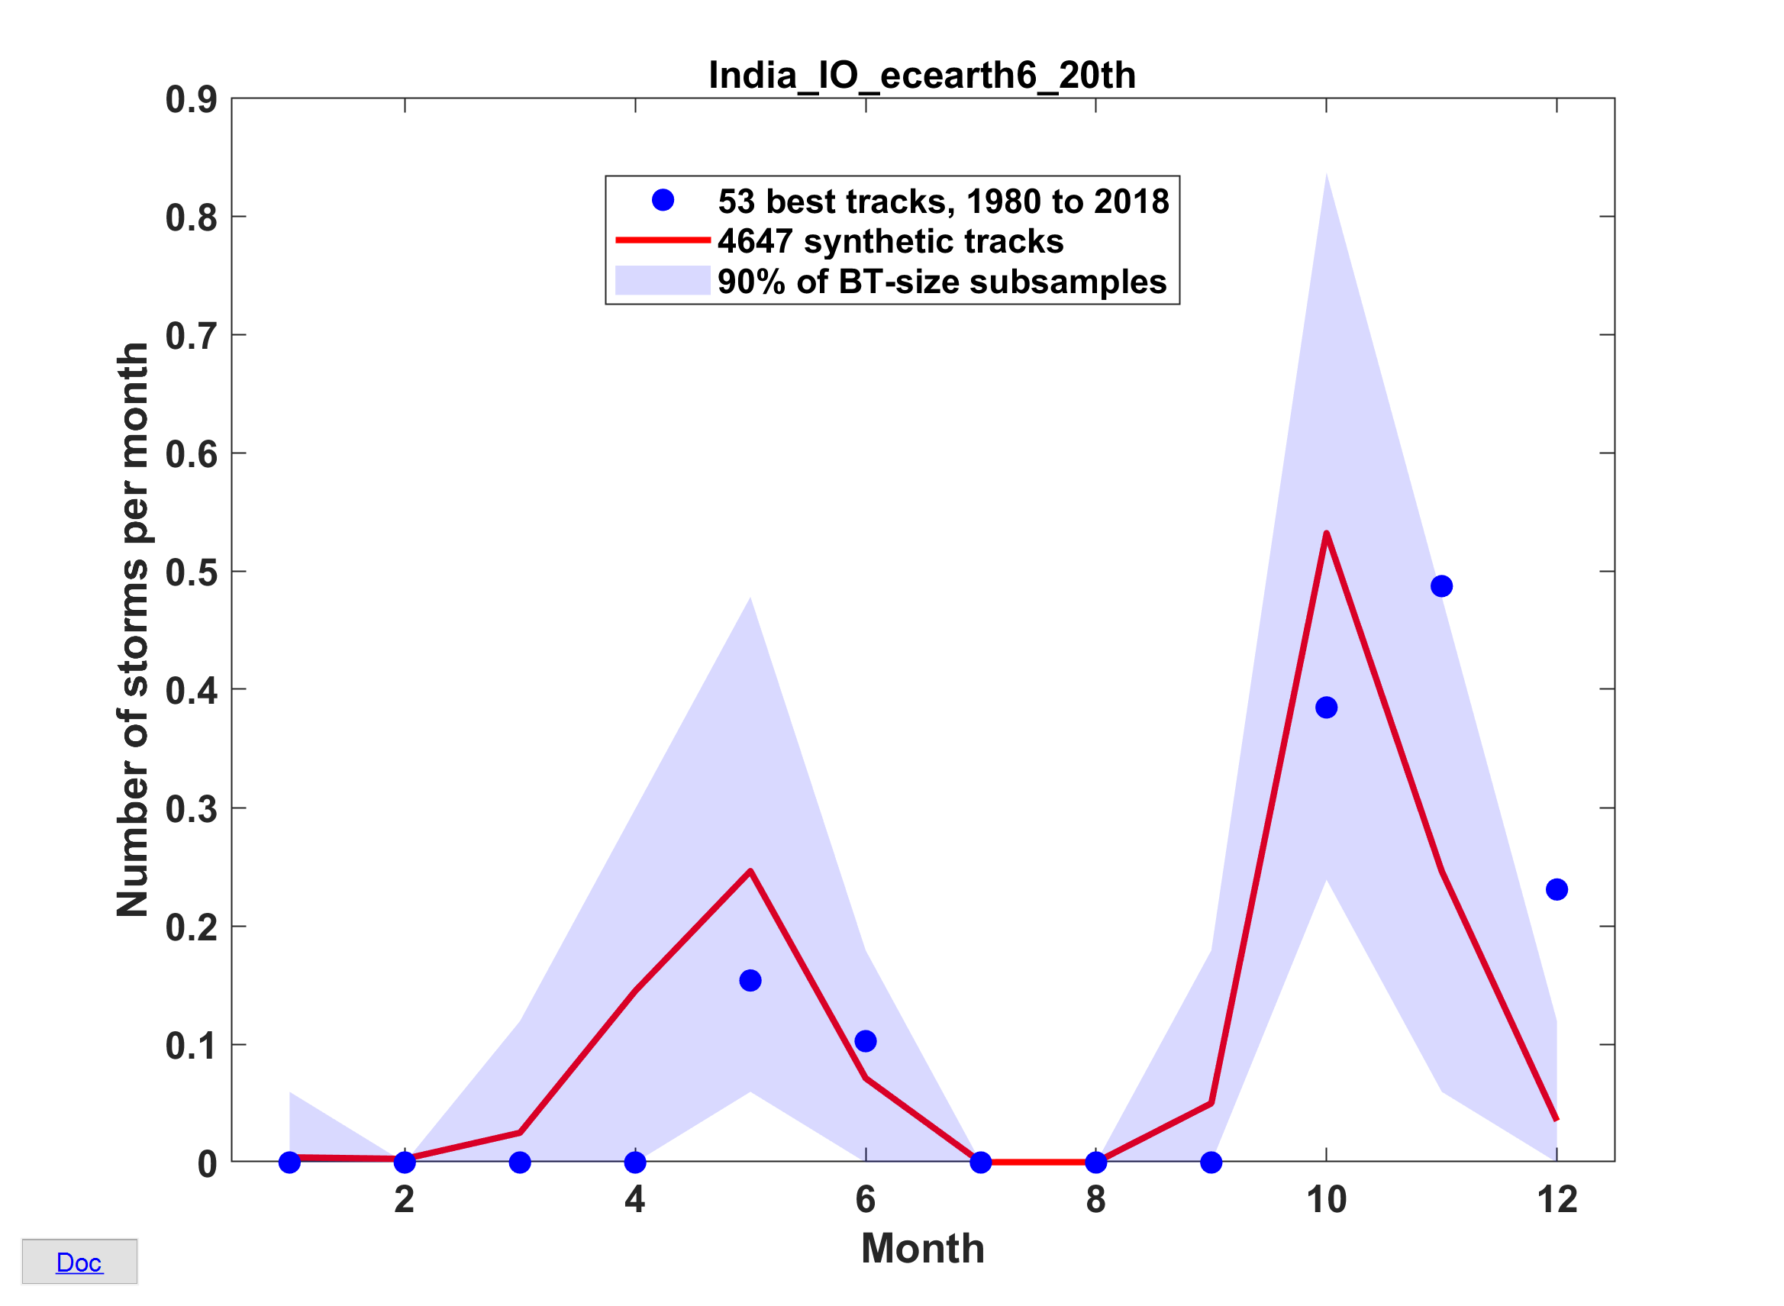
Annual Cycle

Slide 42
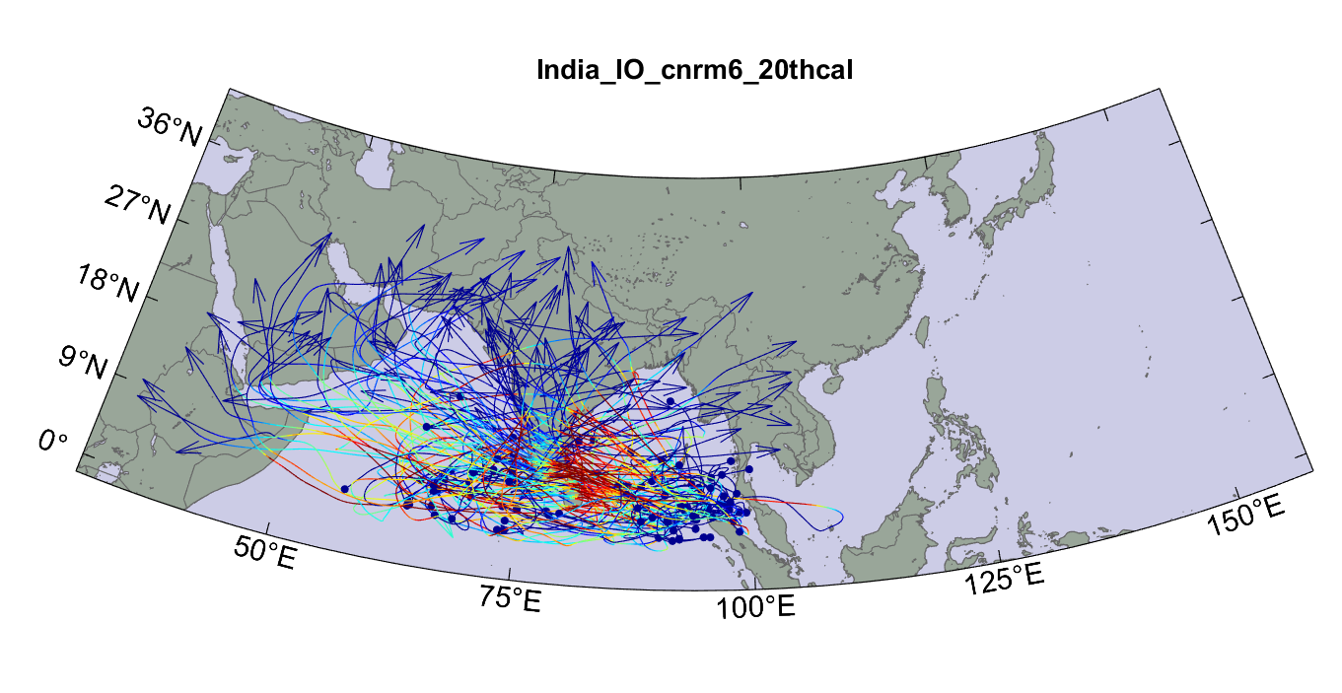
Top 100 out of 5000 TCs Affecting India, 1850-2014

Slide 43
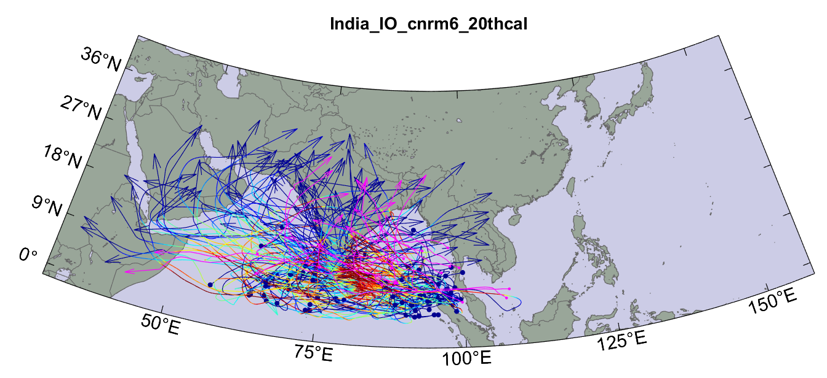
Same, but with top 20 historical tracks

Slide 44
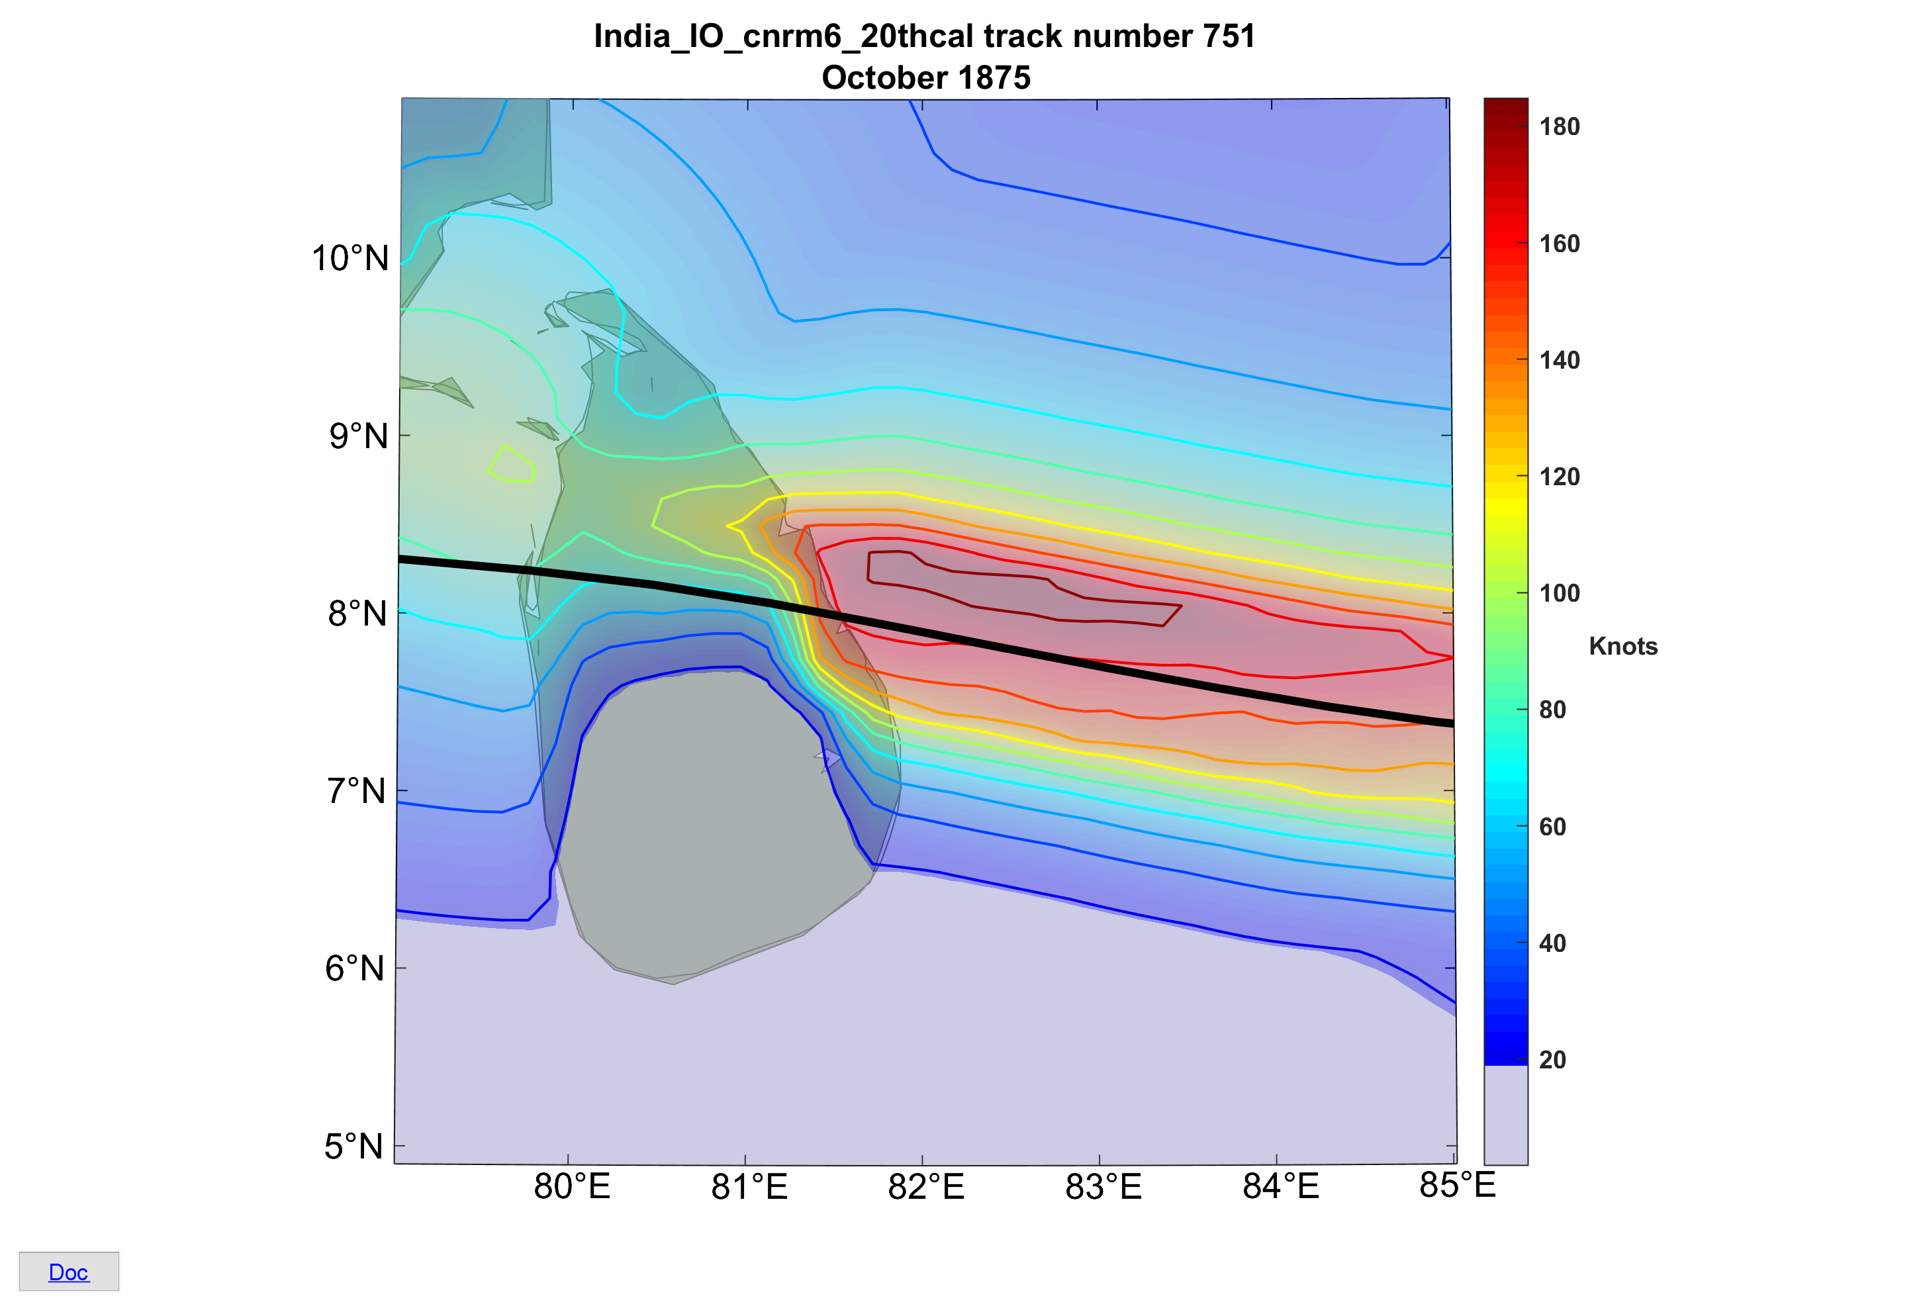
Top Landfall Wind

Slide 45
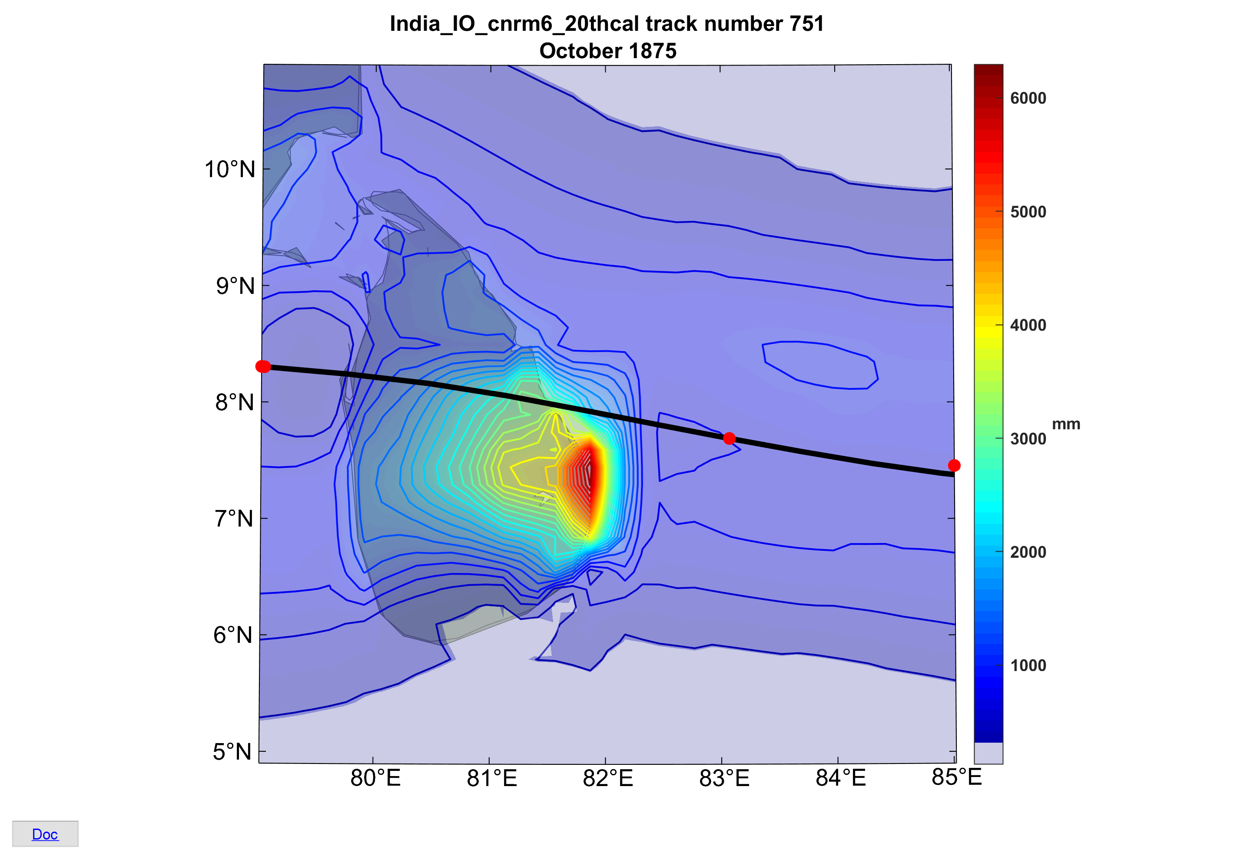
Storm total rainfall for top wind event

Slide 46
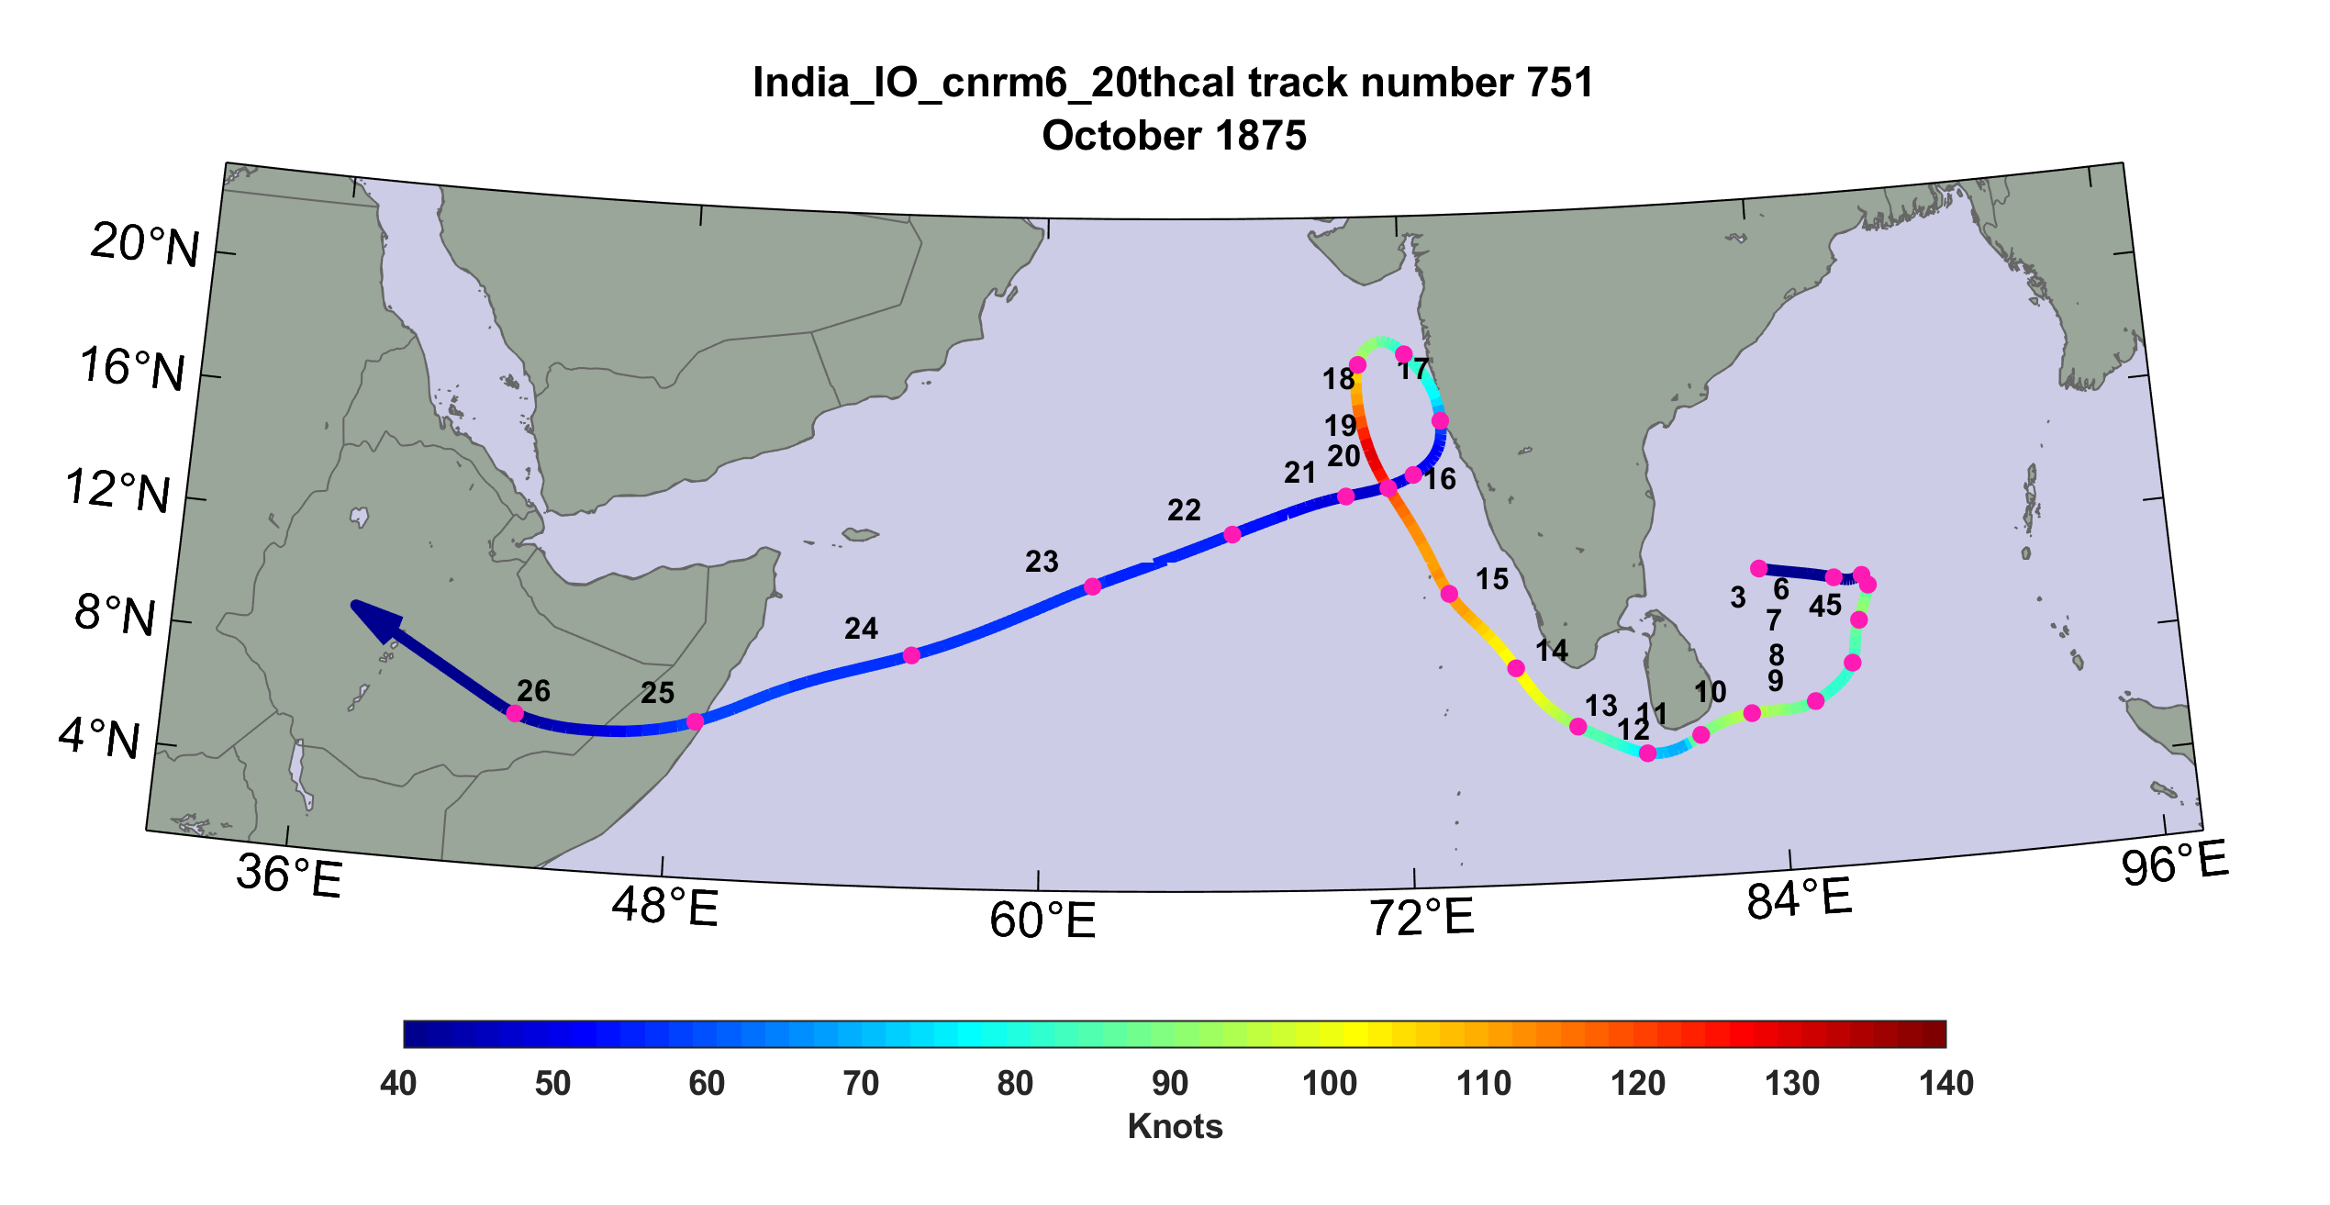
A Heavy Rainfall TC Event near the West Coast

Slide 47
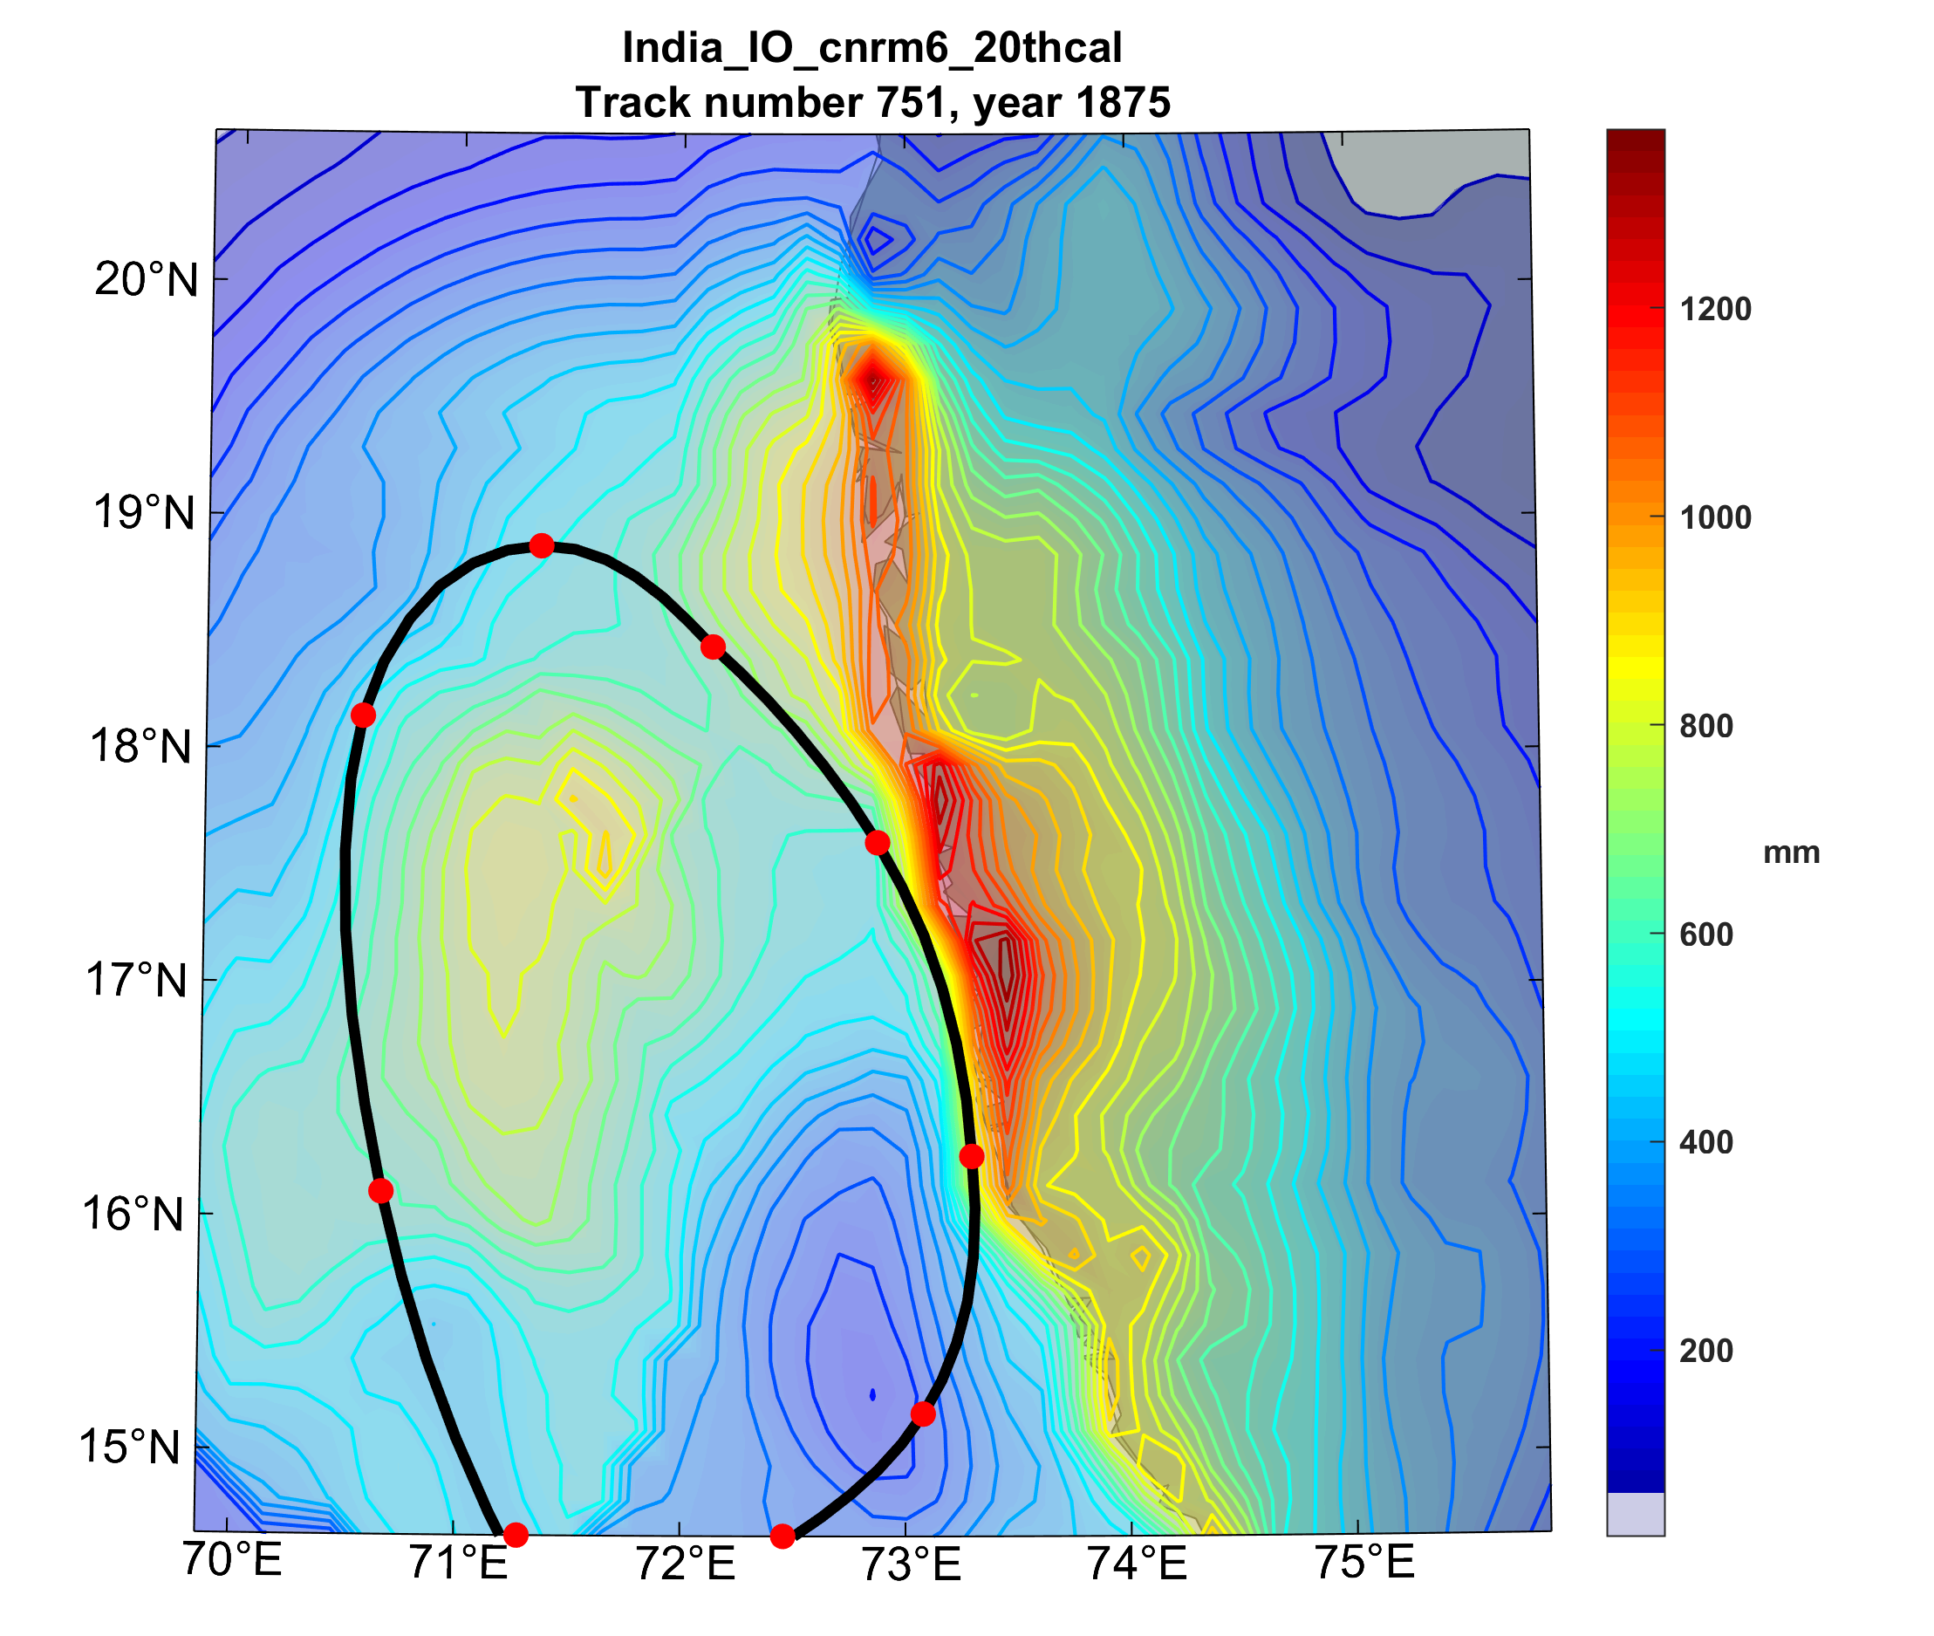

Slide 48
Effects of Climate Change
More moisture in boundary layer
Stronger storms but more compact inner regions
Possibly larger storm diameters
Storms may be moving faster or slower

Slide 49
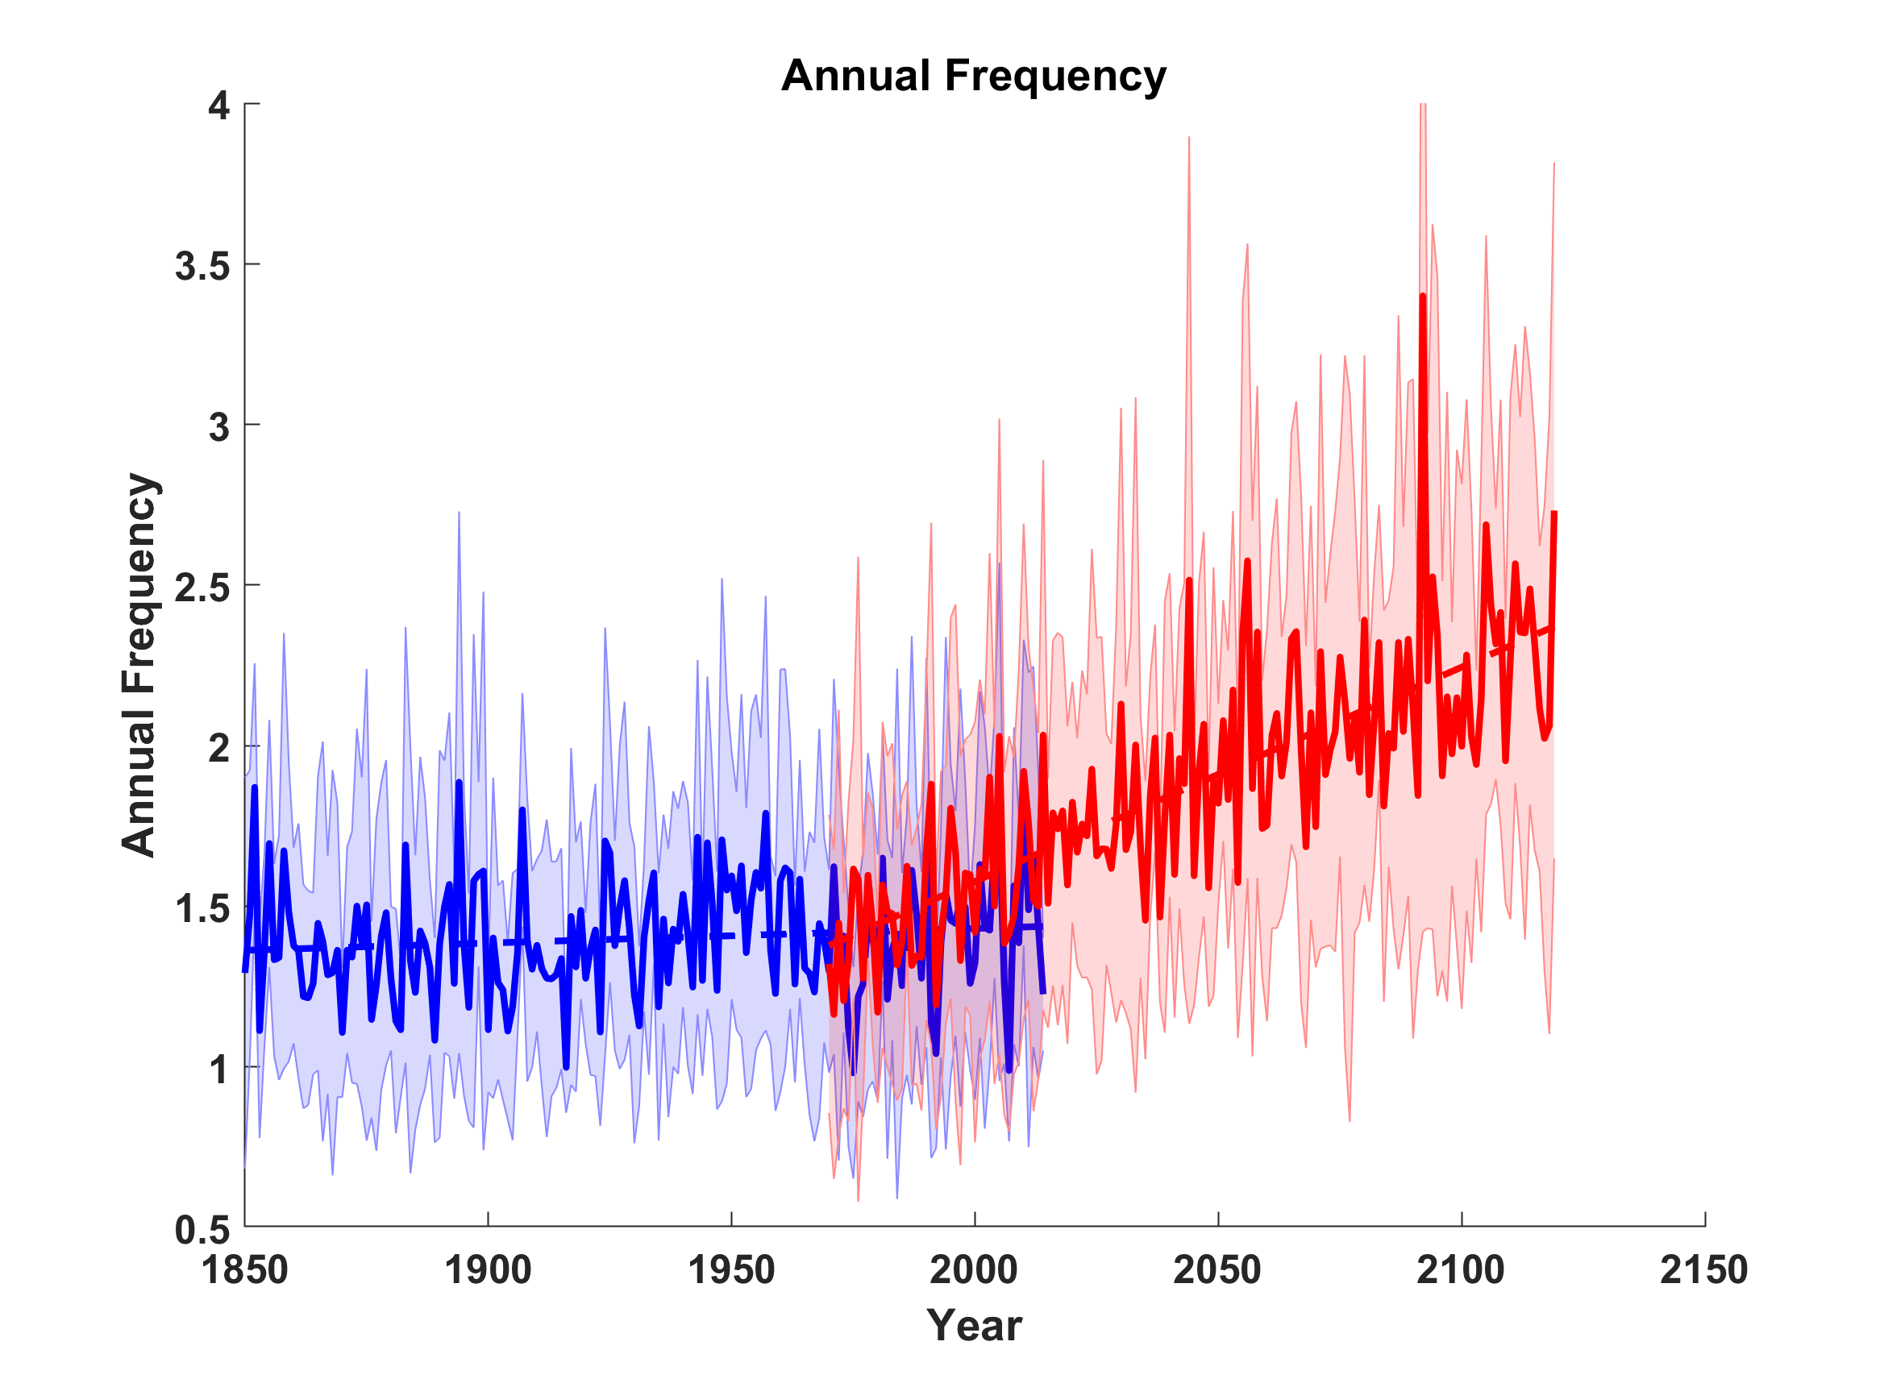
Response of Annual Frequency of India Storms to 1%yr⁻¹ Increase in CO₂ beginning in 1970
Results from downscaling 8 CMIP6 models

Slide 50
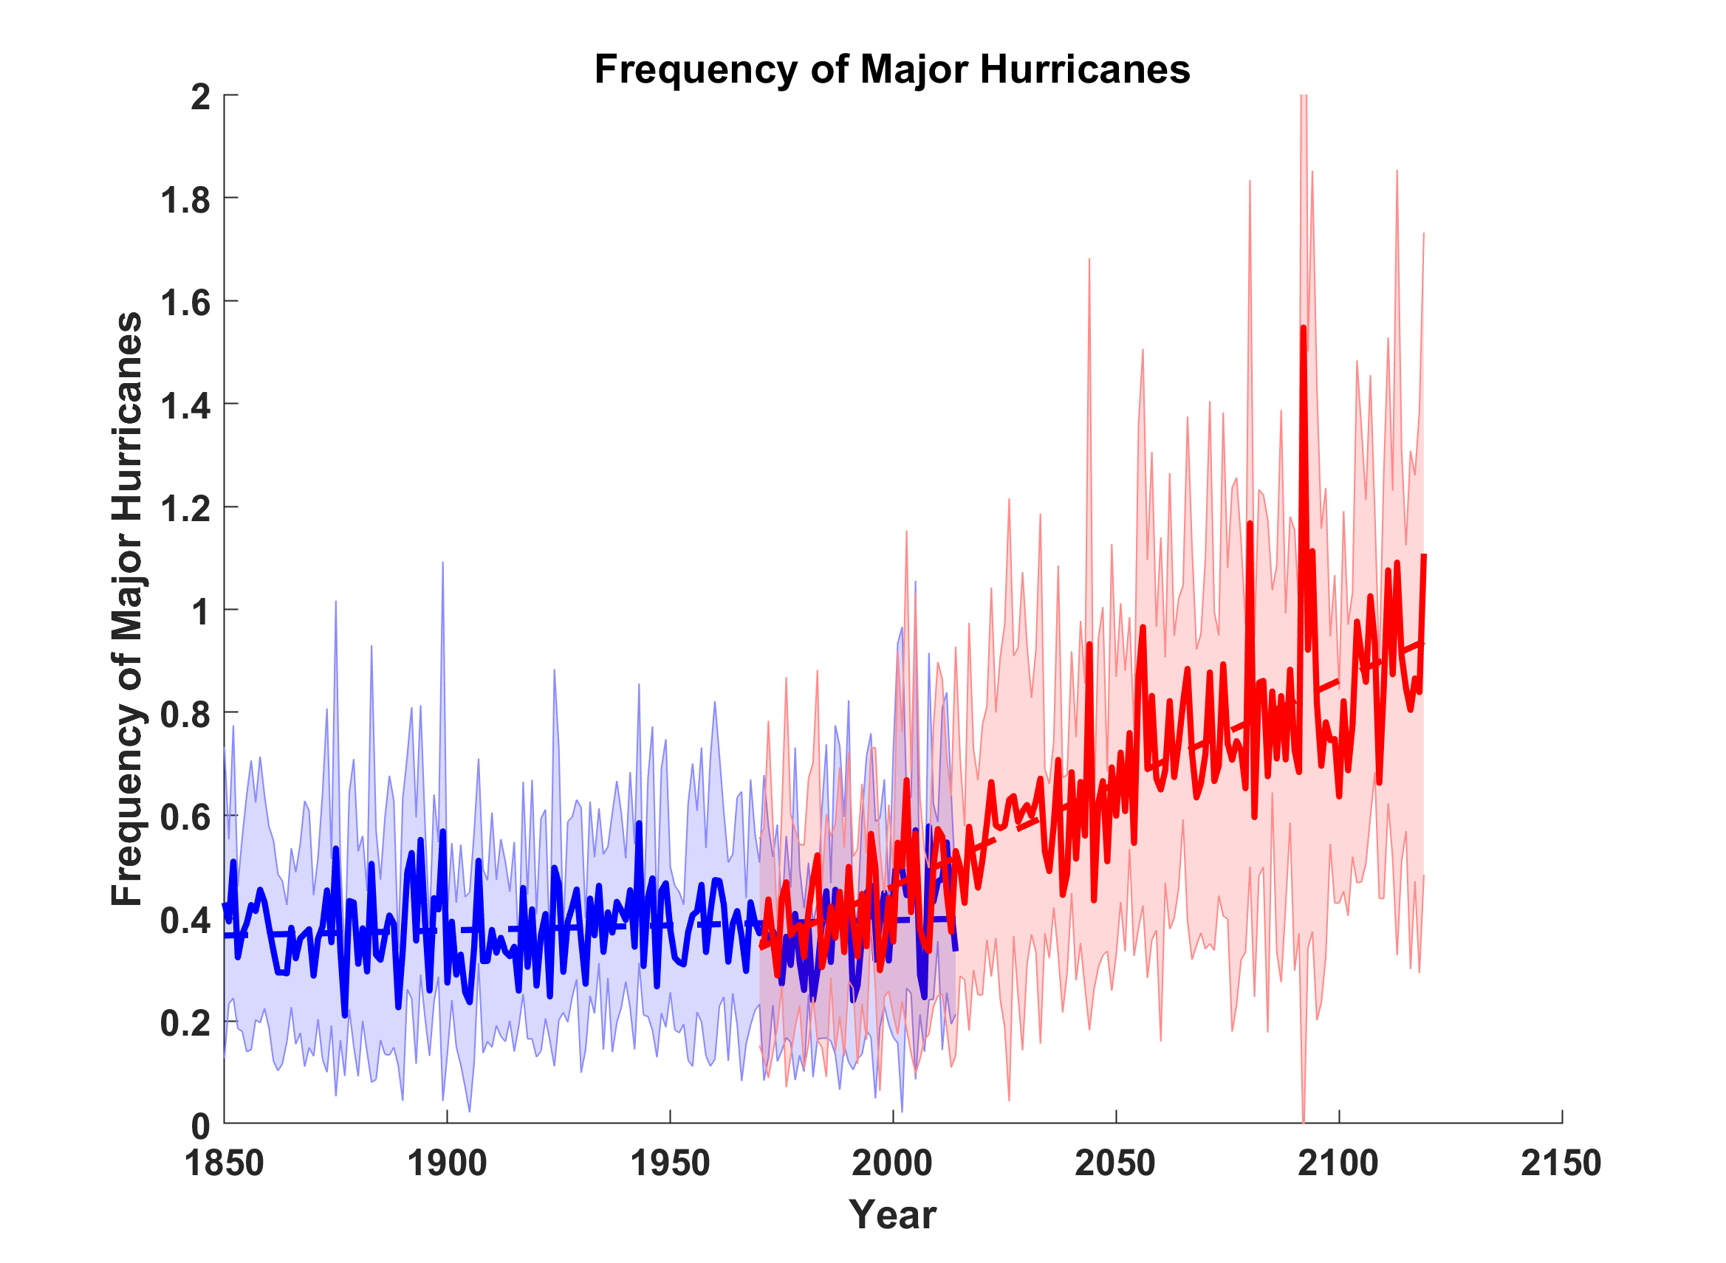
Major Hurricanes

Slide 51
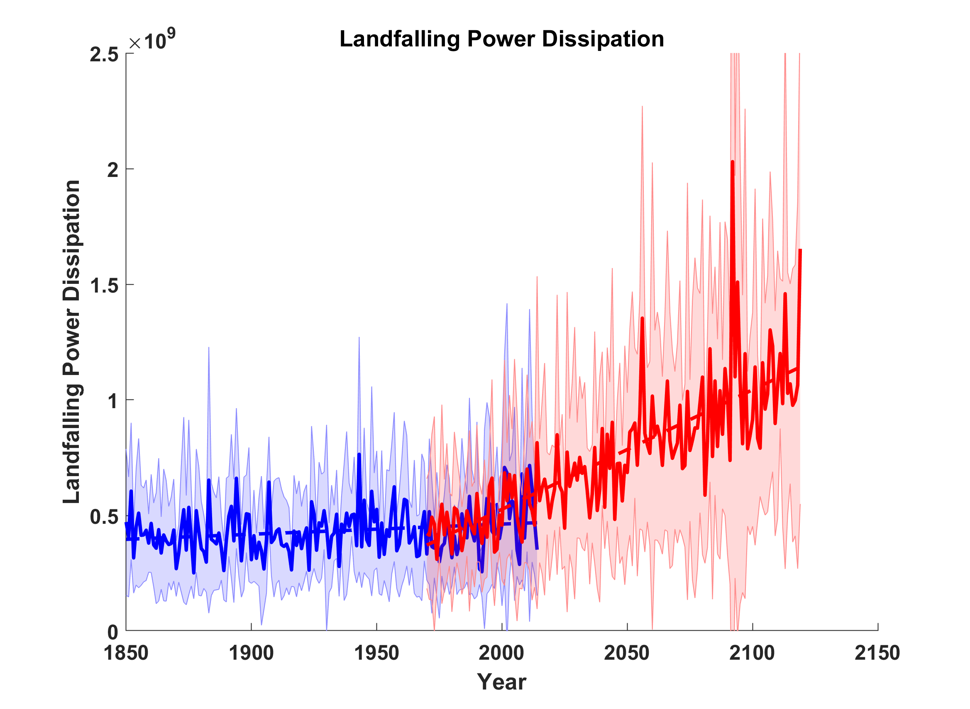
Landfalling Power Dissipation

Slide 52
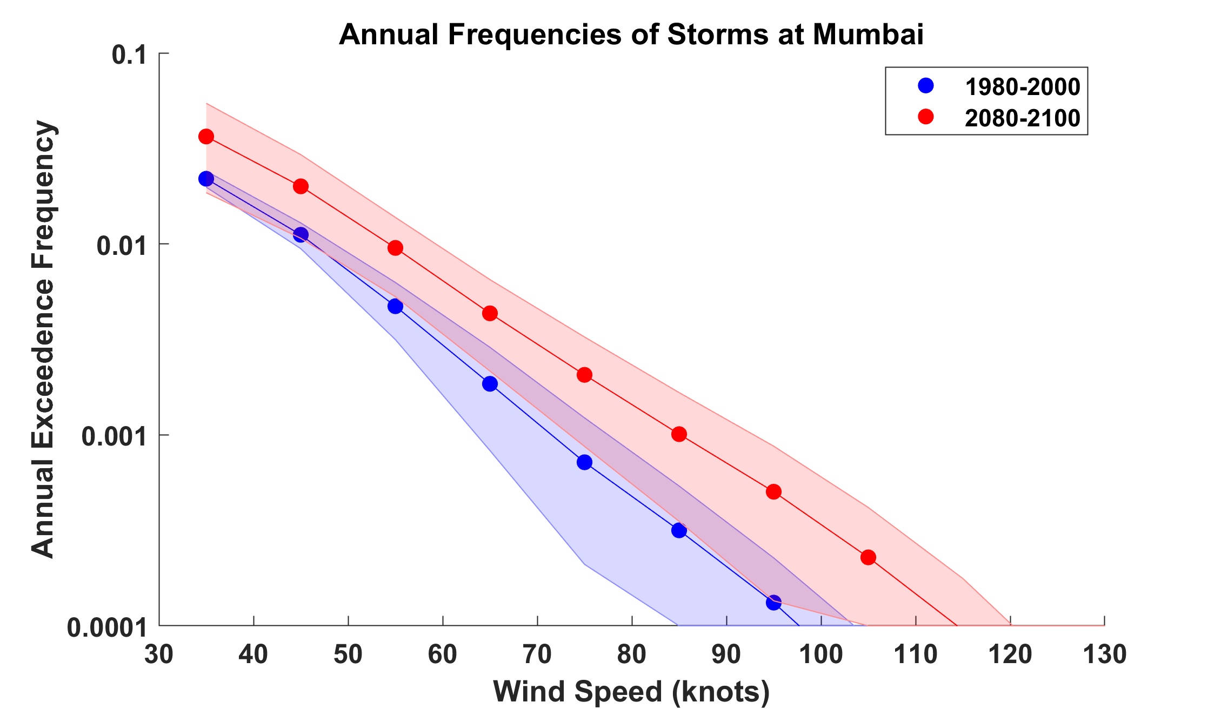
Estimates of Current and Future TC Risk at Mumbai, Based on 7 CMIP5 Models
RCP 8.5 Used for Future Climate
Wind

Slide 53
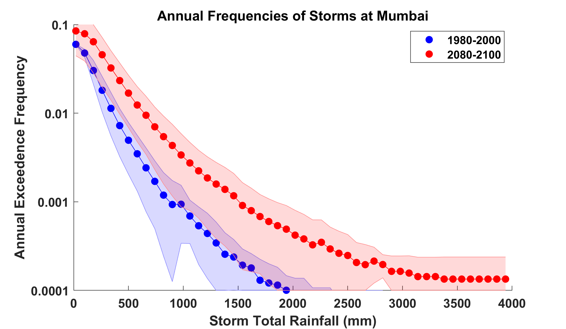
Rain

Slide 54
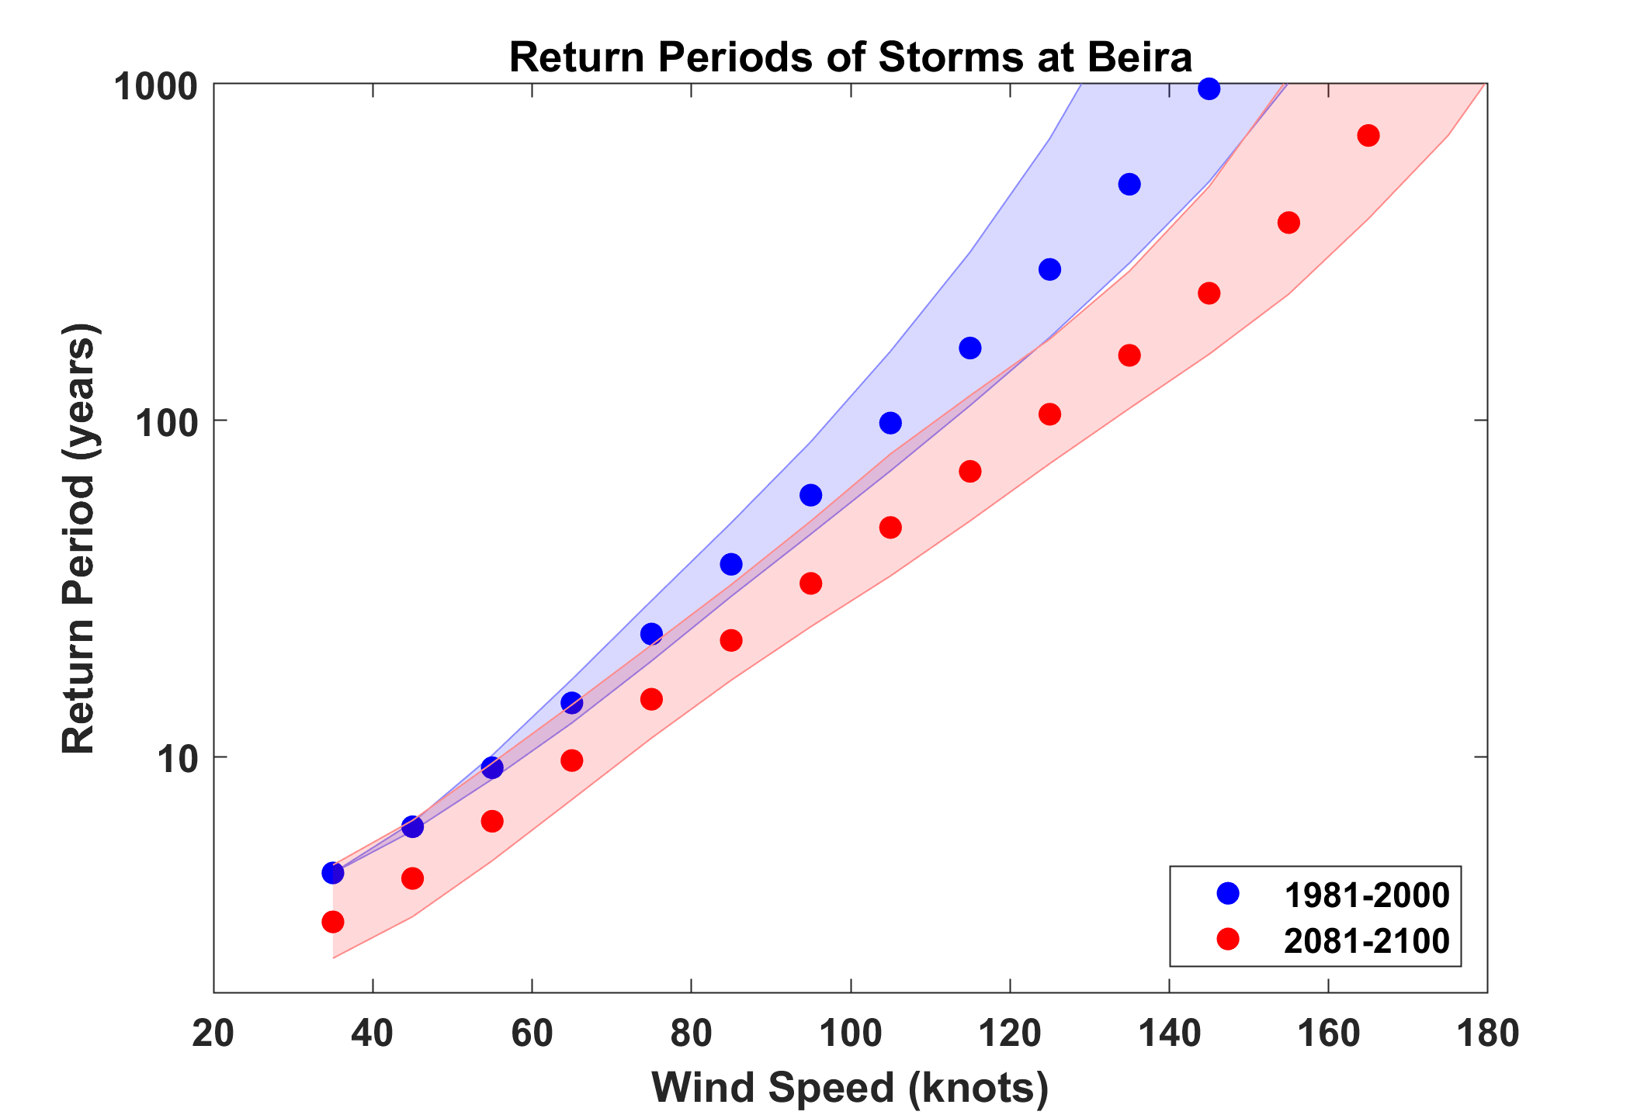
Based on 7 CMIP5 models
Idai

Slide 55
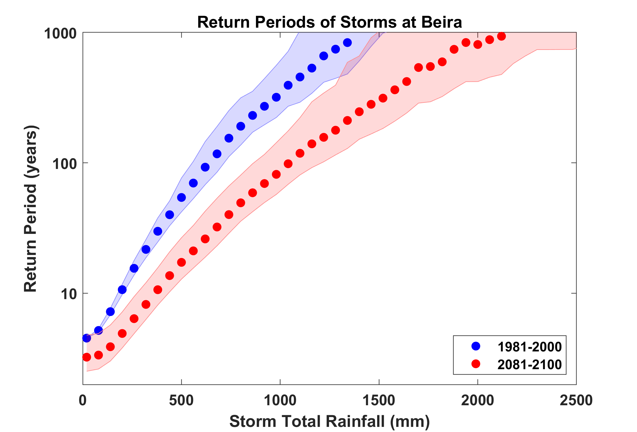
Idai

Slide 56
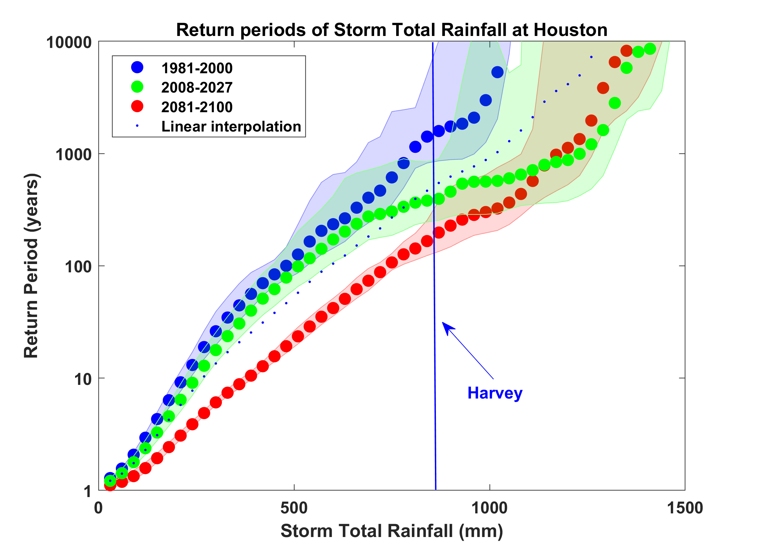
Probability of Storm Accumulated Rainfall in Harris County, from 6 Climate models, 1981-2000, 2008-2027, and 2081-2100, Based on 2000 Events Each, and Using RCP 8.5. Shading Shows Spread Among the Models.

Slide 57
Summary
The observational record of hurricanes is too short and noisy, and of a quality too low to make robust inferences of climate signals
Satellite data do show a migration of peak intensity toward higher latitudes and some indication of a greater fraction of intense storms

Slide 58
Summary (continued)
Potential intensity theory demonstrates that the thermodynamic limit on hurricane intensity rises with temperature
Observations show that this limit is indeed increasing
Physics can be used to model hurricane risk in current and future climates
Global warming is not merely a problem for the future; current risk estimates are already out of date

Slide 59
Spare Slides

Slide 60
Calculating vertical motion in middle troposphere from time-dependent azimuthal gradient wind. Four components:
Vertical motion at the top of the boundary layer owing to frictional effects within the boundary layer. This is estimated using a slab boundary layer model forced by the model gradient wind as well as the low-level environmental wind used as an input to the storm synthesizer. Use spatially varying drag coefficient.
Vertical motion at the top of the boundary layer forced by topography interacting with the combination of storm and environmental flow.

Slide 61
Vertical stretching between the top of the boundary layer and the middle troposphere associated with changes in the vorticity of the (axisymmetric) gradient wind.
Add mid-tropospheric vertical motion caused by the dynamical interaction of the axisymmetric vortical flow and the background shear/horizontal temperature gradient. Classical quasi-balance reasoning!

Slide 62
Given mid-tropospheric vertical motion, rainfall is calculated by assuming ascent along a moist adiabat, calculated using the environmental 600 hPa temperature plus a correction for the storm’s warm core

Slide 63
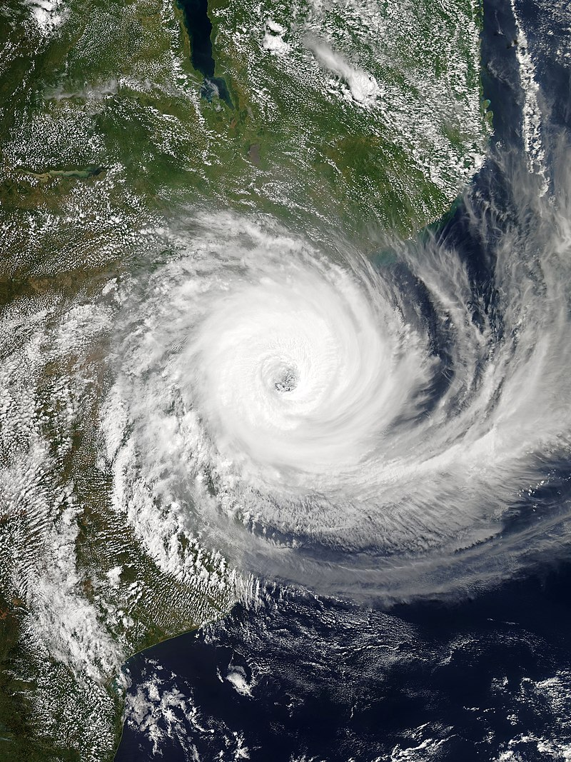
Tropical Cyclone Idai, 2019
Second-deadliest tropical cyclone recorded in the South-West Indian Ocean basin
Third-deadliest tropical cyclone on record in the southern hemisphere
Peak winds of 100 knots
> 500 mm rainfall in some locations
Storm surge of 4.4 m at Beira
~90% of Beira destroyed
> 1,000 lives lost

Slide 64
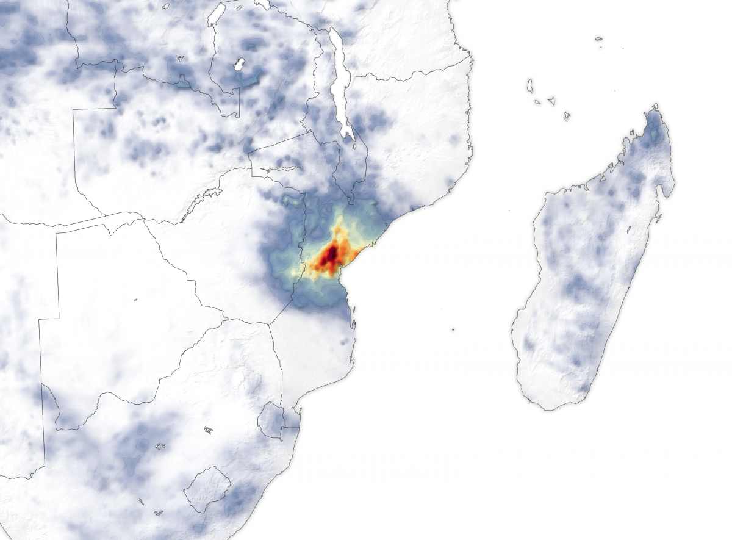
Rainfall accumulation from March 13 to March 20, 2019. Many areas received as much as 50 centimeters (20 inches) of rain. These data are remotely-sensed estimates that come from the Integrated Multi-Satellite Retrievals (IMERG), a product of the Global Precipitation Measurement (GPM) mission. Local rainfall amounts can be significantly higher when measured from the ground. Credit: NASA

