Slide 1

Tropical Cyclogenesis
Kerry Emanuel
Massachusetts Institute of Technology
Notes:
Are hurricanes becoming more powerful and destructive? Are these changes due to a natural cycle of hurricane activity or are they caused by human-induced climate change? Although this is currently a hot debate among scientists, new research suggests that the destructive potential of hurricanes is increasing due to the heating of the oceans.
Image: Satellite image of Hurricane Floyd approaching the east coast of Florida in 1999. The image has been digitally enhanced to lend a three-dimensional perspective. Credit: NASA/Goddard Space Flight Center.

Slide 2
Two Points of View
Macroscopic: What sets the frequency of tropical cyclones on the planet? Are tropical cyclones agents in a system that maintains itself in some critical state?
Microscopic: What are the dynamics and physics underlying tropical cyclogenesis?

Slide 3
The Macroscopic View

Slide 4
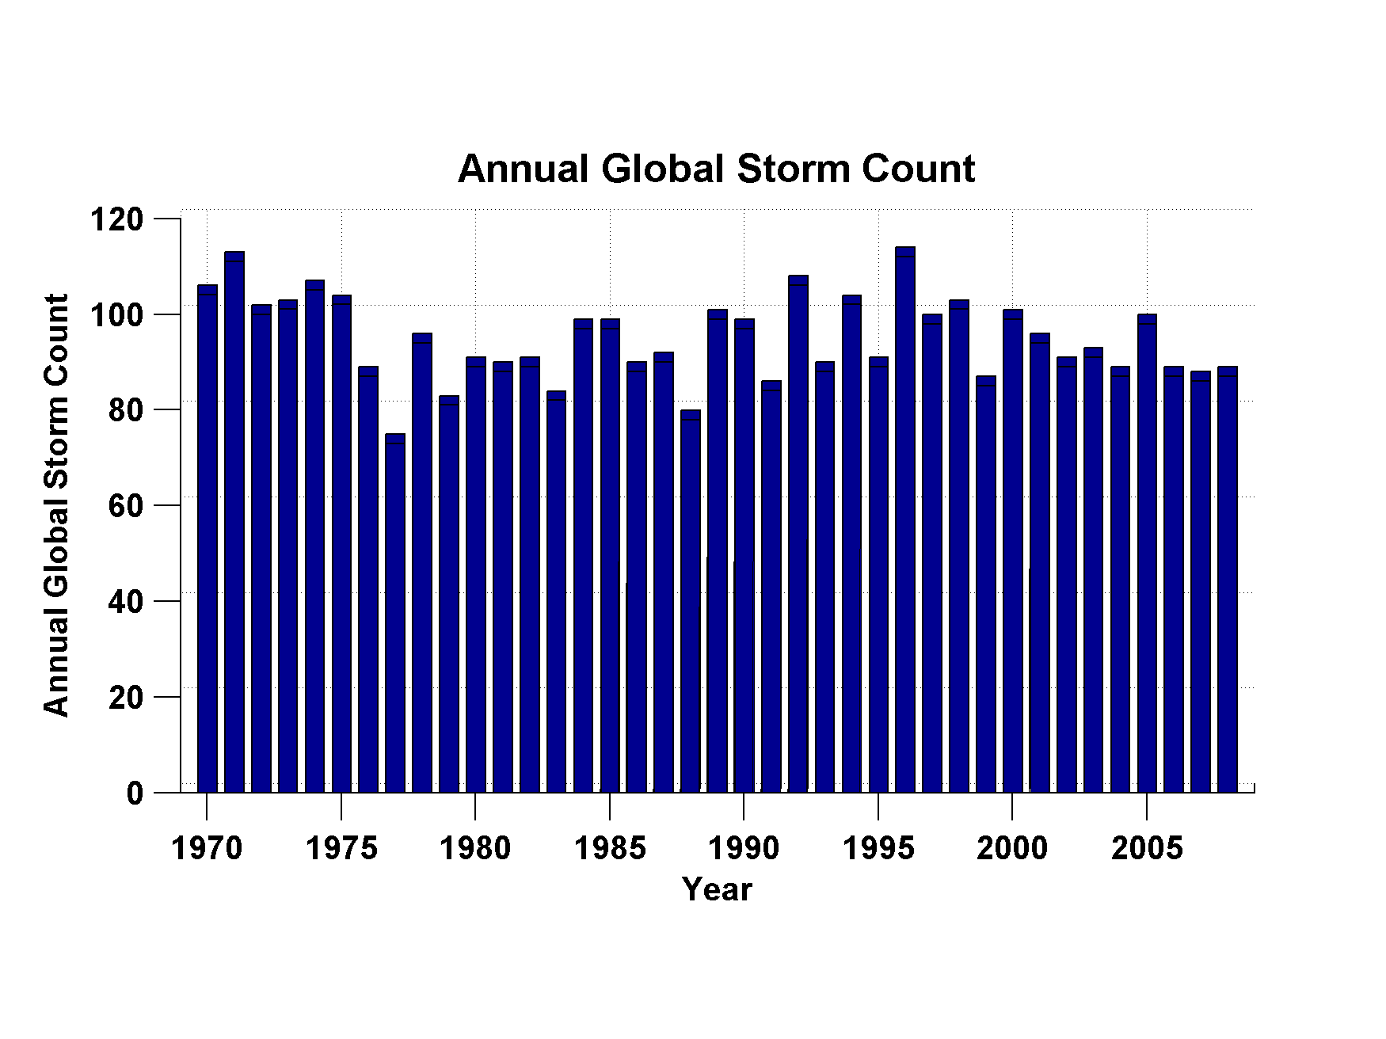
Global Tropical Cyclone Frequency, 1970-2008
Data Sources: NOAA/TPC and NAVY/JTWC
Notes:
4

Slide 5
When/Why Does Convection Form Clusters?

Slide 6
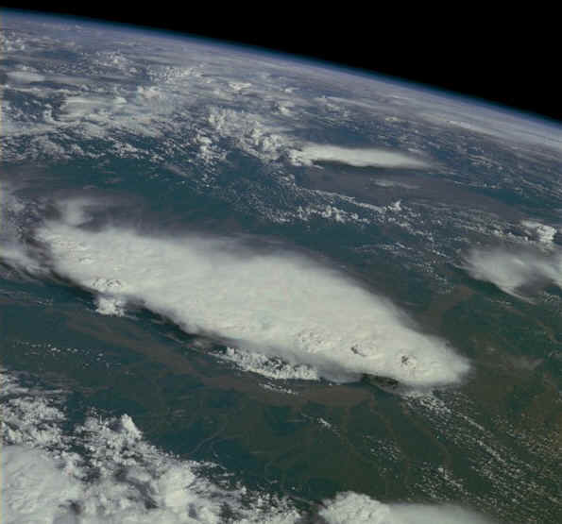
Monsoonal Thunderstorms, Bangladesh and India July 1985

Slide 7
Simplest Statistical Equilibrium State:
Radiative-Convective Equilibrium

Slide 8
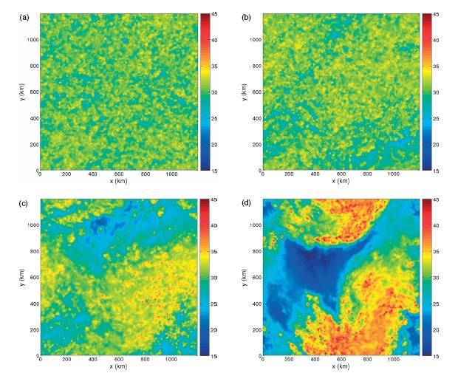
Vertically integrated water vapor at 4 days (Nolan et al., QJRMS, 2007)

Slide 9
Vertically integrated water vapor at 4 (a), 6 (b), 8 (c), and 10 (d) days (Nolan et al., QJRMS, 2007)

Slide 10
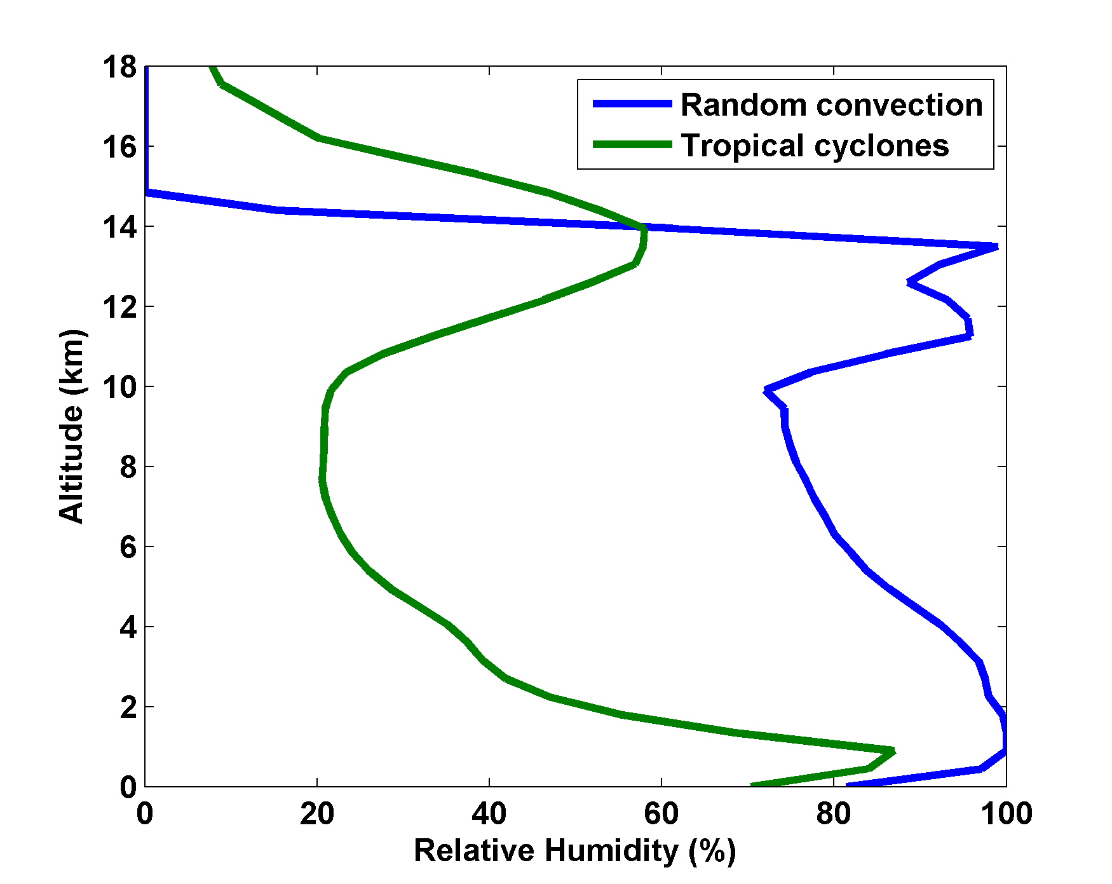
Nolan et al., QJRMS, 2007

Slide 11
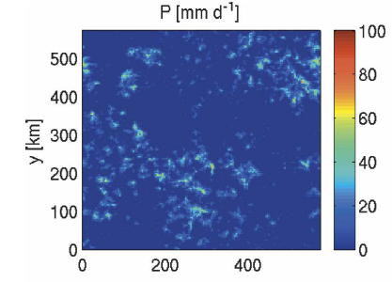
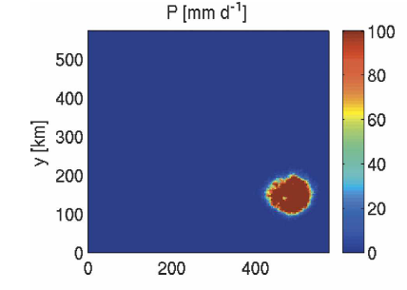
Numerical simulations of RC equilibrium show that, under some conditions, moist convection self-aggregates
Day 10
Day 50
From Bretherton et al. (2005)

Slide 12
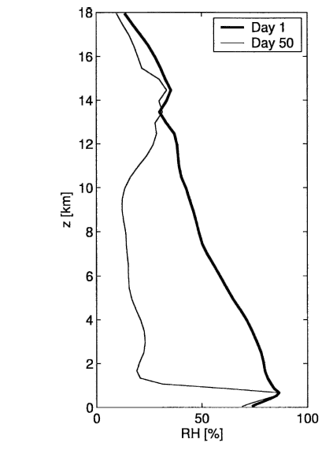
Effect of Self-Aggregation on Humidity
(Bretherton et al. , 2005)

Slide 13
Empirical Necessary Conditions for Self-Aggregation (after Held et al., 1993; Bretherton et al., 2005; Nolan et al.; 2007)
Small vertical shear of horizontal wind
Interaction of radiation with clouds and/or water vapor
Feedback of convective downdraft surface winds on surface fluxes
Sufficiently high surface temperature

Slide 14
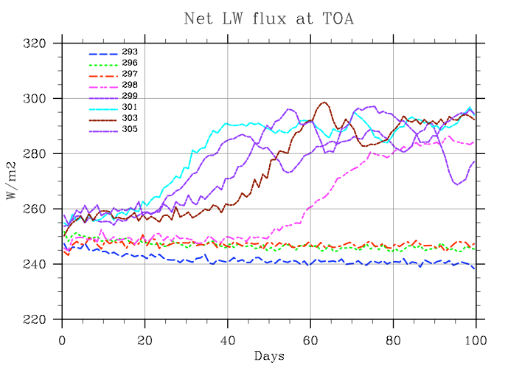
Self-Aggregation is Temperature-Dependent (Nolan et al., 2007; Emanuel and Khairoutdinov, in preparation, 2009)

Slide 15
Hypothesis
At high temperature, convection self-aggregates
→Horizontally averaged humidity drops dramatically
→Reduced greenhouse effect cools system
→Convection disaggregates
→Humidity increases, system warms
→System wants to be near phase transition to aggregated state

Slide 16
Recipe for Self-Organized Criticality
(First proposed by David Neelin, but by different mechanism)
System should reside near critical threshold for self-aggregation
Convective cluster size should follow power law distribution

Slide 17
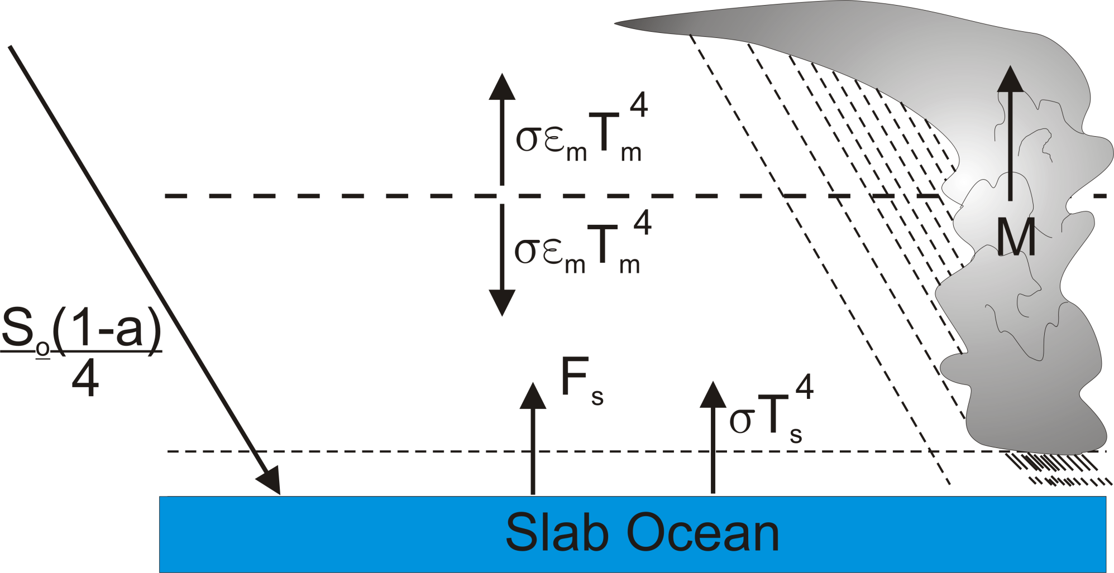
Toy Model

Slide 18
Properties
PBL quasi-equilibrium enforced
Bulk aerodynamic surface fluxes with convective gustiness
Albedo and emissivity simple weighted average of clear and cloudy regions
Water vapor-dependent clear sky emissivity
Horizontally uniform temperature but variable moist static energy (i.e. water vapor) at mid-level
Vertical motion calculated to enforce zero horizontal temperature gradient
PBL moist static energy adjusted to yield zero domain-averaged vertical motion
Slow horizontal diffusion of moisture at mid-level

Slide 19
Results
Self-Aggregation Occurs for:
Small or negative gross moist stability
Sufficiently large feedback between convective gustiness and surface enthalpy fluxes
Sufficiently high surface temperature

Slide 20
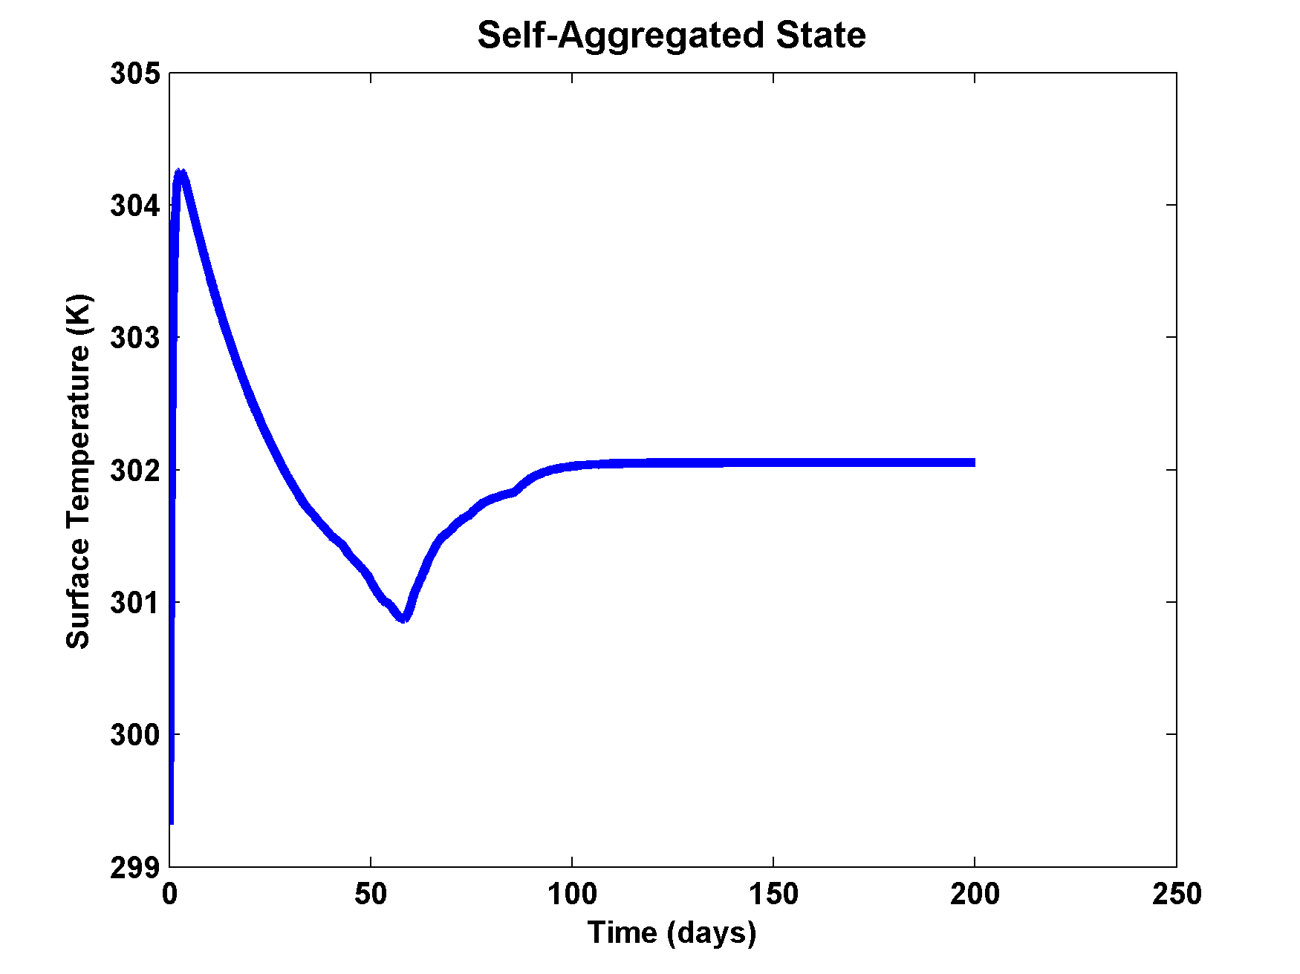
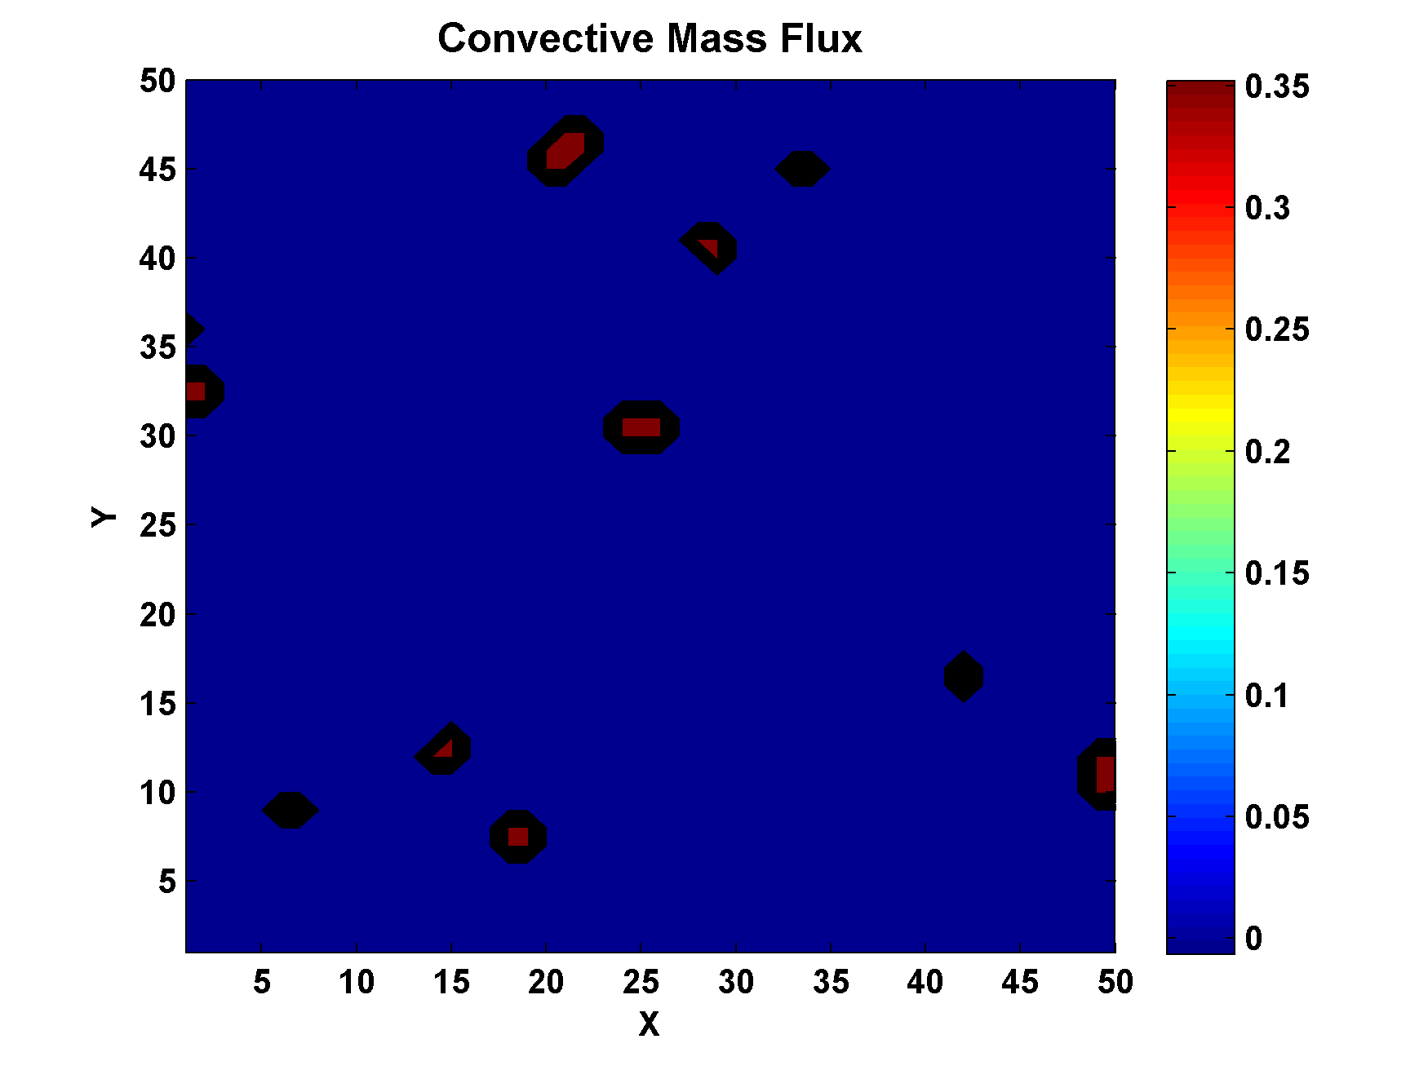

Example:

Slide 21
Summary of Toy Model Results
Self-aggregation driven by convective gustiness at high temperature
No self-aggregation at low temperature
Aggregated state is much drier at mid levels
System tends towards self-organized criticality (SOC)
Climate sensitivity of SOC state much lower (0.04 K/Wm⁻²) than sensitivity of uniform convection (0.2 K/Wm⁻²)

Slide 22
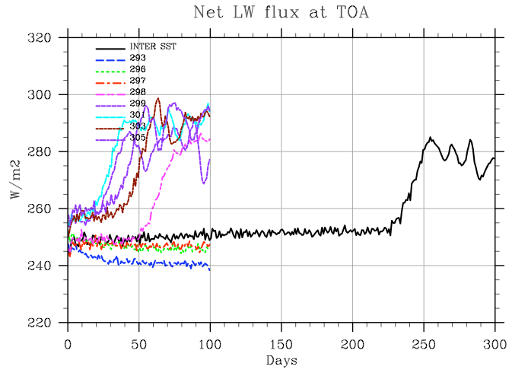
Preliminary Suggestion of Self-Organized Criticality in Full-Physics CRM

Slide 23
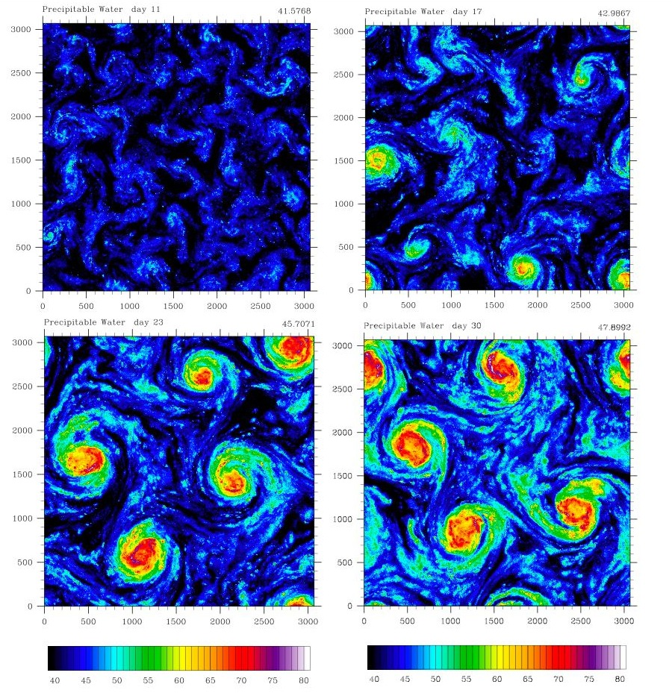
Extension to f-plane
Distance between vortex centers scales as V_{max}/f

Slide 24
Two More Indications of Large-scale Control of Genesis Rates:
Success of Genesis Indices
Success of Random Seeding Technique

Slide 25
New Genesis Potential Index:
850 hPa absolute vorticity (h)
850 – 250 hPa shear (S)
Potential intensity (PI)
Non-dimensional subsaturation of the middle troposphere:

Slide 26
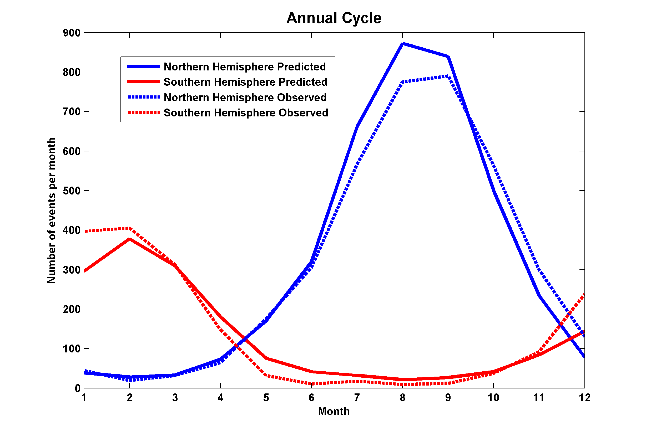
Performance

Slide 27
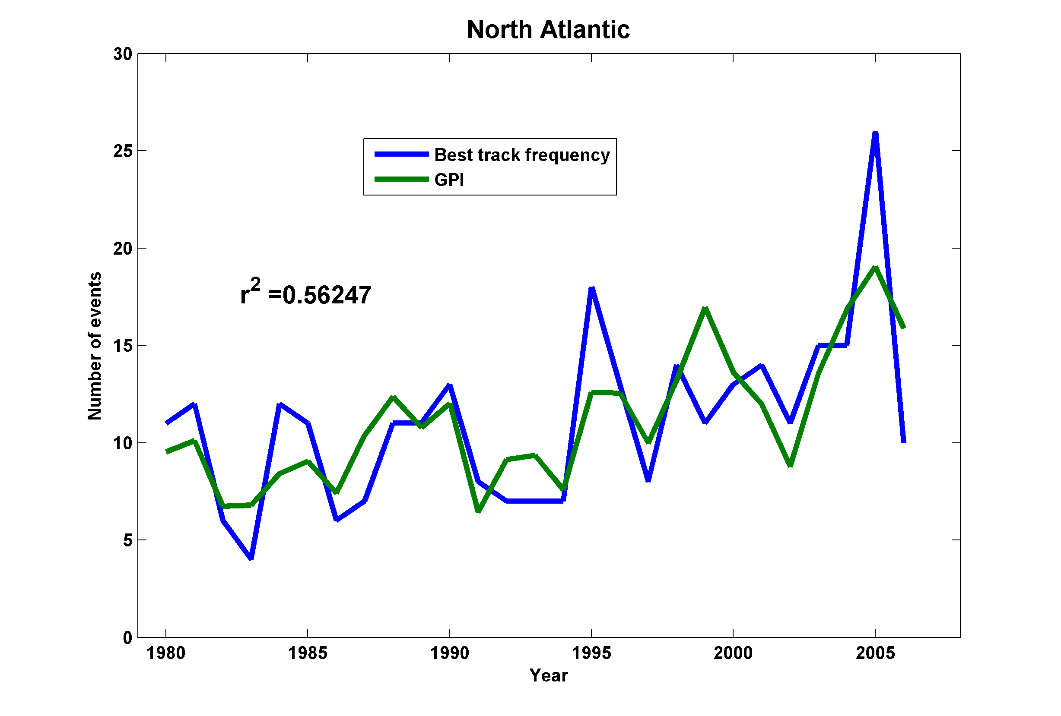
Interannual Variability
No Significant Correlations Outside the Atlantic!

Slide 28

Random Seeding/Natural Selection
Step 1: Seed each ocean basin with a very large number of weak, randomly located cyclones
Step 2: Cyclones are assumed to move with the large scale atmospheric flow in which they are embedded, plus a correction for beta drift
Step 3: Run the CHIPS model for each cyclone, and note how many achieve at least tropical storm strength
Step 4: Using the small fraction of surviving events, determine storm statistics.
Details: Emanuel et al., BAMS, 2008
Notes:
28

Slide 29
Calibration
Absolute genesis frequency calibrated to observed global average, 1980-2005
Notes:
29

Slide 30
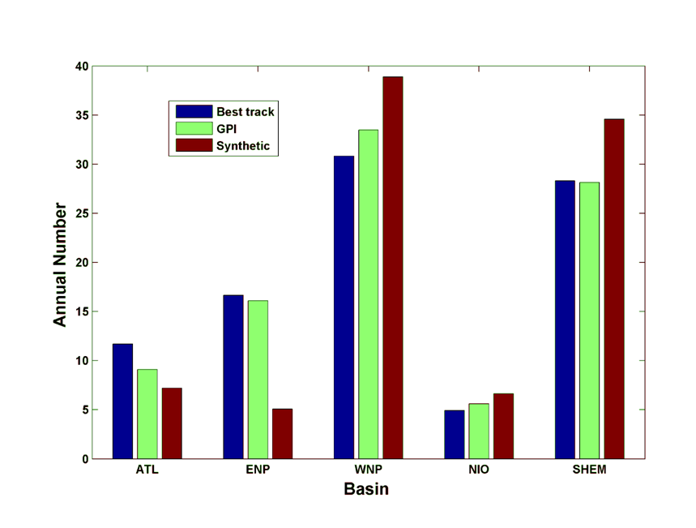
Genesis rates
(Driven by NCEP reanalysis)
Western North Pacific
Southern Hemisphere
Eastern North Pacific
Atlantic
North Indian Ocean
Notes:
30

Slide 31
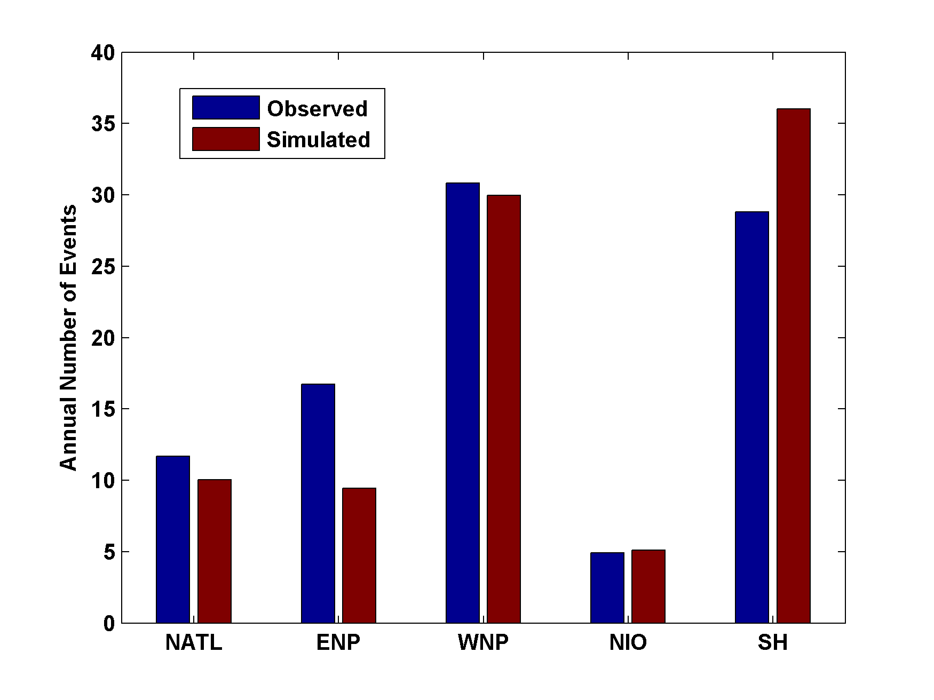
Genesis rates
(Driven by ERA40 Reanalysis)
Western North Pacific
Southern Hemisphere
Eastern North Pacific
Atlantic
North Indian Ocean
Notes:
31

Slide 32
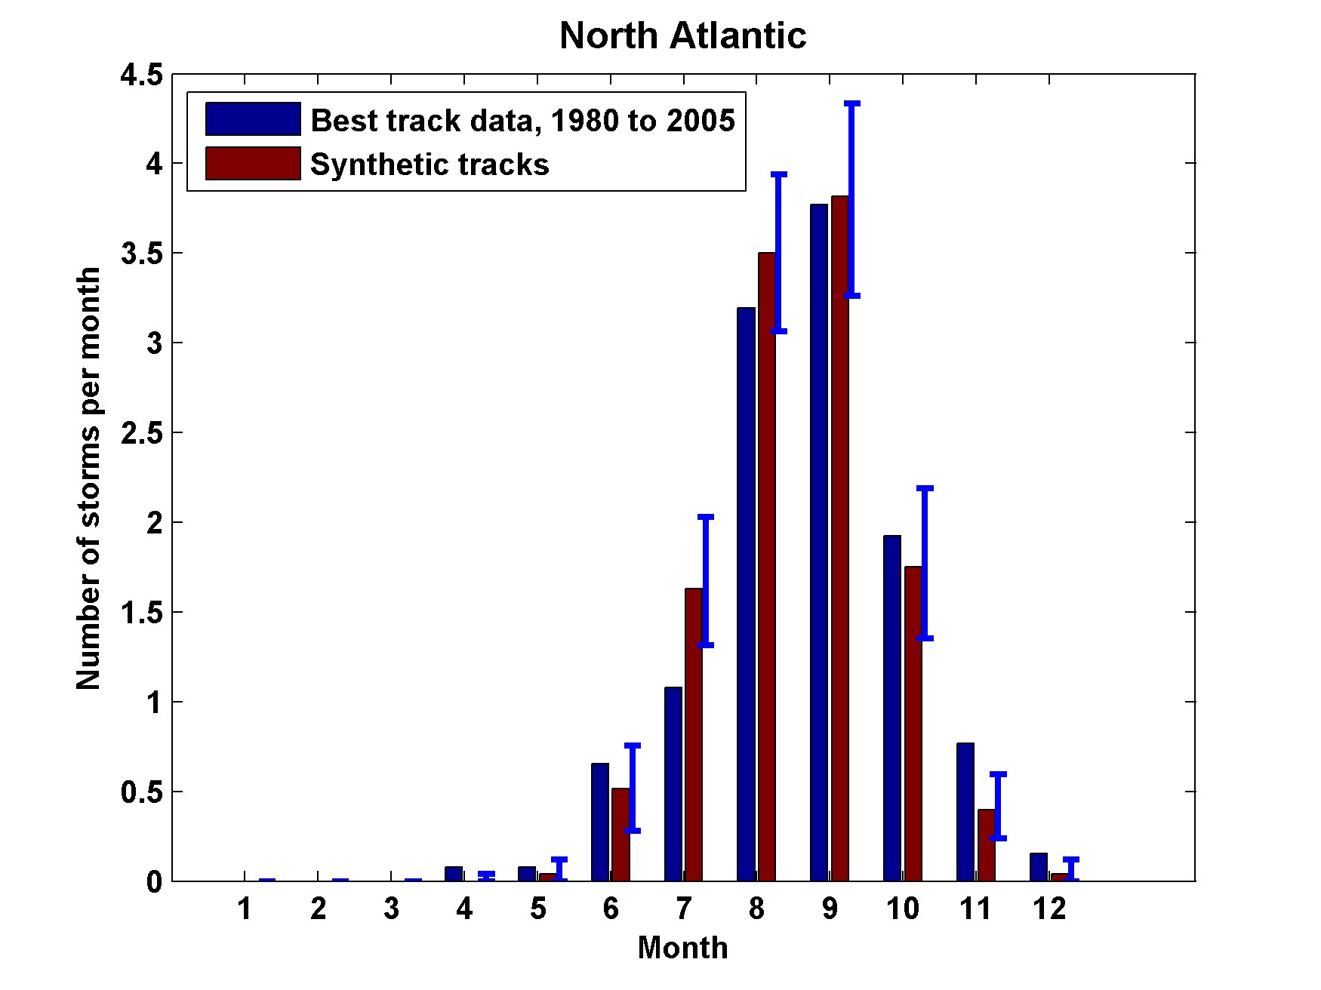
Seasonal Cycles
Notes:
32

Slide 33
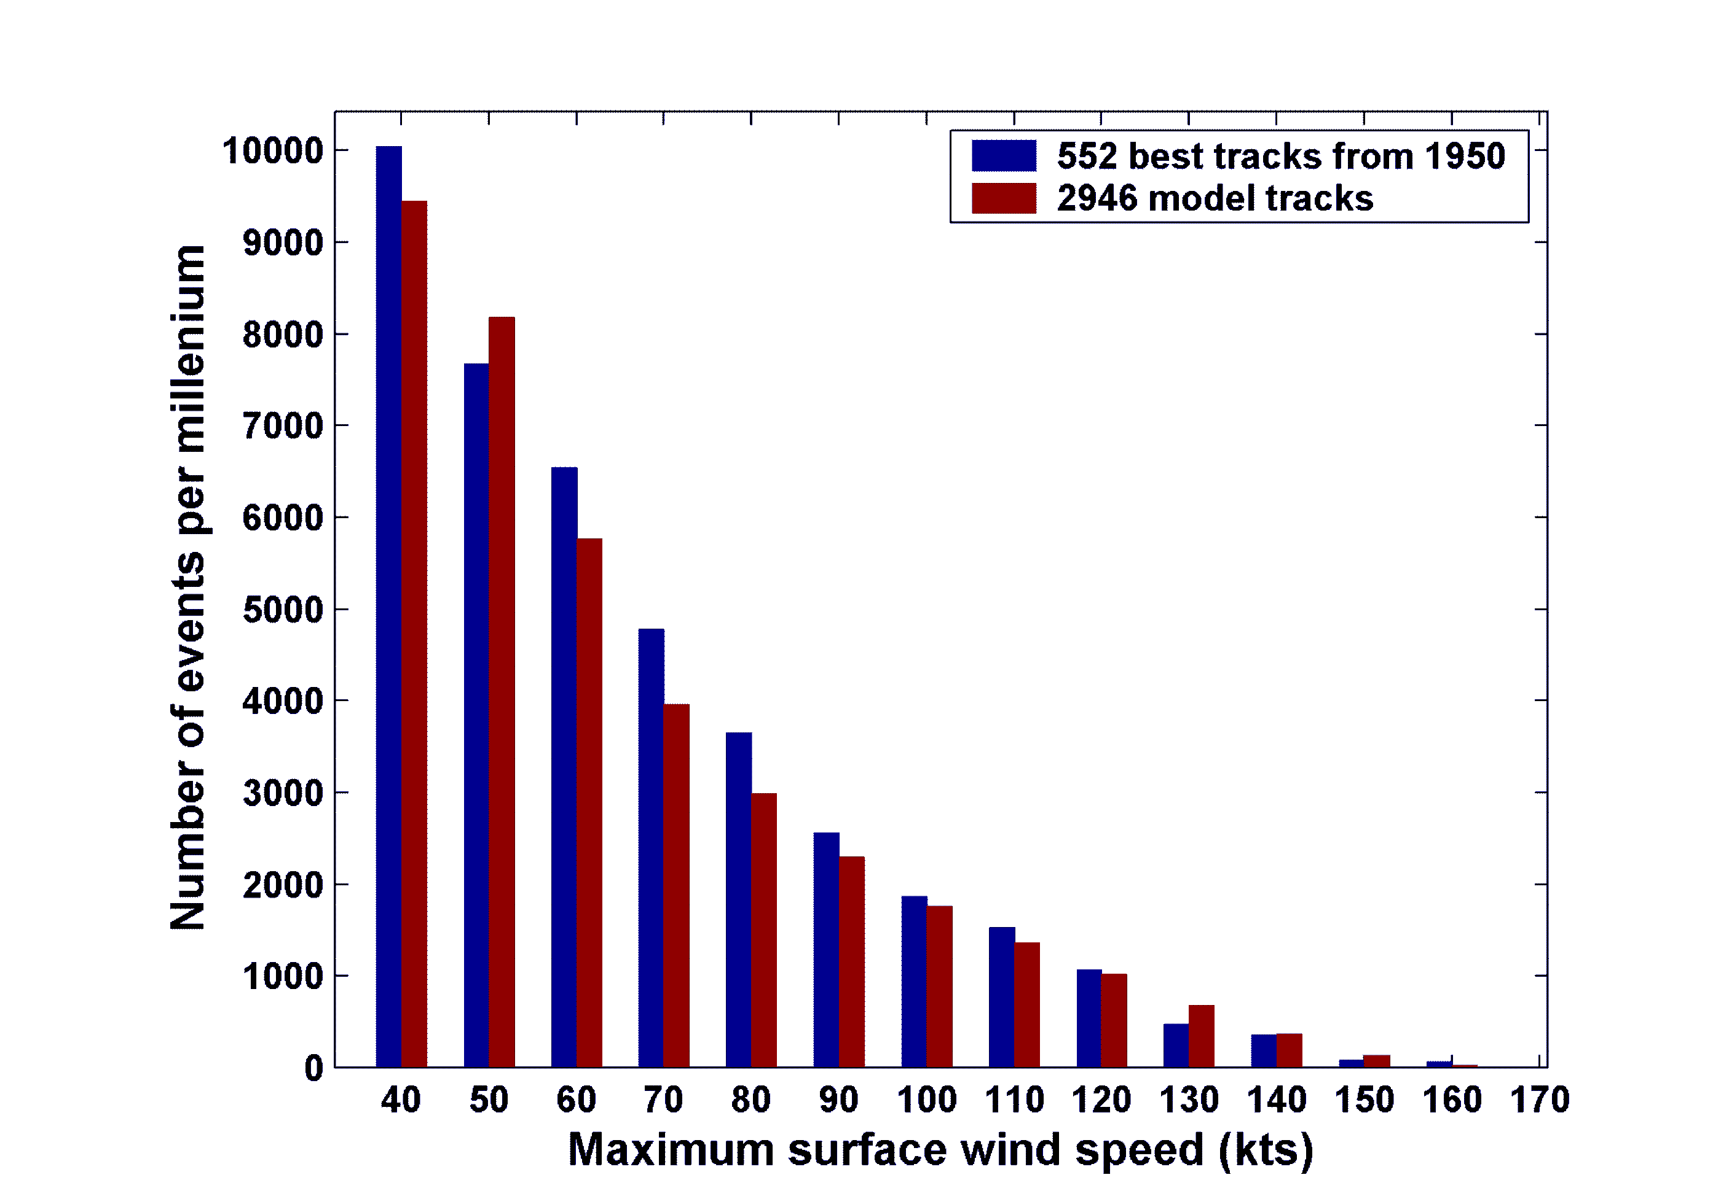
Cumulative Distribution of Storm Lifetime Peak Wind Speed, with Sample of 2946 Synthetic Tracks

Slide 34

Captures effects of regional climate phenomena (e.g. ENSO, AMM)

Slide 35
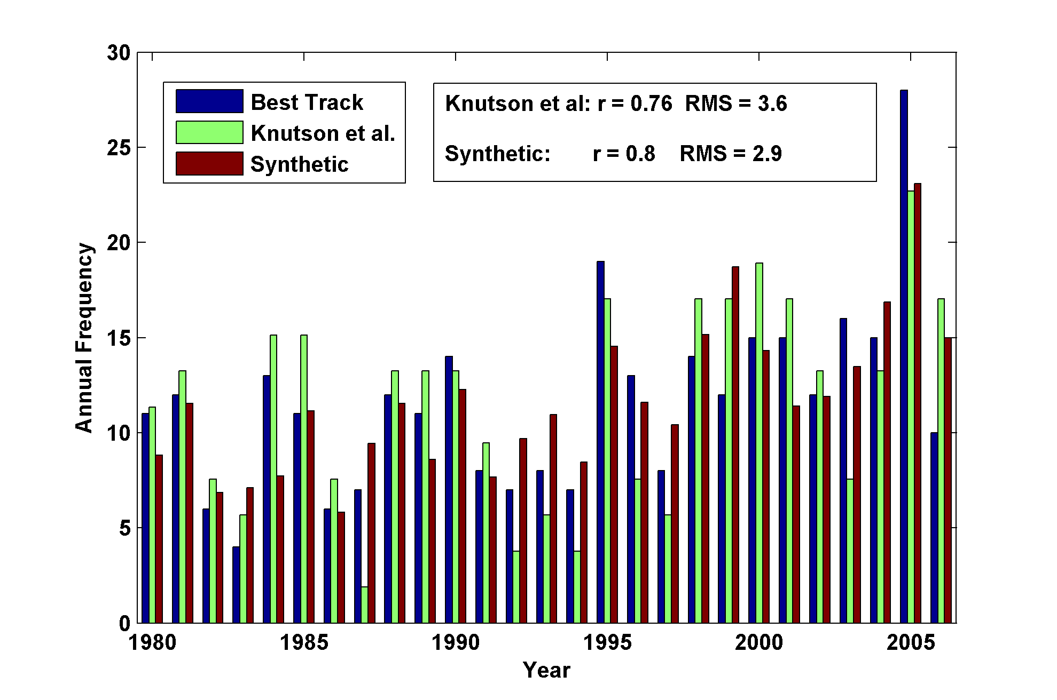
Year by Year Comparison with Best Track and with Knutson et al., 2007

Slide 36
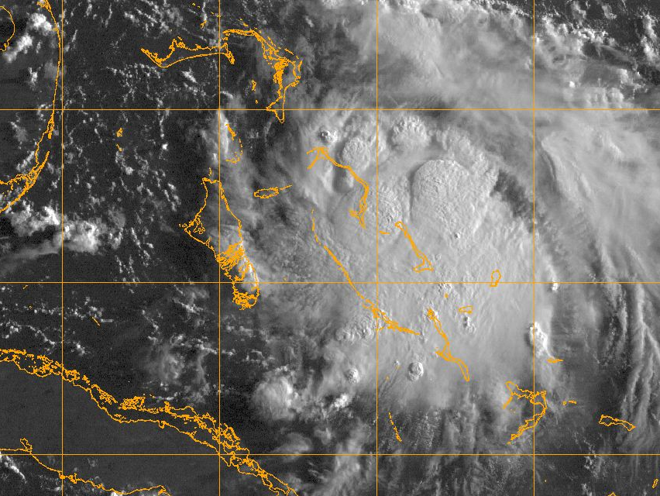
The Microscopic View: Why Hurricanes Need Cold-Core Embryos in which to Develop

Slide 37
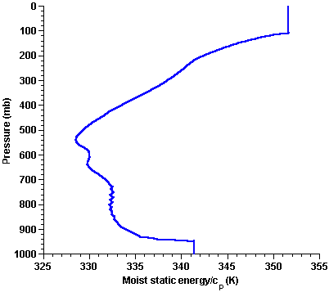
Pronounced entropy (moist static energy) minimum in middle troposphere
Saturation at SST

Slide 38
Genesis: The Conventional Wisdom
Genesis results from organized convection + vorticity
Example:
Numerous cumulonimbus clouds warm and gradually moisten their environment. This warming…produces a pressure fall at the surface, because warm air weighs less than cool air. The slowly converging horizontal winds near the surface respond to this slight drop of pressure by accelerating inward. But the increased inflow produces increased lifting, so that the thunderstorms become more numerous and intense. The feedback loop is now established.
-- from “The Atmosphere”, Anthes et al., 1978

Slide 39
This hypothesis was effectively disproved in 1901 by J. von Hann:
“Since a thundercloud does not give any appreciable pressure fall [at the surface] but even a pressure rise, it would be unreasonable to assume that a magnifying of this process would cause the strongest pressure falls known”
-- As paraphrased by Bergeron, QJRMS, 1954

Slide 40
Diagram from Bergeron, QJRMS, 1954
z
x
y
x

Slide 41
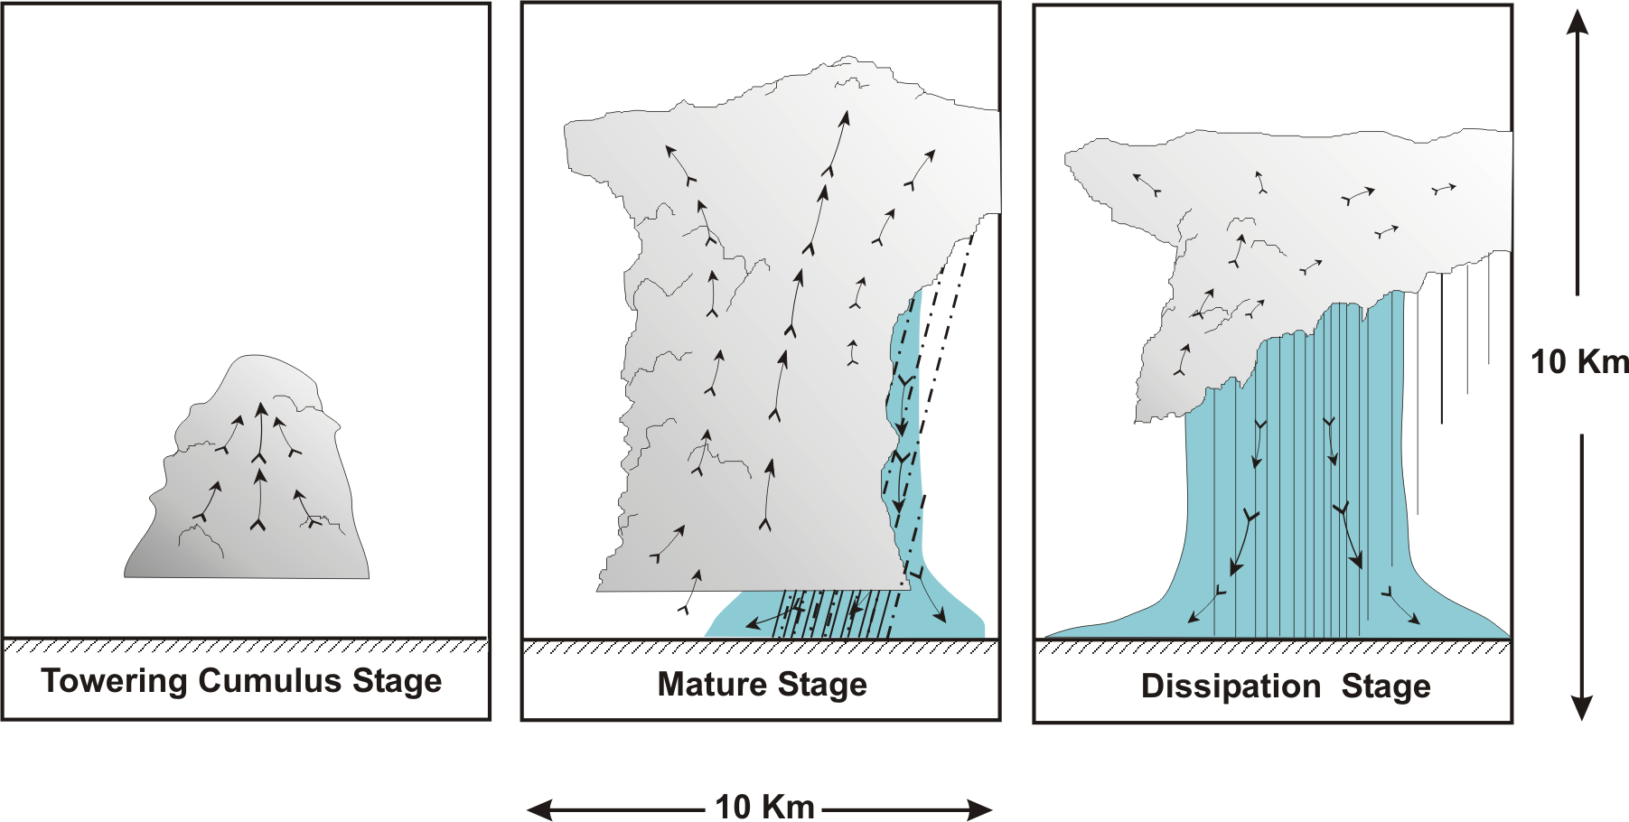
“Air-Mass” Showers:

Slide 42
Saturation at SST

Slide 43
Hypothesis: All tropical cyclones originate in a nearly saturated, cold-core mesoscale or synoptic scale air column with cyclonic rotation aloft and, often, weak anticyclonic rotation near the surface

Slide 44
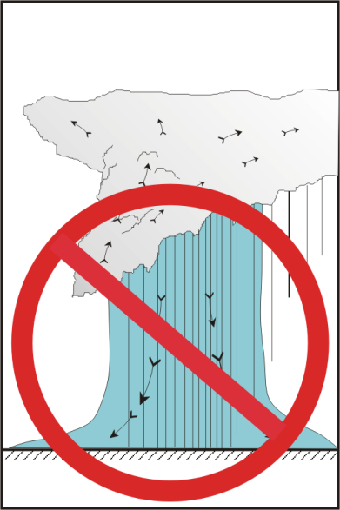
Reasoning:
Downdrafts must be stopped
Can only be stopped by saturating air
on the mesoscale
Saturation + convective neutrality = uniform moist static energy
But moist static energy is conserved
Moist static energy must be reduced near surface
Air must be cold above boundary layer
Cold anomaly must be in rotational balance

Slide 45
Pre-mixing h* profile
Vertically mixed h profile
Saturation at SST

Slide 46
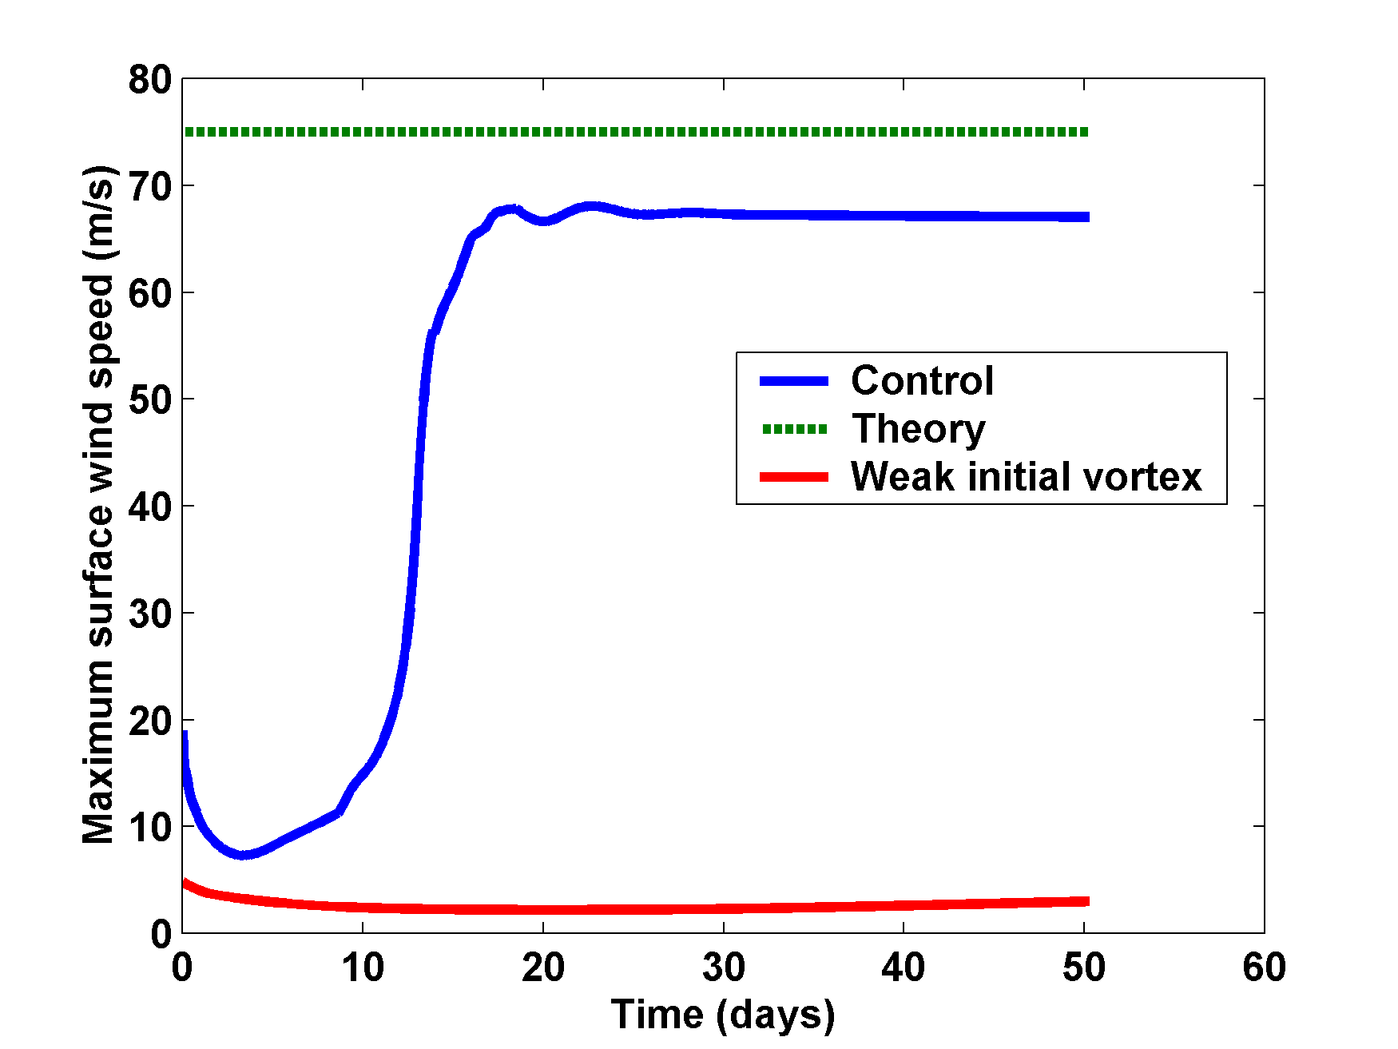
Simulations Using Balanced Axisymmetric Model

Slide 47
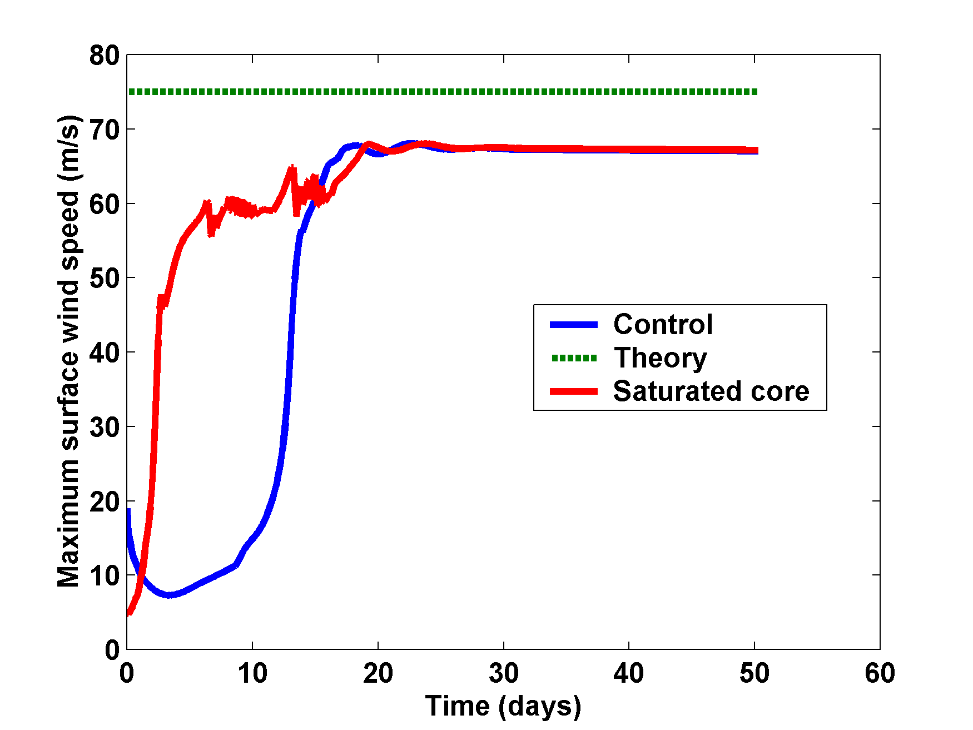
Saturate troposphere inside 100 km in initial state:

Slide 48
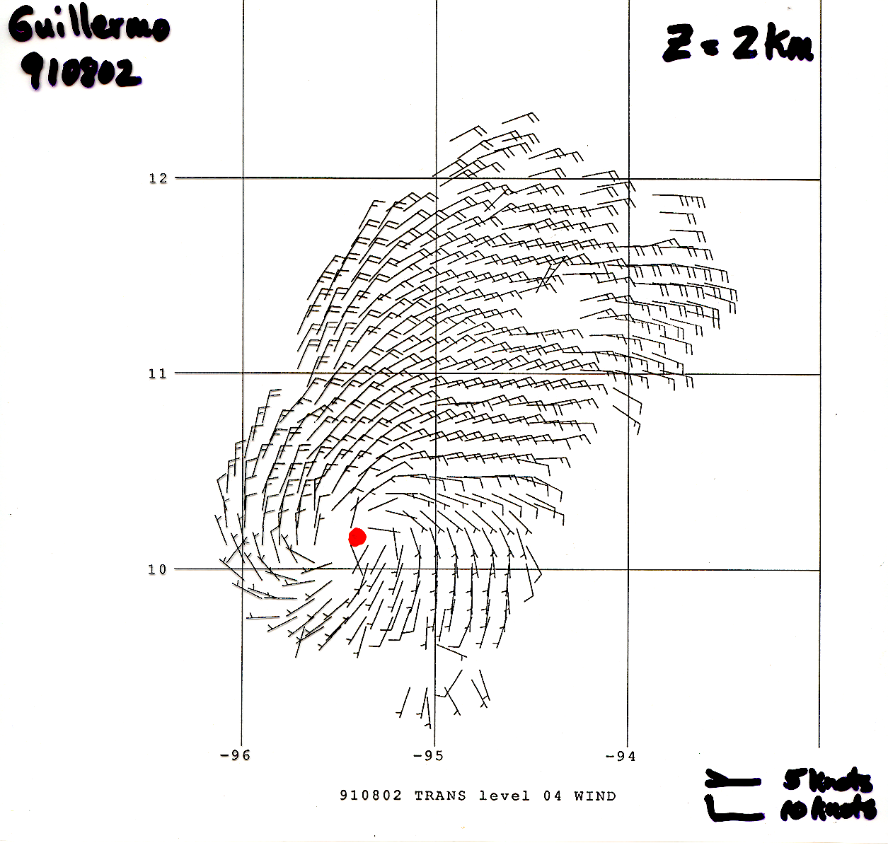

Slide 49
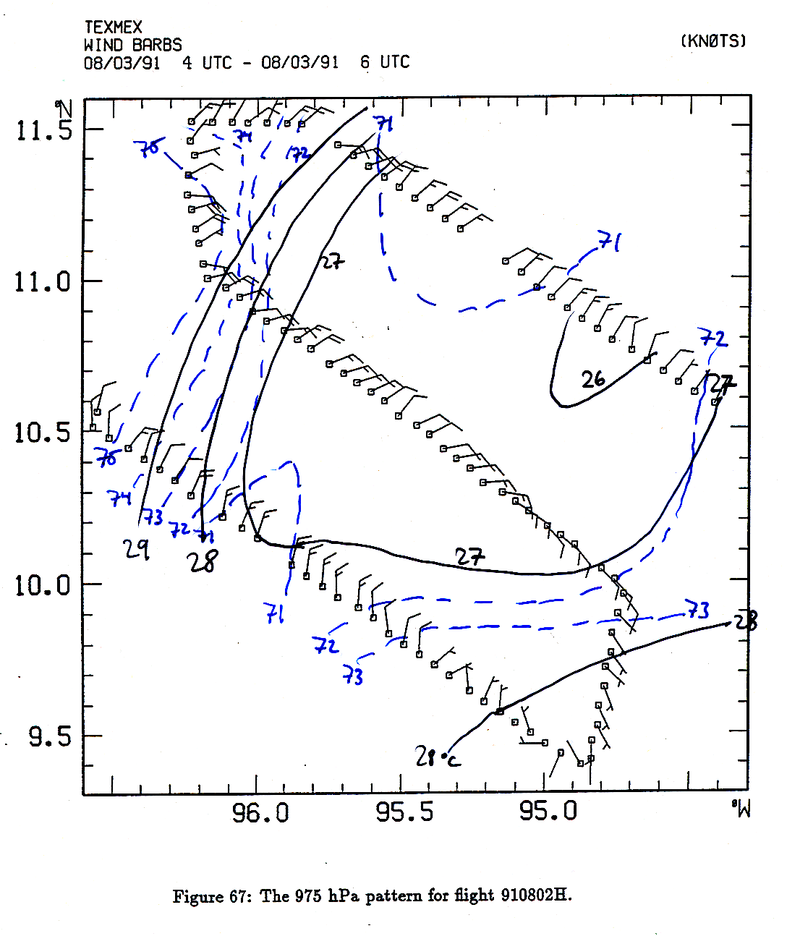

Slide 50
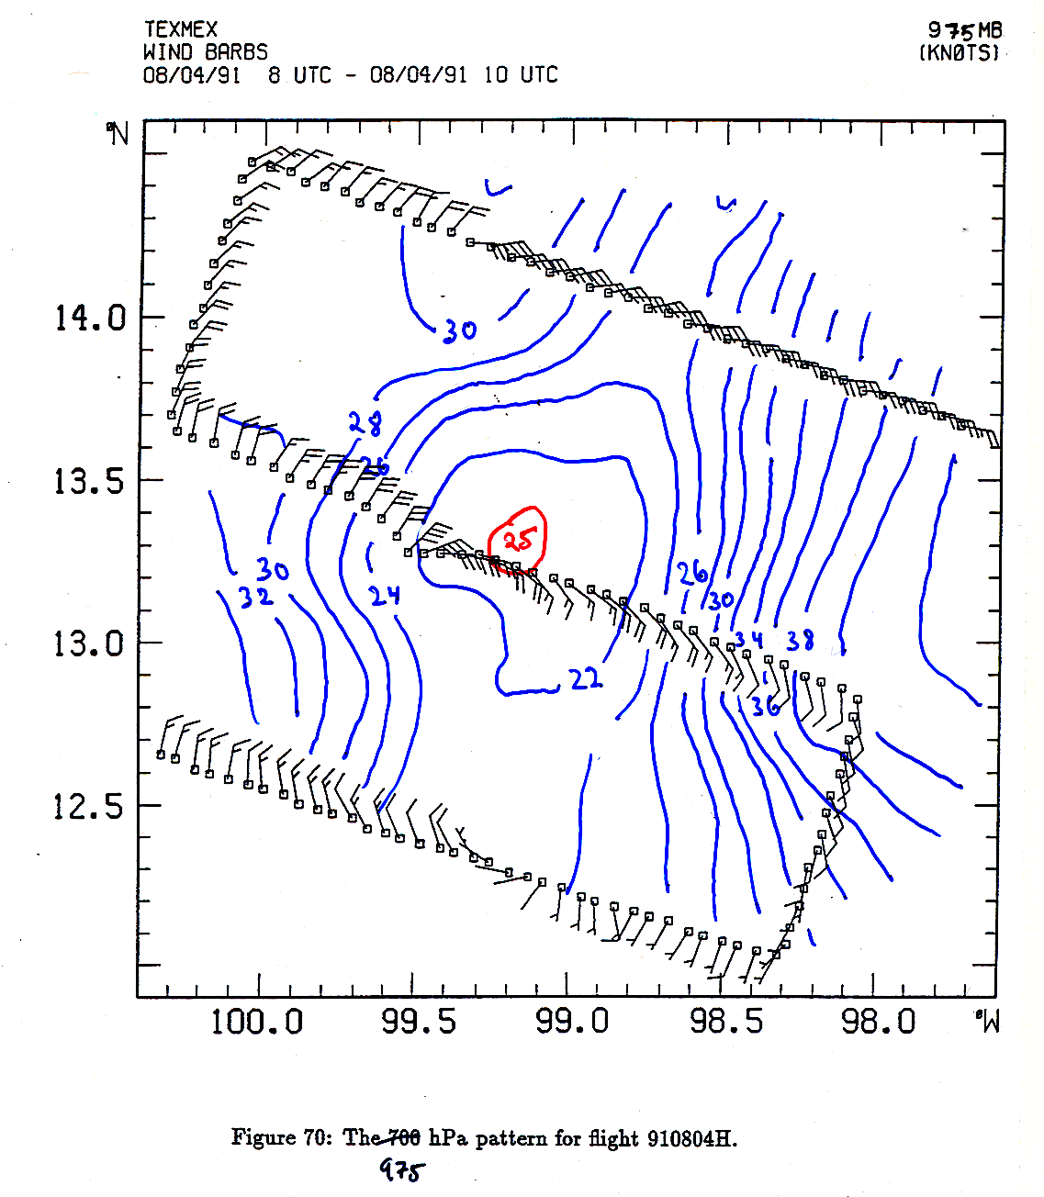

Slide 51
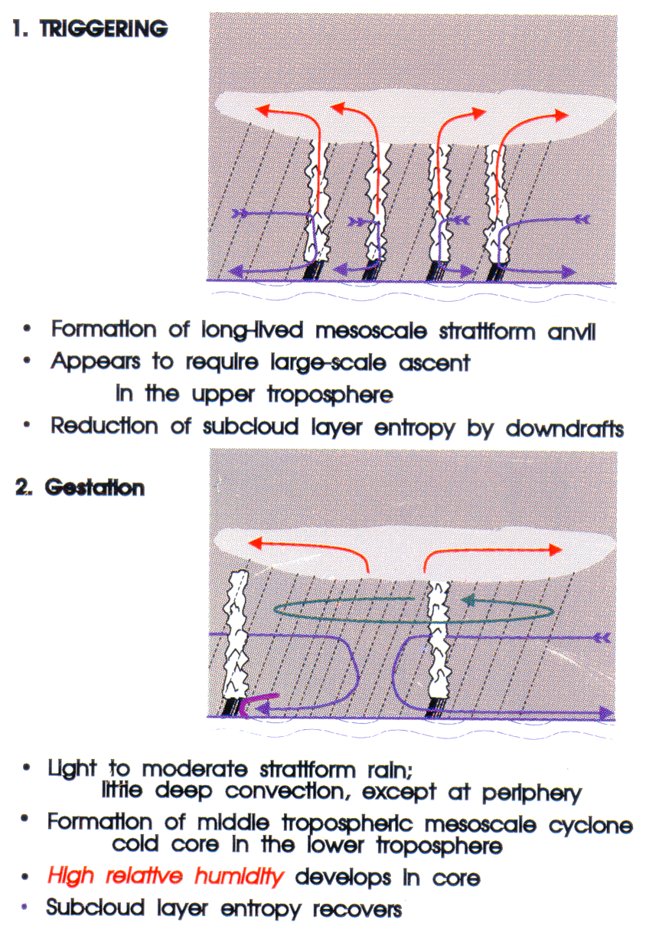
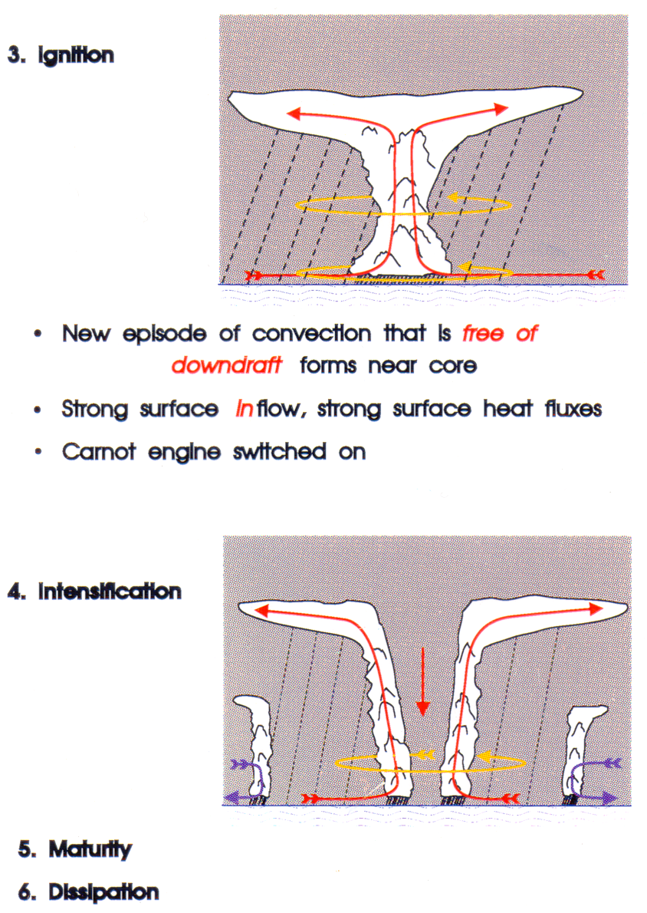

Slide 52
Genesis under initial cold cutoff cyclone aloft
Ambient conditions do not support tropical cyclones
Cold upper low with zero surface winds in initial condition
Axisymmetric, nonhydrostatic, cloud-resolving model of Rotunno and Emanuel (J. Atmos. Sci., 1987); see Emanuel and Rotunno, Tellus, 1989. 3.75 km horizontal resolution; 300 m in vertical

Slide 53
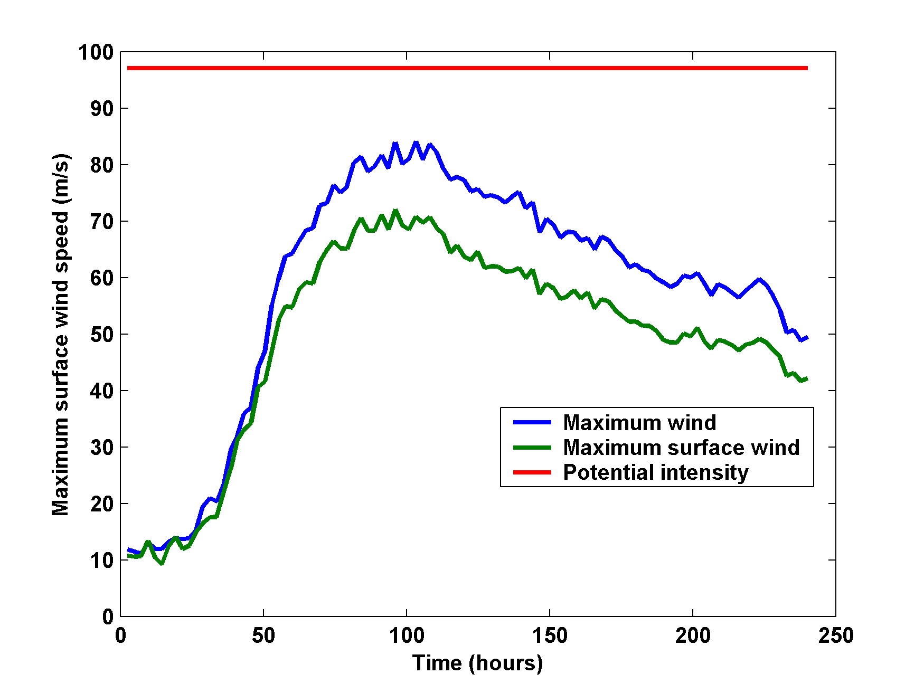

Slide 54
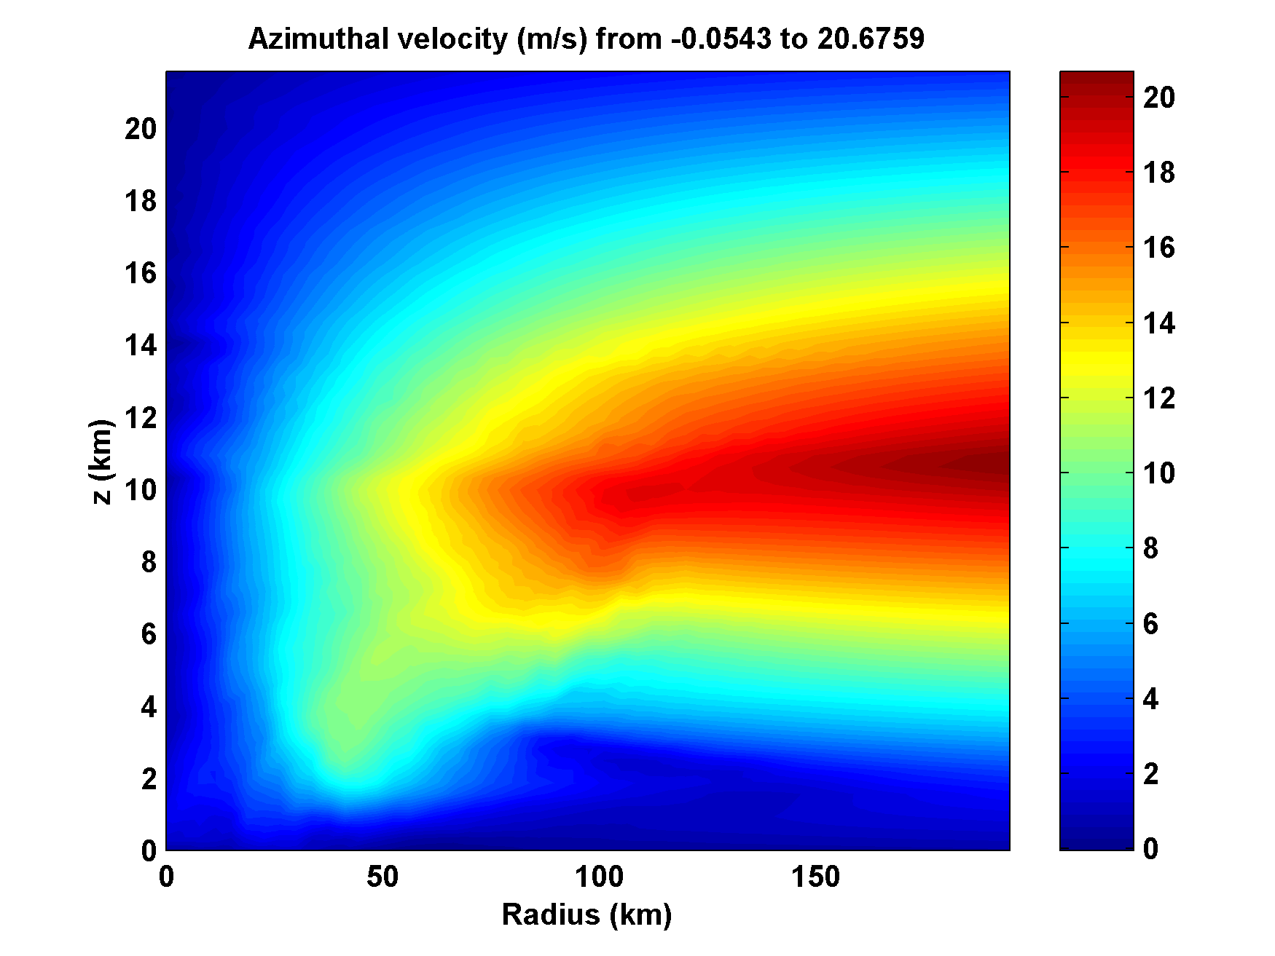
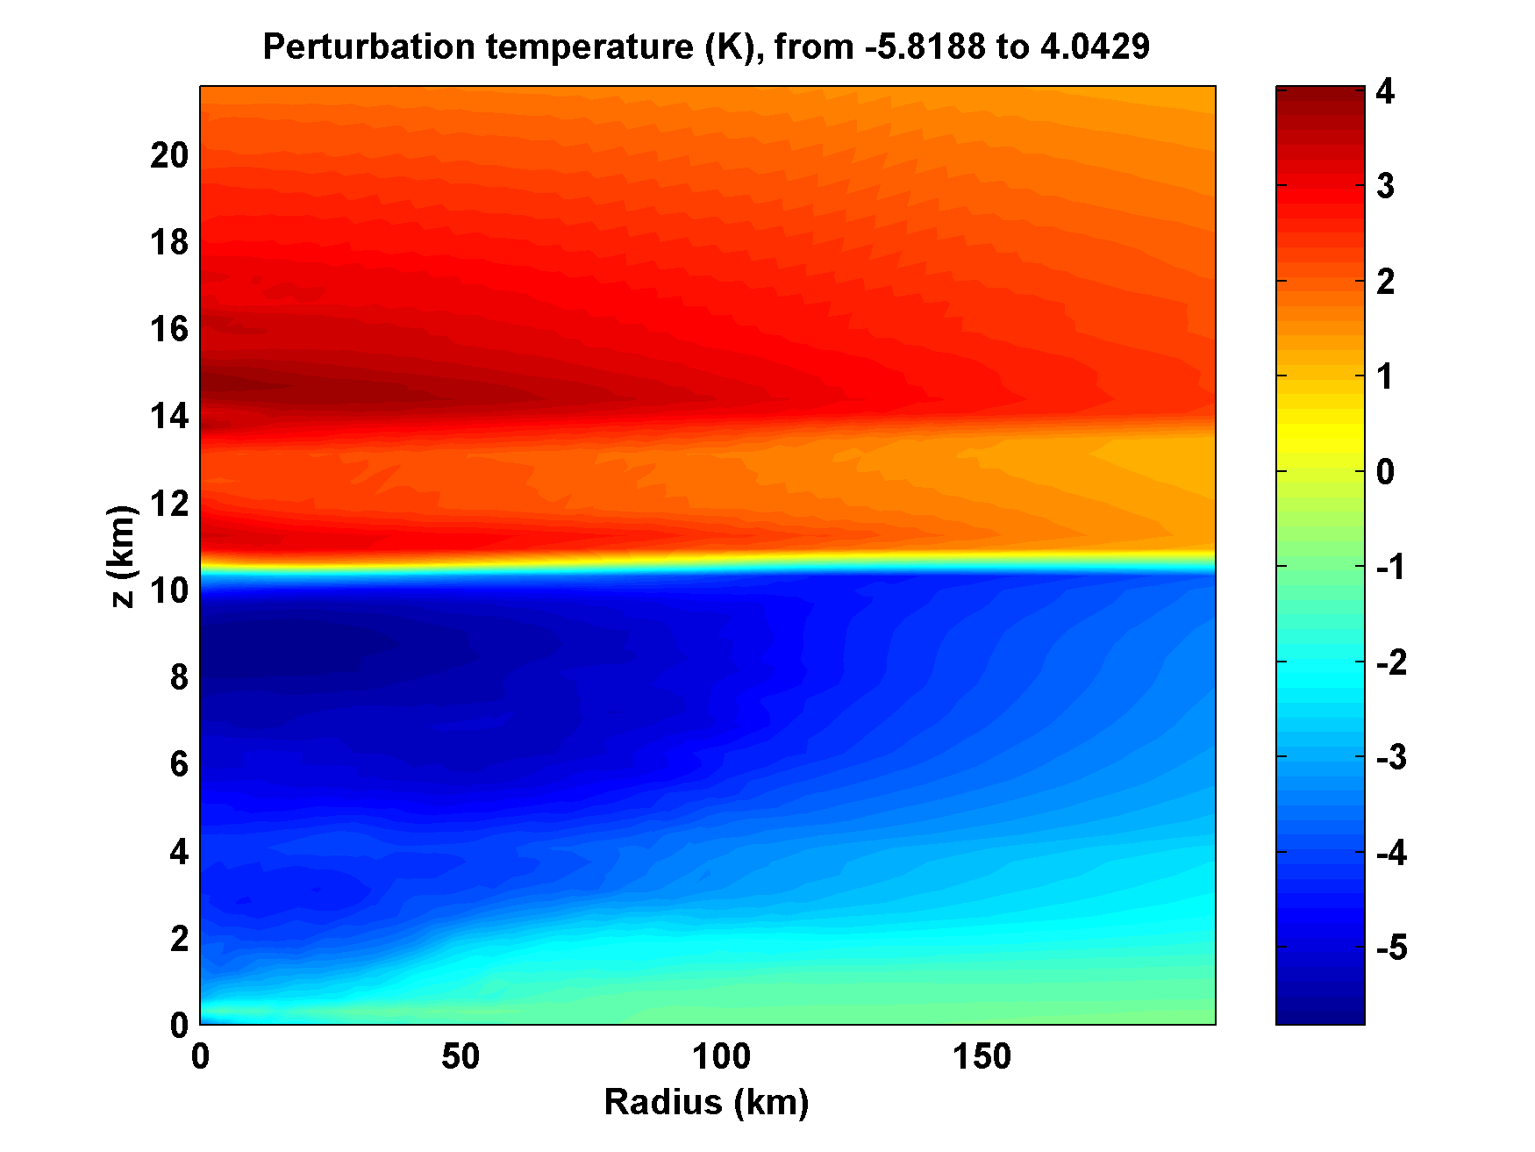
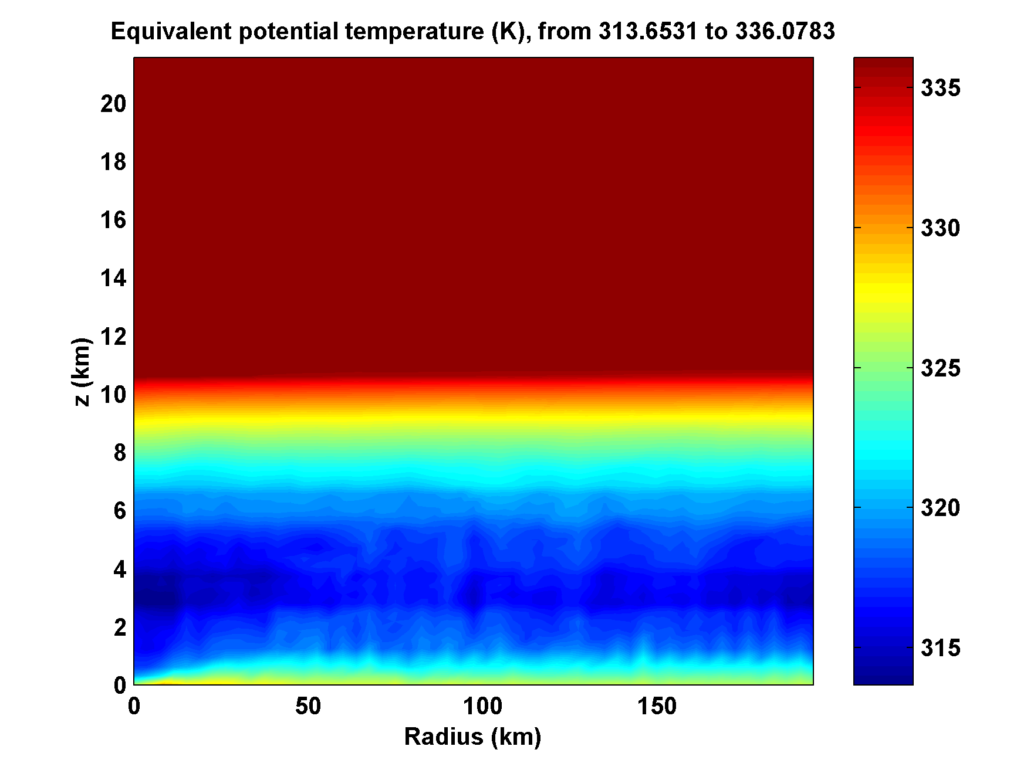
Day 1

Slide 55
Day 1

Slide 56
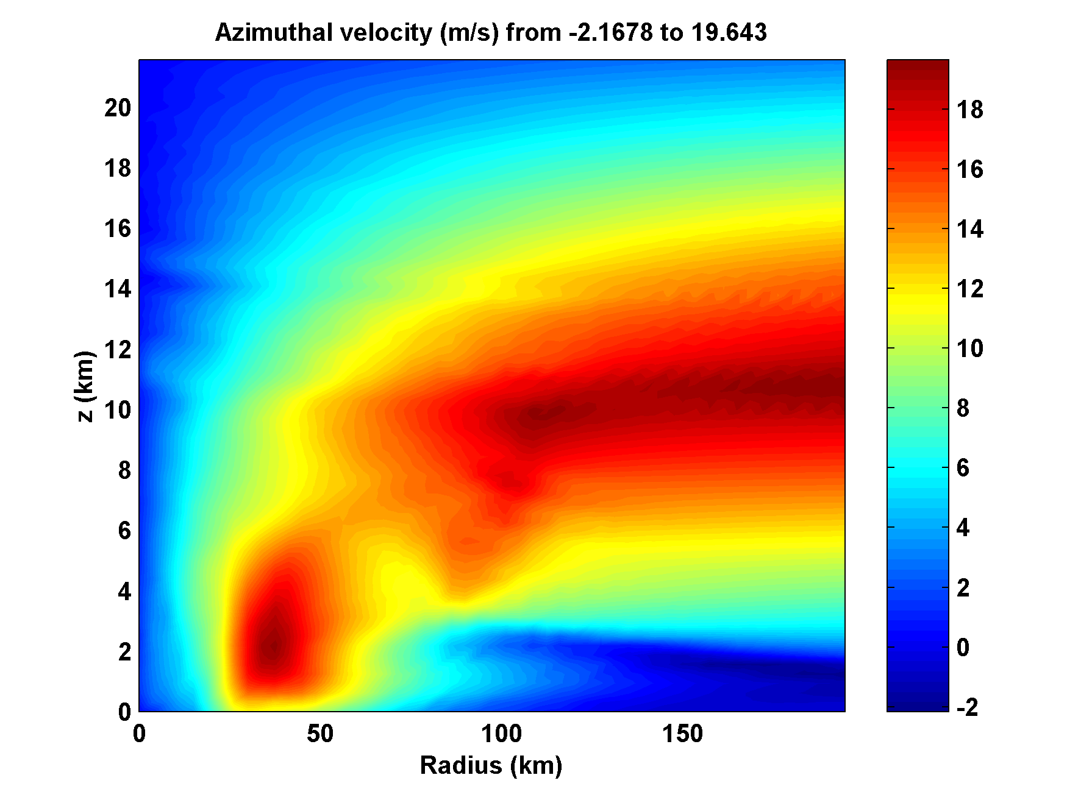
Day 2

Slide 57
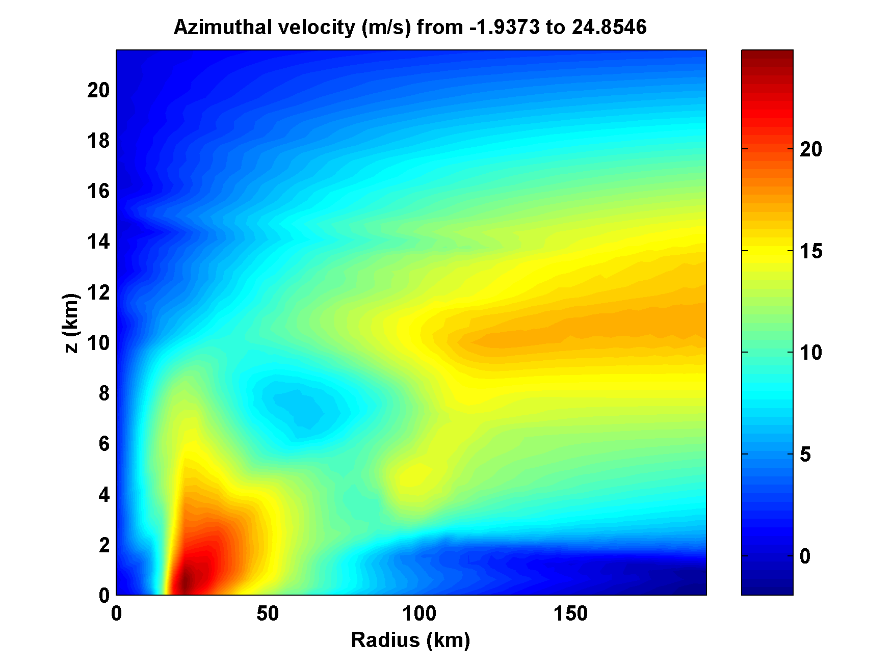
Day 3

Slide 58
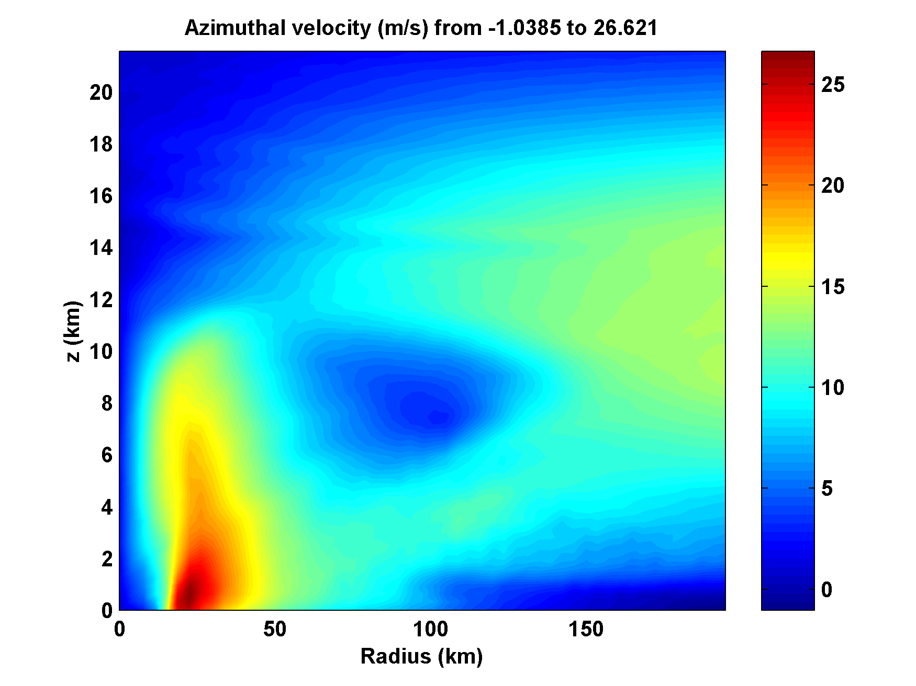
Day 4

Slide 59
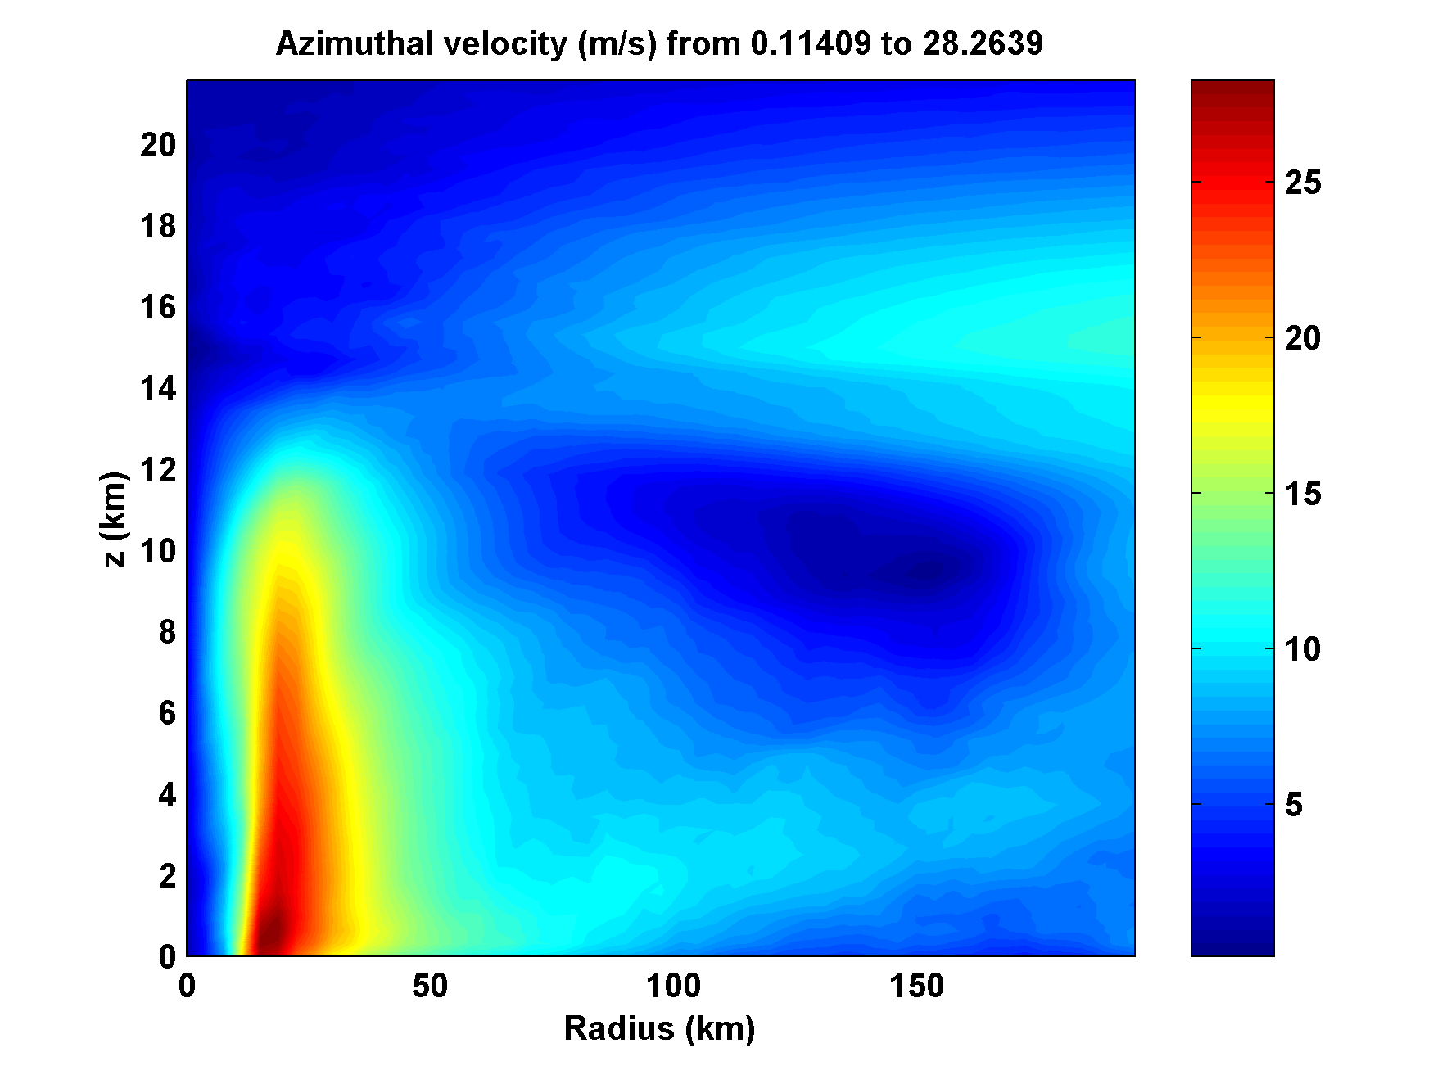
Day 5

Slide 60
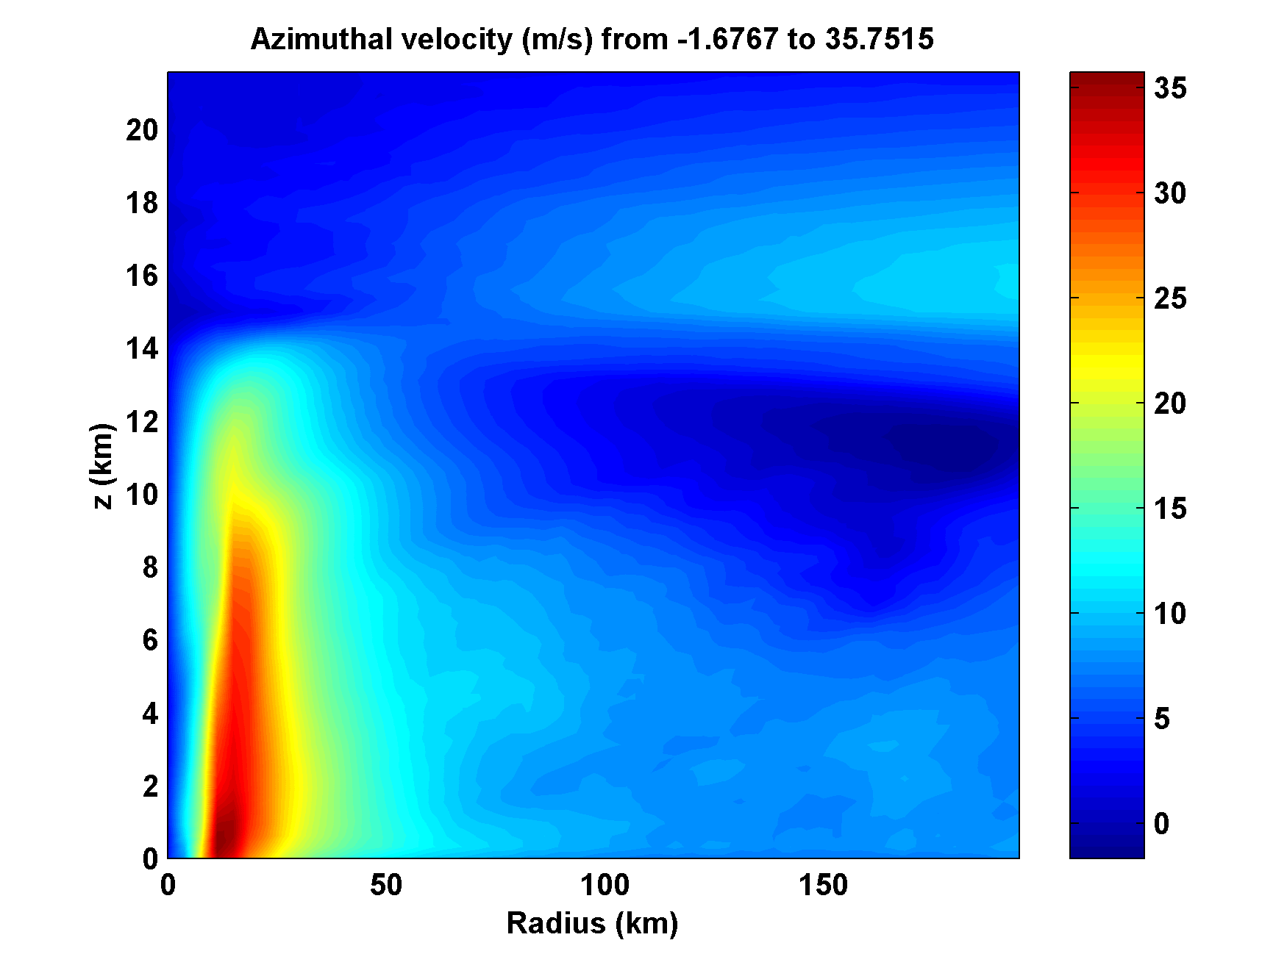
Day 6

Slide 61
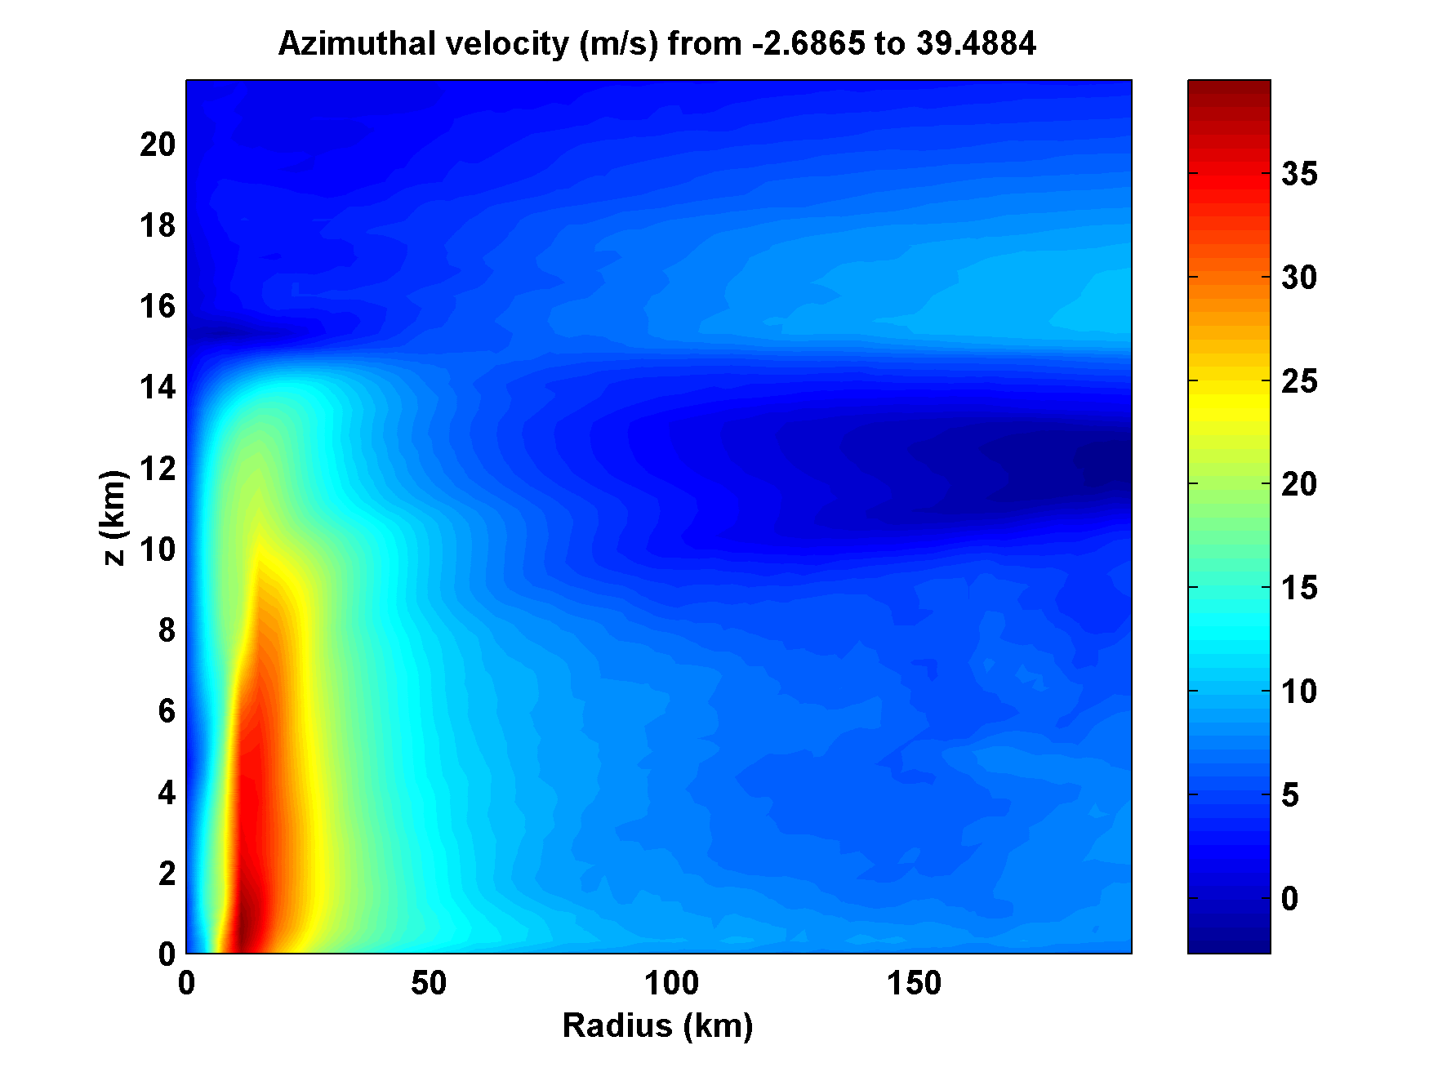
Day 7

Slide 62
Summary
Convection naturally clusters in low-shear, high-temperature conditions
With sufficiently large background vorticity, clusters over water become tropical cyclones
Clustering of convection may be an example of self-organized criticality
The self-organized criticality of convection may be fundamental to climate

Slide 63
Success of genesis indices and downscaling support large-scale control of TC activity (i.e. climatology of TCs not regulated by, e.g., easterly wave activity)
Saturated, cold core lows are natural embryos for TC development and may be necessary precursors.

