Slide 1
Climate and Tropical Cyclones: A Review and Some New Findings
Kerry Emanuel
Program in Atmospheres, Oceans, and Climate
MIT

Slide 2
Issues
What processes control rates of formation of tropical cyclones?
What processes control the actual and potential intensity of TCs?
Do TCs have important feedbacks on climate?

Slide 3
Some Empirical Results

Slide 4

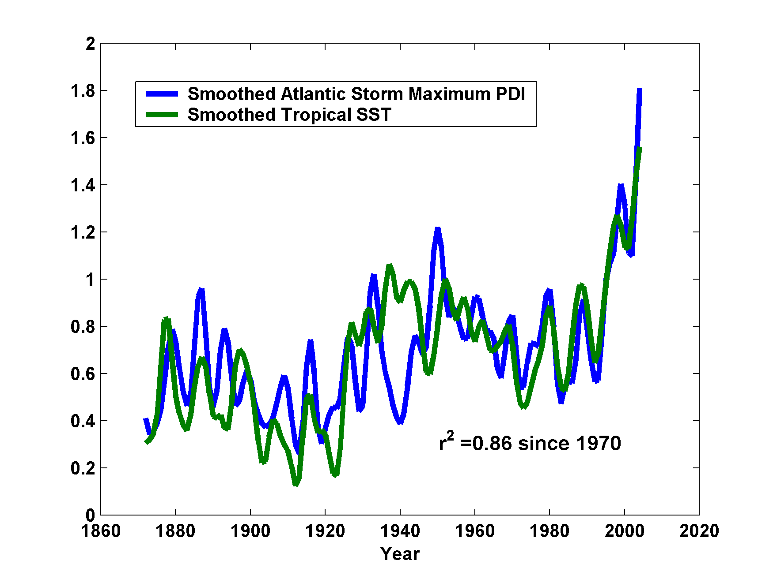
Atlantic Sea Surface Temperatures and Storm Max Power Dissipation
(Smoothed with a 1-3-4-3-1 filter)
Years included: 1870-2006
Power Dissipation Index (PDI)
Scaled Temperature
Data Sources: NOAA/TPC, UKMO/HADSST1
Notes:
4
The low value of storm power in the early 1940s is thought to be due to the lack of reports from ships at sea because of the radio silence imposed during WWII.

Slide 5
The Importance of Potential Intensity for Genesis and for Storm Intensity

Slide 6
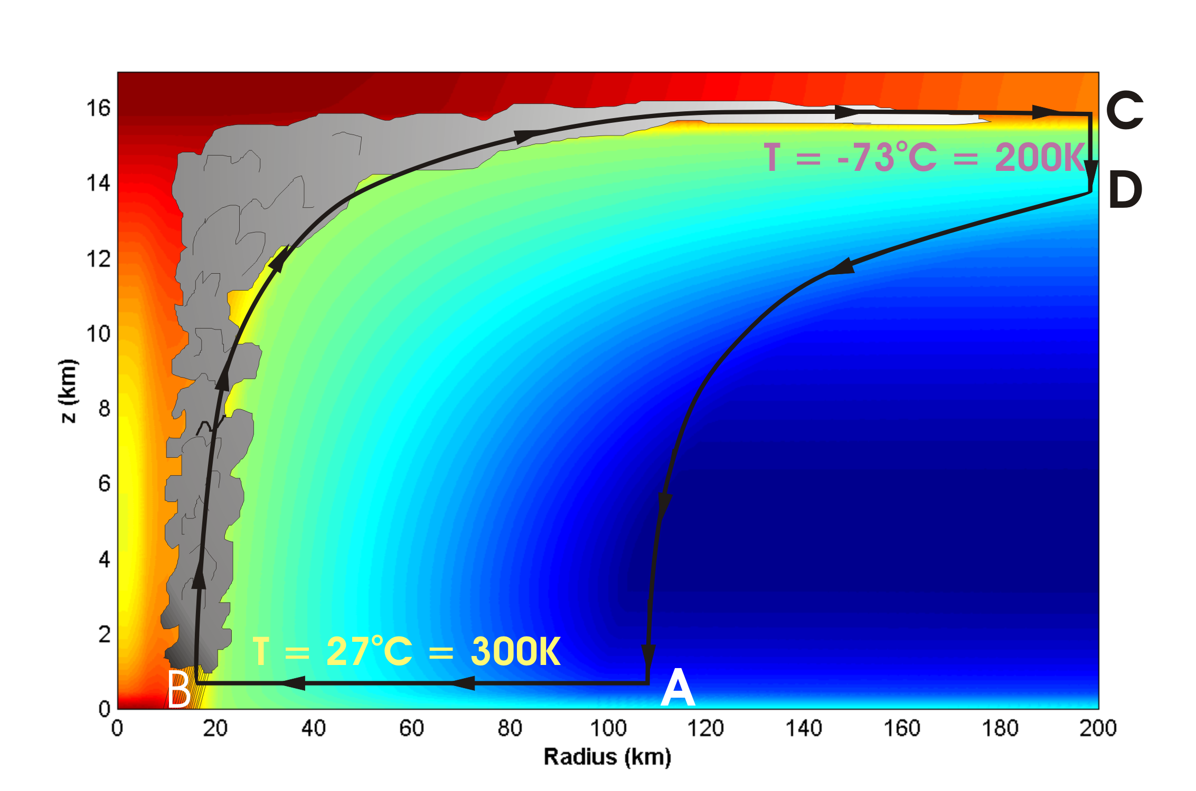
Energy Production Cycle

Slide 7
Theoretical Upper Bound on Hurricane Maximum Wind Speed:
Surface temperature
Air-sea enthalpy disequilibrium
Ratio of exchange coefficients of enthalpy and momentum
Outflow temperature
s₀* = saturation entropy of sea surface
s_{b} = actual entropy of subcloud layer

Slide 8
Condition of convective neutrality:
s_{b} = s* of free troposphere
Also, s* of free troposphere is approximately spatially uniform (WTG approximation)
approximately constant
What matters, apparently, is the SST (s₀*) relative to the tropospheric temperature (s*)

Slide 9
Annual Maximum Potential Intensity (m/s)

Slide 10
Empirical Evidence for the Importance of Potential Intensity to TC Genesis: A Genesis Potential Index (GPI)
Base choice of predictors on physics, intuition, past experience
850 hPa absolute vorticity (h)
850 – 250 hPa shear (S)
Potential intensity (PI)
Non-dimensional subsaturation of the middle troposphere:

Slide 11
Considerations in Developing a GPI:
Dimensional consistency: GPI should yield a rate per unit area
Should yield good fits to:
  Spatial distribution
  Basin annual rates
  Annual cycle
  Interannual variations
  Variability of events generated by random seeding
  Genesis as simulated in cloud-permitting models

Slide 12
New Genesis Potential Index:
850 hPa absolute vorticity (h)
850 – 250 hPa shear (S)
Potential intensity (PI)
Non-dimensional subsaturation of the middle troposphere:

Slide 13
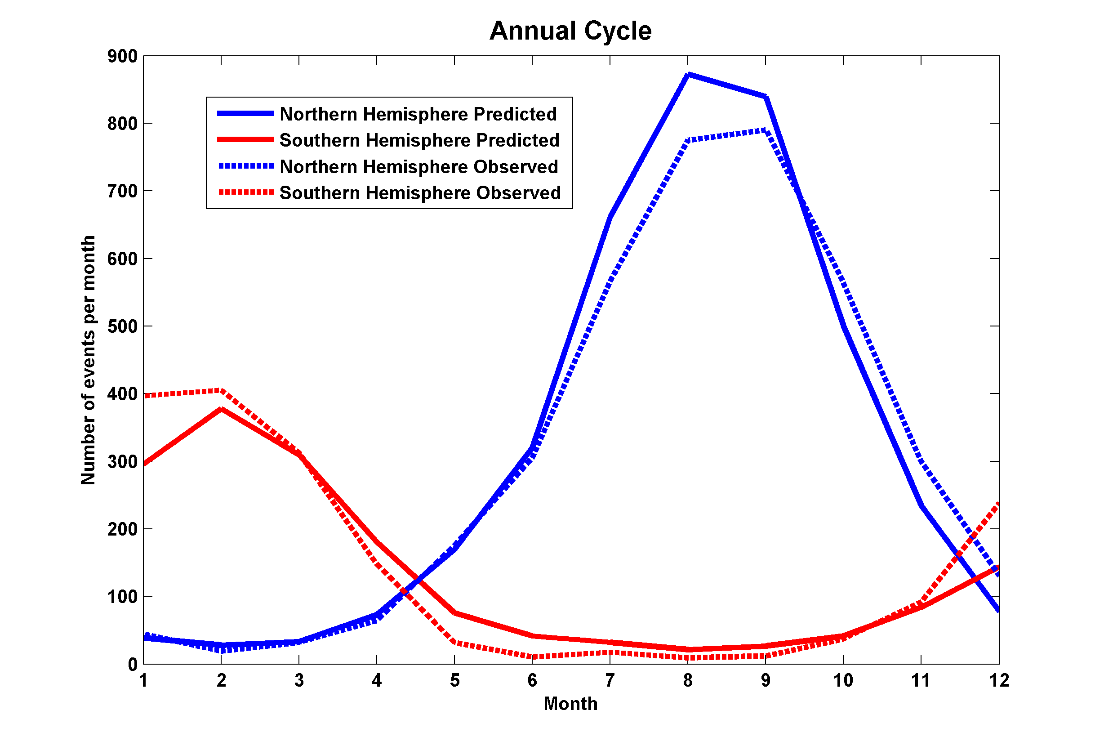
Performance

Slide 14
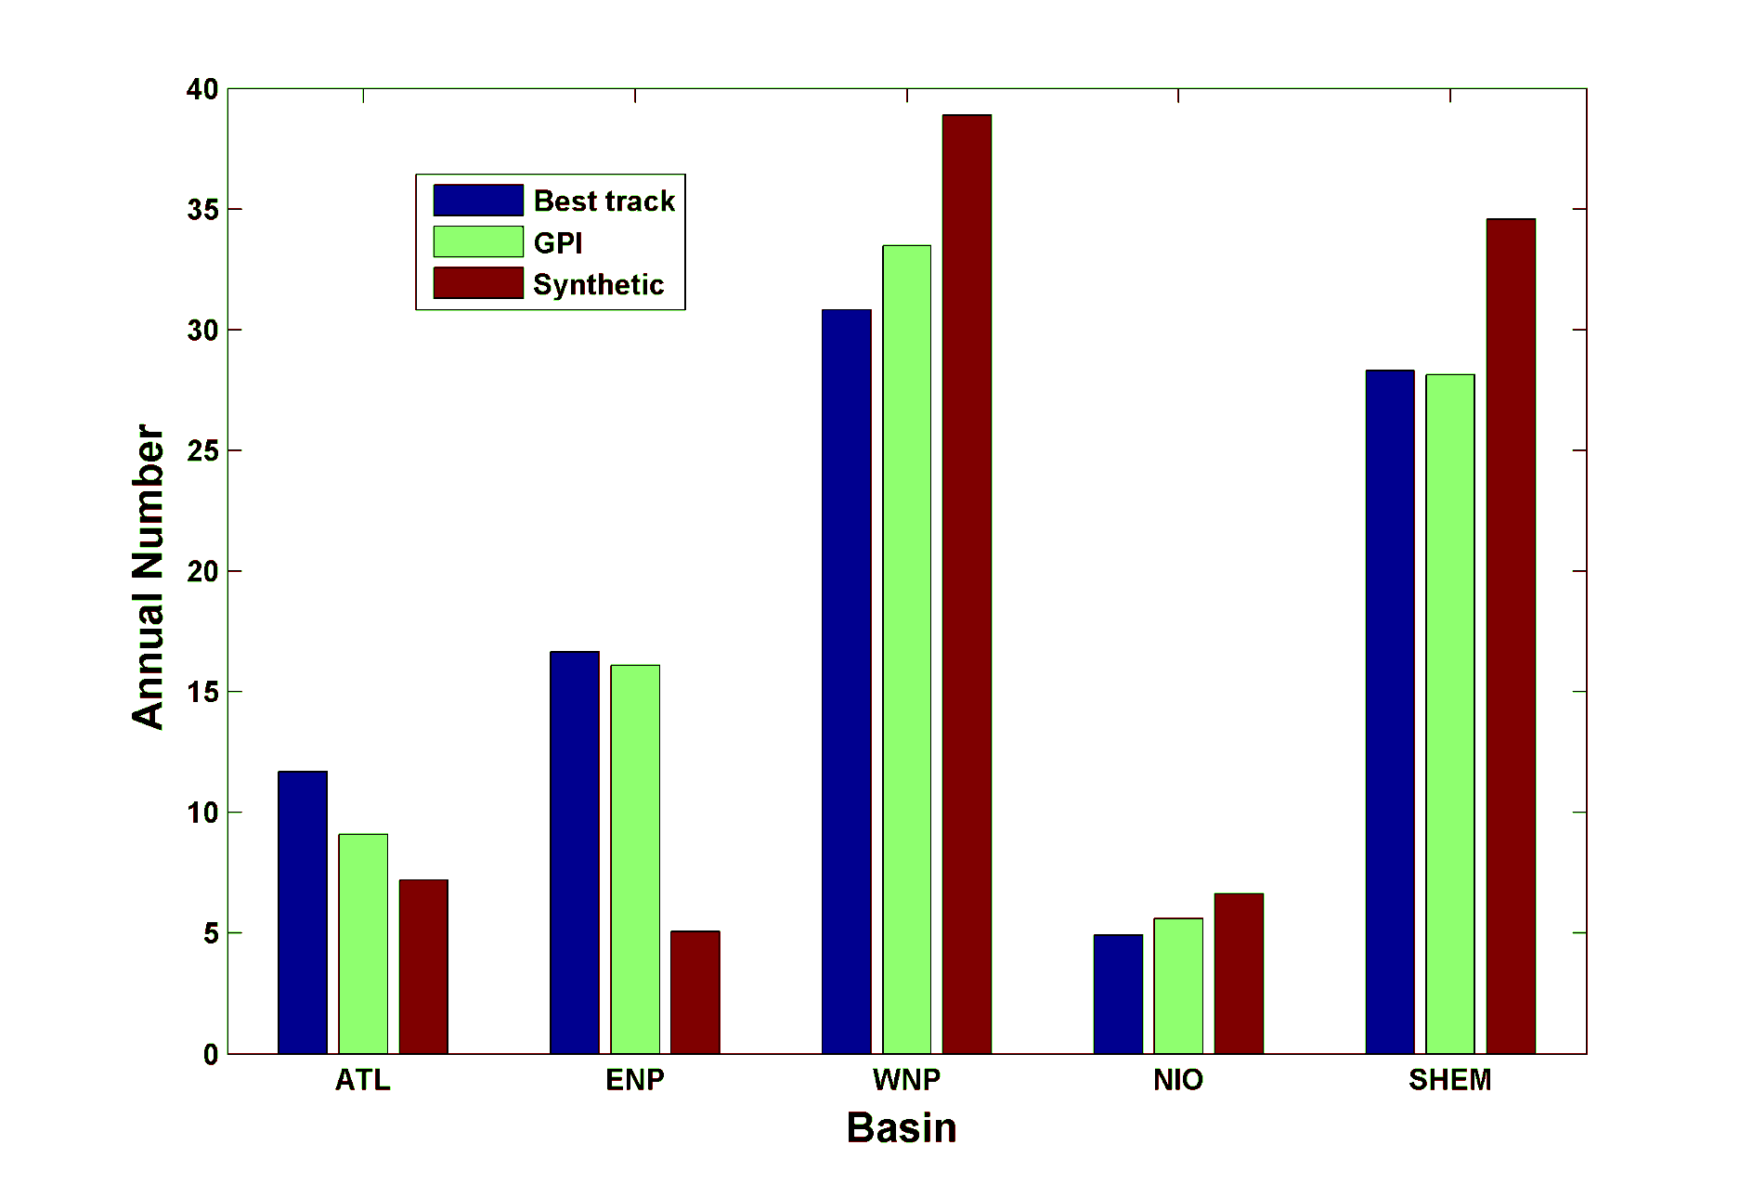
Basin Frequencies

Slide 15
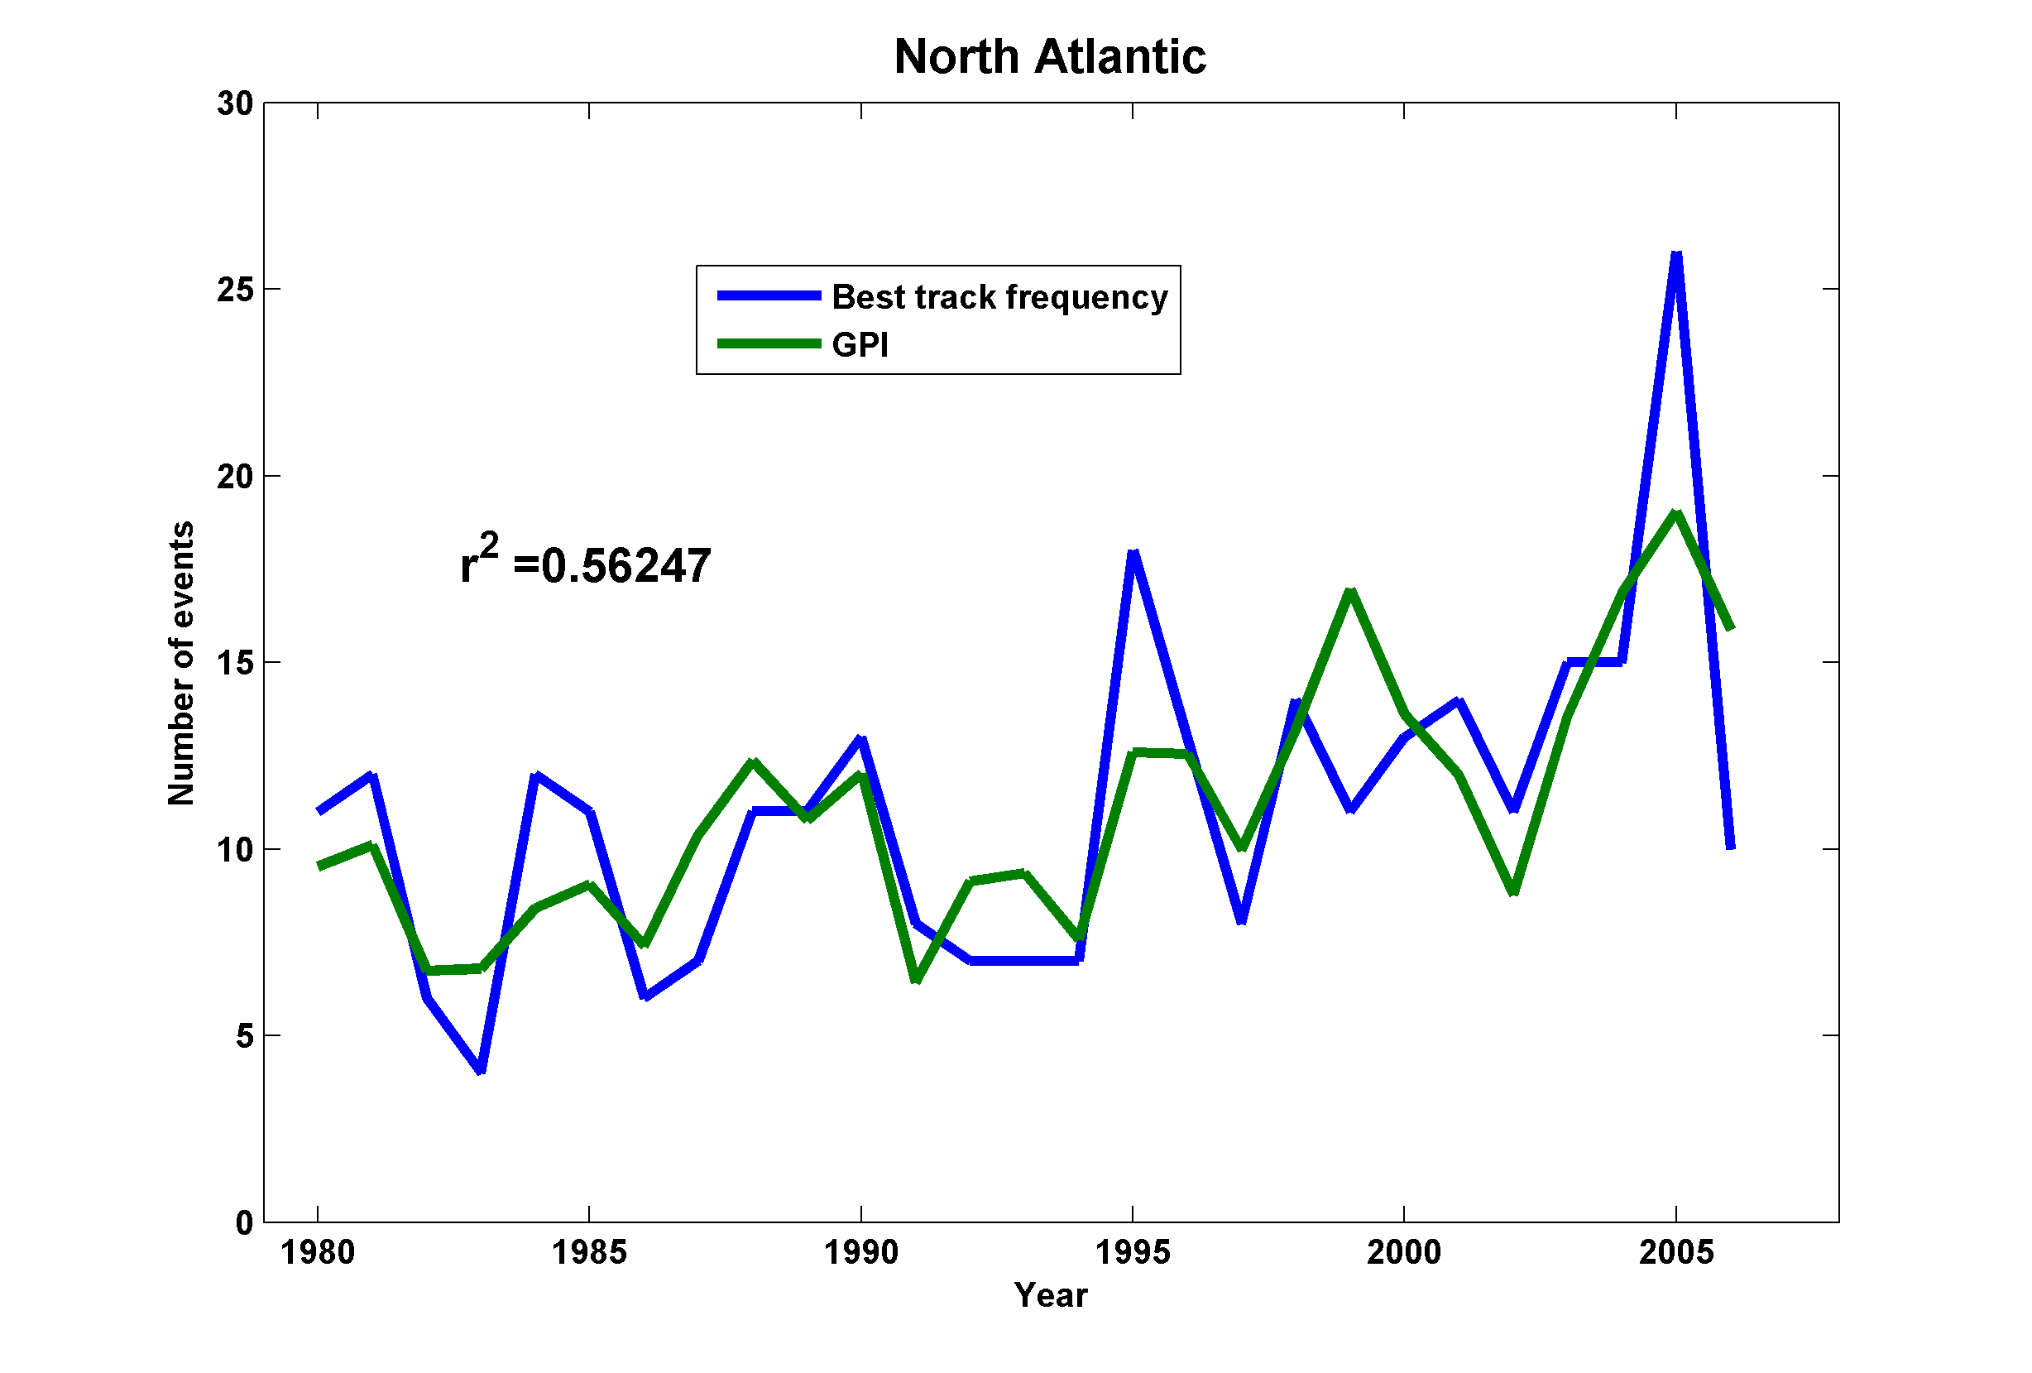
Interannual Variability
No Significant Correlations Outside the Atlantic!

Slide 16
Climate Control of Potential Intensity
Ocean Surface Energy Balance:

Slide 17
Potential intensity is determined by local radiative balance, local convergence of ocean heat flux, local surface wind speed, and local outflow temperature only
Remote influences limited to remote effects on surface wind surface radiation ocean heat flux and, in marginal zones, on outflow temperature
SST cannot vary independently of free atmospheric temperature on long time scales

Slide 18
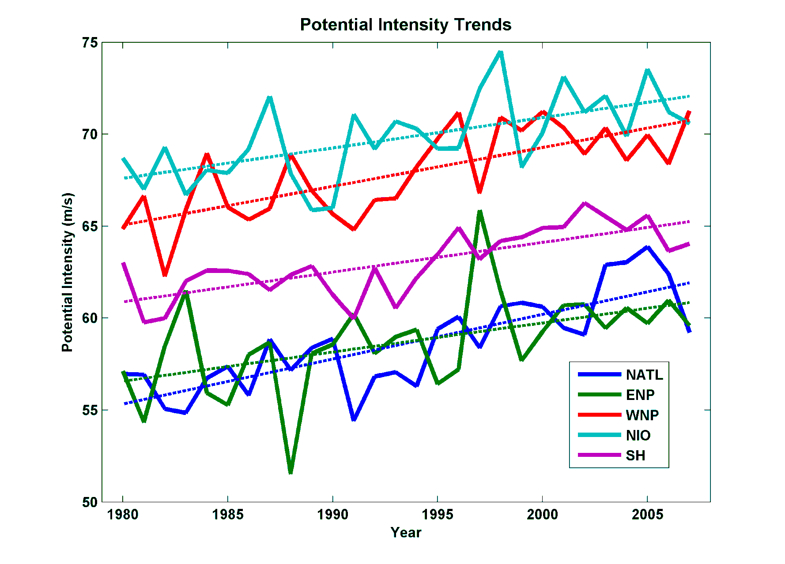
Interpretation of Recent Trends in Potential Intensity
Based on NCAR/NCEP Reanalysis

Slide 20
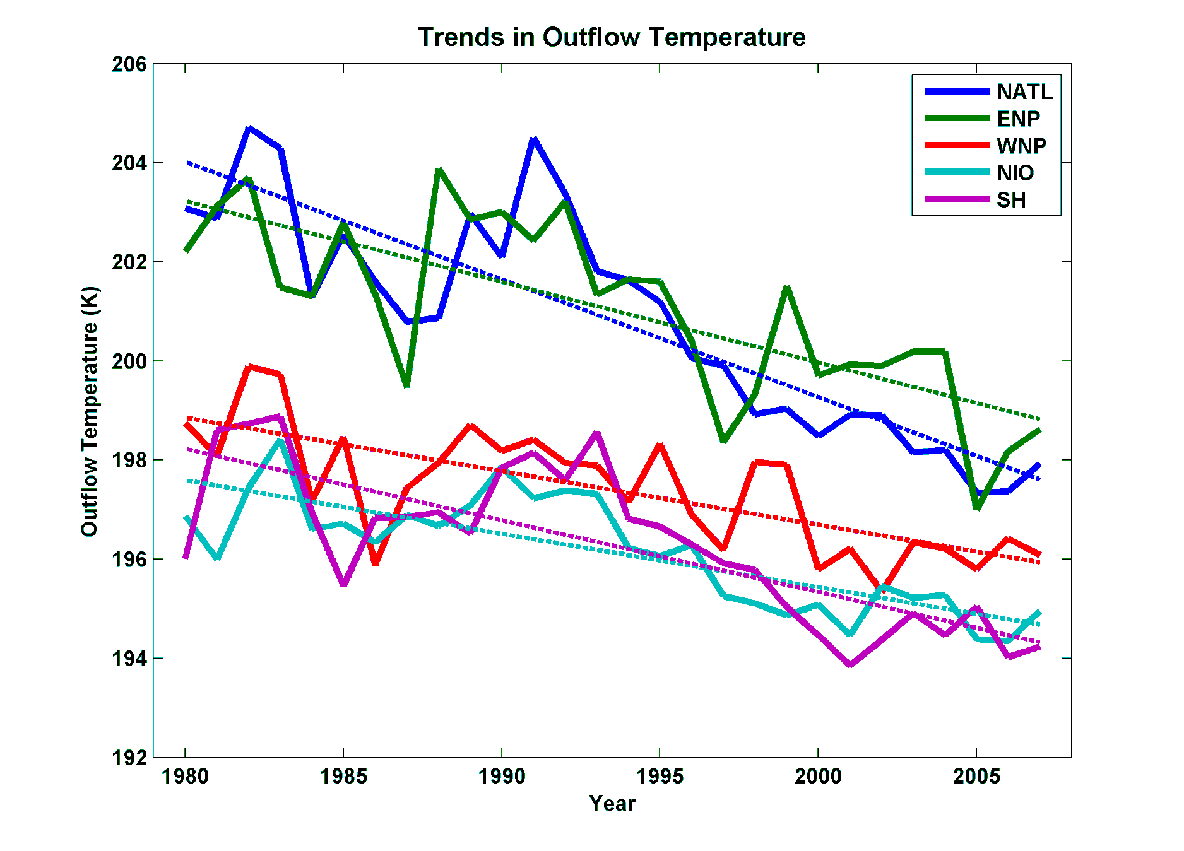
Importance of Trends in Outflow Temperature
From NCEP Reanalysis

Slide 21
Do AGCMs Capture Lower Stratospheric Cooling?

Slide 22
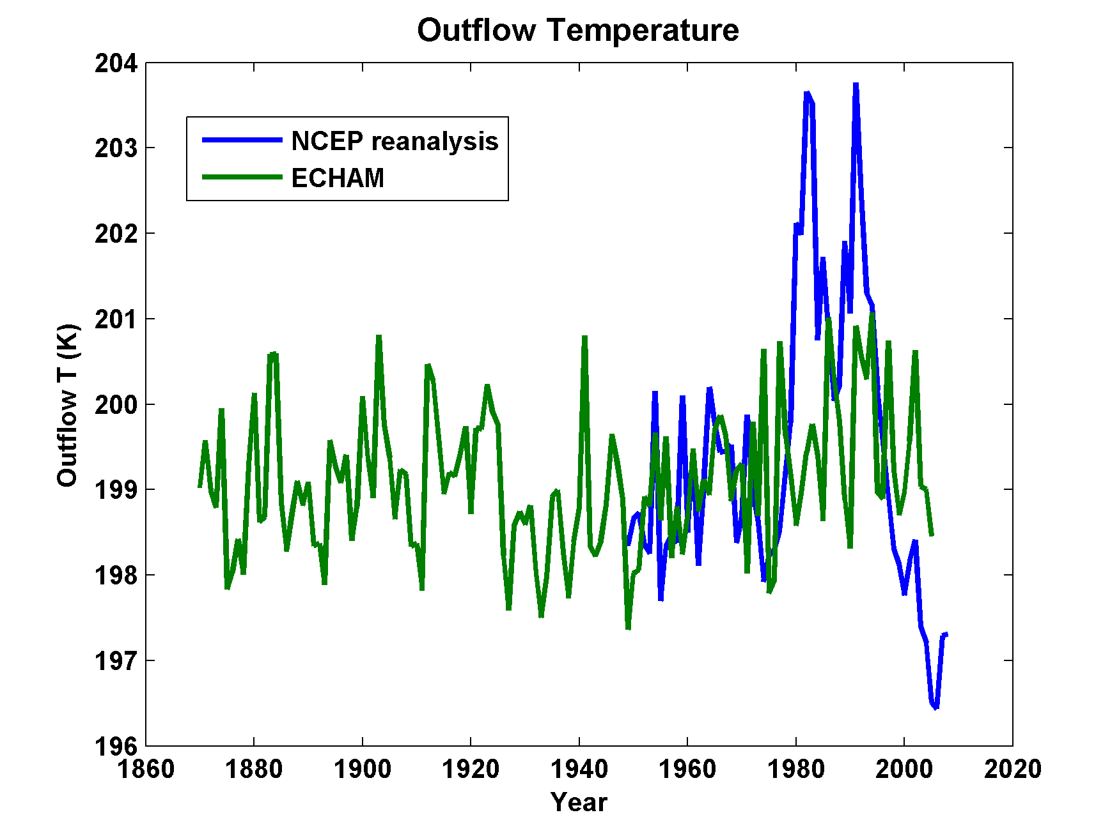
ECHAM AGCM forced by Hadley Centre SSTs and Sea Ice, Compared to NCEP Reanalysis

Slide 23
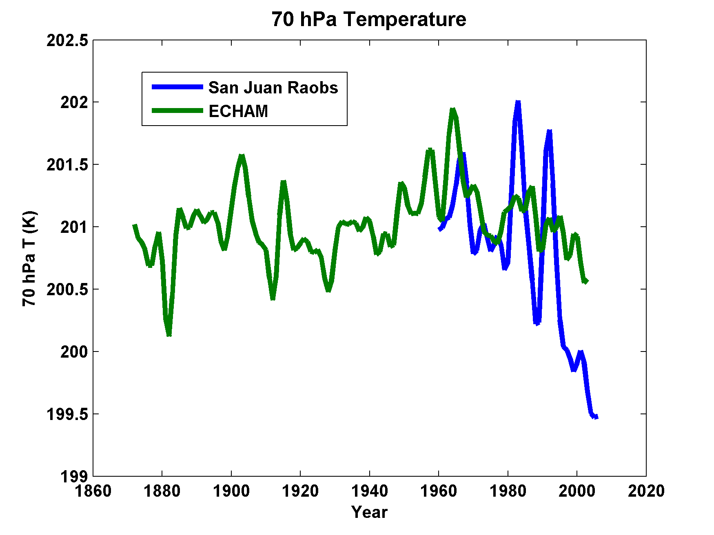

Slide 24
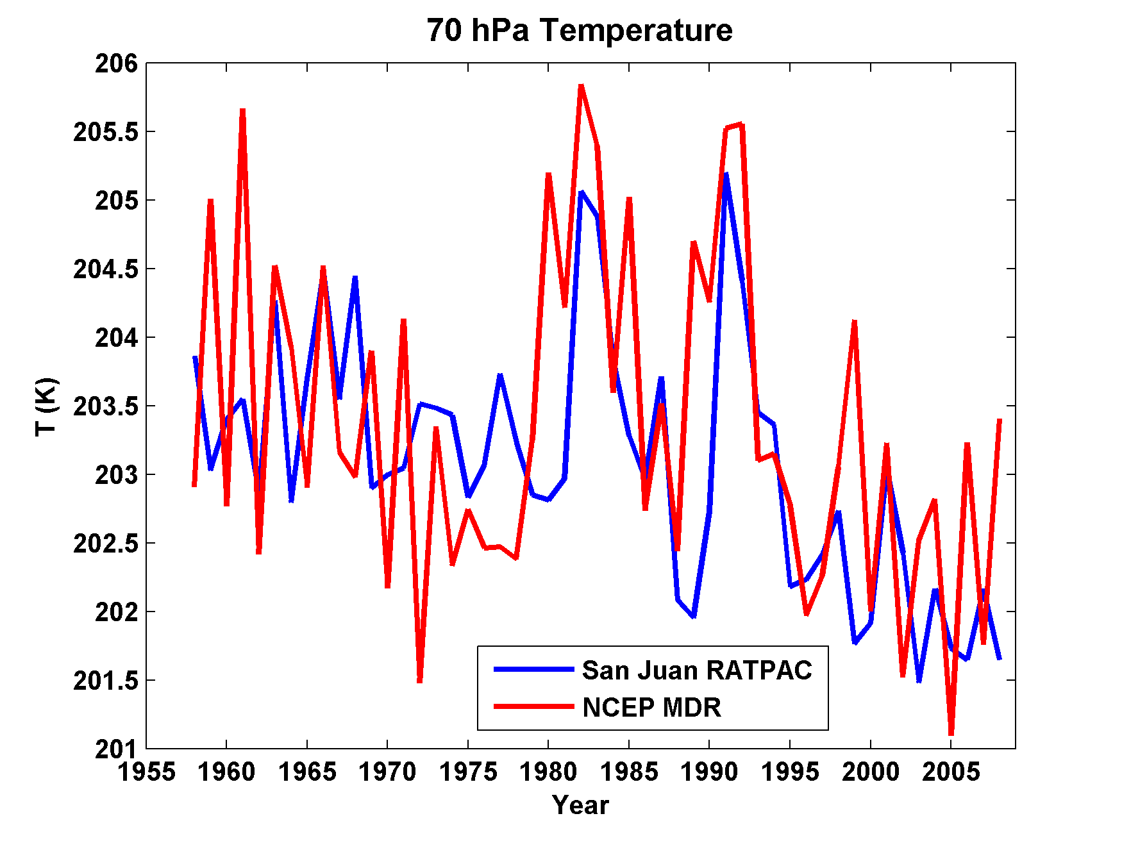

Slide 25
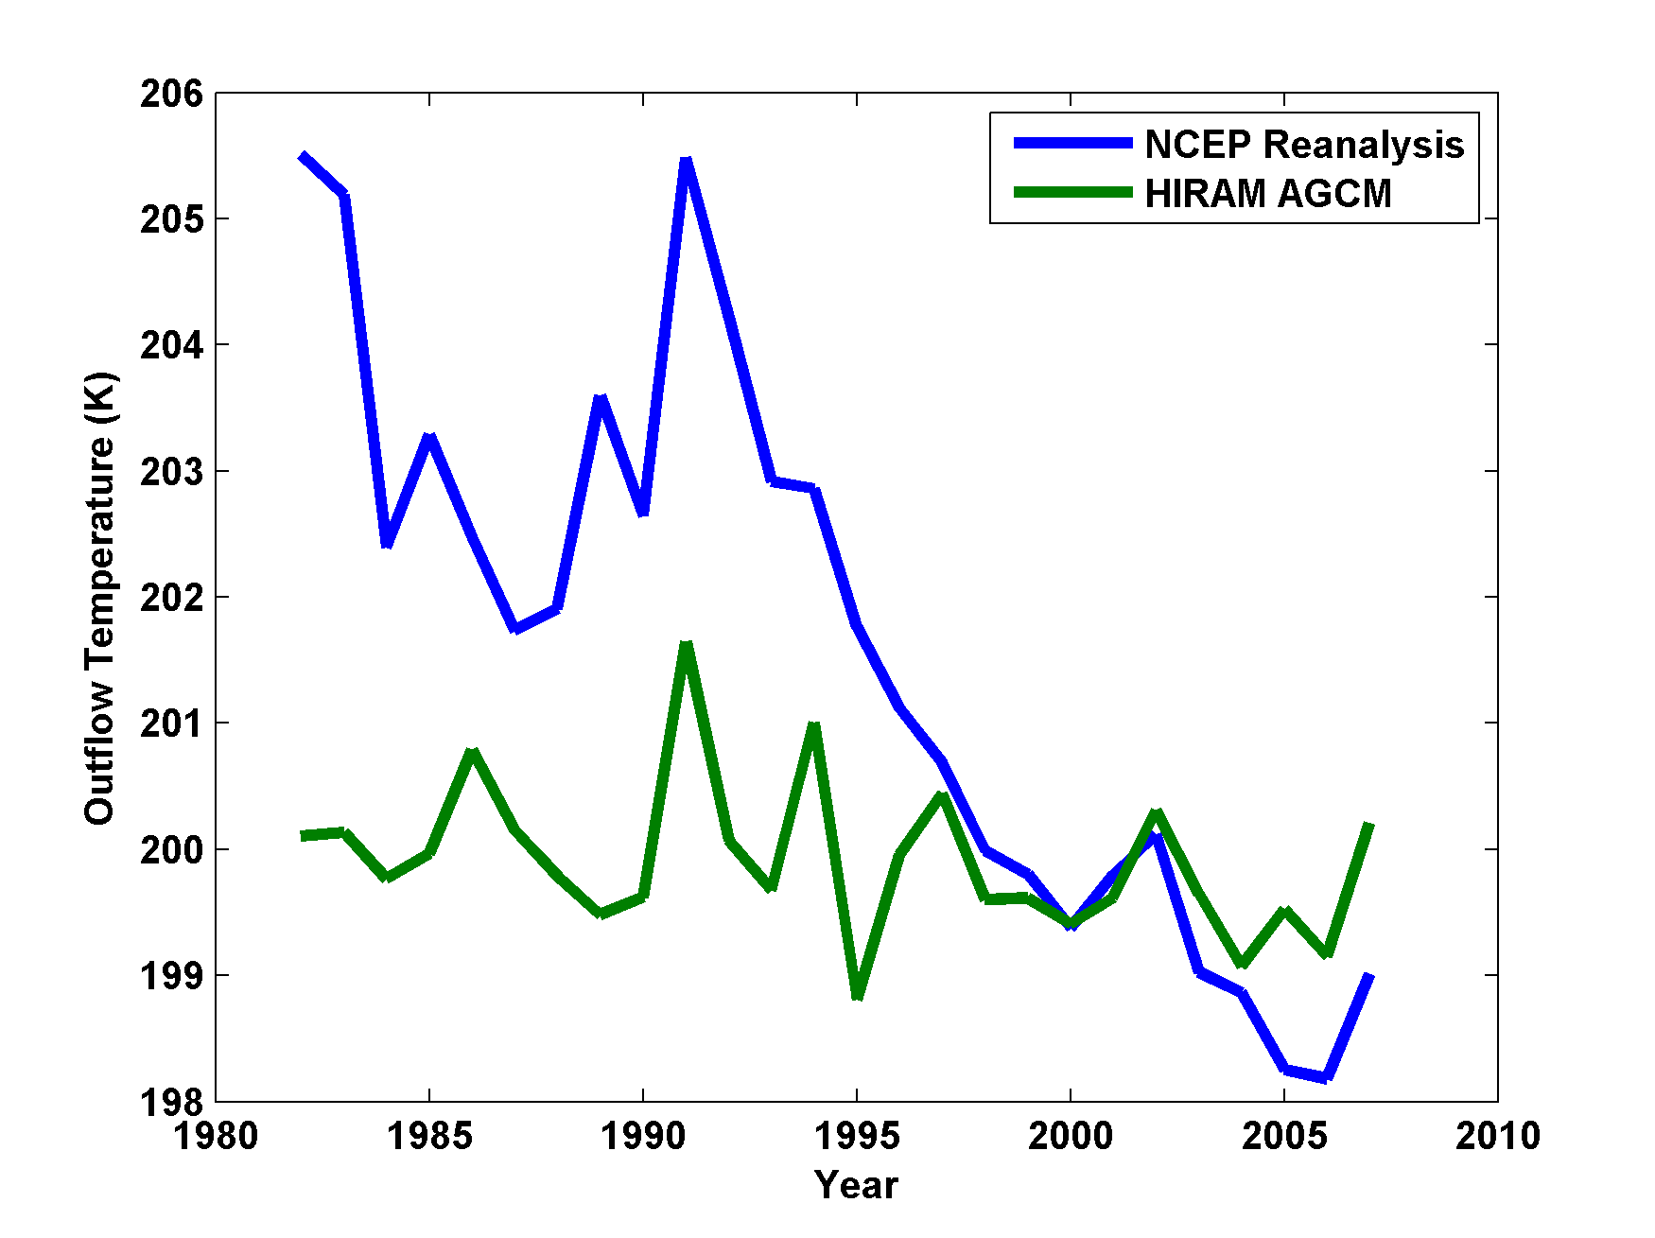
Same, but using GFDL HIRAM Model

Slide 26
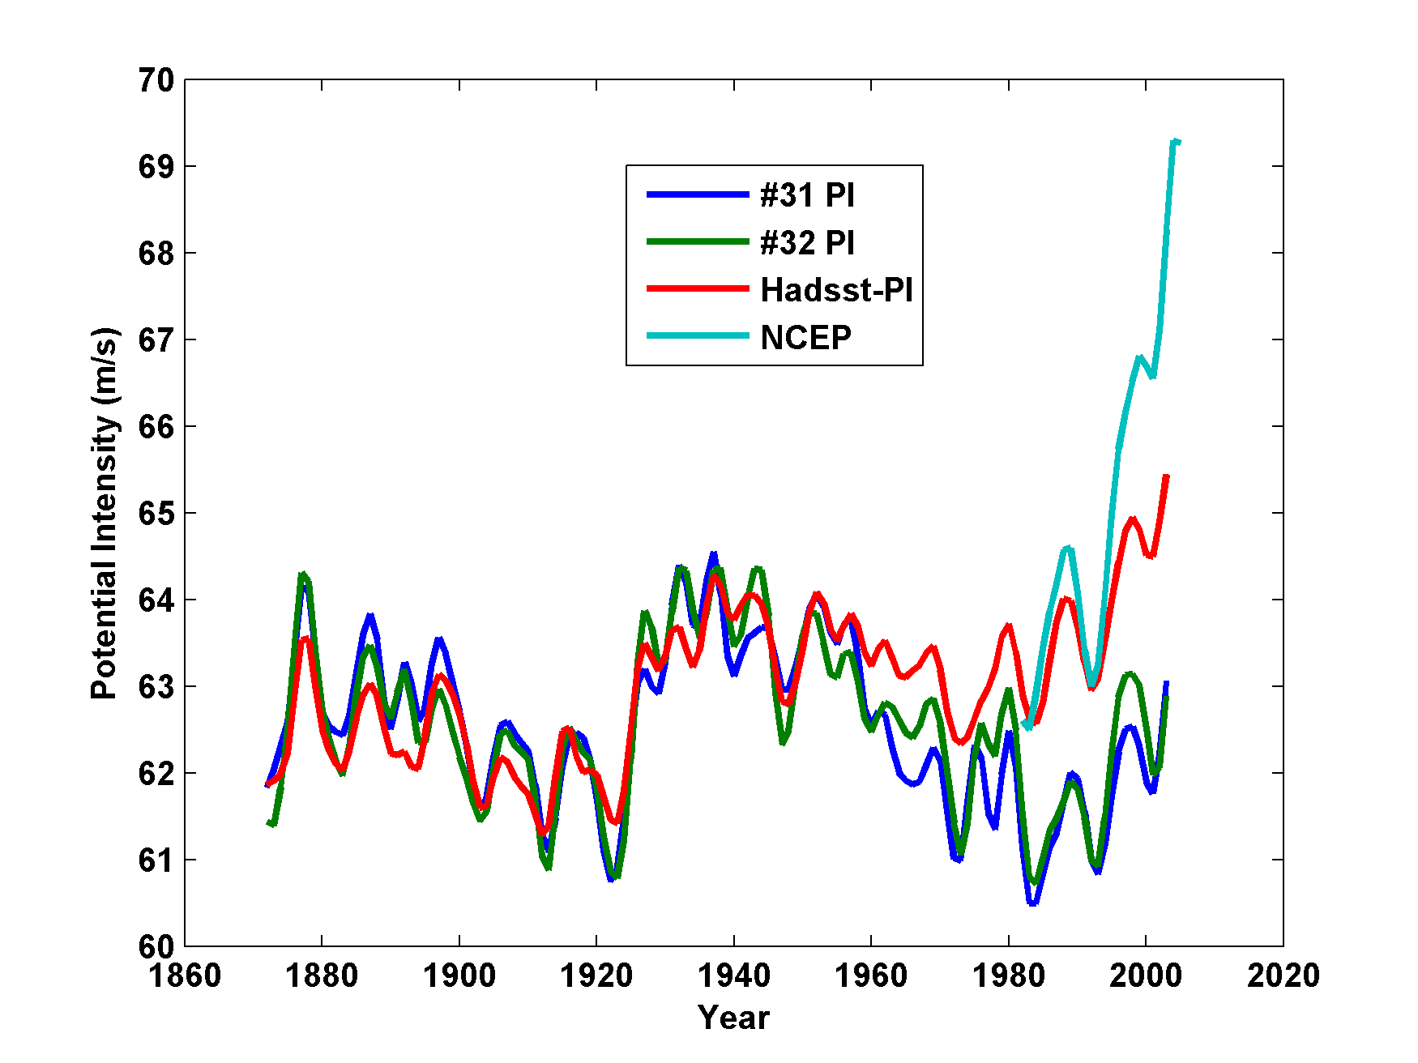
Leads to Problems with Potential Intensities
NCEP
# 31: ECHAM without aerosols
#32: ECHAM with aerosols

Slide 27
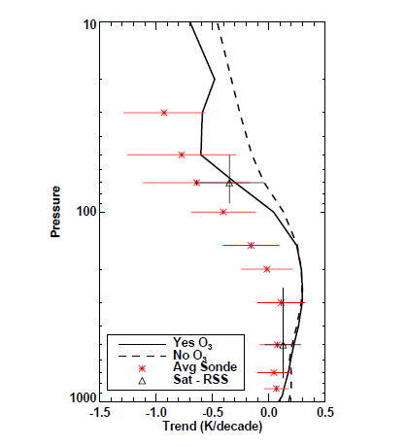
1979-1999 Temperature Trends, 30S-30N. Red: Radiosondes; Solid Black: Mean of Models with Ozone; Dashed Black: Mean of Models without Ozone (Cordero and Forster, 2006)

Slide 28
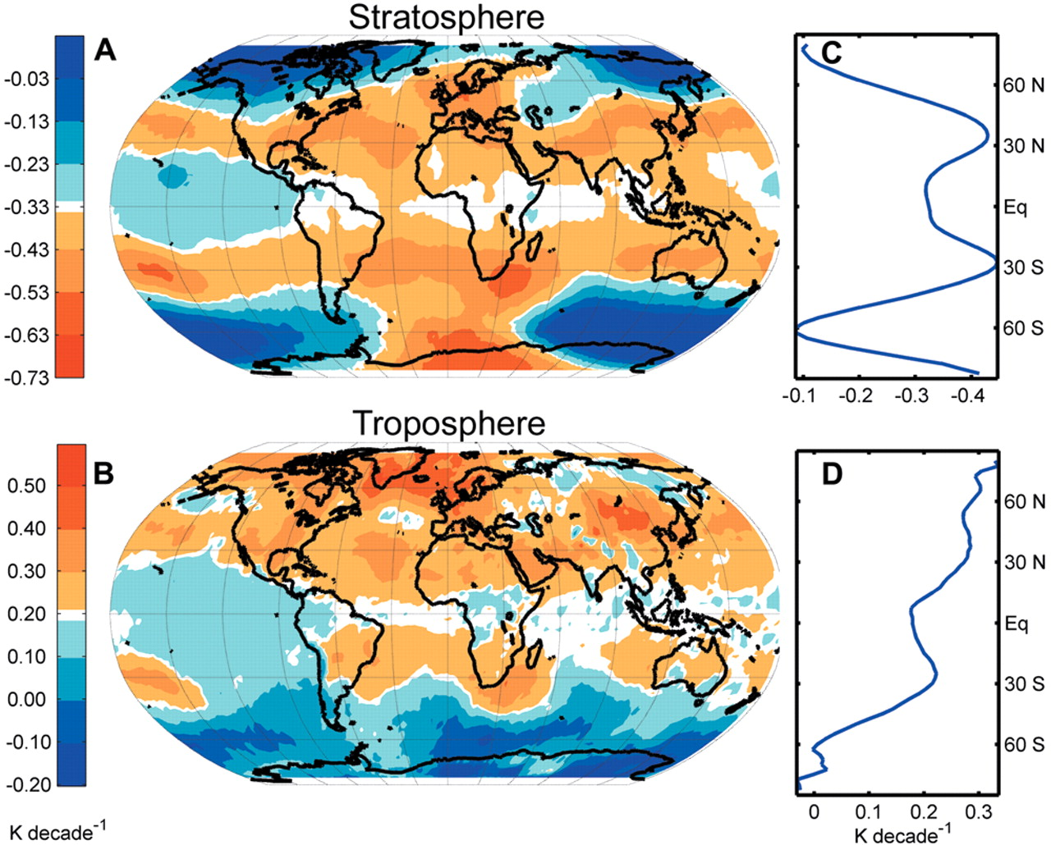
Ozone may not explain spatial pattern of cooling
(Fu and Wallace, Science, 2006)

Slide 29
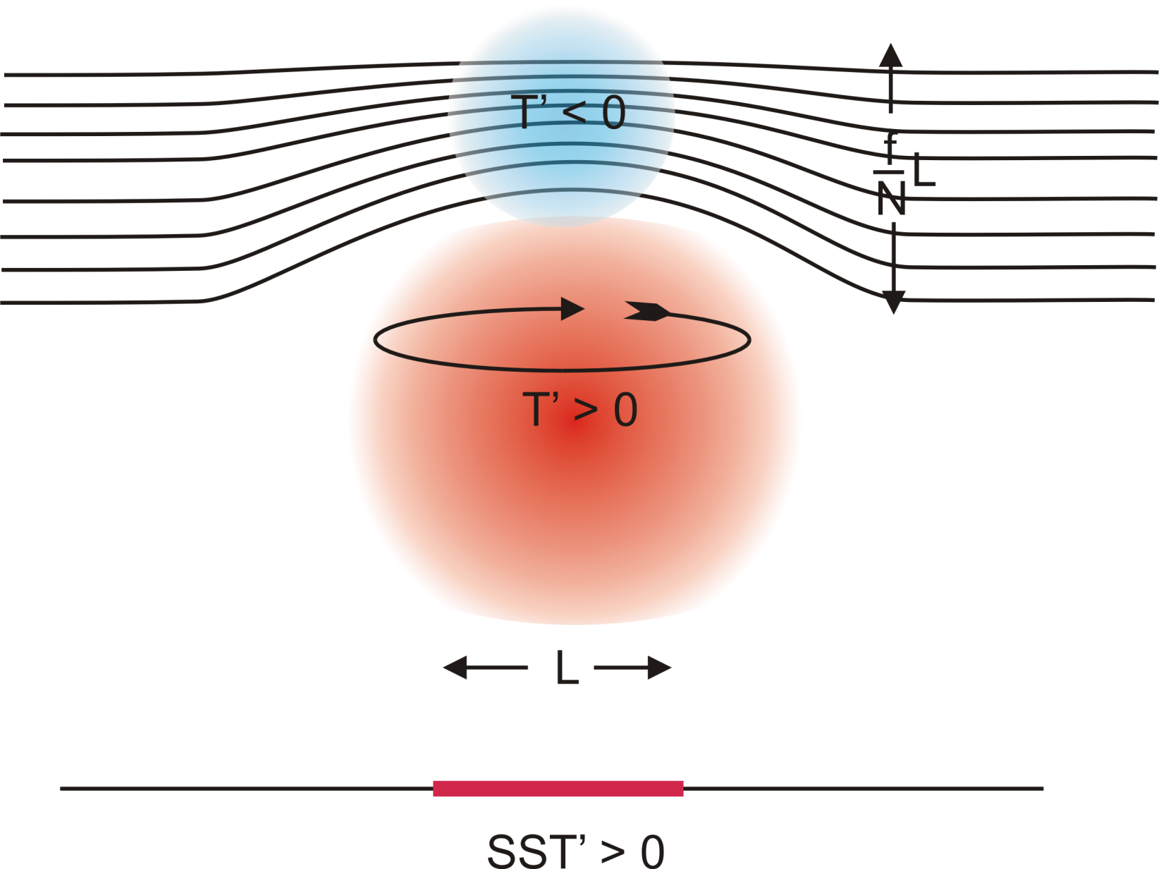
Stratospheric Compensation

Slide 30
Hydrostatic Compensation (following Holloway and Neelin)
Perturbations to moist adiabatic troposphere:
Stratospheric compensation:

Slide 31
For typical values of the parameters

Slide 32
What is Causing Changes in Tropical Atlantic Sea Surface Temperature?

Slide 33
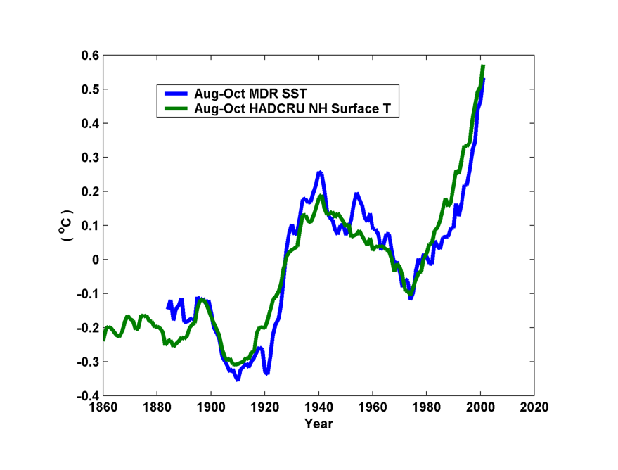
10-year Running Average of Aug-Oct Northern Hemisphere Surface Temp and Hurricane Region Ocean Temp

Slide 34
Estimates of Global Mean Surface Temperature from the Instrumental Record
Notes:
34

Slide 35
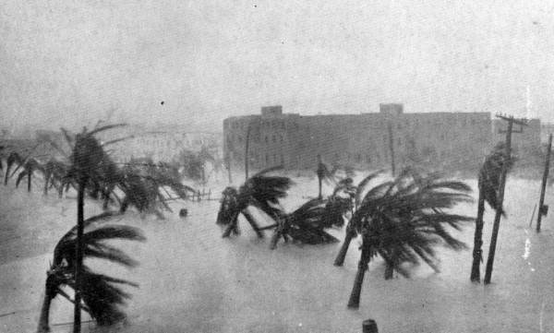
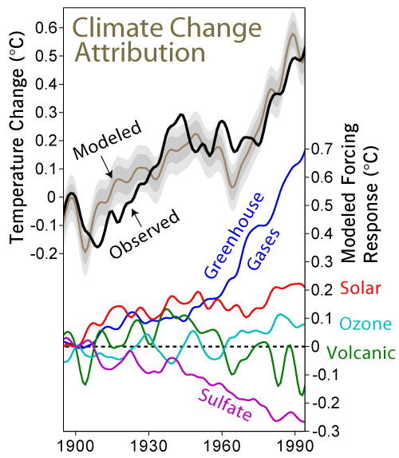

Slide 36
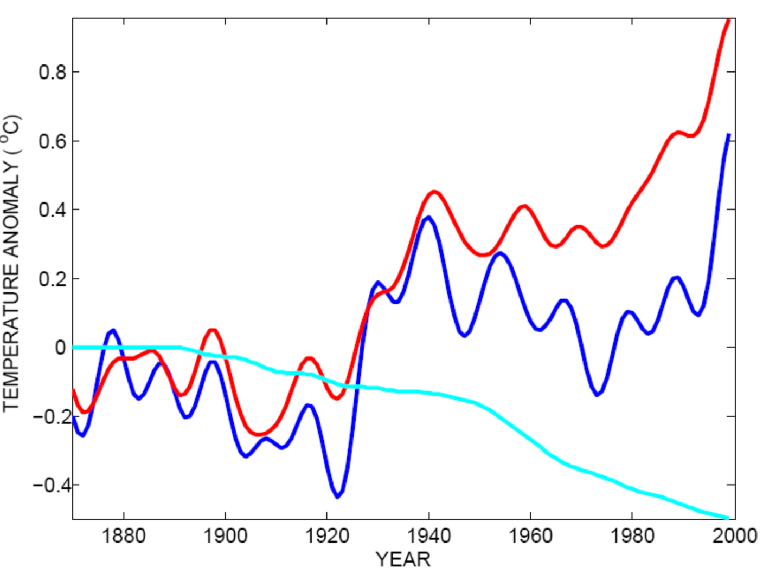
Tropical Atlantic SST(blue), Global Mean Surface Temperature (red),
Aerosol Forcing (aqua)
Global mean surface temperature
Tropical Atlantic sea surface temperature
Sulfate aerosol radiative forcing
Mann, M. E., and K. A. Emanuel, 2006. Atlantic hurricane trends linked to climate change. EOS, 87, 233-244.

Slide 37
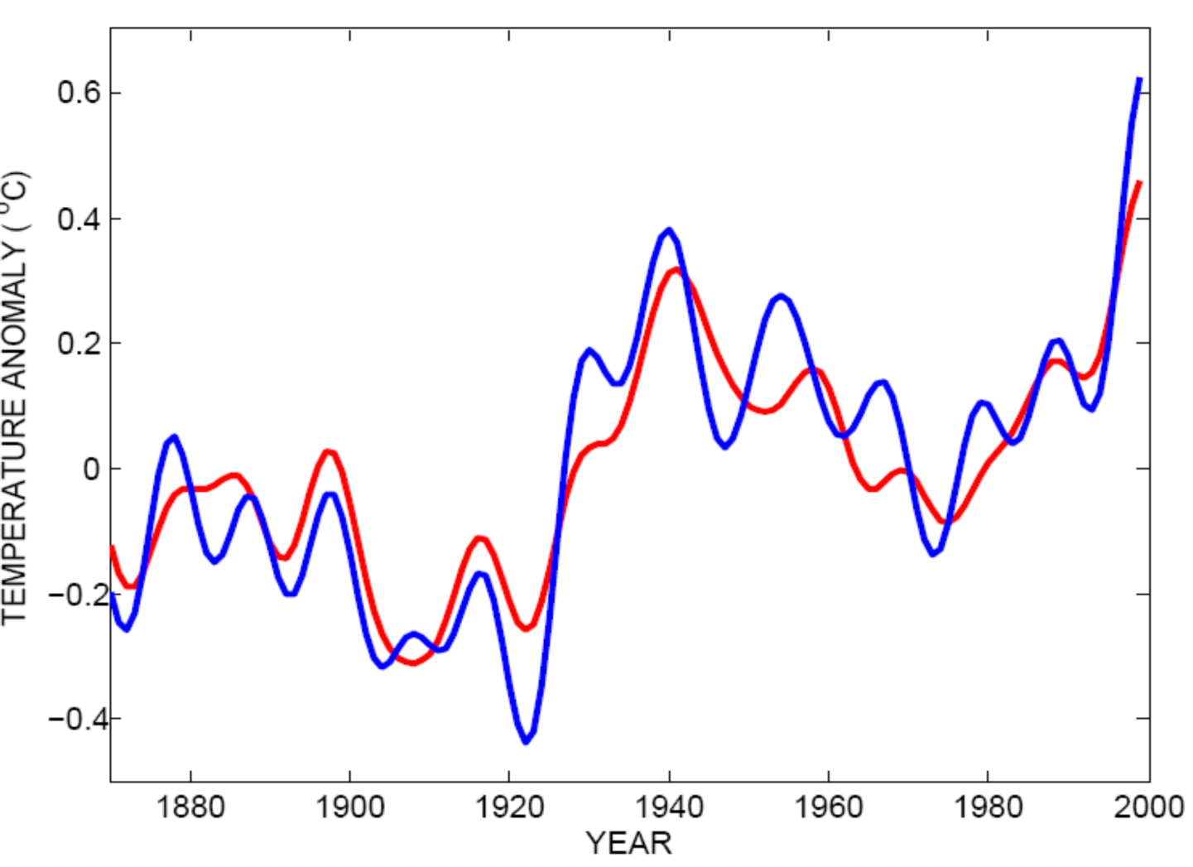
Best Fit Linear Combination of Global Warming and Aerosol Forcing (red) versus Tropical Atlantic SST (blue)
Tropical Atlantic Sea Surface Temperature
Global Surface T + Aerosol Forcing
Mann, M. E., and K. A. Emanuel, 2006. Atlantic hurricane trends linked to climate change. EOS, 87, 233-244.

Slide 38
Inferences from Modeling

Slide 39
The Problem:
Global models are far too coarse to simulate high intensity tropical cyclones
Embedding regional models within global models introduces problems stemming from incompatibility of models, and even regional models are usually too coarse

Slide 40

Histograms of Tropical Cyclone Intensity as Simulated by a Global Model with 50 km grid point spacing. (Courtesy Isaac Held, GFDL)
Category 3

Slide 41


Probability Density of TC Damage, U.S. East Coast
Damage Multiplied by Probability Density of TC Damage, U.S. East Coast

Slide 42
To the extent that they simulate tropical cyclones at all, global models simulate storms that are largely irrelevant to society and to the climate system itself, given that ocean stirring effects are heavily weighted towards the most intense storms

Slide 43
Our Approach
Step 1: Seed each ocean basin with a very large number of weak, randomly located vortices
Step 2: Vortices are assumed to move with the large scale atmospheric flow in which they are embedded
Step 3: Run a coupled, ocean-atmosphere computer model for each vortex, and note how many achieve at least tropical storm strength; discard others
Step 4: Using the small fraction of surviving events, determine storm statistics.

Slide 44
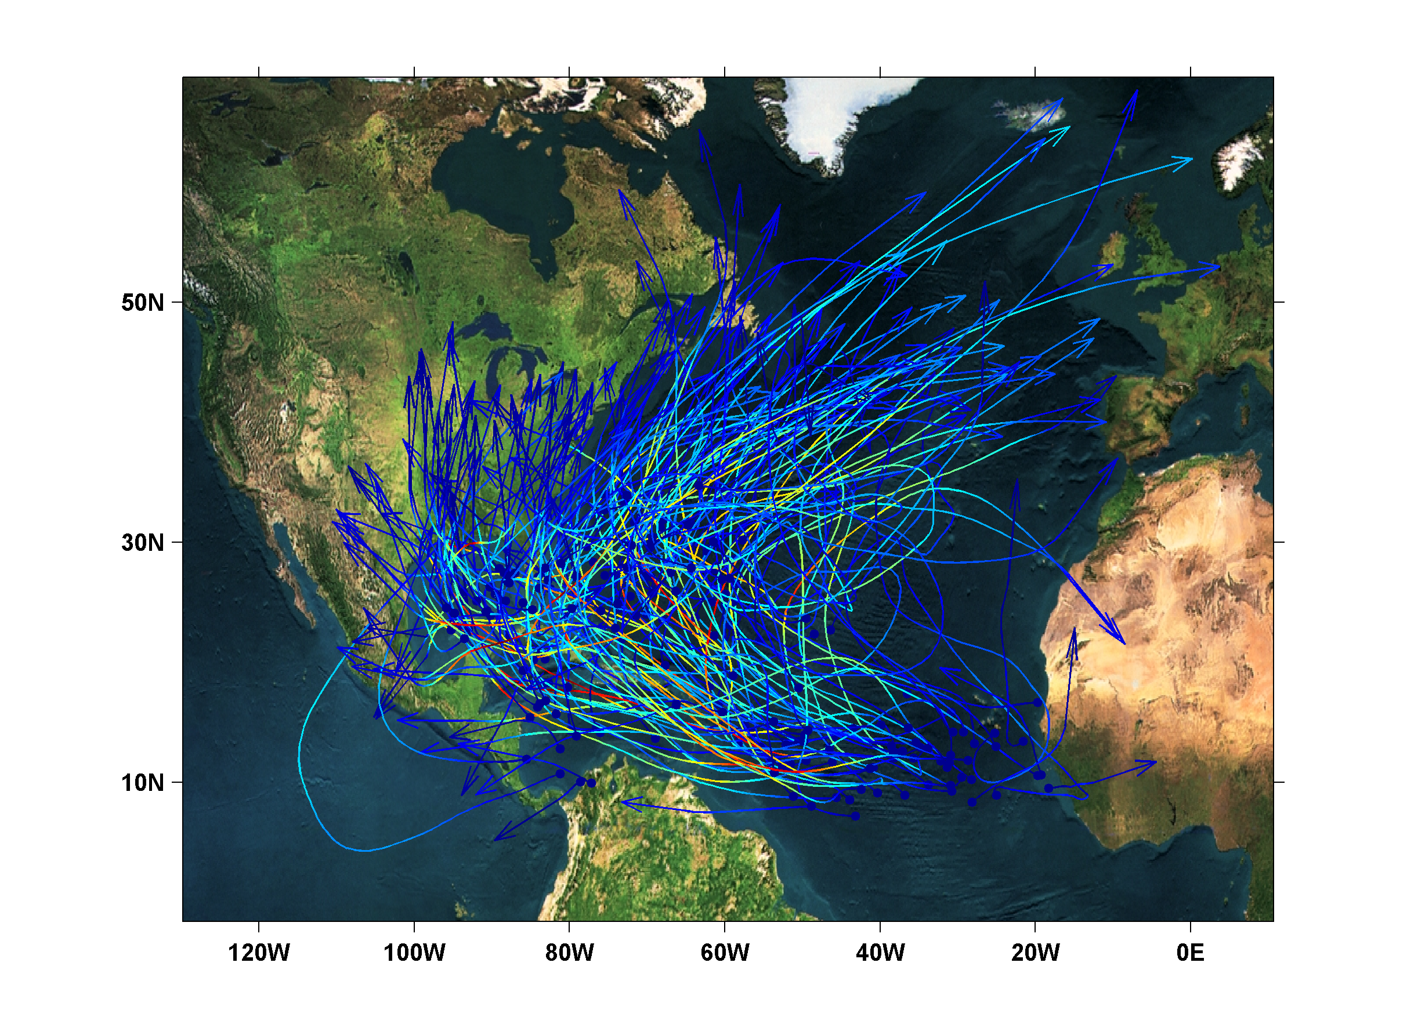
200 Synthetic U.S. Landfalling tracks (color coded by Saffir-Simpson Scale)

Slide 45
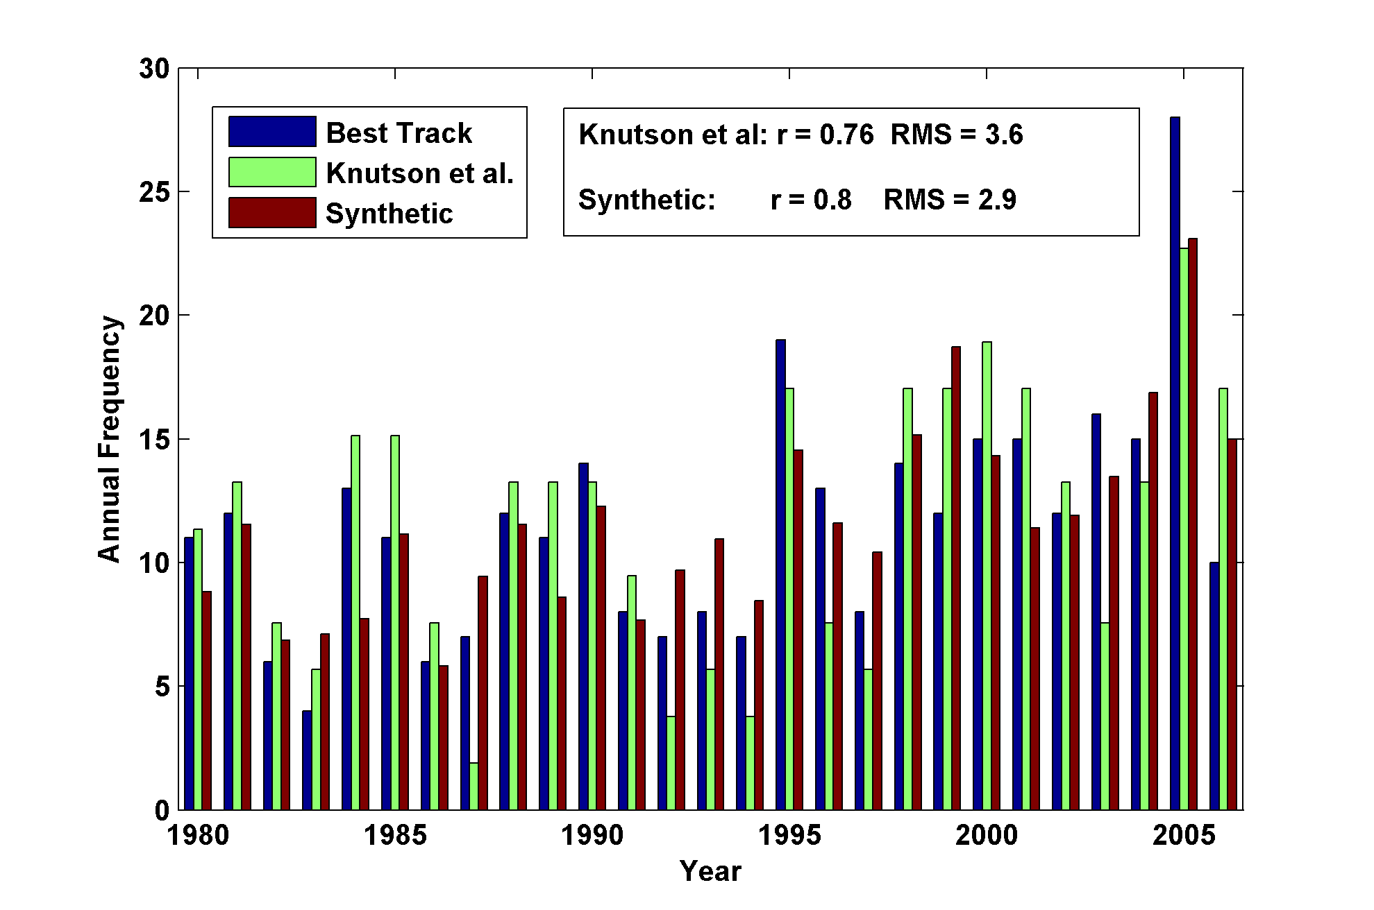
Year by Year Comparison with Best Track and with Knutson et al., 2007

Slide 46
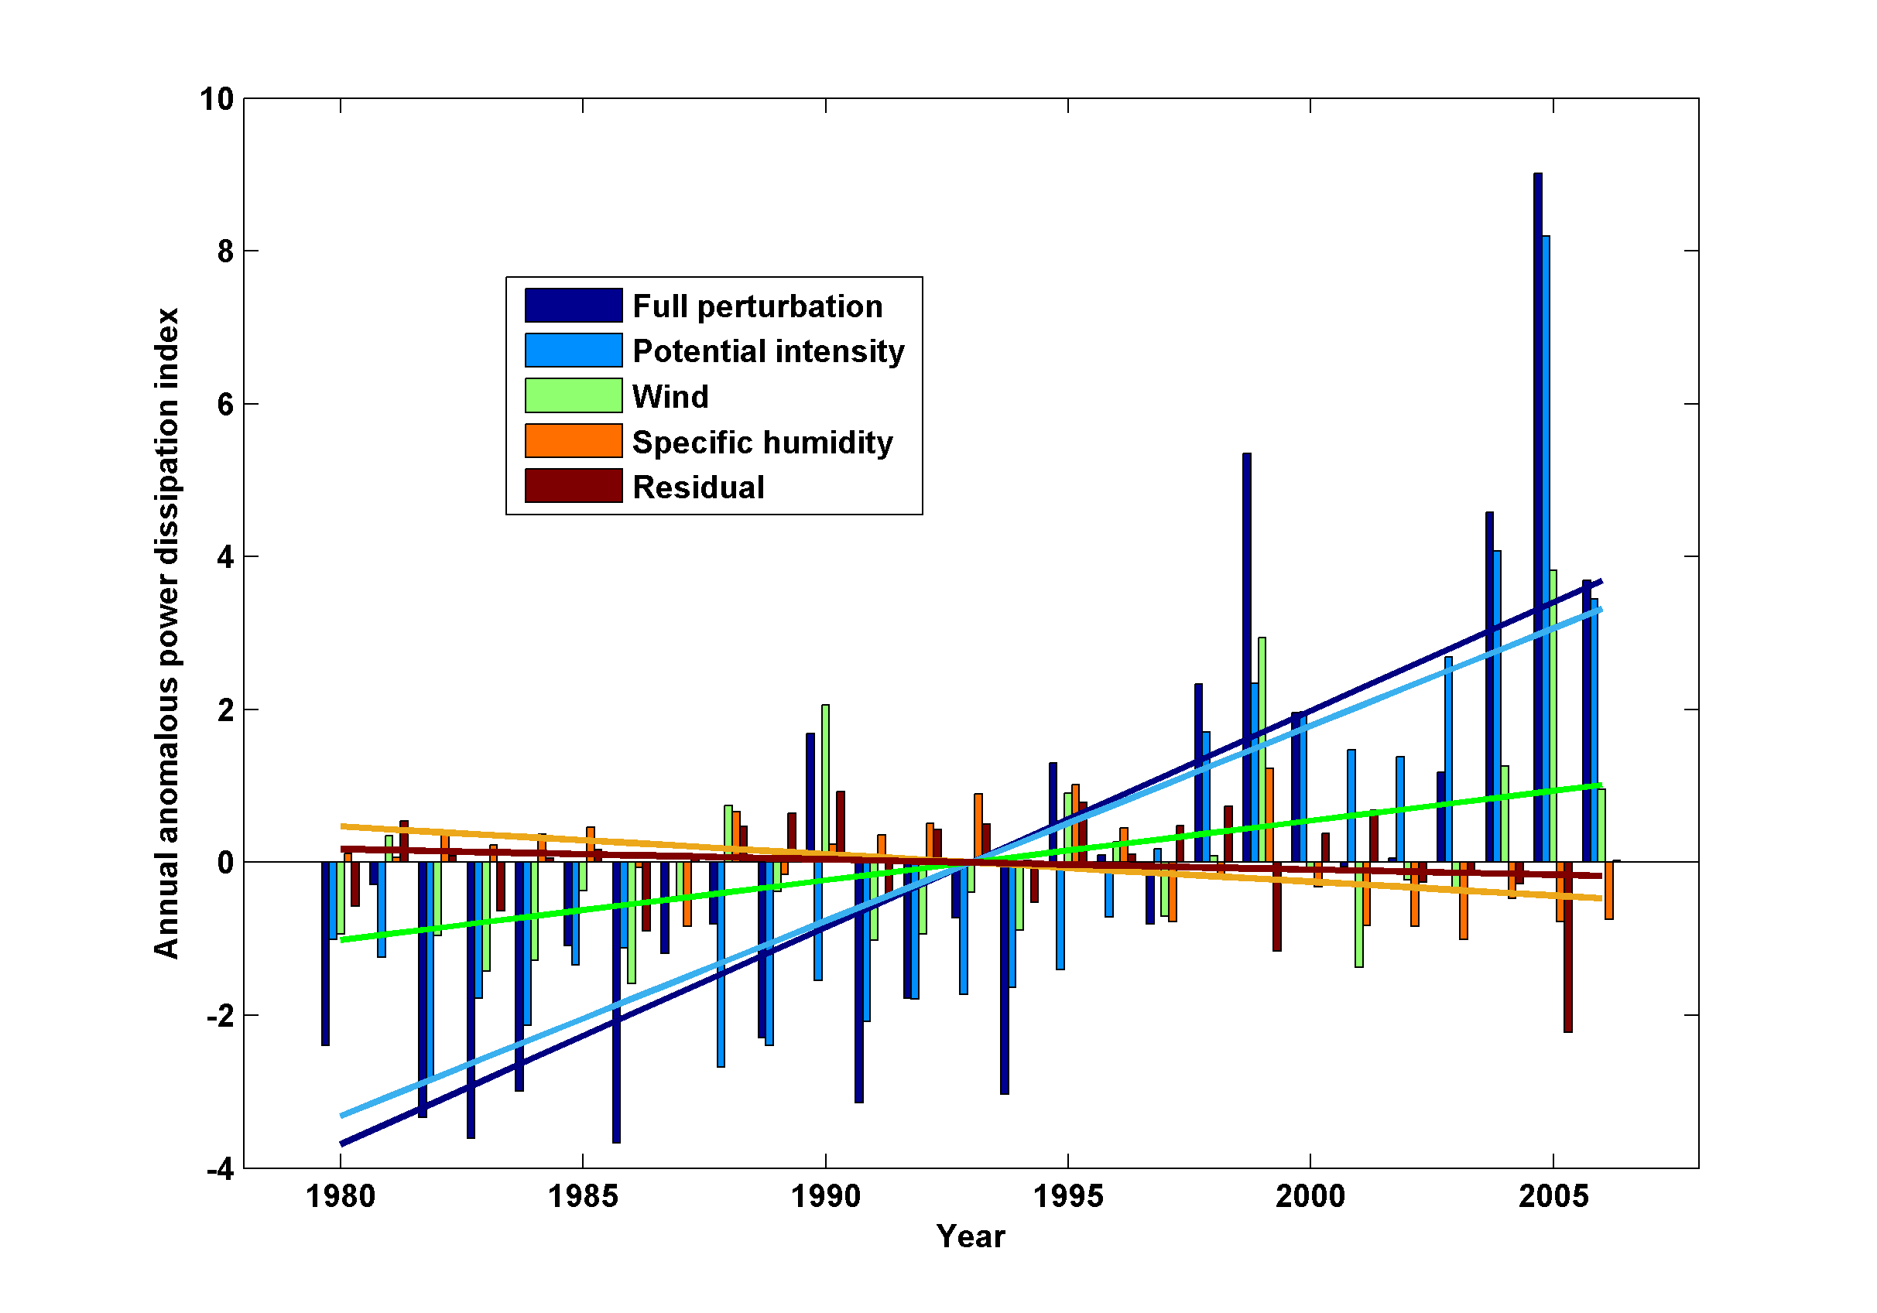
Decomposition of PDI Trends

Slide 47
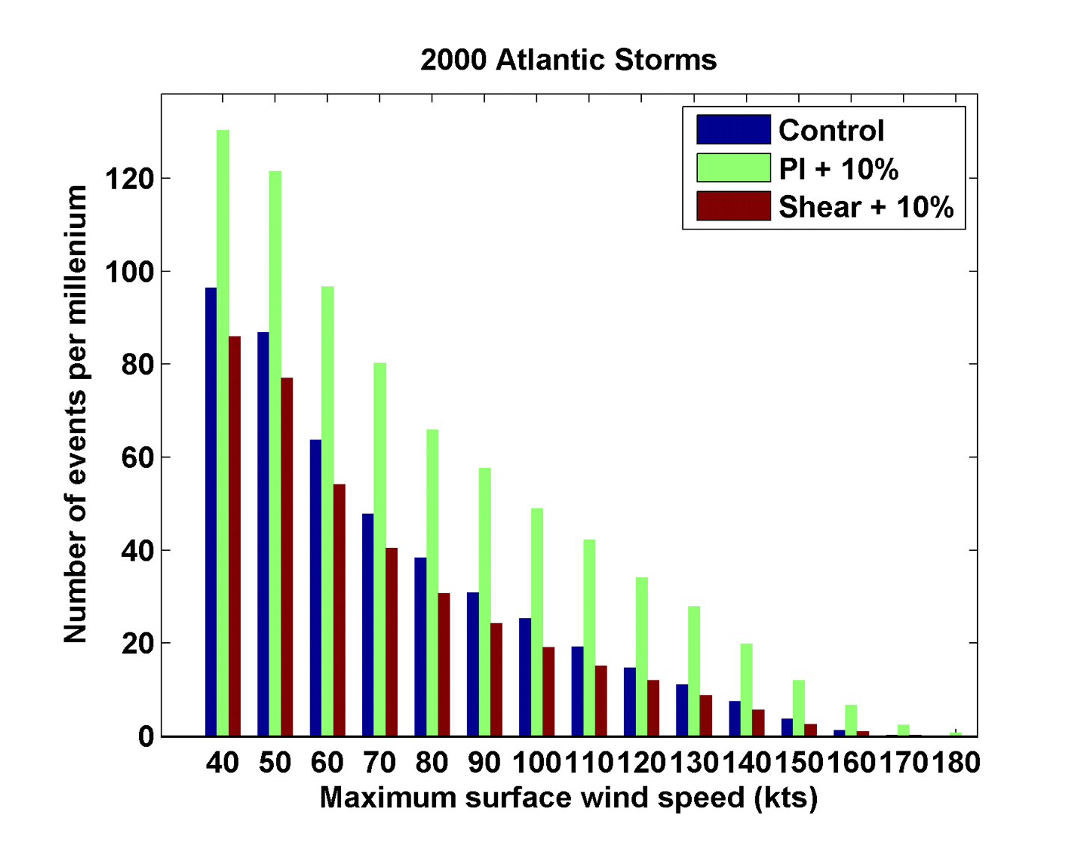
Sensitivity to Shear and Potential Intensity

Slide 48
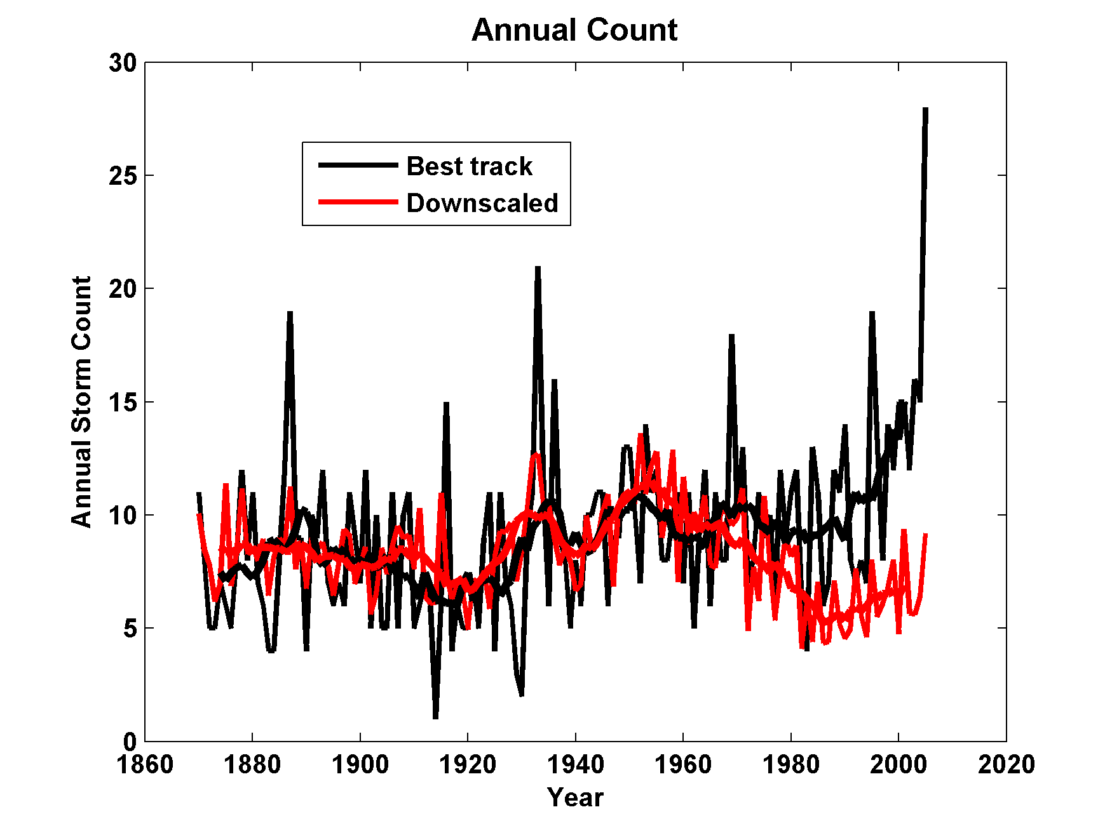
Downscaling ECHAM5 AGCM (T42), 1870-2005
(with Martin Wild and Doris Folini)

Slide 49
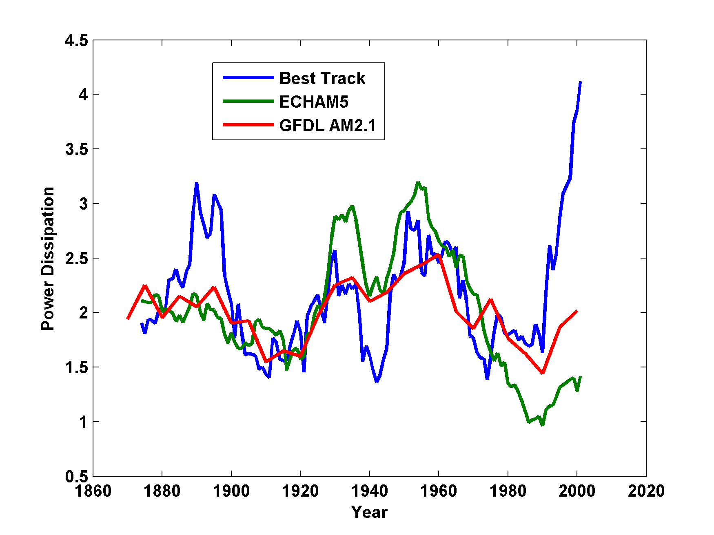
Power Dissipation Downscaled Using ECHAM5 and GFDL AM2.1 Compared to Best Track

Slide 50
Reminder: Problems with Potential Intensities
NCEP
# 31: ECHAM without aerosols
#32: ECHAM with aerosols

Slide 51
Feedback of Global Tropical Cyclone Activity on the Climate System
Notes:
51

Slide 52
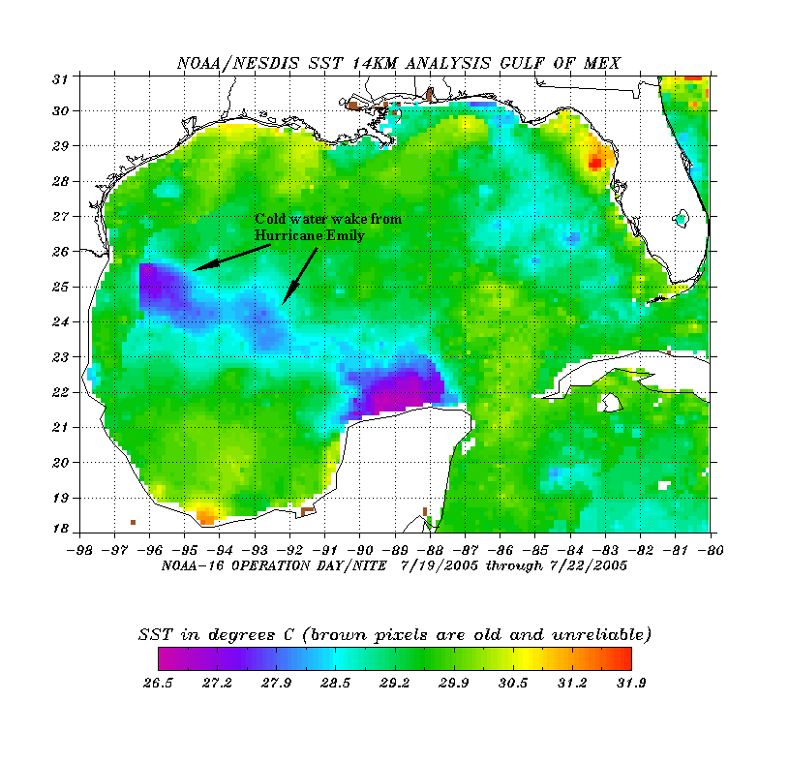
The wake of Hurricane Emily (July 2005)
Sea Surface Temperature in the Wakes of Hurricanes
Hurricane Dennis
(one week earlier)
Source: Rob Korty, CalTech
Notes:
52
We know that tropical cyclones are responsible for strong mixing of the upper oceans and this can be seen in satellite images…

Slide 53
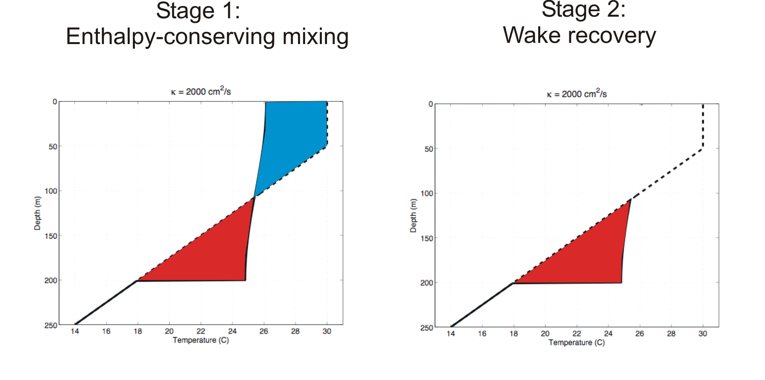
Direct mixing by tropical cyclones
Emanuel (2001) estimated global rate of heat input as 1.4 X 10¹⁵ Watts
Source: Rob Korty, CalTech
Notes:
53

Slide 54
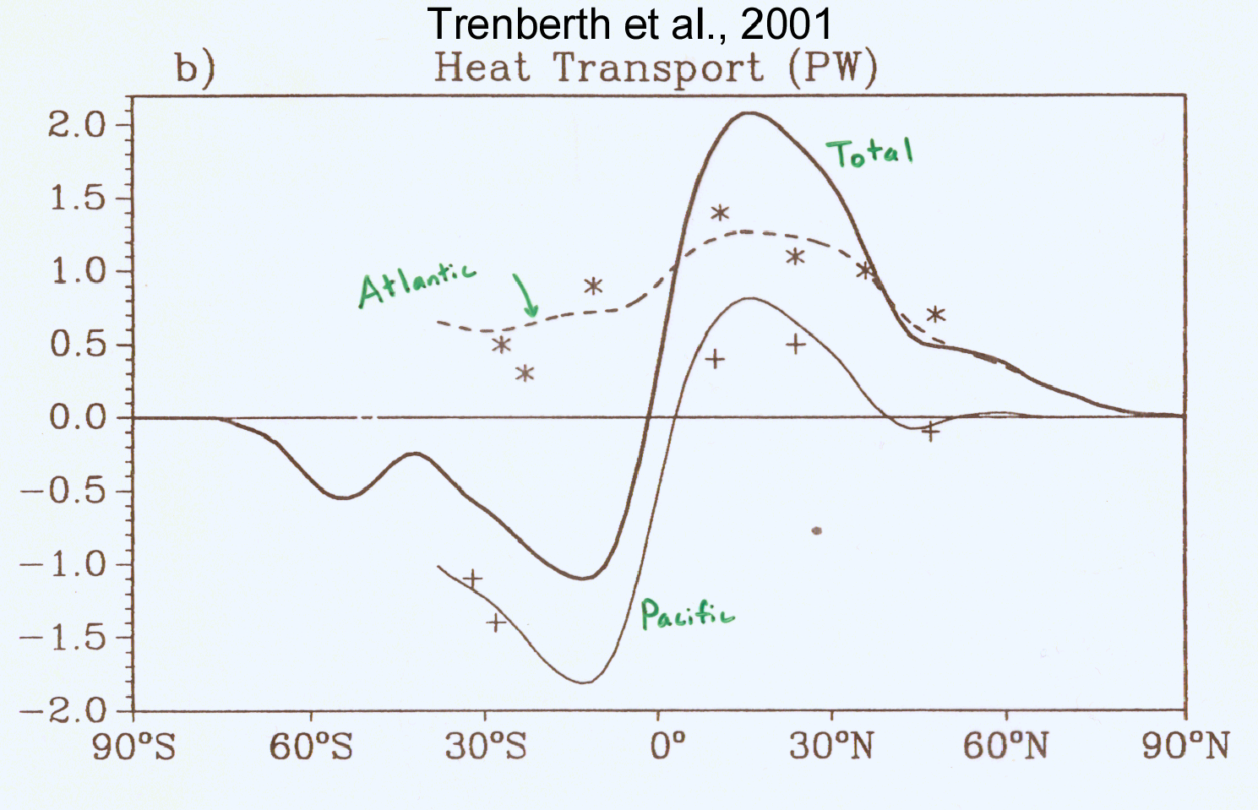
TC Mixing May Induce Much or Most of the Observed Poleward Heat Flux by the Oceans
Notes:
54

Slide 55
Estimate from satellite-derived wake recoveries
Extrapolation from detailed ocean measurements of one storm
Estimate of total heat uptake by tropical oceans

Slide 56
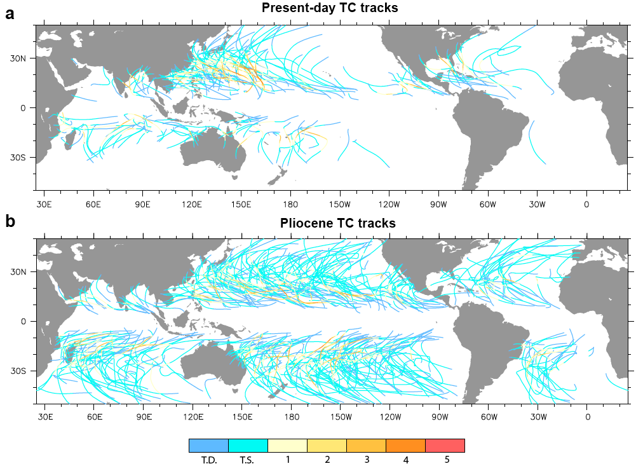

Slide 57
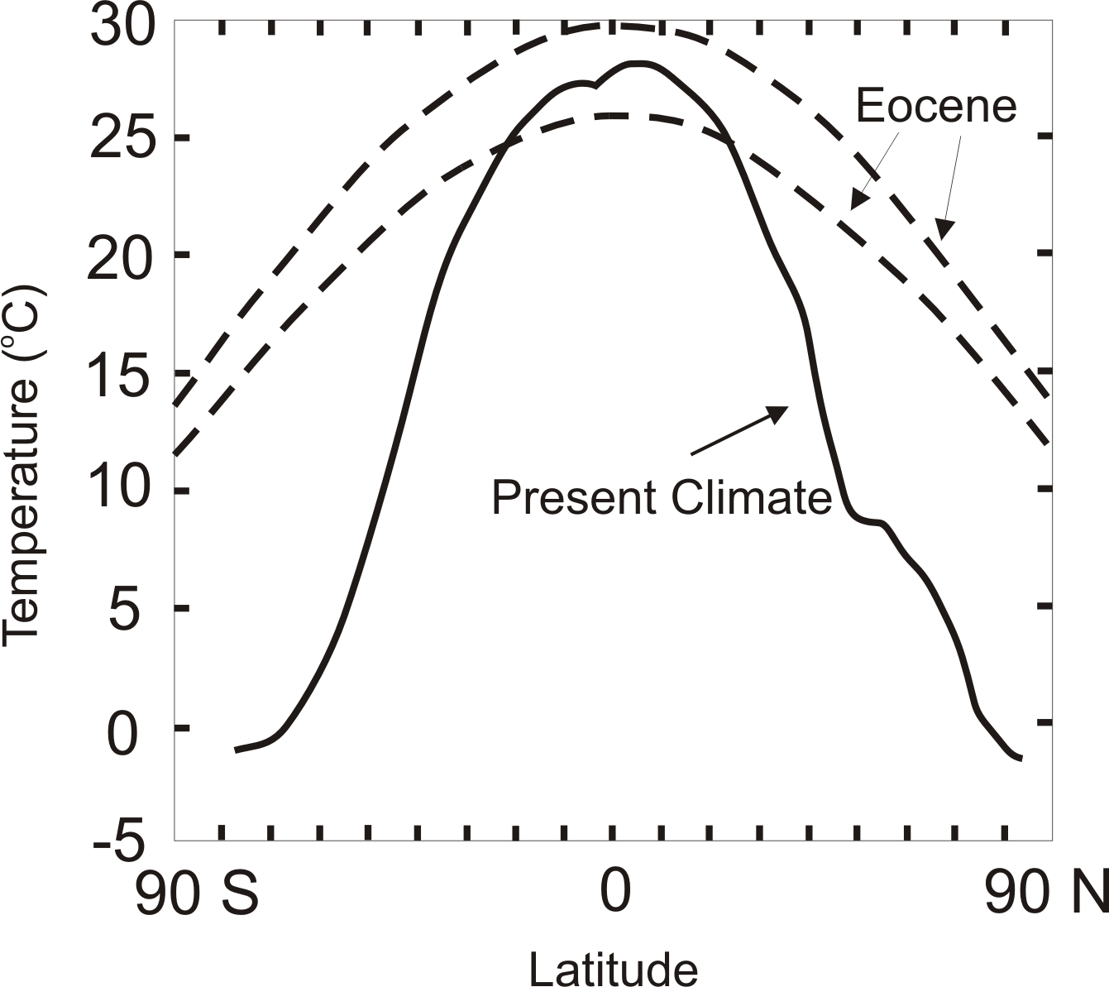
TC-Mixing may be Crucial for High-Latitude Warmth and Low-Latitude Moderation During Warm Climates, such as that of the Eocene
Notes:
57

Slide 58
Summary
Potential intensity is an important (but not the only) control on tropical cyclone activity, including frequency and intensity
On time scales long enough for the ocean mixed layer to be in thermal equilibrium, potential intensity is controlled largely by surface radiation, surface wind speed, ocean heat fluxes, and outflow temperature

Slide 59
Recent large, upward trends in potential intensity are partly attributable to cooling of the lower stratosphere
Models forced with observed SSTs not very successful in capturing this cooling

Slide 60
Simple but high resolution coupled TC model can be used to ‘downscale” TC activity from global climate data sets
Studies based on this downscaling suggest large sensitivity of TCs to climate state, and possibly important role for TC-induced ocean mixing in regulating climate

Slide 61

Depiction of central North America, ~60 million years ago
Our future?
Figure courtesy of Rob Korty, CalTech
Notes:
61

Slide 62
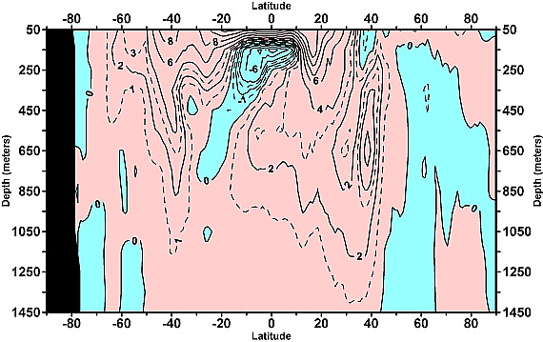
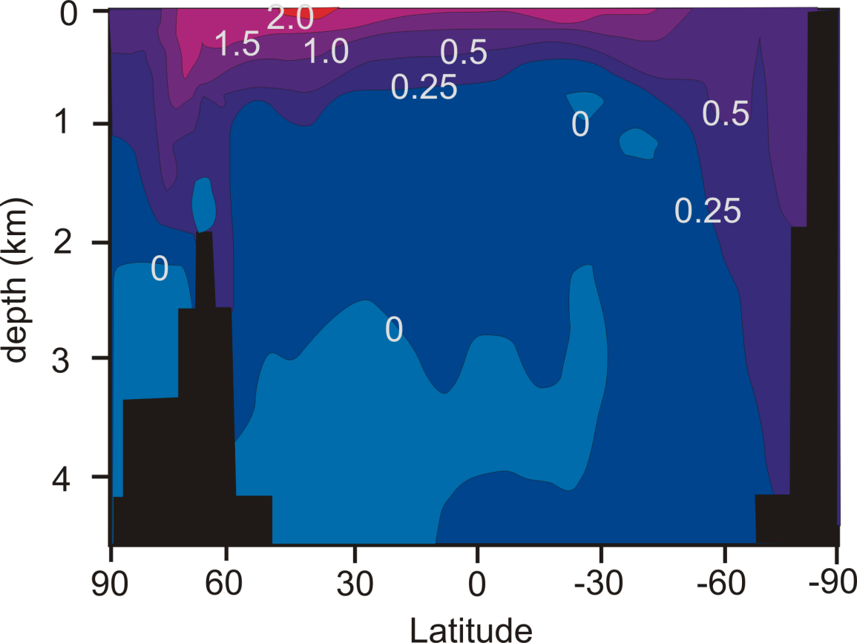
Linear trend (1955–2003) of the zonally integrated heat content of the world ocean by one-degree latitude belts for 100-m thick layers. Source: Levitus et al., 2005
TC-Mixing may explain difference between observed and modeled ocean warming
Zonally averaged temperature trend due to global warming in a coupled climate model. Source: Manabe et al, 1991
Notes:
62

