Slide 1
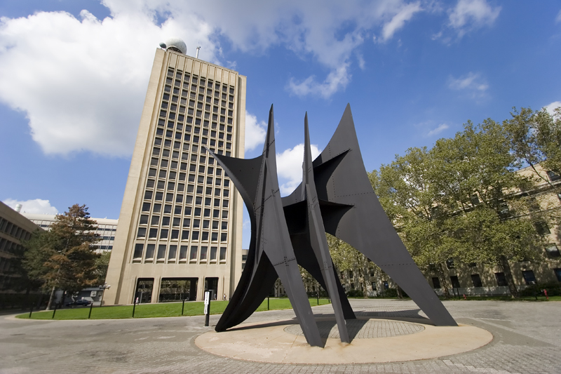
A Brief History of Meteorology and Oceanography at MIT
Kerry Emanuel

Slide 2
Synopsis
Founding of Meteorology at MIT
WWII and the Beginnings of the Department of Meteorology
Oceanography at MIT
Merger with EPS
The Future

Slide 3
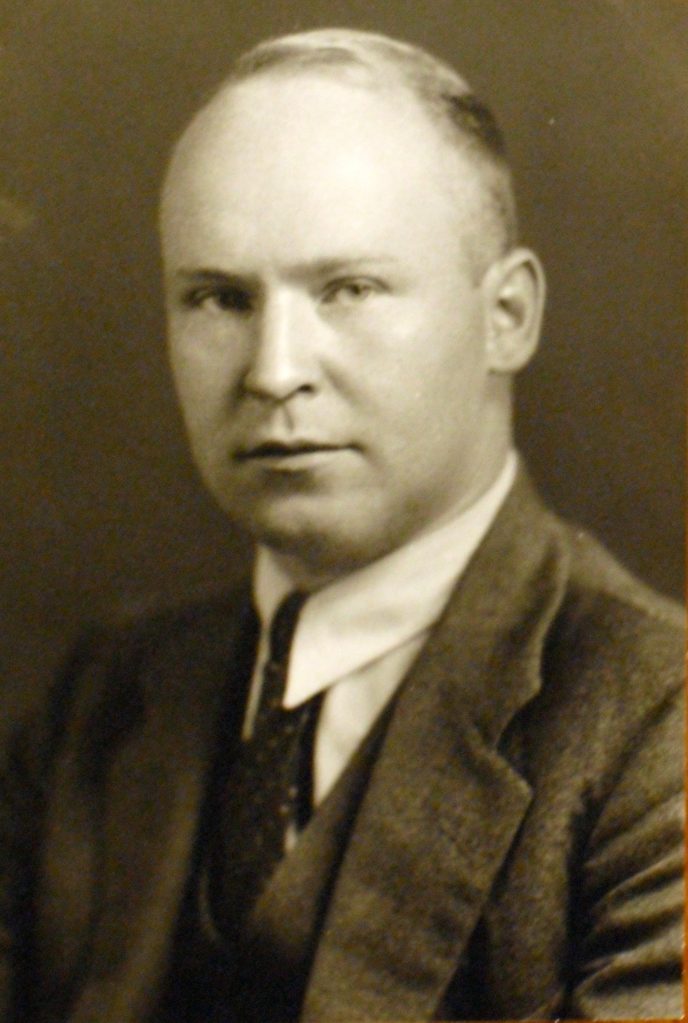
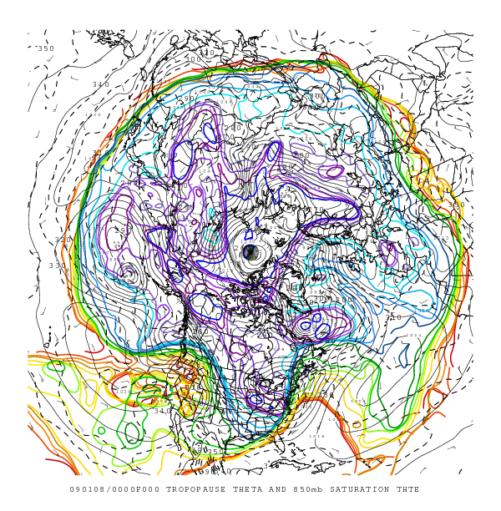
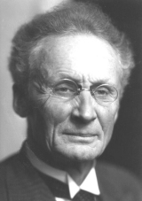
Carl-Gustav Rossby (1898-1957)
Vilhelm Bjerknes
Rossby waves
Rossby in 1933

Slide 4
Early Milestones
Late 1920’s: Guggenheim grant awarded to MIT for the establishment of a “Course in Meteorology”
September 1928: Rossby appointed to take charge of course, within the Department of Aeronautics, after being rejected by U.S. Weather Bureau. Began graduate program in meteorology
Rossby was determined to bridge what he called the “wide gulf between the mathematical theory, on the one hand, and weather map analysis and forecasting, on the other”.

Slide 5
Introduced Norwegian ideas of Fronts and Cyclones to the U.S.
Was persona non grata with the U.S. Weather Bureau before coming to MIT, but later joined the Bureau
Stressed importance of upper air measurements, analysis, and theory
Left MIT in 1939 to manage research and education at the U.S. Weather Bureau
Later founded the Department of Meteorology at the University of Chicago

Slide 6
Rossby with Radiosonde, 1934

Slide 7
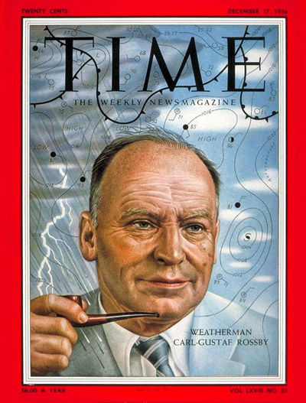
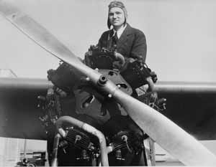
Professor Daniel Sayre ran an aircraft-based observation program under Rossby’s direction. Rossby himself, and Hurd Willett made weather observation flights each morning from East Boston Airport
Cover of Time, Monday, December 17th, 1956

Slide 8
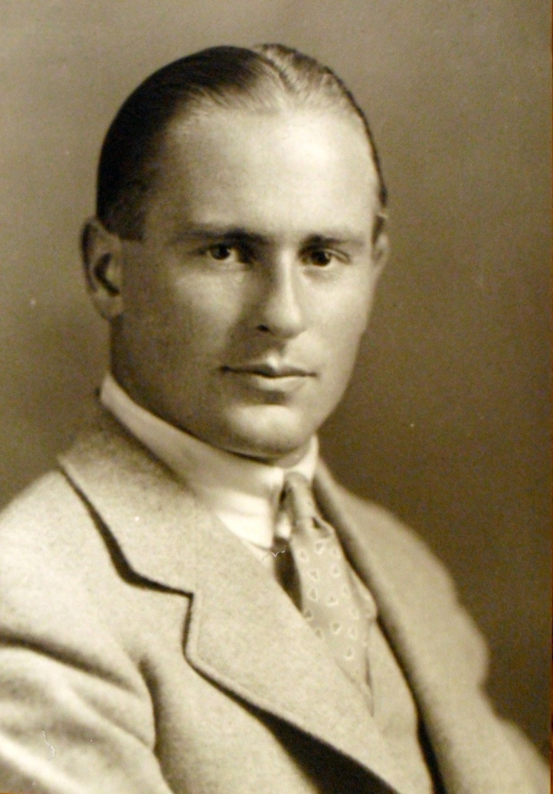
Hurd Curtiss Willett (1903-1992)
Brought to MIT by Rossby in 1929
Remained at MIT, retiring from teaching in 1968 but continuing research through 1988
Specialized in long-range forecasting
Willett in 1933

Slide 9
“Doc Willett” with students

Slide 10
The WWII Era and the Department of Meteorology
Department of Meteorology founded within the School of Engineering in 1941, as Course 14
Norwegian Meteorologist Sverre Petterssen , who had run the Meteorology group since Rossby’s departure in 1939, was appointed first Head of Department

Slide 11
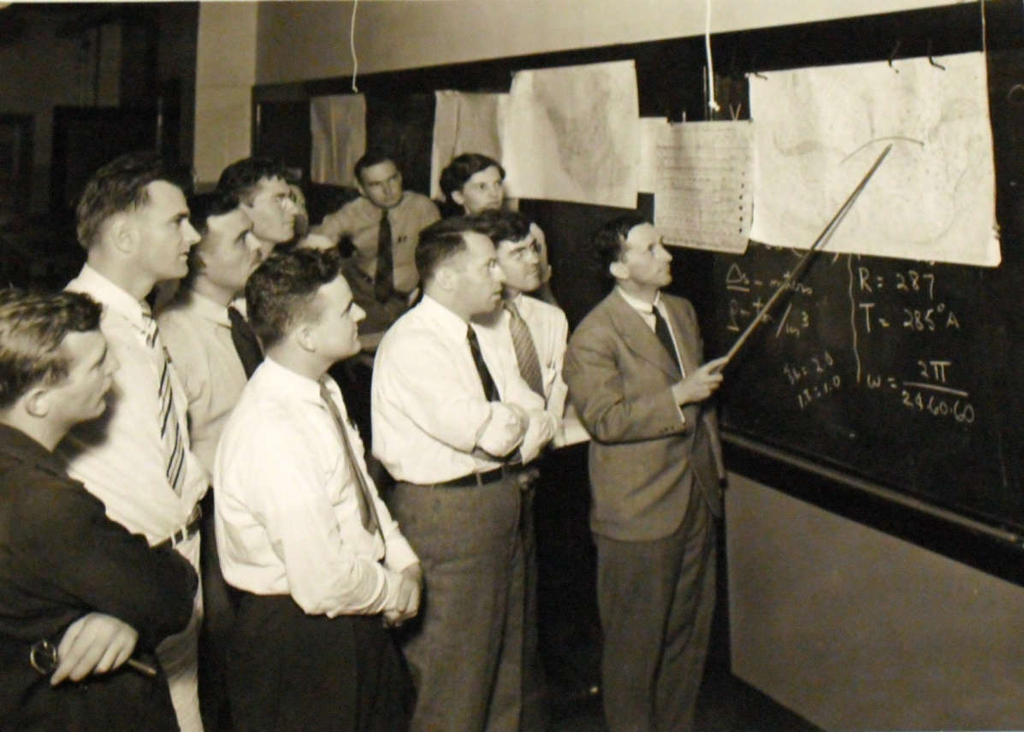
Sverre Petterssen (1898-1974)
Petterssen leading a map discussion at MIT, c. 1940. He resigned from MIT in August, 1942, to assist n the war effort. He was a lead forecaster for the critical forecast for D-Day, June 6th, 1944 . He wrote an autobiography...

Slide 12
The Houghton Era, 1942-1969
Henry Garrett Houghton (1905-1987)

Slide 13
Henry Houghton
Worked at MIT’s Round Hill Research Station from 1928-1938 on the fundamental physics of fog and clouds, including methods for dispersing fog
Served as research associate in aeronautical engineering from 1938-1939 when he became an assistant professor of meteorology
Department Head from 1942-1969

Slide 14
Led the new department’s contribution to the war effort by instituting a training program for weather officers. Enrollment in the department increased from ~30 in 1942 to ~500 in 1944
Oversaw the creation of weather radar
Created the world’s foremost academic research and education program in meteorology, especially by recruiting Jule Charney, Norman Phillips, Victor Starr, and Edward Lorenz in the 1950s
Helped bring oceanography to MIT and integrate it with meteorology
Among the founders of the University Corporation for Atmospheric Research (UCAR) in 1959 and was the first chairman of its board

Slide 15
Hard at work (with a slide rule)
Henry (left) with fog dispersing apparatus at Round Hill

Slide 16
Henry Houghton, Delbar Keily, and James Austin at WBZ Radio, 1948

Slide 17
Early Radar Depiction of a Hurricane (Edna of 1954)

Slide 18
Key Faculty Appointments under Houghton
Victor Starr (1947)
Edward Lorenz (1955)
Frederick Sanders (1955)
Jule Charney (1956)
Norman Phillips (1956)
Willem Malkus (1959)
George Veronis (1961)
Reginald Newell (1961)
Henry Stommel (1963)
Erik Mollo-Christensen (~1963)
Carl Wunsch (1967) (appointed to EPS)
Peter Rhines (1968)

Slide 19
Strong Affiliation with Applied Math at MIT: Key Appointments
Louis Howard (1955)
David Benney (1957)
Harvey Greenspan (1960)
Joseph Pedlosky (1964)
Willem Malkus (1970)

Slide 20
Victor Paul Starr (1909-1974)

Slide 21
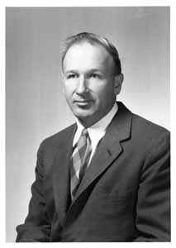
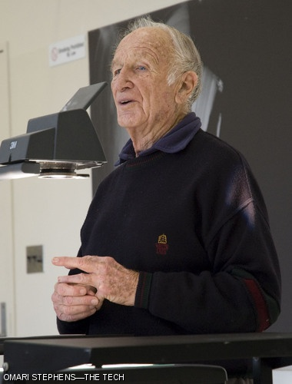
Edward Norton Lorenz (1917-2008)

Slide 22
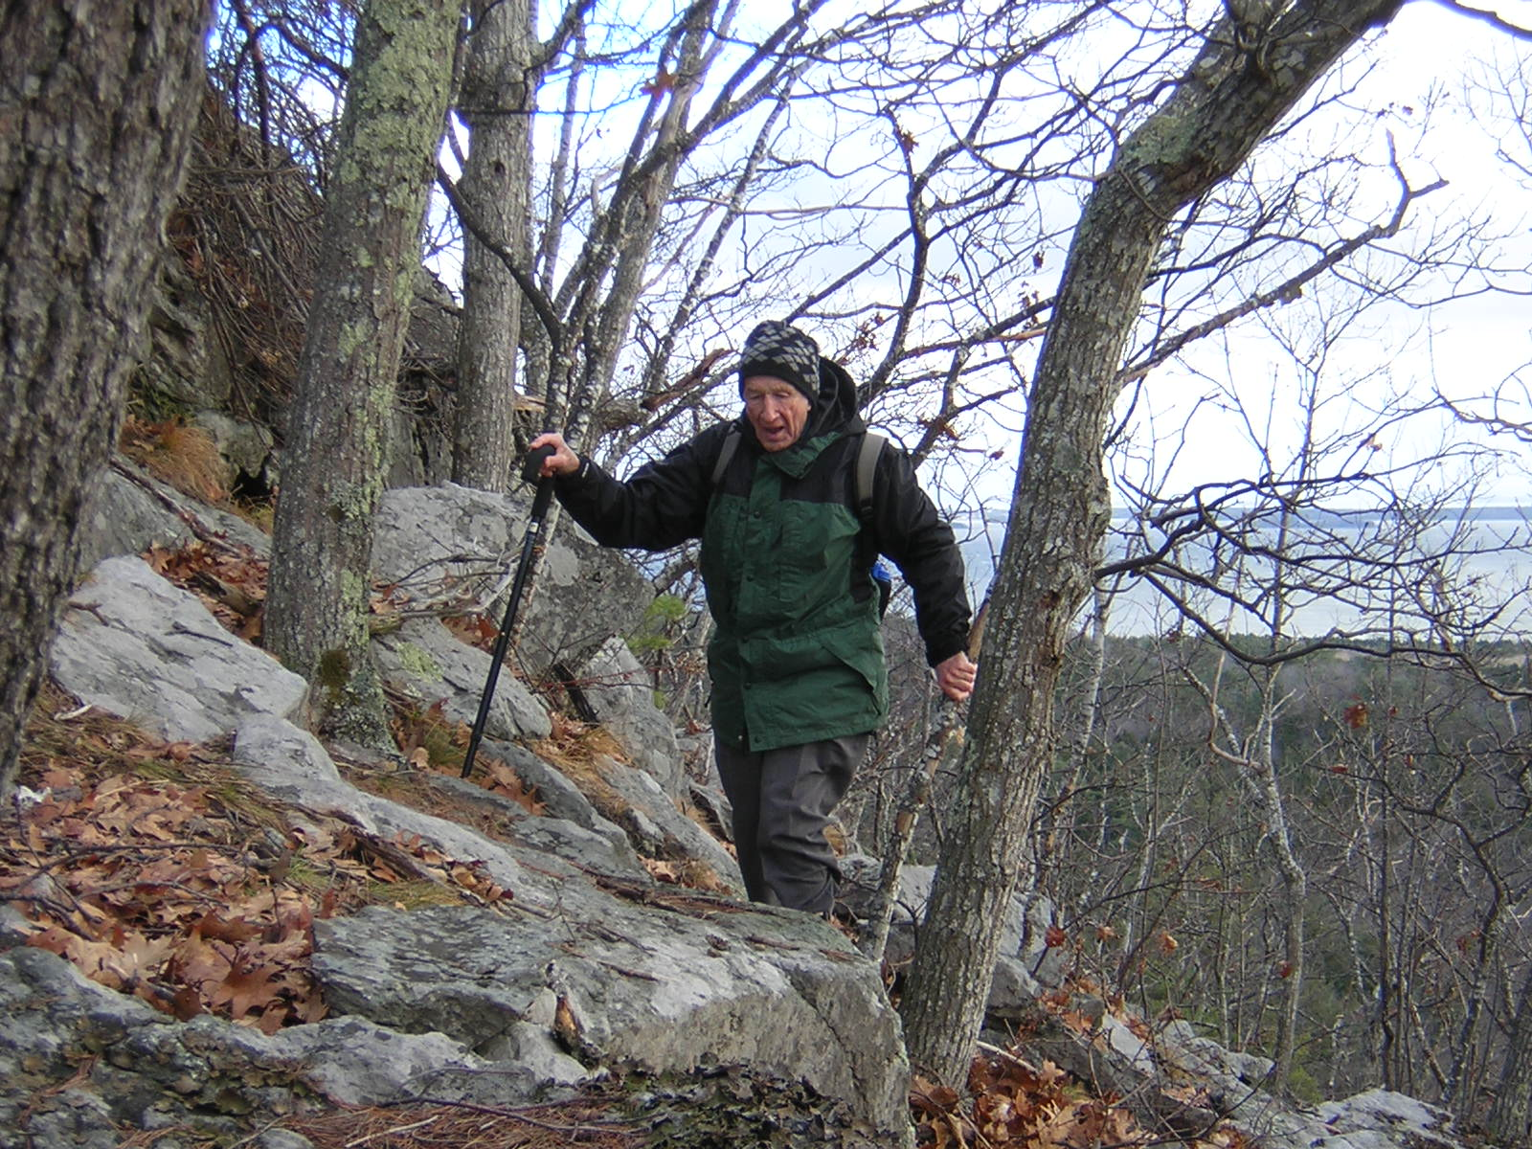
Poincare Diagram of Strange Attractor
Avid Hiker

Slide 23
Frederick Sanders (1923-2006)

Slide 24
Fred Sanders (far left) defending his thesis before Henry Houghton (at board), Alan Bemis (seated at left), Tom Malone, Mort Wurtele, Victor Starr, and Jim Austin

Slide 25
Jule Gregory Charney, (1917-1981)

Slide 26
Norman Alton Phillips (1923 - )

Slide 27
Loessen, Keegan, Thompson, Lettau ,London
Dulezel, Cooley, White ,Wahl, Long, Mintz
Widger, Fultz, Lowell, Martin, Hess, Benton, Wexler, Charney
Salmela, Willett, Kuo, Solot, Shapiro, Bjerknes, Lorenz, Starr

Slide 28
Reginald Newell (1931-2002)

Slide 29
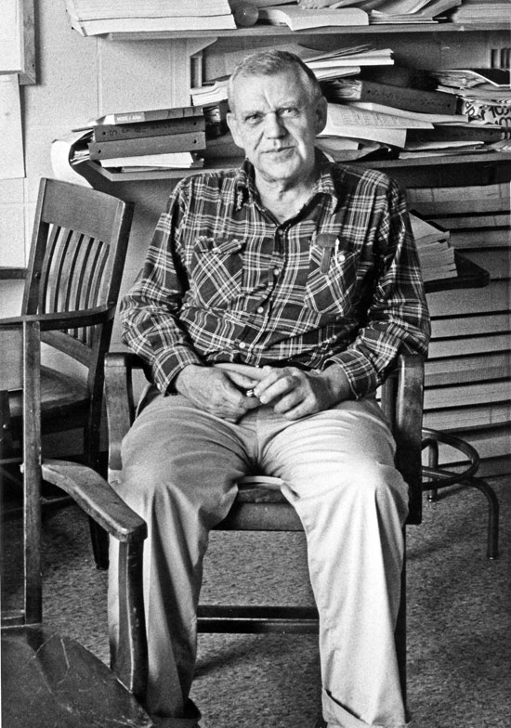
Henry Melson Stommel (1920-1992)

Slide 30
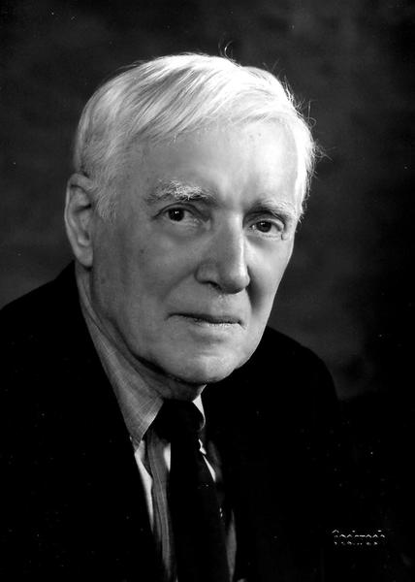
Erik Leonard Mollo-Christensen (1923-2009)

Slide 31
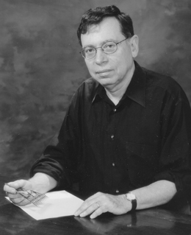
Carl Isaac Wunsch (1941- )

Slide 32
Key Organizational Developments:
Course Number changed to 19 in 1946
Moved from School of Engineering to School of Science in 1957
Moved from Bldg 24 to Cecil and Ida Green Building, 1964
Joint Program with WHOI formed in 1968
Changed name to Department of Meteorology and Physical Oceanography in 1981
Merged with Department of Earth and Planetary Sciences to become EAPS in 1983
Center for Meteorology and Physical Oceanography founded in 1983 to serve as focus for these endeavors within EAPS
Changed name to Program in Atmospheres, Oceans, and Climate in 1997

Slide 33
The Cecil and Ida Green Building
Under Construction, 1963
Completed, 1964

Slide 34
Henry Houghton passed away in 1987, leaving his considerable estate to MIT to
“support of research by students in the fields of meteorology and physical oceanography or for any other purpose that enhances and enriches the total educational experience of such students”.

Slide 35
Department Chairs, 1970-1983
Norman Phillips, 1970‑1974
Jule Charney, 1974‑1977
Edward Lorenz, 1977‑1981
Peter Stone, 1981‑1983
Note: Carl Wunsch chaired EPS, 1977-1981

Slide 36
A Random Selection of Graduates
Horace Byers
Edward Lorenz
Richard Reed
Robert White
David Atlas
Kirk Bryan
Philip Thompson
Barry Saltzmann
Frederick Sanders
Melvyn Stern
Joseph Pedlosky
William Holland
Conway Leovy

Slide 37
Abraham Oort
James Holton
Lance Bosart
Robert Dickinson
John (Mike) Wallace
Isidoro Orlanski
Robert Houze
Ants Leetmaa
Anthony Hollingsworth
Eugenia Kalnay
Peter Webster
Mark Cane
Inez Fung
William Young

Slide 38
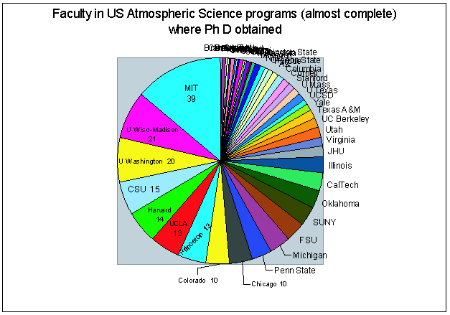
PAOC graduates are disproportionately represented among atmospheric science faculty in the U.S.

Slide 39
Future of PAOC
Objective is to become the world’s leading center for research and education in climate science
Maintain strengths in atmosphere and ocean dynamics and geochemistry while building a diverse expertise in climate science
Become the top graduate program in climate science, worldwide
Play a fundamental role in making MIT undergraduates environmentally literate

Slide 40
Peter Stone and Paola Rizzoli in Venice

