Slide 1

Using physics to assess evolving hurricane risk
Kerry Emanuel
Lorenz Center
Massachusetts Institute of Technology

Slide 2

Program
Limitations of the actuarial approach
A physics-based approach
Example applications

Slide 3
The Global Hurricane Hazard
About 10,000 deaths per year since 1971
$700 Billion 2015 U.S. Dollars in Damages Annually since 1971
Global population exposed to hurricane hazards has tripled since 1970
EM-DAT, 2016: The OFDA/CRED International Disaster Database
http://www.emdat.be/.

Slide 4
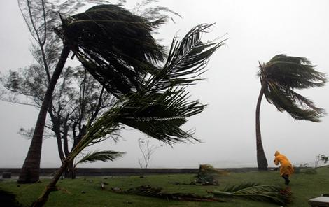
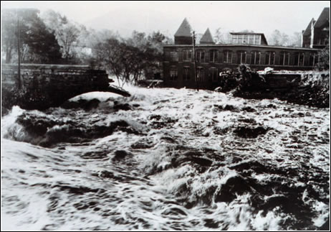
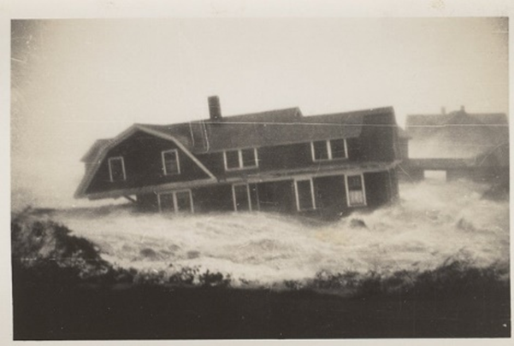
Hurricane Risks:
Wind
Rain
Storm Surge

Slide 5

Publicly
insured…
No $$$
Privately insured… $$$

Slide 6

Limitations of the Actuarial Approach
Notes:
6

Slide 7
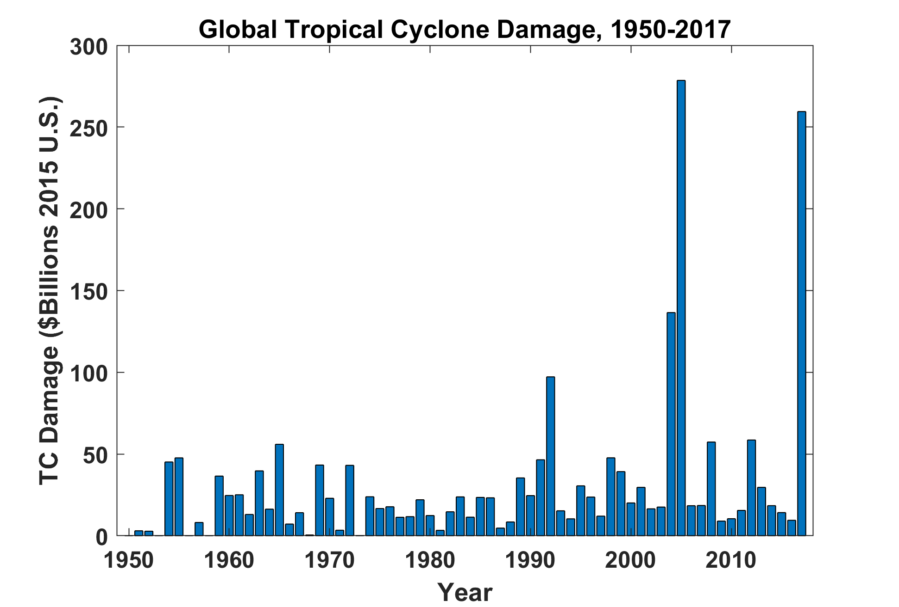
EM-DAT, 2018: The OFDA/CRED International Disaster Database
http://www.emdat.be/. GDP correction from Federal Reserve Bank

Slide 8
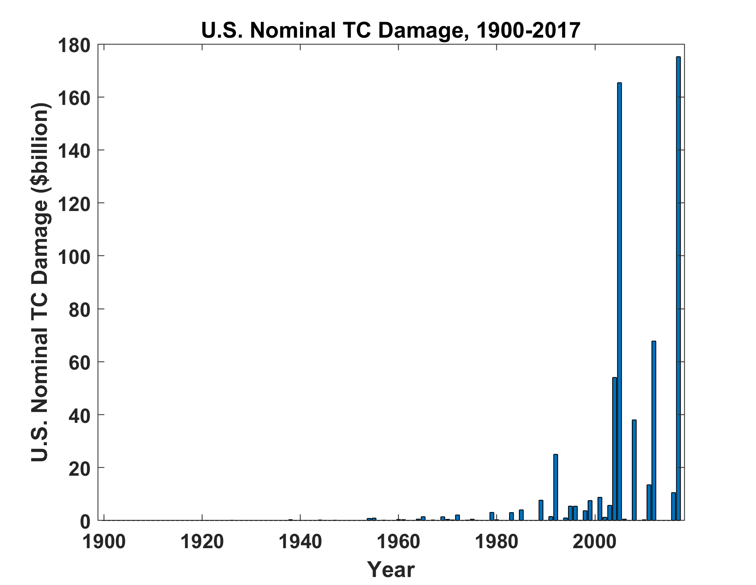
Source: ICAT Damage Estimator, http://www.icatdamageestimator.com/

Slide 9
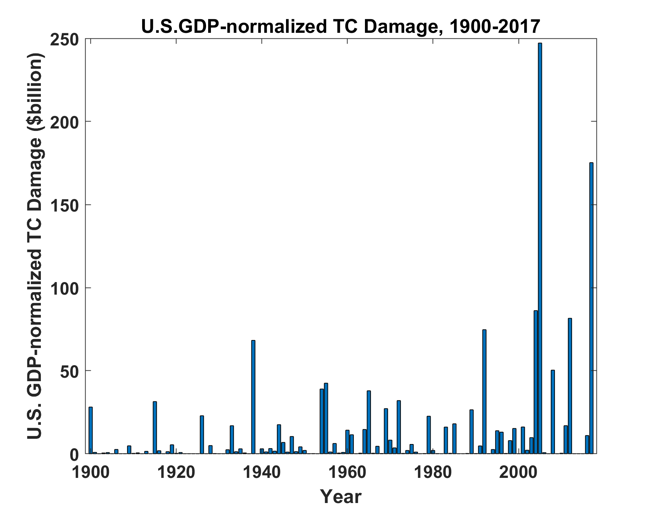
Source: ICAT Damage Estimator, http://www.icatdamageestimator.com/
GDP data from https://www.measuringworth.com/datasets/usgdp/

Slide 10
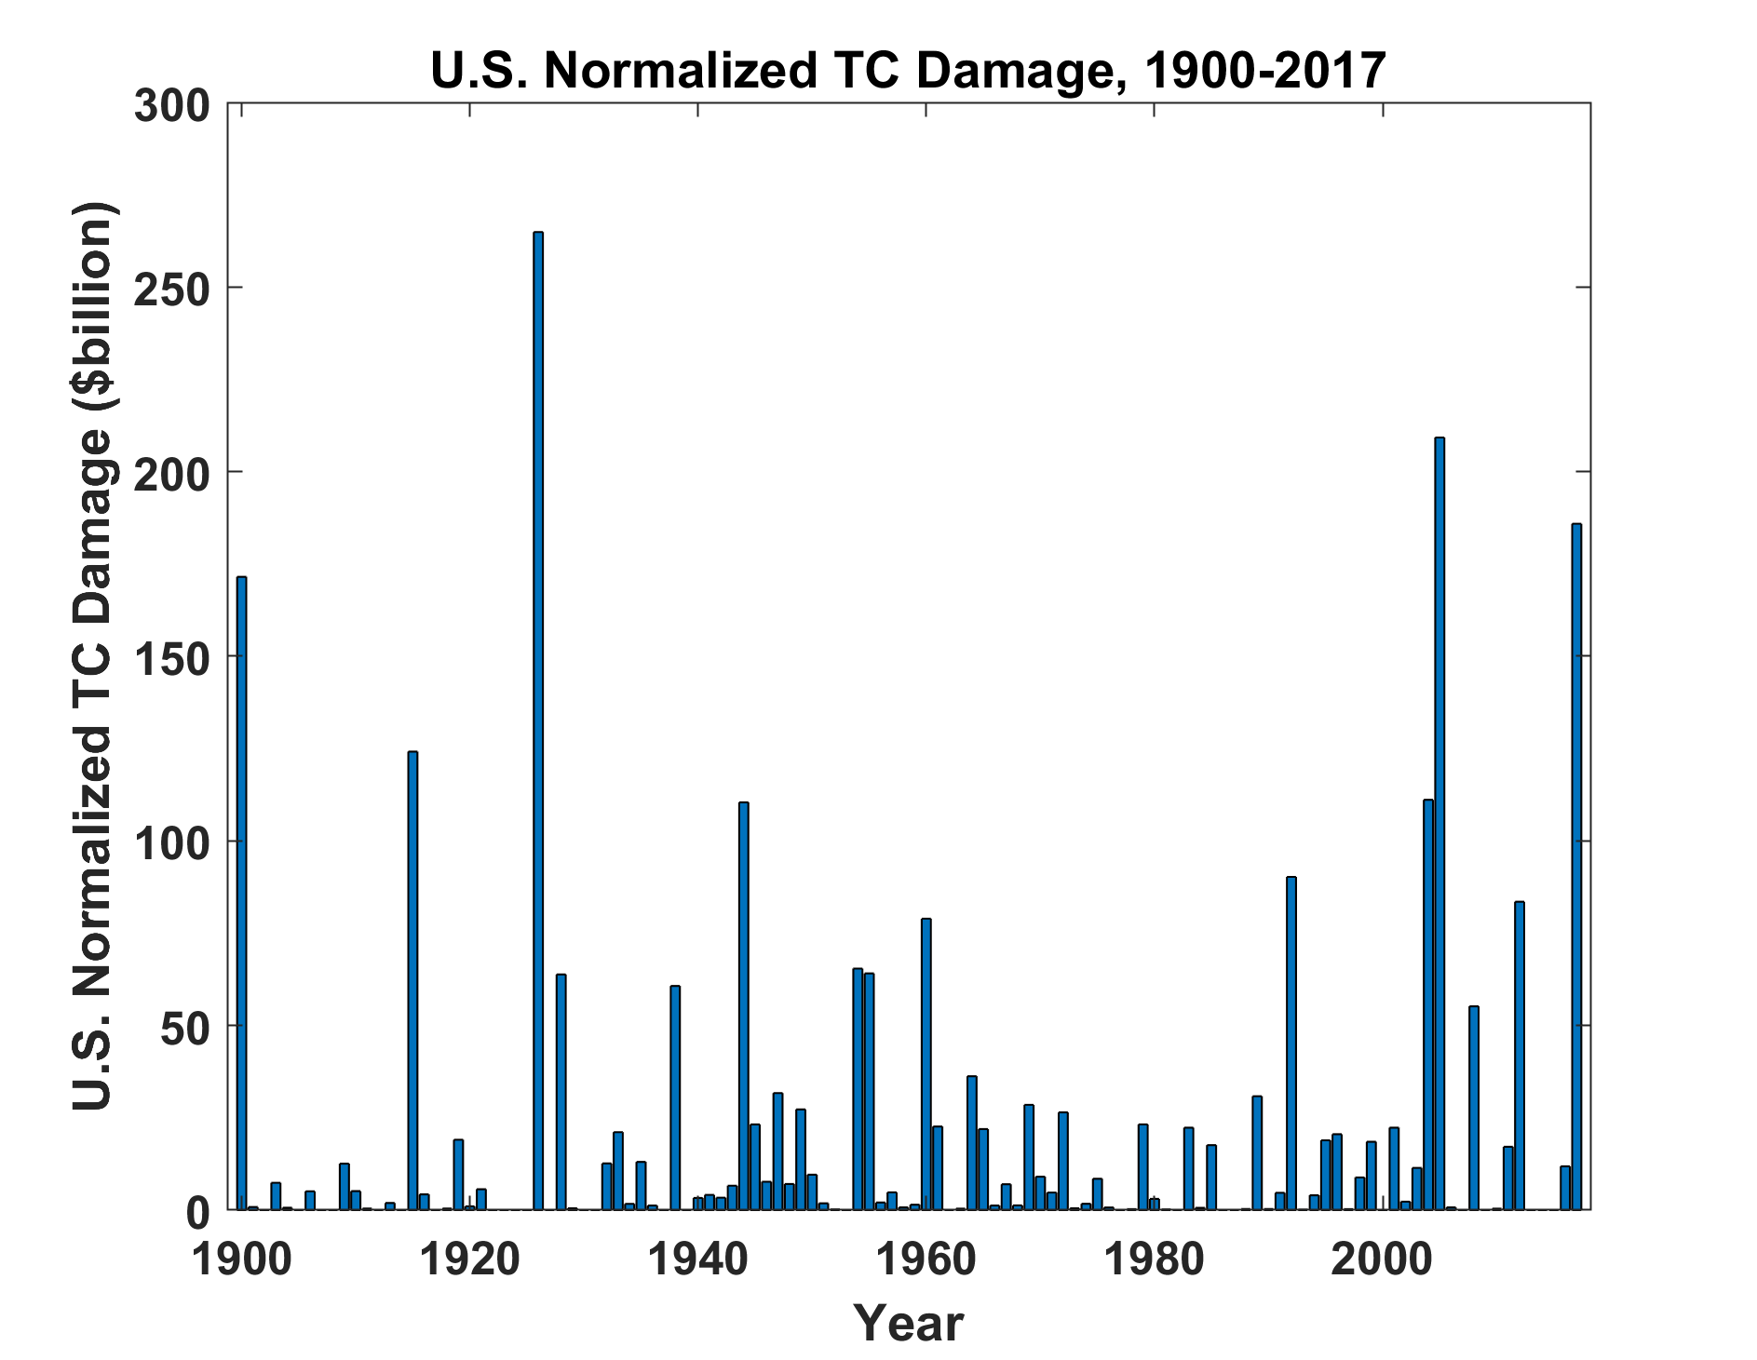
Source: ICAT Damage Estimator, http://www.icatdamageestimator.com/
See also Klotzbach et al., Bull. Amer. Meteor. Soc., 2018

Slide 11
Limitations of a strictly statistical approach to hurricane risk assessment
>50% of all normalized U.S. hurricane damage, 1900-2017, caused by top 10 events, all but one (Sandy) were category 3, 4 and 5
>75% of all damage caused by top 30 events
>78% of all damage caused by storms of category 3 and greater
Landfalling storm statistics are inadequate for assessing hurricane risk

Slide 12

Is Hurricane Risk Changing?

Slide 13
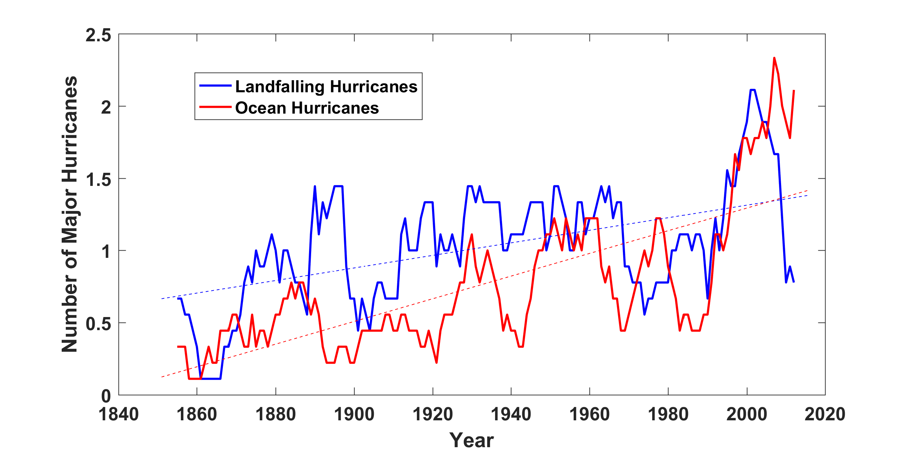
Historical Records:
Prior to 1970, Many Storms Were Missed
Major hurricanes in the North Atlantic, 1851-2016, smoothed using a 10-year running average. Shown in blue are storms that either passed through the chain of Lesser Antilles or made landfall in the continental U.S.; all other major hurricanes are shown in red. The dashed lines show the best fit trend lines for each data set.

Slide 14
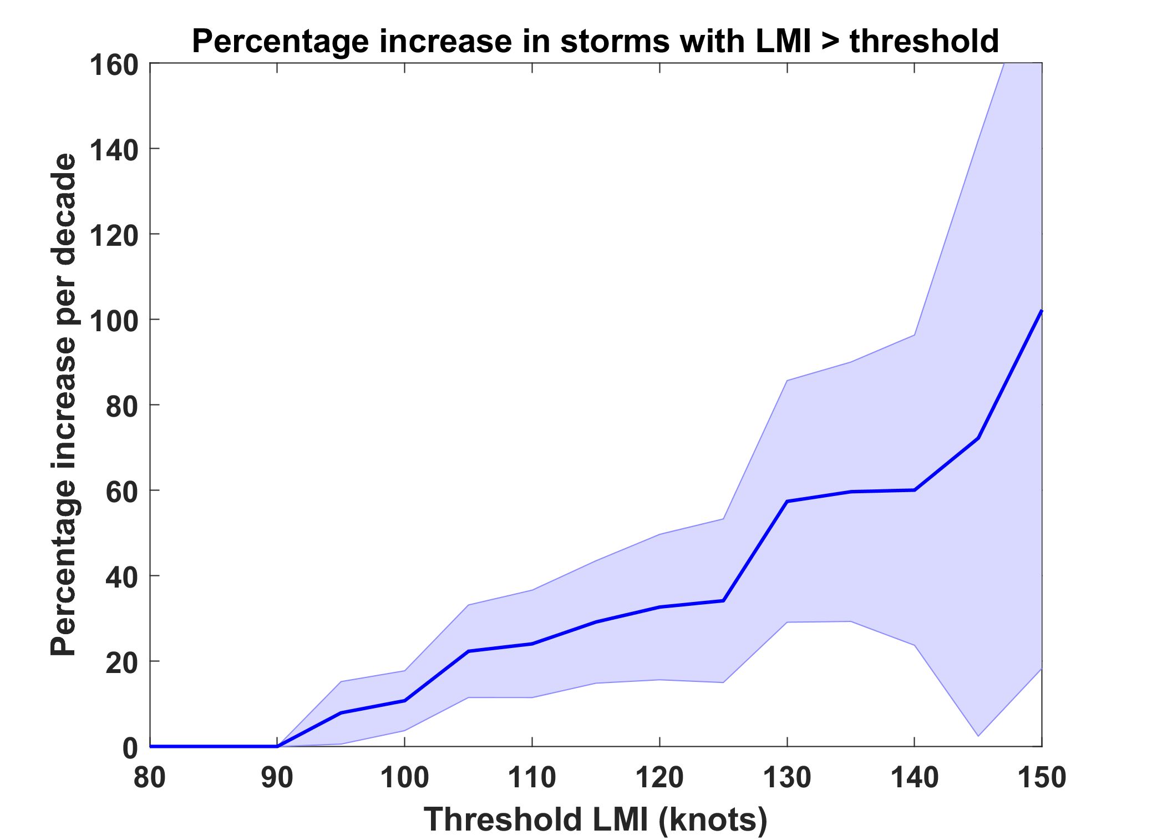
Trends in Global TC Frequency Over Threshold Intensities, from Historical TC Data, 1980-2016. Trends Shown Only When p < 0.05.

Slide 15
Hurricanes are reaching peak intensity at higher latitudes
Time series of the latitudes at which tropical cyclones reach maximum intensity.
From Kossin et al. (2014)

Slide 16
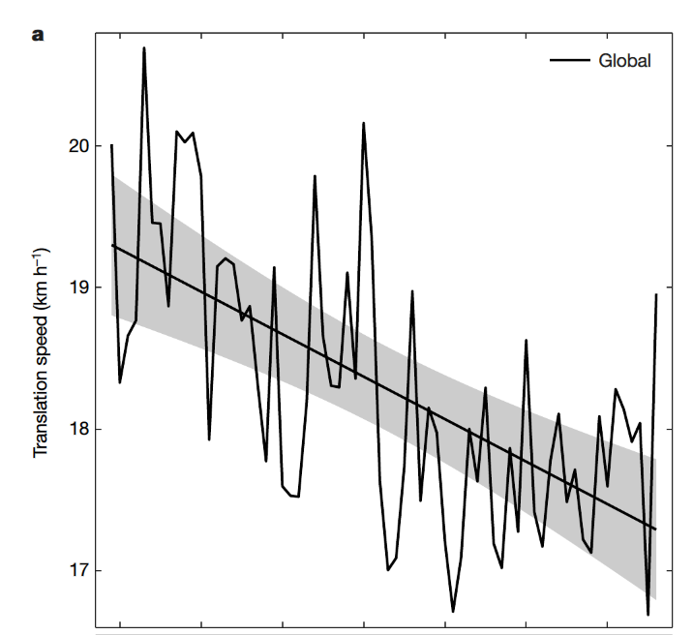
Tropical Cyclones are Slowing Down (Kossin, Nature, 2018)

Slide 17
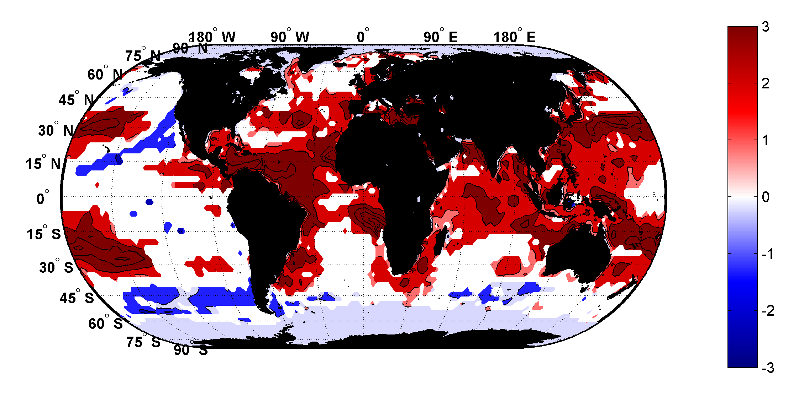
Trends in Thermodynamic Potential for Hurricanes, 1980-2010
(NCAR/NCEP Reanalysis)
ms⁻¹decade⁻¹

Slide 18
Using Physics to Estimate Hurricane Risk

Slide 19
Why Not Use Global Climate Models to Simulate Hurricanes?

Slide 20

Global models do not simulate the storms that cause destruction
Category 2-3 boundary
Modeled
Histograms of Tropical Cyclone Intensity as Simulated by a Global Model with 50 km grid point spacing. (Courtesy Isaac Held, GFDL)
Observed

Slide 21
How to deal with this?
Embed high-resolution, fast coupled ocean-atmosphere hurricane model in global climate model or climate reanalysis data
Coupled Hurricane Intensity prediction Model (CHIPS) has been used for 16 years to forecast real hurricanes in near-real time

Slide 22
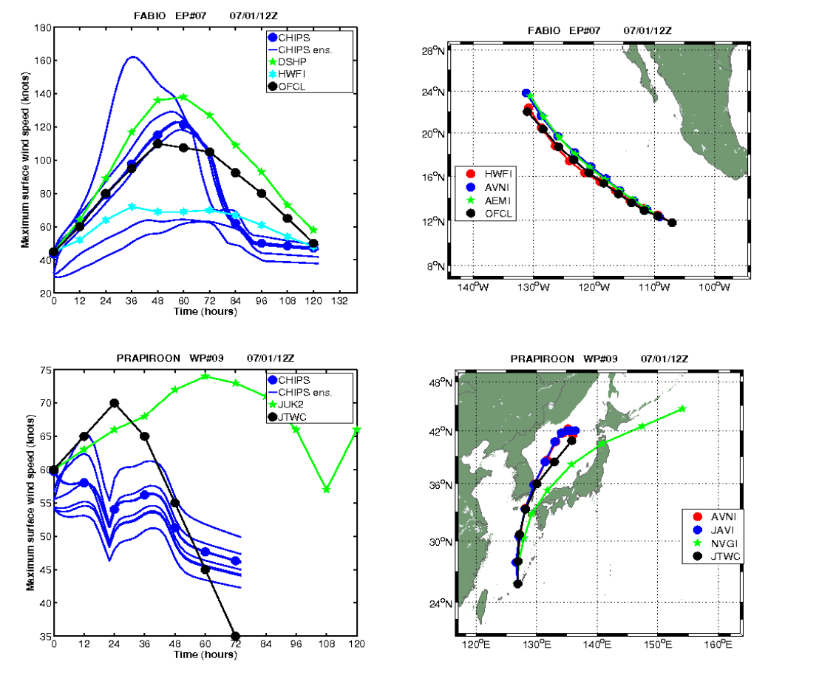
Real-time forecasts at http://wind.mit.edu/~emanuel/storm.html

Slide 23
How Can We Use This Model to Help Assess Hurricane Risk in Current and Future Climates?

Slide 24
Risk Assessment Approach:
Step 1: Seed each ocean basin with a very large number of weak, randomly located cyclones
Step 2: Cyclones are assumed to move with the large scale atmospheric flow in which they are embedded, plus a correction for the earth’s rotation and sphericity
Step 3: Run the CHIPS model for each cyclone, and note how many achieve at least tropical storm strength
Step 4: Using the small fraction of surviving events, determine storm statistics. Can easily generate 100,000 events
Details: Emanuel et al., Bull. Amer. Meteor. Soc, 2008
Notes:
24

Slide 25
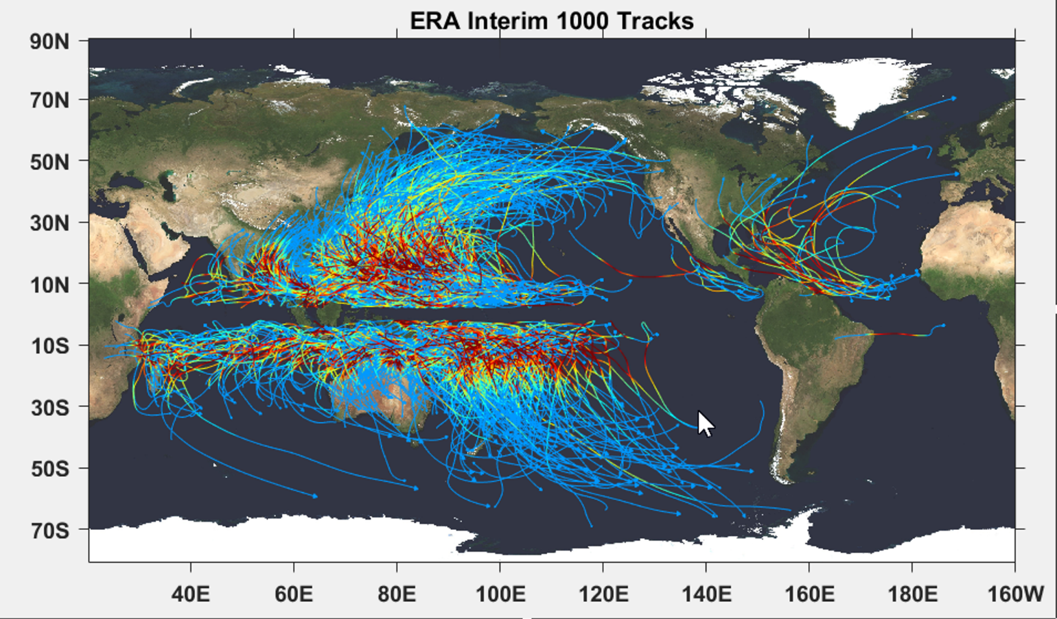

Slide 26
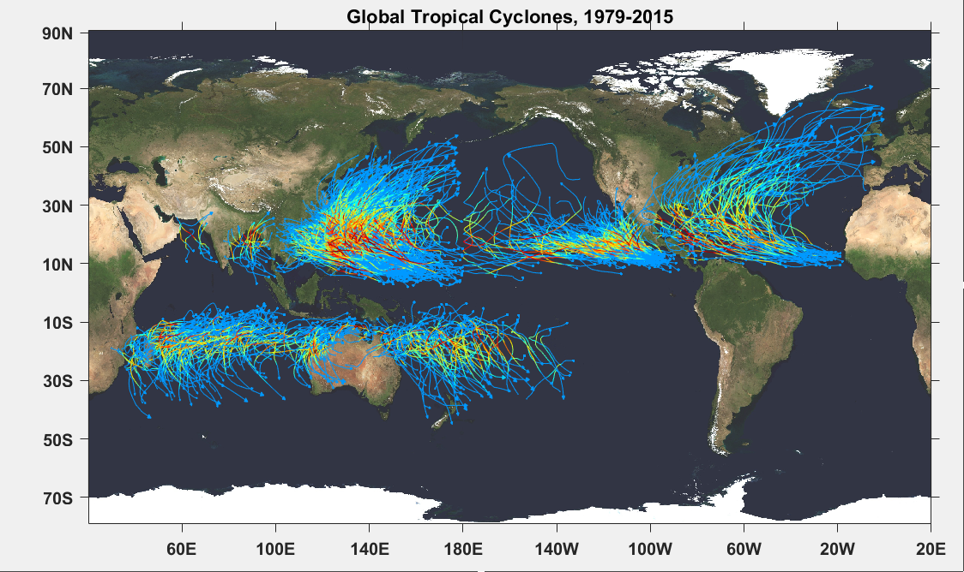

Slide 27
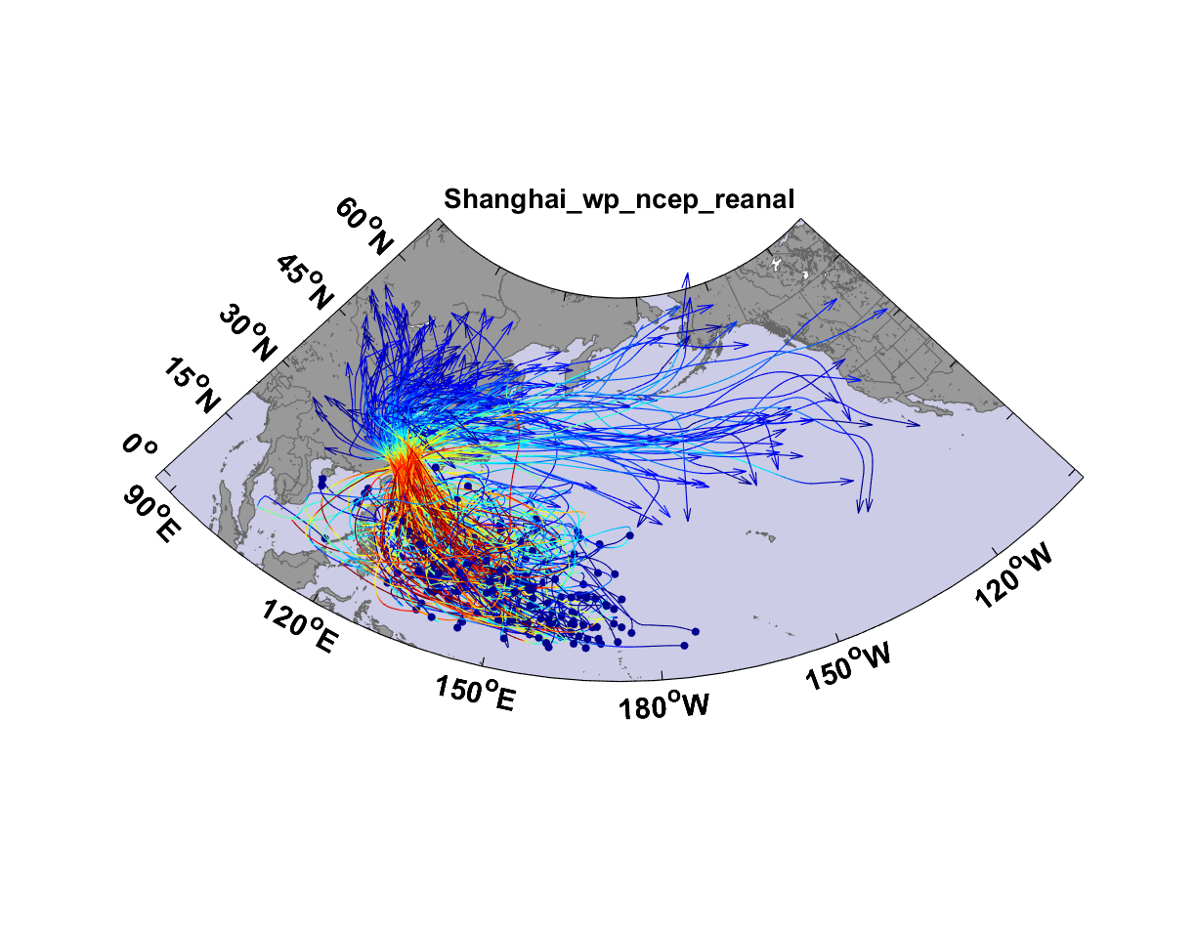
Top 200 out of 5180 TCs Affecting Shanghai

Slide 28
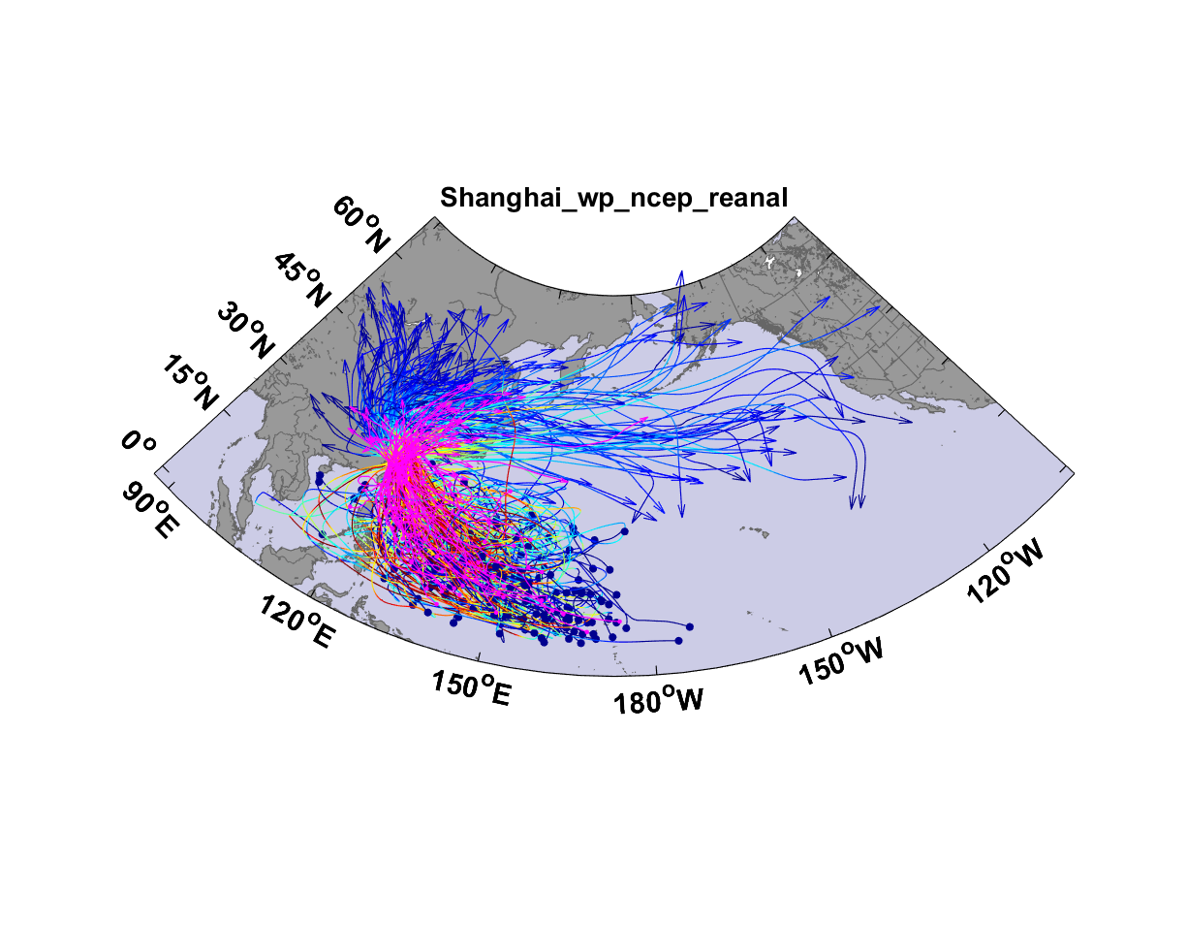
Top 200 out of 5180 TCs Affecting Shanghai

Slide 29
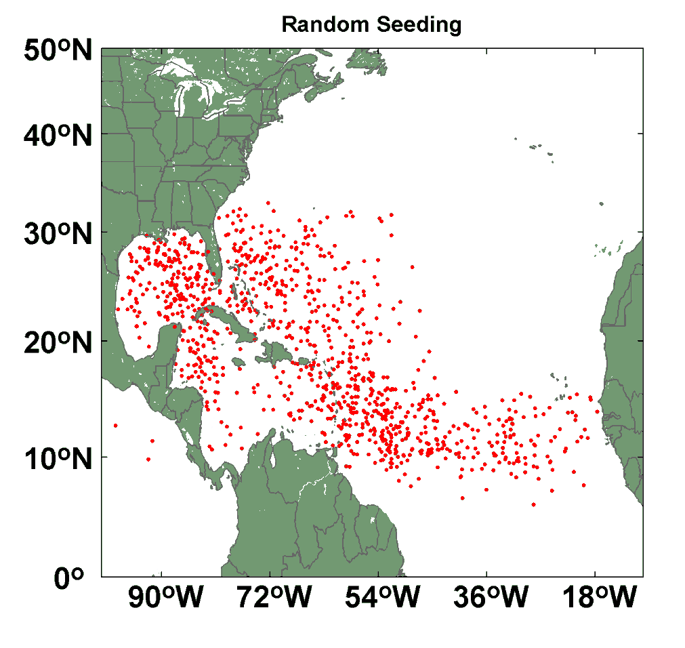
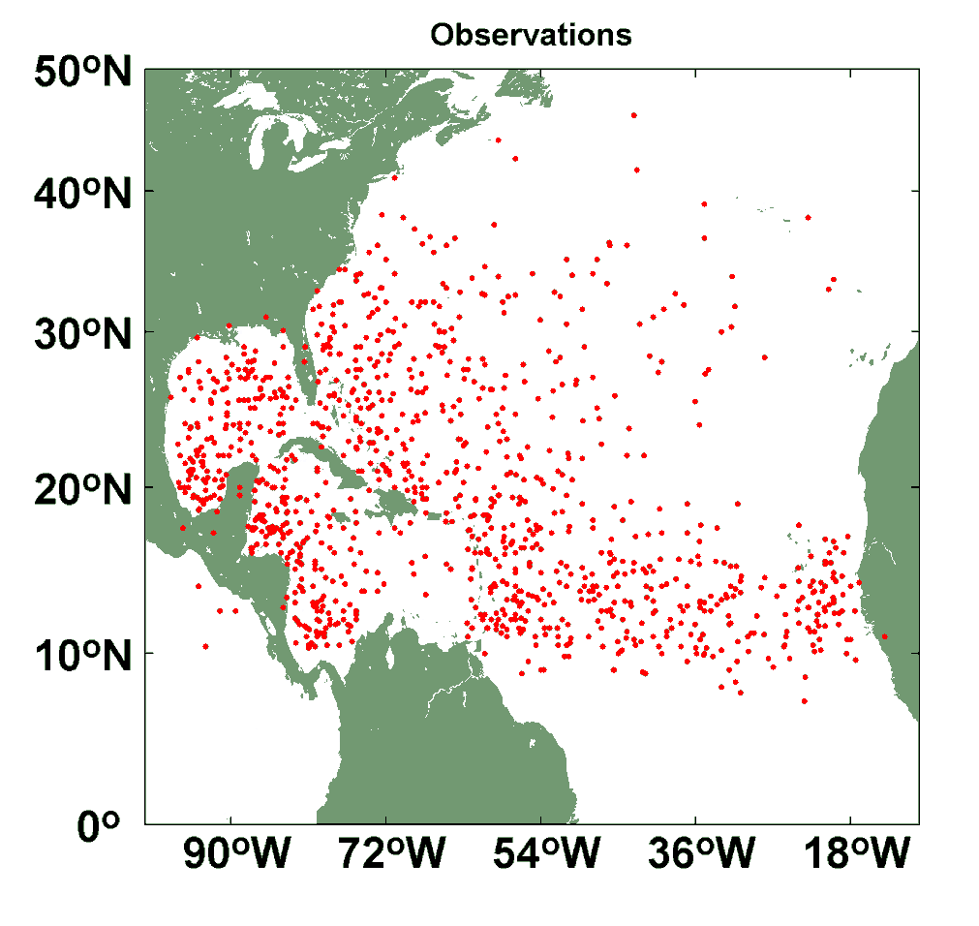
Comparison of Random Seeding Genesis Locations with Observations

Slide 30

Cumulative Distribution of Storm Lifetime Peak Wind Speed, with Sample of 1755 Synthetic Tracks
90% confidence bounds

Slide 31
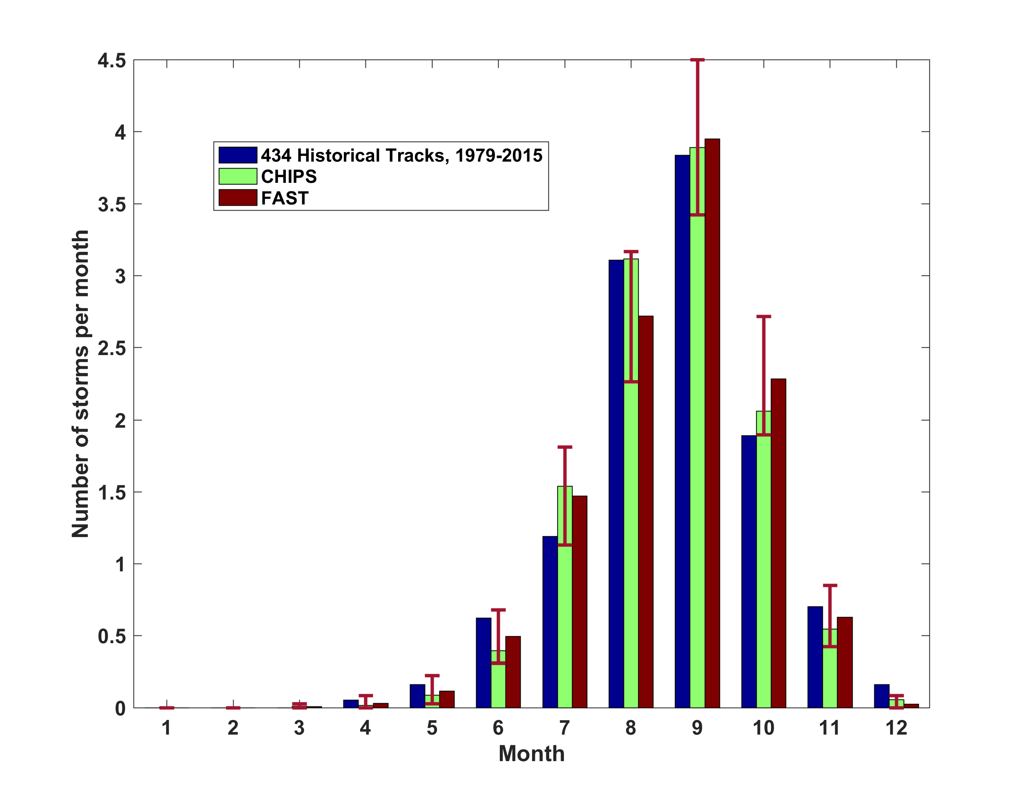
Atlantic Annual Cycle

Slide 32
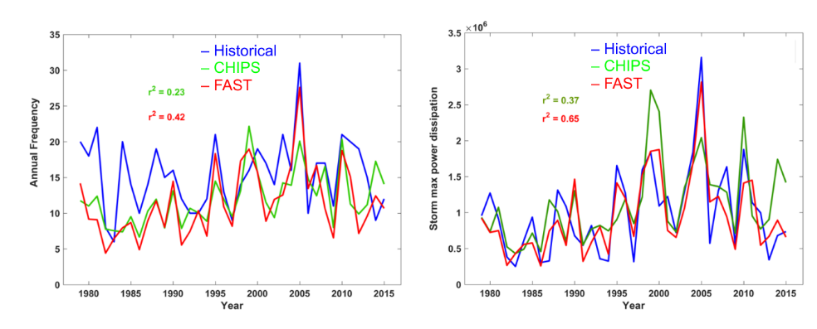
Atlantic Interannual Variability
Frequency
Power Dissipation

Slide 33

Return Periods

Slide 34
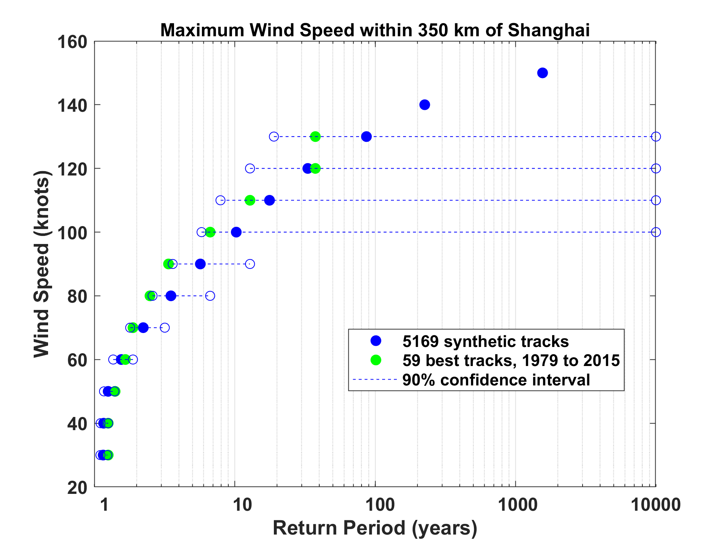

Slide 35
Sample Storm Wind Swath

Slide 36
Accumulated Rainfall (mm)

Slide 37
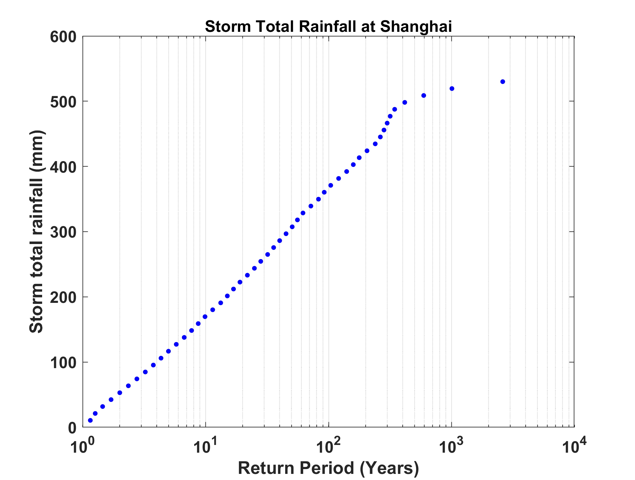

Slide 38
Charleston, SC
Corpus Christi, TX
Radar
Rain gauge
Model
Missing radar data
Sampling uncertainty
Raleigh, NC
New York, NY
(with Monika Feldmann, ETH)

Slide 39


Storm Surge Simulation
SLOSH model
(Jelesnianski et al. 1992)
SLOSH mesh
~ 10³ m
ADCIRC mesh
~ 10² m
Battery
ADCIRC model
(Luettich et al. 1992)
ADCIRC mesh
~ 10 m
(Colle et al. 2008)
Notes:
Given the storm wind and pressure fields (which is estimated from the Holland parametric pressure model) we can simulate the surge. Surge simulations with high resolution are computationally intensive, so to make it possible to simulate accurate surges for our large synthetic storm sets, we apply the two hydrodynamic models with girds of various resolutions in such a way that the main computational effort is concentrated on the storms that determine the risk. First, we apply the SLOSH model, using a mesh with resolution of about 1 km around NYC to simulate the surges for all storms and select the storms that have return periods, in terms of the surge height at the Battery, greater than 10 years. Second, we apply the ADCIRC simulation, using a grid mesh with resolution of ~100 m around NYC, to each of the selected storms. Then, we apply another ADCIRC mesh with resolution as high as ~10 m around NYC, for a set of the most extreme events, to check if the resolution of our ADCIRC grid is sufficient and if needed to make statistical correction to the results.

Slide 40
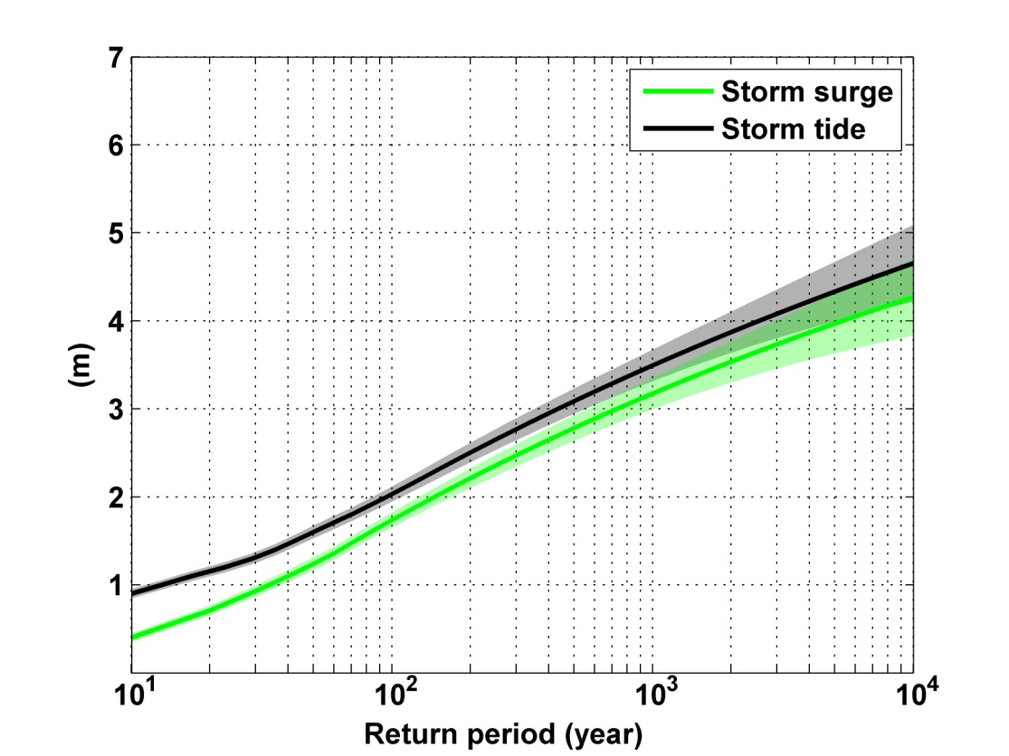
Sandy: ~ 400 years
Notes:
Storm surge and storm tide (surge and tide) return level curves for the Battery, NYC, for the 1981-2000 NCAR/NCEP climate conditions (5000 synthetic storms). Astronomical tide and nonlinear interaction between surge and tide are accounted for statistically.

Slide 41
Taking Climate Change Into Account

Slide 42
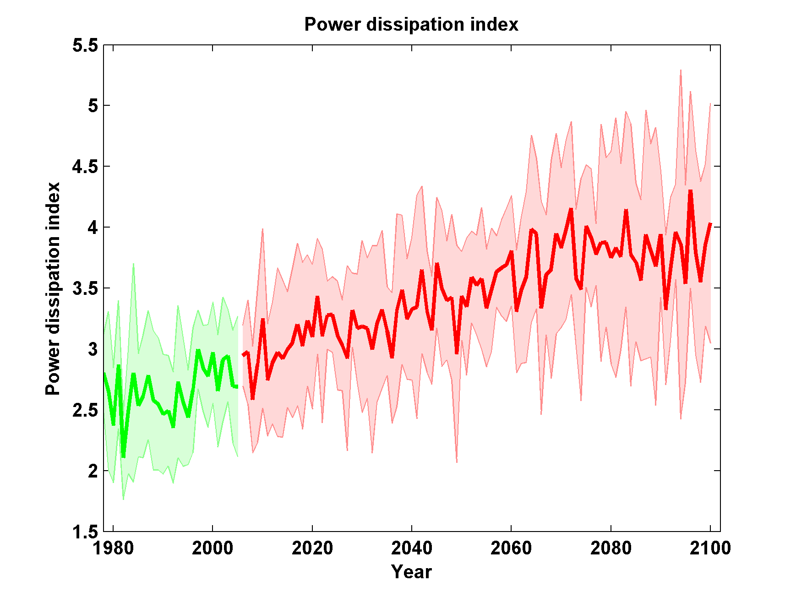
Global Hurricane Power under RCP 8.5
Six Models

Slide 43
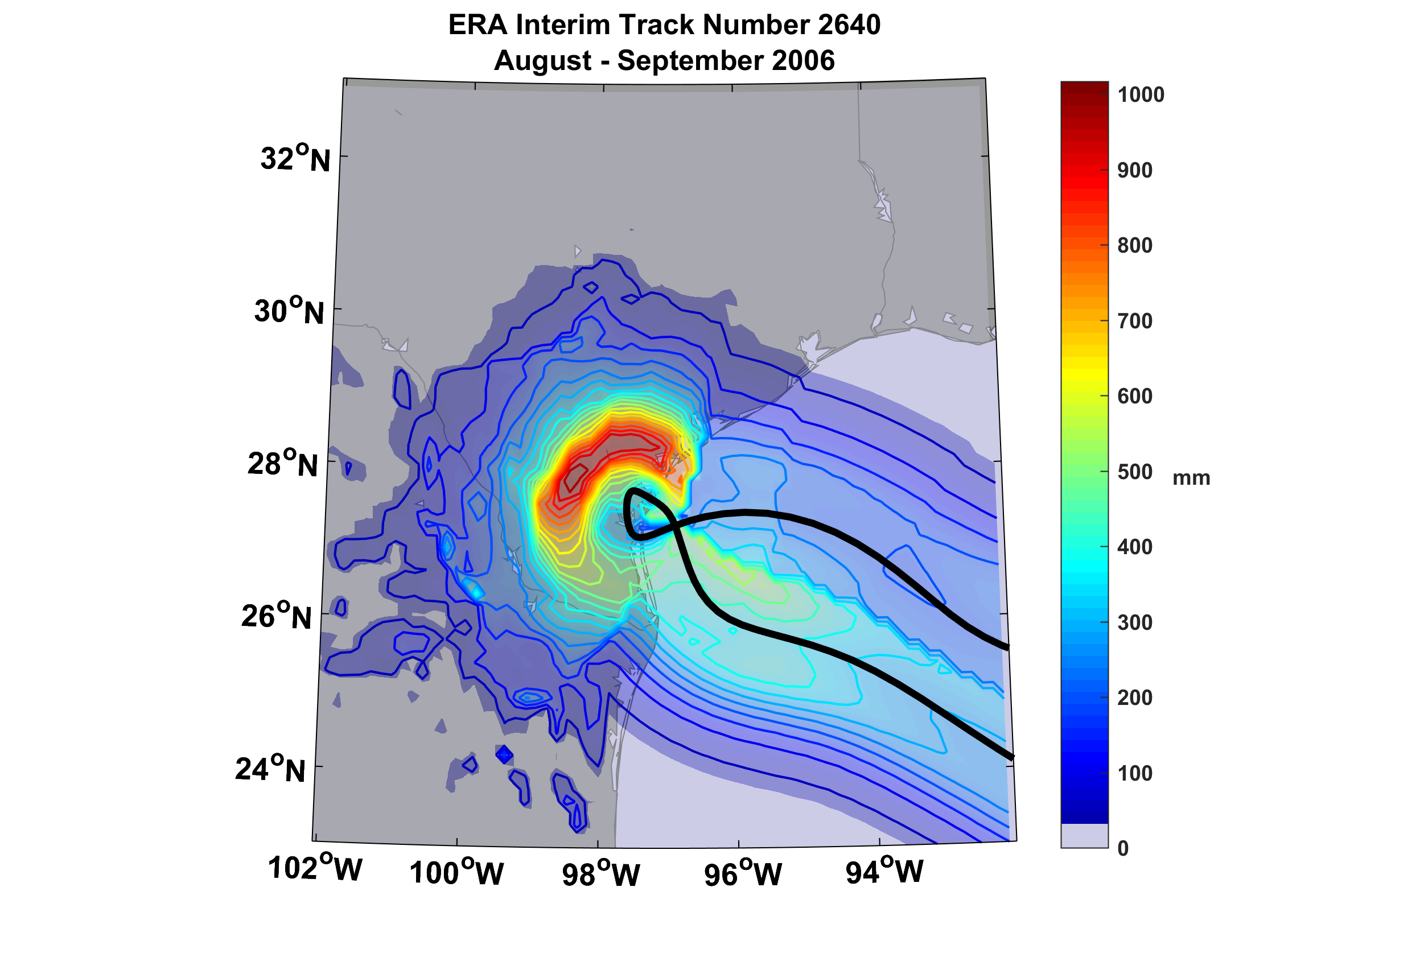
Example of Accumulated Rainfall from a Harvey-like Event Downscaled from ERA Interim Reanalysis

Slide 44
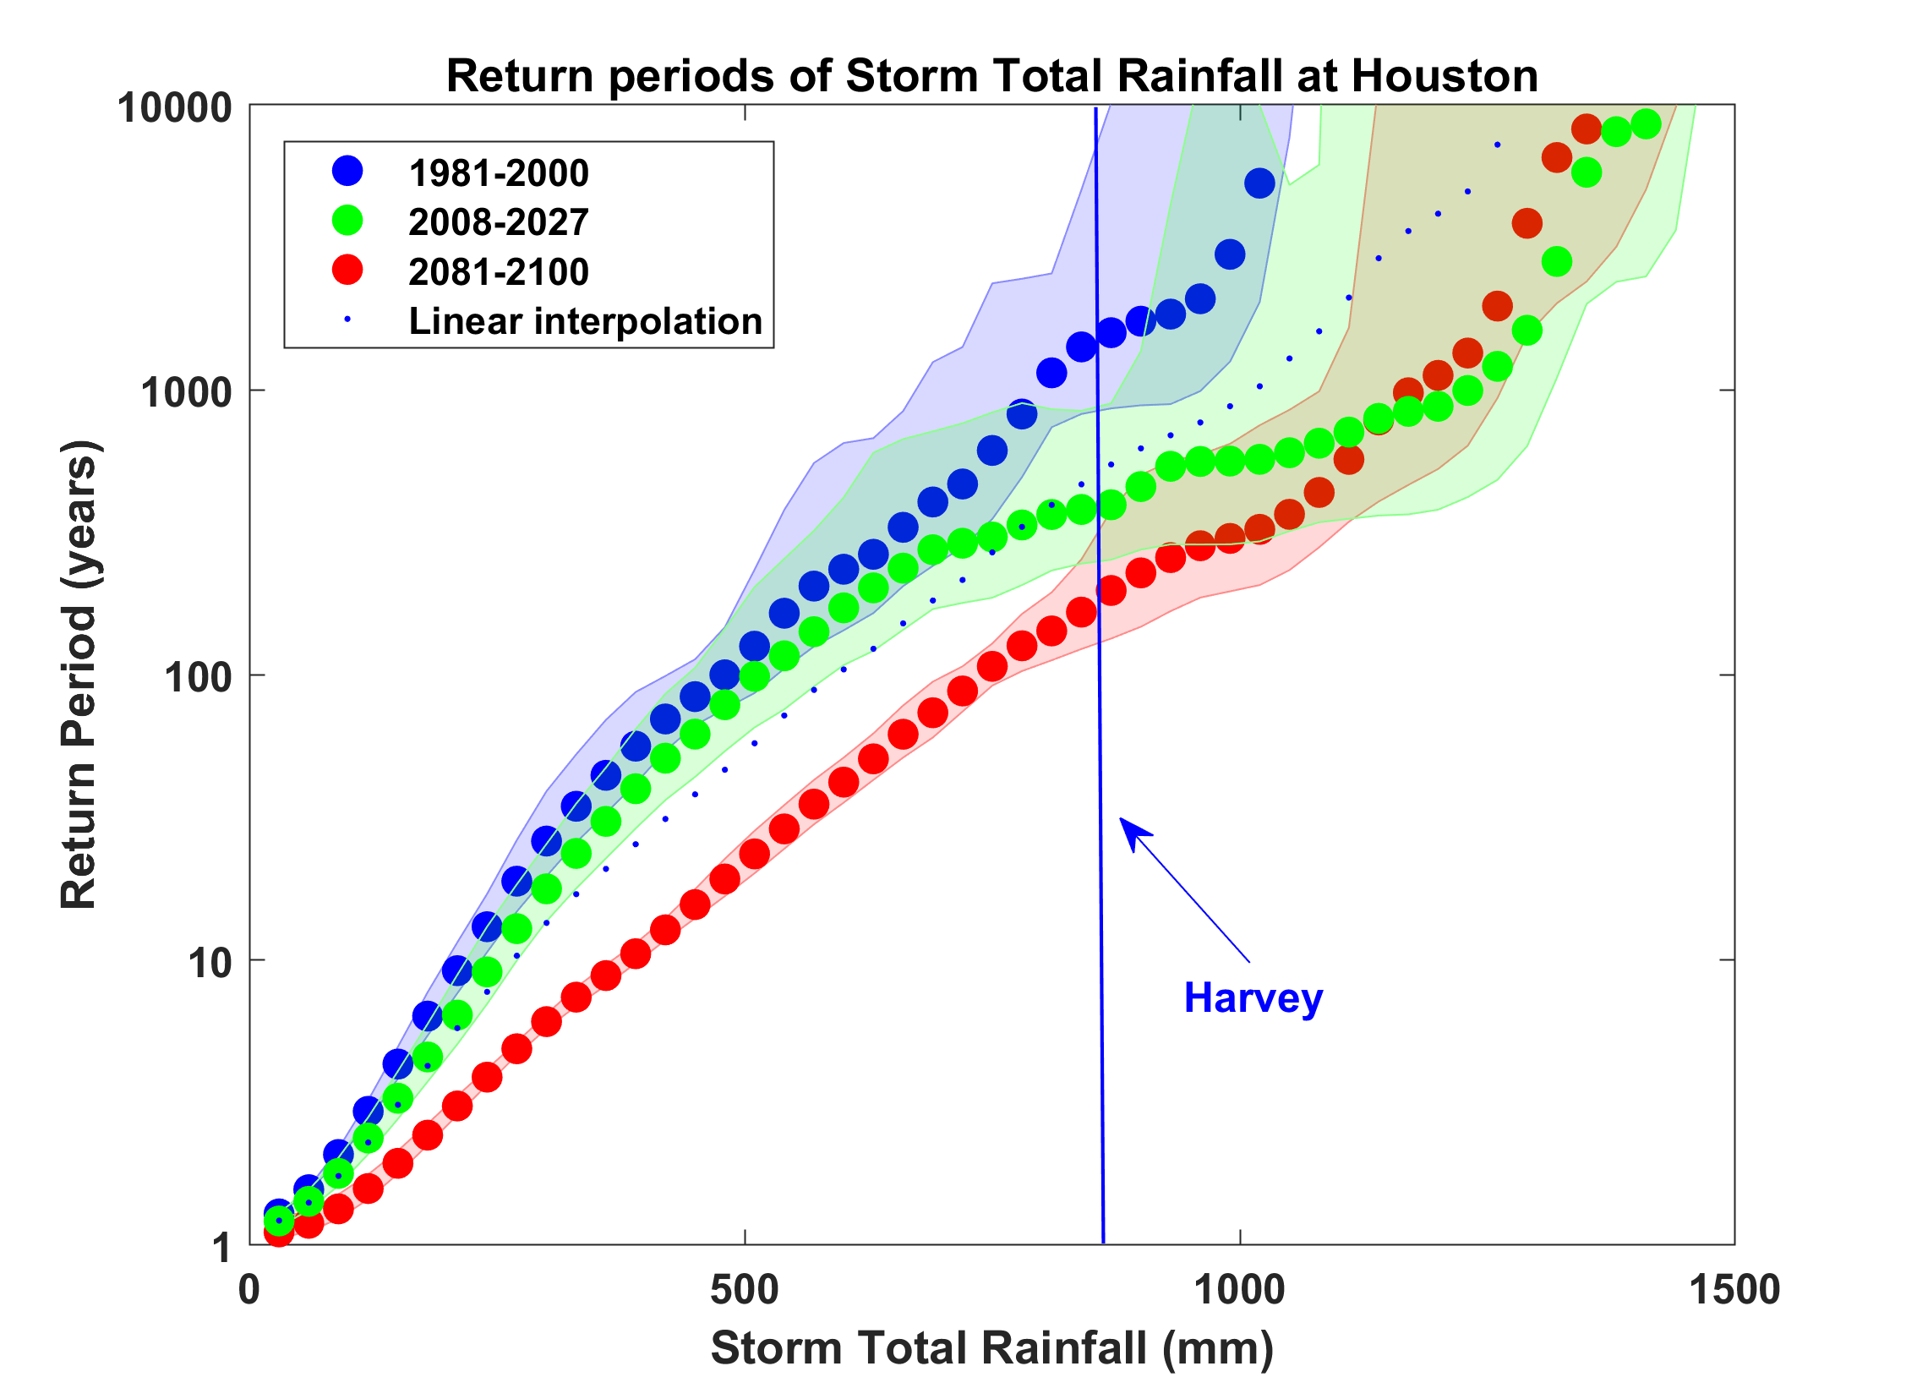
Probability of Storm Accumulated Rainfall in Harris County, from 6 Climate models, 1981-2000, 2008-2027, and 2081-2100, Based on 2000 Events Each, and Using RCP 8.5. Shading Shows Spread Among the Models.

Slide 45
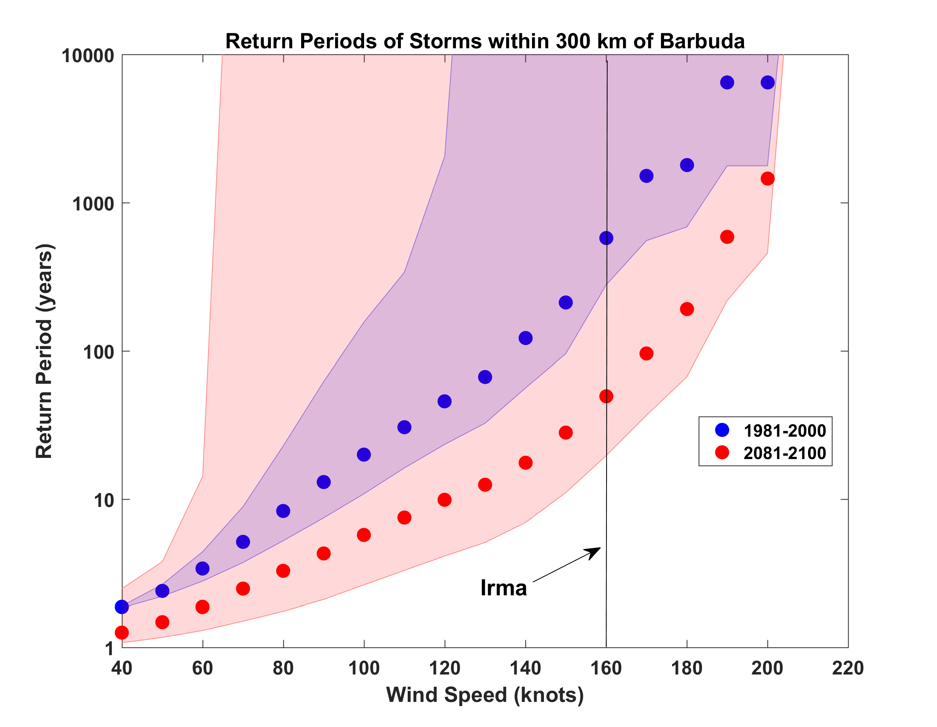
Probabilities of Storms of Irma’s Intensity within 300 km of Barbuda, from 6 Climate models, 1981-2000 and 2081-2100, Based on 2000 Events Each. Shading shows spread among the models.

Slide 46

GCM flood height return level, Battery, Manhattan
(assuming SLR of 1 m for the future climate )
Black: Current climate (1981-2000)
Blue: A1B future climate (2081-2100)
Red: A1B future climate (2081-2100) with R₀ increased by 10% and R_{m} increased by 21%
Lin et al. (2012)
Notes:
Then we calculate the flood height (including surge, tide, and sea level rise) return level for the four climate models, assuming a sea level rise of 1 m for the future climate, for the Battery, NYC. These results show that the combined effects of storm climatology change and sea level rise will greatly shorten the flood return periods for NYC and, by the end of the century, the current 100-year surge flooding may happen less than every 30 years, with CNRM and GFDL prediction to be less than 10 years, and the 500-year flooding may happen less than every 200 years, with the CNRM and GFDL prediction to be 20-30 years.

Slide 47
Sea level rise + changing storms
Sea level rise alone
From: American Climate Prospectus Economic Risks in the United States

Slide 48
Summary
History is too short and imperfect to estimate hurricane risk
We should bring physics to bear on estimating hurricane risk, not just in the future but now
Hurricanes clearly vary with climate and hurricane threats will increase over this century in many places

Slide 49
Spare Slides

Slide 50
Aerts, C. J. H. J., W. J. W. Botzen, K. Emanuel, N. Lin, H. de Moel, and E. O. Michel-Kerjan, 2014: Evaluating flood resilience strategies for coastal megacities. Science, 344, 473-475.

Slide 51
Benefit-Cost Ratios

Slide 53
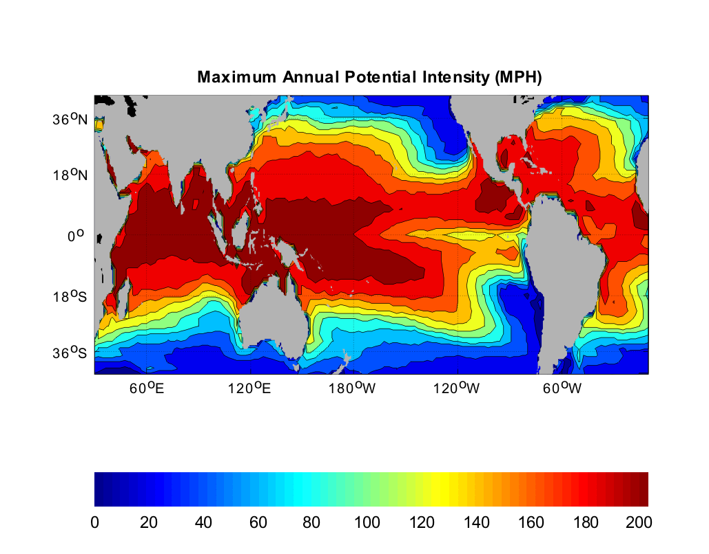
Heat Engine Theory Predicts Maximum Hurricane Winds
MPH
Notes:
53

Slide 54
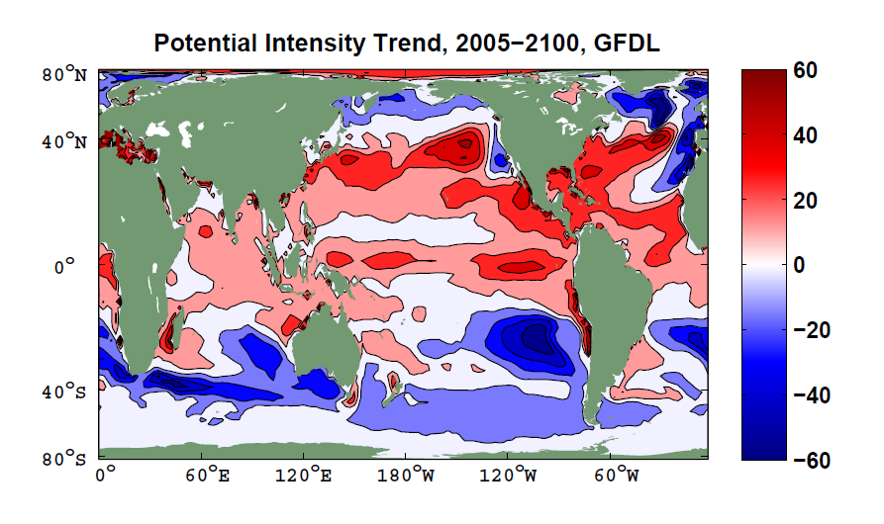

Slide 55

Captures effects of regional climate phenomena (e.g. ENSO, AMM)

Slide 56
CMIP5 Models

