Slide 1
Predictability of Tropical Cyclone Intensity
Kerry Emanuel
Lorenz Center
Massachusetts Institute of Technology
In collaboration with Fuqing Zhang

Slide 2
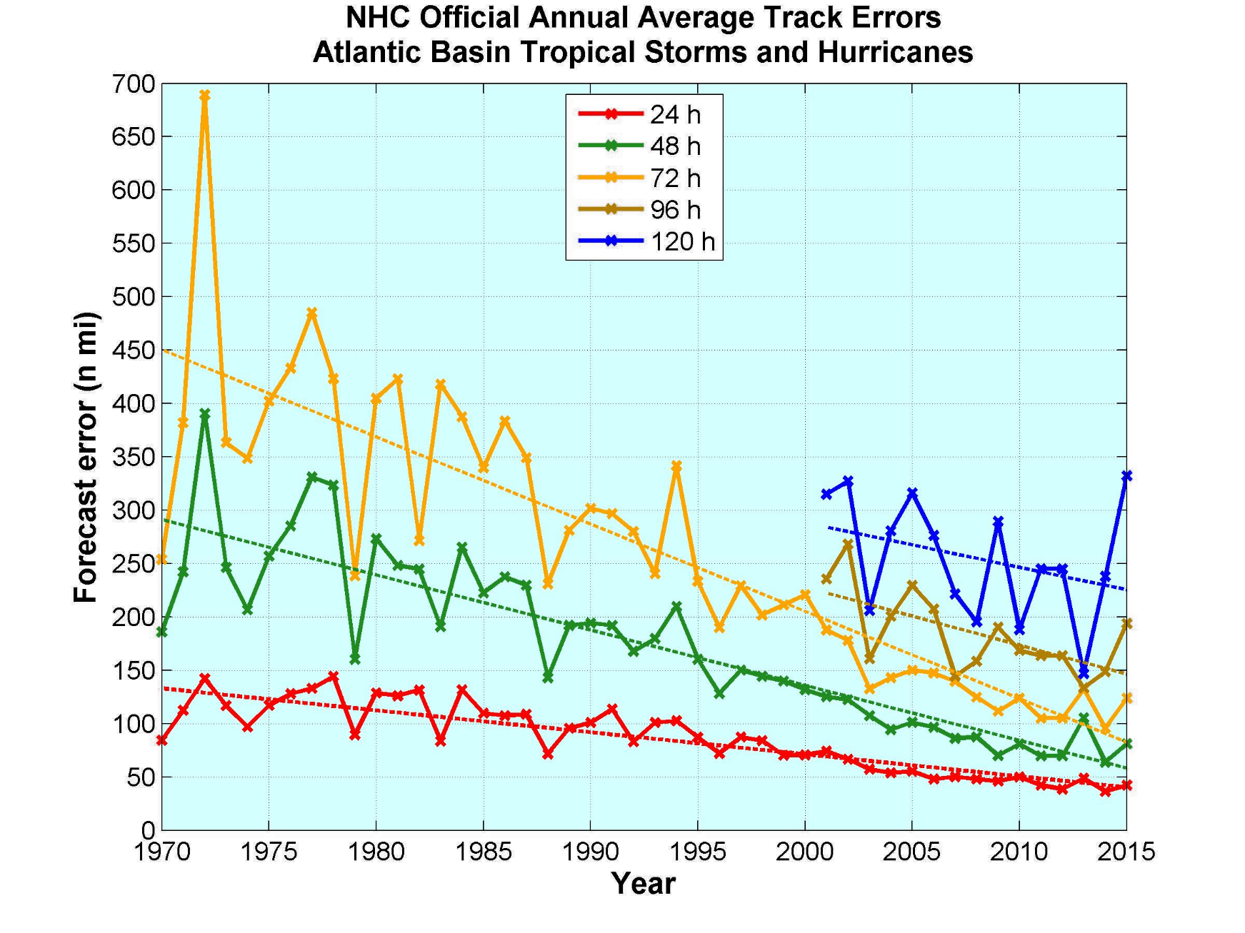
Atlantic Tropical Cyclone Forecasting
Some successes….

Slide 3
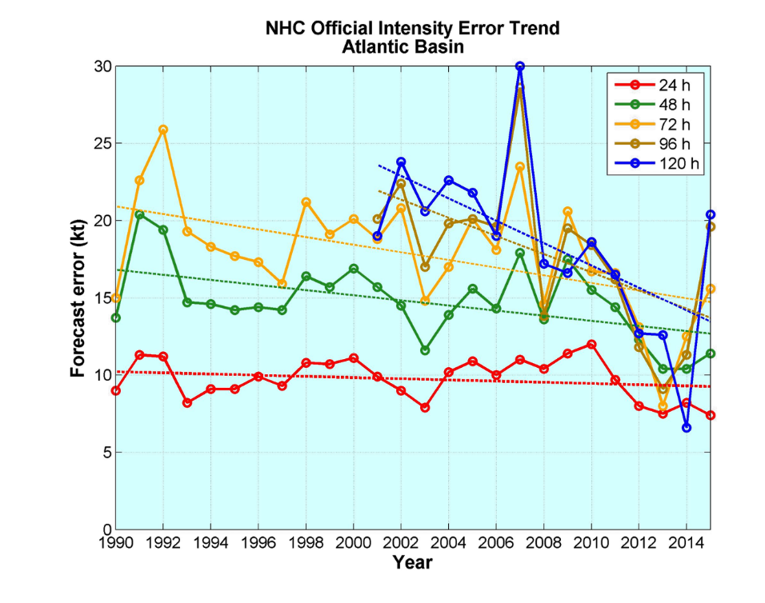
…and some failures:

Slide 4
Some Issues:
What are the main sources of intensity error?
Model error?
Initial conditions?
Track error?
Large scale atmospheric environment?
Oceanic environment?
Can we estimate realistic upper bounds on predictability of intensity?

Slide 5
Approach: Control and perturbation experiments with the MIT TC risk model (“perfect model” approach)
Control:
Begin with monthly potential intensity and mid-level humidity, and daily winds from NCAR/NCEP reanalyses
Storms are seeded randomly around the world
Seeds move according to a beta-and-advection model
CHIPS intensity model predicts their intensity evolution
Only a small fraction of seeds intensify to TS strength or greater; rest are discarded: genesis by natural selection
We generate 3500 storms from 1980 to 2014
Perturbations:
Each control storm above is re-simulated, perturbing
Initial intensity by +3 kts
Allowing environmental shear to de-correlate from control over 25 days
Both of the above
Allow de-correlating environmental winds to affect track
Same as above but add 3 kts to initial intensity

Slide 6
Description of Perturbation Experiments
Perturbation Experiment | Description | Number of Overlapping Cases
Initial intensity only | 3 knots added to initial intensity. | 2711
Shear only | Shear decorrelates from control over 25 days. Track and initial intensity identical to control. | 2916
Shear + initial intensity | 3 knots added to initial intensity and shear decorrelates from control over 25 days. Track identical to control. | 2656
Track | Winds (affecting shear and steering) decorrelate from control over 25 days. Tracks respond to changing steering flow. | 2204
Track + initial intensity | Same as track but 3 knots added to initial intensity. | 2051

Slide 7
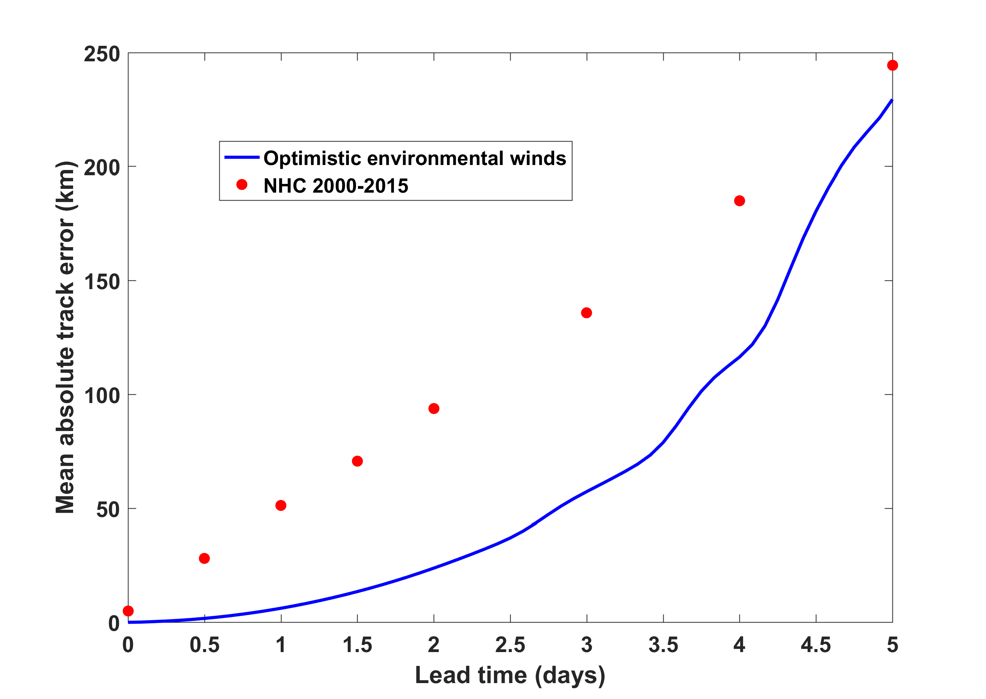
Blue curve: Track errors resulting from environmental winds decorrelating over 25 days
Red dots: NHC Atlantic track errors, 2000-2015

Slide 8
Sources of Intensity Error
(Emanuel and Zhang, JAS, 2016)

Slide 9
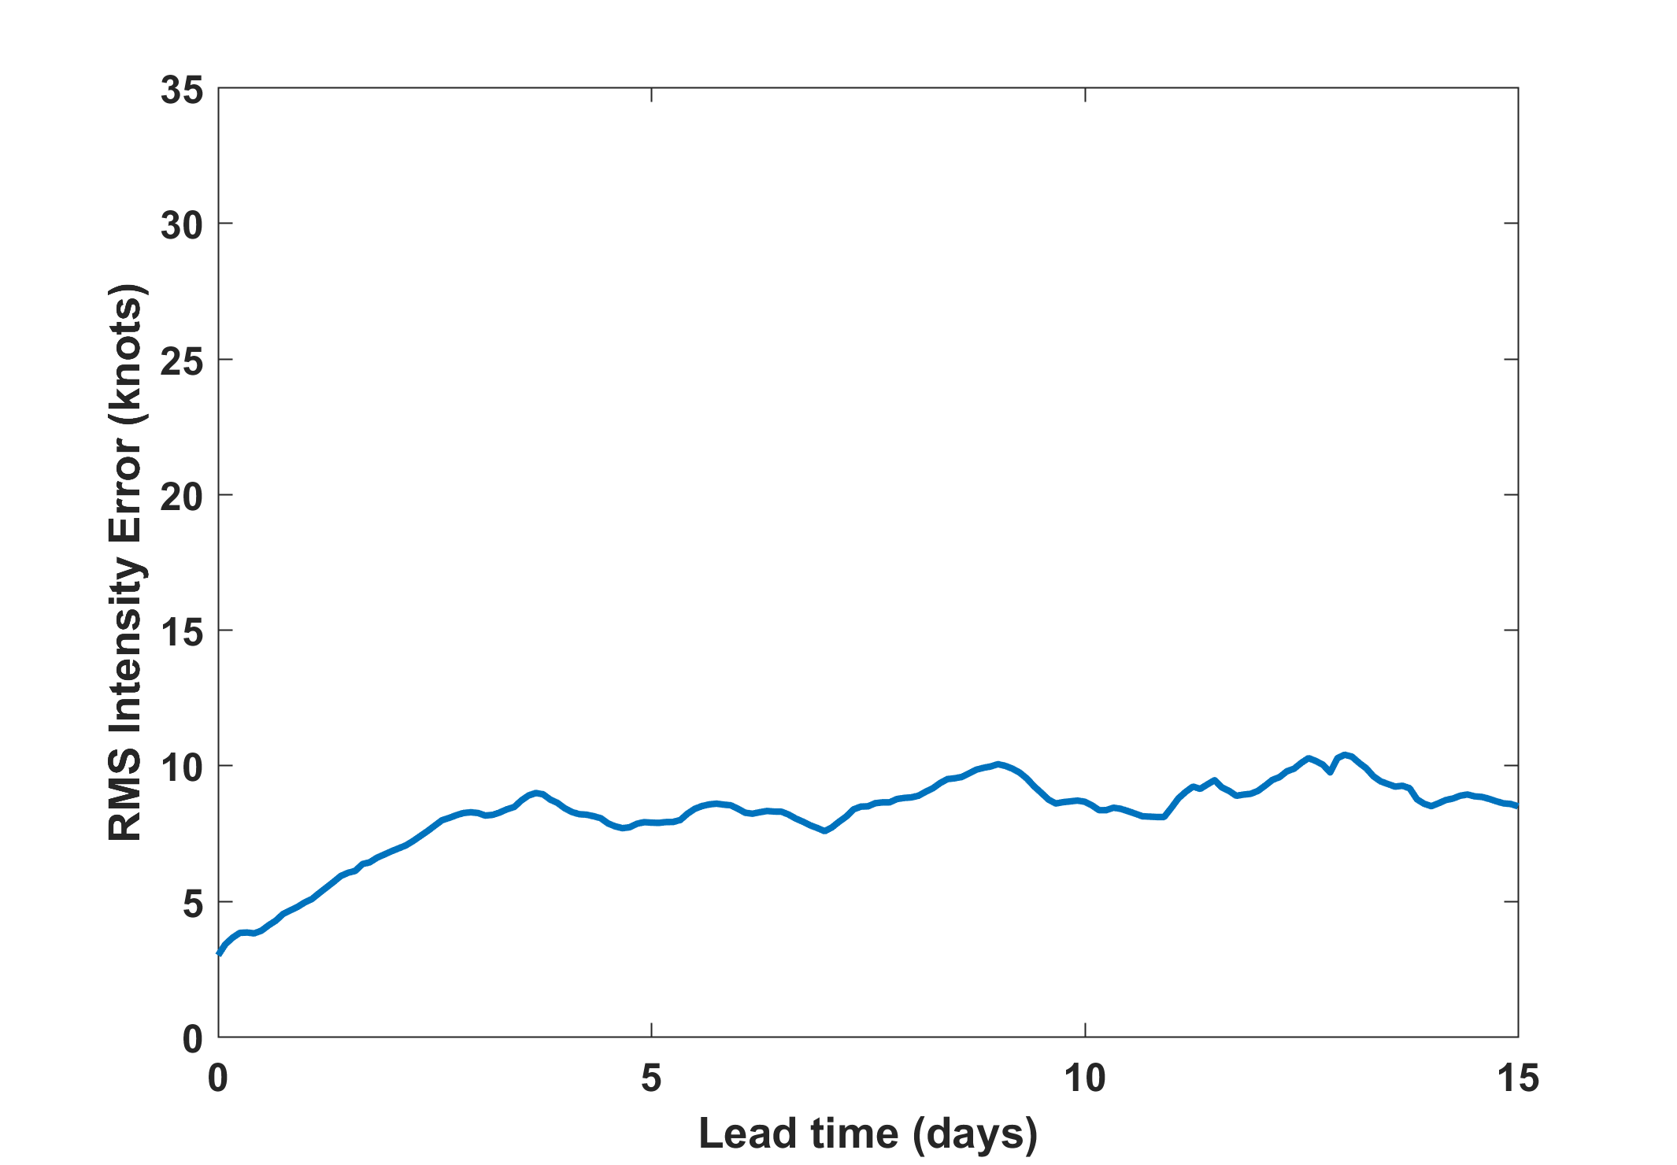
+ 3 kts initial intensity error

Slide 10
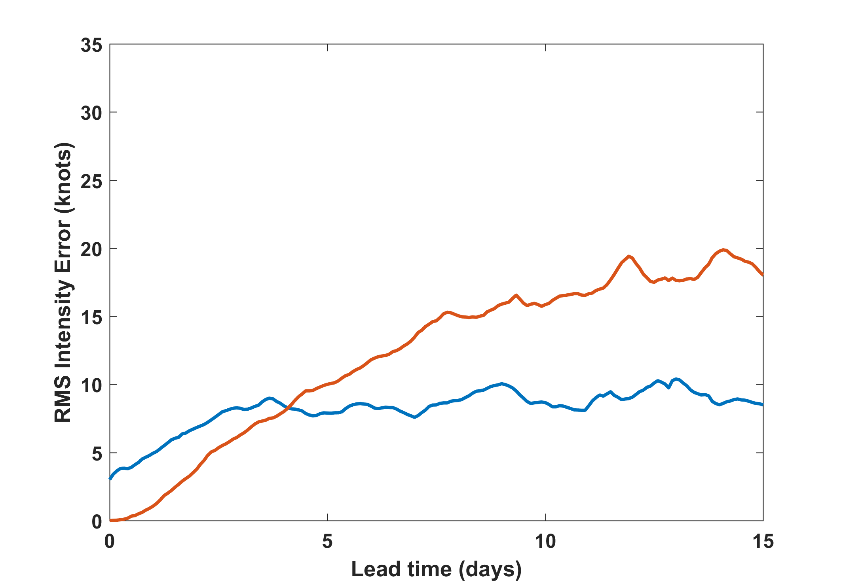
+ 3 kts initial intensity error
Shear only

Slide 11
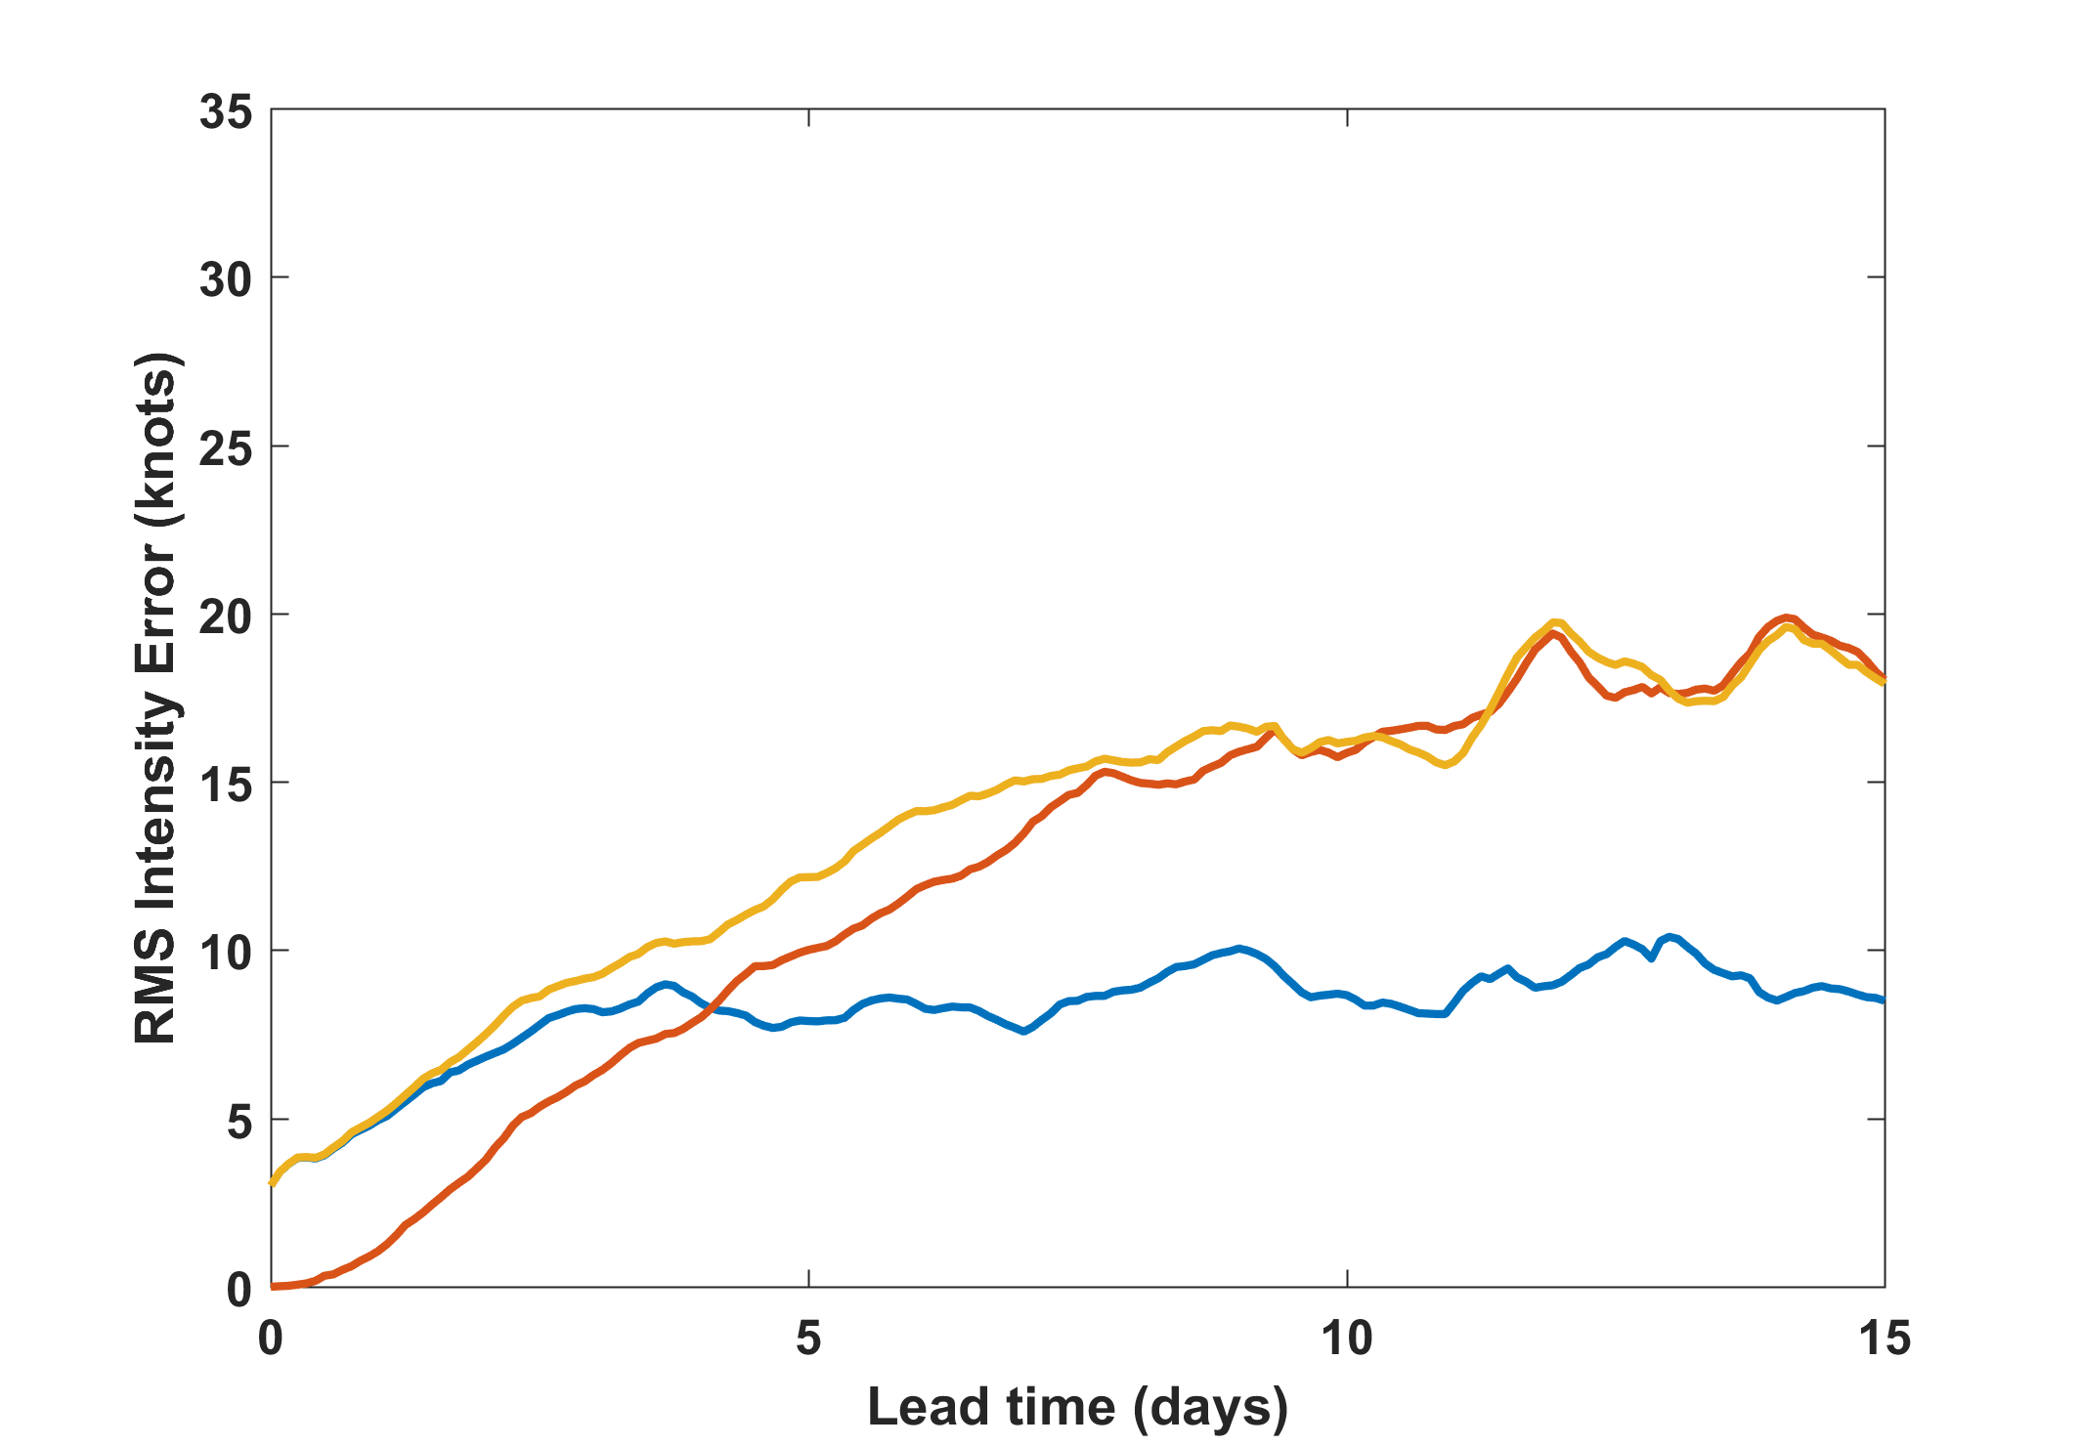
Initial V + shear
+ 3 kts initial intensity error
Shear only

Slide 12
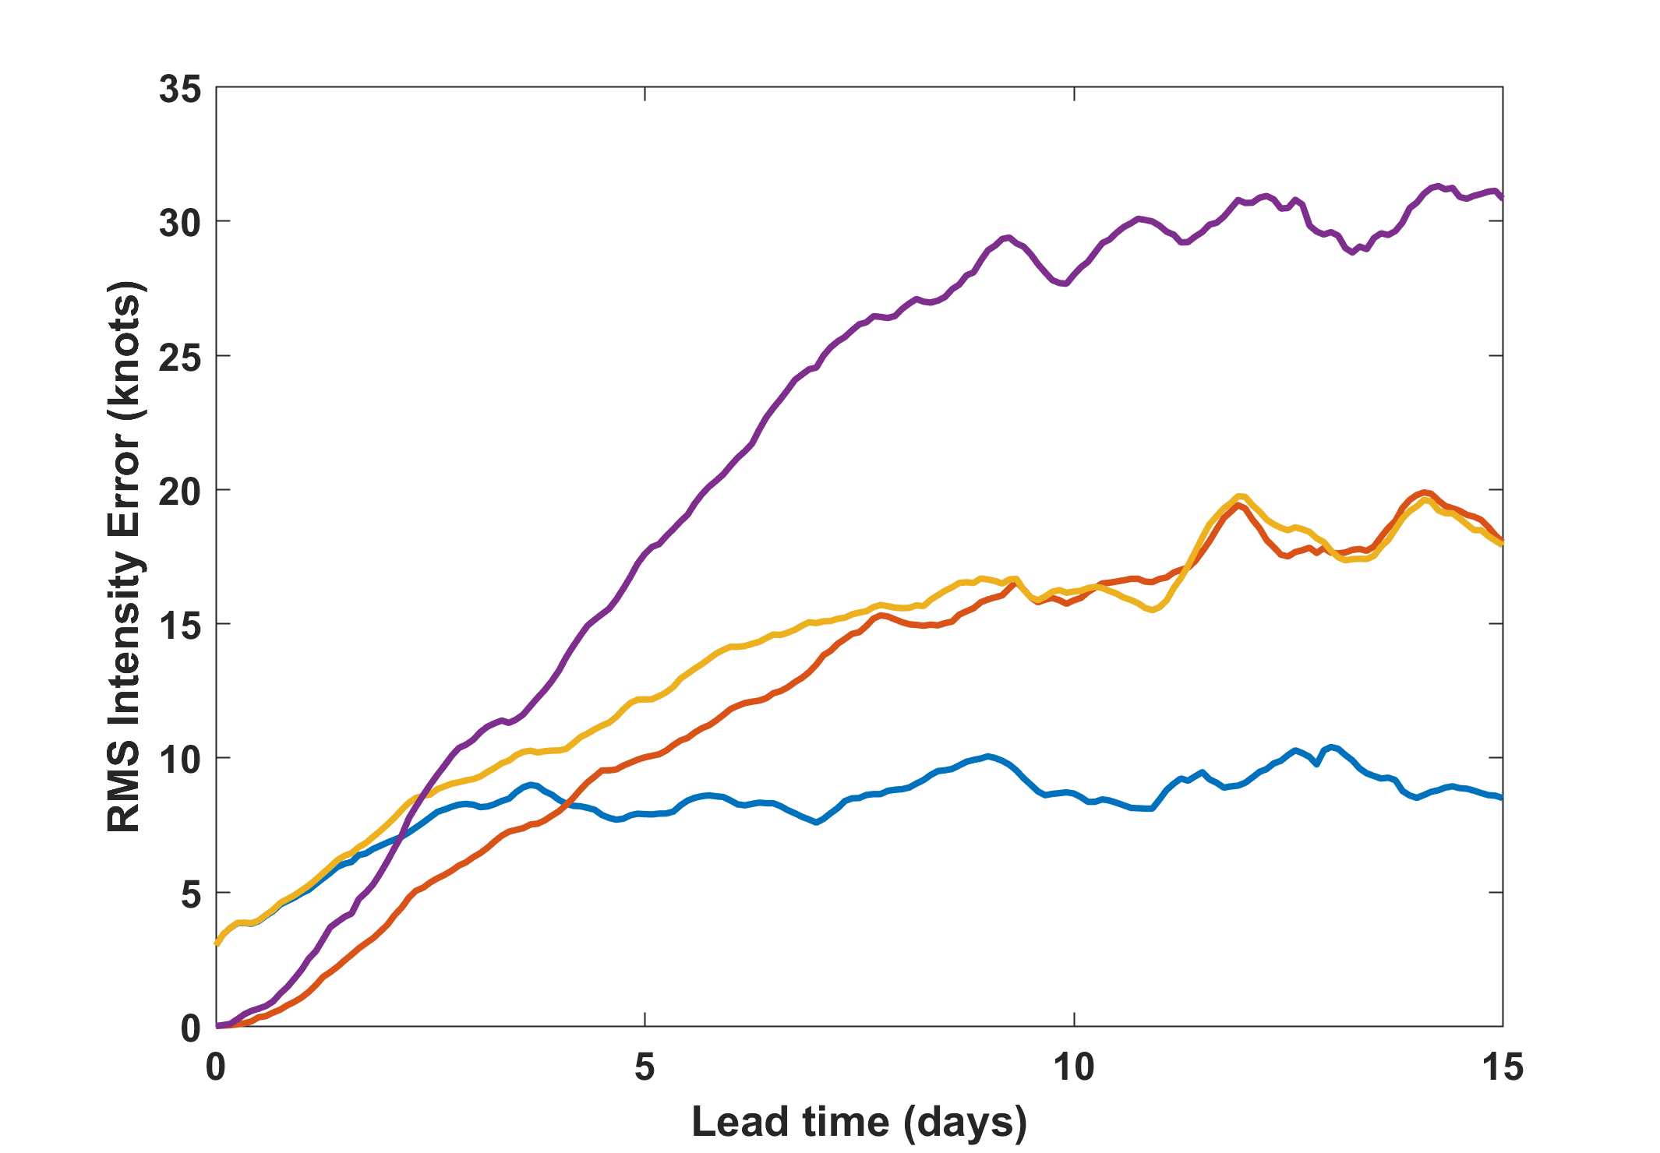
Track
Initial V + shear
+ 3 kts initial intensity error
Shear only

Slide 13
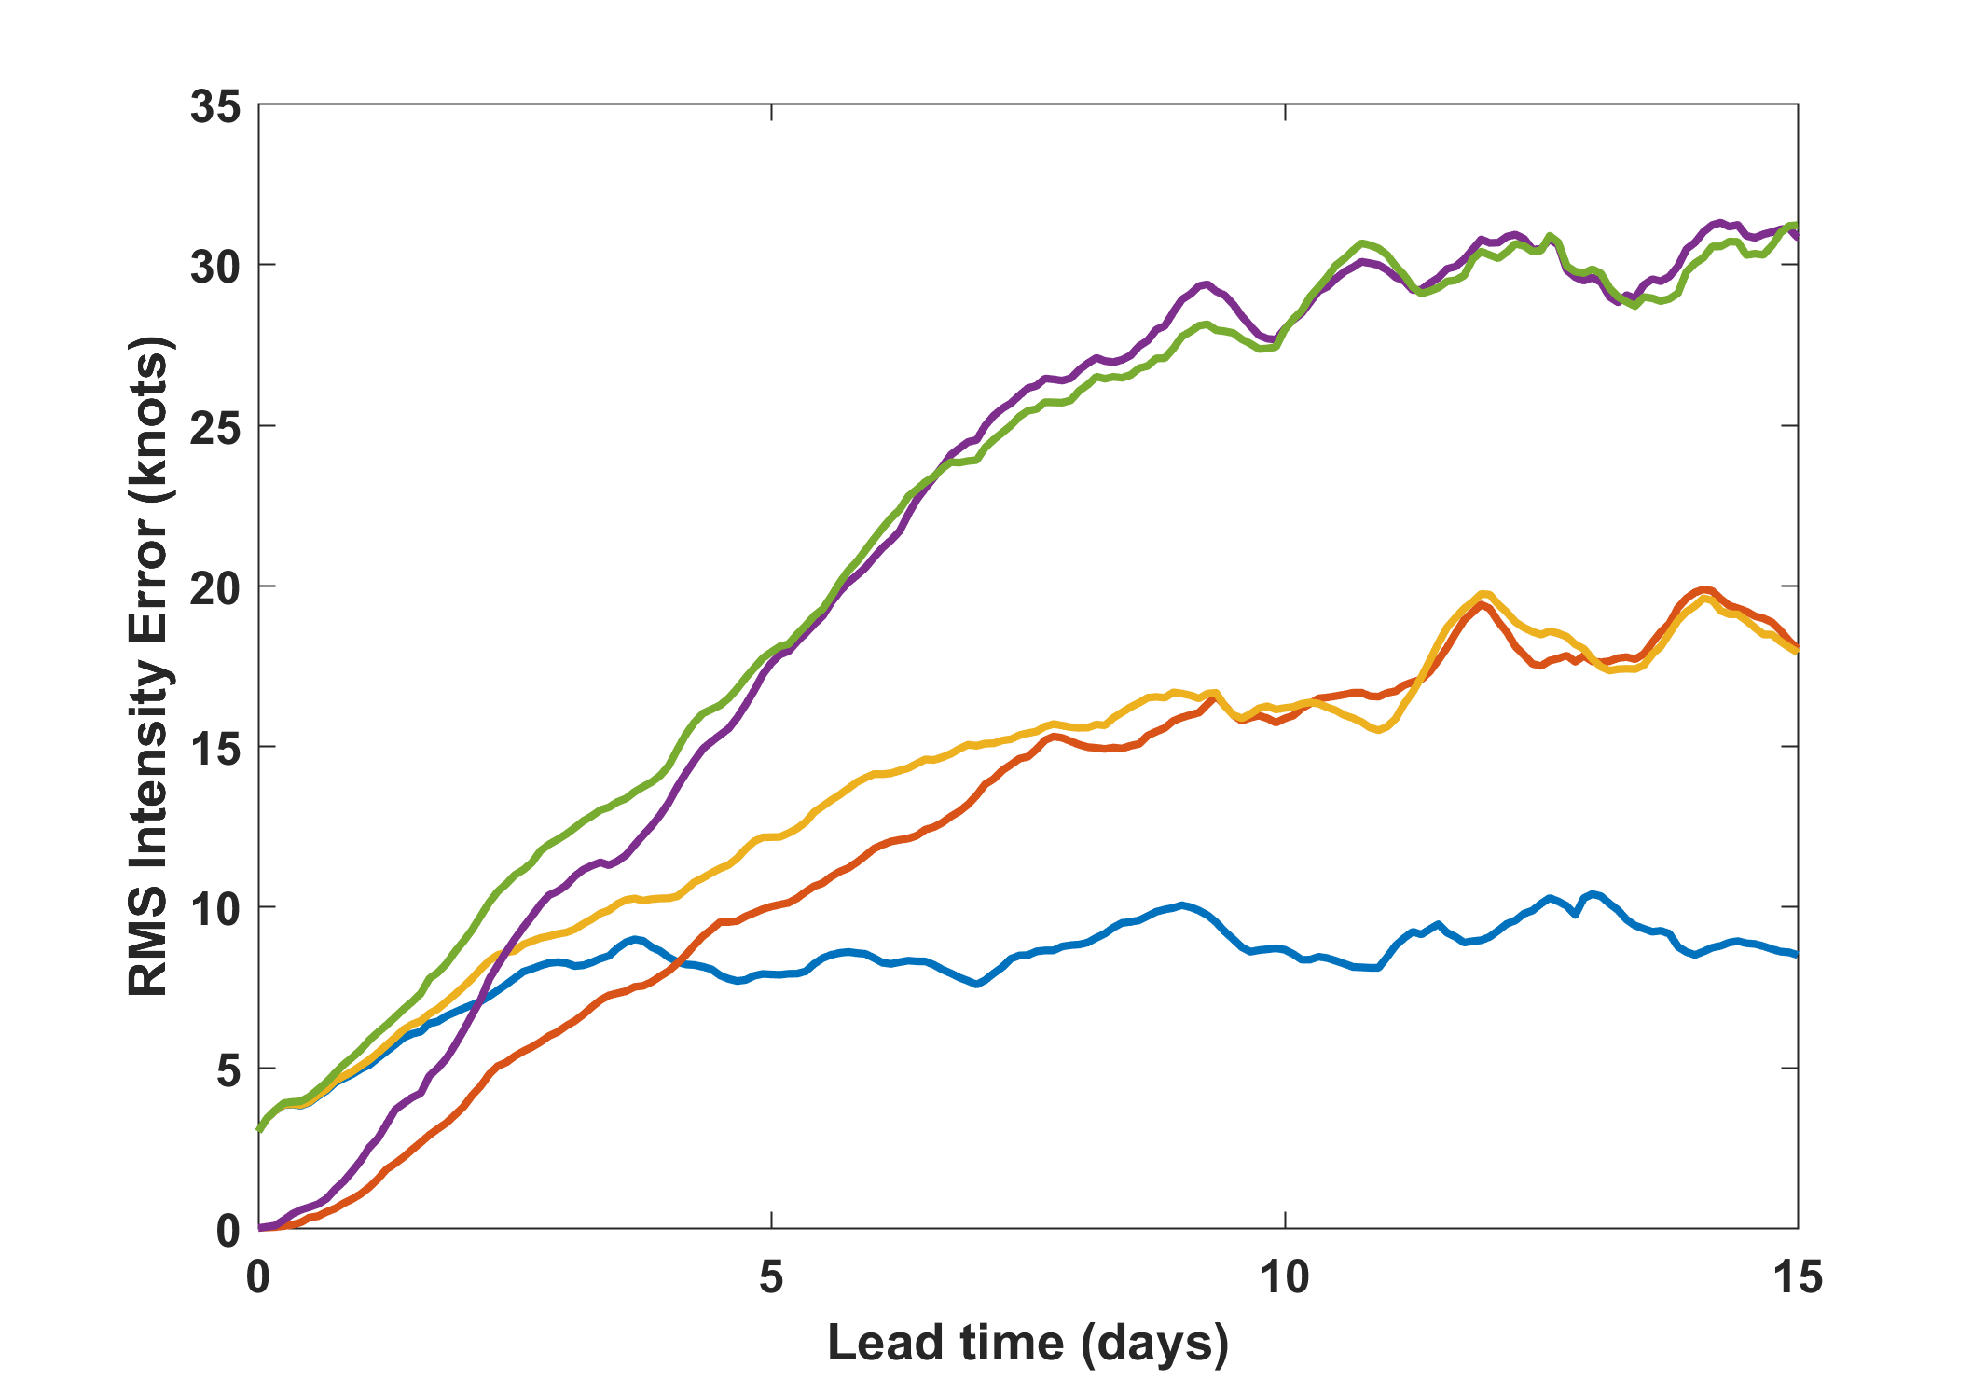
Track
Initial V + shear
Initial + track
+ 3 kts initial intensity error
Shear only

Slide 14
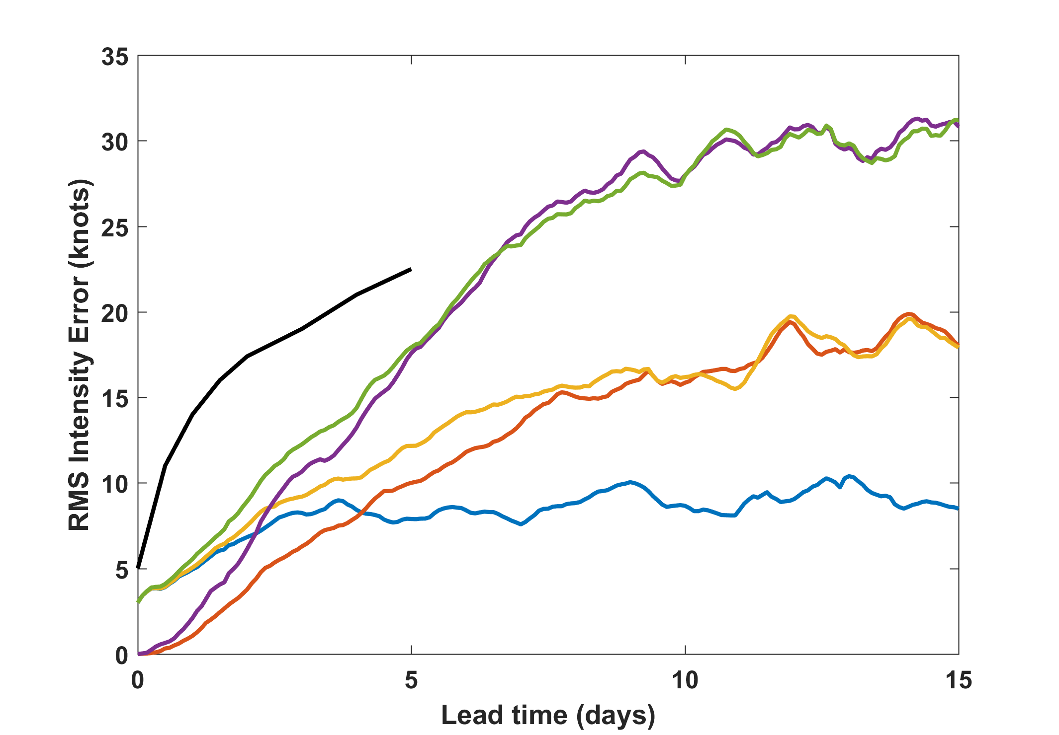
NHC 2009-2015
Track
Initial V + shear
Initial + track
+ 3 kts initial intensity error
Shear only

Slide 15
The Critical Importance of Inner Core Moisture

Slide 16
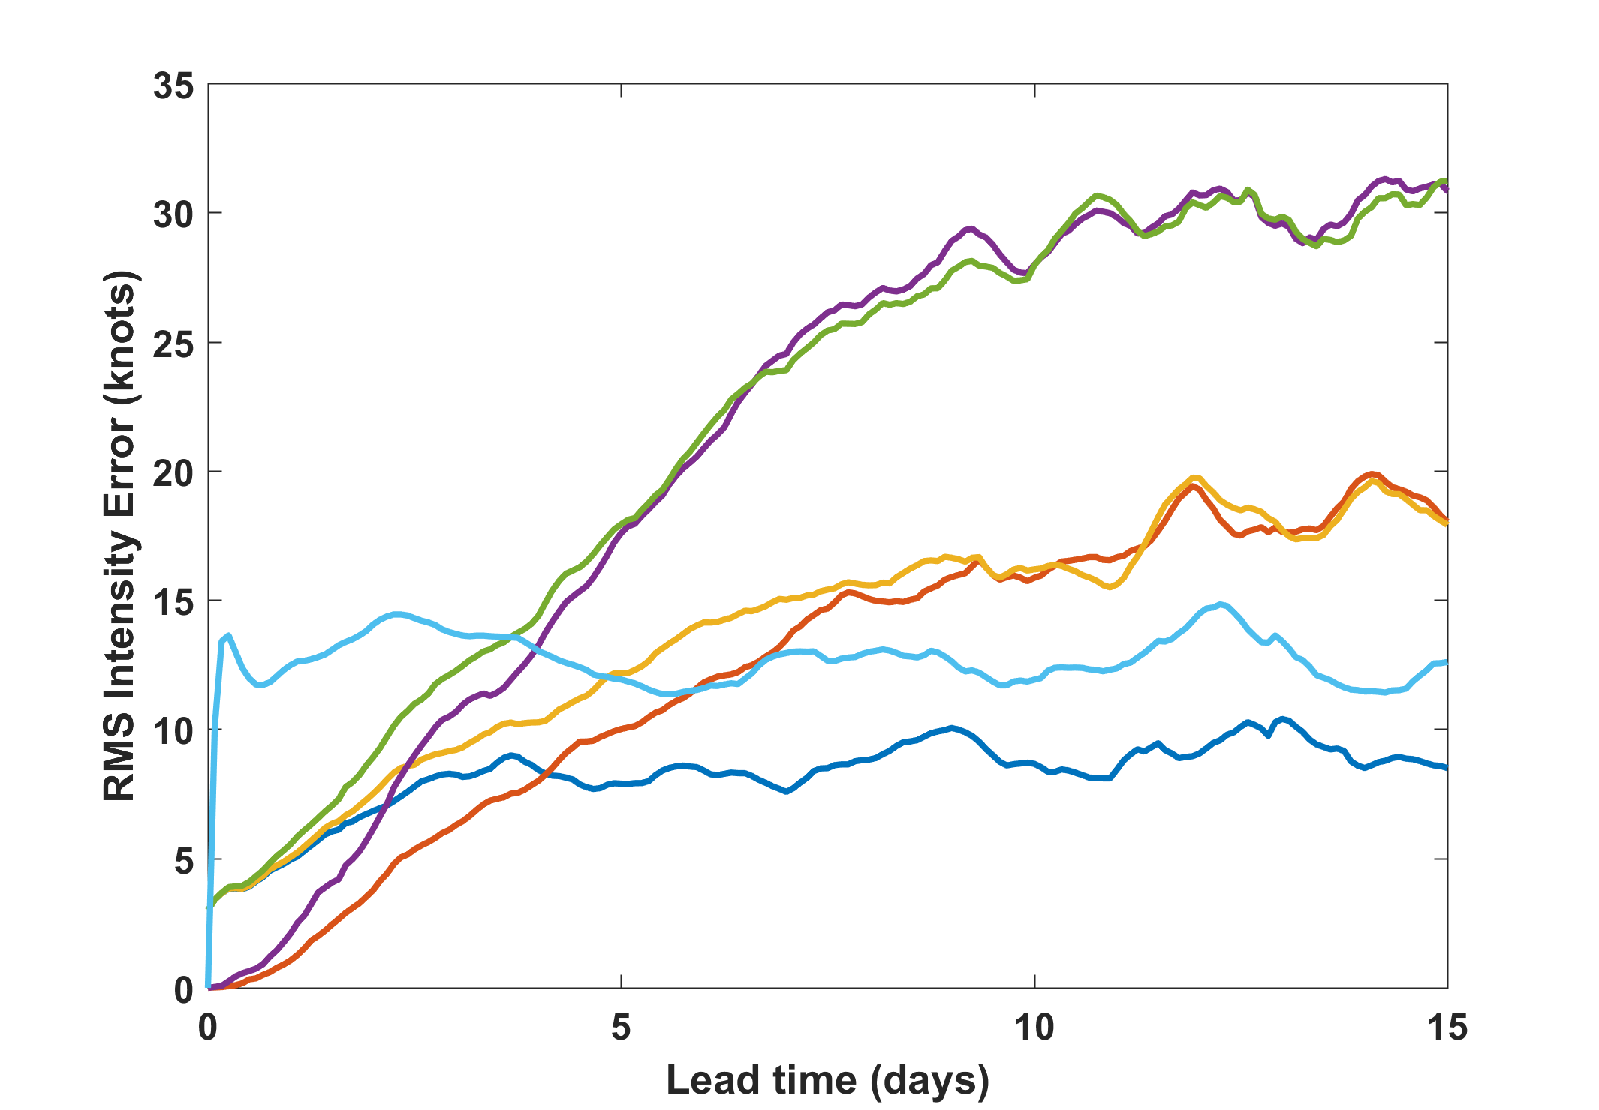
Initial inner core moisture error
Track
Initial + track
Initial V + shear
+ 3 kts initial intensity error
Shear only

Slide 17
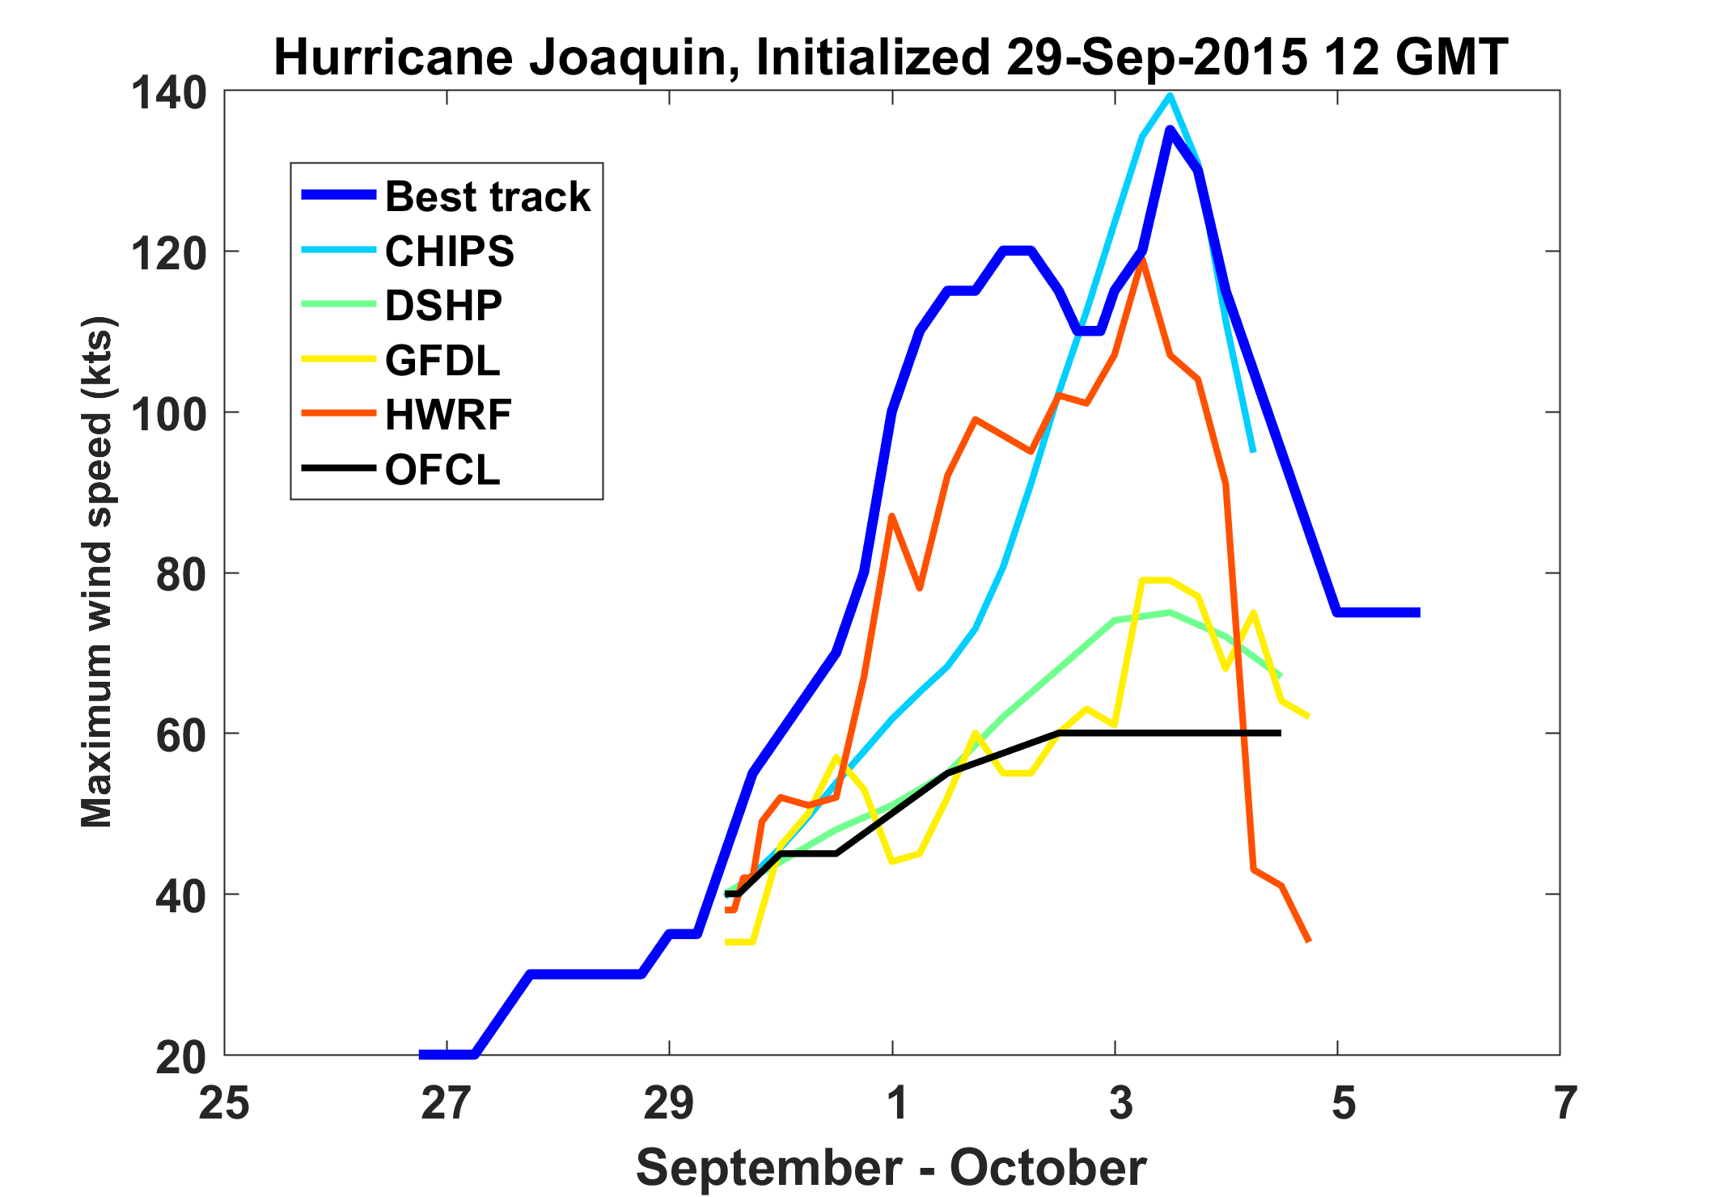
Example of bad intensity forecast: Hurricane Joaquin, 2015

Slide 18
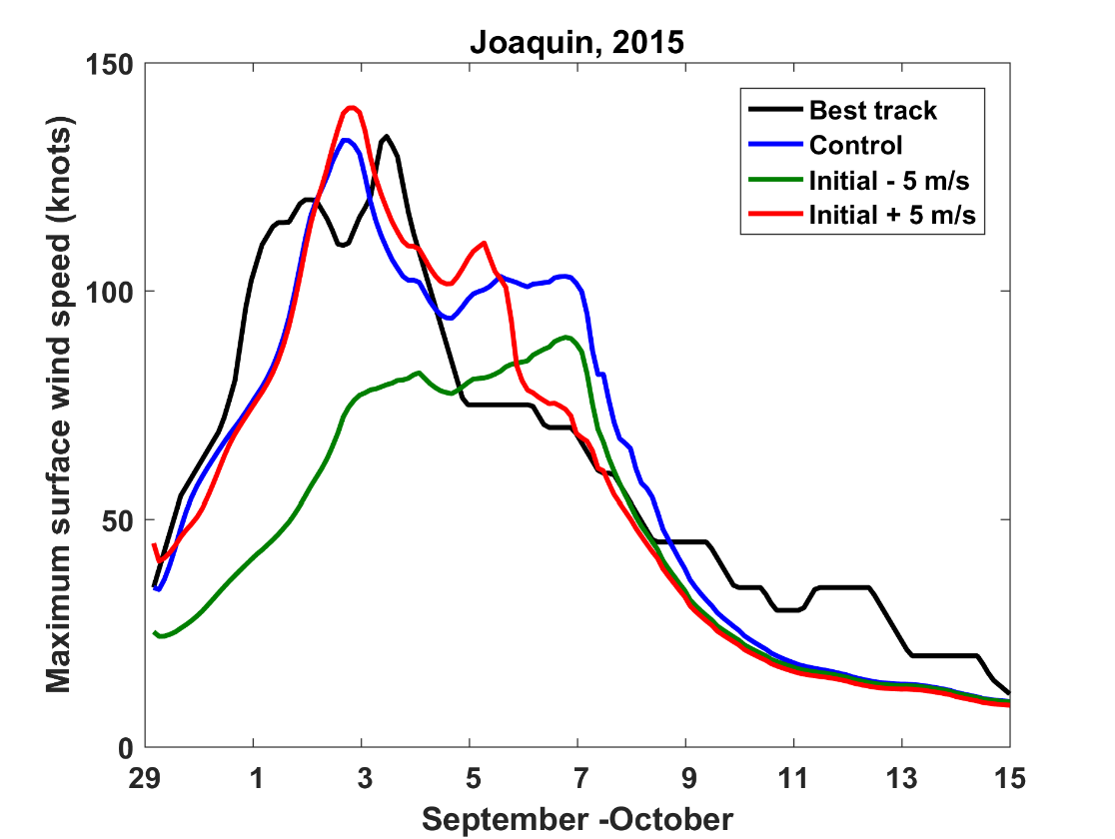
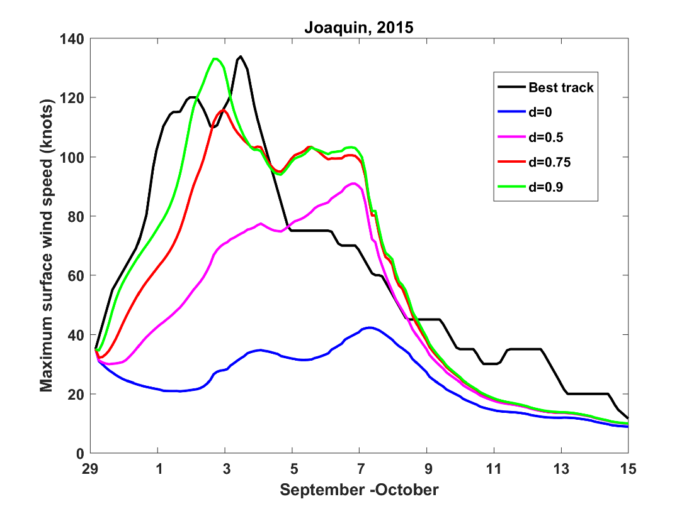
CHIPS hindcasts
Initial intensity errors only
Initial inner core moisture errors only

Slide 19
Initial Intensity Evolution Highly Sensitive to Inner Core Moisture!
How to Initialize Inner Core Moisture?
1. Better observations of tropospheric water vapor within ~250 km
2. Make use of high sensitivity of intensification rate to inner core moisture

Slide 20
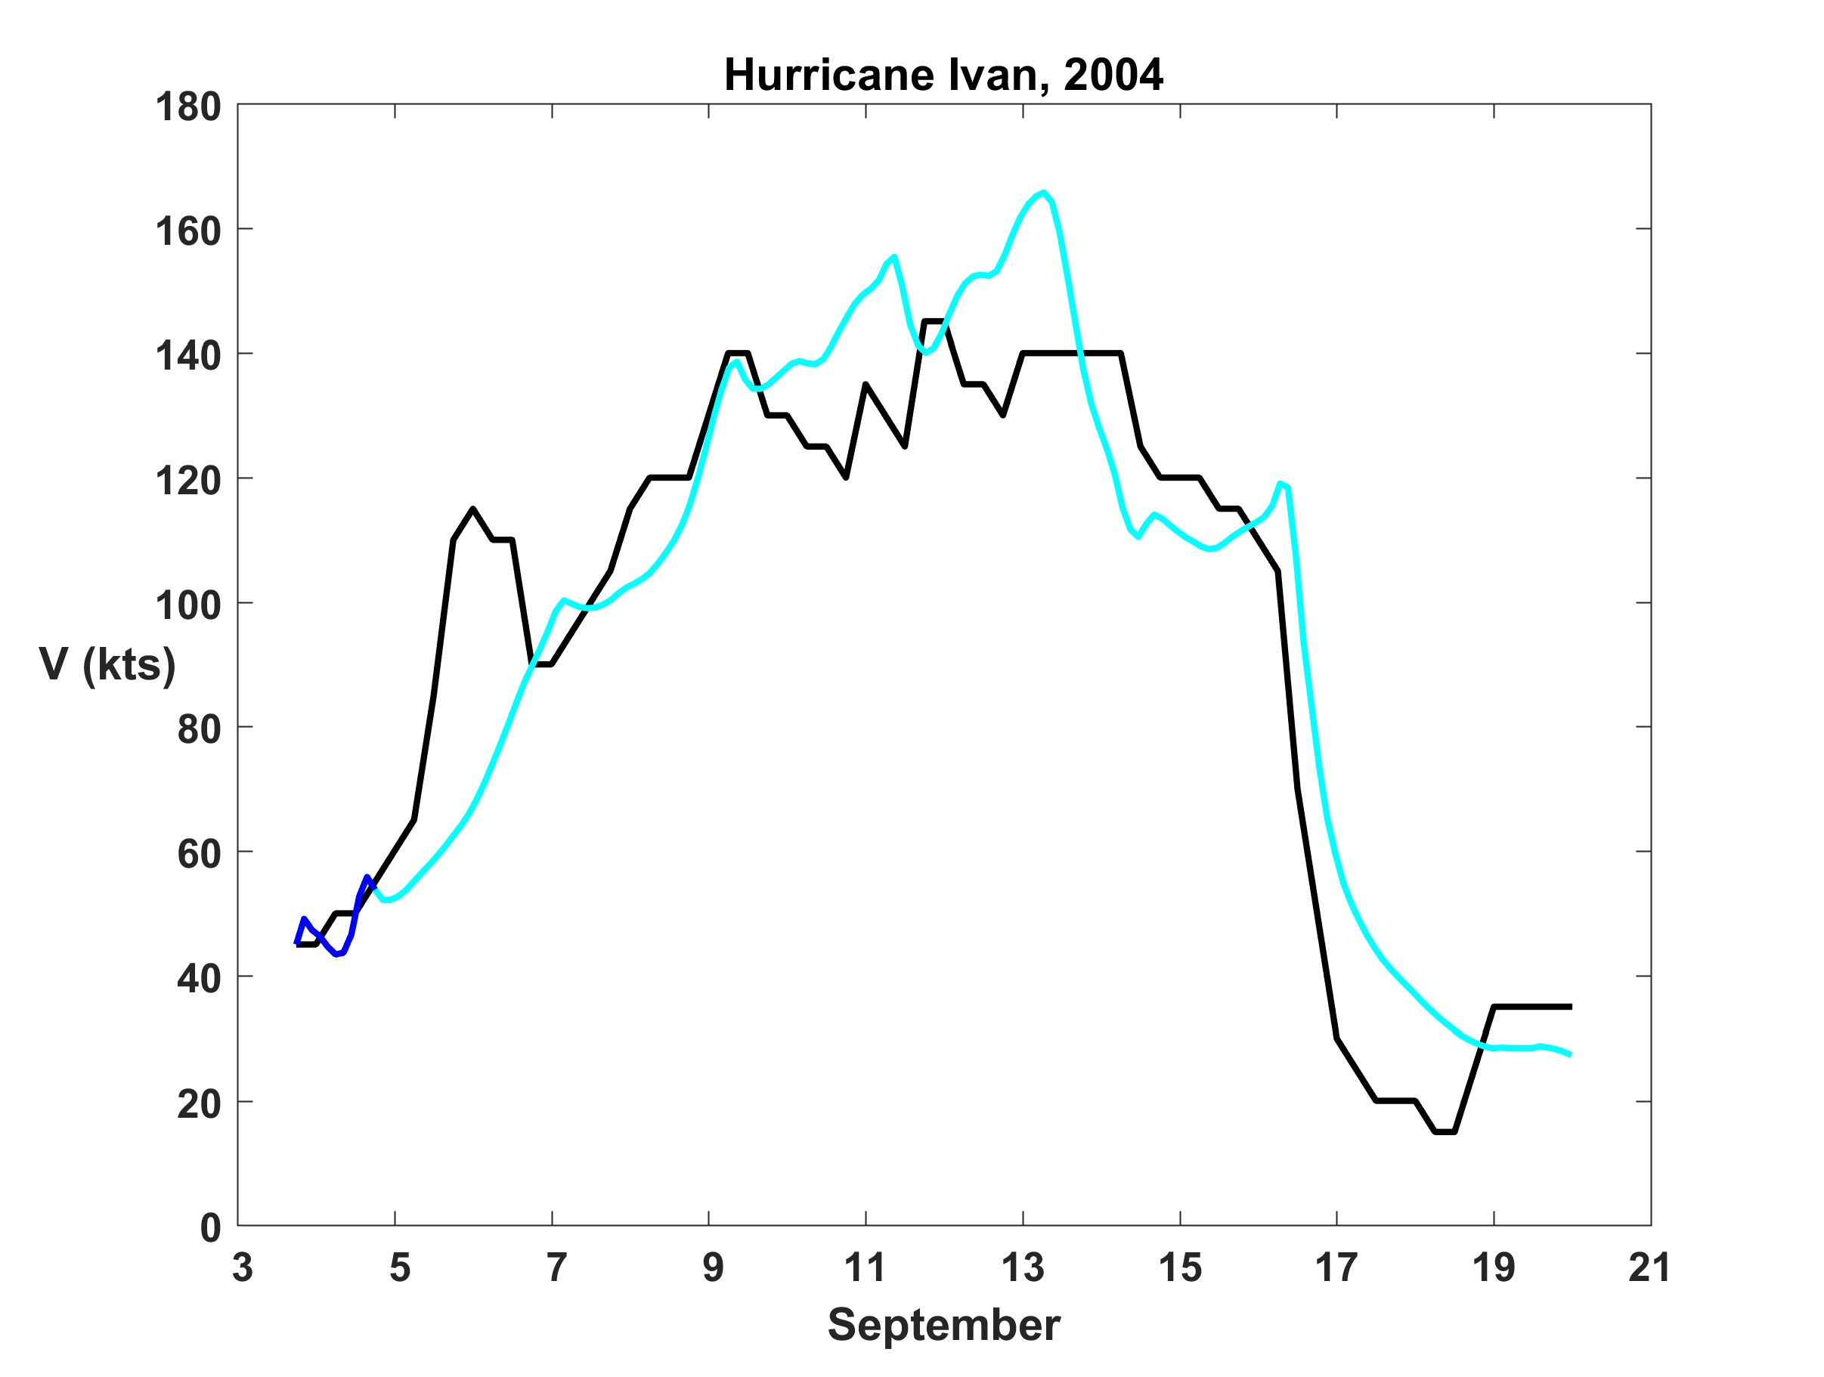
Real-time CHIPS forecasts: Inner core moisture variable is initialized by matching observed rate of intensification
Hindcast of Hurricane Ivan, 2004
Matching period

Slide 21
Initializing inner core moisture:
Prospects for operational, detailed inner core moisture measurements not very good.
Instead: Aim for more better intensity observations with more time continuity, and
Data assimilation systems that, explicitly or implicitly, make use of the high correlation between inner core moisture and rate of intensification

Slide 22
Continuous TC monitoring:
Solar UAV with X-band Doppler

Slide 23
Summary
Progress in TC track predictions will ultimately be limited by predictability of large-scale flow
Intensity errors dominated by initial intensity and inner core moisture errors out to 3-5 days; thereafter by track and environmental shear errors
To reduce 3-5 day intensity errors, we need better observations of time-evolving intensity and data assimilation systems that explicitly or implicitly account for the strong correlation between inner core moisture and intensification. Current difficulties will not be solved by better models alone.
Much is at stake: We must think hard about and ultimately advocate strongly for better ways of measuring TCs globally

Slide 24
Summary (continued)
We should strongly consider migrating away from the traditional dichotomy of track and intensity errors, recognizing that at longer lead times, intensity error is dominated by track error. Predicting and scoring probabilistic intensity forecasts at fixed points in space is more societally relevant.

