Slide 1
Slow Modes of the Equatorial Waveguide
Kerry Emanuel
Lorenz Center
Massachusetts Institute of Technology

Slide 2
Program
Some reflections on the history of research on interaction of moist convection with large-scale circulations
Review of observations of variability of equatorial convection
Review of self-aggregation of convection
Cloud-permitting simulations of equatorial variability
Linear model of equatorial modes
Concluding remarks

Slide 3
Mean and Standard Deviation of Tropical OLR

Slide 4
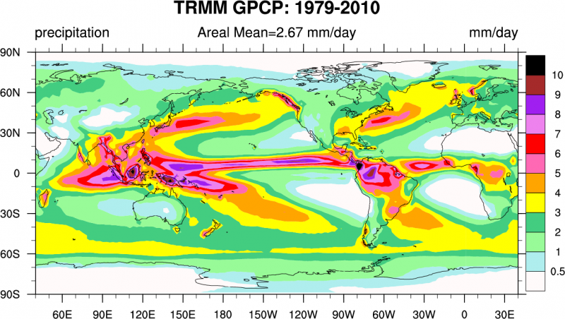
Climatological Annual Mean Precipitation
Climate Data Guide; D. Shea

Slide 5
Observational analyses courtesy of:
George N. Kiladis
NOAA Aeronomy Laboratory, Boulder, Colorado
Katherine H. Straub
Susquehanna University
Patrick T. Haertel
University of North Dakota

Slide 6
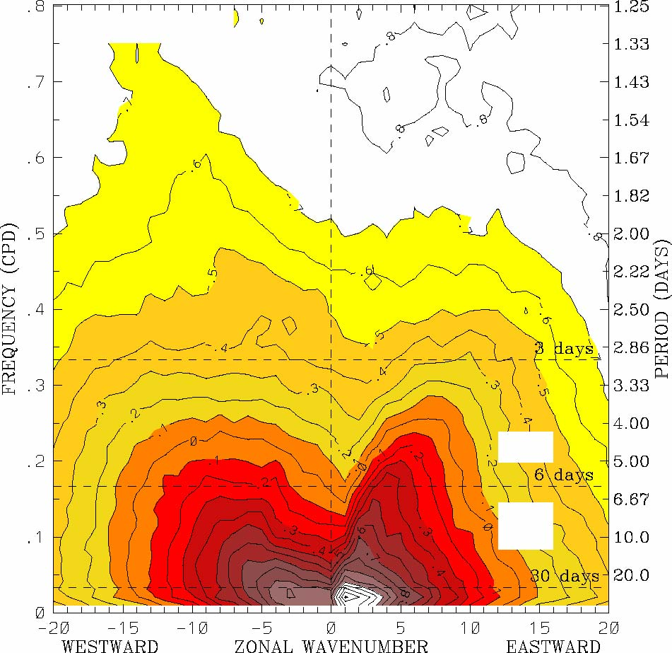
OLR power spectrum, 15ºS-15ºN, 1979–2001 (Symmetric)
from Wheeler and Kiladis, 1999

Slide 7
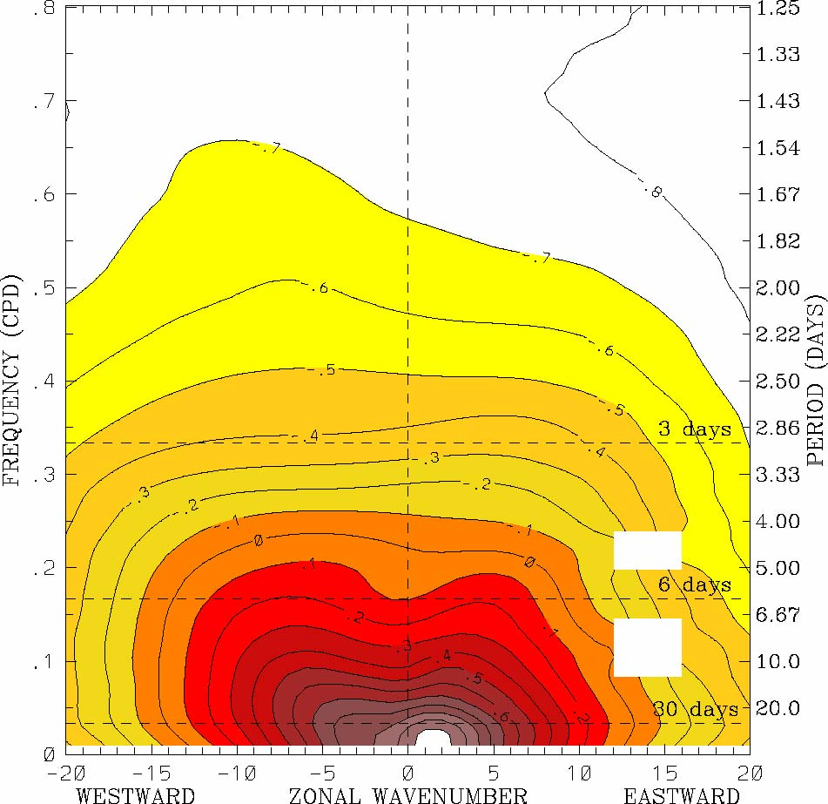
OLR background spectrum, 15ºS-15ºN, 1979–2001
from Wheeler and Kiladis, 1999

Slide 8
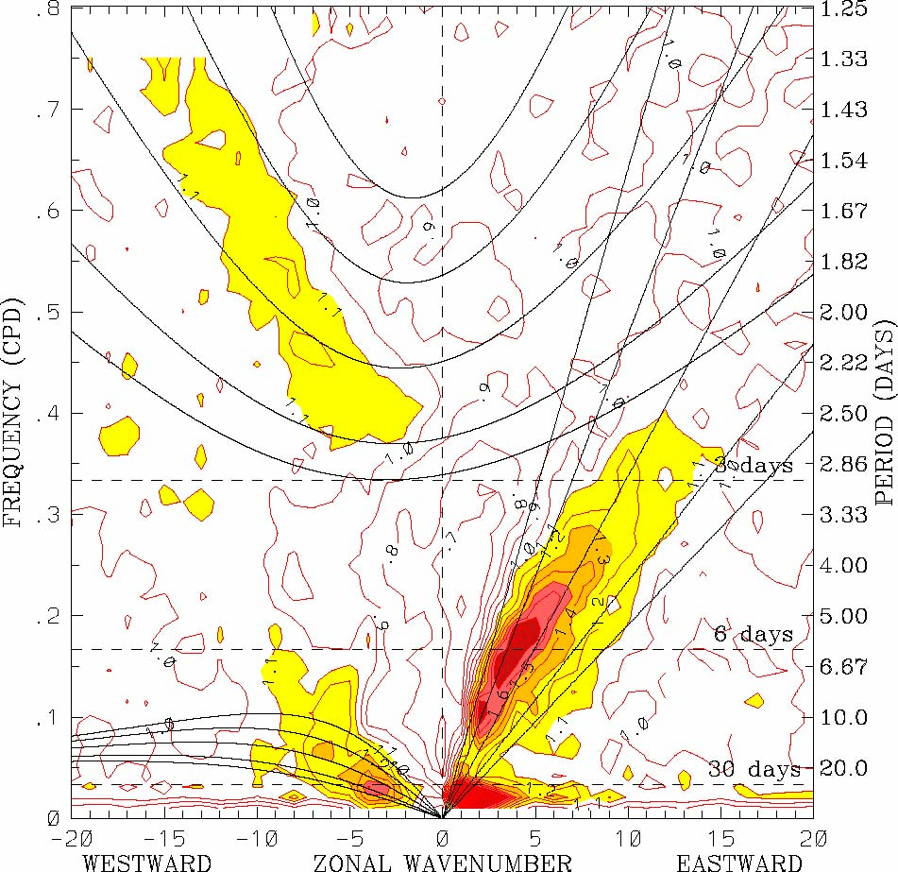
OLR power spectrum, 1979–2001 (Symmetric)
Perturbation spectra
Black lines and curves are dispersion relations for shallow water waves in an equatorial beta-plane (Matsuno, 1966)
from
Wheeler and Kiladis, 1999

Slide 9
OLR power spectrum, 1979–2001 (Symmetric)
Perturbation spectra
Kelvin
from
Wheeler and Kiladis, 1999

Slide 10
OLR power spectrum, 1979–2001 (Symmetric)
Westward Inertio-Gravity
Kelvin
from
Wheeler and Kiladis, 1999

Slide 11
OLR power spectrum, 1979–2001 (Symmetric)
Westward Inertio-Gravity
Kelvin
Equatorial Rossby
from
Wheeler and Kiladis, 1999

Slide 12
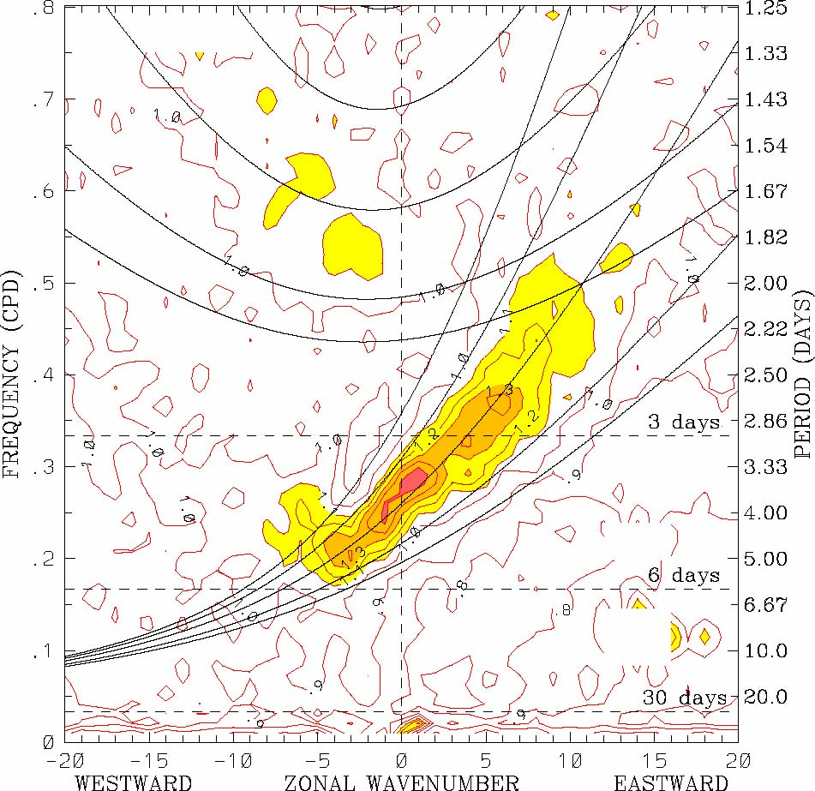
OLR power spectrum, 1979–2001 (Antisymmetric)
Mixed Rossby-Gravity (Yanai)
from
Wheeler and Kiladis, 1999

Slide 13
OLR power spectrum, 1979–2001 (Symmetric)
Westward Inertio-Gravity
Kelvin
Equatorial Rossby
Madden-Julian Oscillation
from
Wheeler and Kiladis, 1999

Slide 14
The MJO variance does not lie along a Matsuno dispersion curve

Slide 15
What is responsible for organizing moist convection on large scales?

Slide 16
Central Hypothesis
Self-organization of convection on scales larger than squall lines requires modulation of radiative cooling rates and/or surface wind speeds

Slide 17
Energy Sources for Large-Scale Circulations
Classical studies of convection (e.g. R.-B.) show that convective energy is released preferentially on small scales (~H)
Under some circumstances, kinetic energy in small scale convection can cascade upward into large scales, usually in rotating systems (e.g. see Guervilly, Hughes, and Jones, 2017)
Energy budget analyses of simulated large-scale tropical systems (even TCs) shows no evidence of such an up-scale cascade
All available evidence points toward large-scale KE originating from APE generated at large-scales in tropical circulations systems

Slide 18
Self-Aggregation of Moist Convection

Slide 19

Compelling Evidence from Cloud-Permitting Models:
Tompkins and Craig, 1998: RCE in 3-D box: “This organization seems to result from interactions between radiation, convection and surface fluxes.”
Bretherton, Blossey and Khairoutdinov (2005): “The self-aggregation is analyzed as an instability of a horizontally homogeneous convecting atmosphere driven by convection–water vapor–radiation feedbacks that systematically dry the drier air columns and moisten the moister air columns.”
  Self-aggregation can be suppressed by horizontally homogenizing the radiative cooling or surface fluxes.

Slide 20
Three-Dimensional Cloud-Permitting Nonhydrostatic models run into statistical equilibrium with calculated or prescribed radiative cooling over a fixed, constant sea surface temperature
(Doubly-periodic domains)

Slide 21
Approach: Idealized modeling of convective organization in radiative-convective equilibrium using a cloud resolving model
System for Atmospheric Modeling (SAM) of Khairoutdinov and Randall (2003)
Constant solar insolation: 413.98 W/m²
Horizontal Resolution: 3km
Vertical Resolution: 64 levels
Periodic lateral boundaries
Initial sounding from domain average of smaller domain run in RCE
Fully interactive RRTM radiation and surface fluxes.
Rigid Lid
28 km
Fixed SST
297-312 K
768 km
768 km
Notes:
Three-dimensional cloud resolving model Anelastic equations of motion RRTM radiation scheme SAM 1-moment microphysics scheme
Prognostic thermodynamic variables:
Liquid water/ice moist static energy: h_{L} = c_{p}T + gz – L_{c}(q_{c}+q_{r})-L_{s}(q_{i}+q_{s}+q_{g})
Total nonprecipitating water
Total precipitating water

Slide 22
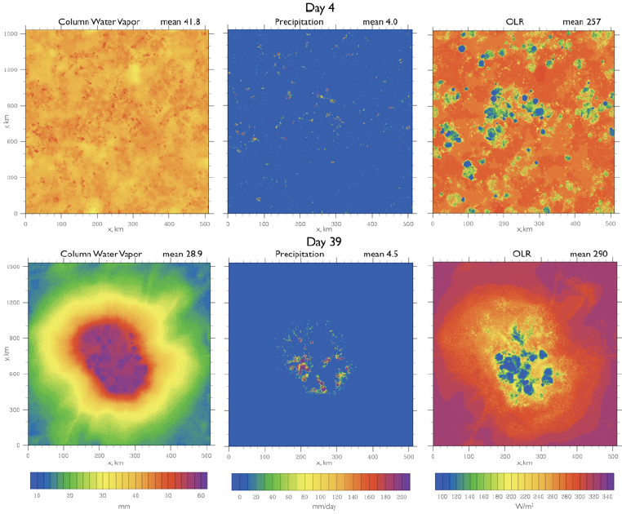
Spontaneous Aggregation of Convection

Slide 23
Spontaneous Aggregation of Convection

Slide 24
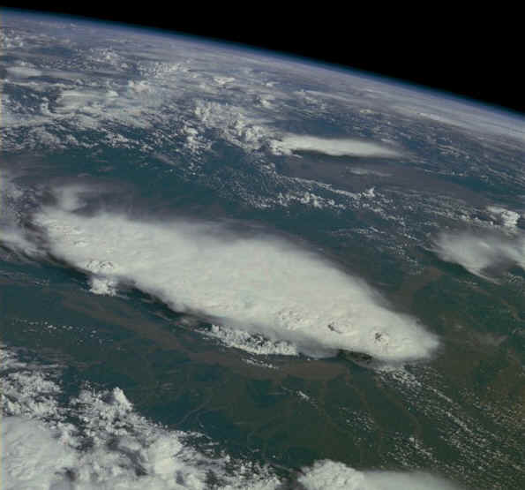
Monsoonal Thunderstorms, Bangladesh and India, July 1985

Slide 25
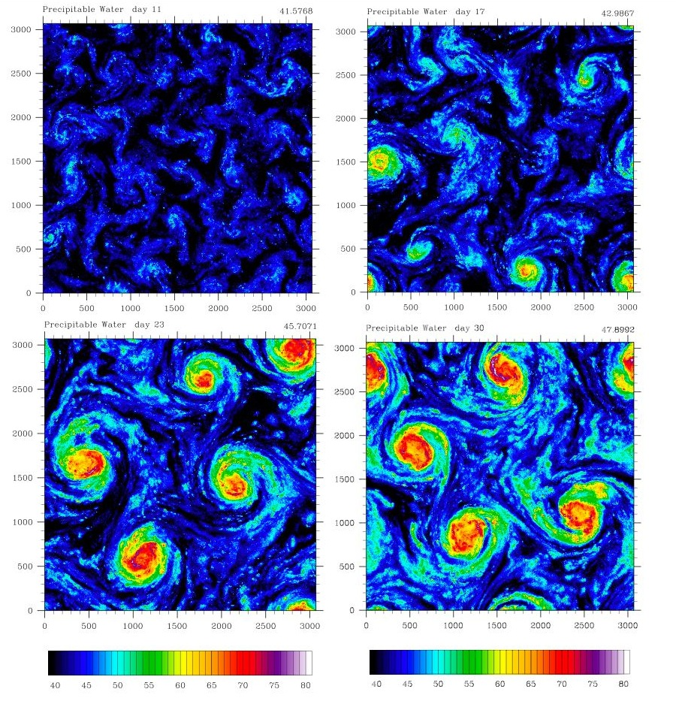
Self-Aggregation on an f-plane
Tropical cyclones emerge spontaneously even more readily than in non-rotating simulations
The “lore” that real-world TCs always arise from pre-existing disturbances may prove to be wrong

Slide 26
The MJO is quite likely owing to self-aggregation of moist convection on a rotating sphere

Slide 27
Self-Aggregation on a Non-rotating Sphere with Uniform SST, using SP-CAM
Arnold and Randall, JAMES, 2015

Slide 28
Self-Aggregation on a Non-rotating Sphere with Uniform SST, using SP-CAM
Convective entrainment rate in ordinary CAM
Arnold and Randall, JAMES, 2015

Slide 29
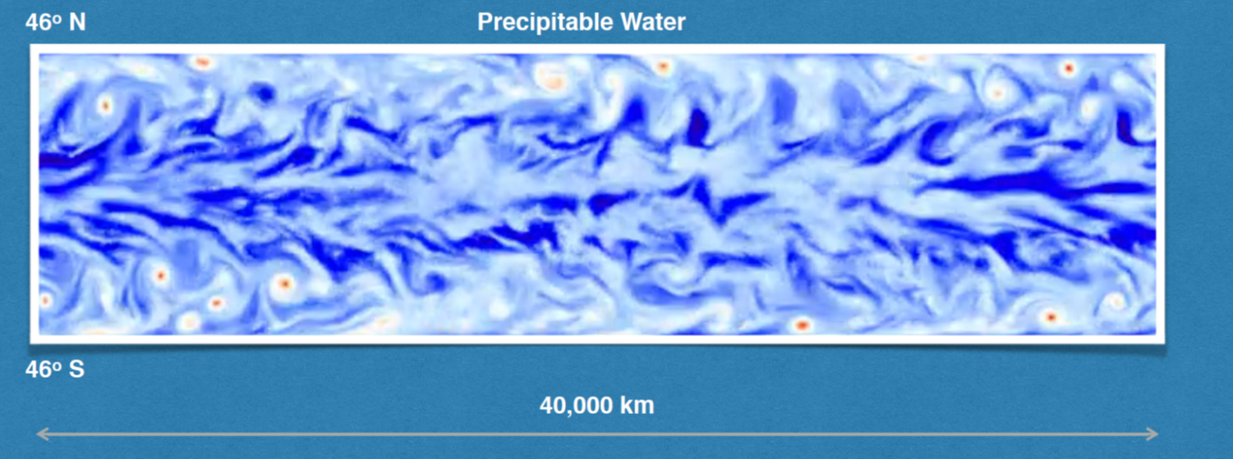
Khairoutdinov and Emanuel (2018)
Model: System for Atmospheric Modeling (SAM; Khairoutdinov and Randall 2003)
Domain: 40,000 km x 10,000 km; top at 30 km
Zonally periodic; solid walls at 46ºN/S; equator at the center
Grid spacing 20 km
Aqua-planet with uniform SST=300K
Constant insolation: 650 W/m² with constant zenith angle of 52º
Realistic Coriolis parameter

Slide 30
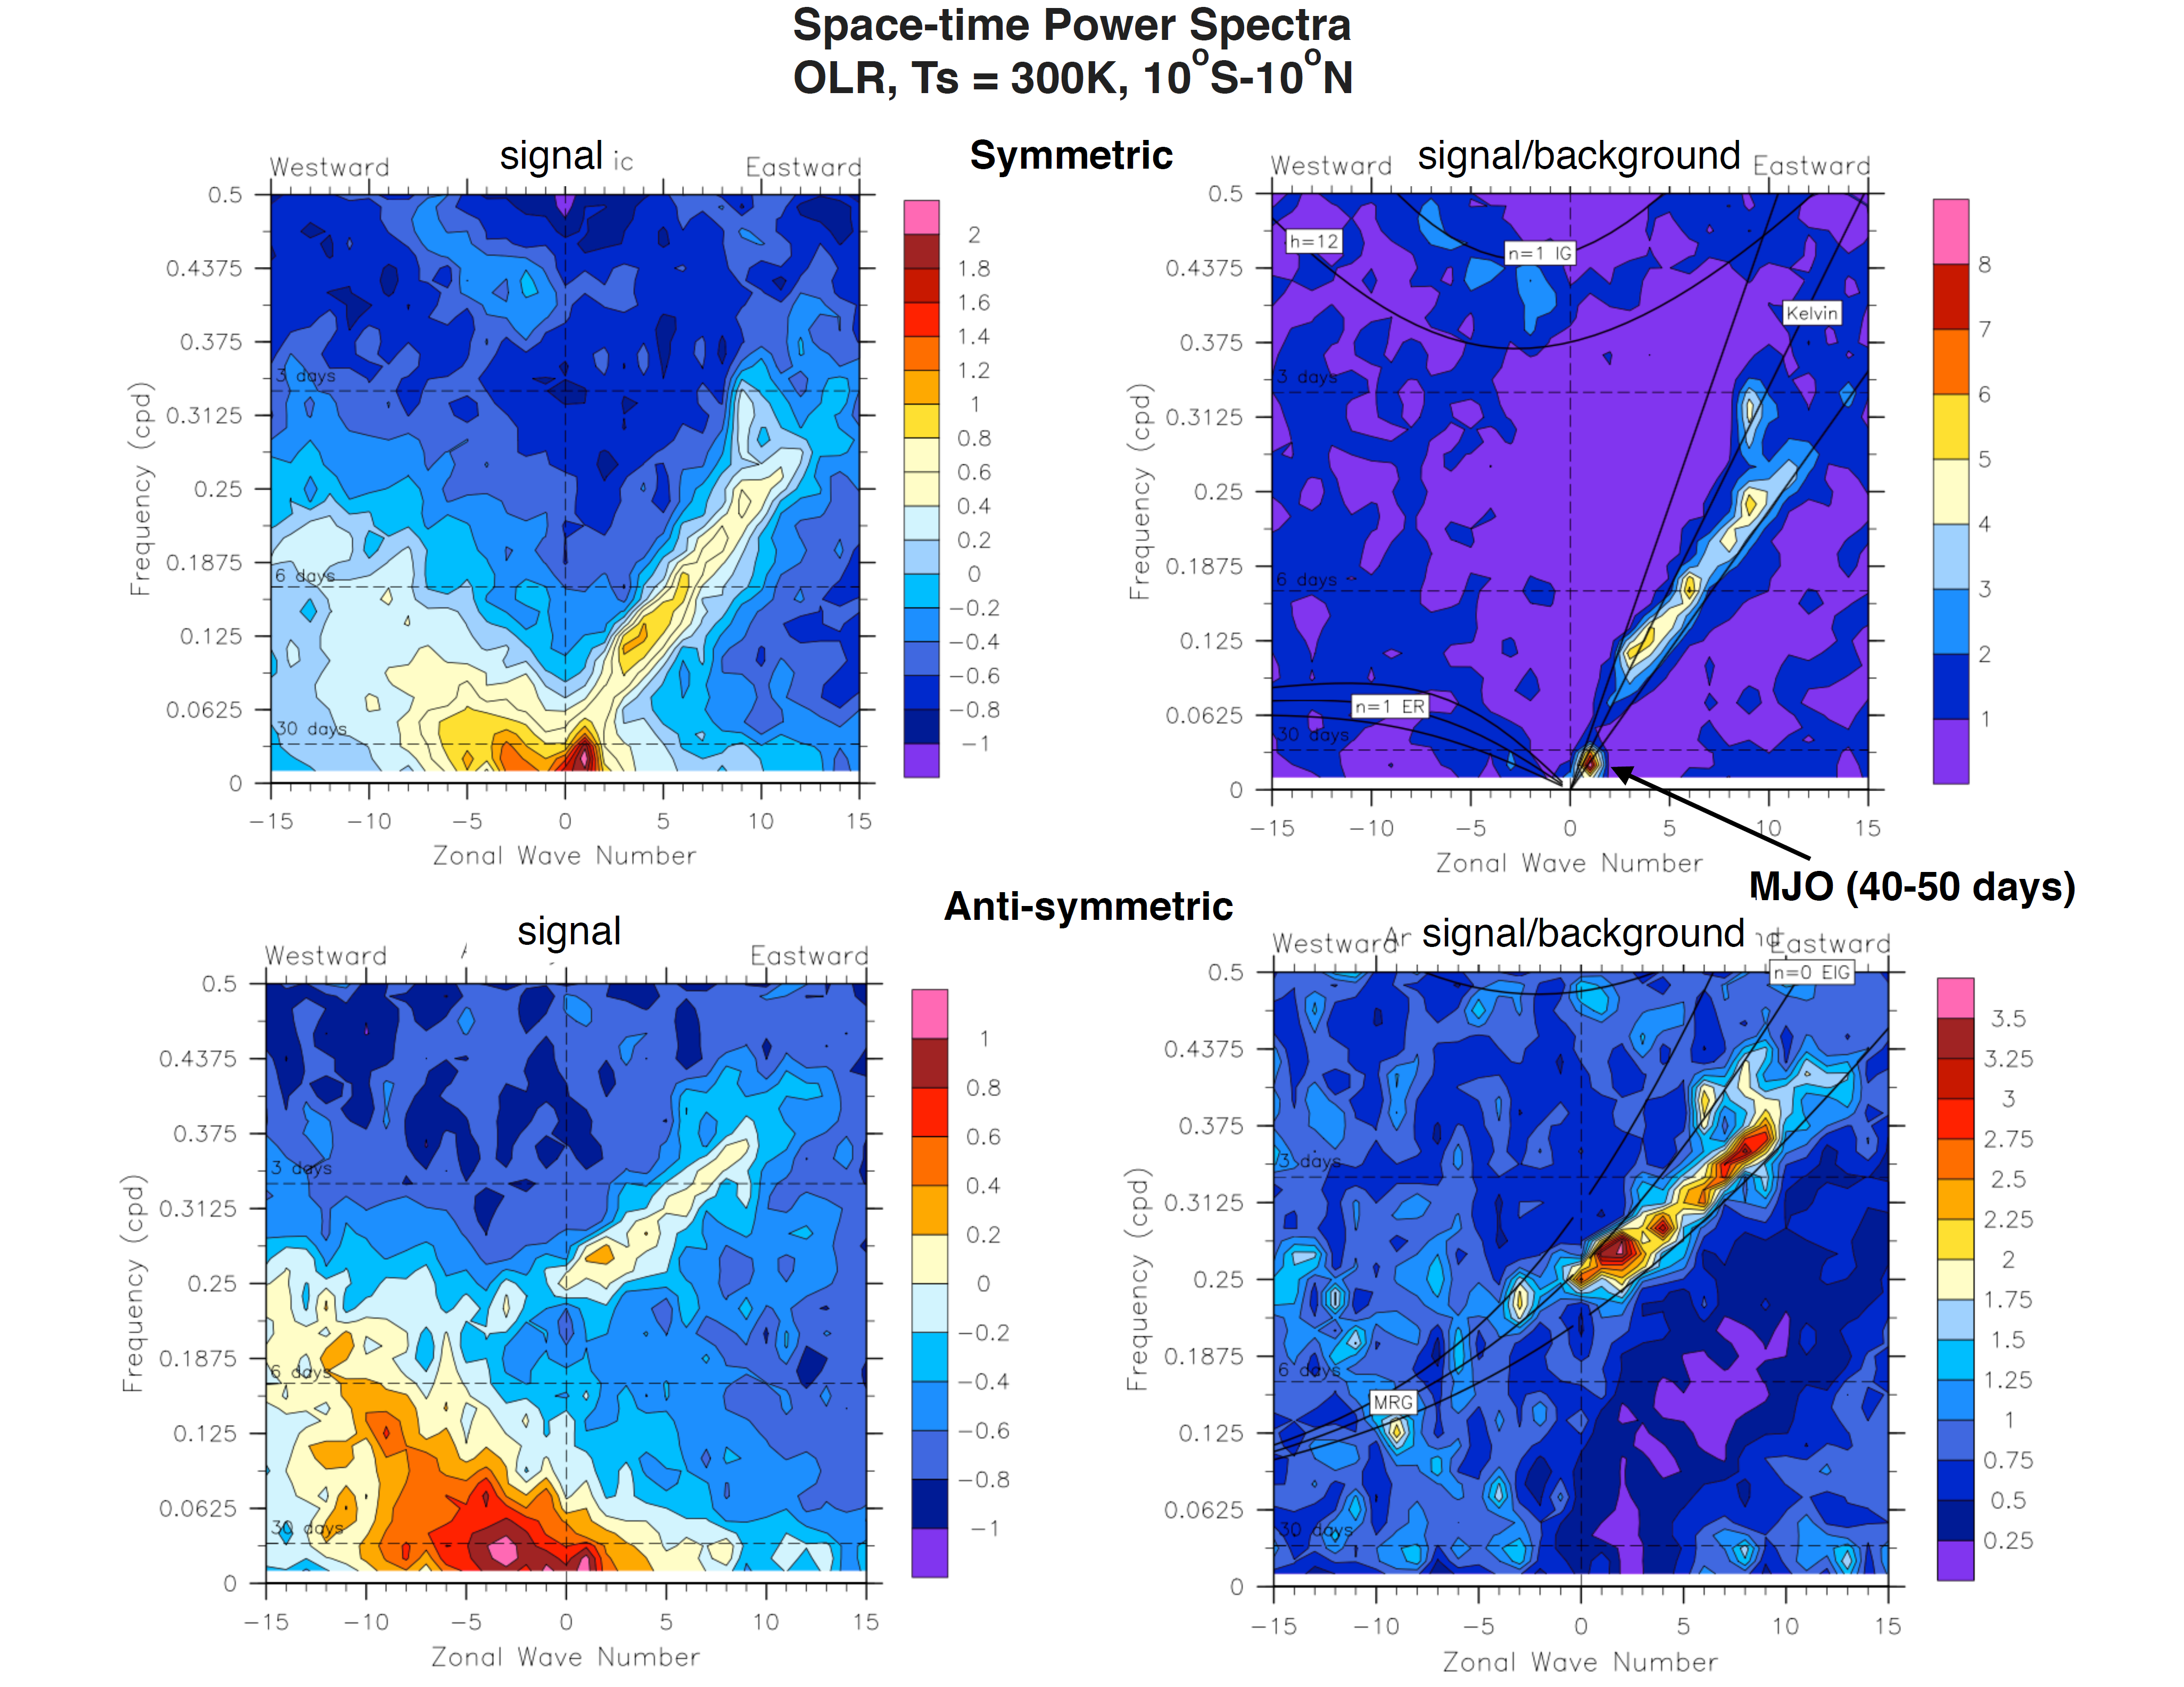
Wavenumber-Frequency Spectra
Symmetric OLR
Anti-symmetric OLR
From Khairoutdinov and Emanuel (2018)

Slide 31
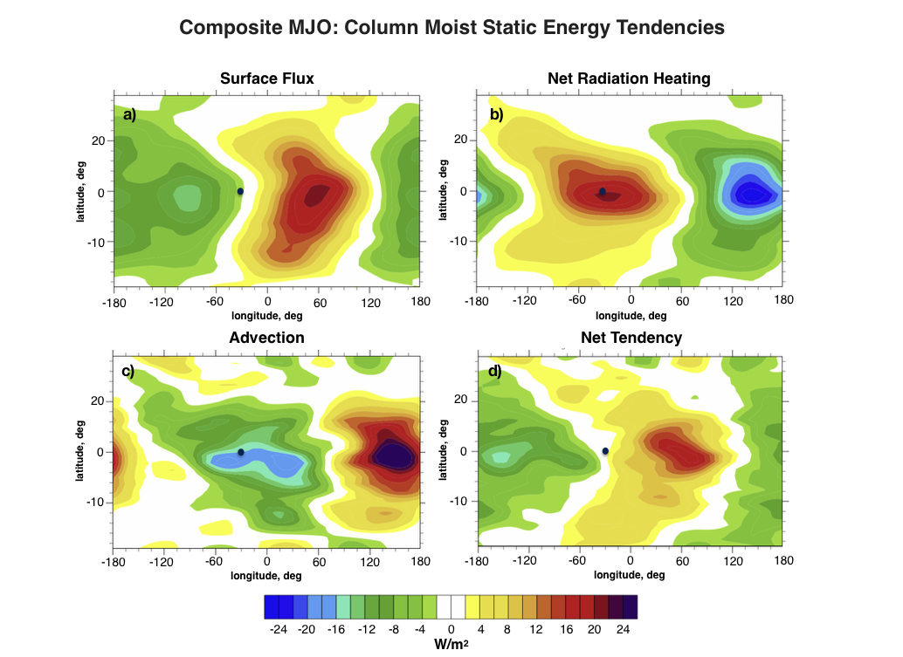
From Khairoutdinov and Emanuel (2018)

Slide 32
Mechanism-Denial Experiments:
Time-Longitude sections on Equator
From Khairoutdinov and Emanuel (2018)

Slide 33
Linear Modes of the Equatorial Waveguide

Slide 34
Crucial simplification: Tropical atmosphere has nearly moist adiabatic lapse rates

Slide 35
Implications of the moist adiabatic lapse rate for the structure of tropical disturbances
Approximate moist adiabatic condition as that of constant saturation entropy:
Assume hydrostatic perturbations:

Slide 36
Maxwell’s relation:
Integrate:
Only barotropic and first baroclinic mode survive

Slide 37
This implies, through the linearized momentum equations, e.g.
that the horizontal velocities may be partitioned similarly:

Slide 38
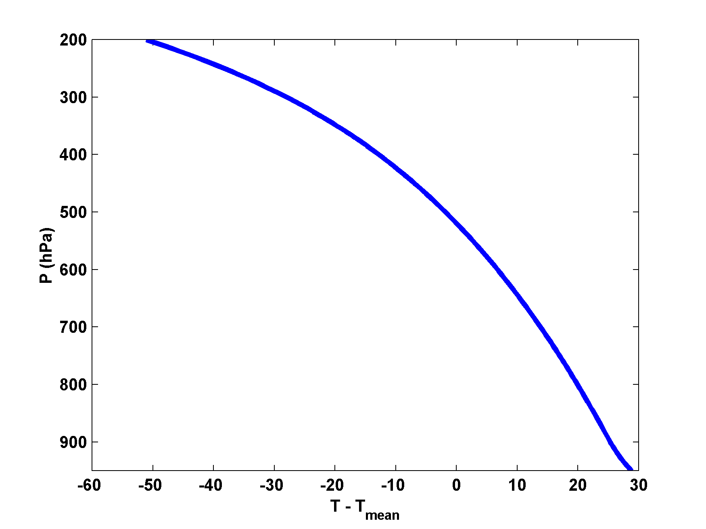

Slide 39
Implications for vertical structure of vertical velocity
Integrate:

Slide 40
At tropopause:
This implies that if a rigid lid is imposed at the tropopause¹, the divergence of the barotropic velocities must vanish and the barotropic components therefore satisfy the barotropic vorticity equation:
¹ This is not such a great approximation for equatorial modes

Slide 41
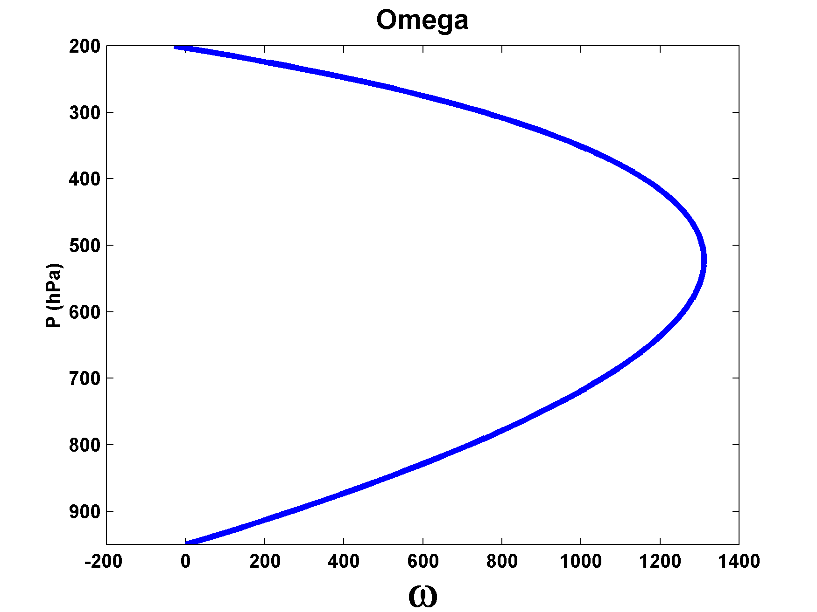

Slide 42

Feedback of Air Motion on (virtual) Temperature
Convection cannot change vertically integrated enthalpy,
Then neglecting surface fluxes, radiation, and horizontal advection,
Neelin and Held (1987): This function is negative for upward motion

Slide 43
Upward motion is associated with column moistening:
Yano and Emanuel, 1991:
Ascent leads to cooling

Slide 44
Prediction: Inviscid, small amplitude perturbations under rigid lid: Shallow water solutions with reduced equivalent depth

Slide 45
Represent convection using boundary layer quasi-equilibrium

Slide 46
Non-dimensional Linear Model
Zonal geostrophy
Zonal wind
Meridional wind
Free troposphere saturation entropy
Surface flux damping
Free troposphere moist entropy
Cloud-radiation feedback
WISHE
Surface flux damping
Gross moist stability
Wave radiation emulator
Moist, first-baroclinic-mode equations with convection based on PBL quasi-equilibrium
From Khairoutdinov and Emanuel (2018)

Slide 47
Integral constraint:
Define an averaging operator:
WISHE
Cloud-radiation
Weird moisture-vertical velocity correlation
Damping terms

Slide 48
Cubic equation for complex growth rate:
Usually one growing and one decaying mode (third root does not satisfy boundary conditions)
Apply Weak Temperature Gradient (WTG) approximation (s=0):
Only a single mode survives:
Wave radiation emulator
Cloud-radiation feedback
WISHE
From Khairoutdinov and Emanuel, J. Atmos. Sci., (2018)

Slide 49
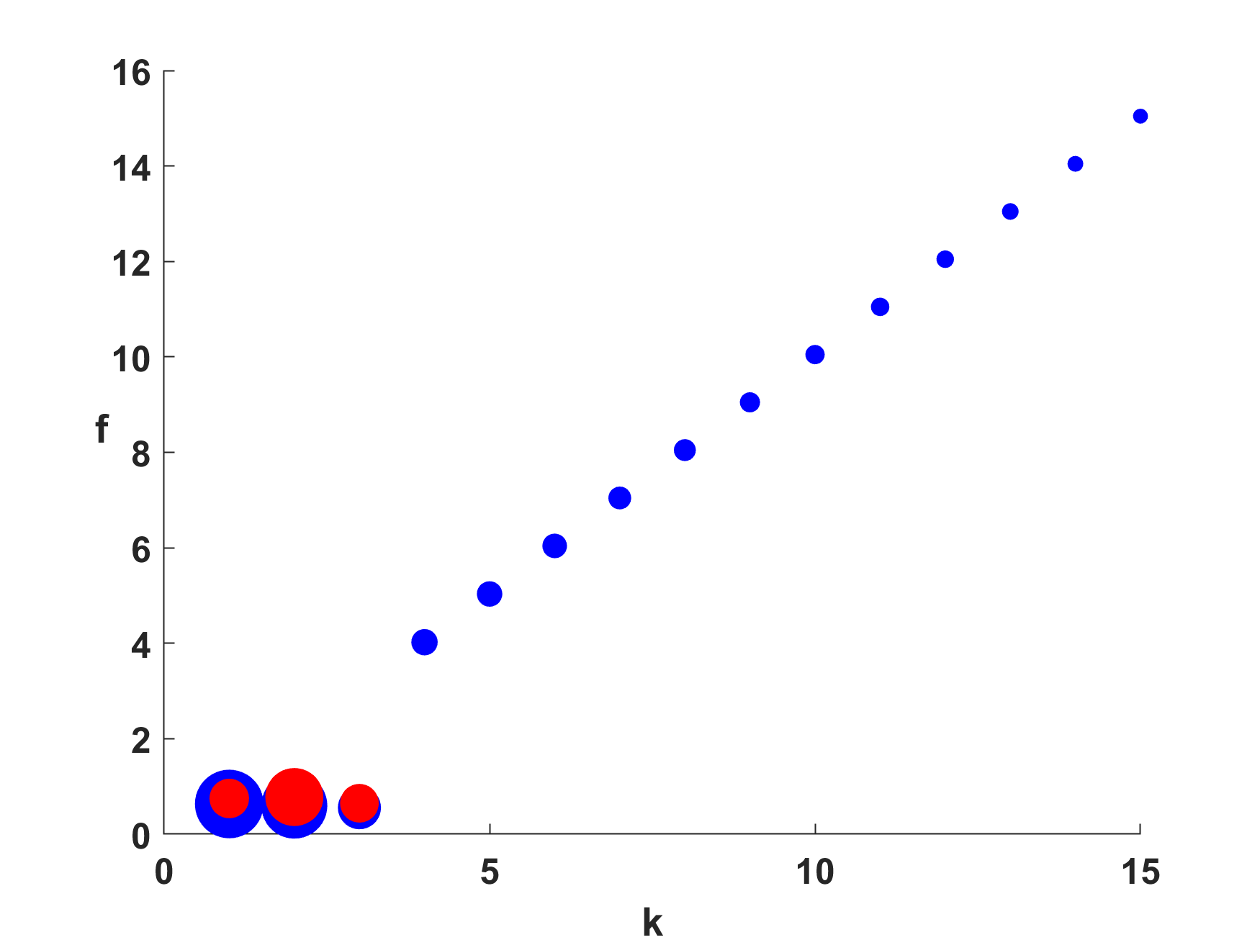
Frequency vs. wavenumber; size of circles proportional to growth rate
WISHE-driven moist Kelvin waves
Nondimensional frequency
WTG approximation
MJO mode
From Khairoutdinov and Emanuel, J. Atmos. Sci., (2018)

Slide 50
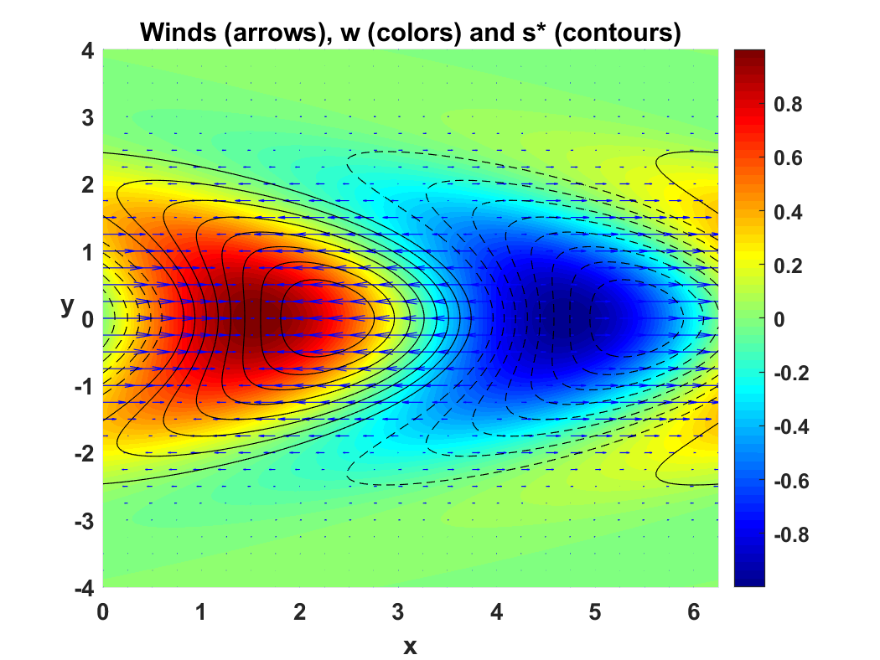
k = 1 mode
After Khairoutdinov and Emanuel, J. Atmos. Sci., (2018)

Slide 51
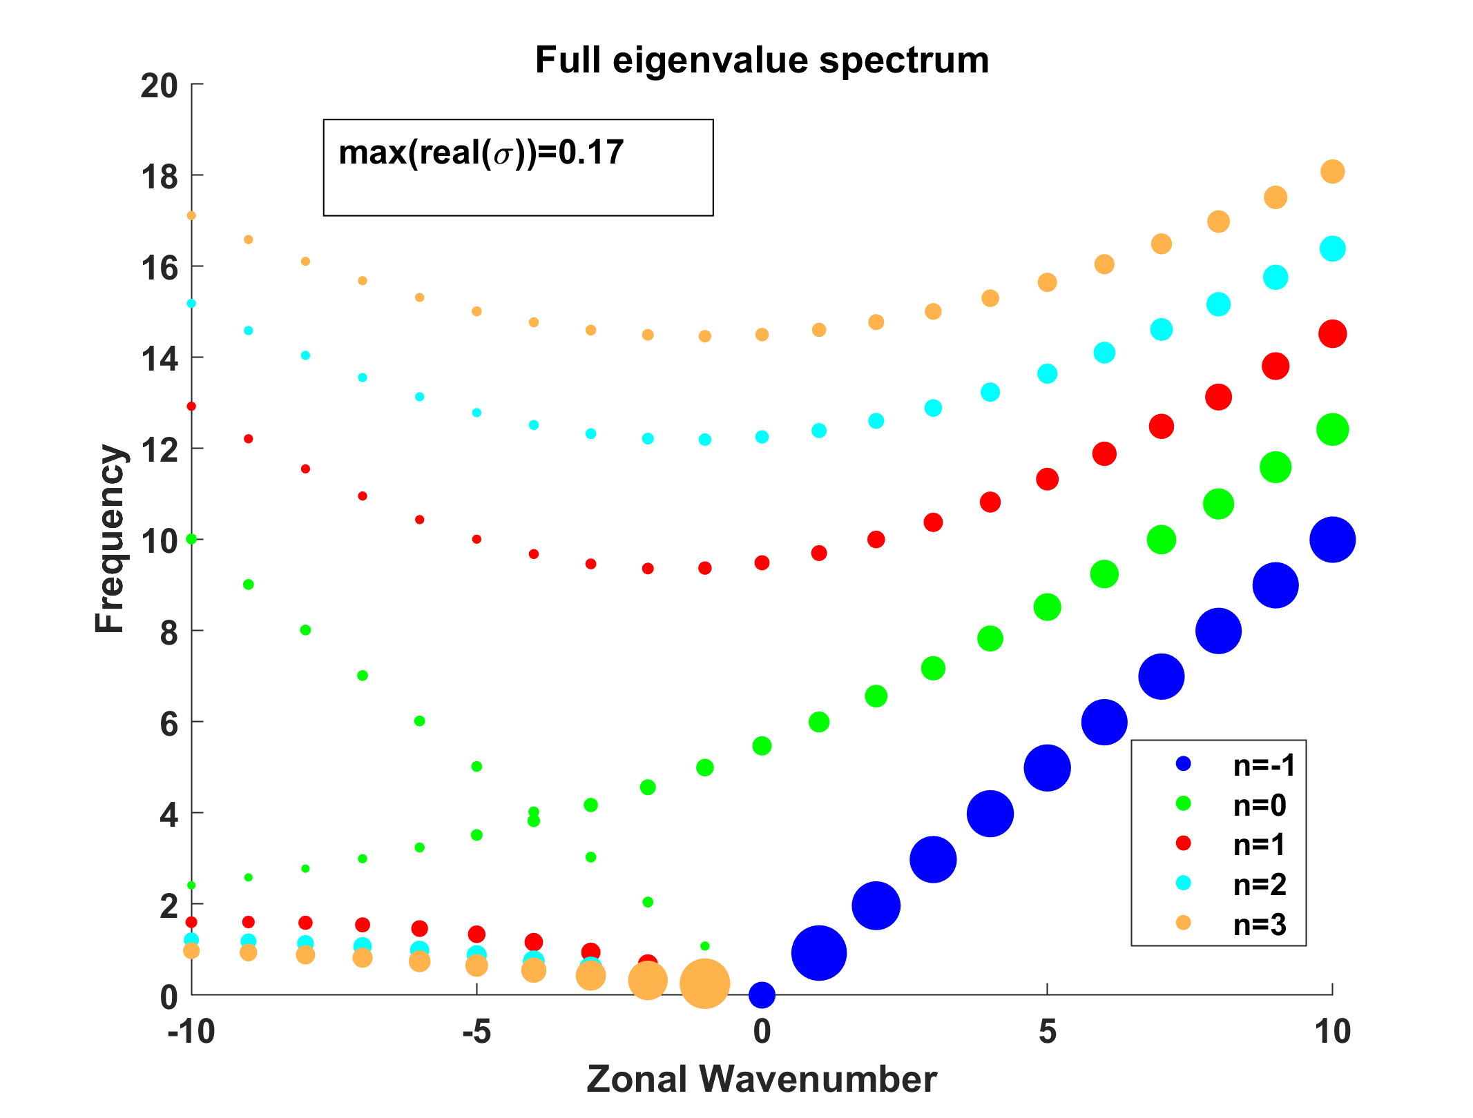
Full Solutions
(Dispersion relation is eight-order polynomial)
1. Set all damping terms to zero and set WISHE and cloud- radiation terms to small values:

Slide 52
2. Use reasonable values of all parameters:

Slide 53
Zoom in on low frequencies

Slide 54
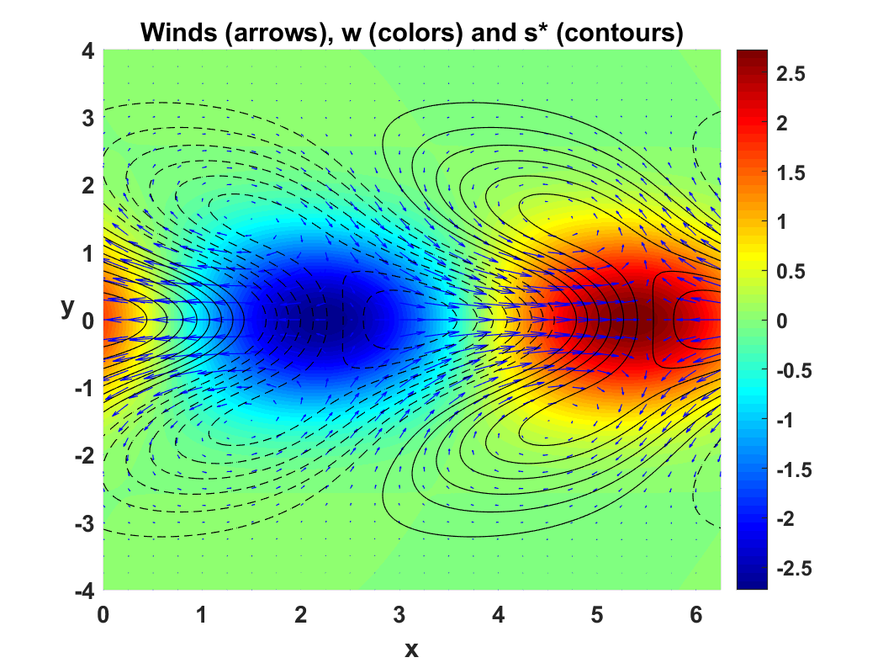
Cloud-radiation and WISHE can drive solutions far away from classical Matusno (neutral) modes
For example, the n=1 eastward mode has elements of Rossby and Kelvin dynamics, but WISHE also plays large role in propagation.

Slide 55
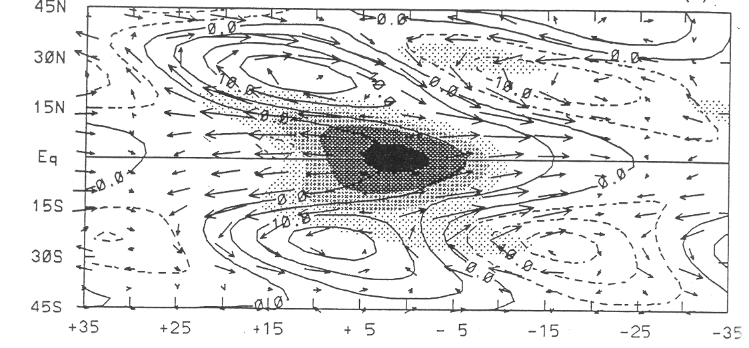
MSU T (Contours), 200 mb winds (arrows), OLR (shaded
Hendon and Liebmann, J. Geophy. Res., 1994

Slide 56
Summary
All available evidence points to the critical roles of cloud- radiation interaction and WISHE in organization of convection on scales larger than squall lines
Purely dynamical theories fail to explain the main observed properties of equatorial modes, even when convective coupling is considered
Recent research has shown that the MJO is quite probably an example of self-aggregation of moist convection occurring on a rotating sphere, driven by cloud-radiation and wind- induced surface enthalpy flux variations

