Slide 1

Climate Risks, Options and Opportunities
Kerry Emanuel
Lorenz Center, MIT
Notes:
1

Slide 2
Program
Update on climate science
Climate risks
Quantitative estimates of climate risks
Solving the problem: A golden opportunity

Slide 3
Our Influence on Greenhouse Gases

Slide 4

Svante Arrhenius, 1859-1927
“Any doubling of the percentage of carbon dioxide in the air would raise the temperature of the earth's surface by 4°; and if the carbon dioxide were increased fourfold, the temperature would rise by 8°.” – Världarnas utveckling (Worlds in the Making), 1906

Slide 6
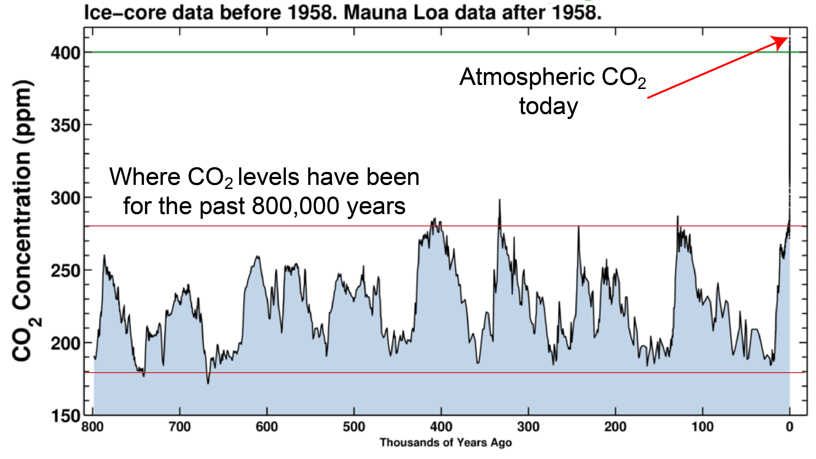

Slide 7

CO₂ May Go Well Beyond Doubling
Double Pre-Industrial

Slide 8

IPCC 2007: Doubling CO₂ will lead to an increase in mean global surface temperature of 2 to 4.5 ºC.
Atmospheric CO₂ assuming that emissions stop altogether after peak concentrations
Global mean surface temperature corresponding to atmospheric CO₂ above
Courtesy Susan Solomon

Slide 9

Climate Risks

Slide 10


Estimate of how much global climate will warm as a result of doubling CO₂: a probability distribution
Substantial risk
Catastrophic risk
Little risk
Source: 100000 PAGE09 runs
Chris Hope, U. Cambridge
courtesy Tim Palmer
Notes:
Describe pdf. Reflects post-IPCC knowledge as well as IPCC AR4.

Slide 11
Formal Definition of Risk:

Slide 12
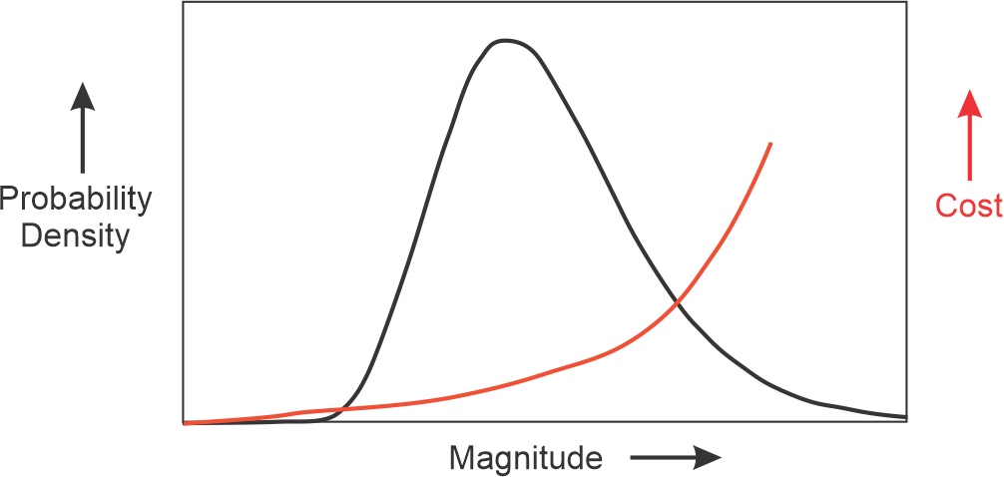
Uncertainty increases risk

Slide 13
Climate Risks
No one really cares whether the world will warm up by 3-5 C (nor should they)
We care about real risks: Heat waves, wild fires, hurricanes, droughts, floods, etc.
We need to quantify these risks, including uncertainty, to position ourselves to make intelligent choices
Insurance is one instrument for quantifying risk, but it is not currently even accounting for climate change that has already occurred
Science is positioned to make rapid progress in quantifying climate risk

Slide 14
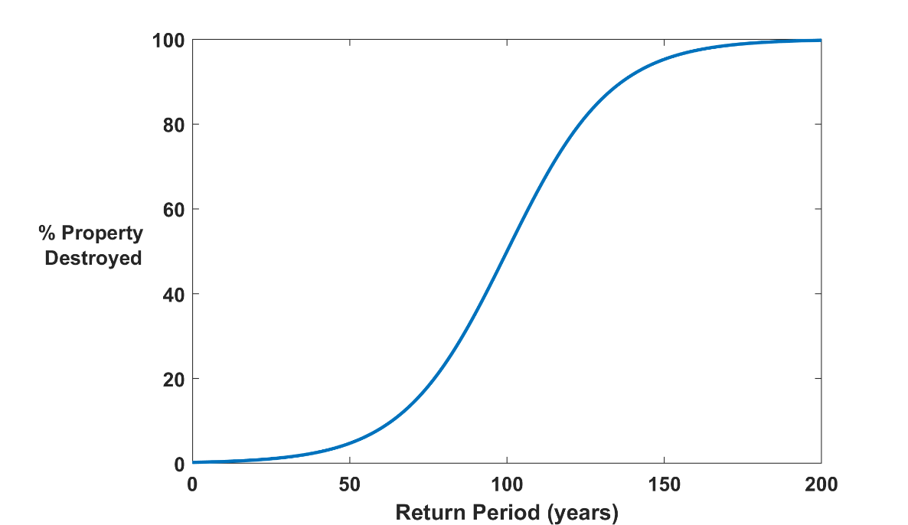

Why Climate Risk is Dominated by Extreme Events:
Societies are usually well adapted to frequent events (> 1/100 yr)
Societies are often poorly adapted to rare events (< 1/100 yr)
Large cost increases result when > 100-yr events become < 100-yr events
Largest slope

Slide 15
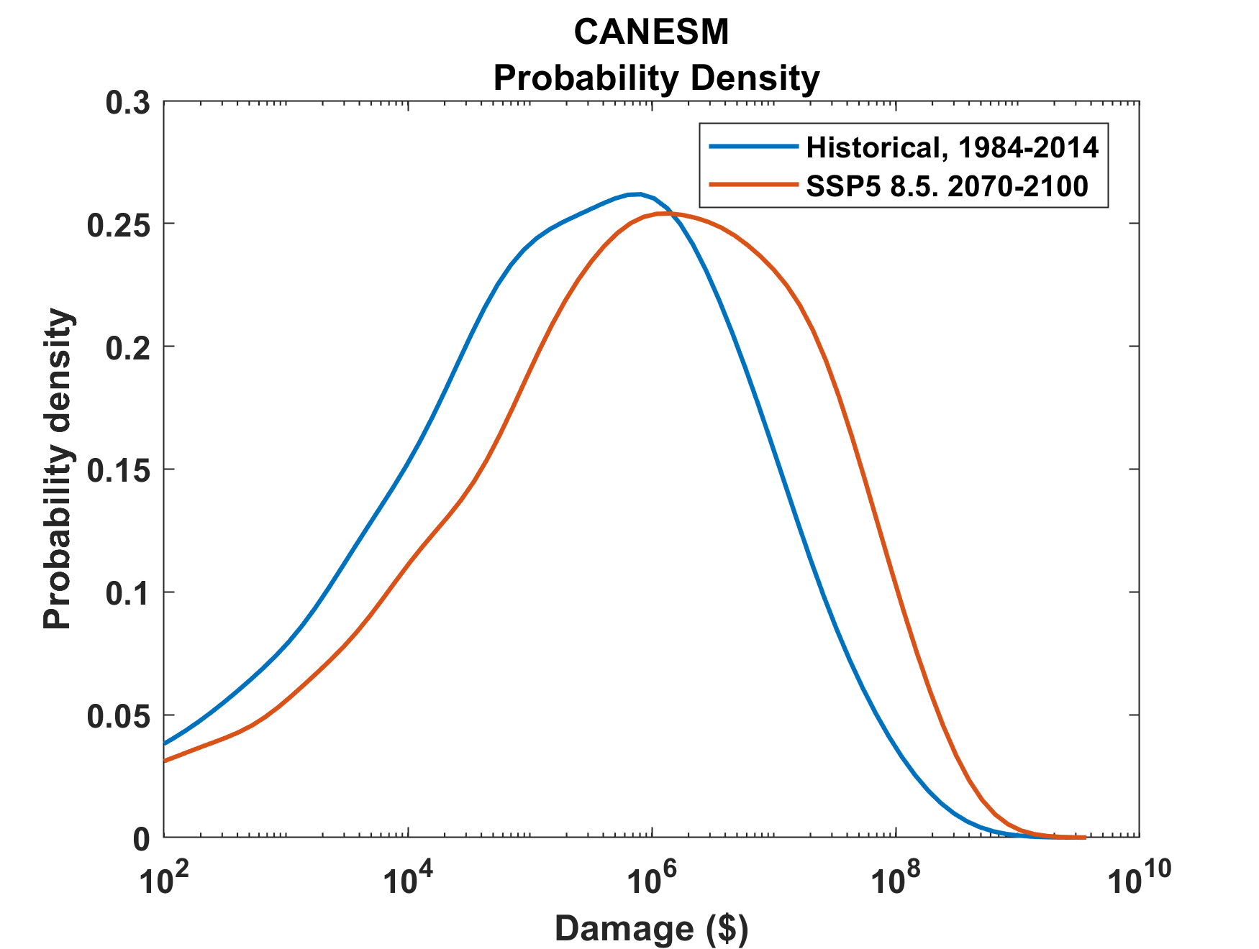
Example:
Tropical Cyclone Risk Arises Largely from High Intensity Events
1984-2014
2070-2100
Probability
Probability density of annual damage to a portfolio of insured property in the U.S.

Slide 16
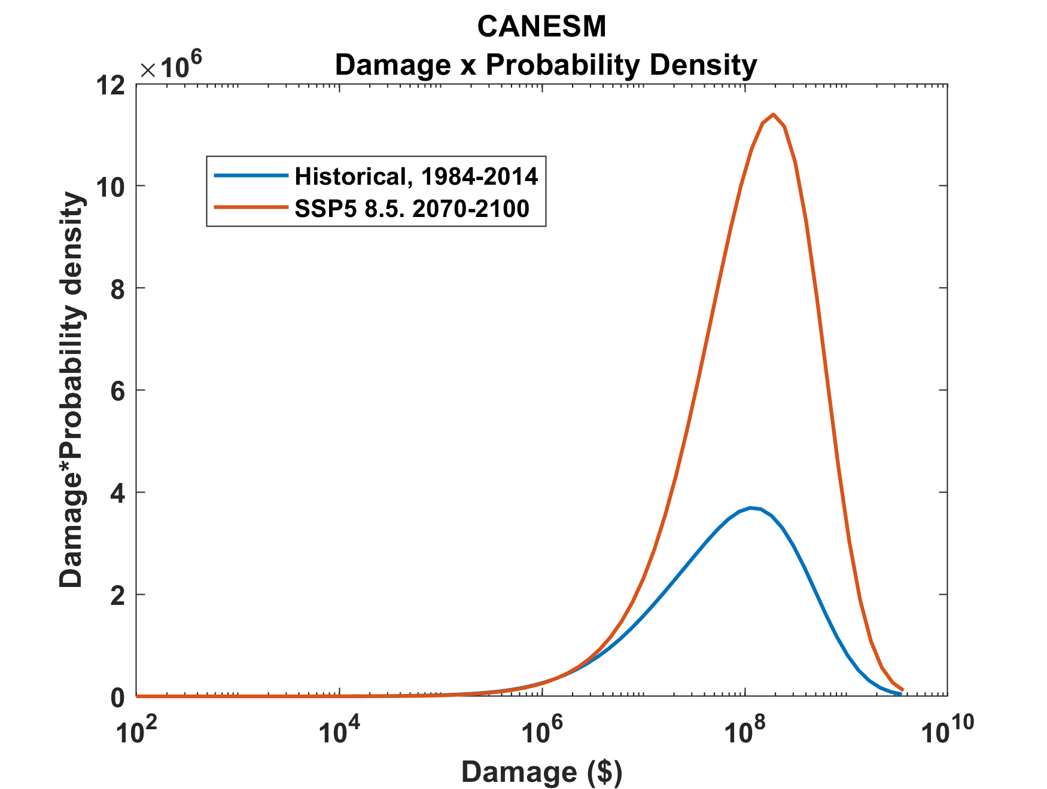
Tropical Cyclone Risk Arises Largely from High Intensity Events
2070-2100
Total expected damage proportional to area under curves
Risk
1984-2014
Damage times probability density of annual damage to a portfolio of insured property in the U.S.

Slide 17
Flawed Basis of Current Risk Modeling
Almost all current risk assessments are based on historical statistics
Historical records are flawed and short, particularly outside North America
Moreover, the past 50-150 years is a poor guide to the present owing to climate change that has already occurred
Industry risk modelers have been slow to migrate to a physics- based approach

Slide 18
Quantifying Climate Risks:
Hurricanes as an Example

Slide 19
The Global Hurricane Hazard
About 10,000 deaths per year since 1971
$700 Billion 2015 U.S. Dollars in Damages since 1971
Global population exposed to hurricane hazards has tripled since 1970
EM-DAT, 2016: The OFDA/CRED International Disaster Database
http://www.emdat.be/.

Slide 20

Is Hurricane Risk Changing?

Slide 21
Global Tropical Cyclone Damage Normalized by Gross World Product
380% increase since 1970
Population of TC-prone regions increased by ~200%
Suggests that climate change has contributed to increasing damage
EM-DAT, 2020: The OFDA/CRED International Disaster Database
http://www.emdat.be/.

Slide 22
Number of Major Hurricanes in the North Atlantic, 1900-2010
Historical Observations (blue) and MIT Risk Model (red)

Slide 23
Global records prior to ~1980 are unreliable

Slide 24
Satellite-derived proportion of major hurricane fixes
Time series of fractional proportion of global major hurricane estimates to all hurricane estimates for the period 1979–2017. Each point, except the earliest, represents the data in a sequence of 3-y periods. The first data point is based on only 2 y (1979 and 1981) to avoid the years with no eastern hemisphere coverage. The linear Theil−Sen trend (black line) is significant at the 98% confidence level (Mann−Kendall P value = 0.02). The proportion increases by 25% in the 39-y period (about 6% per decade).
Kossin et al., PNAS, 2020

Slide 25
Historical tropical cyclone database vastly insufficient for quantitative evaluation of current risk and risk trends

Slide 26
Doing it right:
Bring Physical Models to Bear on Risk Estimation
Satellite Image
Global Model

Slide 27
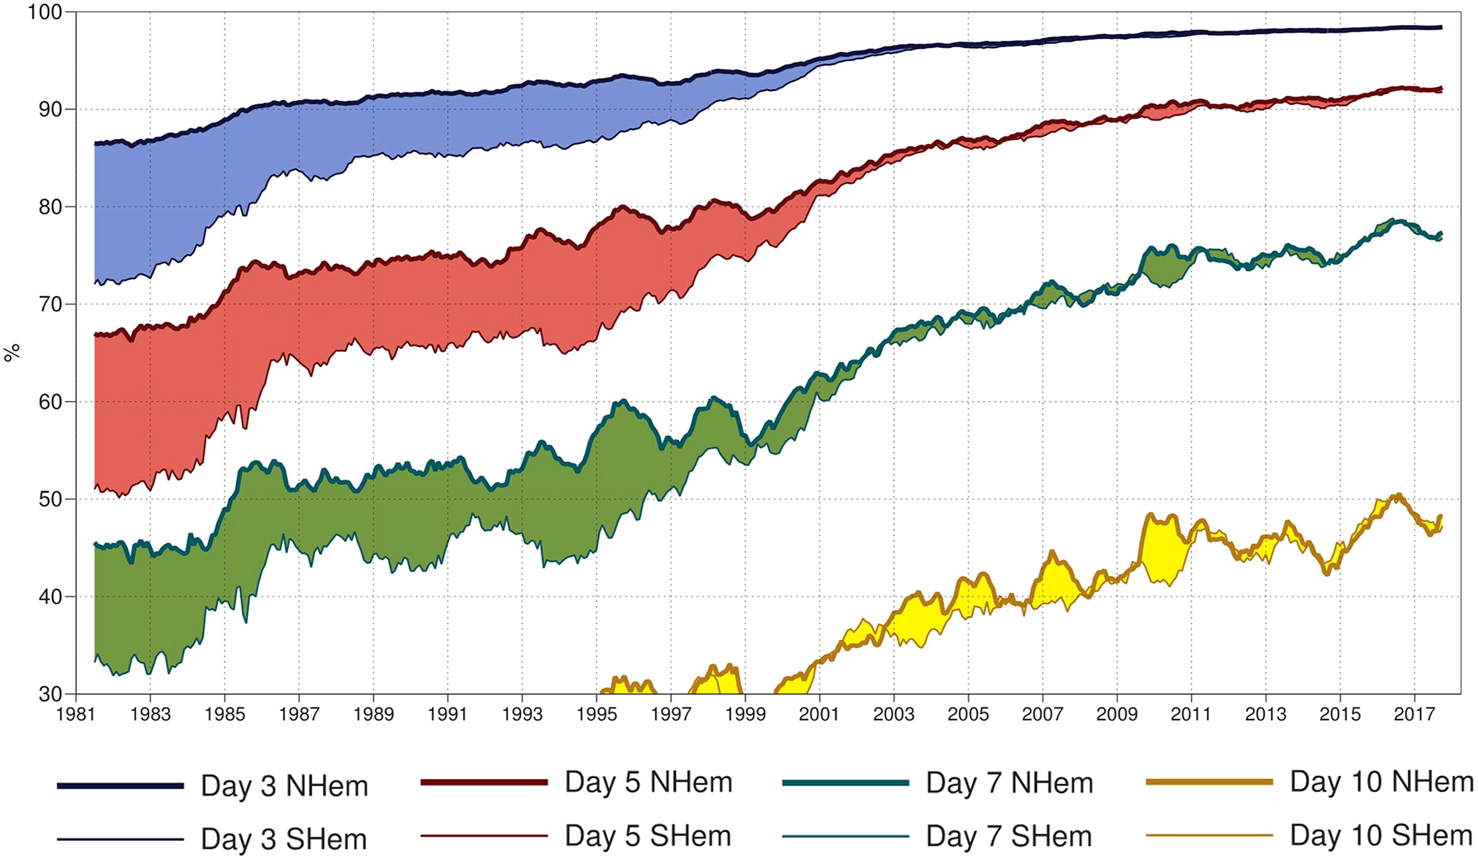
7-day forecast today about as accurate as 3-day forecast in 1980
A measure of the skill of numerical weather prediction models

Slide 28

But global models do not simulate the hurricanes that cause destruction
Category 2-3 boundary
Modeled
Histograms of Tropical Cyclone Intensity as Simulated by a Global Model with 50 km grid point spacing. (Courtesy Isaac Held, GFDL)
Observed

Slide 29
To get the tails right we need to simulate many events
Here at MIT we have learned how to downscale ~100,000 hurricanes from climate models, using an advanced, very high resolution hurricane model embedded in global climate analyses or models

Slide 30
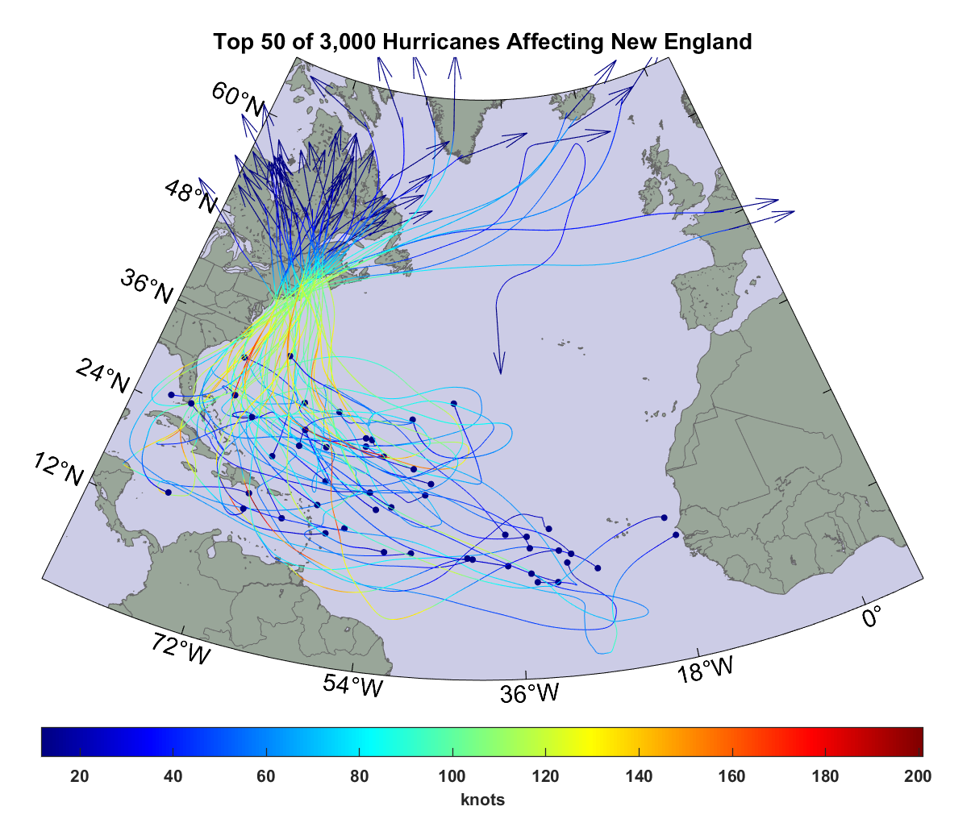

Slide 31
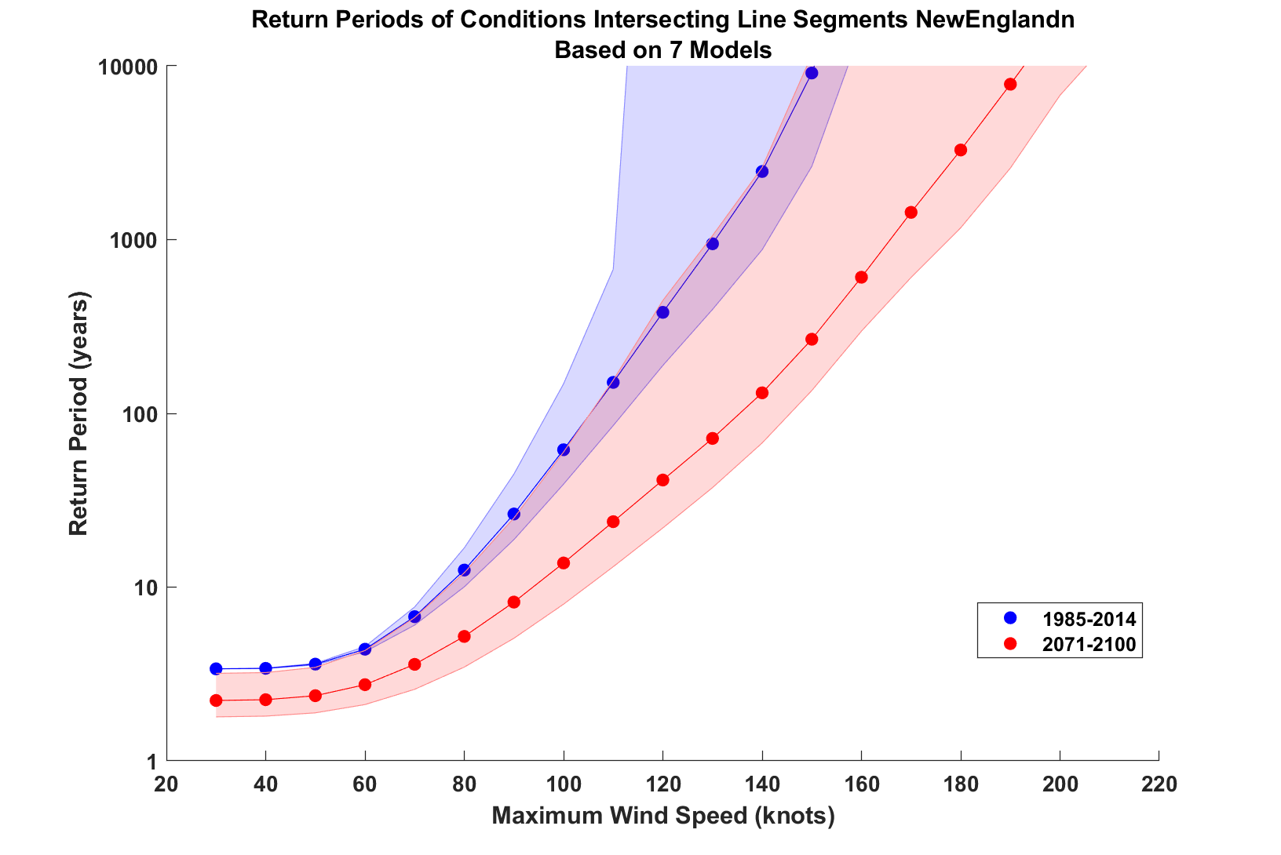

Slide 32
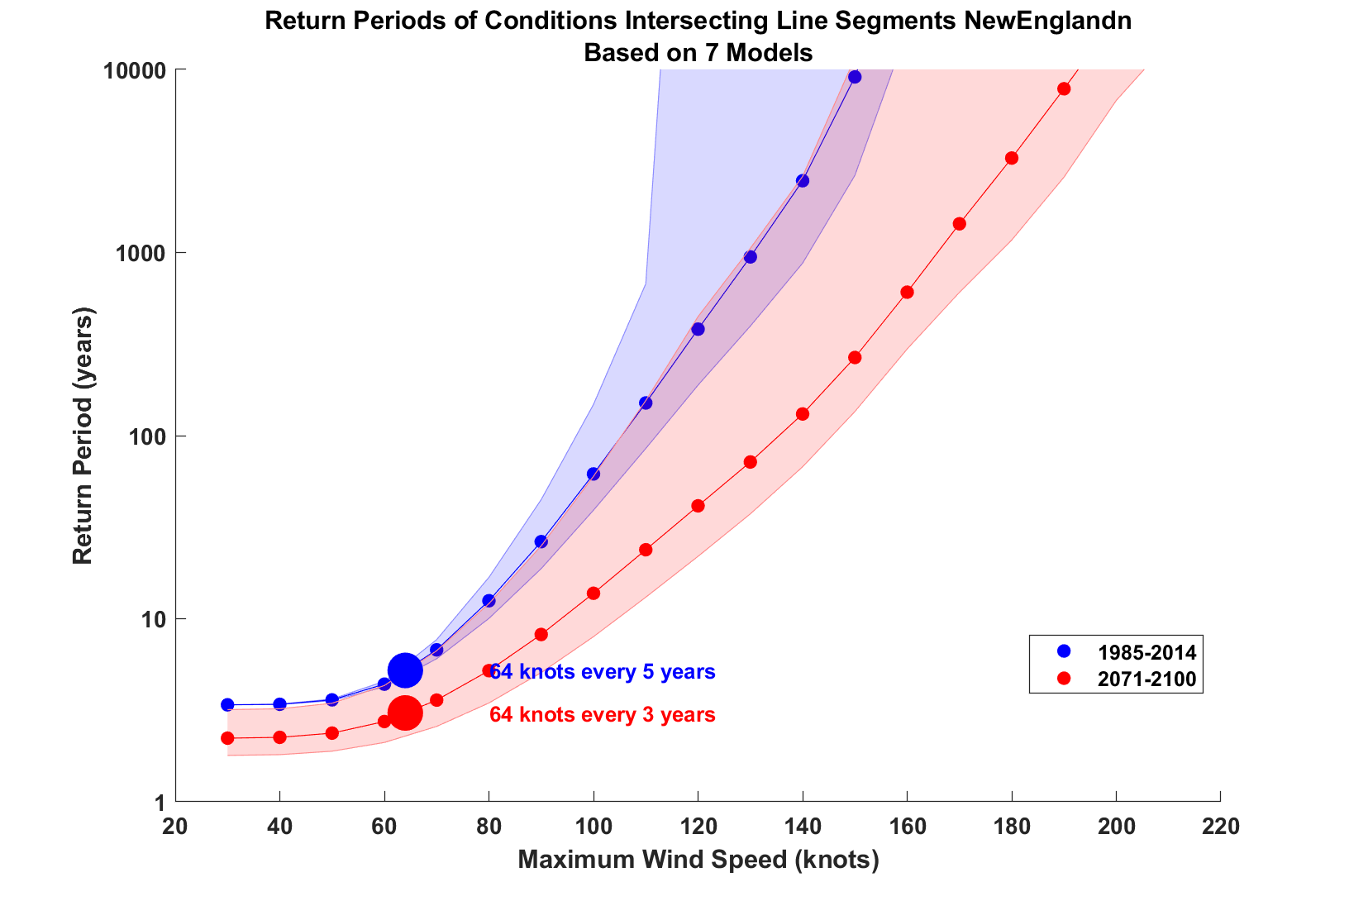

Slide 33
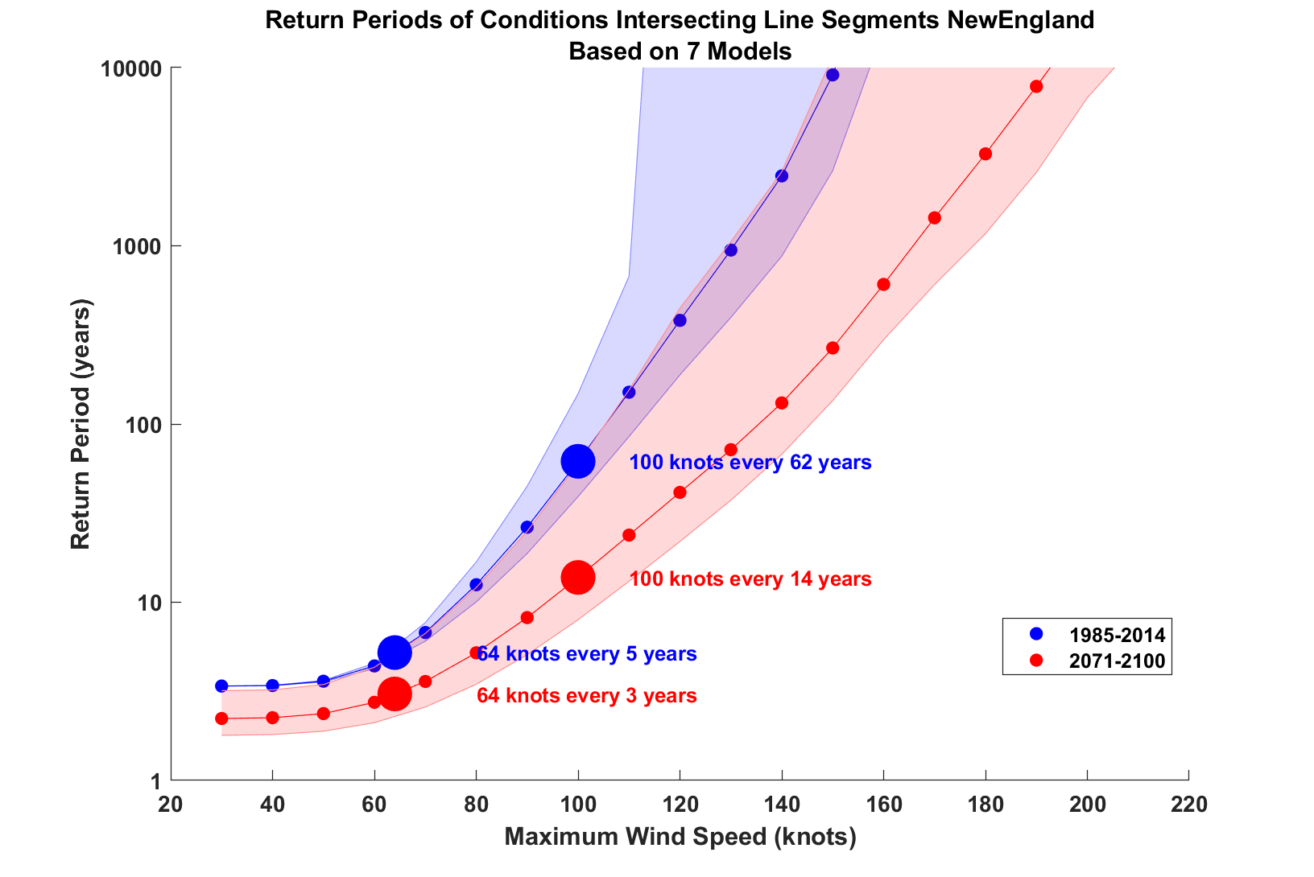

Slide 34
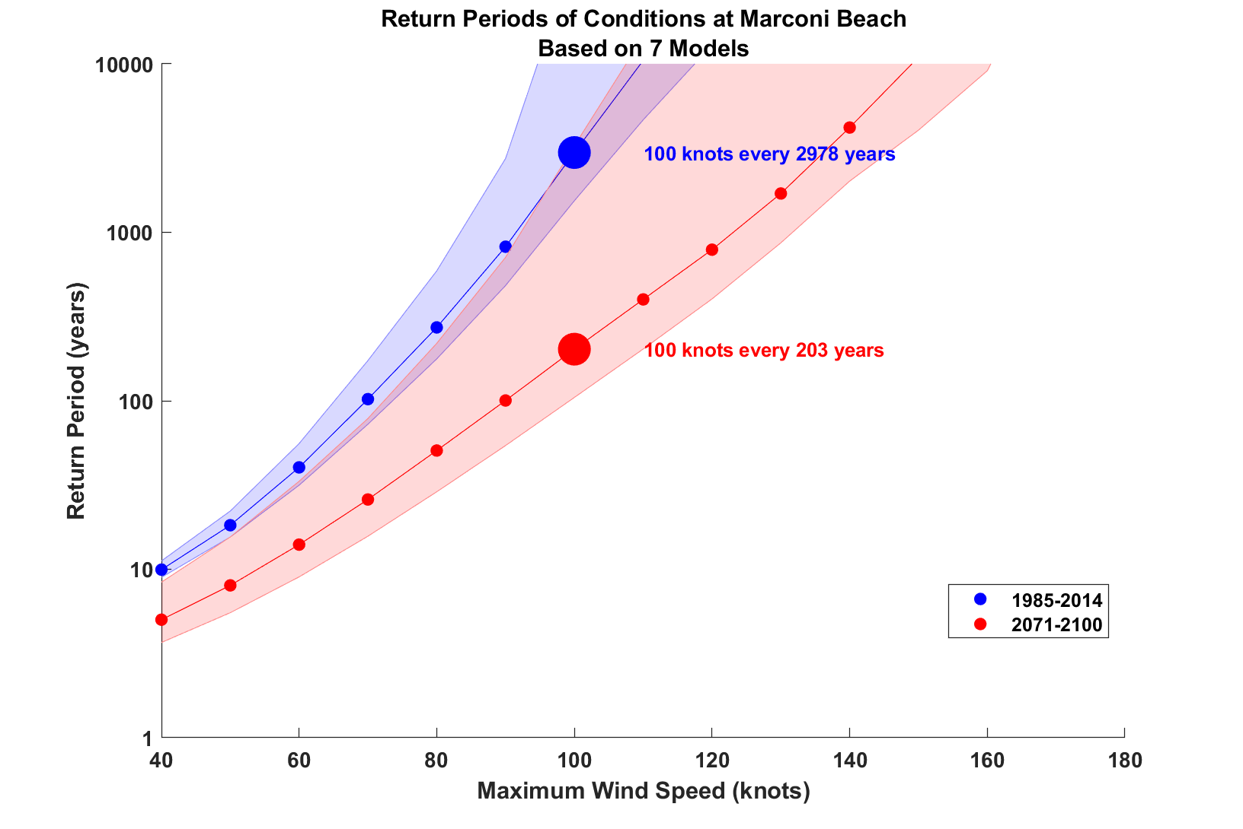

Slide 35
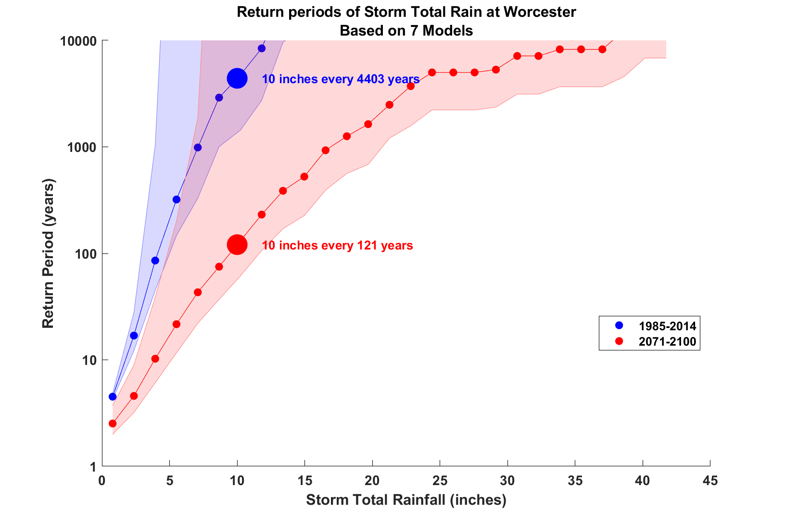

Slide 36
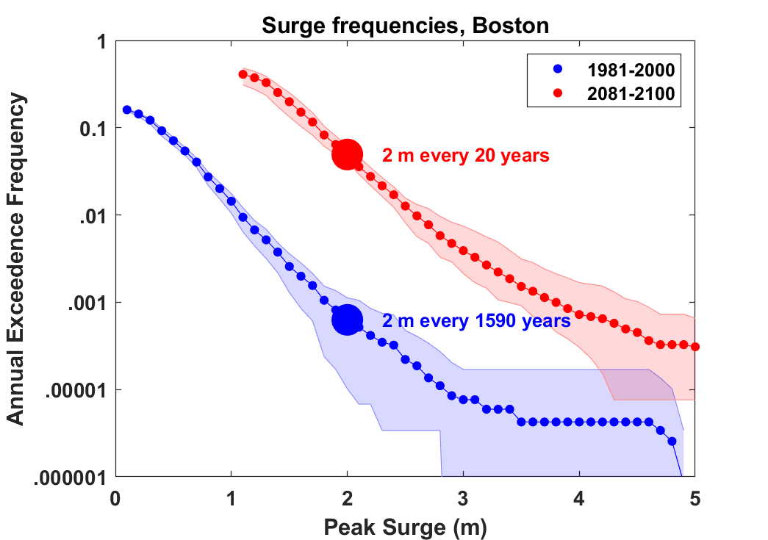
Boston Harbor Surge Risk with 1 meter
Sea Level Rise

Slide 37
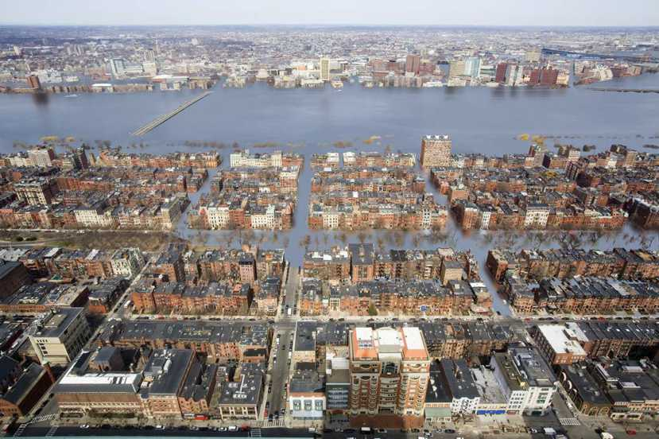
Is This in Our Future?
Combination of Hurricane Storm Surge and Freshwater Flooding

Slide 38
Rational Approach to Climate Policy
Assess climate risks
Use these to assess economic risks
Formulate policies to address the risks
Account for uncertainty at each step

Slide 39
Hsiang et al., Science, 2017
Total direct damage to U.S. economy, summed across all assessed sectors, as a function of global mean temperature change. Dot-whiskers indicate the distribution of direct damages in 2080 to 2099 (averaged) for multiple realizations of each combination of climate models and scenario projection (dot, median; dark line, inner 66% credible interval; medium line, inner 90%; light line, inner 95%). Green are from RCP2.6, yellow from RCP4.5, red from RCP8.5

Slide 40
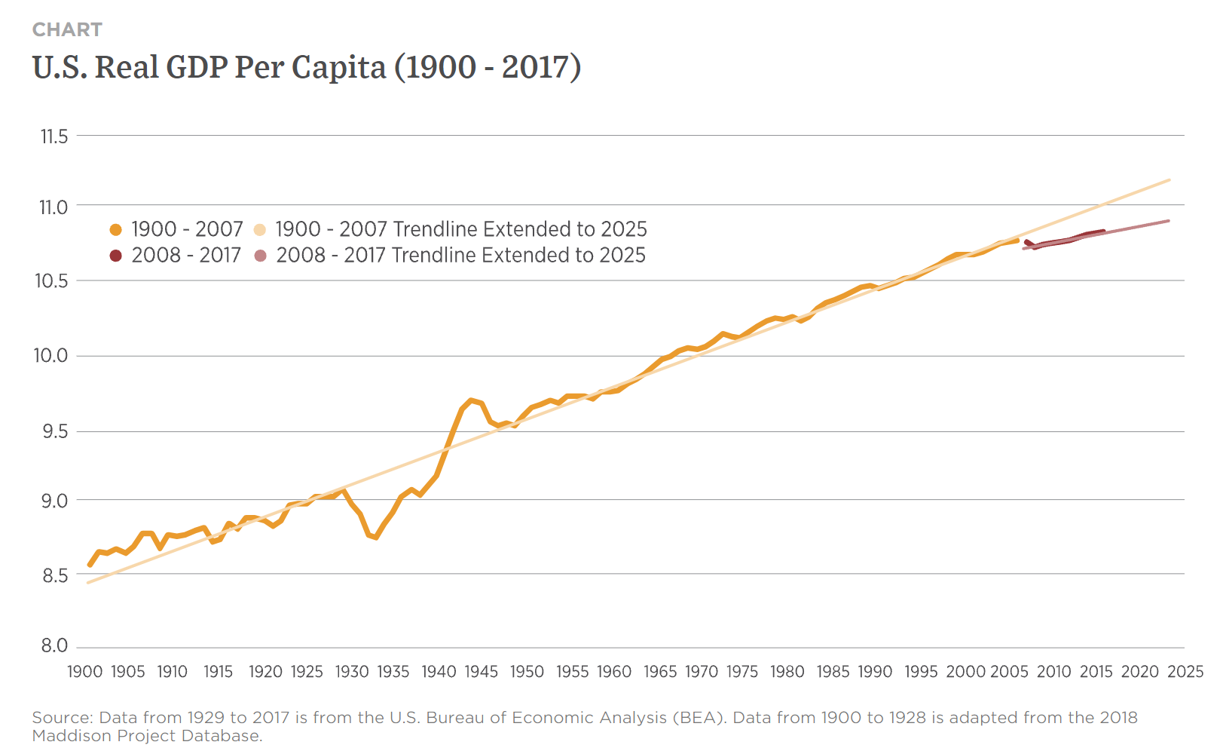
At peak, U.S spent ~40% of its GDP on war effort
But loss of GDP from climate change likely to be sustained over many years.
“Many people do not appreciate that this is actually a few percent per year, every year.” – Amir Jina, co-author
Great Depression
3.3% drop

Slide 41
Where there is Risk there is Opportunity
Current global annual energy market is ~ $8 trillion
Large expected growth in demand from developing world
Energy is slowly being decarbonized
Nations and industries that innovate clean energy will become market leaders
Now is a good time to catalyze energy innovation

Slide 42
Solutions and Opportunities
Renewables (solar and wind)
  Rapidly falling PV and wind turbine costs
  At low (<~30%) market penetration, intermittency dealt with through baseload (mostly coal, natural gas) backup --- must maintain full baseload capacity
  At high market penetration must rely on storage
  Best current and near-term projected method: Lithium-ion batteries¹
  For 12-hours storage capacity, $4000/Kwh projected for 2025¹
  By 2040 will need 5 trillion W capacity globally
  Will cost $ 1 trillion/yr for 20 years
  But current lifetime of Li-ion is only 10 years
  Addition $2 trillion/yr maintenance costs. Only buys 12 hrs storage
¹ U.S. department of Energy: “Energy Storage Technology and Cost Characterization Report”, July 2019

Slide 43
Solutions and Opportunities
Nuclear fission
  Projected electricity demand equivalent to output of 2500 2- GW nuclear reactors
  Would need to build 125 2-GW reactors per year for 20 years
  Current cost to build one 2-GW reactor in South Korea: $4 billion
  Would need to spend $500 billion per year for 20 years
  This is about 0.6% of current world domestic product
  Service life > 80 years
  In 1970s and 1980s Sweden built one 4 GW reactor per 10 million residents per year
  Swedish rate scaled up to world population: 750 4-GW reactors/year

Slide 44
We Can Do Even Better:
Next Generation (Gen IV) Fission Reactors
One Example: Molten Salt Reactors
  Passively safe
  Can help process waste from light water reactors
  Operate at ambient pressure
  Can run on thorium; unsuitable for weapons
  Estimated plant lifetime > 80 years

Slide 45
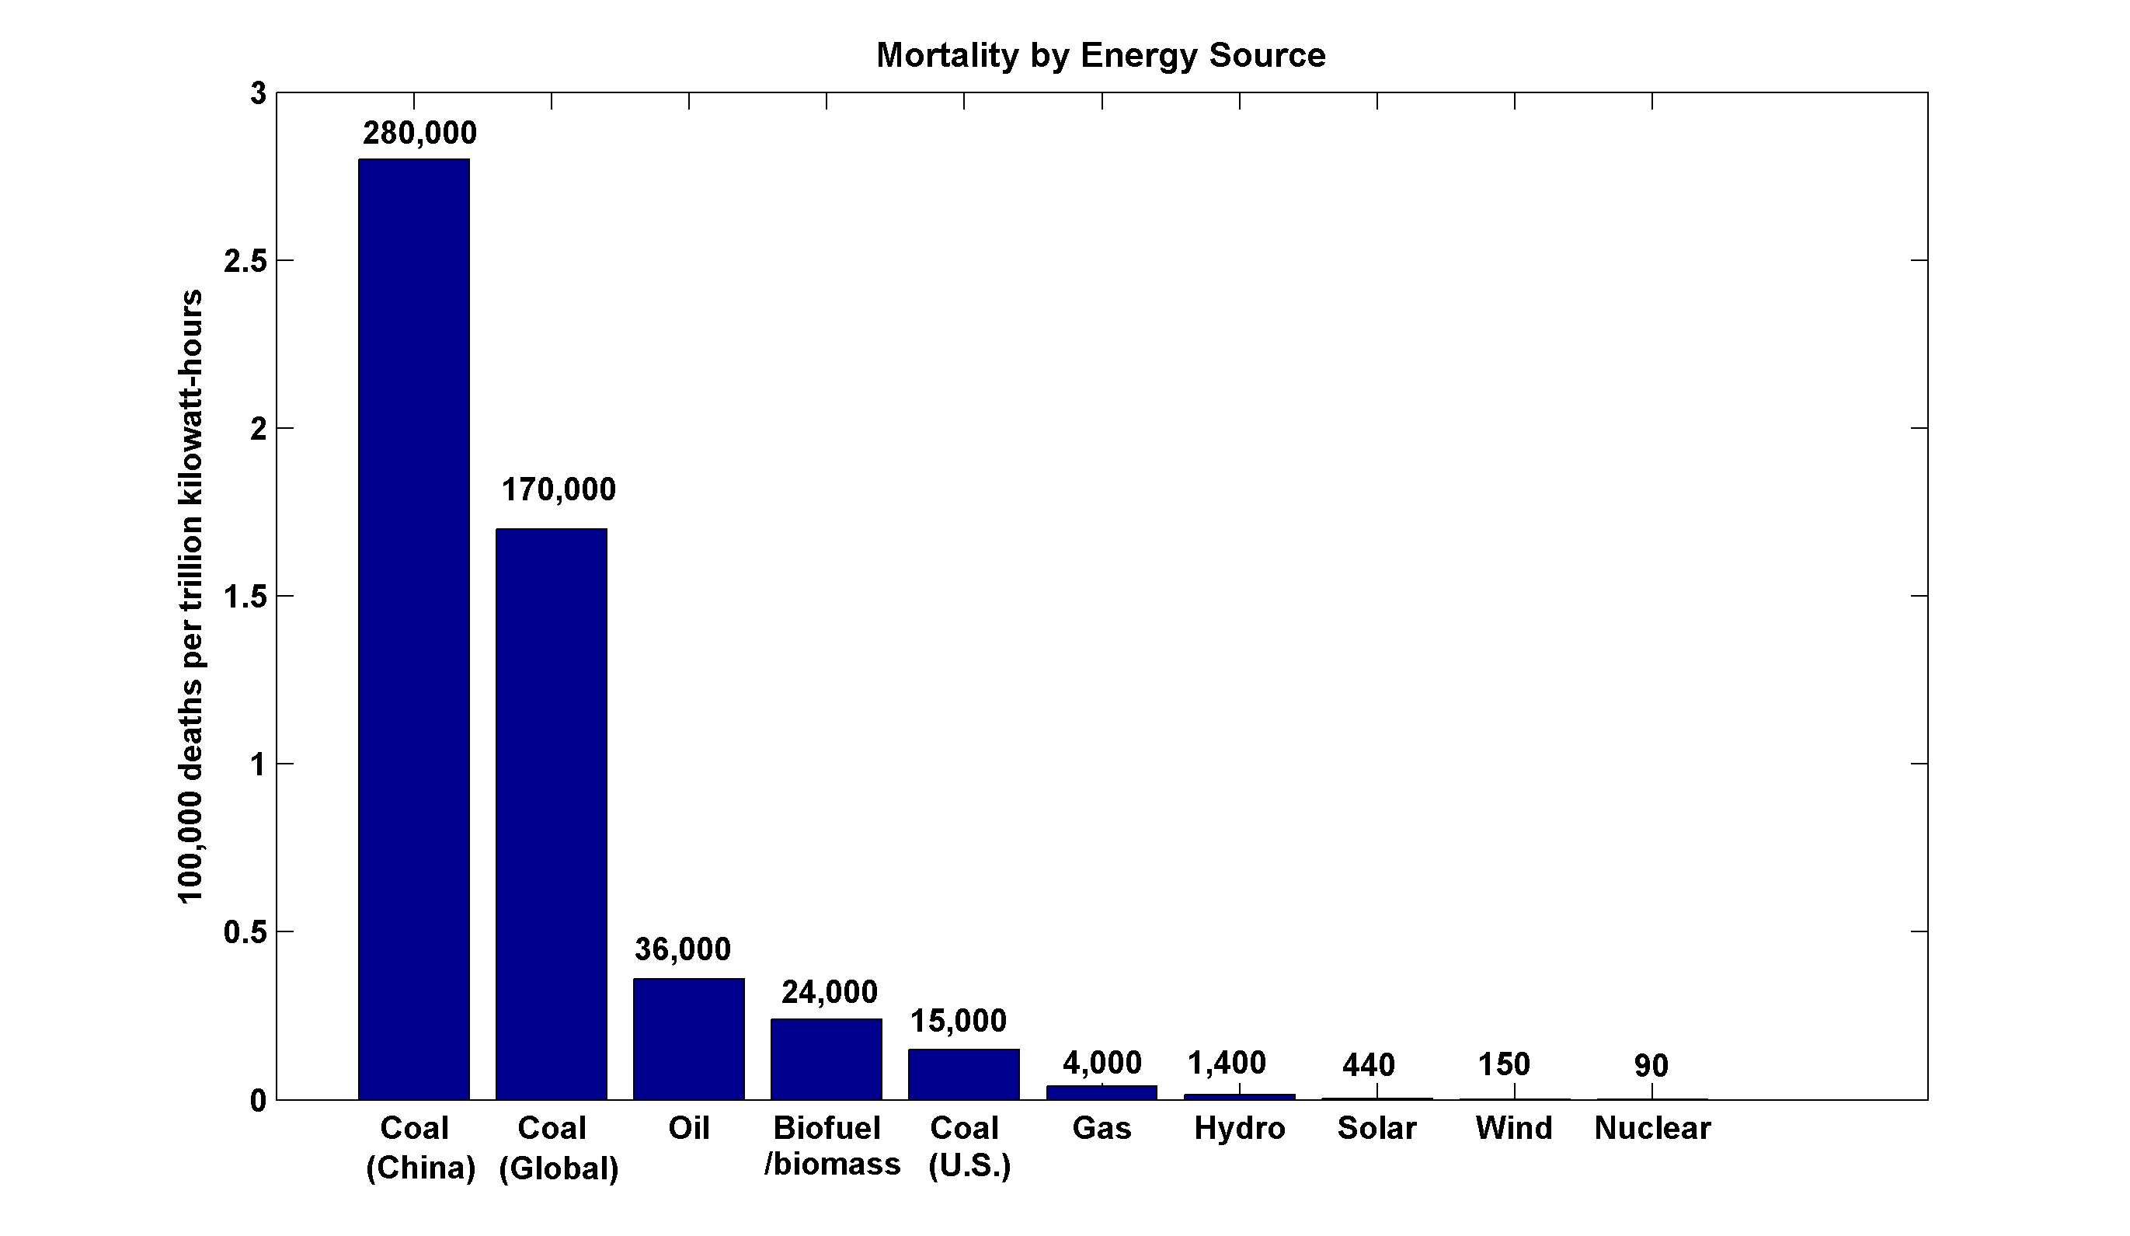
~13,000 premature deaths annually in the U.S. from coal production and combustion, 8.7 million globally
More people die every 3 days from fossil fuel particulates than have died in the whole history of nuclear power
(includes Chernobyl, Fukushima)

Slide 46
Non-climate savings from elimination of fossil fuels
World Health Organization: 4.2 million premature deaths annually from particulate pollution (other estimates as high as $8.7 billion)
Global “economic value of life”: $100,000
By 2040 we would be saving $400 billion per year in the economic value of lives saved
Brings net costs (of nuclear) to $100 billion /year, 0.1% of WDP
In addition, cheap green energy would permit large increases in per capita wealth in developing world
Energy conversion would likely yield NET benefit even before climate change is considered
Climate costs of continued dependence on fossil fuels could be very, very large compared to these numbers ($3 trillion/yr estimated by Intelligence Unit of Economist Magazine)

Slide 47

Summary of Main Points
We are altering the composition of our atmosphere at considerable risk to ourselves and to future generations
Long-term risk is dominated by extreme events
Historical records inadequate for estimating current and future weather risks

Slide 48
Summary of Main Points
We need to embrace advanced modeling techniques for assessing climate risks
Quantitative assessments of climate risks to the economy warrant spending at least 2% of WDP on mitigation (without risk premium)
Using optimal combination of nuclear power and renewables, feasible to decarbonize electricity at ~ 0.5% of WDP, and all energy at ~2% WDP.

Slide 49
Risk vs. Opportunity
Where there is risk there is opportunity
Global annual energy market ~ $7 trillion (1/3 U.S. GDP)
Increasing trend toward decarbonization
China is capturing the low-carbon energy market
U.S. still has an edge in technical innovation
While there are global net transition costs, nations that lead in low-carbon energy technology will come out ahead

Slide 50
In a Nutshell:
We must rapidly decarbonize the global economy
Economic development of poor nations depends crucially on greatly increasing per-capita energy consumption
Far more rapid growth in electricity production required to decarbonize transportation (batteries, synthetic fuels)
Still need non-electrical energy for high-temperature industrial applications
Conservation will help, but not nearly enough

Slide 51
What it would take to decarbonize the global economy by 2040
Projected global electrical power consumption in 2040: 5 trillion Watts: includes vehicle electrification. (2.5 trillion Watts today)
Total projected global energy consumption ~ 25 trillion Watts

Slide 52
Solutions and Opportunities
Gas with Carbon sequestration
  Sequestration currently $200/ton
  Prospects for $100/ton
  Projected emissions in 2040: 40 billion tons/yr
  Cost: $ 4 trillion/yr
  Need to add projected costs of natural gas: ~$ 2 trillion/yr
  Total cost per year: ~$ 6 trillion (just electricity)

Slide 53
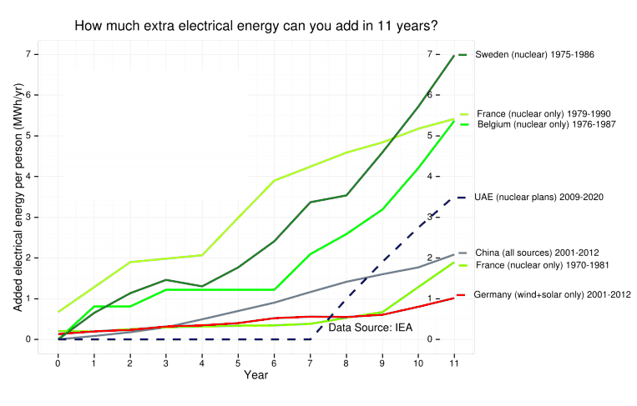
Ramping up Fission Power

Slide 54
~13,000 premature deaths annually in the U.S. from coal production and combustion, 8.7 million globally
More people die every 3 days from fossil fuel particulates than have died in the whole history of nuclear power
(includes Chernobyl, Fukushima)

Slide 55
We Can Do Even Better:
Next Generation (Gen IV) Fission Reactors
One Example: Molten Salt Reactors
  Passively safe
  Can help process waste from light water reactors
  Operate at ambient pressure
  Can run on thorium; unsuitable for weapons
  Estimated plant lifetime > 80 years

Slide 56
Non-climate savings from elimination of fossil fuels
World Health Organization: 4.2 million premature deaths annually from particulate pollution
Global “economic value of life”: $100,000
By 2040 we would be saving $400 billion per year in the economic value of lives saved
Brings net costs (of nuclear) to $100 billion /year, 0.1% of WDP
In addition, cheap green energy would permit large increases in per capita wealth in developing world
Energy conversion would likely yield NET benefit even before climate change is considered
Climate costs of continued dependence on fossil fuels could be very, very large compared to these numbers ($3 trillion/yr estimated by Intelligence Unit of Economist Magazine)

Slide 57
How to Catalyze Solutions
Price the negative externalities of carbon emissions
  Bedrock free-market principle
  > 95% of U.S. economists support this
  Coal would vanish owing to health externalities alone
  Markets rather than ideologies would determine best mix of solutions
Not enough: Government should stimulate innovation

Slide 58
All landfalls (not just USA)
7-year running averages

Slide 59
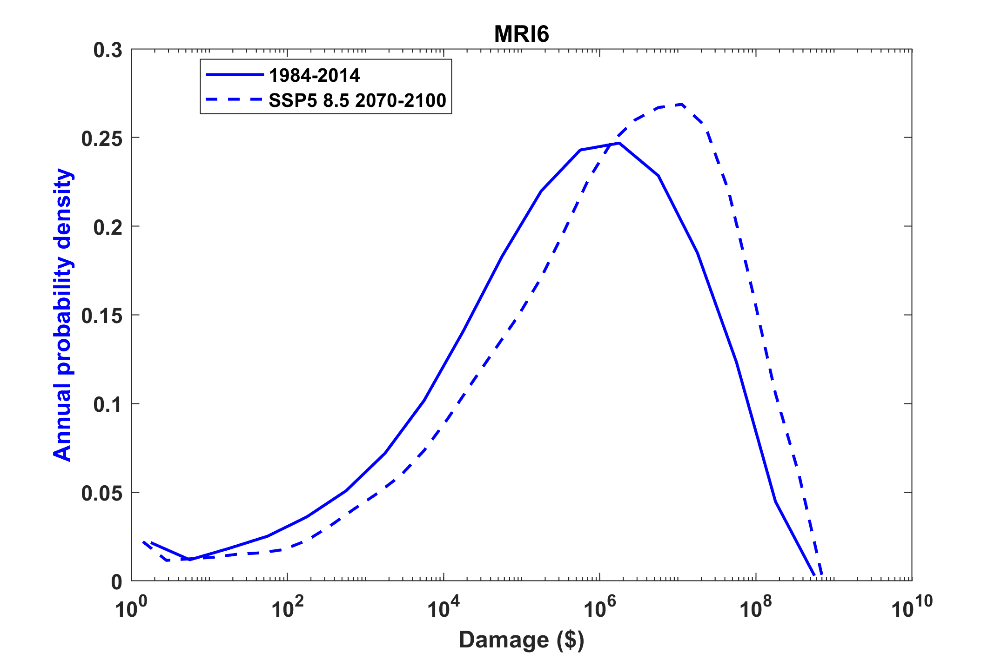
Example:
Tropical Cyclone Risk Arises Largely from High Intensity Events
Probability
Probability density of annual damage to a portfolio of insured property in the U.S.

Slide 60
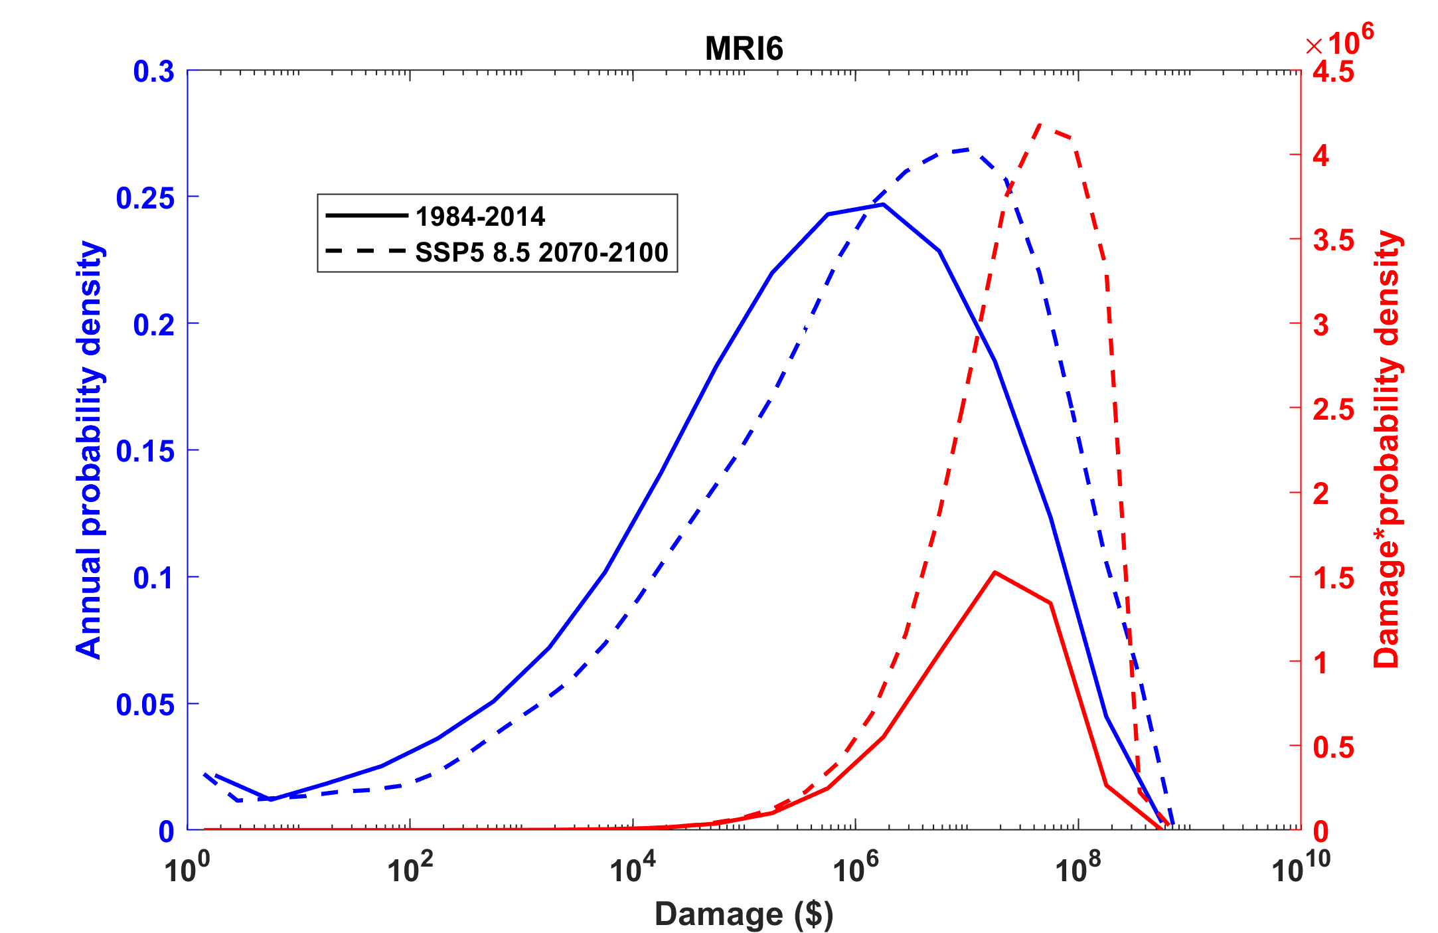
Tropical Cyclone Risk Arises Largely from High Intensity Events
Total expected damage proportional to area under curves.
~3.5-fold increase in damages
Risk
Damage times probability density of annual damage to a portfolio of insured property in the U.S.

Slide 61


Getting it right means getting the low-probability, high cost events. For example, hurricanes:
1984-2014
2070-2100
2070-2100
1984-2014

Slide 62
Atlantic Annual Cycle
Blue dots: Actual
Red line: Predicted

Slide 63


Slide 64
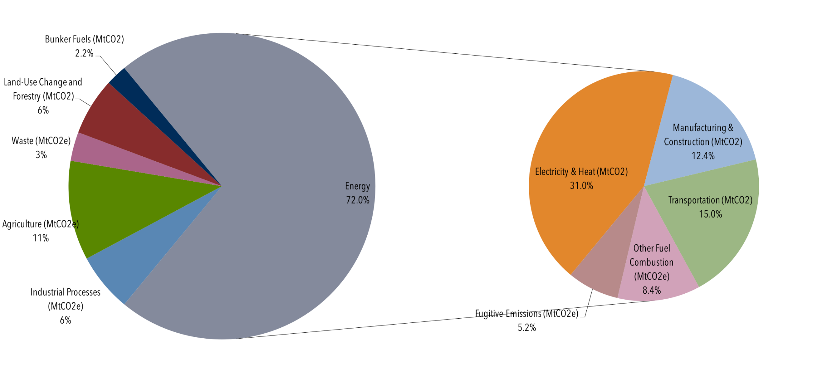
Global Manmade Greenhouse Gas Emissions by Sector, 2013
Source: Center for Climate and Energy Solutions: https://www.c2es.org/content/international-emissions/

Slide 65
Share of industrial heat demand by temperature level
Cannot feasibly be electrified
Data for 2003, 32 countries: EU25 + Bulgaria, Romania, Turkey, Croatia, Iceland, Norway and Switzerland. Source: International Energy Association: https://archive.iea-shc.org/data/sites/1/publications/task33-potential_for_Solar_Heat_in_Industrial_Processes.pdf

Slide 66
Accounting for All Climate Risks

Slide 67
Hsiang et al., Science, 2017
Total direct damage to U.S. economy, summed across all assessed sectors, as a function of global mean temperature change. Dot-whiskers indicate the distribution of direct damages in 2080 to 2099 (averaged) for multiple realizations of each combination of climate models and scenario projection (dot, median; dark line, inner 66% credible interval; medium line, inner 90%; light line, inner 95%). Green are from RCP2.6, yellow from RCP4.5, red from RCP8.5

Slide 68
At peak, U.S spent ~40% of its GDP on war effort
But loss of GDP from climate change likely to be sustained over many years.
“Many people do not appreciate that this is actually a few percent per year, every year.” – Amir Jina, co-author
Great Depression
3.3% drop

Slide 69
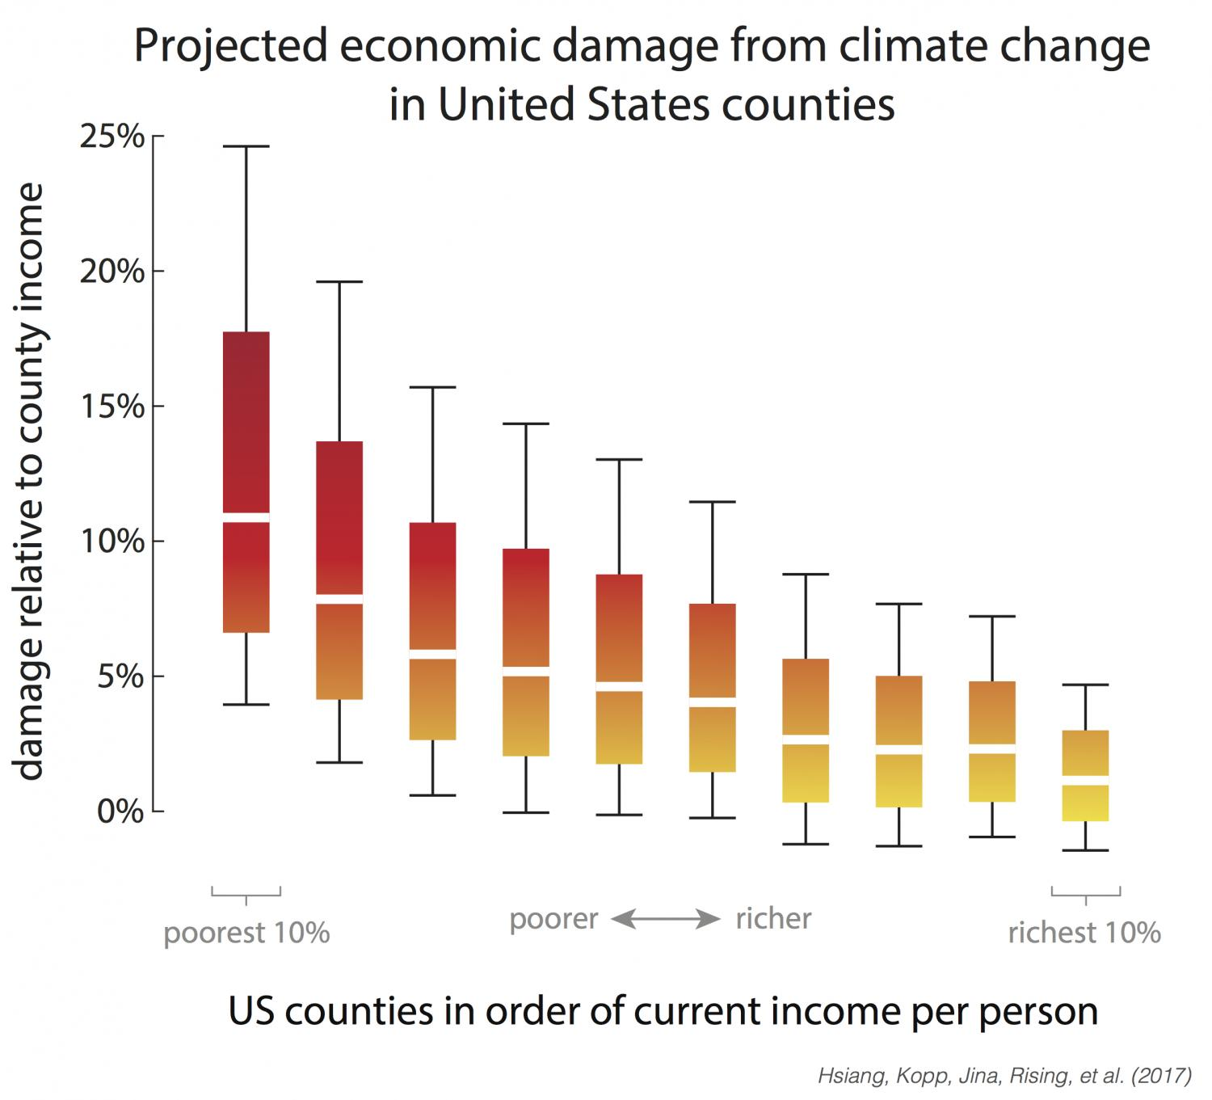
Range of economic damages per year for groupings of US counties, based on their income (29,000 simulations for each of 3,143 counties). The poorest 10% of counties are the leftmost box plot. The richest 10% are the rightmost box plot. Damages are fraction of county income. White lines are median estimates, boxes show the inner 66% of possible outcomes, outer whiskers are inner 90% of possible outcomes.

