Slide 1

Is Global Warming Affecting Hurricanes?
Kerry Emanuel
Massachusetts Institute of Technology
Notes:
Are hurricanes becoming more powerful and destructive? Are these changes due to a natural cycle of hurricane activity or are they caused by human-induced climate change? Although this is currently a hot debate among scientists, new research suggests that the destructive potential of hurricanes is increasing due to the heating of the oceans.
Image: Satellite image of Hurricane Floyd approaching the east coast of Florida in 1999. The image has been digitally enhanced to lend a three-dimensional perspective. Credit: NASA/Goddard Space Flight Center.

Slide 2

Program
Overview of Hurricanes
Hurricane Risk
The Physics of Hurricanes
Hurricanes and Climate

Slide 3
What is a Hurricane?
Formal definition: A tropical cyclone with 1-min average winds at 10 m altitude in excess of 32 m/s (64 knots or 74 MPH) occurring over the North Atlantic or eastern North Pacific

Slide 4


The word Hurricane is derived from the Mayan word Huracan and the Taino and Carib word Hunraken, a terrible God of Evil, and brought to the West by Spanish explorers

Slide 5
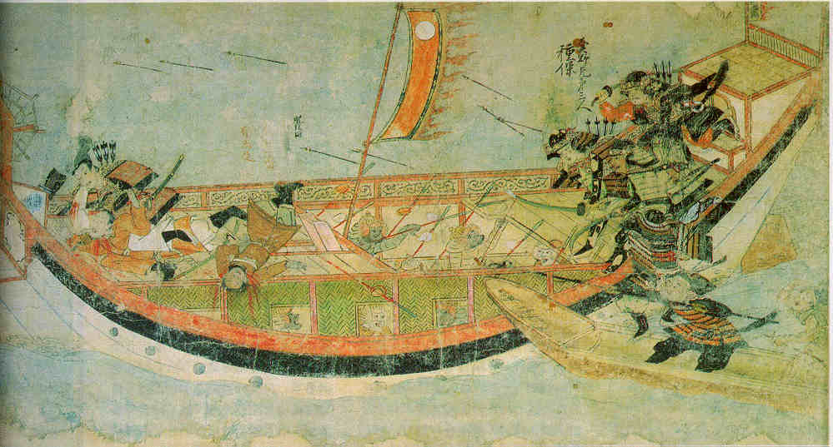
Early historical encounters: The Mongol invasions of Japan in 1274 and 1281
Scene from the 13th century Mongol invasion scrolls, based on a narrative written by the Japanese warrior Takezaki Suenaga.

Slide 6
Overview of Tropical Cyclones
Notes:
6

Slide 7
The View from Space

Slide 8
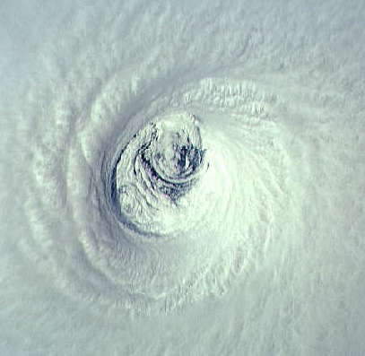

Slide 9
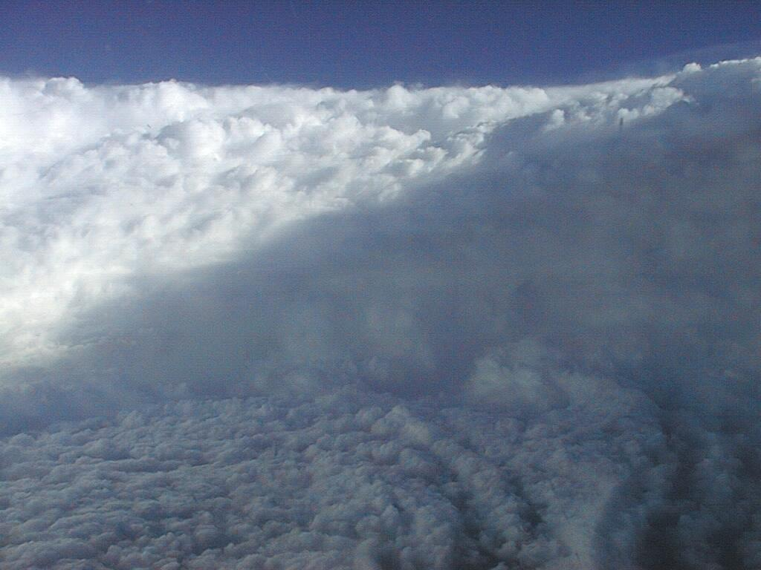

Slide 10
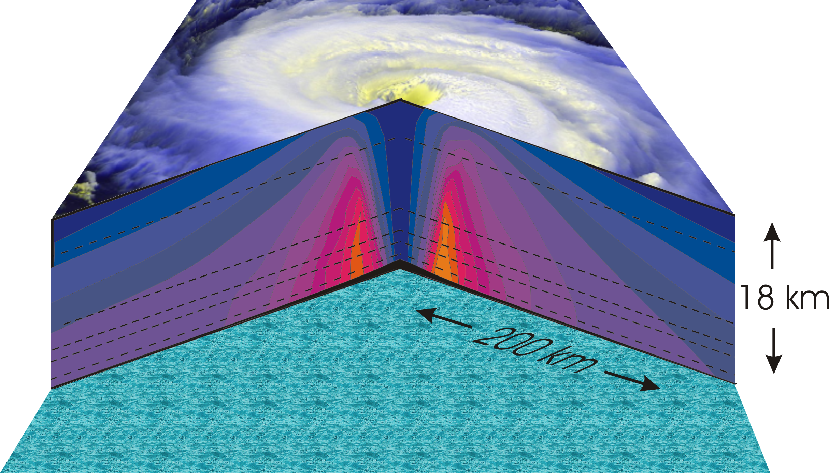
Hurricane Structure
Azimuthal component of wind

Slide 11
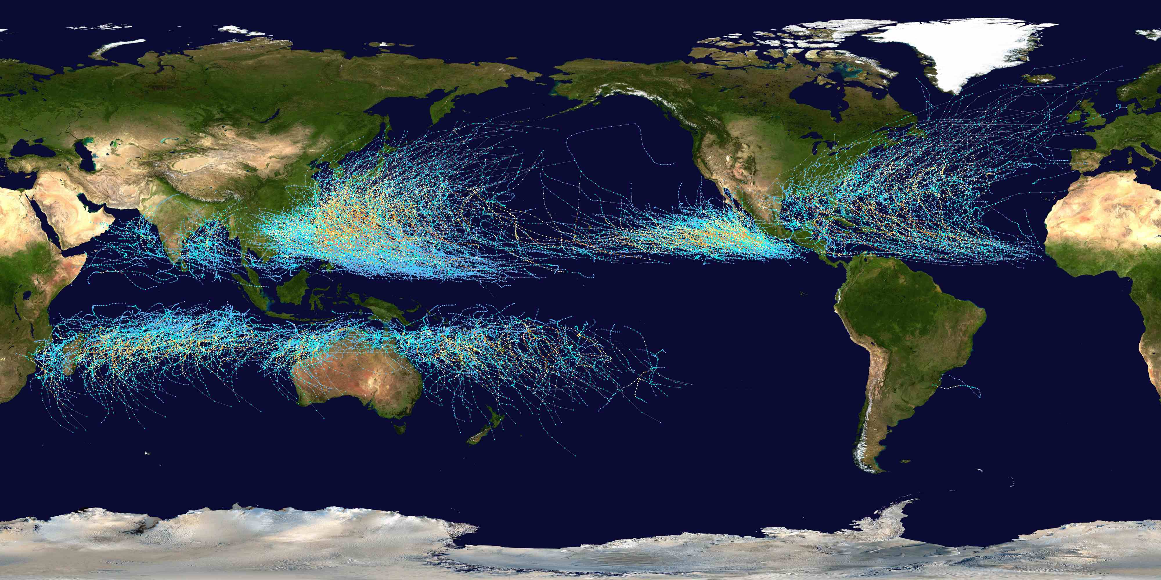
Tracks of all tropical cyclones, 1985-2005
Source: Wikipedia

Slide 12
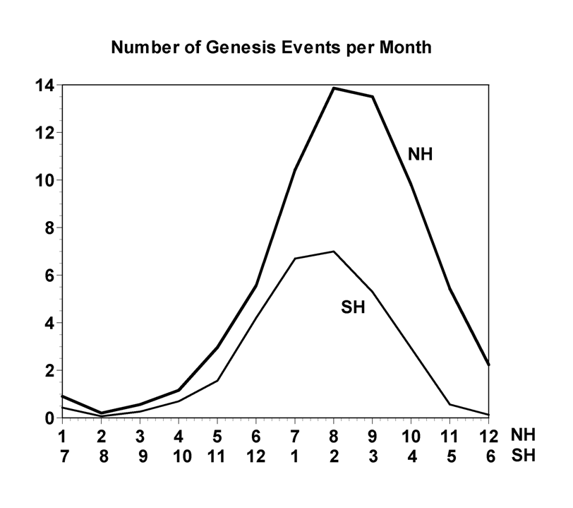
Annual Cycle of Tropical Cyclones

Slide 13
Hurricane Risk

Slide 14
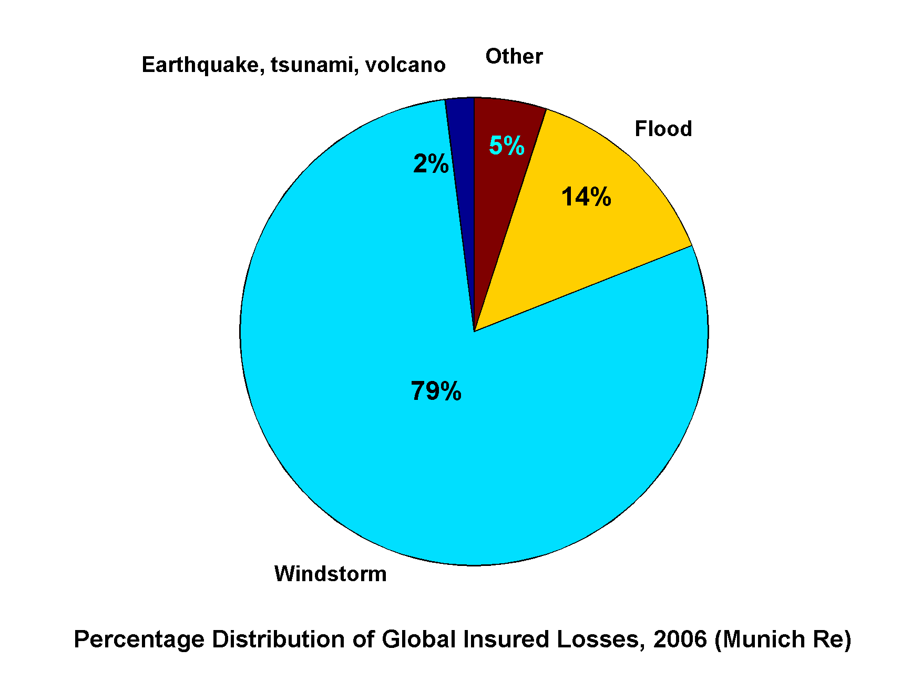
Windstorms Account for Bulk of Insured Losses Worldwide

Slide 15
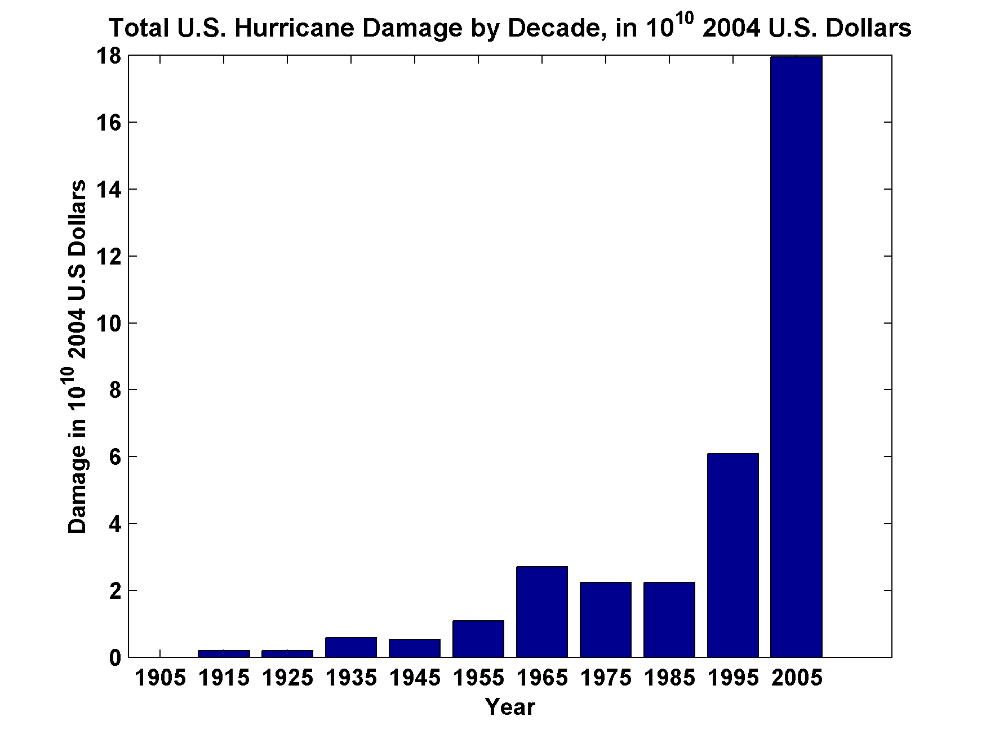
Total U.S. Hurricane Damage by Decade, in 10¹⁰ 2004 U.S. Dollars
Source: Roger Pielke, Jr.

Slide 16
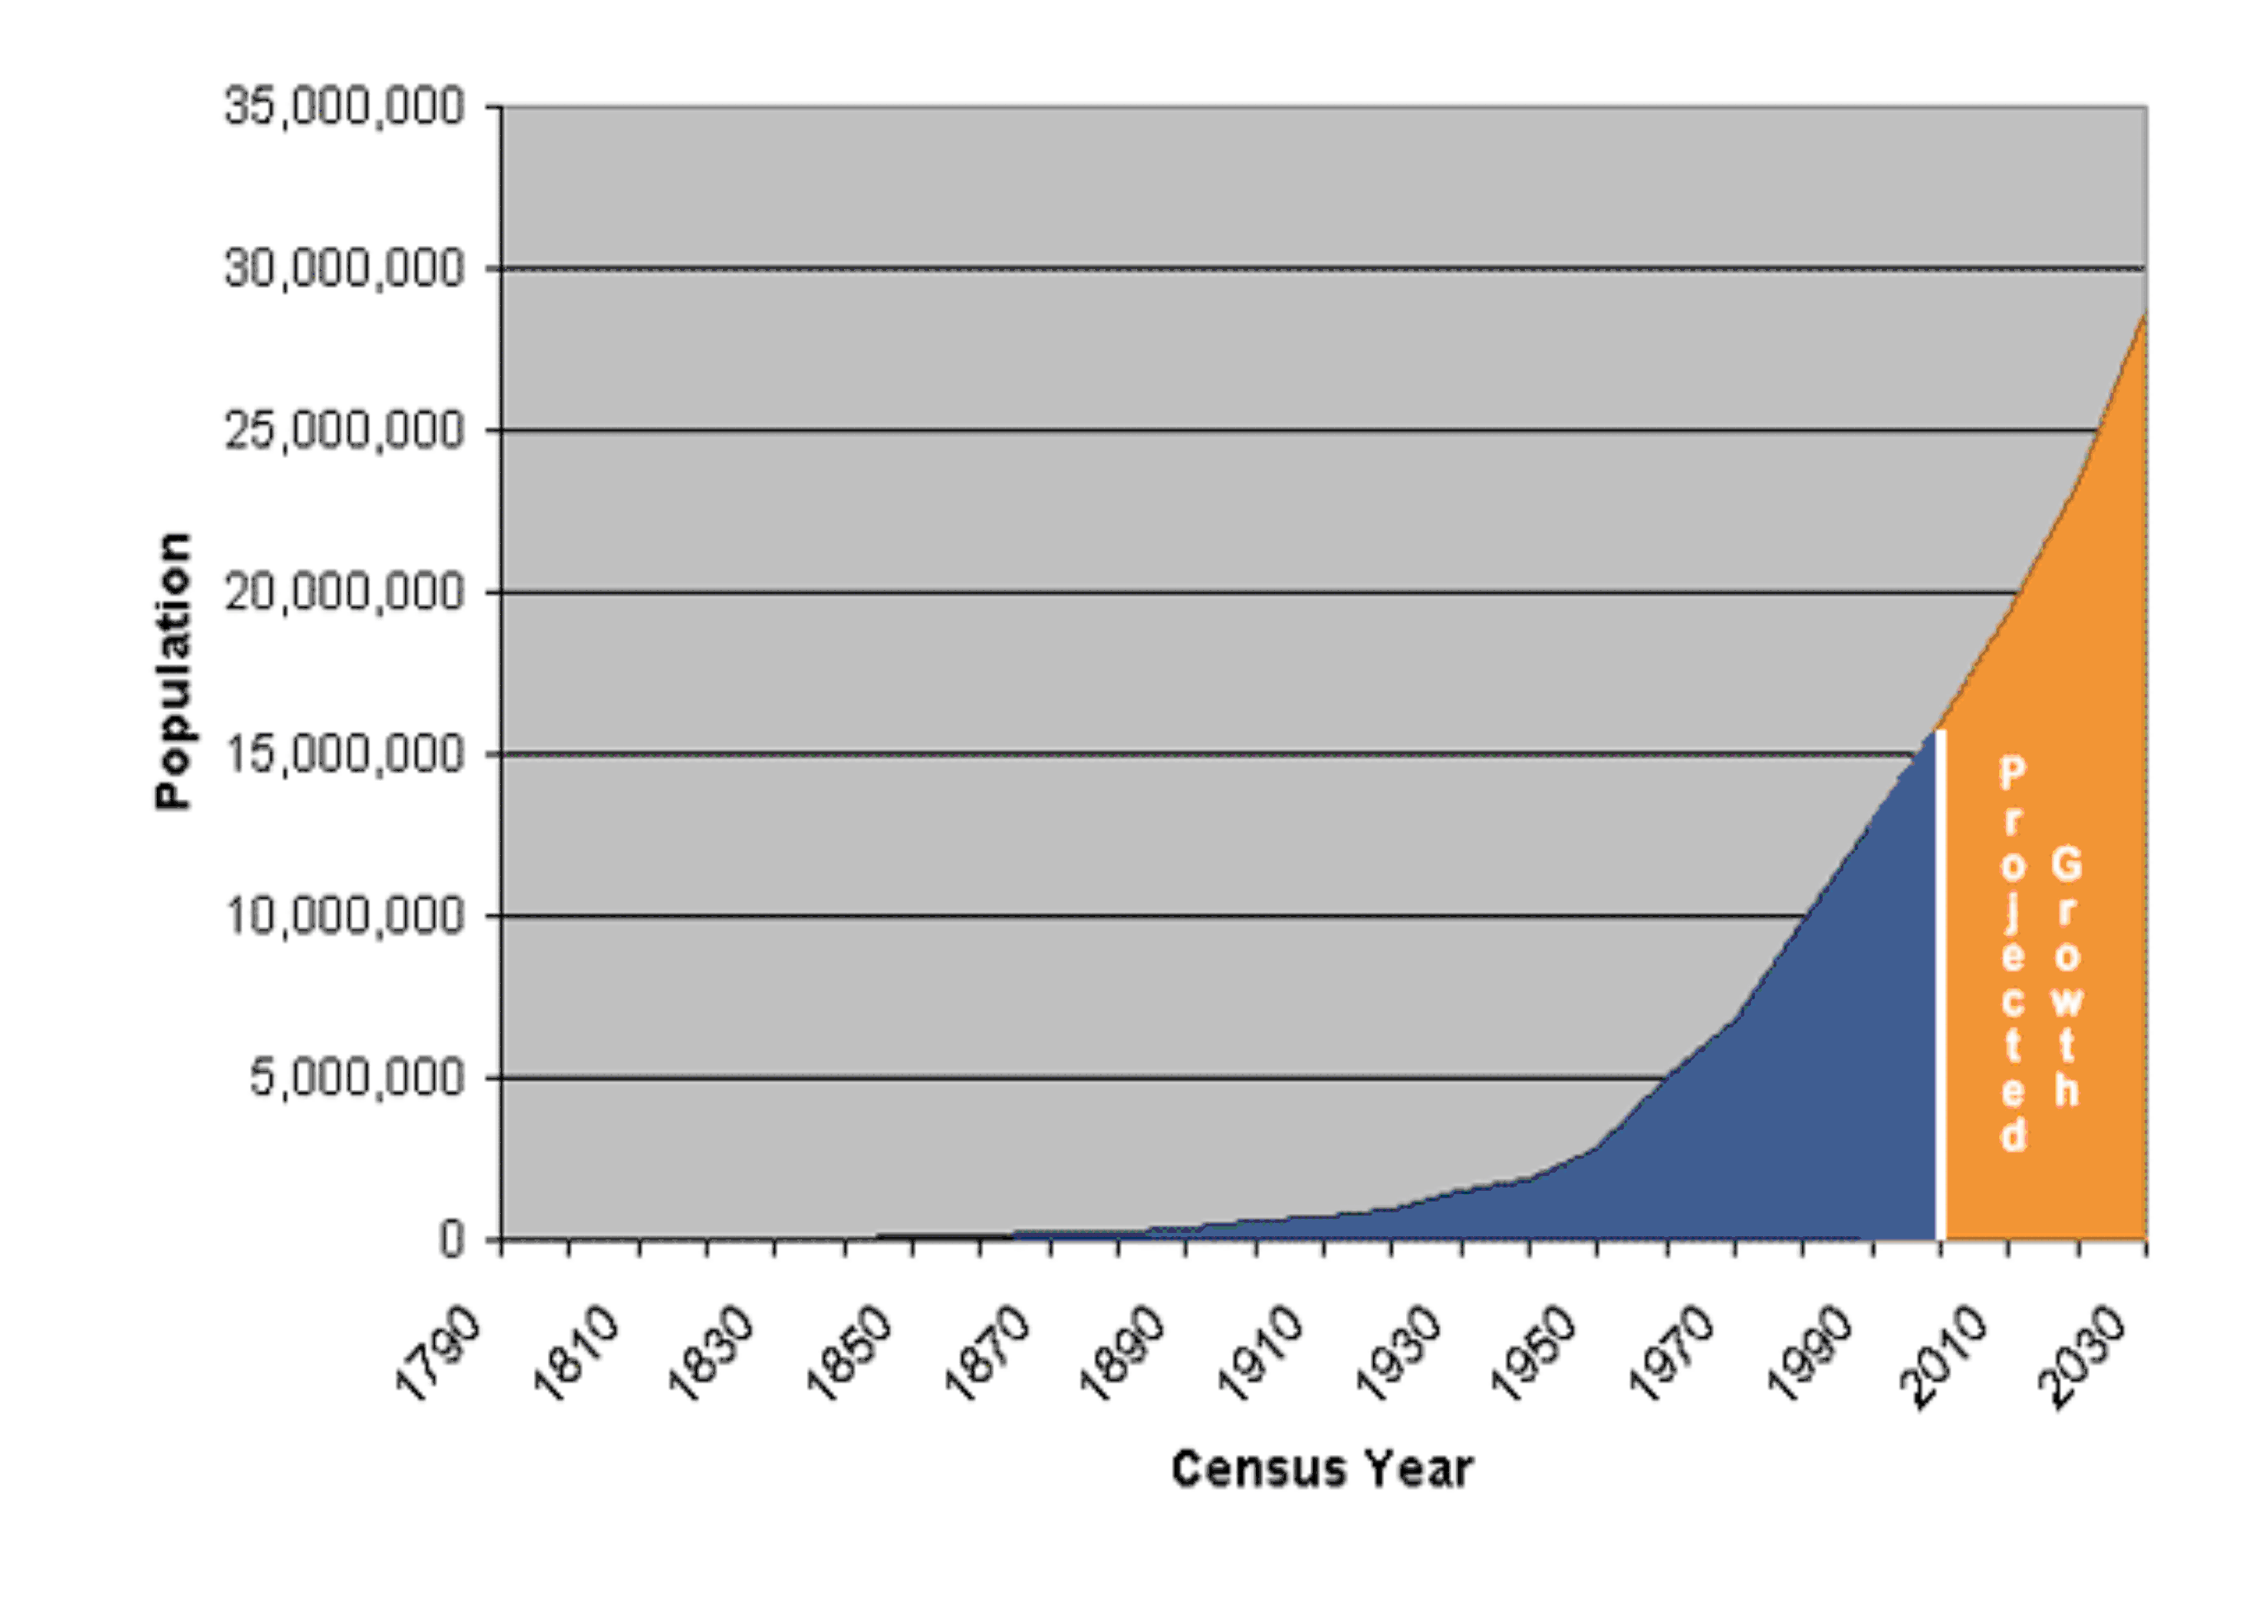
Population of Florida, 1790-2004

Slide 17
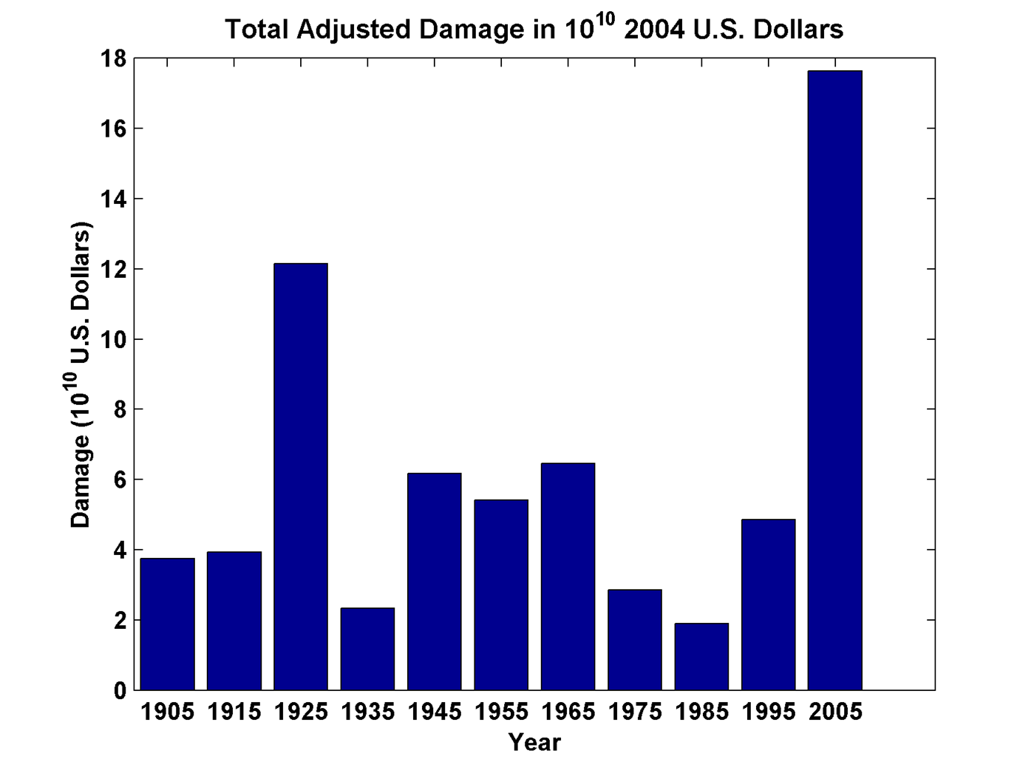
Total Adjusted Damage by Decade, in 10¹⁰ 2004 U.S. Dollars
Source: Roger Pielke, Jr.

Slide 18
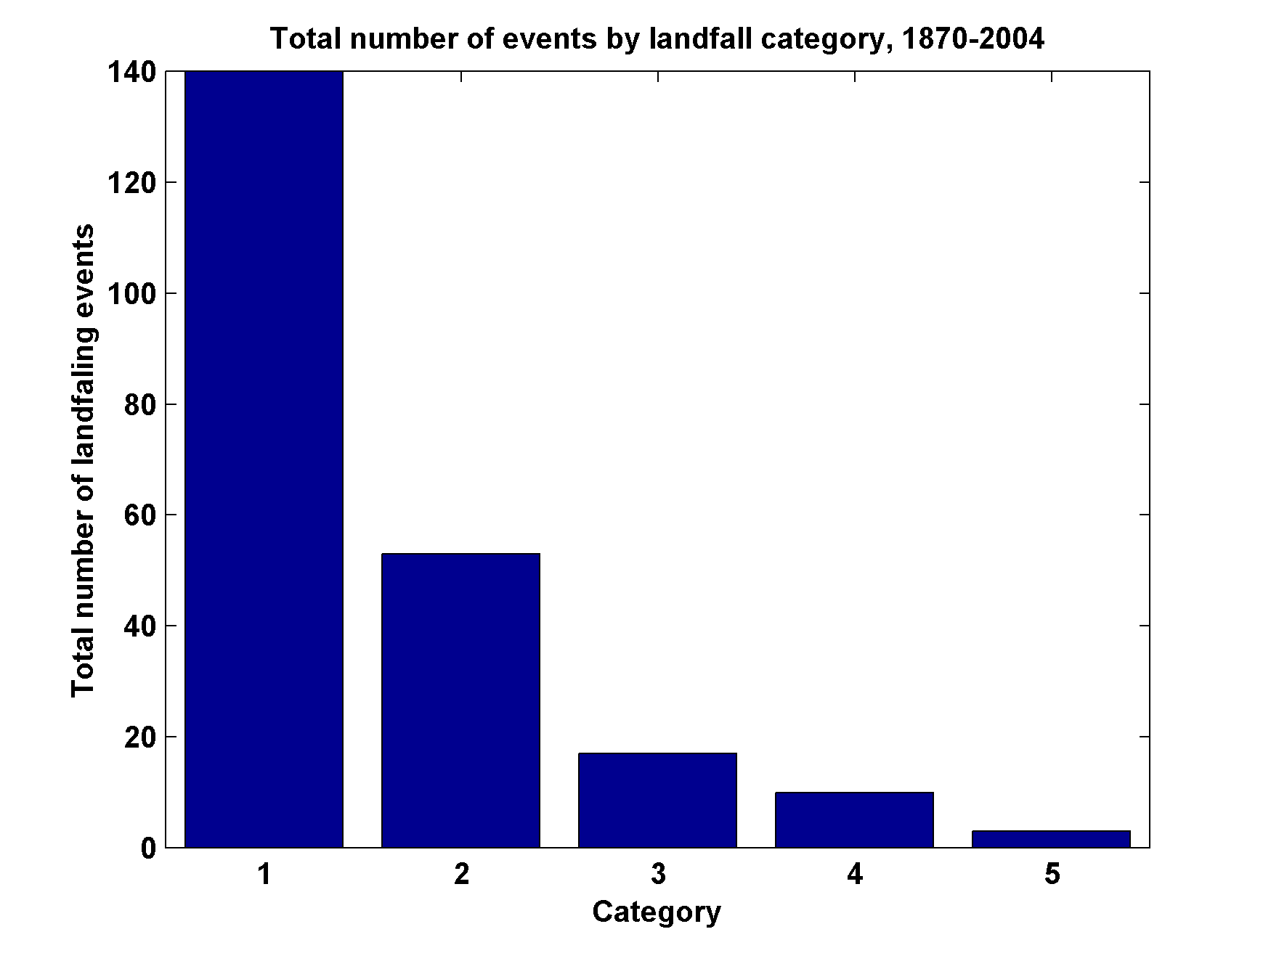
Total Number of Landfall Events, by Category, 1870-2004

Slide 19
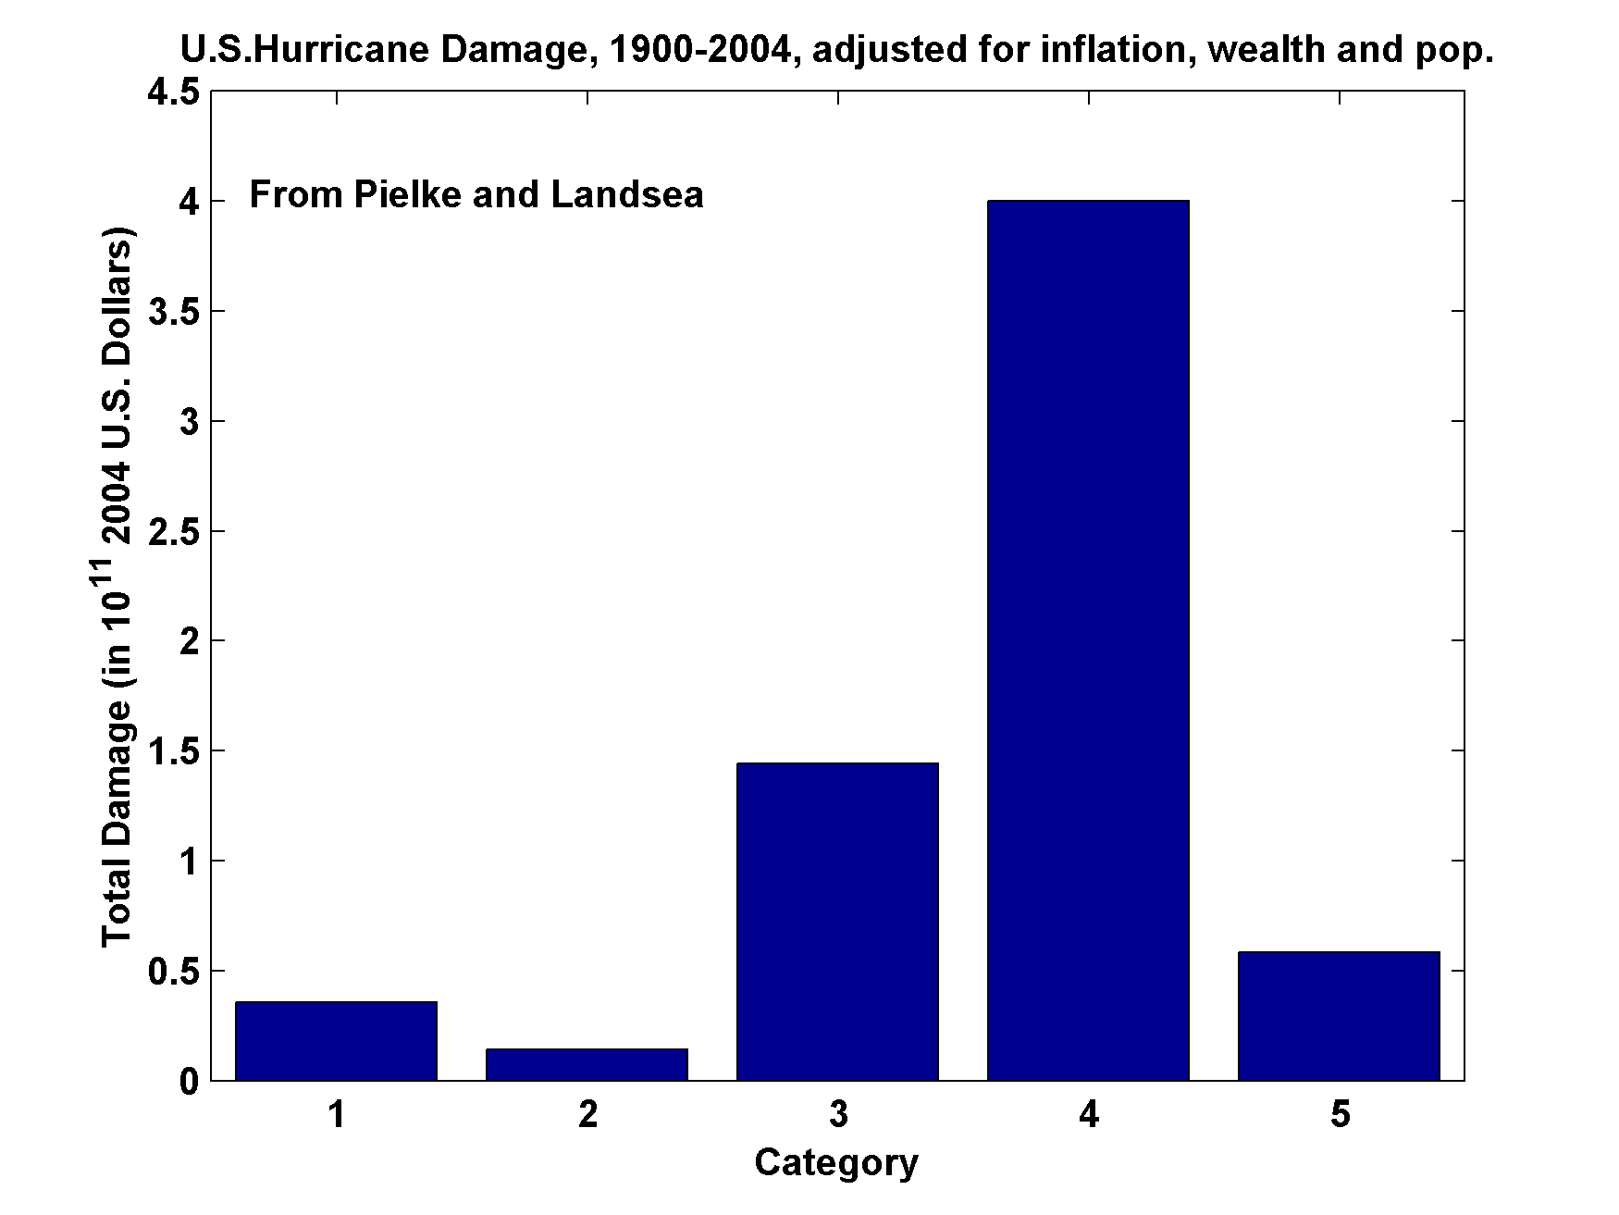
U.S. Hurricane Damage, 1900-2004,Adjusted for Inflation, Wealth, and Population

Slide 20
Summary of U.S. Hurricane Damage Statistics:
>50% of all normalized damage caused by top 8 events, all category 3, 4 and 5
>90% of all damage caused by storms of category 3 and greater
Category 3,4 and 5 events are only 13% of total landfalling events; only 30 since 1870
Landfalling storm statistics are grossly inadequate for assessing hurricane risk

Slide 21
How Do Hurricanes Work?

Slide 22
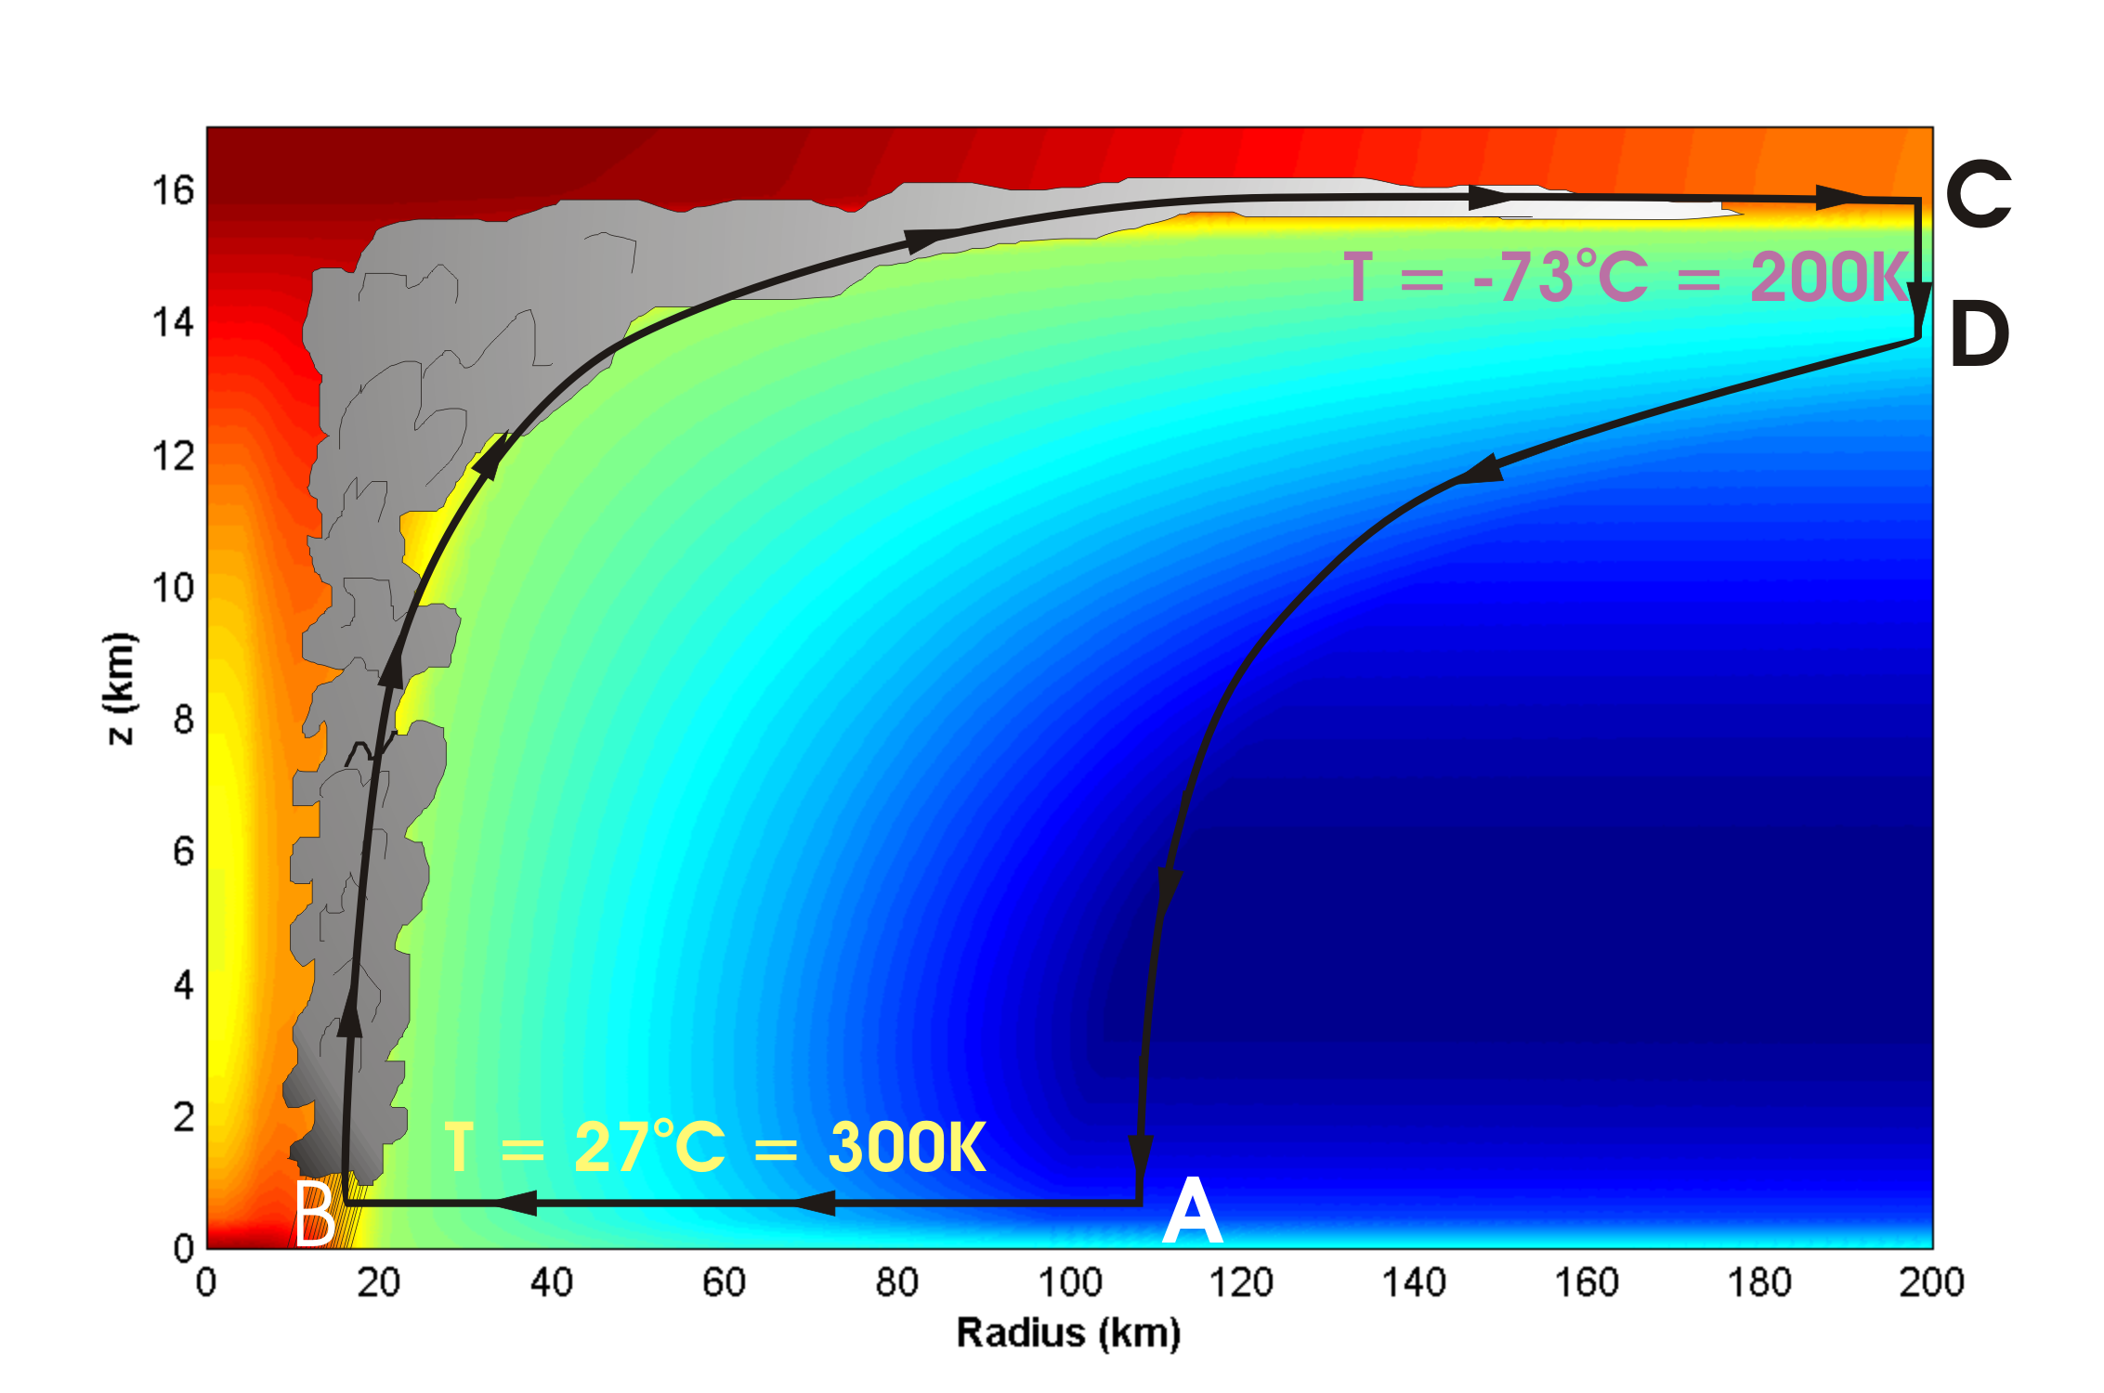
Energy Production Cycle

Slide 23
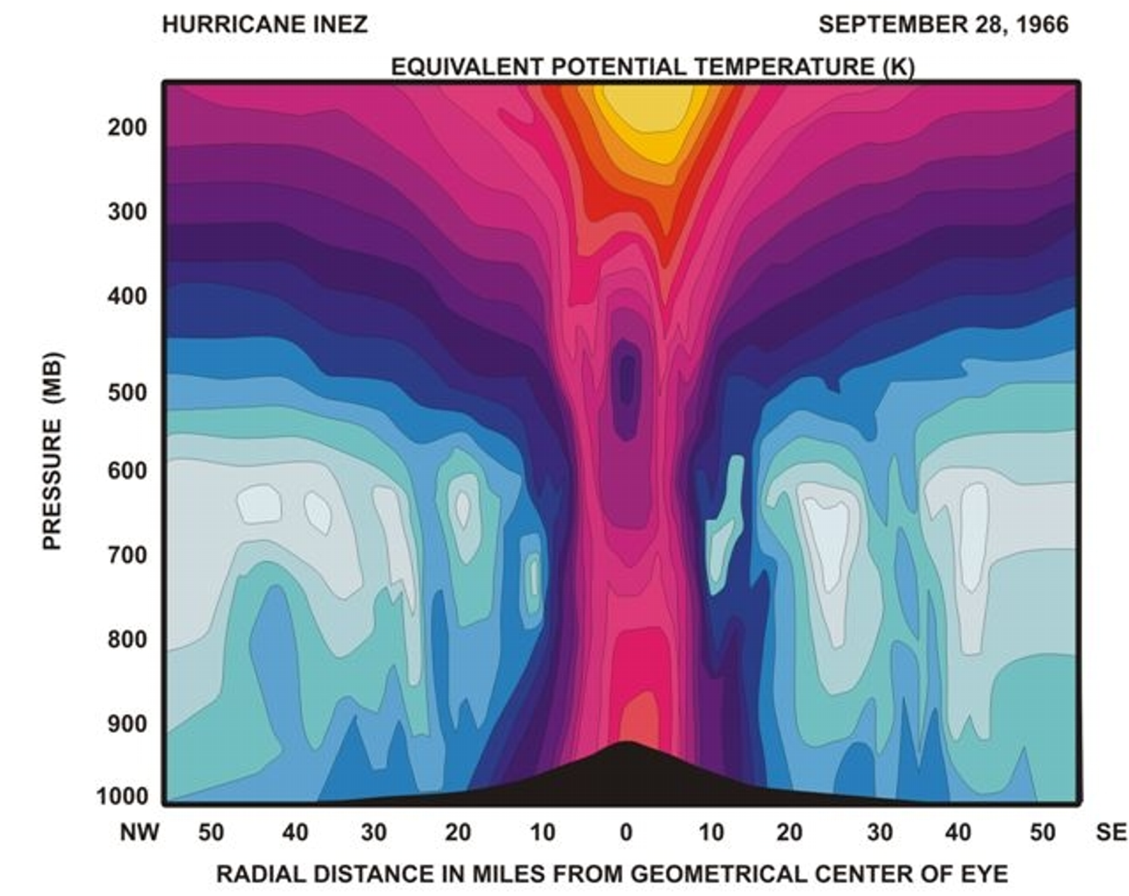
Distribution of Entropy in Hurricane Inez, 1966
Source: Hawkins and Imbembo, 1976

Slide 24
Theoretical Upper Bound on Hurricane Maximum Wind Speed:
Surface temperature
Ratio of exchange coefficients of enthalpy and momentum
Outflow temperature
Air-sea enthalpy disequilibrium
Notes:
24

Slide 25
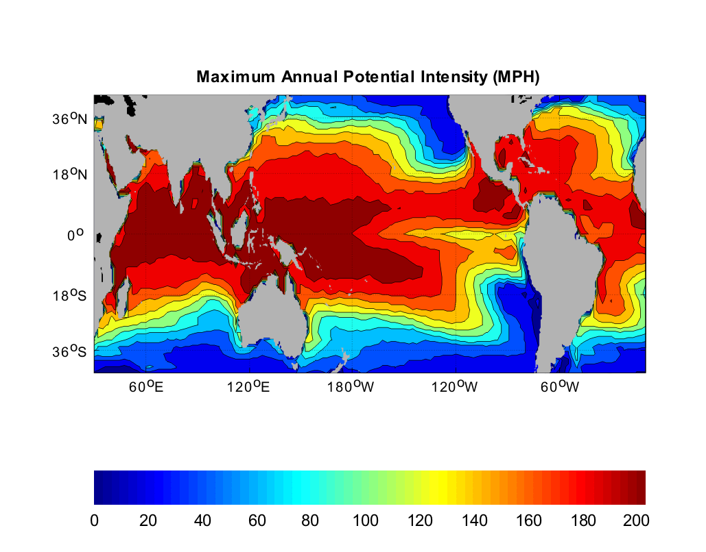
Heat Engine Theory Predicts Maximum Hurricane Winds
MPH
Notes:
25

Slide 26
Effect of Climate Change on Hurricane Activity

Slide 27
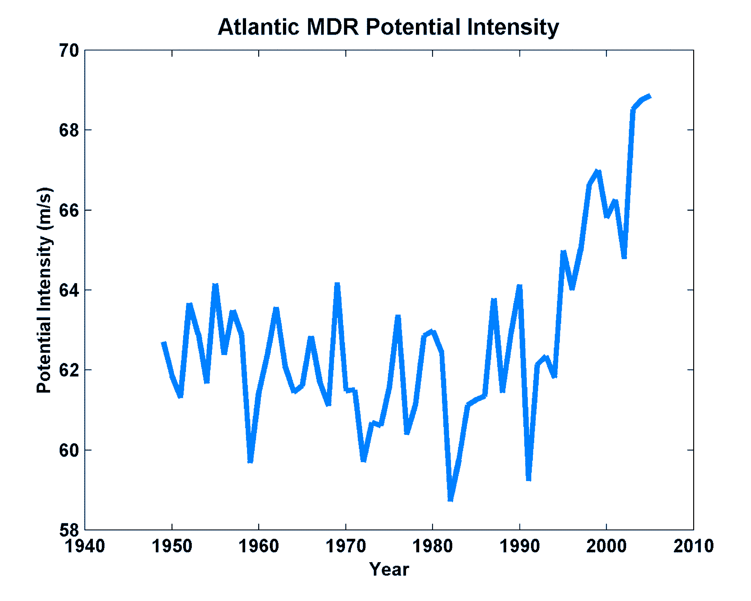
Observed Tropical Atlantic Potential Intensity
Emanuel, K., J. Climate, 2007
Data Sources: NCAR/NCEP re-analysis with pre-1979 bias correction, UKMO/HADSST1

Slide 28
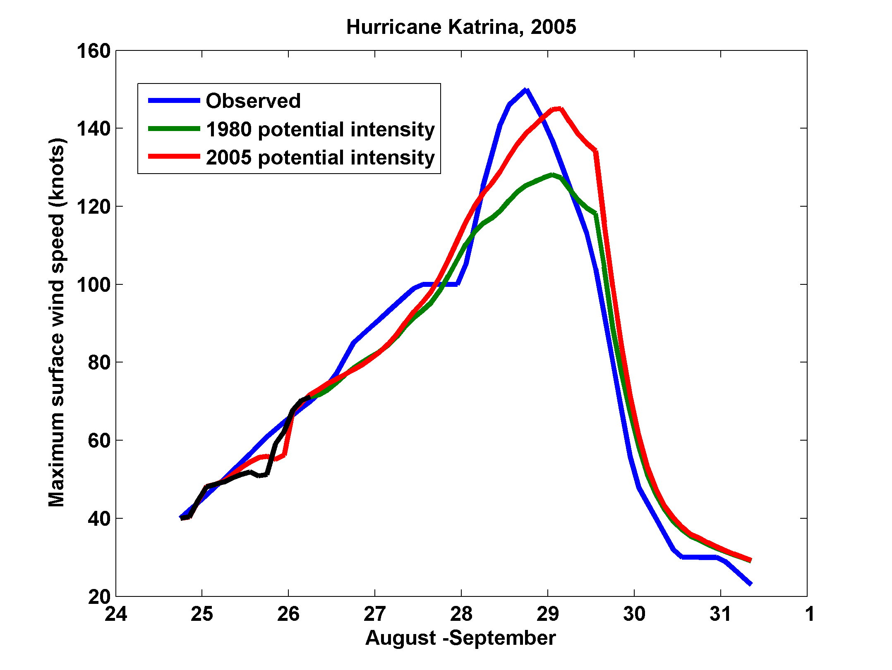
Effect of Increased Potential Intensity on Hurricane Katrina

Slide 29
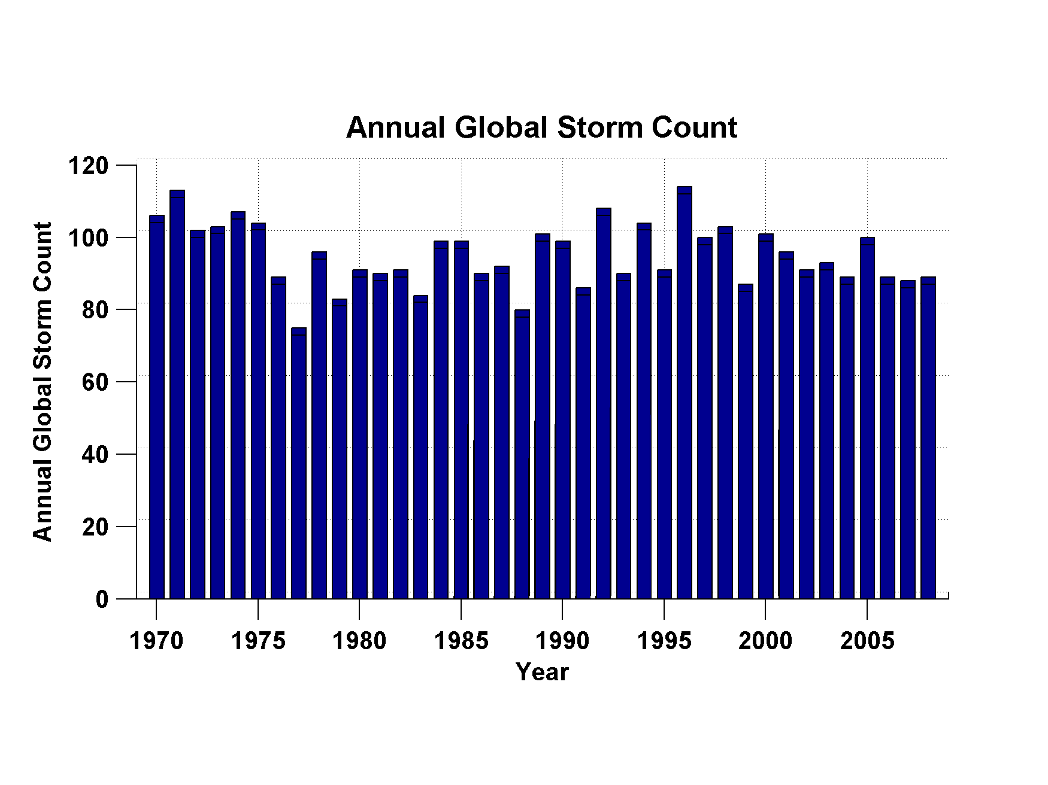
No Obvious Trend in Global Hurricane Frequency, 1970-2008
Data Sources: NOAA/TPC and NAVY/JTWC
Notes:
29

Slide 30
Better Intensity Metric:
Hurricane Power
(Power Dissipation Index)
A measure of the total frictional dissipation of kinetic energy in the hurricane boundary layer over the lifetime of the storm

Slide 31
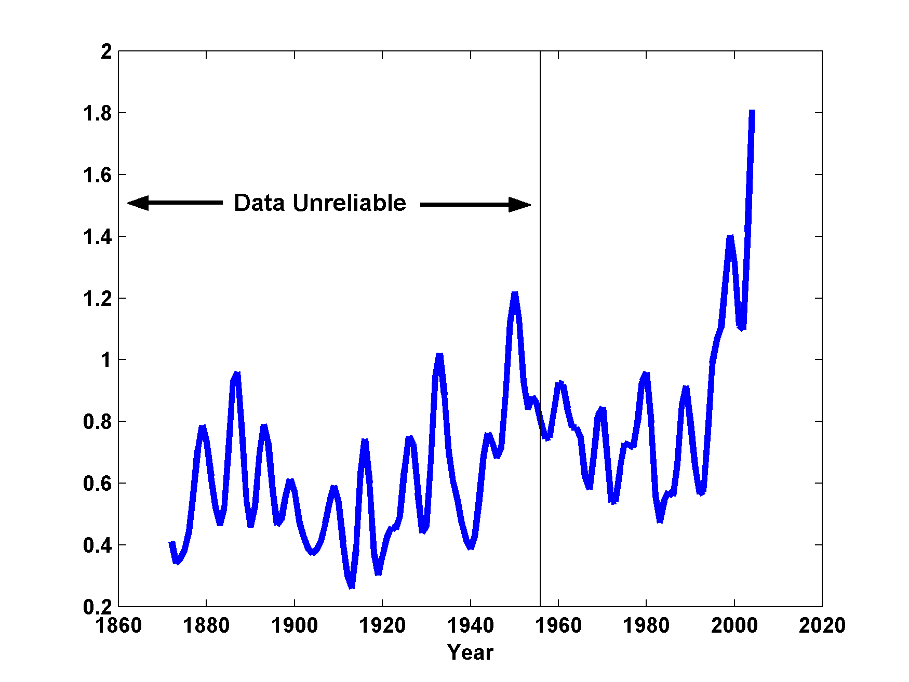
Atlantic Storm Maximum Power Dissipation
(Smoothed with a 1-3-4-3-1 filter)
Years included: 1870-2006
Power Dissipation Index (PDI)
Data Source: NOAA/TPC
Notes:
31
This graph shows the PDI of hurricanes in the 20th century to represent the change of hurricane intensity. This curve has been smoothed as in the previous slides. The hurricane wind speed data used to make this graph are considered unreliable prior to 1948, the year that aircraft surveillance of hurricanes began.

Slide 32
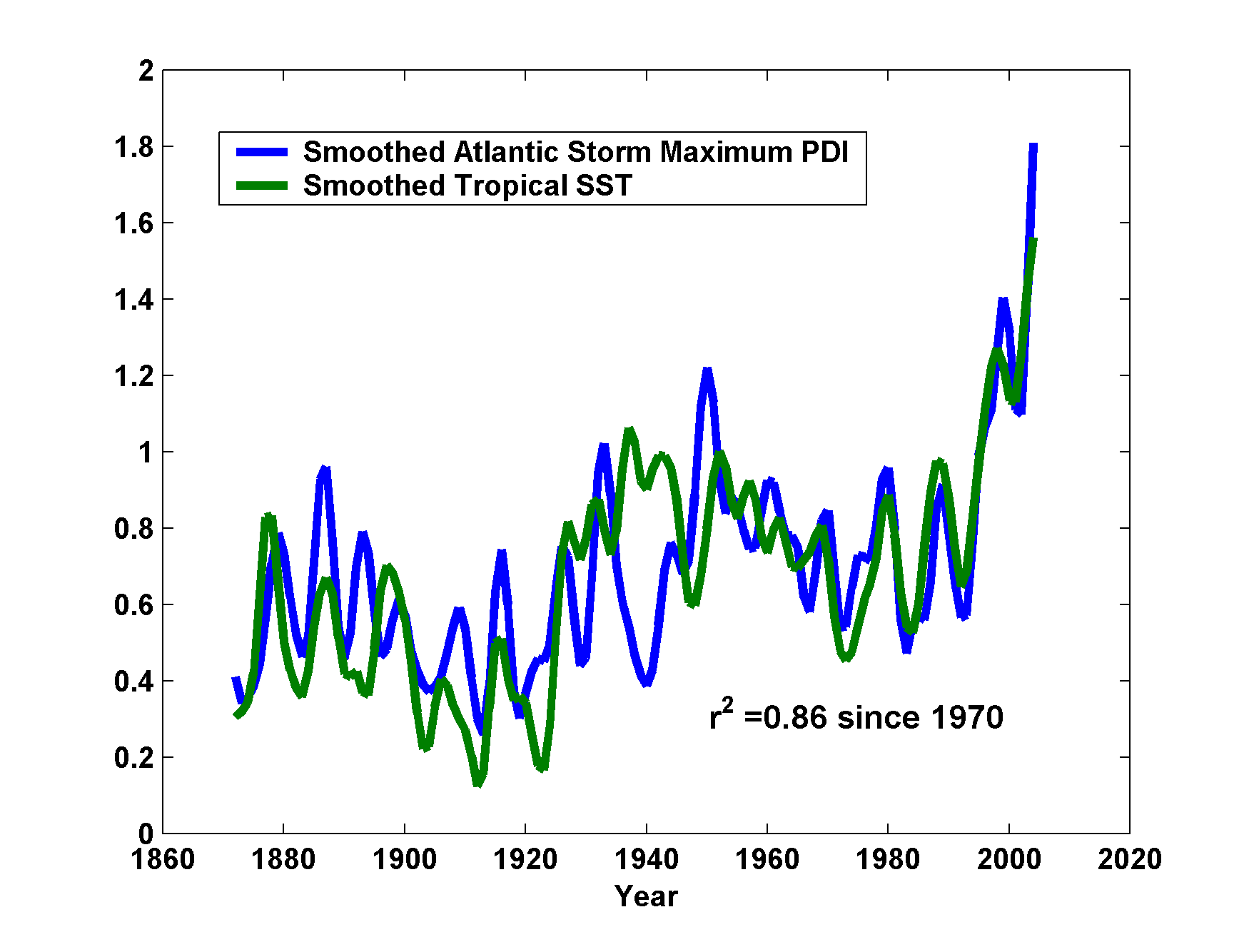
Atlantic Sea Surface Temperatures and Storm Max Power Dissipation
(Smoothed with a 1-3-4-3-1 filter)
Years included: 1870-2006
Power Dissipation Index (PDI)
Scaled Temperature
Data Sources: NOAA/TPC, UKMO/HADSST1
Notes:
32
This graph is similar to the previous graph, but the ocean surface temperature has been added for comparison. The low value of storm power in the early 1940s is thought to be due to the lack of reports from ships at sea because of the radio silence imposed during WWII.

Slide 33
What is Causing Changes in Tropical Atlantic Sea Surface Temperature?

Slide 34
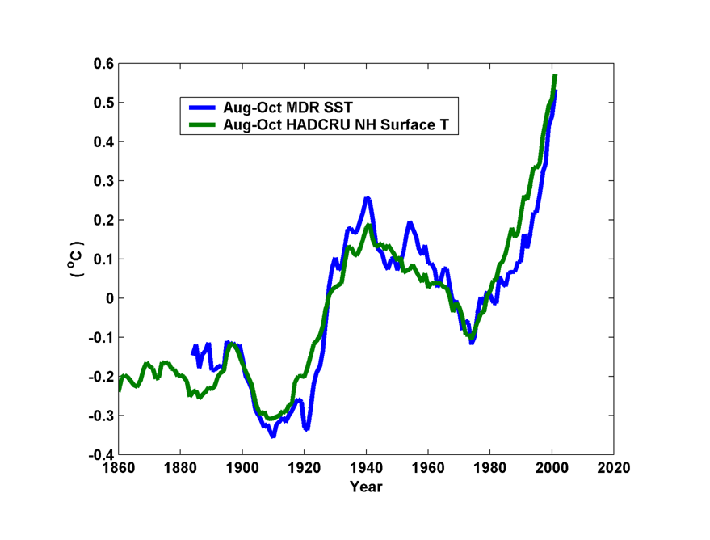
10-year Running Average of Aug-Oct Northern Hemisphere Surface Temp and Hurricane Region Ocean Temp

Slide 35
Estimates of Global Mean Surface Temperature from the Instrumental Record
Notes:
35

Slide 36
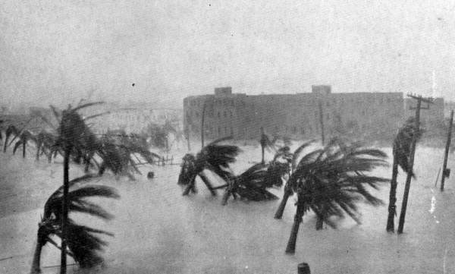
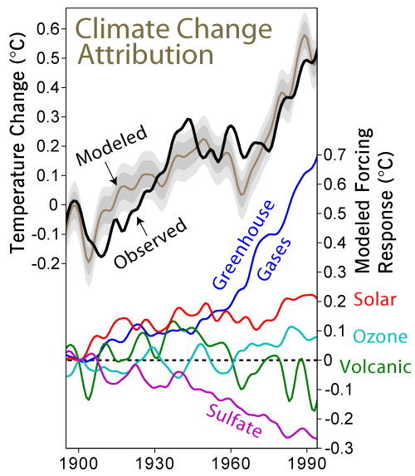

Slide 37
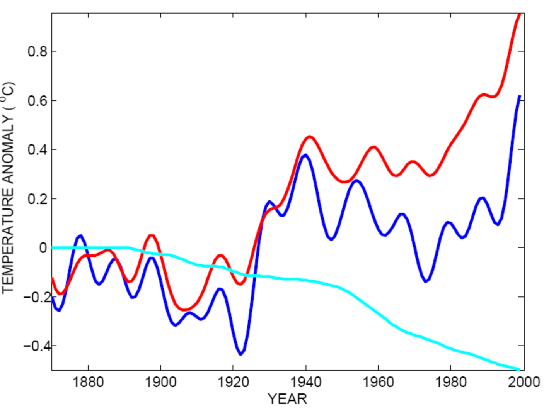
Tropical Atlantic SST(blue), Global Mean Surface Temperature (red),
Aerosol Forcing (aqua)
Global mean surface temperature
Tropical Atlantic sea surface temperature
Sulfate aerosol radiative forcing
Mann, M. E., and K. A. Emanuel, 2006. Atlantic hurricane trends linked to climate change. EOS, 87, 233-244.

Slide 38
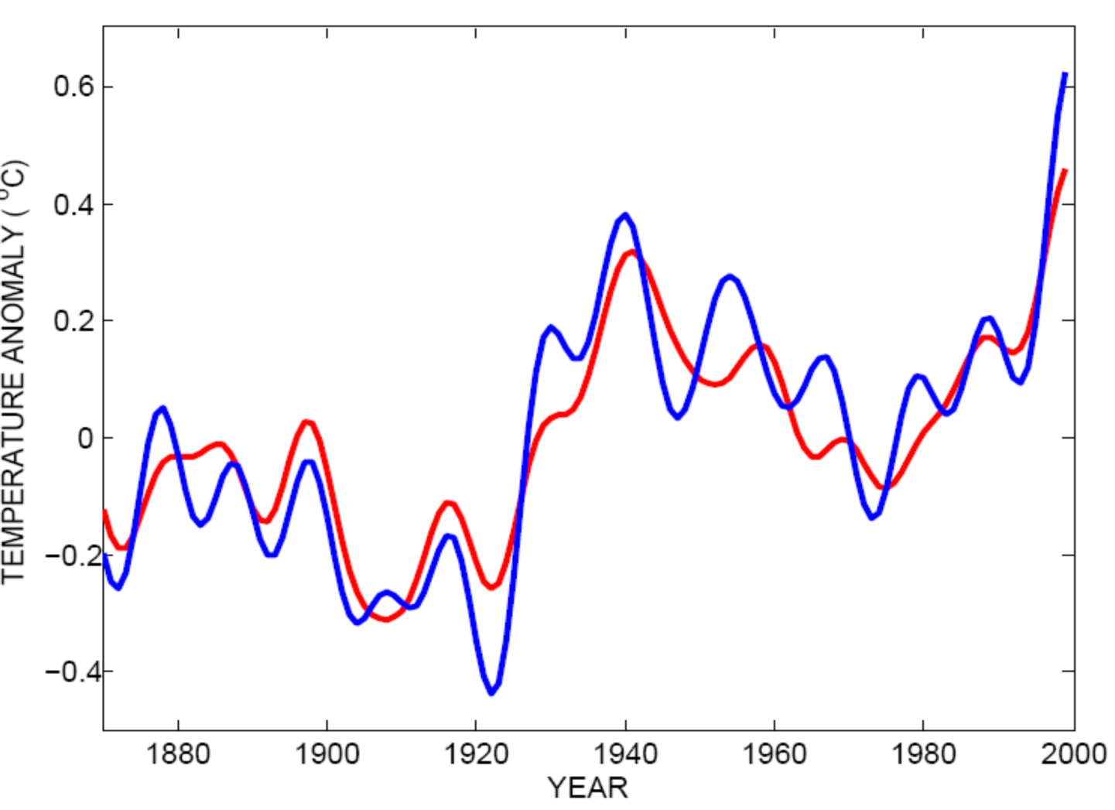
Best Fit Linear Combination of Global Warming and Aerosol Forcing (red) versus Tropical Atlantic SST (blue)
Tropical Atlantic Sea Surface Temperature
Global Surface T + Aerosol Forcing
Mann, M. E., and K. A. Emanuel, 2006. Atlantic hurricane trends linked to climate change. EOS, 87, 233-244.

Slide 39
Pushing Back the Record of Tropical Cyclone Activity:
Paleotempestology
Notes:
39

Slide 40
Paleotempestology
barrier beach
upland
overwash fan
backbarrier marsh
a)
lagoon
barrier beach
upland
overwash fan
b)
backbarrier marsh
lagoon
terminal lobes
flood tidal delta
Source: Jeff Donnelly, WHOI
Notes:
40

Slide 41
Source: Jeff Donnelly, Jon Woodruff, Phil Lane; WHOI
Notes:
41

Slide 42
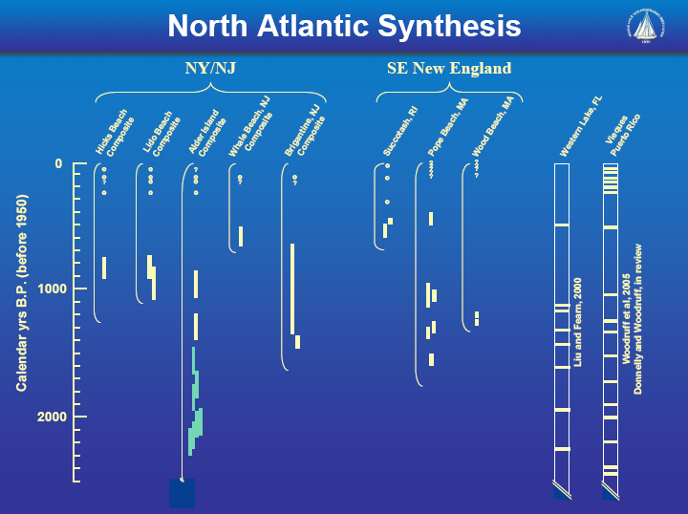
Source: Jeff Donnelly, Jon Woodruff, Phil Lane; WHOI
Notes:
42

Slide 43
Projecting into the Future: Downscaling from Global Climate Models

Slide 44
Our Approach
Step 1: Seed each ocean basin with a very large number of weak, randomly located vortices
Step 2: Vortices are assumed to move with the large scale atmospheric flow in which they are embedded
Step 3: Run a coupled, ocean-atmosphere computer model for each vortex, and note how many achieve at least tropical storm strength; discard others
Step 4: Using the small fraction of surviving events, determine storm statistics.

Slide 45
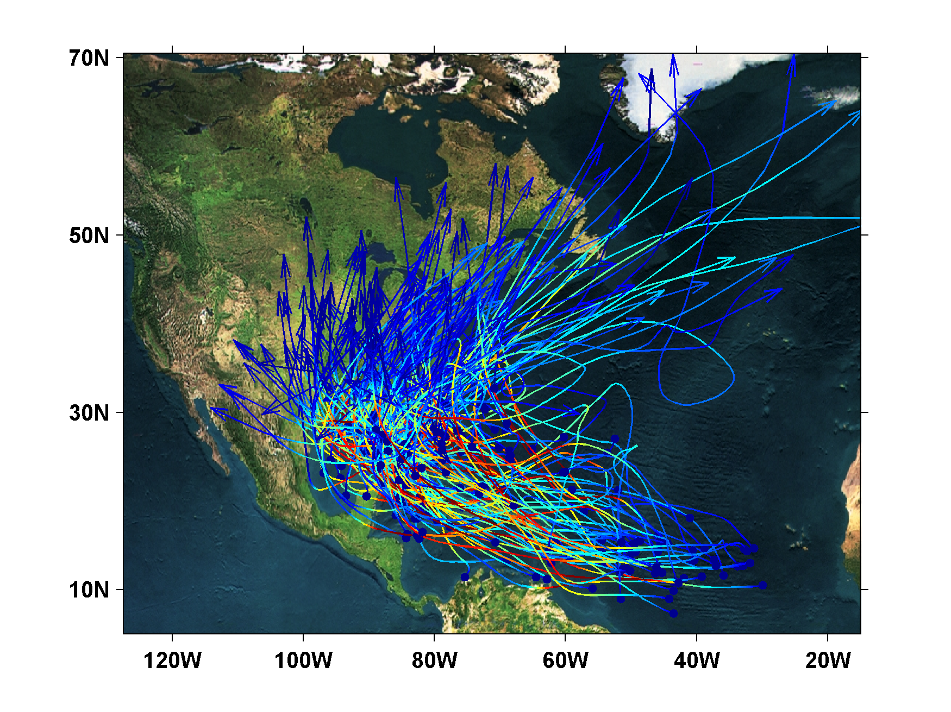
200 Synthetic U.S. Landfalling tracks (color coded by Saffir-Simpson Scale)

Slide 46
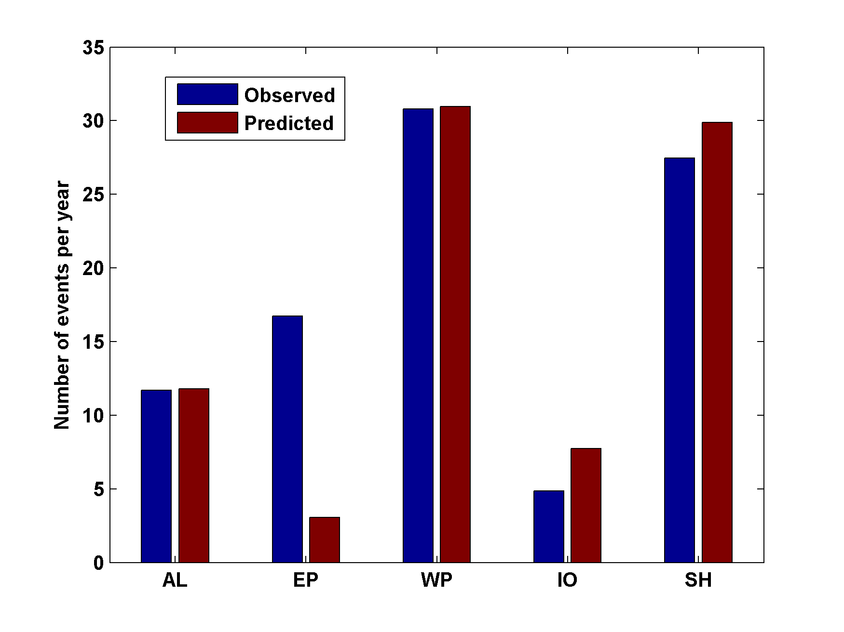
Genesis rates
Western North Pacific
Southern Hemisphere
Eastern North Pacific
Atlantic
North Indian Ocean
Calibrated to Atlantic
Notes:
46

Slide 47
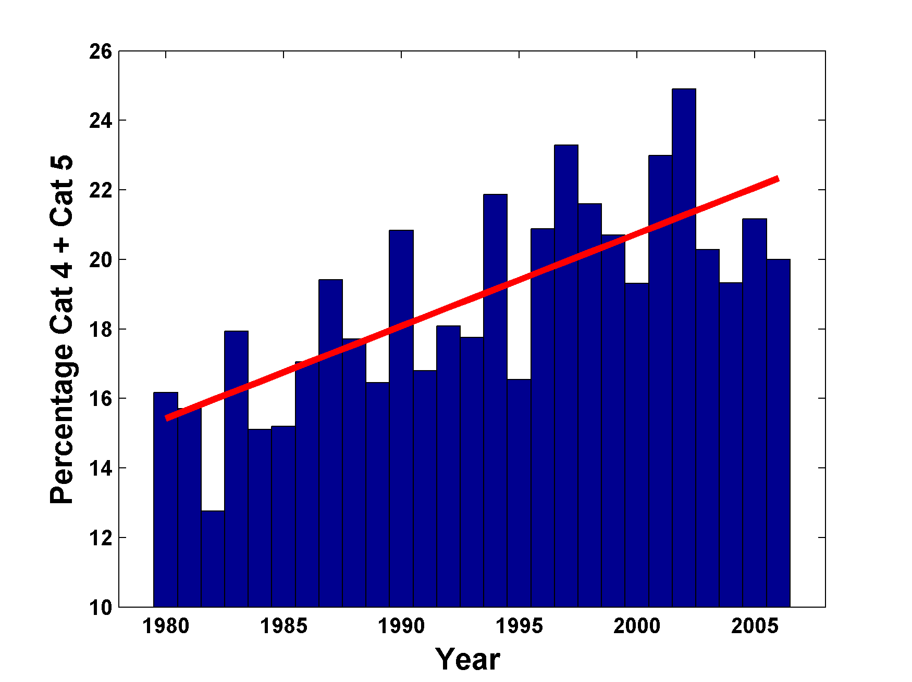
Global Percentage of Cat 4 & Cat 5 Storms

Slide 48
Now Use Daily Output from IPCC Models to Derive Wind Statistics, Thermodynamic State Needed by Synthetic Track Technique

Slide 49
1. Last 20 years of 20th century simulations
2. Years 2180-2200 of IPCC Scenario A1b (CO₂ stabilized at 720 ppm)
Compare two simulations each from 7 IPCC models:

Slide 50
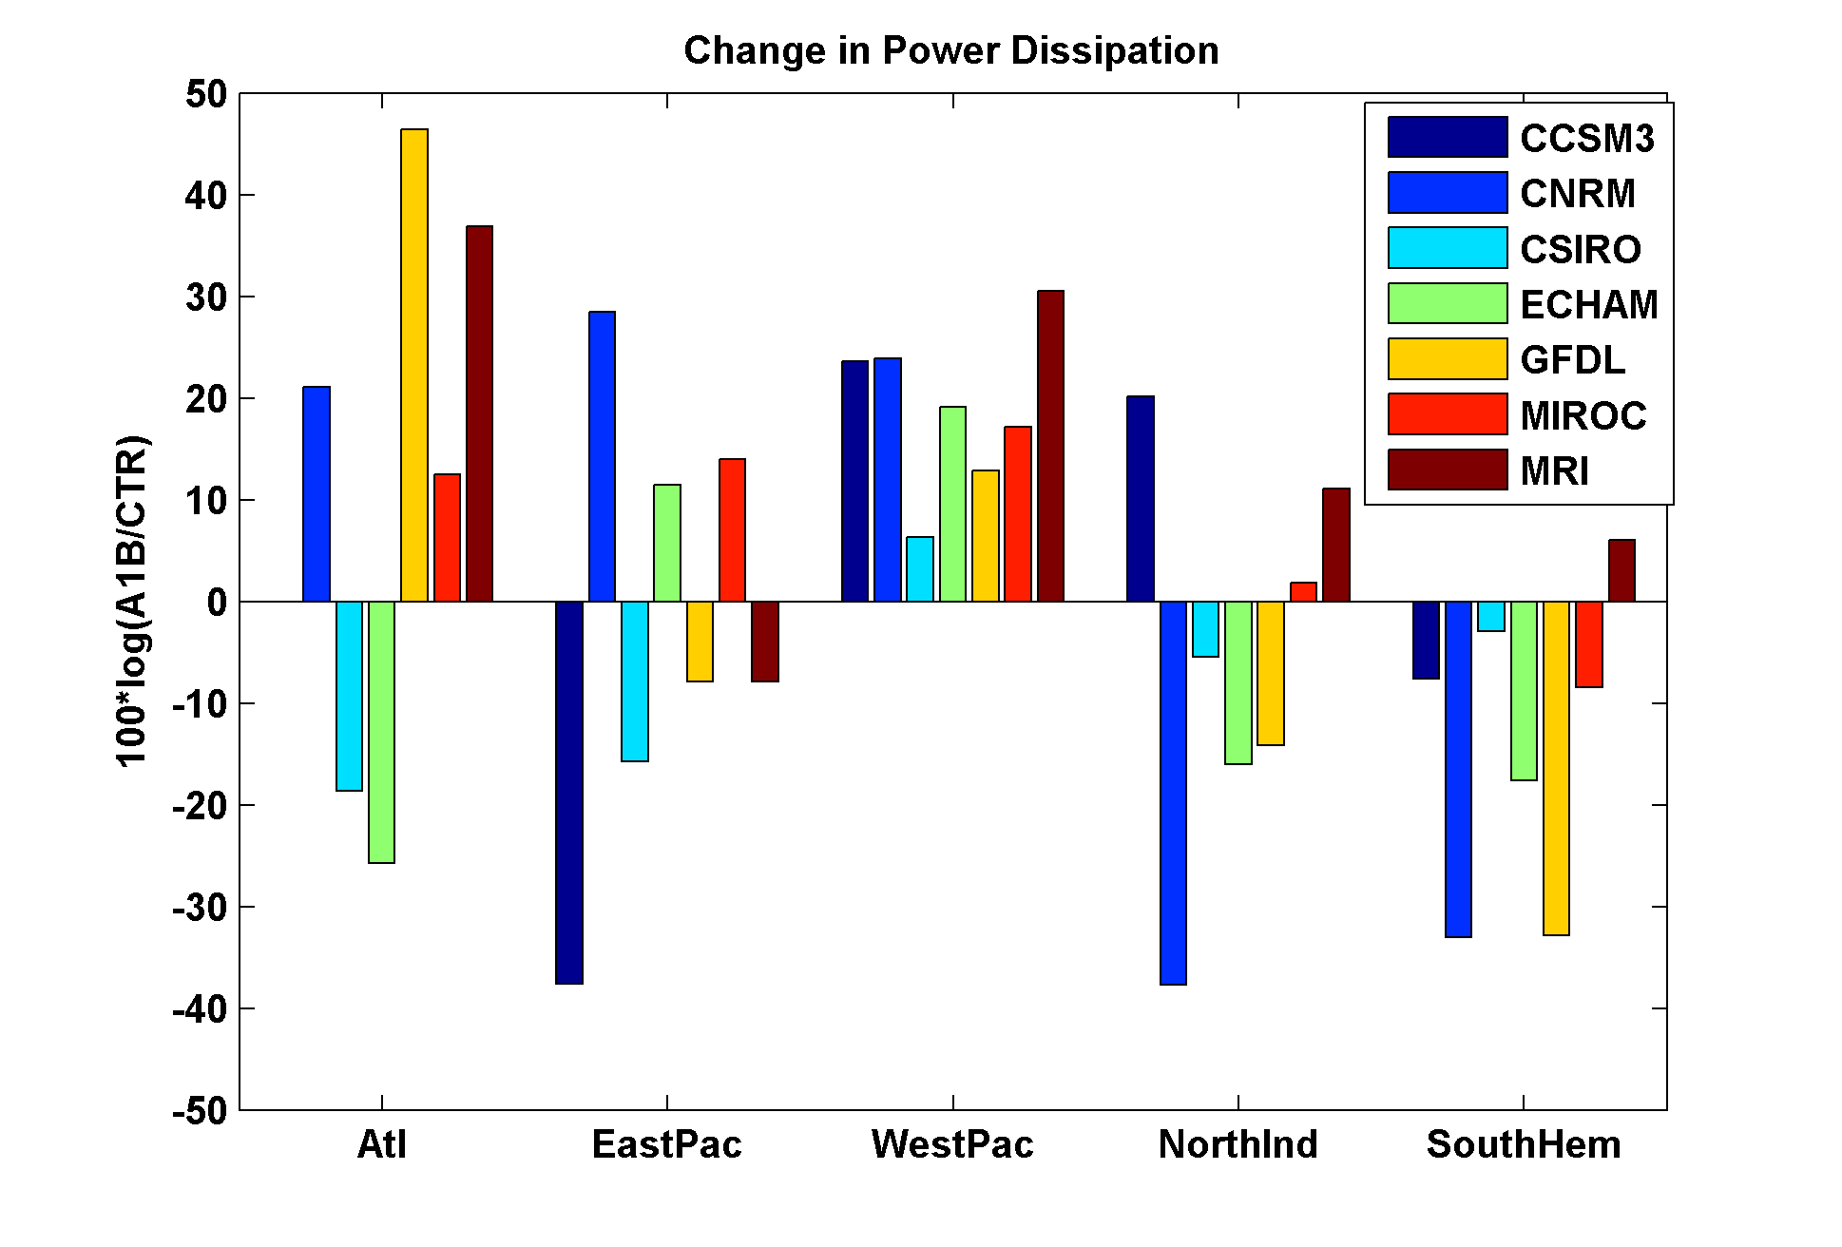
Basin-Wide Percentage Change in Power Dissipation
Different Climate Models
Notes:
50
50

Slide 51
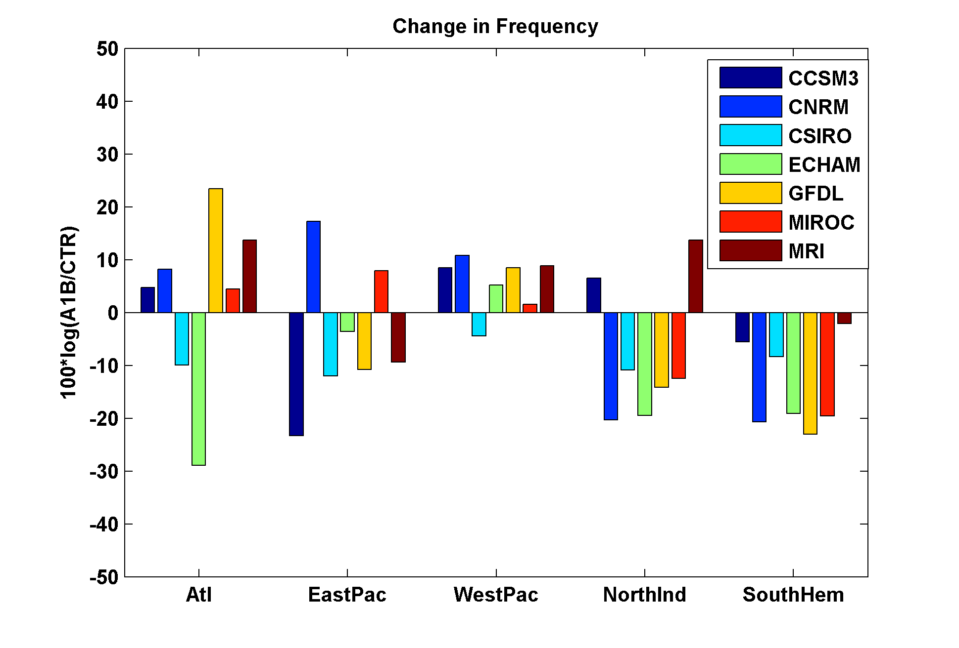
Basin-Wide Percentage Change in Storm Frequency
Different Climate Models
Notes:
51
51

Slide 52
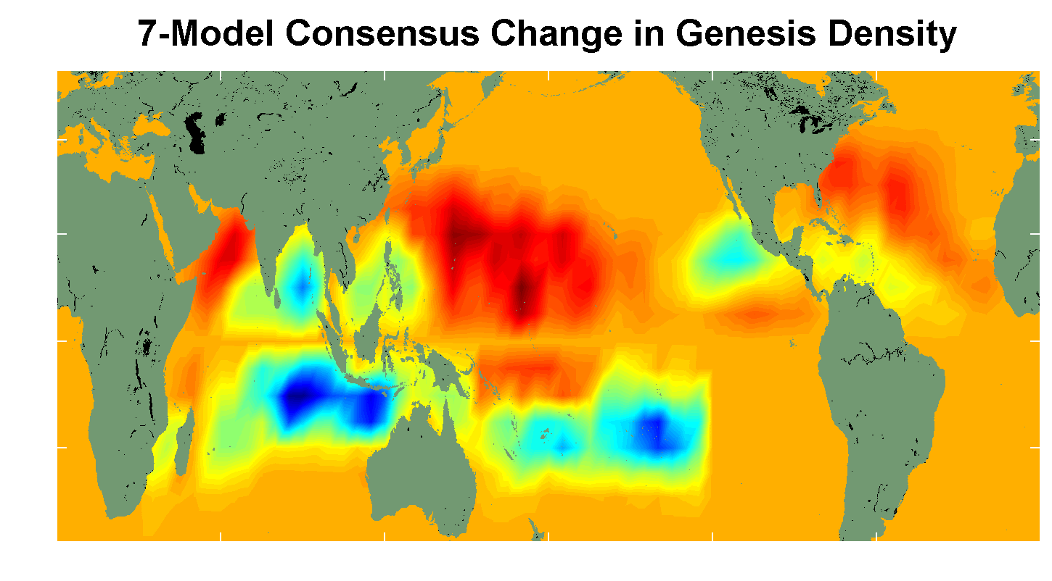
7 Model Consensus Change in Storm Frequency
Reds: Increases Blues: Decreases
Notes:
52
52

Slide 53
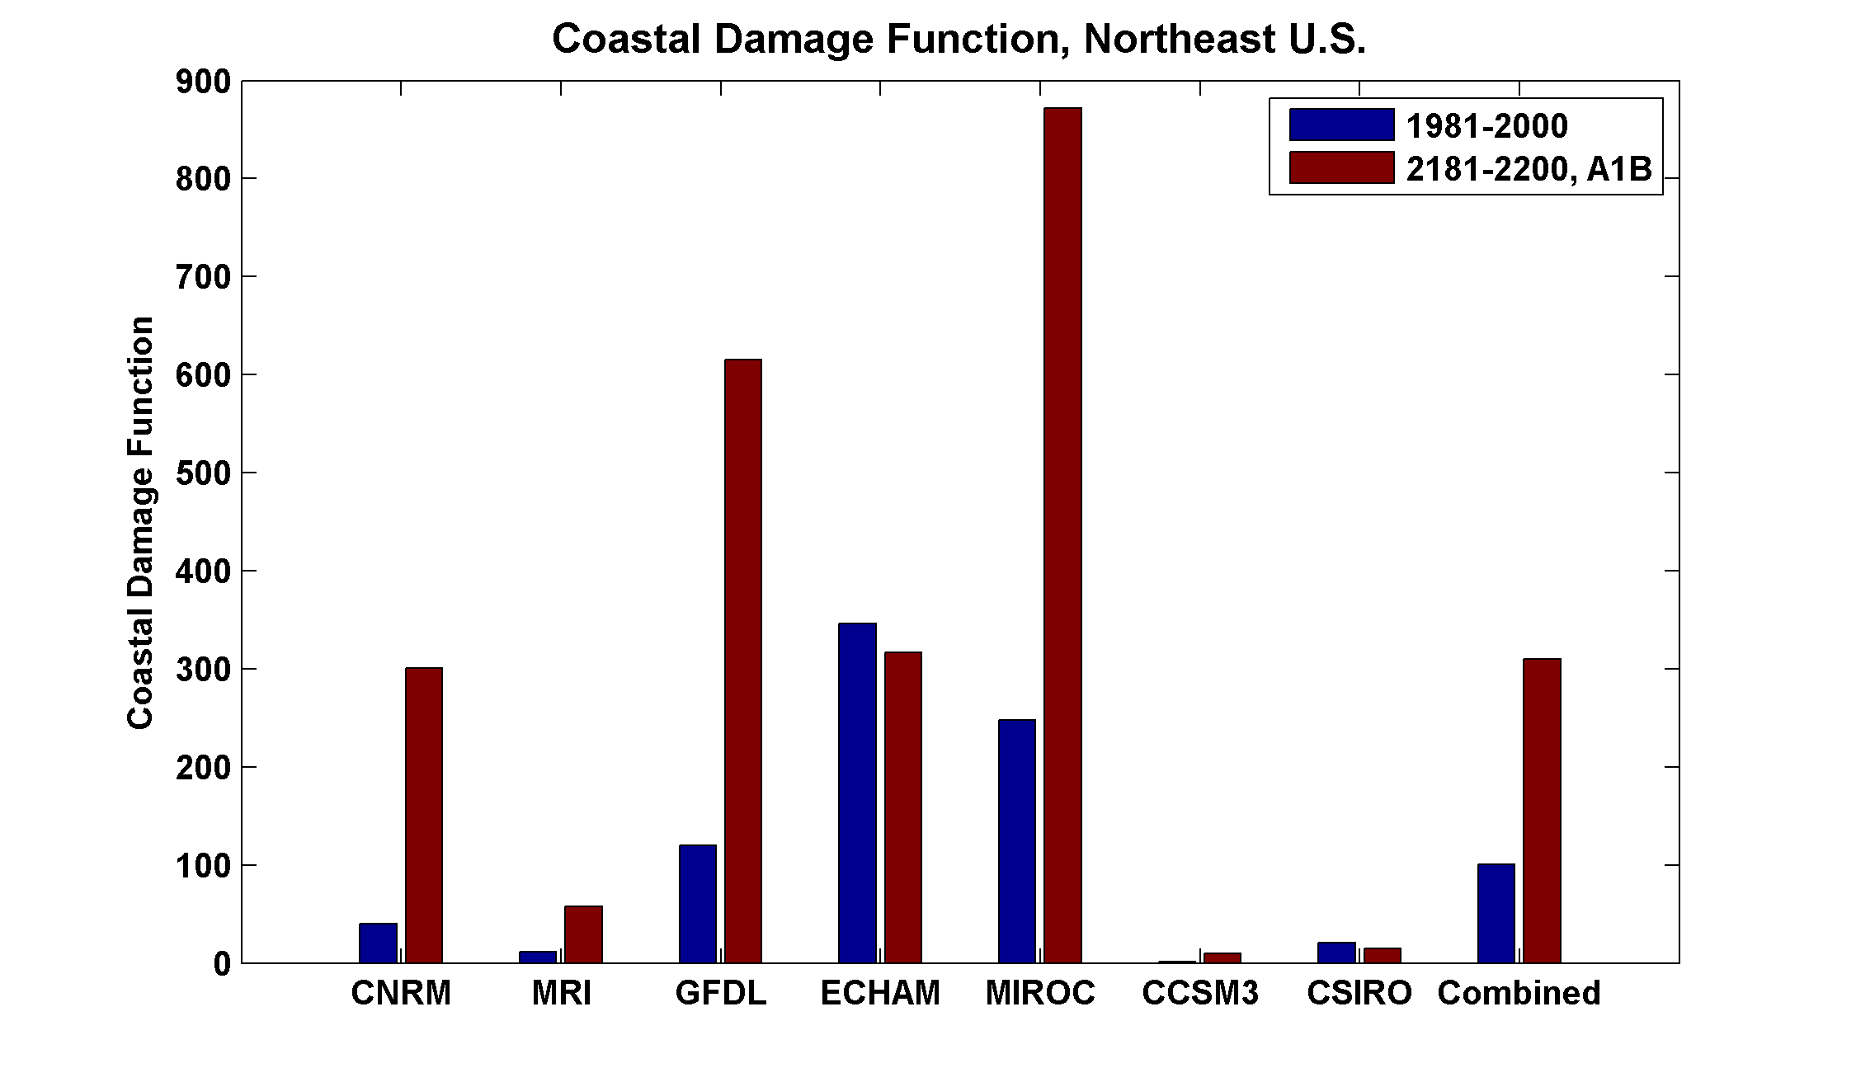

Slide 54
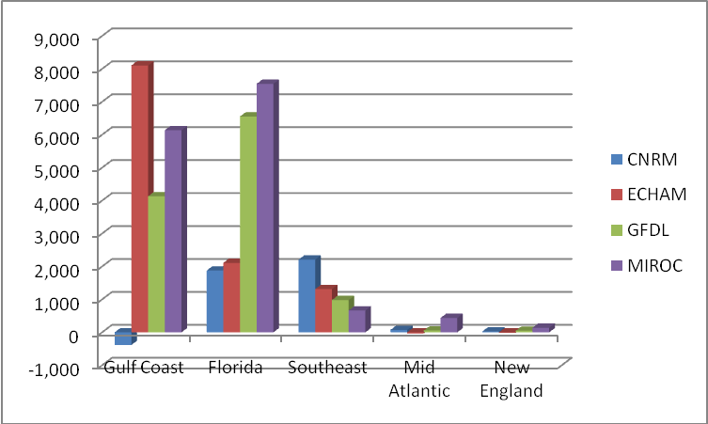
Change in Total Annual Damage in U.S. $millions,
2000-2100, under Scenario A1b

Slide 55
Summary:
Tropical cyclones are sensitive to the climate state, as revealed by historical data and paleotempestology
Observations together with detailed modeling suggest that TC power dissipation increases by ~65% for a 10% increase in potential intensity

Slide 56
New technique for downscaling climate models shows promise for predicting response of global tropical cyclone activity to climate change
Climate models may have systematic errors that compromise estimates of tropical cyclone response to global warming. This includes their omission of tropical cyclones themselves

Slide 57
Feedback of Global Tropical Cyclone Activity on the Climate System
Notes:
57

Slide 58
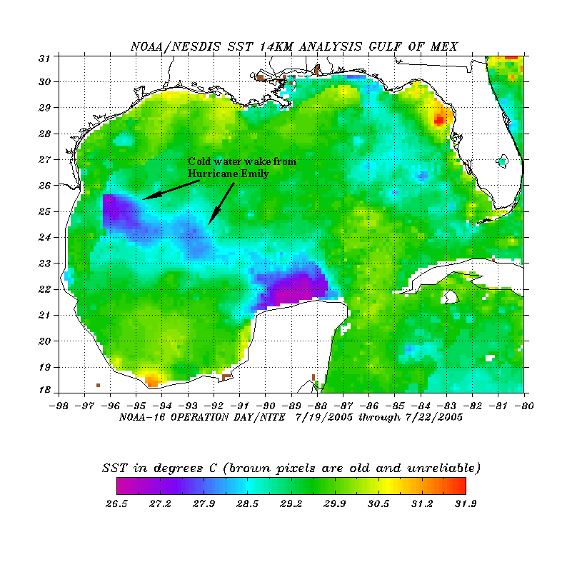
The wake of Hurricane Emily (July 2005)
Sea Surface Temperature in the Wakes of Hurricanes
Hurricane Dennis
(one week earlier)
Source: Rob Korty, CalTech
Notes:
58
We know that tropical cyclones are responsible for strong mixing of the upper oceans and this can be seen in satellite images…

Slide 59
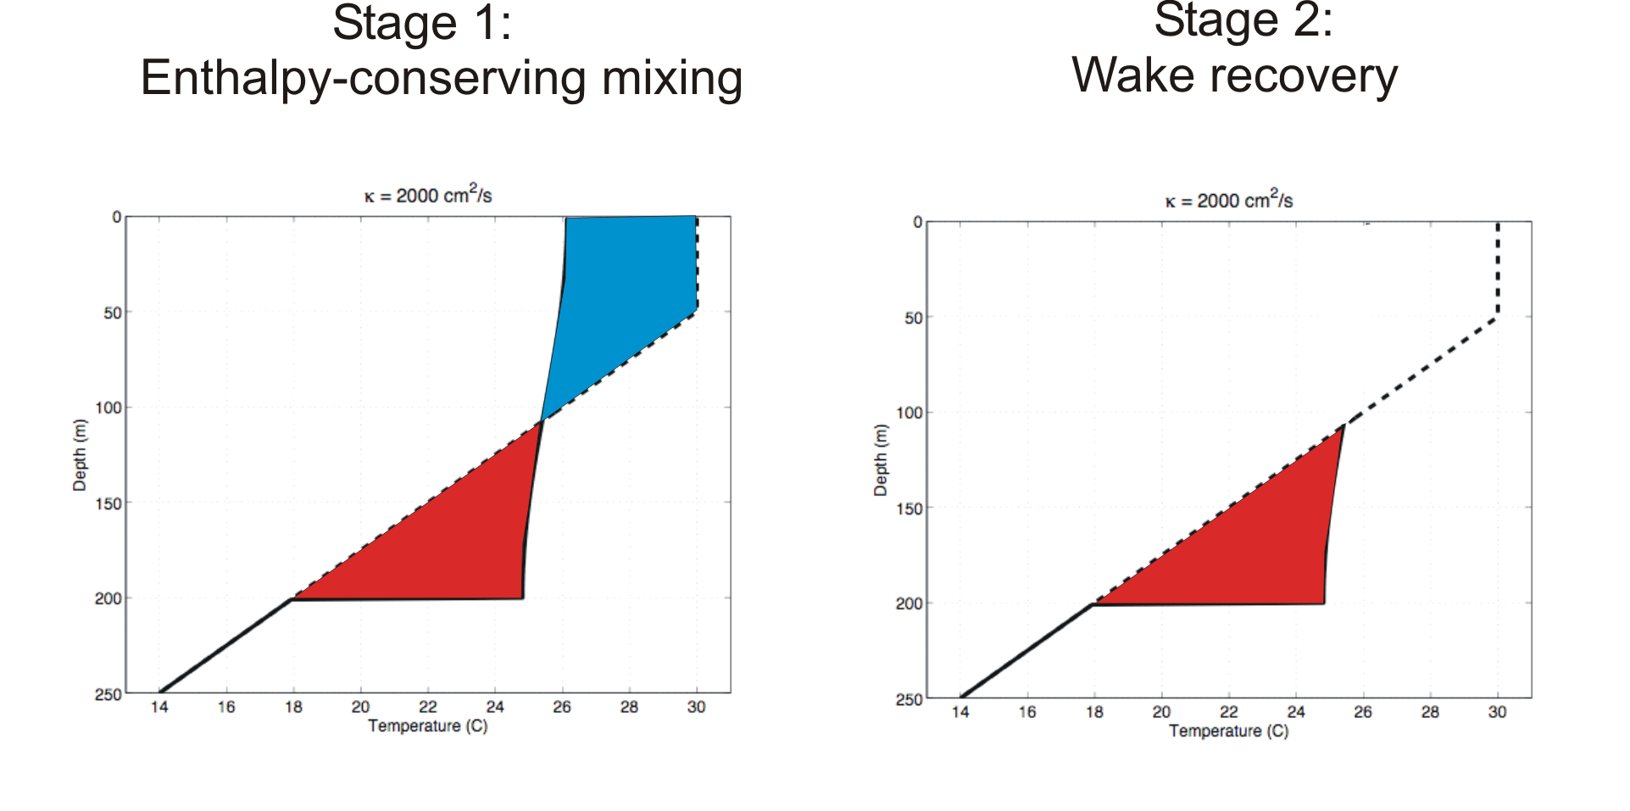
Direct mixing by tropical cyclones
Emanuel (2001) estimated global rate of heat input as 1.4 X 10¹⁵ Watts
Source: Rob Korty, CalTech
Notes:
59

Slide 60
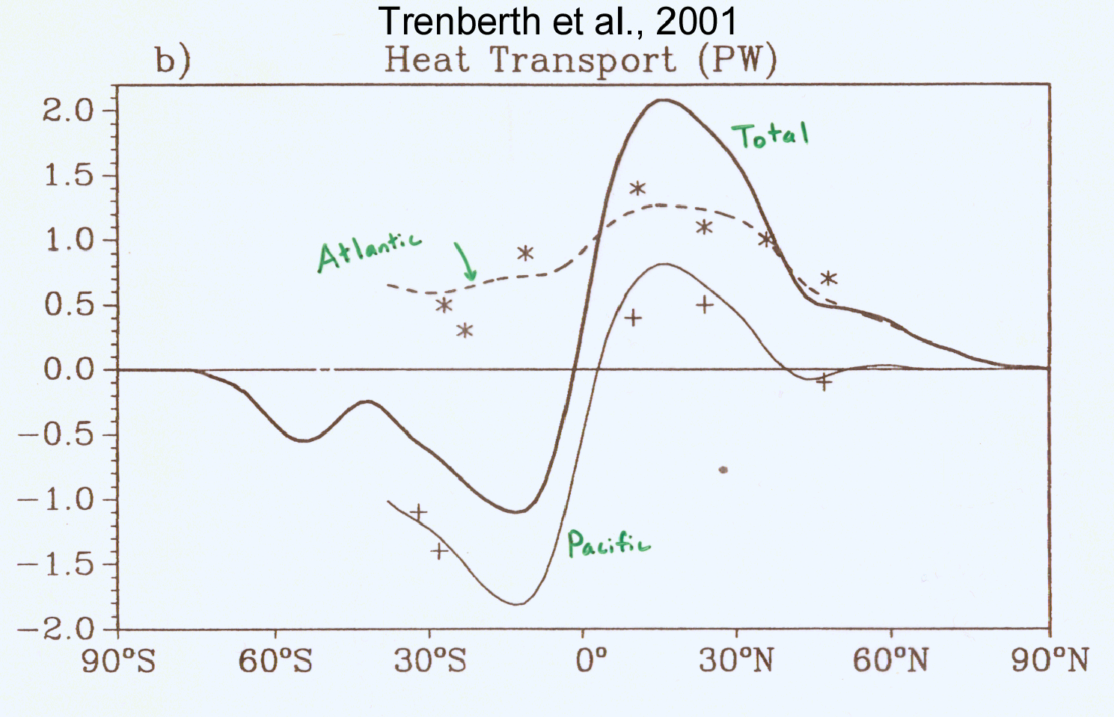
TC Mixing May Induce Much or Most of the Observed Poleward Heat Flux by the Oceans
Notes:
60

Slide 61
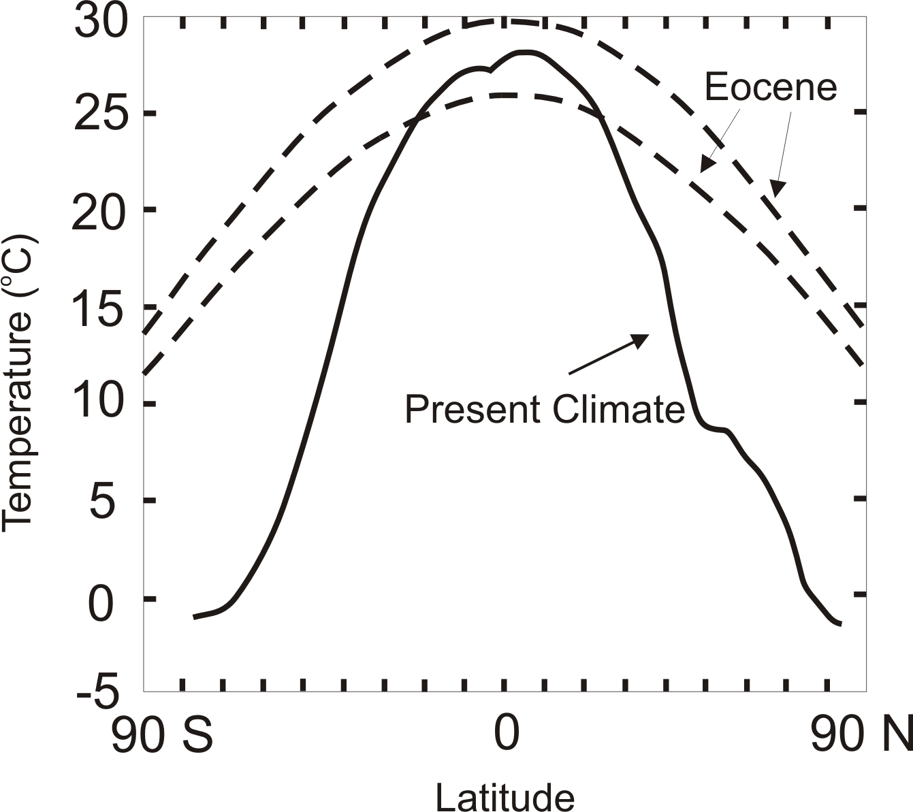
TC-Mixing may be Crucial for High-Latitude Warmth and Low-Latitude Moderation During Warm Climates, such as that of the Eocene
Notes:
61

Slide 62

Depiction of central North America, ~60 million years ago
Our future?
Figure courtesy of Rob Korty, CalTech
Notes:
62

Slide 63
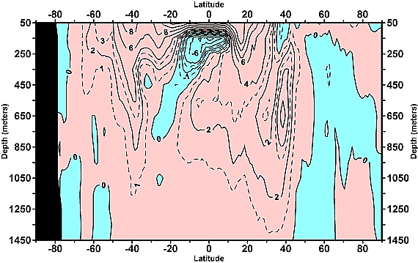
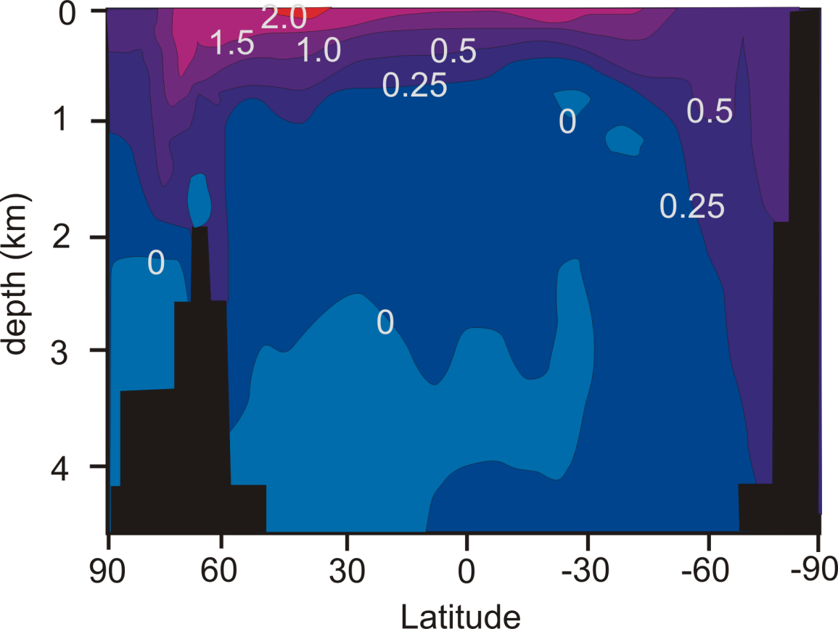
Linear trend (1955–2003) of the zonally integrated heat content of the world ocean by one-degree latitude belts for 100-m thick layers. Source: Levitus et al., 2005
TC-Mixing may explain difference between observed and modeled ocean warming
Zonally averaged temperature trend due to global warming in a coupled climate model. Source: Manabe et al, 1991
Notes:
63

Slide 64
Some Concluding Thoughts
Hurricanes are the worst “natural” catastrophes to affect the U.S., in both economic and mortal terms
Globally, tropical cyclones and flash floods are the leading causes of loss of life by natural hazards

Slide 65
Globally, the frequency of tropical cyclones shows no trend, but their intensity and duration are increasing
Atlantic hurricane intensity and frequency are increasing, probably as a result of global warming, and will likely continue to do so
Hurricanes may be important components of the earth’s climate system

Slide 66
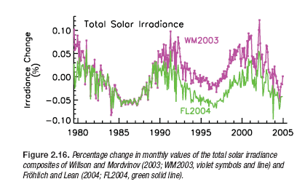
Variations in Solar Output (IPCC, 2007)

Slide 67
Variation with Time of Natural Climate Forcings:
Notes:
67

Slide 68
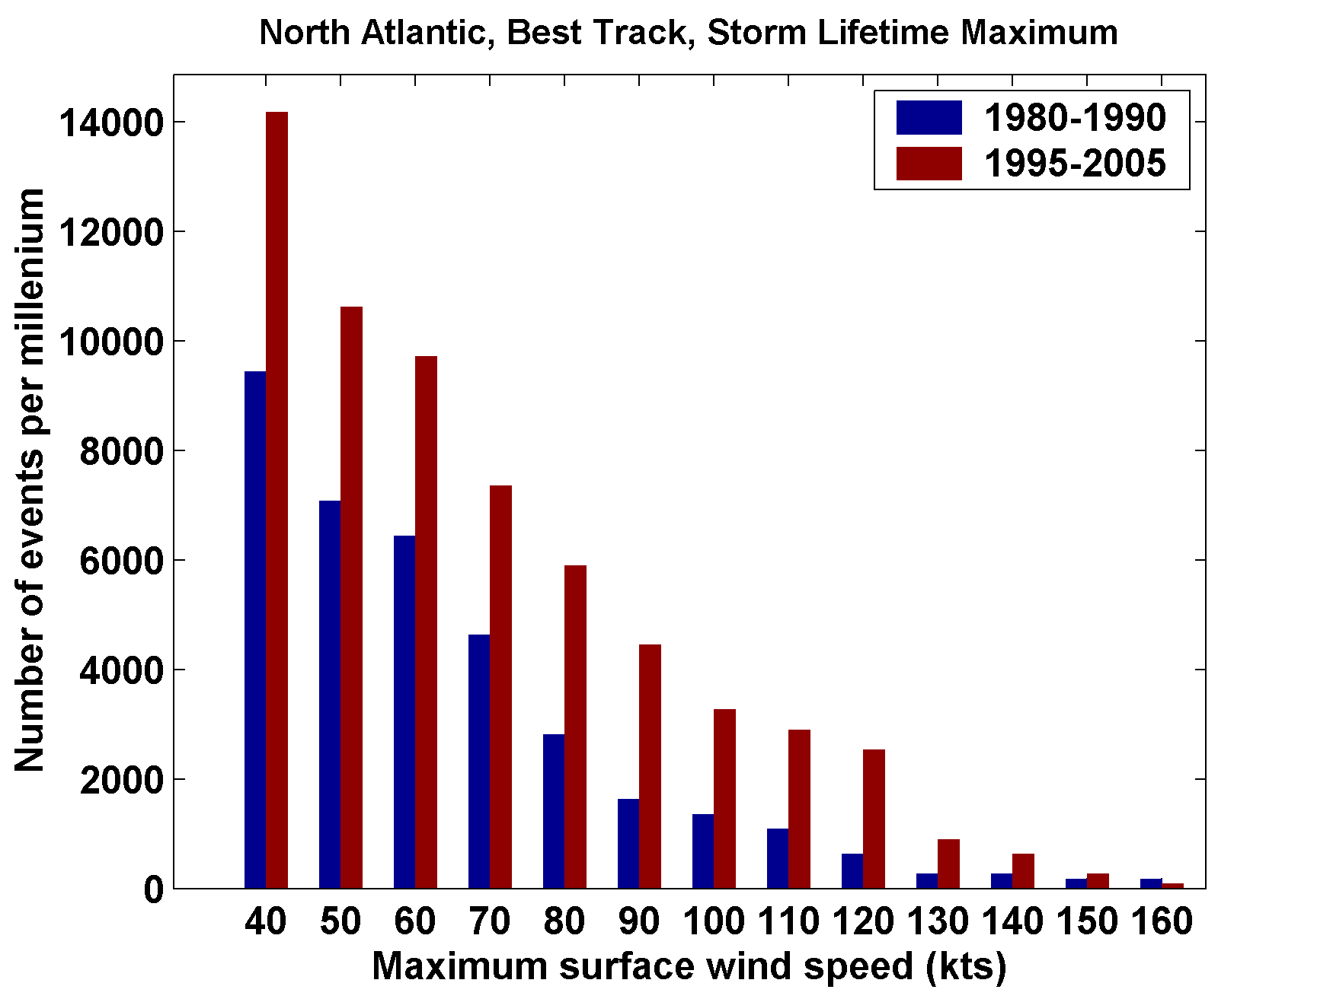
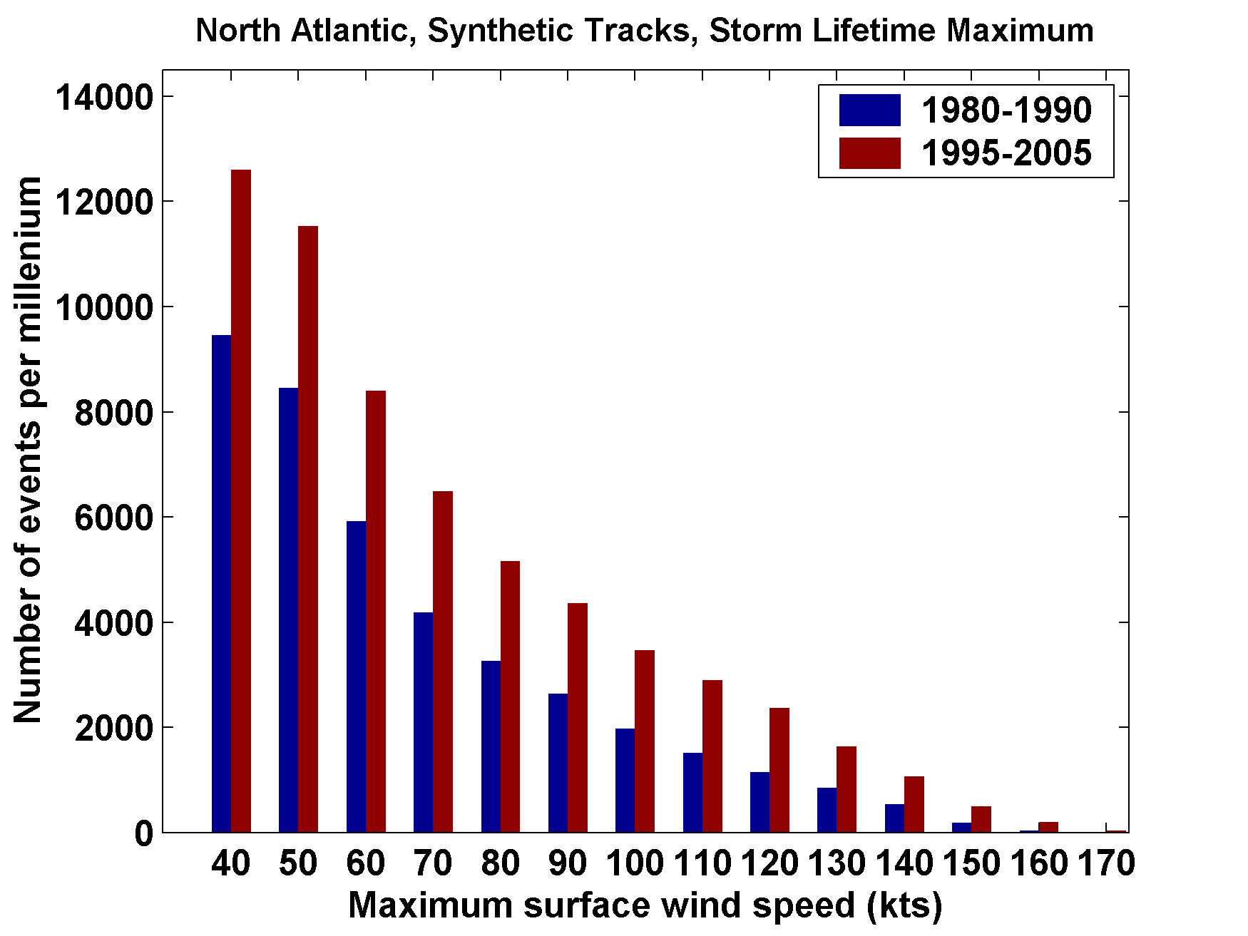
Comparing 1980-1990 (quiet) to 1995-2005 (active)
104-156 HURDAT tracks
1000 Synthetic tracks
Cumulative distributions of storm lifetime maximum wind

Slide 69
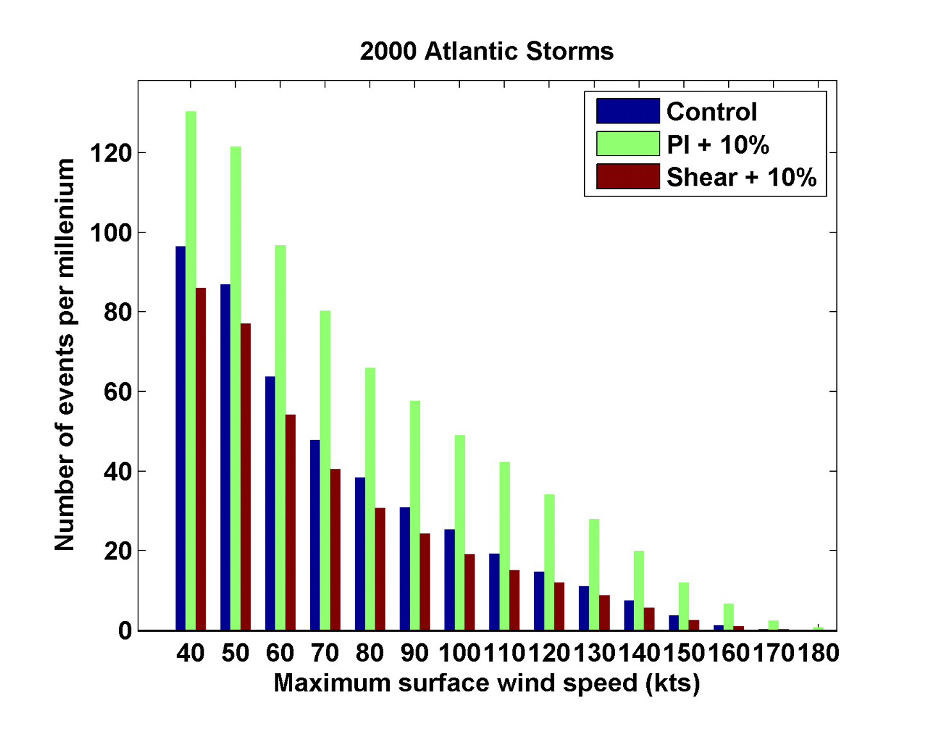
Sensitivity to Shear and Potential Intensity

Slide 70
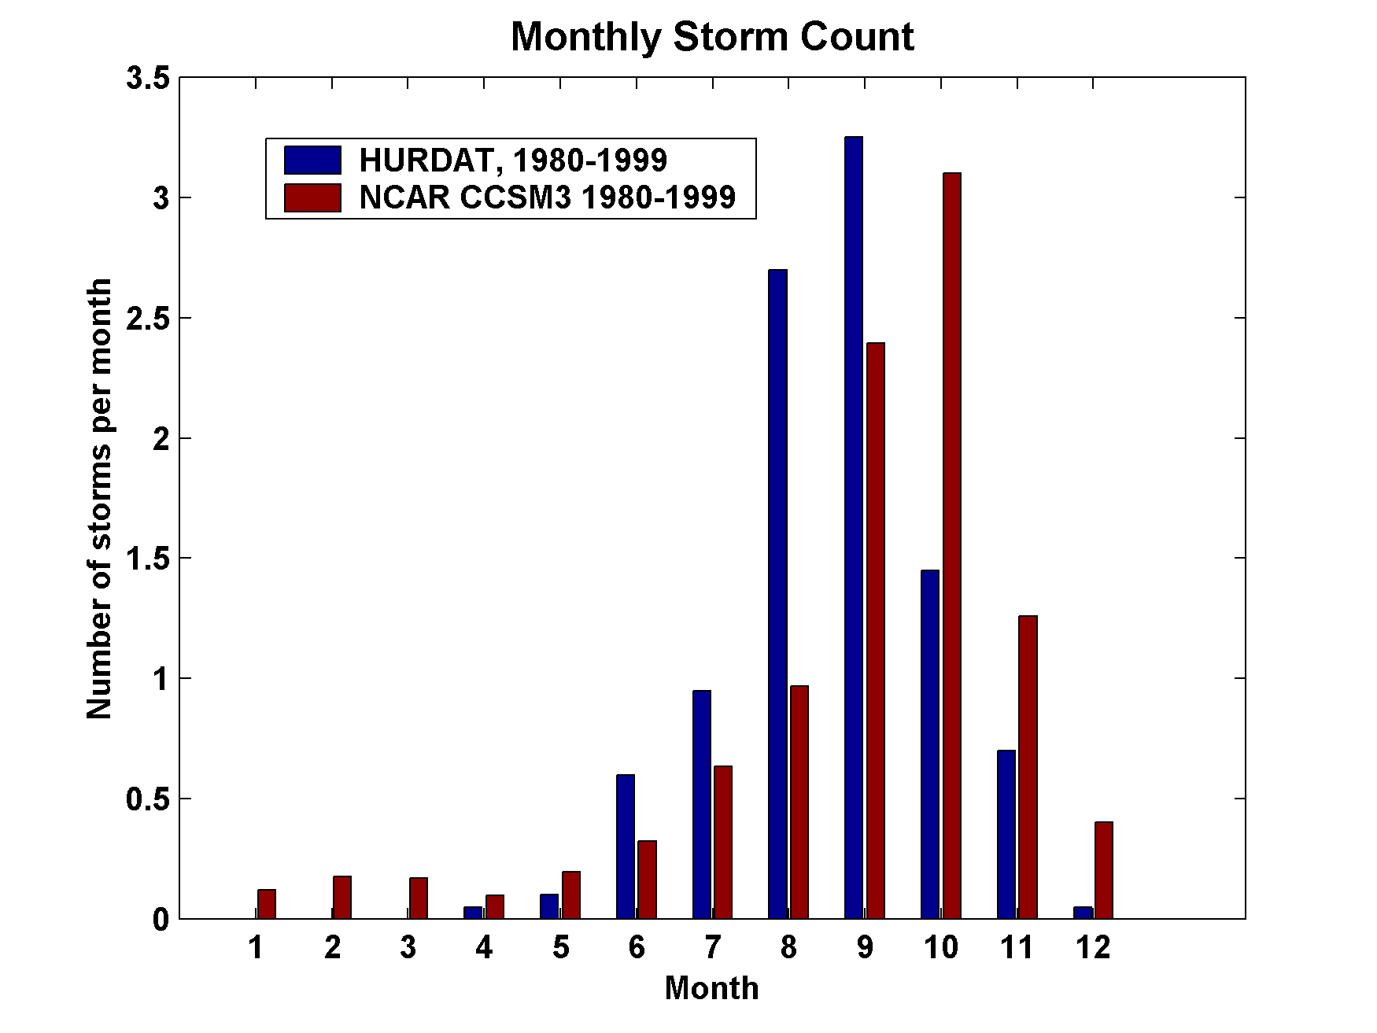
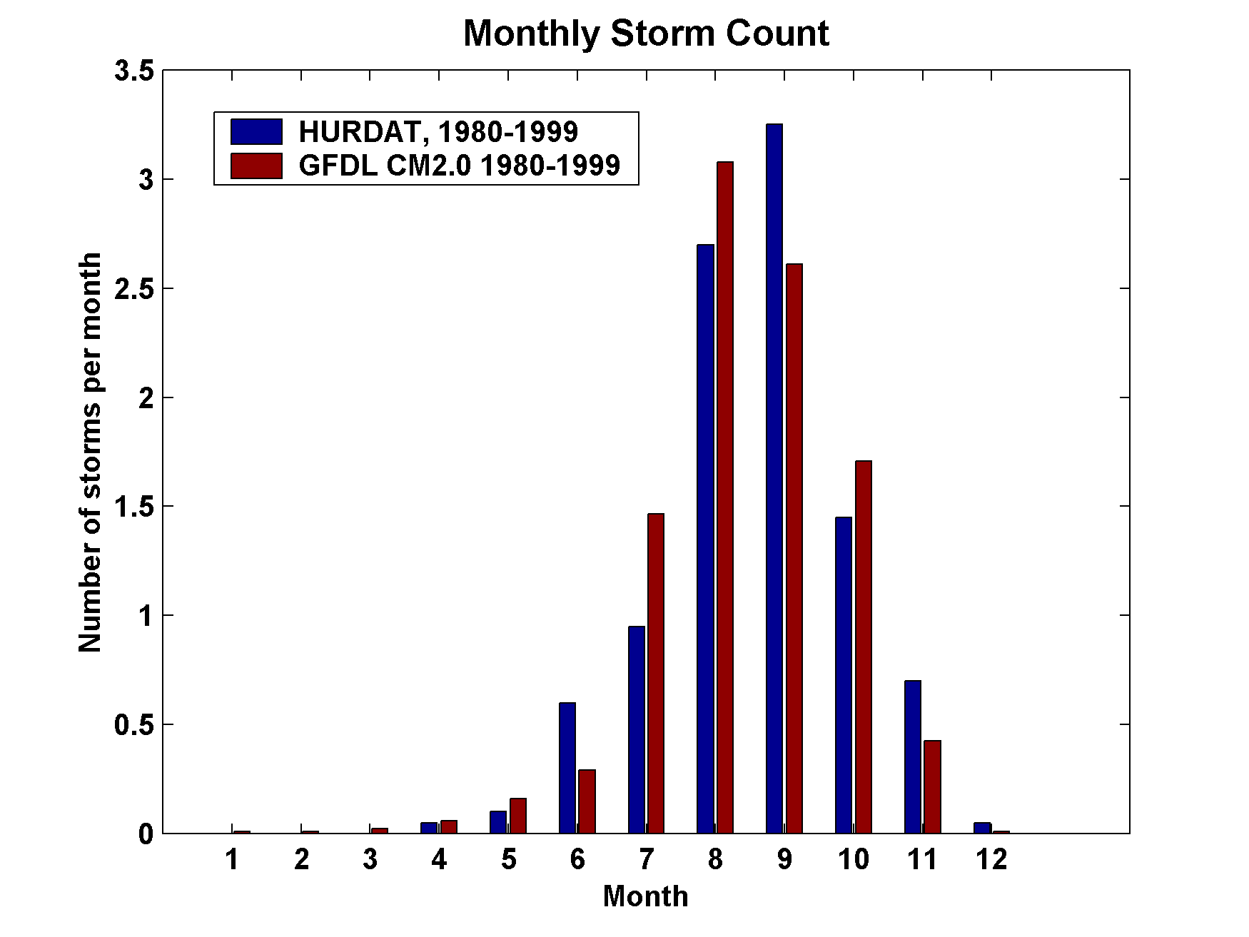
Examples of Annual Cycles of Storm Counts by Month
ATLANTIC
NCAR CCSM3
GFDL CM2.0

Slide 71
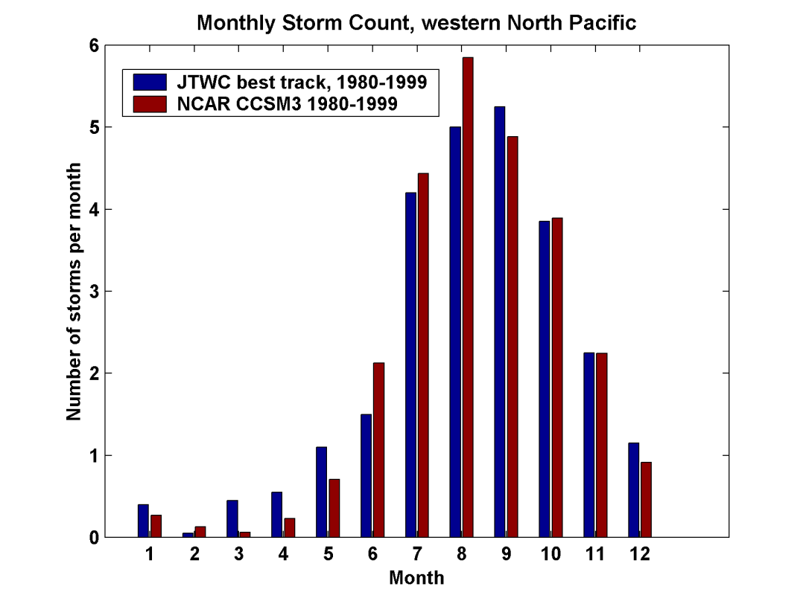
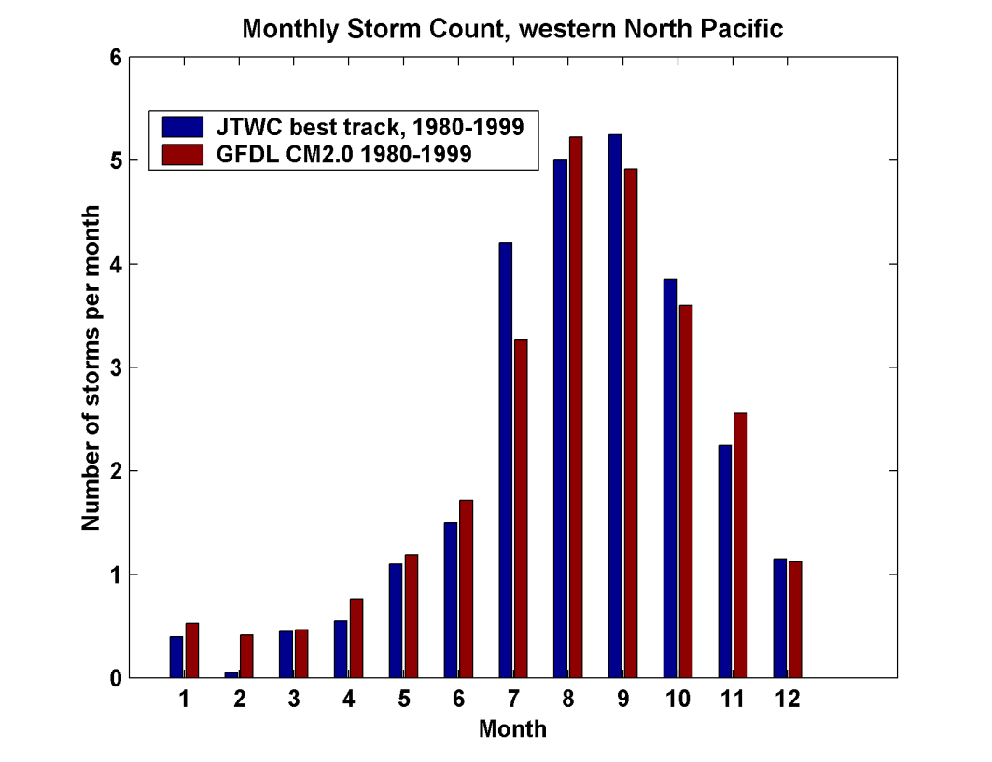
Examples of Annual Cycles of Storm Counts by Month
Western North Pacific
NCAR CCSM3
GFDL CM2.0

Slide 72
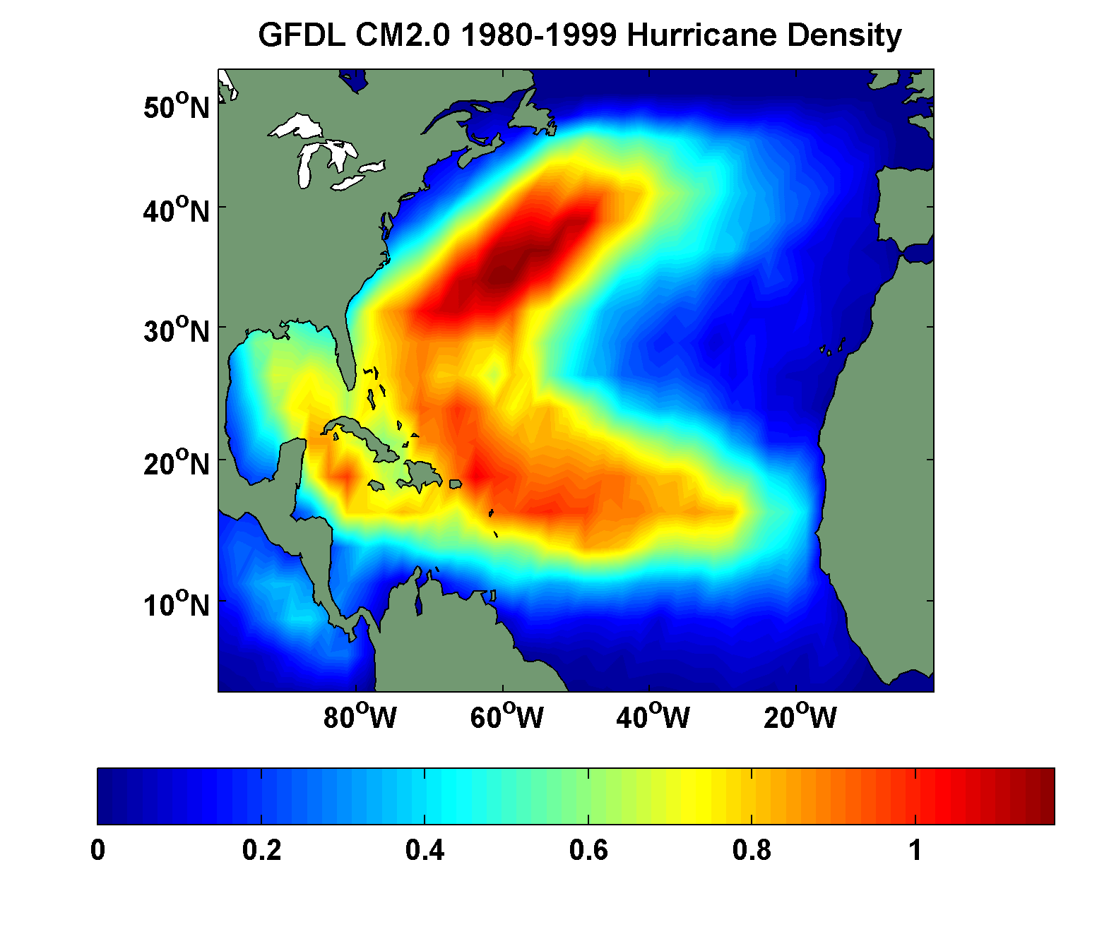
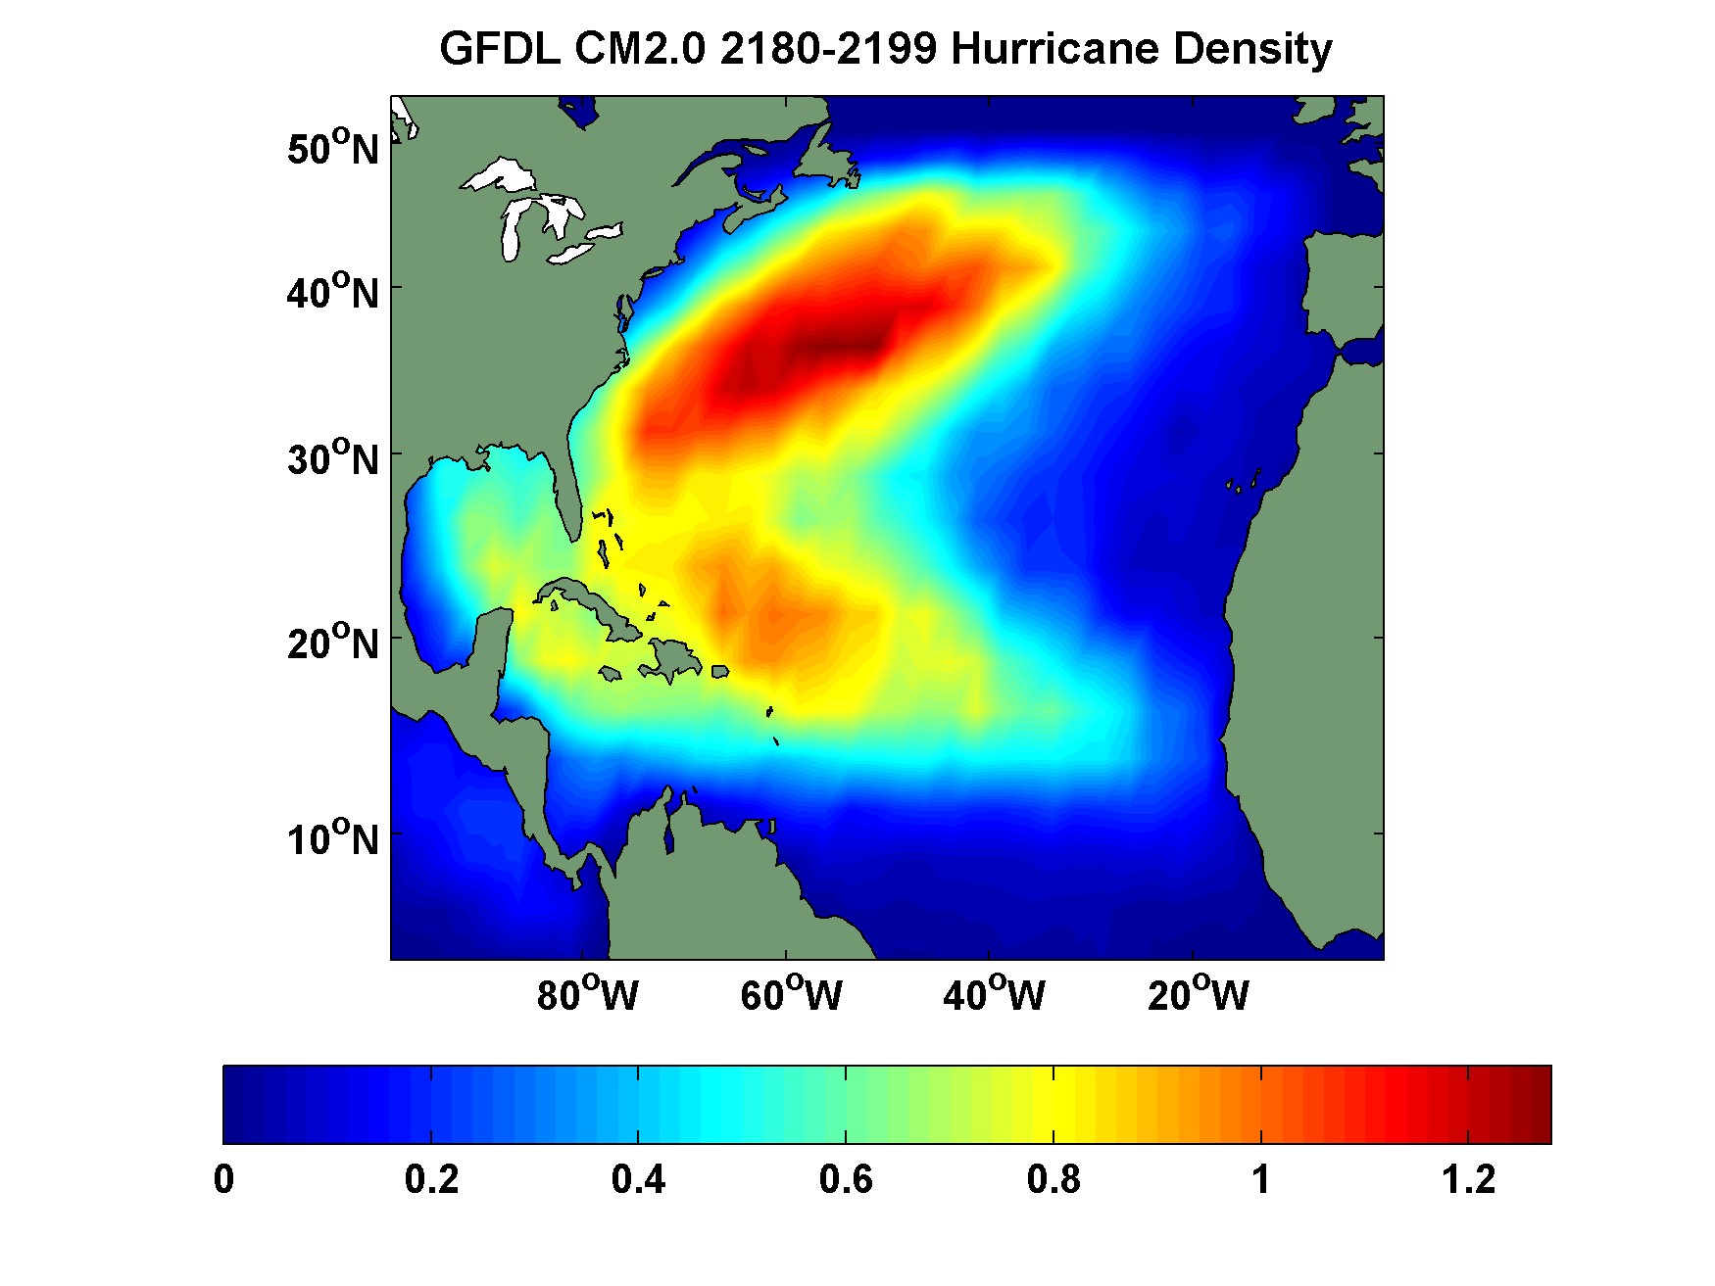
Examples of Shifts in Hurricane Track Density (GFDL CM2.0)
1980-1999
2180-2199

Slide 73


Examples of Shifts in Hurricane Track Density (GFDL CM2.0)
1980-1999
2180-2199

