Slide 1

MIT’s Flood Risk:
Present and Future
Kerry Emanuel
Lorenz Center, MIT
Notes:
1

Slide 2

Program
Brief Overview of New England Floods
Assessment of MIT’s Tropical Cyclone Flood Risk
How will Global Warming Affect MIT Flood Risk?

Slide 3

New England Flooding
Historically, largest floods in New England have been caused by spring rain storms on top of large snow packs, thunderstorms, and tropical cyclones
Charles River susceptible to combination of runoff and storm surge at the Charles River Dam

Slide 4
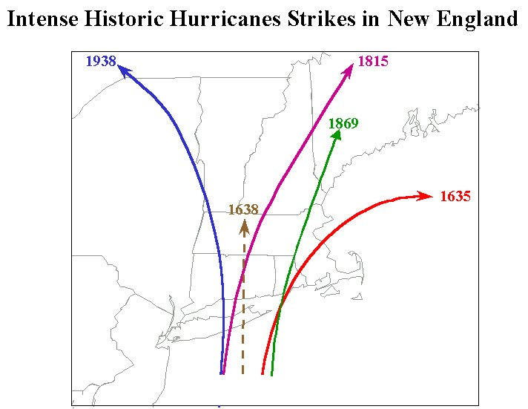
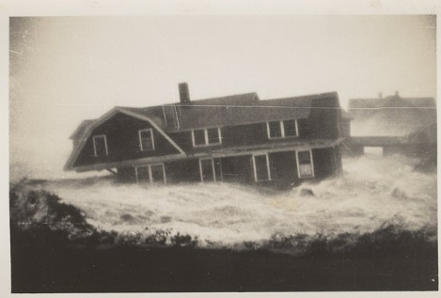
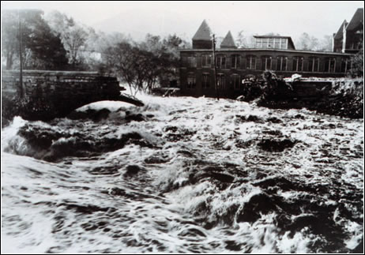
Storm Surge
Inland Flooding from Rain

Slide 5
Limitations of a strictly statistical approach to hurricane risk assessment
>50% of all normalized U.S. hurricane damage caused by top 8 events, all category 3, 4 and 5
>90% of all damage caused by storms of category 3 and greater
Category 3,4 and 5 events are only 13% of total landfalling events; only 30 since 1870
Landfalling storm statistics are inadequate for assessing hurricane risk

Slide 6
Bringing Physics to Bear: Risk Assessment by Direct Numerical Simulation of Hurricanes
The Problem
The hurricane eyewall is an intense, circular front, attaining scales of ~ 1 km or less
At the same time, the storm’s circulation extends to ~1000 km and is embedded in much larger scale flows

Slide 7
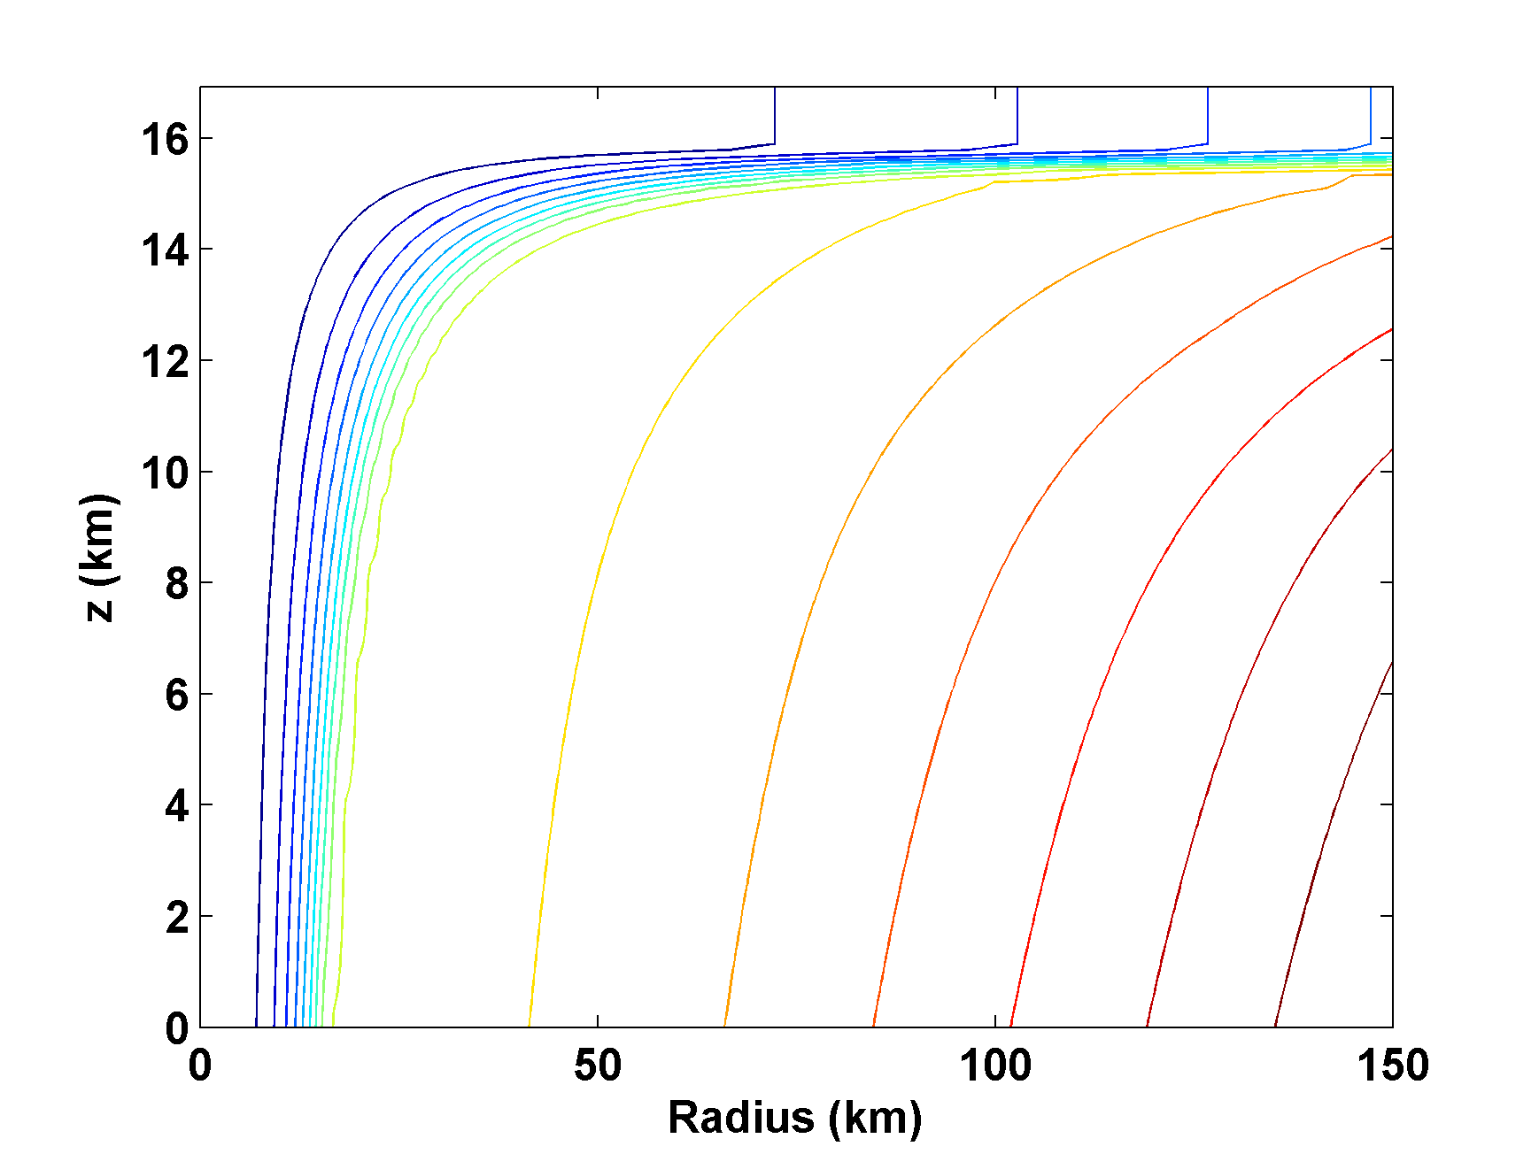
Angular Momentum Distribution
Altitude (km)
Storm Center

Slide 8
Time-dependent, axisymmetric model phrased in R space (CHIPS)
Hydrostatic and gradient balance above PBL
Moist adiabatic lapse rates on M surfaces above PBL
Boundary layer quasi-equilibrium convection
Deformation-based radial diffusion
Coupled to simple 1-D ocean model
Environmental wind shear effects parameterized

Slide 9
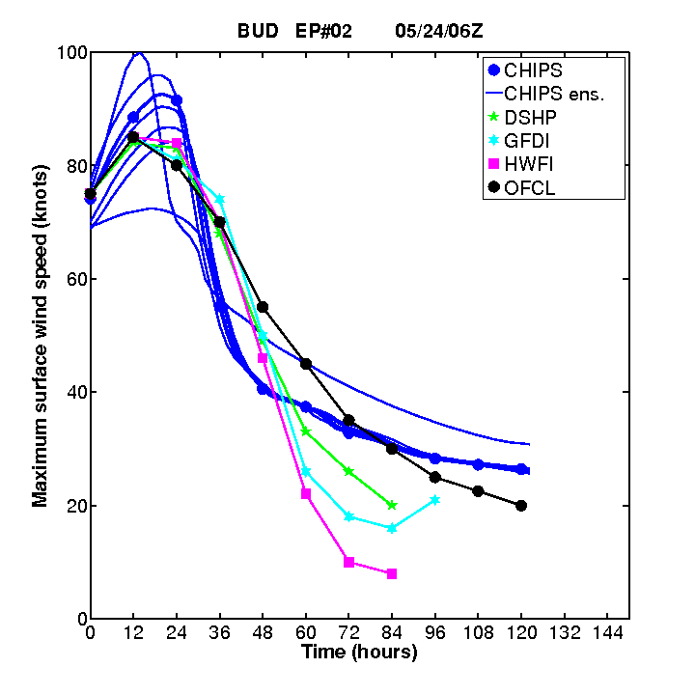
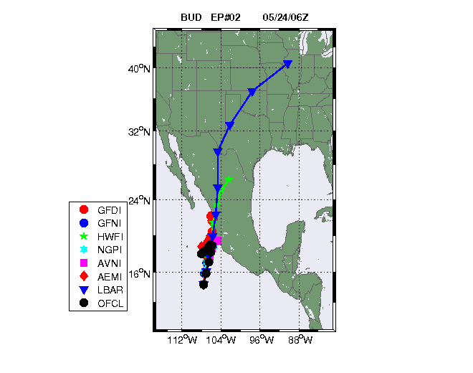
Originally Developed as a Student Laboratory Tool, Later Adapted as a Hurricane Intensity Forecasting Model
(http://wind.mit.edu/~emanuel/storm.html)

Slide 10
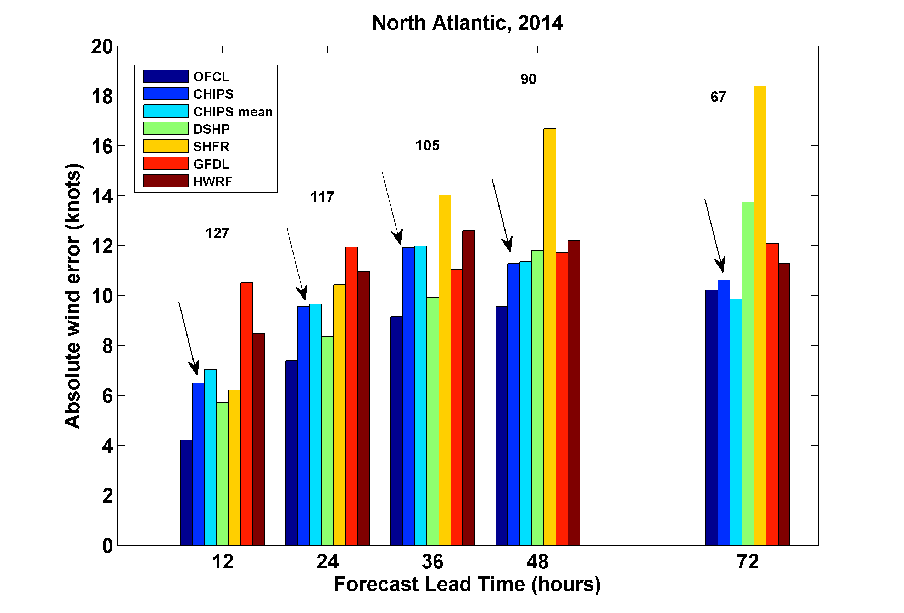

Slide 11
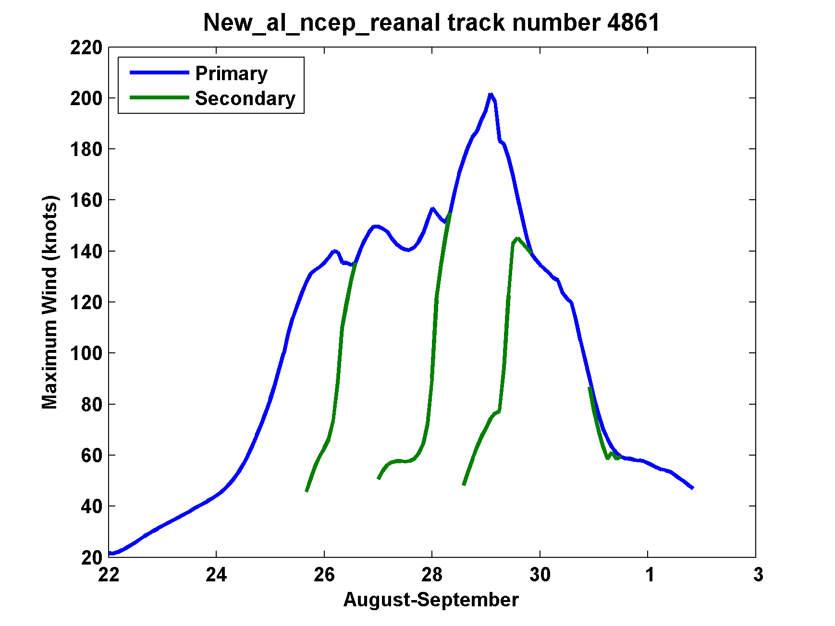
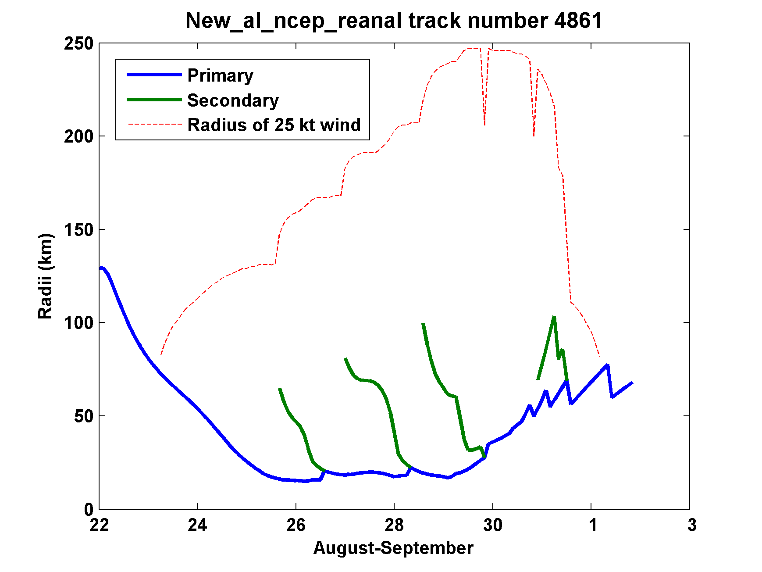
Secondary
eyewalls

Slide 12
How Can We Use This Model to Help Assess Hurricane Wind, Surge, and Rain Risk in Current and Future Climates?

Slide 13
Risk Assessment Approach:
Step 1: Seed each ocean basin with a very large number of weak, randomly located cyclones
Step 2: Cyclones are assumed to move with the large scale atmospheric flow in which they are embedded, plus a correction for beta drift
Step 3: Run the CHIPS model for each cyclone, and note how many achieve at least tropical storm strength
Step 4: Using the small fraction of surviving events, determine storm statistics
Details: Emanuel et al., Bull. Amer. Meteor. Soc, 2008
Notes:
13

Slide 14
Synthetic Track Generation:
Generation of Synthetic Wind Time Series
Postulate that TCs move with vertically averaged environmental flow plus a “beta drift” correction
Approximate “vertically averaged” by weighted mean of 850 and 250 hPa flow

Slide 15
Synthetic wind time series
Monthly mean, variances and co-variances from re-analysis or global climate model data
Synthetic time series constrained to have the correct monthly mean, variance, co-variances and an ω⁻³ power series

Slide 16
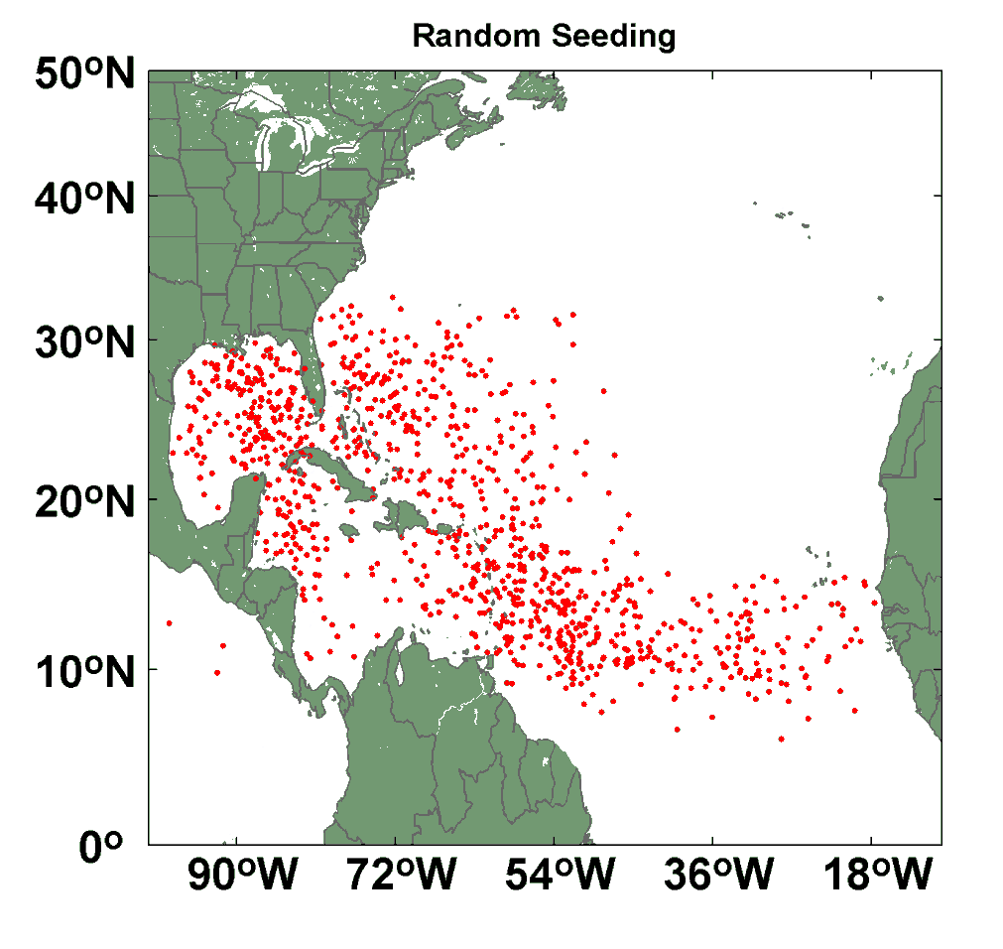
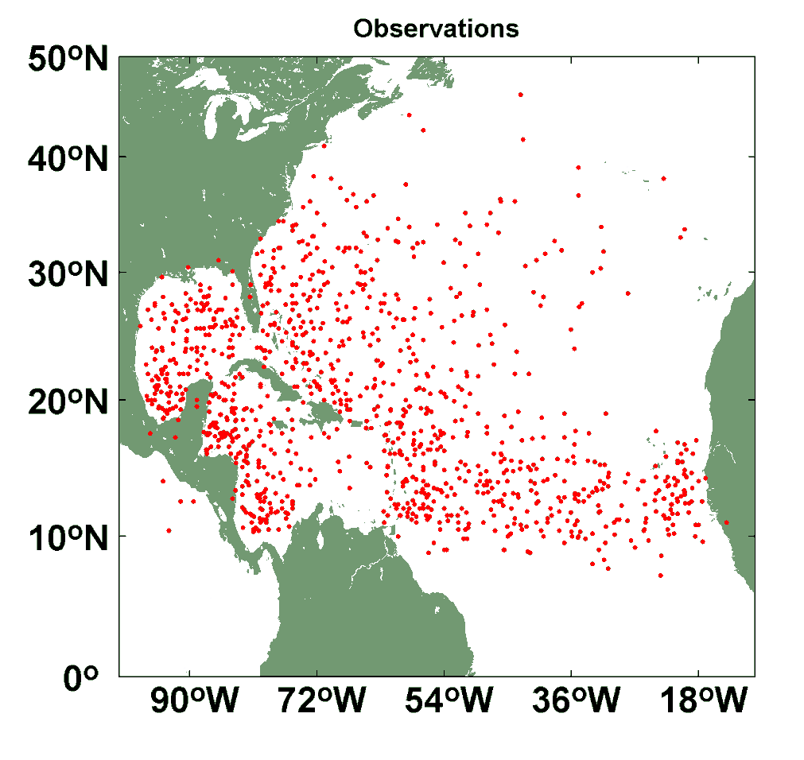
Comparison of Random Seeding Genesis Locations with Observations

Slide 17
Calibration
Absolute genesis frequency calibrated to globe during the period 1980-2005
Notes:
17

Slide 19
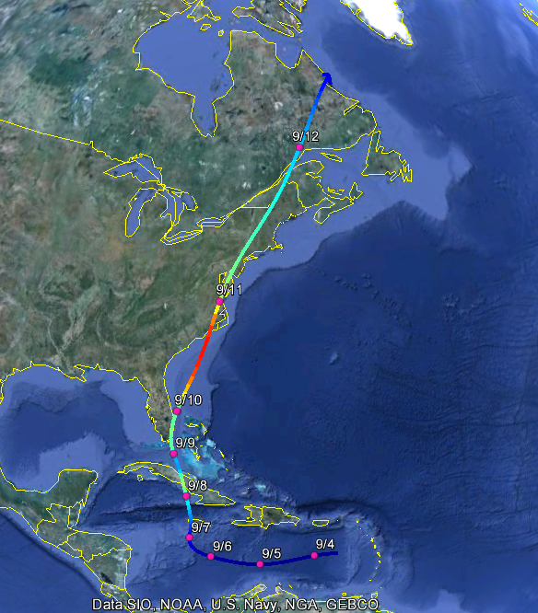
Example: Hurricane affecting New York City

Slide 20
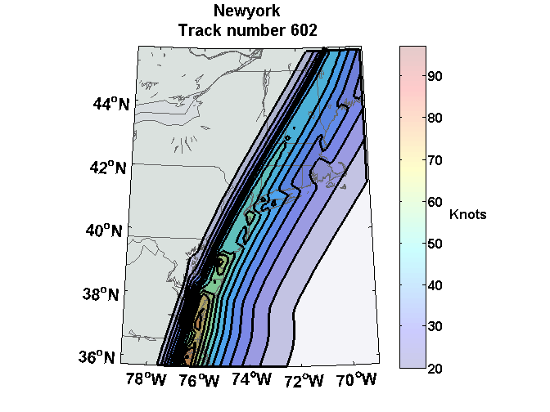
Wind Swath

Slide 21

Return Periods

Slide 22

Captures effects of regional climate phenomena (e.g. ENSO, AMM)

Slide 23


Storm Surge Simulation (Ning Lin)
SLOSH model
(Jelesnianski et al. 1992)
SLOSH mesh
~ 10³ m
ADCIRC mesh
~ 10² m
Battery
ADCIRC model
(Luettich et al. 1992)
ADCIRC mesh
~ 10 m
(Colle et al. 2008)
Notes:
Given the storm wind and pressure fields (which is estimated from the Holland parametric pressure model) we can simulate the surge. Surge simulations with high resolution are computationally intensive, so to make it possible to simulate accurate surges for our large synthetic storm sets, we apply the two hydrodynamic models with girds of various resolutions in such a way that the main computational effort is concentrated on the storms that determine the risk. First, we apply the SLOSH model, using a mesh with resolution of about 1 km around NYC to simulate the surges for all storms and select the storms that have return periods, in terms of the surge height at the Battery, greater than 10 years. Second, we apply the ADCIRC simulation, using a grid mesh with resolution of ~100 m around NYC, to each of the selected storms. Then, we apply another ADCIRC mesh with resolution as high as ~10 m around NYC, for a set of the most extreme events, to check if the resolution of our ADCIRC grid is sufficient and if needed to make statistical correction to the results.

Slide 24
Surge Return Periods for The Battery, New York
Sandy

Slide 25
Predicting Rainfall
The CHIPS models predicts updraft and downdraft convective mass flux as a function of time and potential radius, BUT:
Storing these variables at all radii would increase overall storage requirements by a factor of ~50

Slide 26
For the purposes of producing detailed wind fields, we fit canonical radial wind profiles to predicted values of V_{max} and r_{max}, and add a constant background wind. Can we use this information to determine rainfall?

Slide 27
First calculate vertical motion in middle troposphere from time-dependent azimuthal gradient wind. Four components:
Vertical motion at the top of the boundary layer owing to frictional effects within the boundary layer. This is estimated using a slab boundary layer model forced by the model gradient wind as well as the low-level environmental wind used as an input to the storm synthesizer.
Vertical motion at the top of the boundary layer forced by topography interacting with the combination of storm and environmental flow.

Slide 28
Vertical stretching between the top of the boundary layer and the middle troposphere associated with changes in the vorticity of the (axisymmetric) gradient wind.
Mid-tropospheric vertical motion caused by the dynamical interaction of the axisymmetric vortical flow and the background shear/horizontal temperature gradient.

Slide 29
Given mid-tropospheric vertical motion, rainfall is calculated by assuming ascent along a moist adiabat, calculated using the environmental 600 hPa temperature.

Slide 30
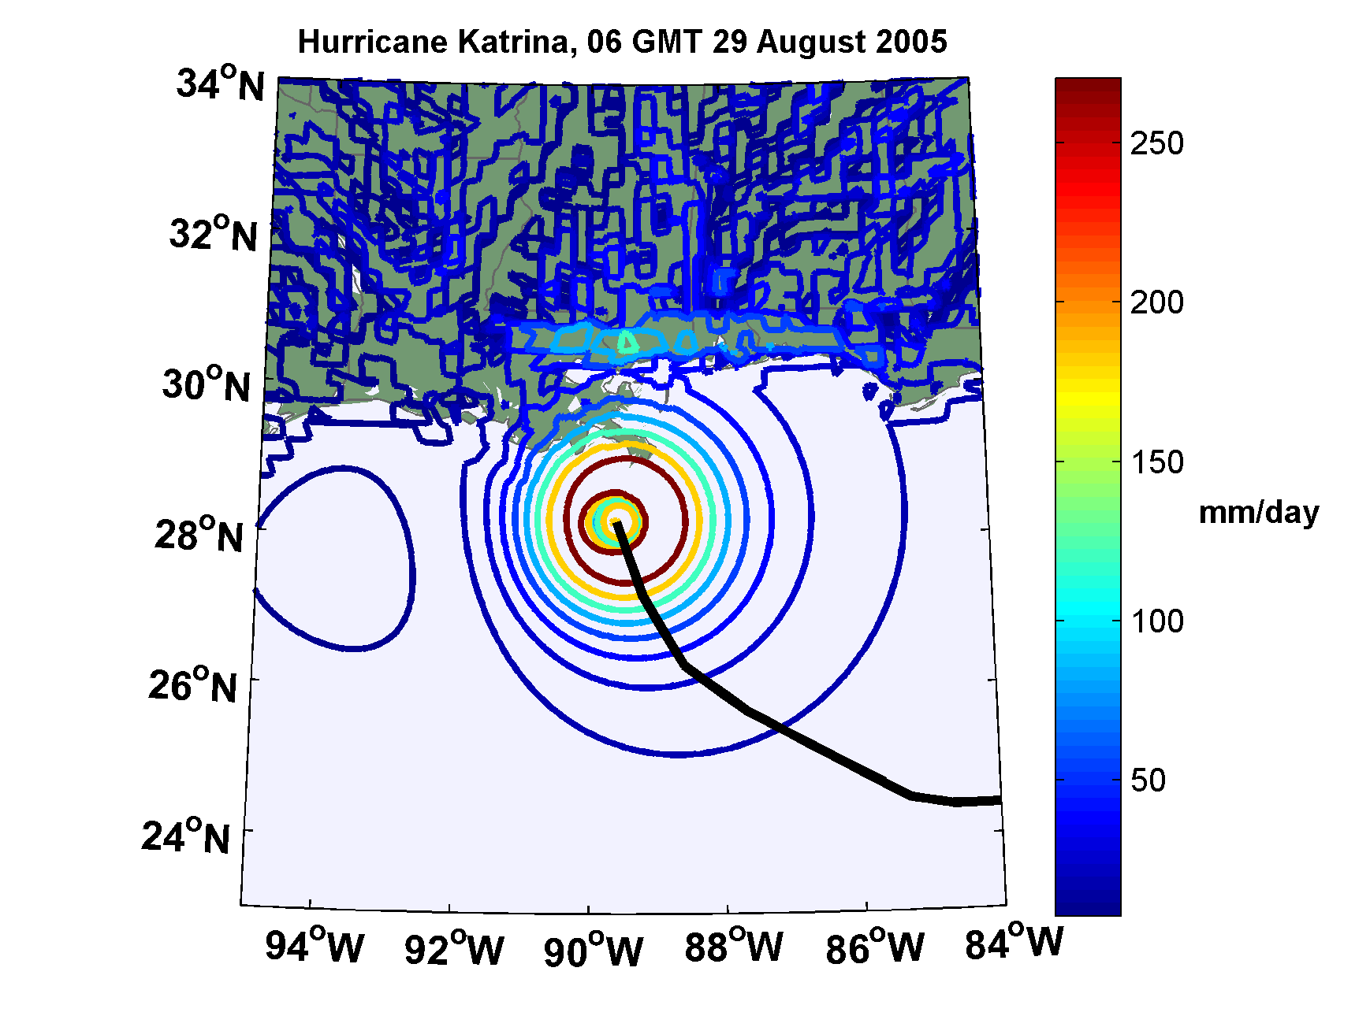
Some results
Instantaneous rainfall rate (mm/day) associated with Hurricane Katrina at 06 GMT 29 August 2005 predicted by the model driven towards Katrina’s observed wind intensity along its observed track

Slide 31
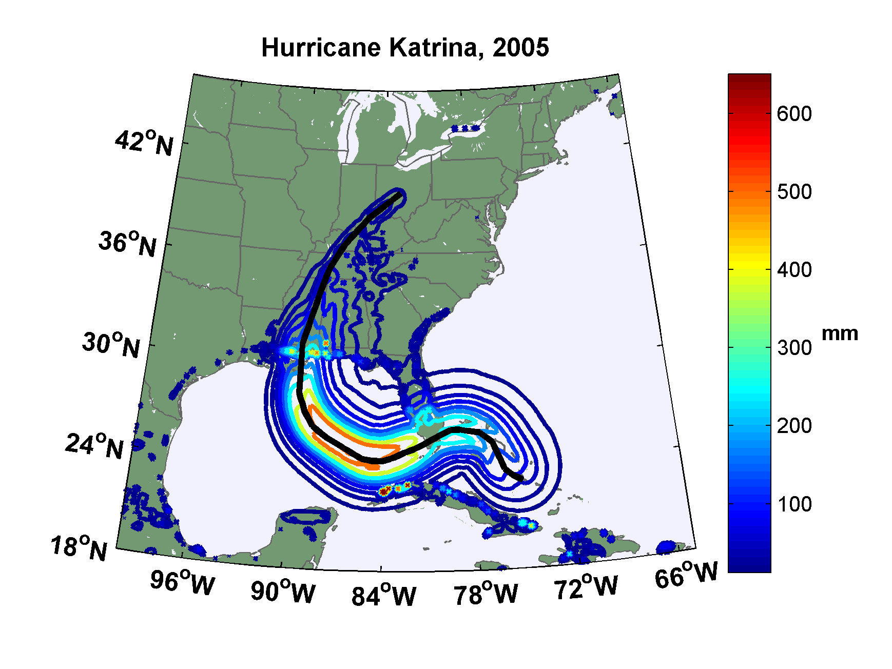
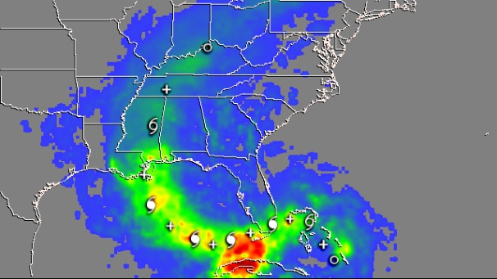
Observed (left) and simulated storm total rainfall accumulation during Hurricane Katrina of 2005. The plot at left is from NASA’s Multi-Satellite Precipitation Analysis, which is based on the Tropical Rainfall Measurement Mission (TRMM) satellite, among others. Dark red areas exceed 300 mm of rainfall; yellow areas exceed 200 mm, and green areas exceed 125 mm

Slide 32
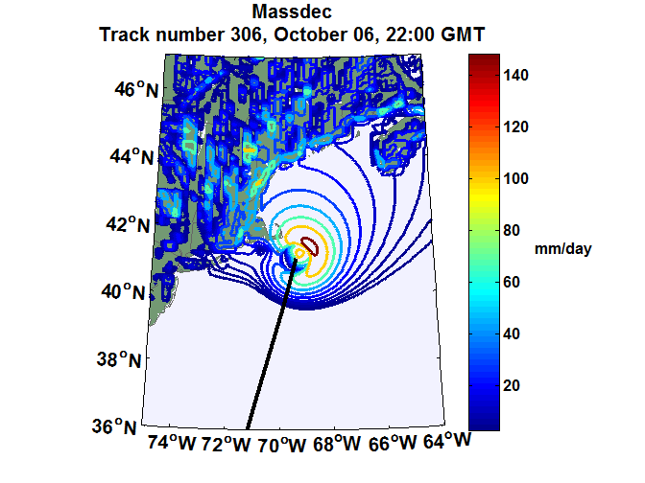
Example showing baroclinic and topographic effects

Slide 33
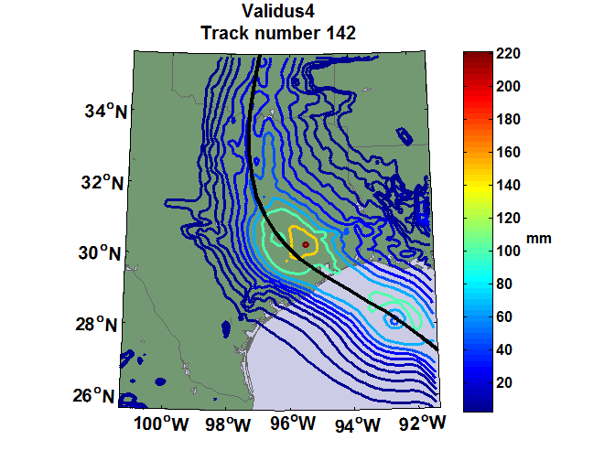

Slide 34
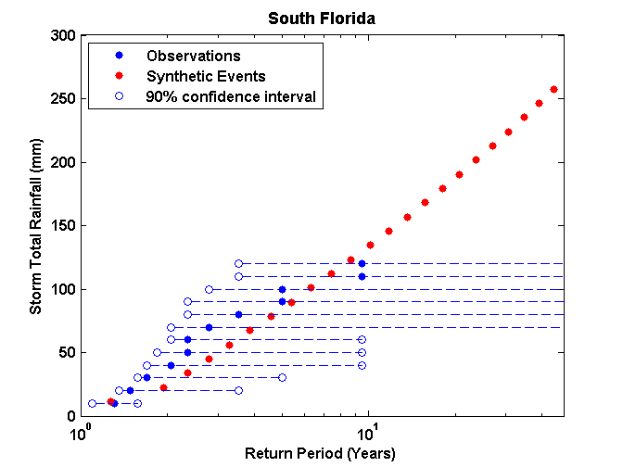
Comparison to inferences based on NEXRAD data
(work of Casey Hilgenbrink)

Slide 35
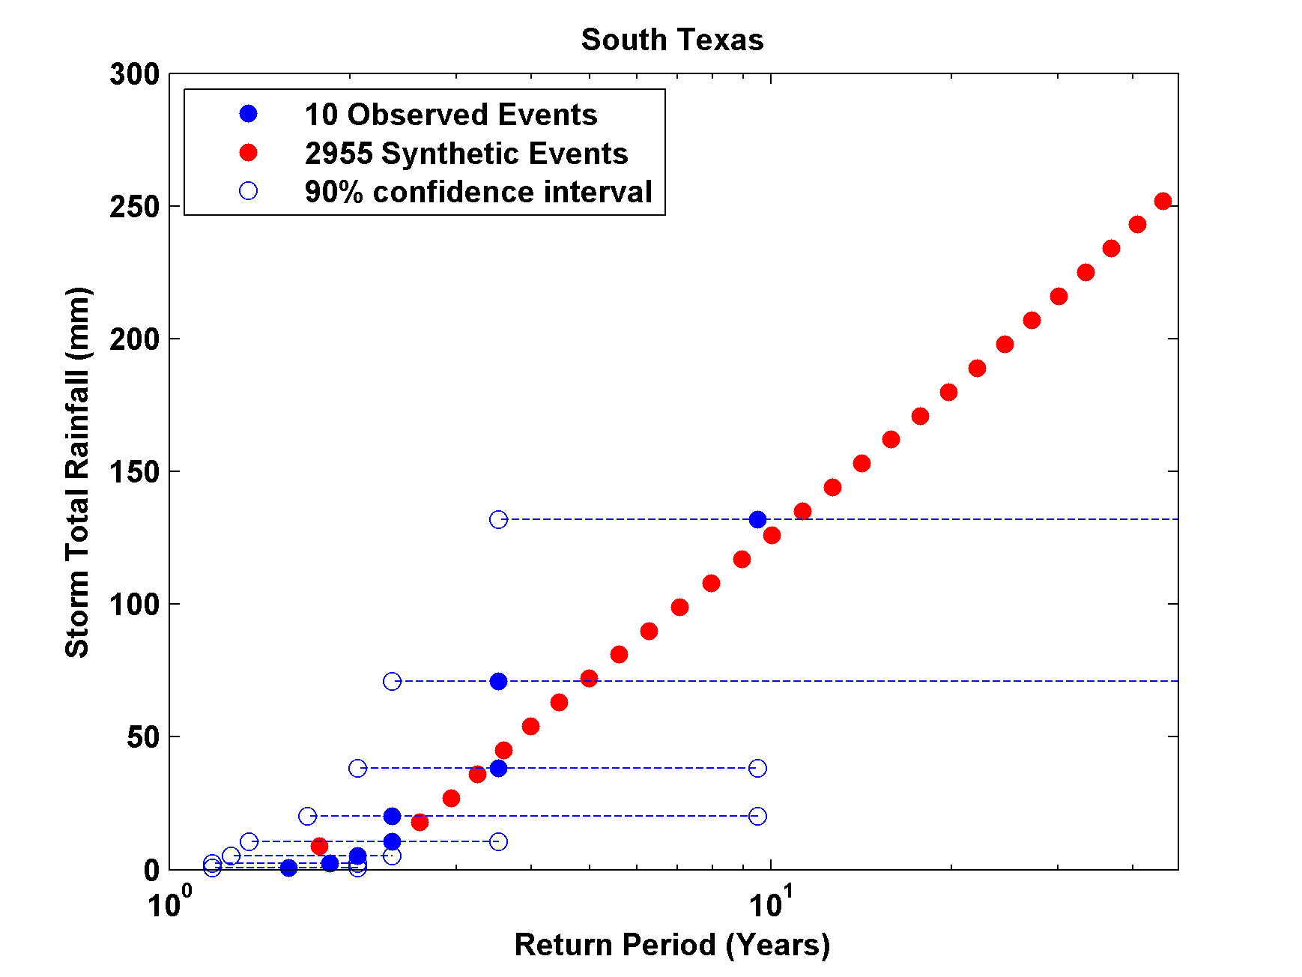

Slide 36
Effects of Climate Change
More moisture in boundary layer
Stronger storms but more compact inner regions
Possibly larger storm diameters

Slide 37

M
M
M
q=q_{b}

Slide 38
Global warming leads to fewer but heavier rain events. Rain intensity in the tropics goes up with Clausius-Clapeyron.
(Global mean precipitation rises much more slowly.)

Slide 39
Downscaling of AR5 GCMs
CCSM4
GFDL-CM3
HadGEM2-ES
IPSL CM5A-LR
MPI-ESM-MR
MIROC-5
MRI-CGCM3
Historical: 1950-2005, RCP8.5 2006-2100

Slide 40

GCM flood height return level, Battery, Manhattan
(assuming SLR of 1 m for the future climate )
Black: Current climate (1981-2000)
Blue: A1B future climate (2081-2100)
Red: A1B future climate (2081-2100) with R₀ increased by 10% and R_{m} increased by 21%
Lin, N., K. Emanuel, M. Oppenheimer, and E. Vanmarcke, 2012: Physically based assessment of hurricane surge threat under climate change. Nature Clim. Change, doi:10.1038/nclimate1389
Notes:
Then we calculate the flood height (including surge, tide, and sea level rise) return level for the four climate models, assuming a sea level rise of 1 m for the future climate, for the Battery, NYC. These results show that the combined effects of storm climatology change and sea level rise will greatly shorten the flood return periods for NYC and, by the end of the century, the current 100-year surge flooding may happen less than every 30 years, with CNRM and GFDL prediction to be less than 10 years, and the 500-year flooding may happen less than every 200 years, with the CNRM and GFDL prediction to be 20-30 years.

Slide 41
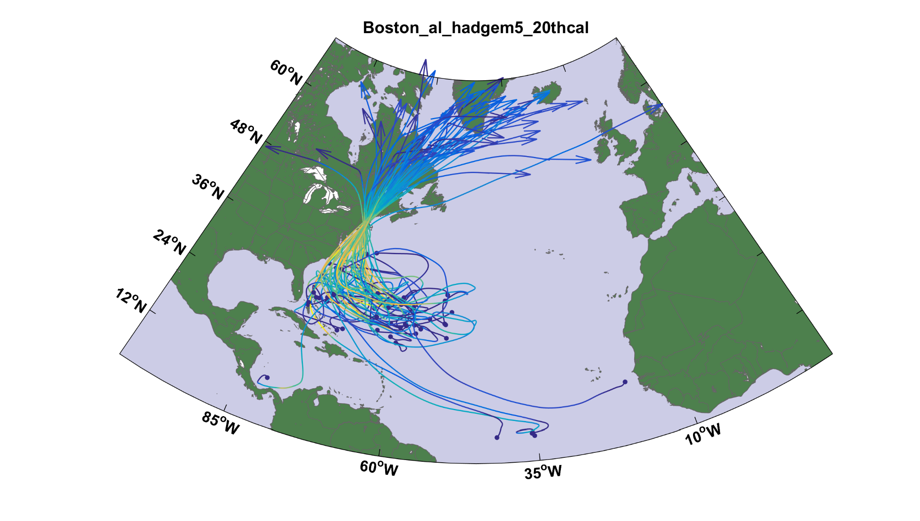
Top 50 of 5,000 events affecting Boston

Slide 42
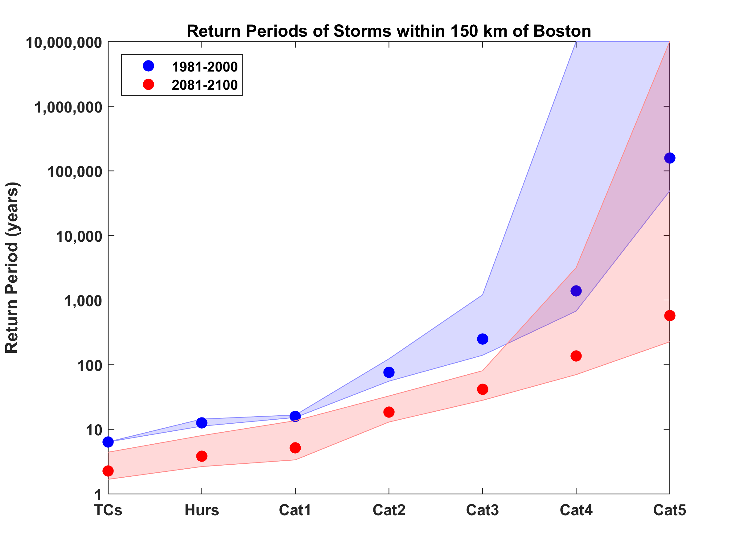
Hurricanes Passing within 150 km of Boston
Downscaled from 5 climate models

Slide 43
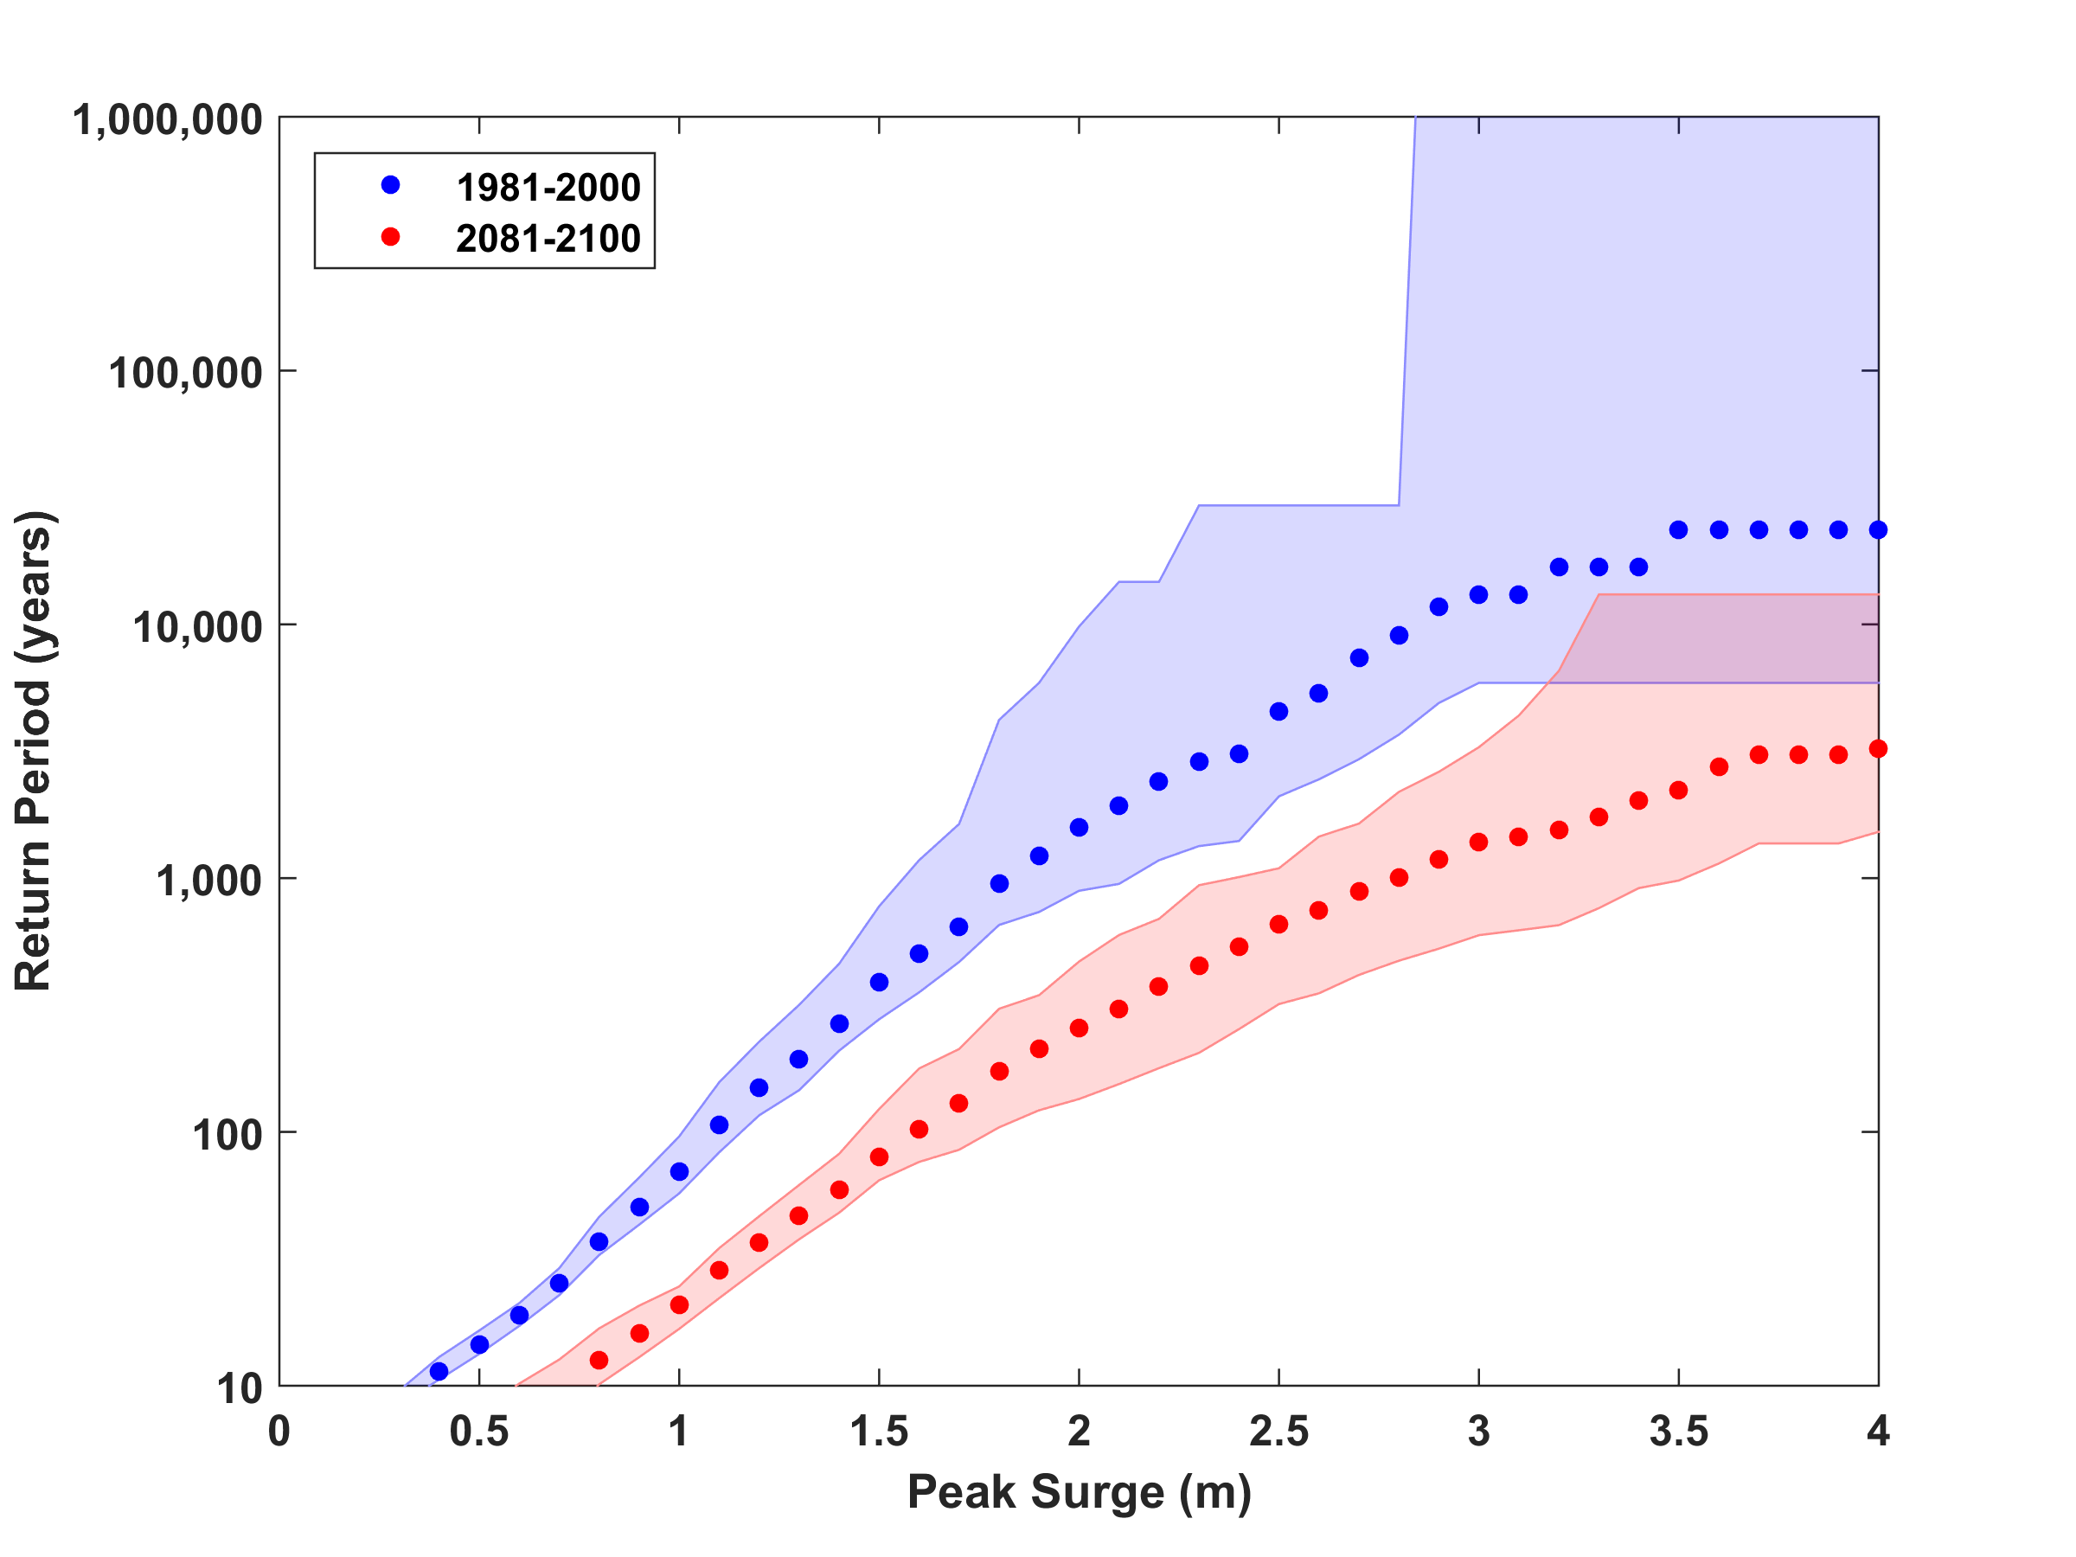
Surge Risk

Slide 45
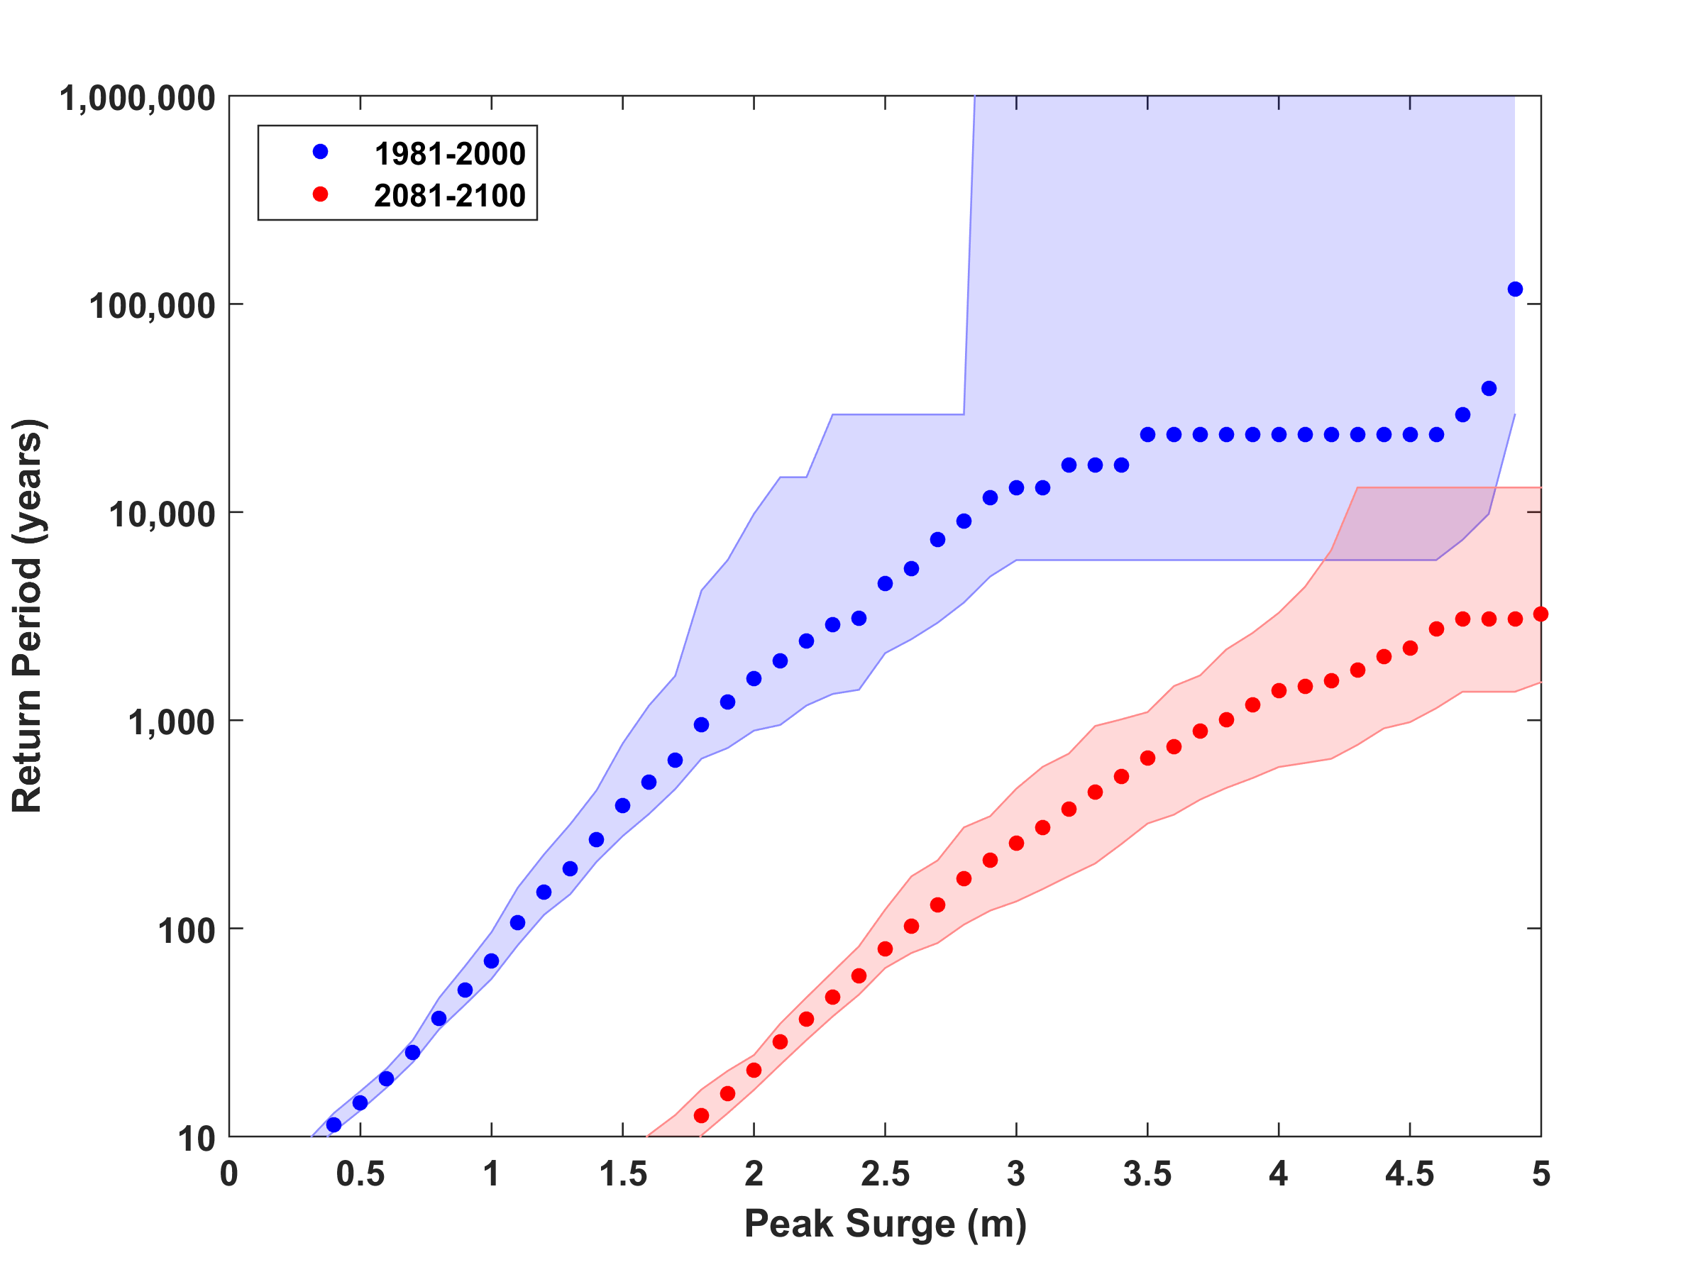
Surge Risk with 1 meter sea level rise

Slide 46
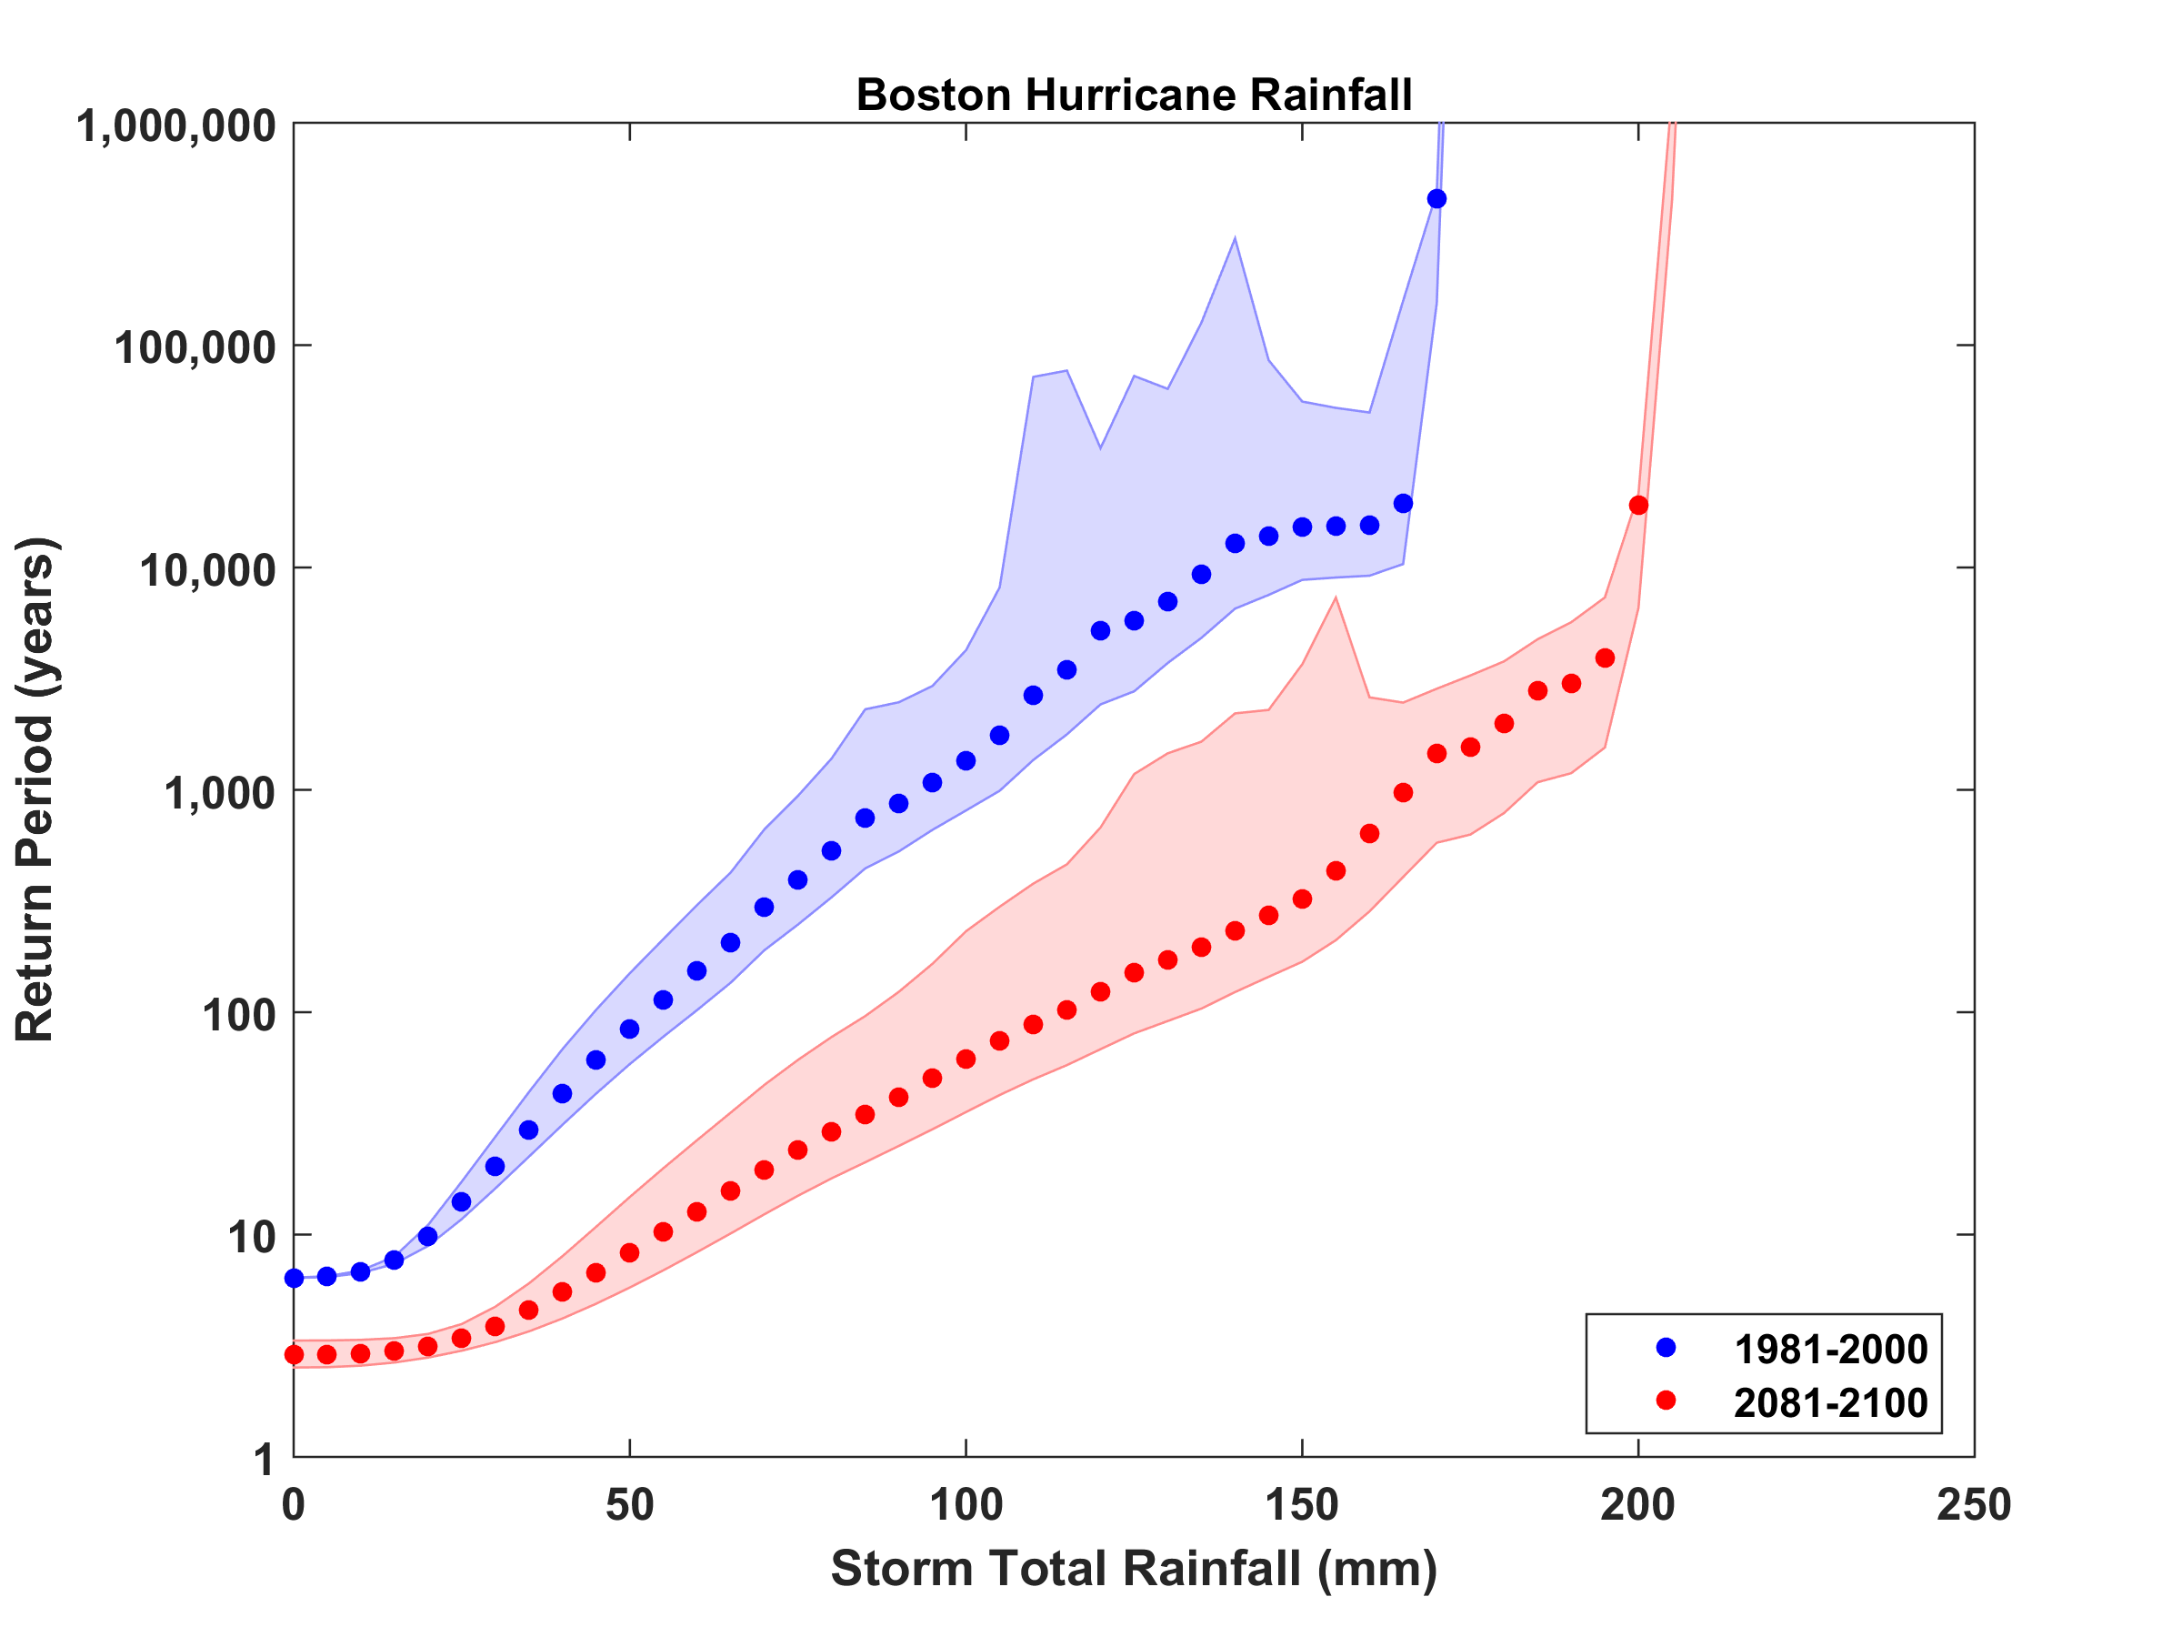
Rain Risk

Slide 47
Sea level rise + changing storms
Sea level rise alone
From: American Climate Prospectus Economic Risks in the United States

Slide 48
Summary
New England history is too short, sparse, and imperfect to estimate MIT’s hurricane risk
Better estimates can be made by downscaling hurricane activity from climatological or global model output
New England hurricanes clearly vary with climate and there is a decided risk that hurricane threats will increase over this century

Slide 49
Spares

Slide 50
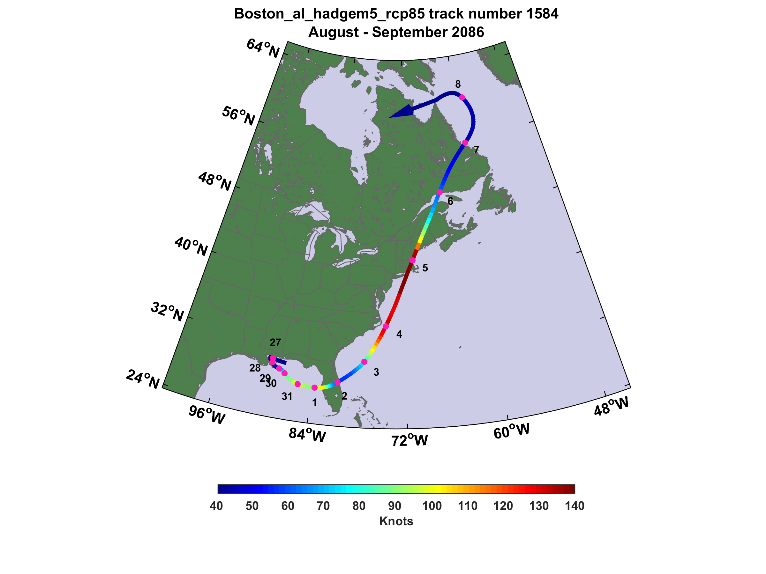

Slide 51
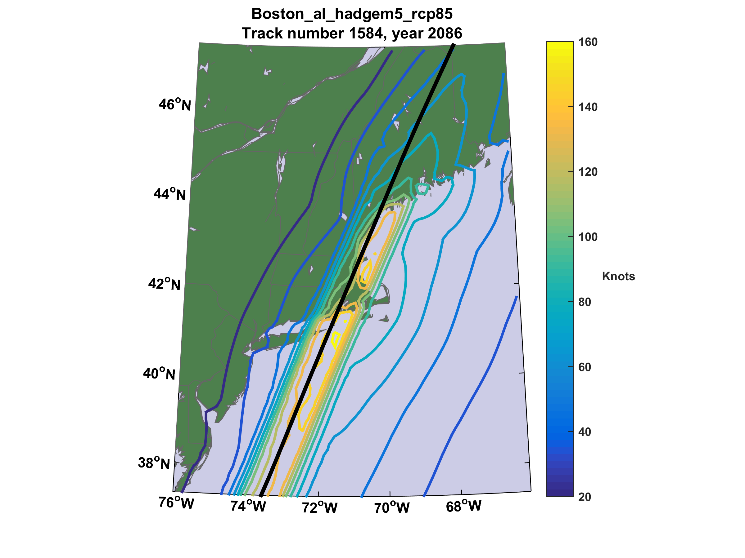

Slide 52
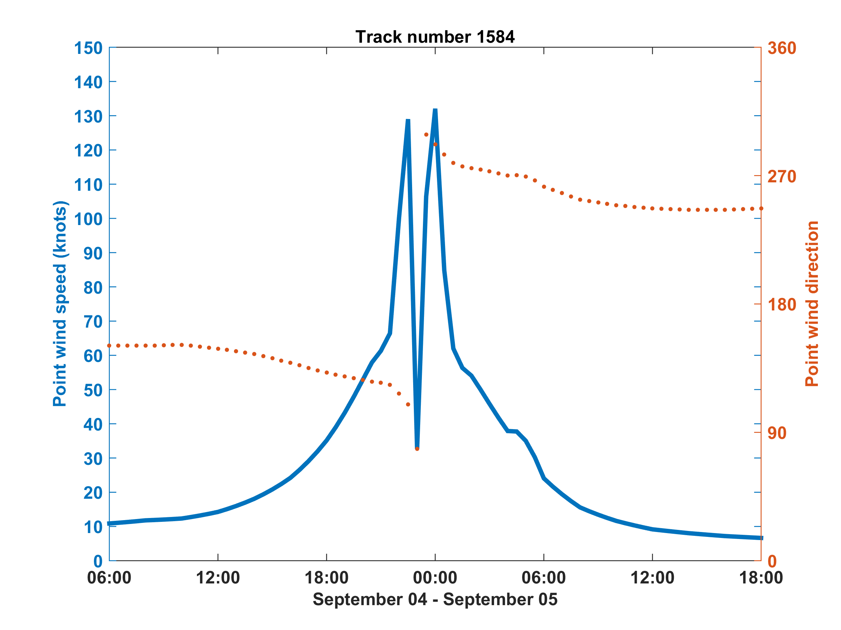
Wind speed and direction at Logan Airport

