Slide 1
Climate Change and What it Means for Massachusetts
Kerry Emanuel
Massachusetts Institute of Technology

Slide 2
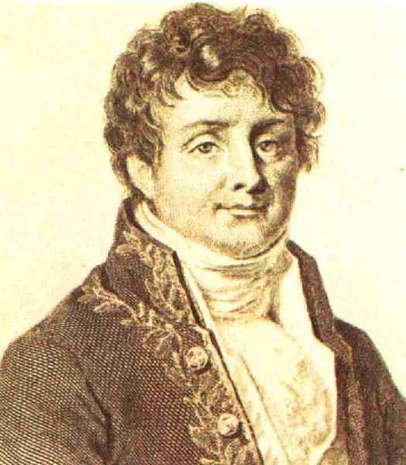
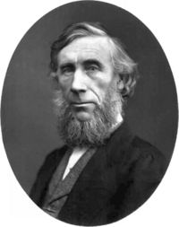
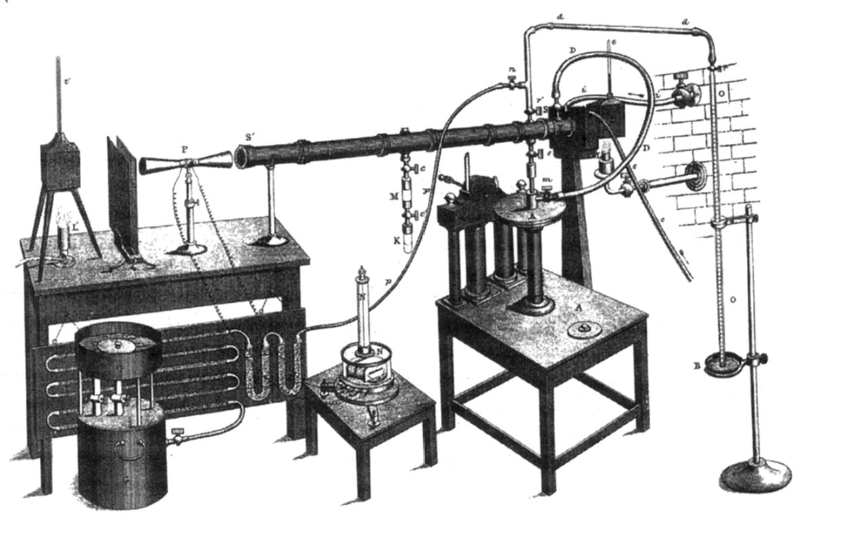
A Little History
Jean Baptiste Joseph Fourier
(1768-1830)
John Tyndall (1820-1893)

Slide 3
Tyndall’s Essential Results:
Oxygen (O₂ ) and nitrogen (N₂), though they make up ~98% of the atmosphere, are almost entirely transparent to solar and terrestrial radiation
Water vapor (H₂O), carbon dioxide (CO₂), nitrous oxide (N₂O), and a handful of other trace gases make the lower atmosphere nearly opaque to infrared radiation, though still largely transparent to solar radiation (but clouds have strong effects on radiation at all wavelengths)

Slide 4
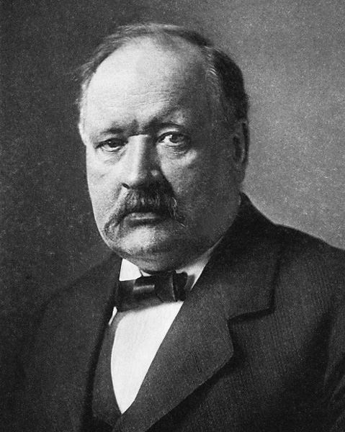
Svante Arrhenius, 1859-1927
Arrhenius was the first to suggest that fossil fuel combustion would lead to appreciable increases in atmospheric CO₂. In 1896, he estimated that doubling CO₂ would increase global temperatures by 5-6ºC.

Slide 5
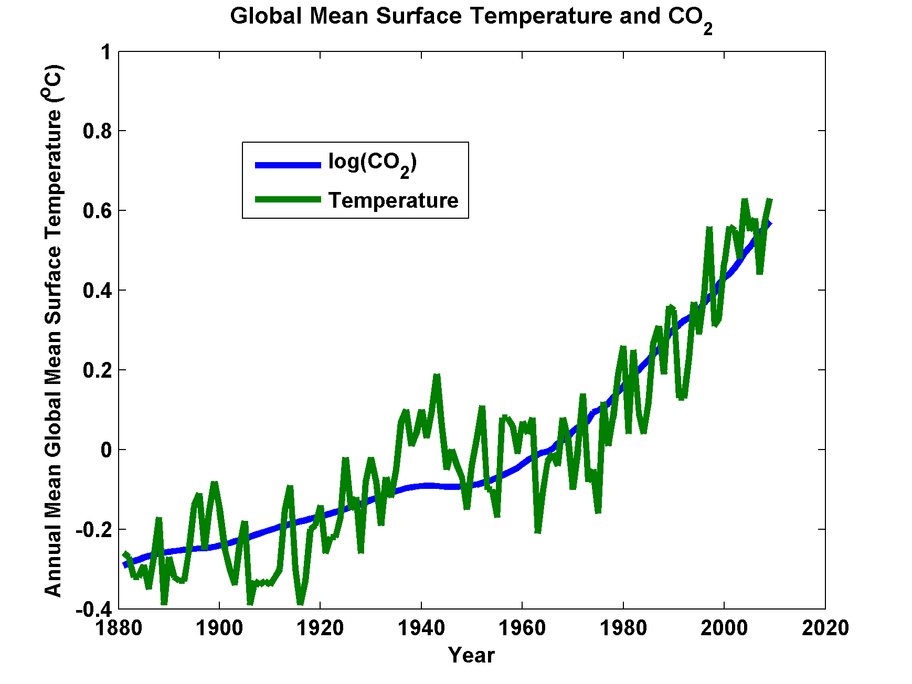

Slide 6
What Does This Mean for Weather?

Slide 7
Heat Waves
© 2007 Geo Risks Research, Munich Re
Mortality and heat stress (8. August 2003, 13 UTC)
Summer 2003,
greatest natural disaster
in Europe
ca. 35.000 fatalities
2,000 †
2,000 †
Heat Stress
7,000 †
extreme
15,000 †
high
moderate
slight
4,000 †
leicht
mäßig
hoch
1,500 †
Mortality data: Earth Policy Institute Heat Stress: Deutscher Wetterdienst
4,000 †
extrem
Kältestress

Slide 8
Heat Waves
2060s
observations
HadCM3 Medium-High (SRES A2)
2040s
2003
Temperature anomaly (wrt 1961-90) °C

Slide 9
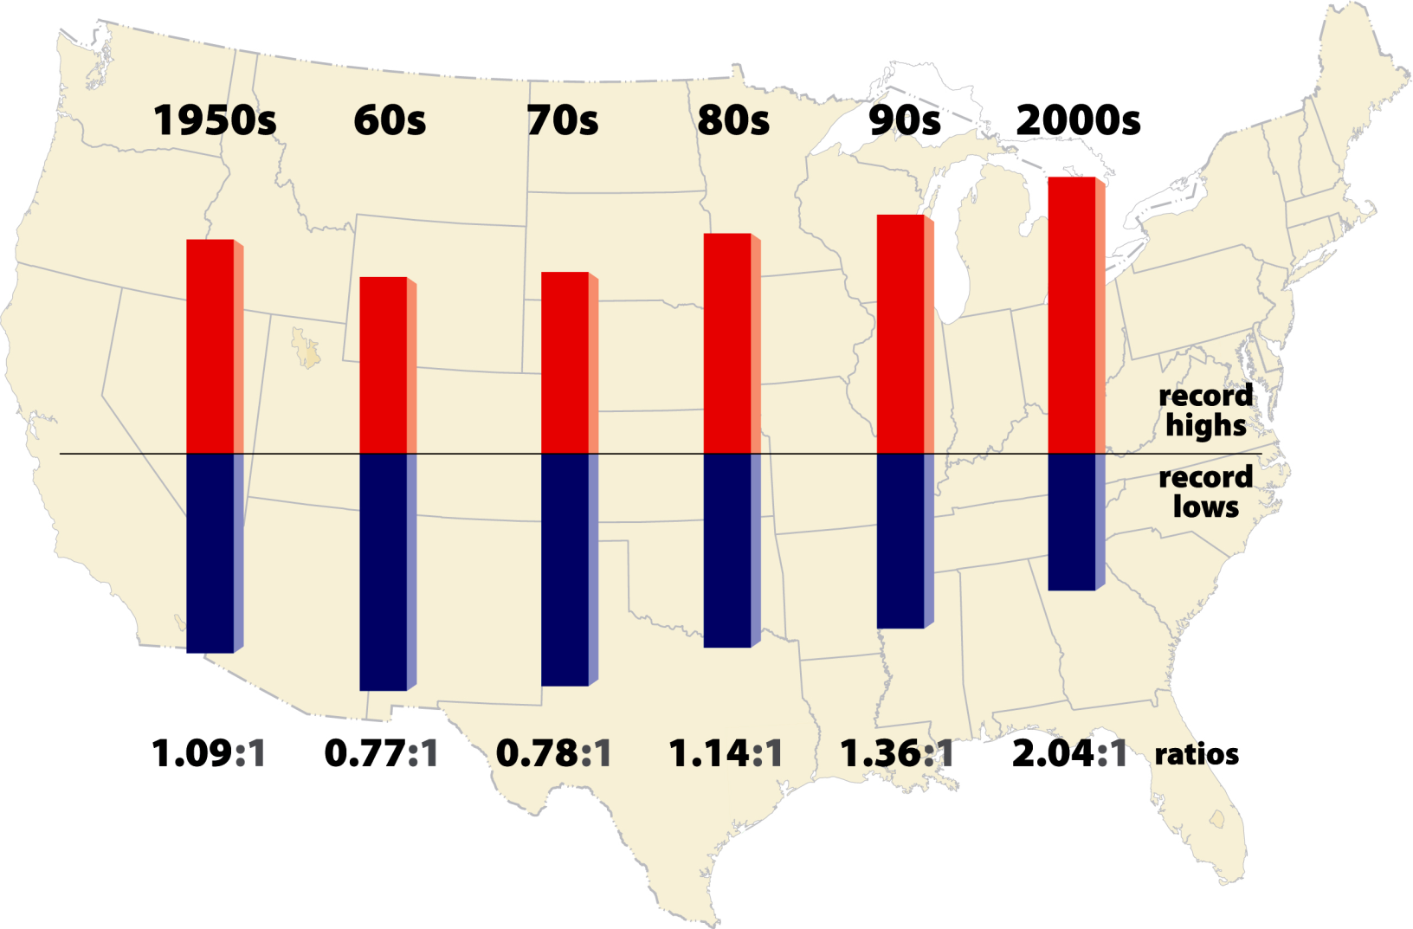
High vs Low Temperature Records
2011- 2.7:1

Slide 10
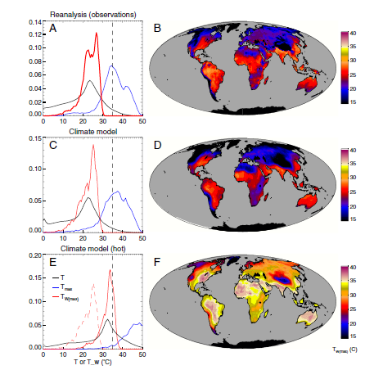
Sherwood and Huber, PNAS, 2010
Adaptation Limit:
Maximum Tolerable Wet Bulb Temperature
12º increase in mean global T

Slide 11
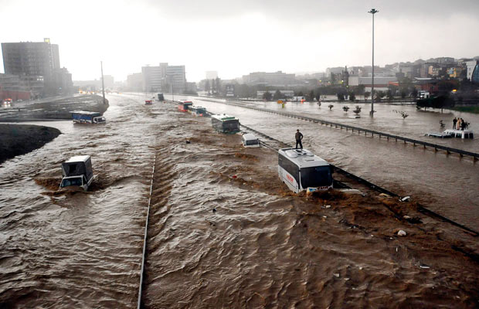
Hydrological Extremes Increase with Temperature
Floods

Slide 12
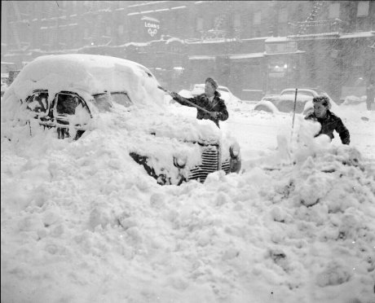
Blizzards

Slide 13
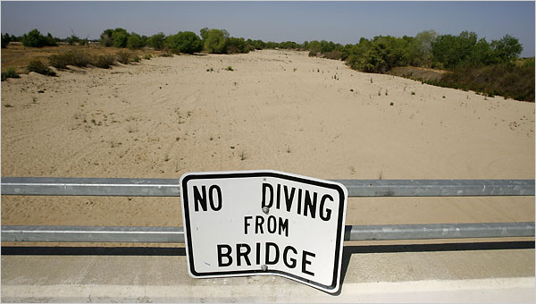
Drought

Slide 14
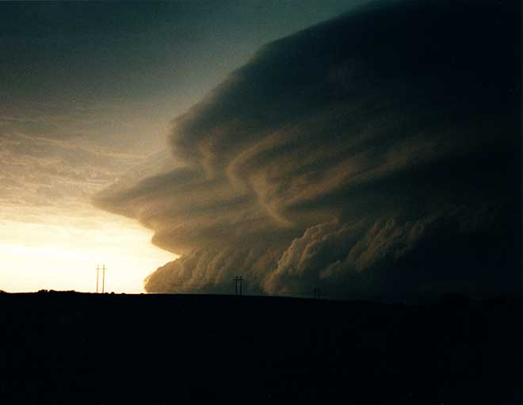
Severe Thunderstorms

Slide 15
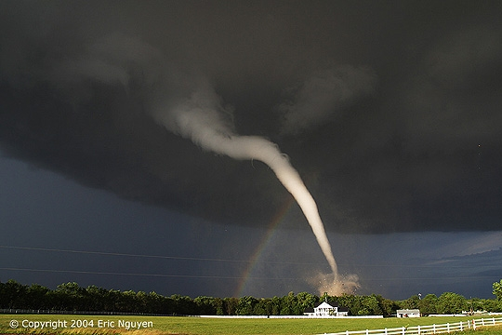
Tornadoes

Slide 16
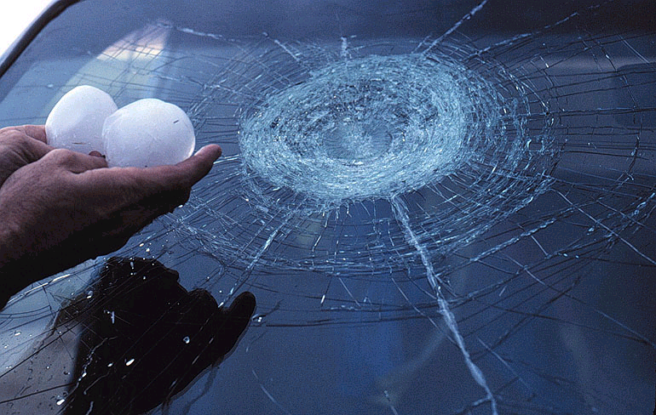
Hail Storms

Slide 17
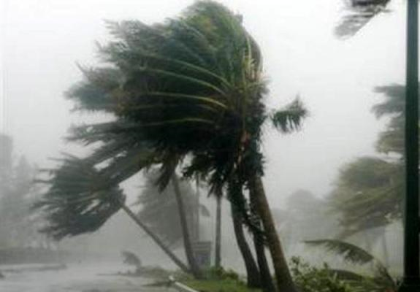
Hurricanes

Slide 18
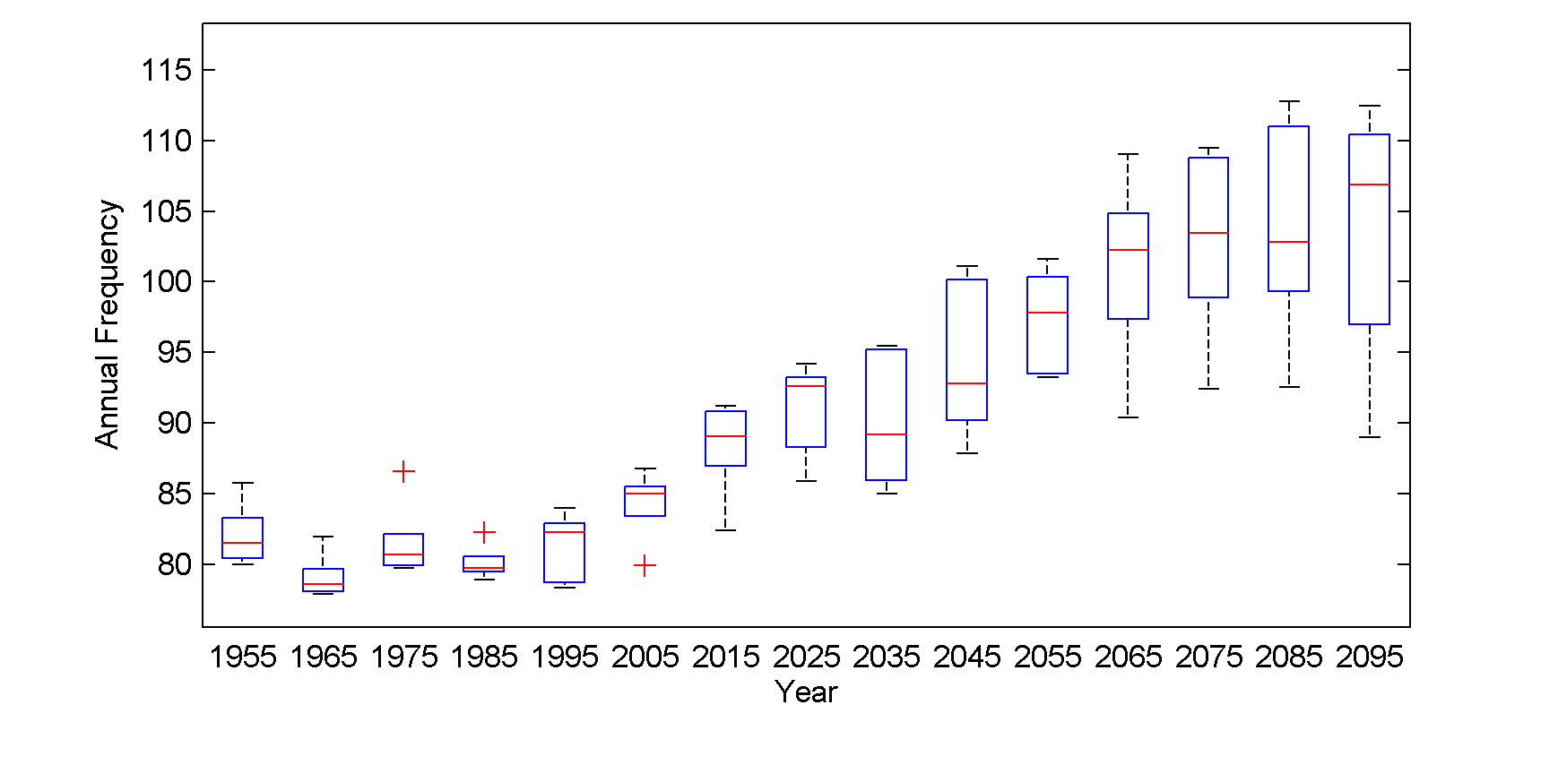
Global annual frequency of tropical cyclones averaged in 10-year blocks for the period 1950-2100, using historical simulations for the period 1950-2005 and the RCP 8.5 scenario for the period 2006-2100. In each box, the red line represents the median among the 5 models, and the bottom and tops of the boxes represent the 25th and 75th percentiles, respectively. The whiskers extent to the most extreme points not considered outliers, which are represented by the red + signs. Points are considered outliers if they lie more than 1.5 times the box height above or below the box.

Slide 19
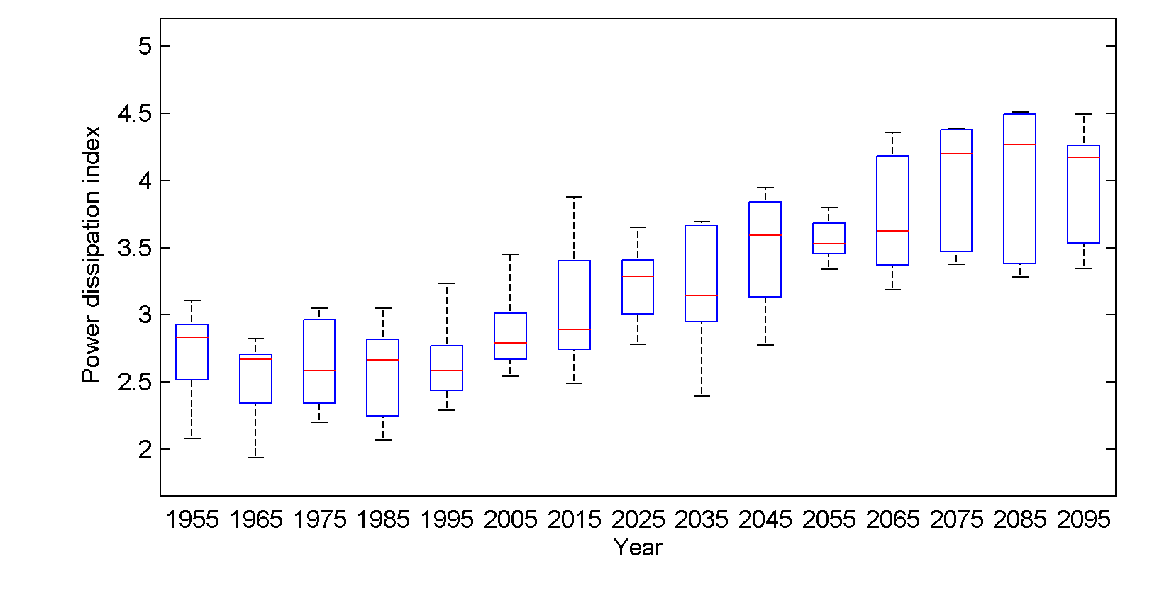
Global Tropical Cyclone Power Dissipation

Slide 20
Global Warming Effects:
Increase in storm intensity
Increase in tropical moisture
Increase in wind and storm surge damage
Increase in incidence of hurricane-induced freshwater floods

Slide 21
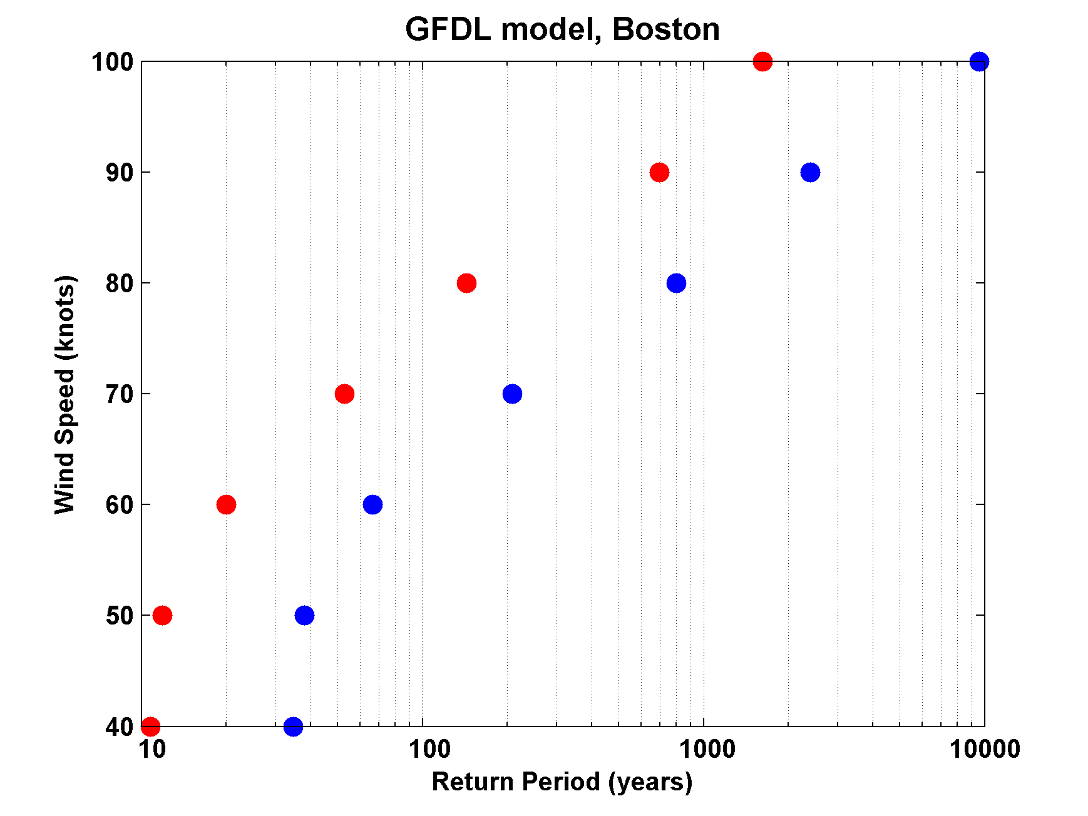
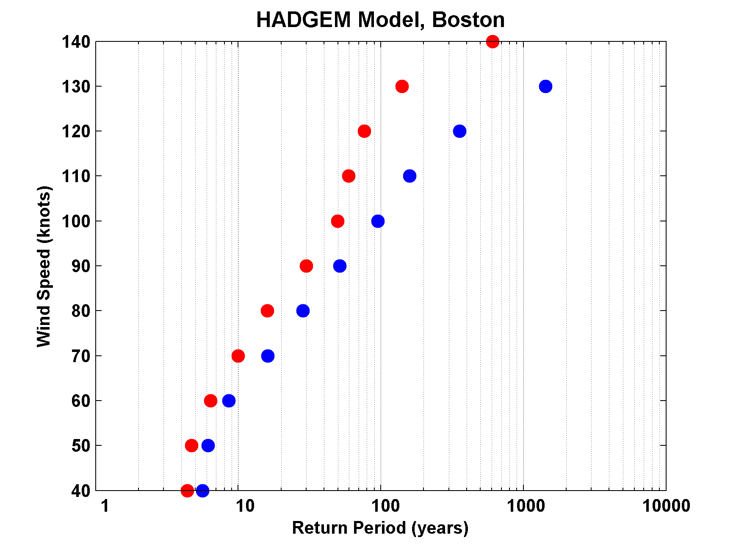
Increased Hurricane Risk in the Boston Region, According to Downscaling of Two Global Models

Slide 22
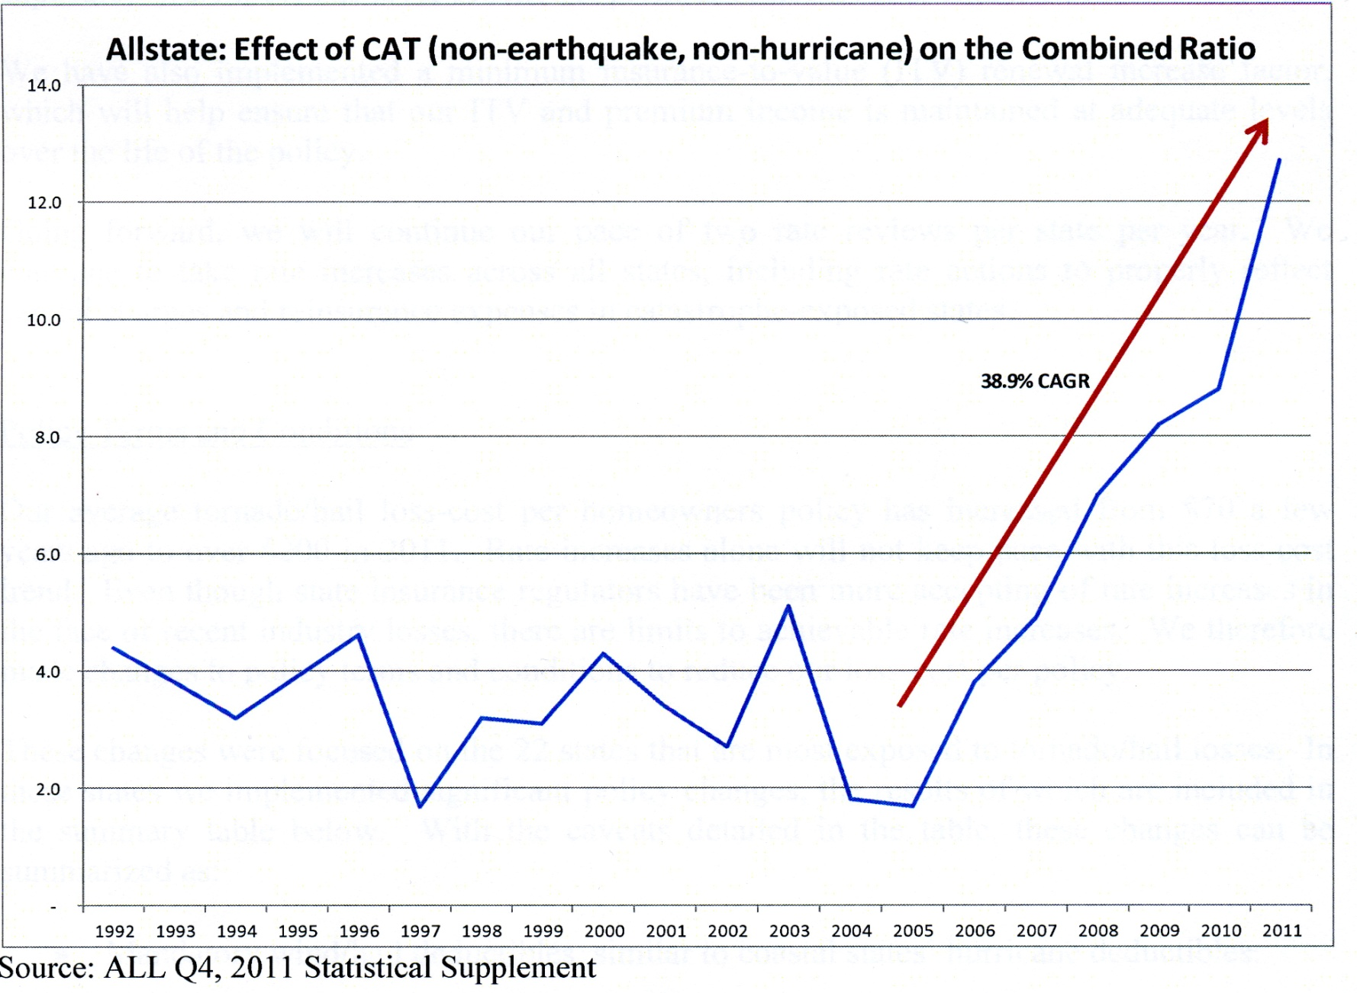
Allstate ratio of losses to premiums

Slide 23
Summary
Projections of climate change effects on weather extremes vary a great deal depending on type of event and model projections
Heat waves become more frequent, but high level of adaptation, up to a point.

Slide 24
Incidence of floods increases fairly rapidly
Incidence of drought also increases rapidly
Frequency of intense (destructive) hurricanes projected to increase, including in Boston
Very little currently known about response of severe thunderstorms to climate change

