Slide 1
How Small-Scale Turbulence Sets the Amplitude and Structure of Tropical Cyclones
Kerry Emanuel
PAOC

Slide 2
Some Critical Questions
What sets upper limit on TC intensity?
What determines TC structure?
Once formed, how do TCs intensify?
Remarkably, outflow turbulence has a strong influence on all of these

Slide 3

Axisymmetric Theory
Hydrostatic and gradient balance
Slantwise neutral vortex
Slab boundary layer

Slide 5
Saturation Potential Vorticity
Slantwise convective neutrality

Slide 6
Thermal Wind
Hydrostatic:
Gradient Wind:
Angular Momentum:
Thermal Wind:

Slide 7
(Maxwell)

Slide 8
Evaluate at top of boundary layer:
T_{o}(s*) = temperature along M surfaces where V_{b} = 0

Slide 9
T at top of PBL
Saturation entropy
Gradient wind at top of PBL
Outflow T
Radius at top of PBL
Absolute angular momentum per unit mass
Set by Boundary Layer Processes

Slide 11
Slab Boundary Layer Entropy Balance (neglect dissipative heating):
Assume steady state and ignore vertical advection in boundary layer:
Integrate over depth of boundary layer:

Slide 13
Not a closed expression: Need equation for k. Nothing about this derivation is peculiar to radius of maximum winds; previous work assumed constant T_{o} and tried to derive structure from k equation. This turns out to be wrong!

Slide 14

Basic Idea
Tropical cyclone outflow surfaces, rather than asymptoting to unperturbed environment, space themselves in vertical so as to achieve a critical Richardson Number

Slide 15
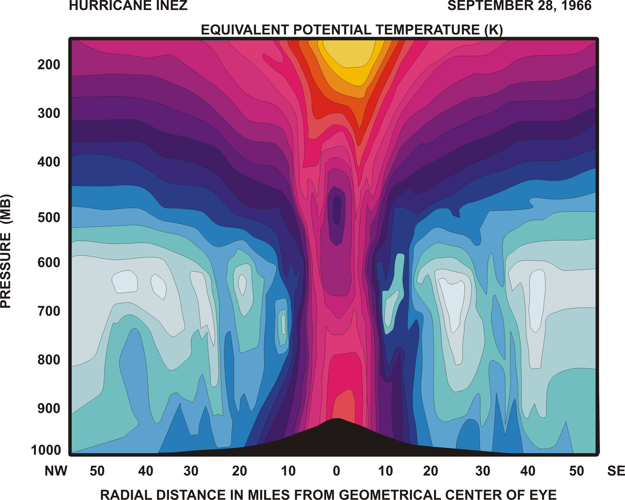

Slide 16
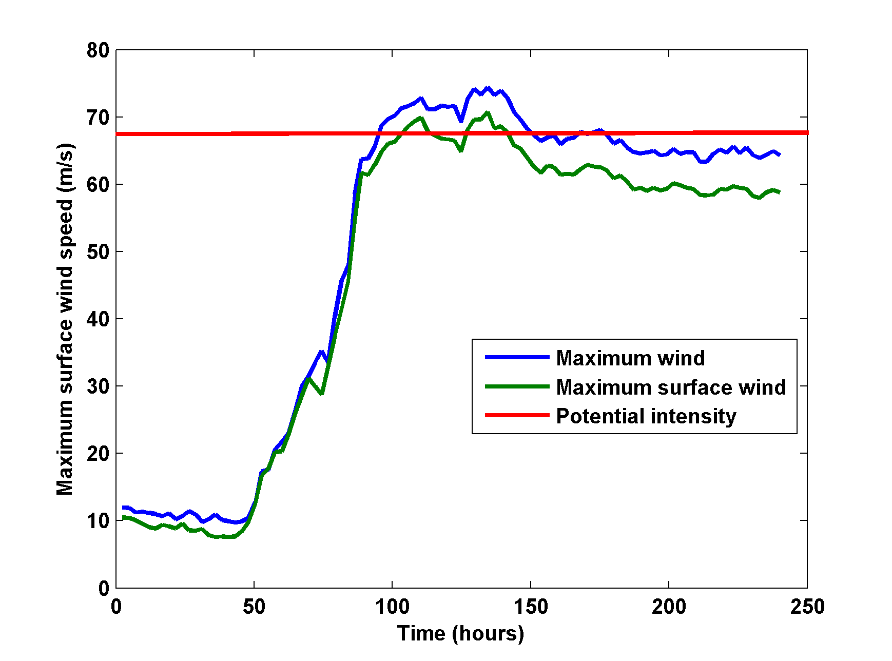
Integration of Rotunno-Emanuel (1987) model, revised to ensure energy conservation

Slide 17
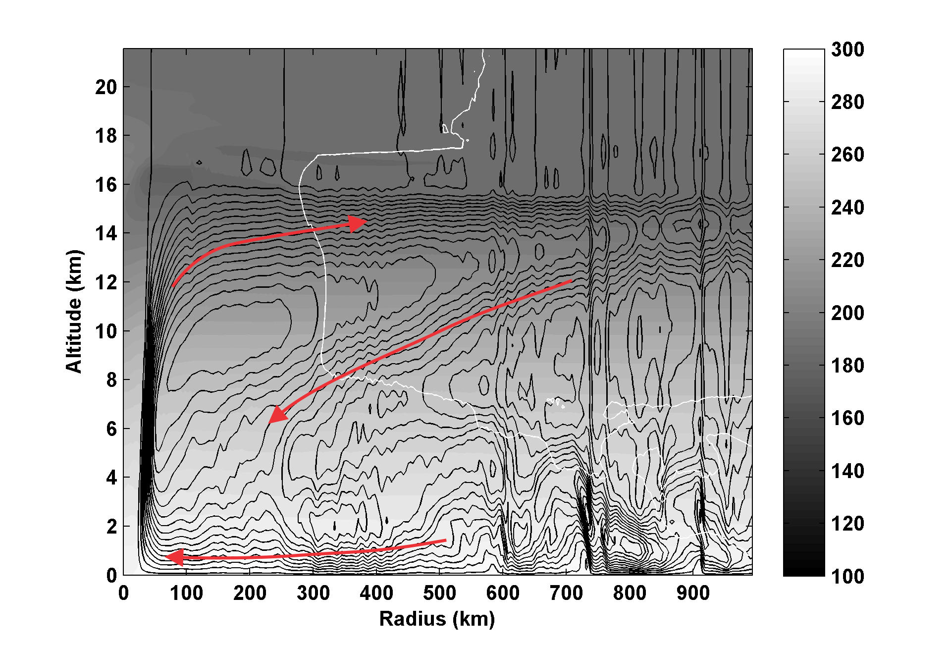
Outflow at V=0 is clearly T-stratified
Streamfunction (black contours), absolute temperature (shading) and V=0 contour(white)

Slide 18
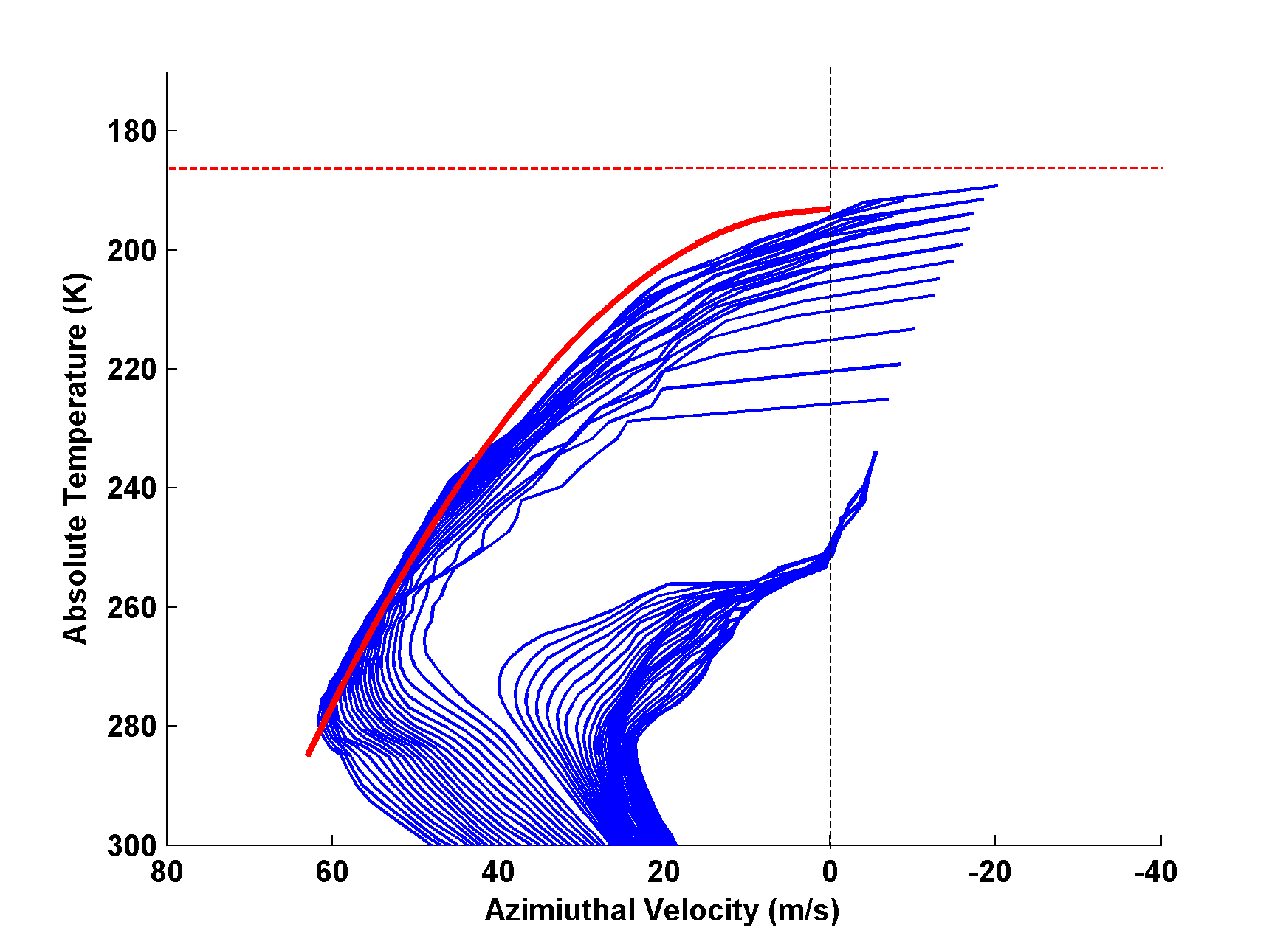
Angular momentum surfaces plotted in the V-T plane. Red curve shows shape of balanced M surface originating at radius of maximum winds. Dashed red line is ambient tropopause temperature.

Slide 19
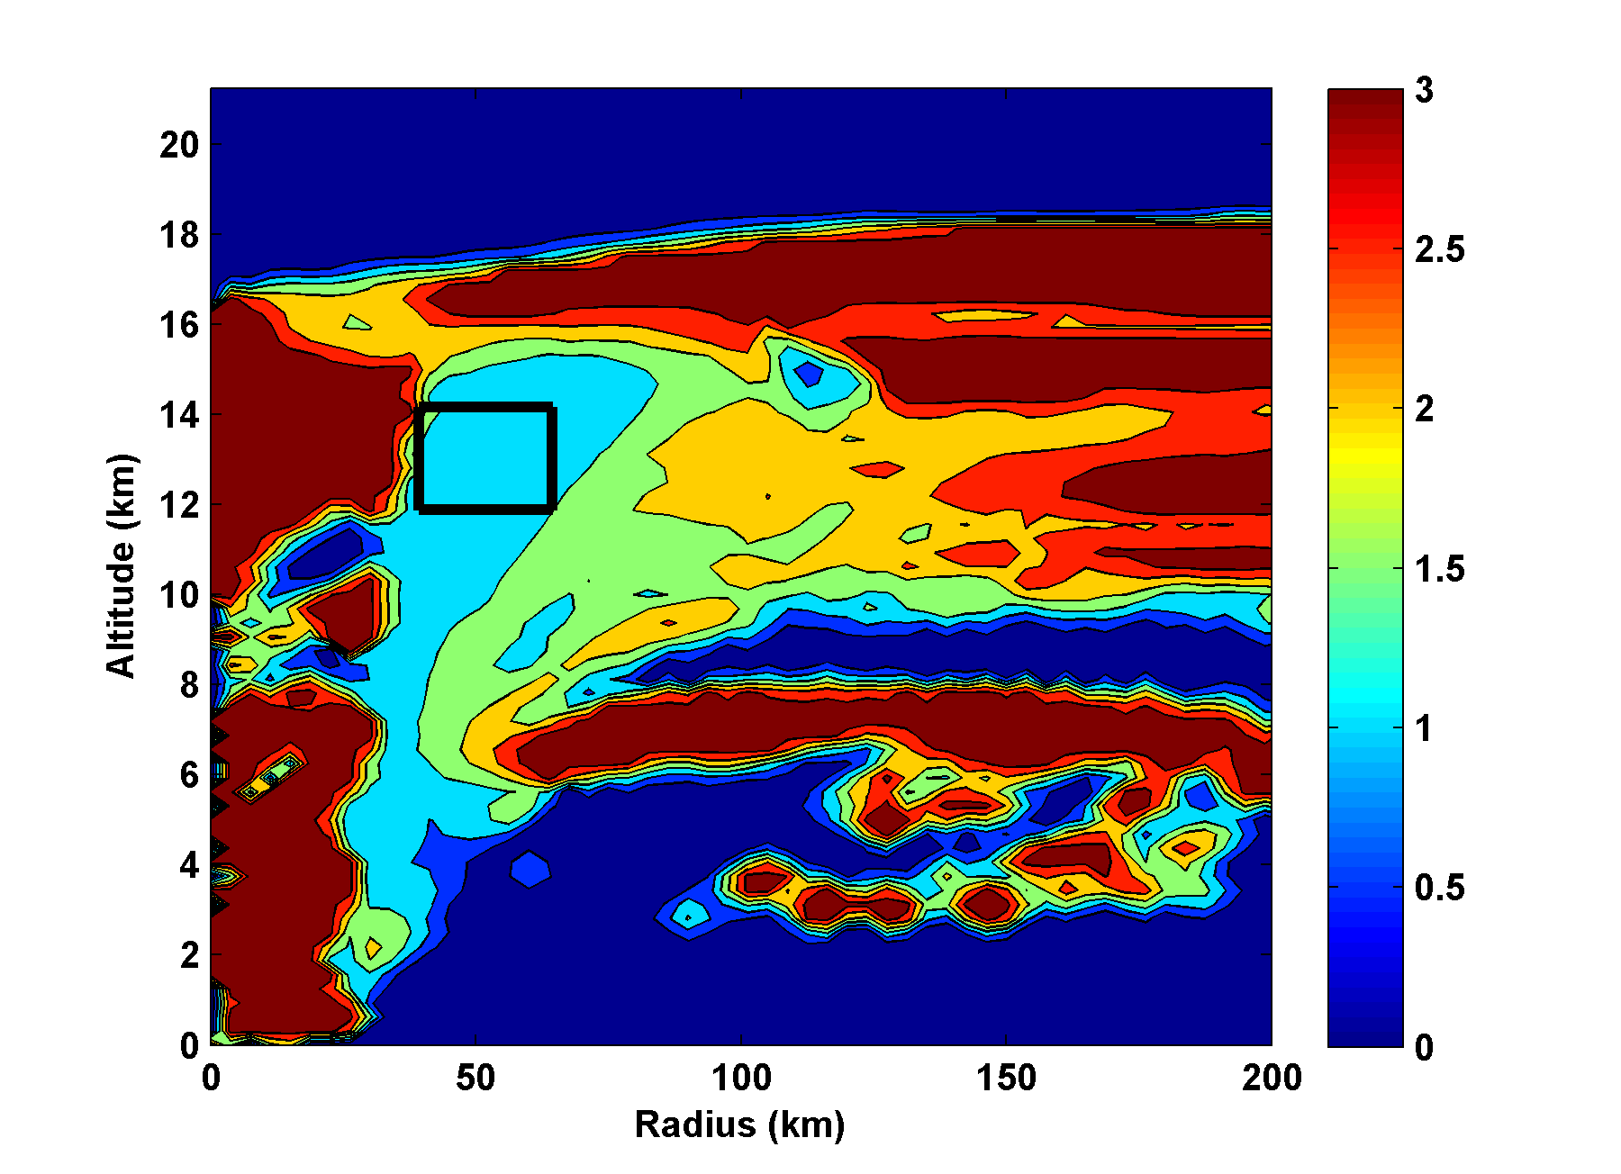
Richardson Number (capped at 3). Box shows area used for scatter plot.

Slide 20
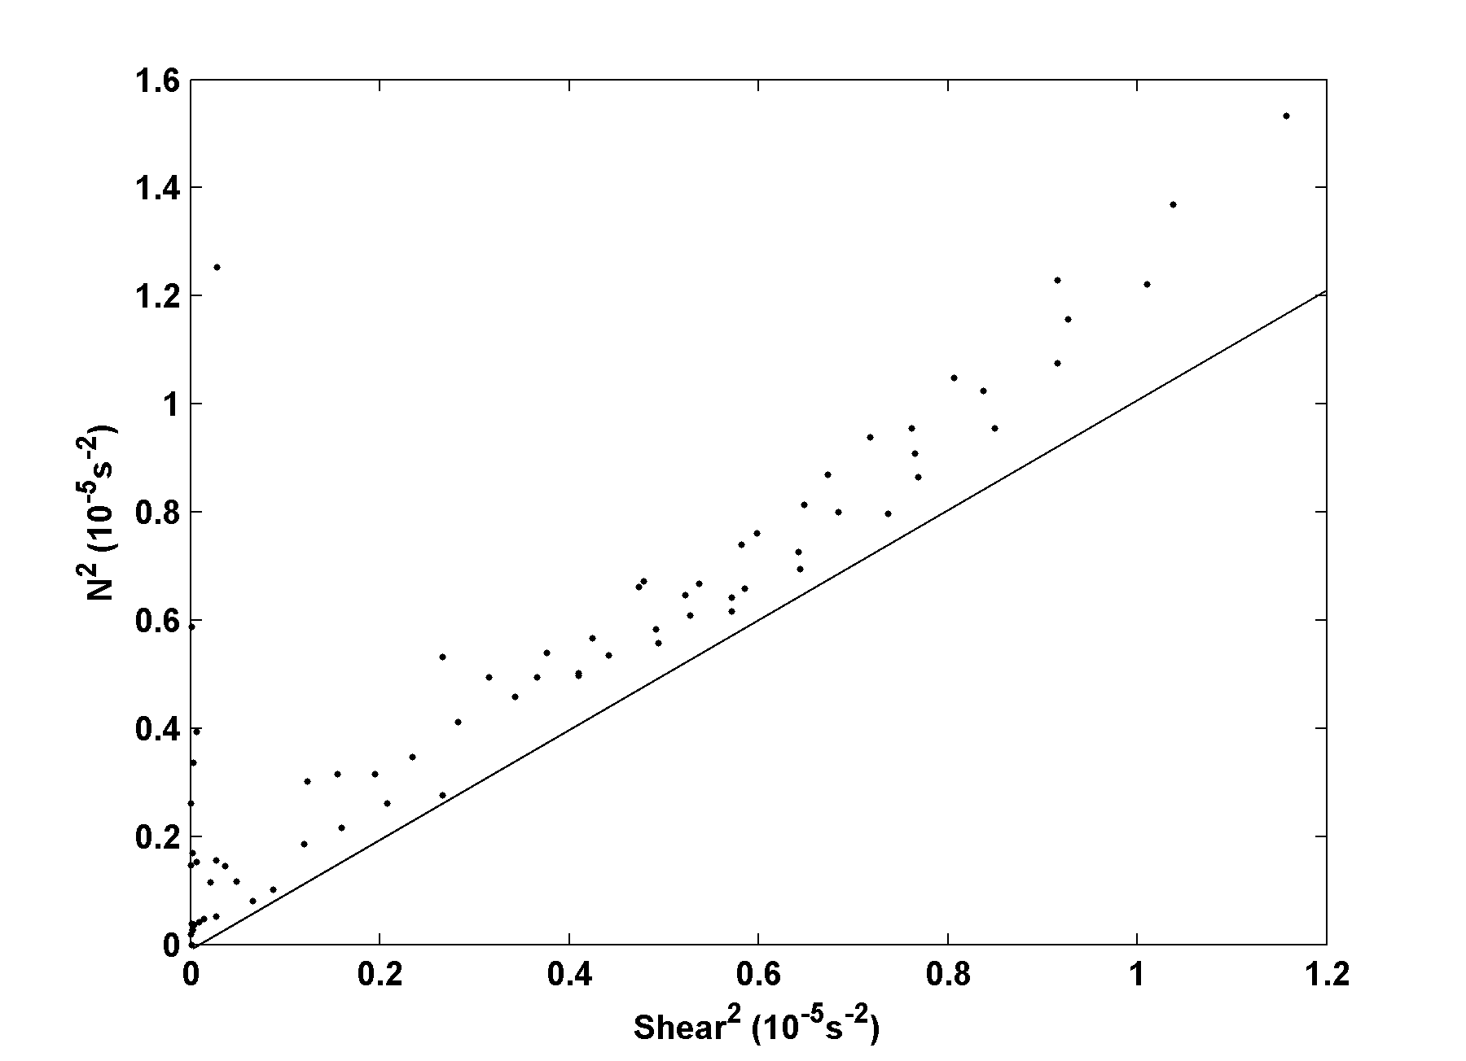
Ri=1

Slide 21

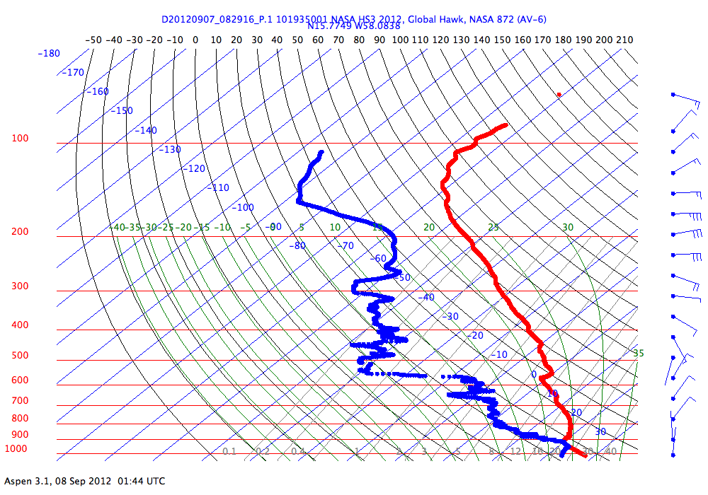
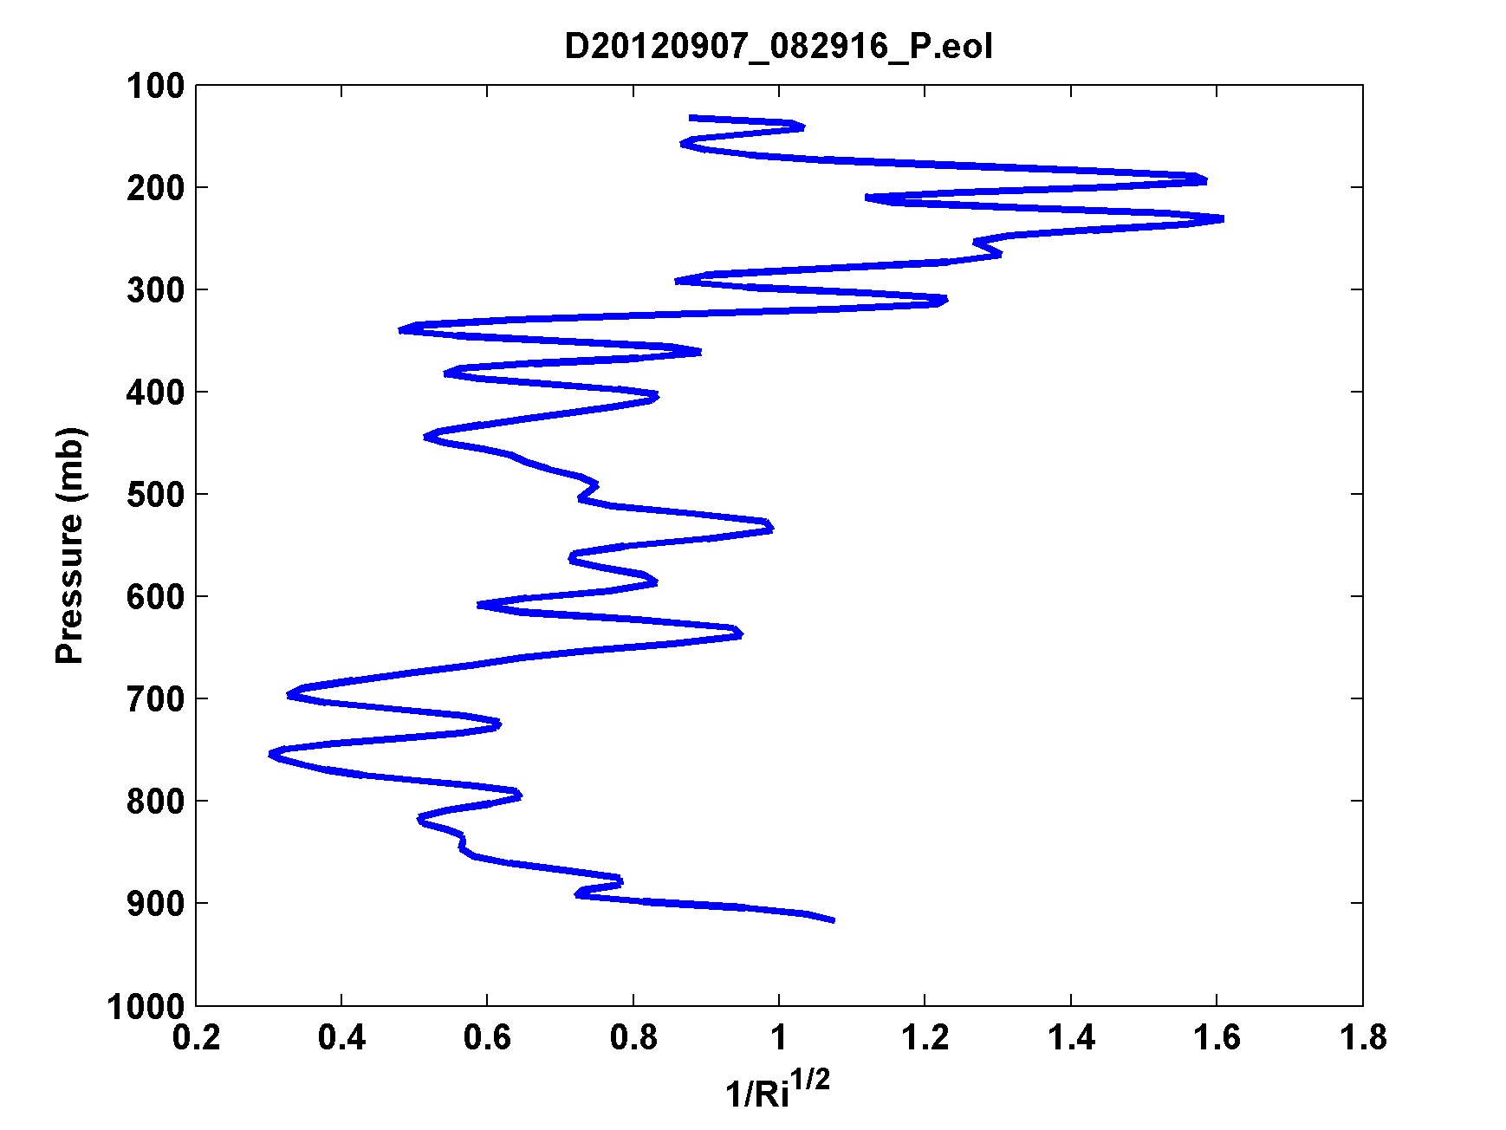
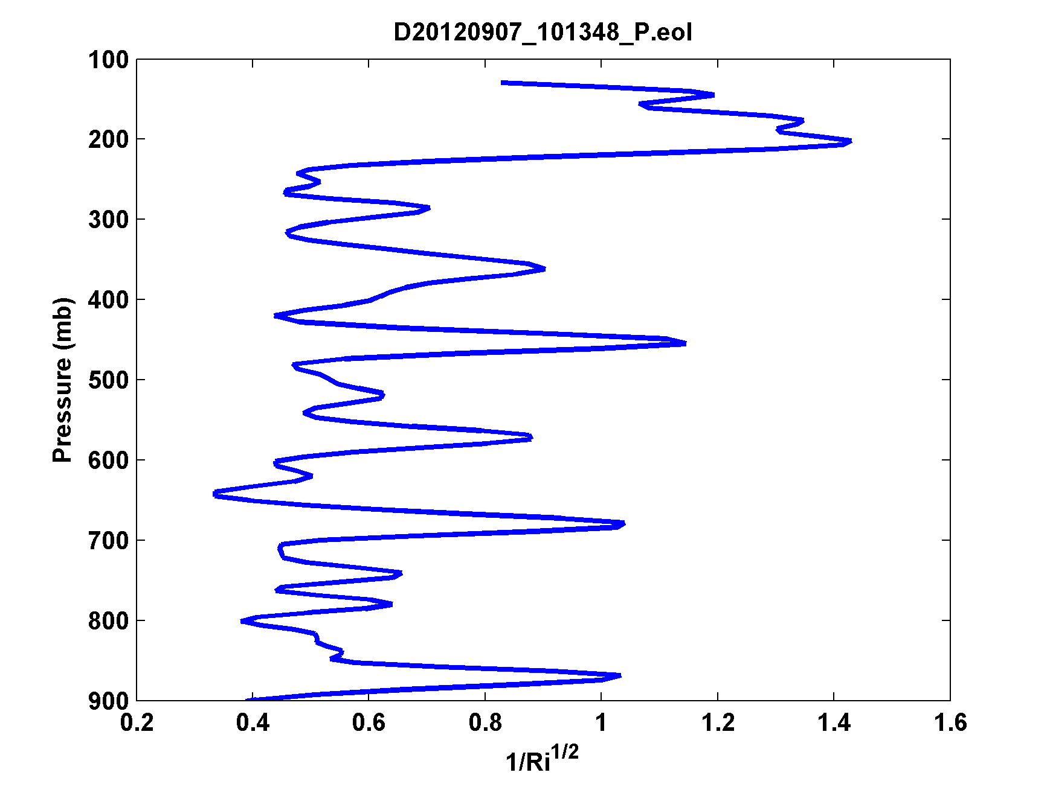
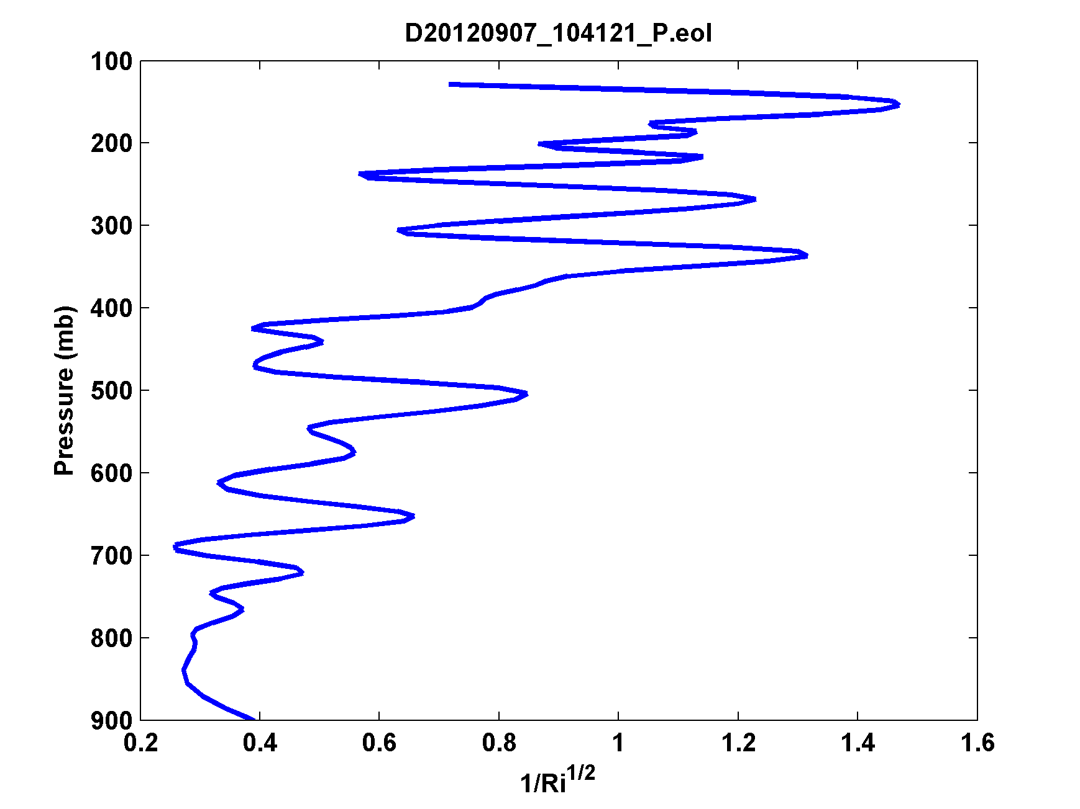
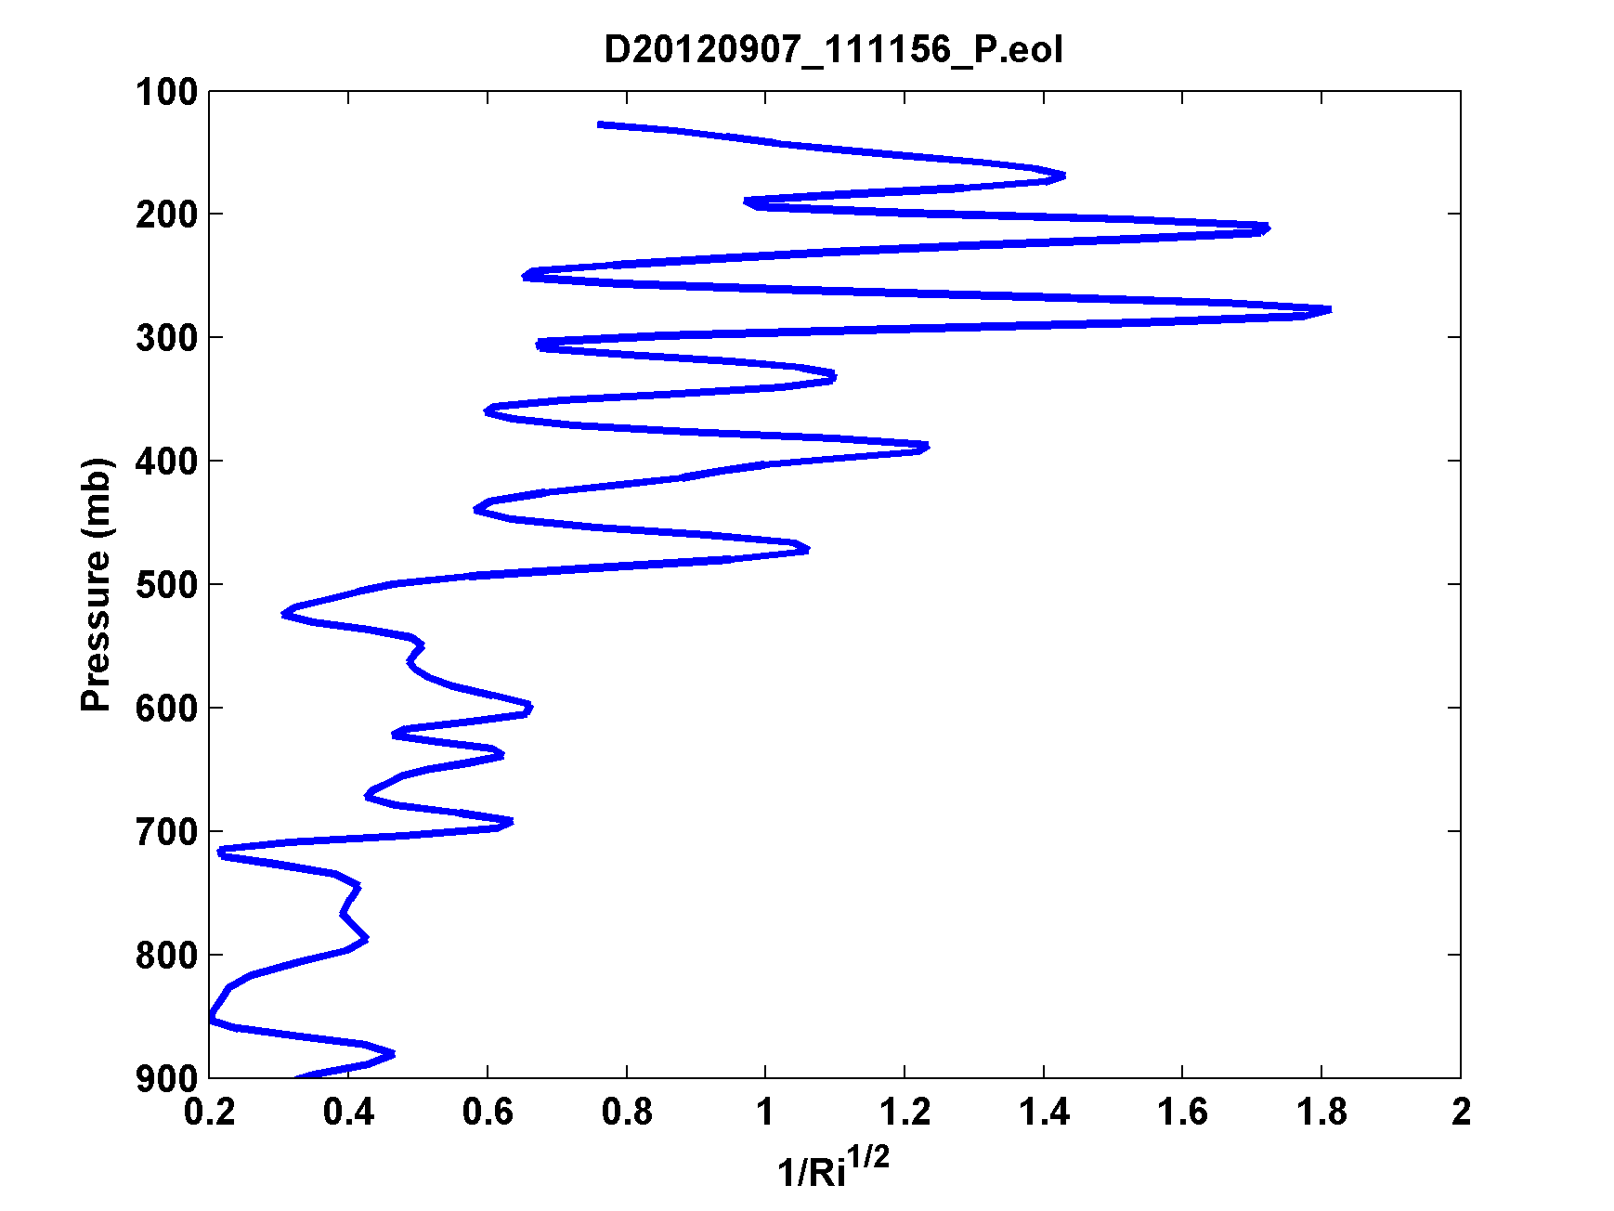
Dropsondes in TCs
Global Hawk-deployed sounding through outflow of Atlantic Hurricane Leslie of 2012 (left; courtesy Michael Black) and smoothed estimate of the inverse of the square root of the Richardson Number (right). Richardson Number criticality is indicated in the 150-300 hPa layer.

Slide 22
Implications for Outflow Criticality for Tropical Cyclone Structure and Intensity
Assumption of constant Richardson Number leads to equation for the dependence of outflow temperature on M:
Combine boundary layer equation:
And thermal wind equation:

Slide 23
System can be integrated inward from some outer radius r_{o}, defined such that
Must choose either r_{o} or r_{t}.
In general, integrating this system will not yield T_{o}=T_{t} at
r=r_{max}. Iterate value of r_{t} until this condition is met.
If V >> fr, we ignore dissipative heating, and we neglect pressure dependence of s₀*, then we can derive an approximate closed-form solution.

Slide 24
Assuming that Ri is critical in the outflow leads to an equation for T_{o} that, coupled to the interior balance equation and the slab boundary layer leads (surprisingly!) to a closed form analytic solution for the gradient wind (as represented by angular momentum, M, at the top of the boundary layer:

Slide 25
Defining

Slide 26
Also,
and

Slide 27
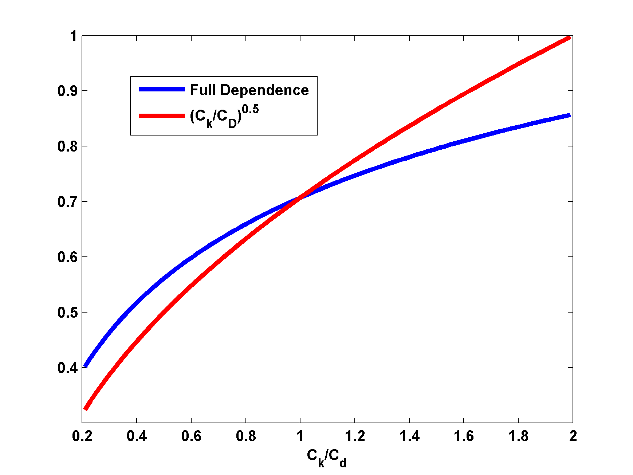
Predicted dependence on C_{k}/C_{D} is weaker than square-root dependence

Slide 28
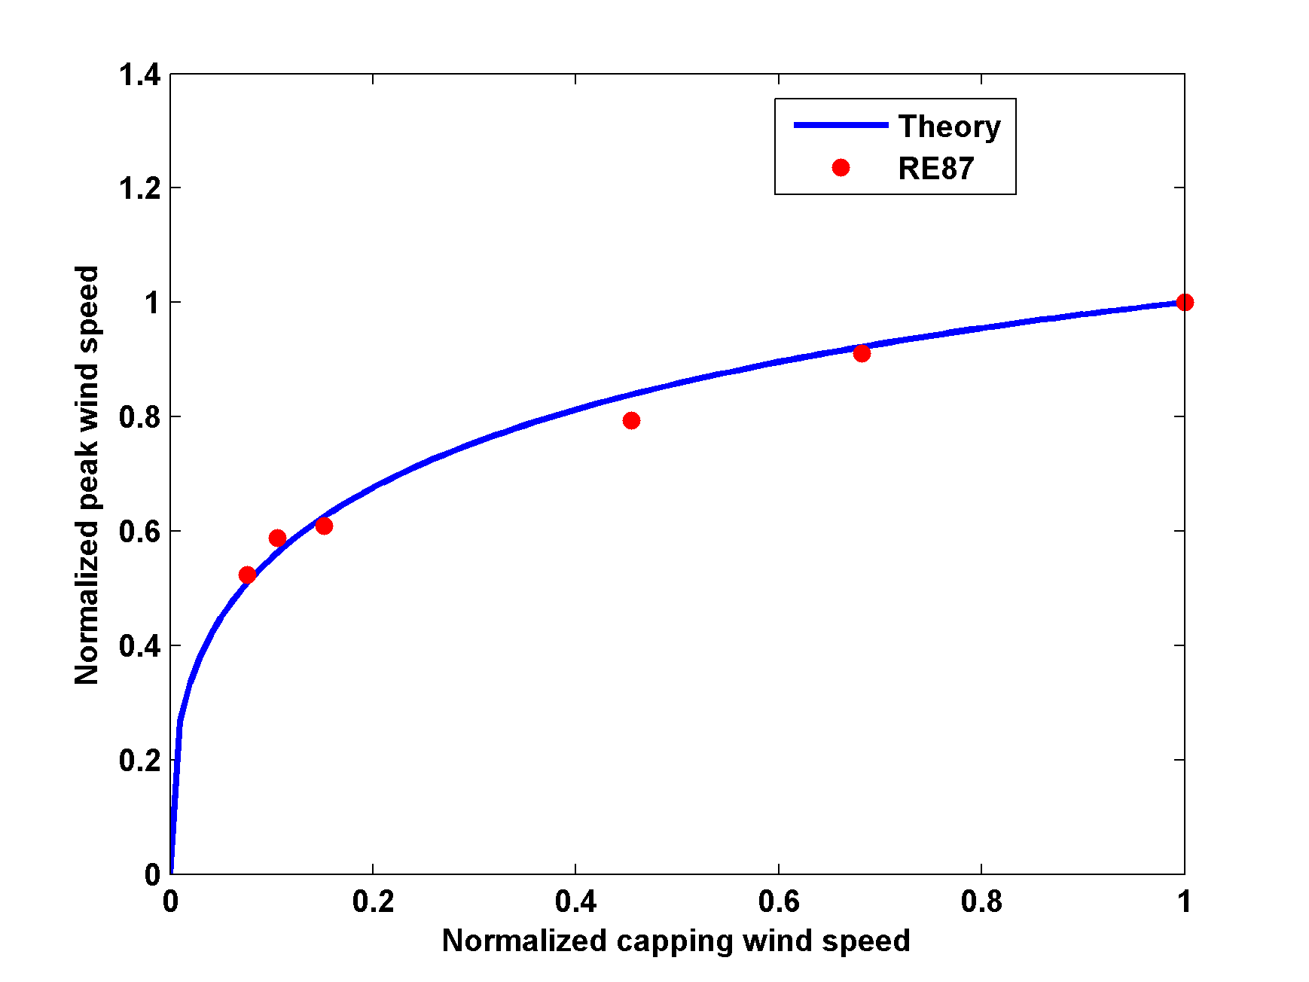
Explains effect of capping the wind speed in the surface enthalpy fluxes

Slide 29
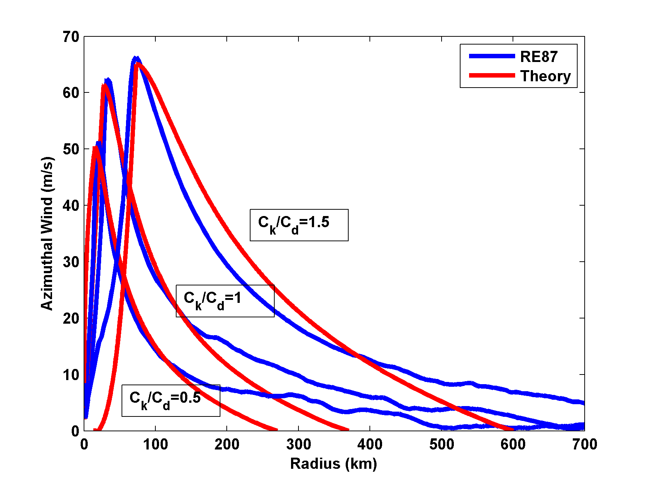
Comparison of analytic model with numerical simulations

Slide 30
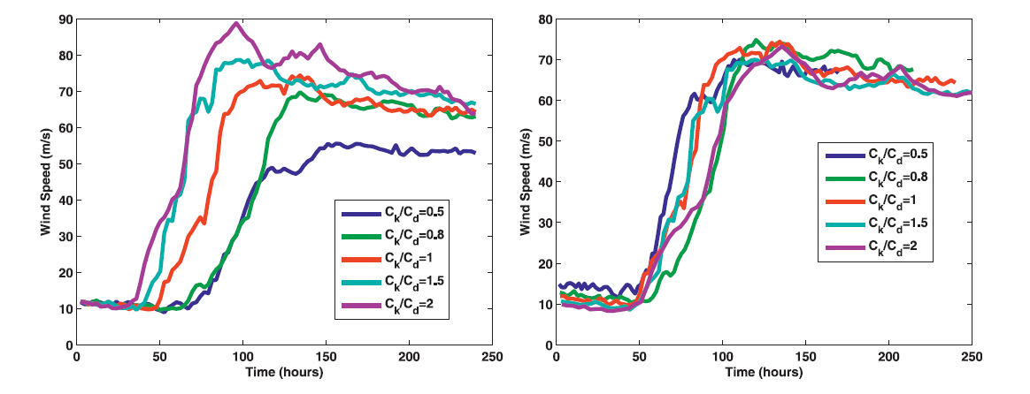
Actual and normalized evolution of maximum wind speed in RE numerical simulations

Slide 31
Time-Dependent System

Slide 32
Approximate System
Neglect pressure dependence of s₀*
V~M/r (inner core)
Neglect dissipative heating
|V| ~ V
h=constant

Slide 34
Combined system:
(14)
Suppose that maximum winds always occur on the same M surface. Then, using
(15)

Slide 35
with
If V = 0 at t = 0, the integration of time-dependent equation gives

Slide 36
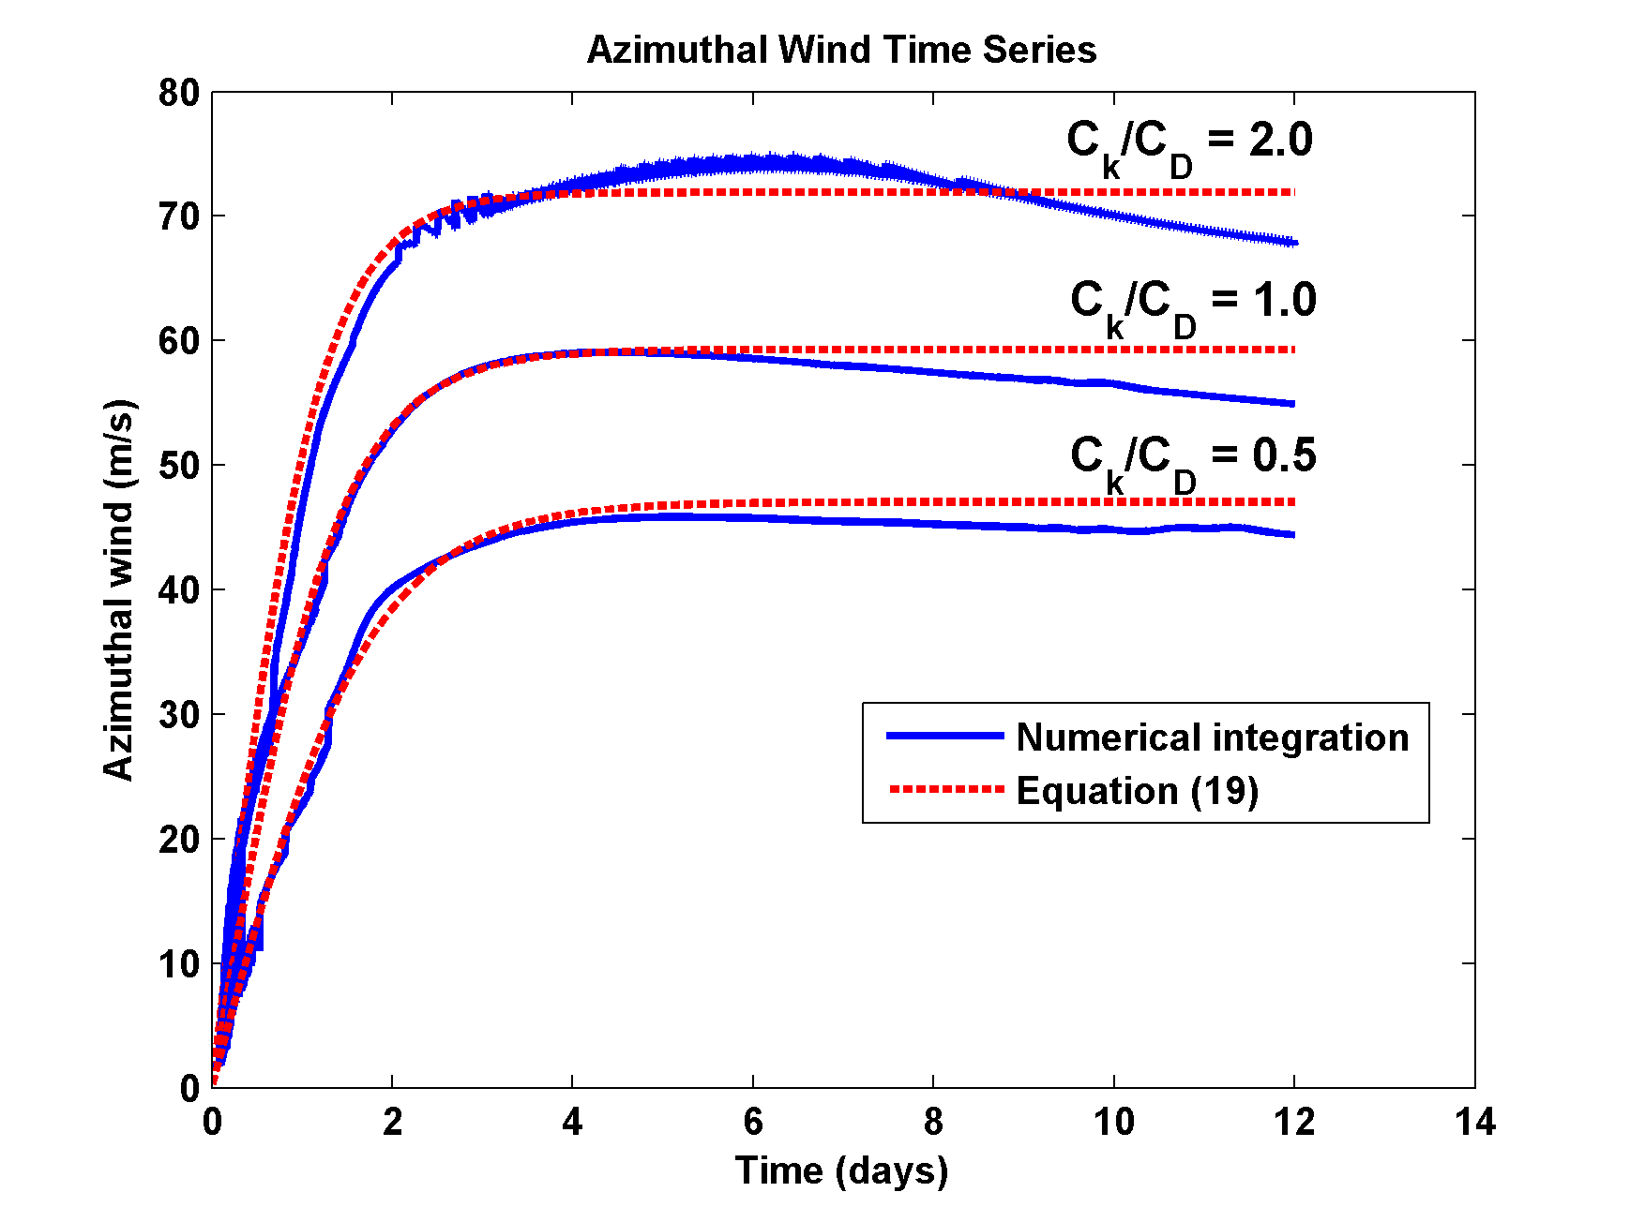
Comparison with numerical solution of (7) – (10)
(17)

Slide 37
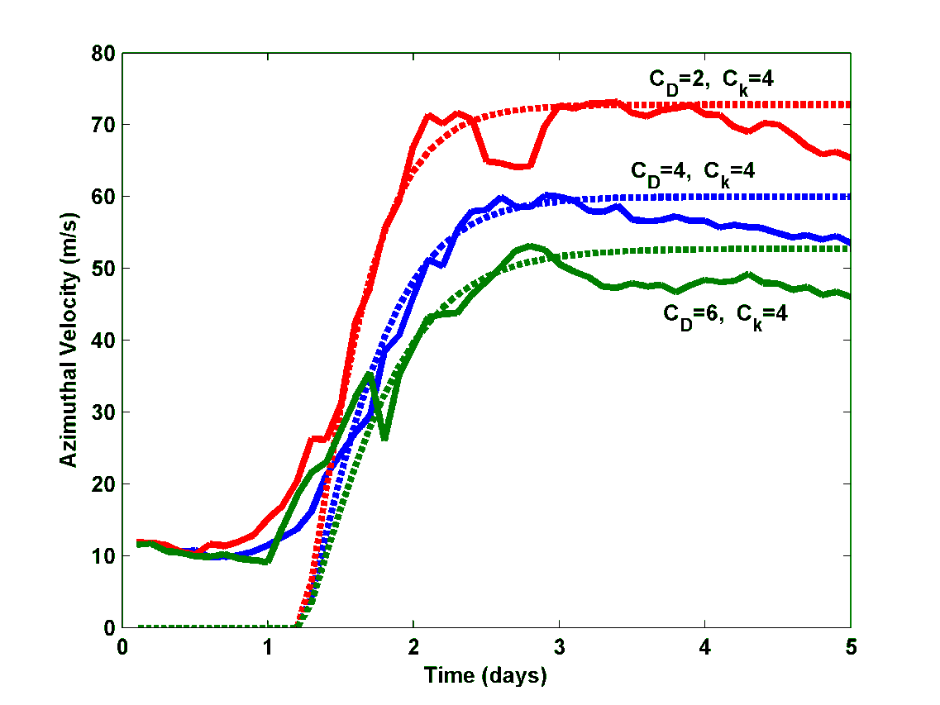
Comparison with Rotunno-Emanuel 1987 Model

Slide 38
Summary
Previous assumption that outflow asymptotes to environmental entropy surfaces appears to be wrong
Instead, outflow stratification appears to be set by the requirement that the Richardson Number remain at or above critical value
Implementing a critical Ri criterion in balance analytical model leads to closed form solution that brings theory into better agreement with numerical simulations

Slide 39
No longer need to make crude assumption about boundary layer entropy distribution outside of eyewall
Weaker dependence of V_{max} on C_{k}/C_{D}, as in numerical simulations
Time-dependent quasi-analytic model no longer needs to assume jump in entropy budget equation
TC intensity, structure, and development all depend on action of turbulence in TC outflow as well as in the boundary layer

Slide 40
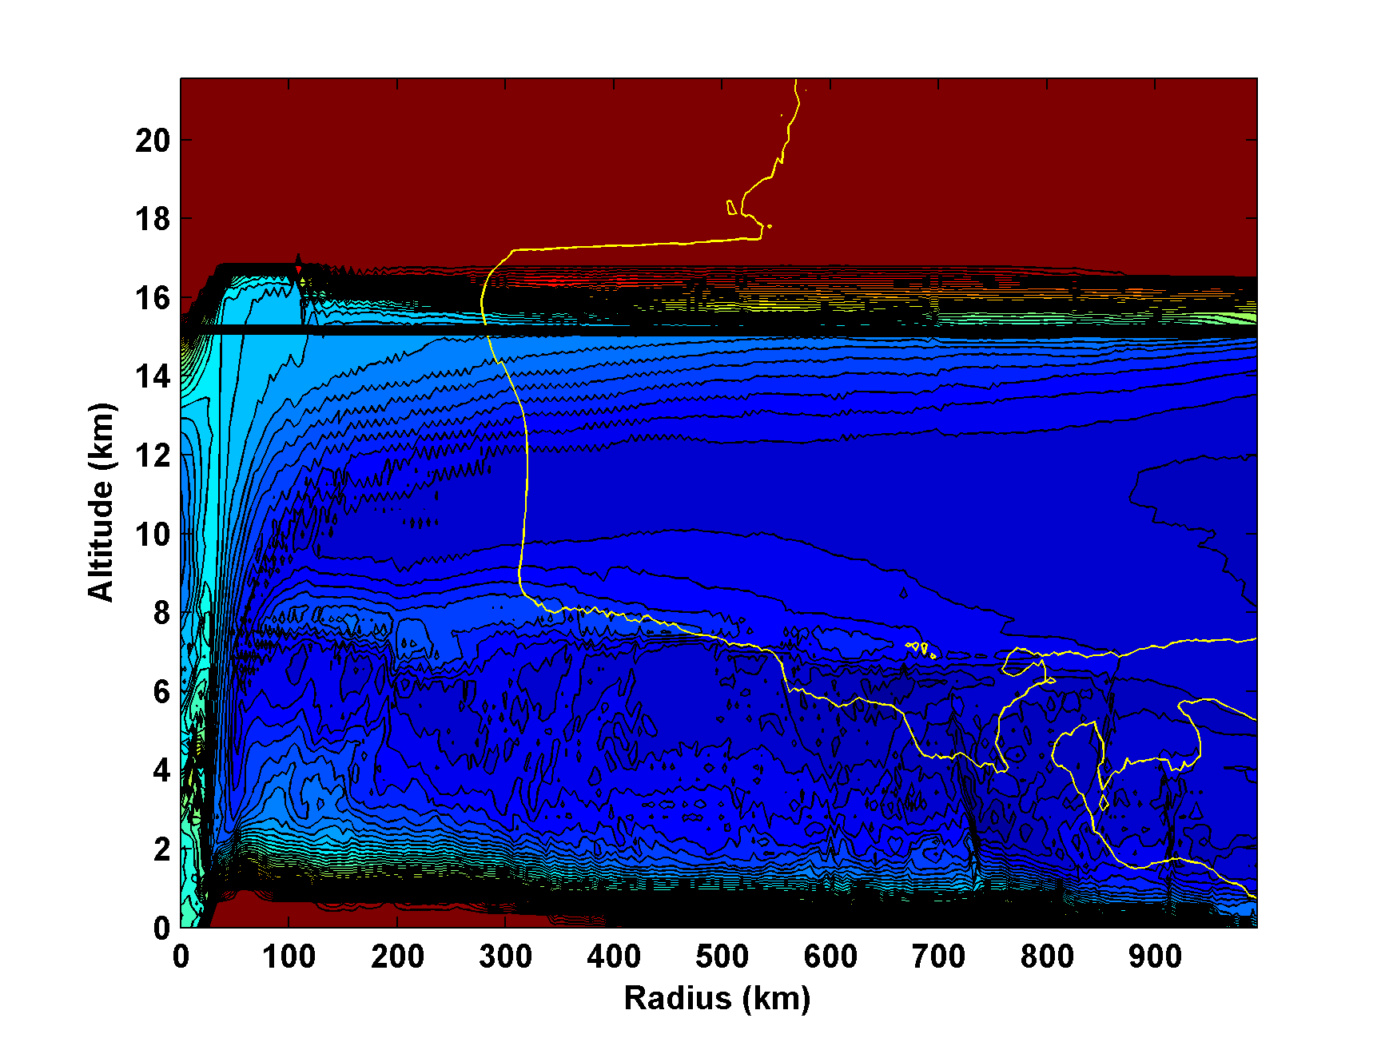
Saturation entropy (contoured) and V=0 line (yellow)

Slide 41
We can also re-write the thermal wind equation as
(1)
Boundary layer entropy (with dissipative heating):
(2)
Boundary layer angular momentum
(3)
Combine (2) and (3):
(4)

Slide 42
Let
(5)
Thermal wind balance:
(6)

Slide 43
Eliminate V_{b} between (5) and (6):
(7)
Eliminate r_{b}² between (20) and (25):
(8)
where
Remember that
(9)

