Slide 1

What Energy Sources Will Stop Global Warming?
Kerry Emanuel
Lorenz Center
Department of Earth, Atmospheric, and Planetary Sciences, MIT
Web: emanuel.mit.edu

Slide 2

Program:
Global warming: The evidence
Climate risks
Options and Opportunities for decarbonizing

Slide 3
Our Influence on Greenhouse Gases

Slide 4

Svante Arrhenius, 1859-1927
“Any doubling of the percentage of carbon dioxide in the air would raise the temperature of the earth's surface by 4°; and if the carbon dioxide were increased fourfold, the temperature would rise by 8°.” – Världarnas utveckling (Worlds in the Making), 1906

Slide 5
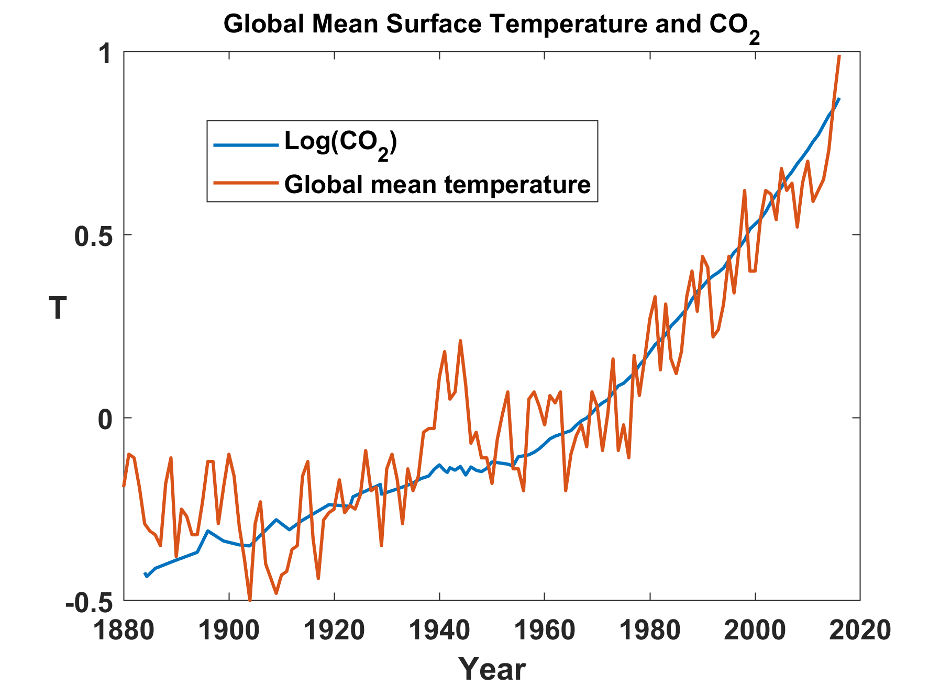

Slide 6
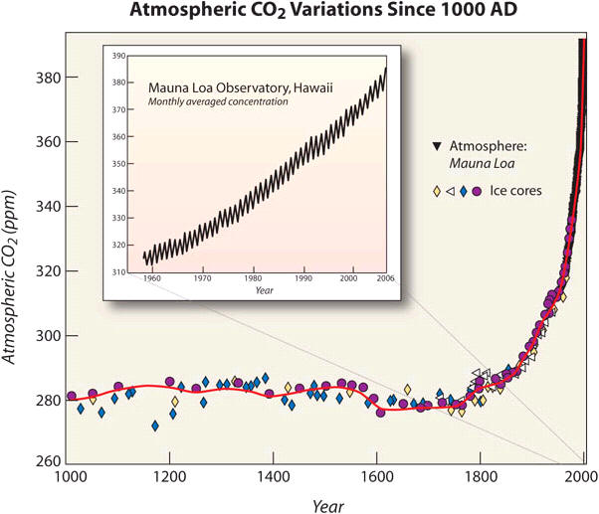

Slide 7
Other Trends

Slide 8
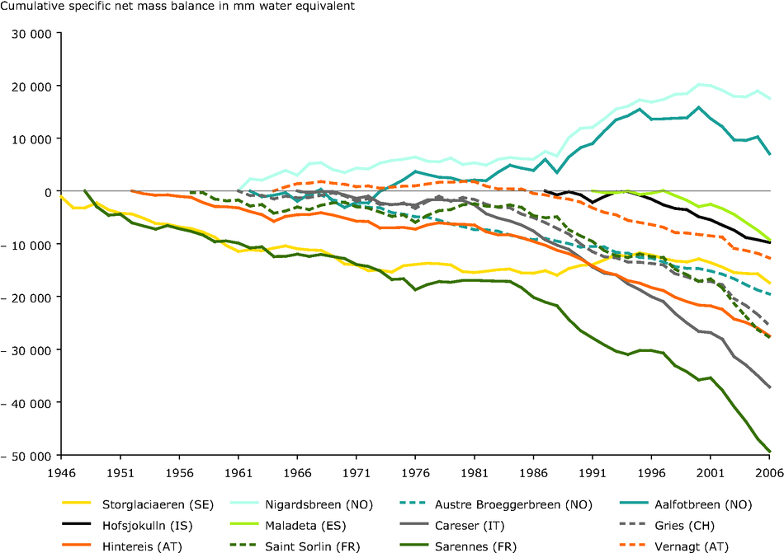
European Alpine Glaciers

Slide 9

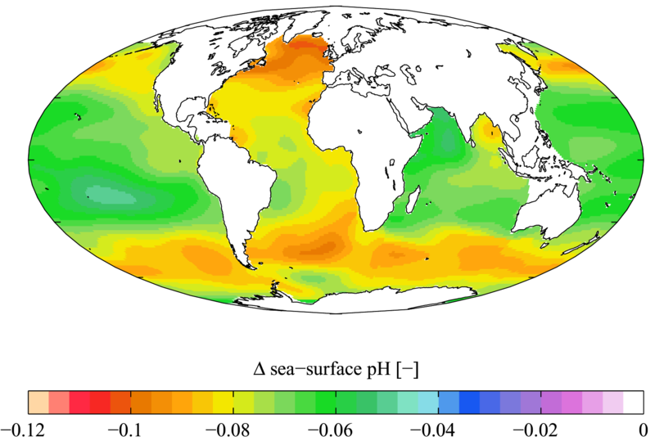

Slide 10

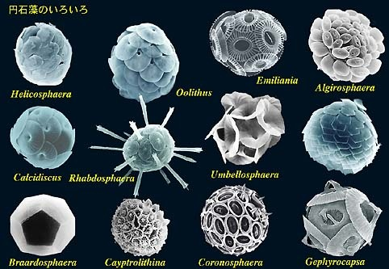

Acidification through CO₂ threatens marine life
Plankton
Coral Reefs
Notes:
Abbildung 4.3-1
Aragonitsättigung und
gegenwärtige Riffstandorte
von Warmwasserkorallen
(blaue Punkte). (a)
vorindustrielle Werte
(ca. 1870, atmosphärische
CO2-Konzentration
280 ppm), (b) Gegenwart
(ca. 2005, 375 ppm CO2), (c)
Zukunft (ca. 2065, 517 ppm
CO2). Der Grad der
Aragonitsättigung (Ù)
bezeichnet das relative
Verhältnis zwischen dem
Produkt der Konzentrationen
von Kalzium- und
Karbonationen und dem
Löslichkeitsprodukt für
Aragonit. Standorte mit
einer Aragonitsättigung
unterhalb von 3,5 sind nur
noch bedingt für riffbildende
Warmwasserkorallen
geeignet (marginal),
unterhalb von 3 sind sie
ungeeignet.
Quelle: Steffen et al., 2004

Slide 11
The Future

Slide 12

CO₂ Likely to Go Well Beyond Doubling
Double Pre-Industrial

Slide 13

IPCC 2007: Doubling CO₂ will lead to an increase in mean global surface temperature of 2 to 4.5 ºC.
Atmospheric CO₂ assuming that emissions stop altogether after peak concentrations
Global mean surface temperature corresponding to atmospheric CO₂ above
Courtesy Susan Solomon

Slide 14
Known Risks
Increasing sea level
Increasing hydrological events… droughts and floods
Increasing incidence of high category hurricanes and associated storm surges and freshwater flooding
More heat stress and other health risks
Armed conflict
Some increase in plant productivity
Reduction in health problems related to cold weather
Benefits

Slide 15
“Taken as a whole, the range of published evidence indicates that the net damage costs of climate change are likely to be significant and to increase over time.”
- Intergovernmental Panel on Climate Change

Slide 16
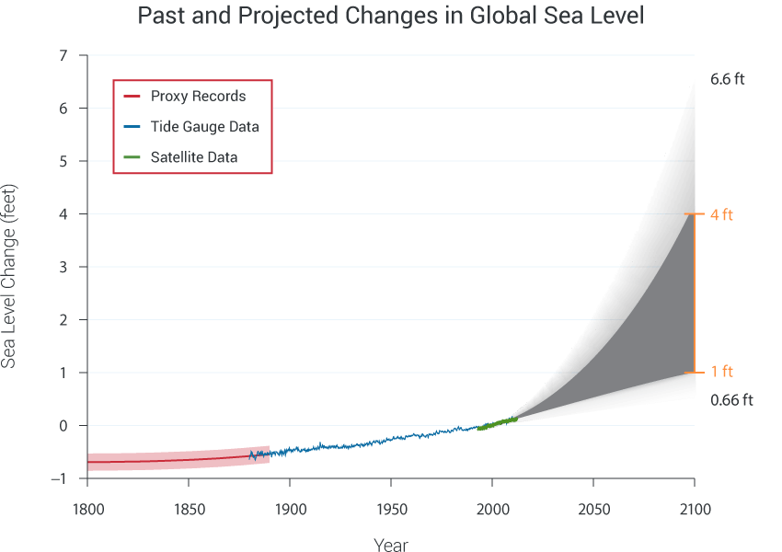

Slide 17
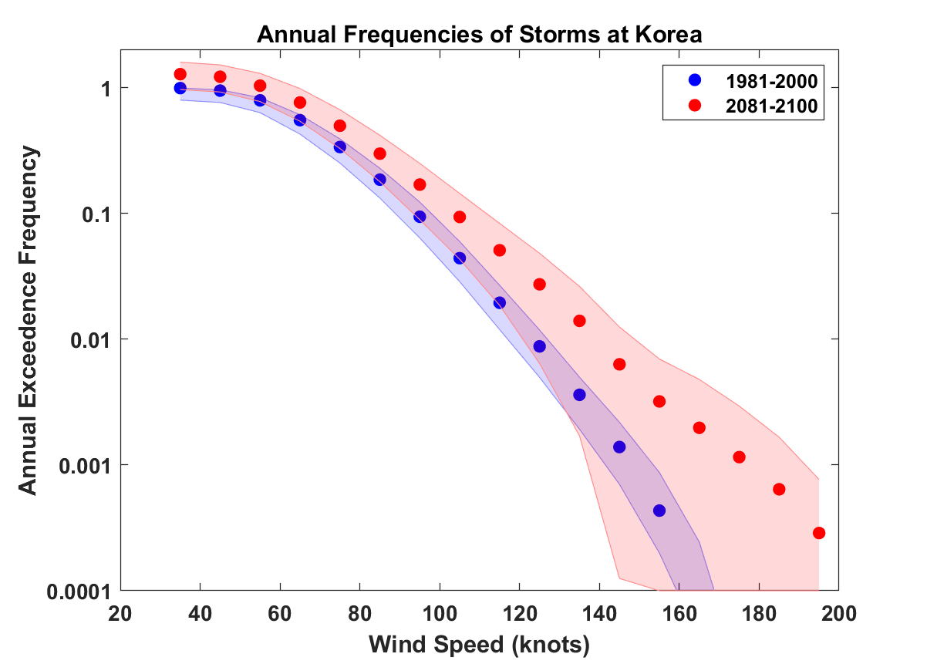
Predicted Increase in Typhoon Intensities in Korea

Slide 18
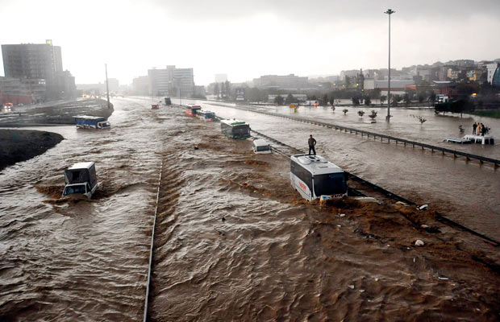
Hydrological Extremes Increase with Temperature
Floods

Slide 19
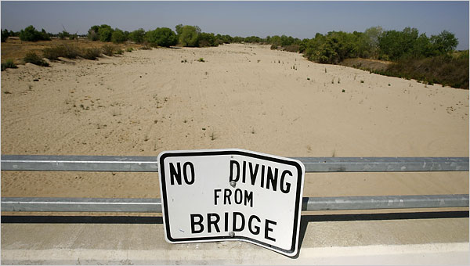
Drought

Slide 20
“Climate change could have significant geopolitical impacts around the world, contributing to poverty, environmental degradation, and the further weakening of fragile governments. Climate change will contribute to food and water scarcity, will increase the spread of disease, and may spur or exacerbate mass migration.”
    -- Quadrennial Defense Review, U.S. Department of Defense, February, 2010

Slide 21
Risk vs. Opportunity
Where there is risk there is opportunity
Global annual energy market ~ $6 trillion (1/3 U.S. GDP)
Increasing trend toward decarbonization
China is capturing the low-carbon energy market
While there are global net transition costs, nations that lead in low-carbon energy technology will come out ahead

Slide 22
Solutions and Opportunities
Renewables (solar and wind)
  Might provide up to 30% of current power needs
  Limited by intermittency and lack of storage
Carbon Capture and Sequestration
  Currently would add ~$200/ton to energy costs
  Reasonable prospects for reducing this to ~$100/ton
  Currently little incentive to develop this
Nuclear fission and fusion

Slide 23
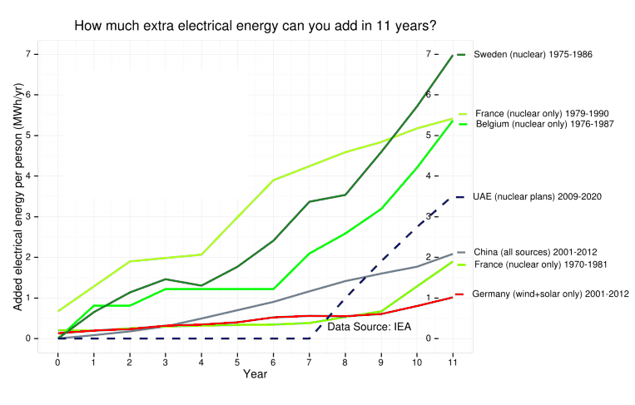
Ramping up Fission Power

Slide 24
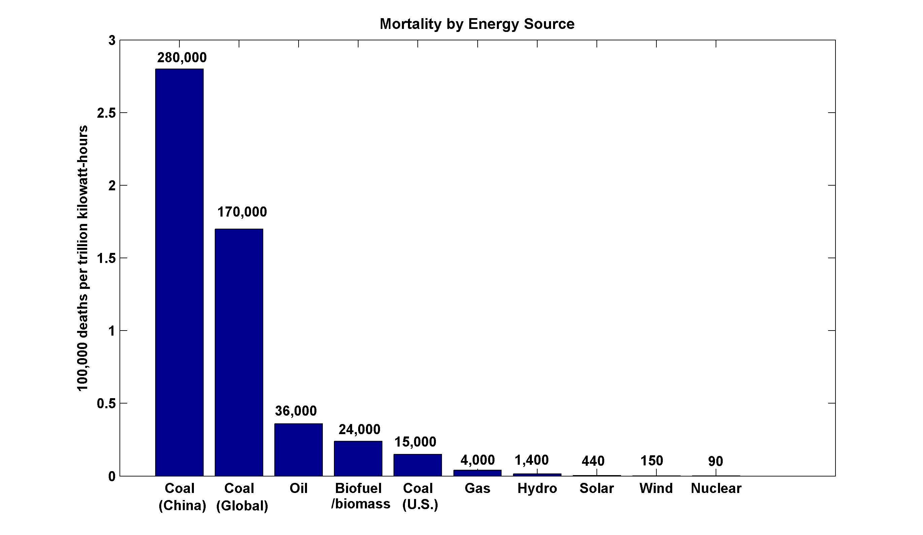
~13,000 premature deaths annually in the U.S. from coal production and combustion
Nuclear power, by replacing fossil fuels, has prevented an estimated 1.84 million air-pollution related deaths worldwide
(includes Chernobyl, Fukushima)

Slide 25
The value proposition of nuclear

Slide 26
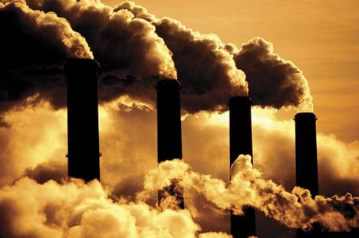
Nuclear plants emit no CO₂ or criteria pollutants, and do not require a continuous fuel supply
Fuel energy content
COAL (C): C + O₂ → CO₂ + 1 unit of energy
NATURAL GAS (CH₄): CH₄ + O₂ → CO₂ + 2H₂O + 2 units of energy
NUCLEAR (U): ²³⁵U + n → ⁹³Rb + ¹⁴¹Cs + 2n + 25 million units of energy
Fuel Consumption, 1000 MWe Power Plant (∼740,000 homes)
COAL: 6,122,250 kg/day
NATURAL GAS: 3,483,648 kg/day
NUCLEAR: 300 kg/day of natural U
Need for continuous fueling can impact reliability of electricity supply (e.g., polar vortex)
Refuel every 18-24 months
Courtesy Jacopo Buongiorno, MIT

Slide 27
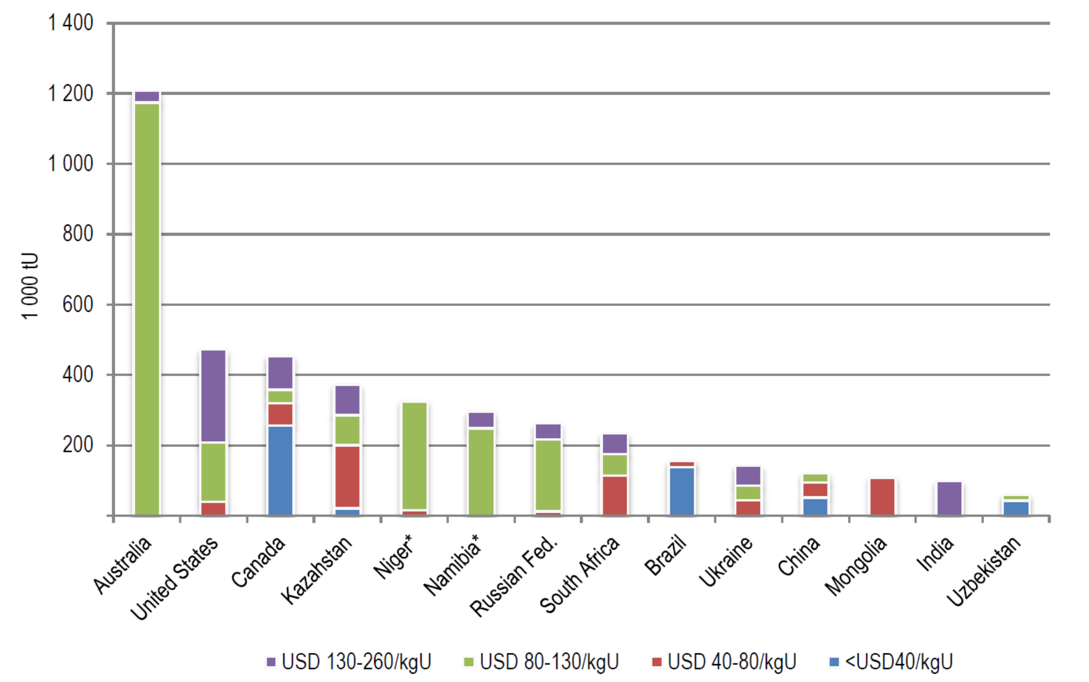

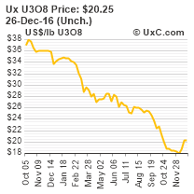


Uranium is abundant and prices are low and set by politically stable countries
Reasonably Assured U Resources (from OECD “redbook” 2014)
Courtesy Jacopo Buongiorno, MIT

Slide 28
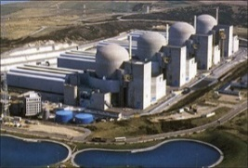
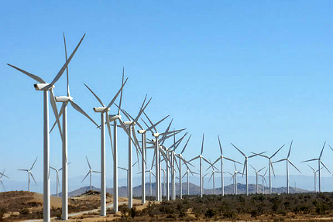
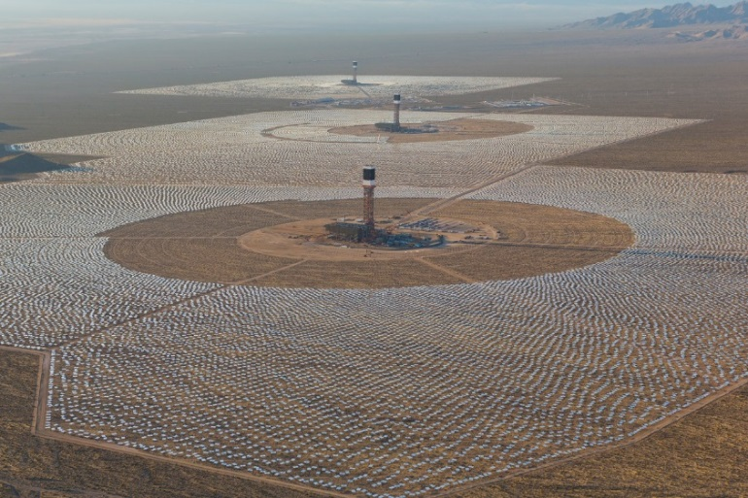
Nuclear plants are dispatchable and reliable, and do not use up much land
NUCLEAR: Paluel, France, 5200 MW (24/7, year around, >90% capacity factor), 0.8 sq. miles
∼ 5850 MW_{e}/mi²
WIND: Alta Wind Farm, CA, 1020 MW max (only if the wind blows,
<40% capacity factor), 5 sq. miles
∼ 82 MW_{e}/mi²
SOLAR: Ivanpah, CA, 390 MW max. (only if the sun shines, nothing at night, <30% capacity factor), 6 sq. miles
∼ 20 MW_{e}/mi²
Courtesy Jacopo Buongiorno, MIT

Slide 29
Nuclear is already the largest source of clean electricity in the U.S. and Europe by far
Courtesy Jacopo Buongiorno, MIT

Slide 30
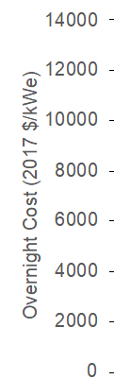
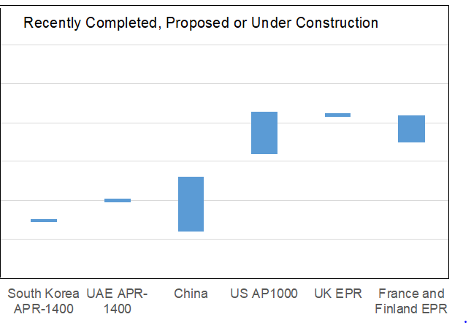
Nuclear cheaper in Asia that in the Europe and Asia
ASIA
U.S./Europe
>90% detailed design completed before starting construction
Proven NSSS supply chain and skilled labor workforce
Fabricators/constructors in included in the design team
A single primary contract manager
Flexible regulator can accommodate changes in design and construction in a timely fashion
Started construction with <50% design completed
Atrophied supply chain, inexperienced workforce
Litigious construction teams
Regulatory process averse to design changes during construction
Courtesy Jacopo Buongiorno, MIT

Slide 31
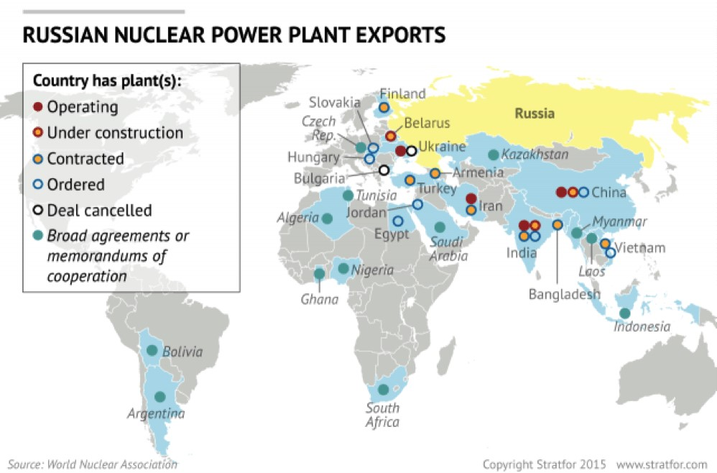



Export market is dominated by Russia
43
Planned
…and soon by China
31
Under
Construction
24
9
2
China
Russia
U.S.
Courtesy Jacopo Buongiorno, MIT

Slide 32
In a low-carbon world, nuclear energy is the lowest-cost, dispatchable heat source for industry
Technology | LCOH $/MWh-thermal | Dispatchable | Low carbon
Solar PV: Rooftop Residential | 190-320 | No | Yes
Solar PV: Crystalline Utility Scale | 45-55 | No | Yes
Solar PV: Thin Film Utility | 40-50 | No | Yes
Solar Thermal Tower with Storage | 50-100 | Yes | Yes
Wind | 30-60 | No | Yes
Nuclear | 35-60 | Yes | Yes
Natural Gas (U.S. price) | 20-40 | Yes | No
LCOH = Levelized Cost of Heat (LCOH)
Courtesy Jacopo Buongiorno, MIT

Slide 33
In the transportation sector, hydrogen and/or electrification could create massive growth opportunities for nuclear
Country | New nuclear capacity required to decarbonize the transportation sector
 | With electrification* | With hydrogen**
U.S. | 285 GW_{e} | 342 GW_{e} and 111 GW_{th}
France | 22 GW_{e} | 28 GW_{e} and 9 GW_{th}
Japan | 33 GW_{e} | 41 GW_{e} and 13 GW_{th}
World | 1060 GW_{e} | 1315 GW_{e} and 428 GW_{th}
* Assumes that (i) the efficiency of internal combustion engines is 20%, and (ii) the efficiency of electric vehicles is 60%
** Assumes that (i) the efficiency of internal combustion engines is 20%, (ii) the efficiency of hydrogen fuel cells is 50%, (iii) hydrogen gas has a lower heating value of approximately 121.5 MJ/kg, and (iv) the energy requirement for high-temperature electrolysis of water is 168 MJ/kg-H_{2,} of which 126 MJ/kg-H₂ is electrical and 41 MJ/kg-H₂ is thermal.
Courtesy Jacopo Buongiorno, MIT

Slide 34
Download the report at
http://energy.mit.edu/studies-reports/

Slide 35
Summary
South Korea’s fleet of nuclear reactors is an enormous social asset, making the country a leader in combating climate change
The export value of nuclear technology should not be underestimated in a world that seeks practical ways of de-carbonizing their economies…potential $6 trillion annual market
Nuclear is the fastest, safest, and best way forward in a de-carbonizing world

