Slide 1

Climate Change and the Future of Hurricane Activity
Kerry Emanuel
Earth, Atmospheric, and Planetary Sciences
Massachusetts Institute of Technology
Notes:
Are hurricanes becoming more powerful and destructive? Are these changes due to a natural cycle of hurricane activity or are they caused by human-induced climate change? Although this is currently a hot debate among scientists, new research suggests that the destructive potential of hurricanes is increasing due to the heating of the oceans.
Image: Satellite image of Hurricane Floyd approaching the east coast of Florida in 1999. The image has been digitally enhanced to lend a three-dimensional perspective. Credit: NASA/Goddard Space Flight Center.

Slide 2

Program
Empirical evidence for effect of climate change on hurricanes
Advances in risk assessment in a changing climate

Slide 3

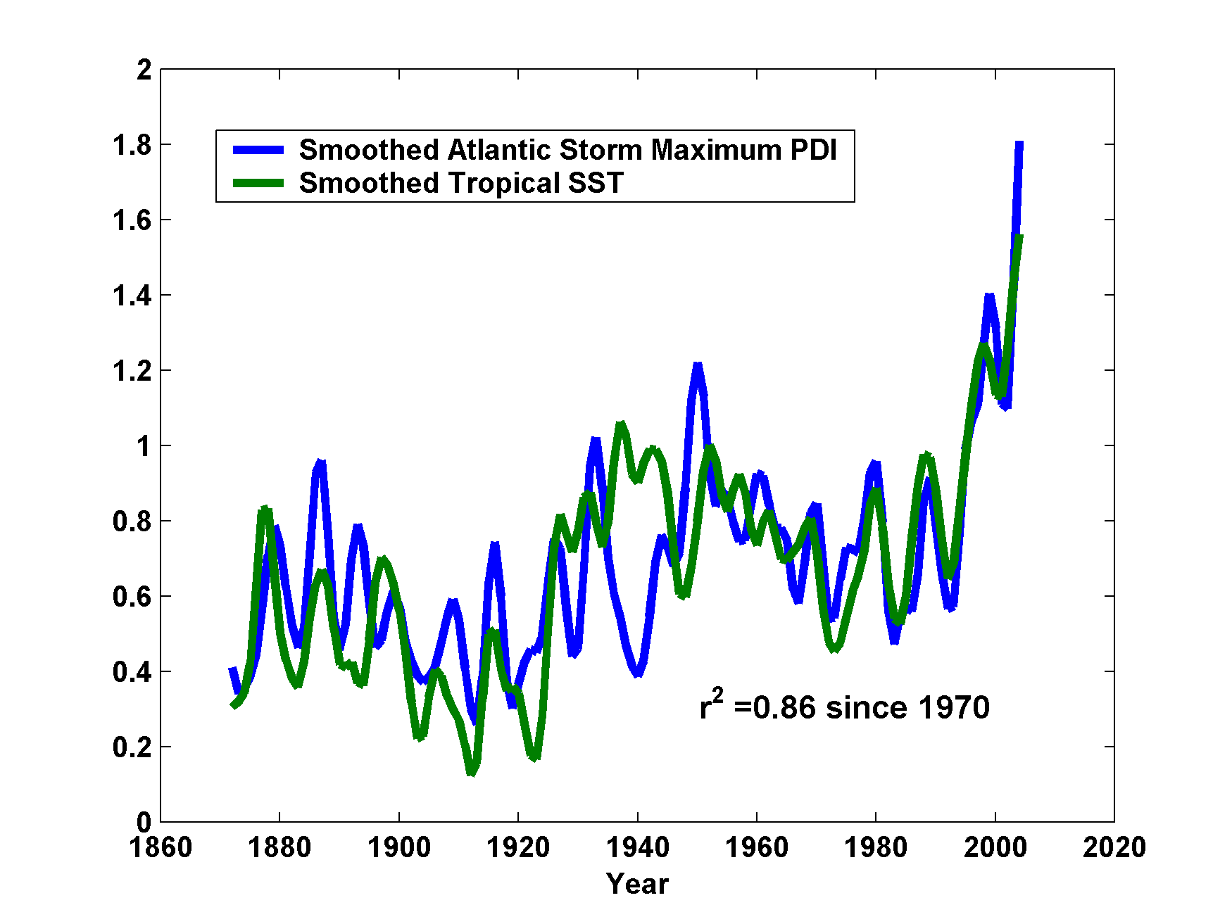
Atlantic Sea Surface Temperatures and Storm Max Power Dissipation
(Smoothed with a 1-3-4-3-1 filter)
Years included: 1870-2006
Power Dissipation Index (PDI)
Scaled Temperature
Data Sources: NOAA/TPC, UKMO/HADSST1
Notes:
3
The low value of storm power in the early 1940s is thought to be due to the lack of reports from ships at sea because of the radio silence imposed during WWII.

Slide 4
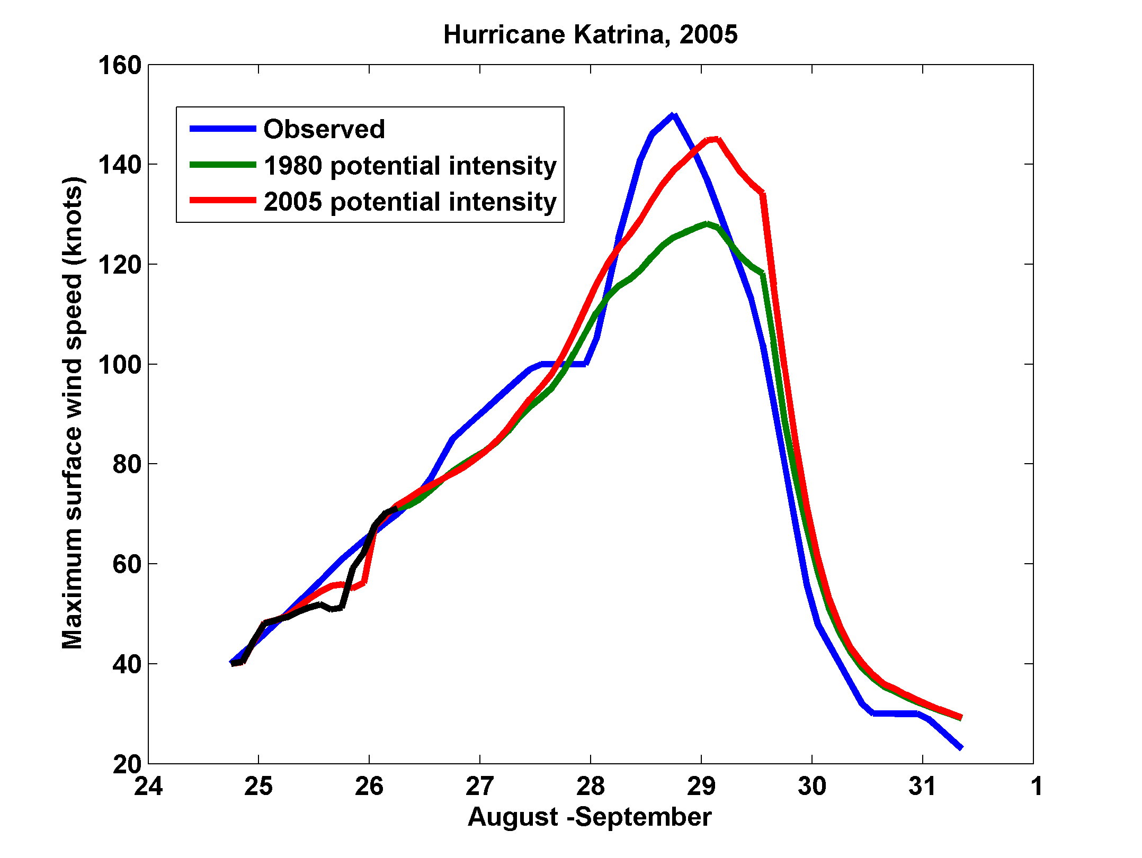
Effect of Increased Potential Intensity on Hurricane Katrina

Slide 5
Some U.S. Hurricane Damage Statistics:
>50% of all normalized damage caused by top 8 events, all category 3, 4 and 5
>90% of all damage caused by storms of category 3 and greater
Category 3,4 and 5 events are only 13% of total landfalling events; only 30 since 1870
Landfalling storm statistics are grossly inadequate for assessing hurricane risk

Slide 6
Using Global and Regional Models to Simulate Hurricanes
The Problem:
Global models are far too coarse to simulate high intensity tropical cyclones
Embedding regional models within global models introduces problems stemming from incompatibility of models, and even regional models are usually too coarse
Models to expensive to run many times.

Slide 7

Histograms of Tropical Cyclone Intensity as Simulated by a Global Model with 50 km grid point spacing. (Courtesy Isaac Held, GFDL)
Category 3

Slide 8
To the extent that they simulate tropical cyclones at all, global models simulate storms that are largely irrelevant to society and to the climate system itself, given that ocean stirring effects are heavily weighted towards the most intense storms

Slide 9
What are the true resolution requirements for simulating tropical cyclones?

Slide 10
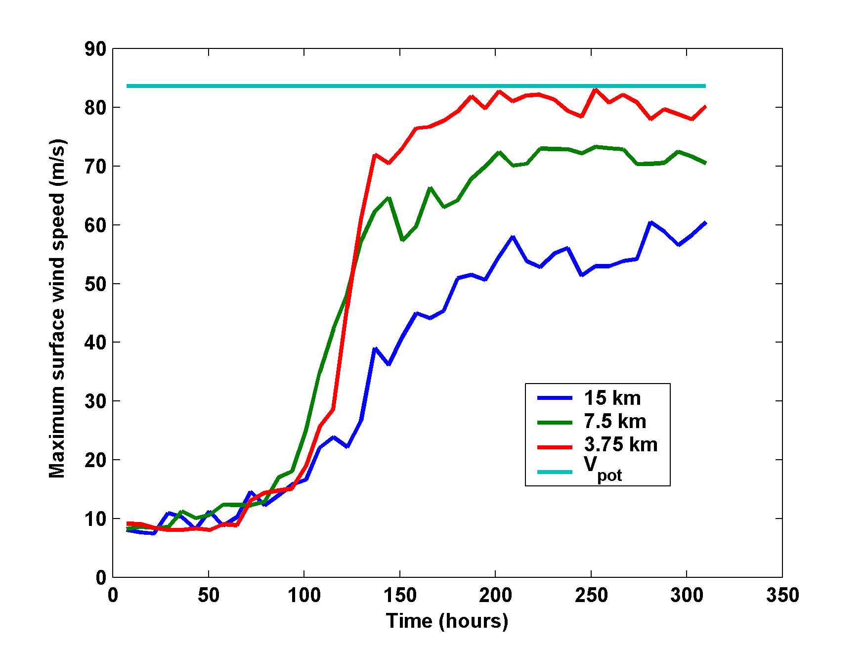
Numerical convergence in an axisymmetric, nonhydrostatic model (Rotunno and Emanuel, 1987)

Slide 11
Our Solution:
Drive a simple but very high resolution, coupled ocean-atmosphere TC model using boundary conditions supplied by the global model or reanalysis data set

Slide 12
Risk Assessment Approach:
Step 1: Seed each ocean basin with a very large number of weak, randomly located cyclones
Step 2: Cyclones are assumed to move with the large scale atmospheric flow in which they are embedded, plus a correction for beta drift
Step 3: Run the CHIPS model for each cyclone, and note how many achieve at least tropical storm strength
Step 4: Using the small fraction of surviving events, determine storm statistics.
Details: Emanuel et al., BAMS, 2008
Notes:
12

Slide 13
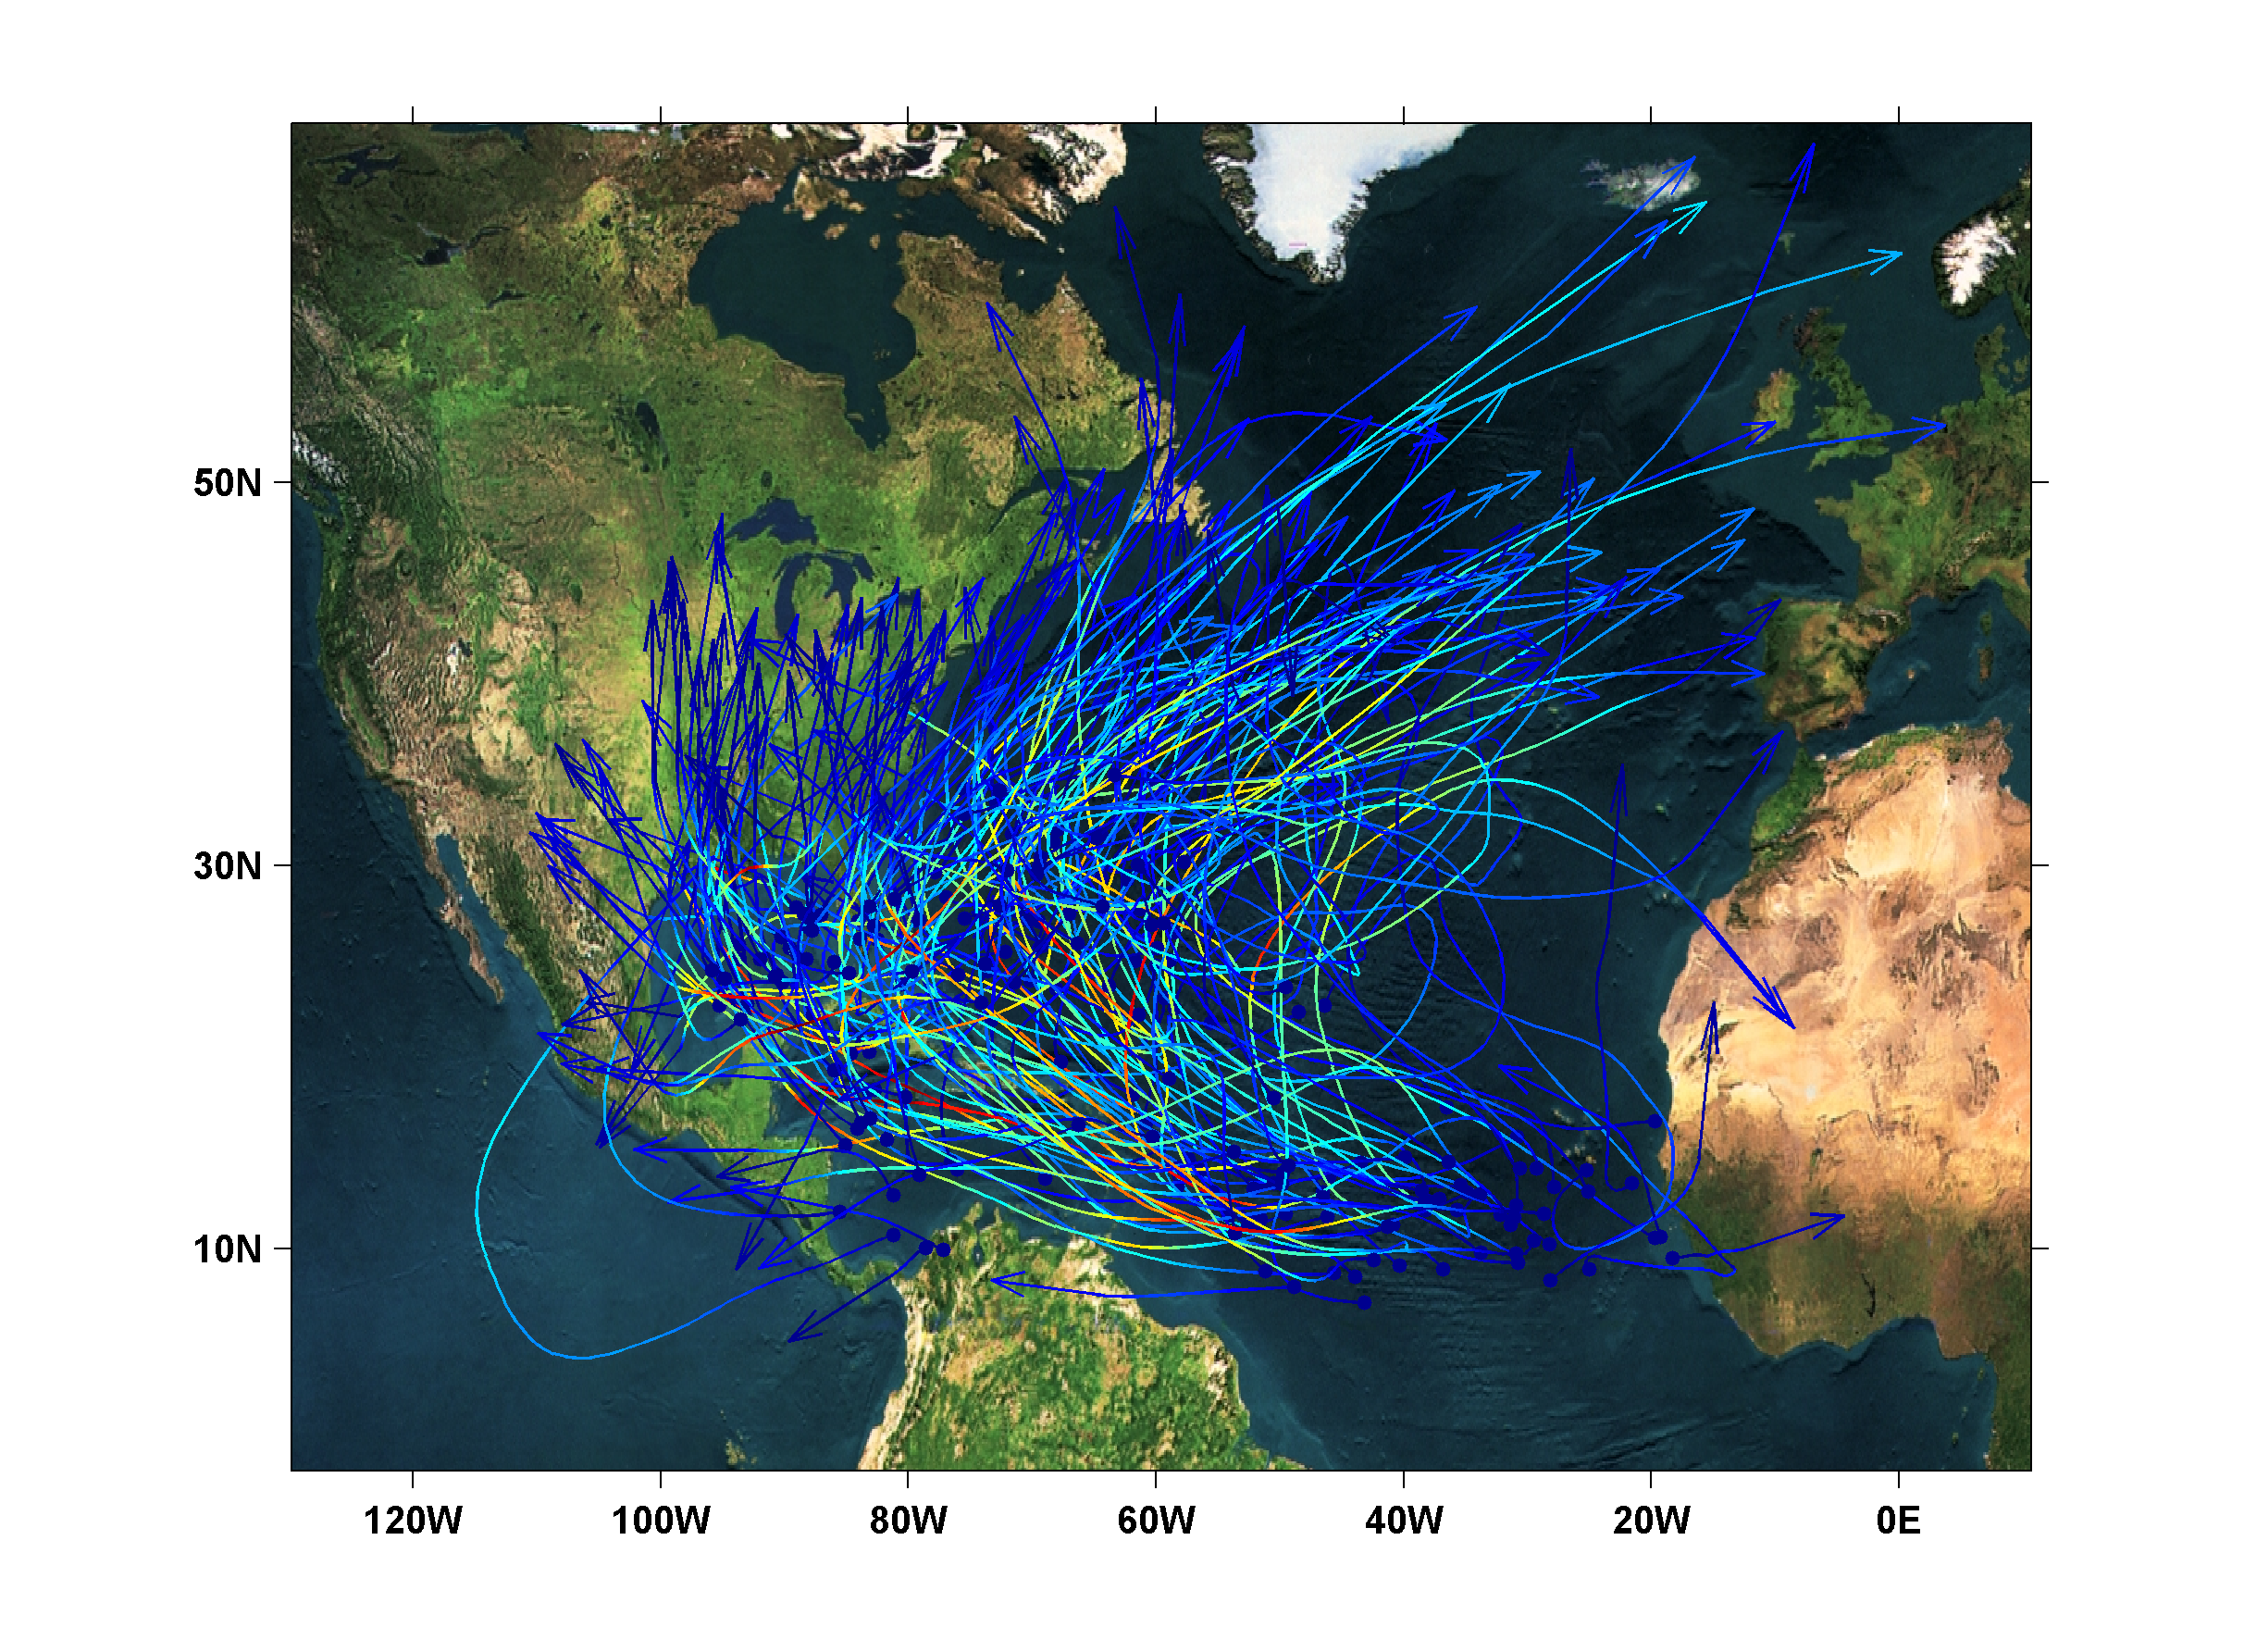
200 Synthetic U.S. Landfalling tracks (color coded by Saffir-Simpson Scale)

Slide 14
Calibration
Absolute genesis frequency calibrated to North Atlantic during the period 1980-2005
Notes:
14

Slide 15
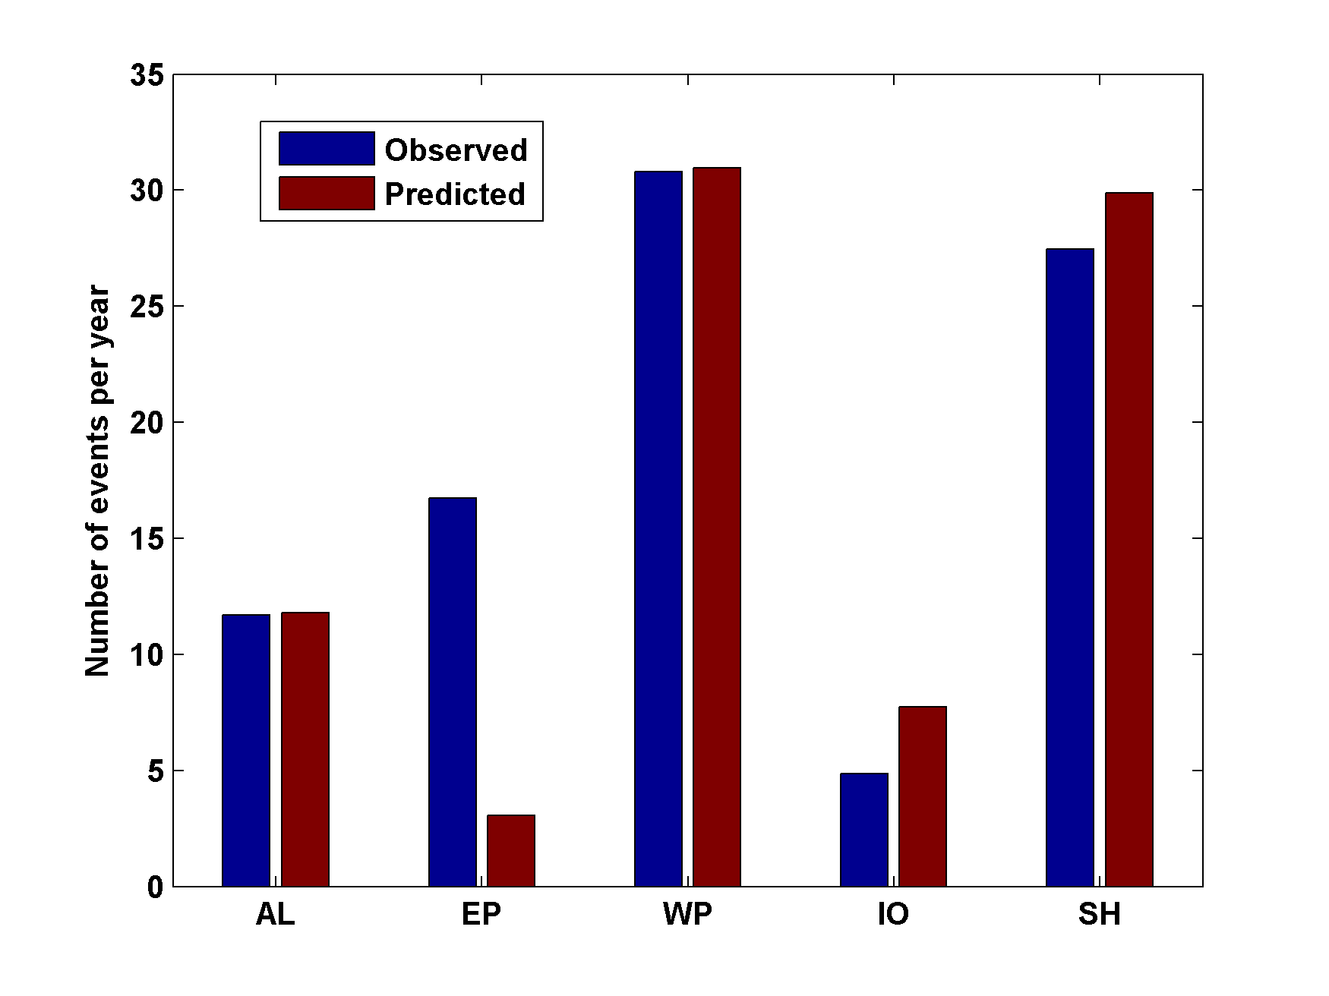
Genesis rates
Western North Pacific
Southern Hemisphere
Eastern North Pacific
Atlantic
North Indian Ocean
Calibrated to Atlantic
Notes:
15

Slide 16
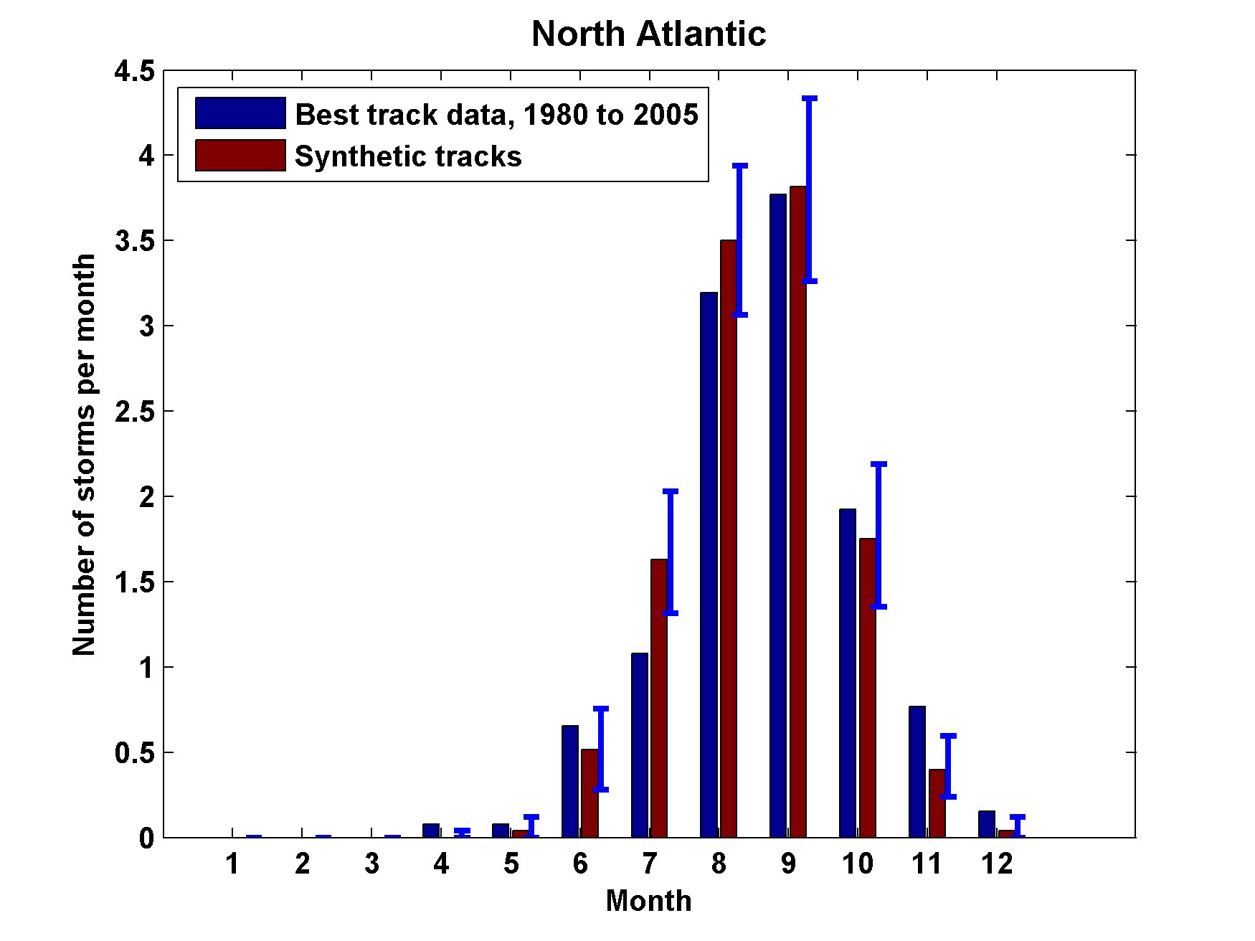
Seasonal Cycles
Atlantic
Notes:
16

Slide 17

Cumulative Distribution of Storm Lifetime Peak Wind Speed, with Sample of 1755 Synthetic Tracks
95% confidence bounds

Slide 18

Return Periods

Slide 19
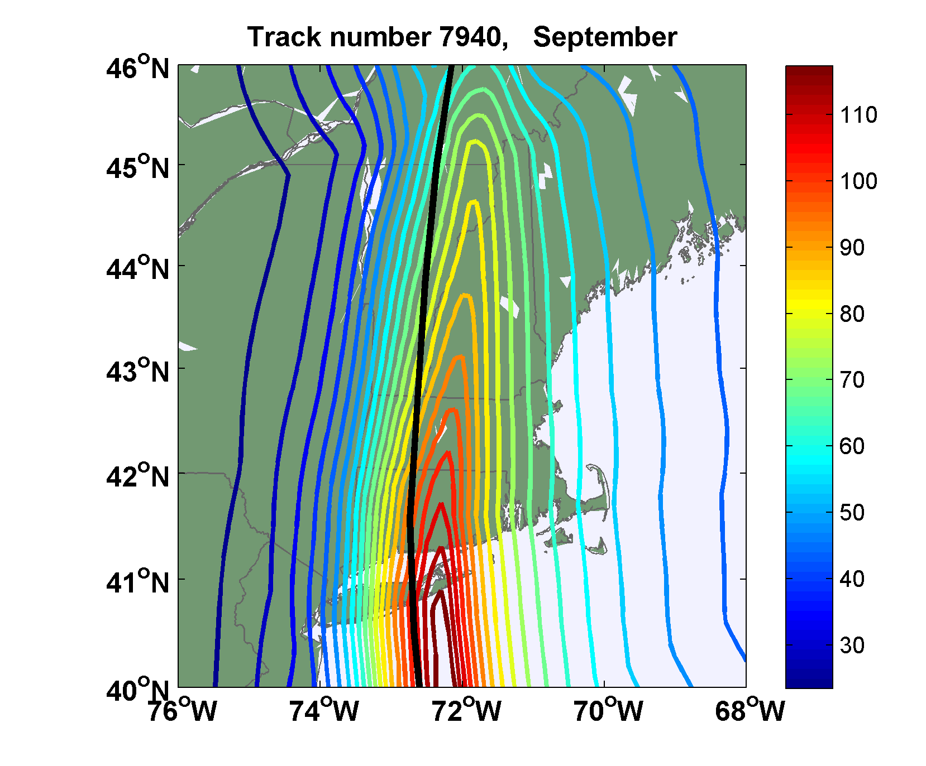
Sample Storm Wind Swath

Slide 20
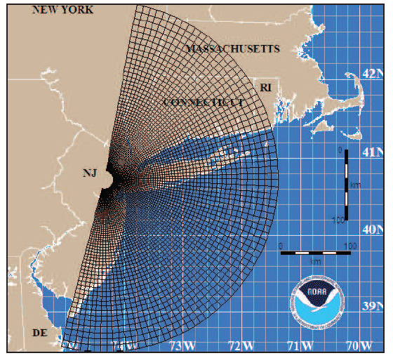
Couple to Storm Surge Model (SLOSH)
Courtesy of Ning Lin, Princeton University

Slide 21
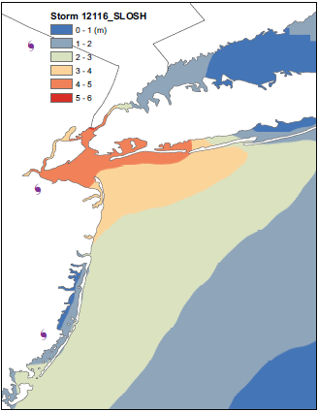
Surge map for single event

Slide 22
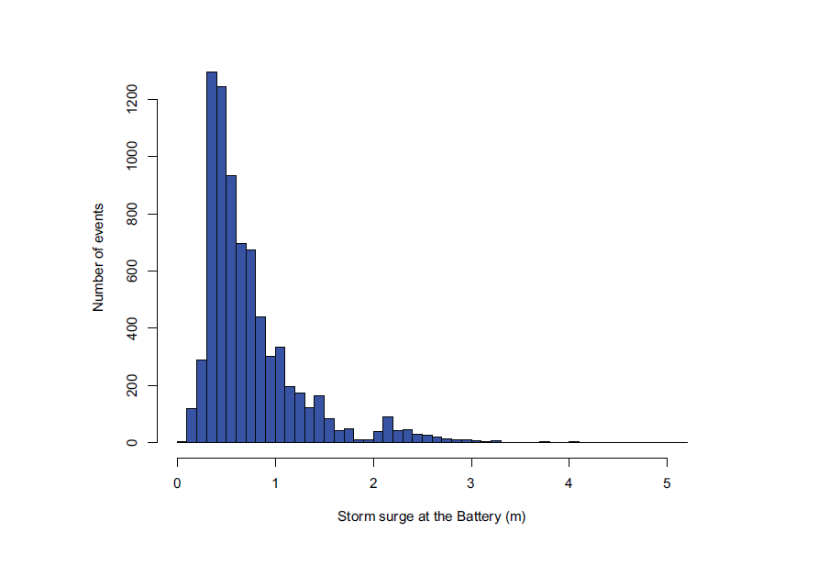
Histogram of the SLOSH-model simulated (primary) storm surge at the Battery for 7555 synthetic tracks that pass within 200 km of the Battery site.

Slide 23
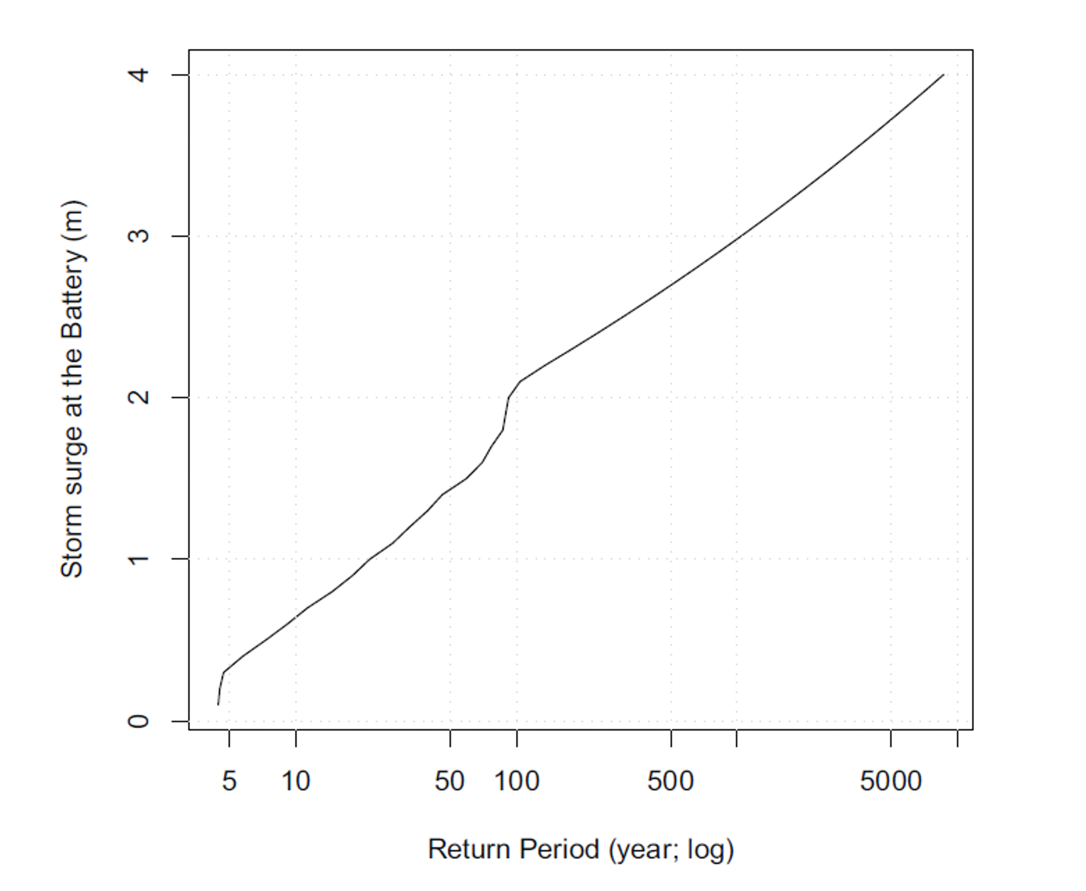
Surge Return Periods, New York City

Slide 24
Now Use Daily Output from IPCC Models to Derive Wind Statistics, Thermodynamic State Needed by Synthetic Track Technique

Slide 25
1. Last 20 years of 20th century simulations
2. Years 2180-2200 of IPCC Scenario A1b (CO₂ stabilized at 720 ppm)
Compare two simulations each from 7 IPCC models:

Slide 26
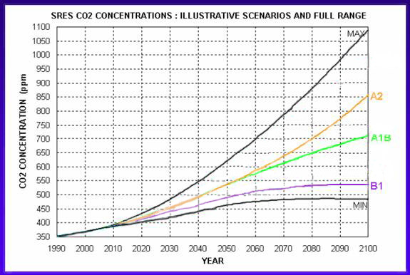
IPCC Emissions Scenarios
This study

Slide 27
Projected Warming:
This study

Slide 28
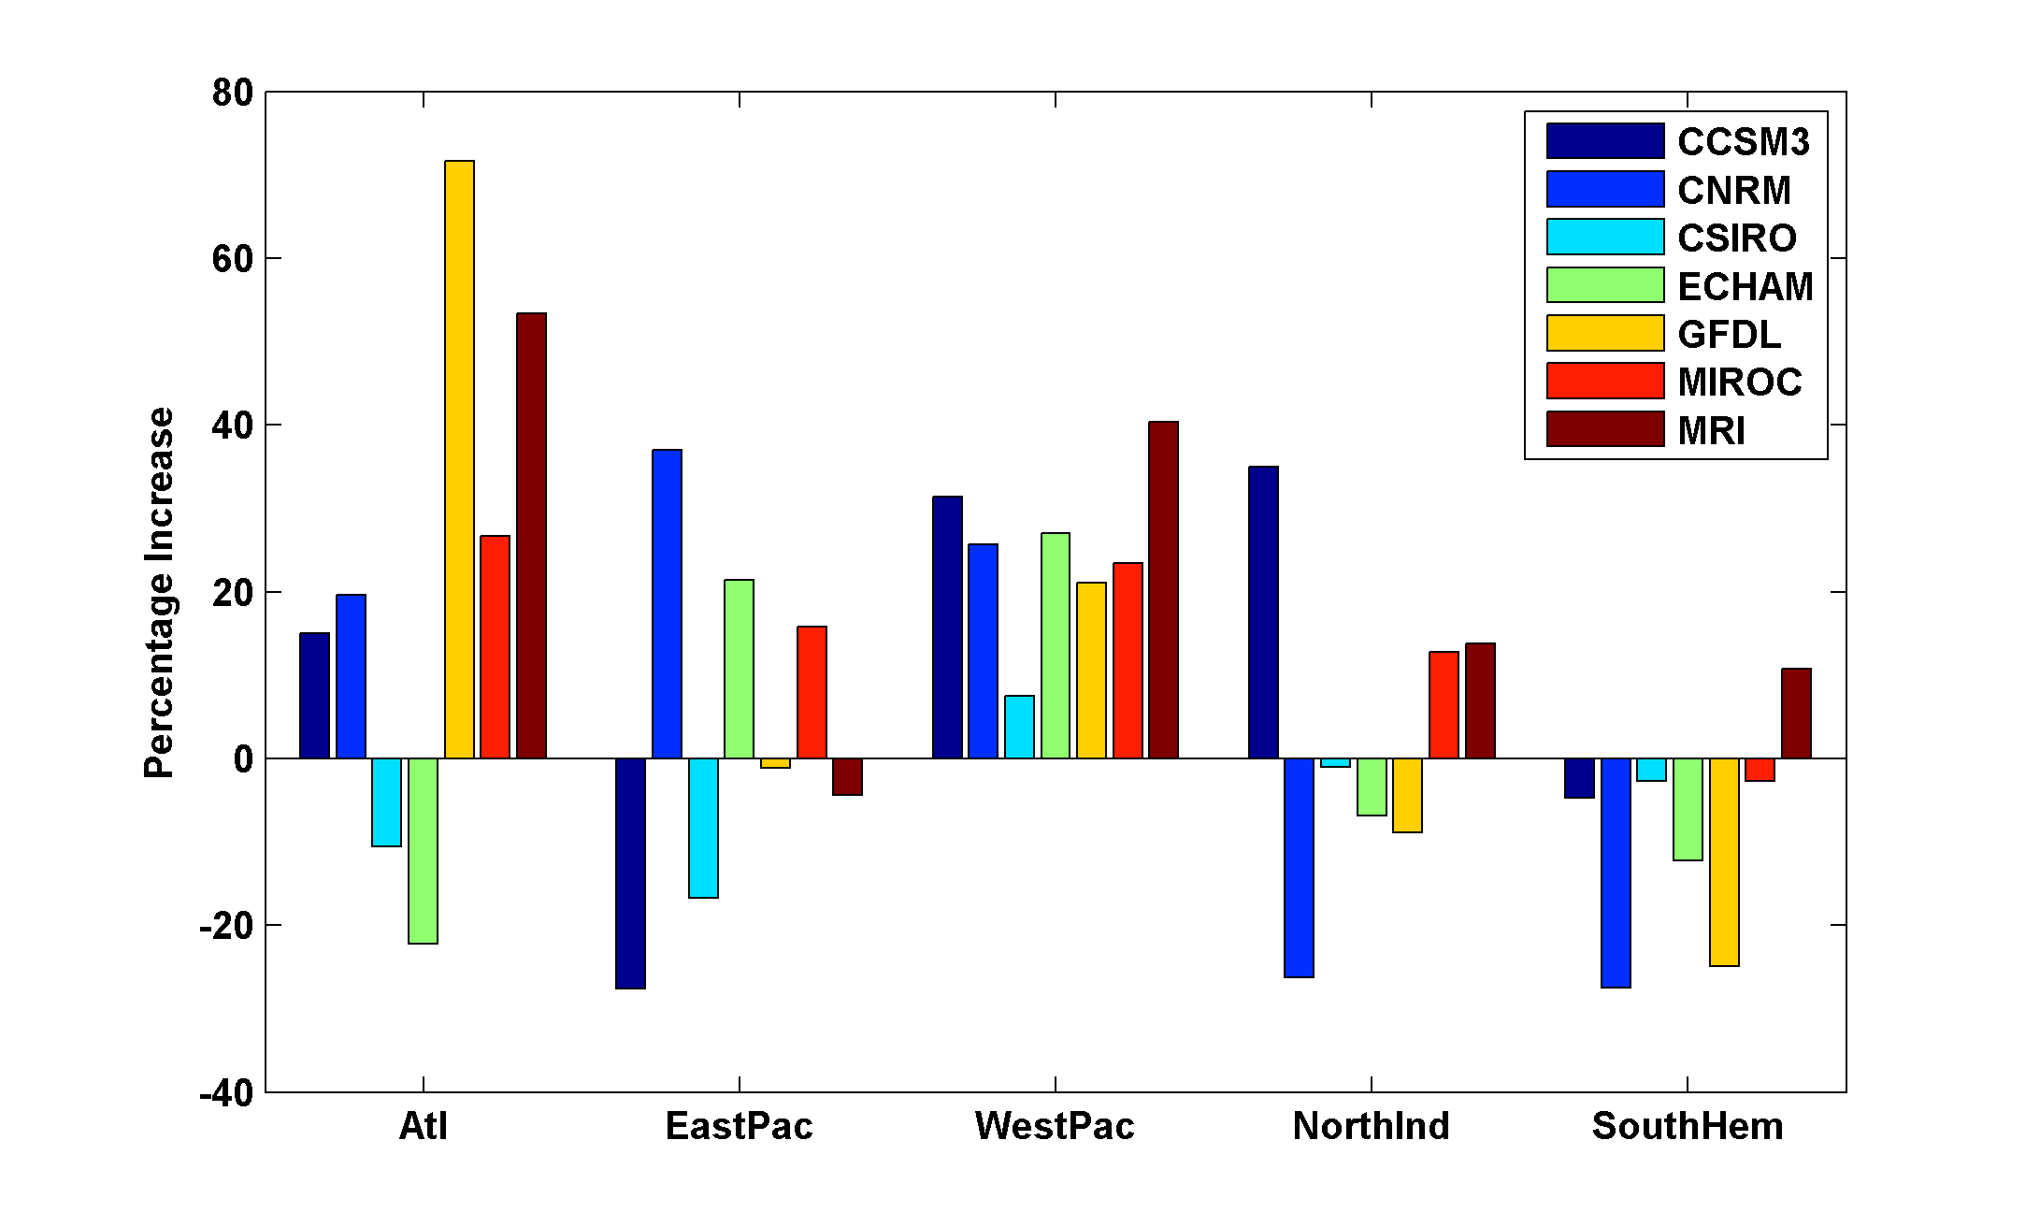
Basin-Wide Percentage Change in Power Dissipation
Different Climate Models
Notes:
28
28

Slide 29
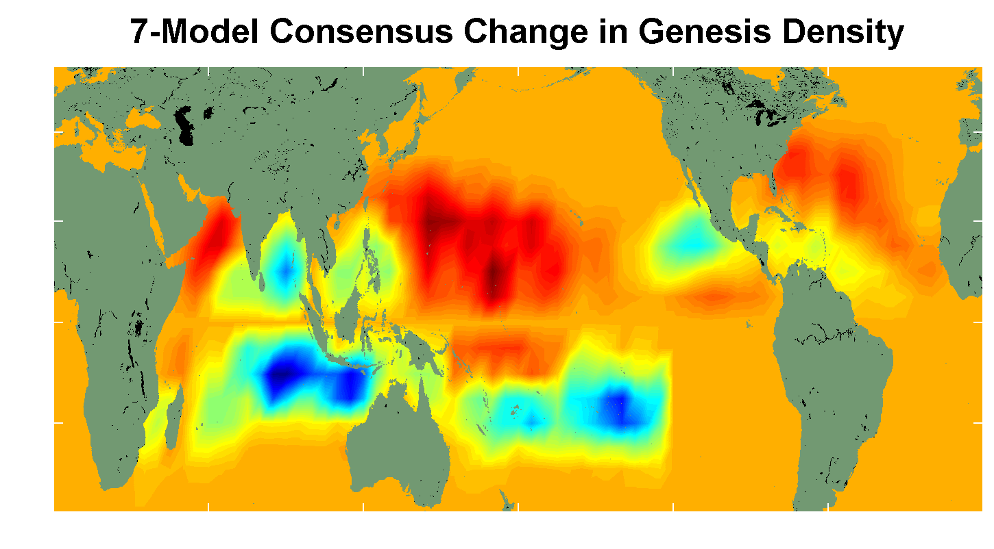
7 Model Consensus Change in Storm Frequency
Notes:
29
29

Slide 30
Economic Analysis of Impact of Climate Change on Tropical Cyclone Damage
With Robert Mendelsohn
Yale

Slide 31
Assessing the Impact of Climate Change
Measure how climate change affects future extreme events
Reflect any underlying changes in vulnerability in future periods
Estimate damage functions for each type of extreme event
Estimate future extreme events caused by climate change

Slide 32
Integrated Assessment Model
Emissions Trajectory
Climate Scenario
Event Risks
Vulnerability Projection
Damage Function
Damage Estimate

Slide 33
Climate Models
CNRM (France)
ECHAM (Germany)
GFDL (U.S.)
MIROC (Japan; tropical cyclones only)

Slide 34
Baseline Changes in Tropical Cyclone Damage (due to population and income, holding climate fixed)
Current Global Damages: $13.9 billion/yr
Future Global Damages: 30.6 billion/yr
Current Global Deaths: 18,918/yr
Future Global Deaths: 7,168/yr

Slide 35


Examples of Modeling Output
Current and Future Probability Density of U.S. Damages, MIROC Model
Current and Future Damage Probability, MIROC Model

Slide 38
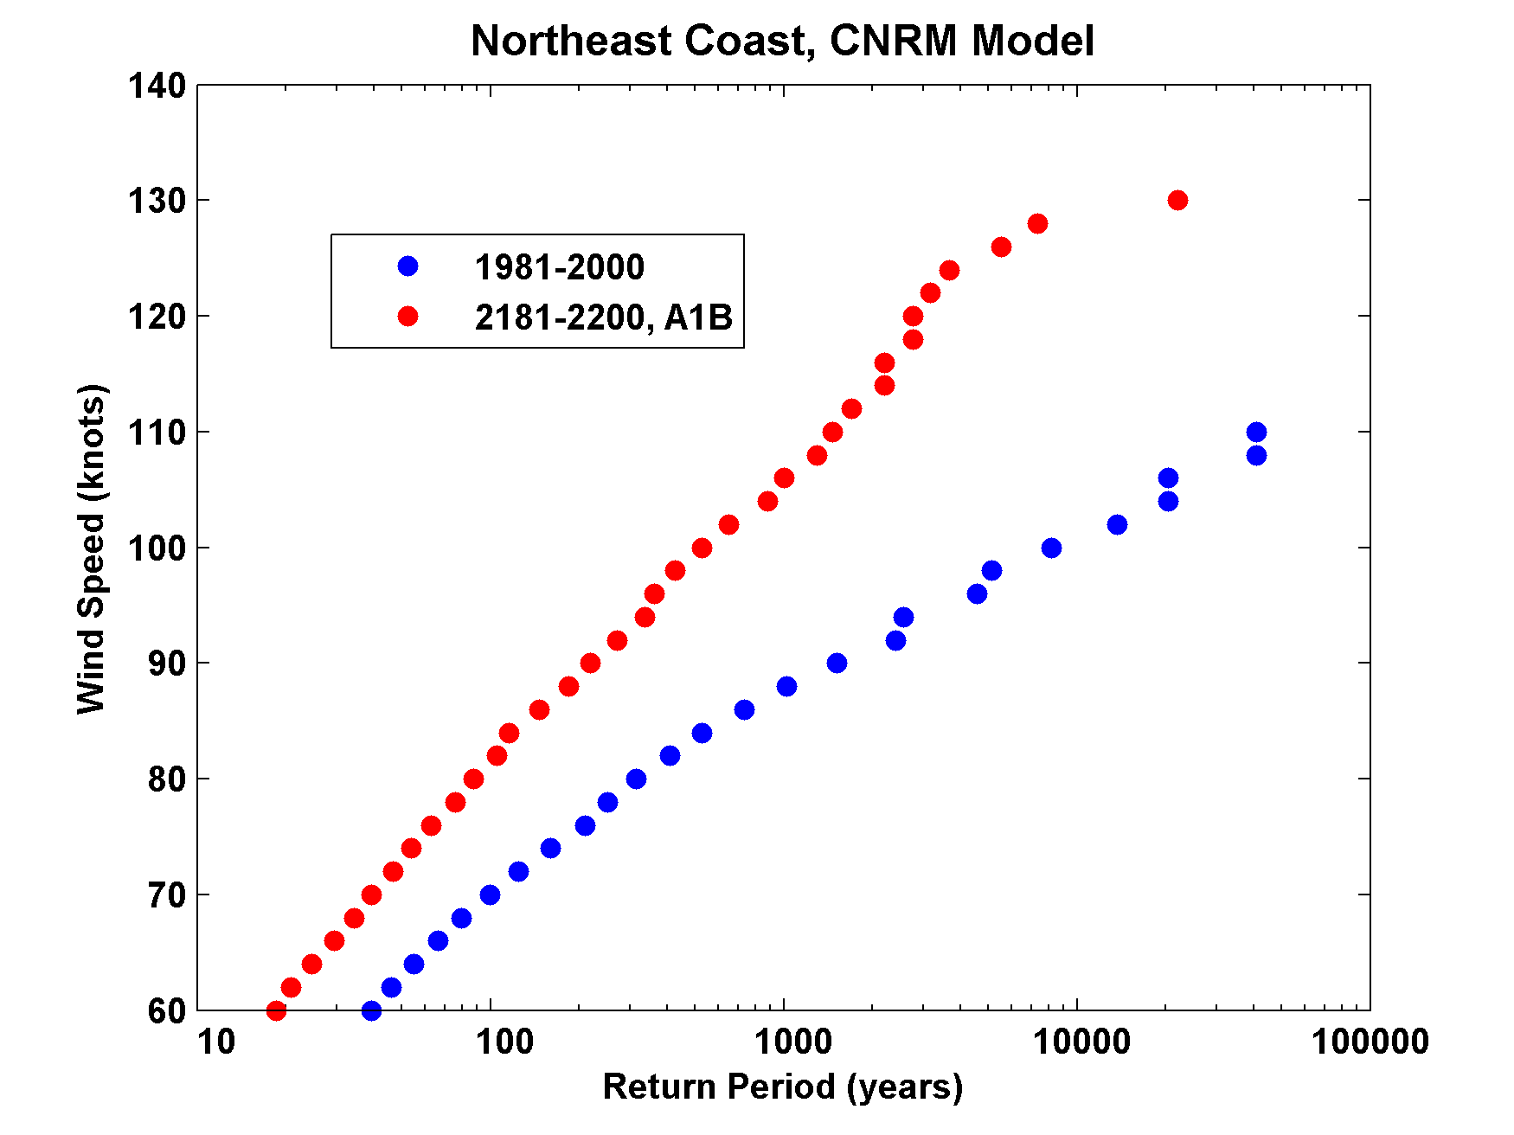

Slide 39
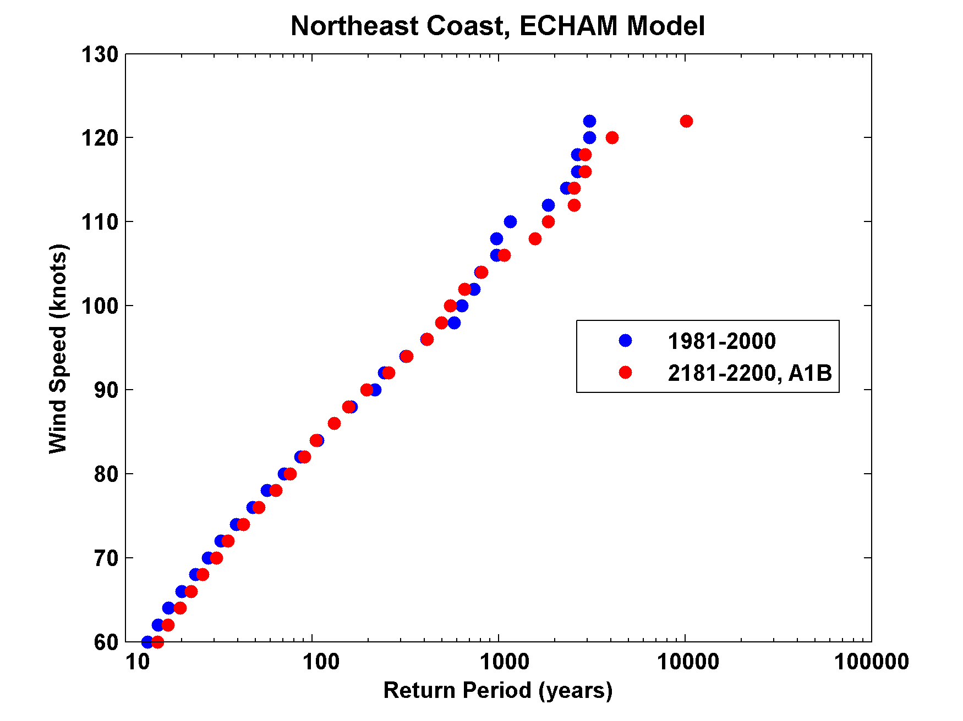

Slide 40
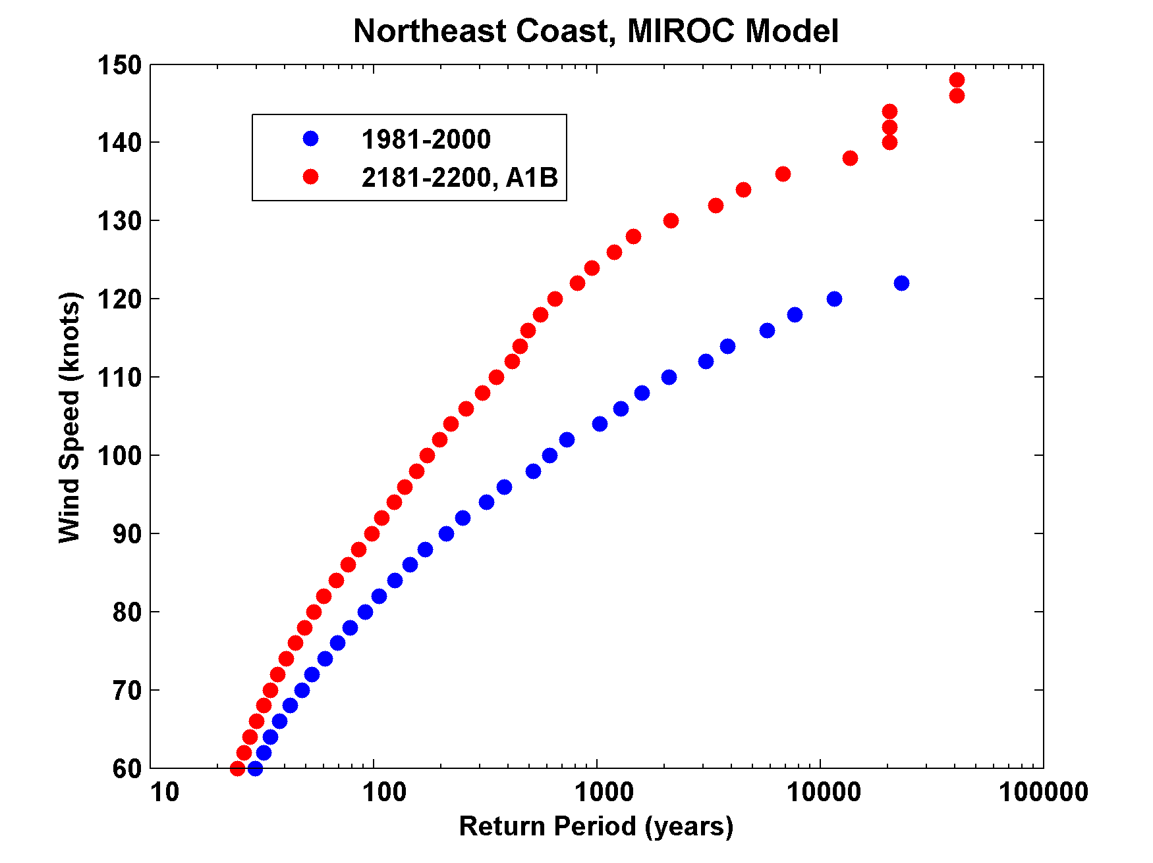

Slide 41
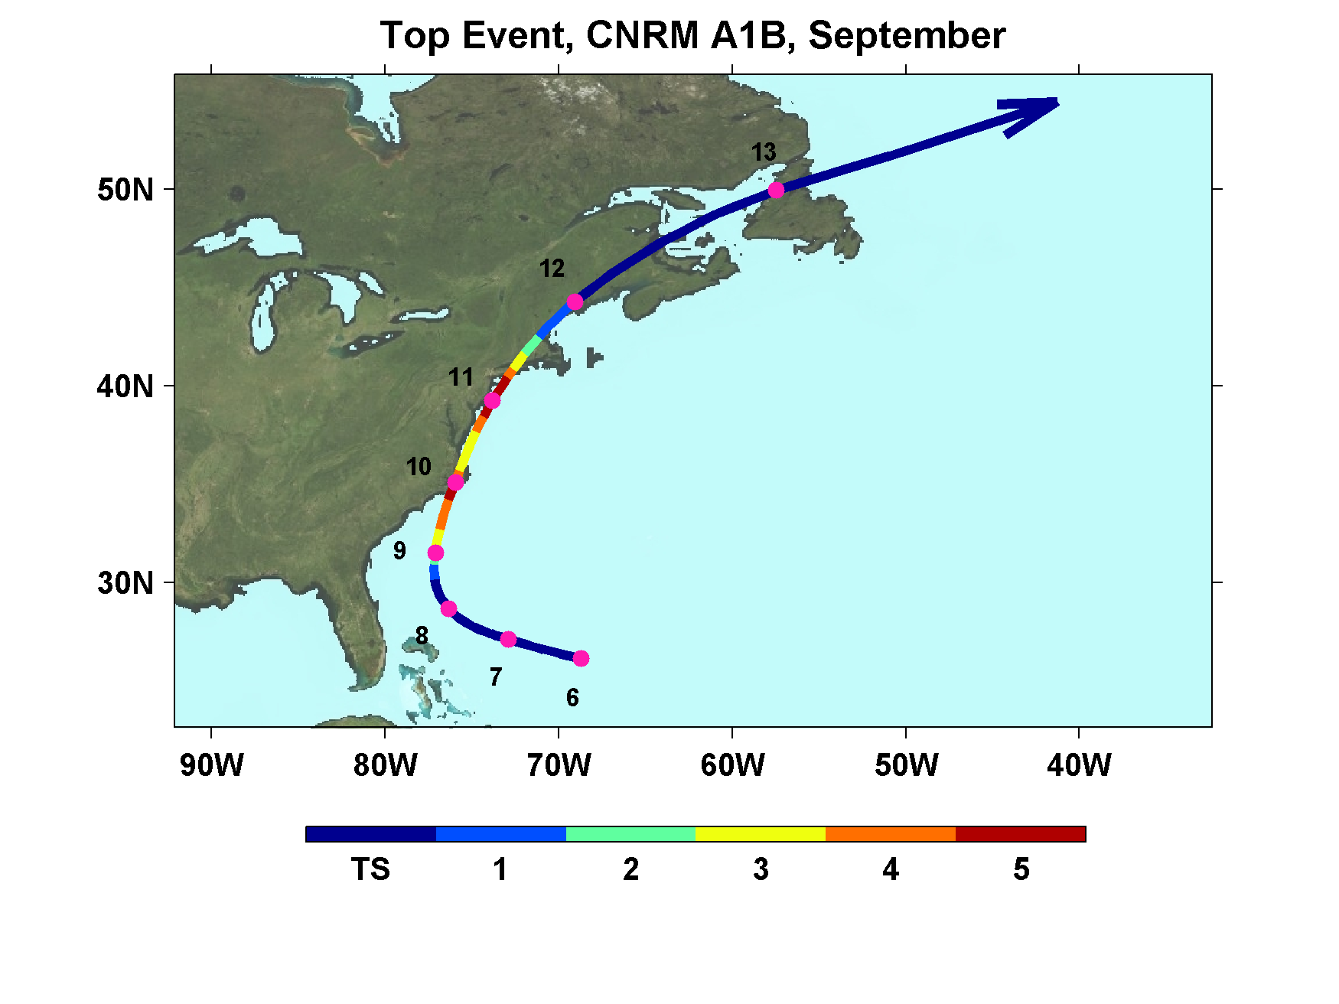

Slide 42
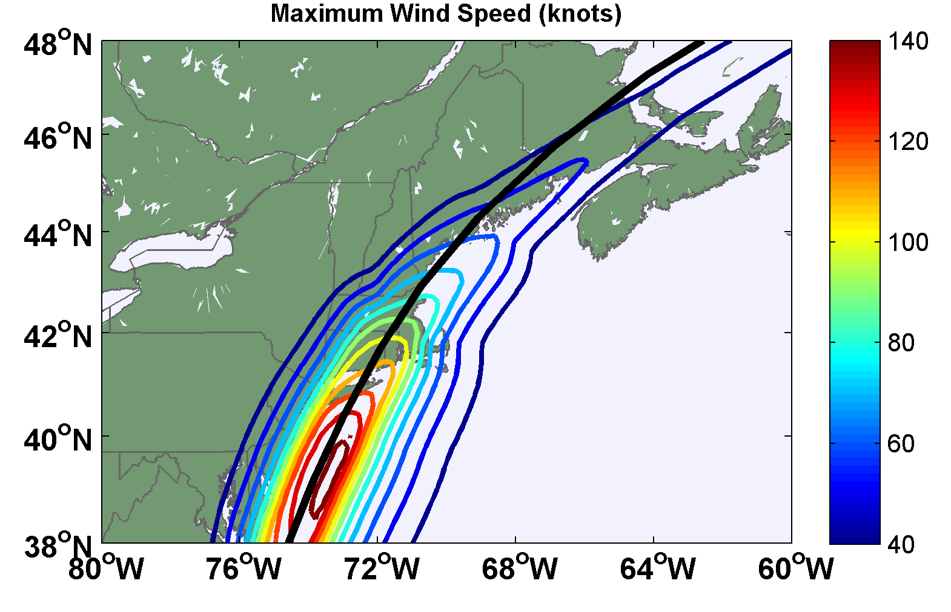

Slide 43
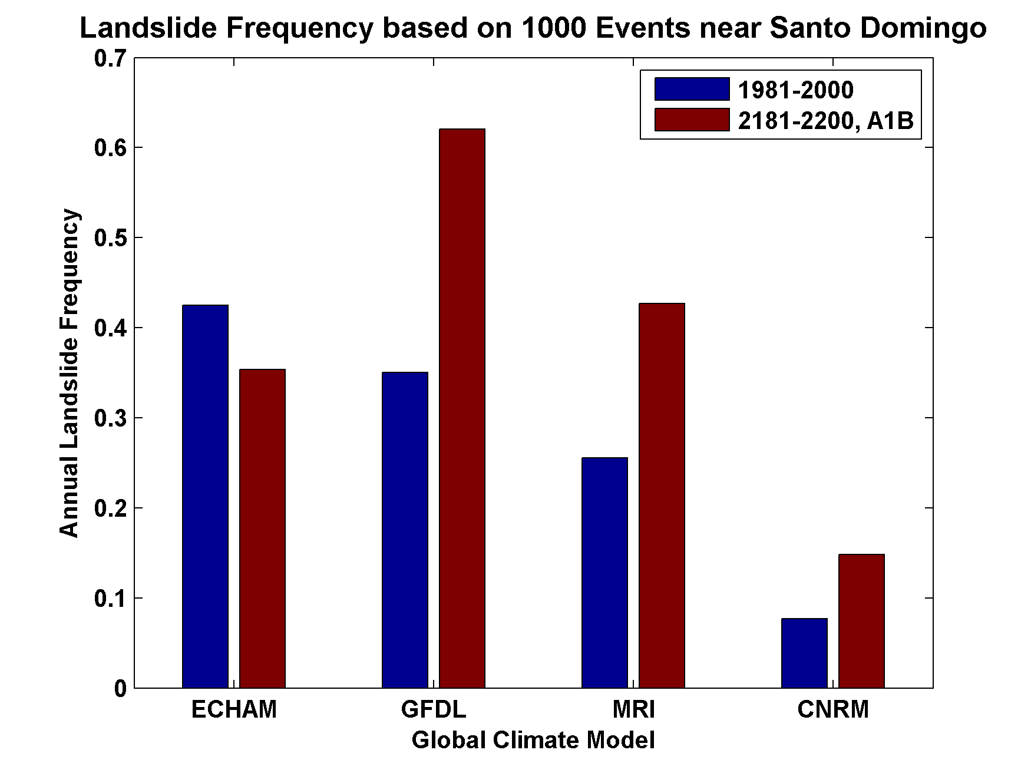
Change in Landslide Risk

Slide 44
Limitations
All steps of the integrated assessment are uncertain: emission path, climate response, tropical cyclone response, and damage function
Sea level rise not yet taken into account
Relationship between storm intensity and fatalities is uncertain
Country level analysis is desirable (likely gains in accuracy from finer resolution analysis)

Slide 45
Summary:
History to short and inaccurate to deduce real risk from tropical cyclones
Global (and most regional) models are far too coarse to simulate reasonably intense tropical cyclones
Globally and regionally simulated tropical cyclones are not coupled to the ocean

Slide 46
We have developed a technique for downscaling global models or reanalysis data sets, using a very high resolution, coupled TC model phrased in angular momentum coordinates
Model shows high skill in capturing spatial and seasonal variability of TCs, has an excellent intensity spectrum, and captures well known climate phenomena such as ENSO and the effects of warming over the past few decades

Slide 47
Application to global models under warming scenarios shows great regional and model-to-model variability. As with many other climate variables, global models are not yet capable of simulating regional variability of TC metrics
Predicted climate impacts from all extreme events (including tropical storms) range from $17 to $25 billion/yr global damages by 2100
Equivalent to 0.003 to 0.004 percent of GWP by 2100
Climate change also predicted to increase fatalities by 2200 to 2500 deaths/yr

