Slide 1

Hurricanes and Hurricane Risk in Barbados
Kerry Emanuel
Lorenz Center, MIT
Notes:
1

Slide 2
Program
Some historical hurricanes affecting Barbados
Using physics to estimate hurricane risk
Current estimates of hurricane risk
How climate change might influence hurricanes affecting Barbados

Slide 3
The Global Hurricane Hazard
About 10,000 deaths per year since 1971
$700 Billion 2015 U.S. dollars in damages annually since 1971
Global population exposed to hurricane hazards has tripled since 1970
EM-DAT, 2016: The OFDA/CRED International Disaster Database
http://www.emdat.be/.

Slide 4
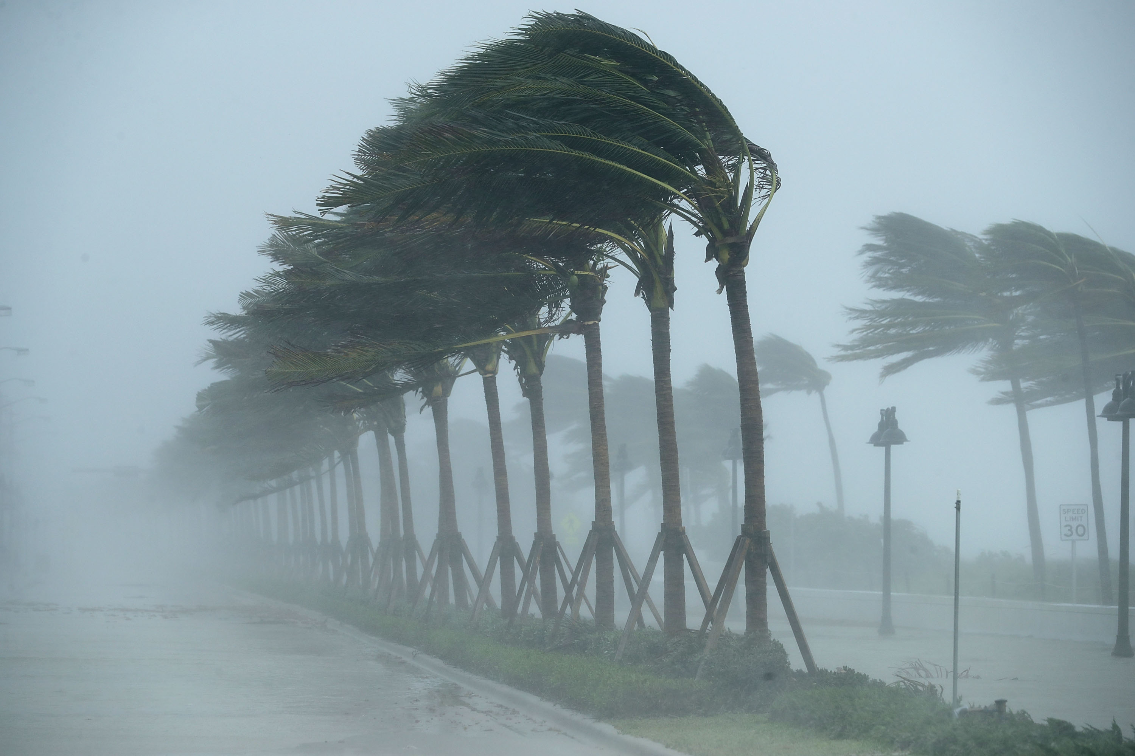
Infamous Barbados Hurricanes

Slide 5
The Great Hurricane of 1780
Almost certainly the most violent hurricane to strike Barbados in recorded history
Deadliest Atlantic hurricane on record, killing more than 22,000 people, including more than 4,500 in Barbados
All houses, forts and trees on Barbados were destroyed
Some estimates of winds speed exceed 200 MPH

Slide 6
The Hurricanes of 1780

Slide 7
The Great Barbados Hurricane of 1831
Destroyed Bridgetown
Killed 1,500 people on the island
17 foot storm surge
Among many buildings destroyed was St. John’s church

Slide 8
The 1898 Windward Islands Hurricane
Winds estimated to have exceeded 100 MPH on Barbados
83 death and 150 injuries
> 5,000 houses destroyed
40,000 – 45,000 people left homeless
Severe damage to sugarcane plantations

Slide 10
Hurricane Janet of 1955
Passed just south of island on September 22
First hurricane to strike Barbados since 1898
Winds on island as strong as 120 MPH
Death toll of 38 on Barbados
$5 million BBD in damage
Later became a Category 5 hurricane and resulted in the loss of a hurricane hunter aircraft with a crew of 11
Total death toll > 1,000

Slide 12
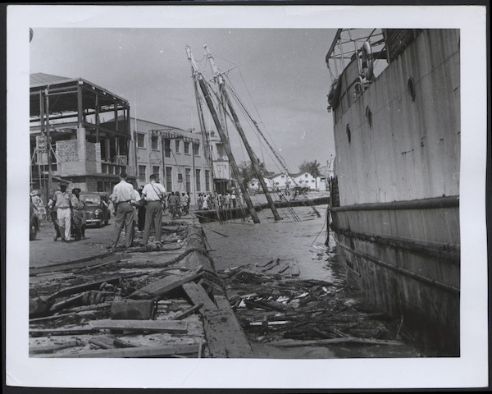
Bridgetown

Slide 13
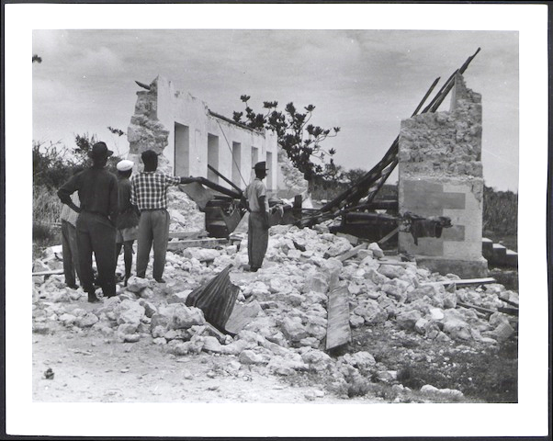
Pilgrim Holiness church

Slide 14
Tropical Storm Tomas, 2010
Passed just to the south of Barbados
Maximum wind gusts of 63 MPH on island
Extensive damage to rooftops
Damages of $17 million BBD

Slide 16
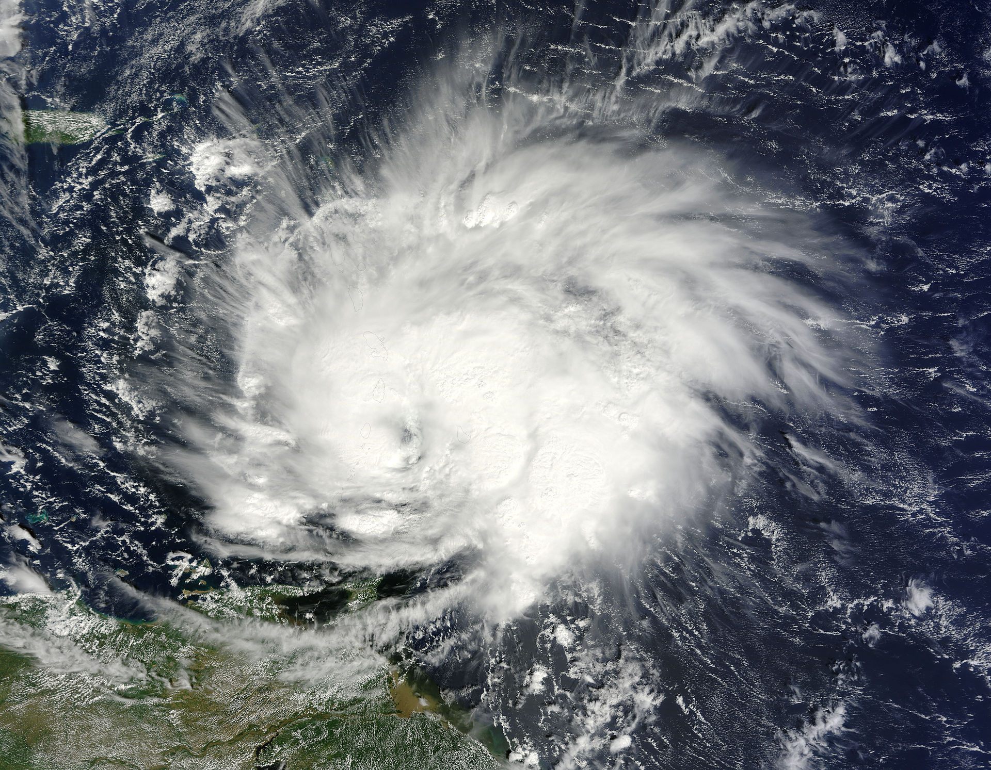
Tropical Storm Tomas near Barbados, October 30, 2010

Slide 17
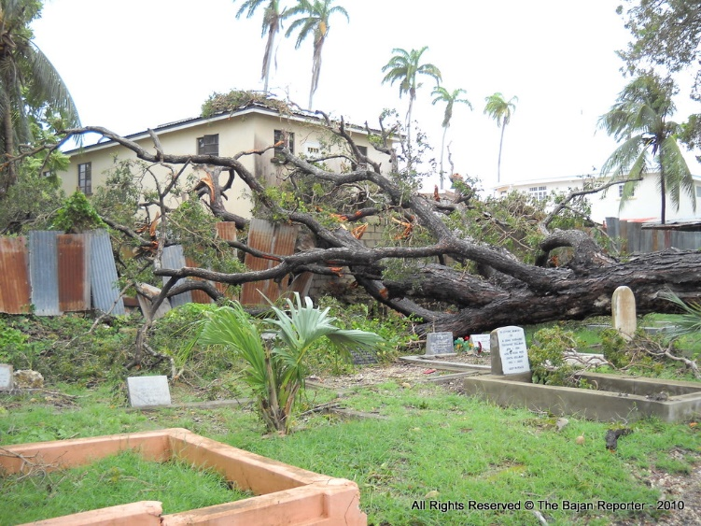
Graveyard by St. Leonard’s Church

Slide 18
Using Physics to Estimate Hurricane Risk

Slide 19
Technique
Embed detailed hurricane forecast model in global climate analyses or climate models
Generate thousands of synthetic hurricane tracks consistent with global climate
Use these synthetic hurricanes to estimate hurricane risk

Slide 20
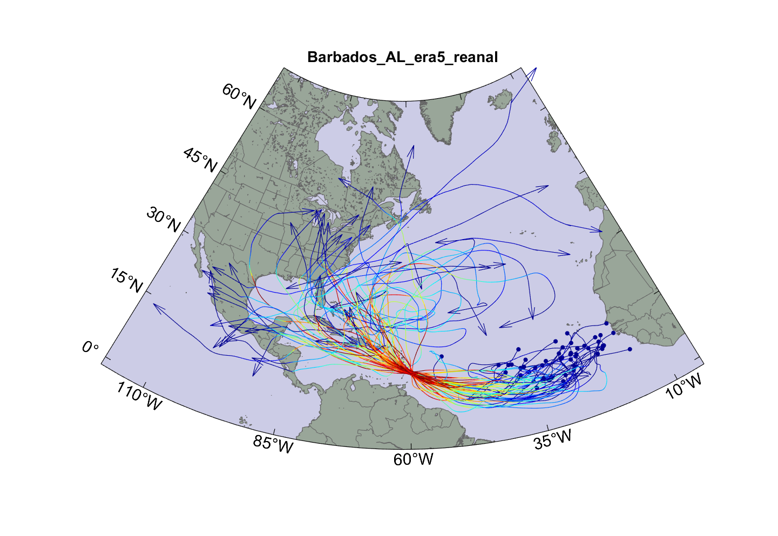
Top 50 of 4,000 synthetic hurricanes affecting Barbados

Slide 21
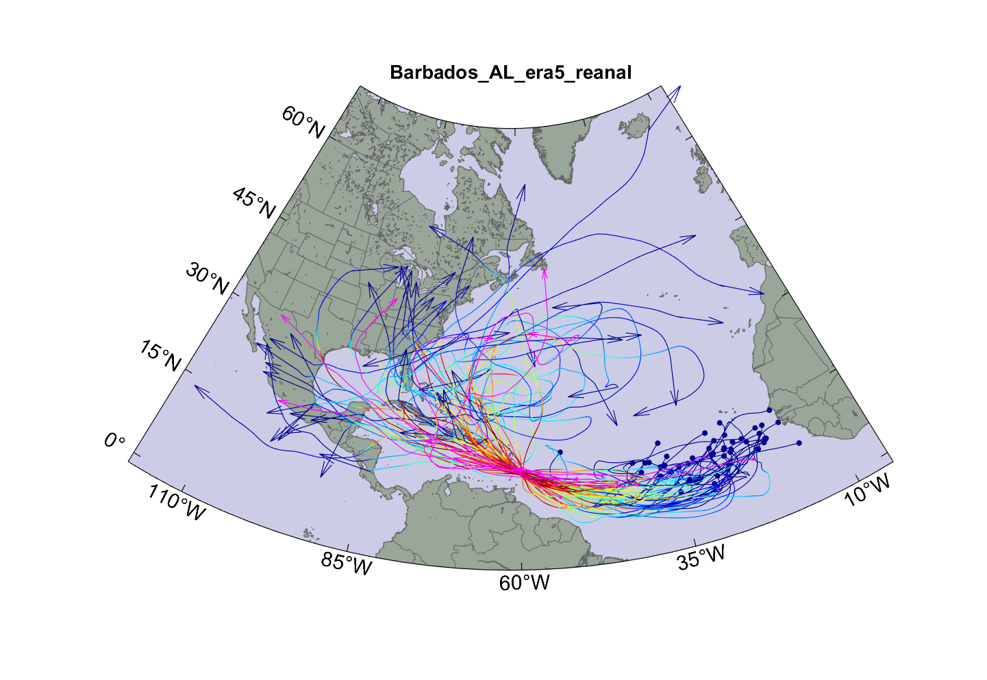
…with 10 historical hurricanes superimposed

Slide 22
Return periods of peak winds within 150 km of Barbados

Slide 23
Peak wind at a point in the center of Barbados
135 knots once in 1,000 years
100 knots once in 100 years
Hurricane force once in 25 years

Slide 24
Storm total rainfall at a point in the center of Barbados
750 mm once in 1,000 years
450 mm once in 100 years

Slide 25
Accounting for Climate Change

Slide 26
Technique
Use same technique but apply it to 6 of the latest generation (CMIP6) global climate models

Slide 27
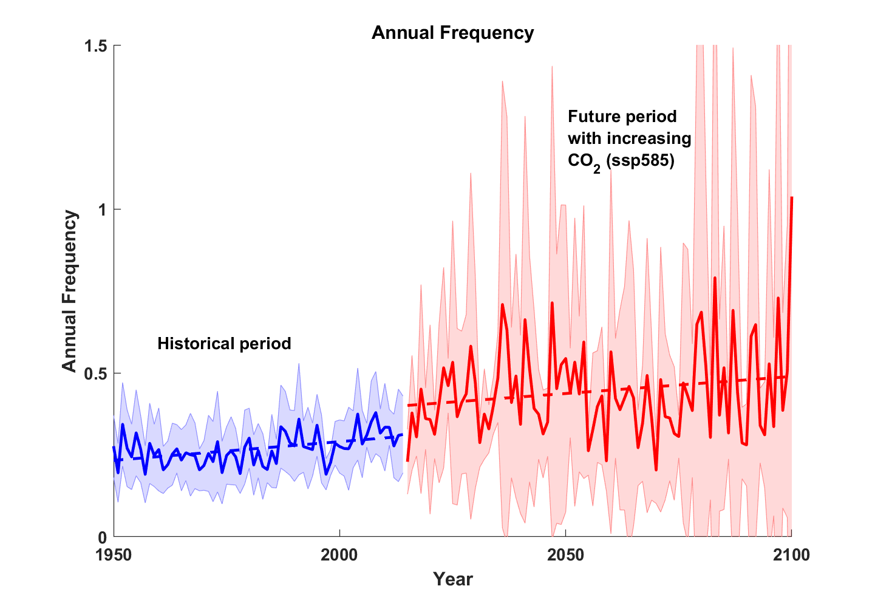
Small but uncertain increase in frequency of tropical cyclones passing within 150 km of Barbados
Shading indicates scatter among global climate models

Slide 28
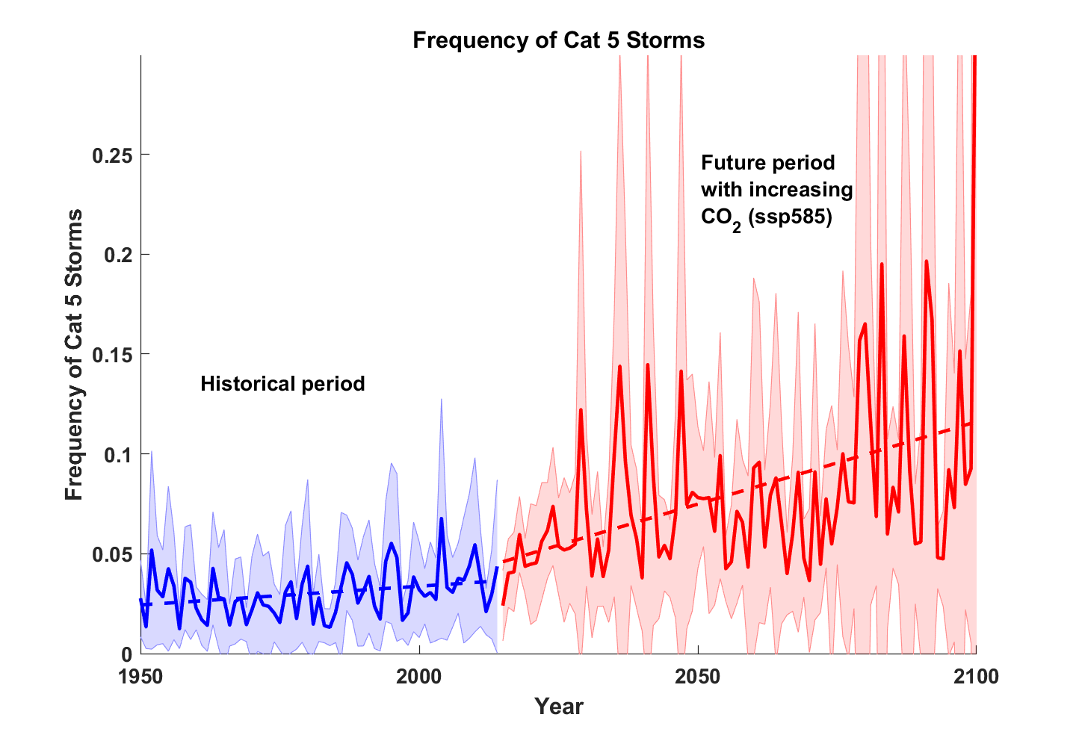
Larger and less uncertain increase in frequency of Cat 5 hurricanes passing within 150 km of Barbados
Shading indicates scatter among global climate models

Slide 29
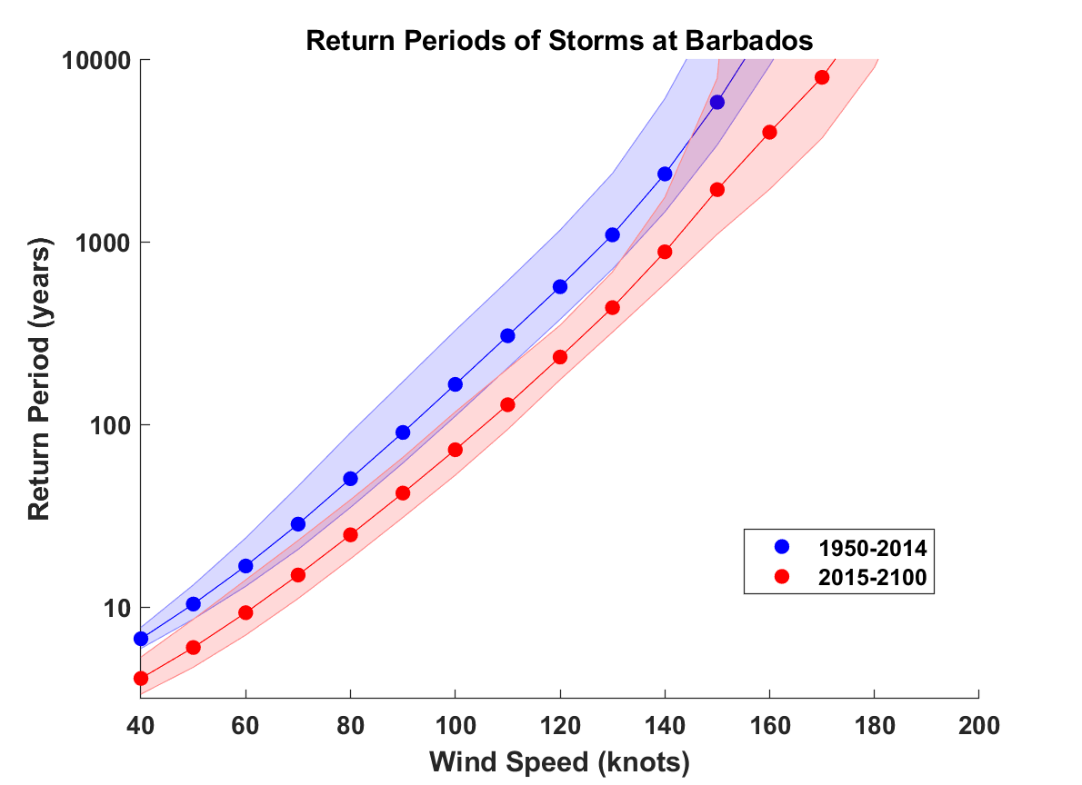
Peak wind at a point in the center of Barbados
130 kts once in 1,100 years
100 kts once in 165 years
130 kts once in 430 years
100 kts once in 70 years

Slide 30
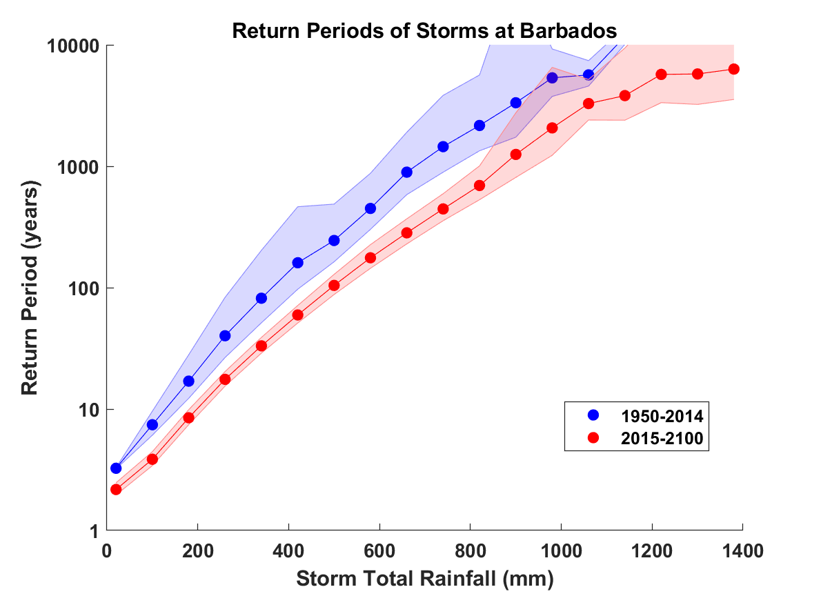
Storm total rainfall at a point in the center of Barbados
660 mm once in 890 years
420 mm once in 160 years
660 mm once in 280 years
420 mm once in 60 years

Slide 31
Summary
Barbados lies on the southern edge of the main hurricane belt, but experiences occasional hurricanes, some of which are violent
In the current climate, the annual probability of winds more than 100 MPH at a point in Barbados is around 1%, but this may increase to more than 2% by 2060
In the current climate, the annual probability of rain more than 400 mm at a point in Barbados is around 1%, but this may increase to more than 2% by 2060

