Slide 1
Tropical Cyclones: What Have We Learned and Where Are We Going?
Kerry Emanuel
Lorenz Center
Massachusetts Institute of Technology

Slide 2
Seventy Years of Progress
Observations
Forecasting
Scientific Understanding

Slide 3

Observations (pre-Houze era)
Ships
Islands

Slide 4

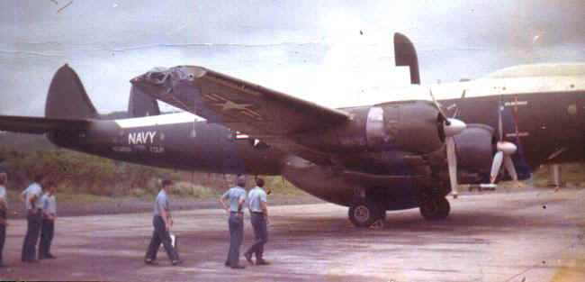
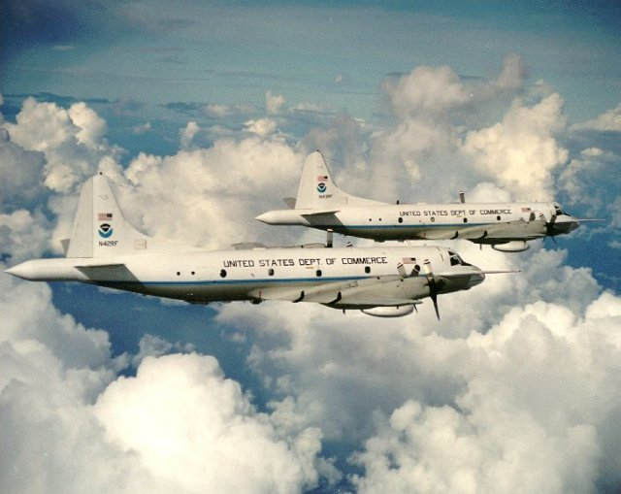

Airborne Reconnaissance
AT-6, 1943
WV-2, 1964
NOAA WP-3Ds
Global Hawk UAV

Slide 5
First Doppler winds in a hurricane: Marks and Houze, BAMS, 1984
Hurricane Debby, 1982

Slide 6
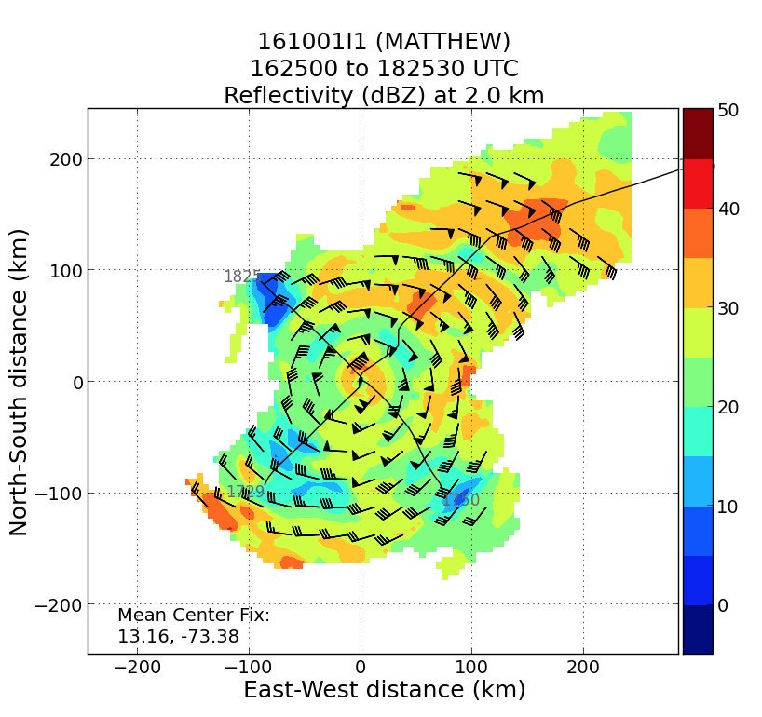
Doppler winds are now routinely collected in Atlantic tropical cyclones

Slide 7
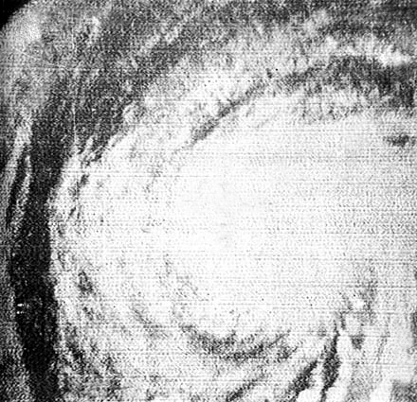
First tropical cyclone to be discovered using satellite imagery: Hurricane Esther of 1961

Slide 8
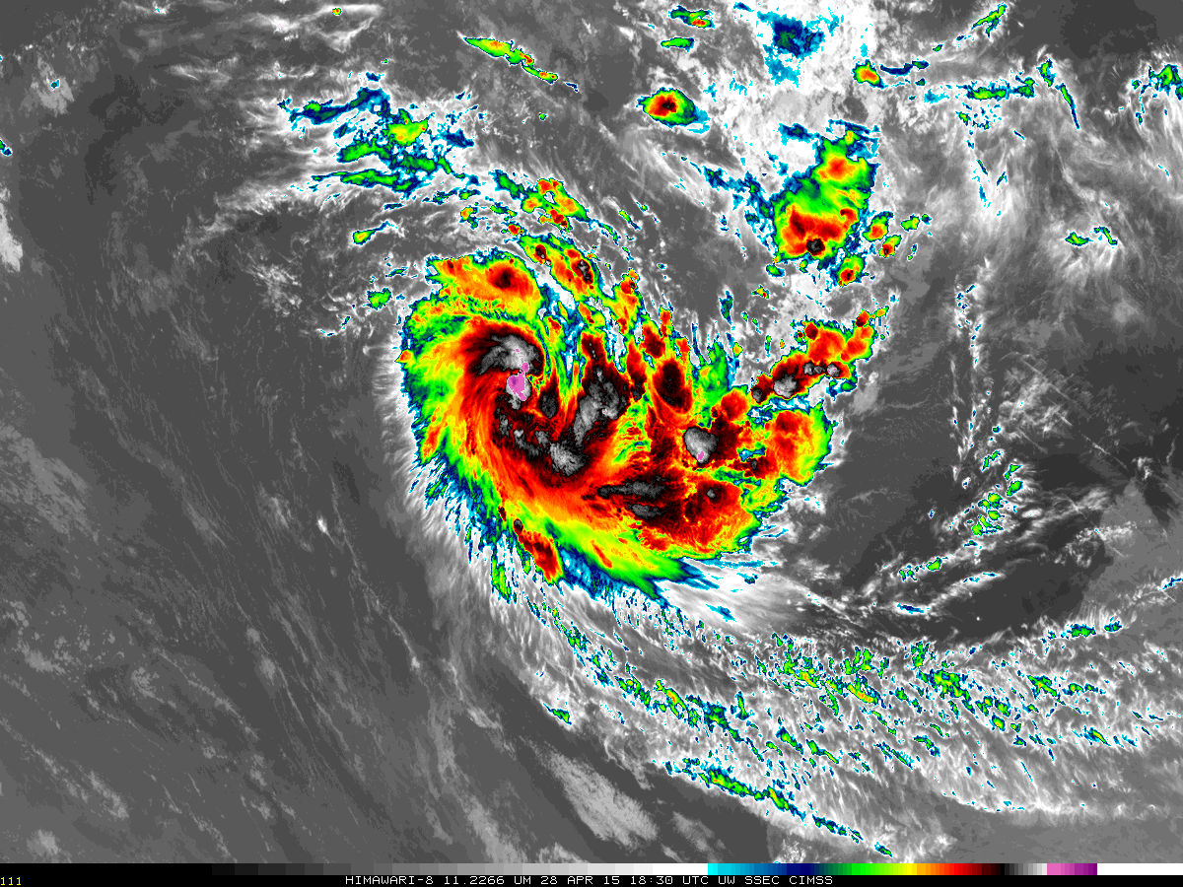
Himawari image of Depression 24S northwest of Australia, 1830 UTC 28 April 2015

Slide 9
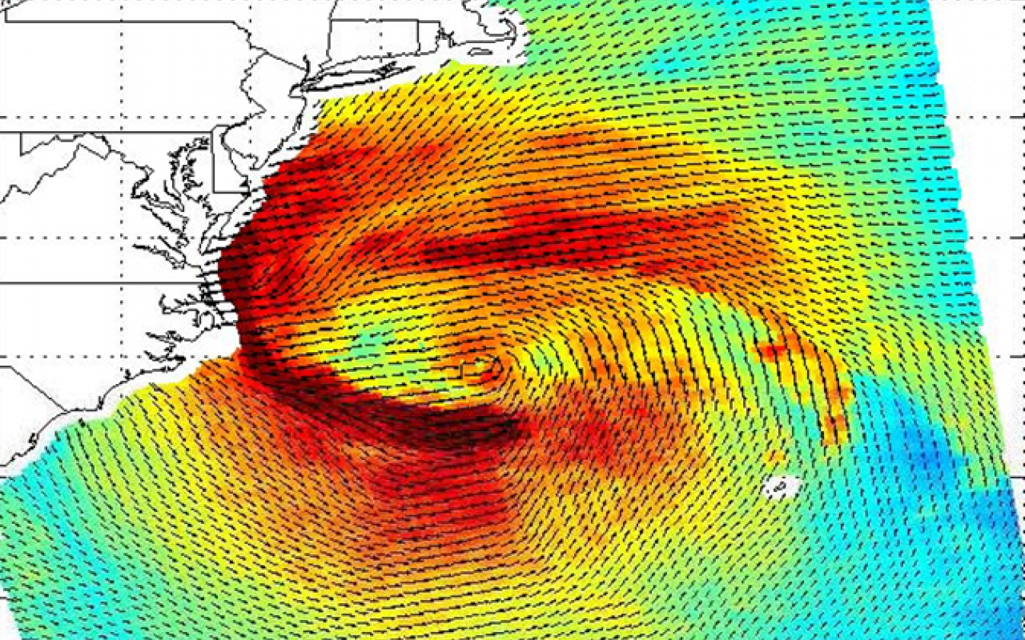
Scatterometer winds in Hurricane Sandy, 04 GMT 29 October 2012

Slide 10
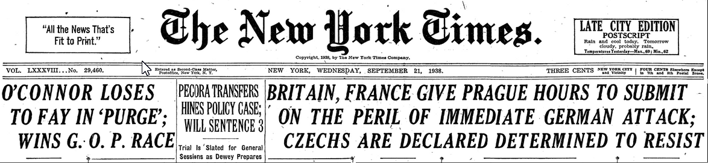

Forecasting
Then:
September 21, 1938
“Rain and cool today.”
Result: > 680 deaths and ~$4 billion 1998 dollars in damage

Slide 11
Now:
Hurricane Igor, 2010 09 17 12 GMT

Slide 12
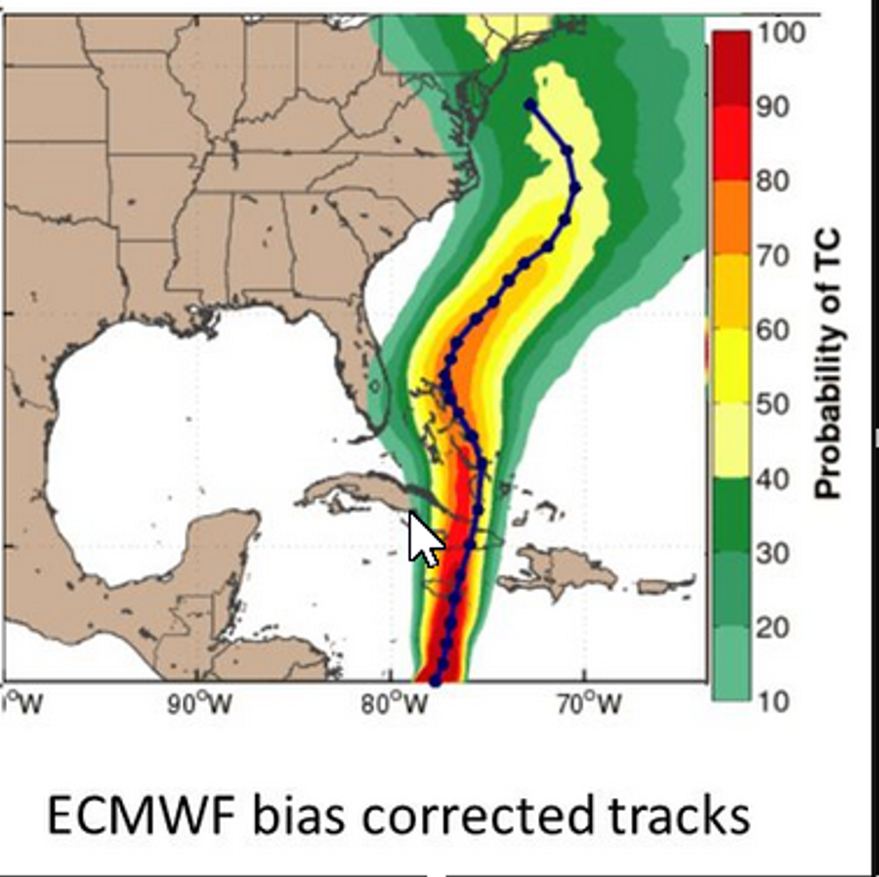
ECMWF Ensemble, 10/23/12 GMT
Landfall in New Jersey, around 12/30.00 GMT
“Sandy continues to steadily approach the region as a 75 mph hurricane, with its center currently east of North Carolina moving northeast. Sandy remains a massive hurricane, with tropical storm force winds extending up to 520 miles outward of its center and its rain bands already moving into the Northeast, as shown in the latest radar to the left. Sandy will turn towards the NW on Monday, making landfall over central New Jersey in the evening, resulting in widespread damage that is set to make Sandy a potentially historic storm.”
-- October 27, 2012

Slide 13
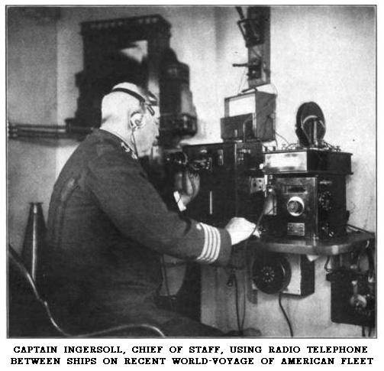
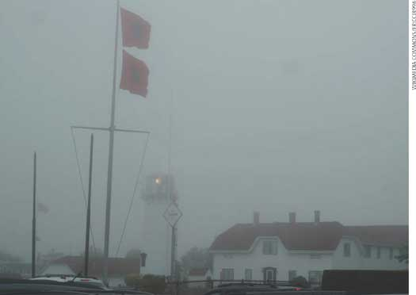
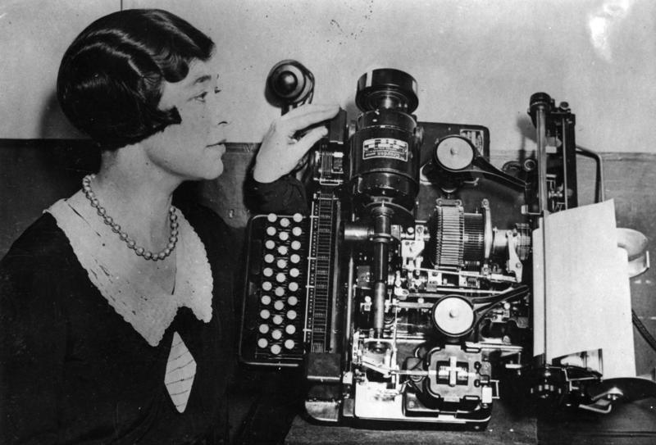
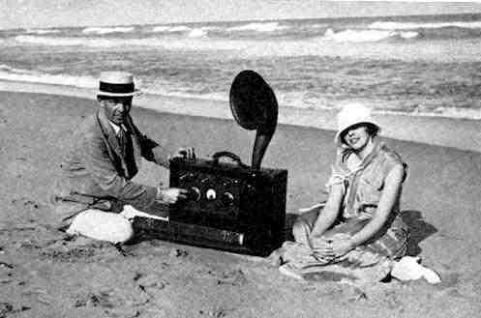
Communications
Flags, 1875
Radio, 1909
Teletype, 1909
First public forecast by radio: 1911

Slide 14
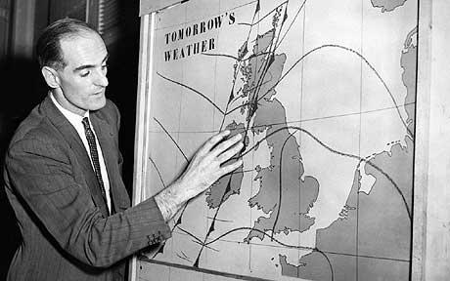
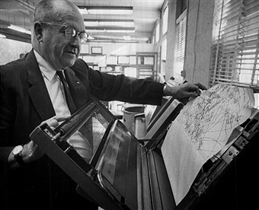

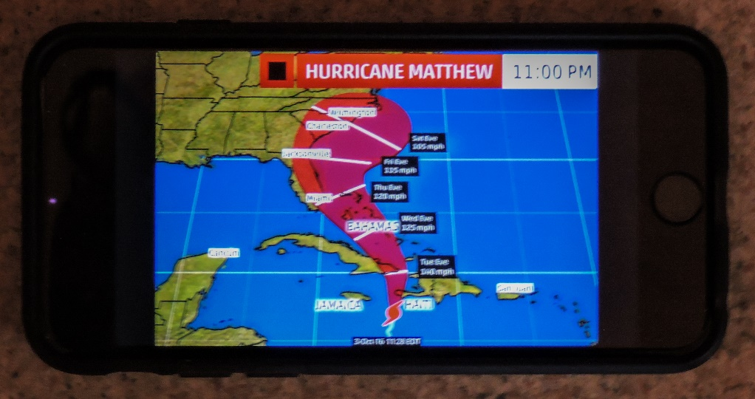
Weather bureau frees up fax licenses, 1954
First TV weather forecast, 1954
NOAA Weather Radio, 1966
Smartphone, 2016

Slide 15
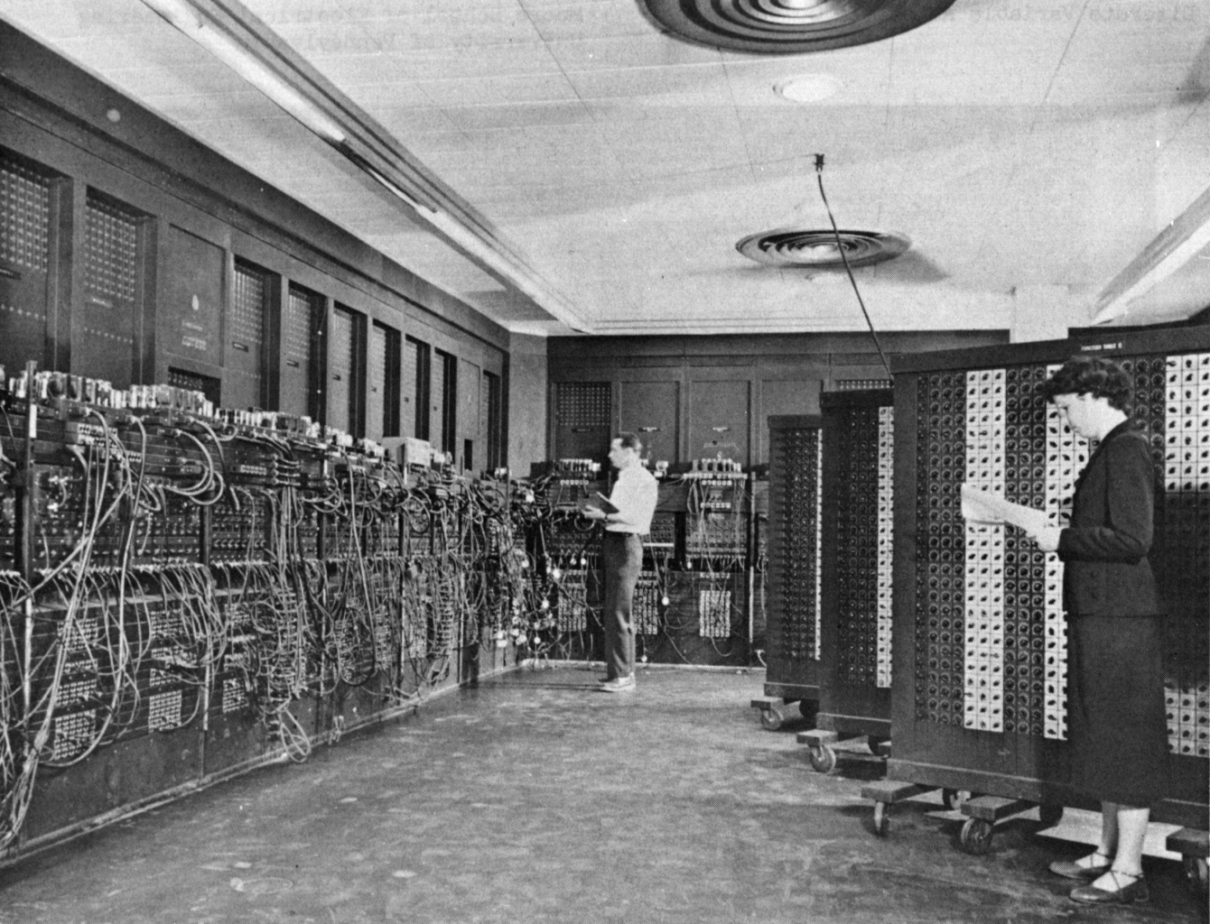
The ENIAC: Electronic Numerical Integrator And Computer (1946)
17,468 vacuum tubes, 7,200 crystal diodes, 1,500 relays, 70,000 resistors, 10,000 capacitors and around 5 million hand-soldered joints. Weight: 30 short tons. 350 floating point operations per second (flops). (Modern PC: >50 Gigaflops!)
Image Credit: U.S. Army

Slide 16
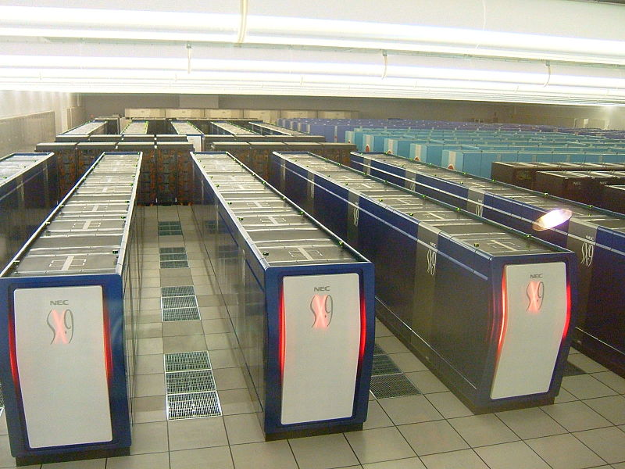
Earth Simulator
(= 10¹⁵ ENIACs)
Earth simulator at JAMSTEC Yokohama Institute for Earth Sciences
Image credit: GenGen, Wikipedia
Notes:
http://en.wikipedia.org/wiki/File:Earth_simulator_ES2.jpg

Slide 17
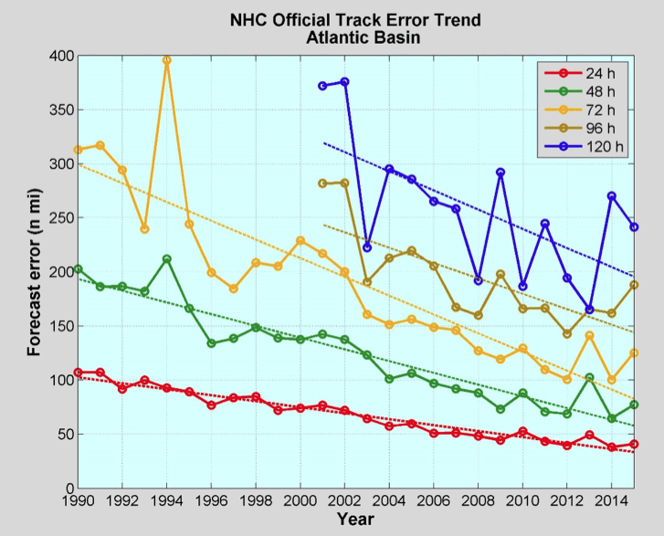

Slide 18
Physical Understanding
“The heat removed from the sea by the storm is the basic energy source of the typhoon”
Kleinschmidt, 1951
“The release of latent heat through condensation and precipitation processes is essential to the development
and maintenance of tropical cyclones.”
Unnamed research paper, 1977
“Once formed, [tropical cyclones] are maintained by the extraction of latent heat from the ocean at high temperature and heat export at the low temperatures of the tropical upper troposphere.”
Current AMS Glossary

Slide 19
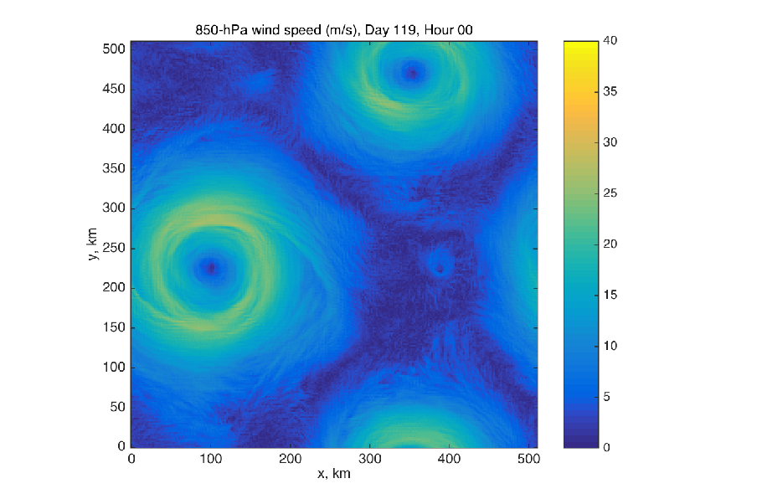
Dry Hurricanes in Dry RCE State
Tim Cronin, MIT

Slide 20

The Future of TC Observations
(This slide will be added to)

Slide 21

Bob Houze at the Pauline Austin Symposium, MIT, December, 2016

