Slide 1
Notes:
Return periods of peak tropical cyclone surface winds within 150 km of downtown Pensacola, FL, based on 5,600 synthetic tropical cyclones for each of 4 climate models and for each of two periods: The historical era, 1950-2005 (blue), and the 21st century from 2006 to 2100 (red) under the AR5 socio-economic pathway RCP-8.5. The shading indicates the scatter among the 4 climate models downscaled. Note that the 20th century simulation overall cyclone frequency has been calibrated against actual tropical cyclones in the historical record; the same calibration factor was applied to the 21st century simulations.

Slide 2
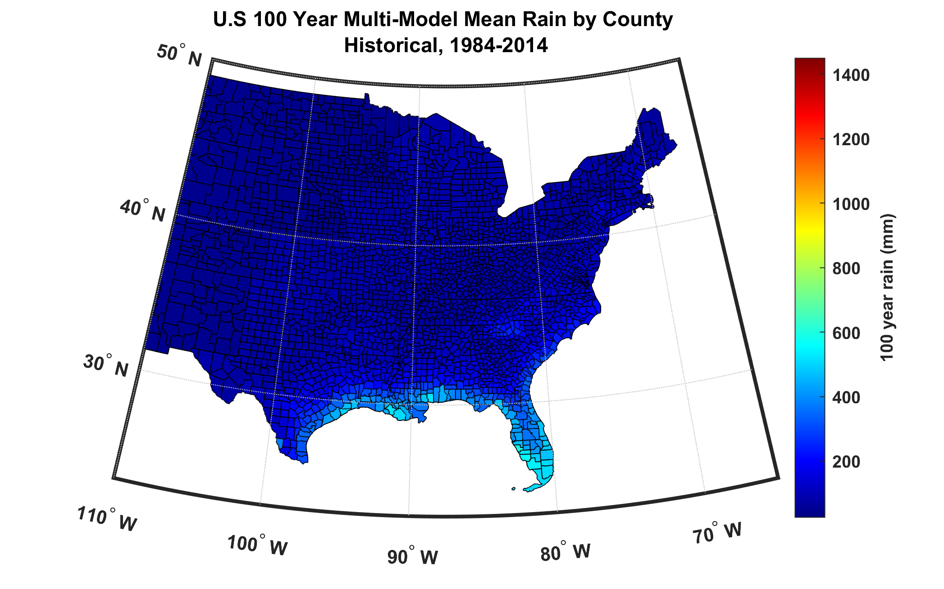
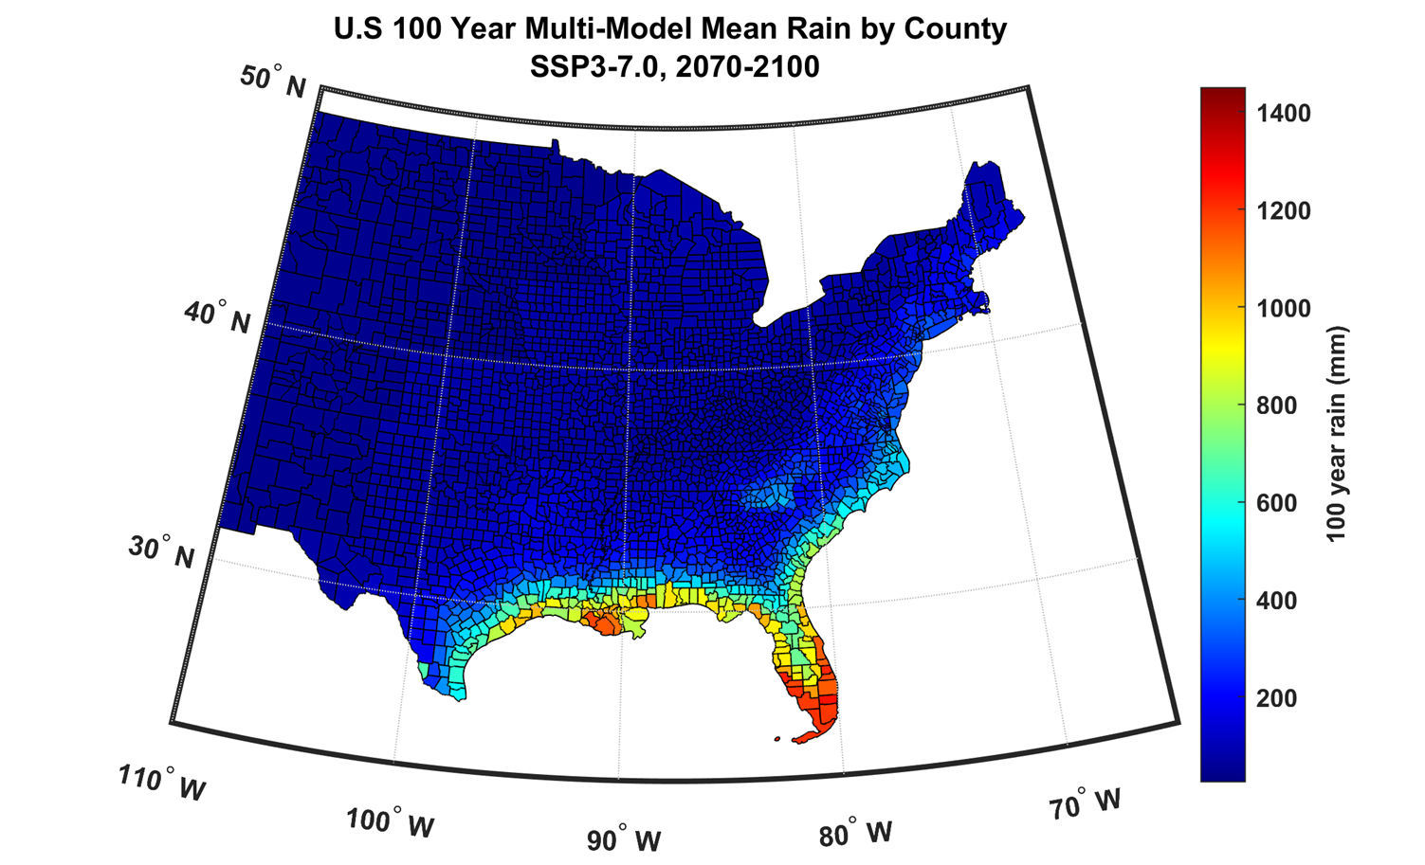
100-year hurricane storm total rain based on downscaling 8 climate models, 1984-2014 (Panel A) and 2070-2100 (Panel B)
Notes:
The 100-year hurricane storm total rainfall at the centroid of each U.S. county based on downscaling 6,200 tropical cyclone events from each of 8 CMIP6-era climate models during each of two periods: The historical period 1984-2014 (left) and the end of the 21st century, 2070-2100 (right), under the AR6 socio-economic pathway SSP5-8.5. Note that the color scales, in mm, are the same for both time periods.

Slide 3
Sandy: Compound Flooding – ERA5 #1299
Notes:
Maximum flood levels (C) in and around New York City from compound surge and freshwater inputs from a single tropical cyclone event that resembles (but is not identical to) Hurricane Sandy of 2012. The event was downscaled from ERA-5 reanalyses. The track of the center of the synthetic storm is shown by the black curves in panels (A) and (B). The maximum wind speed experienced by all points during the event is contoured and panel (A) while the storm total rainfall is shown in (B).

Slide 4
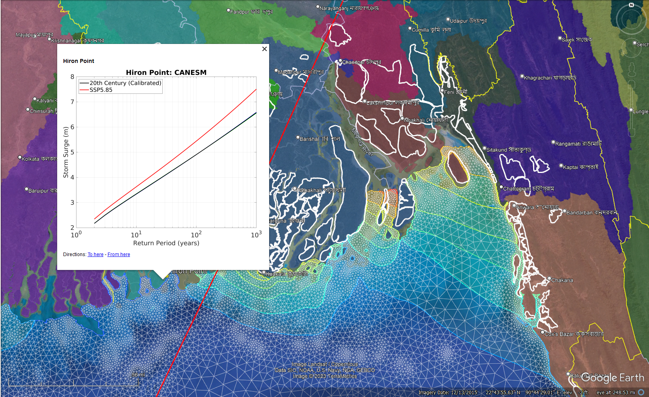
Hiron Point
CANESM
Surge
return period
comparison
20th Century
& SSP5.85
-- model
calibrated to
reanalyses
Notes:
In downscaling tropical cyclones passing over Bangladesh using seven CMIP6 climate models under SSP5.85 scenario allows us to determine non-stationary risk by simulating storm tides, fluvial-tidal inundation, and rainfall-driven inundation, including their compound effect. Shown here is a return period chart at Hiron point using one of the models (CANESM) in comparison to the 20th century climate, which shows a clearly amplified surge risk that one would incorporate in improving coastal defense. Similar charts can be calculated for each climate model separately or all together, and at multiple points along the coast or inland. In the background, is shown the computational mesh (in white) with color coded hydrobasin patches, and white contours depicting the polder infrastructure. Contours of water levels for a historical cyclone (Sidr, in red), passing over Bangladesh are also shown. Our model verifies against observed historical storms. We will present our results in a holistic geo-referenced format that enables quick investigation of multiple perils across the domain of interest.

Slide 5
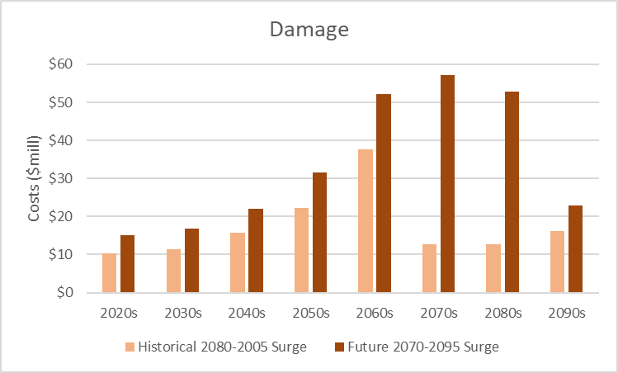
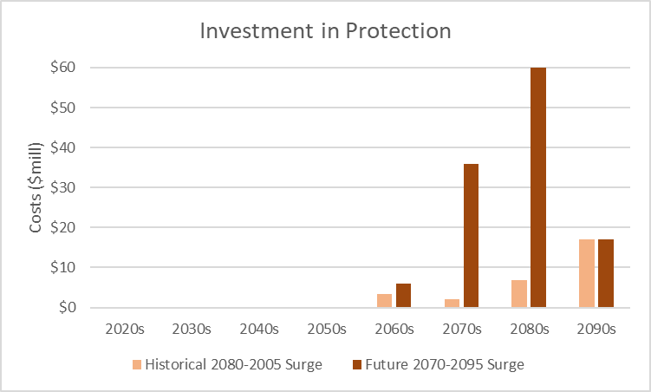
Illustration of Benefit to DoD of Our Product
Top panel: difference between estimated storm surge damage to Norfolk County, VA private (non-military) infrastructure using historical tide gauge data with projected SLR (beige bar); and projected surge data using WindRiskTech tools and data. Damage is net of potential adaptation investment in sea walls, beach nourishment, and structure elevation.
Bottom panel: estimated optimal investment in adaptation/protection over time using historical tide gauge data and projected surge data using WindRiskTech tools and data.
See Technical Proposal Section 6 for additional detail
Note: For illustration of potential Benefit to DoD only – we do not propose to estimate property or other economic damages under the proposed work.

