Slide 1

Tropical Cyclone Risk in a Changing Climate
Kerry Emanuel
Lorenz Center, MIT
Notes:
1

Slide 2
The Global Hurricane Hazard
About 10,000 deaths per year since 1971
$700 Billion 2015 U.S. Dollars in Damages since 1971
Global population exposed to hurricane hazards has tripled since 1970
EM-DAT, 2016: The OFDA/CRED International Disaster Database
http://www.emdat.be/.

Slide 3

Publicly
insured…
No $$$
Privately insured… $$$

Slide 4

Is Hurricane Risk Changing?

Slide 5
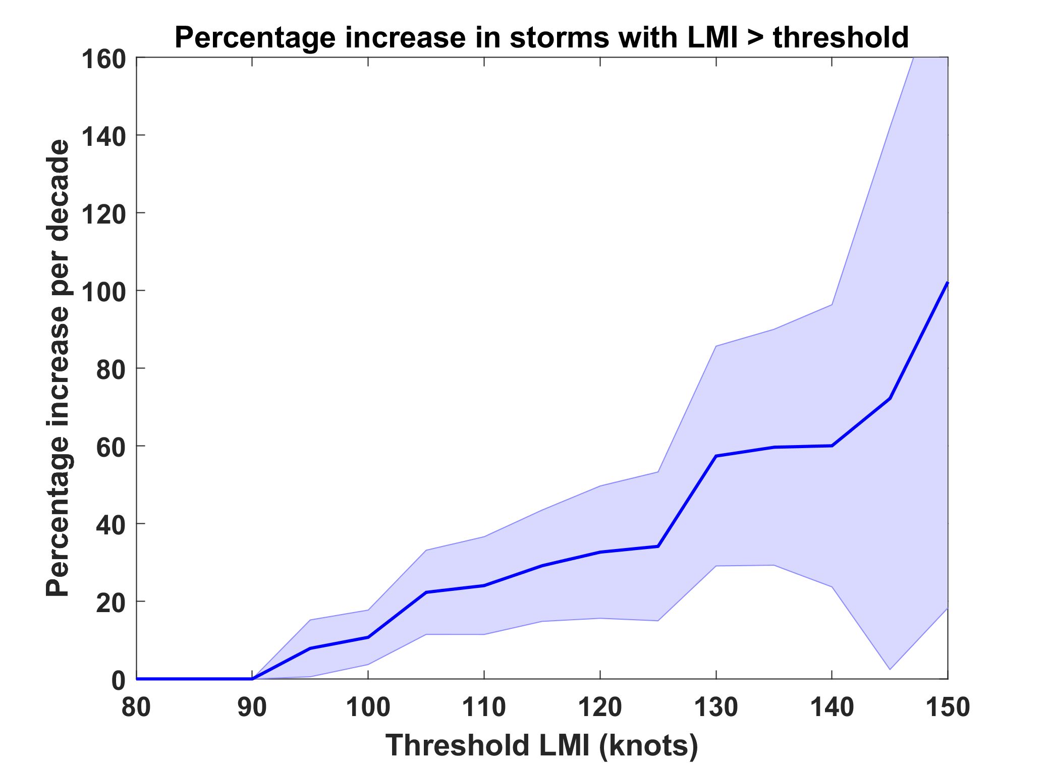
Trends in Global TC Frequency Over Threshold Intensities, from Historical TC Data, 1980-2016. Trends Shown Only When p < 0.05.

Slide 6
Hurricanes are reaching peak intensity at higher latitudes
Time series of the latitudes at which tropical cyclones reach maximum intensity.
From Kossin et al. (2014)

Slide 7
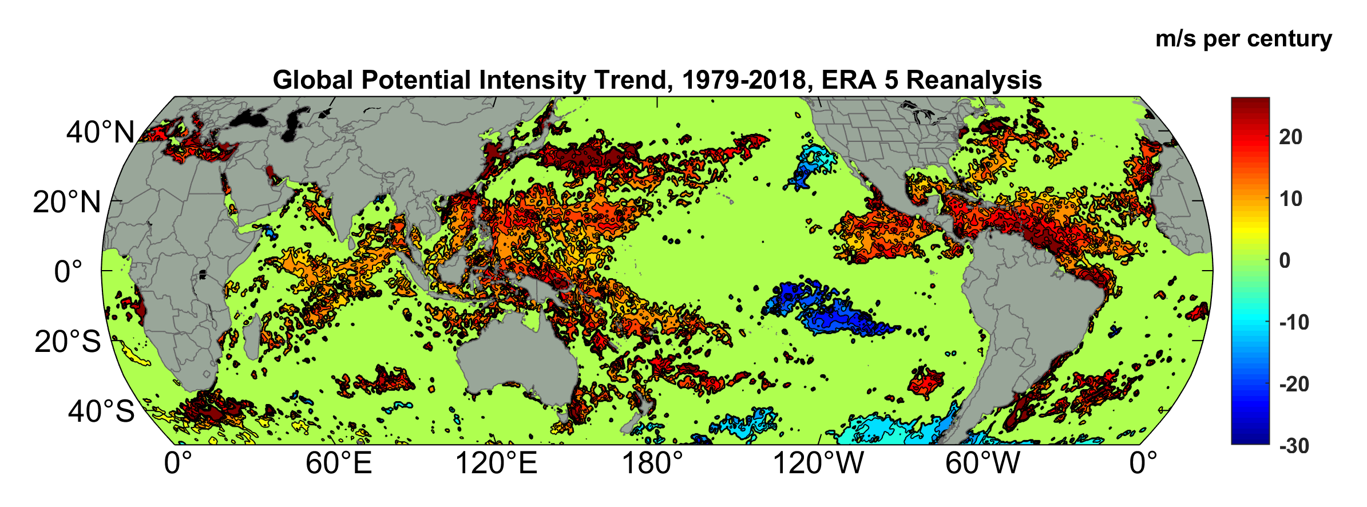
Potential Intensity Trend, 1979-2018, ERA 5 Reanalysis
(Trend shown only where p value < 0.05)

Slide 8
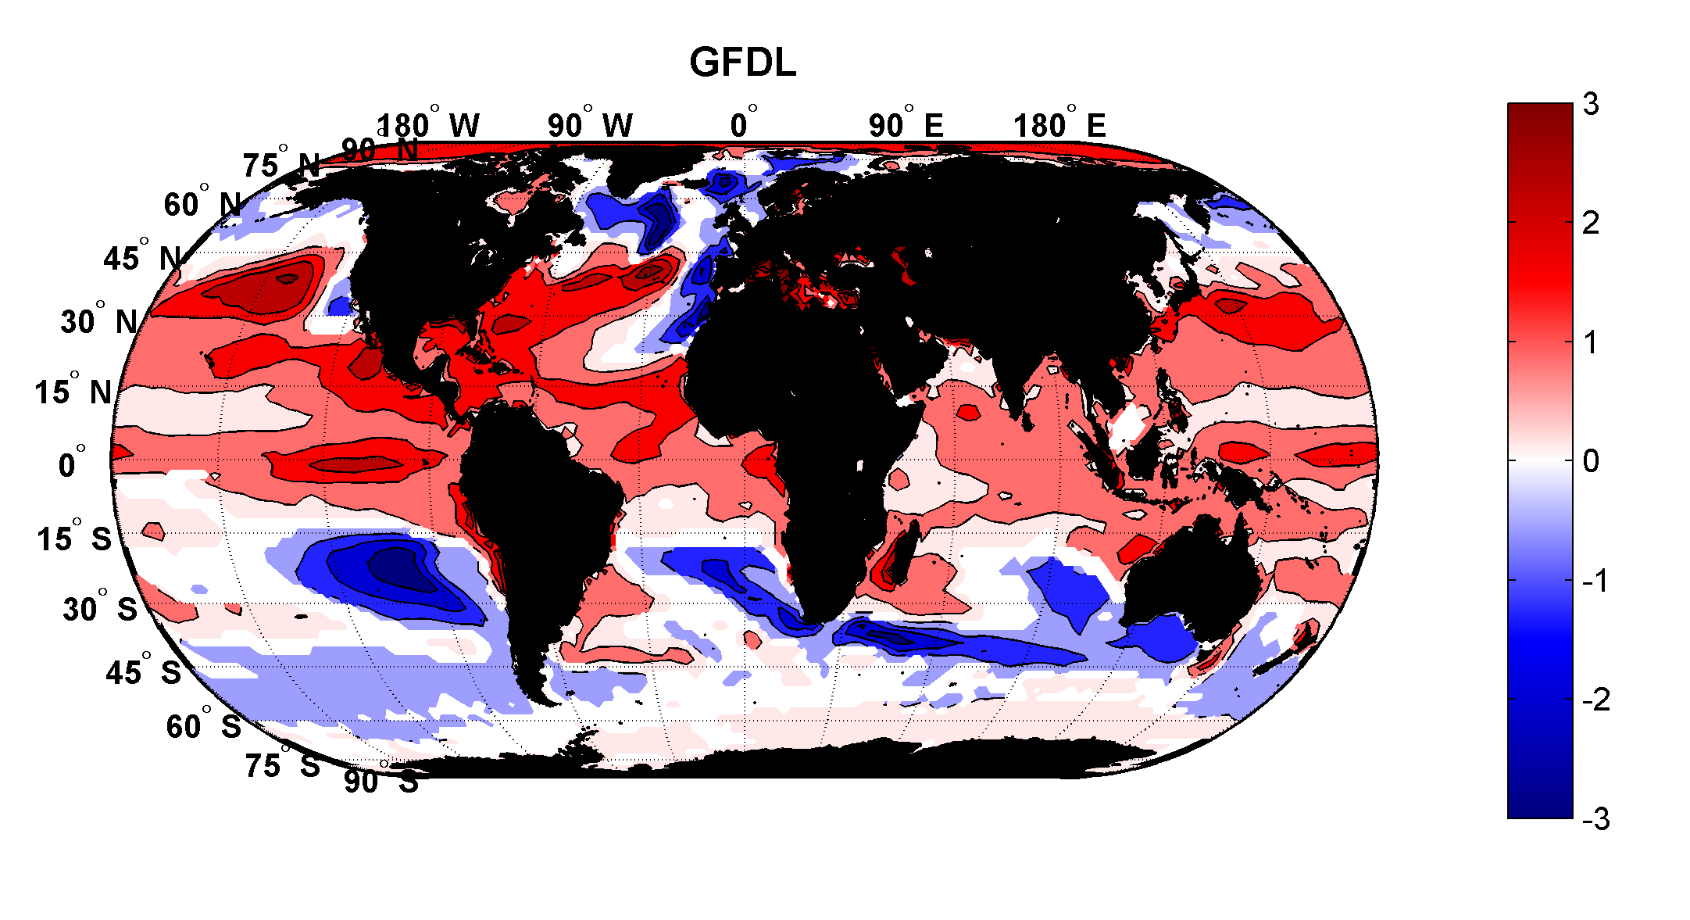
Projected Trend Over 21st Century: GFDL model under RCP 8.5
ms⁻¹decade⁻¹

Slide 9

Inferences from Basic Theory:
Potential intensity increases with global warming
Incidence of high-intensity hurricanes should increase
Increases in potential intensity should be faster in sub-tropics
Hurricanes will produce substantially more rain: Clausius-Clapeyron yields ~7% increase in water vapor per 1ºC warming

Slide 10
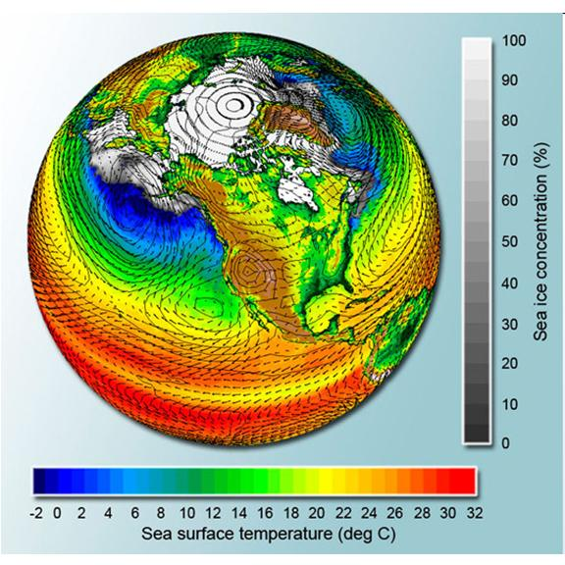
Why Not use Climate Models to Simulate Future Hurricanes?

Slide 11

Problem: Today’s models are far too coarse to simulate destructive hurricanes
Histograms of Tropical Cyclone Intensity as Simulated by a Global Model with 30 mile grid point spacing. (Courtesy Isaac Held, GFDL)
Category 3
Modeled
Observed
Global models do not simulate the storms that cause destruction
Wind Speed (meters per second)

Slide 12
Using Physics to Assess Hurricane Risk
Reliable, global records of coarse-scale climate are robust and widely available
Cull from these datasets the key statistics known to control tropical cyclone generation, movement, and intensity evolution
Bootstrap these key statistic to create unlimited synthetic time series of the hurricane-relevant environmental variables
Use these to drive specialized, very high resolution physical hurricane models
Extensively validate the results against historical hurricane data
Exact same method can be applied to output of climate models

Slide 13
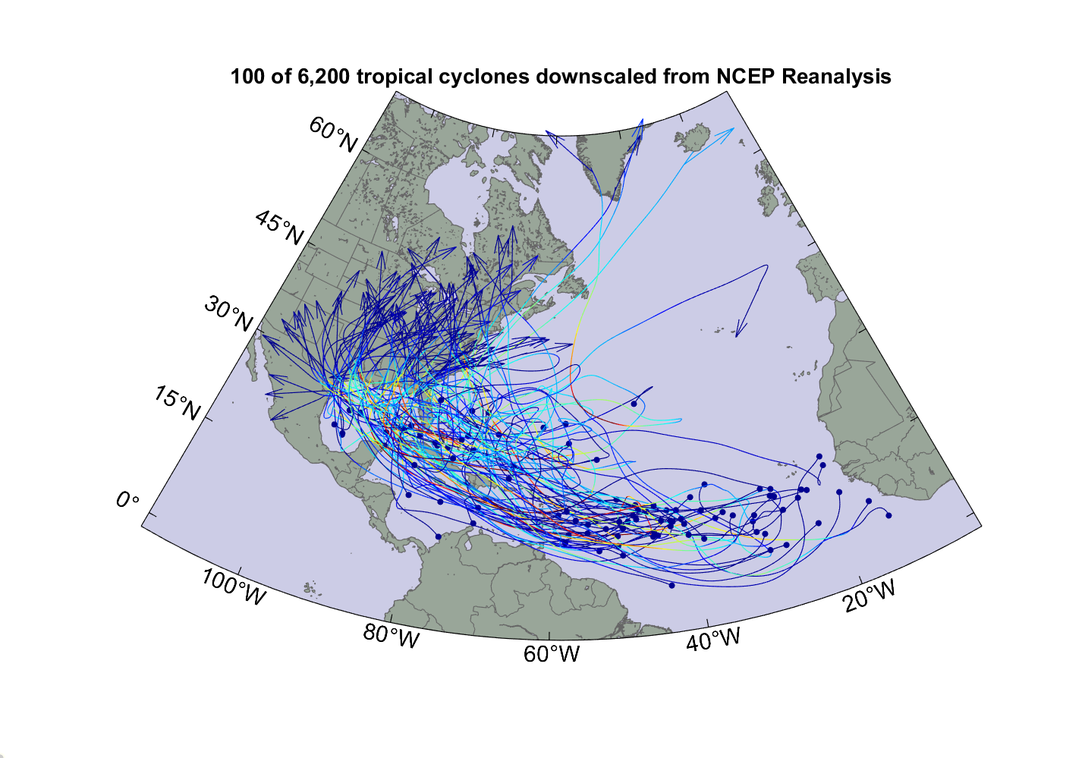

Slide 14
A Portfolio of Properties Exposed to Hurricane Risk

Slide 15
Damage Function

Slide 16
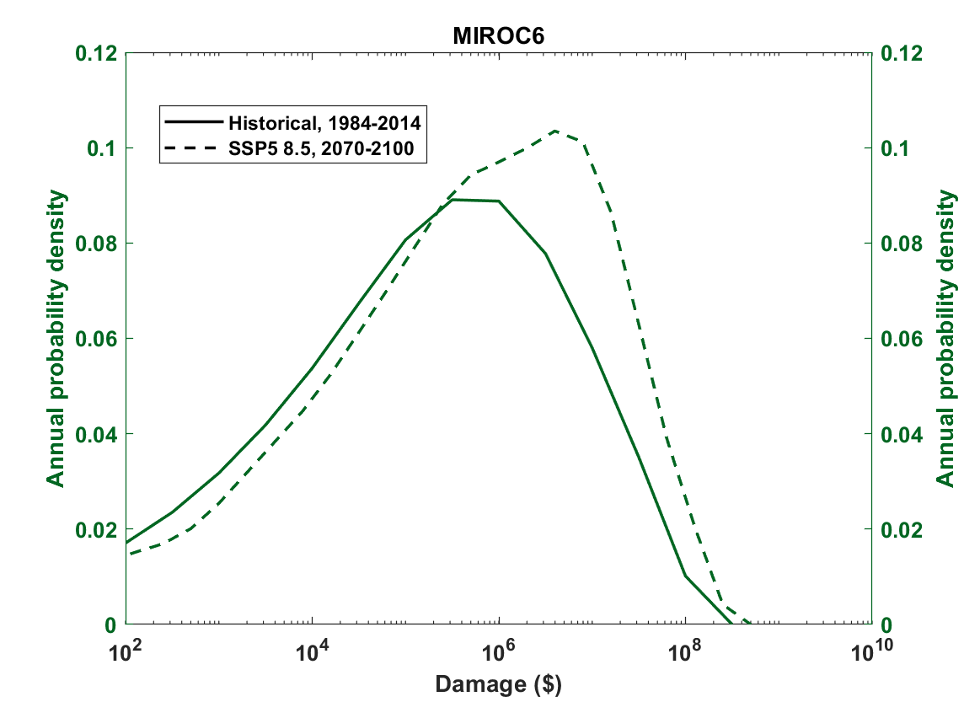

Slide 17
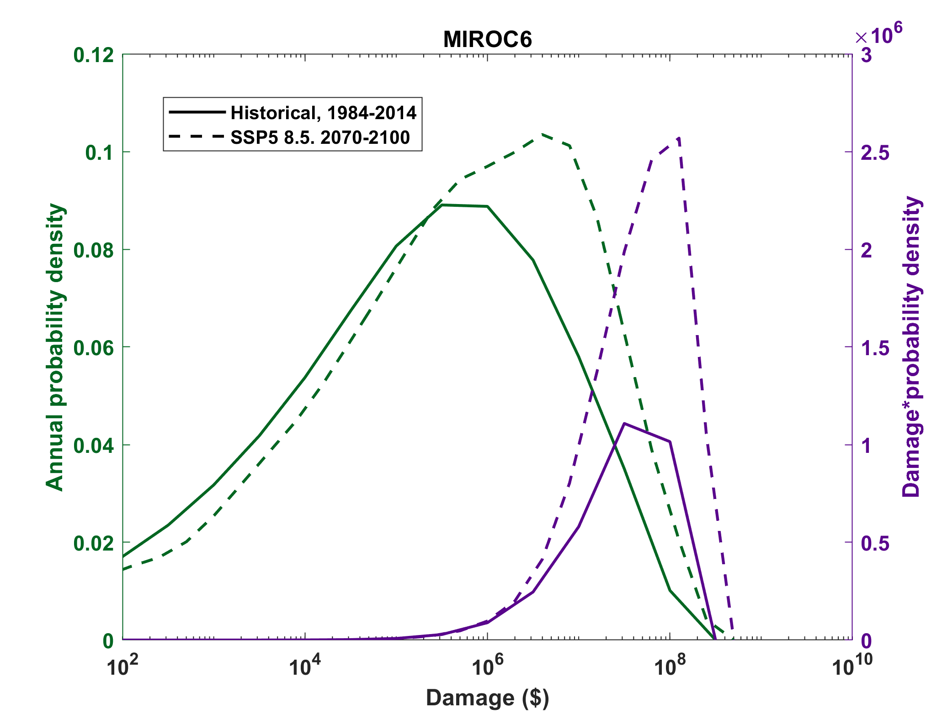

Slide 18

Cumulative Distribution of Storm Lifetime Peak Wind Speed, with Sample of 1755 Synthetic Tracks
90% confidence bounds

Slide 19
Atlantic Annual Cycle

Slide 20

Captures effects of regional climate phenomena (e.g. ENSO, AMM)

Slide 21
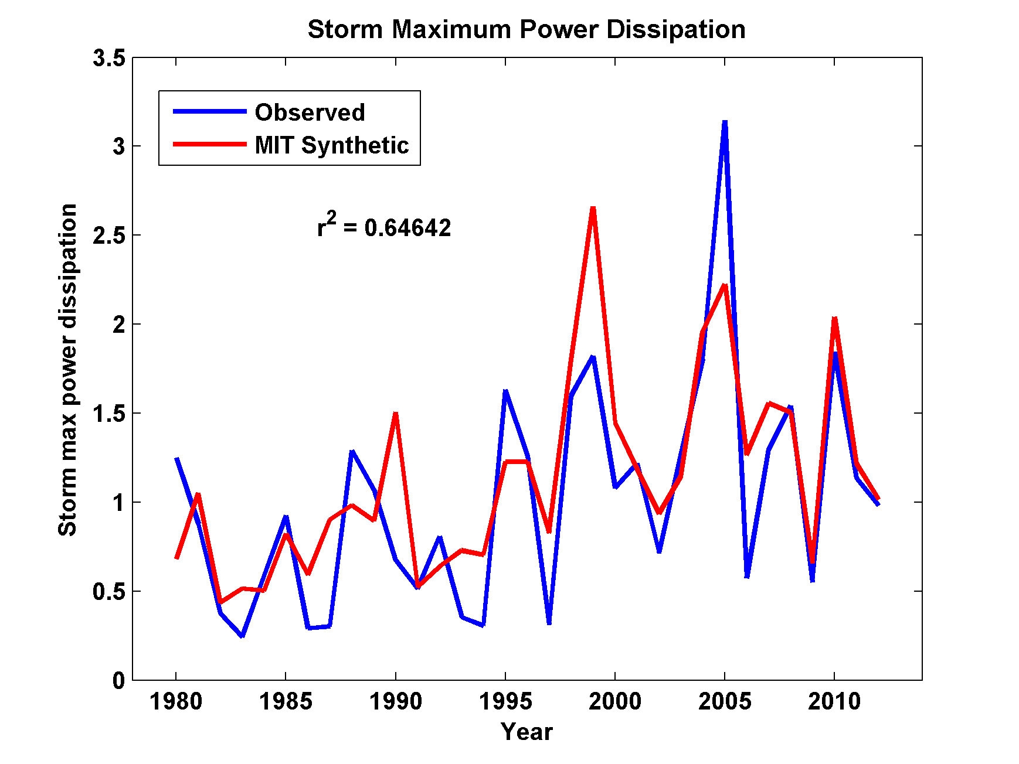
Captures Much of the Observed North Atlantic Interannual Variability
r²=0.65

Slide 22
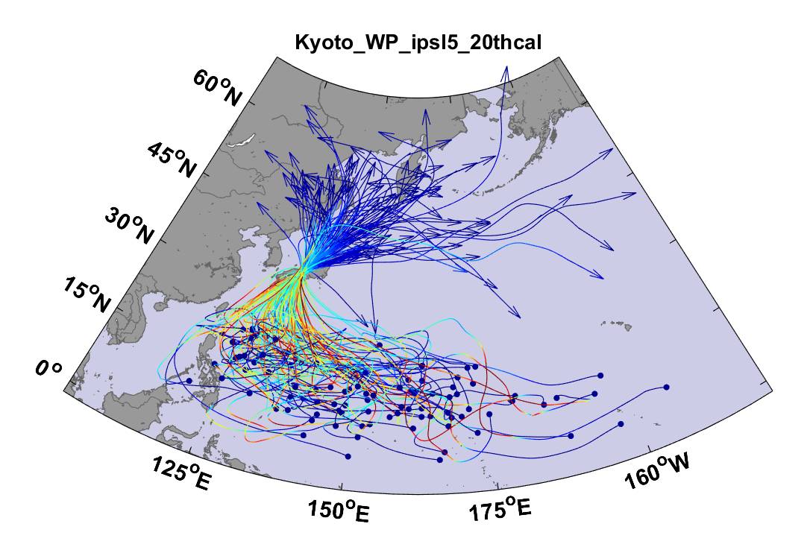
Top 100 out of 2000 TCs Affecting Kyoto, 1981-2000

Slide 23
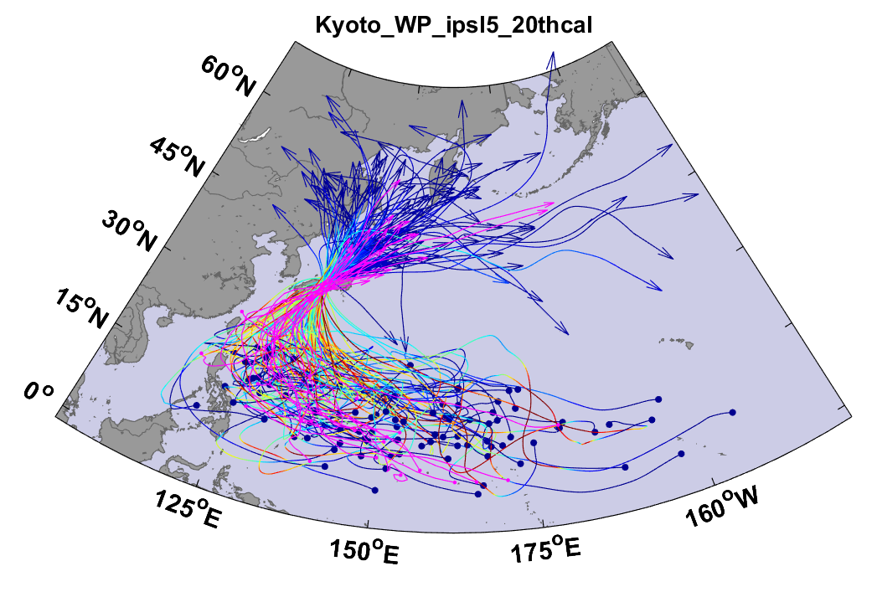
Same, but with top 20 historical tracks

Slide 25
Storm total rainfall

Slide 26

Return Periods

Slide 27


Storm Surge Simulation (Ning Lin)
SLOSH model
(Jelesnianski et al. 1992)
SLOSH mesh
~ 10³ m
ADCIRC mesh
~ 10² m
Battery
ADCIRC model
(Luettich et al. 1992)
ADCIRC mesh
~ 10 m
(Colle et al. 2008)
Notes:
Given the storm wind and pressure fields (which is estimated from the Holland parametric pressure model) we can simulate the surge. Surge simulations with high resolution are computationally intensive, so to make it possible to simulate accurate surges for our large synthetic storm sets, we apply the two hydrodynamic models with girds of various resolutions in such a way that the main computational effort is concentrated on the storms that determine the risk. First, we apply the SLOSH model, using a mesh with resolution of about 1 km around NYC to simulate the surges for all storms and select the storms that have return periods, in terms of the surge height at the Battery, greater than 10 years. Second, we apply the ADCIRC simulation, using a grid mesh with resolution of ~100 m around NYC, to each of the selected storms. Then, we apply another ADCIRC mesh with resolution as high as ~10 m around NYC, for a set of the most extreme events, to check if the resolution of our ADCIRC grid is sufficient and if needed to make statistical correction to the results.

Slide 28
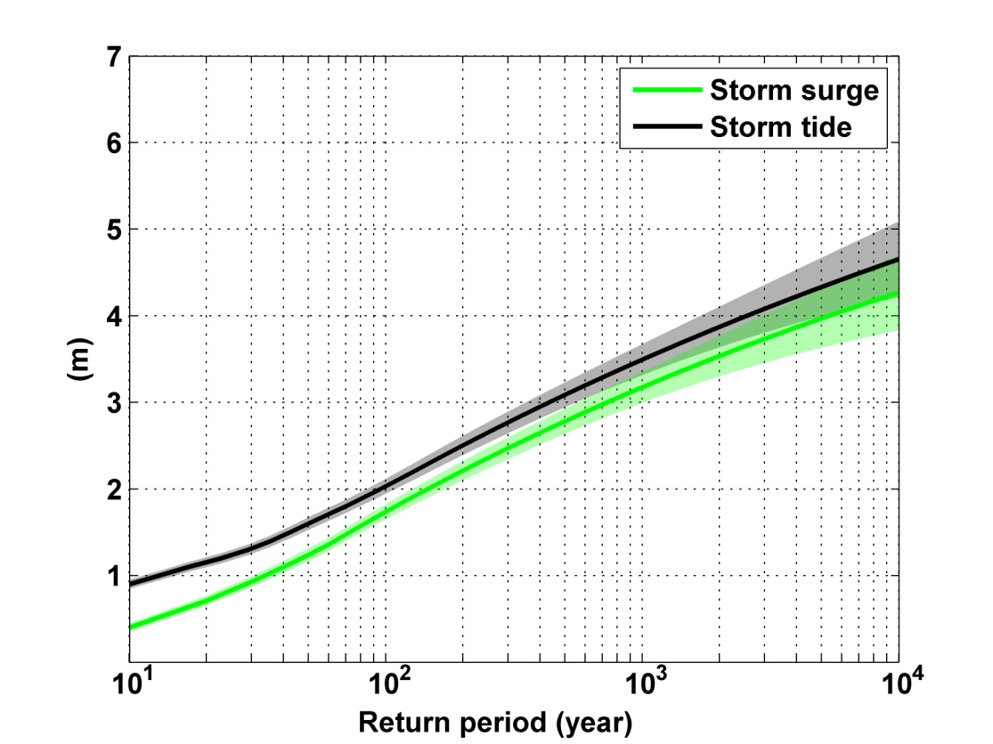
Sandy, 2012
Sandy: ~ 400 years
Notes:
Storm surge and storm tide (surge and tide) return level curves for the Battery, NYC, for the 1981-2000 NCAR/NCEP climate conditions (5000 synthetic storms). Astronomical tide and nonlinear interaction between surge and tide are accounted for statistically.

Slide 29
NEXRAD Sites

Slide 30
An Example:
Estimated gauge sampling error
Estimated radar sampling error

Slide 31
Effects of Climate Change
More moisture in boundary layer
Stronger storms but more compact inner regions
Possibly larger storm diameters
Storms may be moving faster or slower

Slide 32
Taking Climate Change Into Account

Slide 33
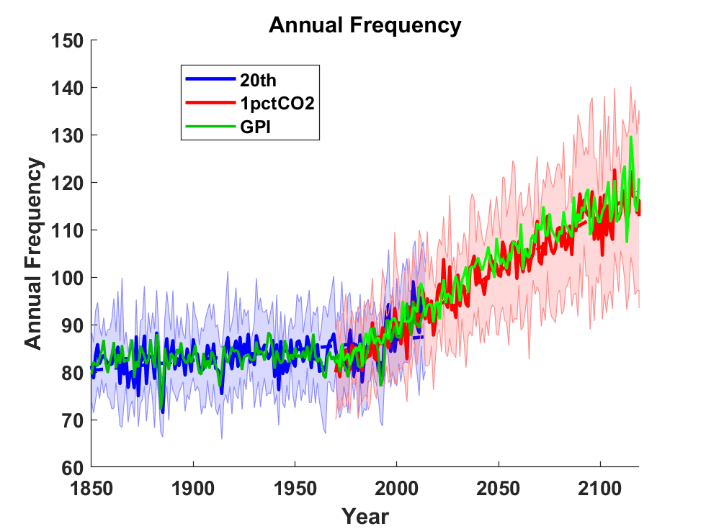
Global Tropical Cyclone Frequency from 9 Current Generation (CMIP6) Climate Models

Slide 34
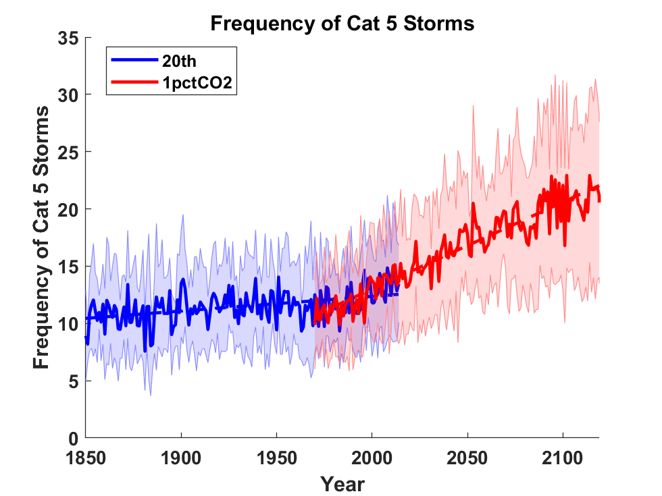

Slide 35
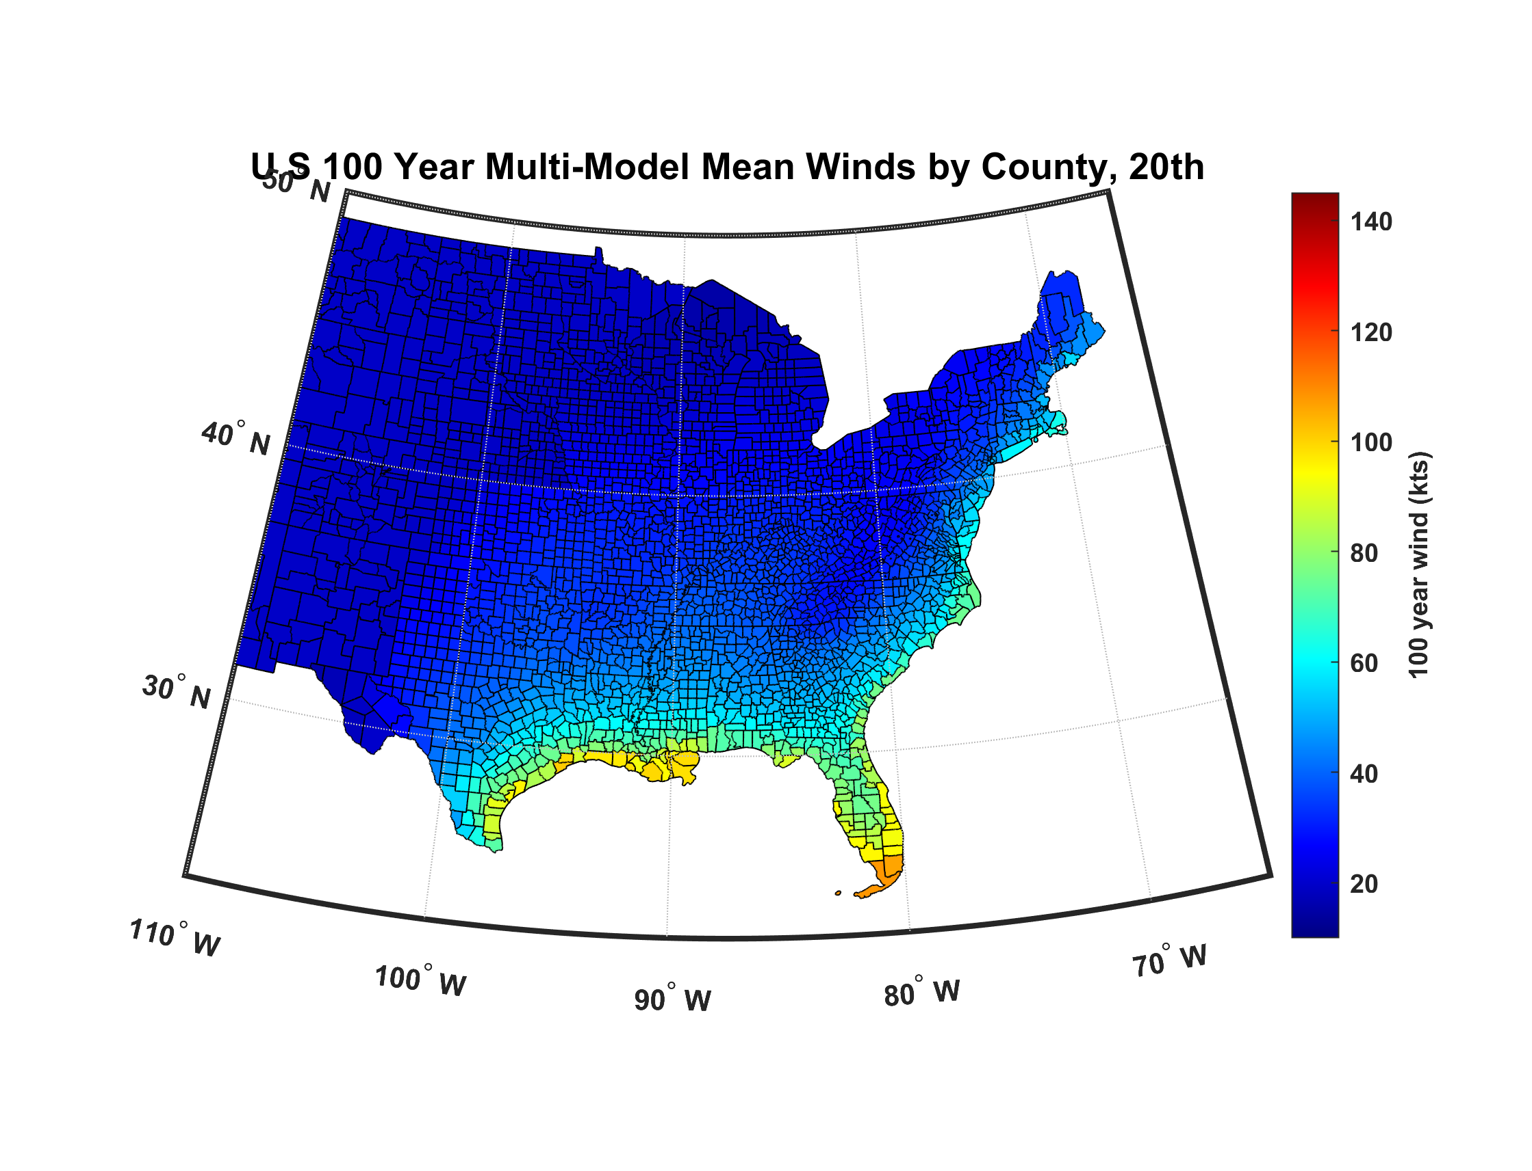

Slide 36
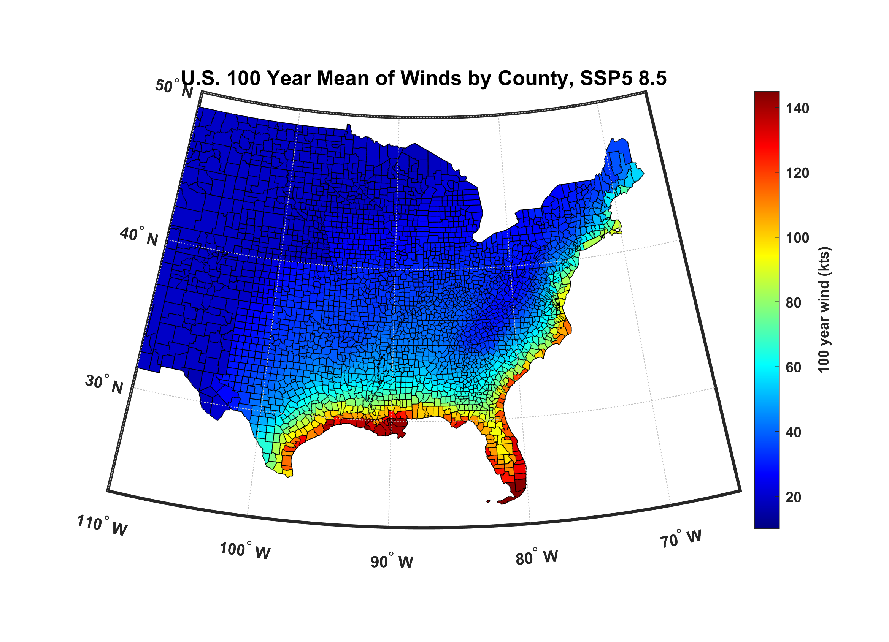

Slide 37
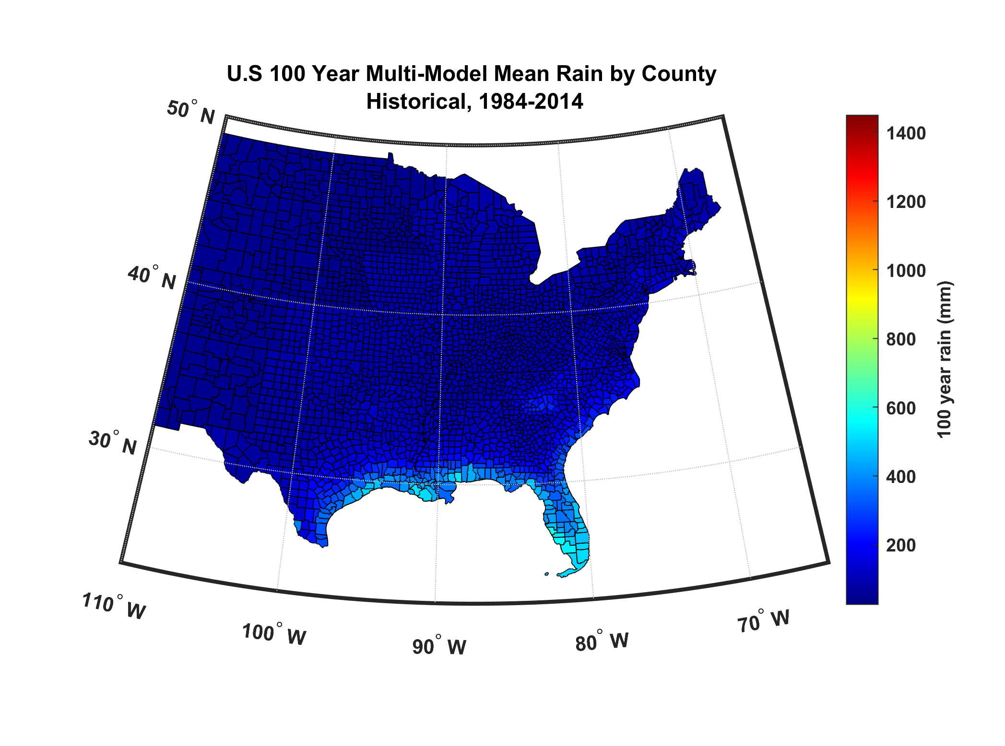

Slide 38
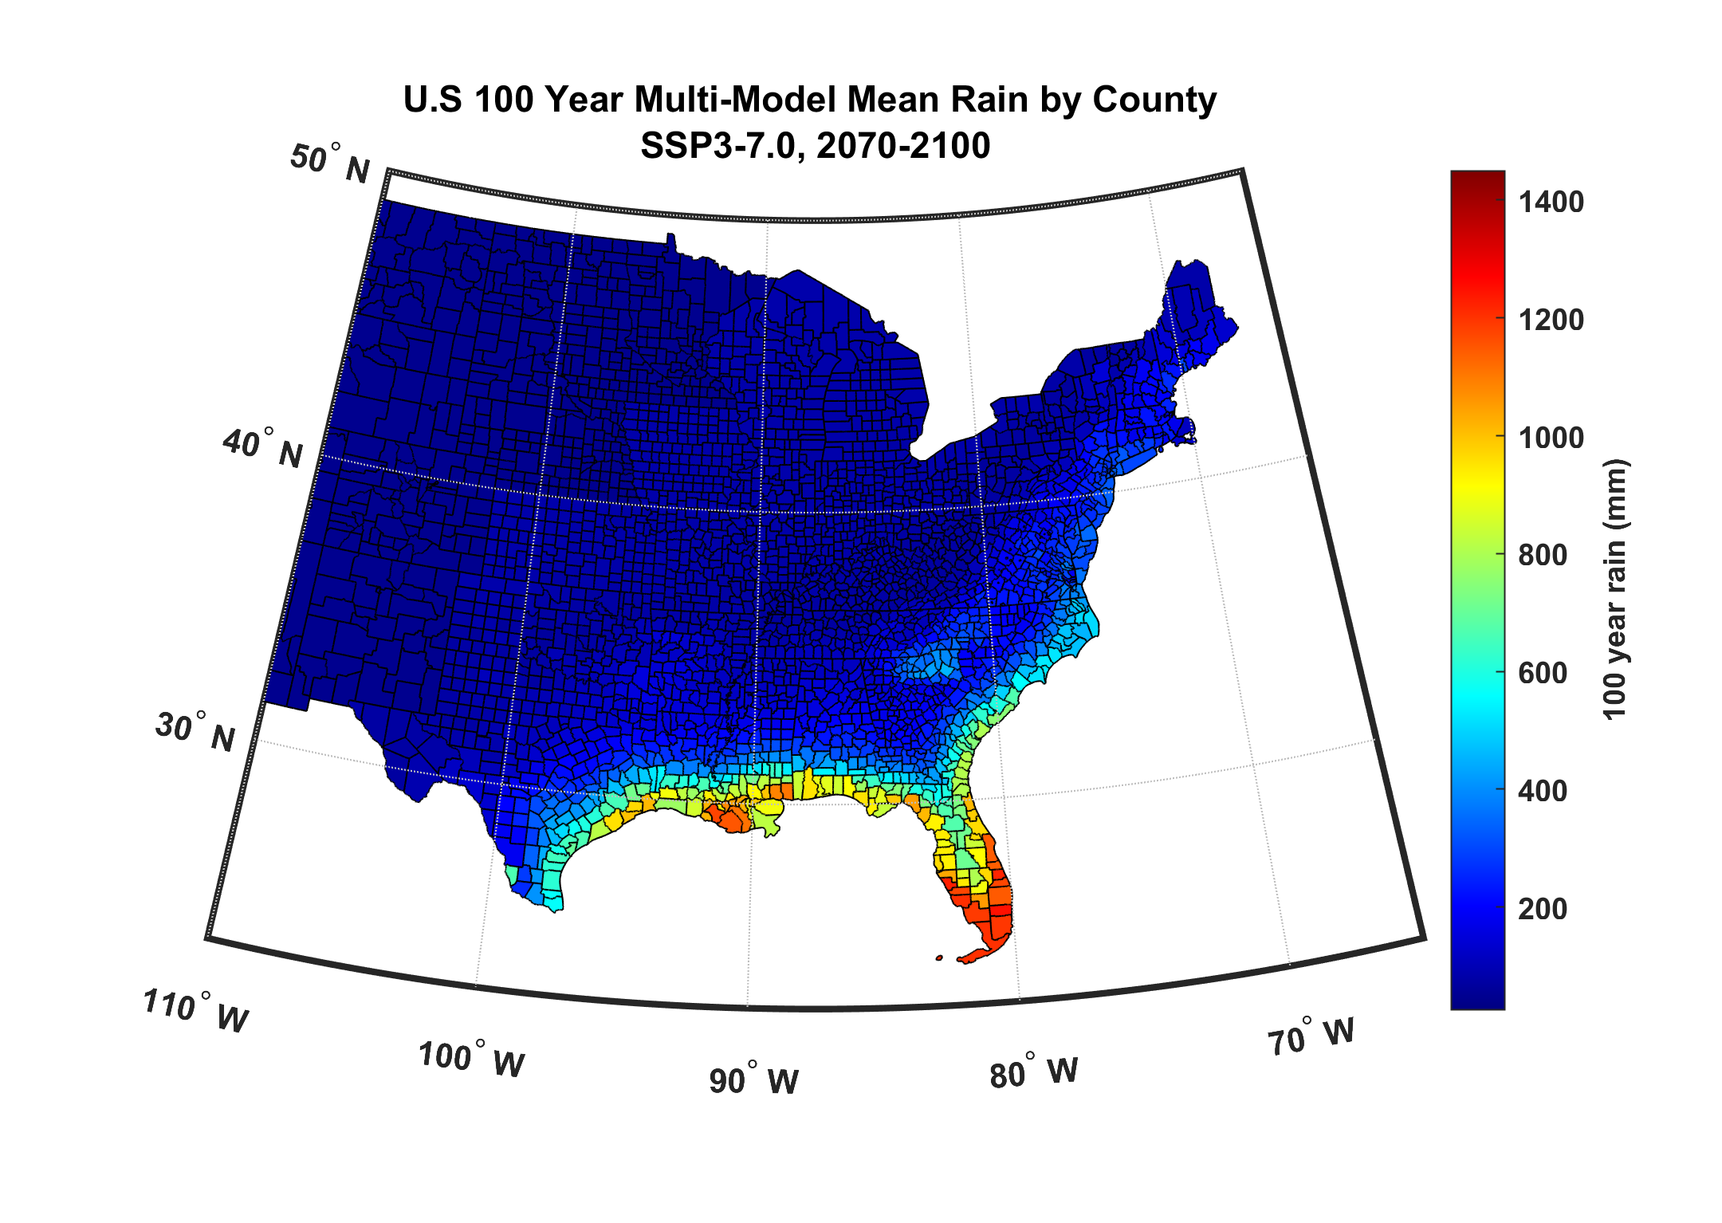

Slide 39

GCM flood height return level, Battery, Manhattan
(assuming SLR of 1 m for the future climate )
Black: Current climate (1981-2000)
Blue: A1B future climate (2081-2100)
Red: A1B future climate (2081-2100) with R₀ increased by 10% and R_{m} increased by 21%
Lin et al. (2012)
Notes:
Then we calculate the flood height (including surge, tide, and sea level rise) return level for the four climate models, assuming a sea level rise of 1 m for the future climate, for the Battery, NYC. These results show that the combined effects of storm climatology change and sea level rise will greatly shorten the flood return periods for NYC and, by the end of the century, the current 100-year surge flooding may happen less than every 30 years, with CNRM and GFDL prediction to be less than 10 years, and the 500-year flooding may happen less than every 200 years, with the CNRM and GFDL prediction to be 20-30 years.

Slide 40
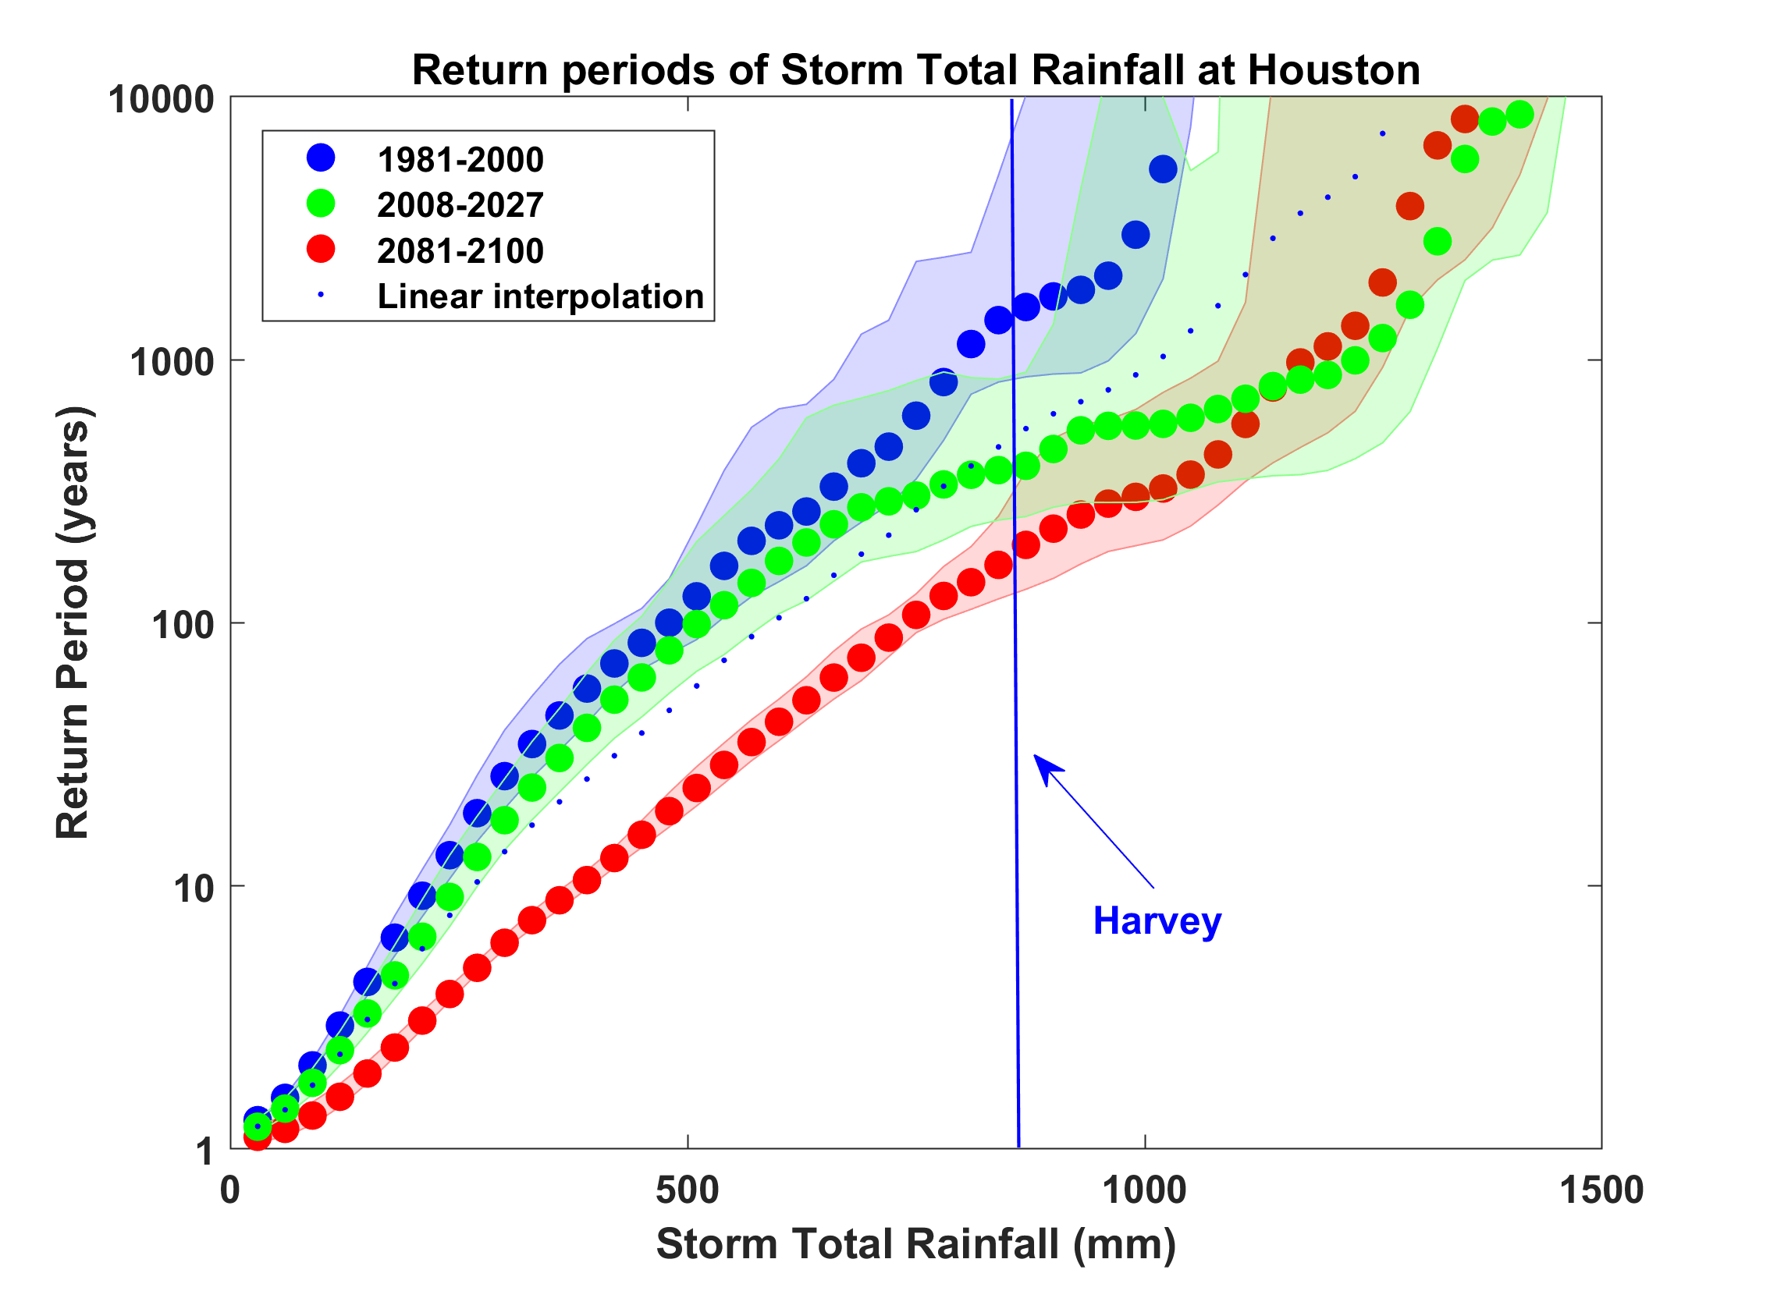
Probability of Storm Accumulated Rainfall in Harris County, from 6 Climate models, 1981-2000, 2008-2027, and 2081-2100, Based on 2000 Events Each, and Using RCP 8.5. Shading Shows Spread Among the Models.

Slide 41
Summary
The observational record of hurricanes is too short and noisy, and of a quality too low to make robust inferences of climate signals
Satellite data do show a migration of peak intensity toward higher latitudes and some indication of a greater fraction of intense storms

Slide 42
Summary (continued)
Potential intensity theory demonstrates that the thermodynamic limit on hurricane intensity rises with temperature
Observations show that this limit is indeed increasing
Physics can be used to model hurricane risk in current and future climates
Global warming is not merely a problem for the future; current risk estimates are already out of date

