Slide 1

Radiative-Convective Instability and Tropical Weather and Climate Prediction
Kerry Emanuel
Massachusetts Institute of Technology
Notes:
1

Slide 2
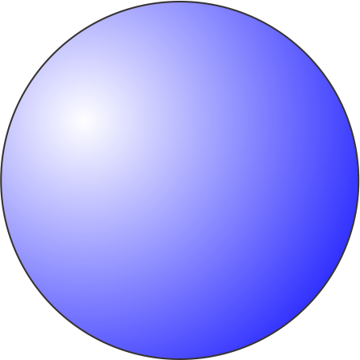
Several Possibly Inter-related Enigmas of the Tropical Atmosphere
Why does moist convection often cluster?
What determines the number of tropical cyclones on the planet?
What are the basic physics of the Madden-Julian Oscillation?
Why is tropical climate so stable?

Slide 3
When/Why Does Convection Form Clusters?

Slide 4
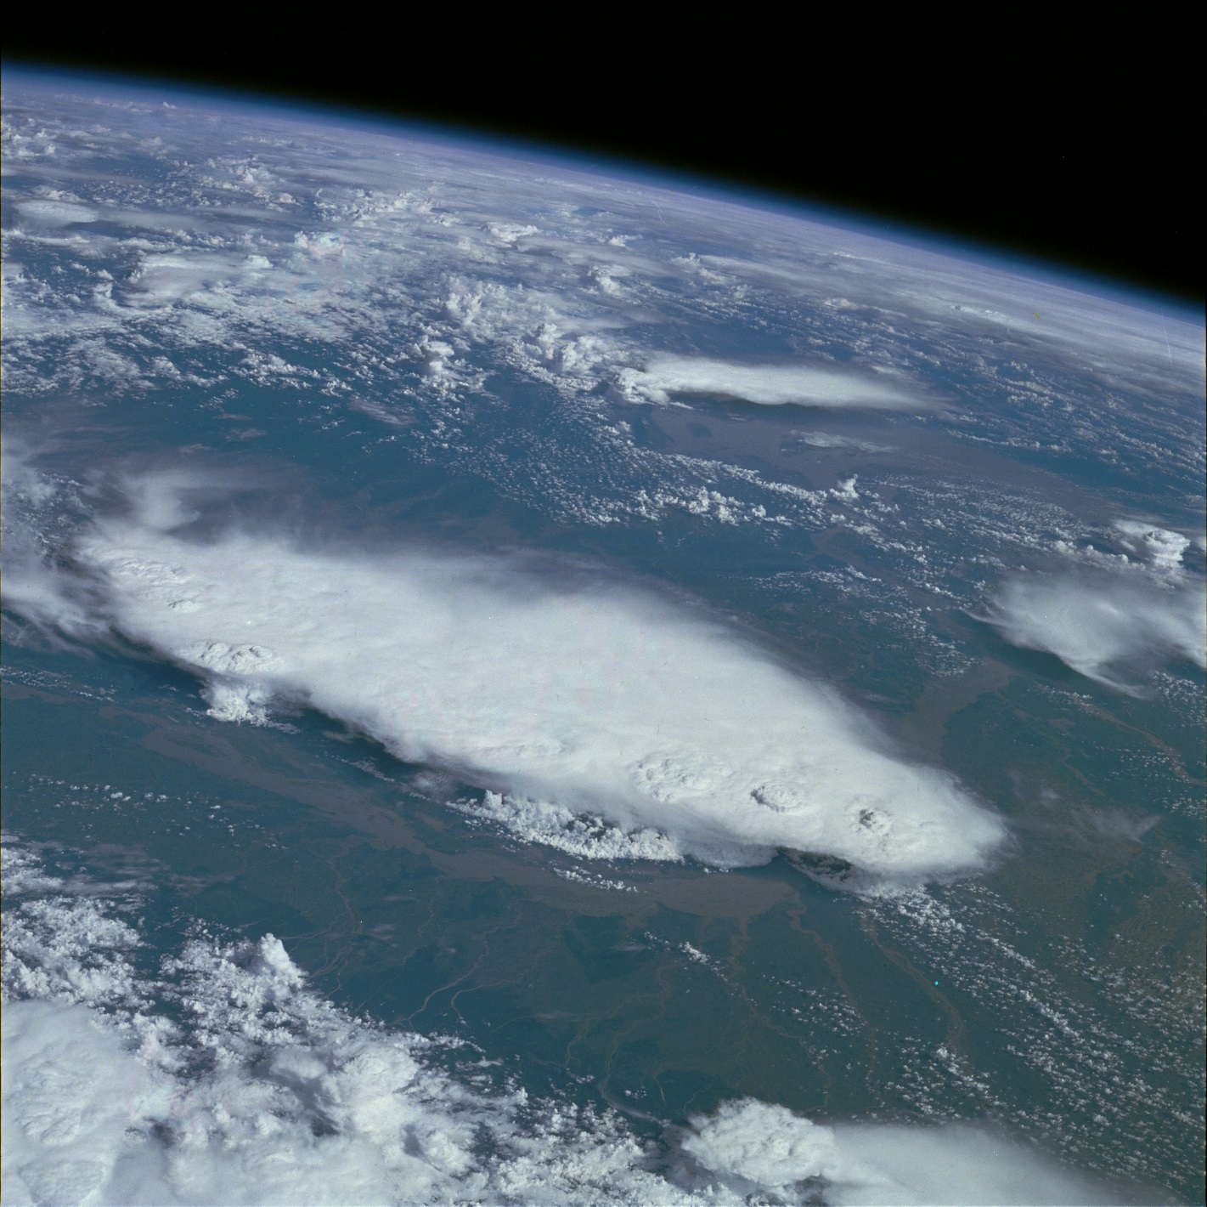
Monsoonal Thunderstorms, Bangladesh and India July 1985

Slide 5
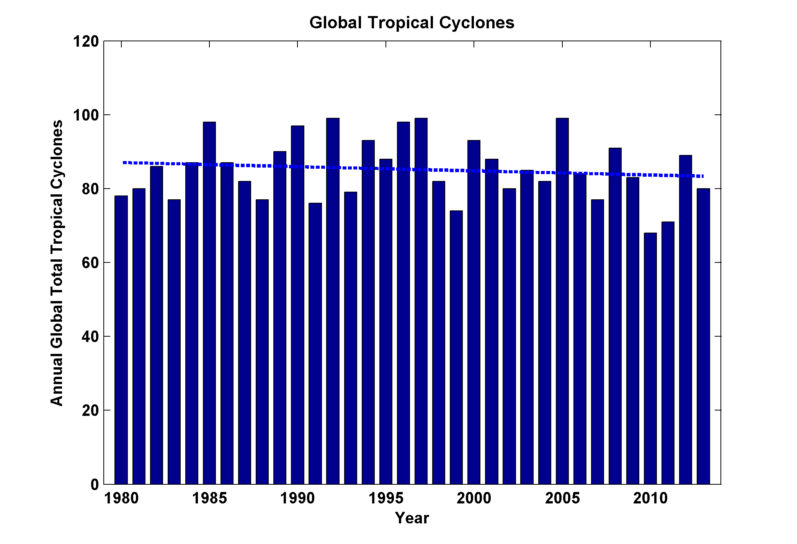
Global Tropical Cyclone Frequency, 1980-2013
Data Sources: NOAA/TPC and NAVY/JTWC
Notes:
5

Slide 6
Simplest Statistical Equilibrium State:
Radiative-Convective Equilibrium

Slide 7
Radiative-Moist Convective Equilibrium
Vertical profile nearly neutral to moist convection
Strongly-two way interaction: Radiation drives profile toward instability, convection lofts water that strongly affects radiative transfer

Slide 9
Approach: Idealized modeling of convective organization in radiative-convective equilibrium using a cloud resolving model
System for Atmospheric Modeling (SAM) of Khairoutdinov and Randall (2003)
Constant solar insolation: 413.98 W/m²
Horizontal Resolution: 3km
Vertical Resolution: 64 levels
Periodic lateral boundaries
Initial sounding from domain average of smaller domain run in RCE
Fully interactive RRTM radiation and surface fluxes.
Rigid Lid
28 km
Fixed SST
297-312 K
768 km
768 km
Notes:
Three-dimensional cloud resolving model Anelastic equations of motion RRTM radiation scheme SAM 1-moment microphysics scheme
Prognostic thermodynamic variables:
Liquid water/ice moist static energy: h_{L} = c_{p}T + gz – L_{c}(q_{c}+q_{r})-L_{s}(q_{i}+q_{s}+q_{g})
Total nonprecipitating water
Total precipitating water

Slide 10
Snapshot of Outgoing Longwave Radiation (OLR) in Radiative-Convective Equilibrium

Slide 11
Evolution of Vertically Integrated Water Vapor
Notes:
Day 1 is pretty homogeneous. By day 10 small area has become drier.

Slide 12
Evolution of Vertically Integrated Water Vapor
Notes:
Over next 20 days, small dry patch amplfies and expands. By day 30 covers nearly a quarter of the domain.

Slide 13
Evolution of Vertically Integrated Water Vapor
Notes:
Process continues and by day 50 areas of the domain not in dry patch have become moister than they were initially.

Slide 14
Evolution of Vertically Integrated Water Vapor
Notes:
Now the expanding dry region has confined all the moist area (which is now moister than anywhere earlier in the simulation) to one band. This band evolves

Slide 15
Evolution of Vertically Integrated Water Vapor
Notes:
Evolves into a single circular cluster in which high tpw values are concentrated. Outside the moist cluster, the rest of the domain has very low values of tpw.

Slide 16
Surface Temperature Dependence
Larger domain needed for high SSTs to aggregate
Notes:
Speculated that high SST simulations required a larger domain size, perhaps because of the large values of dry static stability that occur at high temperature.

Slide 17
2. Single-Column Model
MIT Single-Column Model
Fouquart and Bonnel shortwave radiation, Morcrette longwave
Emanuel-Zivkovic-Rothman convection
Bony-Emanuel cloud scheme
25 hPa level spacing in troposphere; higher resolution in stratosphere
Run into RCE state with fixed SST, then re-initialized in WTG mode with T fixed at 850 hPa and above; small perturbations to w in initial condition

Slide 18
Results
No drift from RCE state when SST <~ 32 C
Migration toward states with ascent or descent at higher SSTs
These states correspond to multiple equilibria in two-column models by Raymond and Zeng (2000) and by several others since (e.g. Sobel et al., 2007; Sessions et al. 2010)

Slide 19
Descending Branch

Slide 20
25 ºC
40 ºC
Perturbation shortwave (red), longwave (blue), and net (black) radiative heating rates in response to an instantaneous reduction of specific humidity of 20% from the RCE states for (left) SST = 25C and (right) 40C. Note the different scales on the abscissas.

Slide 21
Perturbation net radiative heating rates in response to an instantaneous reduction of specific humidity of 20% from the RCE states for SSTs ranging from 25 to 45C.

Slide 22
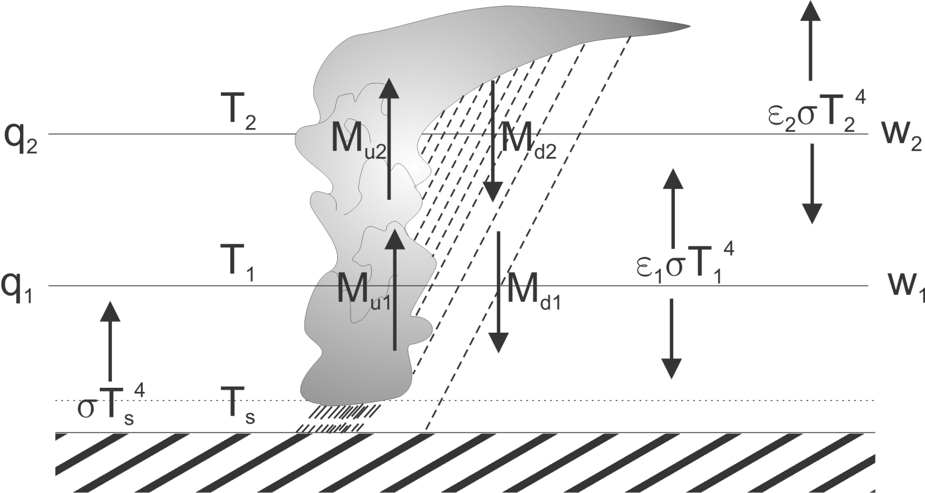
3. Two-Layer Model
Temperatures held constant, IR emissivities depend on q, convective mass fluxes calculated from boundary layer QE, w’s calculated from WTG

Slide 23
Results of Linear Stability Analysis of Two-Layer Model:
Criterion for instability:
Dry static stabilities
emissivities
Precipitation efficiency
< 0
< 0
> 0
Radiative-convective equilibrium becomes linearly unstable when the infrared opacity of the lower troposphere becomes sufficiently large, and when precipitation efficiency is large

Slide 24
Note:
Once cluster forms, it is strongly maintained by intense negative OLR anomaly associated with central dense overcast. But cloud feedbacks are NOT important in instigating the instability. This leads to strong hysteresis in the radiative-convective system

Slide 25
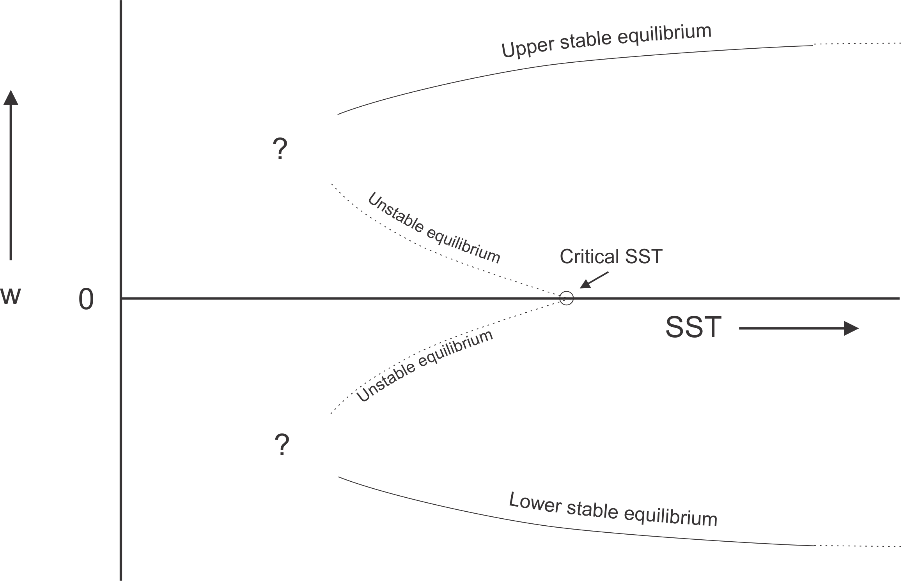
Hypothesized Subcritical Bifurcation
Clustering metric

Slide 26
Consequences

Slide 27
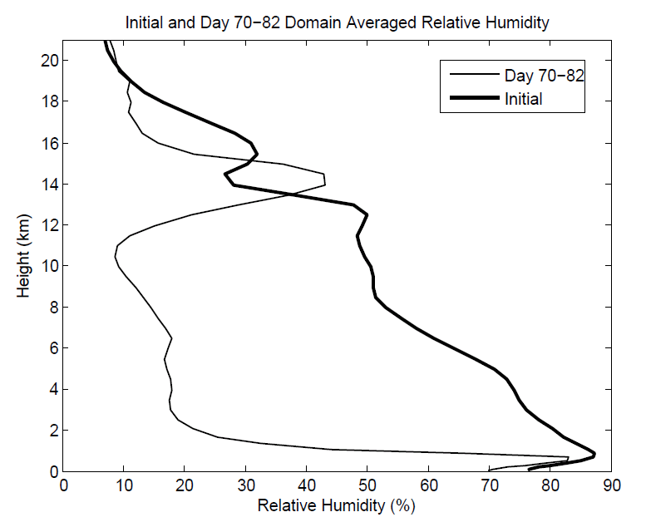
Aggregation Dramatically Dries Atmosphere!

Slide 28
Hypothesis
At high temperature, convection self-aggregates
→Horizontally averaged humidity drops dramatically
→Reduced greenhouse effect cools system
→Convection disaggregates
→Humidity increases, system warms
→System wants to be near phase transition to aggregated state

Slide 29
Recipe for Self-Organized Criticality
(First proposed by David Neelin, but by different mechanism)
System should reside near critical threshold for self-aggregation: Regulation of tropical sea surface temperature!
Convective cluster size should follow power law distribution

Slide 30
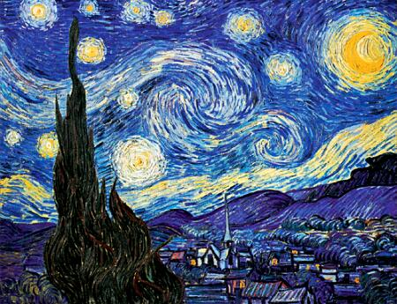
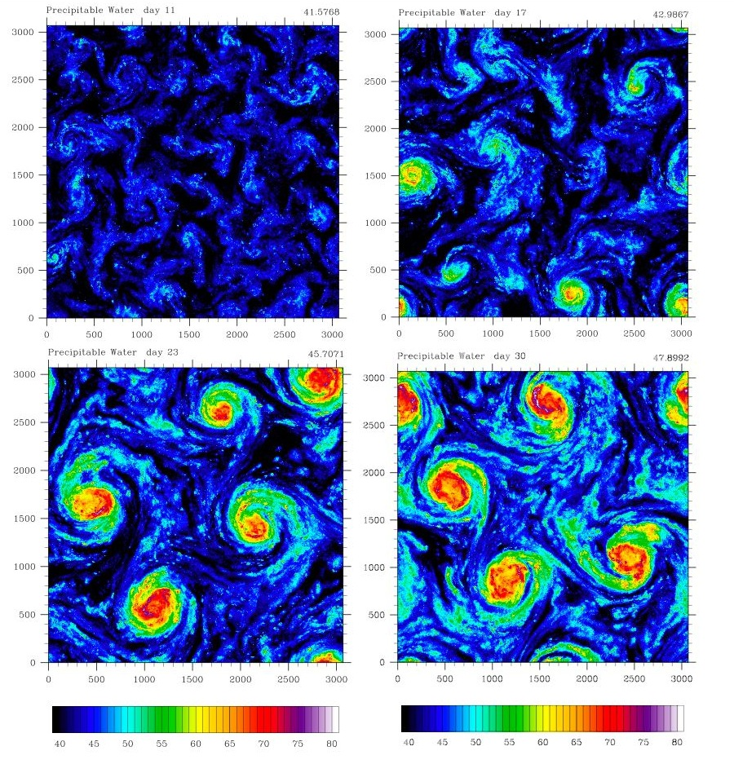
Self-Aggregation on an f-plane
Vincent Van Gogh: Starry Night

Slide 31
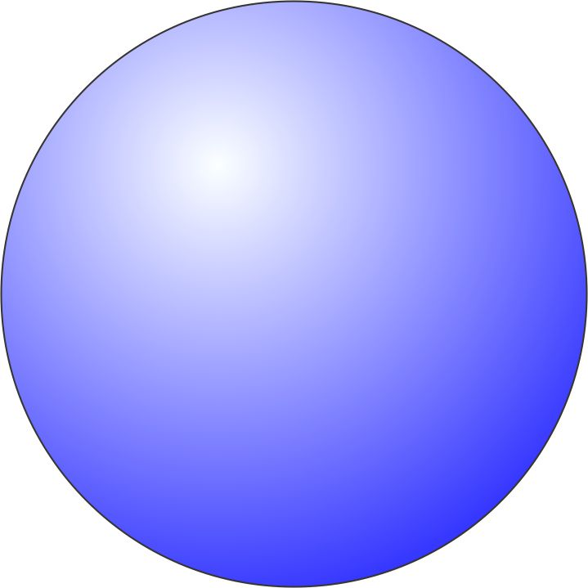
Hurricane-World Scaling
Modified thermodynamic efficiency:
Angular velocity of earth’s rotation:
Saturation water concentration of sea surface:
Net top-of-atmosphere upward radiative flux:
Net upward surface radiative flux:
Potential intensity:

Slide 32
Hurricane-World Scaling
Radius of maximum winds:
Distance between storm centers:
Number density:

Slide 33
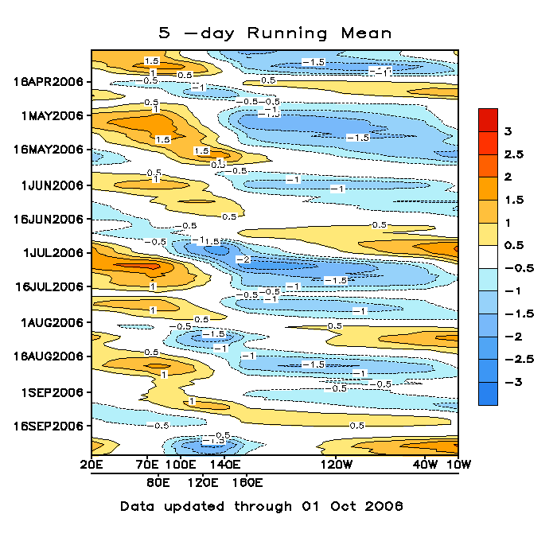
The Madden-Julian Oscillation
A time-longitude diagram of the 5-day running mean of outgoing longwave radiation showing the MJO. Time increases from top to bottom in the figure, so contours that are oriented from upper-left to lower-right represent movement from west to east.
Image source: NOAA

Slide 34
Summary
The genesis of tropical cyclones and cloud clusters (and perhaps the MJO) may be owing to a fundamental instability of the radiative-convective equilibrium state
Cloud clusters and tropical cyclones (and perhaps the MJO) may constitute a self-organized critical system that helps regulate climate, possibly explaining the stability of tropical climate and the annual number of tropical cyclones

Slide 35
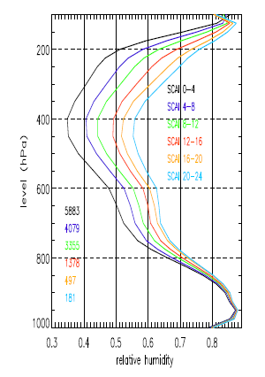
Variation of tropical relative humidity profiles with a Simple Convective Aggregation Index (SCAI).
Courtesy Isabelle Tobin, Sandrine Bony, and Remy Roca
Tobin, Bony, and Roca, J. Climate, 2012

Slide 36
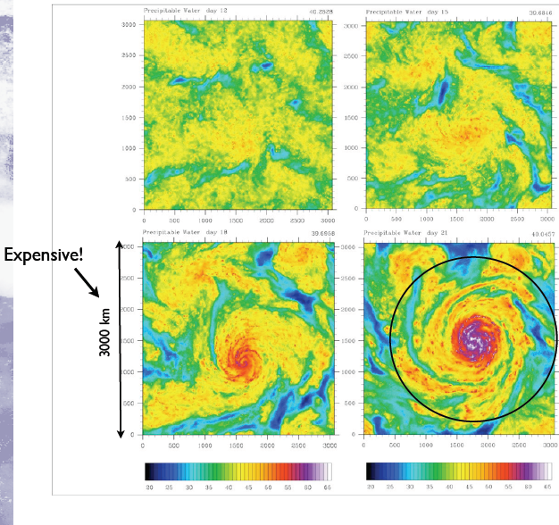
Self-Aggregation on an f-plane
(with Marat Khairoutdinov)
Khairoutdinov, M, and K. Emanuel, 2013: Rotating radiative-convective equilibrium simulated by a cloud-resolving model. J. Adv. Model. Earth Sys., 5, doi: 10.1002/2013MS000253

Slide 37
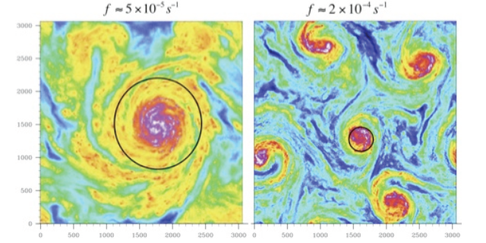

Slide 38
