Slide 1
What can we learn from atmospheric soundings, simple models, and complex models in idealized settings?
Kerry Emanuel
Lorenz Center
MIT

Slide 2
Some Thoughts on Parameterization
Under what circumstances is a process “parameterizable”?
How should we go about building and testing parameterizations?
What do observations tell us about convection and its parameterization?
What observations are most effective at constraining convection schemes?

Slide 3
When is convection parameterizable?
If the key statistics of convection (e.g time/area-averaged fluxes of enthalpy, water, and momentum) can be specified as a unique function of the recent time history of large- scale (model) variables

Slide 4
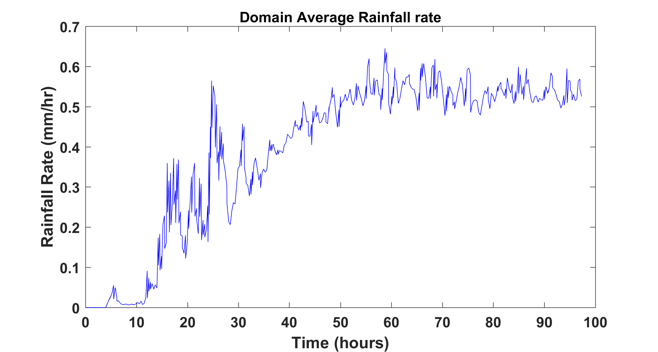
Simple example: Radiative-convective equilibrium (RCE)
Domain: 60x60x20 km, 2 km horizontal grid spacing
After Islam, S., R.L. Bras, and K.A. Emanuel, 1993: Predictability of mesoscale rainfall in the tropics. J. Appl. Meteor., 32, 297-310.

Slide 5
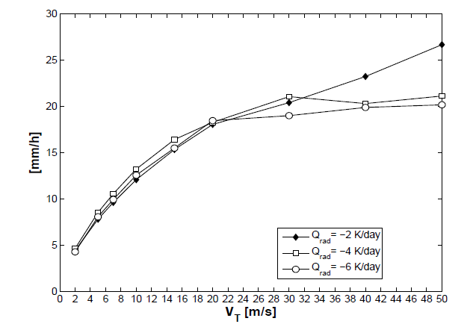
Rainfall Intensity vs. Terminal Fall Speed
Parodi, A., and K. Emanuel, 2009: A theory for buoyancy and velocity scales in deep moist convection. J. Atmos. Sci., 66, 3449-3463

Slide 6
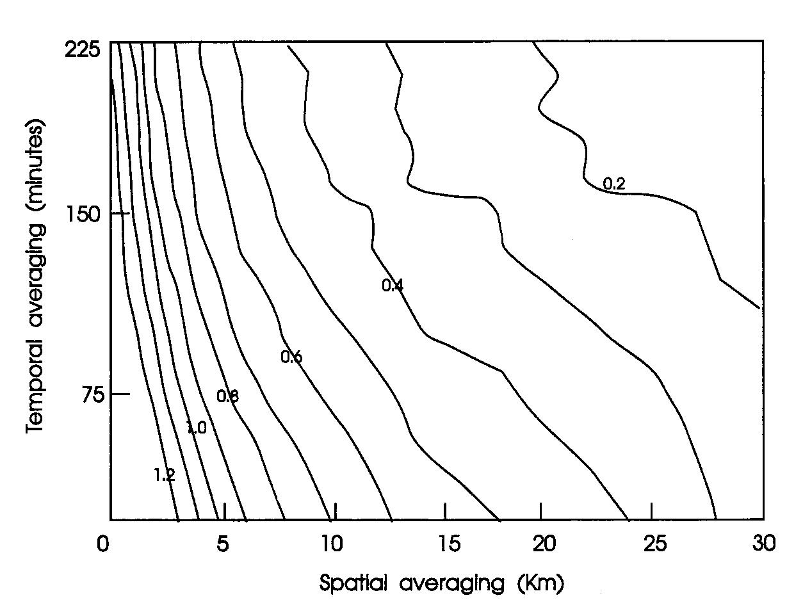
Ratio of Standard Deviation to Mean Rainfall

Slide 7
RCE is parameterizable on space scales of more than ~ 50 X 50 km and time scales more than a few hours.

Slide 8
For what phenomena may it be reasonable to parameterize convection?
Large–scale tropical circulations such as Hadley and Walker cells and monsoons:
  Yes
Tropical cyclones and other aggregated convection:
  Yes, at least for track and intensity
Supercells:
  No
Squall lines:
  No, unless, possibly, cold pools are explicitly simulated, in which case convective rain must be coupled to explicit rain
Diurnal cycle:
  Yes, possibly, if convection responds over non-zero time scale
Non-equilibrium convection:
  No, unless large explicit ensembles are used

Slide 9
How should we go about building and testing parameterizations?
Frequently used method:
  Design new scheme or improve existing scheme
  Put in model
  Evaluate performance
  Modify scheme
More engineering than science: recipe for disaster when applied across multiple parameterizations
Better method:
  Design new scheme or improve existing scheme
  Test offline against actual observations
  Modify scheme
  Final step: Put in model. No retuning!!
  HARD WORK!

Slide 10
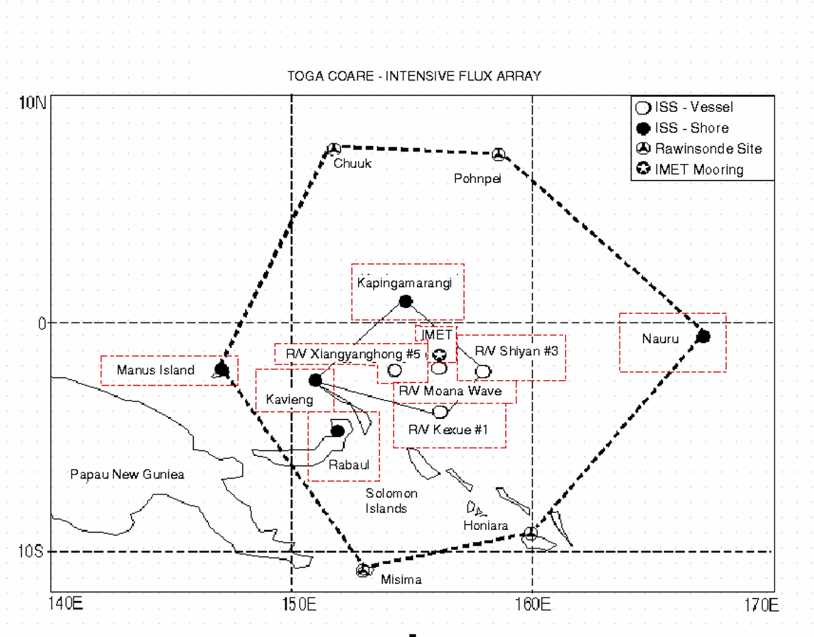
Example: TOGA-COARE Inner Flux Array (IFA) Observations

Slide 11
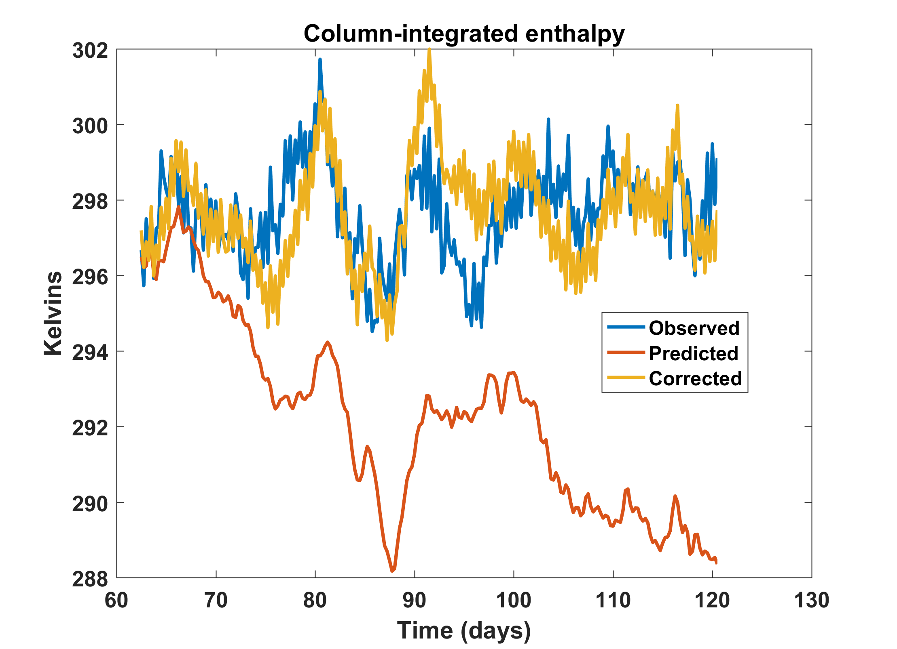
Energetic consistency of observations:

Slide 12
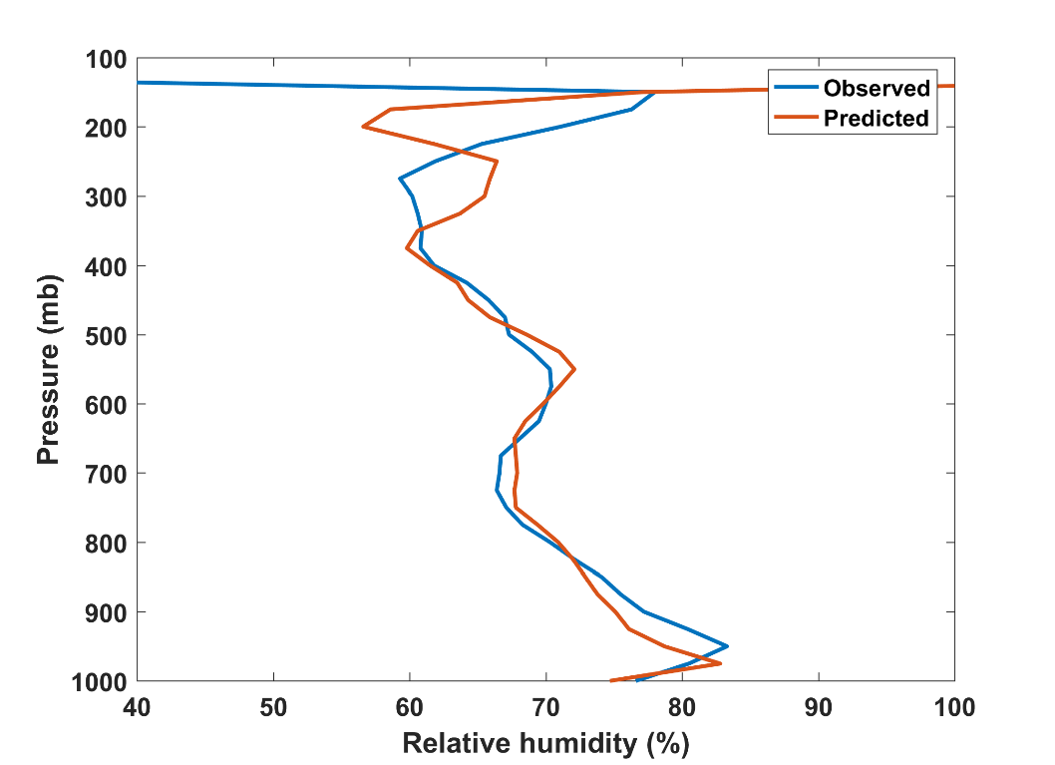
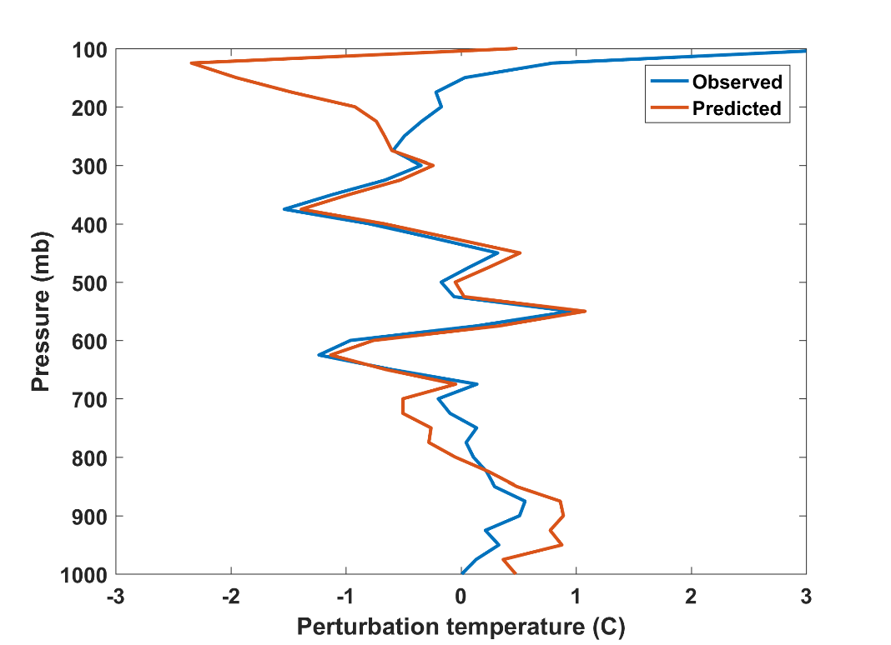
After much optimization:

Slide 13
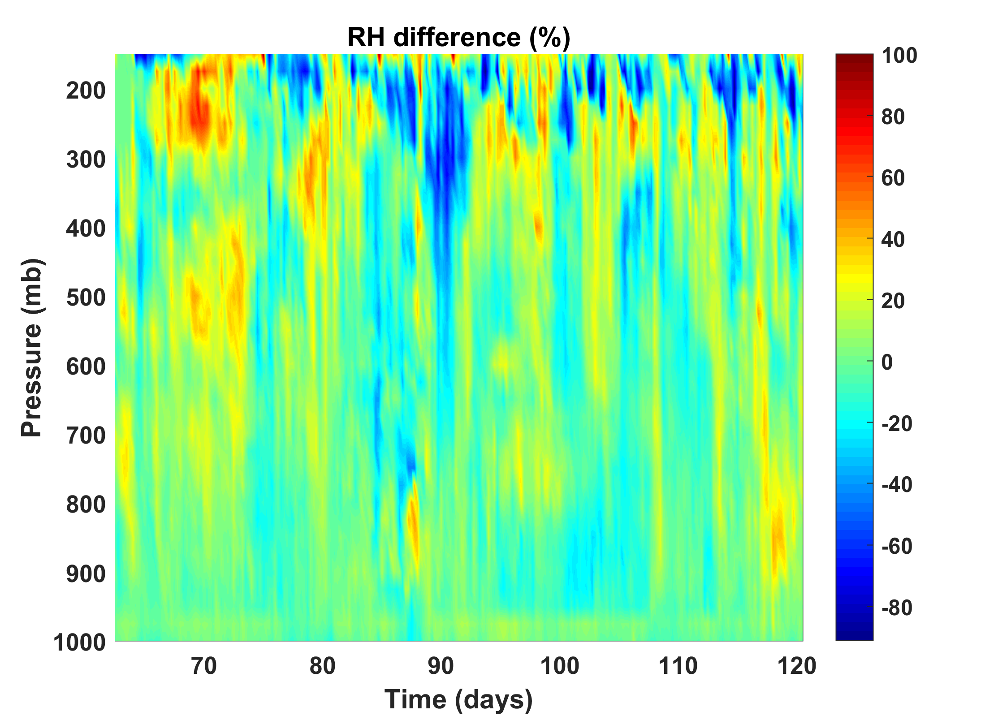
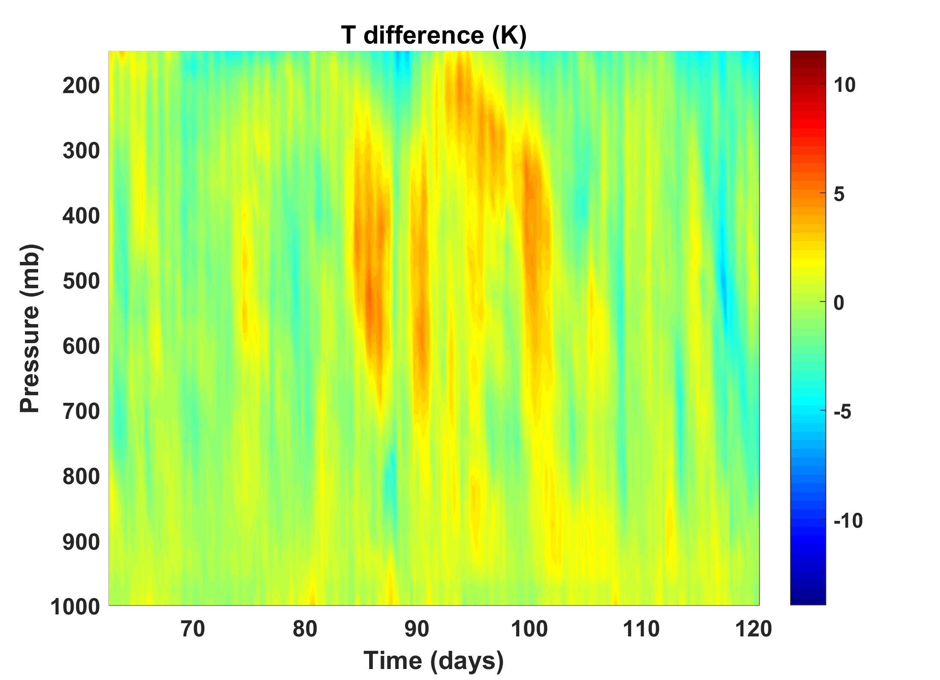
Still, large differences at individual times/altitudes:

Slide 14
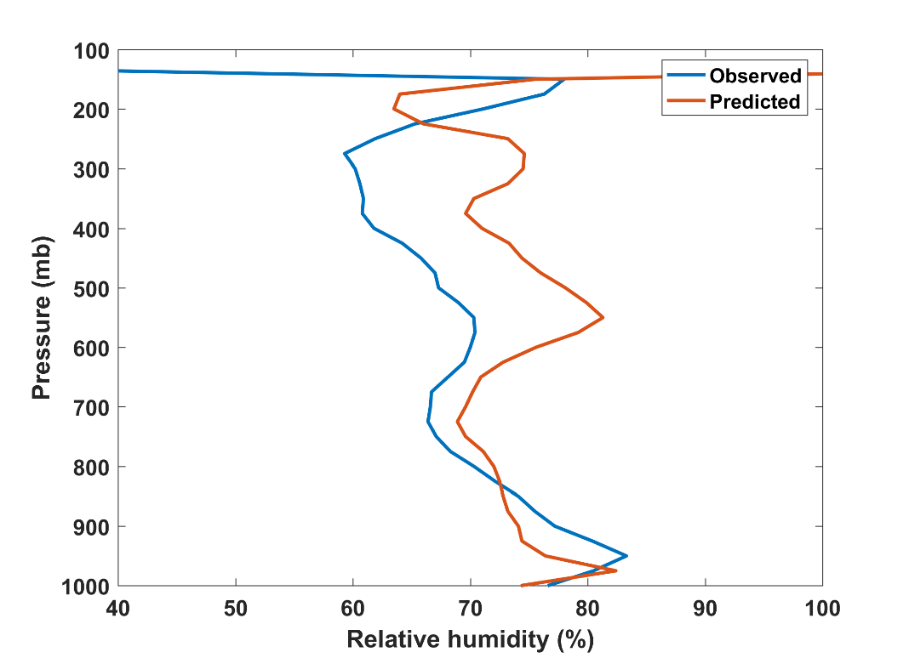
Sensitivity to microphysics:
Decrease area covered by unsaturated downdraft
Control

Slide 15
Climate sensitivity of CMIP3 models verses a measure of convective mixing
Sherwood, Bony and Dufresne, Nature, 2014

Slide 16
Other Observational Tests

Slide 17
Column-integrated water vapor (mm)
Bretherton, Peters, and Back, J. Climate, 2004

Slide 18
“Precipitation has been found to be sensitive to variations in water vapor along the vertical on large space and time scales both in observations and in models. This is due to the effect of water vapor on the buoyancy of cloud plumes as they entrain surrounding air by turbulent mixing.”
-- Peters and Neelin, Nature Phys., 2006
Is this interpretation correct?

Slide 19
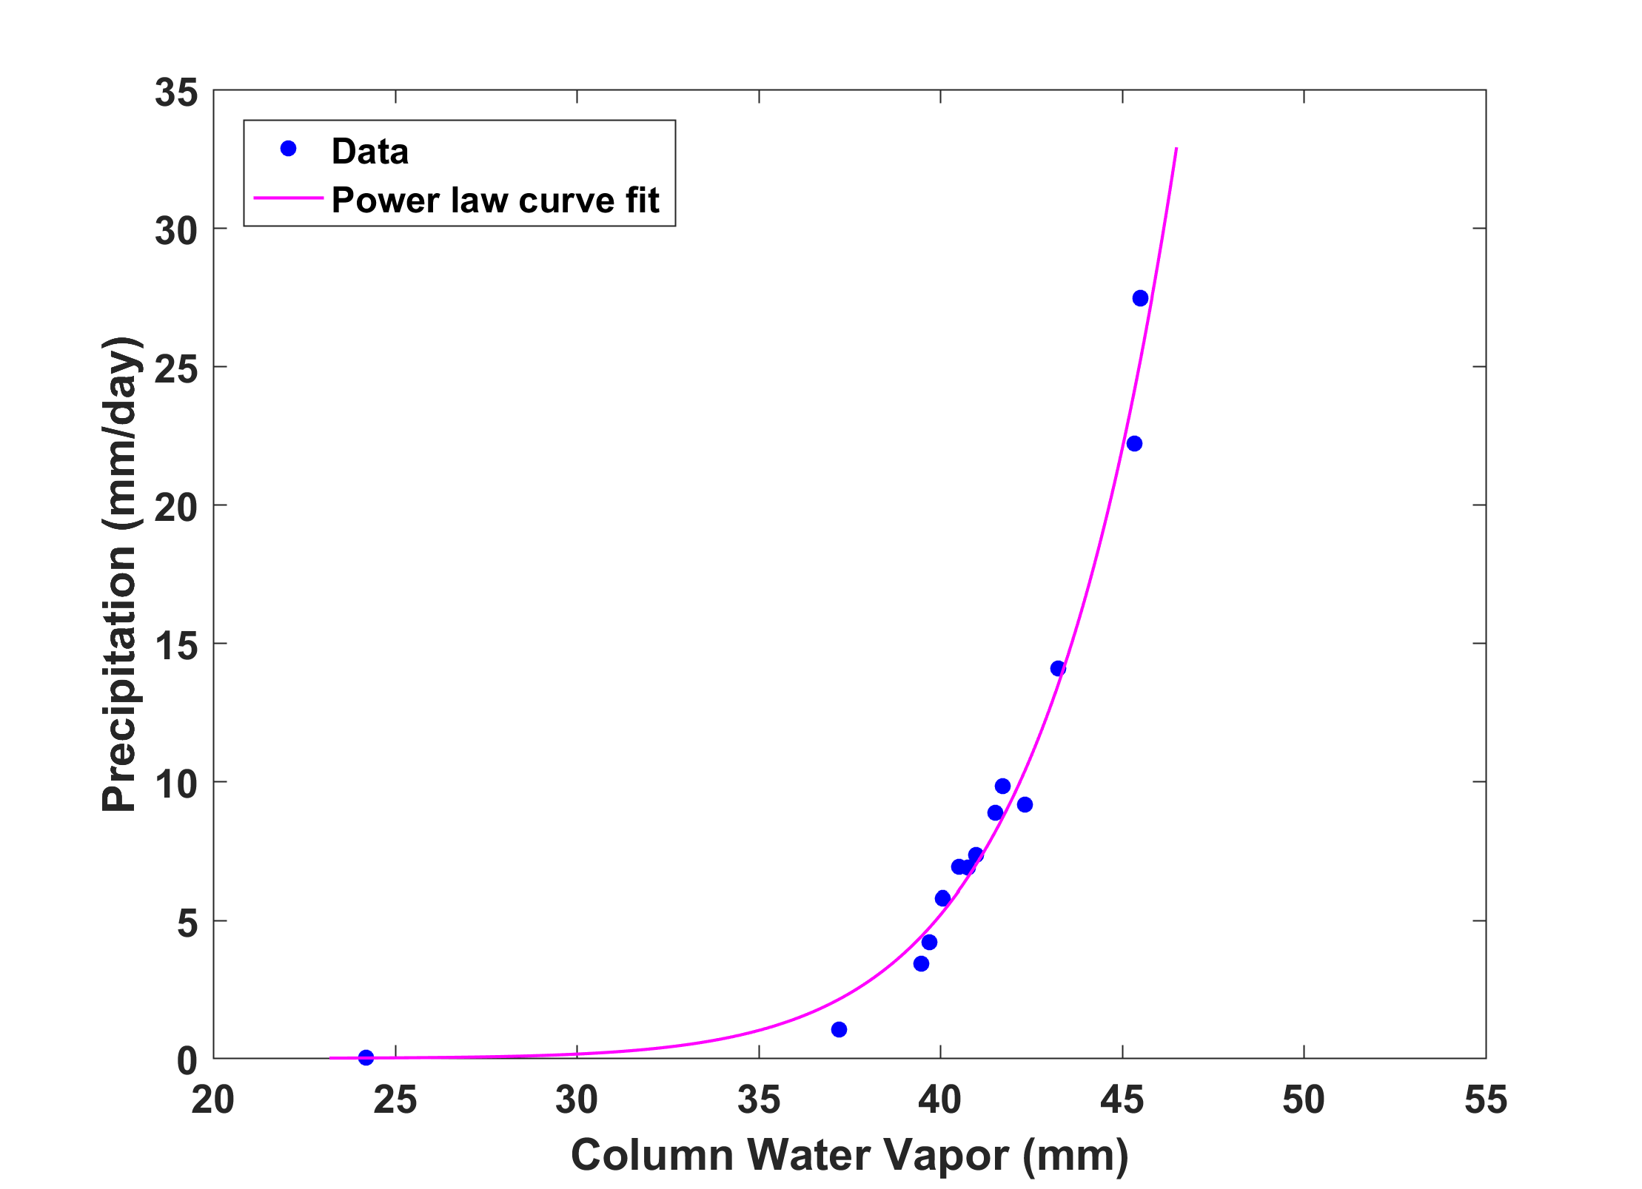
Run single-column model in weak-temperature-gradient mode, starting from RCE and varying SST, surface wind, or free atmosphere water source
Varying SST
Notes:
Single-column experiments with full physics and fixed SST, run under WTG conditions with temperature fixed above 850 hPa. Blue dots show experiments varying SST and plotting time-mean precipitation against time-mean vertically integrated water vapor.

Slide 20
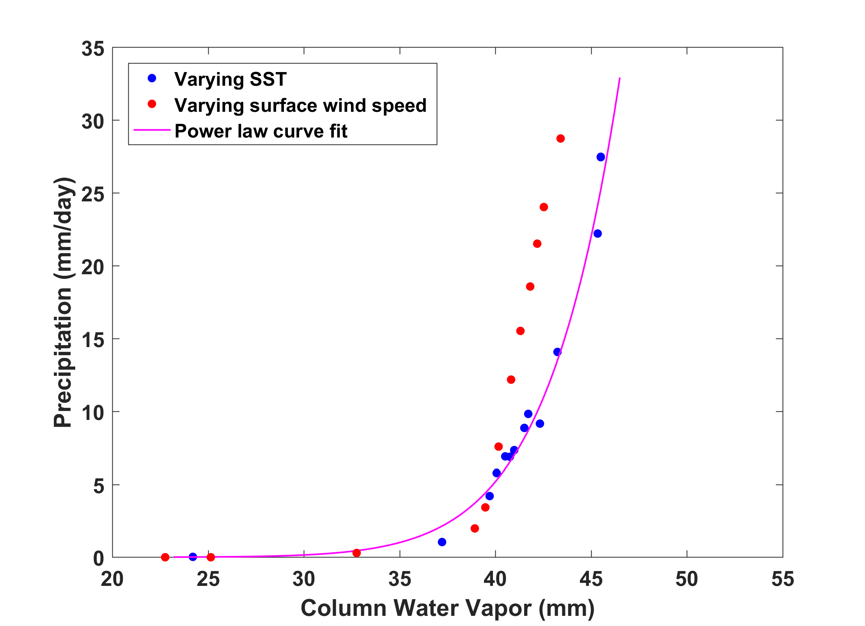
Varying surface wind speed
Notes:
Same as previous figure but adding results (red dots) of experiments varying surface wind speed while holding SST fixed at RCE value.

Slide 21
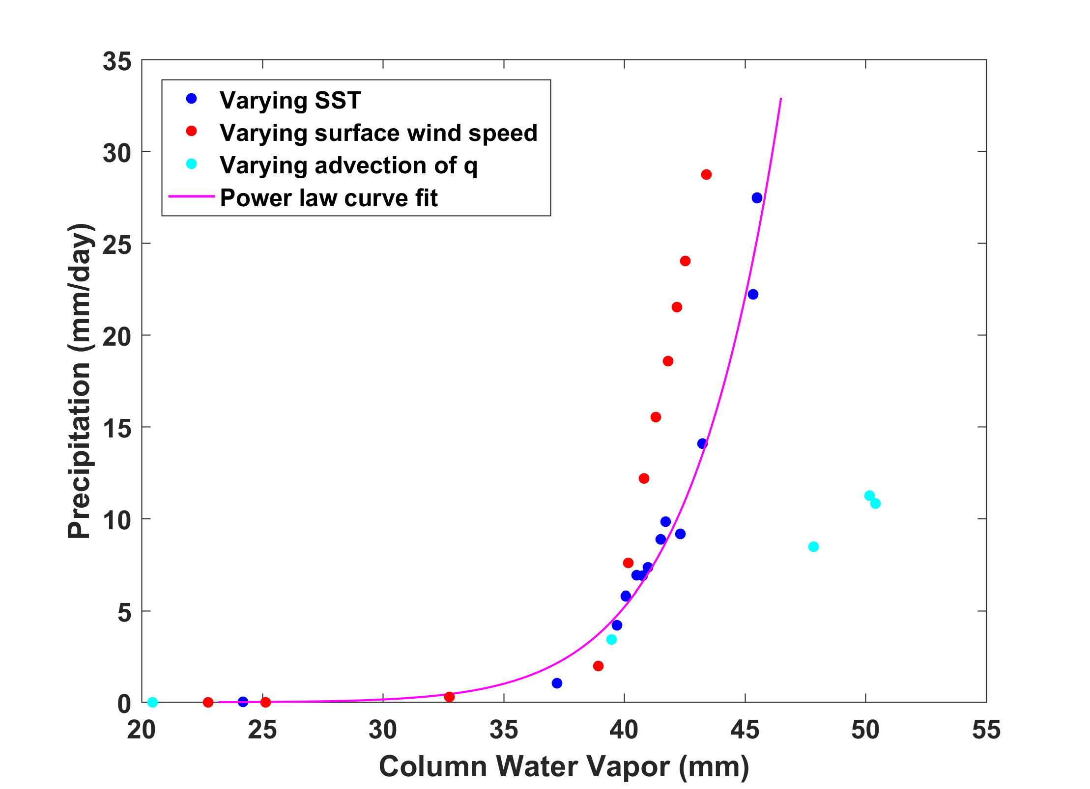
Varying free tropospheric water source
Notes:
Same as previous figure but adding results (cyan dots) of adding source of water vapor at each level above 850 hPa, proportional to RCE value of water vapor at each level.
These results suggest that there is no universal curve but rather that precip and water vapor vary according to the nature of the source.

Slide 22
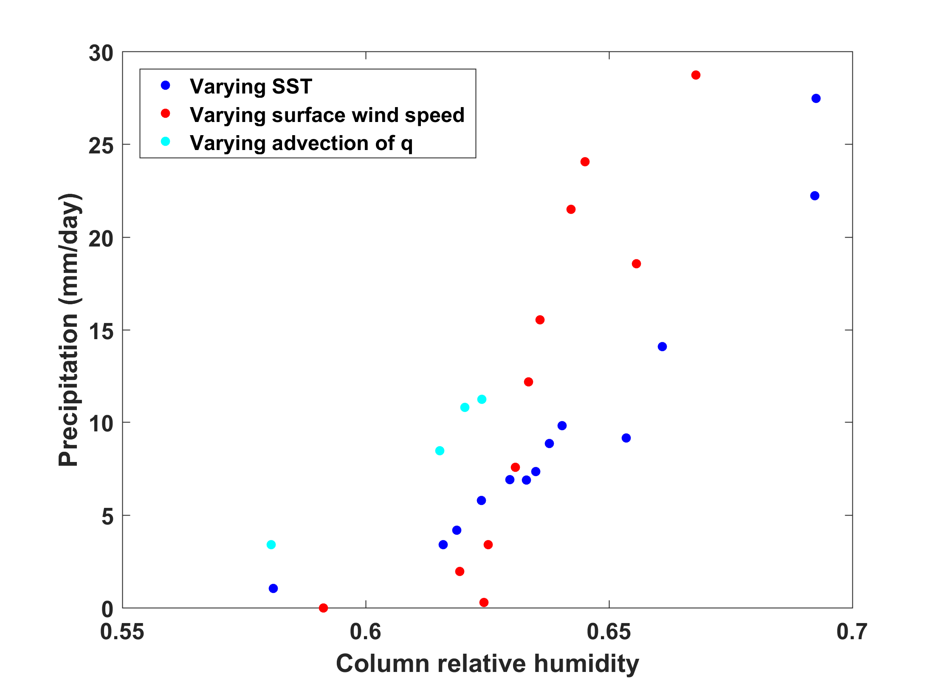
Same as previous, but vs. column relative humidity
Notes:
Same as previous slide, but graphing against column relative humidity

Slide 23
Simple Model of Precipitation vs Surface Fluxes and Column Humidity
Based on marriage of 4 principles:
  Boundary layer equilibrium: Moist convective moist static energy flux out of PBL equals PBL enthalpy source
  Weak Temperature Gradient Approximation: Temperature above PBL does not change
  Global energy conservation: Advection of moist static energy out of column equals net enthalpy source in column
  Approximate expression for Gross Moist Stability:

Slide 24
Precipitation as a function of Surface fluxes:
boundary layer specific humidity
vertically integrated radiative cooling
dry static stability
surface enthalpy flux divided by radiative cooling
precipitation efficiency
ratio of vertical velocity at top of PBL to max value

Slide 25
Mid-level moist static energy deficit (proportional to gross moist stability):

Slide 26
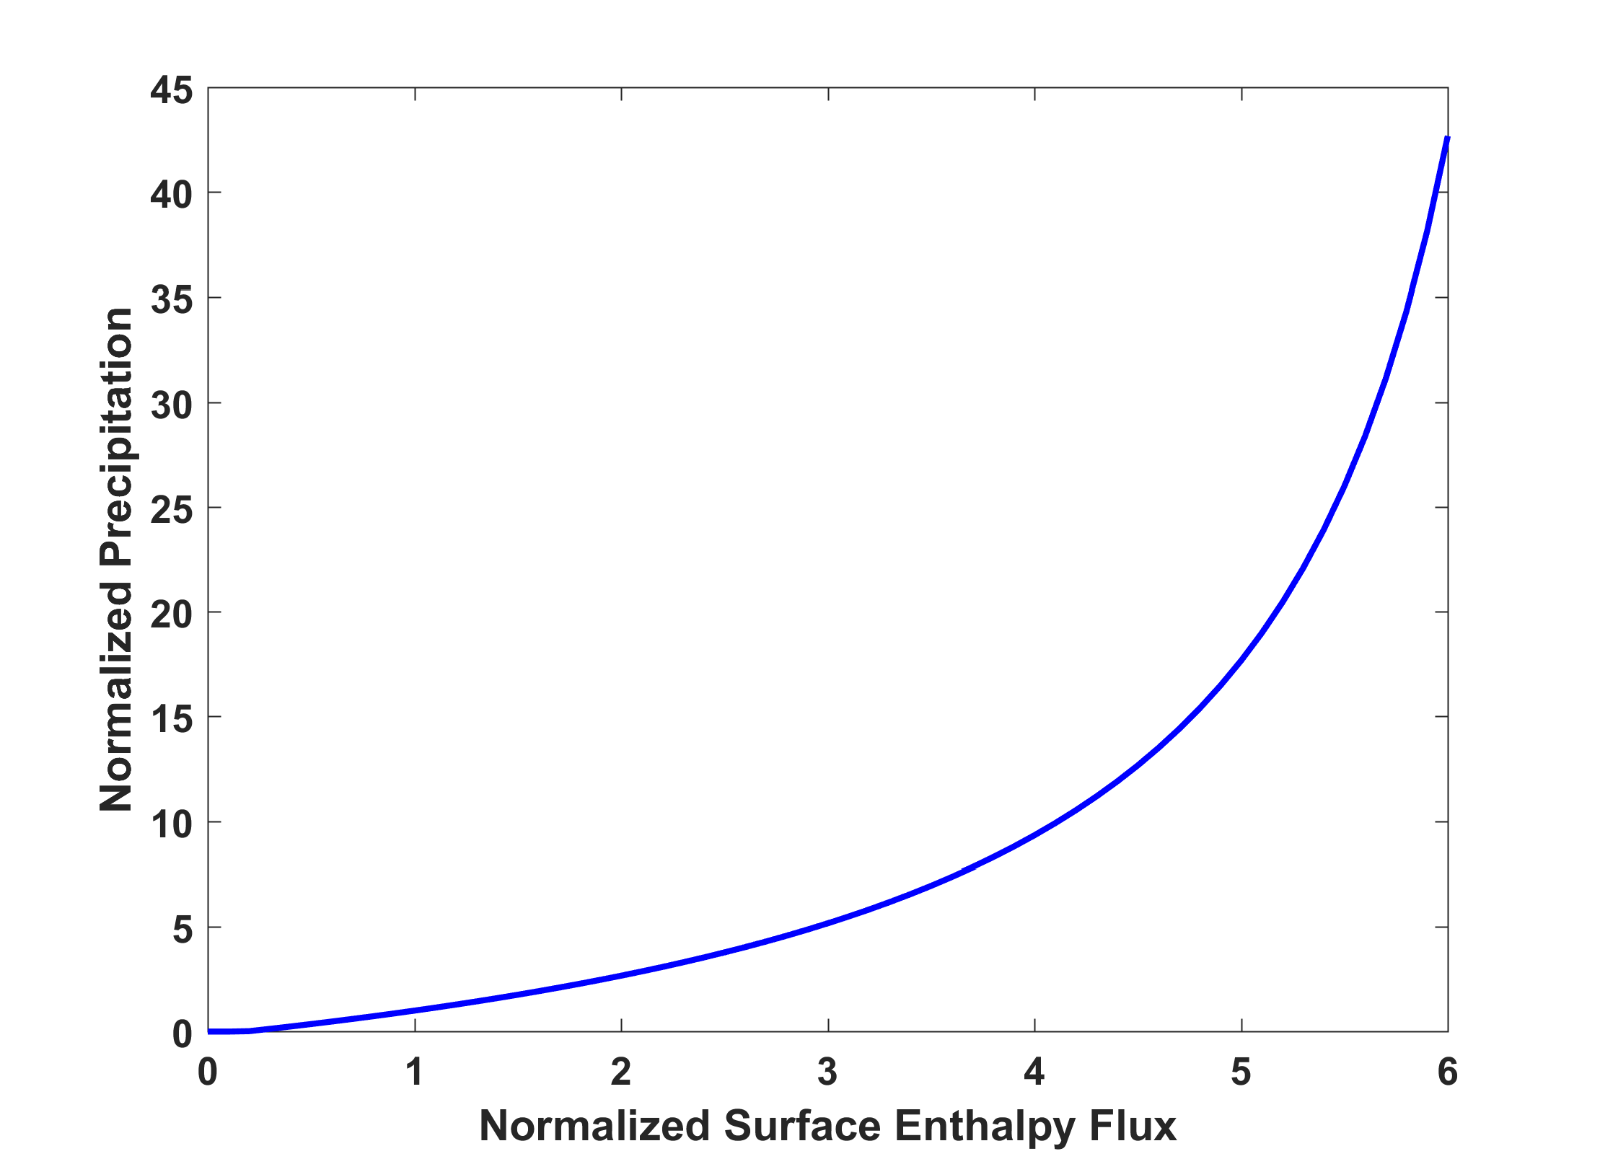
RCE

Slide 27
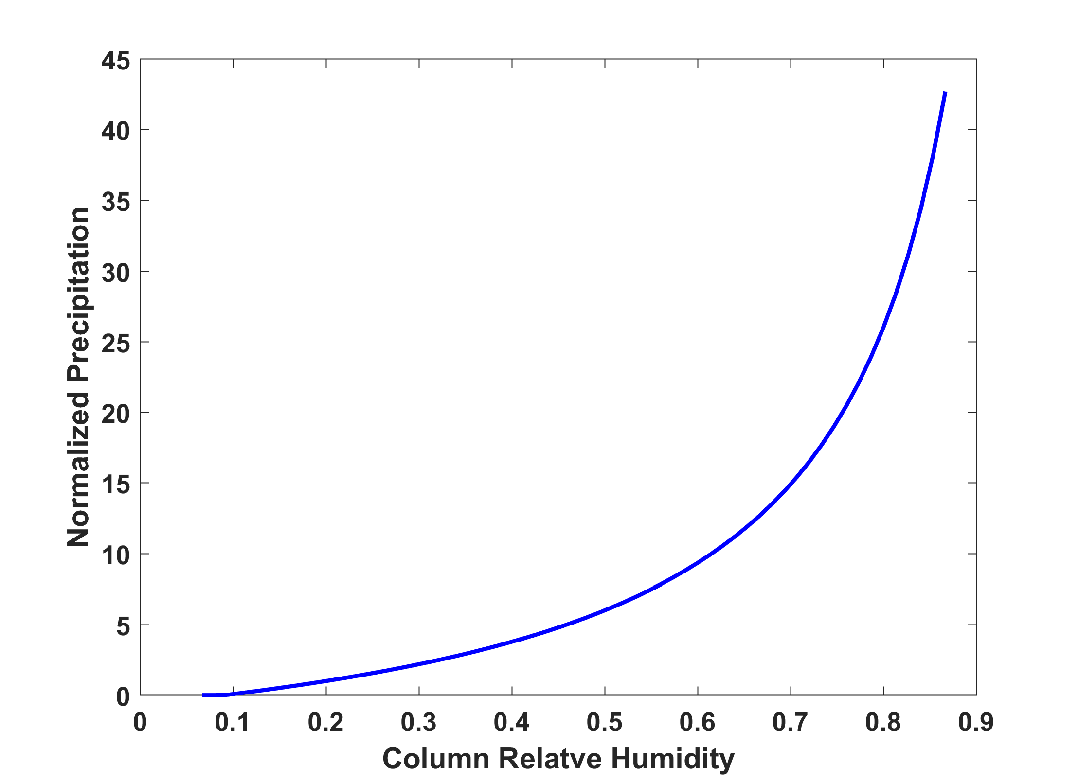

Slide 28
What can we learn from atmospheric soundings?

Slide 29
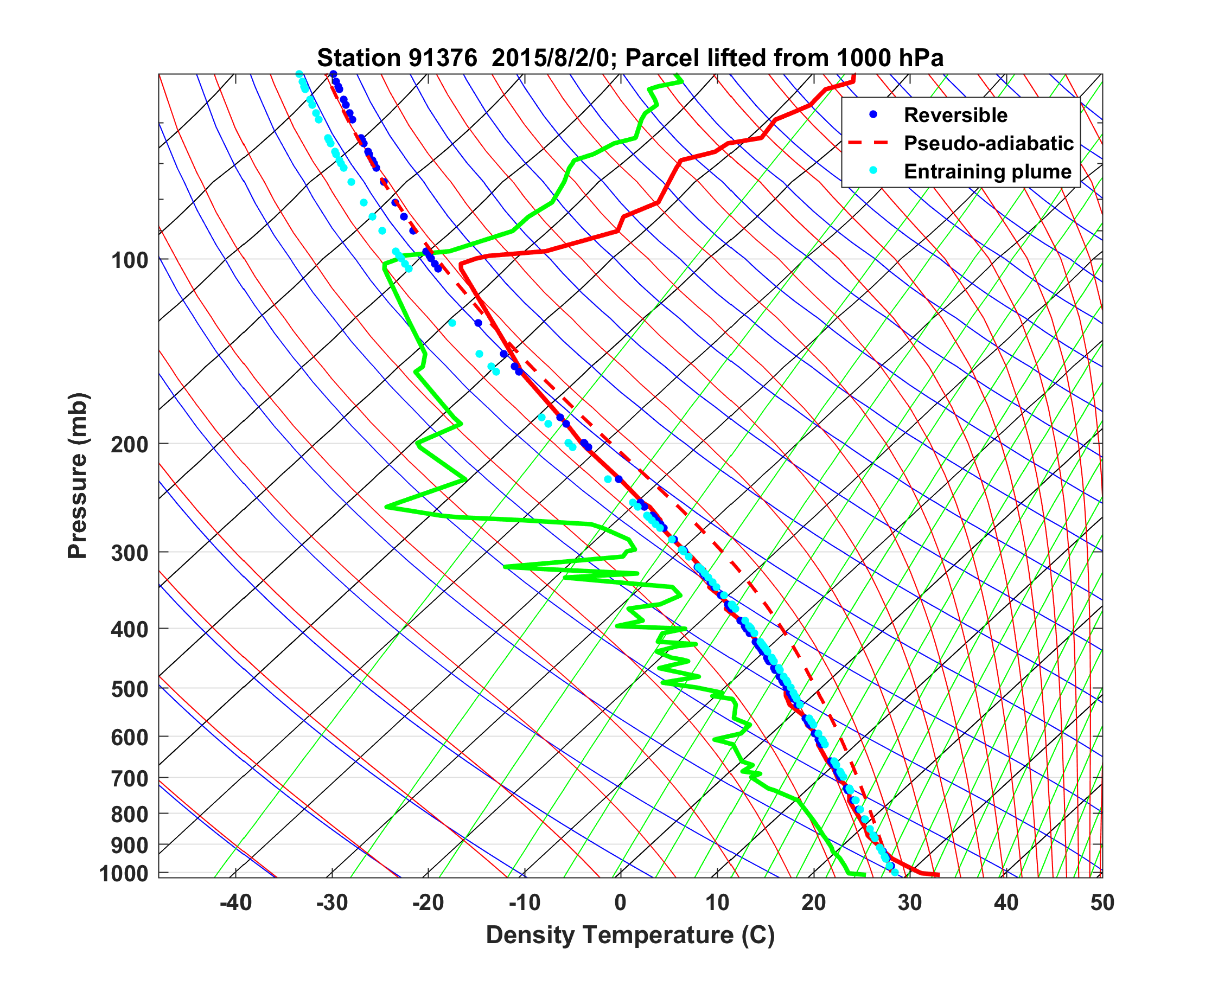
Notes:
Majuro sounding on 8/2/2015 at 00 GMT with pseudo-adiabatic reversible (w/o ice) and entraining plume with ice [parcel ascent from 1000 hPa.

Slide 30
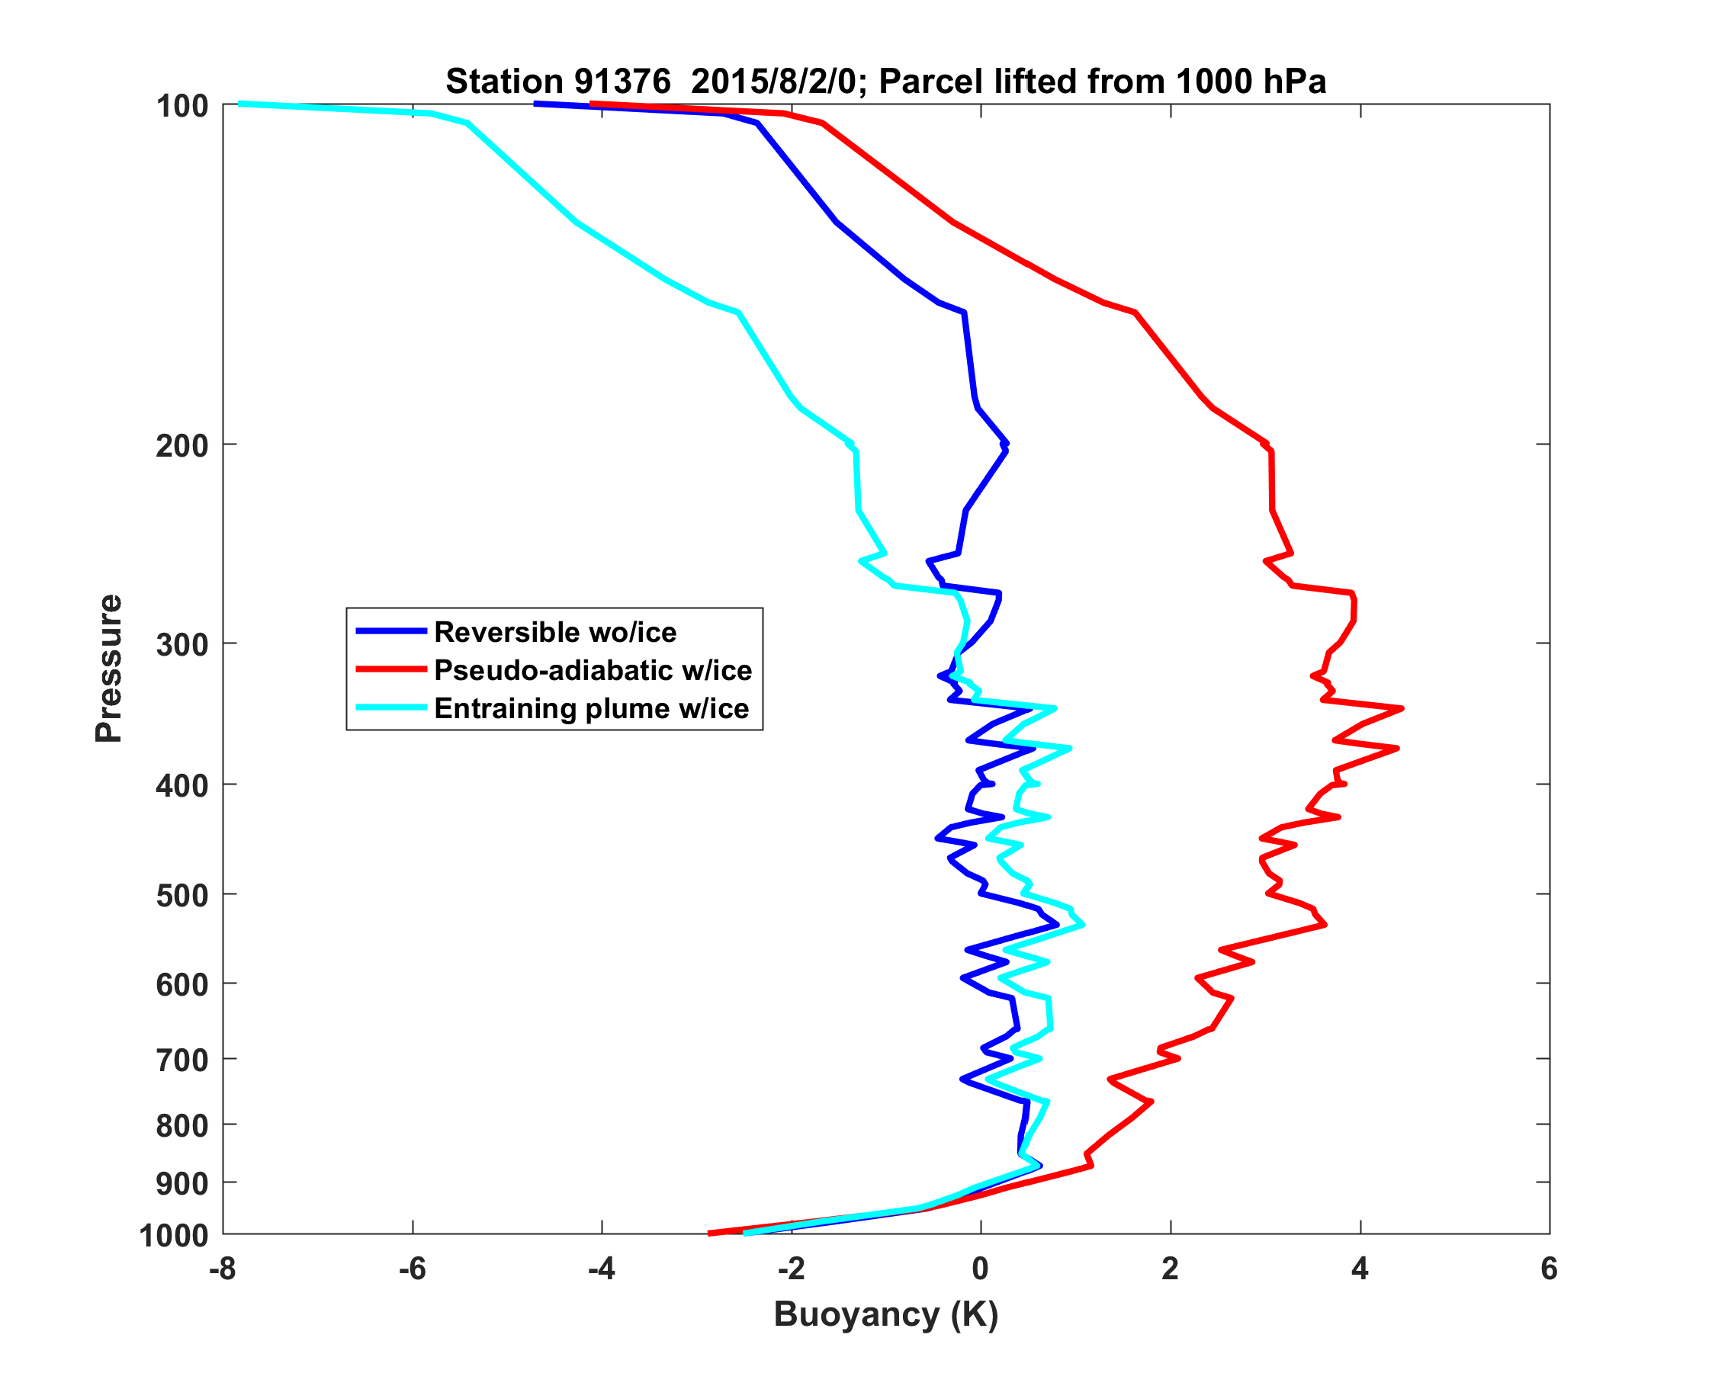
Notes:
Difference in density temperature between lifted parcel and environment.

Slide 31
Ratio of modelled to observed trends in upper tropospheric temperature. Santer et al., J. Climate, 2017

Slide 32
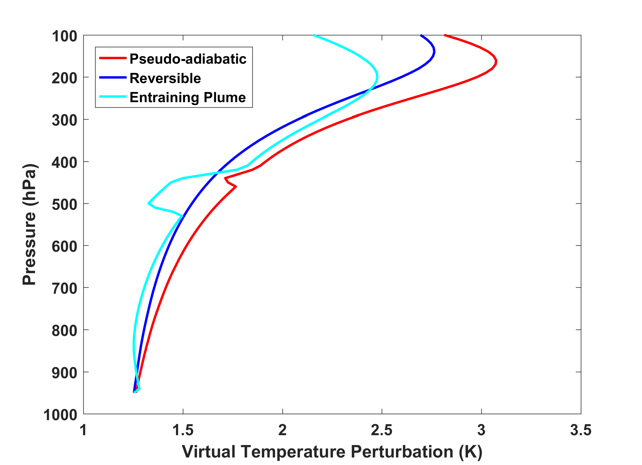
Warming along three different neutral buoyancy plumes:

Slide 33
Coupling ice clouds to convection: Importance for self-aggregation

Slide 34
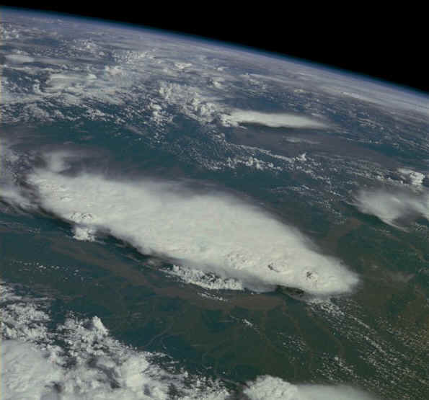
Monsoonal Thunderstorms, Bangladesh and India, July 1985

Slide 35
From Hohenegger and Stevens, JAMES, 2016
Notes:
Time evolution of (a–c) components of the surface energy budget (W/m^2) and (d) SST (K) in U50D (black) and U50D_noagg (orange). All quantities from daily averages.

Slide 36
Summary
In spite of the advent of convection-permitting models, there is still a strong need for convective parameterizations
All parameterizations must be rigorously tested against observations before being used in models; tuning them within models may be ill-posed
Simple models and cloud-permitting models are valuable for advancing our understanding of convection, a prerequisite to improving convective schemes.
Atmospheric soundings contain valuable clues to the effect of convection on the large-scale environment
More attention needs to be paid to how convective schemes interact with stratified clouds (explicit or parameterized), especially as this may strongly affect aggregation of convection.

Slide 37
From Peters and Neelin, Nat. Phys., 2006
Notes:
Order parameter and susceptibility. The main figure shows the collapsed (see text) precipitation rates <P>(w) and their variances for the tropical Eastern (red) and Western (green) Pacific as well as a power-law fit above the critical point (solid line). The inset displays on double-logarithmic scales the precipitation rate as a function of reduced water vapor (see text) for Western Pacific (green,
120E to 170W), Eastern Pacific (red, 170W to 70W), Atlantic (blue, 70W to 20E), and Indian Ocean (pink, 30E to 120E). Data are shifted by a small arbitrary factor for visual ease. The straight lines are to guide the eye. They all have slope 0.215, fitting the data from all regions well.

