Slide 1
The Influence of the Lower Stratosphere and Tropical Tropopause Layer on Tropical Cyclones
Kerry Emanuel
Lorenz Center
MIT

Slide 2
Susan Solomon has actively addressed this issue, focusing on the effect of near-tropopause temperature on tropical cyclone potential intensity
Worked with Daniel Gilford, Allison Wing, Doris Folini, Sean Davis, Chiara Gagnazzo, and myself
Today: Review of this work with extension through 2018, and some new research on high frequency variability of tropical cyclone environmental variables

Slide 3
Main Conclusion: The Stratosphere and Tropical Tropopause Layer Matter for Tropical Cyclones

Slide 4
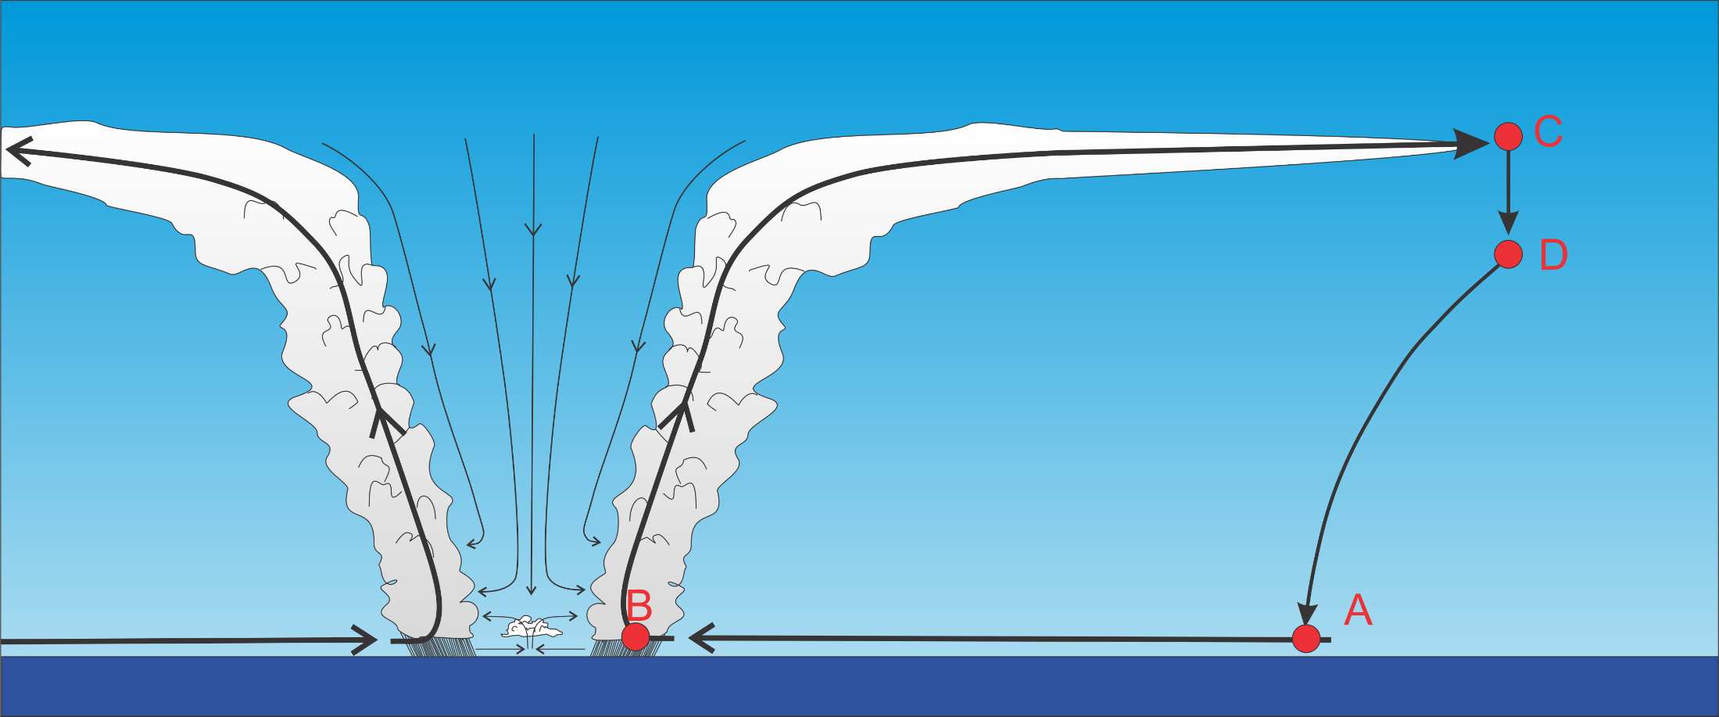
Basic TC Physics: Energy Production
Isothermal
Loss
Moist adiabatic
Moist adiabatic
Isothermal; large input of heat from sea

Slide 5
Theoretical Steady-State Maximum Hurricane Wind Speed:
Surface temperature
Saturation static energy of sea surface
Saturation static energy of the boundary layer
Ratio of surface exchange coefficients of enthalpy and momentum
Outflow temperature
Air-sea enthalpy disequilibrium of moist static energy

Slide 6
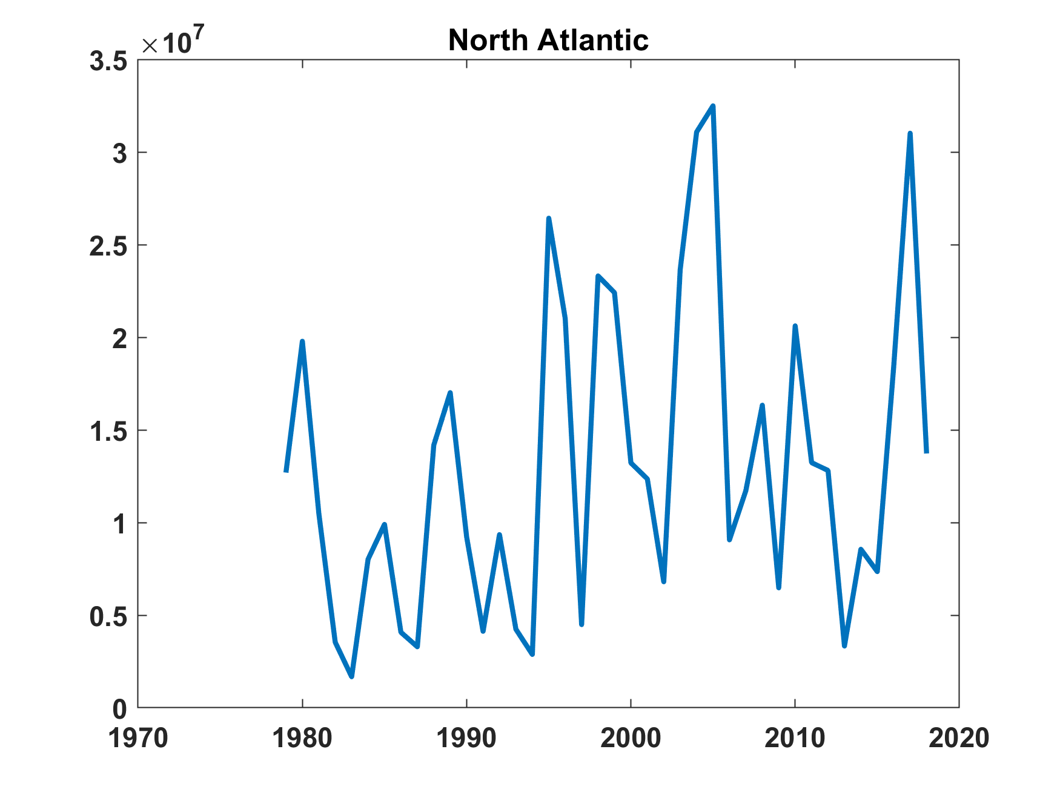
North Atlantic Tropical Cyclone Power Dissipation (from historical TC data)

Slide 7
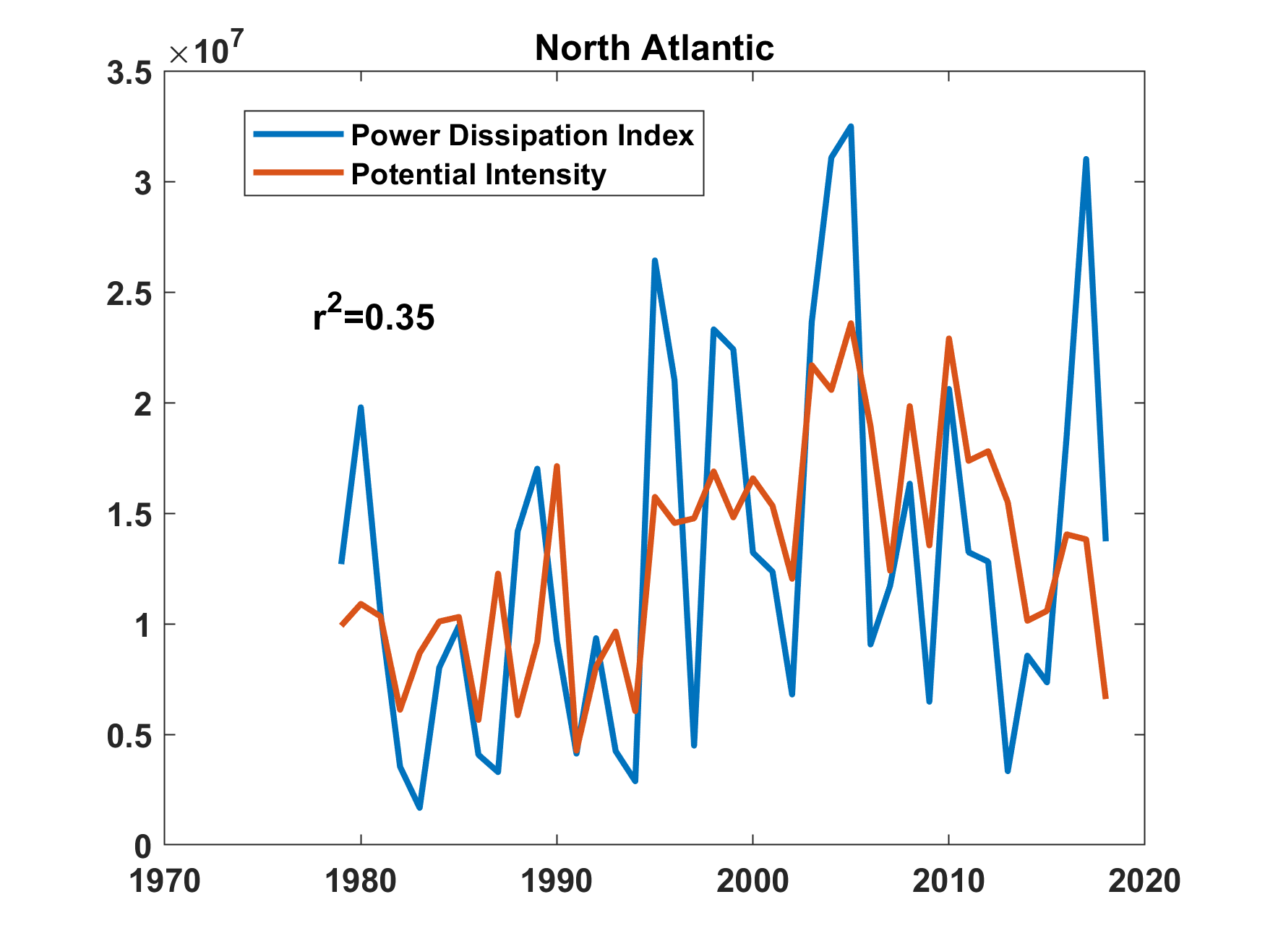
Correlation Between TC Power Dissipation and Potential Intensity (from ERA5 Reanalyses)
(PI calculated over Atlantic Main Development Region, August-October)

Slide 8
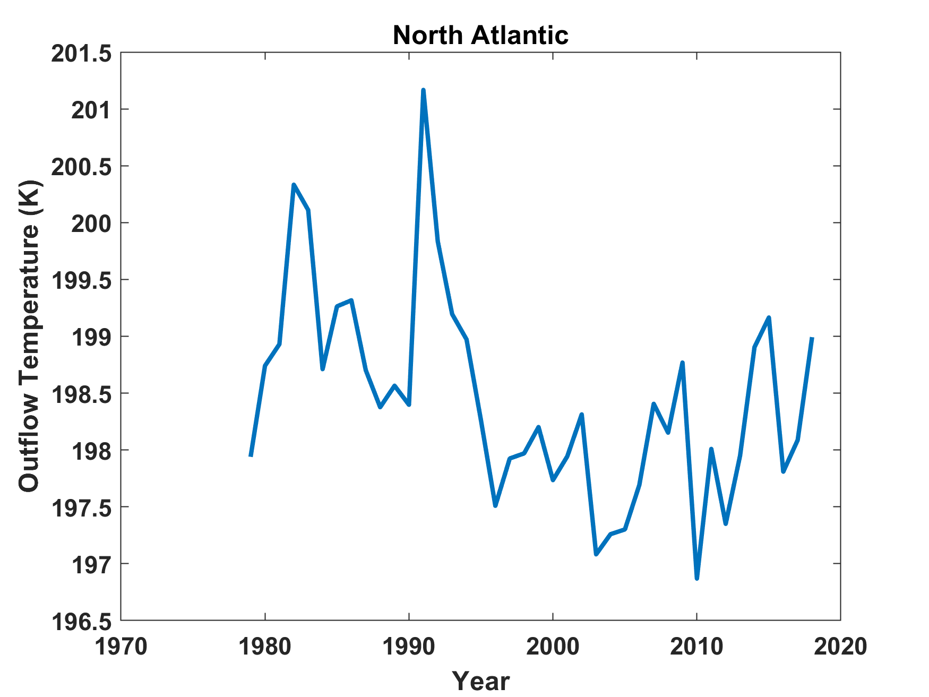
Outflow Temperature (ERA5)
Pinatubo
El Chichon
(Calculated over Atlantic Main Development Region, August-October)
Cooling induced by ozone loss?

Slide 9
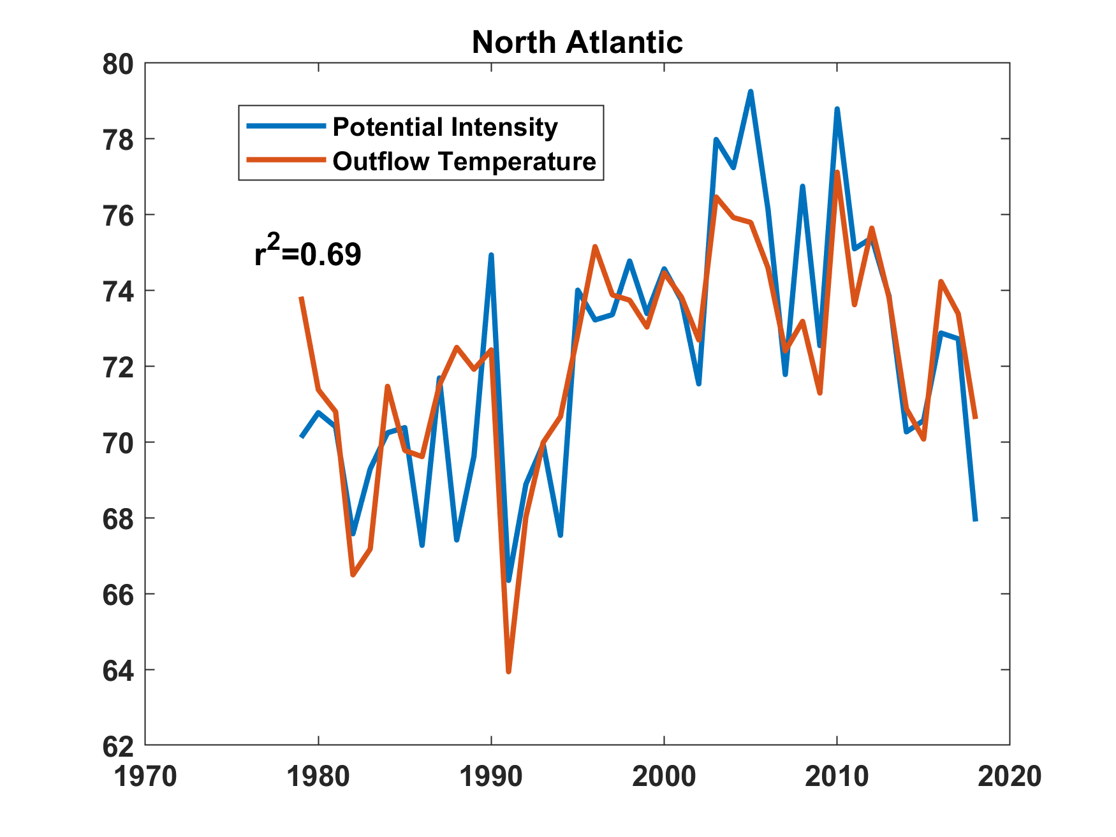
Correlation Between Outflow Temperature and Potential Intensity
m/s

Slide 10
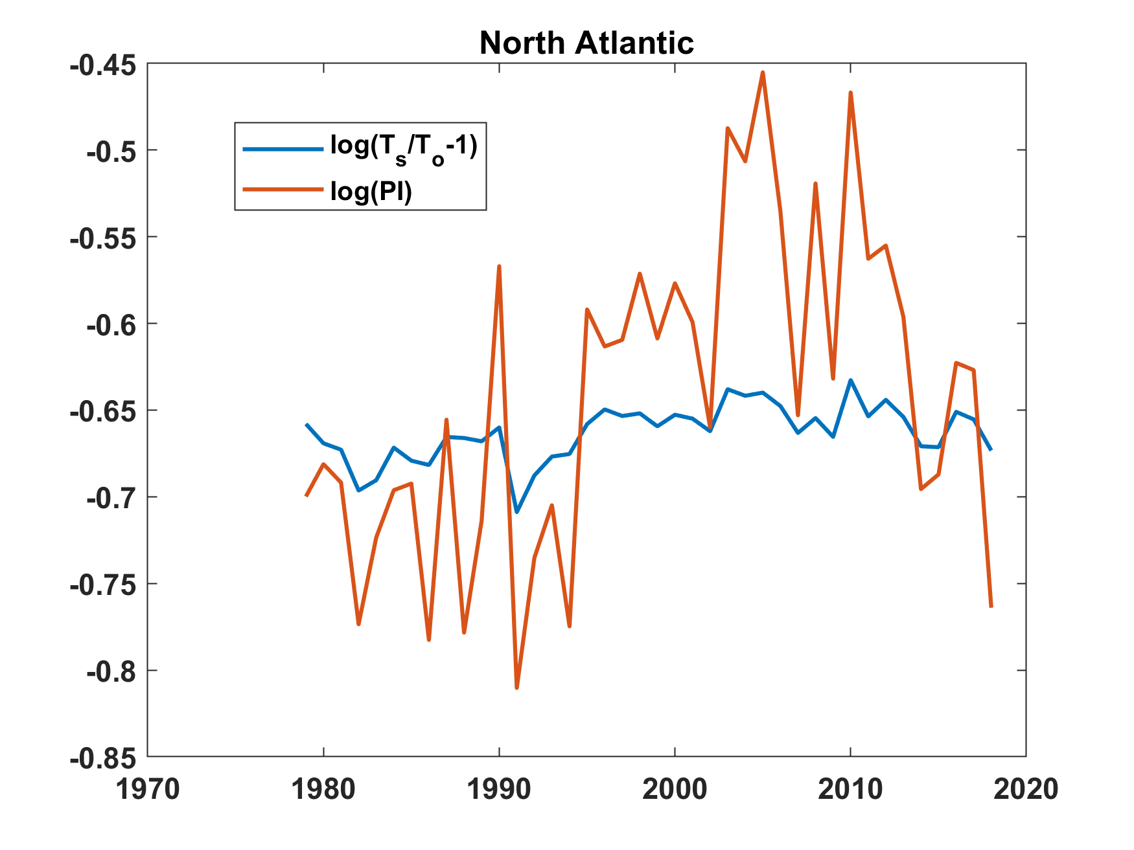
Yet variability in outflow temperature accounts directly for only ~10% of variability of potential intensity

Slide 11
High Frequency Variability of Potential Intensity
PI calculated from twice-daily rawinsonde data at tropical island stations together with monthly mean sea surface temperature linearly interpolated to the location and time of the rawinsonde
00 and 12 GMT radiosonde-derived quantities are averaged together to reduce diurnal signal

Slide 12
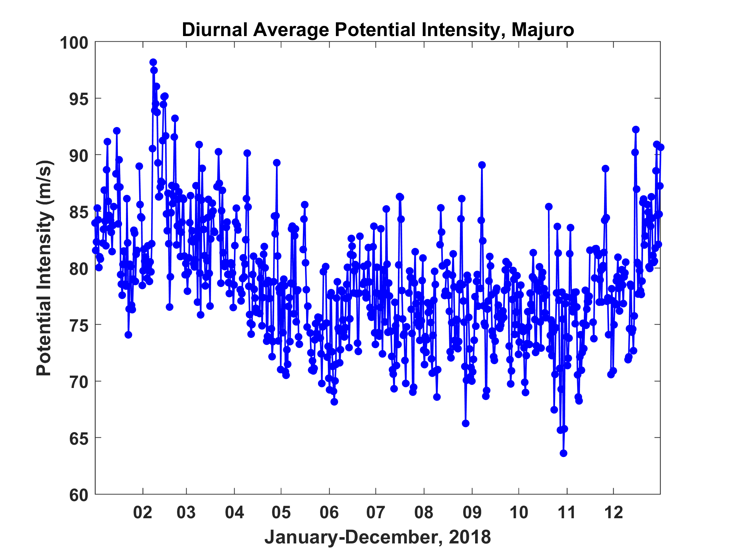
Daily Mean Potential Intensity, Majuro, 2018

Slide 13
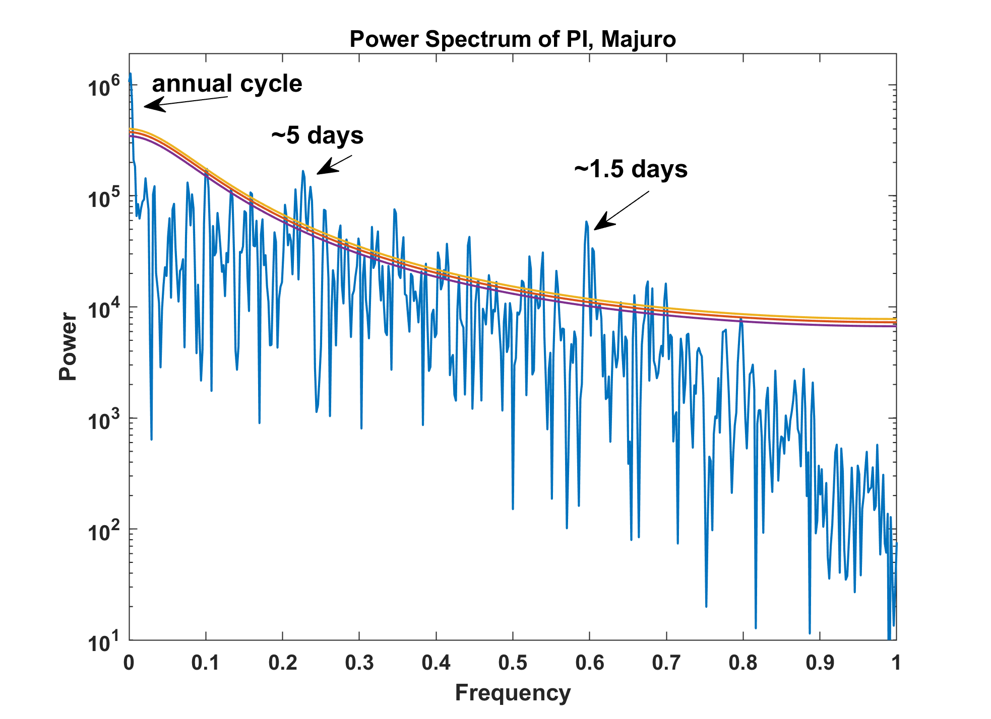
Power Spectrum of Potential Intensity, Majuro, 2018

Slide 14
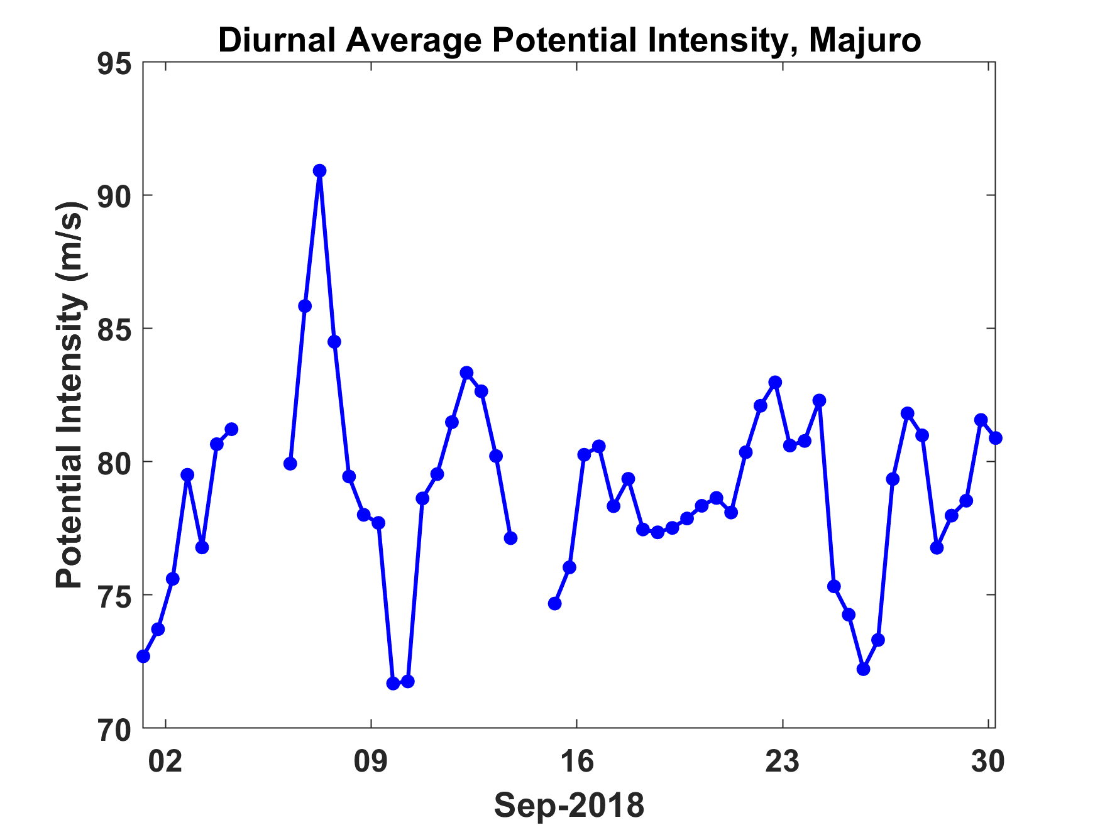
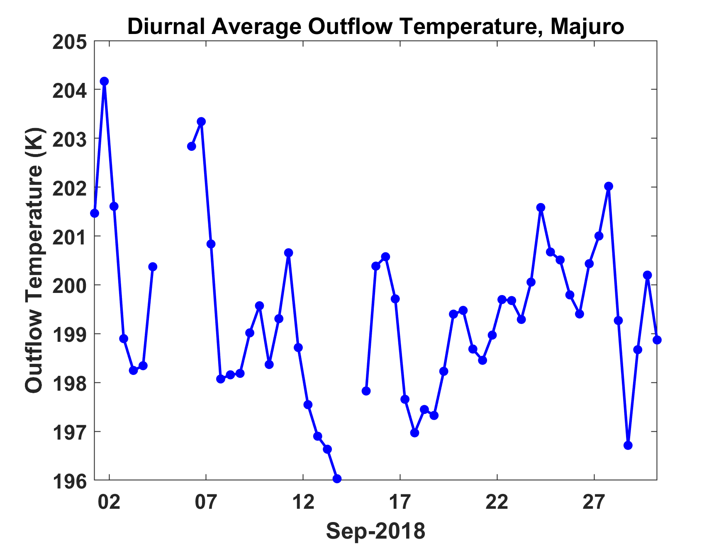
Majuro, September 2018
Potential Intensity
Outflow Temperature

Slide 15
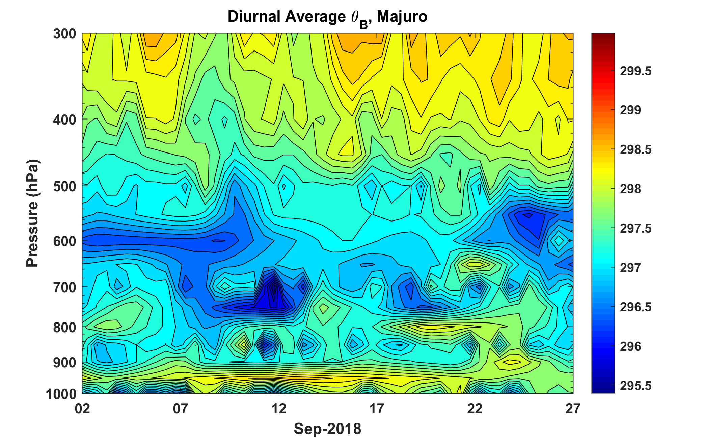
Time-Pressure Section of θ_{B} , September, 2018

Slide 16
Summary
Temperature in the tropical tropopause layer can have a substantial effect on tropical cyclone activity through modulation of the TC outflow temperature
Volcanoes reduce potential intensity by increasing outflow temperature owing to shortwave absorption by aerosols for a few years after major eruptions
It is possible that chlorine-driven ozone destruction is enhanced by volcanic aerosols, leading to cooling of the lower stratosphere that persists after the direct aerosol warming
There is substantial high frequency (2-10 day) variability of tropical cyclone potential intensity, whose source is being investigated

