Slide 1
A tropical cyclone precipitation data set from an advanced downscaling model
Kerry Emanuel
Lorenz Center
Massachusetts Institute of Technology

Slide 2
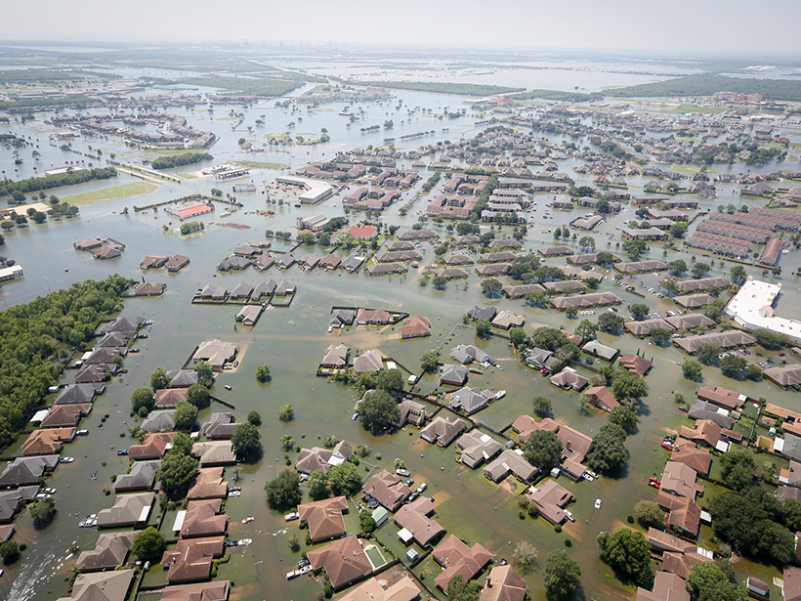
Why Hurricane Rain is Important

Slide 3
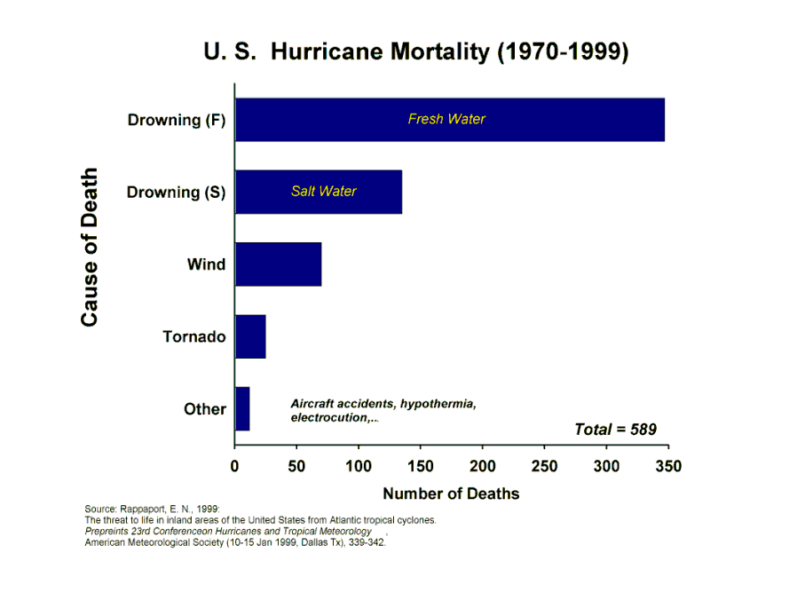
~500 from water, ~80 from wind

Slide 4
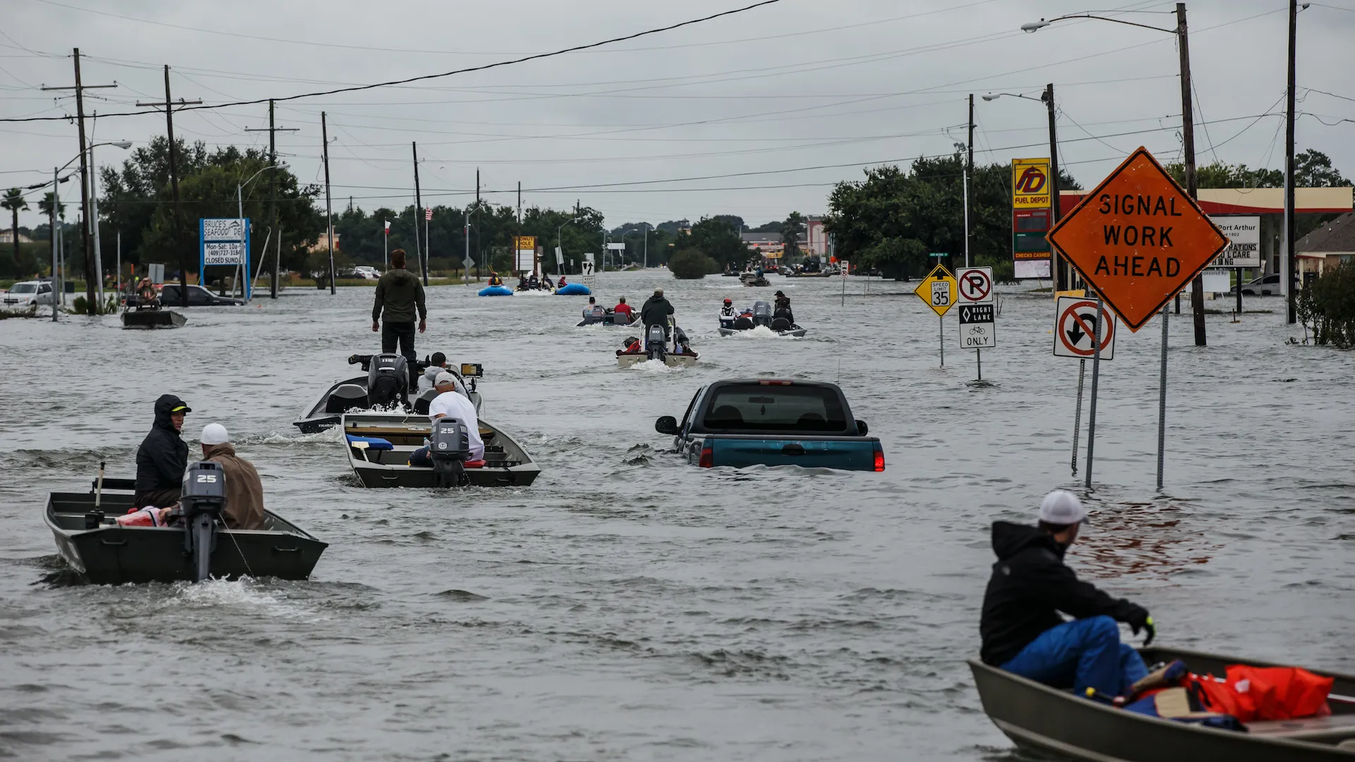
How do we estimate long-term hurricane flood risk in a changing climate?

Slide 5
Using Physics to Assess Hurricane Risk
Reliable, global records of coarse-scale climate are robust and widely available
Cull from these datasets the key statistics known to control tropical cyclone generation, movement, and intensity evolution
Bootstrap these key statistic to create unlimited synthetic time series of the hurricane-relevant environmental variables
Use these to drive specialized, very high resolution physical hurricane models
Extensively validate the results against historical hurricane data
Exact same method can be applied to output of climate models

Slide 6
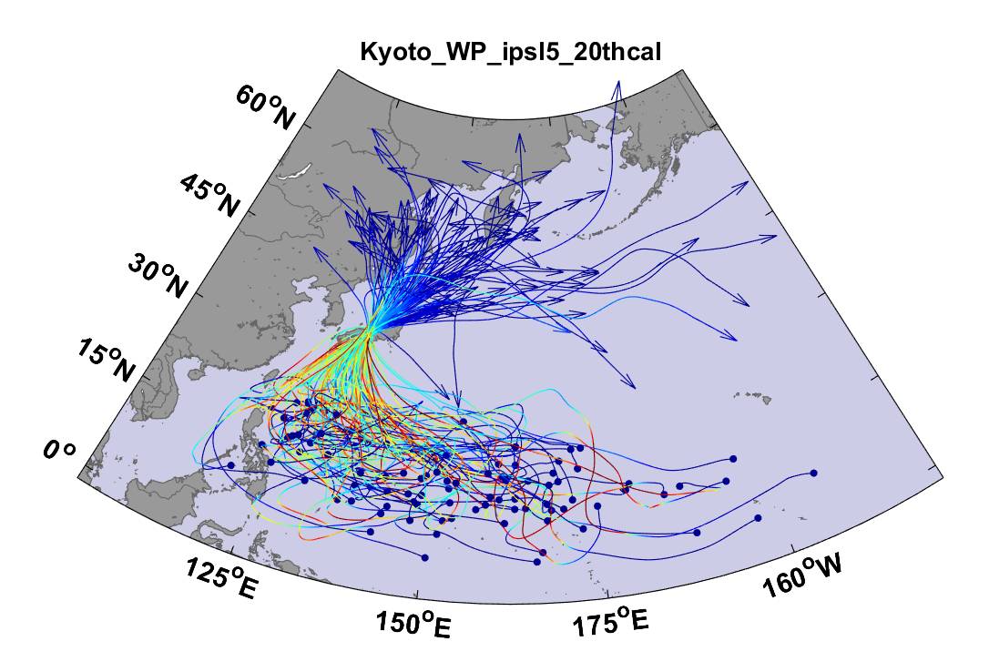
Example:
Top 100 out of 2000 TCs Affecting Kyoto, 1981-2000

Slide 7
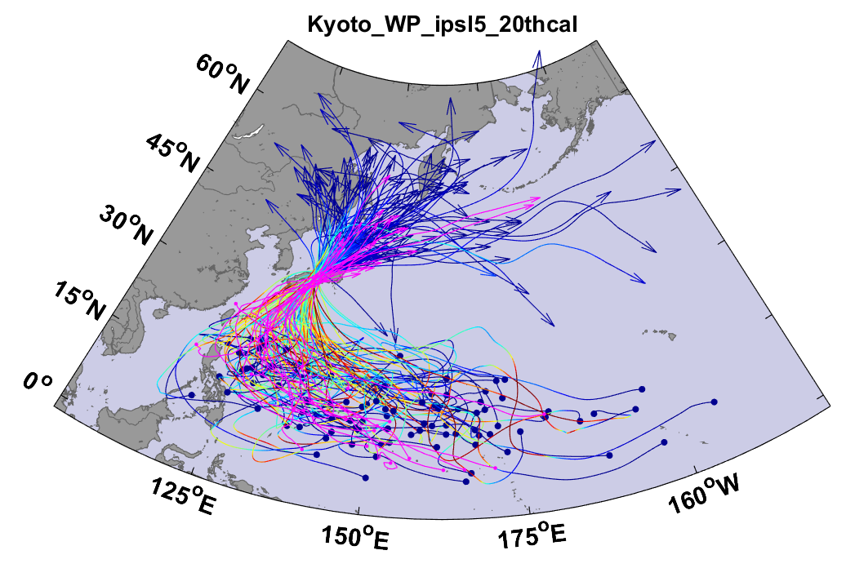
Same, but with top 20 historical tracks

Slide 8
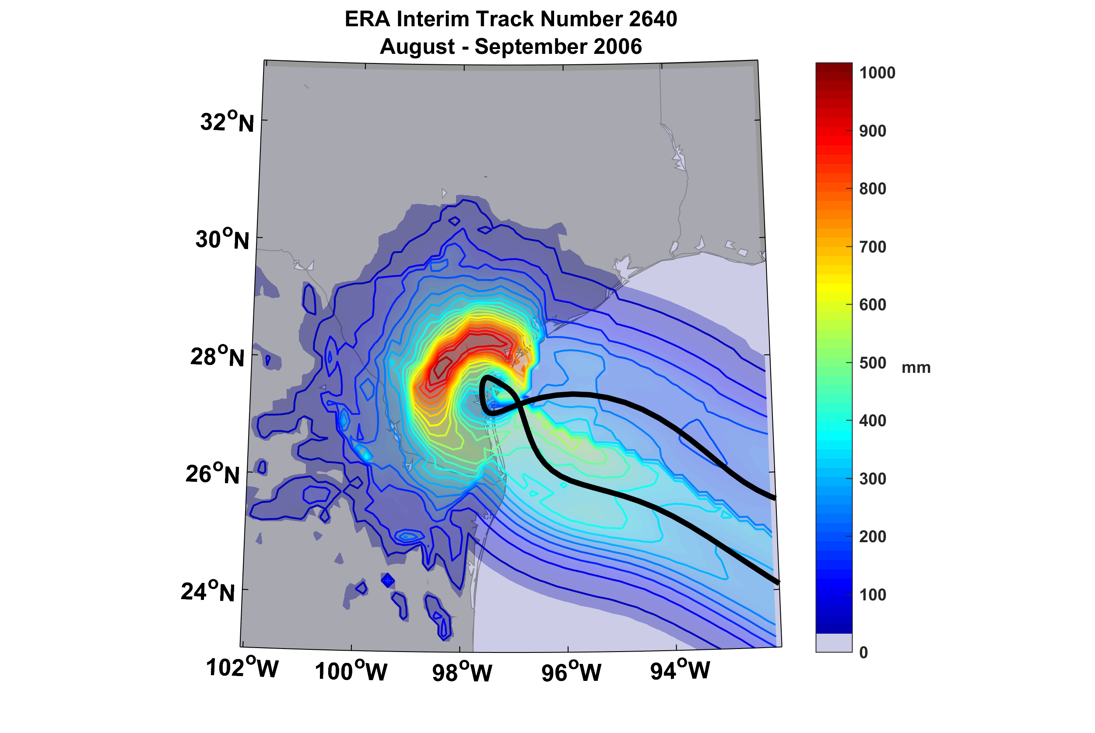
Example of Accumulated Rainfall from a Harvey-like Event Downscaled from ERA Interim Reanalysis

Slide 9
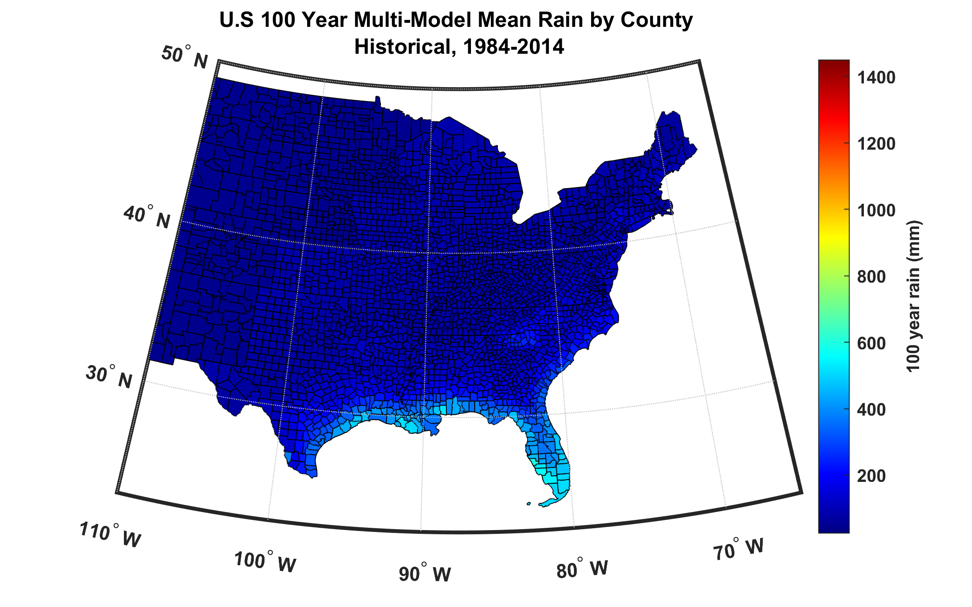
100-year hurricane storm total rain based on downscaling 8 climate models, 1984-2014

Slide 10
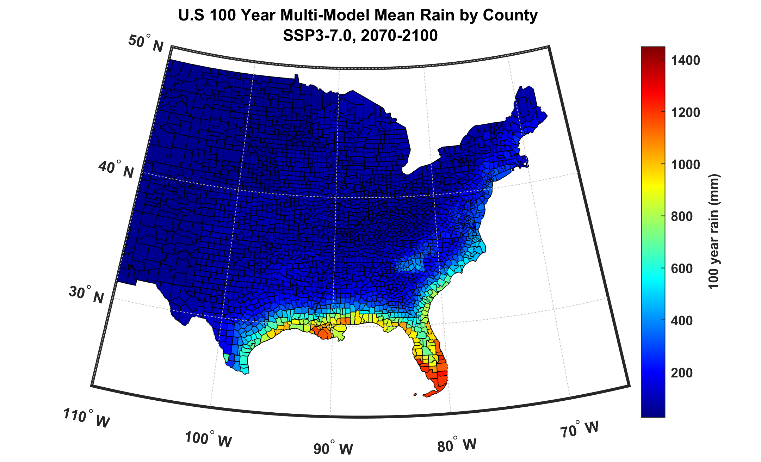
100-year hurricane storm total rain based on downscaling 8 climate models, 2070-2100

