Slide 1
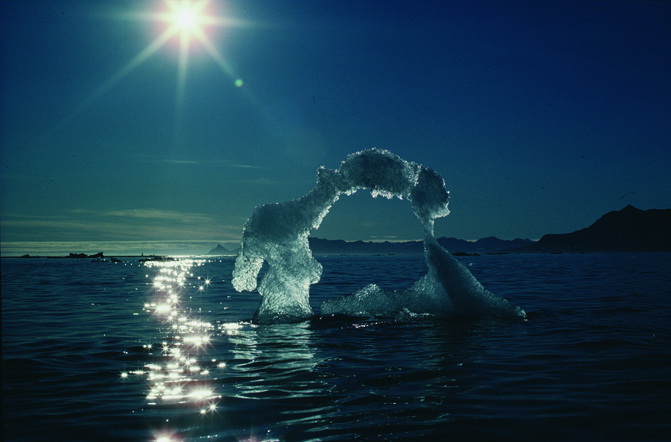


The John Carlson Lecture:
Predicting Climate in a Chaotic World: How certain can we be?
Tim Palmer
University of Oxford

Slide 2
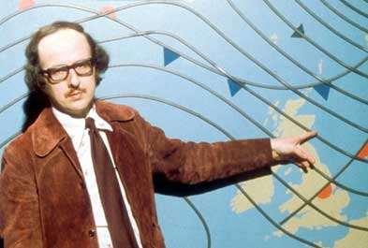
October 1987. The worst UK weather forecast since records began!

Slide 3
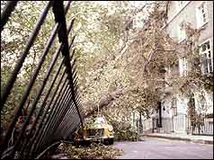
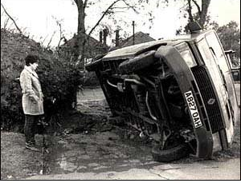
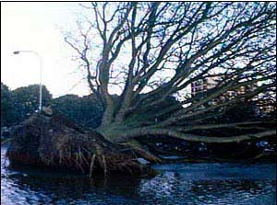
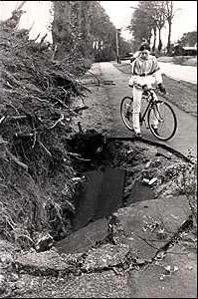
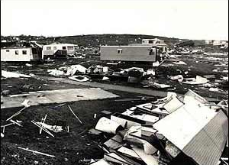
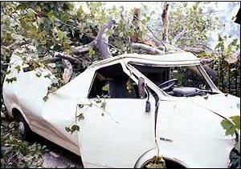
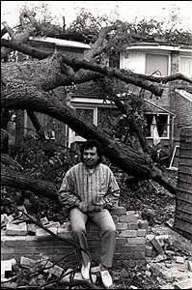
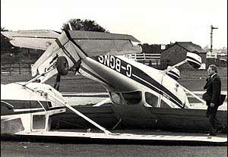
Just a little breezy tomorrow!
Worst Storm in 300 years!

Slide 4
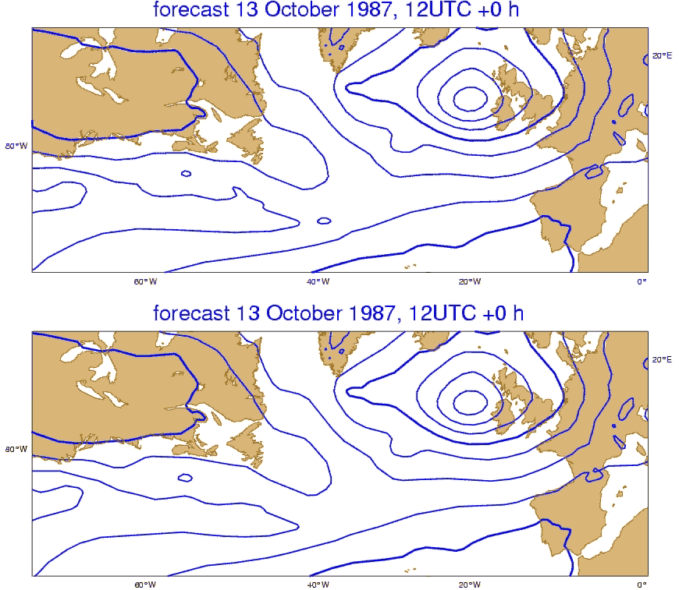

Slide 5
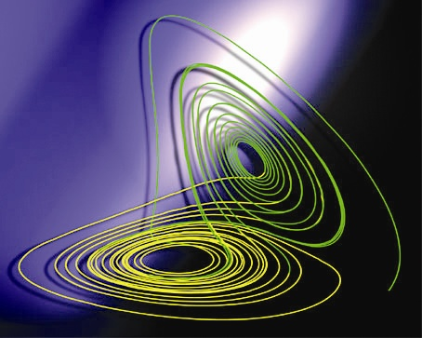
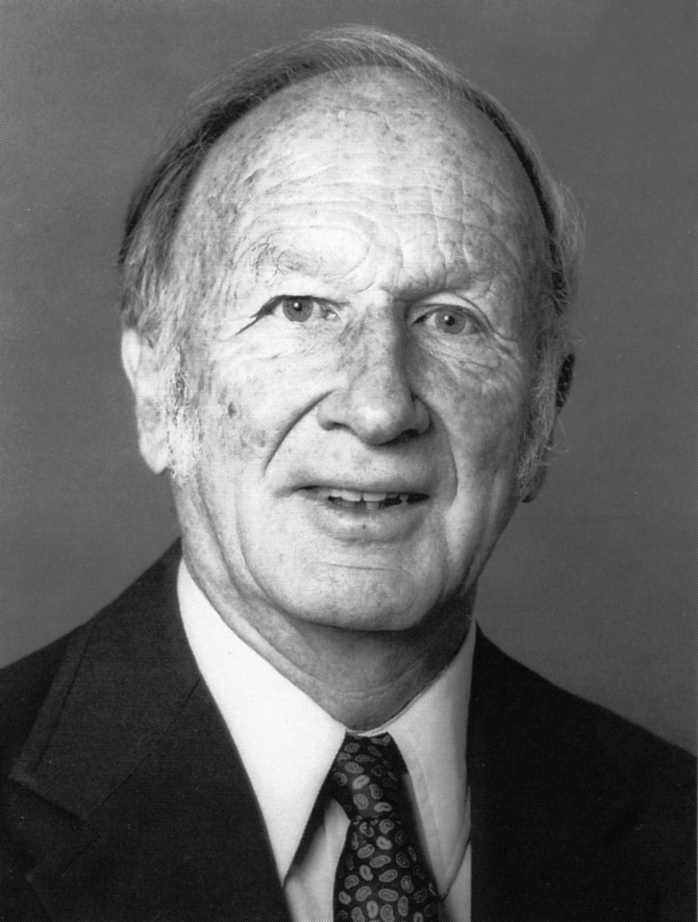

Slide 6

Chaos
“… one flap of a sea-gull’s wing may forever change the future course of the weather” (Lorenz, 1965)
Chaos Theory plays a central role in:
Astronomy, quantum physics, engineering, chemistry, biology, economics……..

Slide 7
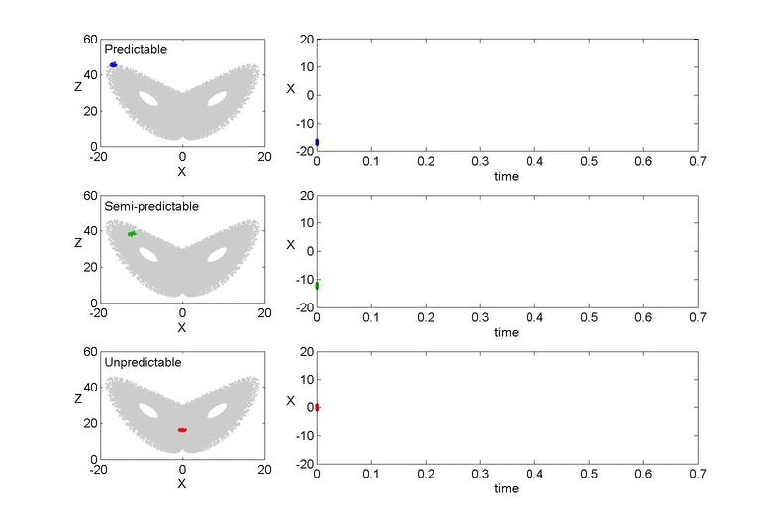

Slide 8
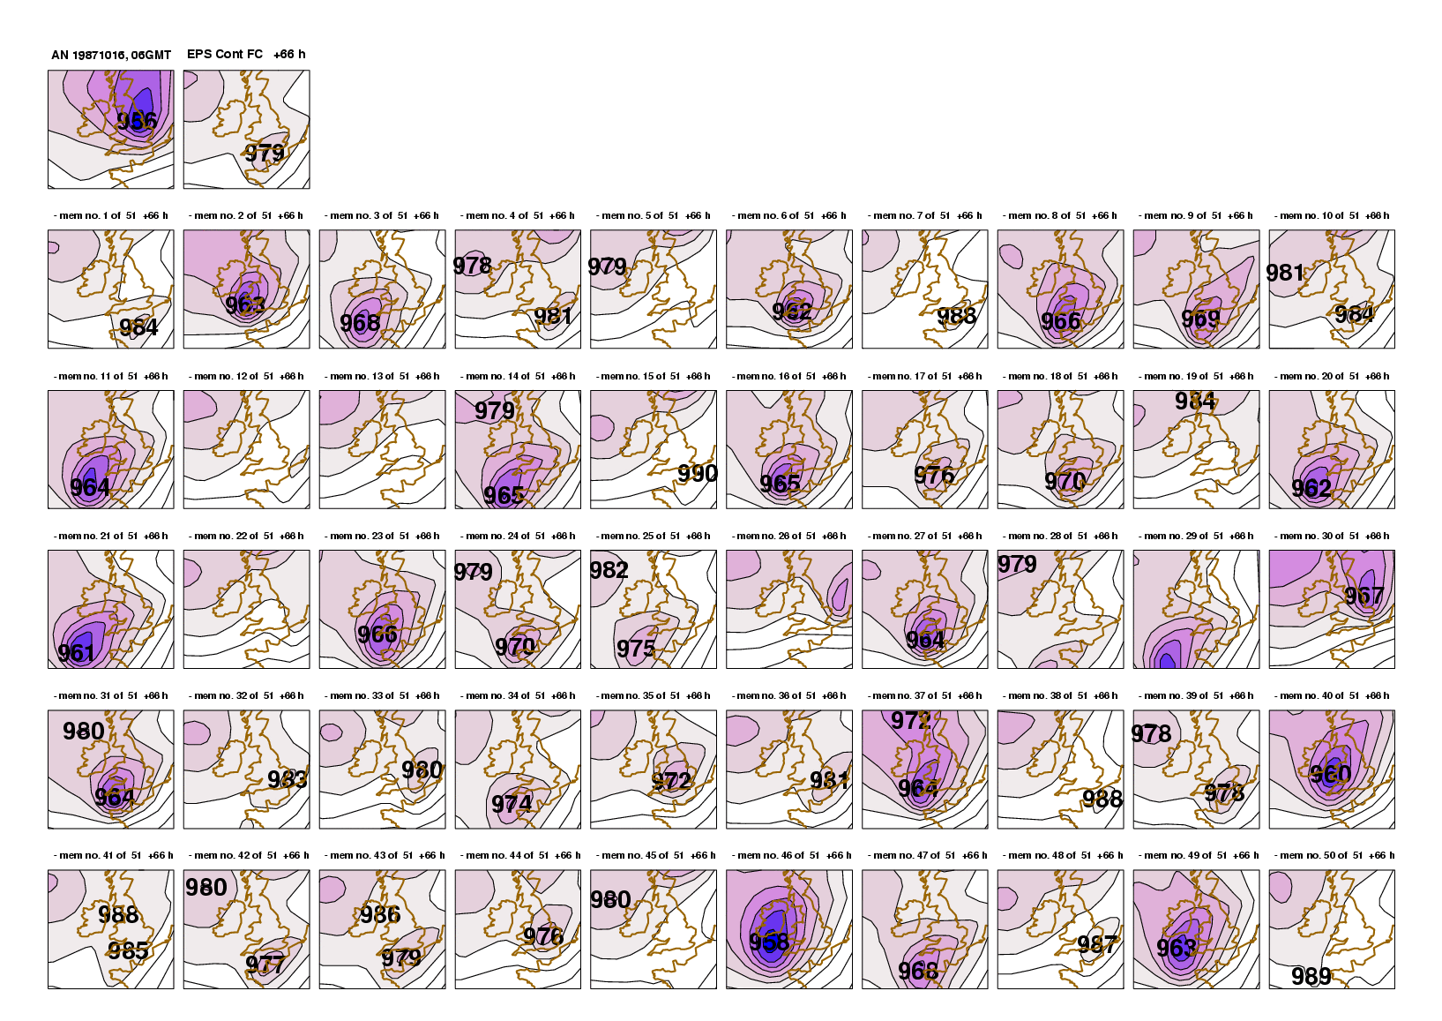
Oct 87 Storm Ensemble Reforecast

Slide 9
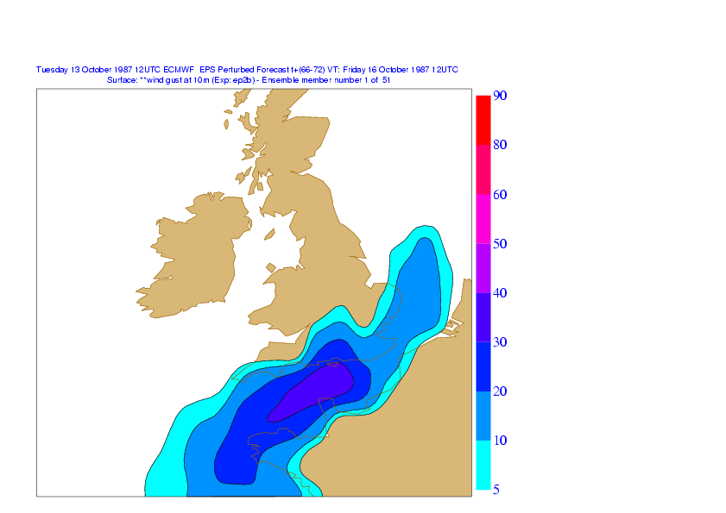
Probability of hurricane-force gusts on October 16th 1987

Slide 10
Sandy

Slide 11
Cyclone Sidr : Predictable
Hurricane Katrina: Semi-Predictable
Hurricane Nadine: Unpredictable

Slide 12
“Don’t tell me about uncertainty, it just makes decision making more difficult, even impossible!”
No! Predictions with quantitative estimates of uncertainty make for better decisions.

Slide 13
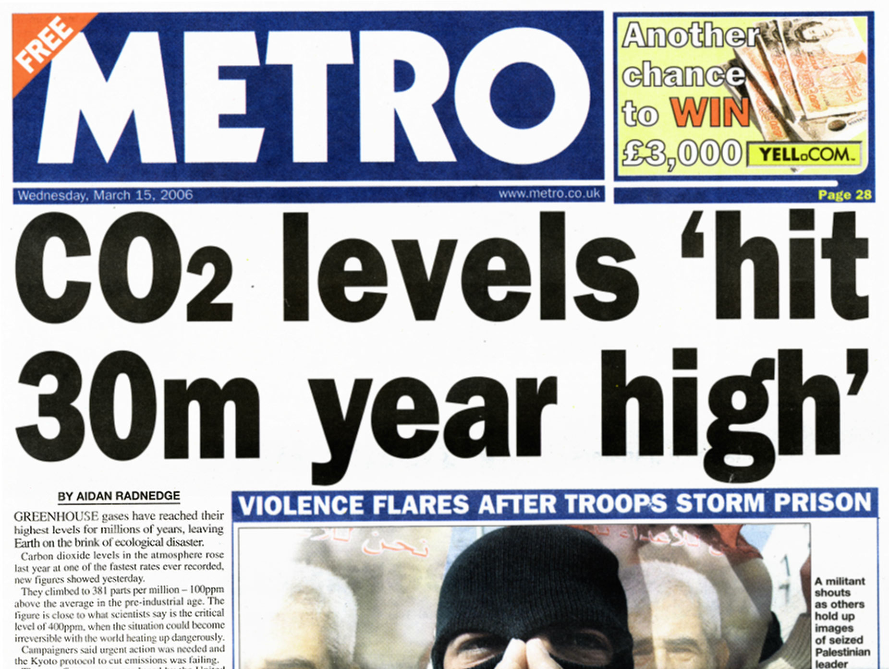

Slide 14
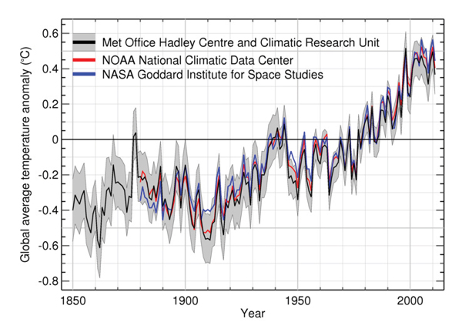
Global Mean Temperature

Slide 15
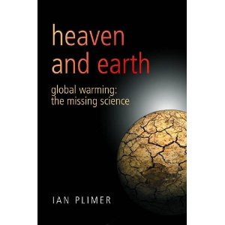
“How can we trust global climate forecasts 100 years into the future when the same models can’t demonstrate shorter-range forecasts.”

Slide 16


Slide 17


Slide 18
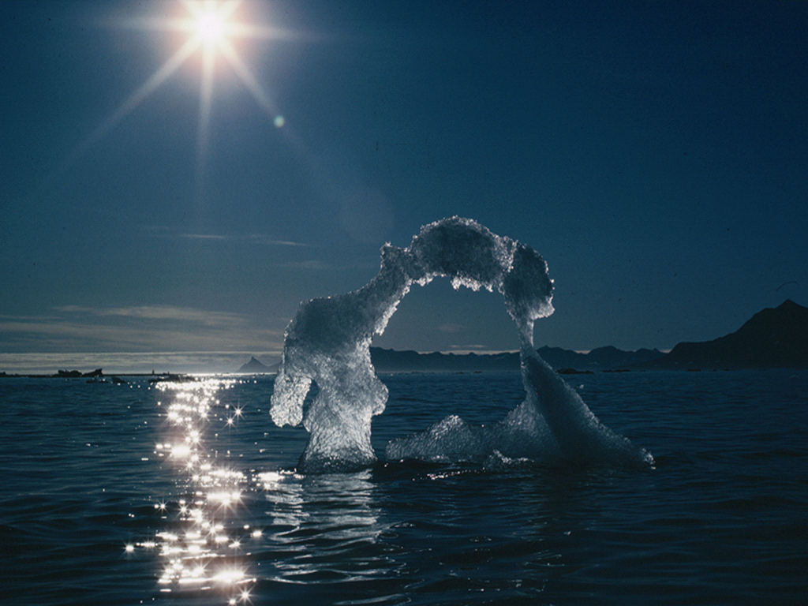
Potential Amplifiers of the effect of anthropogenic carbon emissions
Clouds
Water Vapour
Clouds
Carbon cycle
Ice albedo
Methane

Slide 19
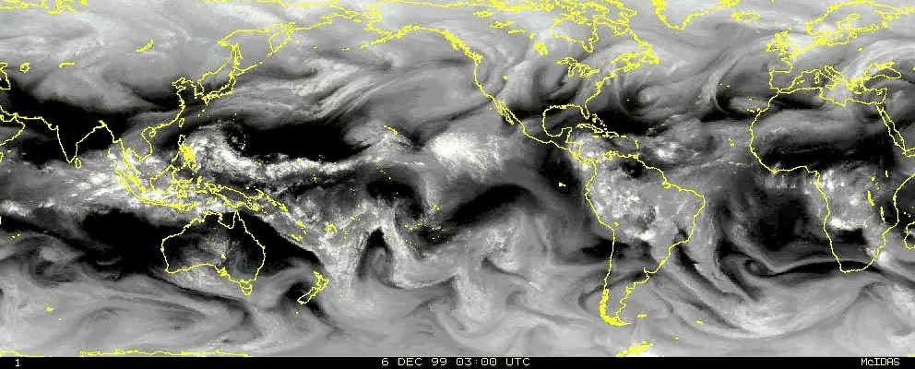

Slide 20
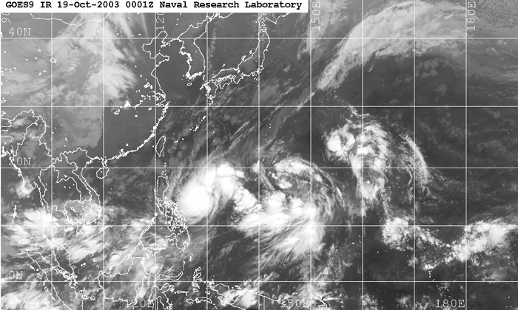

Slide 21
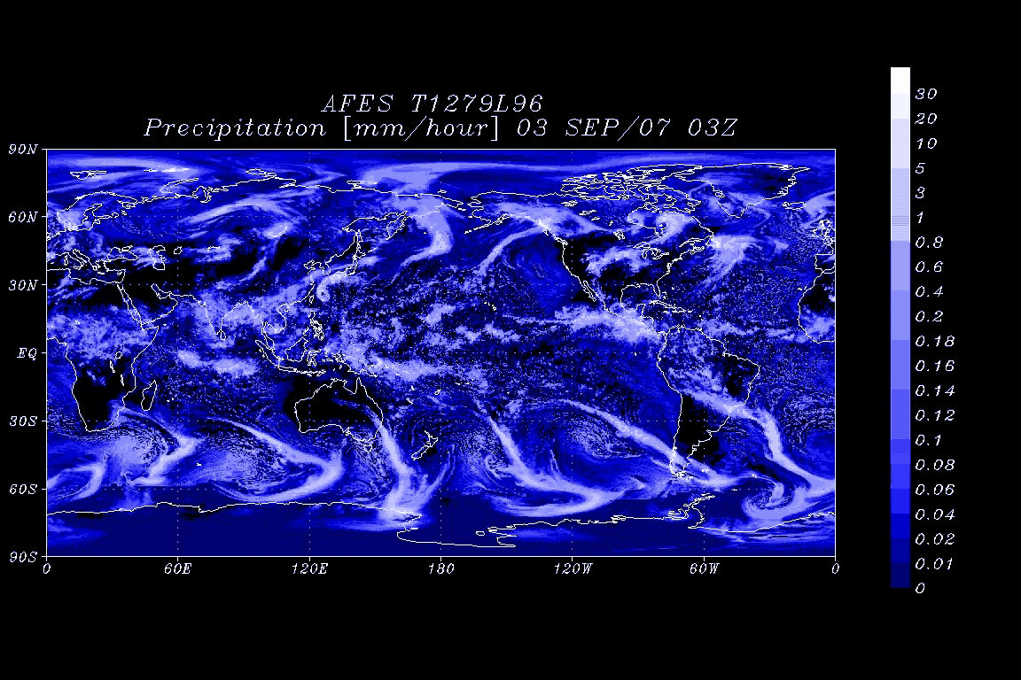
A Computer Simulation of Climate

Slide 22
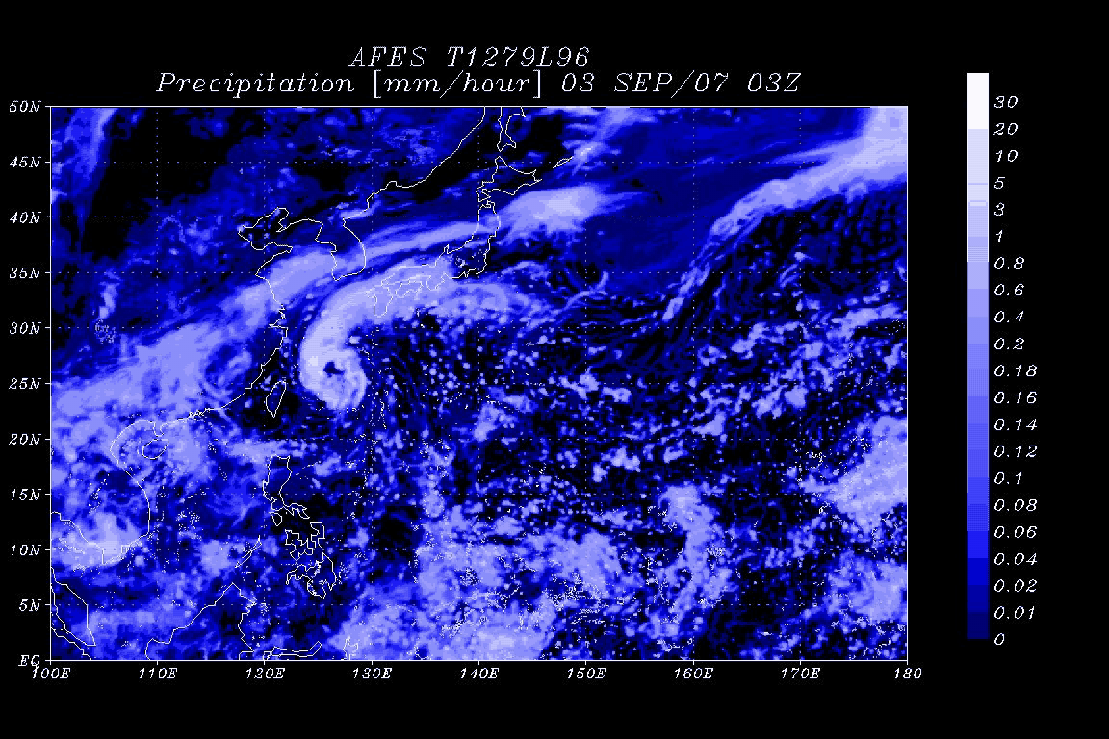

Slide 23
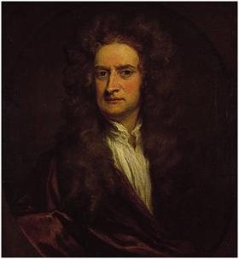
Computer Simulators of Weather and Climate
Force= Mass x Acceleration
F=ma

Slide 24


Simulating Weather and Climate
Newton’s 2nd Law (F=ma), applied to the atmosphere

Slide 25



Unpacks into..
10,000km
<1 mm
…..
Unpacks into billions of individual equations, describing scales of motion from planetary scales to microscopic scales.

Slide 26
Even the world’s biggest computers aren’t big enough to represent all scales of motion in the atmosphere..
10,000km
100km
…..
Simplified approximate formulae to describe the bulk effect of atmospheric process that the simulator can’t resolve

Slide 27
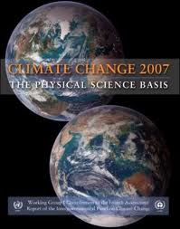
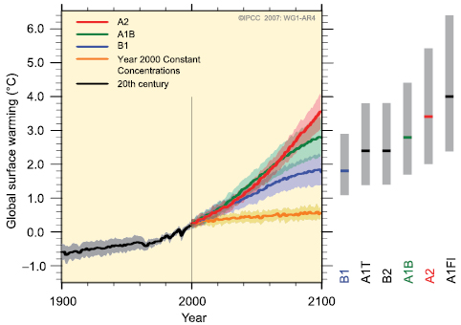
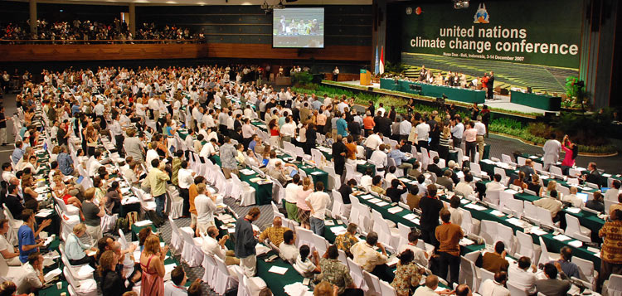
Climate models provide key input to climate mitigation policy

Slide 28
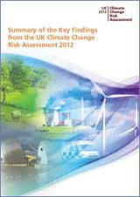
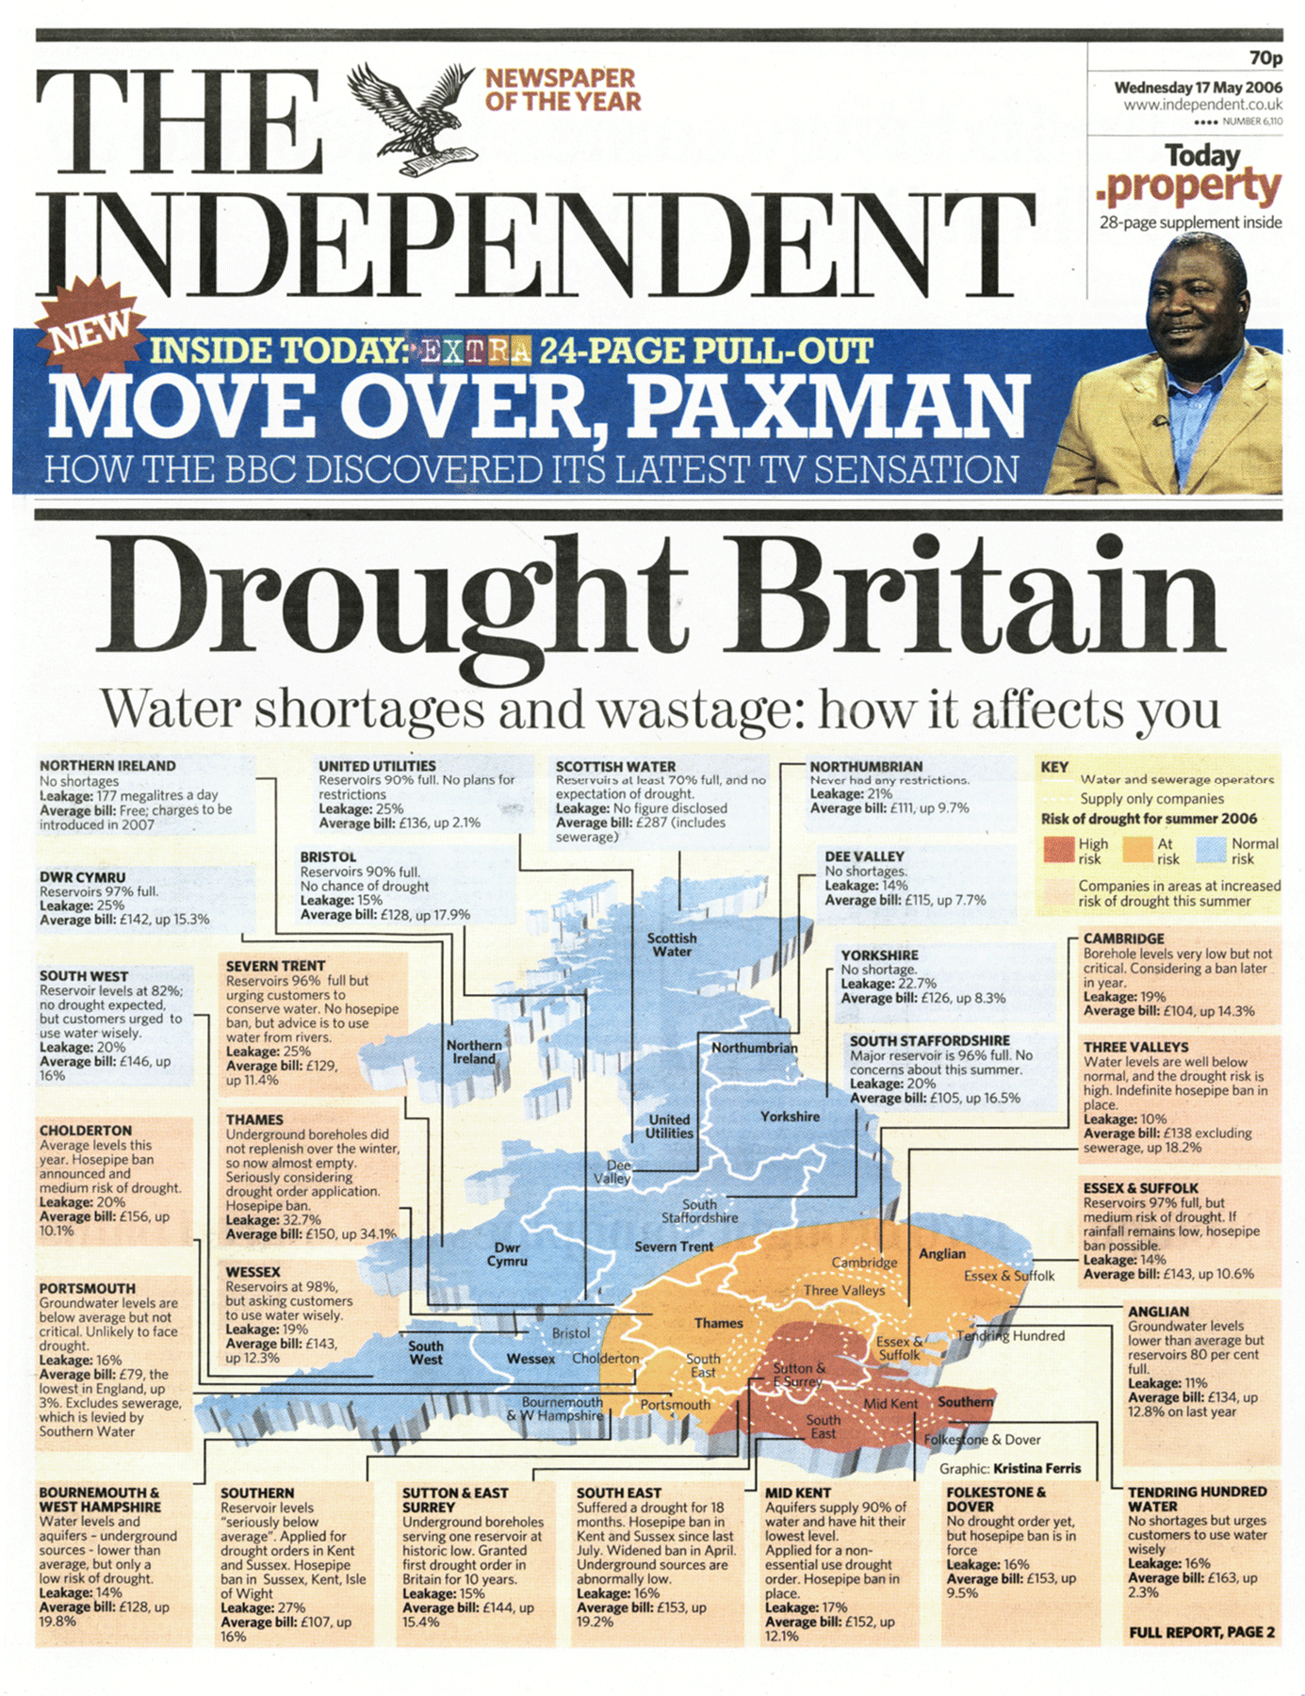
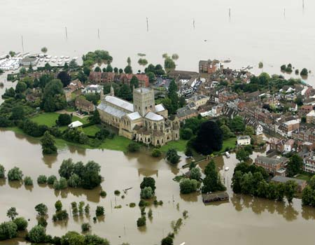
…are central to the development of sound regional adaptation strategies

Slide 29


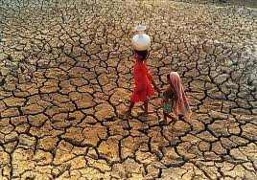
…can help prepare for onset of drought and climate-related epidemics on seasonal timescales

Slide 30
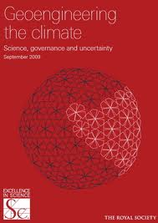
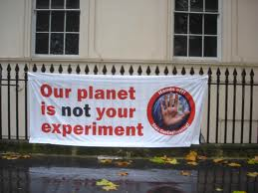
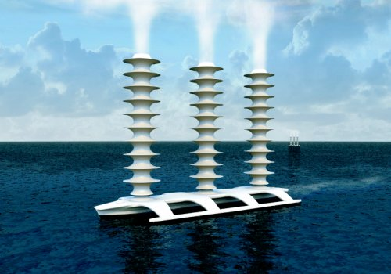
…and are needed to assess regional impacts of climate geoengineering proposals
Probability of permanent El Nino, shutoff in monsoons…..????

Slide 31
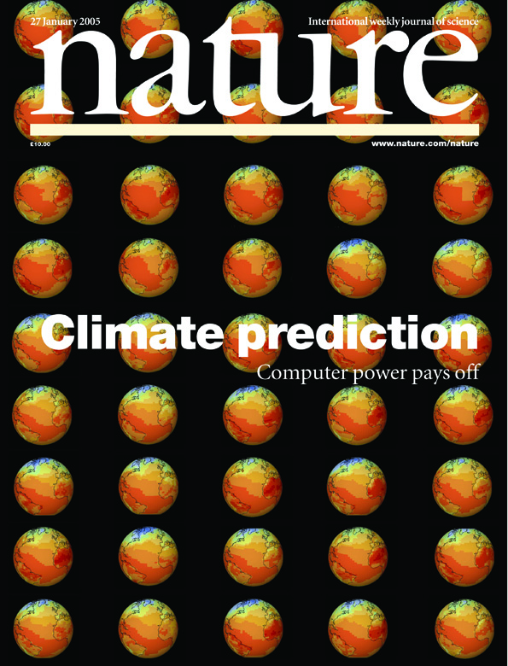
As with modern weather forecasting, climate prediction is inherently probabilistic and based on ensembles of forecasts using slightly different computer model equations.

Slide 32
“Don’t tell me about uncertainty, it just makes decision making more difficult, even impossible!”
No! Predictions with quantitative estimates of uncertainty make for better decisions.

Slide 33
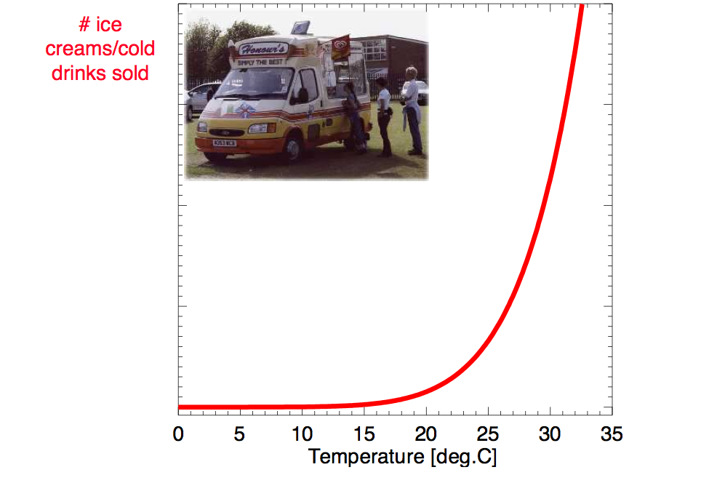
300
200
100

Slide 34
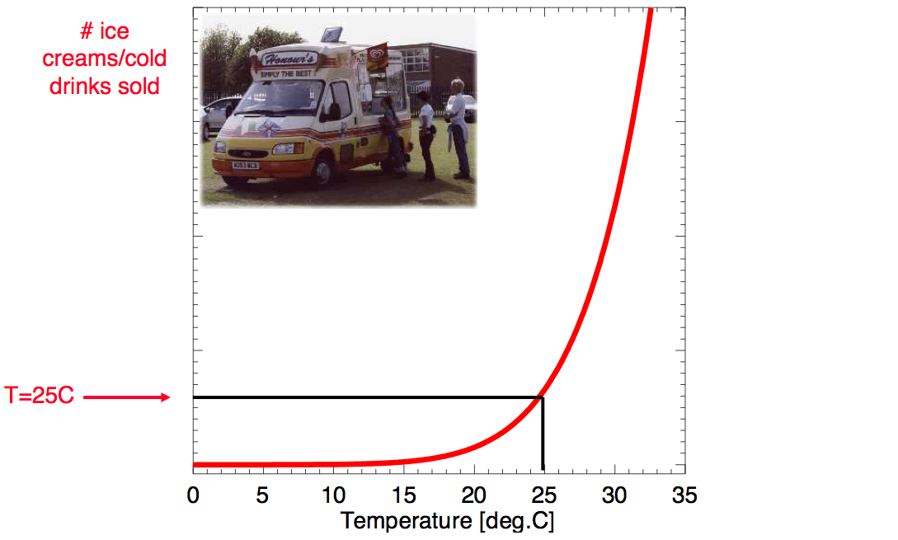
300
200
100

Slide 35
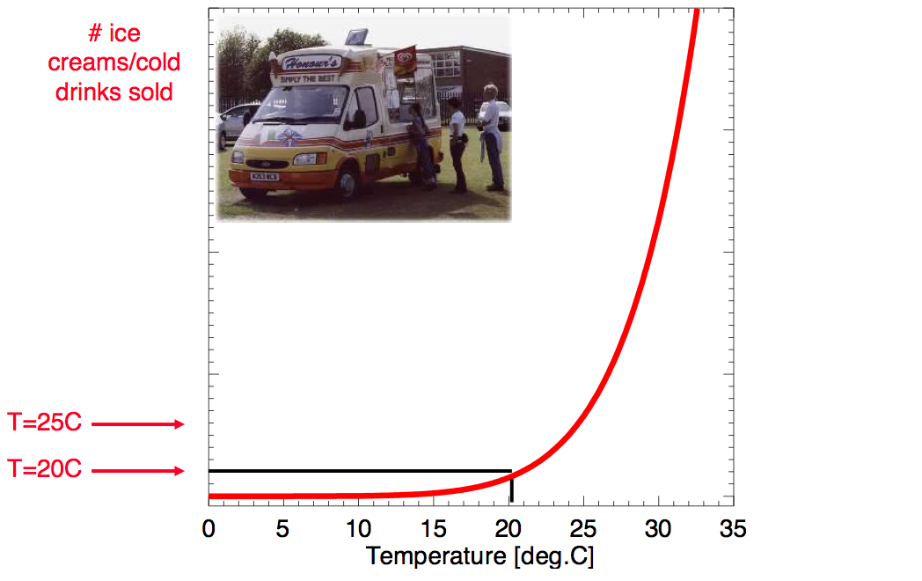
300
200
100

Slide 36
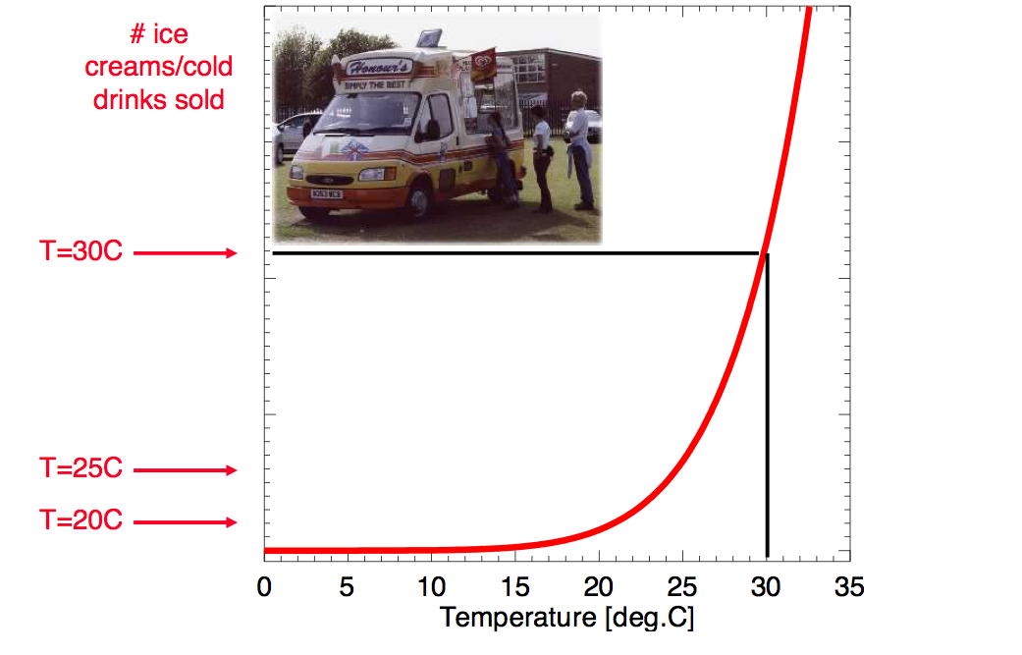
300
200
100

Slide 37
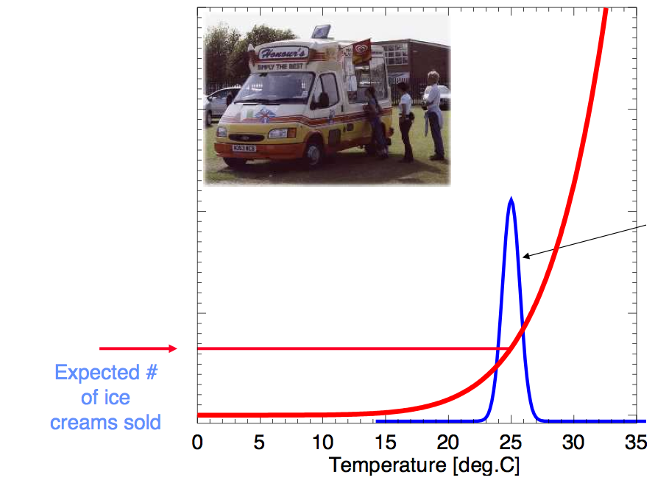
300
200
Forecast probability
100

Slide 38
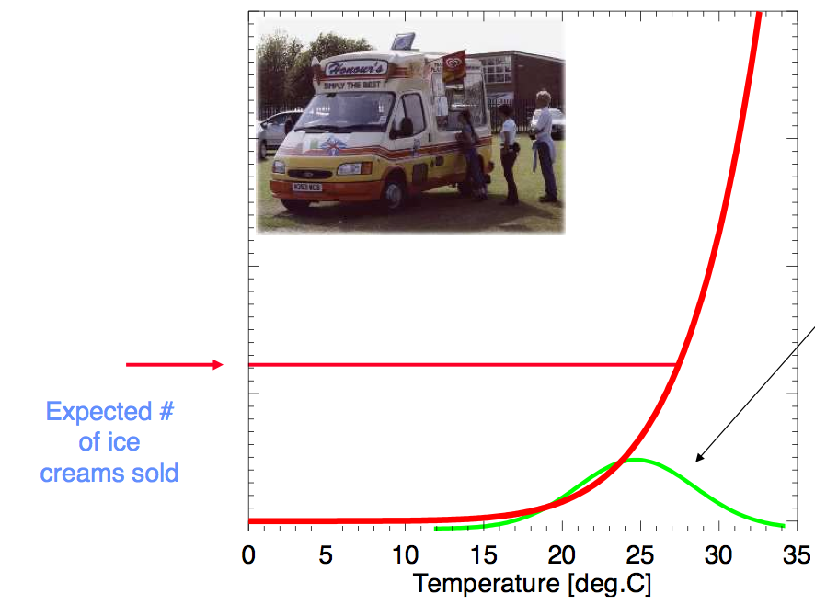
300
200
Forecast probability
100

Slide 39


Our best estimate of how much global climate will warm as a result of doubling CO₂: a probability distribution
Source: 100000 PAGE09 runs
Chris Hope, U. Cambridge
Notes:
Describe pdf. Reflects post-IPCC knowledge as well as IPCC AR4.

Slide 40
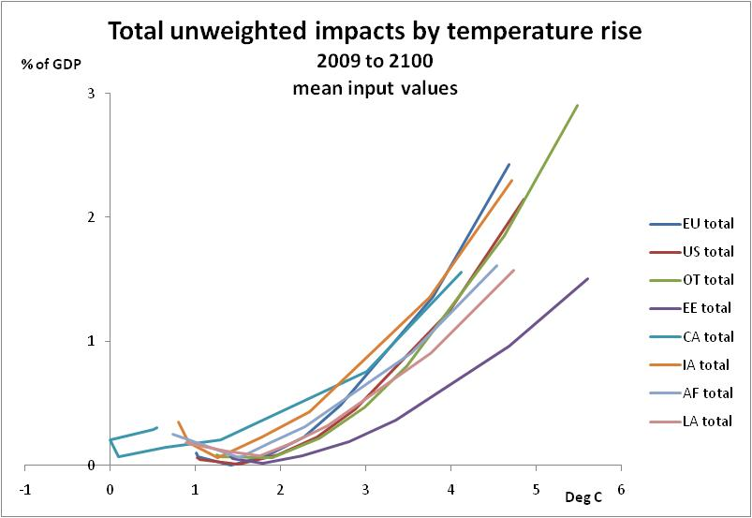
Chris Hope: Source: PAGE09; A1B scenario
Notes:
Including adaptation

Slide 41
Based on the most likely climate change only:
Expected damage/ impacts = $ 150 trillion
Cost of mitigation = $ 162 trillion
Based on the probability distribution of possible climate change:
Expected damage/ impacts = $ 314 trillion
Chris Hope, U. Cambridge
Notes:
Mean ptp just over 1% per year
Mean EMUC 1.17
Ignores uncertainty.

Slide 42
Our approach to Climate Change should not be polarised around “belief” or “denial”
There are uncertainties about the magnitude (even sign) of some of the natural amplifiers of anthropogenic climate change
Hence, like modern weather forecasts, climate change predictions must necessary be couched in probabilistic terms
Eg based on our best attempts at solving the laws of physics, there is about a 5-10% chance that the climate of the next century will be as different from that of the 20th Century as the 20th Century was from the climate of the last ice age.
Is it worth taking mitigating action now (by cutting GHG emissions) to minimise the risk of such changes happening?
This is the fundamental question – it’s not about belief or denial

