Slide 1

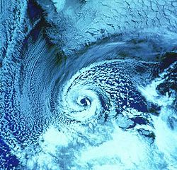
The "real" butterfly effect:
A study of predictability in multi-scale systems, with implications for weather and climate by
T.N.Palmer
University of Oxford
ECMWF

Slide 2

“The Butterfly Effect is a phrase that encapsulates the more technical notion of sensitive dependence on initial conditions in chaos theory” (Wikipedia)

Slide 3
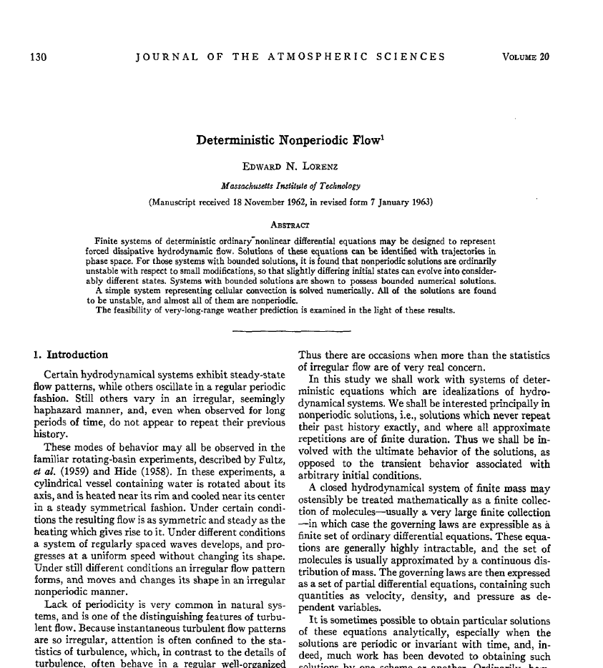
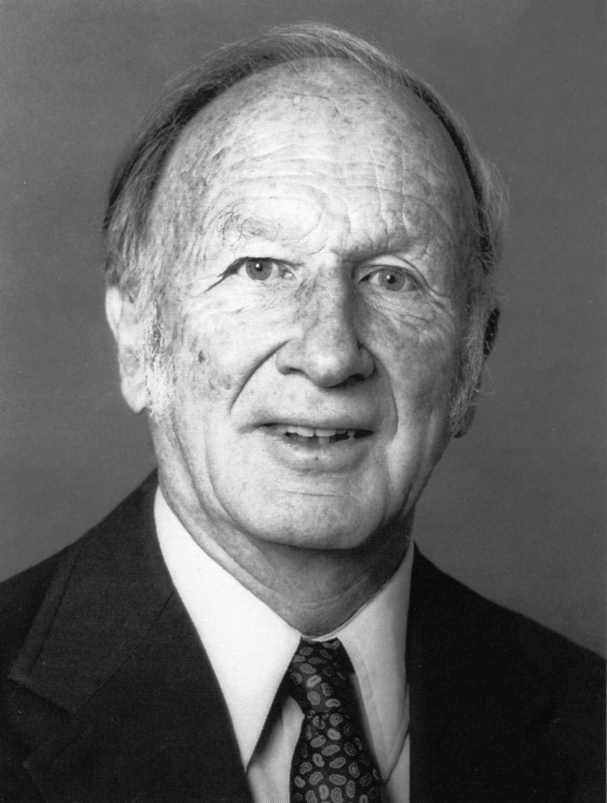
Journal of the Atmospheric Sciences 1963

Slide 4


Slide 5
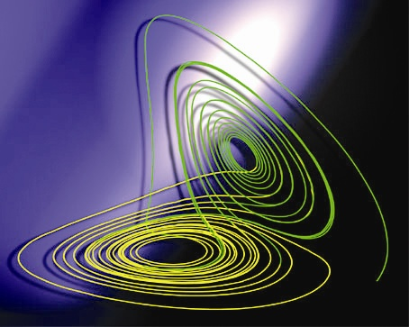
Exhibits sensitive but nevertheless continuous dependence on initial conditions – you tell me how accurately you want to know the forecast state, I’ll tell you how accurately you need to know the initial conditions.
This is not what Lorenz had in mind by “The Butterfly Effect” – he had in mind systems which might not exhibit continuous dependence on initial conditions – these exhibit a much more radical type of unpredictability.

Slide 6
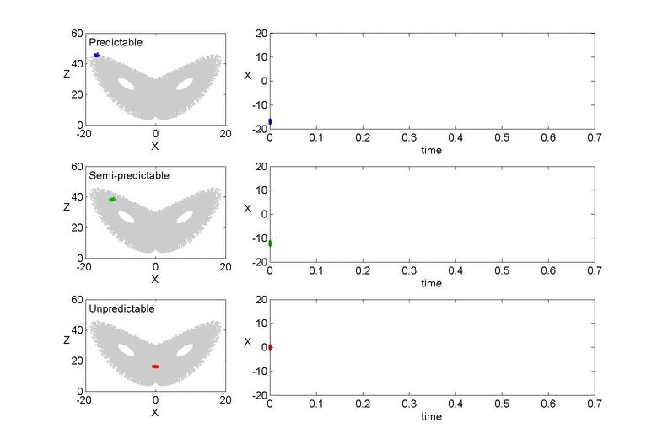

Slide 7
Cyclone Sidr : Predictable
Hurricane Katrina: Semi-Predictable
Hurricane Nadine: Unpredictable

Slide 8
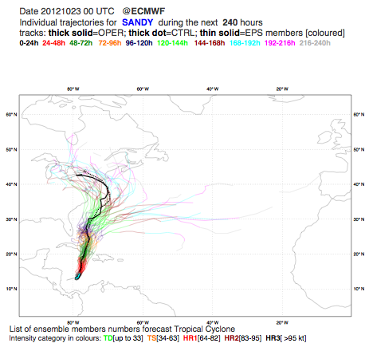
On the other hand, the Canadian model - which had conjured up an absolutely devastating storm for the northern mid-Atlantic and Northeast in earlier runs - has shifted the storm’s track out to sea. The GFS model also has an out to sea track, but has shifted a bit closer to the coast compared to yesterday.
www.washingtonpost.com

Slide 9

Lorenz. The Essence of Chaos (1993)
“The expression (The Butterfly Effect) has a somewhat cloudy history: It appears to have arisen following a paper that I presented at a meeting in Washington in 1972, entitled: Does the Flap of a Butterfly’s Wings in Brazil Set Off a Tornado in Texas..”

Slide 10
“The following is the text of the talk I presented …in Washington..on 1972…in its original form
Predictability:Does the Flap of a Butterfly’s Wings in Brazil Set Off a Tornado in Texas?
…The most significant results are the following:
Small errors in the coarser structure of the weather patterns…tend to double in about three days..
Small errors in the finer structure, eg the positions of individual clouds- tend to grow much more rapidly, doubling in hours or less…
Errors in the finer structure, having attained appreciable size, tend to induce errors in the coarser structure. This result...implies that after a day or so there will be appreciable errors in the coarser structure. Cutting the observational error in the finer structure in half – a formidable task - would extend the range of acceptable prediction of even the coarser structure only by hours or less...”

Slide 11
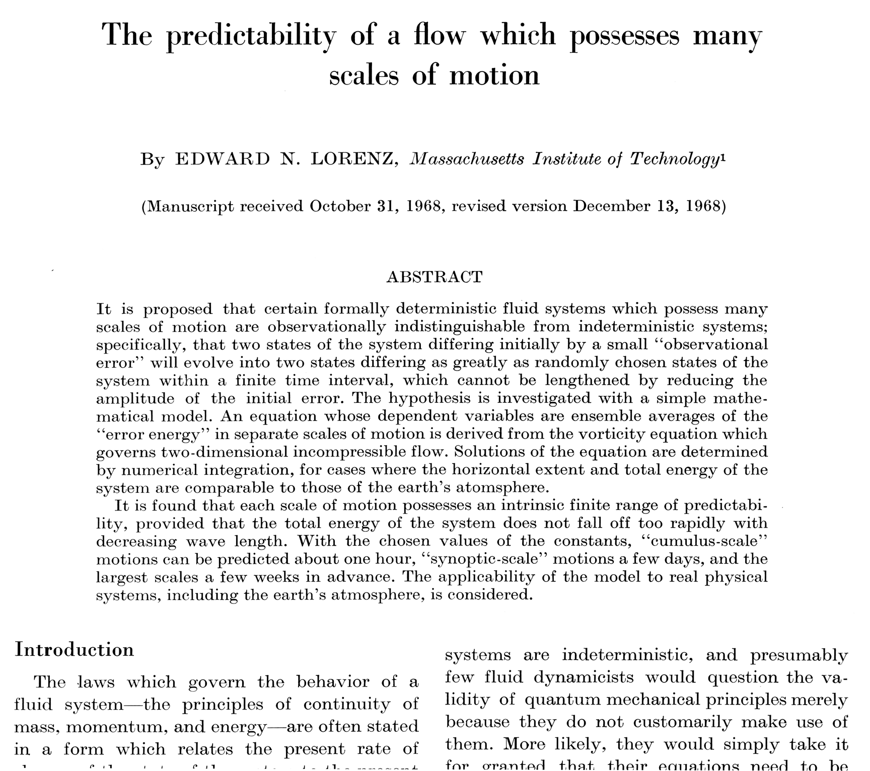
Tellus 1969

Slide 12
“It is proposed that certain formally deterministic fluid systems which possess many scales of motion are observationally indistinguishable from indeterministic systems; specifically that two states of the system differing initially by a small “observational error” will evolve into two states differing as greatly as randomly chosen states of the system within a finite time interval, which cannot be lengthened by reducing the amplitude of the initial error…..”
Lorenz 1969 Tellus

Slide 13
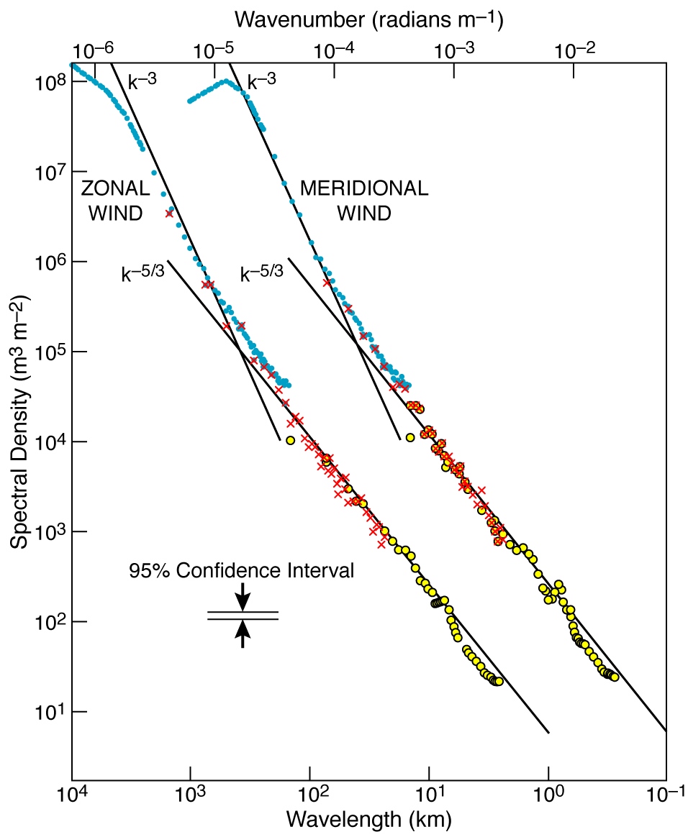
Atmospheric Wavenumber Spectra

Slide 14
The “Real” Butterfly Effect: A problem in PDEs, not ODEs
?

Slide 18
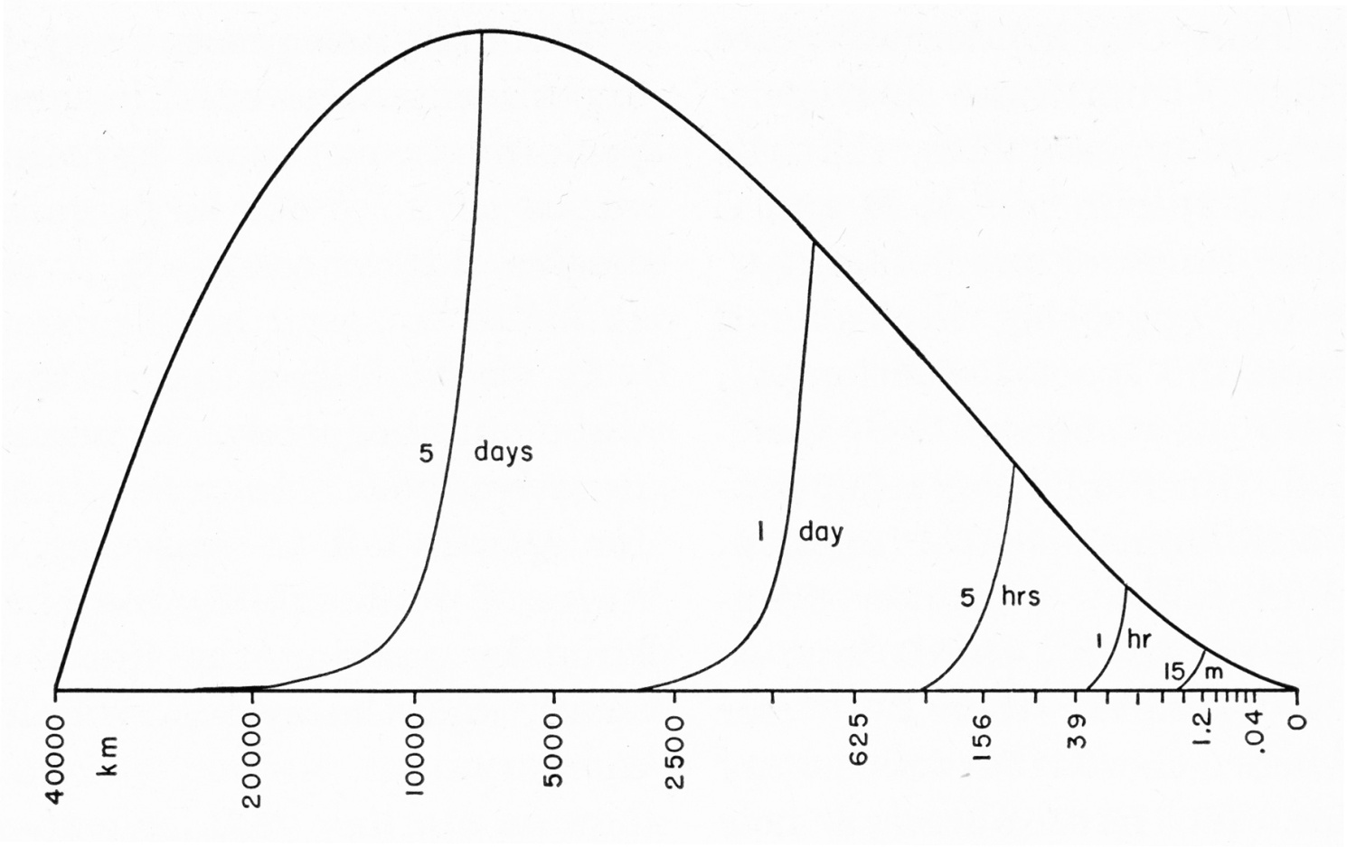
The “Real Butterfly Effect”
Error
Increasing scale
The Predictability of a Flow Which Possesses Many Scales of Motion. E.N.Lorenz (1969). Tellus.

Slide 19
Most of the time, small (eg convective) scales are controlled by large (eg synoptic scales) and hence L69 is an overly pessimistic estimate of predictability. But intermittently the opposite occurs…

Slide 20
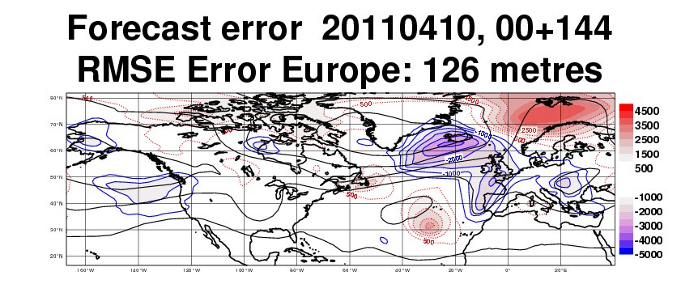
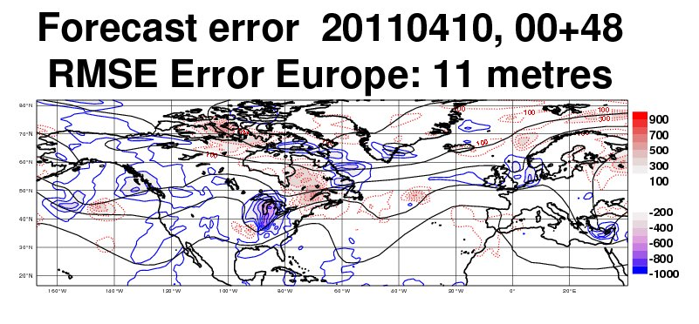

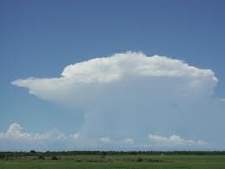
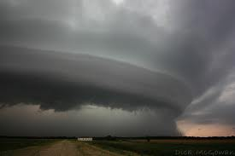
Eg
This is when the real butterfly effect is most active.

Slide 21
For such cases, could it literally be true that errors propagate up to the large scale from arbitrarily small scales in finite time?

Slide 22
“We have not been able to prove or disprove our conjecture, since in order to render the appropriate equations tractable we have been forced to introduce certain statistical assumptions which cannot be rigorously defended.”
Lorenz 1969

Slide 23
Lifted from Wikipedia:
The mathematical term well-posed problem stems from a definition given by Jacques Hadamard. He believed that mathematical models of physical phenomena should have the properties that
A solution exists
The solution is unique
The solution depends continuously on the data, in some reasonable topology.
If the “real” butterfly effect is true as N➔∞, then the initial value problem for the Navier-Stokes equations is not well posed. Is it literally true?

Slide 24
Clay Mathematics Millenium Problems
Birch and Swinnerton-Dyer Conjecture
Hodge Conjecture
Navier-Stokes Equations
P vs NP
Poincaré Conjecture
Riemann Hypothesis
Yang-Mills Theory

Slide 25
Clay Mathematics Millenium Problems
Birch and Swinnerton-Dyer Conjecture
Hodge Conjecture
Navier-Stokes Equations
P vs NP
Poincaré Conjecture
Riemann Hypothesis
Yang-Mills Theory

Slide 26
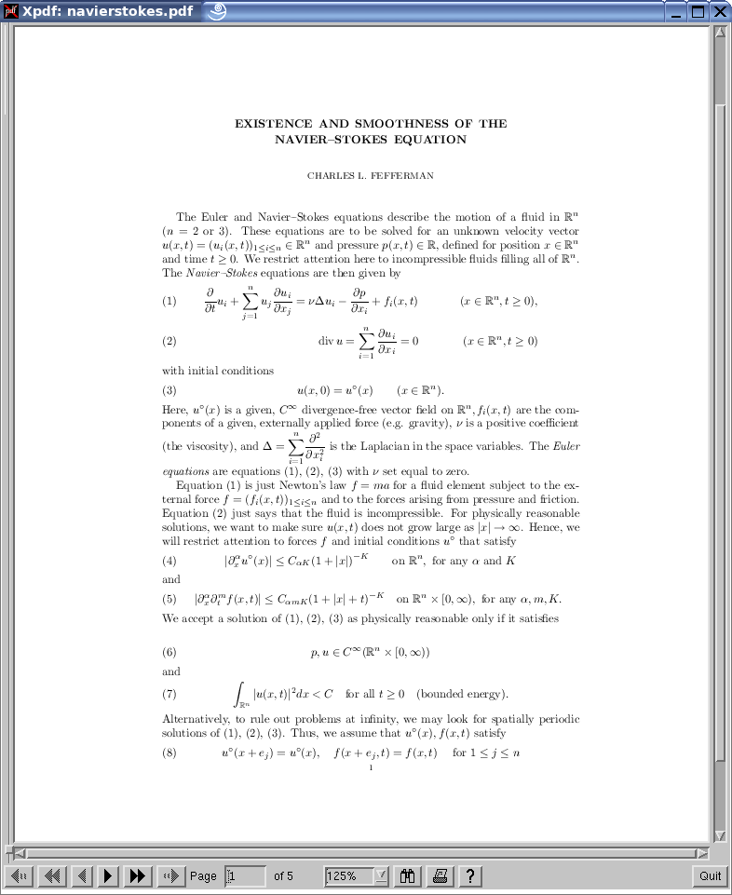
MNS
Navier-Stokes Equations
For smooth initial conditions
and suitably regular boundary conditions
do there exist smooth, bounded solutions at all future times?

Slide 27
Is the initial value problem for the 3D Navier-Stokes problem well posed?
1. Because MNS is an open problem, we formally don’t know. Certainly one can choose to work with function spaces where the initial value-problem is not well posed. However, such function spaces would probably not be considered “physical” and the corresponding topologies not “reasonable”.
2. However, it is known that if we assume a “sufficiently smooth” global solution and perturb the initial data of the basic solution in some “reasonable” way, then the perturbed solution converges to the basic solution on any finite time interval, as long as the perturbed initial data converges to the basic initial data.
The question of what “sufficiently smooth” means is problematic. It is unknown whether finite-energy solutions are “sufficiently smooth”
(Gregory Seregin - personal communication).

Slide 28
Asymptotic Ill Posedness
The question of strict ill-posedness is not physically relevant to weather and climate prediction: trunction scales in weather prediction models are many orders of magnitude larger than the viscous scale.
Consider, the weaker but more physically relevant conjecture where the predictability time Ω(N) diverges as N→∞, but nevertheless asymptotes to some finite value as initial errors are confined to smaller and smaller scales (larger and larger N), each still larger than the viscous scales.

Slide 29
The real butterfly effect
Can we find “empirical evidence” from operational NWP models?

Slide 30
Nigel Roberts. Met Office

Slide 32
What’s Going On?
For deterministic short-range prediction, increased model resolution will give better representations of topography, land-sea contrast etc , but this will be offset by an increase in forecast error because smaller-scale circulations with faster error-doubling times will be simulated explicitly. Overall, deterministic skill scores (RMS error, ACC etc) may not increase with increased model resolution.
The conclusion is not that high-resolution modelling is a waste of time and resources, but rather that all predictions, even for the short range, must be considered probabilistic, ie ensemble based. There is no range at which the forecast problem can be treated deterministically. The “classical” era of deterministic numerical weather prediction should be drawing to a close, even for short-range prediction.
Probabilistic skill scores will increase with model resolution, provided the underpinning ensemble prediction systems (EPSs) are statistically reliable. The Real Buttefly Effect suggests that model error can be a significant source of forecast uncertainty even in the short range and must be represented in an EPS. Stochastic parametrisation is an emerging technique for representing model error on all timescales.

Slide 33
Traditional computational ansatz for weather/climate simulators
Eg
Increasing scale
Eg momentum“transport” by:
Turbulent eddies in boundary layer
Orographic gravity wave drag.
Convective clouds
Deterministic local bulk-formula parametrisation

Slide 34
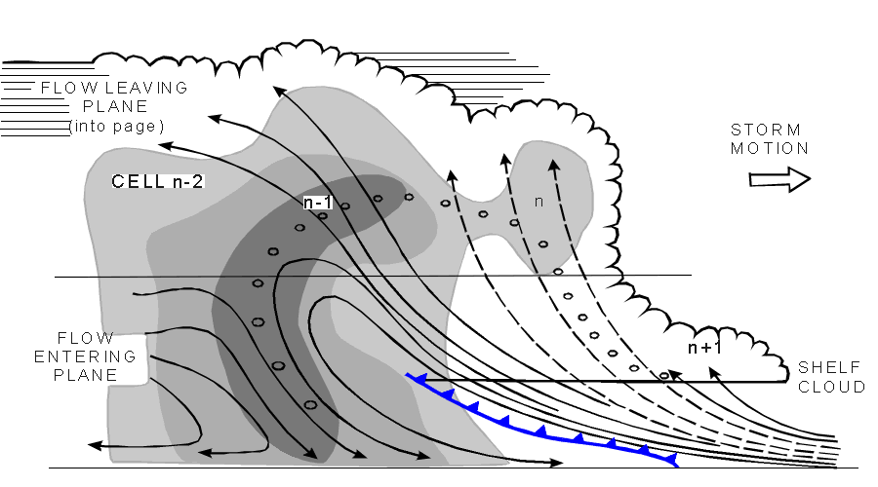
grid box
grid box
Deterministic bulk-formula parametrisation is based on the notion of averaging over some putative ensemble of sub-grid processes in quasi-equilibrium with the resolved flow (eg Arakawa and Schubert, 1974)

Slide 36
Hence reality is more consistent with
grid box
grid box
which can’t be parametrised deterministically

Slide 37
What’s Going On?
For deterministic short-range prediction, increased model resolution will give better representations of topography, land-sea contrast etc , but this will be offset by an increase in forecast error because smaller-scale circulations with faster error-doubling times will be simulated explicitly. Overall, deterministic skill scores (RMS error, ACC etc) may not increase with increased model resolution.
The conclusion is not that high-resolution modelling is a waste of time and resources, but rather that all predictions, even for the short range, must be considered probabilistic, ie ensemble based. There is no range at which the forecast problem can be treated deterministically. The “classical” era of deterministic numerical weather prediction should be drawing to a close, even for short-range prediction.
Probabilistic skill scores will increase with model resolution, provided the underpinning ensemble prediction systems (EPSs) are statistically reliable. Model error is a significant source of forecast uncertainty even in the short range and must be represented in an EPS. Stochastic parametrisation is an emerging technique for representing model error on all timescales.
Climate models may only converge to reality slowly. We may need convectively resolved models not only for reliable short-range prediction, but also for reliable climate prediction.

Slide 38
Conclusions
By the “Butterfly Effect”, Lorenz had something more radical and more unpredictable than just sensitive dependence on initial conditions.
The “Real Butterfly Effect” refers to the problem of predictability associated with high-dimensional fluid turbulence in PDEs. Formally, it seems to be an open problem.
The Real Butterfly Effect is associated with “asymptotic ill posedness”. This can be studied numerically.
Understanding the “Real Butterfly Effect” is relevant to both short-range weather prediction and climate prediction, and in particular to the representation of model error in ensemble prediction systems.

Slide 39
In order to produce reliable forecast probability distributions, it is necessary to represent the errors introduced by deterministic closure schemes in our ensemble prediction systems.
These errors may be random, but can still impact on the mean state of the model

Slide 40
Example of a very unreliable prediction system: the ECMWF medium-range high resolution deterministic forecast over Europe!
Thomas Haiden, personal communication
On about 70% of the occasions when the day 4-5 ECMWF high-res forecast said it would rain at least 10mm/day, it didn’t! Not good for decision makers.

Slide 41
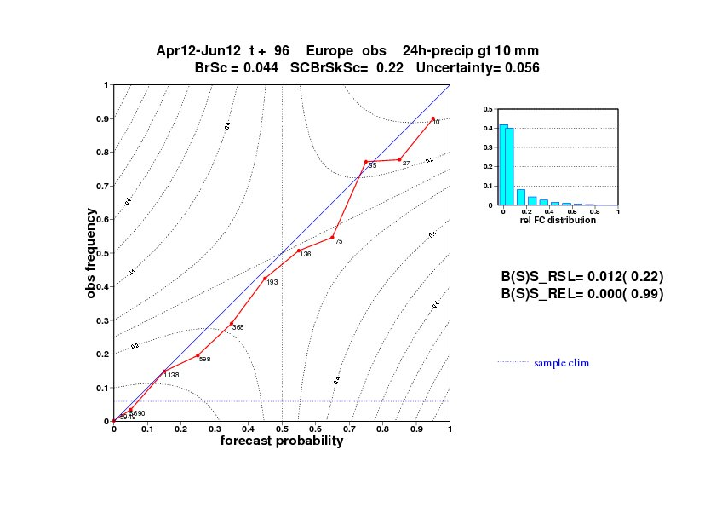
By contrast, probabilistic forecasts from the Ensemble Prediction System are reliable
The single most important verification statistic from a decision maker’s point of view

Slide 42
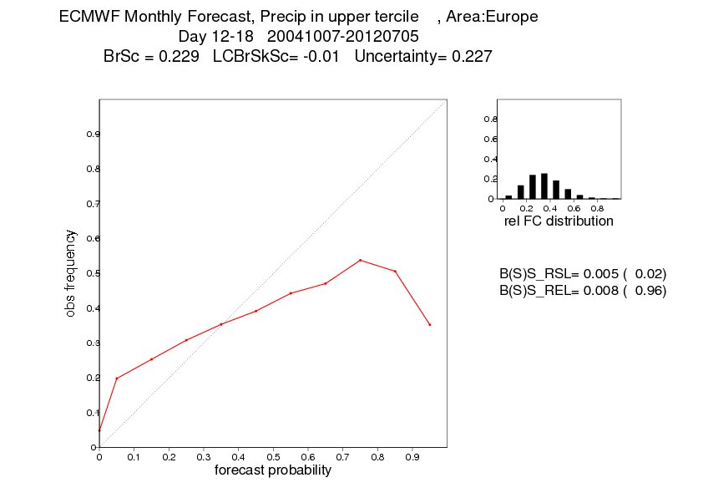

Beyond the medium range, precip forecasts start to loose reliability

Slide 43
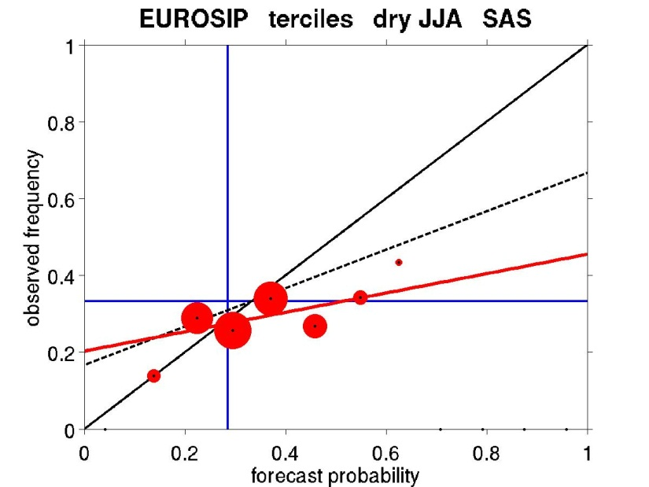
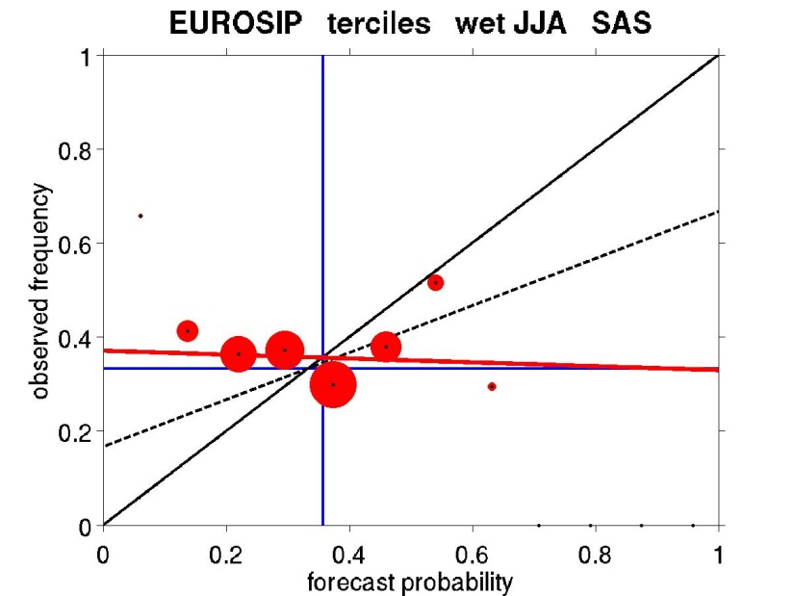
Southern Asia (India)
EUROSIP
(E0002)

Slide 44
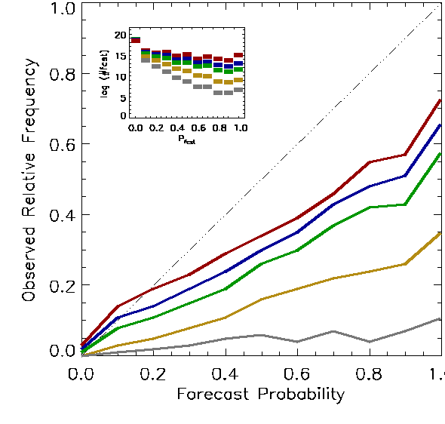
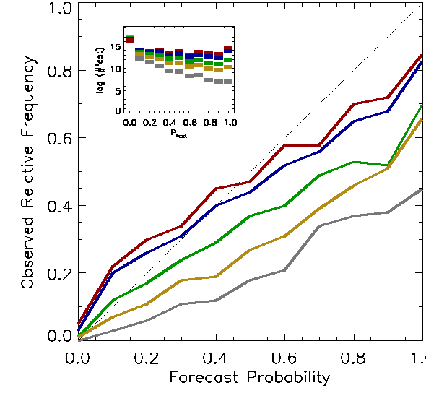
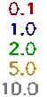
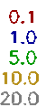
PREC(1h) Summer 2011 00UTC
Unreliability also a problem for short range forecasts of intense rainfall
Reliability diagram
PREC(1h)
PREC(6h)
log (# fcst)
Christoph Gebhardt, personal communication

Slide 45
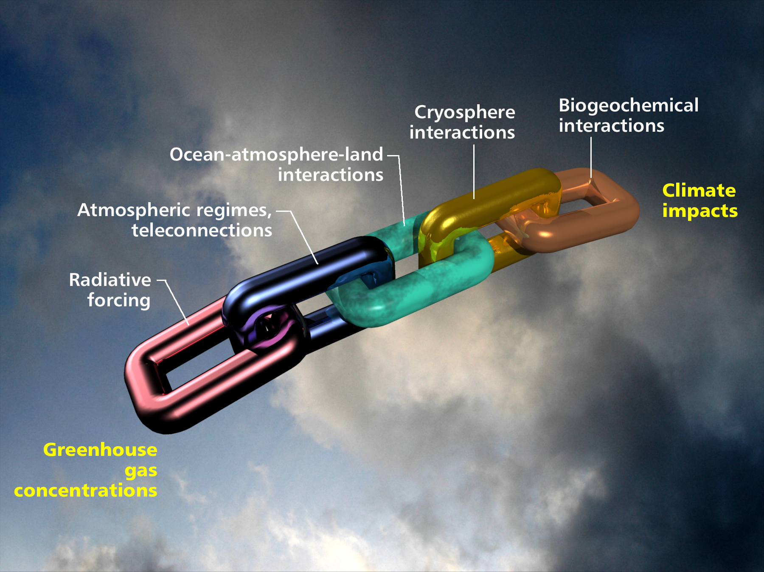
A Nonlinear Perspective on Climate Change
Seamless Prediction techniques allow us to test the strength of at least the first three links
BAMS April 2008 (Palmer, Doblas-Reyes, Rodwell, Weisheimer

