Slide 1
Towards the Probabilistic Earth-System Simulator:
A Vision for the Future of Weather and Climate Prediction
T.N.Palmer
University of Oxford
ECMWF

Slide 2
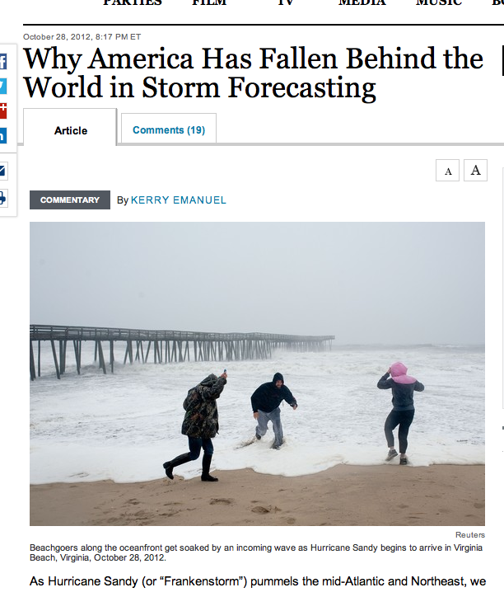
On the other hand, the Canadian model - which had conjured up an absolutely devastating storm for the northern mid-Atlantic and Northeast in earlier runs - has shifted the storm’s track out to sea. The GFS model also has an out to sea track, but has shifted a bit closer to the coast compared to yesterday.
www.washingtonpost.com

Slide 3
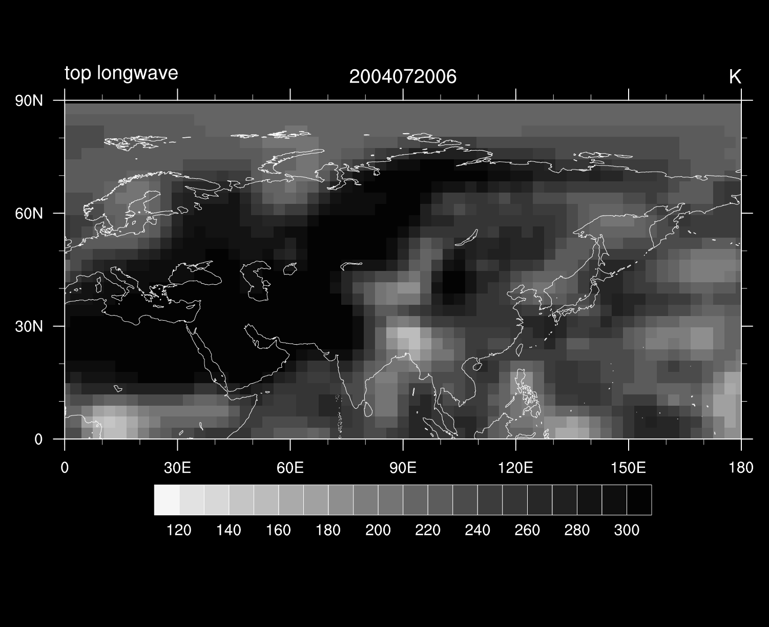
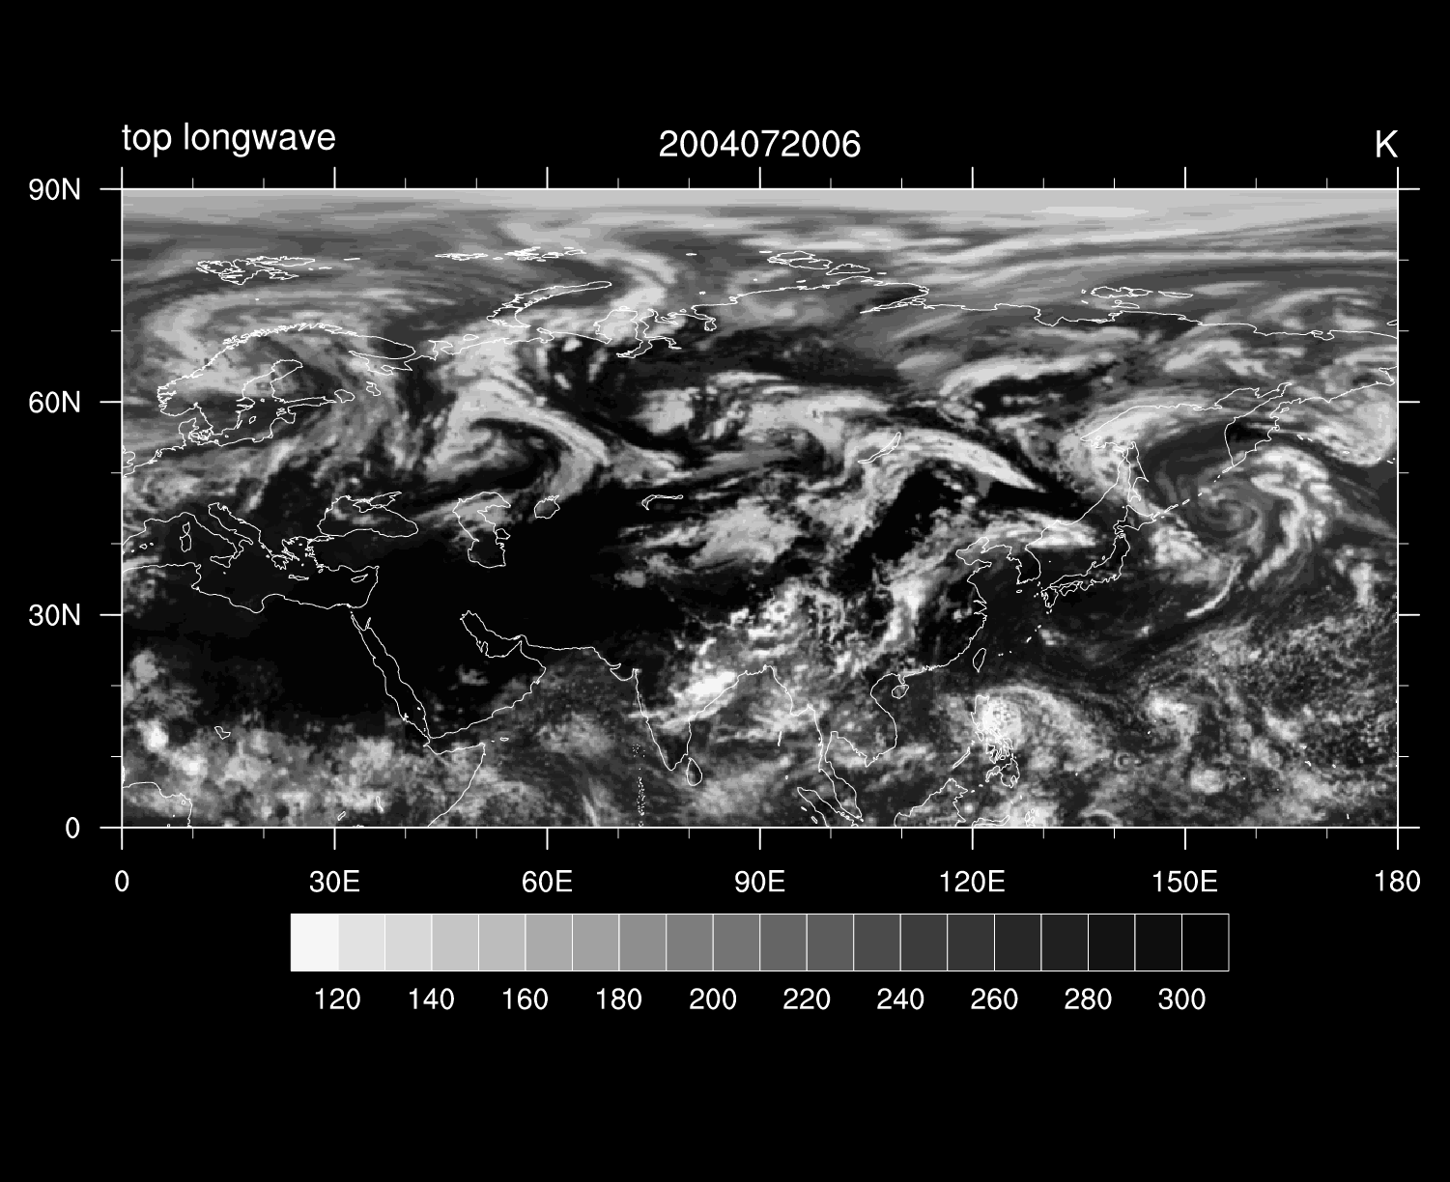
How Can We Improve our Forecasts?
More and Better Observations
Better ways to Assimilate Observations into models
More accurate eg higher resolution models
Better representations of the inherent uncertainty in the observations and the models.

Slide 4
Three parts to this talk
Why we need to focus on ensemble forecast techniques and improve our representations of model uncertainty
We we need higher resolution models
How to reconcile these two needs

Slide 5
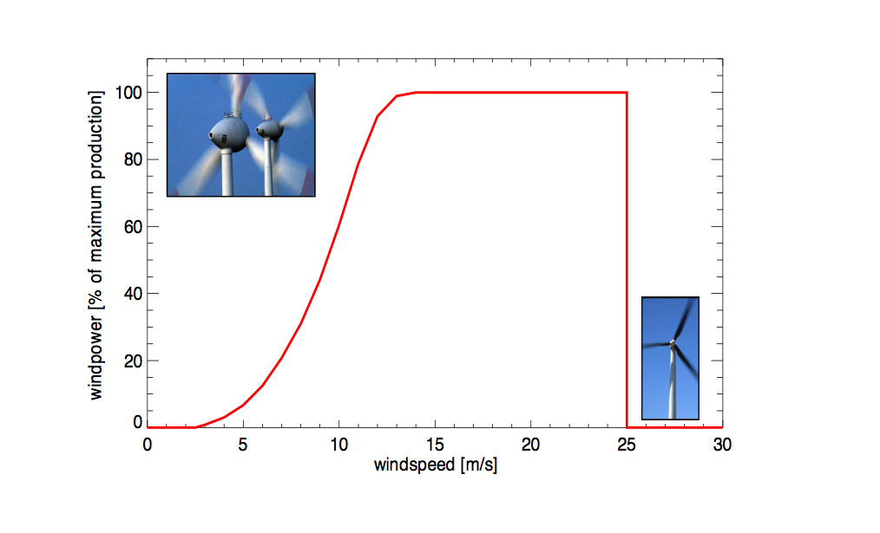
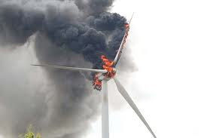
Electricity Production vs Windspeed

Slide 6
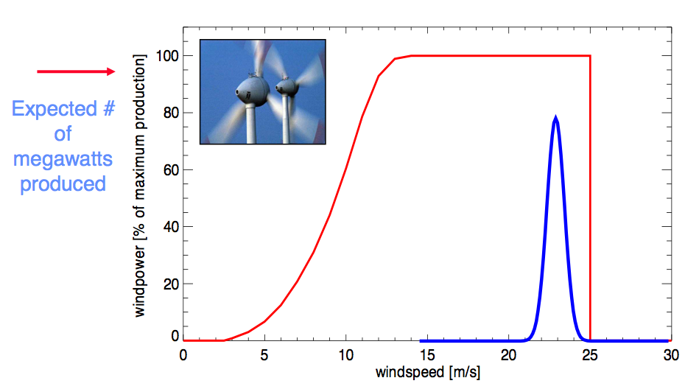
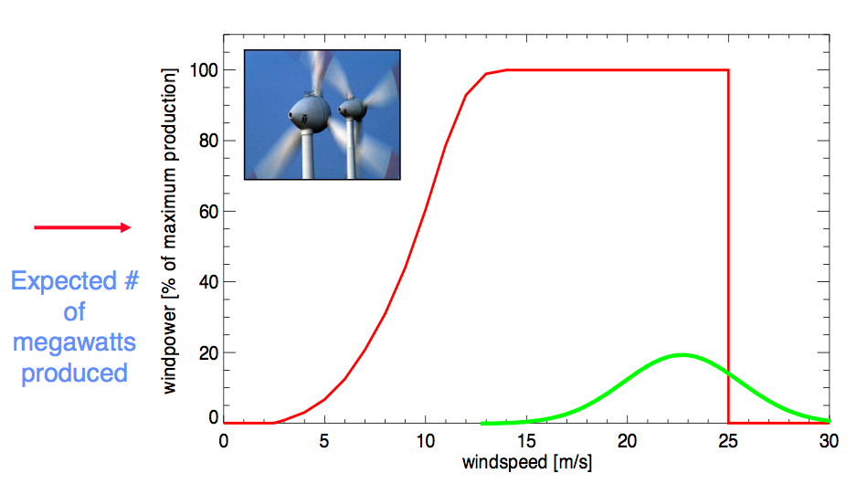
Forecast windspeed. Small uncertainty
Forecast windspeed. Large uncertainty

Slide 7
“ I don’t care about uncertainty. I need to make a decision. Just give me the most likely forecast!”
NO!!
Utility Function
Meteorological Variables
Expected utility – this is what decision makers should use to make decisions!

Slide 8
Traditional computational ansatz for weather/climate simulators
Eg
Increasing scale
Eg momentum“transport” by:
Turbulent eddies in boundary layer
Orographic gravity wave drag.
Convective clouds
Deterministic local bulk-formula parametrisation

Slide 9
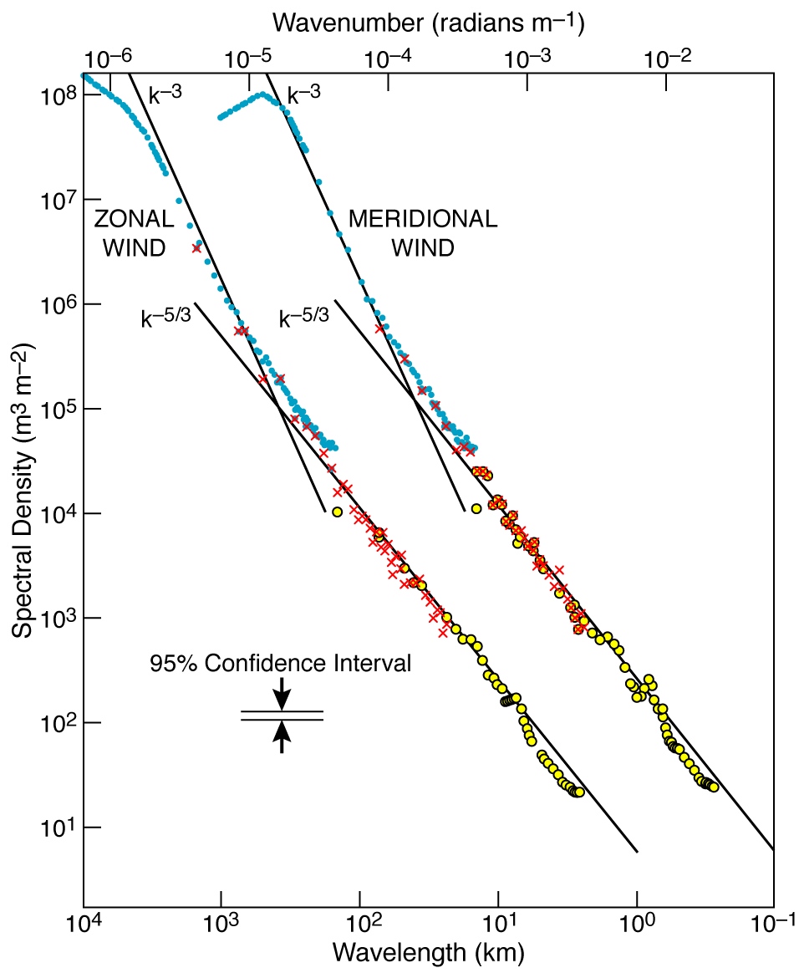
is clearly inconsistent with
hence model uncertainty

Slide 10
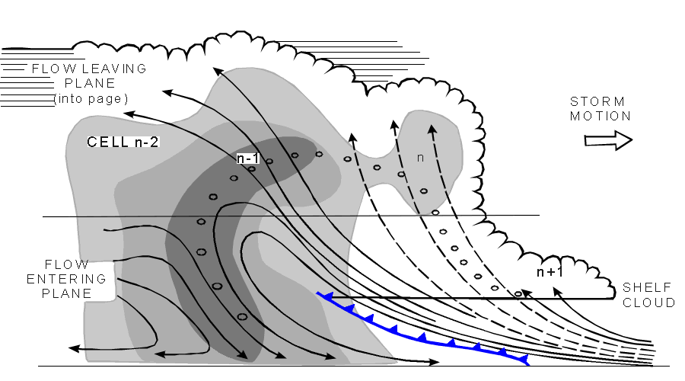
grid box
grid box
Deterministic bulk-formula parametrisation is based on the notion of averaging over some putative ensemble of sub-grid processes in quasi-equilibrium with the resolved flow (eg Arakawa and Schubert, 1974)

Slide 11
However, reality is more consistent with
grid box
grid box

Slide 12
Stochastic Parametrisation
Provides the sub-grid tendency associated with a potential realisation of the sub-grid flow, not the tendency associated with an ensemble average of sub-grid processes.
Can incorporate physical processes (eg energy backscatter) not described in conventional parametrisations.
Parametrisation development can be informed by coarse-graining budget analyses of very high resolution (eg cloud resolving) models.

Slide 13
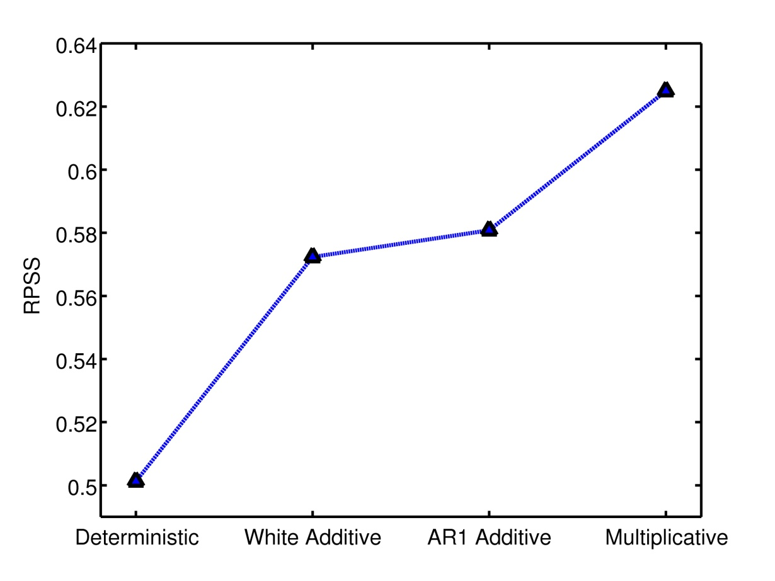
Experiments with the Lorenz ‘96 System
Assume Y unresolved
RPSS
Approximate sub-grid tendency by U
Better
Forecast Skill
Deterministic: U = U_{det}
Additive: U = U_{det} + e_{w,r}
Multiplicative: U = (1+e_{r}) U_{det}
Where:
U_{det} = cubic polynomial in X
e_{w,r} = white / red noise
Fit parameters from full model
Arnold et al, Phil Trans Roy Soc

Slide 14
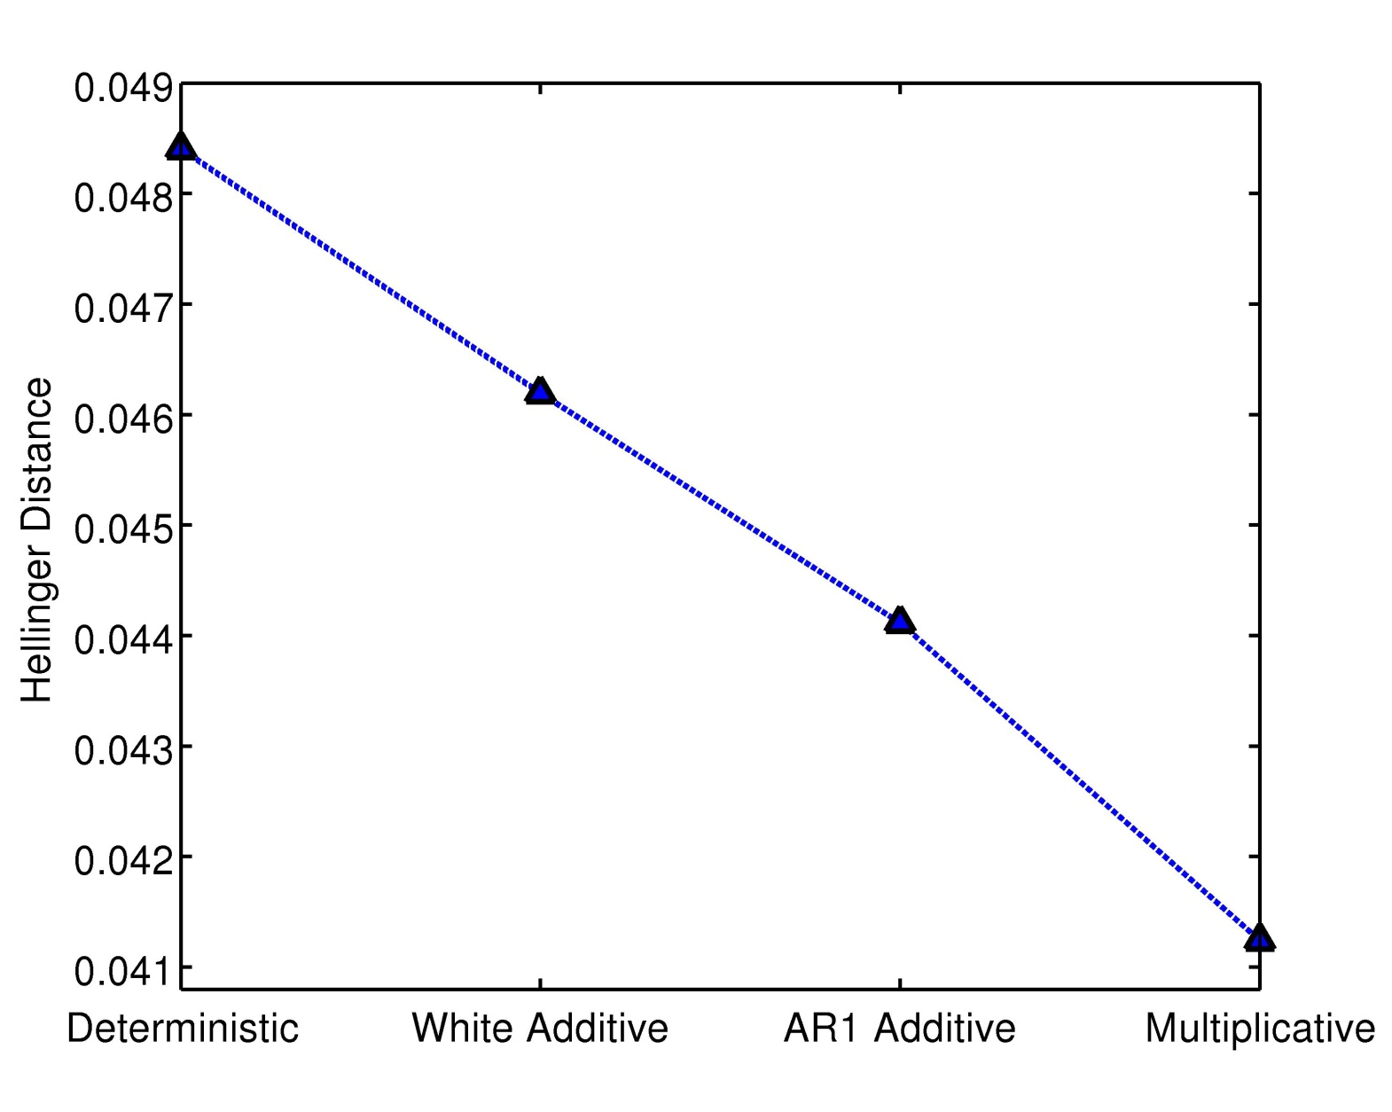
Experiments with the Lorenz ‘96 System
Assume Y unresolved
Approximate sub-grid tendency by U
Worse
Skill in simulating climate pdf
Deterministic: U = U_{det}
Additive: U = U_{det} + e_{w,r}
Multiplicative: U = (1+e_{r}) U_{det}
Where:
U_{det} = cubic polynomial in X
e_{w,r} = white / red noise
Fit parameters from full model

Slide 15
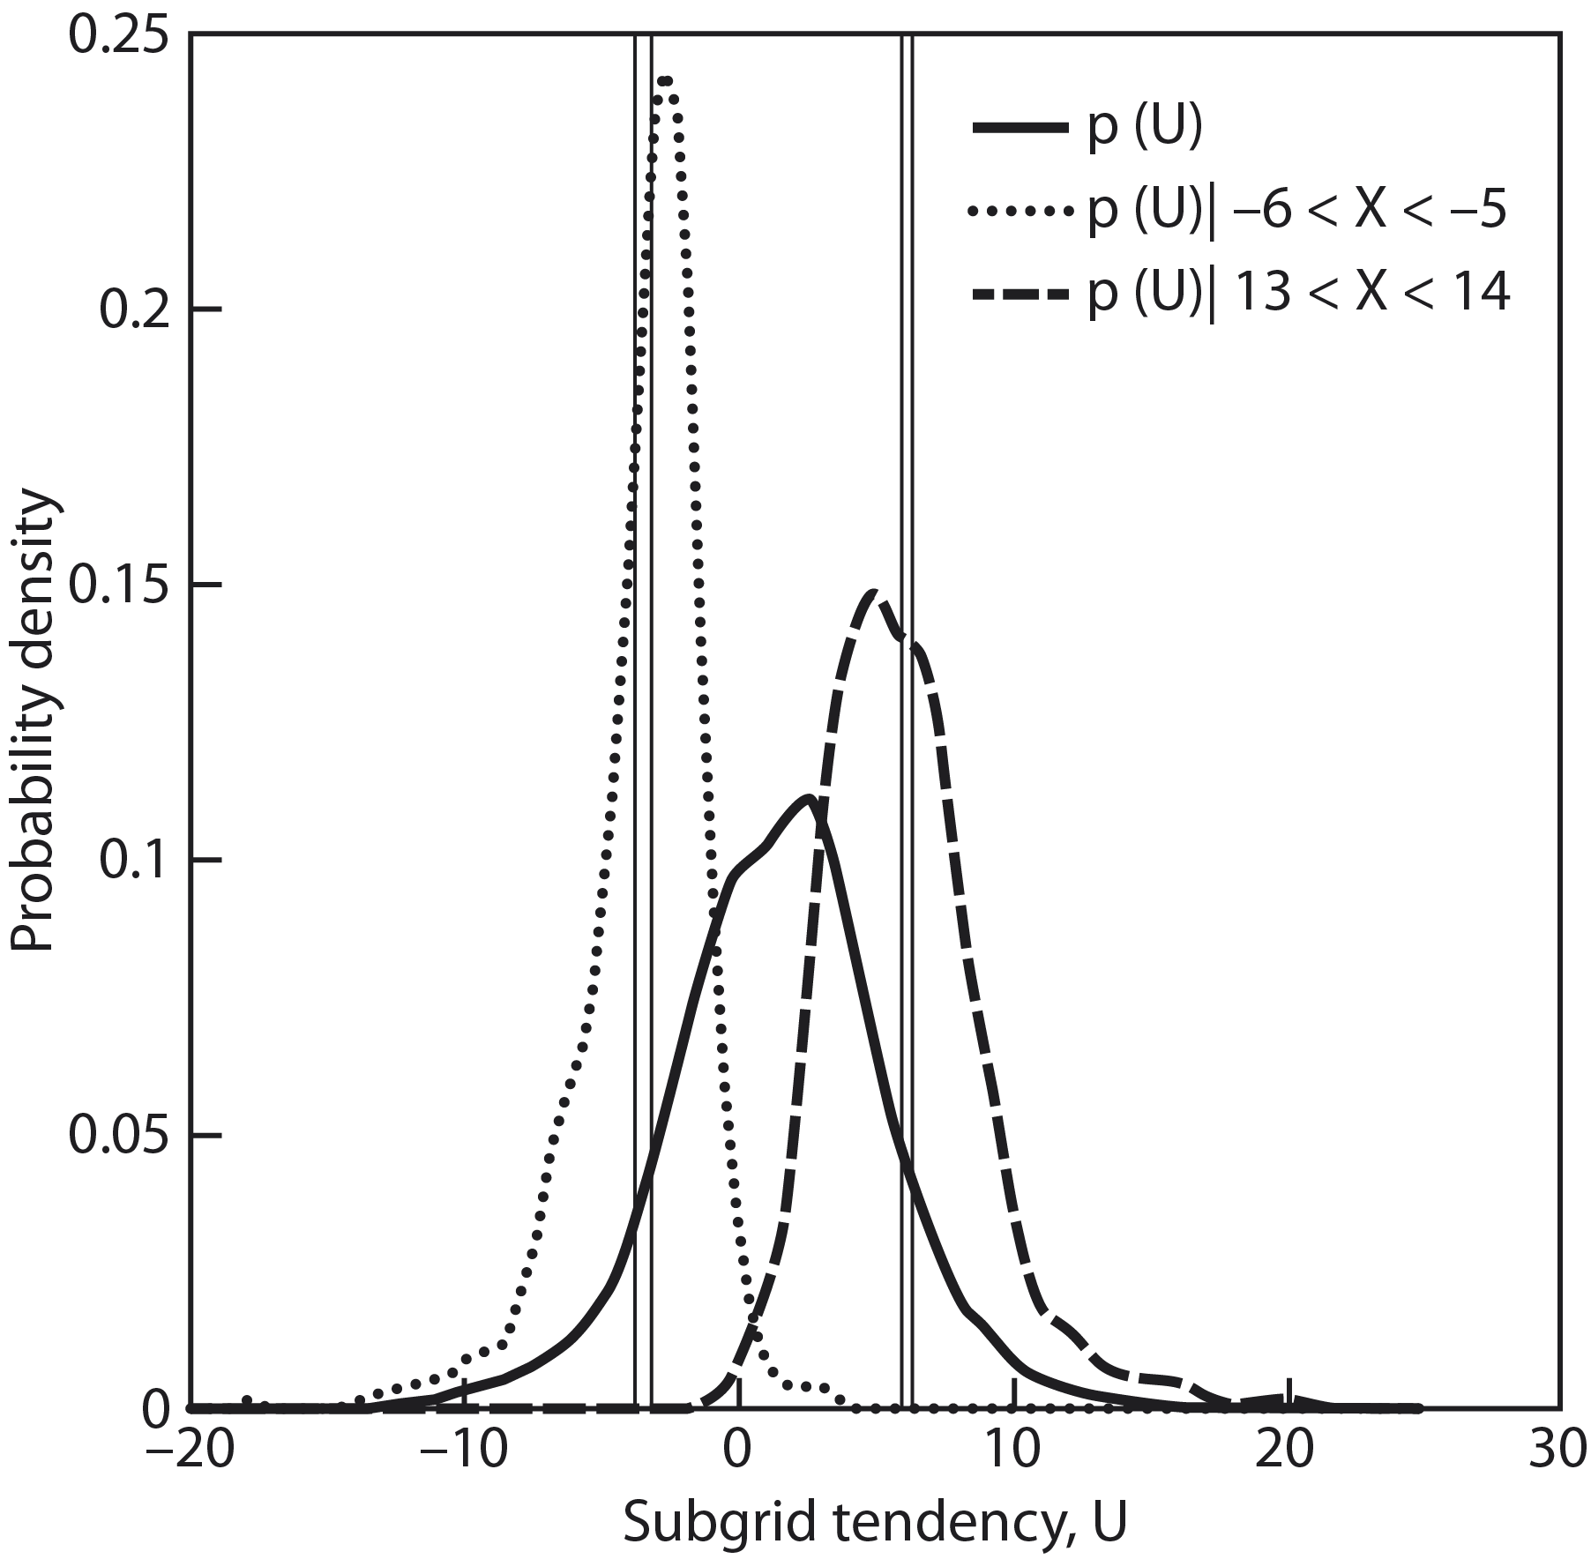
Parametrisation not as a deterministic bulk formula, but as a constraint on a sub-grid pdf
Pdfs from Lorenz 96

Slide 16


Slide 17
Brier Skill Score: ENSEMBLES MME vs ECMWF stochastic physics ensemble (SPE)
lead time: 1 month
 | T2m |  |  |  | precip
 | May |  | Nov |  | May |  | Nov
 | cold | warm | cold | warm | dry | wet | dry | wet
MME | 0.178 | 0.195 | 0.141 | 0.159 | 0.085 | 0.079 | 0.080 | 0.099
SPE | 0.194 | 0.192 | 0.149 | 0.172 | 0.104 | 0.118 | 0.095 | 0.114
CTRL | 0.147 | 0.148 | 0.126 | 0.148 | 0.044 | 0.061 | 0.058 | 0.075
Hindcast period: 1991-2005
SP version 1055m007
Weisheimer et al GRL (2011)

Slide 18
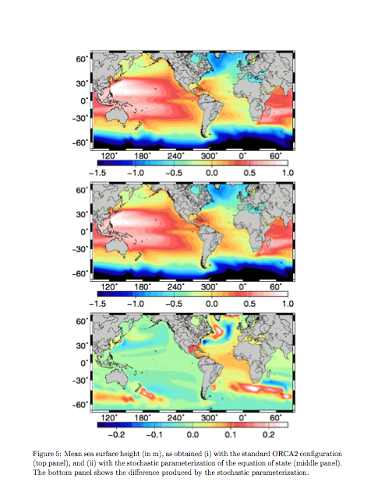
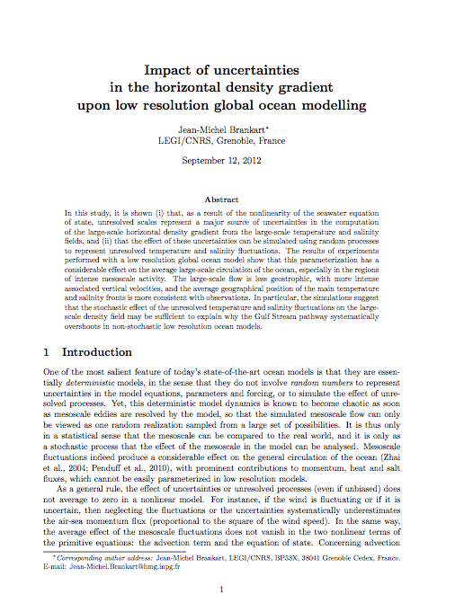

Slide 19
J. Clim Submitted

Slide 20
The ice strength parameter P* is a key parameter in dynamic-thermodynamic sea ice models. Controls the threshold for plastic deformation. Value affected by the liquid content in the sea ice. Cannot be measured directly.
A stochastic representation of P* is developed in a finite element sea-ice-ocean model, based on AR1 multiplicative noise and spatial autocorrelation between nodes of the finite element grid
Despite symmetric perturbations, the stochastic scheme leads to a substantial increase in sea ice volume and mean thickness
An ensemble of eight perturbed simulations generates a spread in the multiyear ice comparable with interannual variability in the model.
Results cannot be reproduced by a simple constant global modification to P*
Impact of different versions of stochastic P* with respect to a reference run. Top: Sea ice thickness. Bottom: sea ice concentration.

Slide 21
A skilful stochastic model cannot be obtained from a tuned deterministic model with bolt-on stochastics.

Slide 22
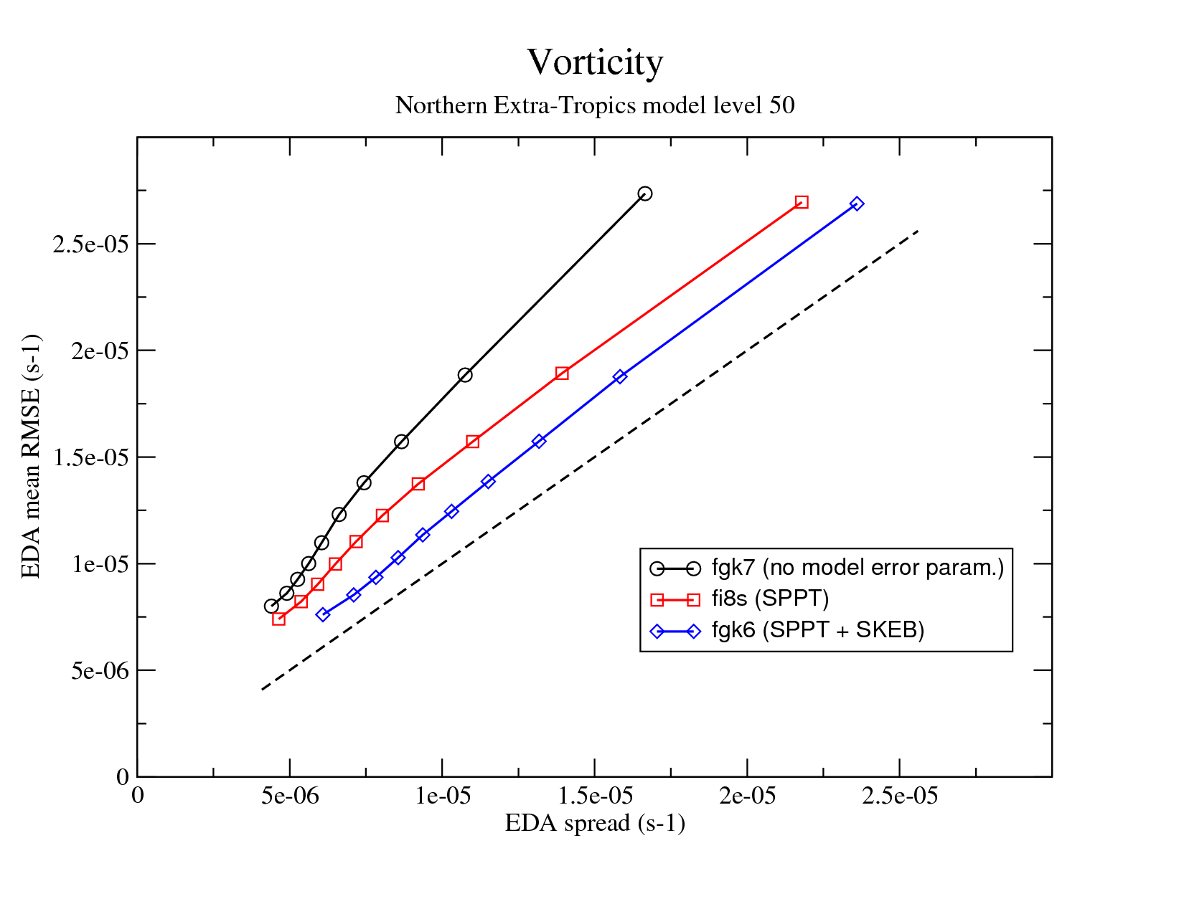
Performance of stochastic parametrisation in data assimilation mode. M. Bonavita, personal communication.

Slide 23
How Can We Improve our Forecasts?
More and Better Observations
Better ways to Assimilate Observations into models
More accurate eg higher resolution models
Better representations of the inherent uncertainty in the observations and the models.

Slide 24
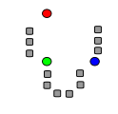
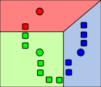
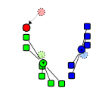
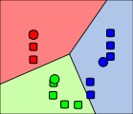
We study weather-regime clustering in the Euro-Atlantic sector using ERA and using T159 and T1279 AMIP runs from the Athena Project (Kinter et al, 2012, BAMS to appear).
Clustering by K-means Partition
PC1
PC2

Slide 30
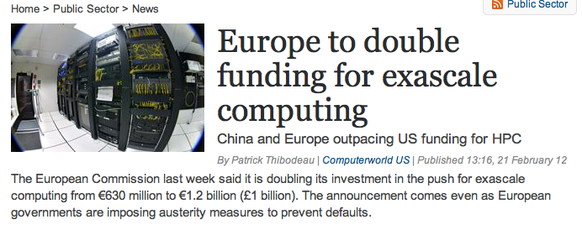
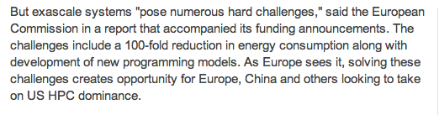

Slide 31
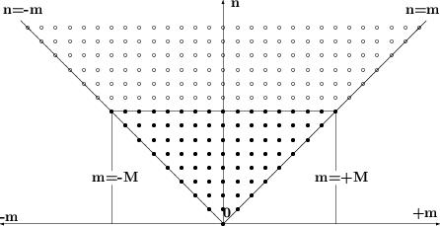
Spectral Dynamical Core
Parametrisation
Triangular Truncation

Slide 32
Stochastic Parametrisation
Triangular Truncation
Partially Stochastic
Are we over-engineering our dynamical cores by using double precision bit-reproducible computations for wavenumbers near the truncation scale?

Slide 33

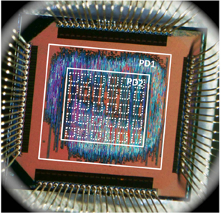

Superefficient inexact chips
http://news.rice.edu/2012/05/17/computing-experts-unveil-superefficient-inexact-chip/
In terms of speed, energy consumption and size, inexact computer chips like this prototype, are about 15 times more efficient than today's microchips.
Krishna Palem. Rice, NTU Singapore
This comparison shows frames produced with video-processing software on traditional processing elements (left), inexact processing hardware with a relative error of 0.54 percent (middle) and with a relative error of 7.58 percent (right). The inexact chips are smaller, faster and consume less energy. The chip that produced the frame with the most errors (right) is about 15 times more efficient in terms of speed, space and energy than the chip that produced the pristine image (left).

Slide 34



Towards the Stochastic Dynamical Core
Stochastic Parametrisation
Efficiency/speed/inexactness of chip
Triangular Truncation
and precision at which the data is stored and passed between processors.
At Oxford we are beginning to work with IBM Zurich and Technical Uni Singapore and U Illinois to develop these ideas…

Slide 35
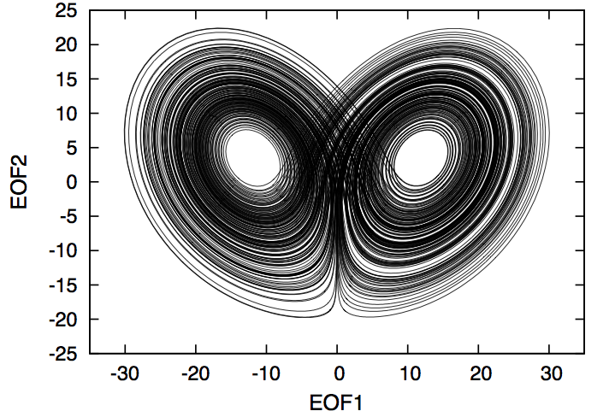
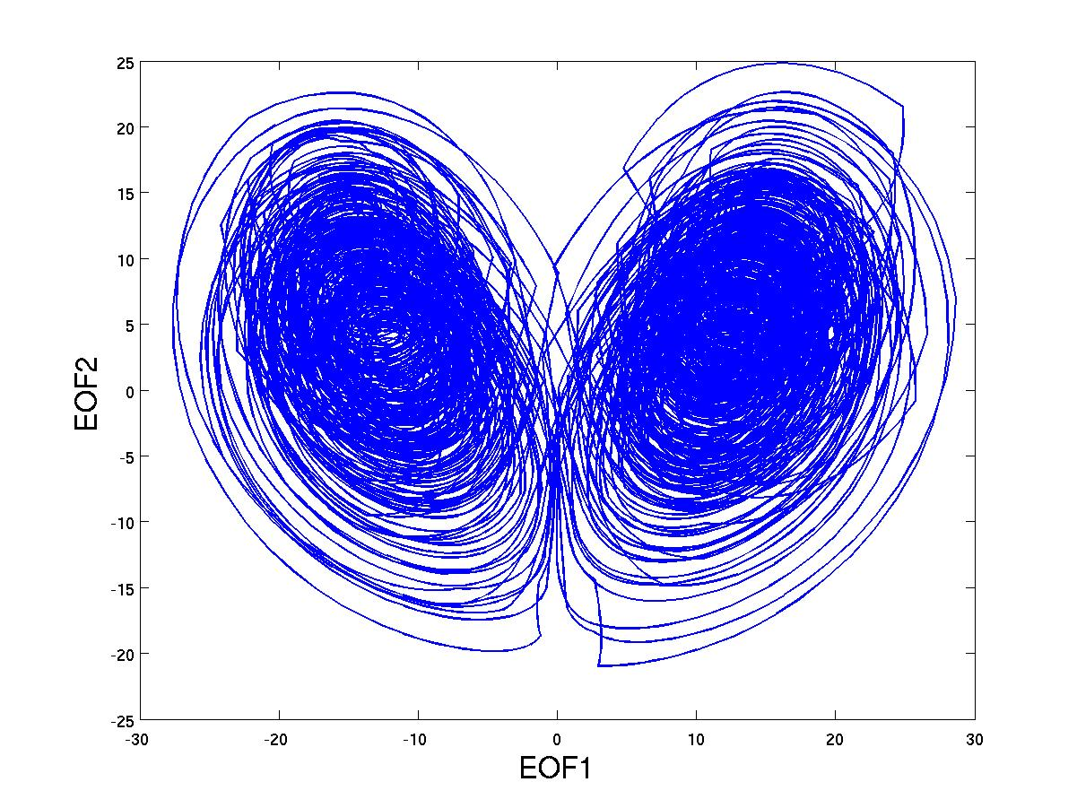
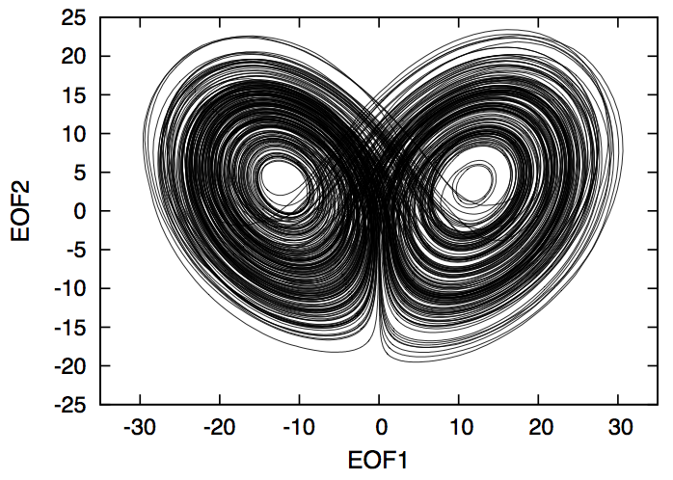
Represent a₃. by stochastic noise
Integrate 3rd equation on emulator of stochastic chip.

Slide 36
Suppose you had enough dollars to buy either
Computer A: Bit reproducible, double precision, allows 10km resolution. Parametrised convection.
Computer B: 1000 faster, but 90% of processors are probabilistic (errors in mantissa of all floating point numbers). Variable precision arithmetic. Potential for 1km resolution with explicit convection.

Slide 37
30 Years Ago
Dynamics
Parametrisation
O(100km)

Slide 38
Now
Dynamics
Parametrisation
O(10km)

Slide 39
In 30 years
Dynamics
Parametrisation
O(1km)

Slide 40
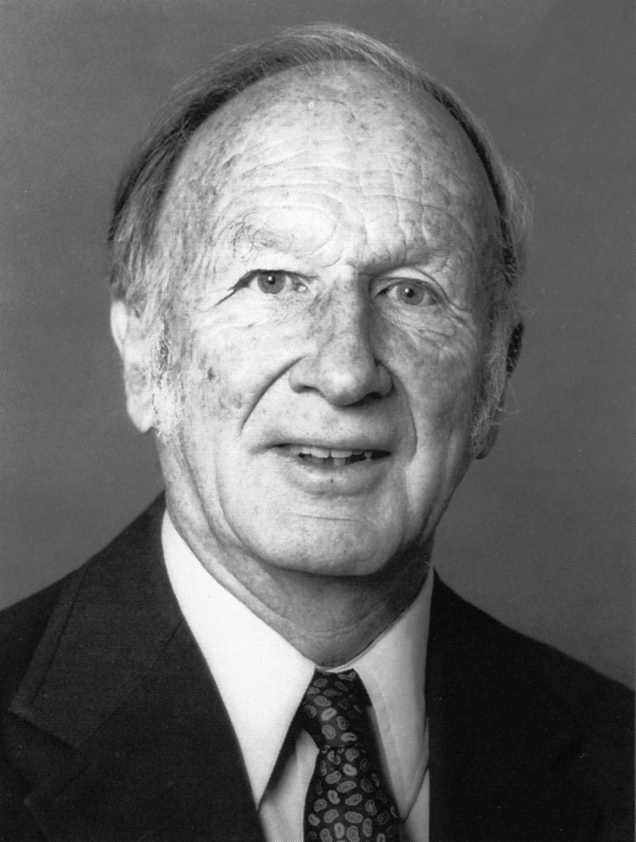
Edward Norton Lorenz (1917-2008)
I believe that the ultimate climate models..will be stochastic, ie random numbers will
appear somewhere in the time derivatives Lorenz (1975).

