Slide 1
12.340x
Global Warming Science
Wrap-Up

Slide 2
Some Key Points
Climate has changed on many different time scales throughout the history of our planet
Such climate change is thought to have been caused by variations in absorbed sunlight (solar and orbital variability, and volcanoes), changing concentrations of key greenhouse gases, and changing continental configuration
Transfer of radiation through the atmosphere is affected primarily by clouds and by trace quantities of greenhouse gases
Of these, carbon dioxide is the most important on long times scales, owing to its long lifetime in the atmosphere

Slide 3
Some Key Points (2)
CO₂ is increasing owing to industrial processes and changes in land use
The basic response of surface temperature to increasing concentrations of CO₂ was predicted more than 100 years ago
The global mean response to changing CO₂ appears to be well captured by radiative-convective models
Circulation of the atmosphere and oceans redistributes energy and strongly affects the distributions of water vapor, clouds, and aerosols
Aerosols can have strong direct and indirect effects on climate
Simple and complex climate models indicate the possibility of substantial climate change in response to increasing CO₂ concentrations

Slide 4
Some Key Points
Climate has changed on many different time scales throughout the history of our planet
Such climate change is thought to have been caused by variations in absorbed sunlight sunlight (solar and orbital variability, and volcanoes), changing concentrations of key greenhouse gases, and changing continental configuration
Transfer of radiation through the atmosphere is affected primarily by clouds and by trace quantities of greenhouse gases
Of these, carbon dioxide is the most important on long times scales, owing to its long lifetime in the atmosphere

Slide 5
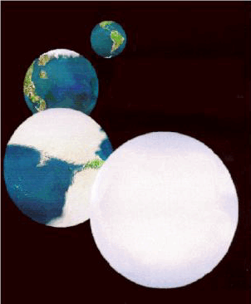
The Snowball Earth
Image credit: NASA

Slide 6
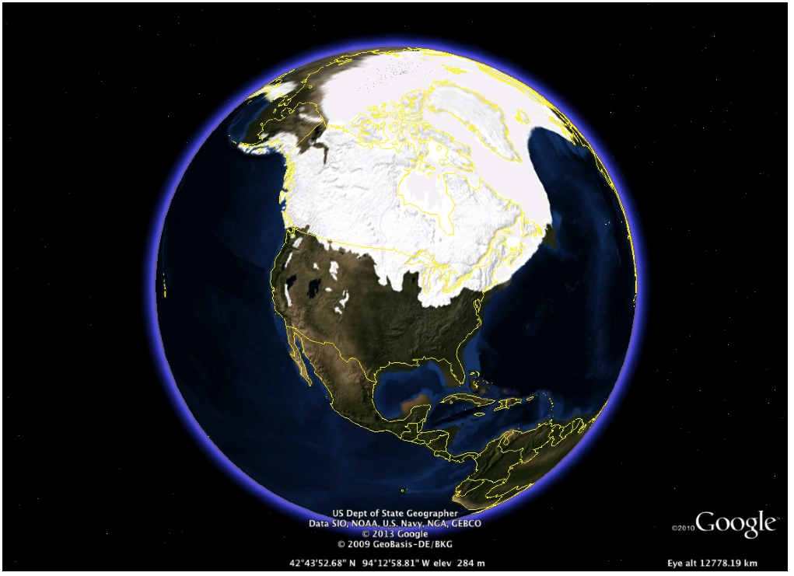
Last Glacial Maximum, ~22,000 years ago
NOAA/Science on a Sphere
Notes:
Consistency
Sawtooth
Modern day values

Slide 7

Polar radiative forcing: 10 W/m²
Global mean temperature fluctuation: ~5 C
Image credit: Robert A. Rohde/Global Warming Art

Slide 8
Some Key Points
Climate has changed on many different time scales throughout the history of our planet
Such climate change is thought to have been caused by variations in absorbed sunlight sunlight (solar and orbital variability, and volcanoes), changing concentrations of key greenhouse gases, and changing continental configuration
Transfer of radiation through the atmosphere is affected primarily by clouds and by trace quantities of greenhouse gases
Of these, carbon dioxide is the most important on long times scales, owing to its long lifetime in the atmosphere

Slide 9
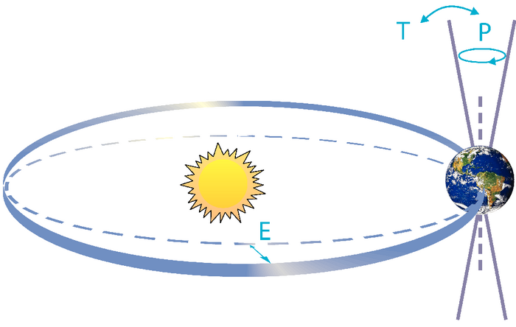
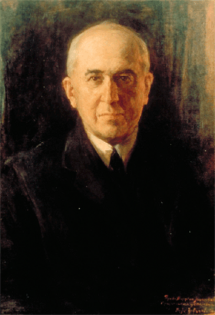
Climate Forcing by Orbital Variations
‘T’ denotes tilt (or obliquity) of the Earth’s axis, ‘E’ denotes eccentricity of the orbit, and ‘P’ denotes precession, that is, the direction of the axis tilt at a given point of the orbit.
Source: Rahmstorf and Schellnhuber (2006): Der Klimawandel – Diagnose, Prognose, Therapie, C. H. Beck, Munich
Milutin Milanković, 1879-1958
Portrait by Paja Jovanović (1859-1957)
Notes:
Right-side figure: S. Rahmstorf/H. J. Schellnhuber:
Der Klimawandel – Diagnose, Prognose, Therapie
2006. 144 S., 7,90 Euro
ISBN 3-406-50866-9
C.H. Beck, München
http://www.pik-potsdam.de/~stefan/klimawandel.html
Also printed in IPCC AR4

Slide 10
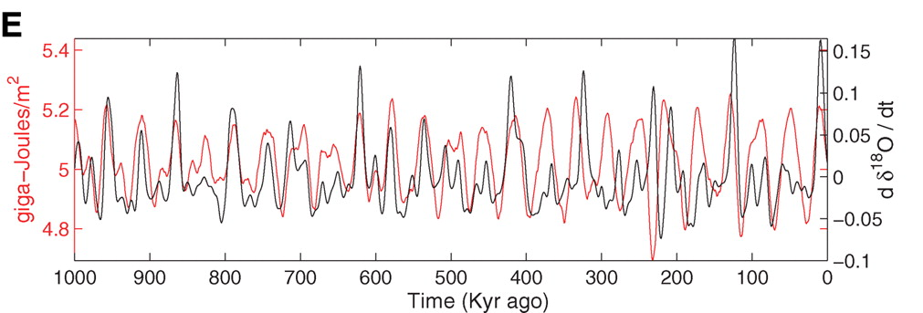

Strong Correlation between High Latitude Summer Insolation and Ice Volume
Black: Time rate of change of ice volume
Red: Summer high latitude sunlight
Huybers, P., Science 28 July 2006, Vol. 313 no. 5786 pp. 508-511, DOI: 10.1126/science.1125249

Slide 11
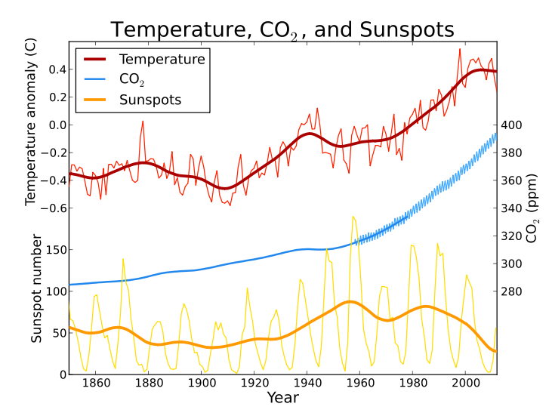
Global average temperature, atmospheric CO₂, and sunspot activity since 1850. Thick lines for temperature and sunspots represent a 25 year moving average smoothing of the raw data.
Image credit: Leland McInnes, Wikipedia
Notes:
http://commons.wikimedia.org/wiki/File:Temp-sunspot-co2.svg

Slide 12
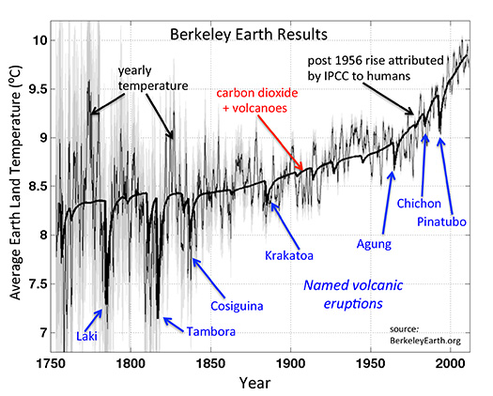
Image credit: Berkeley Earth
Notes:
http://berkeleyearth.org/volcanoes/

Slide 13
Some Key Points
Climate has changed on many different time scales throughout the history of our planet
Such climate change is thought to have been caused by variations in absorbed sunlight (solar and orbital variability, and volcanoes), changing concentrations of key greenhouse gases, and changing continental configuration
Transfer of radiation through the atmosphere is affected primarily by clouds and by trace quantities of greenhouse gases
Of these, carbon dioxide is the most important on long times scales, owing to its long lifetime in the atmosphere

Slide 14


John Tyndall (1820-1893)

Slide 15

Tyndall’s Essential Results:
Oxygen (O₂ ), nitrogen (N₂), and argon (Ar), though they make up ~99% of the atmosphere, are almost entirely transparent to solar and terrestrial radiation
Water vapor (H₂O), carbon dioxide (CO₂), nitrous oxide (N₂O), and a handful of other trace gases make the lower atmosphere nearly opaque to infrared radiation, though still largely transparent to solar radiation (but clouds have strong effects on radiation at all wavelengths). Together they increase the Earth’s surface temperature from about -18ºC to around 15ºC.

Slide 16
Atmospheric Composition
The orange sliver (can you see it?) makes the difference between a mean surface temperature of -18ºC and of 15ºC.

Slide 17
Water Vapor (H₂O), about 0.25% of the mass of the atmosphere, is the most important greenhouse gas, but responds to atmospheric temperature change on a time scale of about 2 weeks
Climate is therefore strongly influenced by long-lived greenhouse gases (e.g. CO₂, CH₄, N₂O) that together comprise about 0.04% of the mass of the atmosphere. Concentration of CO₂ has increased by 43% since the dawn of the industrial revolution

Slide 18
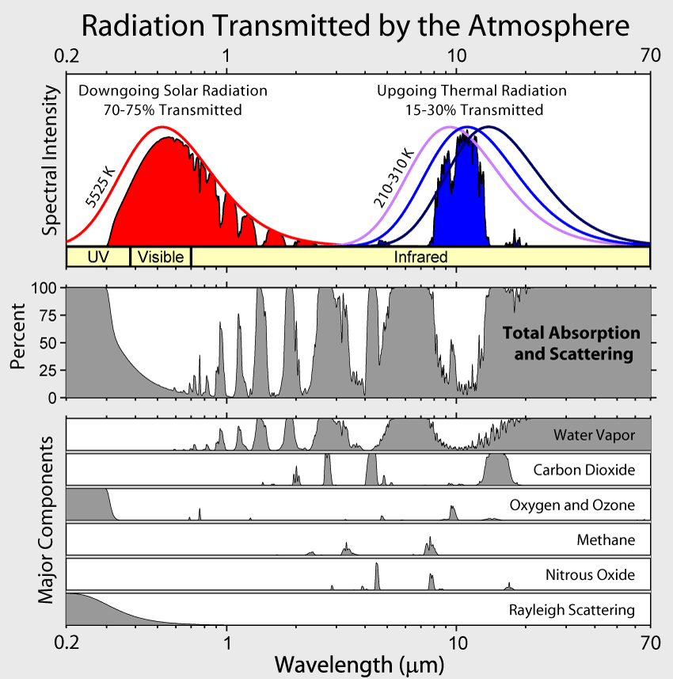
Image created by Robert A. Rohde / Global Warming Art
Notes:
http://commons.wikimedia.org/wiki/File:Atmospheric_Transmission.png which shows CC BY-SA, along with link for more detailed terms to
http://www.globalwarmingart.com/wiki/File:Atmospheric_Transmission_png
Which specifies use is fine, along with credit line now added to slide.

Slide 19
Some Key Points
Climate has changed on many different time scales throughout the history of our planet
Such climate change is thought to have been caused by variations in absorbed sunlight (solar and orbital variability, and volcanoes), changing concentrations of key greenhouse gases, and changing continental configuration
Transfer of radiation through the atmosphere is affected primarily by clouds and by trace quantities of greenhouse gases
Of these, carbon dioxide is the most important on long times scales, owing to its long lifetime in the atmosphere

Slide 20

Atmospheric CO₂ assuming that emissions stop altogether after peak concentrations
Image source: Solomon, S., G.-K. Plattner, R. Knutti, and P. Friedlingstein, 2009, PNAS, 106, 1704-1709

Slide 21
Some Key Points (2)
CO₂ is increasing owing to industrial processes and changes in land use
The basic response of surface temperature to increasing concentrations of CO₂ was predicted more than 100 years ago
The global mean response to changing CO₂ appears to be well captured by radiative-convective models
Circulation of the atmosphere and oceans redistributes energy and strongly affects the distributions of water vapor, clouds, and aerosols
Aerosols can have strong direct and indirect effects on climate
Simple and complex climate models indicate a possibility of substantial climate change in response to increasing CO₂ concentrations

Slide 22
Carbon dioxide concentrations from ice cores (green dots) and direct measurements (blue curve)
Source: IPCC Assessment Report 5 (Chapter 6)

Slide 23
Some Key Points (2)
CO₂ is increasing owing to industrial processes and changes in land use
The basic response of surface temperature to increasing concentrations of CO₂ was predicted more than 100 years ago
The global mean response to changing CO₂ appears to be well captured by radiative-convective models
Circulation of the atmosphere and oceans redistributes energy and strongly affects the distributions of water vapor, clouds, and aerosols
Aerosols can have strong direct and indirect effects on climate
Simple and complex climate models indicate a possibility of substantial climate change in response to increasing CO₂ concentrations

Slide 24

Svante Arrhenius, 1859-1927
“Any doubling of the percentage of carbon dioxide in the air would raise the temperature of the earth's surface by 4°; and if the carbon dioxide were increased fourfold, the temperature would rise by 8°.” – Världarnas utveckling (Worlds in the Making), 1906

Slide 25
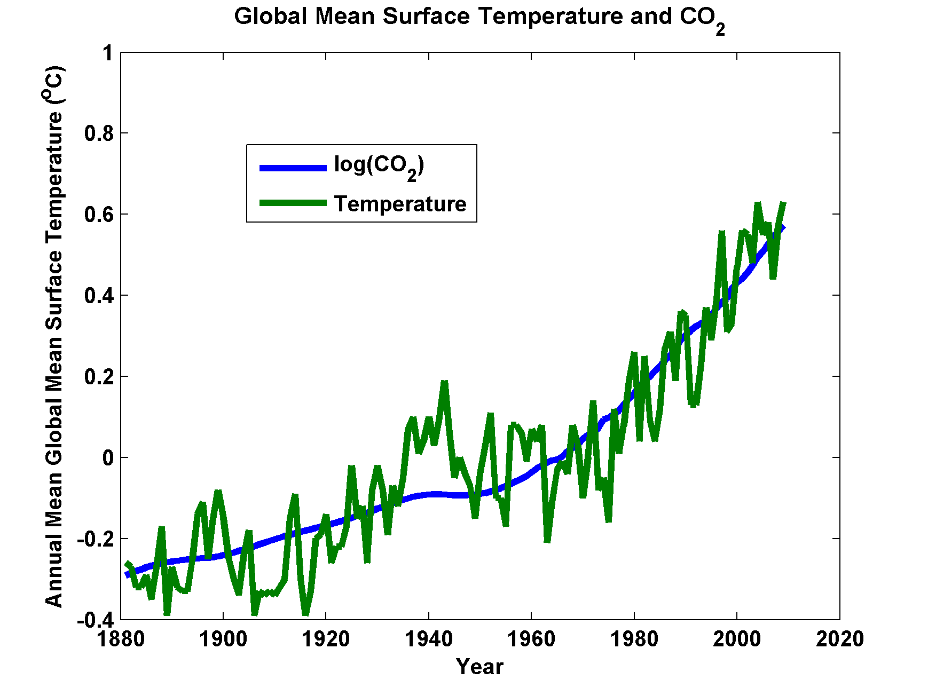

Slide 26
Some Key Points (2)
CO₂ is increasing owing to industrial processes and changes in land use
The basic response of surface temperature to increasing concentrations of CO₂ was predicted more than 100 years ago
The global mean response to changing CO₂ appears to be well captured by radiative-convective models
Circulation of the atmosphere and oceans redistributes energy and strongly affects the distributions of water vapor, clouds, and aerosols
Aerosols can have strong direct and indirect effects on climate
Simple and complex climate models indicate a possibility of substantial climate change in response to increasing CO₂ concentrations

Slide 27
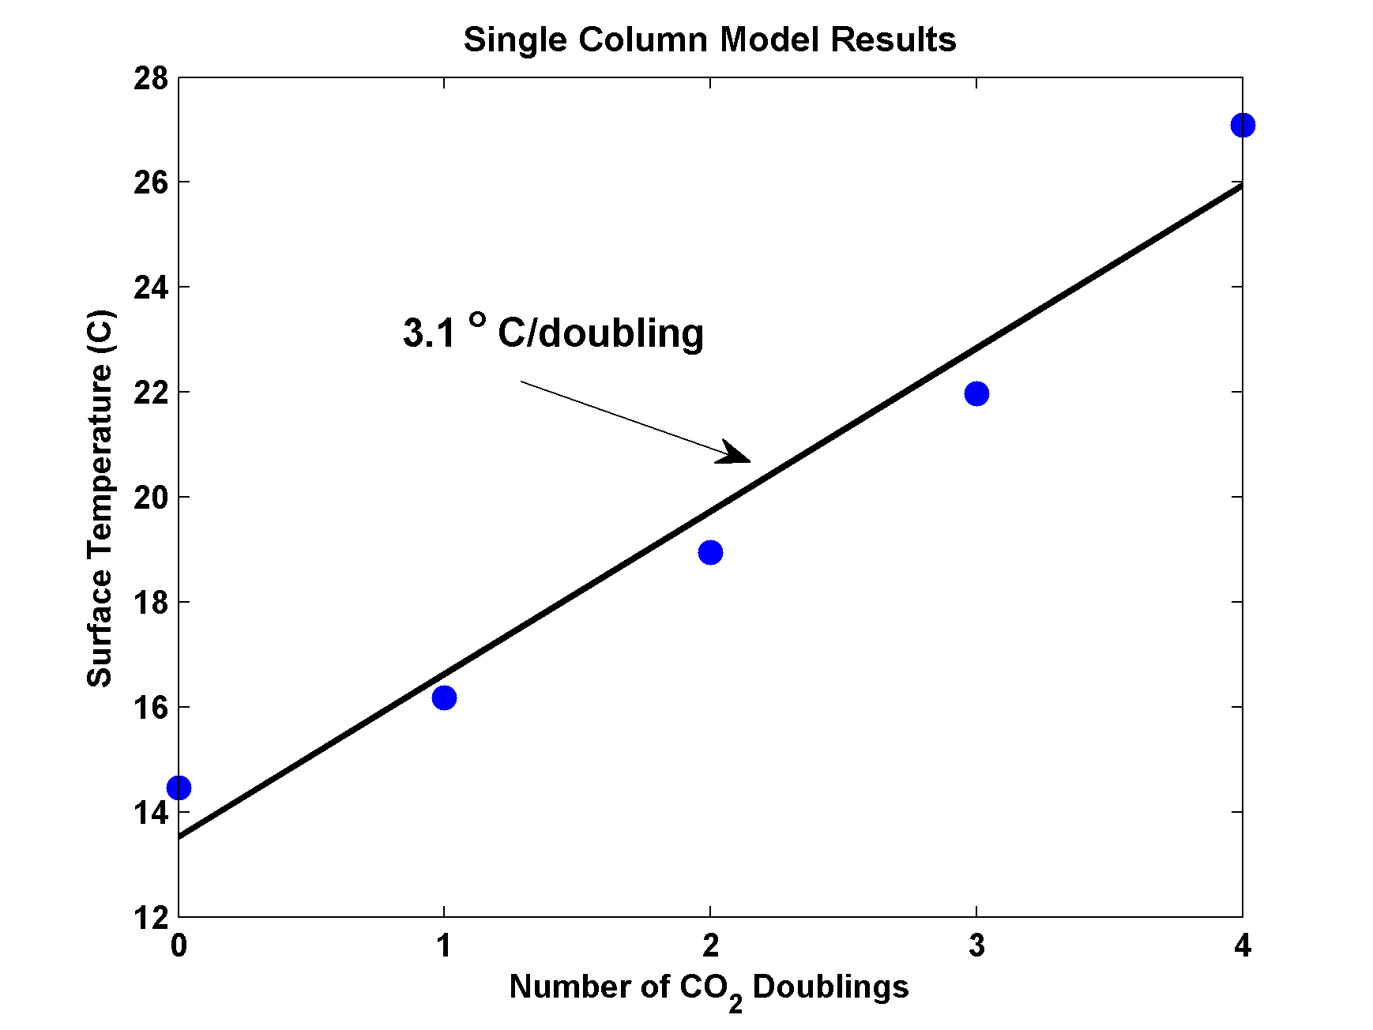
MIT Single Column Model
IPCC Estimate:
1.5-4.5 ºC

Slide 28
Some Key Points (2)
CO₂ is increasing owing to industrial processes and changes in land use
The basic response of surface temperature to increasing concentrations of CO₂ was predicted more than 100 years ago
The global mean response to changing CO₂ appears to be well captured by radiative-convective models
Circulation of the atmosphere and oceans redistributes energy and strongly affects the distributions of water vapor, clouds, and aerosols
Aerosols can have strong direct and indirect effects on climate
Simple and complex climate models indicate a possibility of substantial climate change in response to increasing CO₂ concentrations

Slide 29
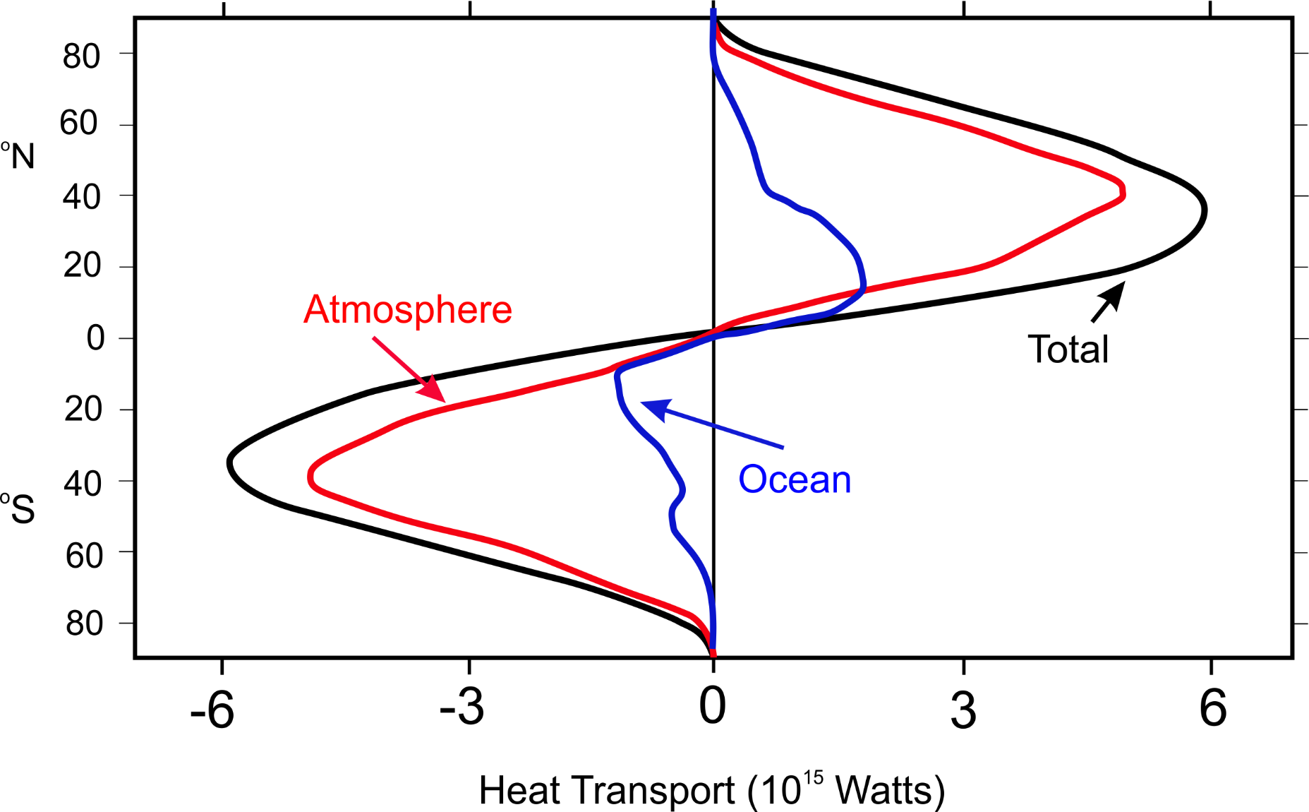
Lateral Heat Transport by Atmosphere and Oceans
Image credit: After Fasullo, John T., Kevin E. Trenberth, 2008: The Annual Cycle of the Energy Budget. Part II: Meridional Structures and Poleward Transports. J. Climate, 21, 2313–2325.
Notes:
Re-drafted by K. Emanuel

Slide 30
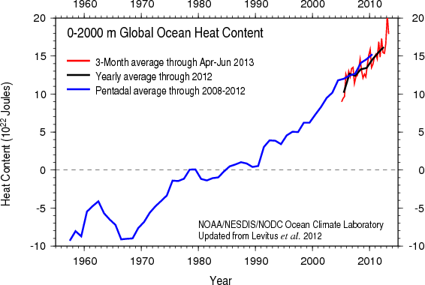
Based on bathythermograph and ARGO (post-2004) data
Image credit: NOAA

Slide 31
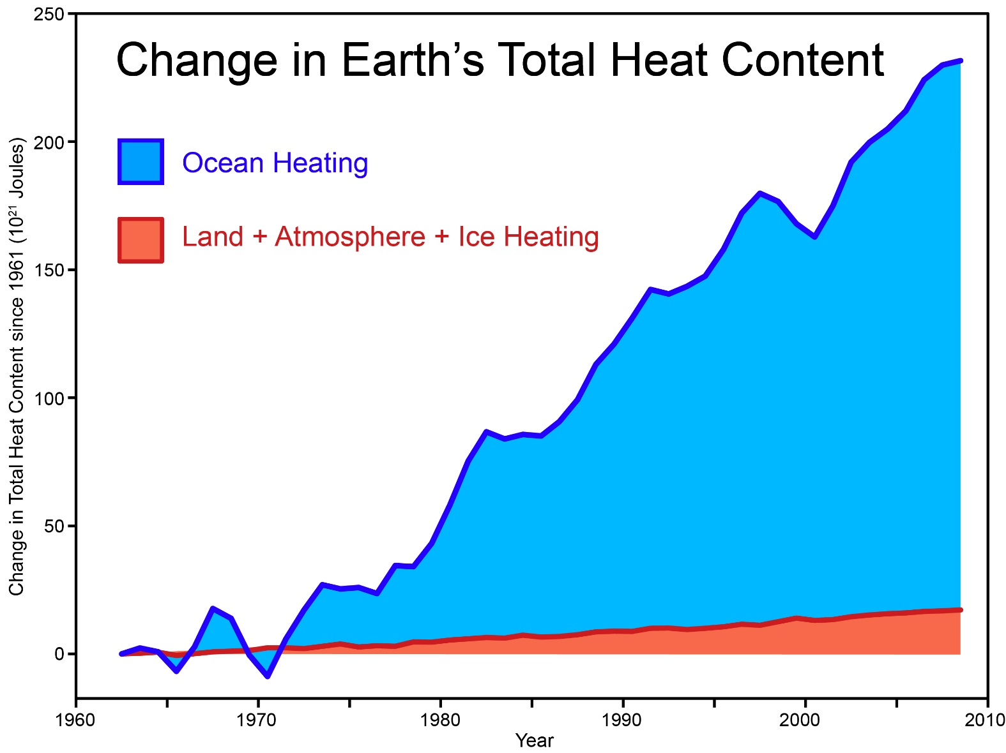
Total amount of heat from global warming that has accumulated in Earth's climate system since 1961, from Church et al. (2011) (many thanks to Neil White from the CSIRO for sharing their data).
Notes:
http://www.skepticalscience.com/graphics.php?g=46

Slide 32
Some Key Points (2)
CO₂ is increasing owing to industrial processes and changes in land use
The basic response of surface temperature to increasing concentrations of CO₂ was predicted more than 100 years ago
The global mean response to changing CO₂ appears to be well captured by radiative-convective models
Circulation of the atmosphere and oceans redistributes energy and strongly affects the distributions of water vapor, clouds, and aerosols
Aerosols can have strong direct and indirect effects on climate
Simple and complex climate models indicate a possibility of substantial climate change in response to increasing CO₂ concentrations

Slide 33
SOA=secondary organic aerosols
OC= Organic carbon
Image Credit: IPCC WGI Fifth Assessment Report
Notes:
Time evolution of RF due to aerosol-radiation interaction and BC on snow and ice. Multi-model results for
1850, 1930, 1980, and 2000 from ACCMIP for aerosol-radiation interaction (Shindell et al., 2013c) and BC on snow and ice (Lee et al., 2013) are combined with higher temporal-resolution results from the GISS-E2 and Oslo-CTM2 models (aerosol-radiation interaction) and Oslo-CTM2 (BC on snow and ice). Uncertainty ranges (5–95%) for year 2010 are shown with vertical lines. Values next to the uncertainty lines are for cases where uncertainties go beyond the scale. The total includes the RF due to aerosol-radiation interaction for six aerosol components and RF due to BC on snow and ice.

Slide 34
Some Key Points (2)
CO₂ is increasing owing to industrial processes and changes in land use
The basic response of surface temperature to increasing concentrations of CO₂ was predicted more than 100 years ago
The global mean response to changing CO₂ appears to be well captured by radiative-convective models
Circulation of the atmosphere and oceans redistributes energy and strongly affects the distributions of water vapor, clouds, and aerosols
Aerosols can have strong direct and indirect effects on climate
Simple and complex climate models indicate a possibility of substantial climate change in response to increasing CO₂ concentrations

Slide 35


Estimate of how much global climate will warm as a result of doubling CO₂: a probability distribution
Source: 100000 PAGE09 runs
Degrees C
Chris Hope, U. Cambridge
courtesy Tim Palmer
Notes:
Reflects post-IPCC knowledge as well as IPCC AR4.

Slide 36

CO₂ Will Likely Go Well Beyond Doubling
Double Pre-Industrial

Slide 37
IPCC 2007: Doubling CO₂ will lead to an increase in mean global surface temperature of 2 to 4.5 ºC.
Atmospheric CO₂ assuming that emissions stop altogether after peak concentrations
Global mean surface temperature corresponding to atmospheric CO₂ above
Image source: Solomon, S., G.-K. Plattner, R. Knutti, and P. Friedlingstein, 2009, PNAS, 106, 1704-1709

Slide 38
Thanks!

Slide 39
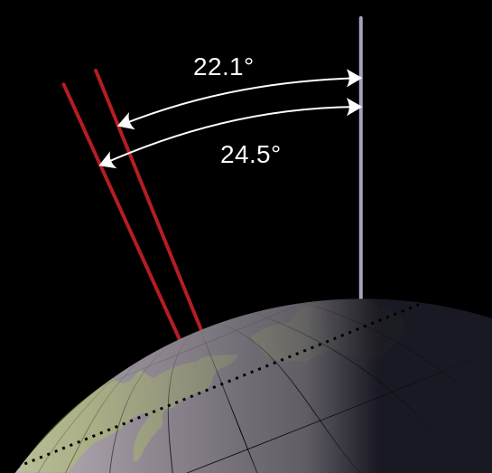
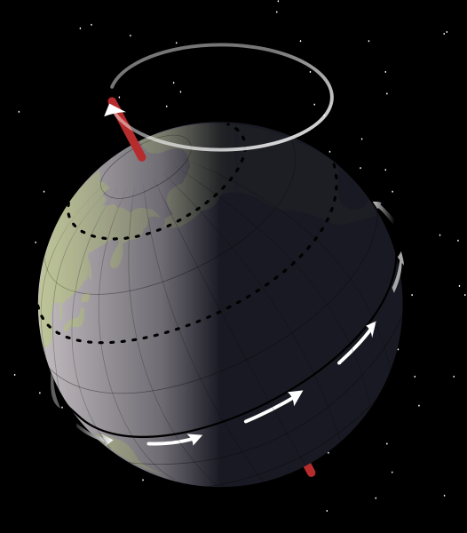
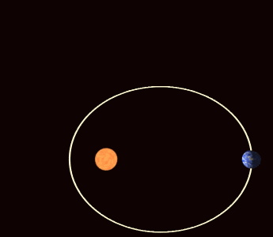
Climate Forcing by Orbital Variations
Milutin Milanković, 1879-1958
Portrait by Paja Jovanović (1859-1957)
Notes:
Right-side figure: S. Rahmstorf/H. J. Schellnhuber:
Der Klimawandel – Diagnose, Prognose, Therapie
2006. 144 S., 7,90 Euro
ISBN 3-406-50866-9
C.H. Beck, München
http://www.pik-potsdam.de/~stefan/klimawandel.html
Also printed in IPCC AR4

