Slide 1
Radiative Transfer Through the Atmosphere
Importance for Climate:
Shortwave Absorption:
  Clouds, H₂O, O₃, some CO₂
Shortwave Reflection:
  Clouds, surface, atmosphere
Longwave Absorption:
  Clouds, H₂O, CO₂, CH₄, N₂O

Slide 2
Program
Black-body radiation
Interaction of radiation with gases
Interaction of radiation with clouds and aerosols

Slide 3
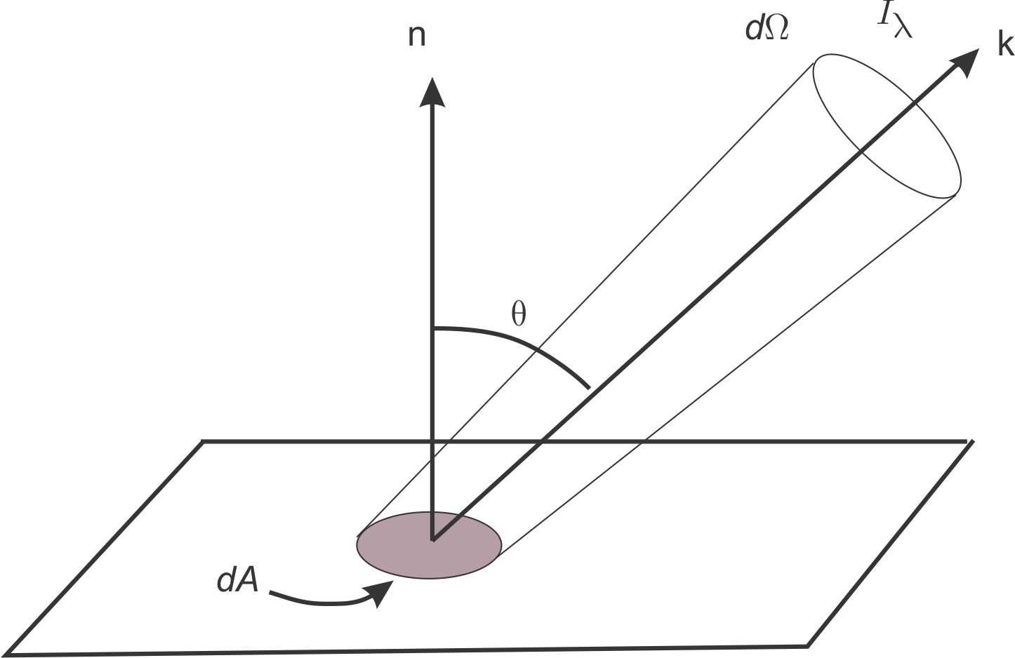
Intensity
Image credit: Kerry Emanuel

Slide 4
Intensity, Flux Density, Total Flux Density, Total Flux
Intensity
Flux density is the normal component of intensity integrated over all solid angles
Total flux density is the flux density integrated over all wavelengths
Total flux is the integral of the total flux density over area and is the radiant power in Watts

Slide 5
Intensity, Flux Density, Total Flux Density, Total Flux
Intensity
Flux density is the normal component of intensity integrated over all solid angles
Total flux density is the flux density integrated over all wavelengths
Total flux is the integral of the total flux density over area and is the radiant power in Watts

Slide 6
Intensity, Flux Density, Total Flux Density, Total Flux
Intensity
Flux density is the normal component of intensity integrated over all solid angles
Total flux density is the flux density integrated over all wavelengths
Total flux is the integral of the total flux density over area and is the radiant power in Watts

Slide 7
Intensity, Flux Density, Total Flux Density, Total Flux
Intensity
Flux density is the normal component of intensity integrated over all solid angles
Total flux density is the flux density integrated over all wavelengths
Total flux is the integral of the total flux density over area and is the radiant power in Watts

Slide 8
Intensity, Flux Density, Total Flux Density, Total Flux
Intensity
Flux density is the normal component of intensity integrated over all solid angles
Total flux density is the flux density integrated over all wavelengths
Total flux is the integral of the total flux density over area and is the radiant power in Watts

Slide 9
Black-body Radiation
Planck’s Law
Based on assumption of local thermodynamic equilibrium
  (Not valid at very high altitudes in atmosphere)

Slide 10
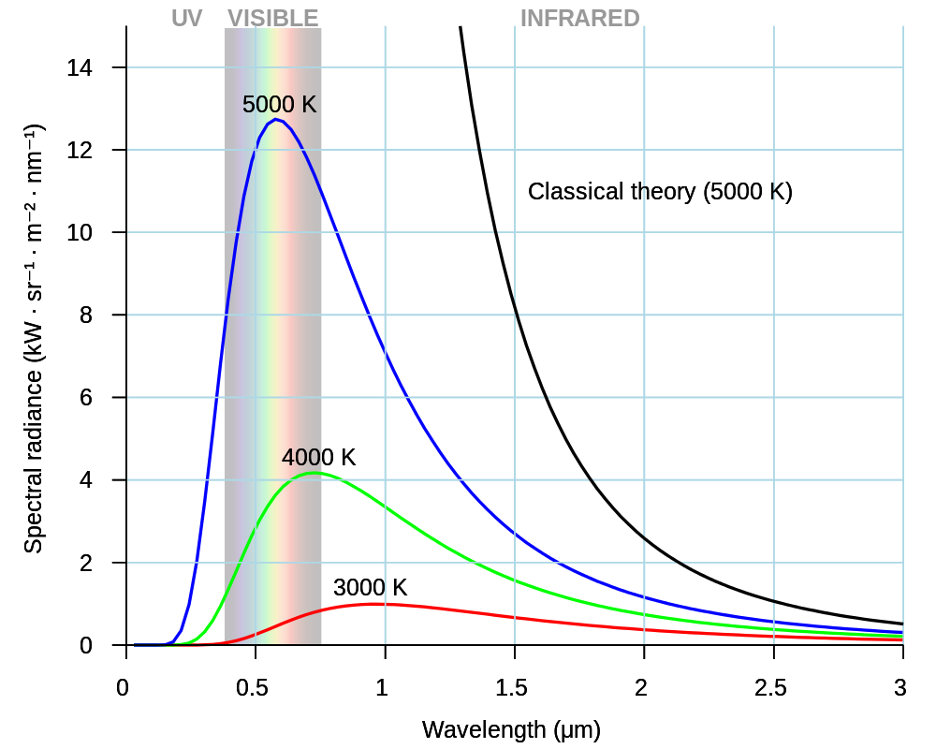
Image credit: Darth Kule
Notes:
Wikimedia commons. “I, the copyright holder of this work, release this work into the public domain. This applies worldwide.In some countries this may not be legally possible; if so: I grant anyone the right to use this work for any purpose, without any conditions, unless such conditions are required by law.”

Slide 11
Wien’s Displacement Law
Wavelength of maximum emission

Slide 12
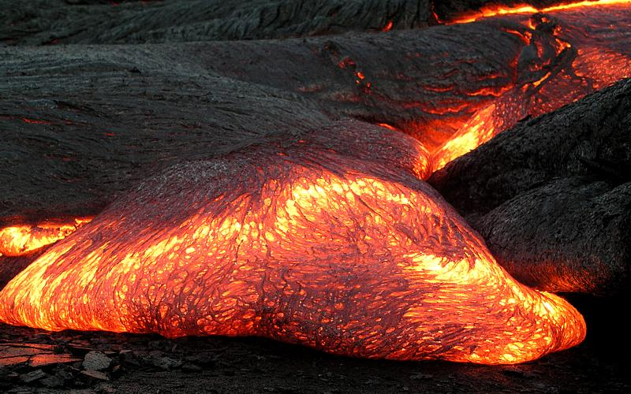
Pāhoehoe Lava, Hawaii
Image credit: Hawaii Volcano Observatory
Notes:
This image is in the public domain because it contains materials that originally came from the United States Geological Survey, an agency of the United States Department of the Interior. For more information, see the official USGS copyright policy.

Slide 13
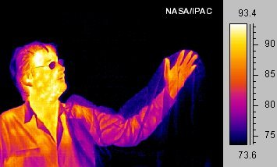
Image credit: NASA/IPAC
Notes:
Wikipedia. This work is in the public domain in the United States because it is a work prepared by an officer or employee of the United States Government as part of that person’s official duties under the terms of Title 17, Chapter 1, Section 105 of the US Code. See Copyright.

Slide 14
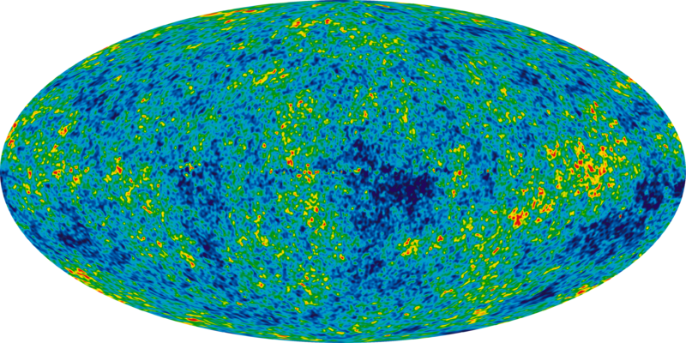
9 year image of background cosmic radiation
Image credit: NASA/WMAP Science Team
Notes:
This file is in the public domain because it was solely created by NASA. NASA copyright policy states that "NASA material is not protected by copyright unless noted". (

Slide 15
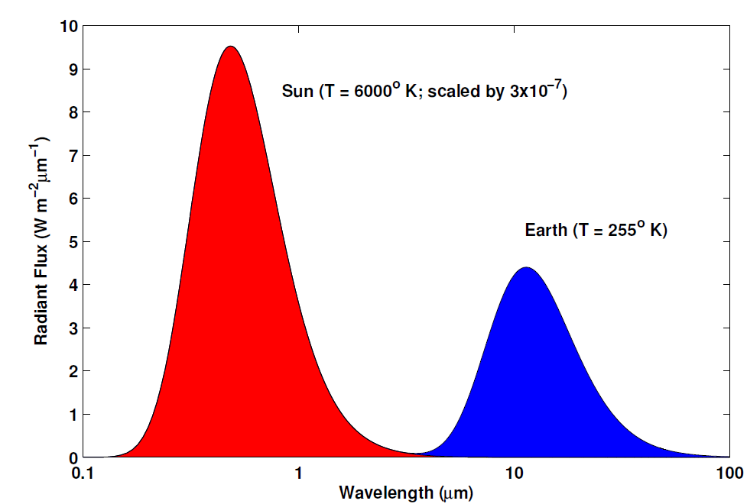
Comparison of Black-body Curves of Earth and Sun
Image credit: Kerry Emanuel

Slide 16
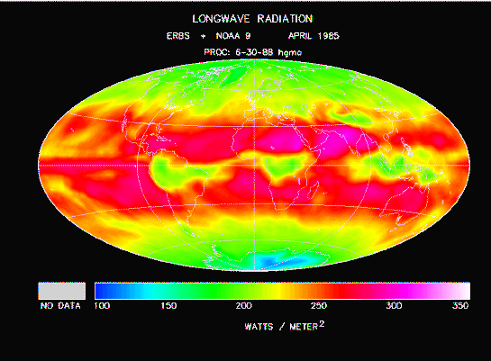
Image credit: NASA

Slide 17
The Stefan-Boltzmann Law is the integral of the Planck function over all frequencies and all angles in a hemisphere:

Slide 18
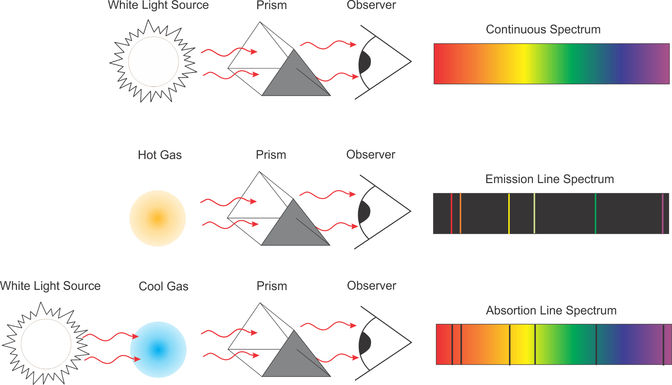
Emission and Absorption Spectra
Image source: Kerry Emanuel

Slide 19
Emission and Absorption Spectra
Image source: Kerry Emanuel

Slide 20
Emission and Absorption Spectra
Image source: Kerry Emanuel

Slide 21
Absorption and Emission in a Gas

Slide 22
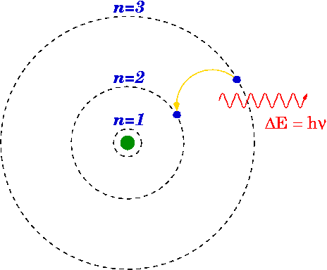
Electronic Transitions
Electric transition in the quantum energy states of an atom resulting in the emission of a photon
Image credit: Willow, Wikipedia
Notes:
Permission is granted to copy, distribute and/or modify this document under the terms of the GNU Free Documentation License, Version 1.2 or any later version published by the Free Software Foundation; with no Invariant Sections, no Front-Cover Texts, and no Back-Cover Texts. A copy of the license is included in the section entitled GNU Free Documentation License.
http://commons.wikimedia.org/wiki/File:Bohr_model_Balmer_32.png

Slide 23
Electronic Transitions
An isolated atom can absorb only those photons whose energy is equal to the difference between two atomic energy levels. Mostly involves ultraviolet and visible parts of solar spectrum.
Molecules have additional energy levels:

Slide 24
Rotational and Vibrational Transitions
Simple homonuclear diatomic molecule (e.g. N₂, O₂):
No electric dipole moment (difference between center of mass and center of charge):
No interaction with electromagnetic radiation
Image credit: Kerry Emanuel

Slide 25
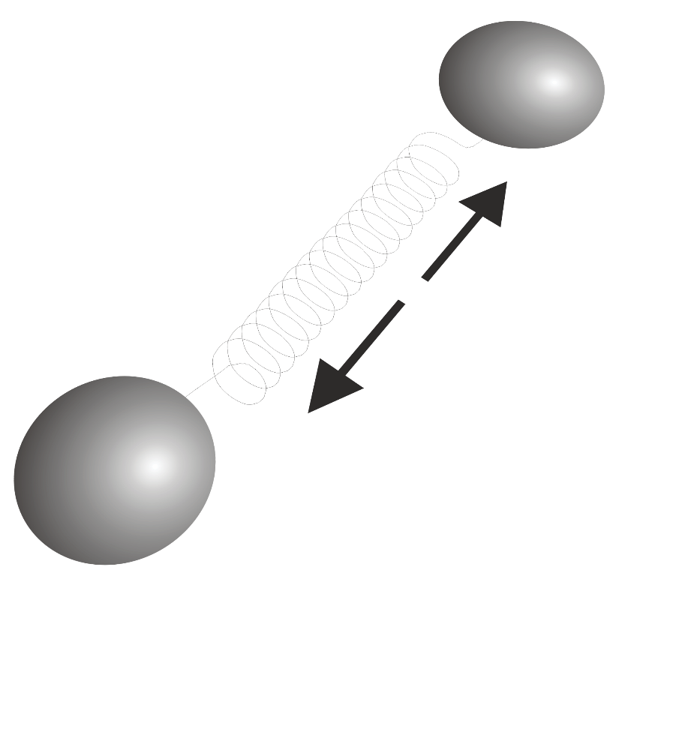
Rotational and Vibrational Transitions
Heteronuclear diatomic molecule (e.g. CO):
Electric dipole moment, rotational modes
Image credit: Kerry Emanuel

Slide 26
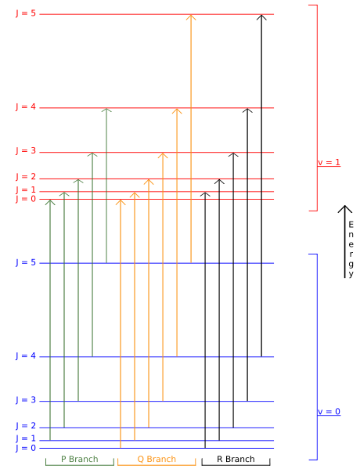
Energy level diagram for rotational-vibrational transitions
Image credit: David-i98, Wikipedia
Notes:
This work has been released into the public domain by its author, David-i98 at the wikipedia project. This applies worldwide.
In case this is not legally possible:
David-i98 grants anyone the right to use this work for any purpose, without any conditions, unless such conditions are required by law.
http://en.wikipedia.org/wiki/File:Vibrationrotationenergy.svg

Slide 27
Polyatomic Molecules
3N-6 vibrational modes and numerous rotational and rotational-vibrational modes
Image credit: Kerry Emanuel

Slide 28
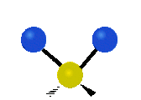
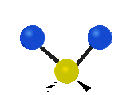
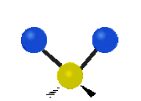
The three fundamental modes of a water molecule
ν₁,O-H symmetric stretching
3657 cm⁻¹ (2.734 μm)
ν₂, H-O-H bending
1595 cm⁻¹ (6.269 μm)
ν₃, O-H asymmetric stretching
3756 cm⁻¹ (2.662 μm)
Image credit: Tiago Becerra Paolini, Wikipedia
Notes:
http://en.wikipedia.org/wiki/File:Symmetrical_stretching.gif
I, the copyright holder of this work, release this work into the public domain. This applies worldwide.
In some countries this may not be legally possible; if so:
I grant anyone the right to use this work for any purpose, without any conditions, unless such conditions are required by law.

Slide 29
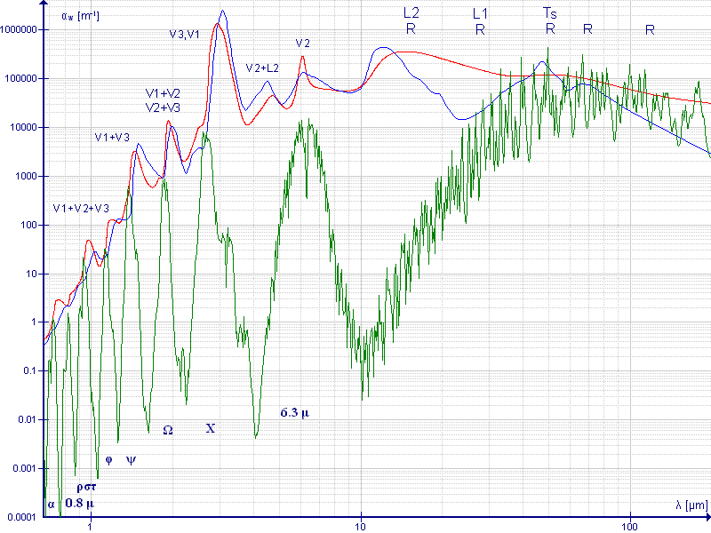
Water infrared absorption coefficient
Liquid
Ice
Absorption
Vapor
Wavelength
Image credit: Darekk2, Wikipedia
Notes:
http://en.wikipedia.org/wiki/File:Water_infrared_absorption_coefficient_large.gif
This file is licensed under the Creative Commons Attribution-Share Alike 3.0 Unported license. You are free: to share – to copy, distribute and transmit the work
to remix – to adapt the work
Under the following conditions: attribution – You must attribute the work in the manner specified by the author or licensor (but not in any way that suggests that they endorse you or your use of the work).
share alike – If you alter, transform, or build upon this work, you may distribute the resulting work only under the same or similar license to this one.

Slide 30
Kirchoff’s Law
Absorptivity = Emissivity

Slide 31
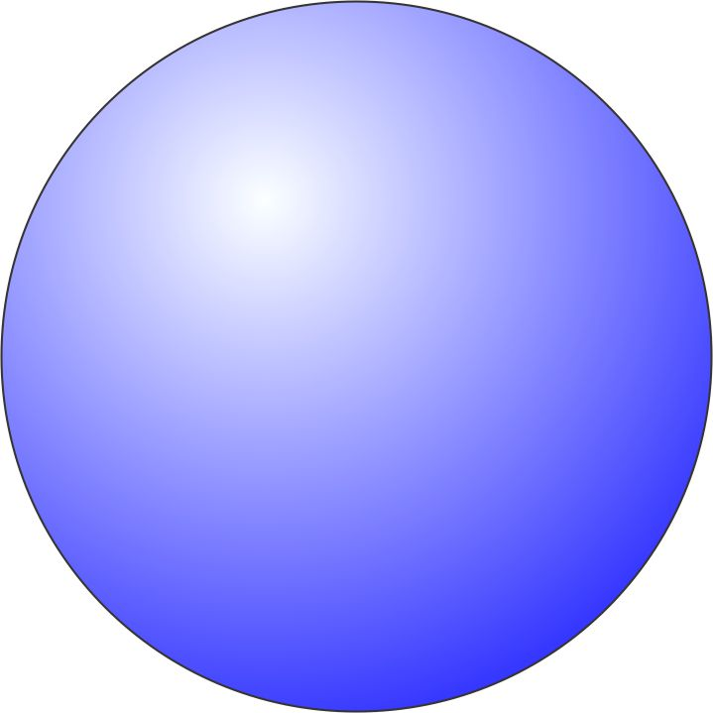
For molecules in a gas:
Translational energy is the kinetic energy of molecular motions in a gas, proportional to the gas temperature. Not quantized.
Molecules in a gas can absorb more frequencies than isolated atoms.
Collisions between molecules can carry away energy or supply energy to interactions between matter and photons.

Slide 32
Natural, Pressure and Doppler Broadening
Natural broadening: Heisenberg’s uncertainty principle places a lower bound on actual line width
Doppler broadening: Caused by the fact that the velocity of atoms or molecules relative to the observer follows a Maxwell Distribution, so the effect is dependent on temperature. Produces a Gaussian line shape.
Pressure broadening: Collisions between molecules affect absorption and emission. This effect depends on mostly on pressure, which is proportional to the rate of collisions. The broadening effect is described by a Lorentzian profile in most cases
There are other broadening mechanisms, but they are less important in our atmosphere

Slide 33
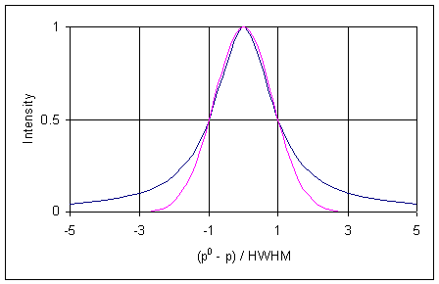
Doppler and Pressure Broadening
Lorentzian
Gaussian
Image credit: Petergans, Wikipedia
Notes:
http://en.wikipedia.org/wiki/File:Gauss_and_Lorentz_lineshapes.png
I, the copyright holder of this work, release this work into the public domain. This applies worldwide.
In some countries this may not be legally possible; if so:
I grant anyone the right to use this work for any purpose, without any conditions, unless such conditions are required by law.

Slide 34
Principal Atmospheric Absorbers
H₂O: Bent triatomic, with permanent dipole moment and pure rotational bands as well as rotation-vibration transitions
O₃: Like water, but also involved in photodissociation
CO₂: No permanent dipole moment, so no pure rotational transitions, but temporary dipole during vibrational transitions
Other gases: N₂O, CH₄

Slide 35
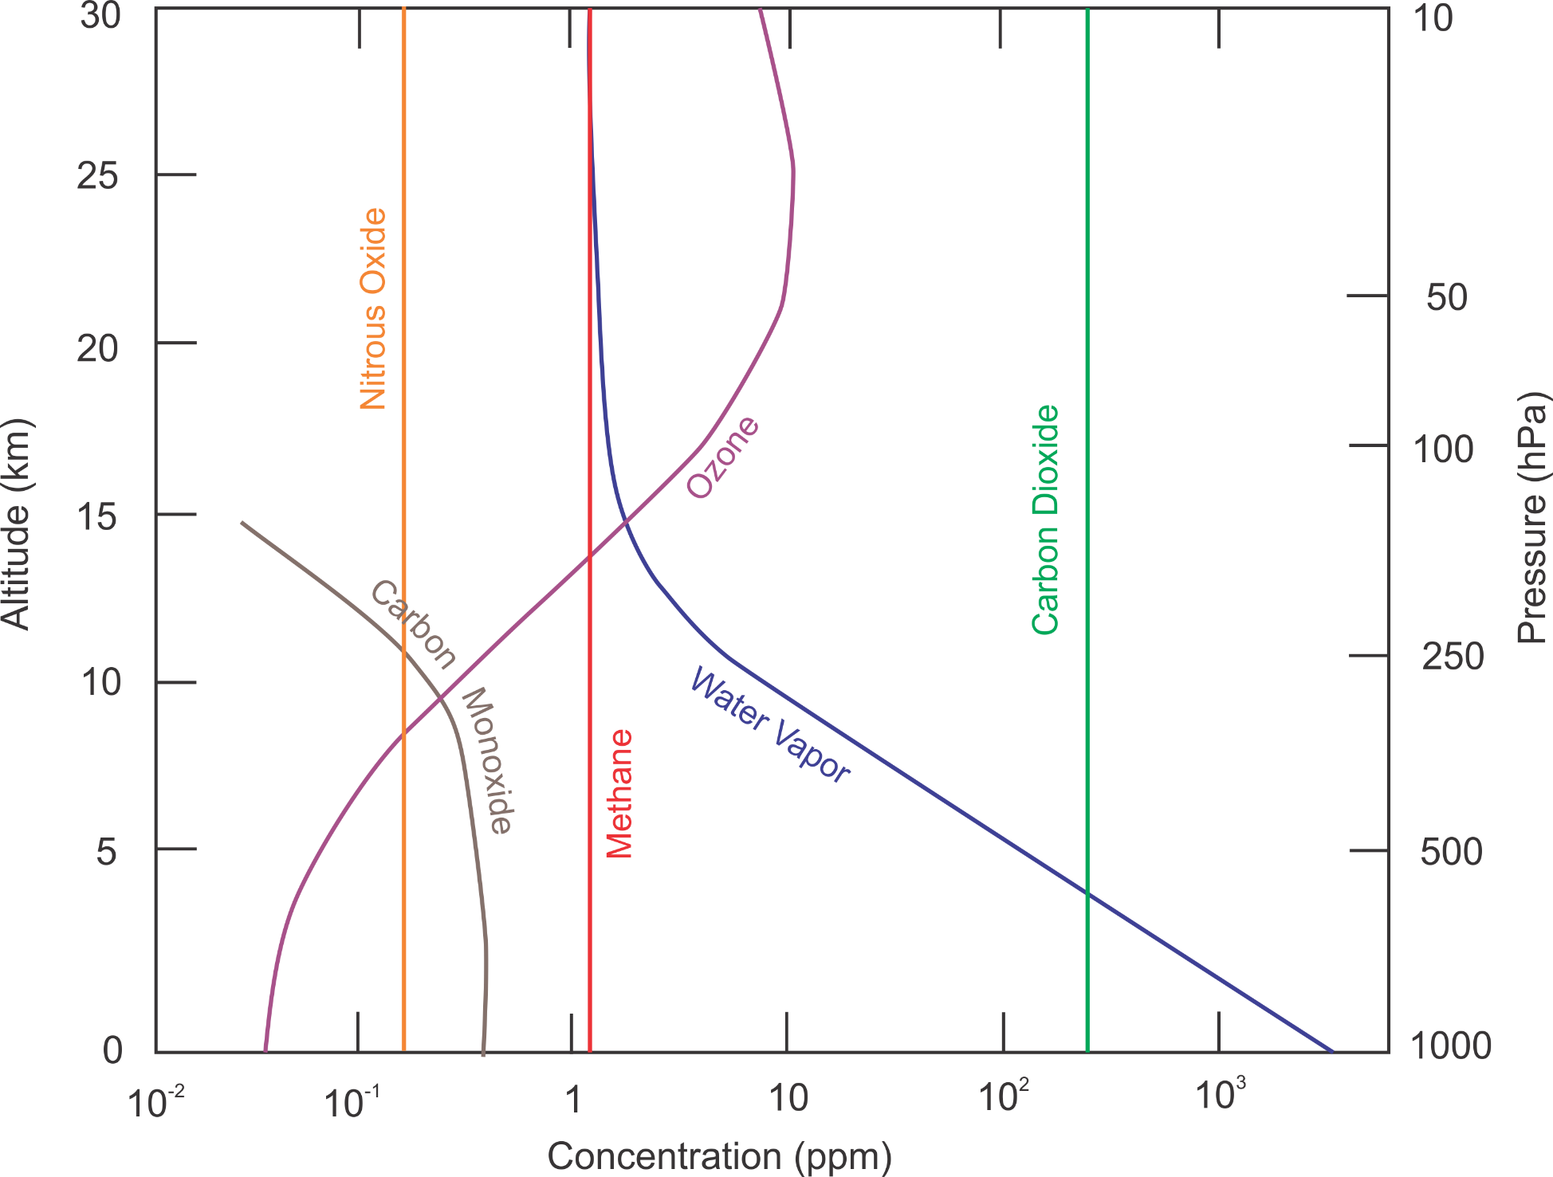
Image credit: Kerry Emanuel

Slide 36
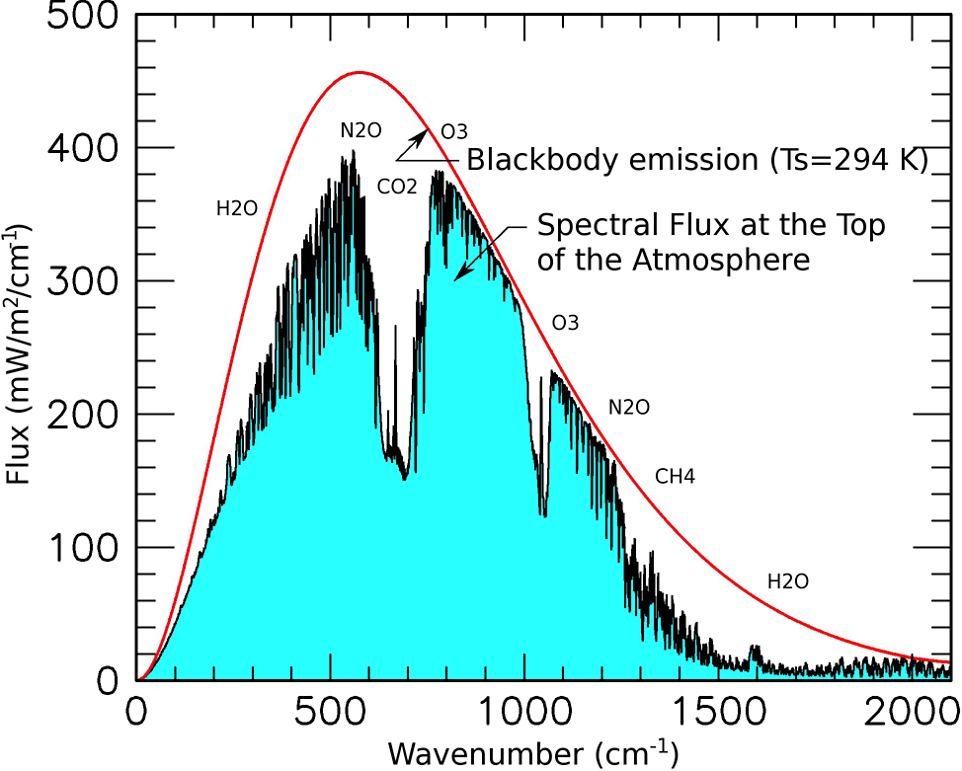
Image credit: NASA
Notes:
http://www.giss.nasa.gov/research/briefs/schmidt_05/

Slide 37
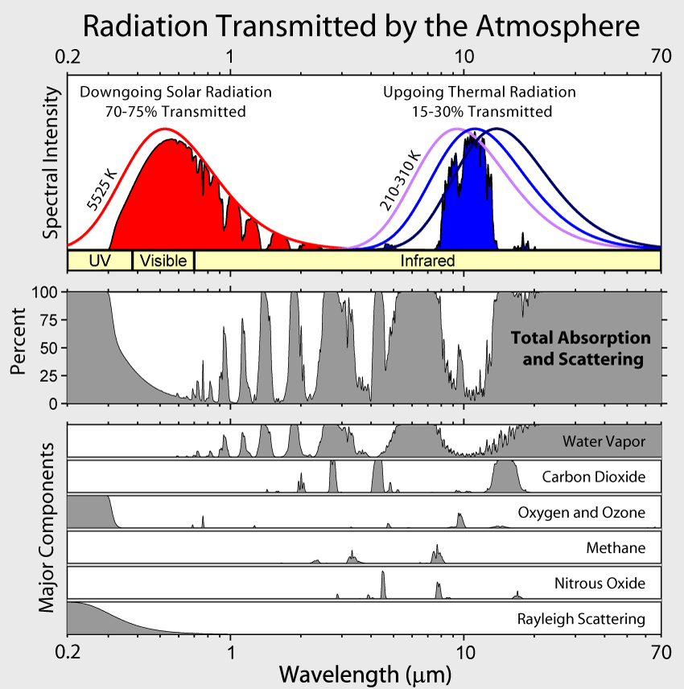
Image credit: Robert A. Rohde, Wikipedia
Notes:
http://en.wikipedia.org/wiki/File:Atmospheric_Transmission.png

Slide 38
Mean Surface Temperature in the Absence of Greenhouse Gases
Solar constant
Effective emission temperature
Planetary albedo

Slide 39
Effective emission temperatures of three planets

Slide 40
Aerosols, Clouds and Radiation
Scattering
Absorption and Emission

Slide 41
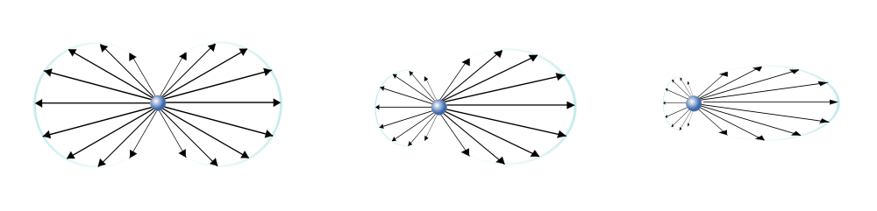
Types of Scattering
Direction of Incident Radiation
Rayleigh Scattering
Mie Scattering,
Small Particles
Mie Scattering,
Large Particles
Less wavelength dependence
Image credit: Sharayanan, Wikipedia
Notes:
http://commons.wikimedia.org/wiki/File:Mie_scattering.svg
This file is licensed under the Creative Commons Attribution-Share Alike 3.0 Unported license. You are free: to share – to copy, distribute and transmit the work
to remix – to adapt the work
Under the following conditions: attribution – You must attribute the work in the manner specified by the author or licensor (but not in any way that suggests that they endorse you or your use of the work).
share alike – If you alter, transform, or build upon this work, you may distribute the resulting work only under the same or similar license to this one.

Slide 42
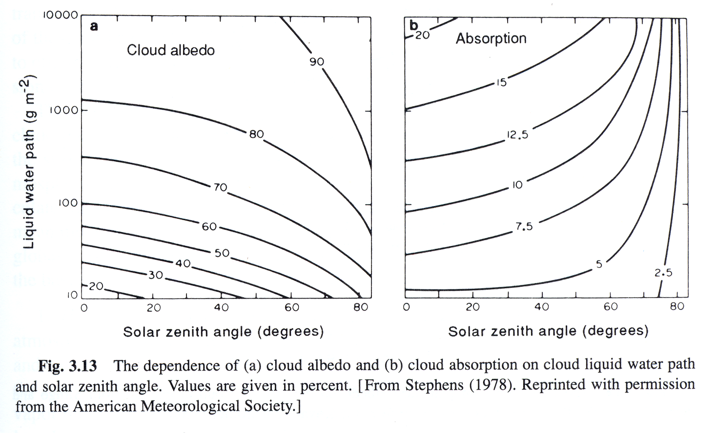
Image credit: Stephens, G.L., 1978: Radiation profiles in extended water clouds. J. Atmos. Sci., 35, 2123-2132

Slide 43
Cloud and Aerosol Effects
Air: Rayleigh scattering principally of shorter wavelengths (blue and ultraviolet)
Aerosols: Mostly Mie scattering; some absorption depending on composition
Cloud droplets and ice crystals: Mie scattering and absorption
Rain drops: Geometric optics in visible spectrum (rainbows)

Slide 44
Elements of the Greenhouse Effect
from IPCC AR4
Notes:
Full citation follows this format – note Cambridge U Press.
Climate Change 2007: The Physical Science Basis. Working Group I Contribution to the Fourth Assessment Report of the Intergovernmental Panel on Climate Change, Figure X.Y. Cambridge University Press. Used with permission.

