Slide 1
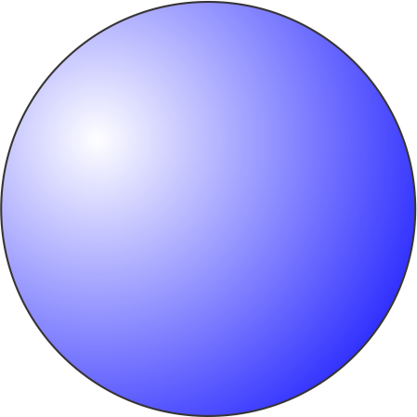
Radiative Equilibrium
Equilibrium state of atmosphere and surface in the absence of non-radiative enthalpy fluxes
Radiative heating drives actual state toward state of radiative equilibrium

Slide 2
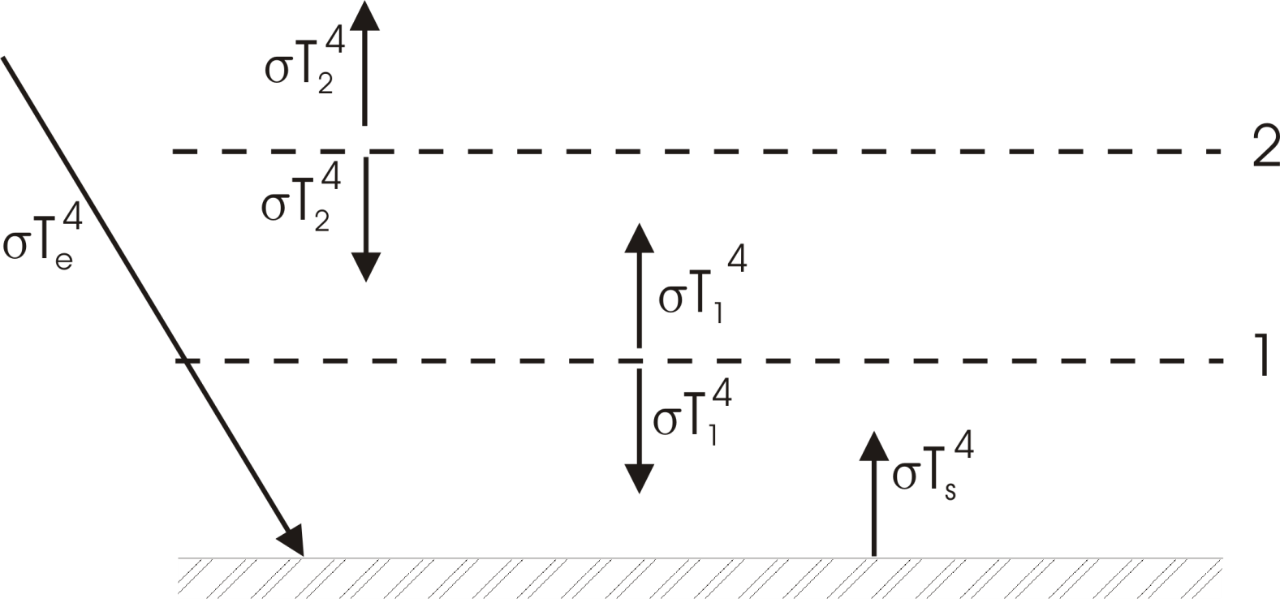
Extended Layer Models

Slide 3
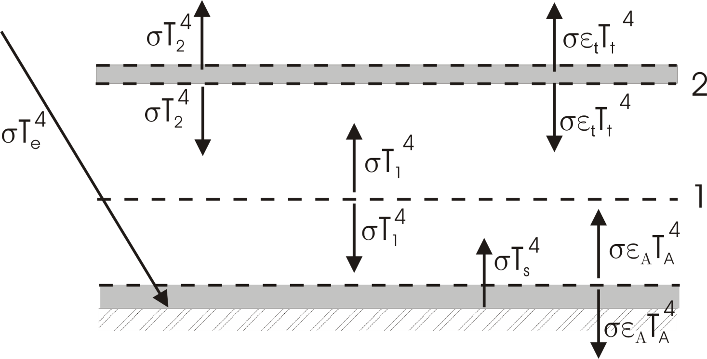
Effects of emissivity<1

Slide 4
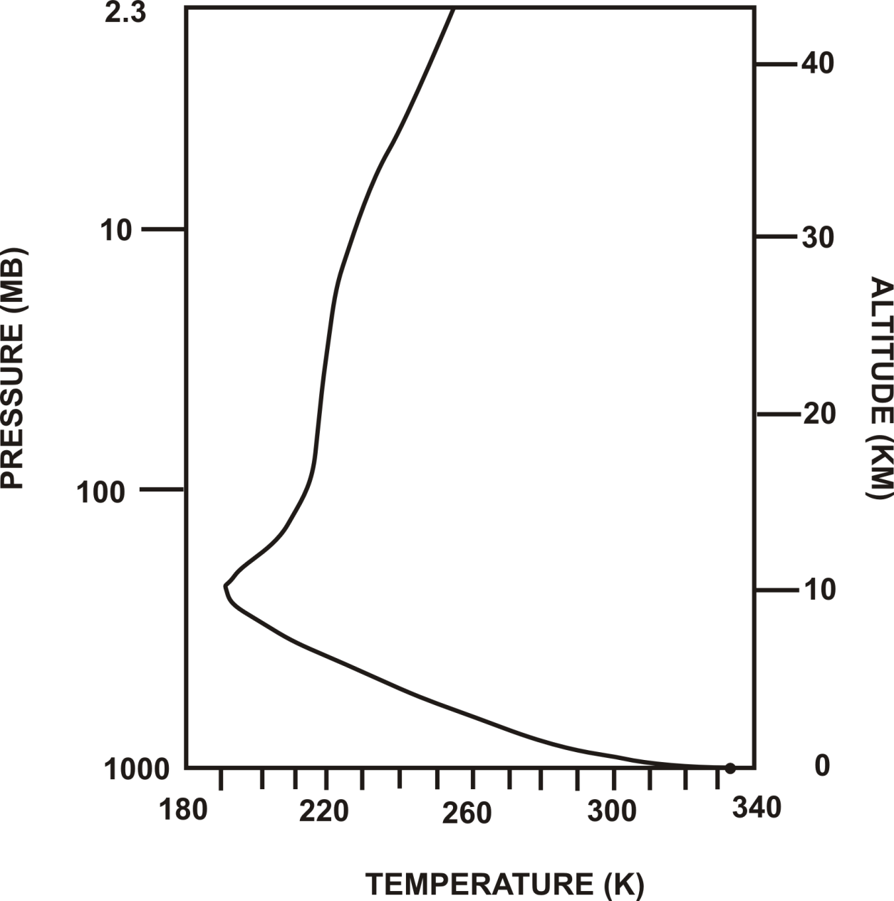
Full calculation of radiative equilibrium

Slide 5
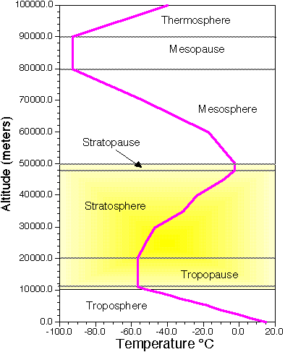

Slide 6
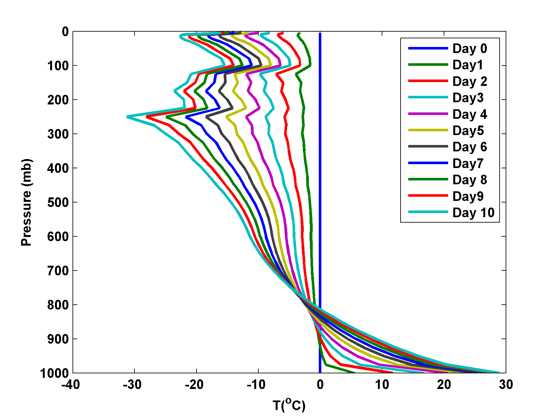
Time scale of approach to equilibrium

Slide 7
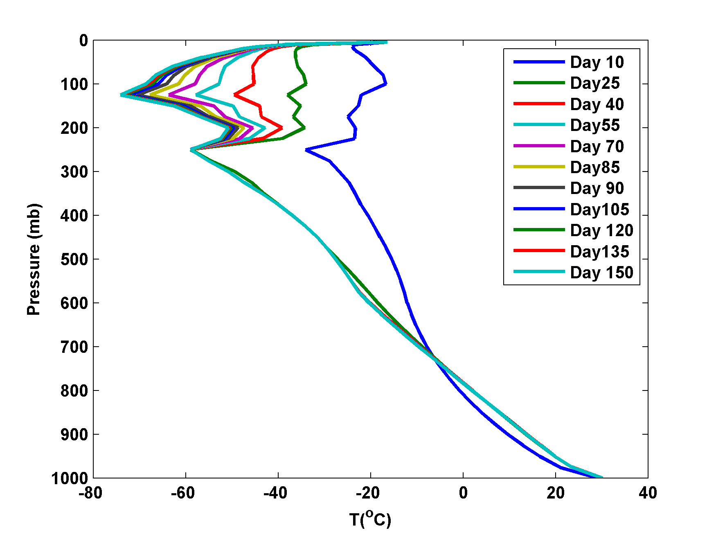

Slide 8
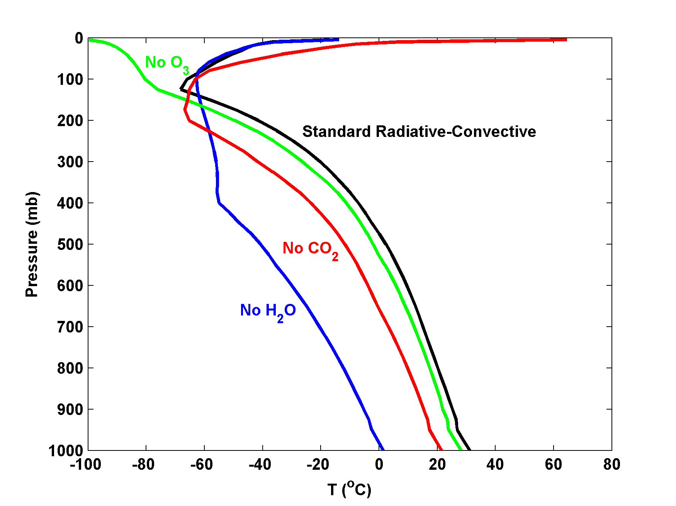
Contributions of various absorbers
Note: All simulations have variable clouds interacting with radiation

Slide 9
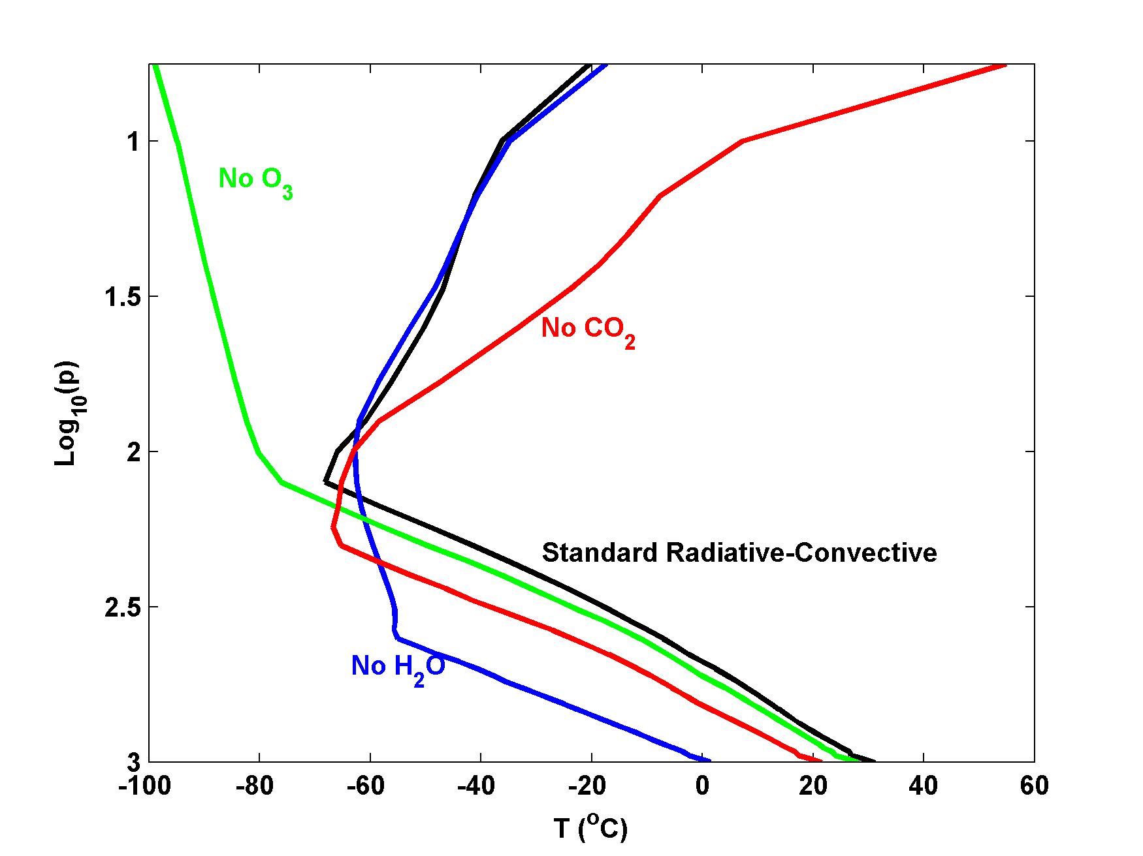

Slide 10
Full calculation of radiative equilibrium

Slide 11
Problems with radiative equilibrium solution
Too hot at and near surface
Too cold at a near tropopause
Lapse rate of temperature too large in the troposphere
(But stratosphere temperature close to observed)

Slide 12
Missing ingredient: Convection
As important as radiation in transporting enthalpy in the vertical
Also controls distribution of water vapor and clouds, the two most important constituents in radiative transfer

Slide 13
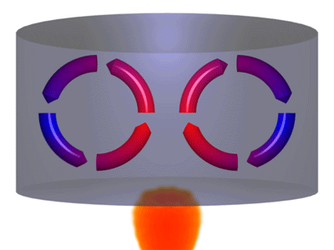

Slide 14
When is a fluid unstable to convection?
Pressure and hydrostatic equilibrium
Buoyancy
Stability

Slide 15
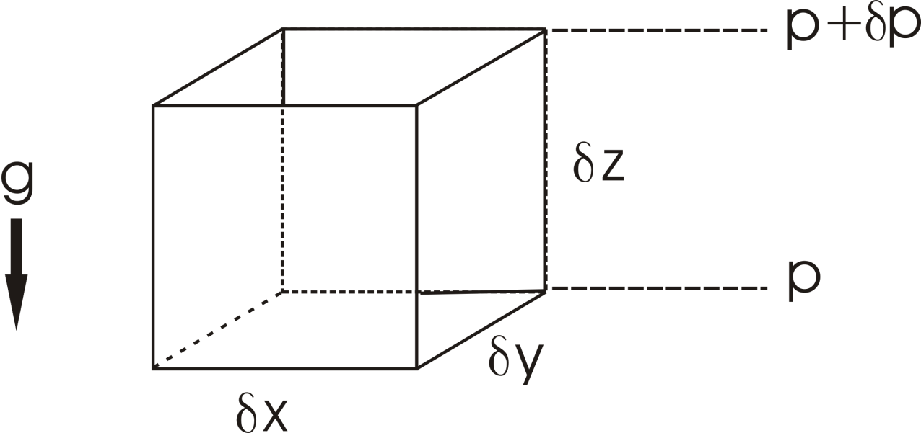
Hydrostatic equilibrium

Slide 16
Pressure distribution in atmosphere at rest
Earth: H~ 8 Km

Slide 17
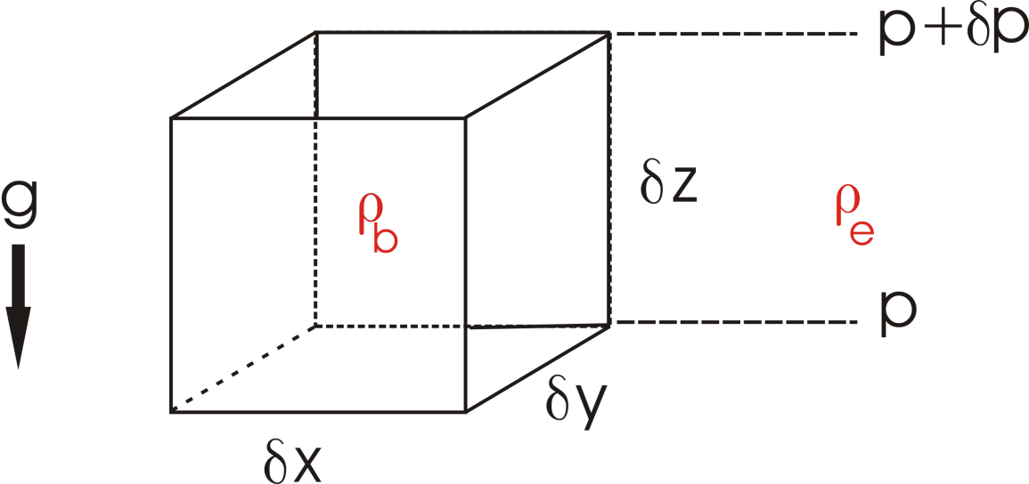
Buoyancy

Slide 18
Buoyancy and Entropy
Specific Volume:
Specific Entropy: s

Slide 19
The adiabatic lapse rate

Slide 20
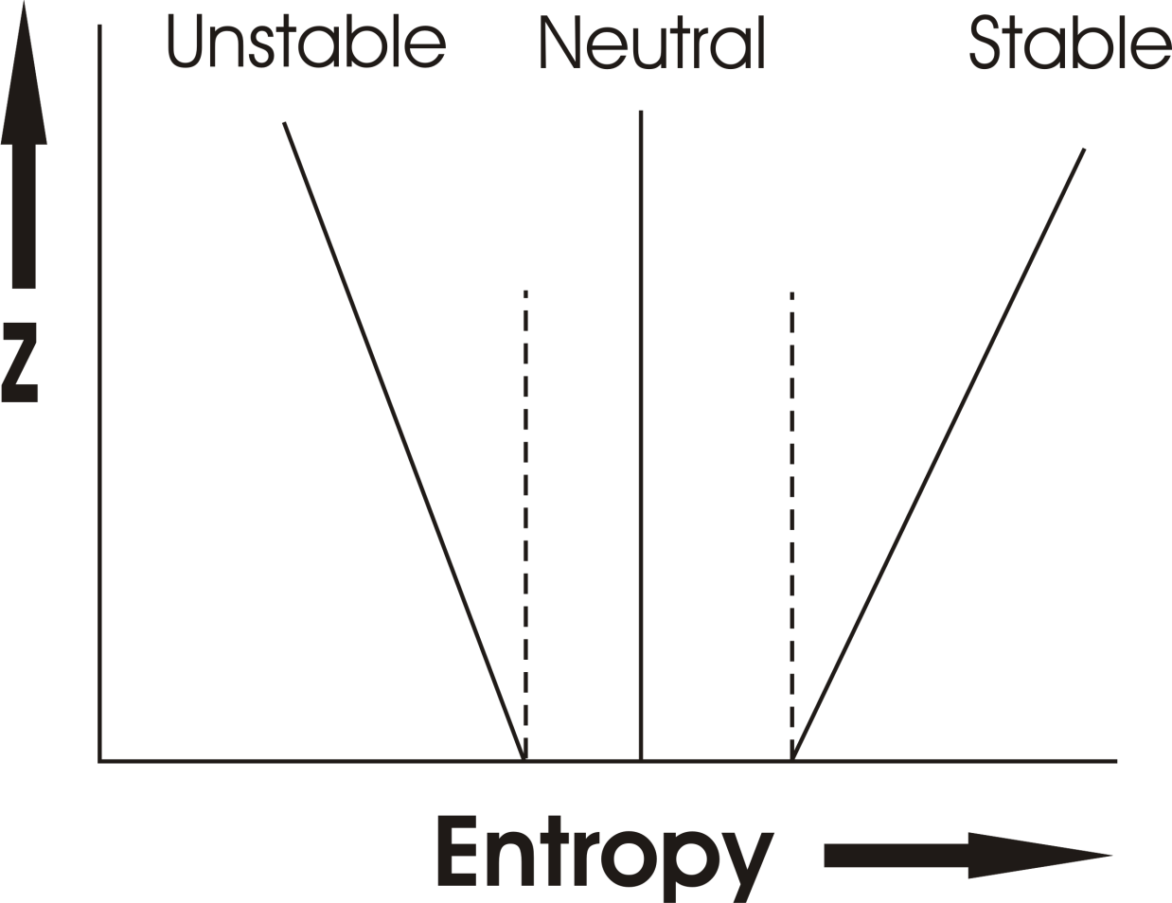
Earth’s atmosphere:

Slide 21
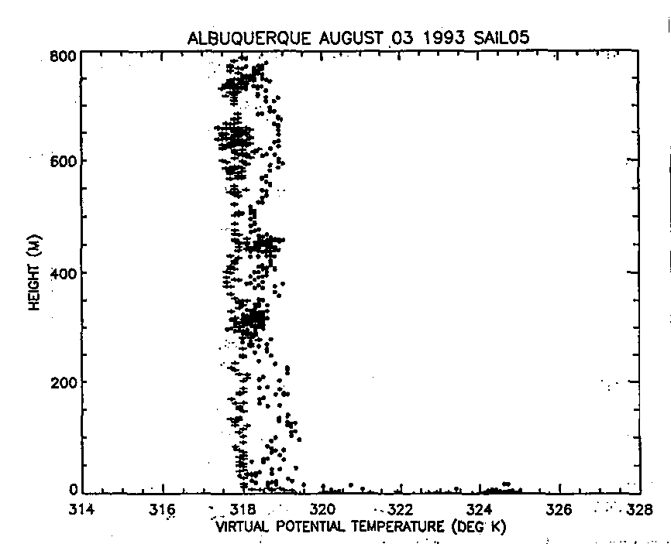
Model Aircraft Measurements
(Renno and Williams, 1995)

Slide 22
Radiative equilibrium is unstable in the troposphere
Re-calculate equilibrium assuming that tropospheric stability is rendered neutral by convection:
Radiative-Convective Equilibrium

Slide 23
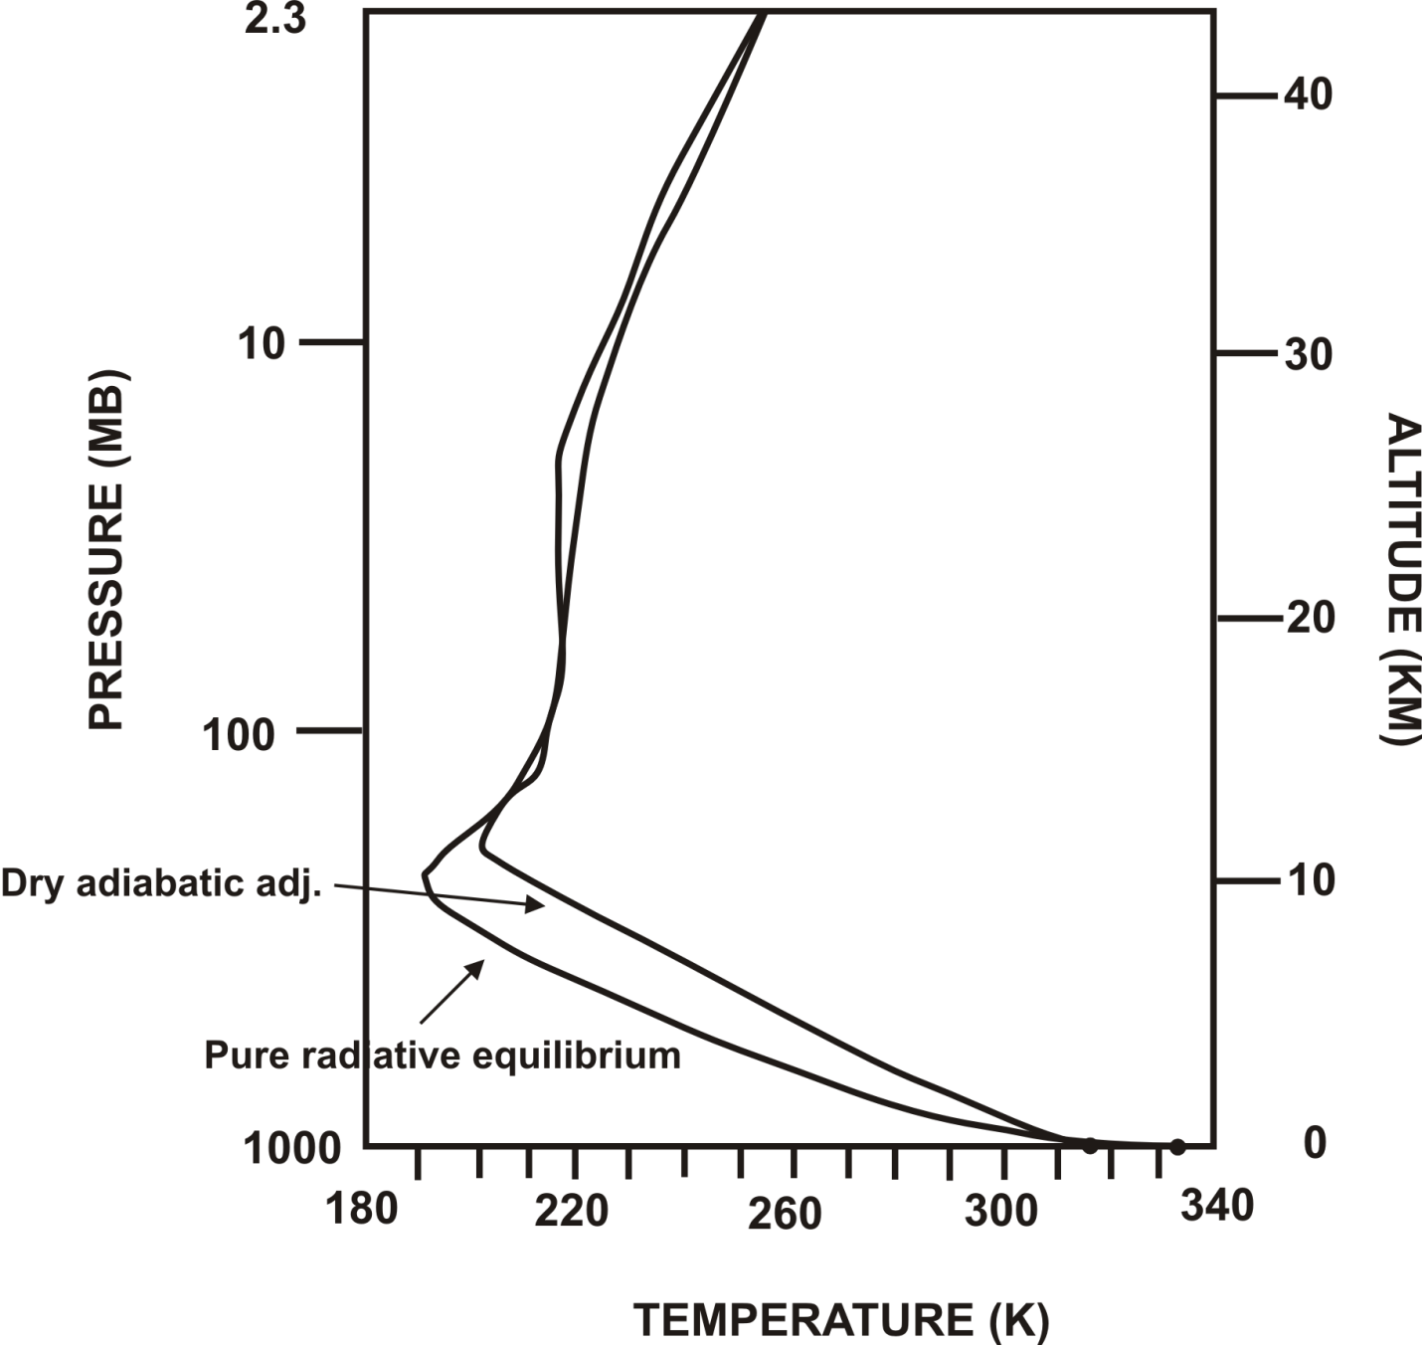
Better, but still too hot at surface, too cold at tropopause

Slide 24
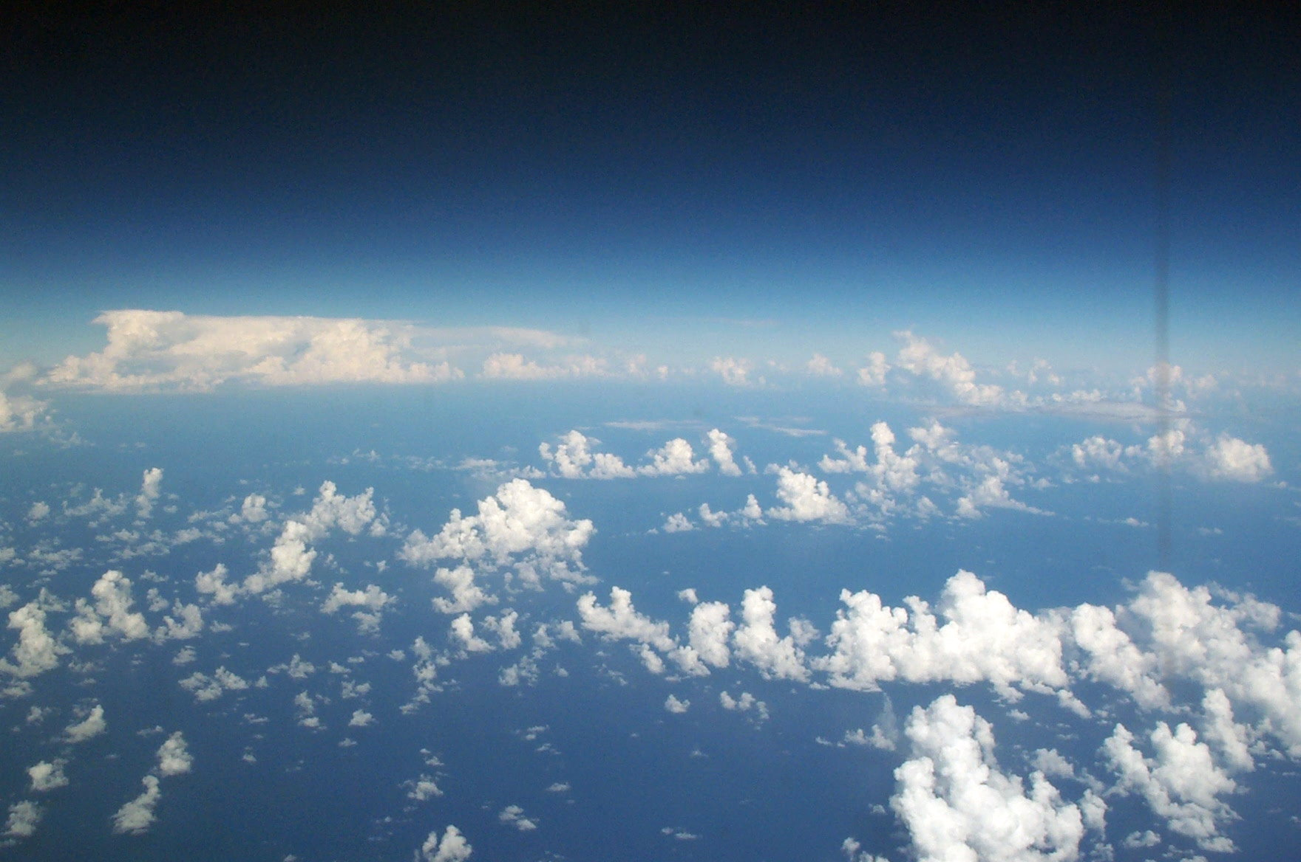
Above a thin boundary layer, most atmospheric convection involves phase change of water:
Moist Convection

Slide 25
Moist Convection
Significant heating owing to phase changes of water
Redistribution of water vapor – most important greenhouse gas
Significant contributor to stratiform cloudiness – albedo and longwave trapping

Slide 26
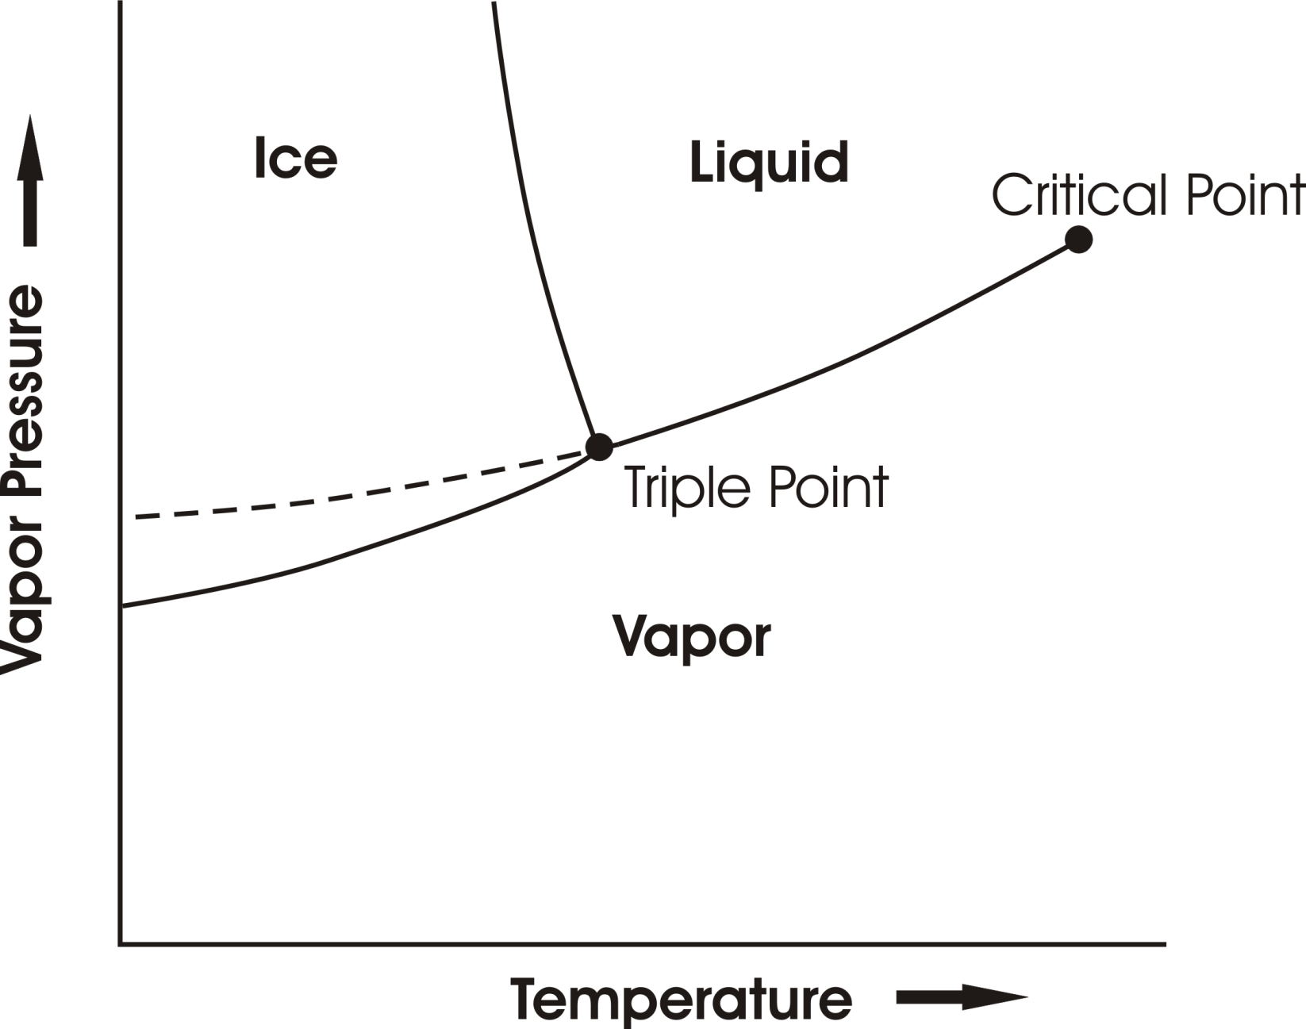
Phase Equilibria

Slide 27
When Saturation Occurs…
Heterogeneous Nucleation
Supersaturations very small in atmosphere
Drop size distribution sensitive to size distribution of cloud condensation nuclei

Slide 28
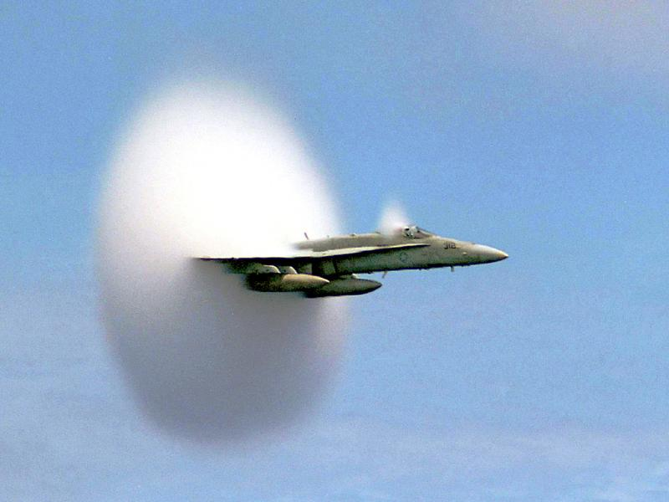

Slide 29
Precipitation Formation
Stochastic coalescence (sensitive to drop size distributions)
Bergeron-Findeisen Process
Strongly nonlinear function of cloud water concentration
Time scale of precipitation formation ~10-30 minutes

Slide 30
Stability
No simple criterion based on entropy. But air inside ascending cumulus turrets has roughly the same density as that of it environment. It can be shown that neutral stability corresponds to the constancy of the saturation entropy s*:

Slide 31
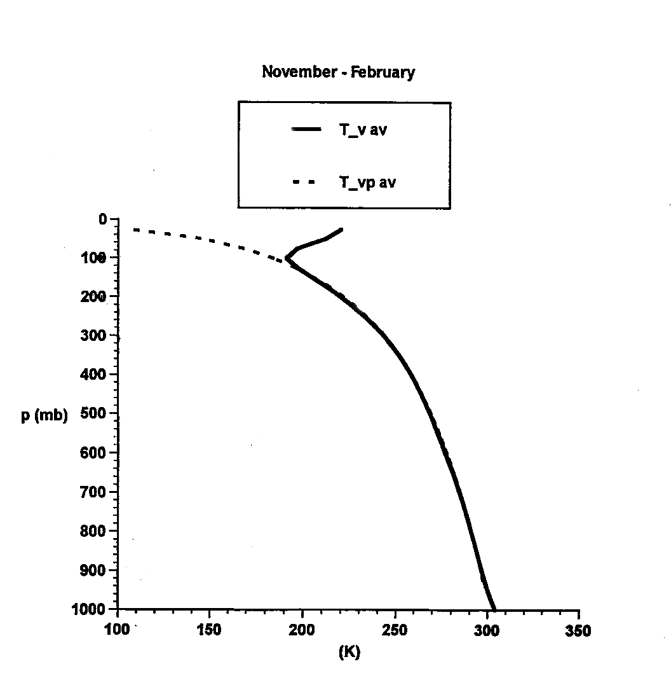
Tropical Soundings

Slide 32
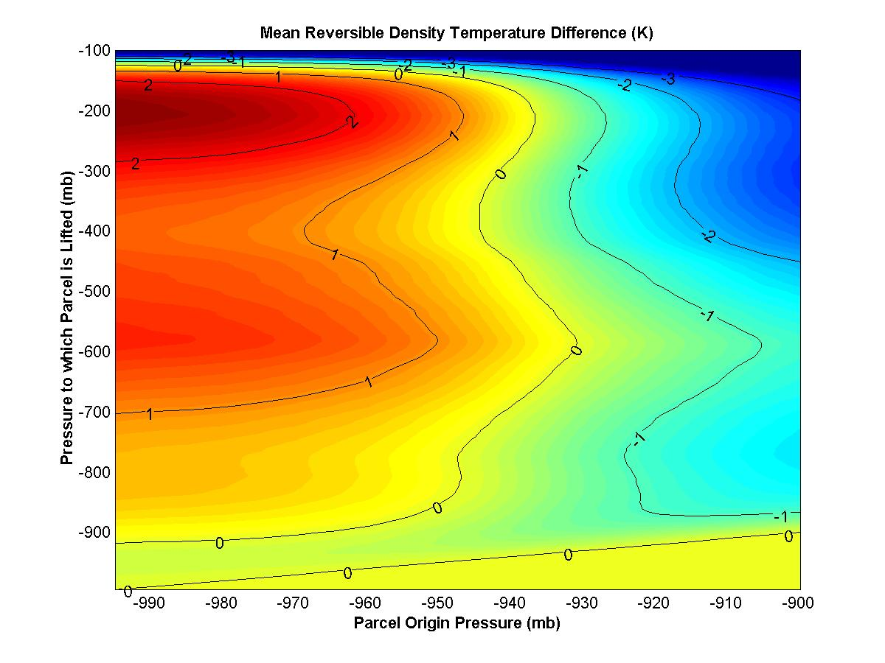
Average density difference between reversibly lifted parcels and their environments, deep Tropics

Slide 33
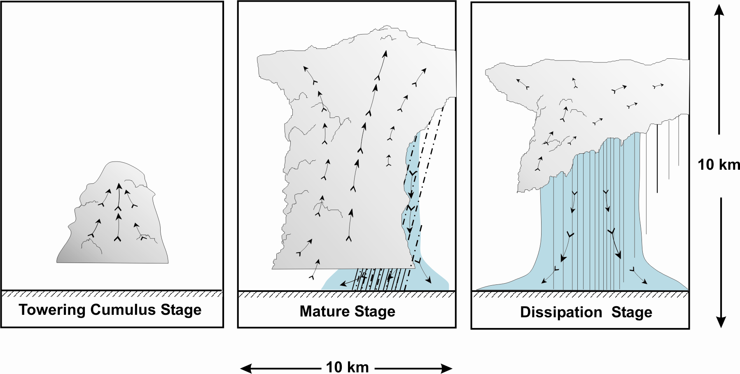
“Air-Mass” Showers:

Slide 34
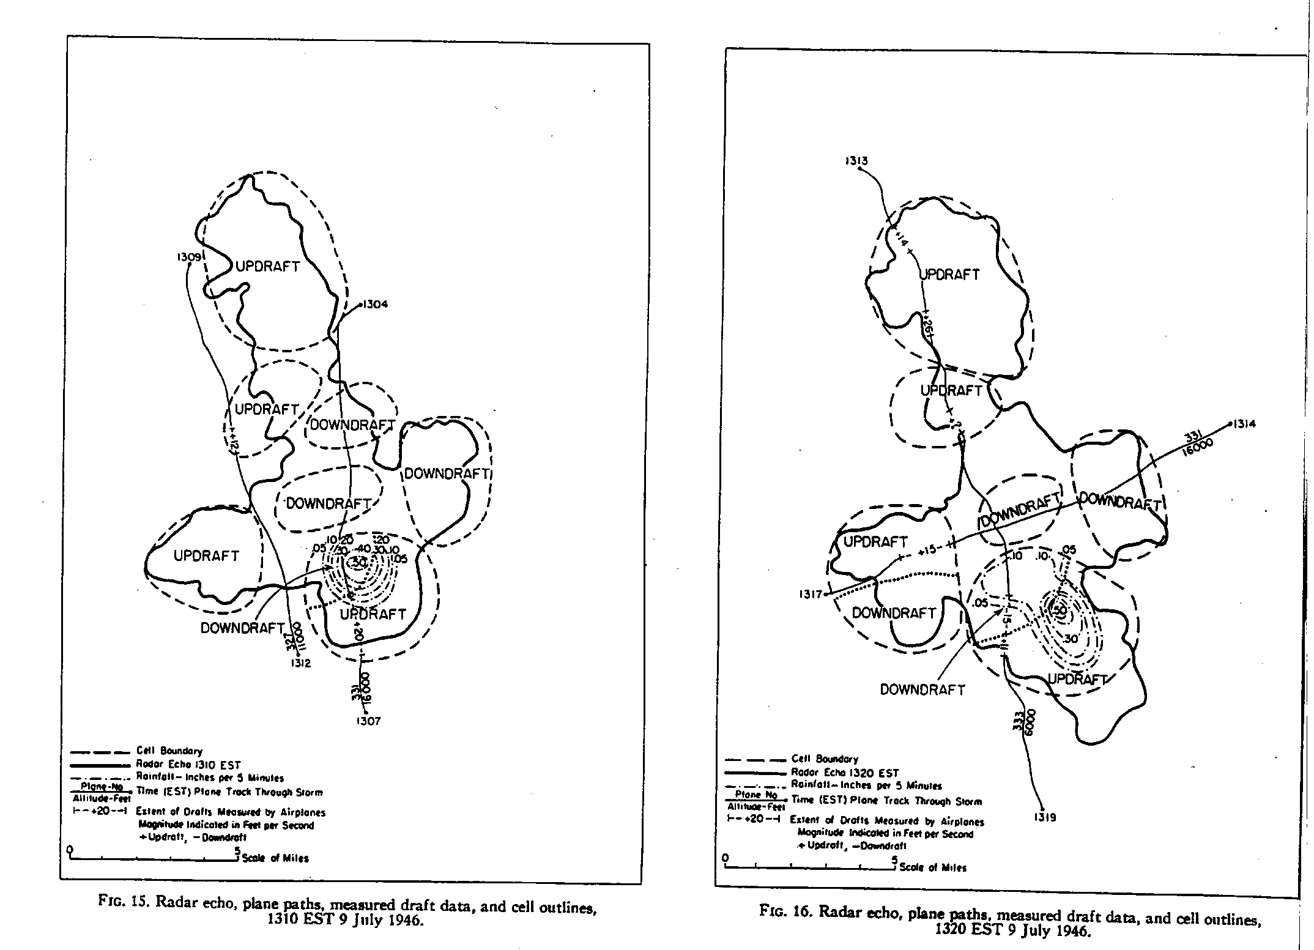

Slide 35
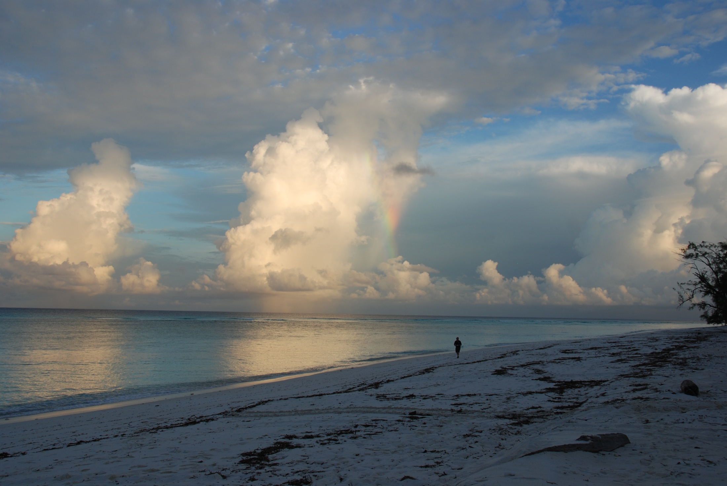

Slide 36
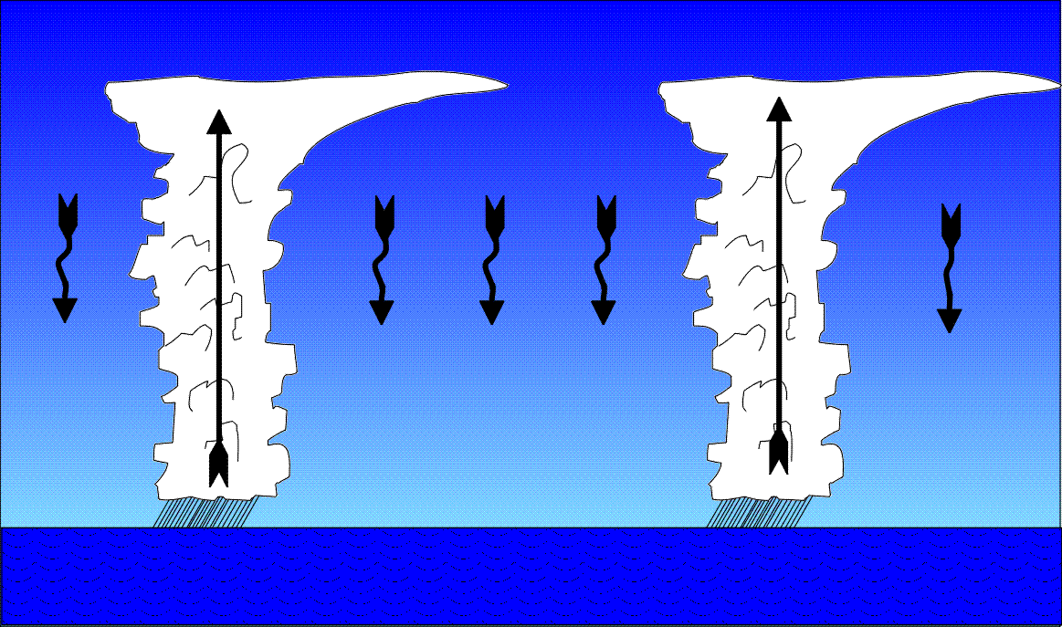
Precipitating Convection favors Widely Spaced Clouds (Bjerknes, 1938)

Slide 38
Properties of Moist Convection
Convective updrafts widely spaced
Surface enthalpy flux equal to vertically integrated radiative cooling
Precipitation = Evaporation = Radiative Cooling
Radiation and convection highly interactive

Slide 39
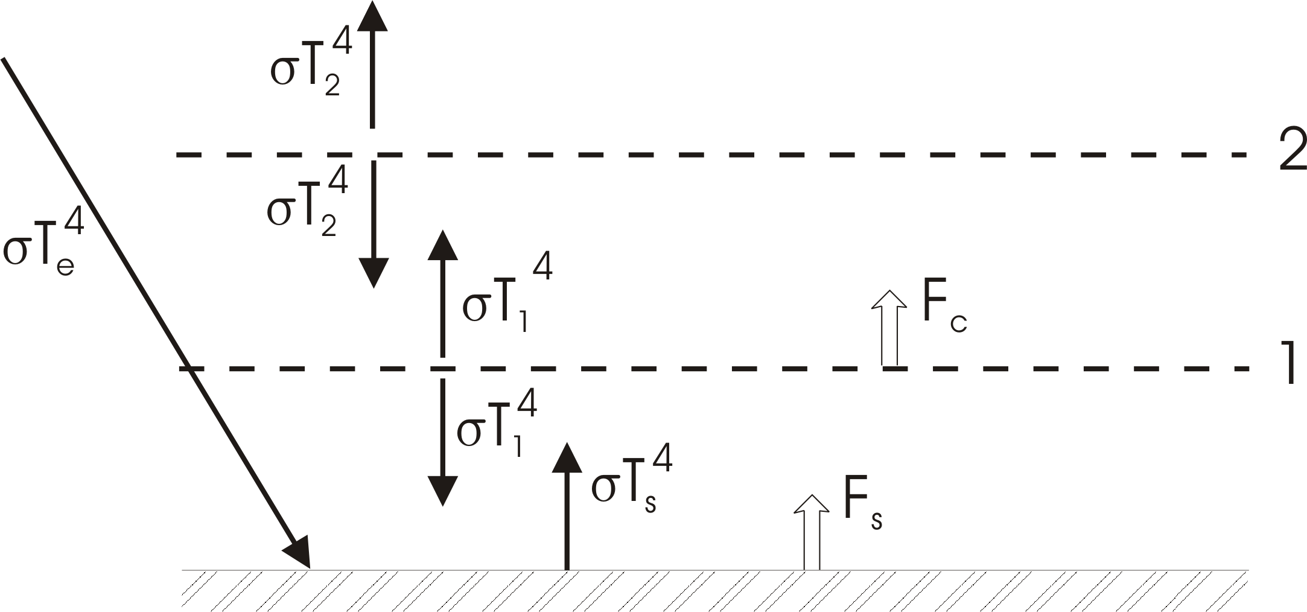
Simple Radiative-Convective Model
Enforce convective neutrality:

Slide 40
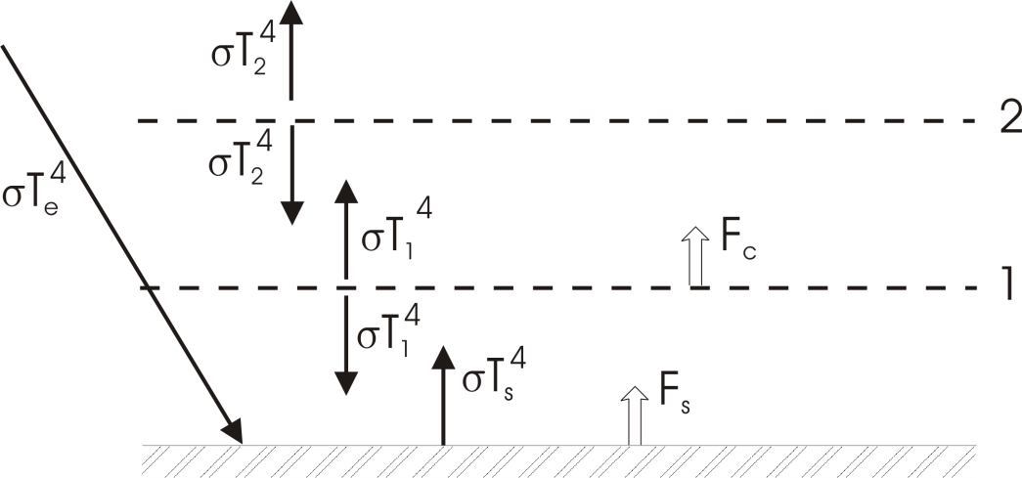

Slide 41
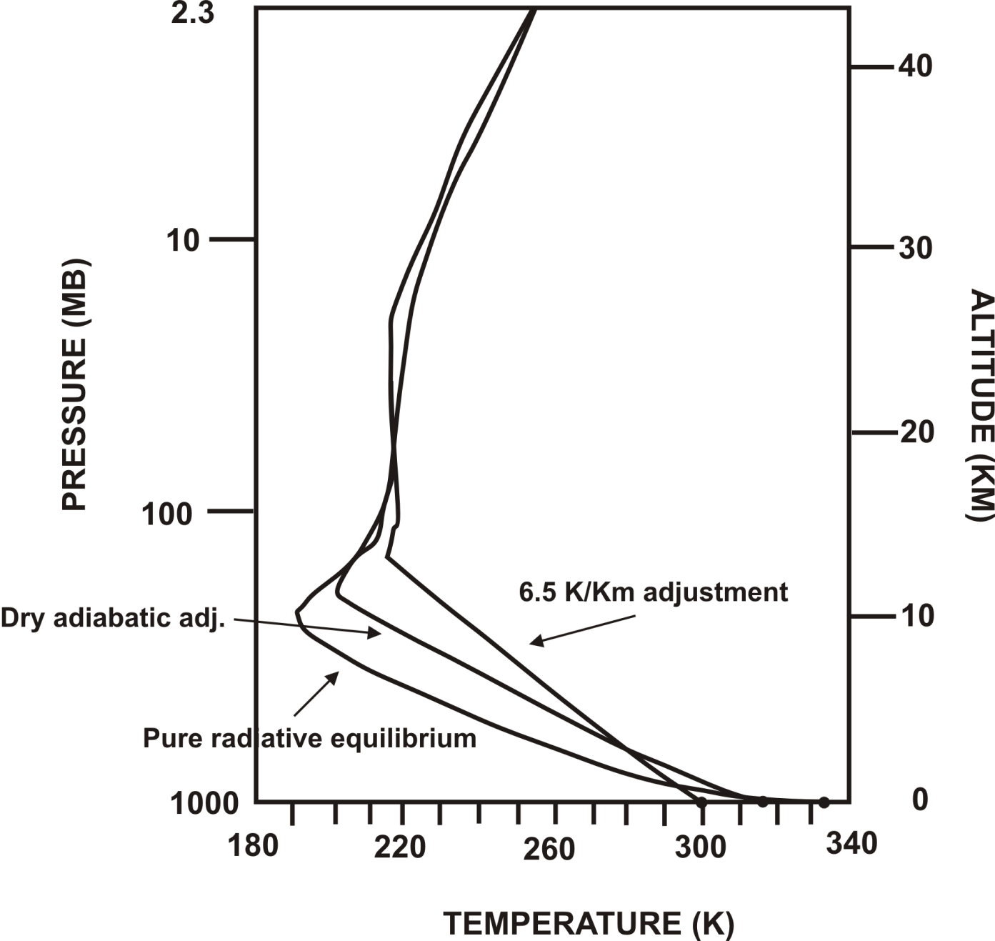
Manabe and Strickler 1964 calculation:

Slide 42
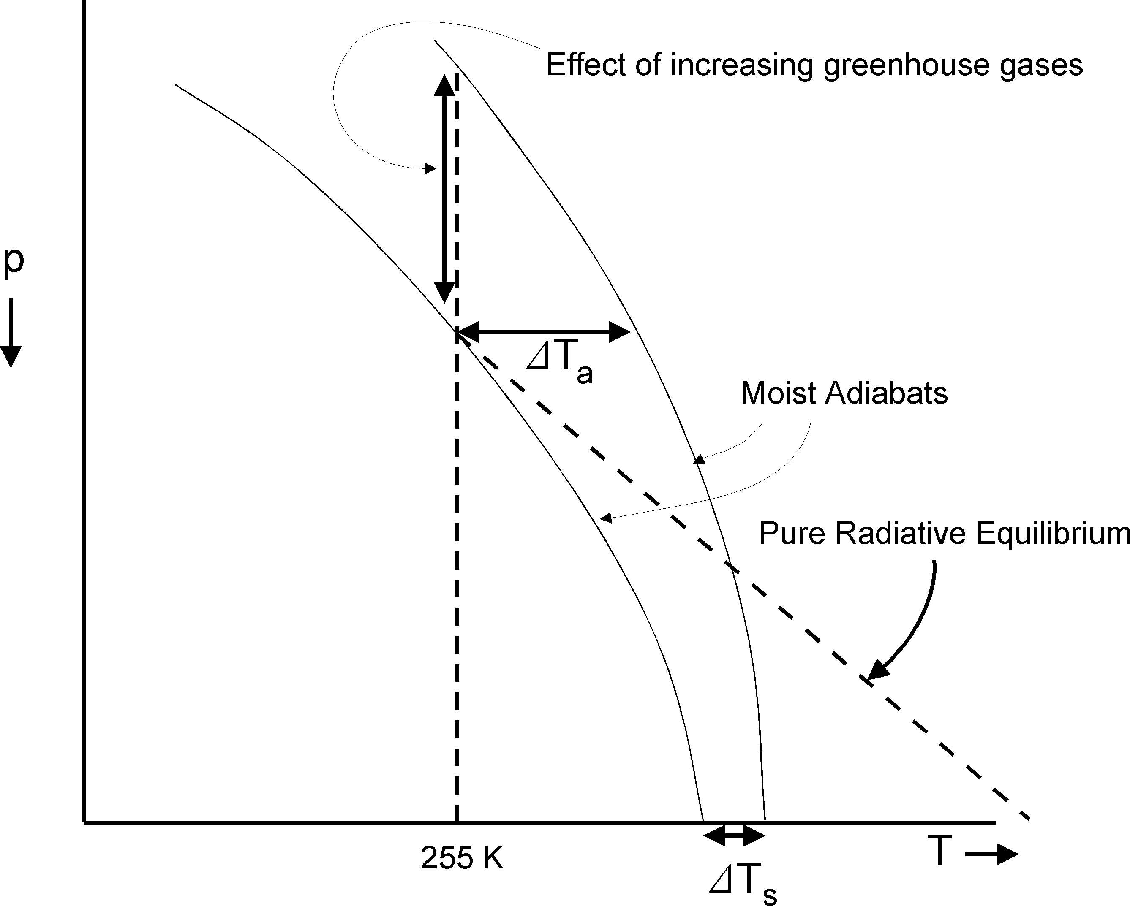
Effect of Moist Convective Adjustment on Climate Sensitivity

Slide 43
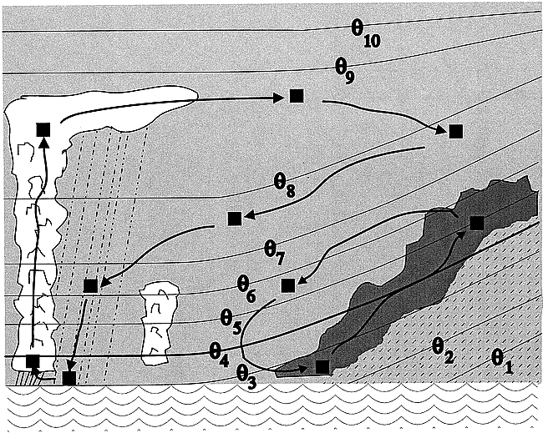
Flux of water by convection makes real problem complex

Slide 44
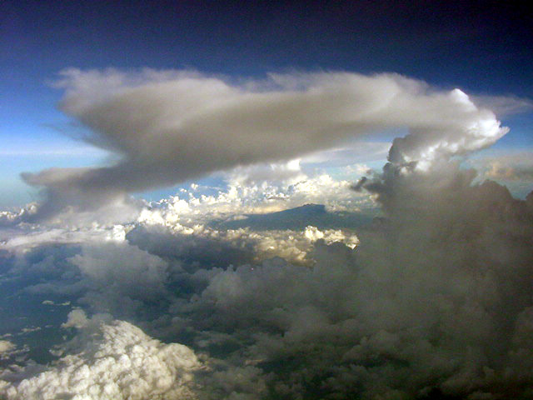

Slide 45
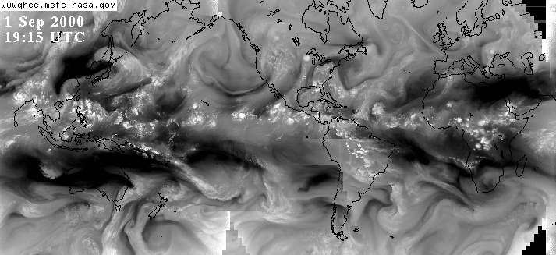

Slide 46
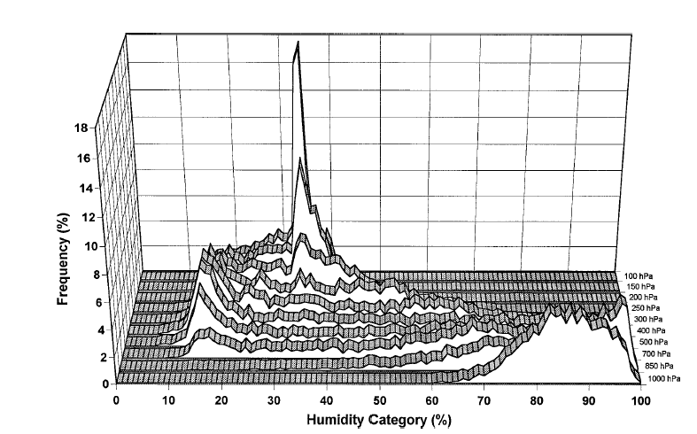
Frequency histogram of rawindsonde relative humidities from 1600 ascents at the tropical Pacific islands of Yap, Koror, Ponape and Majuro, January-May, 1994-95. Spencer and Braswell, Bull. Amer. Meteor. Soc., 1997.

Slide 47
Effects of Clouds on Radiative Transfer
Responsible for much of Earth’s albedo
Important greenhouse effect from longwave absorption and re-emission

Slide 48
Globally Averaged Energy Balance

Slide 49
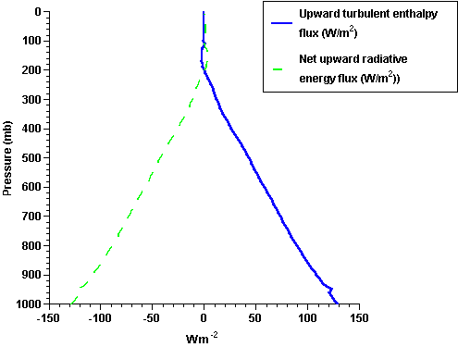

Slide 51
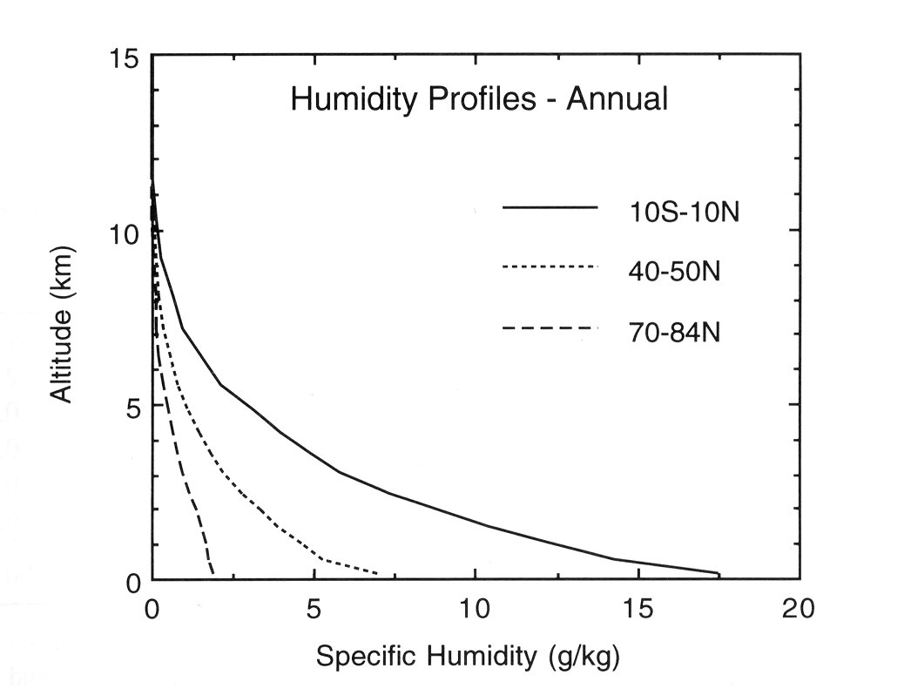

Slide 52
Radiative-Convective Model
Band-averaged radiation
Radiation interacts with H₂0, CO₂, O₃, clouds
Two-stream approximation: radiation assumed to travel vertically
Moist convection whenever instability exists
Convection transports H₂0, enthalpy
Representation of layered clouds

Slide 53
Open MATLAB
Type “run_model”
1) Restart from last run? [n]
2) Interactive radiation? [y]
3) Interactive clouds? [y]
4) Interactive surface temp? [n]
5) Time-dependent radiation? [n]
6) Date-dependent radiation? [n]
7) Diurnal-average radiation? [n]
8) Annual-average radiation? [y]
9) Surface albedo [0.32]
10) Amount of CO2 [360 ppm]
11) End time of integration [100 days]
12) Graphics averaging time [1 days]
13) Frequency of radiation calls [3 hours]
14) Frequency of graphics output [2 hours]
0) Run model with current configuration.

Slide 54
Suggested Experiments
Annual cycle: Average results over 365 days, run for 5x365=1825 days; repeat with double CO₂. Allow interactive surface temperature
Do same but without interactive clouds
Same as first bullet above, but test sensitivity to surface albedo
Same as above, but without interactive clouds

