Slide 1
PART 1

Slide 2
Paleoclimate
12.340x Global Warming Science

Slide 3
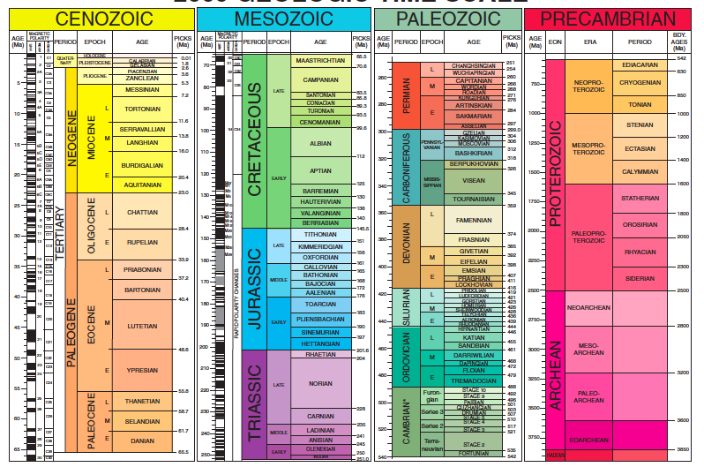
Geological Society of America

Slide 4
Key determinants of Earth’s surface temperature
Solar constant
Albedo
Greenhouse gas concentrations
Notes:
Absorption per unit area linearly related to solar constant

Slide 5
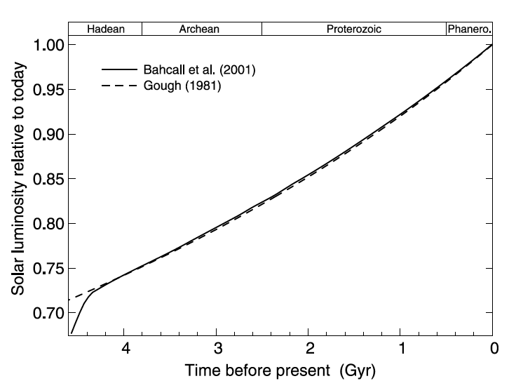
The faint young sun problem
Feulner, Reviews of Geophysics 2012
Notes:
Absorption per unit area linearly related to solar constant

Slide 6
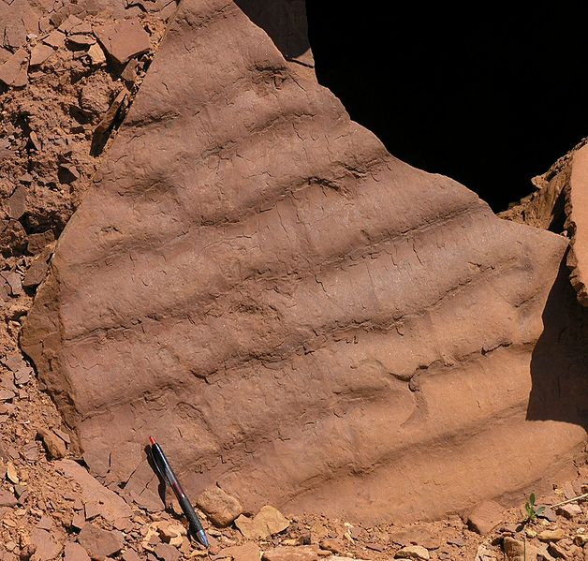
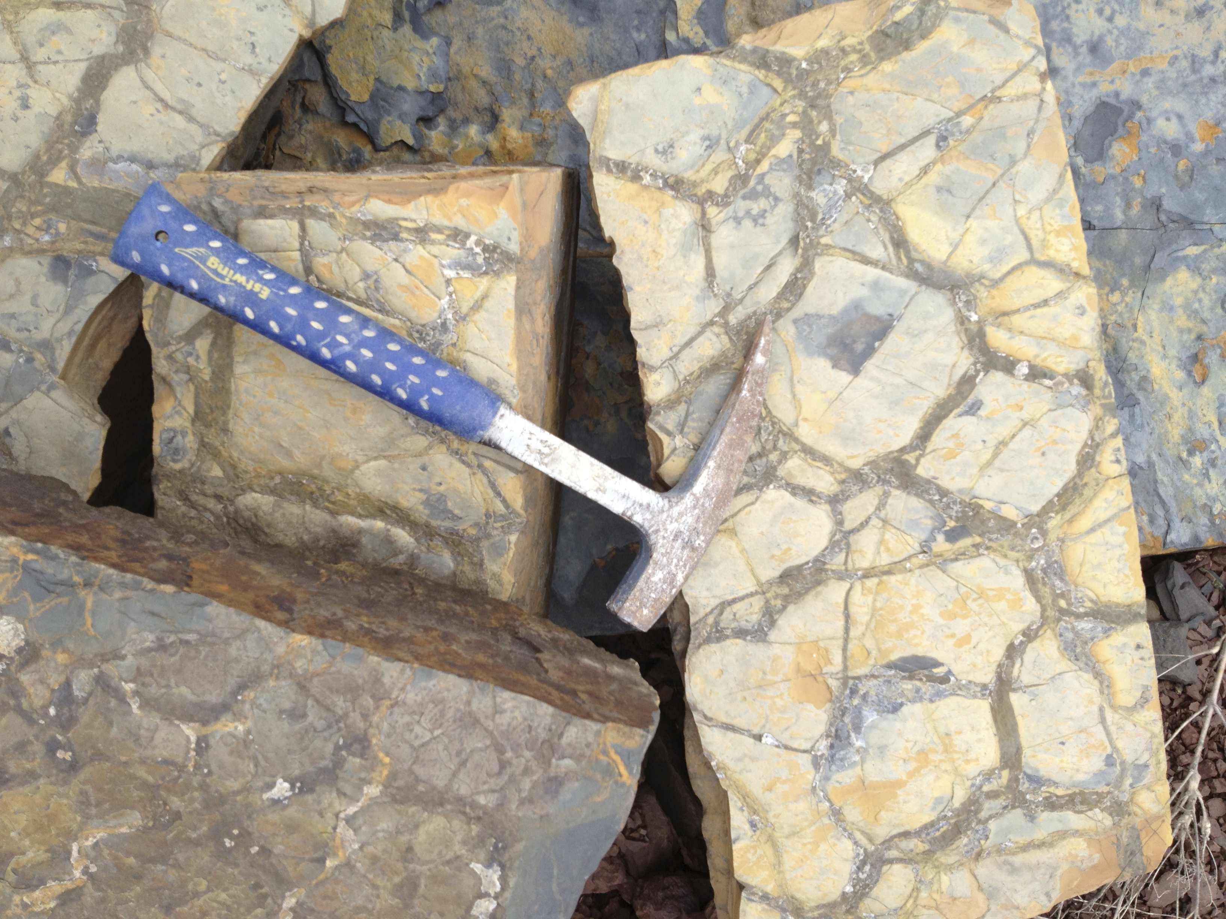
Evidence for liquid water at Earth’s surface in the Archean (3.8-2.5 Byr ago) is thought to be strong.
Sediments deposited in moving water
Mud cracks
Limited occurrence of glacially derived sediments
Abundance of marine limestones
Oxygen isotopes in zircons
was
Mean global temperatures were likely ~15˚C (similar to today) or greater.
Photo credit: Wikipedia Commons
Photo credit: D. McGee

Slide 7
If the solar constant was 25% lower but temperatures were similar to today, we’re left with two (not mutually exclusive) options for warming Earth’s surface temperatures:
Albedo
Greenhouse gas concentrations
Notes:
Absorption per unit area linearly related to solar constant

Slide 8
The Faint Young Sun problem
Most attempts to explain above-freezing surface temperatures during the Archean have focused on these greenhouse gases:
Ammonia (NH₃)
Methane (CH₄)
Carbon dioxide (CO₂)
was

Slide 9
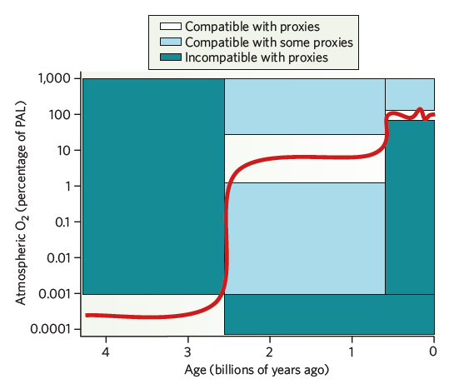
Kump, Nature 2008
Notes:
Temperature_eff
Temperature with GHG
How can Earth’s temperature change? (Solar constant, albedo, GHGs)
Faint Young Sun --

Slide 10
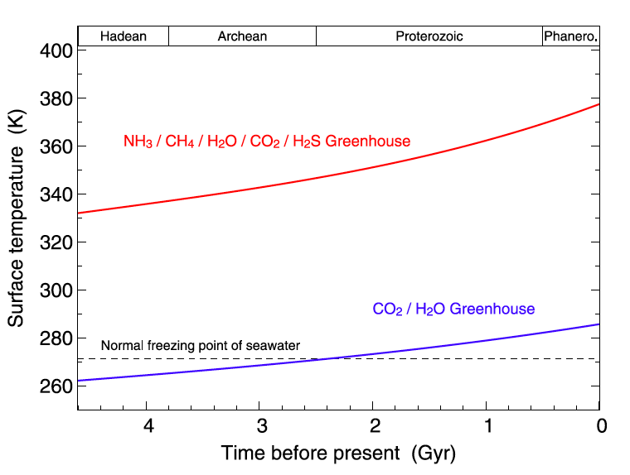
(CO₂ and albedo similar to today)
Feulner, Reviews of Geophysics 2012
Notes:
Temperature_eff
Temperature with GHG
How can Earth’s temperature change? (Solar constant, albedo, GHGs)
Faint Young Sun --

Slide 11
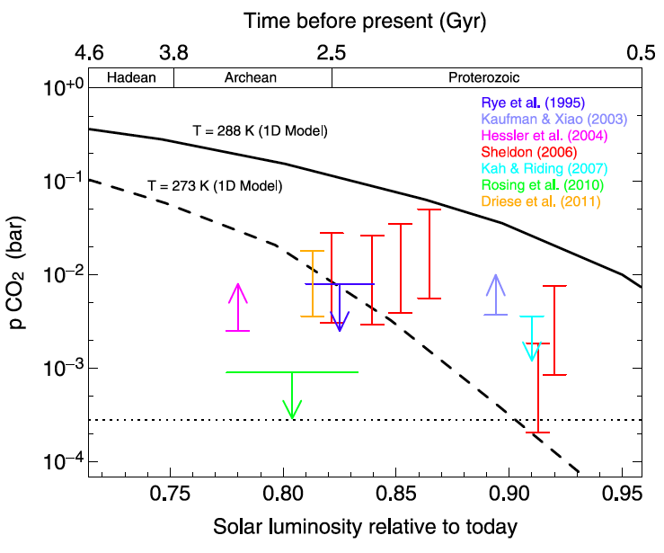
Empirical estimates of Archean CO₂ levels
Feulner, Reviews of Geophysics 2012
Notes:
Temperature_eff
Temperature with GHG
How can Earth’s temperature change? (Solar constant, albedo, GHGs)
Faint Young Sun --

Slide 12
First evidence of low-latitude glaciation
Kump, Nature 2008
Notes:
Temperature_eff
Temperature with GHG
How can Earth’s temperature change? (Solar constant, albedo, GHGs)
Faint Young Sun --

Slide 13
PART 2
Notes:
Temperature_eff
Temperature with GHG
How can Earth’s temperature change? (Solar constant, albedo, GHGs)
Faint Young Sun --

Slide 14
Snowball Earth glaciations

Slide 15
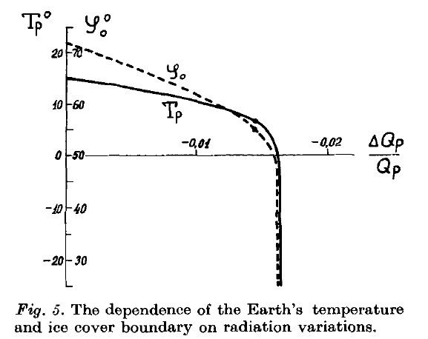
T_{p} = planetary T (˚C)
ϕ₀=ice-line latitude
Q_{p}=insolation
Budyko, Tellus 1969

Slide 16
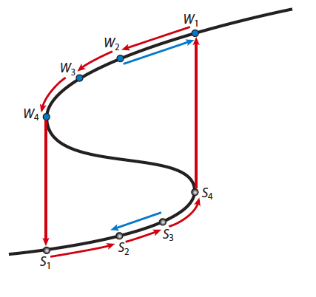
Bifurcation diagrams: a way of communicating thresholds/nonlinearities
Global mean T
Solar constant or pCO₂
Pierrehumbert et al., Ann Rev Earth Planet Sci 2011

Slide 17
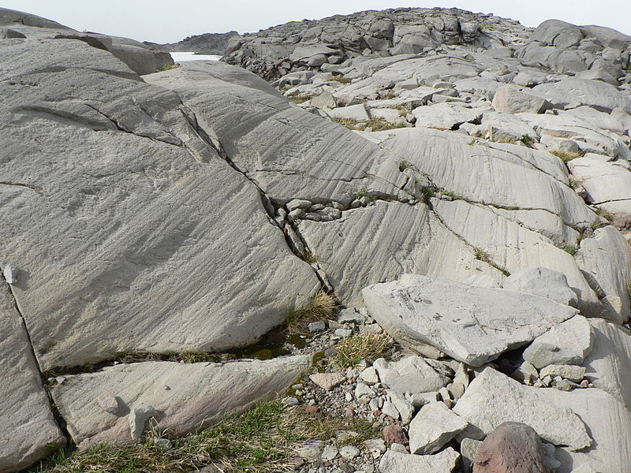
Wikipedia Commons/Walter Siegmund

Slide 18
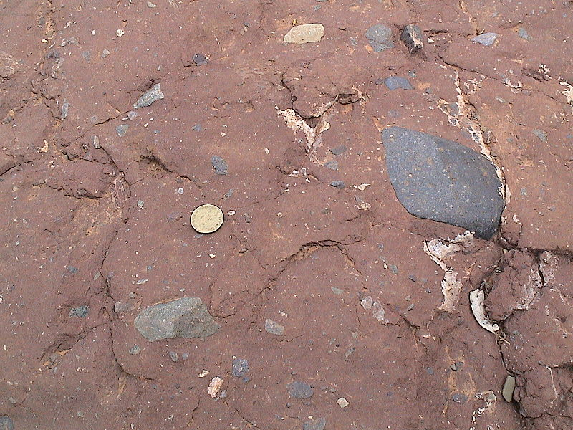
Wikipedia Commons/Diamictite

Slide 19
P. Hoffman; snowballearth.org

Slide 20
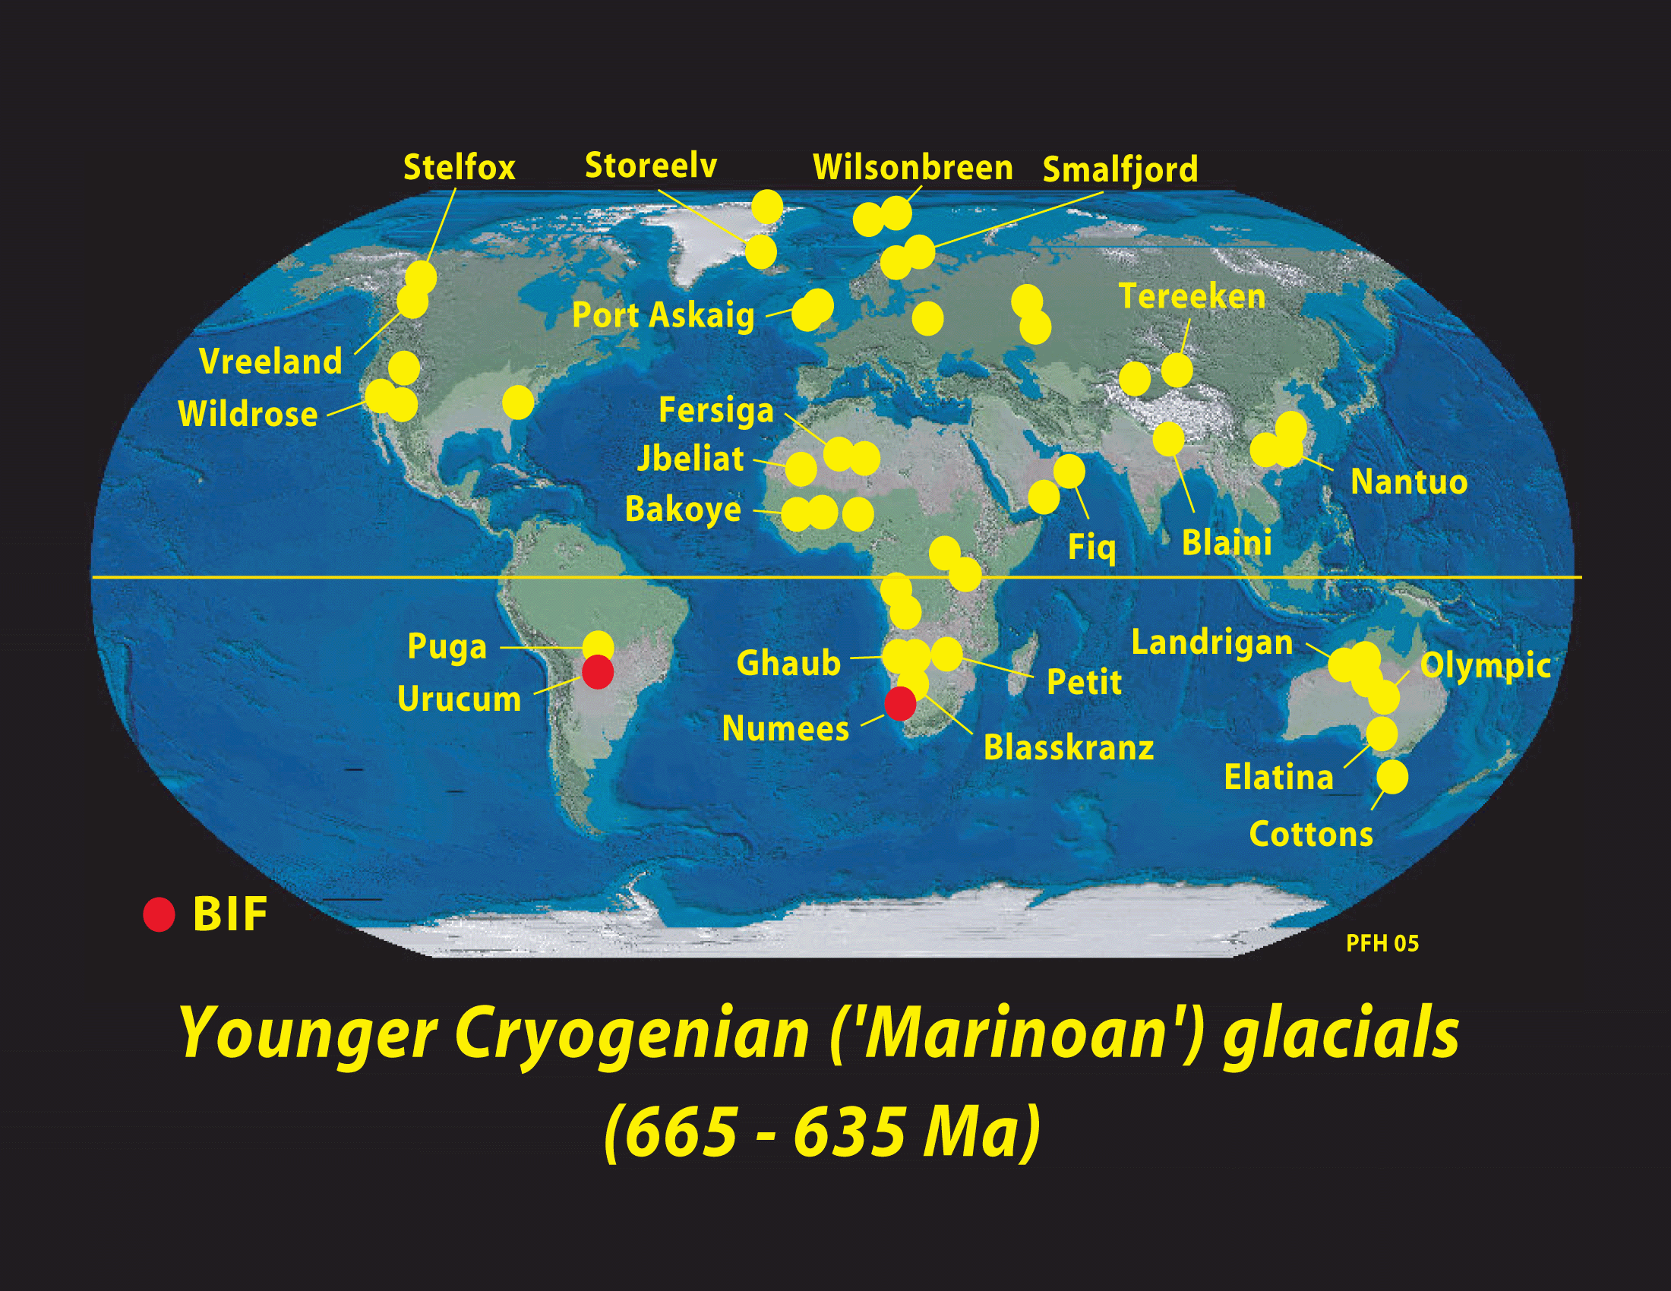
P. Hoffman; snowballearth.org

Slide 21
P. Hoffman; snowballearth.org

Slide 22
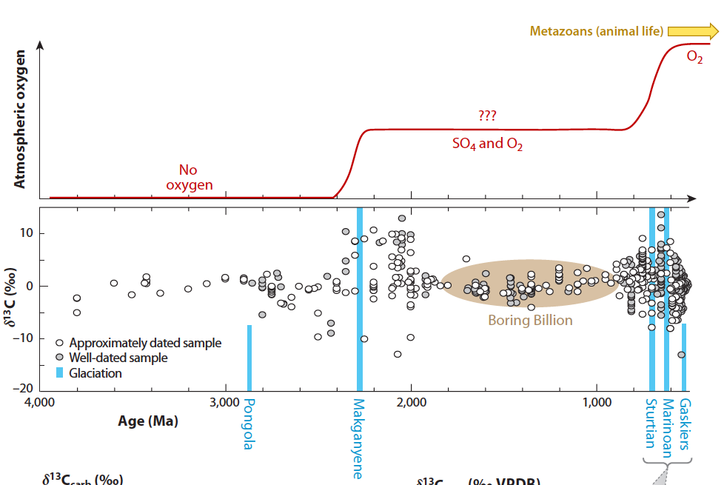
Pierrehumbert et al., Ann Rev Earth Planet Sci 2011

Slide 23
Hypothesized sequence of events in a snowball Earth episode
Global cooling
Runaway icehouse
Slower weathering, less Ca supplied to ocean
CO₂ builds up to very high levels in atmosphere
Deglaciation

Slide 24
Open questions about Snowball events
What caused them?
Why haven’t there been any in the last 600 Ma?
Why are they correlated in time with the rise of complex life?

Slide 25
PART 3
Notes:
Temperature_eff
Temperature with GHG
How can Earth’s temperature change? (Solar constant, albedo, GHGs)
Faint Young Sun --

Slide 26
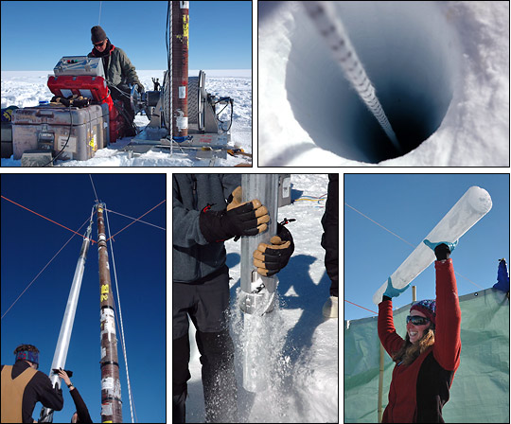
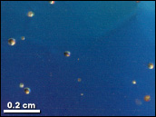
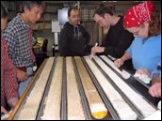
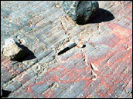
How do we get information about climates of the more recent past?
Climate archives
ice cores
tree rings
ocean and lake sediments
corals
fossils
glacial features
boreholes
stalagmites
earthobservatory.nasa.gov

Slide 27
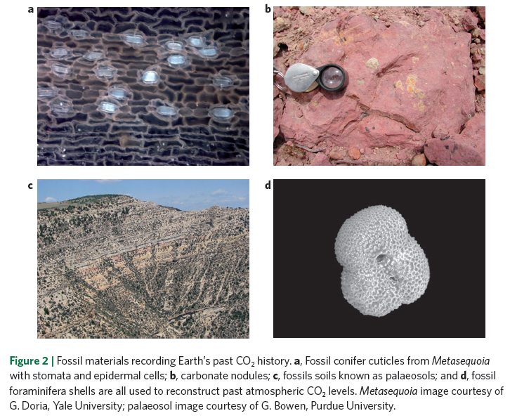
Beerling and Royer, Nature Geoscience 2011

Slide 28
Climate and CO₂ over the last 400 Myr
IPCC AR4
Notes:
Talk about data – how are paleoCO2 levels estimated?
What do you notice?

Slide 29
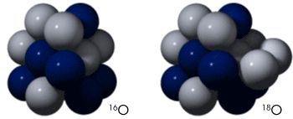
Oxygen isotopes: Versatile recorders of paleoclimatic conditions
earthobservatory.nasa.gov

Slide 30
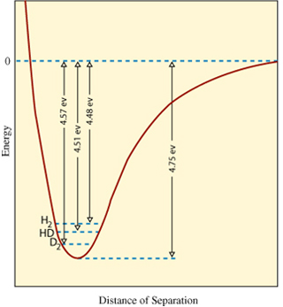
Oxygen isotope fractionation
As a general rule of thumb, ¹⁸O tends to be enriched relative to ¹⁶O in the most “immobile” state involved in a reaction or transformation
Figure: more energy is needed
to break bonds involving
heavier isotopes (in this case,
H-H vs. H-D vs. D-D, where
D=²H, H=¹H)
MIT OCW

Slide 31
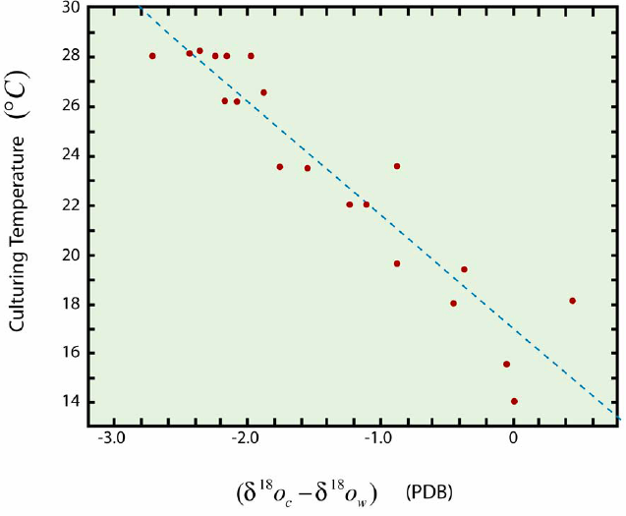
Oxygen isotope fractionation
Fractionation increases with decreasing temperature
Figure: δ¹⁸O enrichment in cultured foraminifera vs. temperature
MIT OCW, after Erez et al., 1983
Beerling and Royer, Nature Geoscience 2011

Slide 32
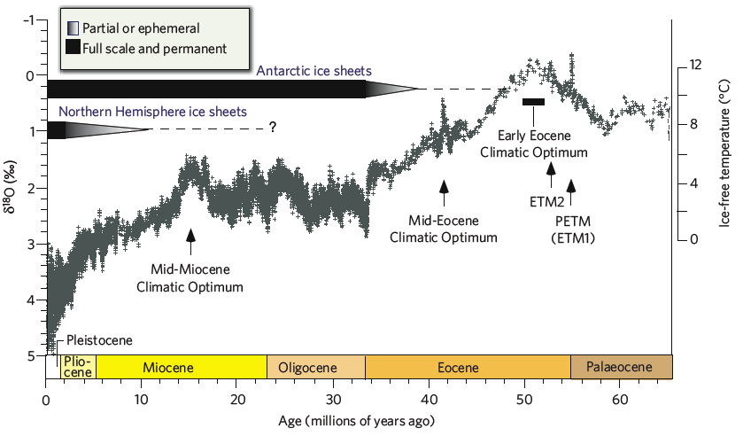
Climate over the last 65 Myr (beware the flipping x-axis…)
Zachos et al., Nature 2008

Slide 33
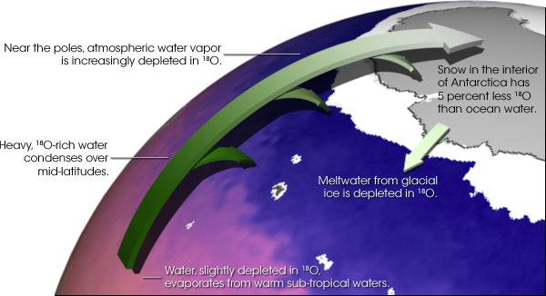
Oxygen isotope fractionation
Water vapor is depleted in ¹⁸O relative to liquid water due to the greater mass of H₂¹⁸O vs. H₂¹⁶O
Air masses become more ¹⁸O-depleted with increasing rain-out and decreasing temperatures
earthobservatory.nasa.gov

Slide 35
Decreasing temperature
temperature
Where
R_{v} = ¹⁸O/¹⁶O ratio
R_{v}⁰ = initial ¹⁸O/¹⁶O ratio
f = fraction of vapor remaining
α = fractionation factor (~1.01)

Slide 36
Oxygen isotope fractionation
Because ice sheets are made with ¹⁸O-depleted precipitation, ice sheet growth causes global oceans to be enriched in ¹⁸O.
As a result, global oceans at the peak of the last glacial period had δ¹⁸O ~1‰ more positive than at present

Slide 37
Climate over the last 65 Myr (beware the flipping x-axis…)
Zachos et al., Nature 2008

Slide 38
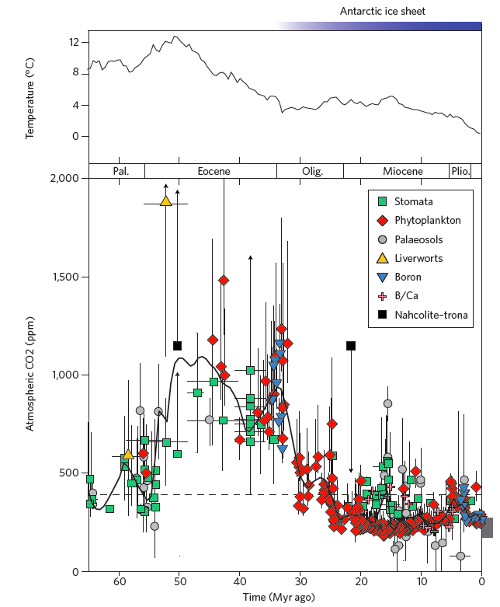
Climate and CO₂ over the last 65 Myr
Beerling and Royer
Nature Geoscience 2011

Slide 39
PART 4

Slide 40
Climate over the last 65 Myr
Zachos et al., Nature 2008

Slide 41
The Paleocene-Eocene Thermal Maximum (PETM), 55 Myr ago
Addition of low-¹³C carbon to the atmosphere and ocean
Temperature rise
Zachos et al., Science 2001

Slide 42
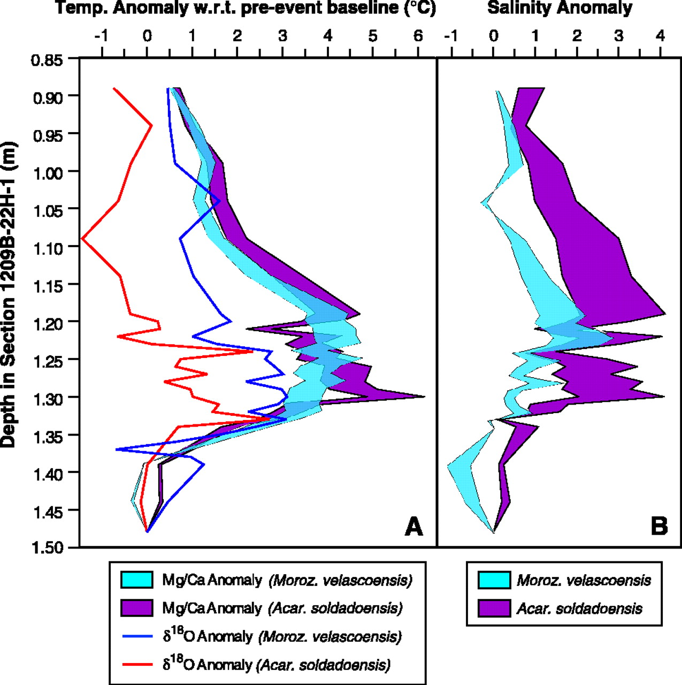
The Paleocene-Eocene Thermal Maximum (PETM), 55 Myr ago
55
Global temps rose ~5-9˚C in 1-10 kyr
Zachos et al., Science 2003

Slide 43
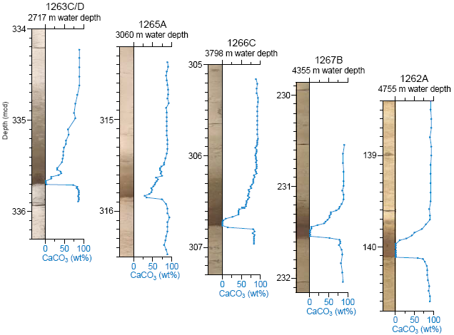
PETM ocean acidification consistent with large pCO₂ increase
Zachos et al., Science 2005

Slide 44
Where did the carbon come from?
Hypothesized sources:
Methane hydrates
Volcanic intrusion into organic-rich sediments
Melting permafrost
Terrestrial biomass burning
Oxidation of organic carbon buried in shallow seas

Slide 45
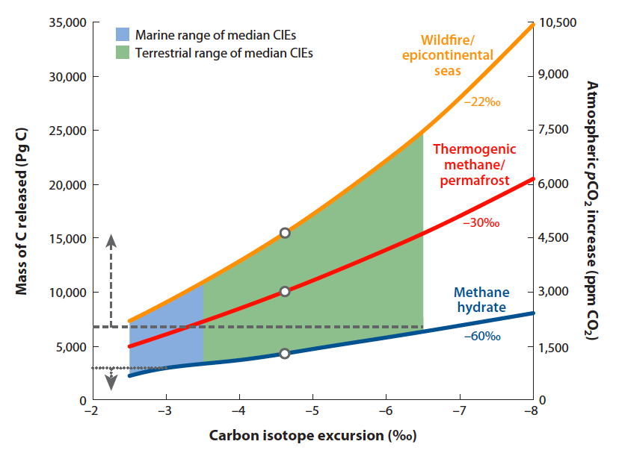
How much carbon was added to the atmosphere?
McInerney and Wing, Annual Review of Earth and Planetary Sciences, 2011

Slide 46
Duration of perturbation ~200 kyr
Zachos et al., Science 2001

Slide 47
PART 5

Slide 48
Oxygen isotope fractionation
Water vapor is depleted in ¹⁸O relative to liquid water due to the greater mass of H₂¹⁸O vs. H₂¹⁶O
Air masses become more ¹⁸O-depleted with increasing rain-out and decreasing temperatures
earthobservatory.nasa.gov

Slide 49
Climate change captured by seafloor foraminifera
Increasing ice volume/
Decreasing temperature
Over the last 3 Myr:
Increasing ice volume
Decreasing temperature
Increasing variability
Cyclic changes (glacial-interglacial cycles)
Data from Lisiecki and Raymo, Paleoceanography 2005

Slide 50
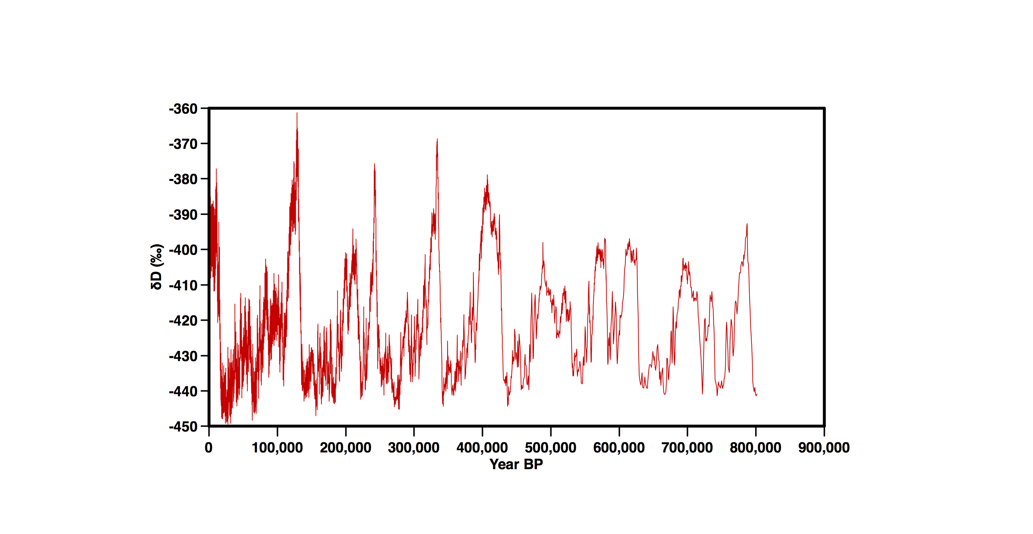
Climate change over the last 1 Myr in Antarctic ice
Decreasing temperature
Jouzel et al., 2007

Slide 51
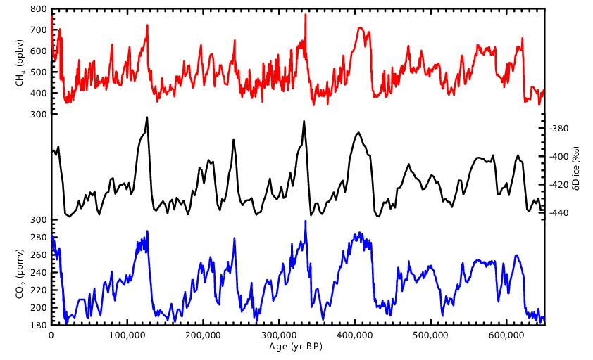
Glacial-interglacial greenhouse gas and temperature changes
It is generally agreed that these CO₂ changes are caused by changes in the storage of carbon in the deep ocean, but the precise mechanisms are still an area of active research.
Realclimate.org
Notes:
Consistency
Sawtooth
Modern day values

Slide 52
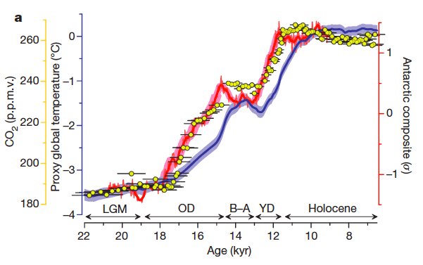
The most recent glacial-interglacial transition
Shakun et al., Nature 2012
Notes:
Consistency
Sawtooth
Modern day values

Slide 53
The most recent glacial-interglacial transition
NOAA/Science on a Sphere
Notes:
Consistency
Sawtooth
Modern day values

Slide 54
The most recent glacial-interglacial transition
NOAA/Science on a Sphere
Notes:
Consistency
Sawtooth
Modern day values

Slide 55
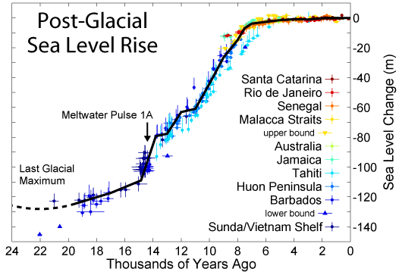
The most recent glacial-interglacial transition
Image created by Robert A. Rohde/Global Warming Art
Notes:
Consistency
Sawtooth
Modern day values

Slide 56
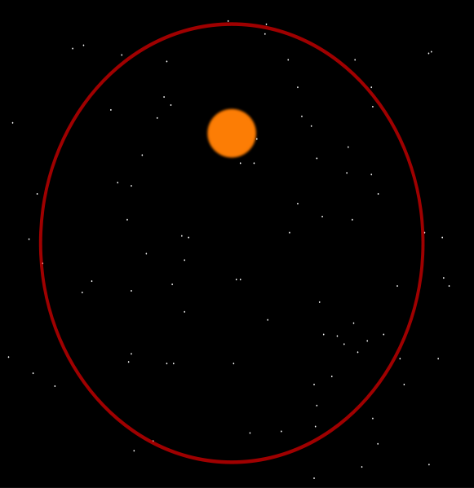
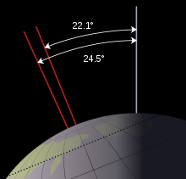
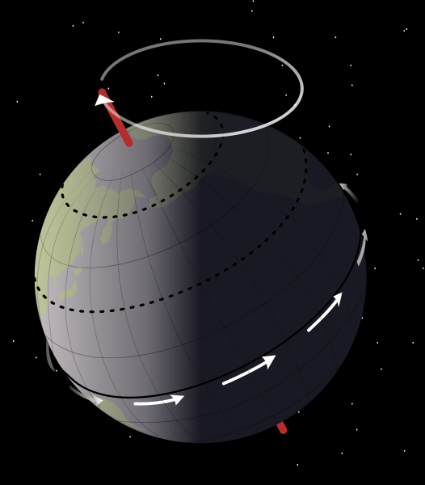
Orbital changes thought to drive climate change on timescales of 10s of thousands of years
Eccentricity
~100 kyr
Obliquity (tilt)
~41 kyr
Precession
~22 kyr
earthobservatory.nasa.gov
Notes:
Consistency
Sawtooth
Modern day values

Slide 57
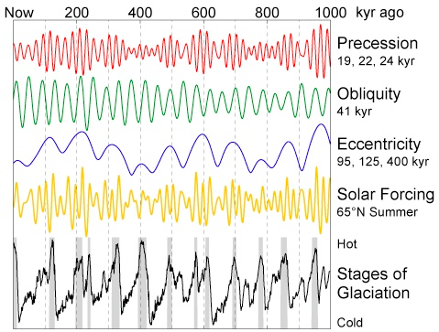
Summer insolation at 65˚N is thought to pace ice ages
…but the precise links between orbital variations and glacial-interglacial cycles are still debated.
Image created by Robert A. Rohde/Global Warming Art
Notes:
Consistency
Sawtooth
Modern day values

Slide 58
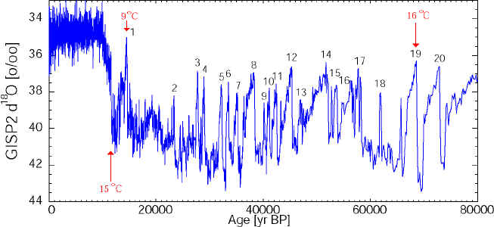
Abrupt climate changes over the last 100,000 yrs recorded in Greenland ice
Decreasing temperature
Grootes and Stuiver, Journal of Geophysical Research 1997

Slide 59
The last interglacial period 125,000 years ago
High latitude temperatures ~2-3˚ warmer than present
Data from Jouzel et al., Science 2007

Slide 60
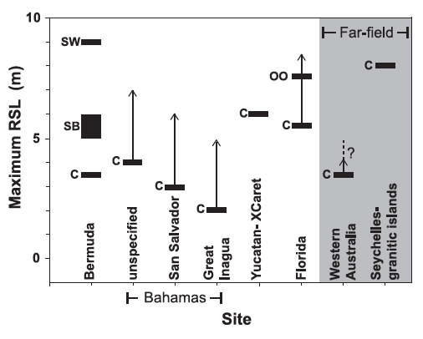
Last interglacial sea levels estimated from coral reefs
Best estimate: last interglacial sea levels were 5-9 m higher than at present.
This implies complete large-scale
melting of the Greenland ice sheet along with partial melting of the West Antarctic ice sheet.
Dutton and Lambeck, Science 2012

Slide 61
PART 6

Slide 62
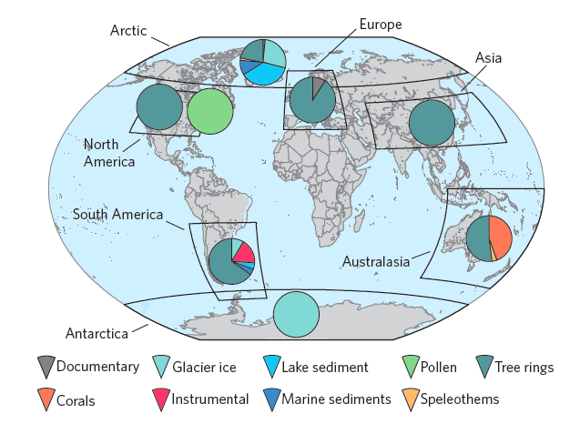
Temperature changes over the last 2000 years
Data sources
PAGES 2K Consortium, Nature Geoscience 2013

Slide 63
Temperature changes over the last 2000 years
Number of records
PAGES 2K Consortium, Nature Geoscience 2013

Slide 64
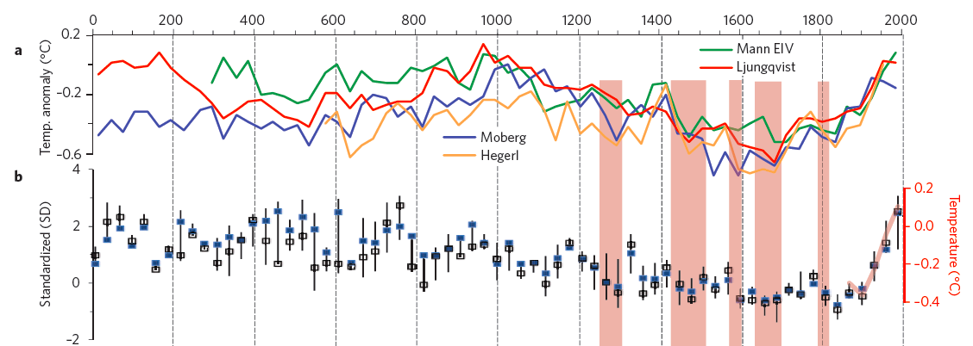
Temperature changes over the last 2000 years
PAGES 2K Consortium, Nature Geoscience 2013

Slide 65
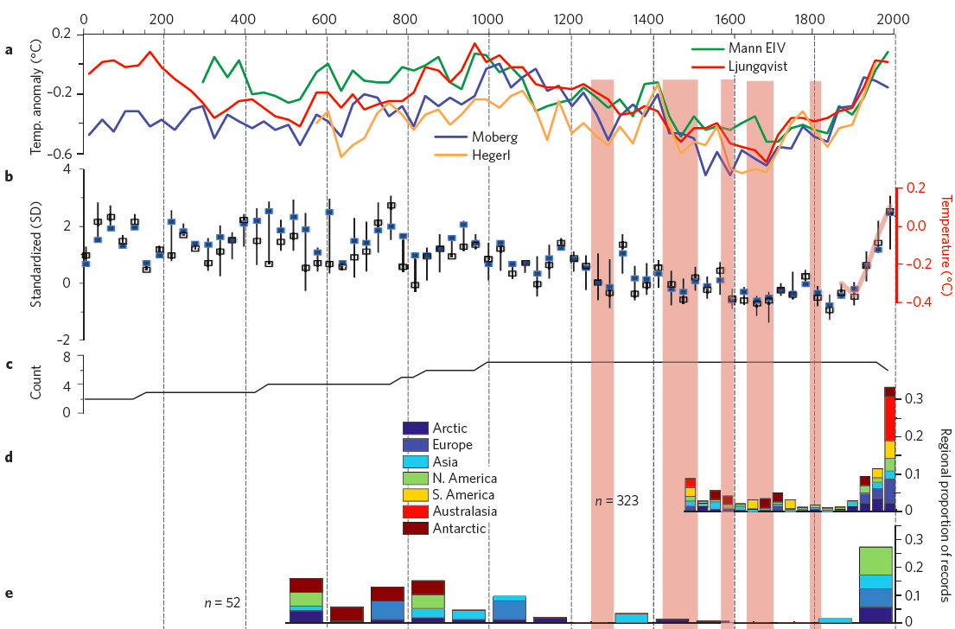
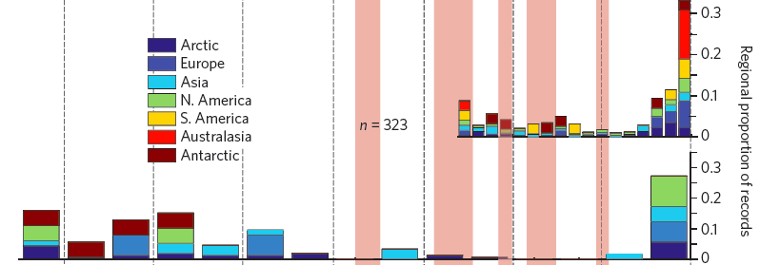
PAGES 2K Consortium, Nature Geoscience 2013

Slide 66
The last 2000 years: sea level rise
Kemp et al., PNAS 2011

