Slide 1
The Oceans and Climate
Important considerations:
  The ocean has almost all of the water on the planet
  It has an immense heat capacity compared to the atmosphere
  It retains a memory of past disturbances that can extend to thousands of years
  It exchanges energy with the atmosphere (heat, moisture) and transports it in very large amounts
  It absorbs, stores, and ejects carbon dioxide in very large amounts
  It is the site of a large fraction of the biological activity on Earth
  It is a major component of the biogeochemical cycles (nitrogen, phosphorous, etc.) on Earth
  When frozen, it can undergo a very large albedo change

Slide 2
Comparison to the Atmosphere
Similarities to atmosphere:
    Governing equations nearly identical
    Global-scale fluid on a rotating earth
Major differences:
  Continental barriers to east-west motions
  Ocean virtually opaque to radiation
  The ocean is heated (and cooled) at its upper surface
  No equivalent in the ocean of moist convection (although salinity introduces some analogous issues)
  Much more difficult to observe the ocean

Slide 3
Observing the Oceans
Difficult because radio waves do not travel through water; not possible to relay information from sensors
Therefore, must make in situ measurements
Historically, these have been very expensive

Slide 4
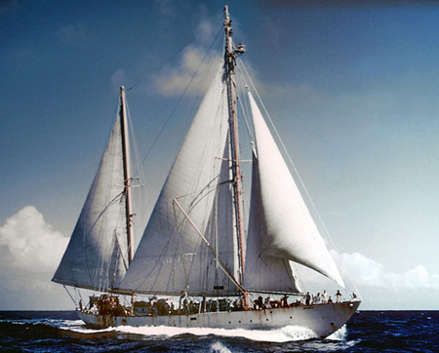
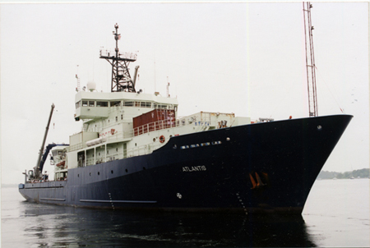
Ships
Research Vessel Atlantis 1, used by the Woods Hole Oceanographic Institution from 1931 to 1964
Research Vessel Atlantis 3, used by the Woods Hole Oceanographic Institution from 1998 to the present
Photos courtesy of Woods Hole Oceanographic Institution, Archives©WHOI
Notes:
Permission sought from WHOI; permission granted 12/17/2013; email from Erika Fitzpatrick, WHOI

Slide 5
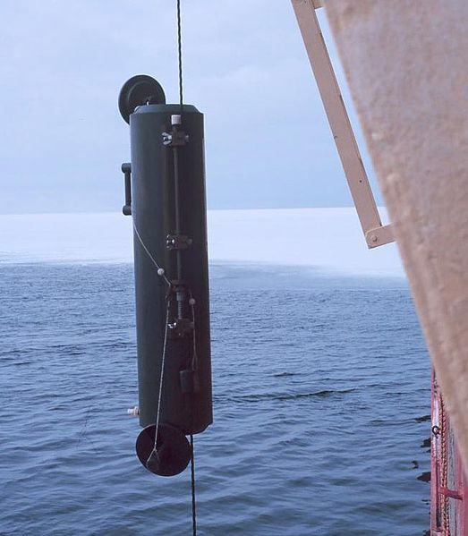
Measurements at Depth
Photo credit: NOAA
A Niskin Bottle being lowered into the water. The two end caps are visible, held in place by a thin cord running round the outside of the cylinder. The bungee cord which will pull them both close is barely visible at the very top of the cylinder.
Notes:
http://en.wikipedia.org/wiki/File:Niskin-bottle.jpg

Slide 6
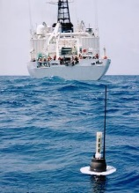
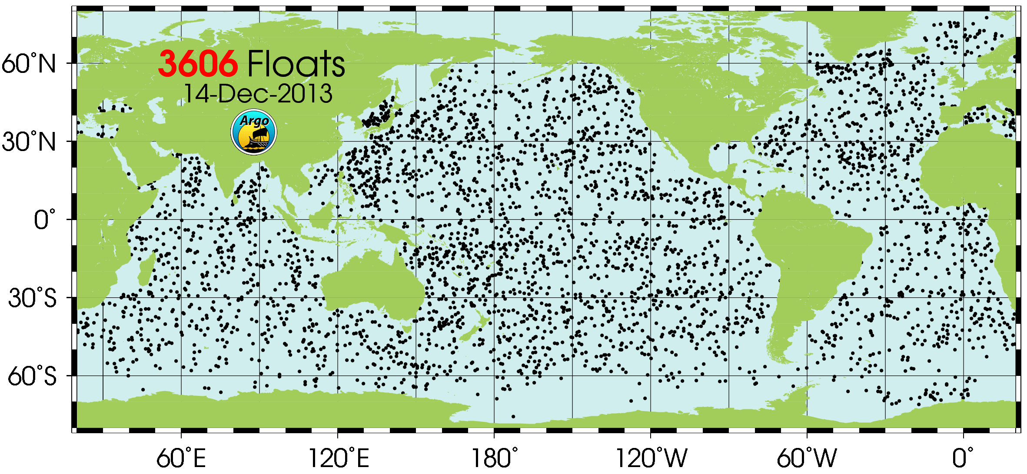
ARGO robotic submersible floats
Image credit: Argo Program
Notes:
http://www.argo.ucsd.edu/ These data were collected and made freely available by the International Argo Program and the national programs that contribute to it. (http://www.argo.ucsd.edu, http://argo.jcommops.org). The Argo Program is part of the Global Ocean Observing System

Slide 7
The Ocean as a Thermal Reservoir
Mass of the ocean is about 350 times larger than the mass of the atmosphere
Heat capacity of the ocean is about 500 times the effective heat capacity of the atmosphere
Heat is rapidly mixed through the very top of the ocean.. 20-150 m, depending on location and season

Slide 8
Approximate equation for upper ocean temperature, T:
= Heat capacity of liquid water
= Air temperature
= Density of seawater
= Depth of ocean mixed layer
= Net downward radiative flux
= Dimensionless heat transfer coefficient
= Density of air at sea level
= Surface wind speed
= Heat capacity of air

Slide 9
Suppose F_{rad} does not vary in time, and that T_{A} is just white noise. Then the equation for the time varying sea temperature is just
Where q just varies randomly in time, with zero mean, and τ is defined:
Solve the equation numerically, with q changing every 3 days. One solution is shown on next slide:

Slide 10
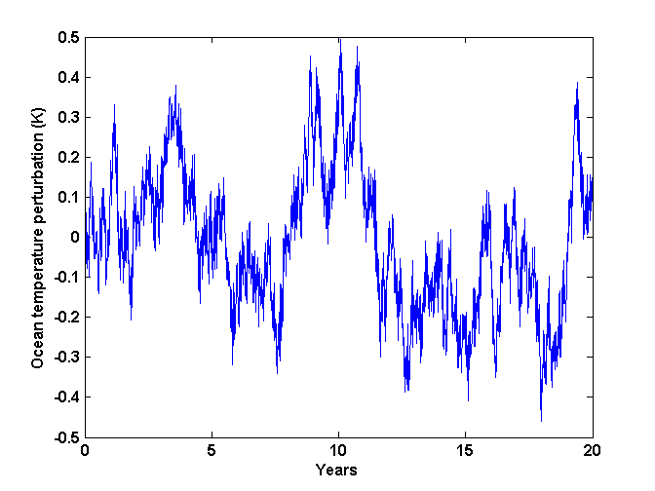
Note strong fluctuation on time scales from years to decades!
Image credit: K. Emanuel

Slide 11
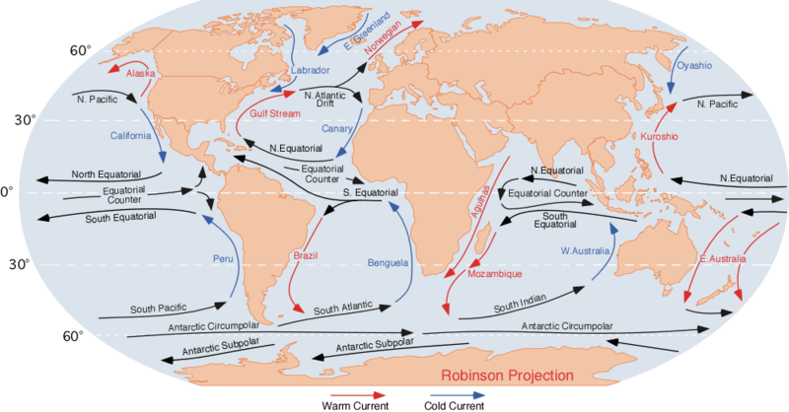
Time Mean Ocean Surface Circulation
Image credit: Dr. Michael Pidwirny
Notes:
http://en.wikipedia.org/wiki/File:Corrientes-oceanicas.gif

Slide 12
Sea Surface Height (cm)
Heights are in centimeters relative to a surface defined to
be a gravitational equipotential.
Image credit: NASA/JPL
Notes:
stopped here 29 october 2007

Slide 13
Ocean Circulation
Worth watching all of
http://svs.gsfc.nasa.gov/vis/a000000/a003800/a003827/prepetual_ocean_1080p30.mp4
Movie on following slide created from the MITgcm, an ocean model developed at MIT. Credit also to NASA; see link above.

Slide 14
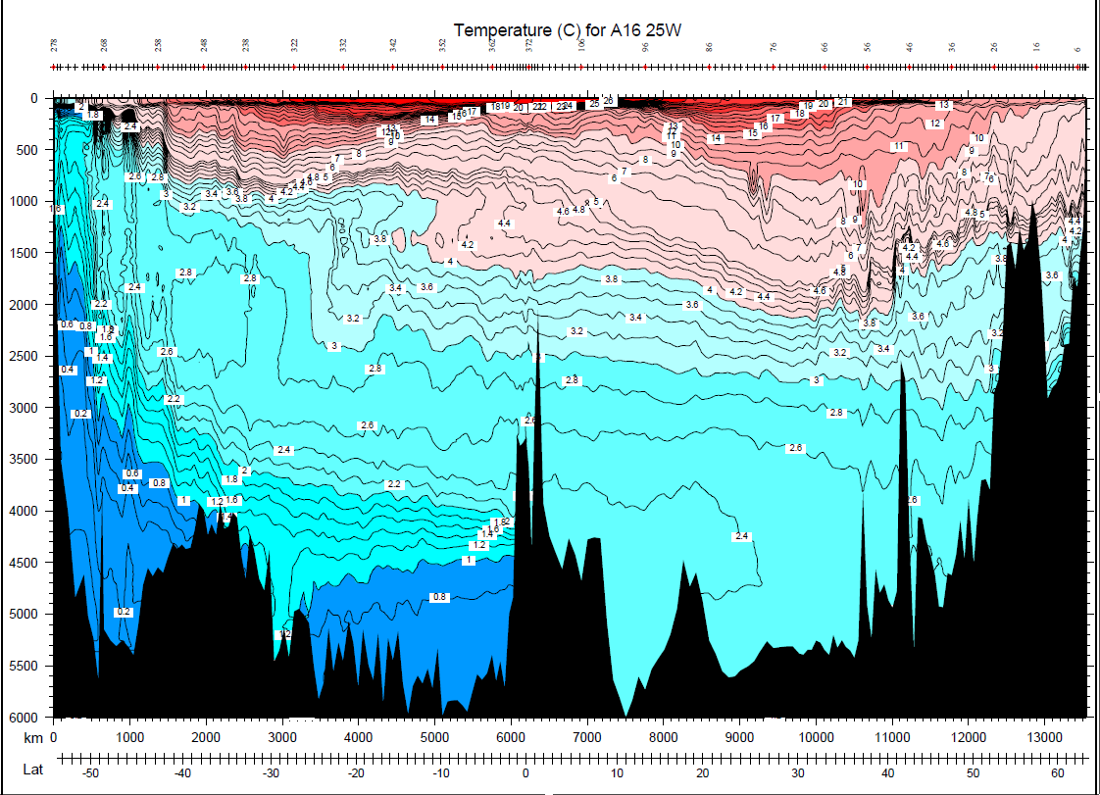
Vertical Temperature Cross-section at 25 W in the North Atlantic
Image credit: Lynn Talley
Notes:
http://sam.ucsd.edu/vertical_sections/Atlantic.html
By permission from Lynn Talley; email of 12/16/2013

Slide 15
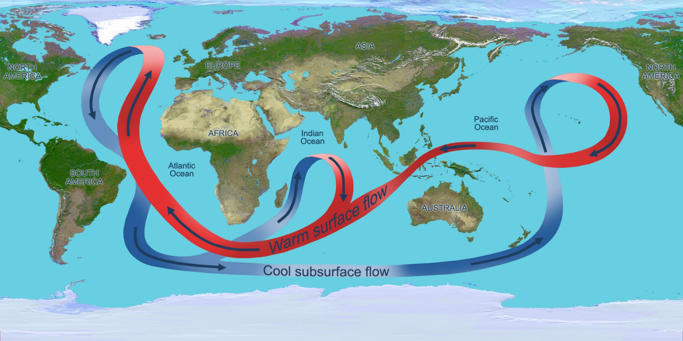
Deep Overturning
Image credit: NASA/JPL
Notes:
http://www.nasa.gov/topics/earth/features/atlantic20100325.html

Slide 16
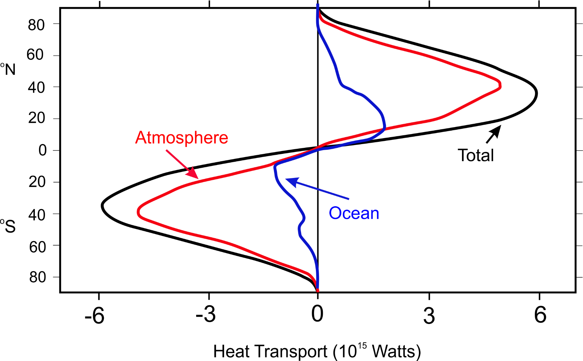
Lateral Heat Transport by Atmosphere and Oceans
Image credit: After Fasullo, John T., Kevin E. Trenberth, 2008: The Annual Cycle of the Energy Budget. Part II: Meridional Structures and Poleward Transports. J. Climate, 21, 2313–2325.
Notes:
Re-drafted by K. Emanuel

Slide 17
What Drives the Ocean Circulation?
Wind
Vertical Mixing
N
Image credit: K. Emanuel

Slide 18

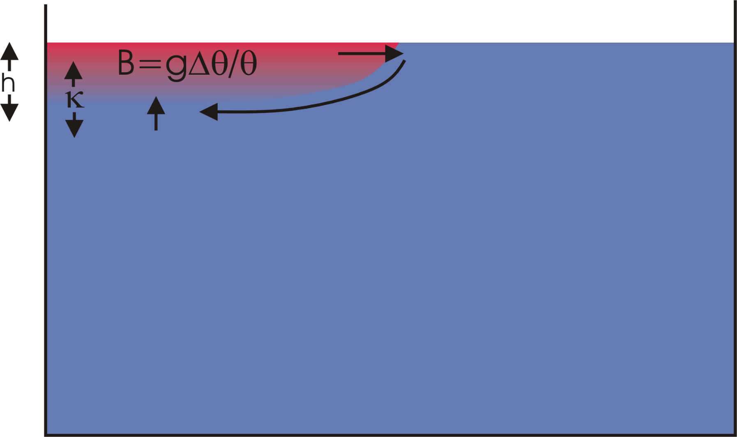
A hot plate is brought in contact with the left half of the surface of a swimming pool of cold water. Heat diffuses downward and the warm water begins to rise. The strength of the circulation is controlled in part by the rate of heat diffusion. In the real world, this rate is very, very small.
Image credit: K. Emanuel

Slide 19
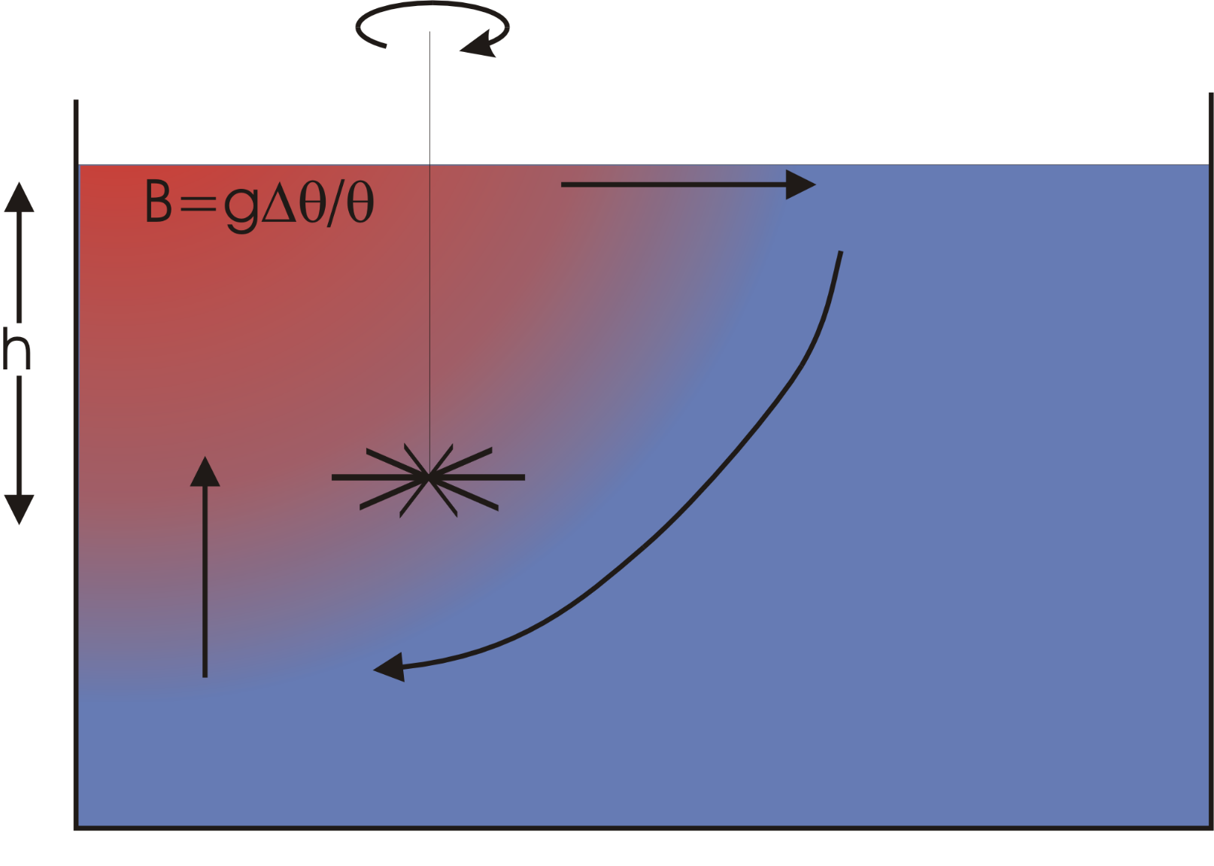
Adding a stirring rod to this picture greatly enhances the circulation by mixing the warm water to greater depth and bringing more cold water in contact with the plate. The strength of the lateral heat flux is proportional to the product of some power of the imposed temperature gradient and some power of the mixing intensity
Image credit: K. Emanuel

Slide 20
Vertical Temperature Cross-section at 25 W in the North Atlantic
Image credit: Lynn Talley
Notes:
http://sam.ucsd.edu/vertical_sections/Atlantic.html
By permission from Lynn Talley; email of 12/16/2013

Slide 21
The Wind-Driven Circulation

Slide 22
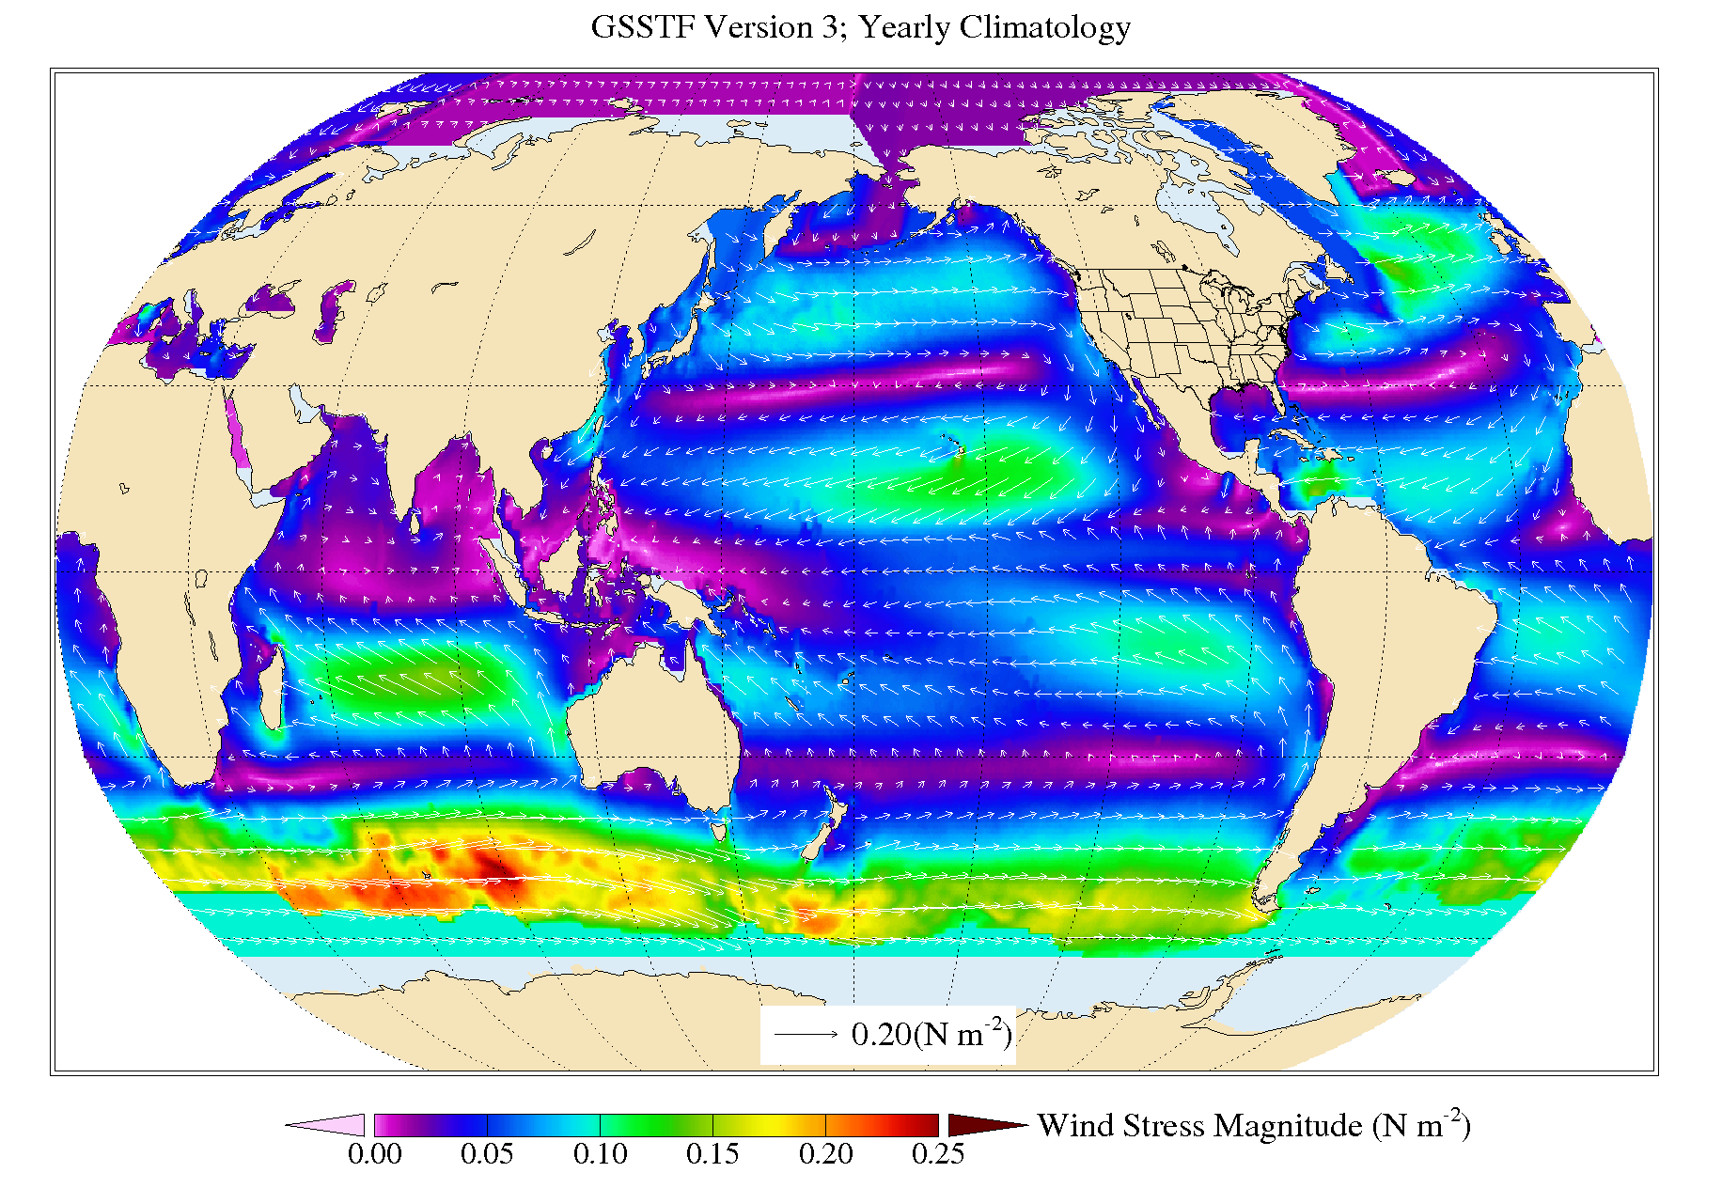
Image credit: NASA
Notes:
http://disc.sci.gsfc.nasa.gov/datareleases/gsstf-version-3

Slide 23
How Does Wind Cause the Ocean to Move on a Rotating Planet?
Problem:
Conservation of angular momentum inhibits motion in the north-south direction

Slide 24
Equations governing slowly evolving ocean circulation

Slide 25
Eliminate pressure between first two equations, and ignore local derivative in time as well as some small terms involving w, also making use of last two equations:
(1)
where
Ignore nonlinear terms:

Slide 26
(2)
where
Integrate through the whole depth of the ocean, taking into account that w=0 at the top and bottom, and ignoring turbulent stress at the bottom:
(3)
where is the wind stress applied at the ocean surface and H is depth.
This remarkable relation was developed in the 1940s by Harald Sverdrup

Slide 27
Implied vertically averaged v:
Image credit: NASA, annotated with arrows by K. Emanuel
Notes:
http://disc.sci.gsfc.nasa.gov/datareleases/gsstf-version-3

Slide 28
But vertically integrated mass continuity equation is
so
Cannot satisfy u=0 at both east and west side of ocean. Henry Stommel showed that u=0 must be satisfied on eastern boundary while all the return flow is concentrated in narrow western boundary currents likes the Gulf Stream.

Slide 29
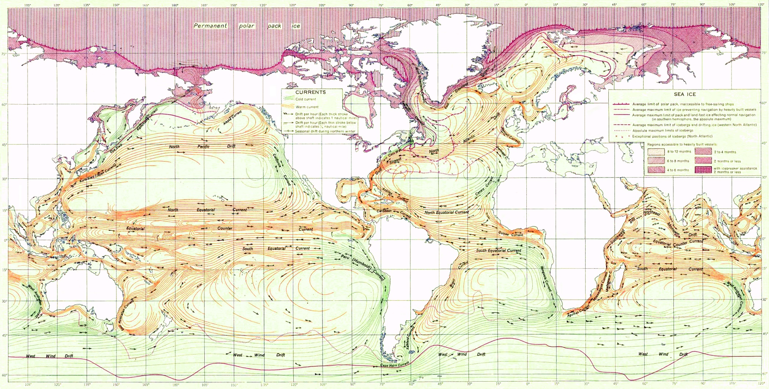
Ocean Currents and Sea Ice from Atlas of World Maps,
produced by the United States Army Service Forces, Army Specialized Training Division in 1943
Image credit: U.S. Army
Notes:
http://en.wikipedia.org/wiki/File:Ocean_currents_1943_%28borderless%293.png

Slide 30
Issues:
What are the relative roles of ocean circulation induced by vertical mixing and by large-scale wind stress, in transporting heat, salt, and tracers?
How do these various circulations interact?
What is the energy source for vertical mixing in the ocean?
How important are transient eddies in ocean dynamics and transport?
How does climate change affect ocean heat transport and other properties of the oceans?

Slide 31
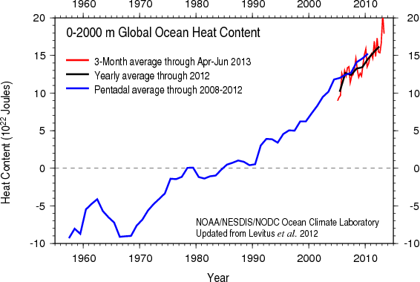
Based on bathythermograph and ARGO (post-2004) data
Image credit: NOAA

Slide 32
Based on bathythermograph and ARGO (post-2004) data
Image credit: Nuccitteli et al, 2012, Phys. Let., A., 45, 3466-3468
Notes:
http://www.sciencedirect.com/science/article/pii/S0375960112010389
Nuccitelli, D., R. Way, R. Painting, J. Church, and J. Cook, 2012: Comment on “Ocean heat content and Earthʼs radiation imbalance. II. Relation to climate shifts”, Phys. Let., A. ,45, 3466-3468

Slide 33
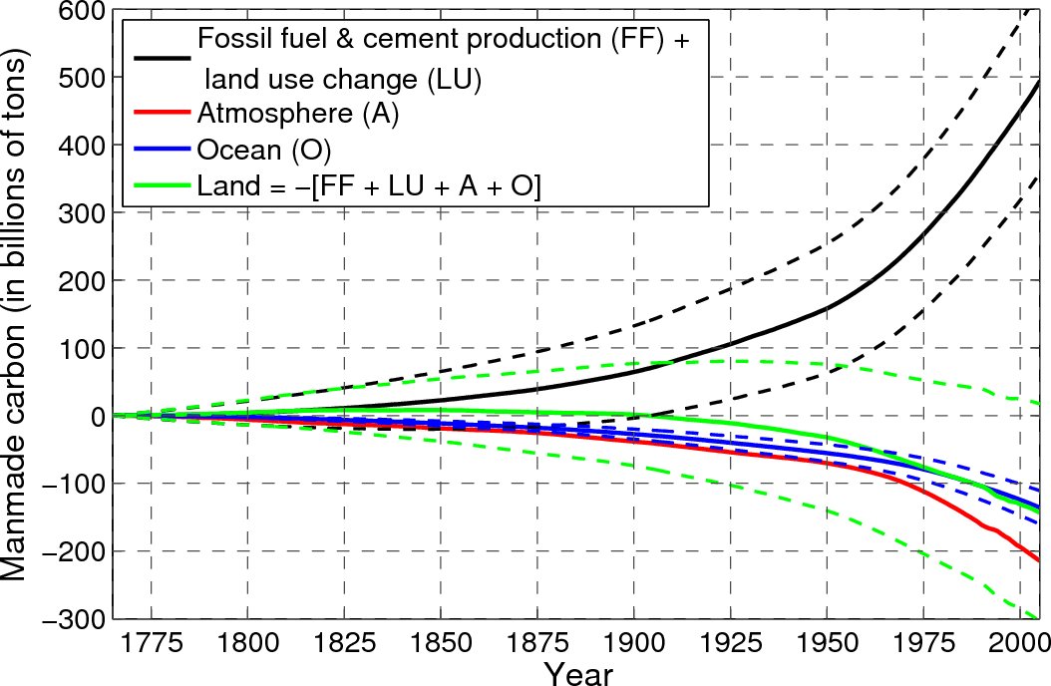
Carbon Sources and Sinks
Image credit: Samar Khatiwala
Notes:
http://www.earth.columbia.edu/articles/view/2586
By permission of Samar Khatiwala, email of 12/16/2013

Slide 34
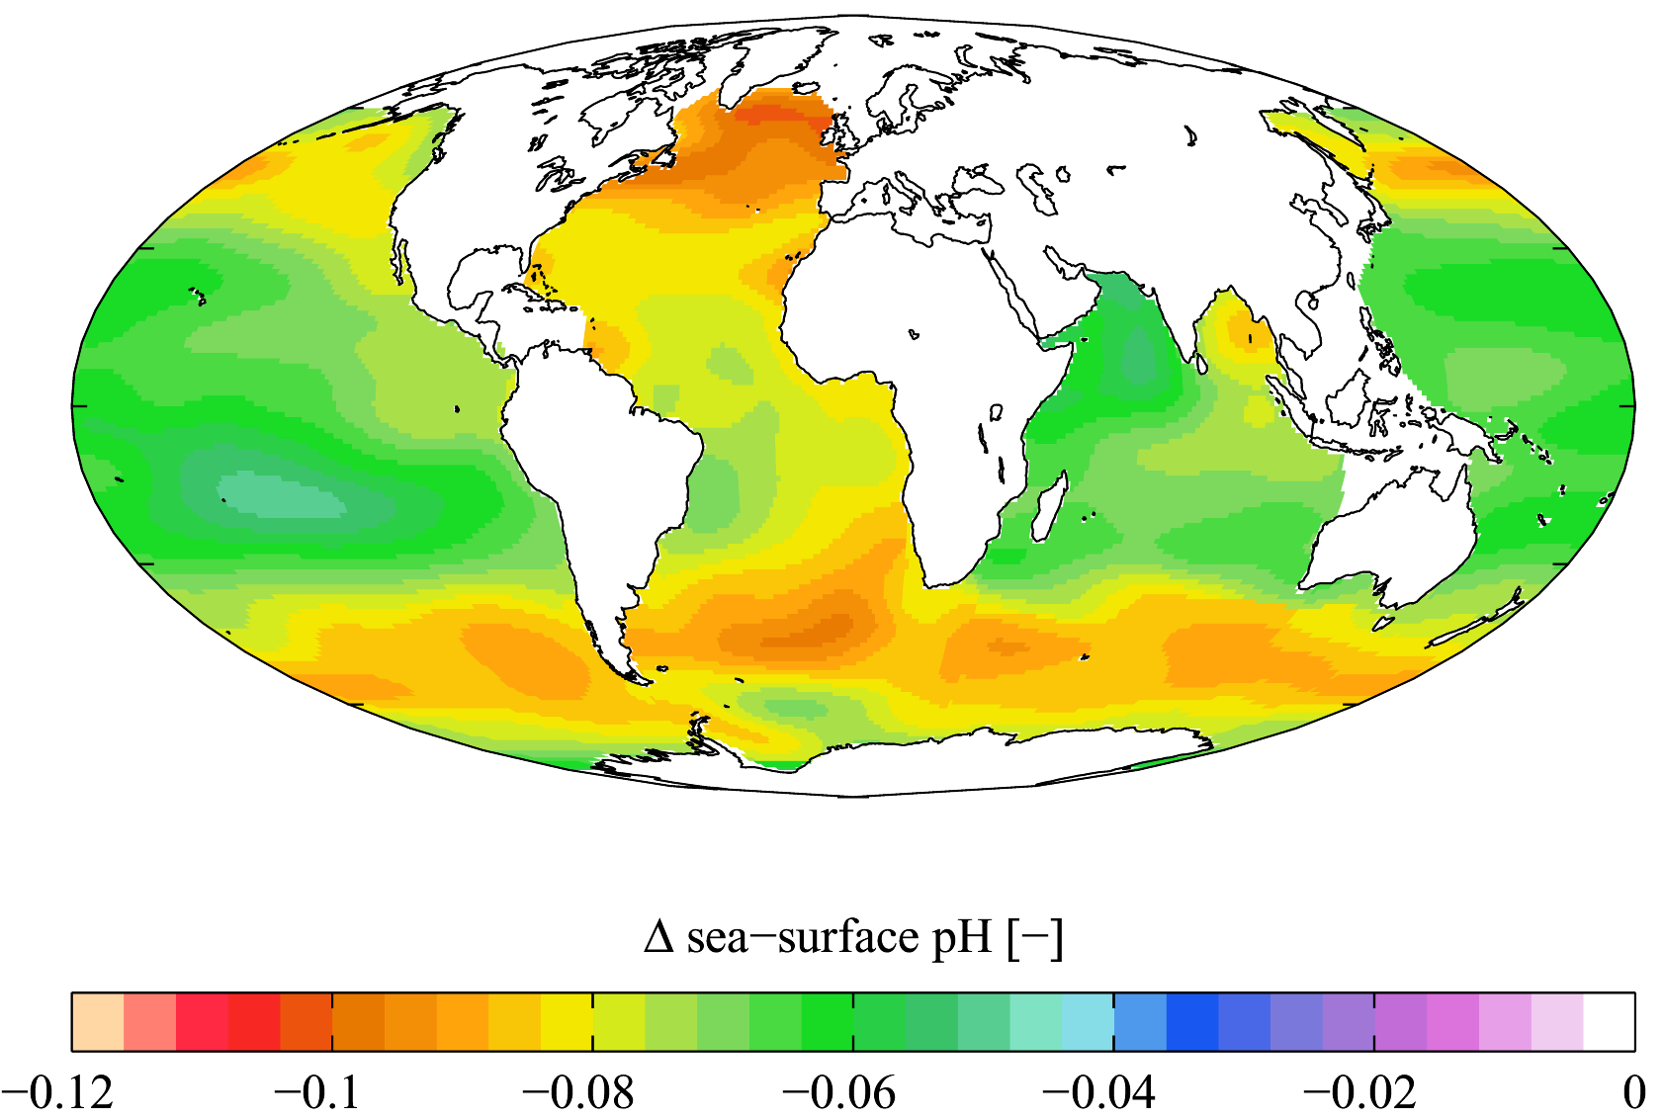
Oceans are Becoming More Acidic
Estimated change in annual mean sea surface pH between the pre-industrial period (1700s) and the present day (1990s). Δ pH here is in standard pH units. Calculated from fields of dissolved inorganic carbon and alkalinity from the Global Ocean Data Analysis Project climatology and temperature and salinity from the World Ocean Atlas (2005) climatology
Image credit: Plumbago, Wikipedia
Notes:
http://en.wikipedia.org/wiki/File:WOA05_GLODAP_del_pH_AYool.png

Slide 35
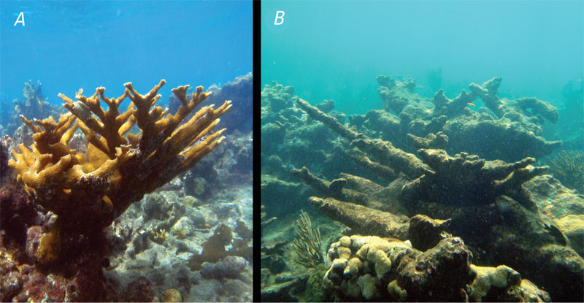
Ocean acidification may be partly responsible for decline of corals and other shell-building organisms as well as other life forms that depend on them
Corals and coral reefs are severely threatened by processes such as ocean acidification: A, "Healthy" coral reef with living Acropora palmata and good water quality. B, Degraded coral reef with dead A. palmata and poor water quality. Processes such as ocean acidification are rapidly transforming healthy reefs into degraded reefs in Puerto Rico and other Caribbean and western tropical Atlantic Ocean regions.
Image credit: Ryan Moyer, USGS
Notes:
http://soundwaves.usgs.gov/2009/11/

Slide 36
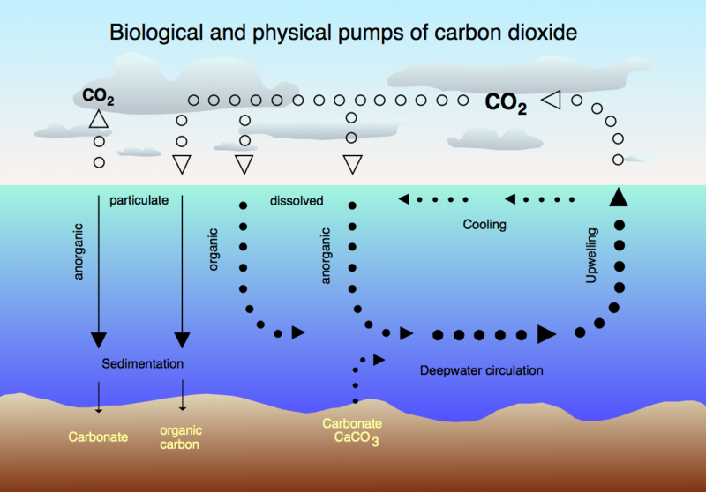
The Ocean-Atmosphere Carbon Cycle
Image credit: Hannes Grobe Alfred Wegener Institute for Polar and Marine Research, Bremerhaven, Germany
Notes:
http://en.wikipedia.org/wiki/File:CO2_pump_hg.png

Slide 37

Ocean biogeochemistry is main long-term sink for atmospheric CO₂
Image credit: Susan Solomon

Slide 38
Spare Slide

Slide 39
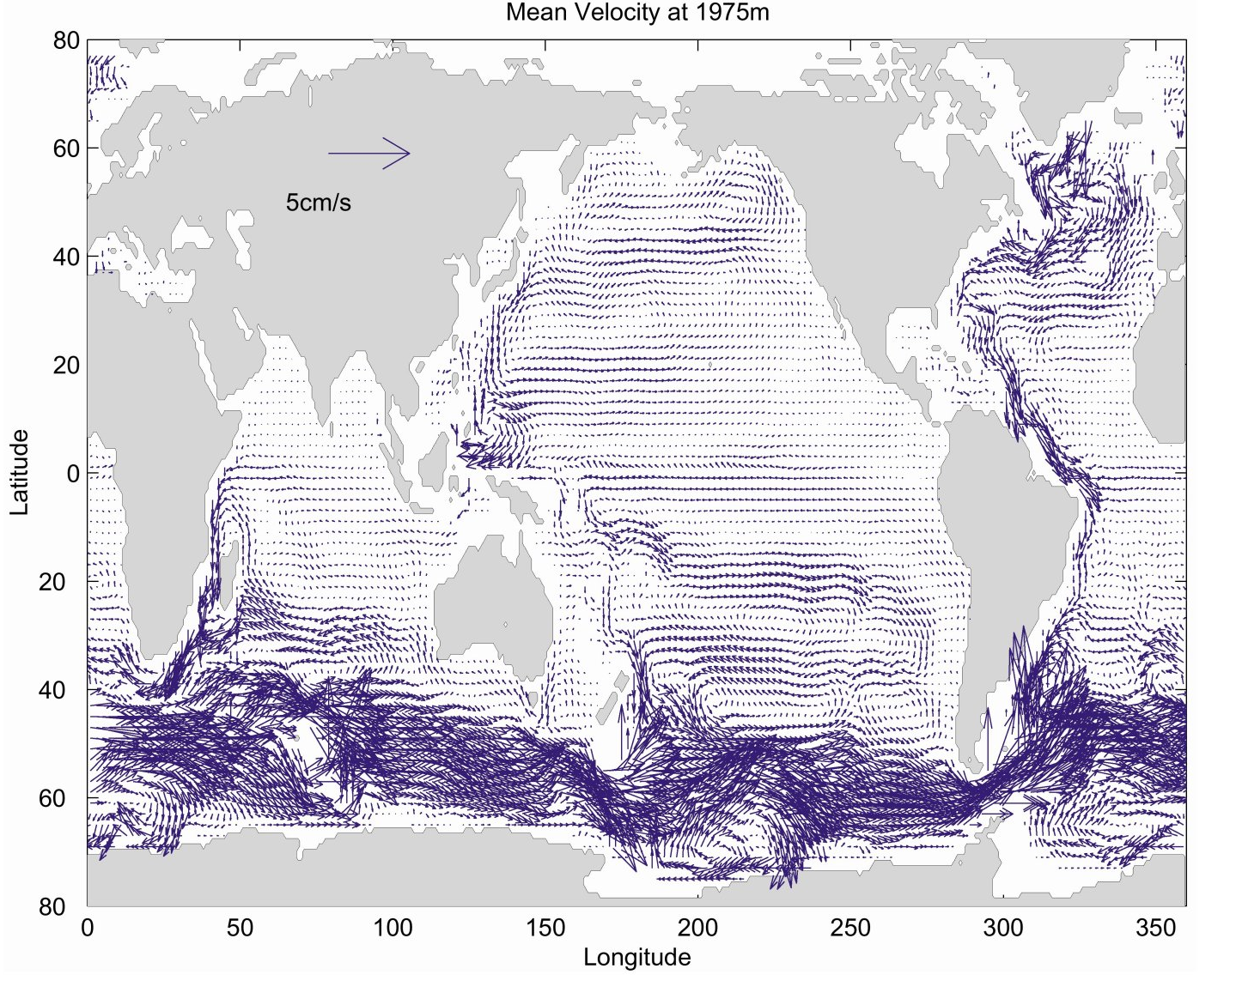
Flow at almost 2 km depth, from a combination of observations and a computational model.
Notes:
http://www.ocean.washington.edu/courses/oc513/
Permission sought from Peter Rhines, U. Washington as of 12/16/2013

