Slide 1

12.340x
Global Warming Science
Kerry Emanuel, Daniel Cziczo, and David McGee, Instructors
With Introductions by
Heidi Cullen

Slide 2

Purpose of this Course
Develop a broad understanding of the earth’s climate system
Understand and use some of the basic tools of climate science
Develop an awareness of possible consequences of climate change

Slide 3
What this Course is Not
This is not a course about the politics or policies surrounding the issue of global warming

Slide 4
Prerequisites
Calculus, through ordinary differential equations. (Partial differential equations helpful, but not required.)
Basic mechanics and electromagnetism
Some background in thermodynamics will be helpful

Slide 5
Course Overview

Slide 6
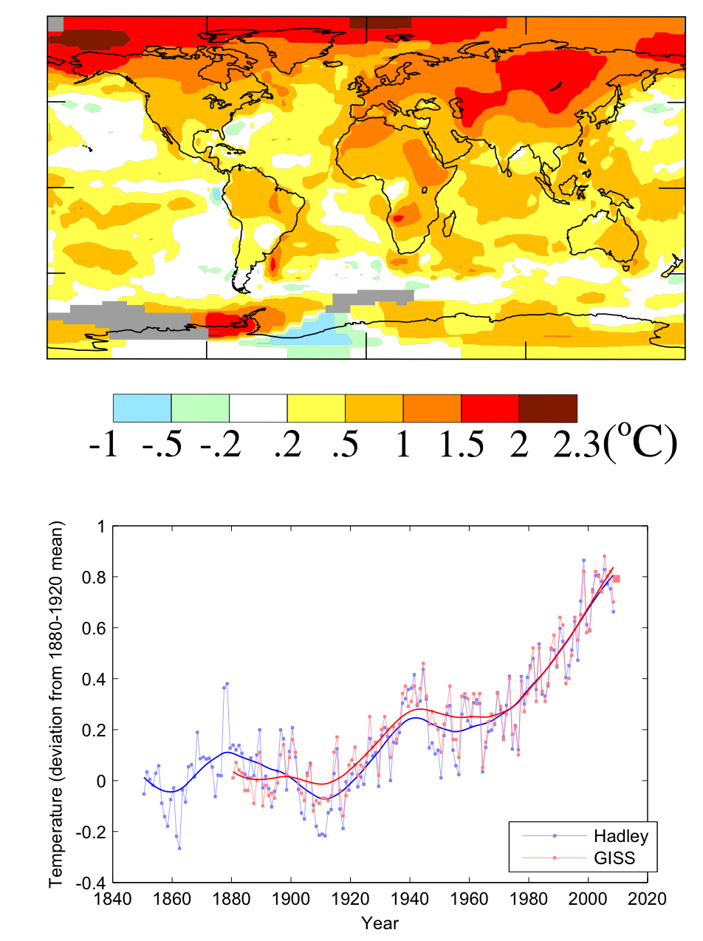
Mean temperature change between 1950’s and 2000’s
The World is Warming. Why?
Global average temperature change from 1850

Slide 7
Central Questions
What is climate?
What physical, chemical, and biological processes control climate?
How has earth’s climate varied since the formation of the planet, and why?
How has climate been varying on human time scales, and why?
What tools are used to study climate?
How might climate change in the future?

Slide 8
Definition of “Climate”
Popular definitions:
  Climate is the average weather
  Climate is what you expect, weather is what you get
Technical usage:
  “Climate” is the statistics of weather
    This includes not just the average weather, but the statistics of its variability
    Commonly calculated over periods of one year or more

Slide 9
Definition of “Climate”
Popular definitions:
  Climate is the average weather
  Climate is what you expect, weather is what you get
Technical usage:
  “Climate” is the statistics of weather
    This includes not just the average weather, but the statistics of its variability
    Commonly calculated over periods of one year or more

Slide 10
Examples of Climate Variability:
El Niño/La Niña (2-4 years)
“Little ice age” (100 years)
Glacial cycles (20,000-100,000 years)
Paleocene-Eocene Thermal Maximum (onset ~20,000 years; decay ~100,000 years)
Cooling from Cretaceous to present (~50 million years)

Slide 11
Climate Change Through Geologic Time

Slide 12
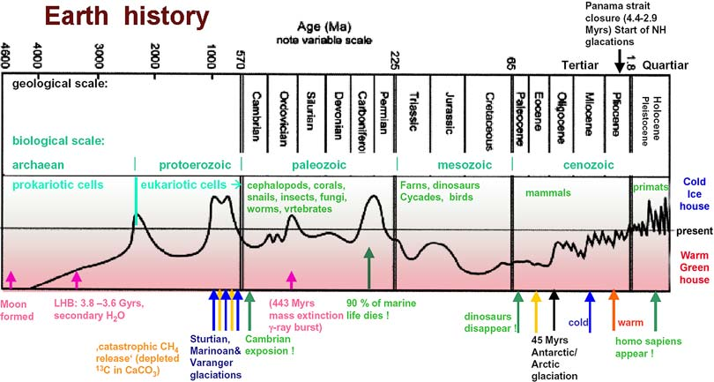

Slide 13
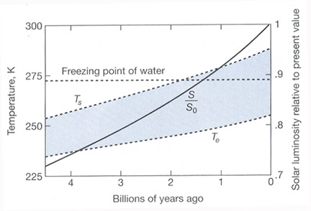
The Faint Young Sun Paradox: Why didn’t the Earth Freeze?

Slide 14
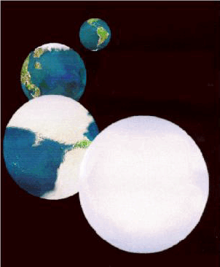
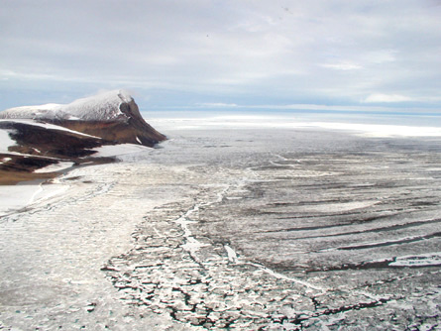
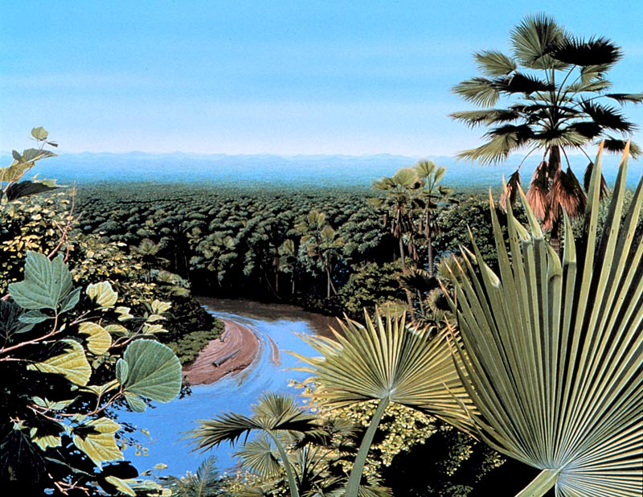
The Snowball Earth

Slide 15
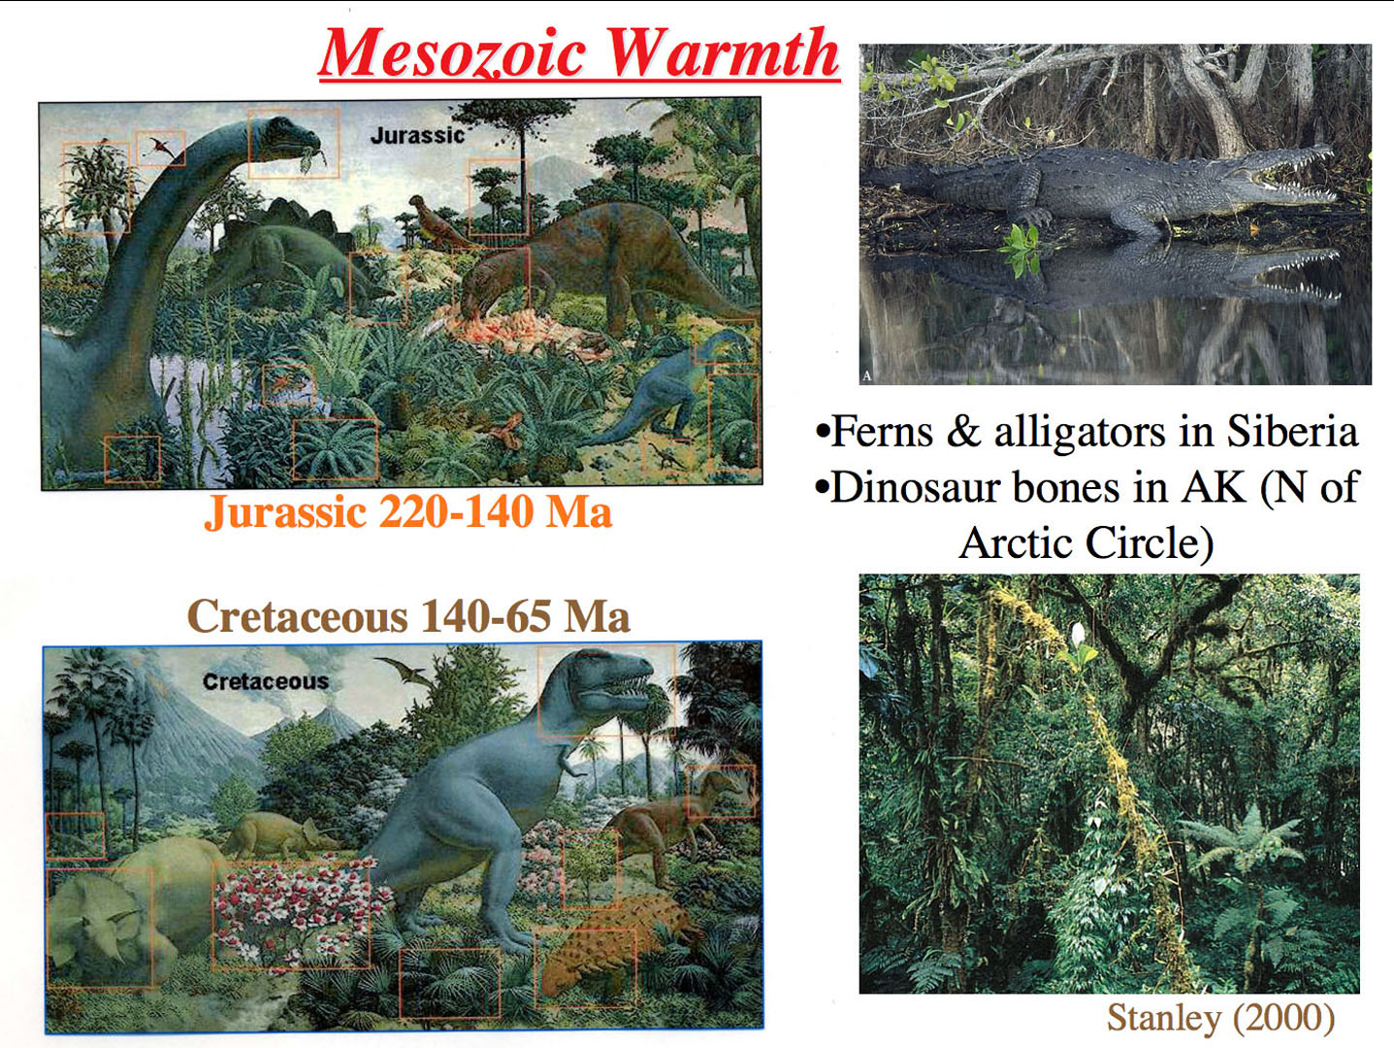
Notes:
Tropical plant & animal fossils found in polar latitudes

Slide 16
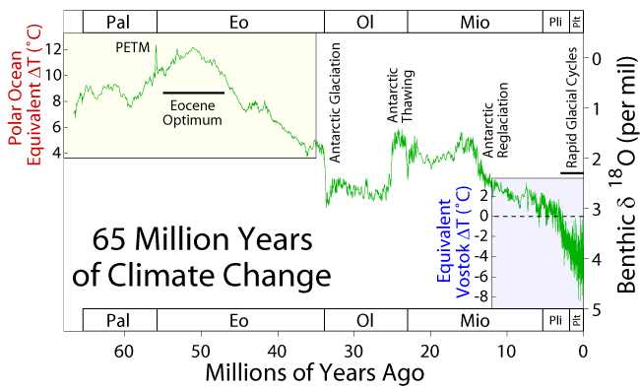
Paleocene-Eocene Thermal Maximum

Slide 17
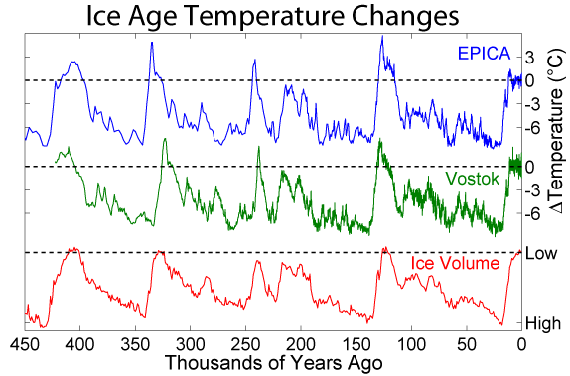
Last 450 Thousand Years

Slide 18
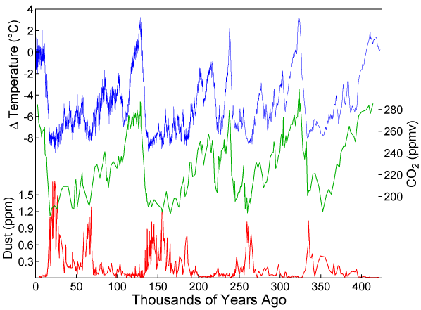
A detailed record of the earth’s climate has emerged over the last few decades, from analyses of ice cores and deep sea sediments

Slide 19
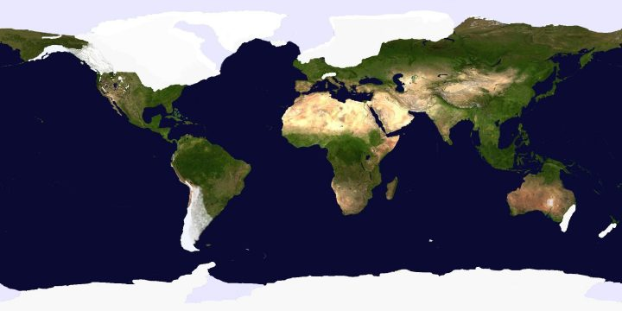
Ice Cover, Last Glacial Maximum (~18,000 years ago)
Notes:
19

Slide 20


Slide 21

Paleo reconstructions of temperature change over the last 2000 years
“Hockey Stick”
Instrumental Record
Year
Notes:
21

Slide 22
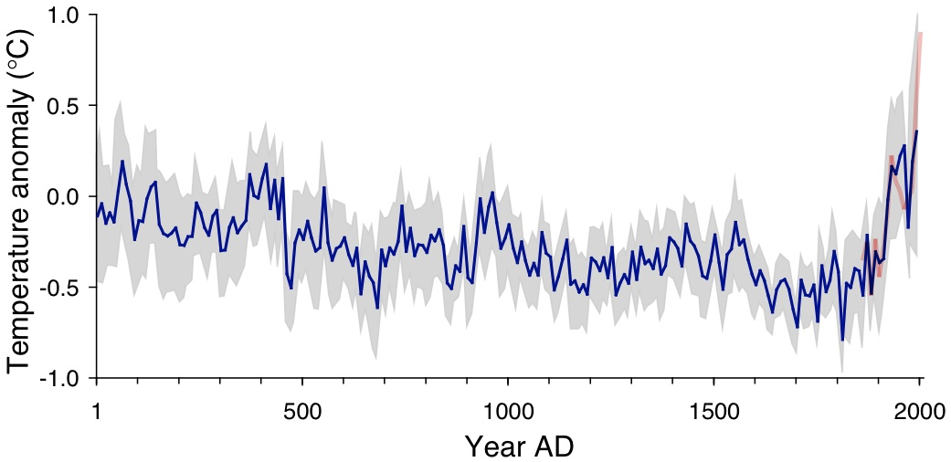
Arctic air temperature change reconstructed (blue), observed (red)
The long-term cooling trend in the Arctic was reversed during recent decades. The blue line shows the estimated Arctic average summer temperature over the last 2000 years, based on proxy records from lake sediments, ice cores, and tree rings. The shaded area represents variability among the 23 sites use for the reconstruction. The red line shows the recent warming based on instrumental temperatures. From Kaufman et al. (2009).

Slide 23
Estimates of Global Mean Surface Temperature from the Instrumental Record
Notes:
23

Slide 24
Climate Science
Described by some as the most difficult scientific problem ever faced
Draws on all the major scientific disciplines:
  Chemistry, geology, atmospheric science, oceanography, solar physics, orbital mechanics, biology
  Climate prediction also requires understanding of economics, politics, human psychology
Very much a frontier science

Slide 25
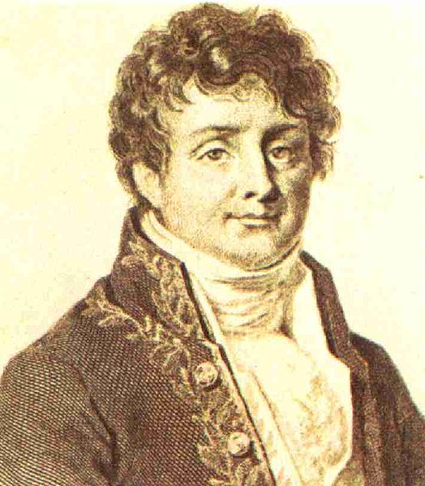


The Greenhouse Effect
Jean Baptiste Joseph Fourier
(1768-1830)
John Tyndall (1820-1893)

Slide 26

Svante Arrhenius, 1859-1927
“Any doubling of the percentage of carbon dioxide in the air would raise the temperature of the earth's surface by 4°; and if the carbon dioxide were increased fourfold, the temperature would rise by 8°.” – Världarnas utveckling (Worlds in the Making), 1906

Slide 27

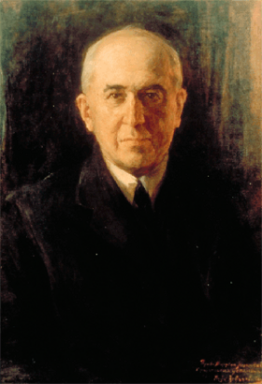
Climate Forcing by Orbital Variations
Milutin Milanković, 1879-1958

Slide 28
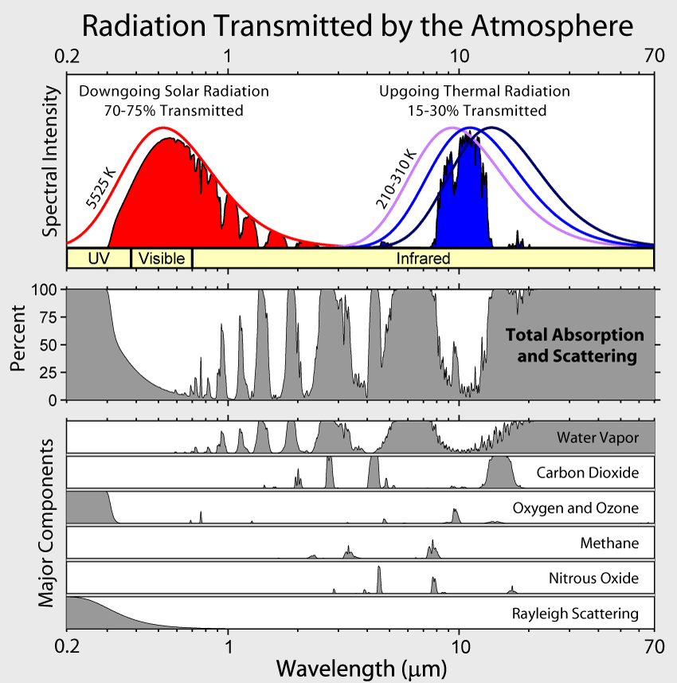

Slide 29
Elements of the Greenhouse Effect

Slide 30
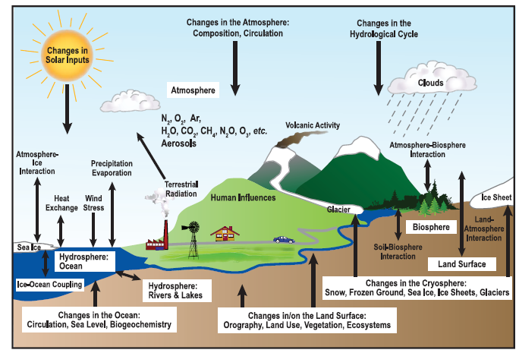
Climate Elements and Feedbacks

Slide 31
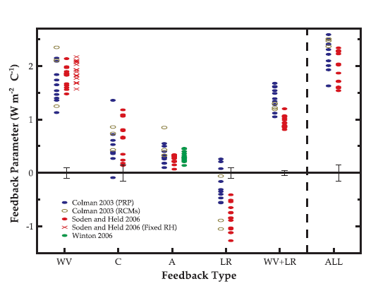
Feedbacks in Climate Models
Water vapor
Cloud
Surface albedo
Lapse rate
Water vapor + lapse rate

Slide 32
Free versus Forced Climate Variability

Slide 33
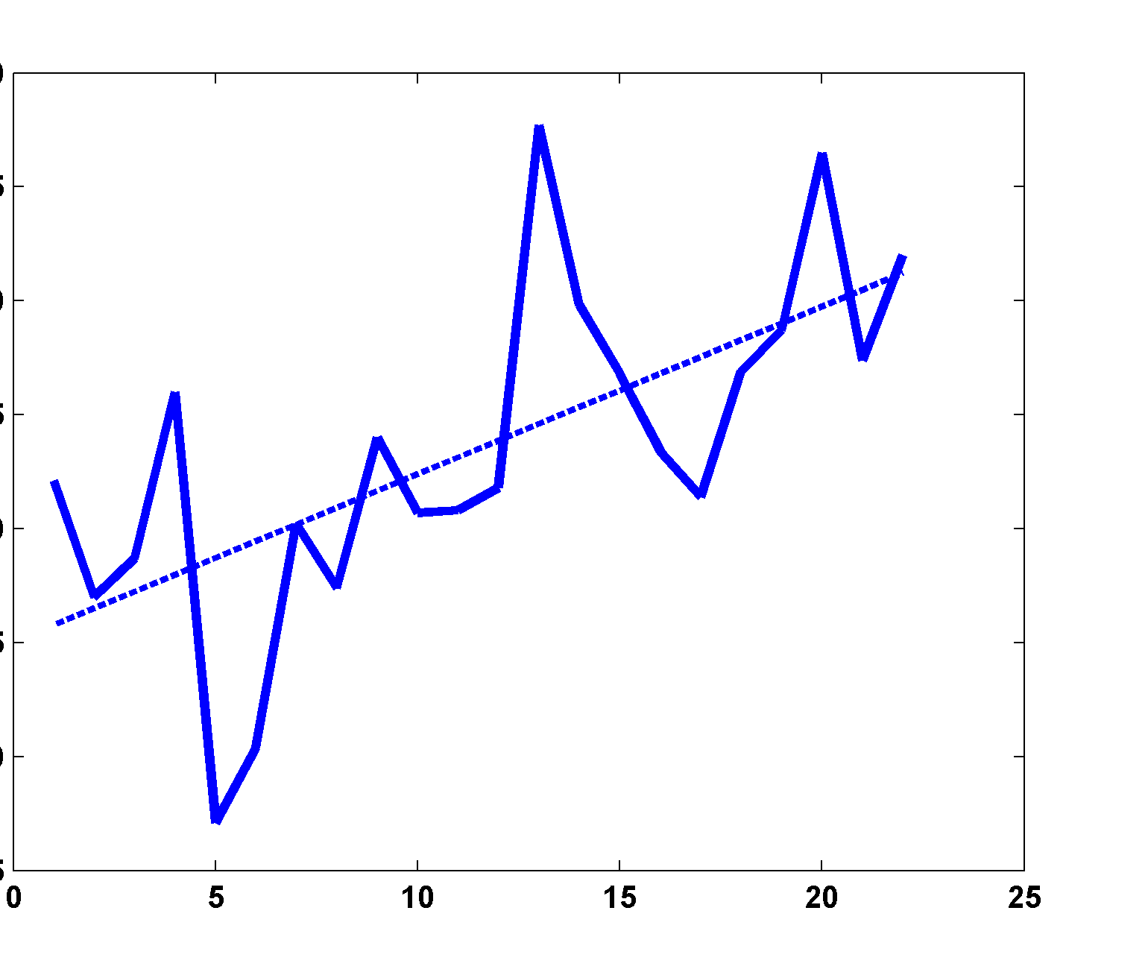
An example
It’s getting warmer!....
Time

Slide 34
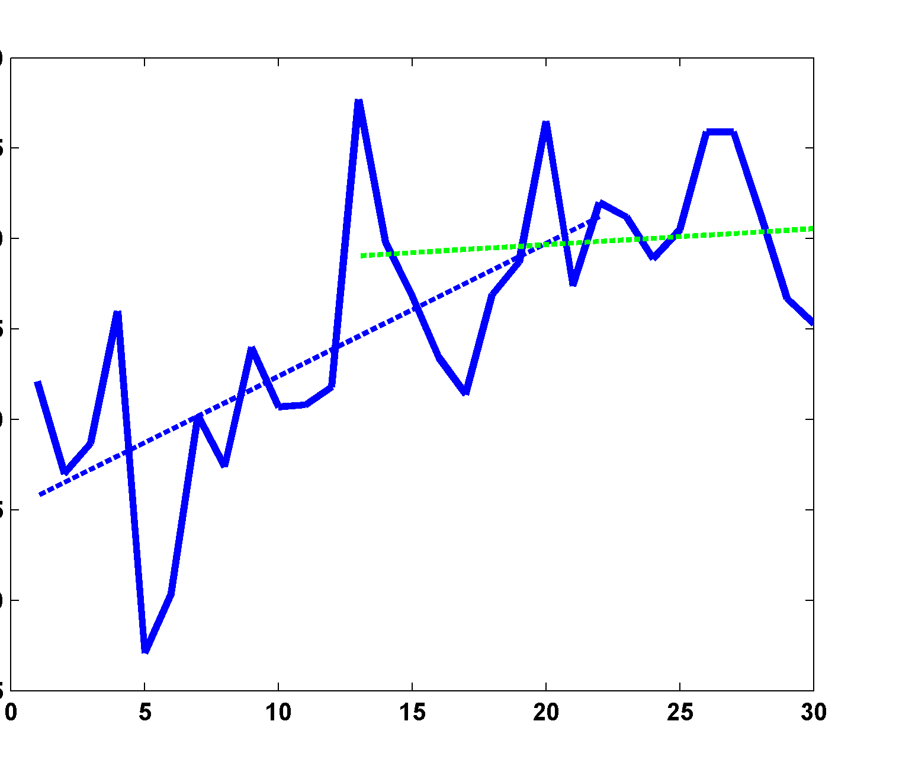
It’s getting warmer!....
No, it’s not! Warming stopped at 13! In fact, 13 was warmer than at any time since then!
Time

Slide 35
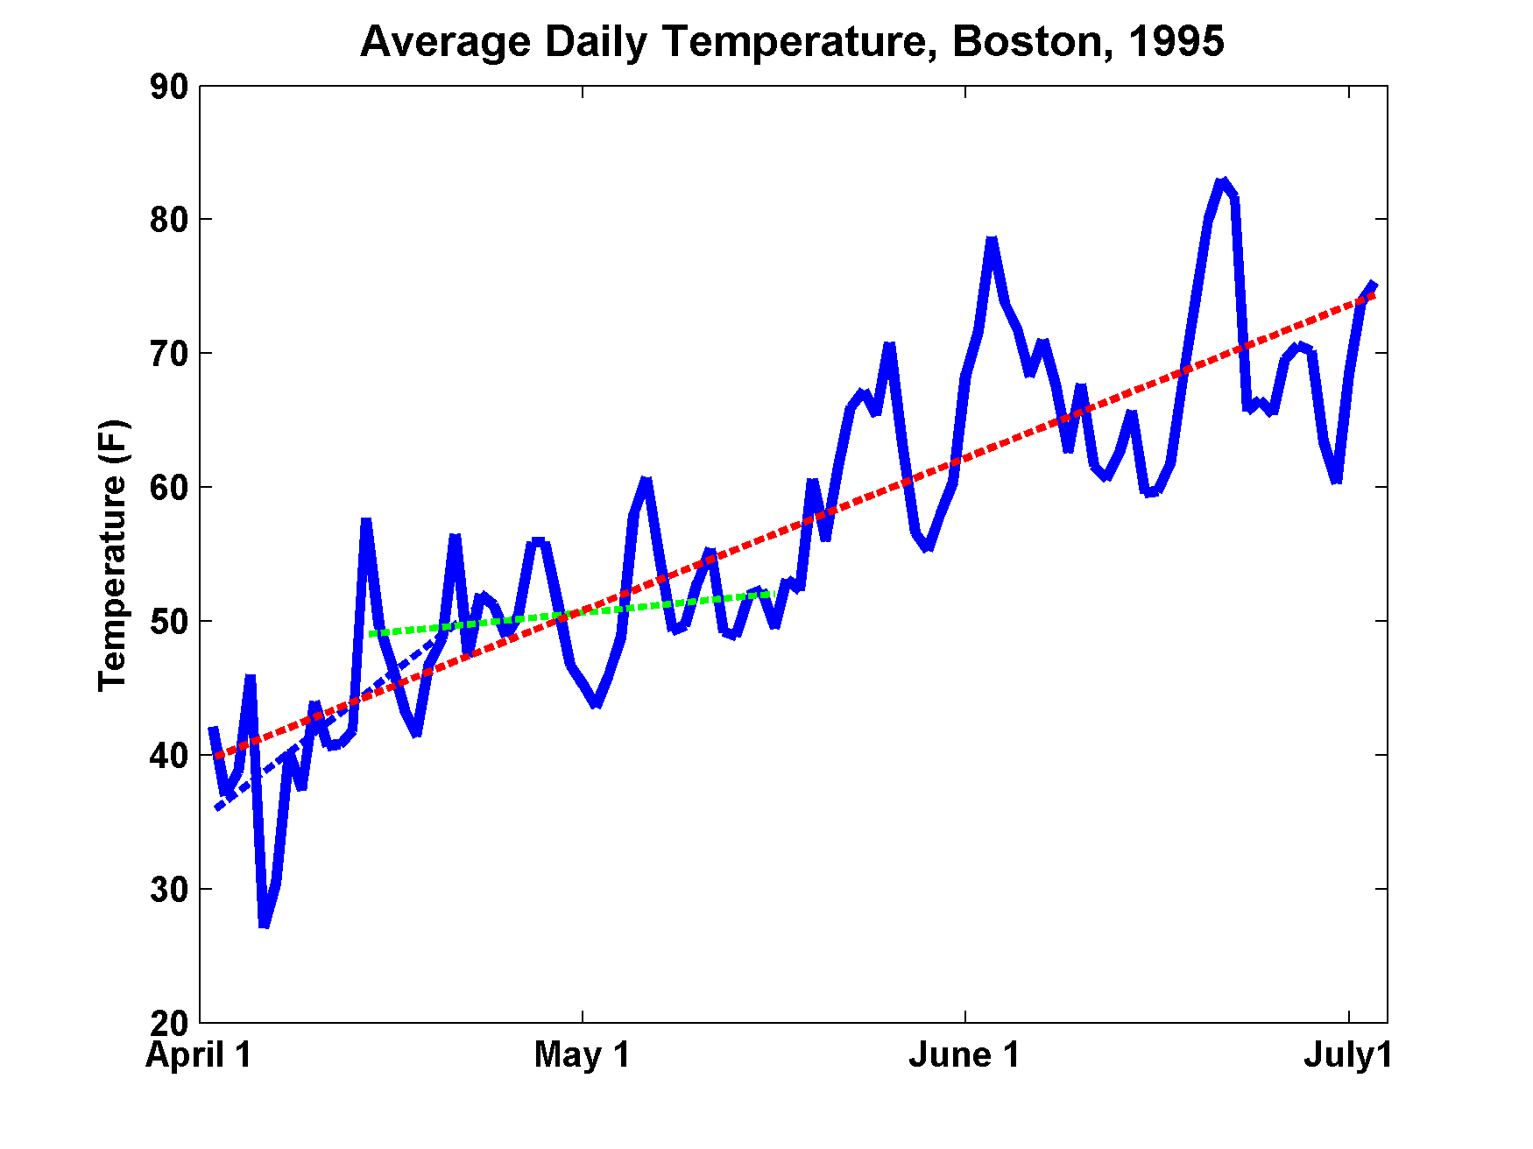
0 30 60 90

Slide 36
Average Daily Temperature, Boston, 1995
Note: We can forecast that summer will be warmer than winter, even though we cannot forecast the weather beyond a few days

Slide 37
Climate Forcing, Natural and Otherwise

Slide 38
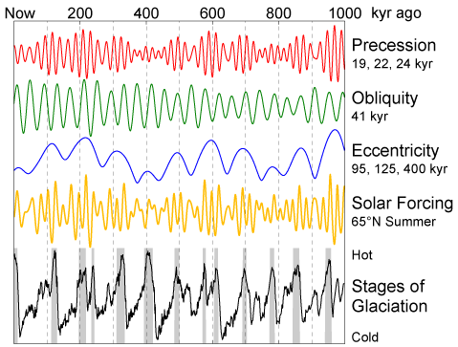
Orbital Forcing and Response

Slide 39
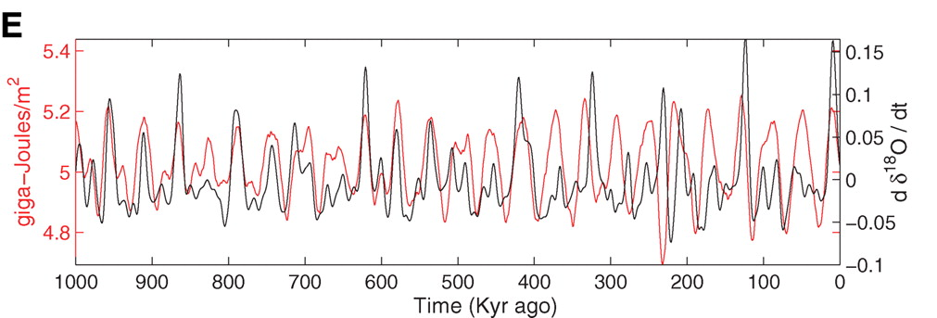
Strong Correlation between High Latitude Summer Insolation and Ice Volume
Black: Time rate of change of ice volume
Red: Summer high latitude sunlight
P. Huybers, Science, 2006

Slide 40
Causes of Recent Climate Change

Slide 41
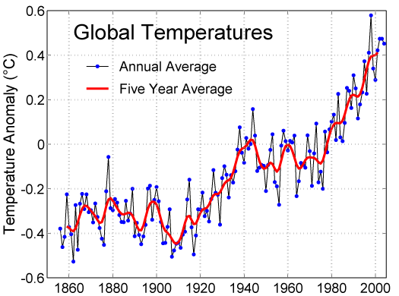

Slide 42
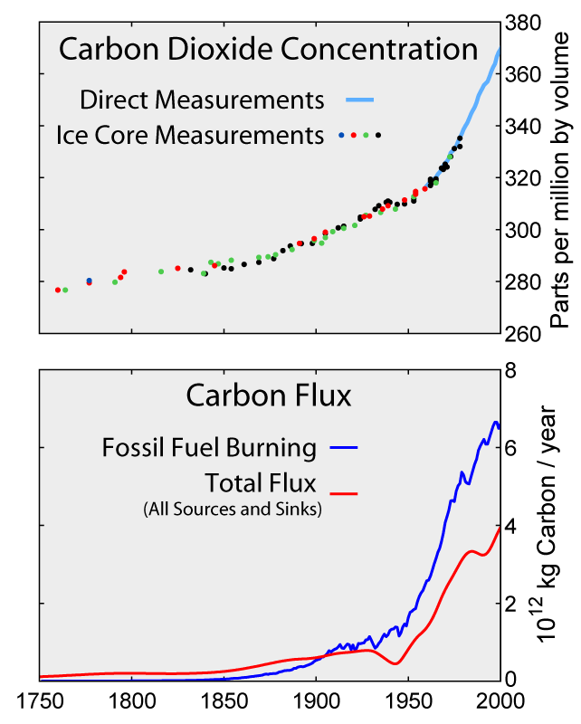

Slide 43
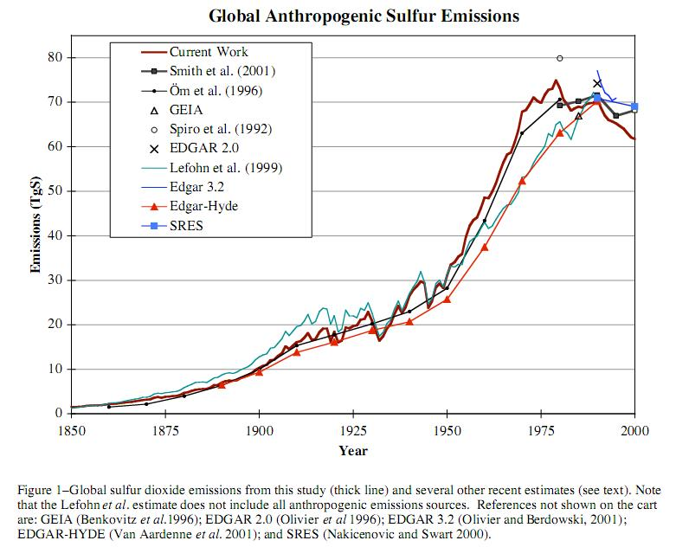

Slide 44
Recent History of Volcanic Eruptions

Slide 45
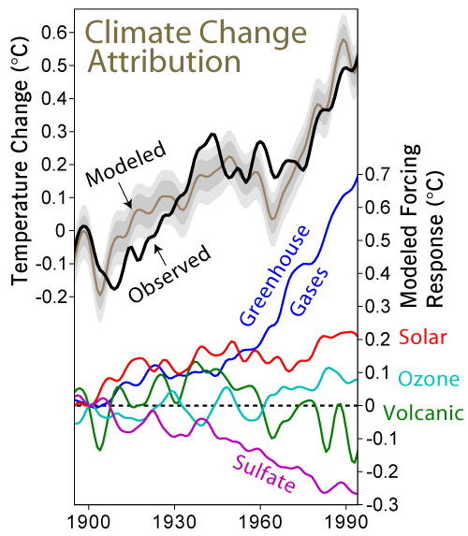

Slide 46
Distribution of temperature change, 1901-2005

Slide 47
Global Climate Models:
How Good Are They, and What Do They Tell Us about The Future?

Slide 48
Global mean temperature (black) and simulations using many different global models (colors) including all forcings

Slide 49
Global mean temperature (black) and simulations using many different global models (colors) including all forcings
Same as above, but models run with only natural forcings

Slide 50
Projected Warming:

Slide 51
Consequences

Slide 52
Greenland surface elevation change, 1989-2005

Slide 53
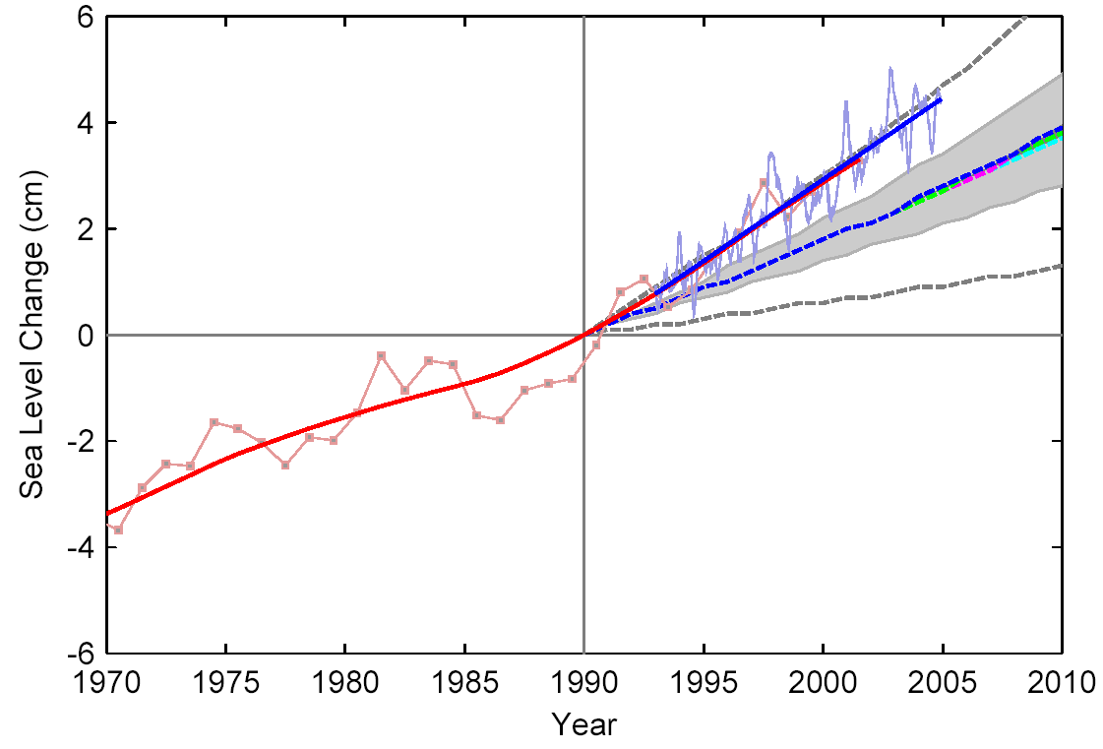
Sea Level Rise
Satellite Altimeter
IPCC
IPCC 2007:
for 1961–2003:
Models 1.2 mm/year
Data 1.8 mm/year
Tide Gauges

Slide 54
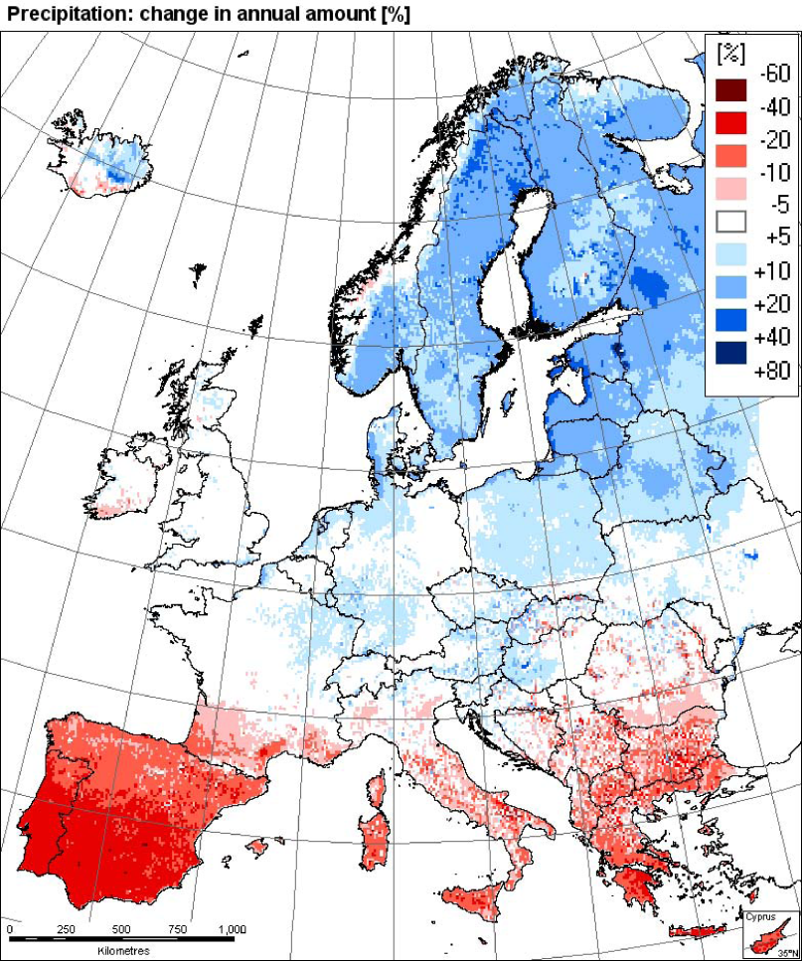
Changes in Precipitation
Observations: trend 1961-2006
Model simulation
Southern Europe
Is drying out
EEA
2008

Slide 55
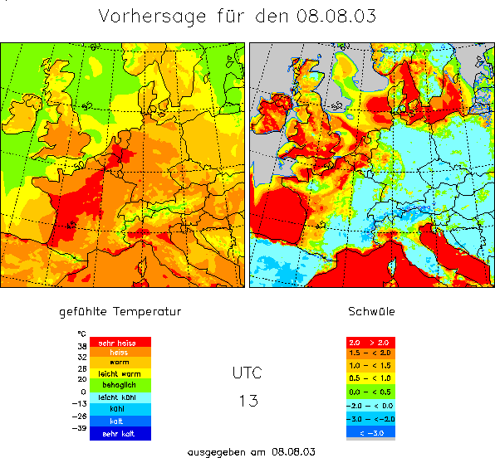
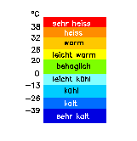
Heat Waves
Mortality and heat stress (8. August 2003, 13 UTC)
Summer 2003,
greatest natural disaster
in Europe
ca. 35.000 fatalities
2,000
†
2,000
†
Heat Stress
7,000
†
extreme
15,000
†
high
moderate
slight
4,000
†
leicht
mäßig
hoch
1,500
†
Mortality data: Earth Policy Institute
Heat Stress: Deutscher Wetterdienst
4,000
†
extrem
Kältestress
© 2007 Geo Risks Research, Munich Re

Slide 56
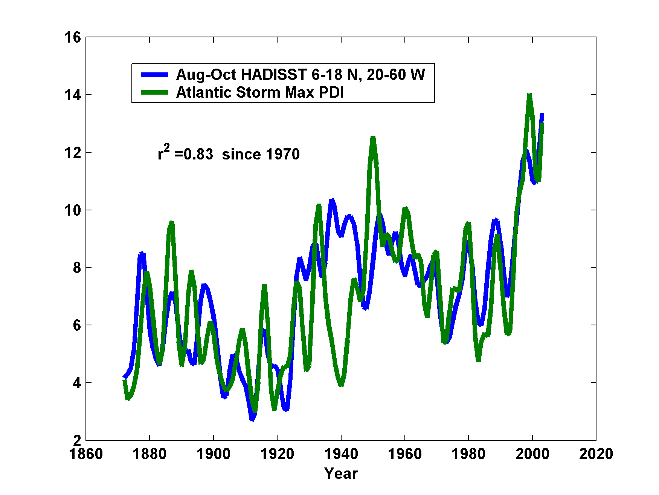
Hurricane Power is Changing in Concert with Tropical Ocean Temperature

Slide 57
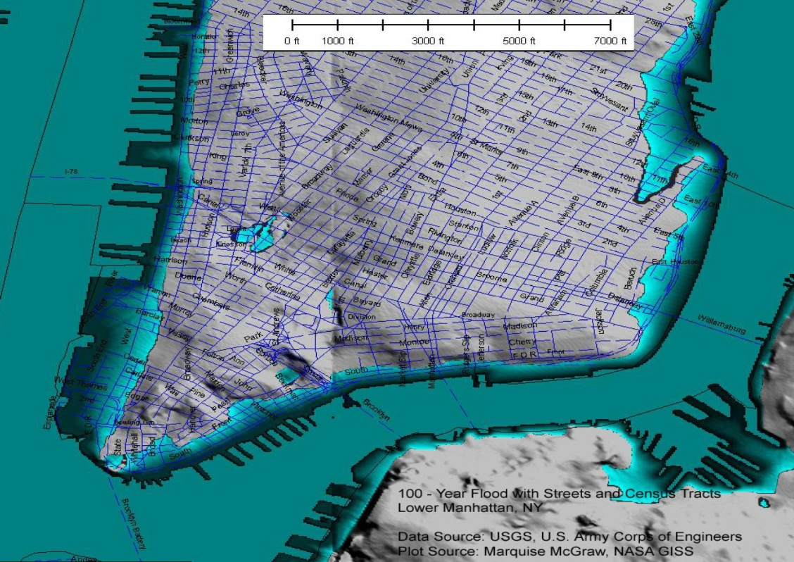
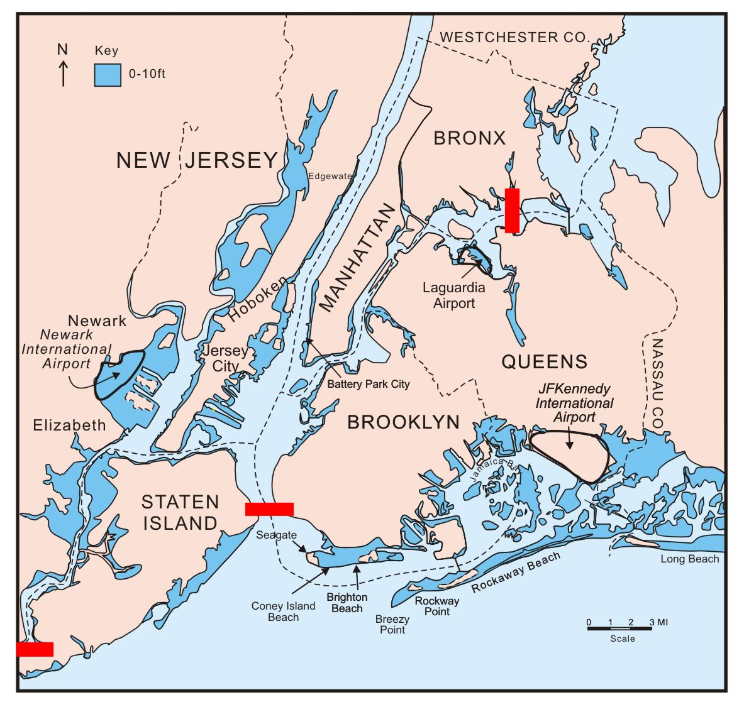
Storm Surge Risk in New York
Today: once in 100 years
After 1 m rise: once in 3 years
Notes:
„Kein Wissenschaftler sagt eine Überschwemmung New Yorks voraus, das bleibt allein dem Politiker Al Gore vorbehalten und den Klimahysterikern in Deutschland,“ so Report München am 9. Juli 2007.

Slide 58

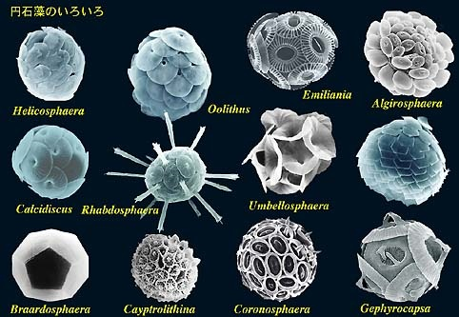
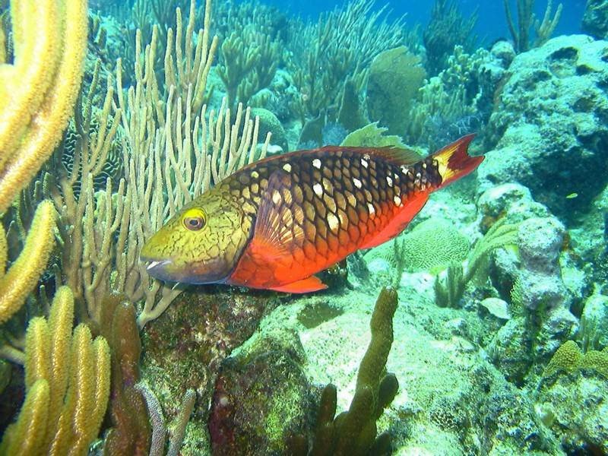
The Oceans are Turning Sour
Acidification through CO₂ threatens marine life
Plankton
Coral Reefs
Notes:
Abbildung 4.3-1
Aragonitsättigung und
gegenwärtige Riffstandorte
von Warmwasserkorallen
(blaue Punkte). (a)
vorindustrielle Werte
(ca. 1870, atmosphärische
CO2-Konzentration
280 ppm), (b) Gegenwart
(ca. 2005, 375 ppm CO2), (c)
Zukunft (ca. 2065, 517 ppm
CO2). Der Grad der
Aragonitsättigung (Ù)
bezeichnet das relative
Verhältnis zwischen dem
Produkt der Konzentrationen
von Kalzium- und
Karbonationen und dem
Löslichkeitsprodukt für
Aragonit. Standorte mit
einer Aragonitsättigung
unterhalb von 3,5 sind nur
noch bedingt für riffbildende
Warmwasserkorallen
geeignet (marginal),
unterhalb von 3 sind sie
ungeeignet.
Quelle: Steffen et al., 2004

Slide 59
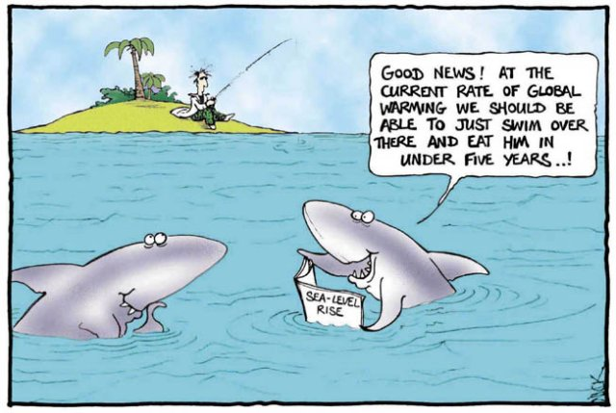
Should He Really Be Worried?
Stay Tuned....

Slide 60
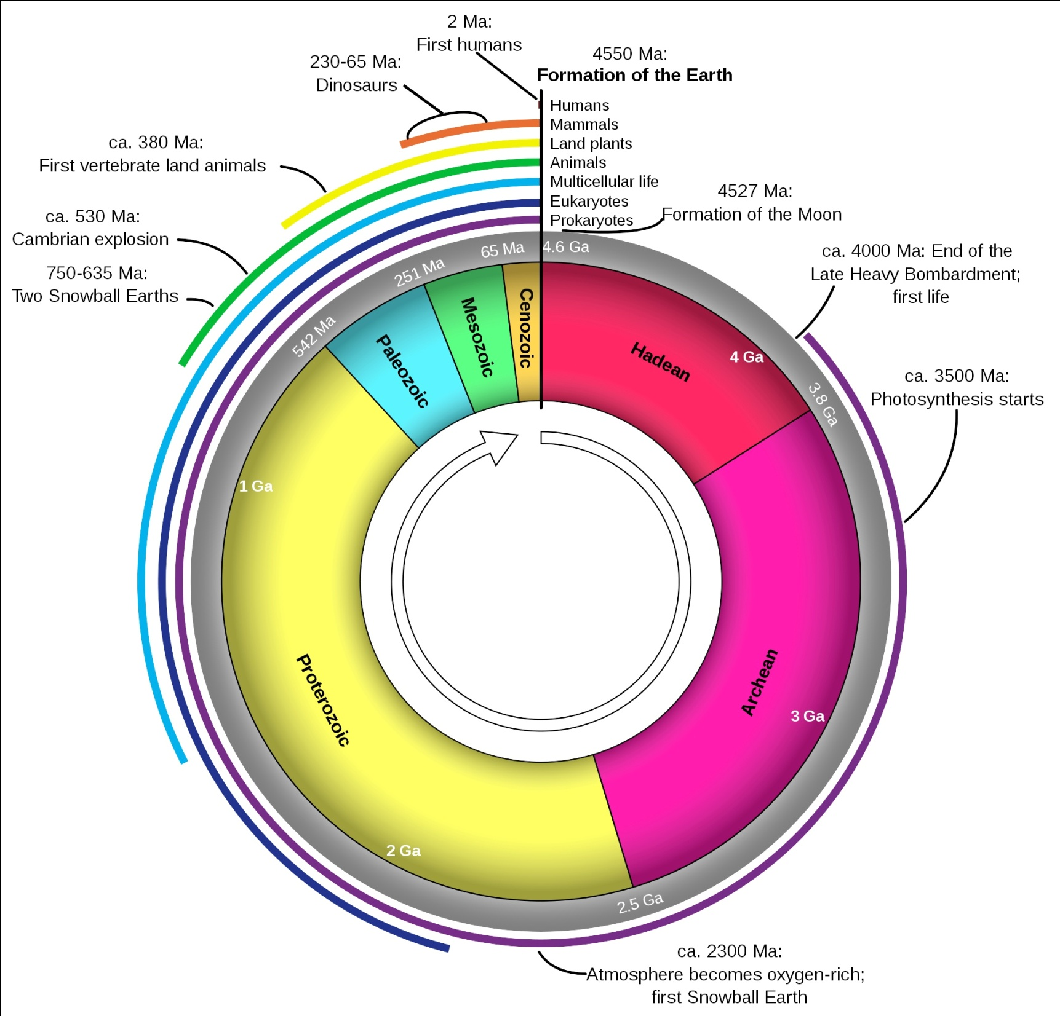
Geologic Time Scale

