Slide 1
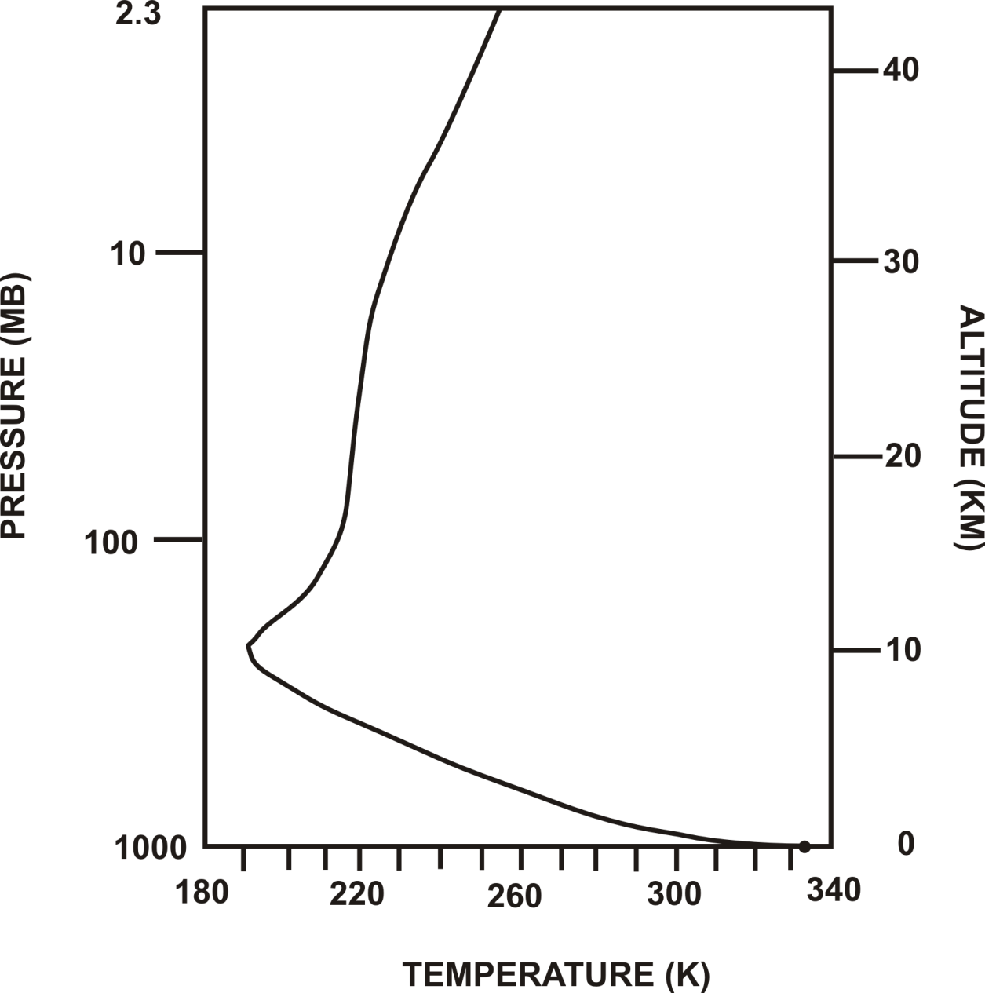
Full calculation of radiative equilibrium

Slide 2
Problems with radiative equilibrium solution
Too hot at and near surface
Too cold at and near tropopause
Lapse rate of temperature too large in the troposphere
(But stratosphere temperature close to observed)

Slide 3
Missing ingredient: Convection
As important as radiation in transporting enthalpy in the vertical
Also controls distribution of water vapor and clouds, the two most important constituents in radiative transfer

Slide 4
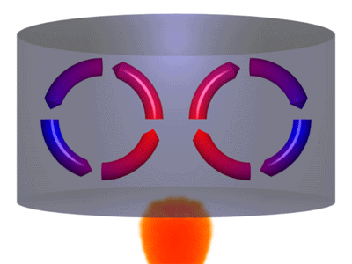

Slide 5
When is a fluid unstable to convection?
Stability
Pressure and hydrostatic equilibrium
Buoyancy

Slide 6
Stability

Slide 7
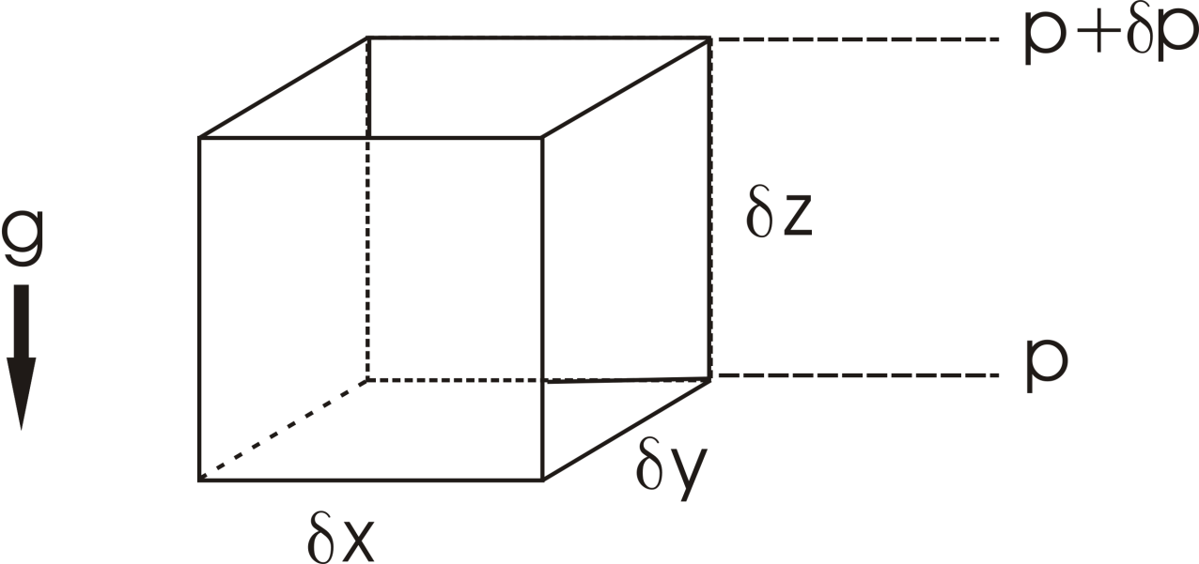
Hydrostatic equilibrium

Slide 8
Hydrostatic equilibrium

Slide 9
Hydrostatic equilibrium

Slide 10
Hydrostatic equilibrium

Slide 11
Hydrostatic equilibrium

Slide 12
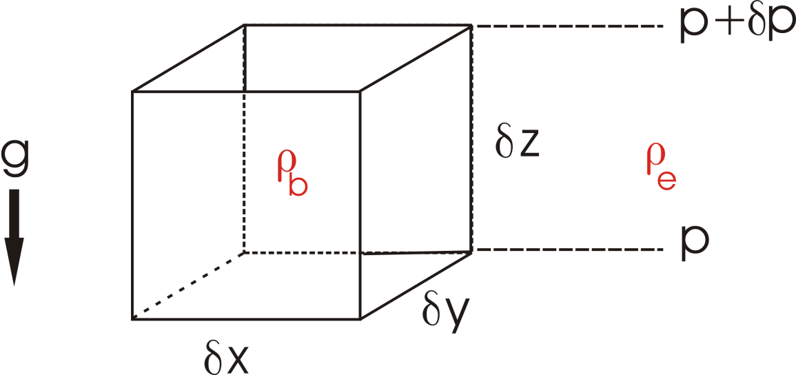
Buoyancy

Slide 13
Buoyancy

Slide 14
Buoyancy

Slide 15
Buoyancy

Slide 16
Buoyancy

Slide 17
Buoyancy

Slide 18
Pressure distribution in atmosphere at rest
Earth: H~ 8 Km

Slide 19
Pressure distribution in atmosphere at rest
Earth: H~ 8 Km

Slide 20
Pressure distribution in atmosphere at rest
Earth: H~ 8 Km

Slide 21
Pressure distribution in atmosphere at rest
Earth: H~ 8 Km

Slide 22
Pressure distribution in atmosphere at rest
Earth: H~ 8 Km

Slide 23
Buoyancy and Entropy
Specific Volume:
Specific Entropy: s

Slide 24
The adiabatic lapse rate

Slide 25
The adiabatic lapse rate

Slide 26
The adiabatic lapse rate

Slide 27
The adiabatic lapse rate

Slide 28
The adiabatic lapse rate

Slide 29
The adiabatic lapse rate

Slide 30
The adiabatic lapse rate

Slide 31
The adiabatic lapse rate

Slide 32
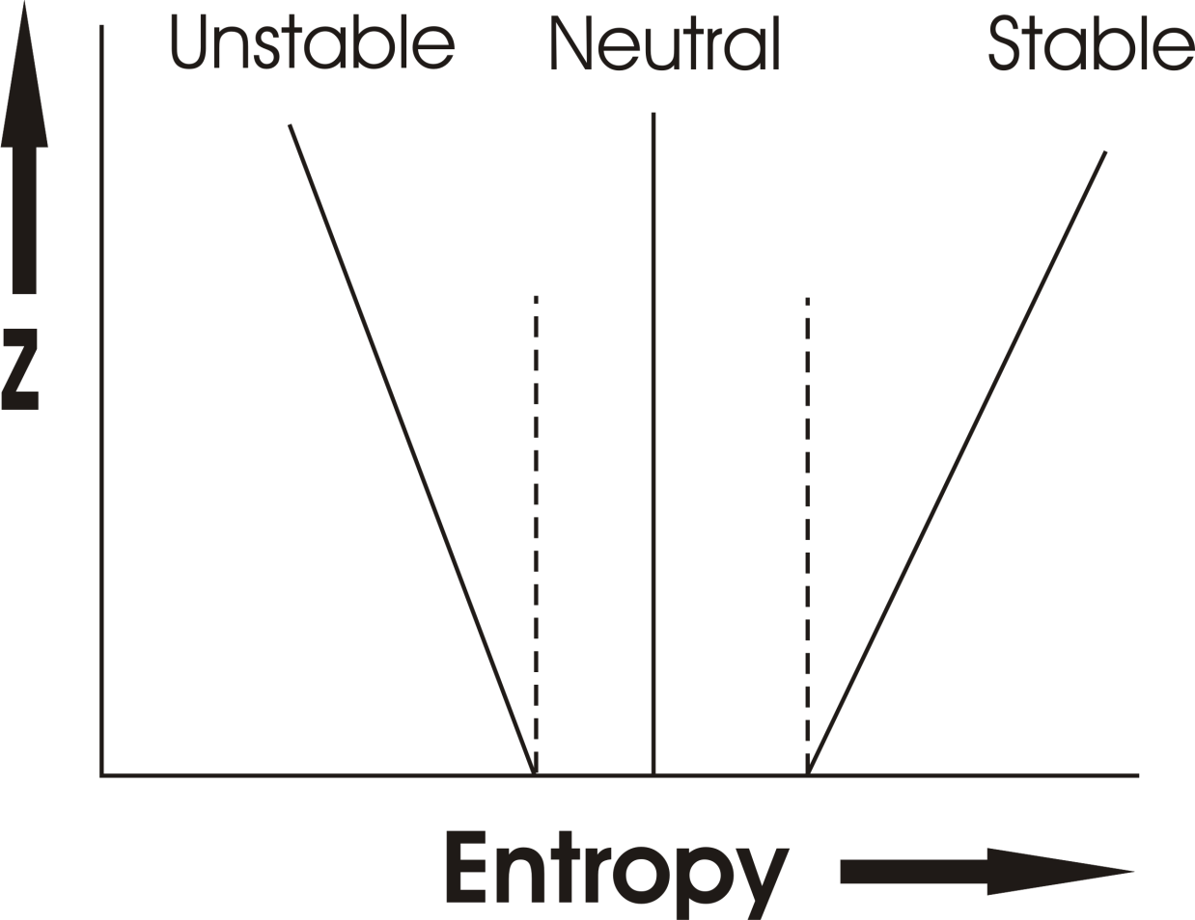
Earth’s atmosphere:

Slide 33
Model Aircraft Measurements (Renno and Williams, 1995)

Slide 34
Radiative equilibrium is unstable in the troposphere Re-calculate equilibrium assuming that tropospheric stability is rendered neutral by convection: Radiative-Convective Equilibrium

Slide 35
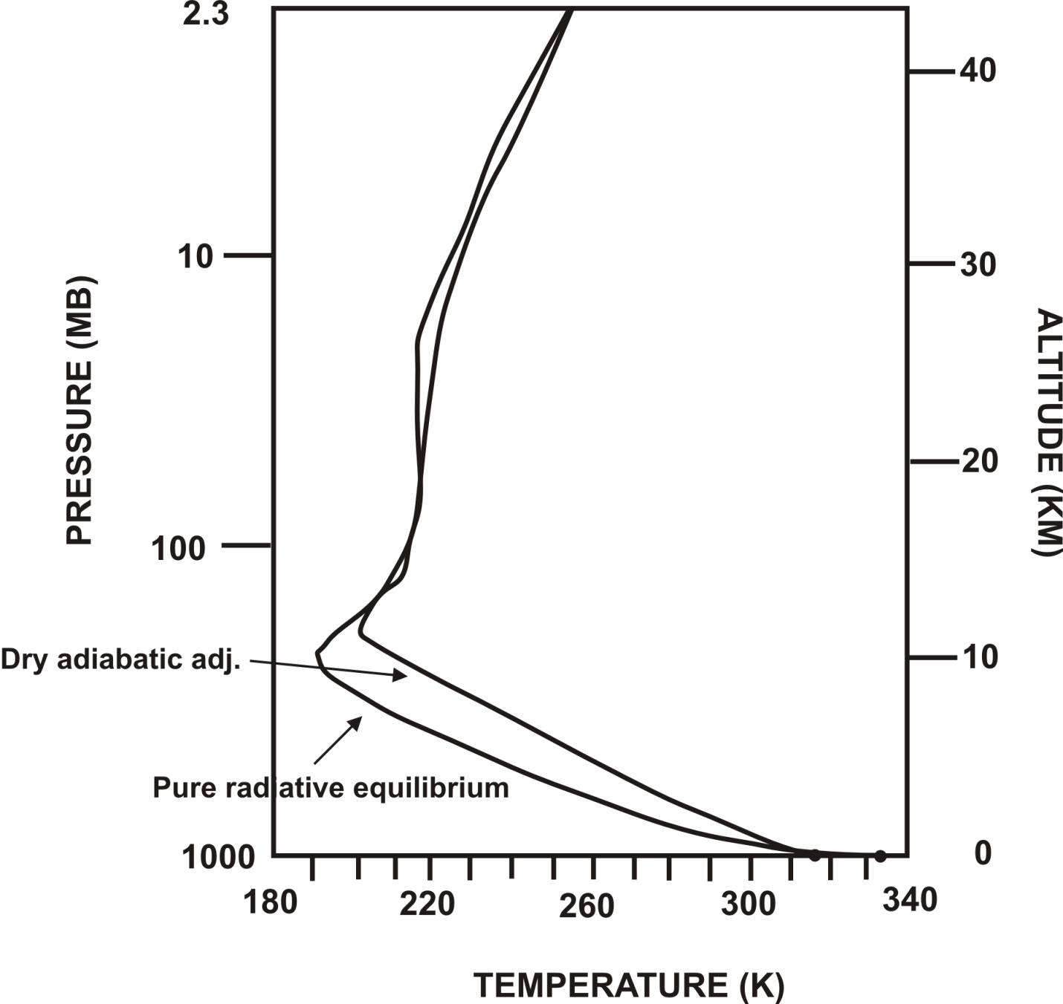
Better, but still too hot at surface, too cold at tropopause

Slide 36
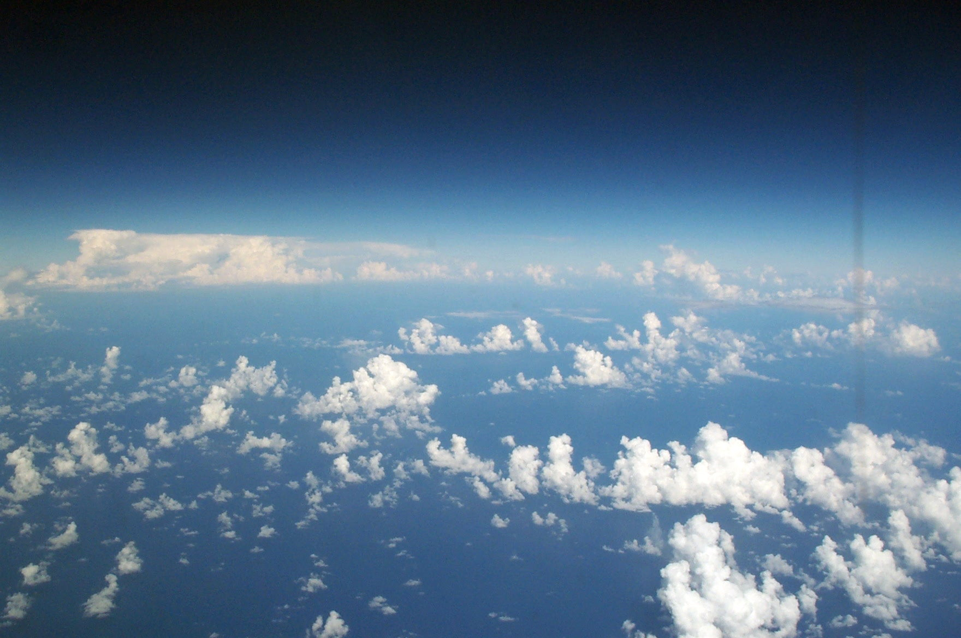
Above a thin boundary layer, most atmospheric convection involves phase change of water: Moist Convection

Slide 37
Moist Convection
Significant heating owing to phase changes of water
Redistribution of water vapor – most important greenhouse gas
Significant contributor to stratiform cloudiness – albedo and longwave trapping

Slide 38
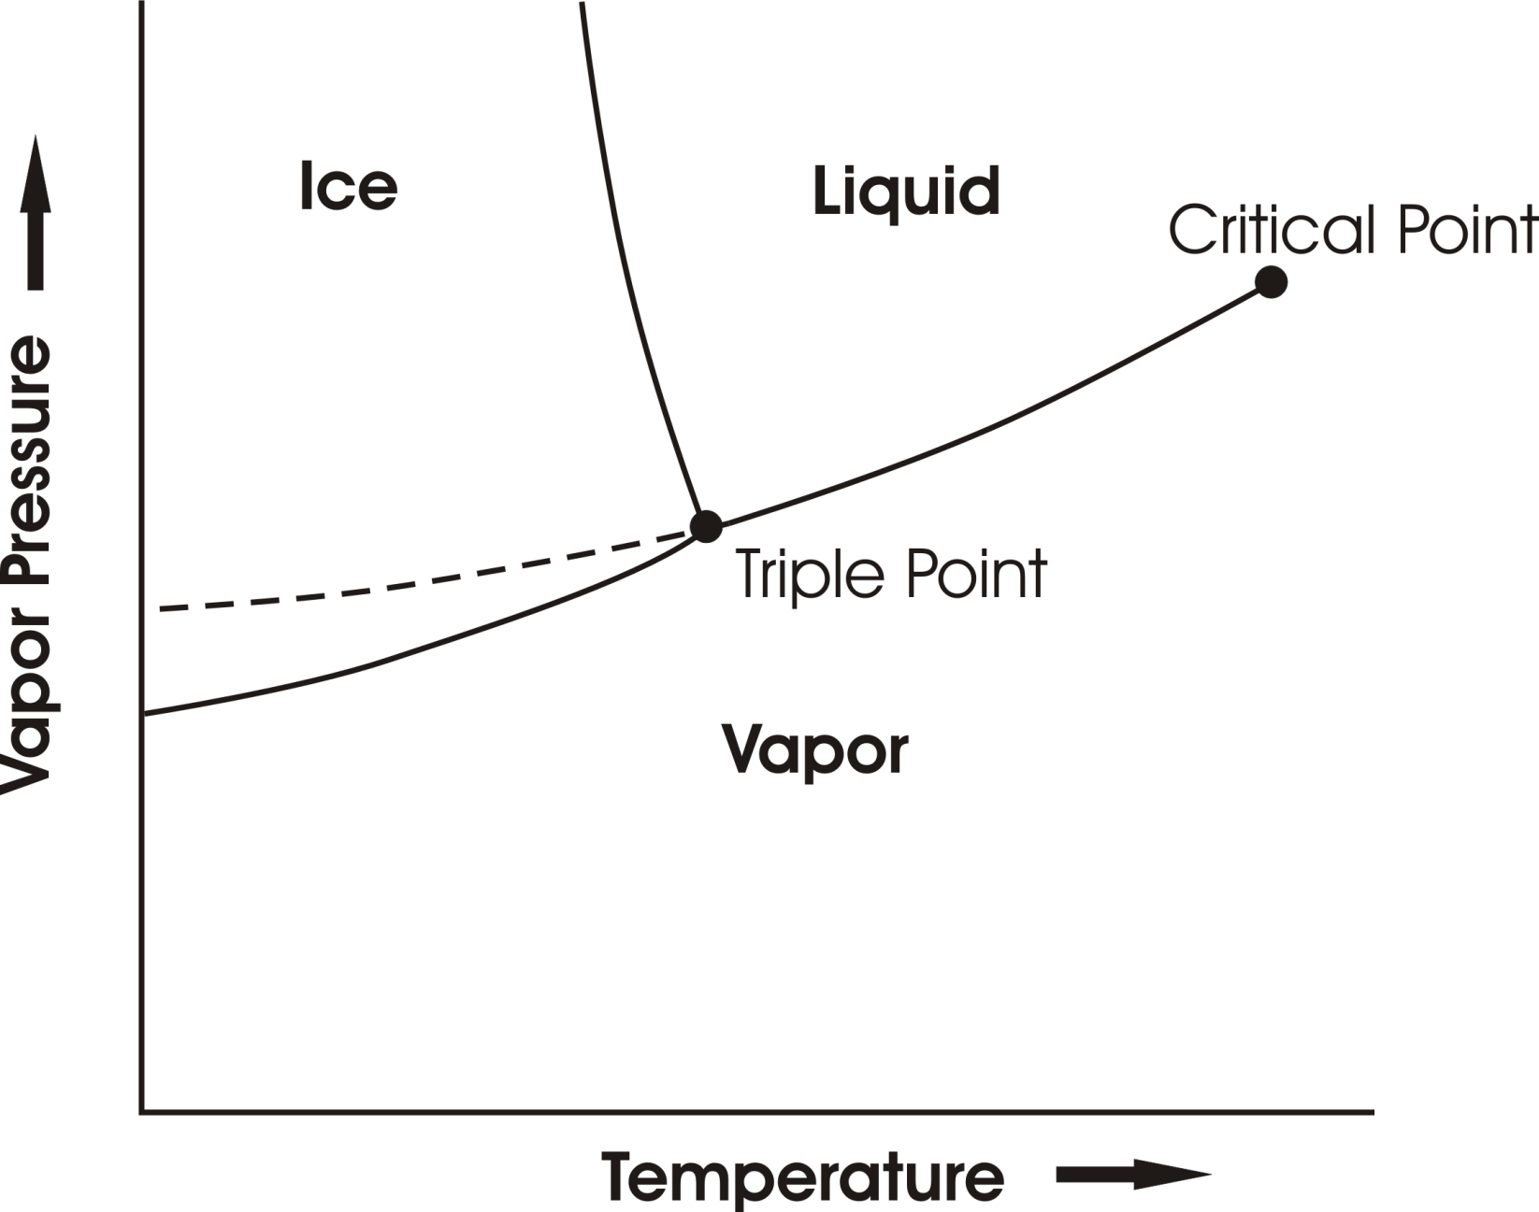
Phase Equilibria

Slide 39
When Saturation Occurs…
Heterogeneous Nucleation
Supersaturations very small in atmosphere
Drop size distribution sensitive to size distribution of cloud condensation nuclei

Slide 40
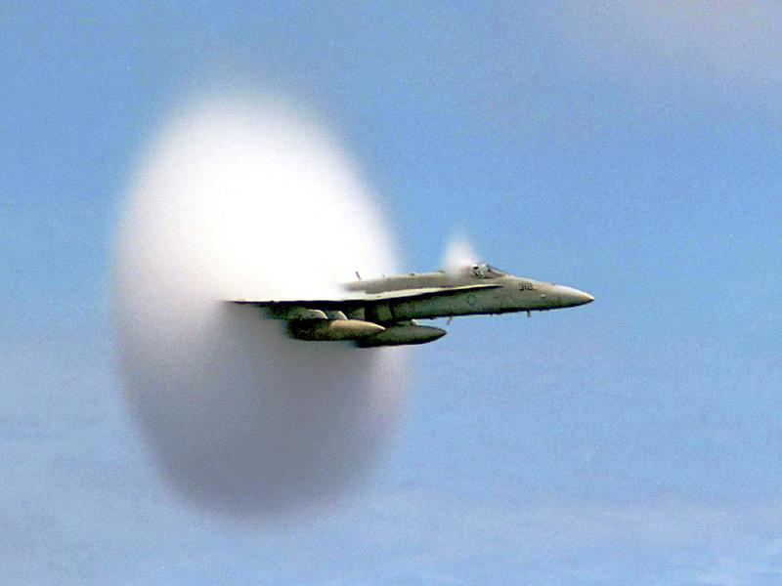

Slide 41
Precipitation Formation
Bergeron-Findeisen Process

Slide 42
Phase Equilibria

Slide 43
Precipitation Formation
Bergeron-Findeisen Process
Stochastic coalescence (sensitive to drop size distributions)
Strongly nonlinear function of cloud water concentration
Time scale of precipitation formation ~10-30 minutes

Slide 44
Stability
No simple criterion based on entropy. But air inside ascending cumulus turrets has roughly the same density as that of it environment. It can be shown that neutral stability corresponds to the constancy of the saturation entropy s*:

Slide 45
Tropical Soundings

Slide 46
Average density difference between reversibly lifted parcels and their environments, deep Tropics

Slide 47
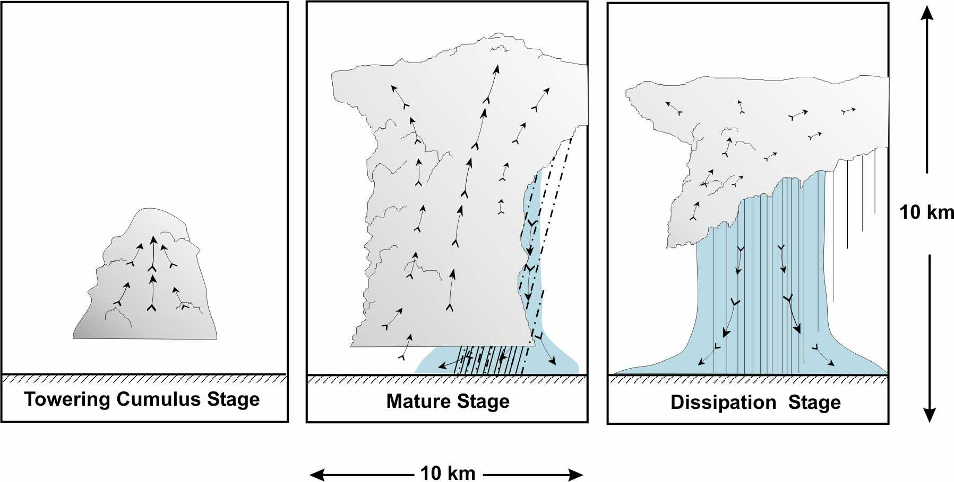
“Air-Mass” Showers:

Slide 48
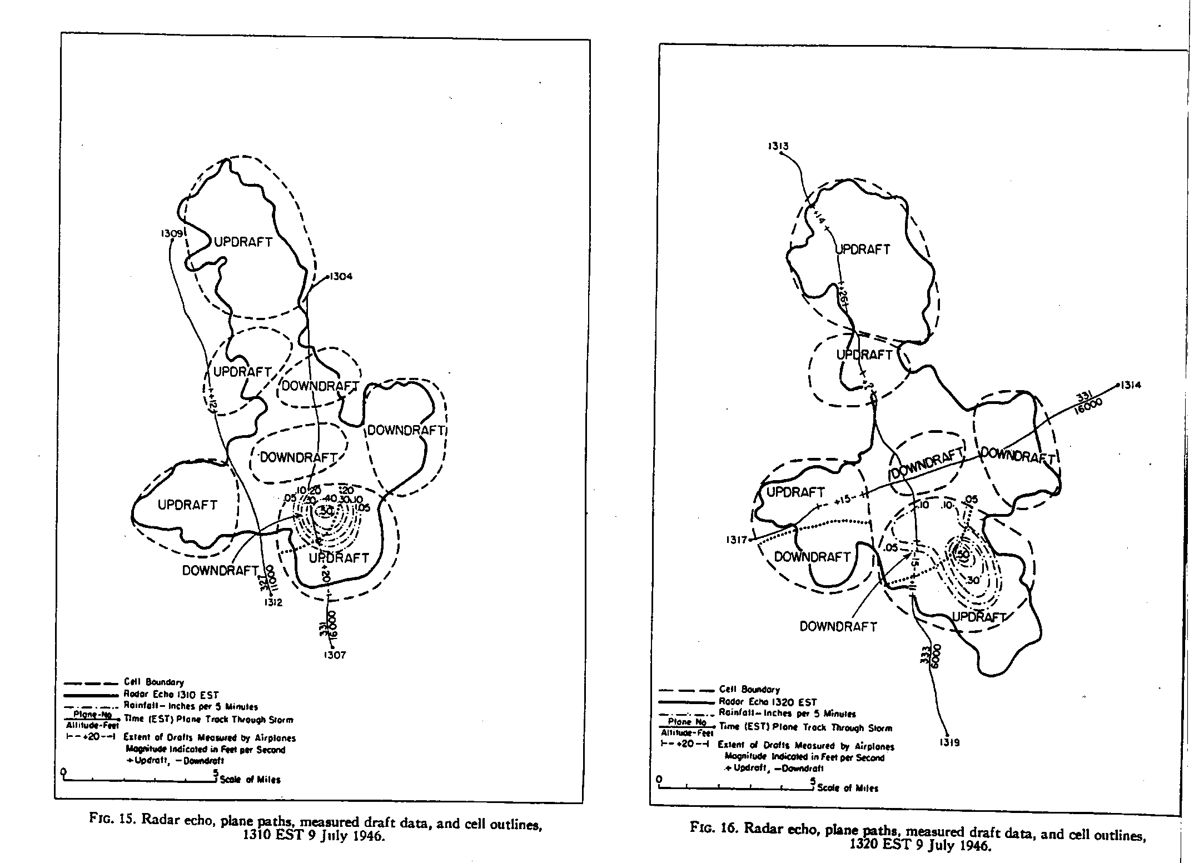

Slide 49
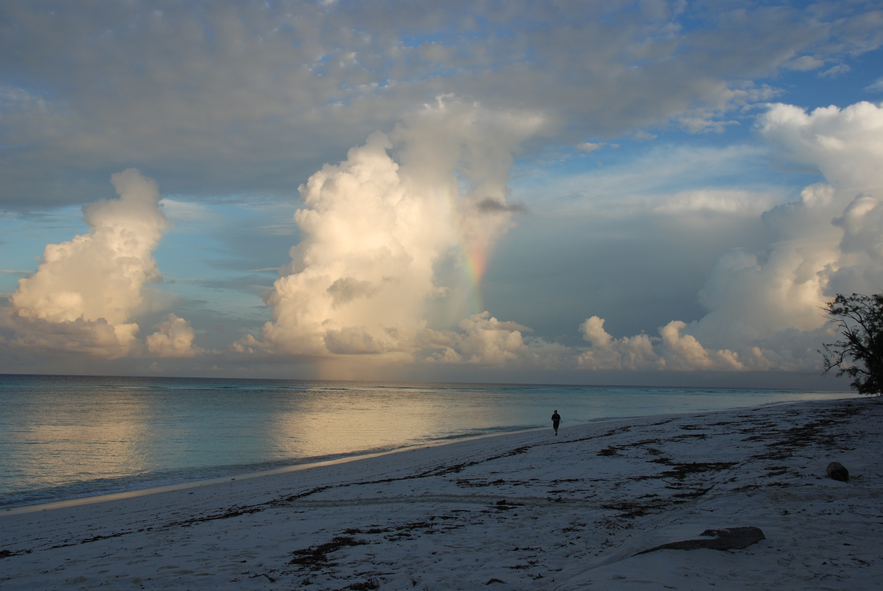

Slide 50
Precipitating Convection favors Widely Spaced Clouds (Bjerknes, 1938)

Slide 52
Properties of Moist Convection
Convective updrafts widely spaced
Surface enthalpy flux equal to vertically integrated radiative cooling
Precipitation = Evaporation = Radiative Cooling
Radiation and convection highly interactive

Slide 53
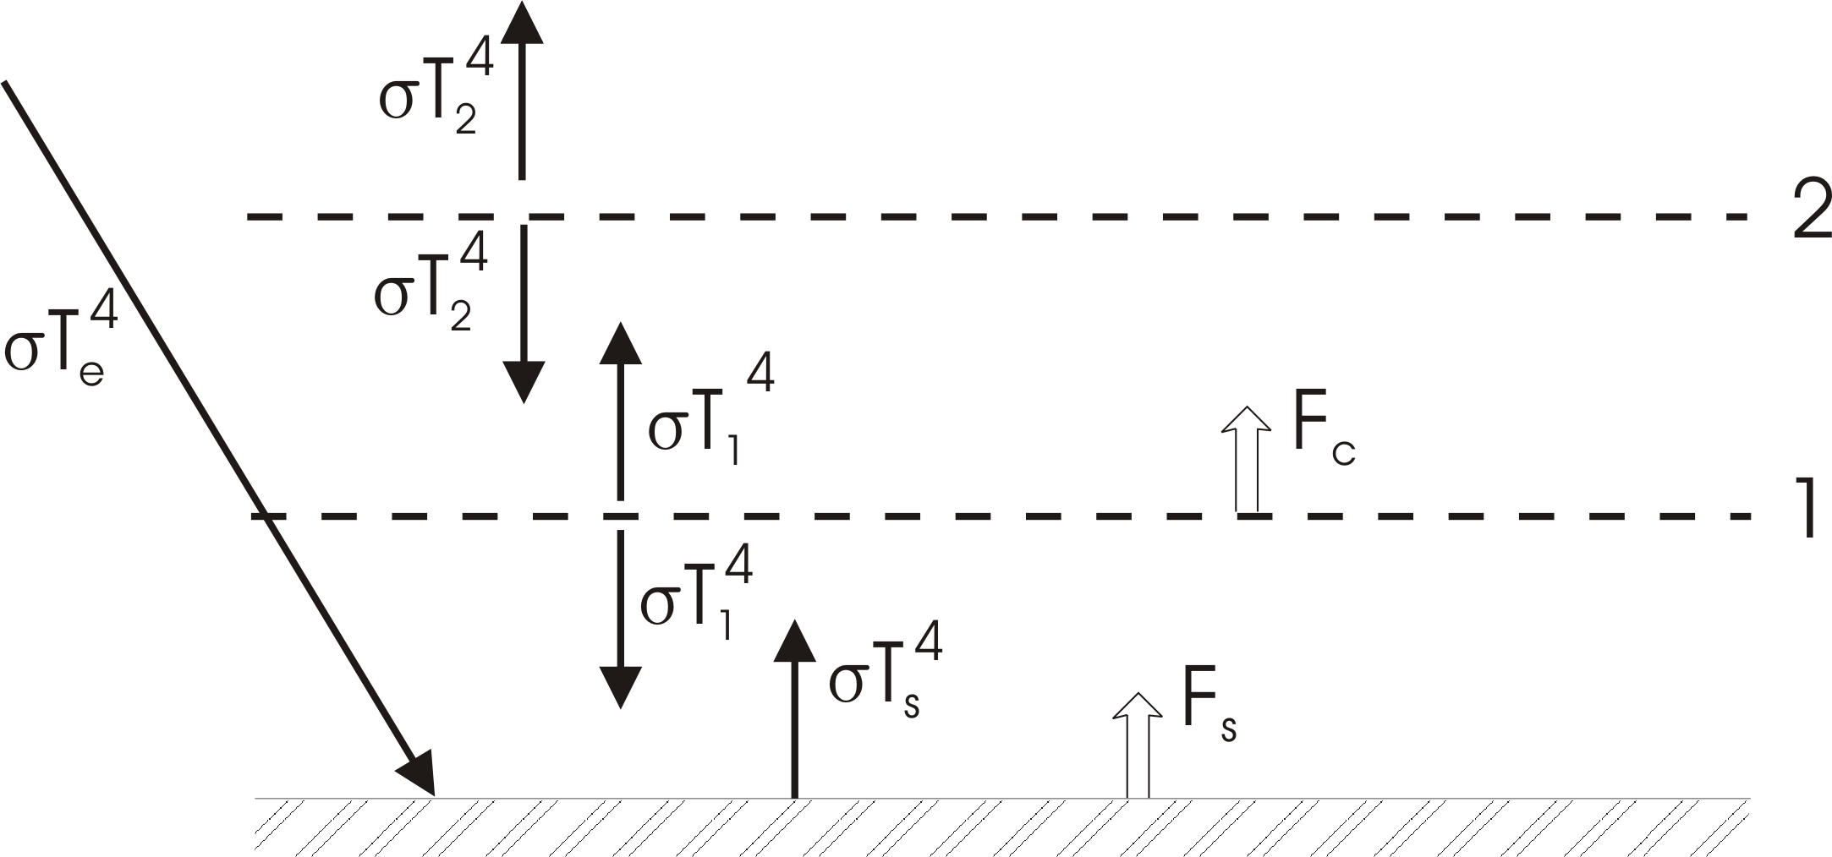
Simple Radiative-Convective Model
Enforce convective neutrality:

Slide 54
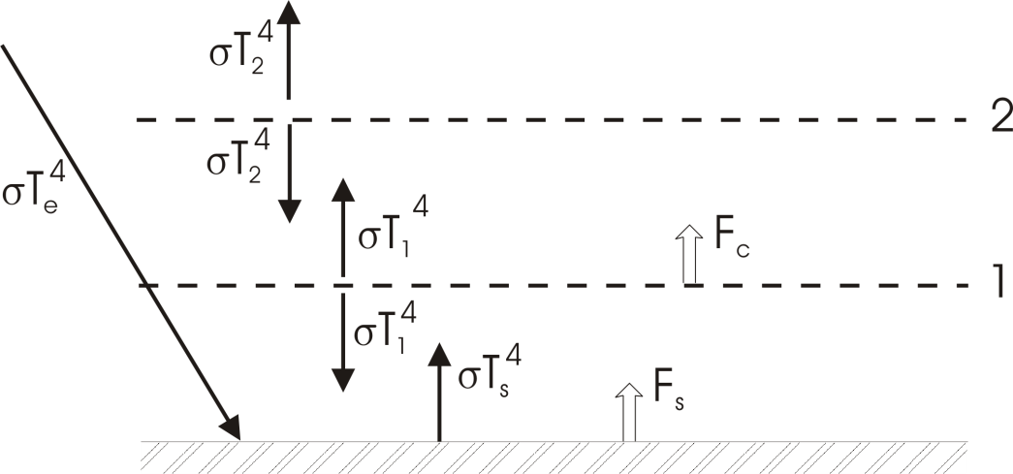

Slide 60
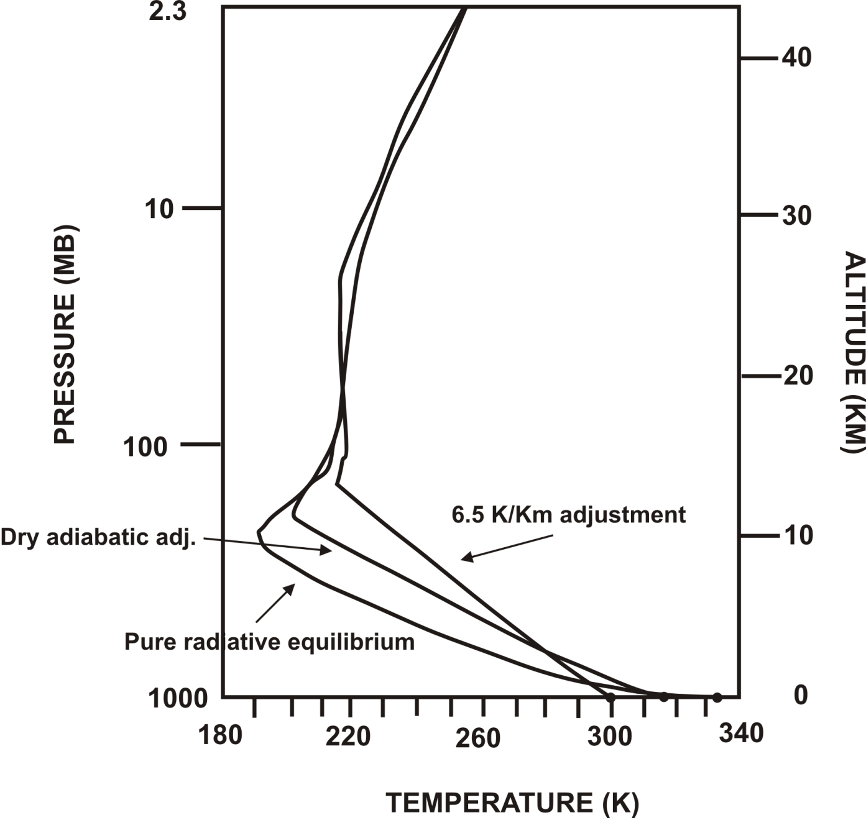
Manabe and Strickler 1964 calculation:

