Slide 1
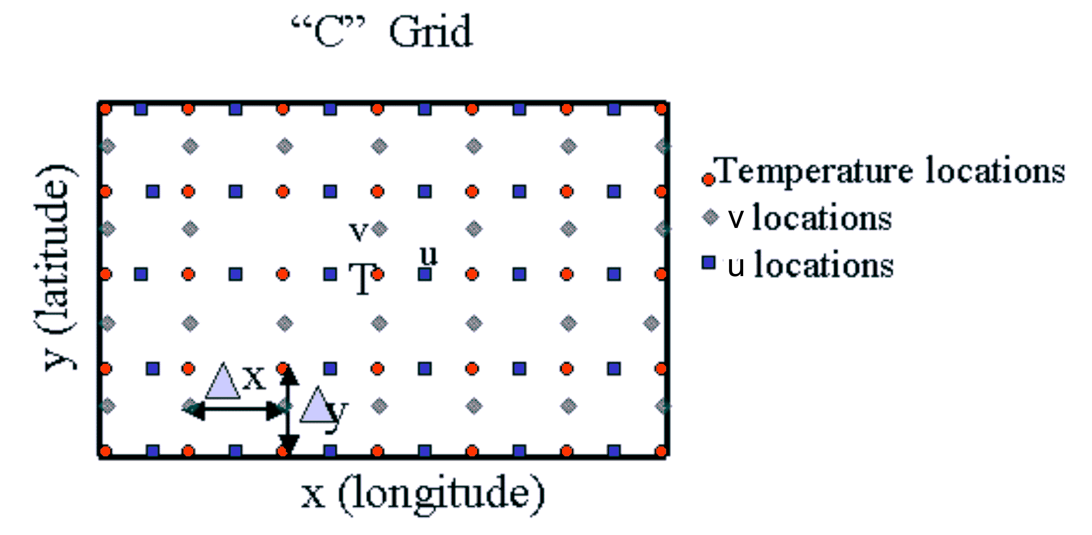
Image credit: U.S. Navy Postgraduate School
Notes:
http://www.oc.nps.edu/nom/modeling/grids.html

